Slide 1
ULISSE: One-Shot Sky Exploration
Finding AGNs and galaxy properties from a single image
Lars Doorenbos (UniBE) in collaboration with: Olena Torbaniuk (UNIBO), Stefano Cavuoti (INAF-OACN), Maurizio Paolillo (UNINA), Giuseppe Longo (UNINA), Massimo Brescia (UNINA), Raphael Sznitman (UniBE), Pablo Márquez-Neila (UniBE)
International Conference on Machine Learning for Astrophysics (ML4ASTRO2), 8–12 July 2024, Catania

Slide 2
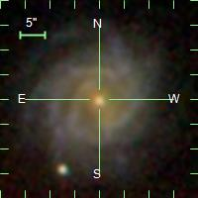
Motivation
Prototype/target object

Slide 3
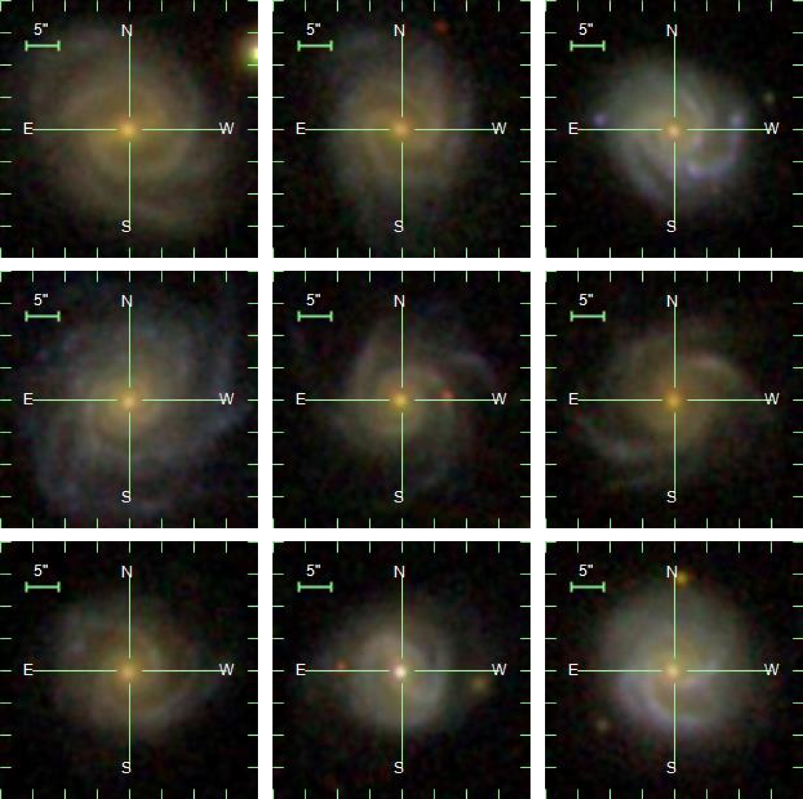
Motivation
Prototype/target object
Neighbors
ULISSE

Slide 4
Motivation
Prototype/target object
Neighbors
ULISSE
Applications in Large Sky Surveys:
Discover objects with similar appearance or physical properties.
Identify Active Galactic Nucleus (AGN) candidates.
Retrieve physical properties, such as Star Formation Rate (SFR) and stellar mass, for samples with unknown characteristics.
and many others…

Slide 5
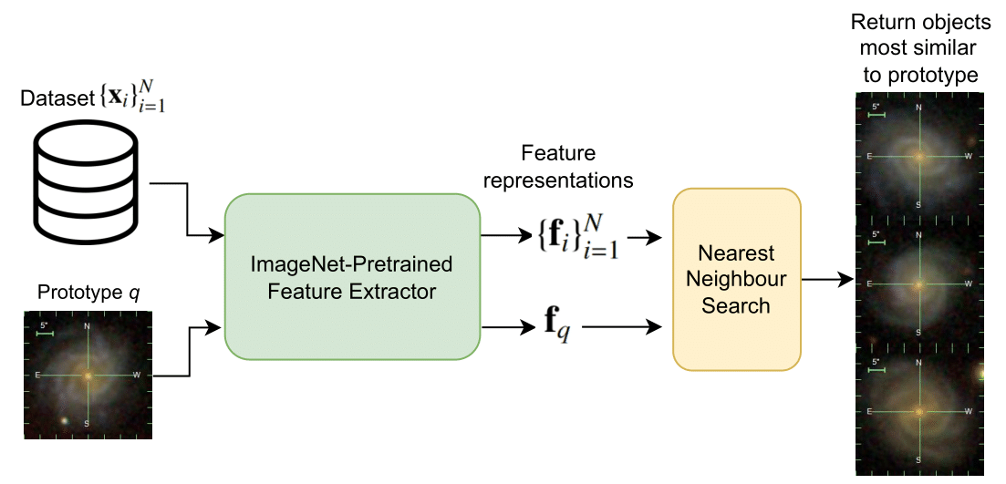
ULISSE: the method
We directly use the features of a neural network pre-trained on ImageNet to find similar objects No training needed!
Features
Objects & Activations

Slide 6
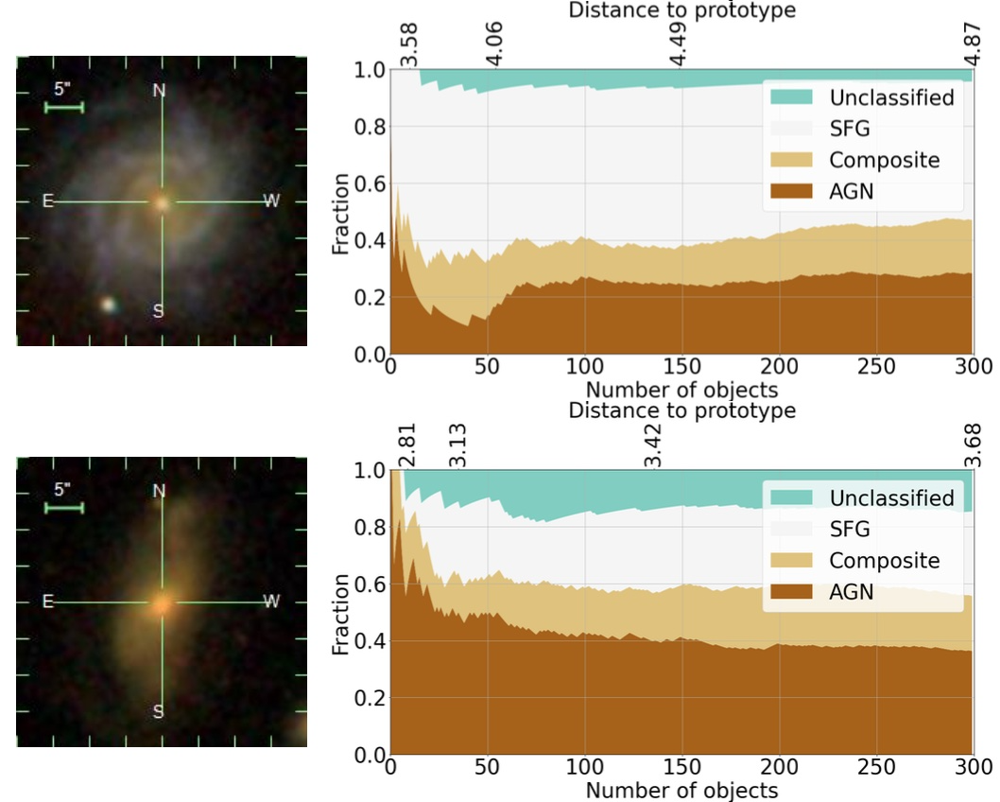
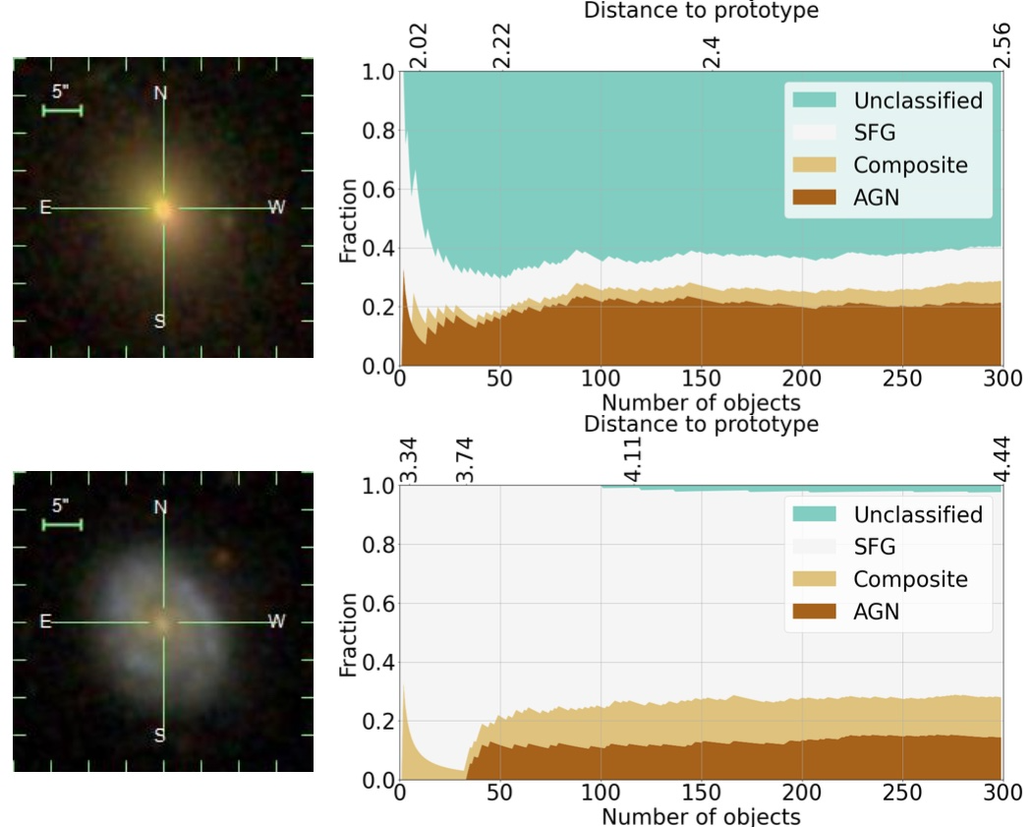
AGNs identification with ULISSE
Doorenbos et al. 2022 A&A, 666, 117
AGN retrieval efficiency ranging from 21% to 65% (including composite sources) depending on the prototype, where the random guess baseline based on the BPT selection criteria is 12%.
AGN prototypes
non-AGN prototypes
The random guess baseline
The random guess baseline
The random guess baseline
The random guess baseline

Slide 7
SFR and stellar mass prediction
Torbaniuk et al. 2024, in preparation
z = 0.084 E (elliptical, smooth) Unclassified (non-AGN)
Target objects
Redshift: Galaxy Zoo 2 morphology BPT class:
z = 0.047 S (spiral with bulge) Star-forming (non-AGN)
Star-forming galaxies
Main sequence (MS) of SFG
MS of SFG - 1.3dex
Quiescent galaxies

Slide 8
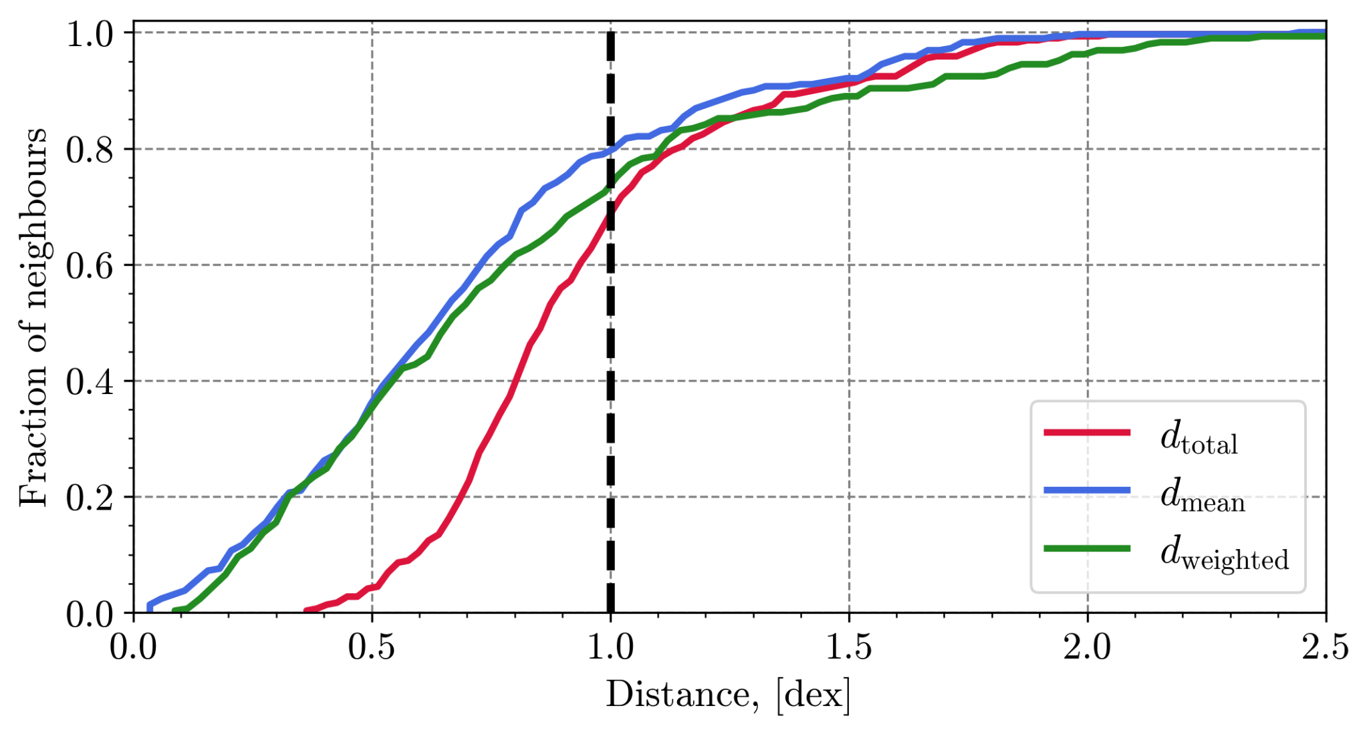
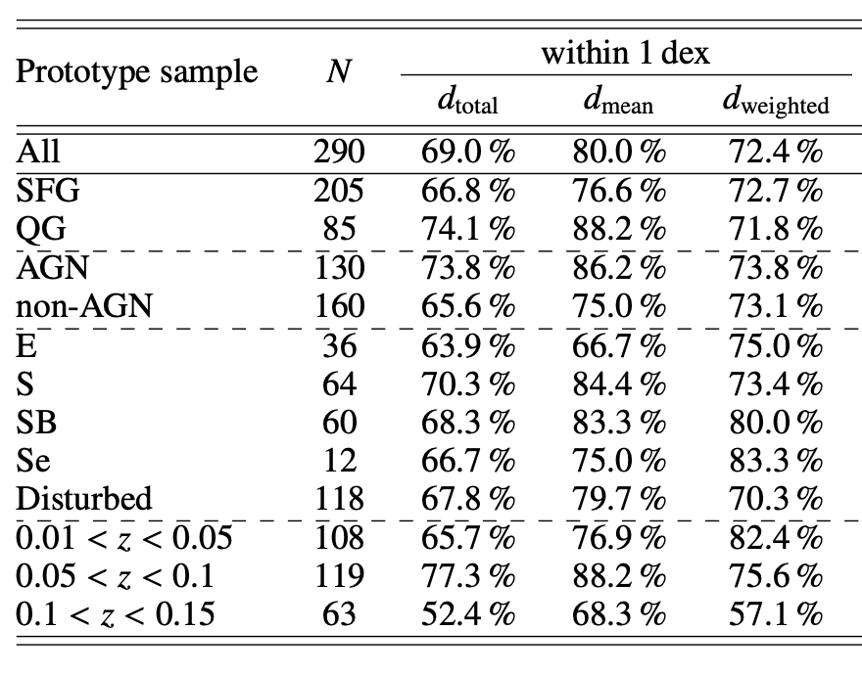
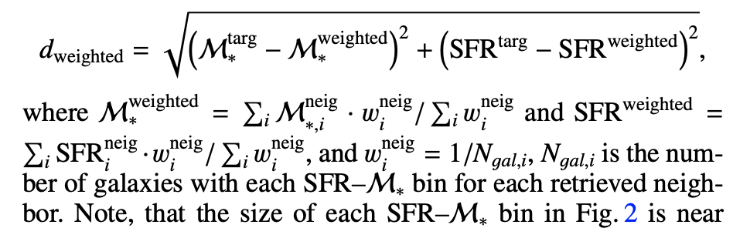
SFR and stellar mass prediction
Torbaniuk et al. 2024, in preparation
All galaxies
To quantify the efficiency in retrieving objects with SFR and stellar mass similar to the target object, we used the set of `distances’ defined as:
Target sample

Slide 9
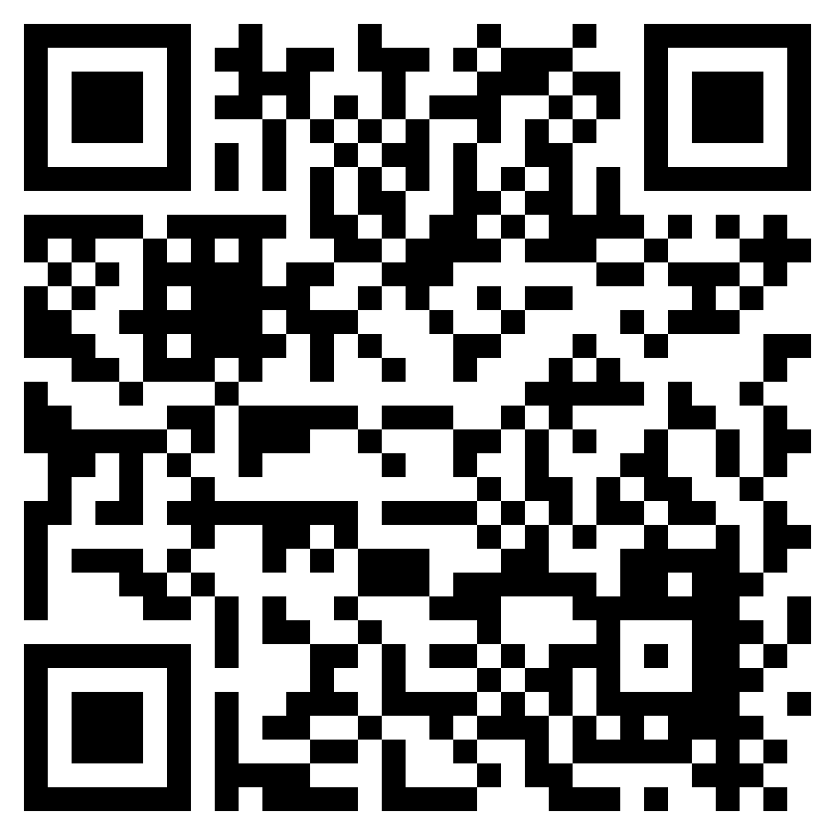
Conclusions
ULISSE performance is based on a combination of host galaxy morphology, color, and the presence of a central nuclear source.
ULISSE efficiency in identifying AGN candidates varies from 21% to 53% for different prototypes, which significantly larger than the average AGN content of 12% in the sample (according to the BPT classification).
Including “composite” sources, the retrieved AGN fraction rises to 65%;
ULISSE efficiency in retrieving galaxies with similar properties (SFR and stellar mass within 1 dex from the target object) varies from 64% up to 89% depending on the morphology of the target object and the presence of AGN in it.
At the same time, the efficiency of retrieving separately SFR and stellar mass within 1 dex from the target object is >81% for SFR and >94% for stellar mass, respectively.
ULISSE could be a promising tool for selecting different types of astrophysical objects and/or retrieving of their physical parameters in current and future wide-field surveys (e.g., Euclid, LSST etc.) that target millions of sources every single night.
AGN
SFR & stellar mass
Find ULISSE paper here!
Stay tuned for the 2nd paper soon!
Write us if you have questions on the:
technical part: lars.doorenbos@unibe.ch
astrophysical part: olena.torbaniuk@unibo.it
Thank you for your attention!

