Slide 1
Machine Learning-Based Parametrization of Solar Active Regions Using Disentangled Variational Autoencoders
Ekaterina Dineva¹, Giovanni Lapenta†, George Miloshevich¹, Hanne Baeke¹ and Jorge Amaya² ¹ KU Leuven, Centre for mathematical Plasma-Astrophysics ² European Space Agency (ESA)

Slide 2
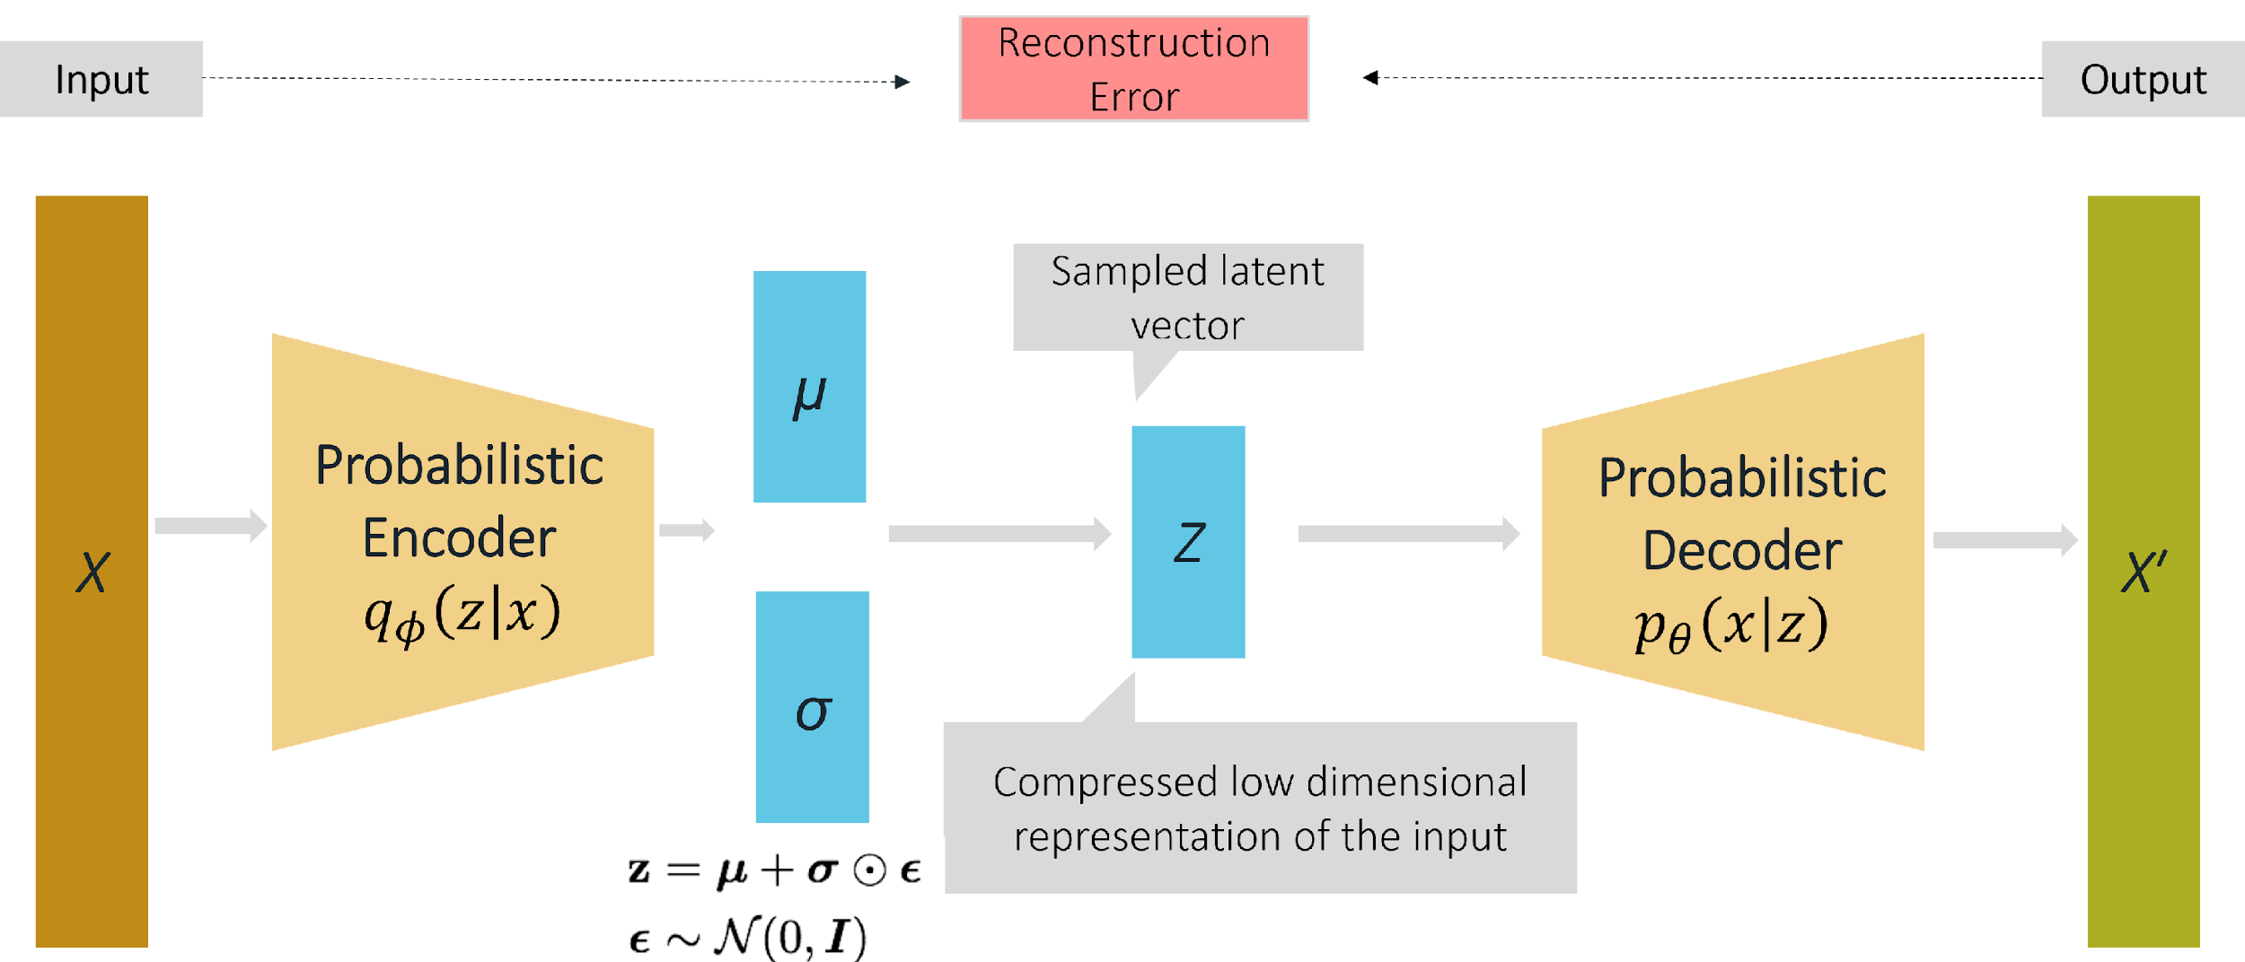
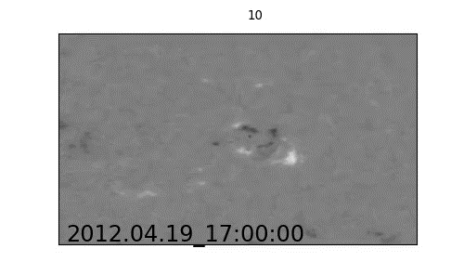
Variational Autoencoder
Reconstruction Loss + Latent Loss
VAE latent space aims to generalize the information contained in the input
VAE can be used to generate new information
Why VAE:
Dimensionality reduction while keeping fundamental information about structure
Latent space: ML features for active region parametrization
Anomaly detection and pattern recognition
β-VAE: an implementation of the VAE framework that employs an adjustable hyperparameter β
Disentangled representation: a single latent variable is sensitive to a specific data generative factor
β > 1 results in more disentangled latent representation
Reconstruction Loss
Latent Loss

Slide 3
Variational Autoencoder (reconstructions)
Test dataset: 16 active regions (AR)
Segments: VMF maps (B_{r}, B_{θ}, B_{φ})
Physics: surface magnetic field
Why: parametrization of the active regions and identify solar flares triggers
Solar Cycle 24: 2012 – 2019 year
Excluded images: solar-limb observations (bad data)
Normalized before passing to the NN
Resized: 128 x 256 pix
Dataset split: 50/50

Slide 4
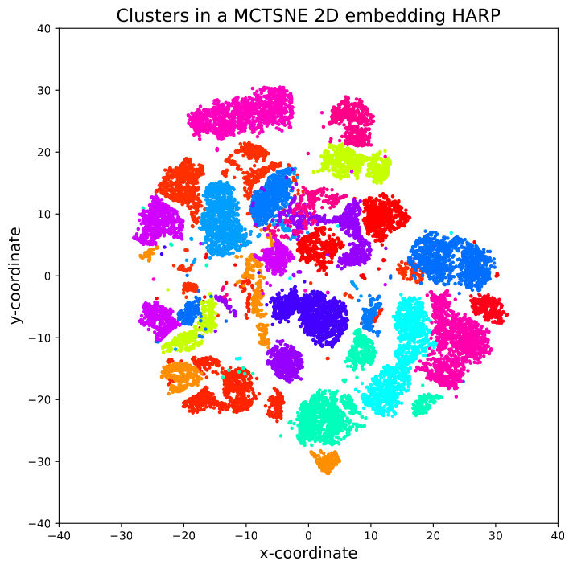
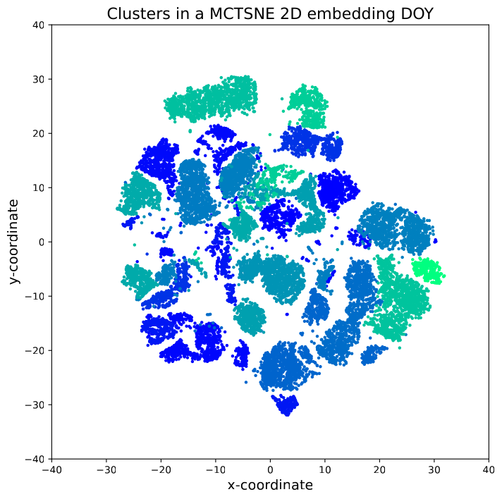
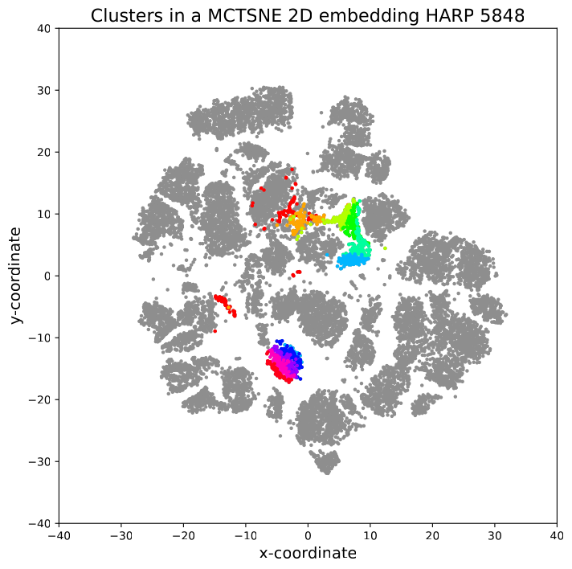
VAE Latent Vector Exploration
t-Distributed Stochastic Neighbor Embedding (t-SNE): dimensionality reduction (2D) and similarity visualization
Cluster identification according to: HARP number and day of the year (DOY)

Slide 5
VAE Latent Vector Exploration: Take-home Message
VAE-based latent variables (features):
Successfully trace the active region morphological evolution
Relate to physical properties of the magnetic field
Allow for the identification of extreme values and outliers

