Slide 1
Galaxy stellar and total mass estimation using machine learning
Jiani Chu (zjn20@mails.tsinghua.edu.cn)
Supervisor: Dandan Xu
collaborate with Hongming Tang, Shengdong Lu, Richard Long

Slide 2
Motivation
Projection effect
Light path: dust attenuation…
Instrument limit: resolution…
Model assumptions
Credit: NASA/JWST
How well can I know the property of galaxies ?
Conventional models suffer from assumptions and degeneracies.
=>A fundamental question: whether current observations provide sufficient info to decode true dynamical properties of external galaxies?
EM wave,…
To answer this question, we go for machine learning.

Slide 3
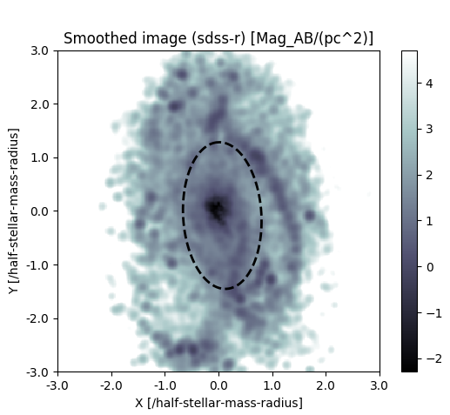
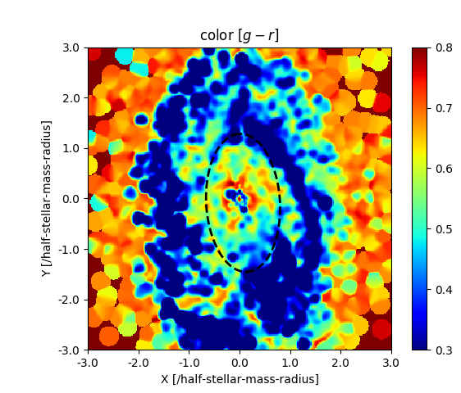
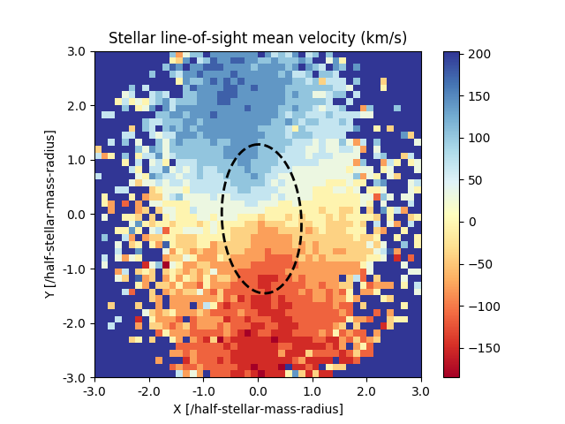
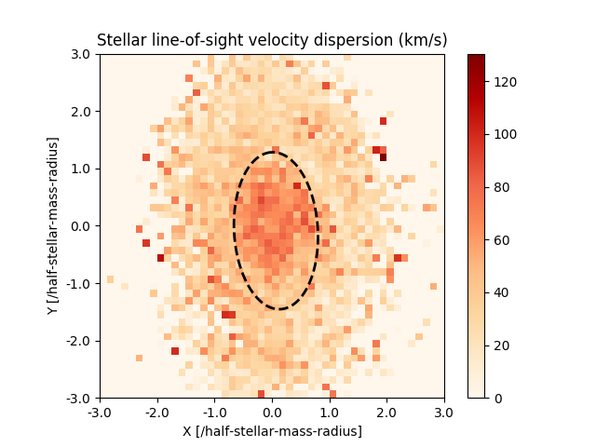
Samples & Machine learning
image analysis:
More parameters->
More model complexity
MaNGA-like galaxy samples from TNG-100
CNN: Convolutional Neural Network
$r$ Image
$g$-$r$ color map
$V_{mean}$ map
$σ$ map
total mass $M_{tot}$
stellar mass $M_{∗}$
M-to-L ratio ${M_{∗}}/L$
Summary statistics:
$$M_{r},g−r,SFR,n_{Ser},c/a,σ_{v},λ,B/T,f_{cold},f_{hot}$$
GBDT: Gradient Boosting Decision Tree
catalog data:
Feature importance

Slide 4
Results
CNN:
Prediction | Input | Mean±1σ
 |  | 0.00±0.04
 |  | 0.00±0.06
 |  | 0.00±0.04
JAM on Illustris
0.12~0.18 dex
$$M_{∗}$$
$$r,V_{mean},σ$$
$$M_{tot}$$
$$r,V_{mean},σ$$
0.05~0.06 dex
$${M_{∗}}/L$$
$$g−r,r,V_{mean},σ$$
0.11~0.15 dex
(Li et al. 2015)
GBDT:
Prediction | Mean±1σ | Contributing features
 | 0.00±0.05
 | 0.00±0.08
 | 0.00±0.06
$$M_{∗}$$
$$M_{r},σ_{v}$$
$$M_{tot}$$
$$M_{r},σ_{v}$$
$${M_{∗}}/L$$
$$σ_{v},g−r,M_{r}$$

Slide 5
Summary
ML (both CNN & GBDT) successfully predicts galaxy aperture properties from multi-band images and stellar kinetic maps.
Luminosity and Velocity dispersion contribute most in predicting mass, SFR or color helps to predict mass-to-light ratio (${M_{∗}}/L$)
Whether current observations provide sufficient info to decode true dynamical properties of external galaxies?
YES!
arXiv: 2311.10351
Thank you for your time!

