Slide 1
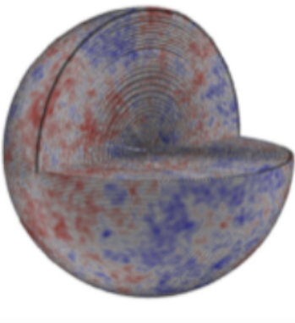

Symbolic Regression
Deaglan Bartlett
https://deaglanbartlett.github.io/
Institut d’Astrophysique de Paris
CNRS & Sorbonne Université
deaglan.bartlett@iap.fr
11 July 2024

Slide 2
Outline
01
What is Symbolic Regression?
02
Survey of methods
03
Model selection
04
Benchmarking
05
SR in Astrophysics and Cosmology

Slide 3
01
What is Symbolic Regression?

Slide 4
Symbolic Regression: Find not just the parameters, but the function too

Slide 5
Given some dictionary of functions, how do I combine these to produce an accurate and simple function which describes my data?

Slide 6

Symbolic Regression
Motivation and Challenges
Goals:
Discover “physical laws” - necessarily analytic
Guide theory - discover what limits a model should have
Effective prescriptions of complex, non-linear systems
Advantages:
More general - reduce confirmation bias
Prevent overfitting
Highly interpretable
Fast
Difficulties:
Larger search space - convergence harder
Optimisation methods of numerical regression (gradients) not applicable

Slide 7
Competing objectives: Accuracy and Simplicity
Feasible Solutions
Pareto front
(pick one of these)

Slide 8
02
Survey of methods

Slide 9
Symbolic Regressions Methods
Represent functions as trees or lists
“Complexity” = Number of Nodes

Slide 10
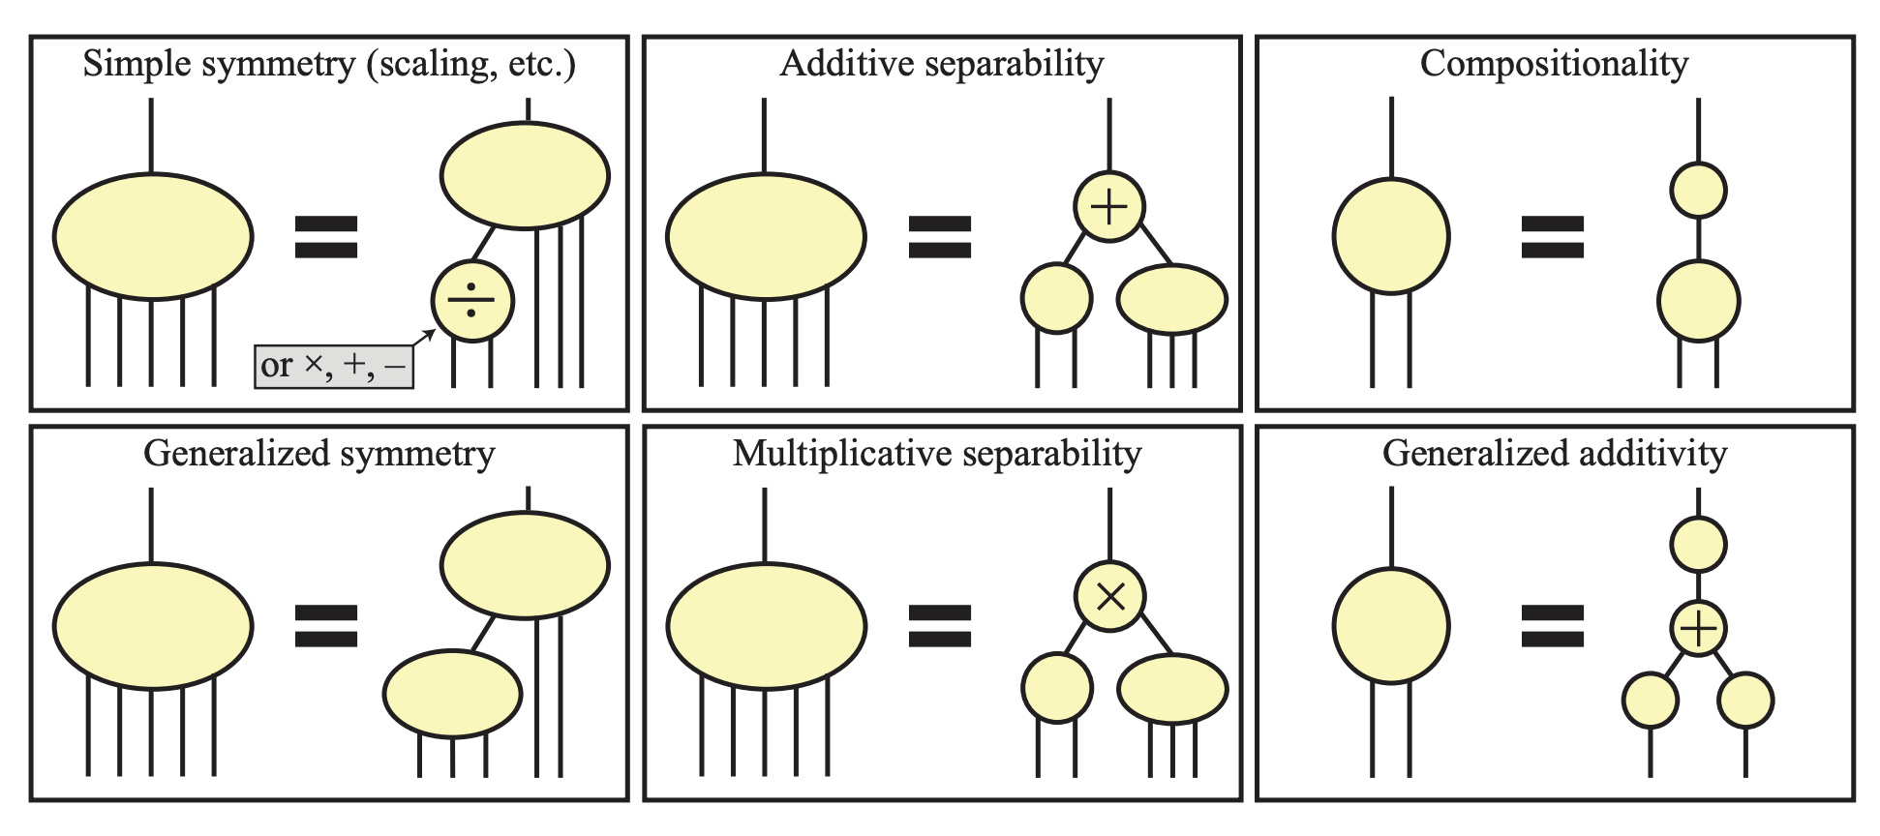
Symbolic Regressions Methods
AIFeynman – Physics Inspired Search (look for symmetries)
Udrescu & Tegmark 2019 (1905.11481); Udrescu et al. 2020 (2006.10782)

Slide 11
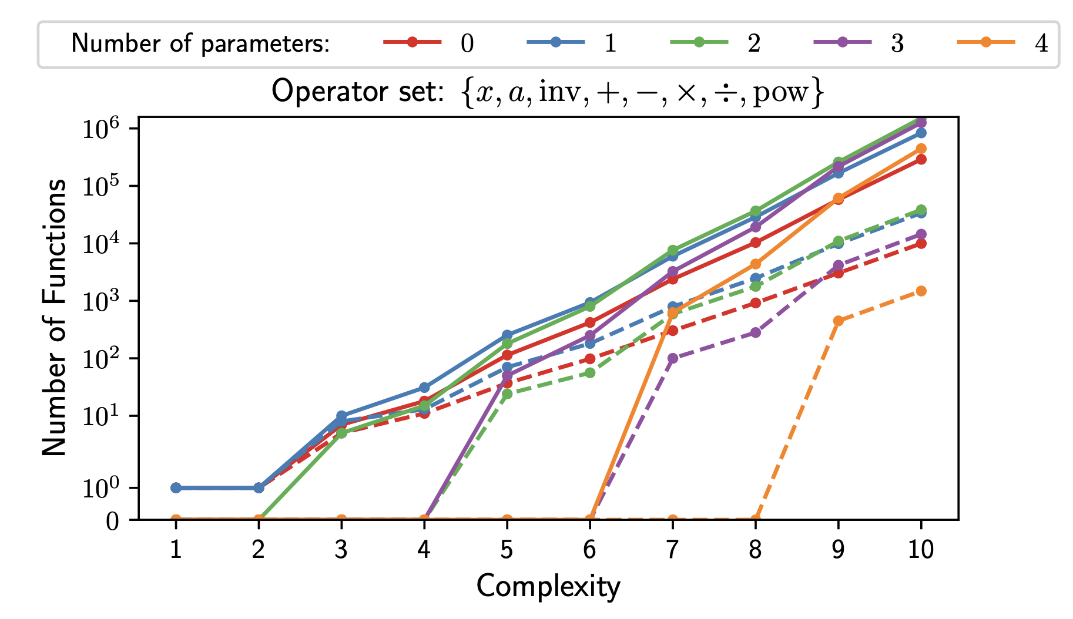
Symbolic Regressions Methods
ESR – For simple functions, can exhaustively test the search space
In Physics, we often use simple functions:
Identifying duplicates (dashed lines) dramtically reduces number of functions to fit (total=solid lines)
NFW
Friedmann Equation
Bartlett, Desmond & Ferreira 2022 (2211.11461); https://github.com/DeaglanBartlett/ESR

Slide 12
Genetic programming

Slide 13
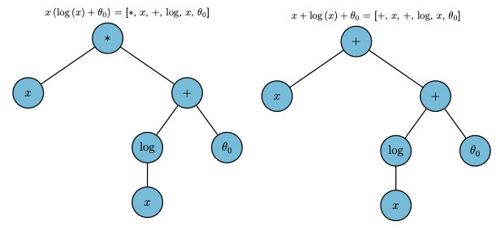
Genetic Programming
Equations evolve to become fit data better – survival of the fittest
Start with a population of functions
Allows these to mutate and breed
Optimise parameters of the functions
Keep functions which fit data well and are simple
Repeat. Functions should evolve to fit data well

Slide 14
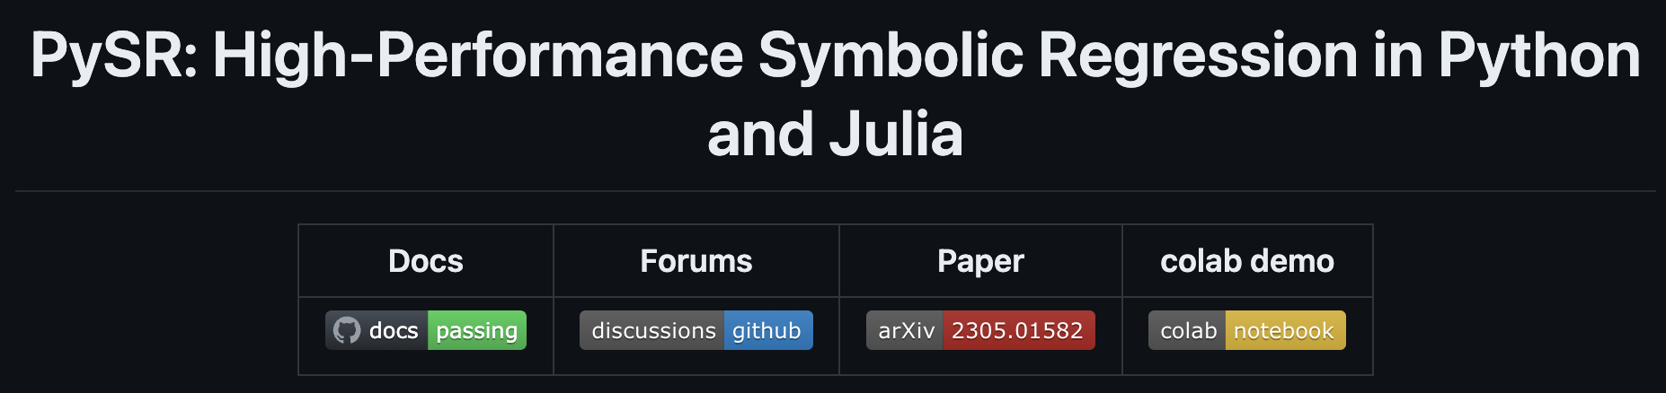
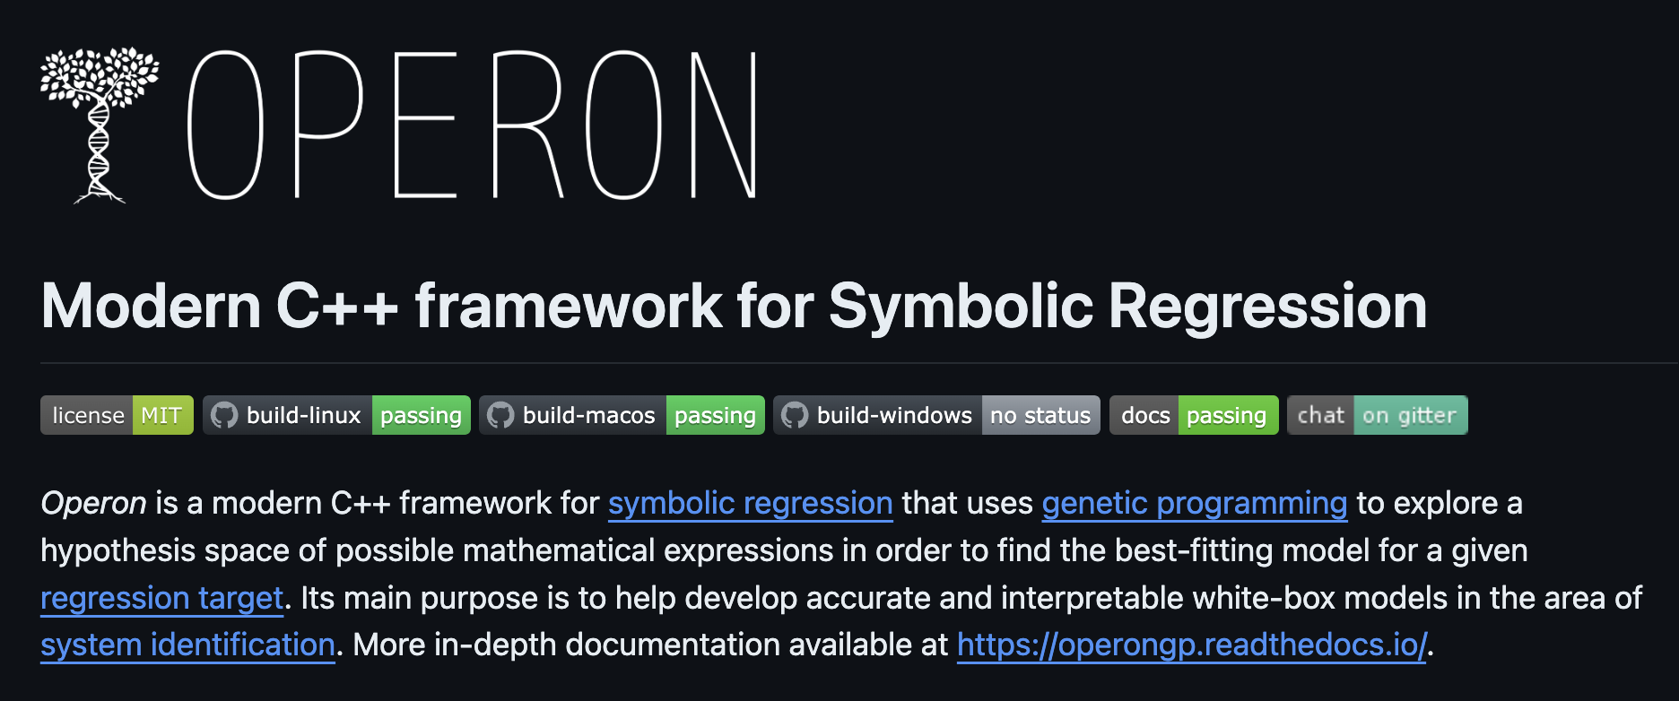
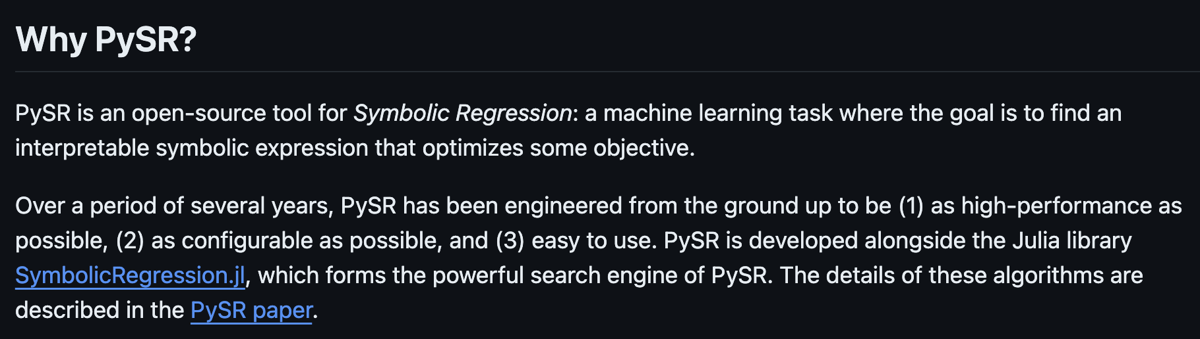
Genetic Programming
Common GP codes used in Astrophysics and Cosmology
Python wrapper with C++ backend
High performance, few hyper-parameters
Python wrapper with Julia backend
Easy to write custom losses
https://github.com/heal-research/pyoperon (Burlacu, Kronberger and Kommenda, 2020)
https://github.com/MilesCranmer/PySR (Cranmer, 2023)

Slide 15
Neural networks

Slide 16
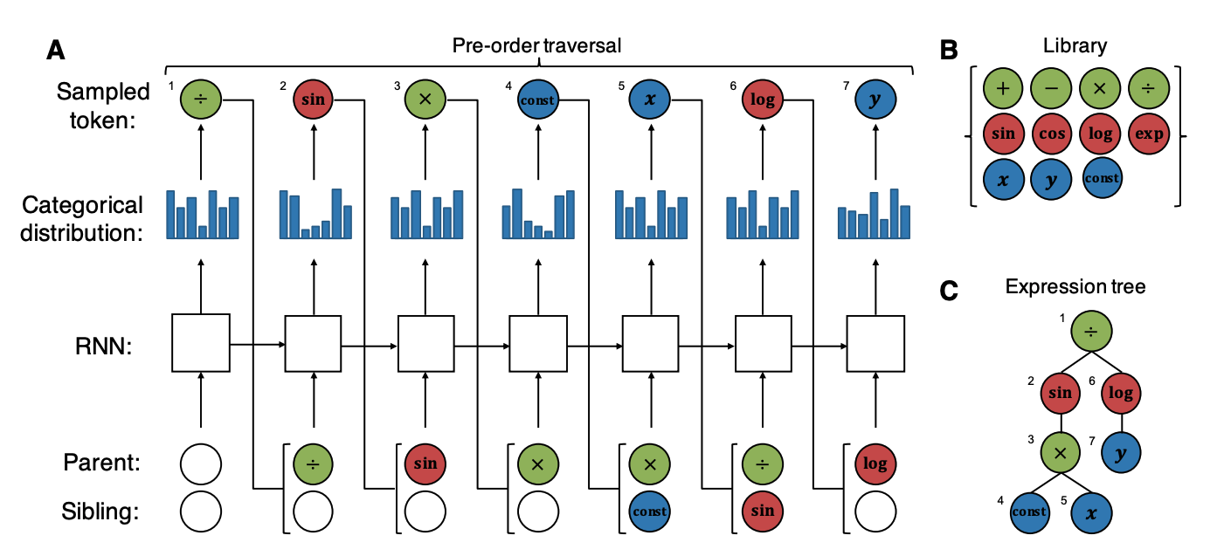
Neural Networks
Deep Symbolic Regression - recurrent neural network to learn categorical distribution
Petersen et al. 2021 (1912.04871)

Slide 17
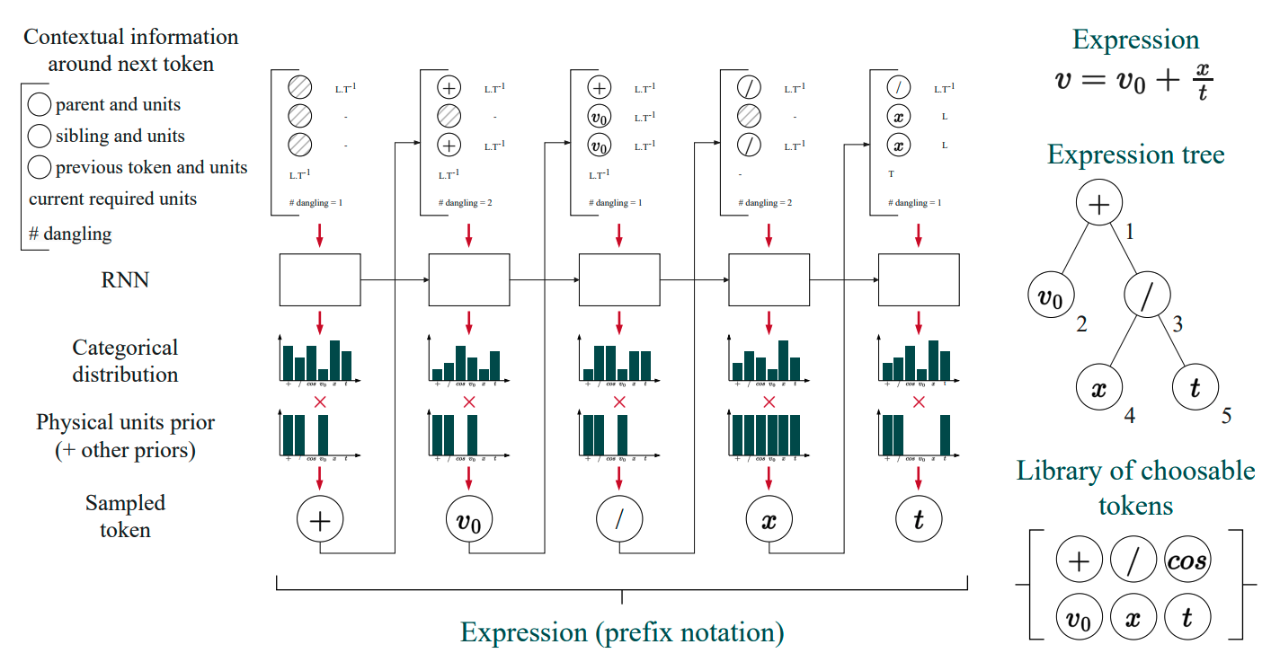
Neural Networks
Φ-SO – Deep Symbolic Regression + Dimensional Analysis
Tenachi, Ibata and Diakogiannis 2023 (2303.03192)

Slide 18
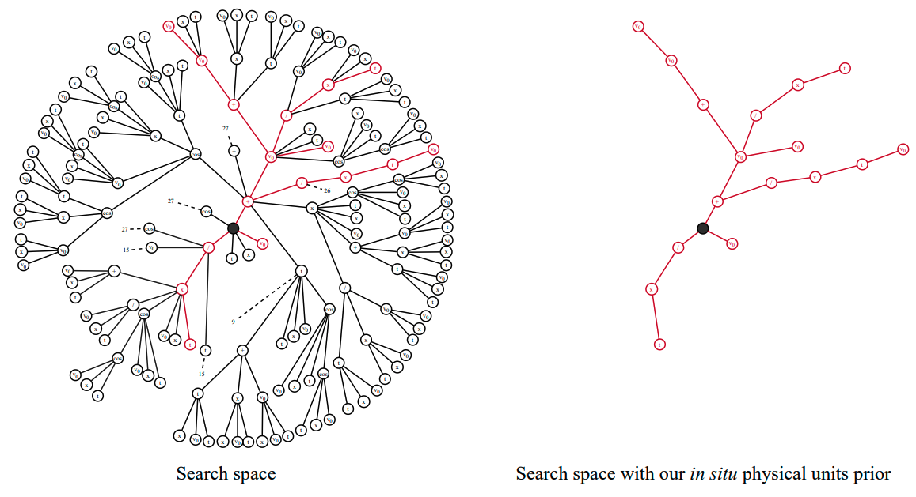
Neural Networks
Φ-SO – Dimensional Analysis can dramatically reduce search space
Number of equations with up to 5 symbols to predict a velocity.
Basis: {+,/,cos,v₀, x, t)
Dimensional analysis in SR previously introduced by
Choi 2011 (1106.3834)
Villar et al. 2022 (2204.00887)
Tenachi, Ibata and Diakogiannis 2023 (2303.03192)

Slide 19
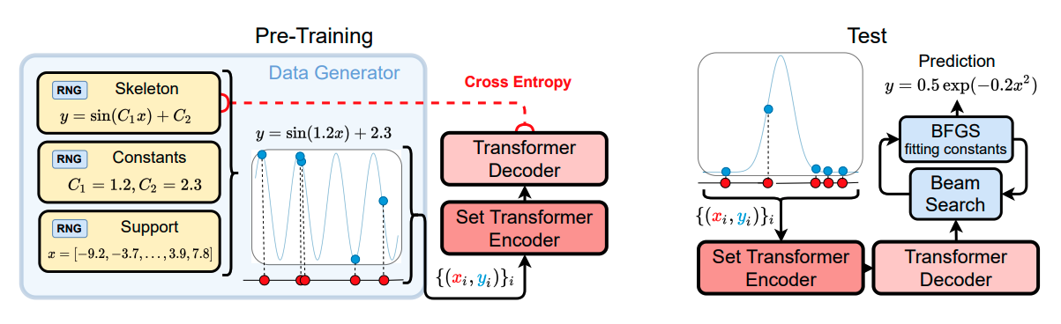
Neural Networks
Neural Symbolic Regression that Scales - Transformers to give equations given input data
Biggio et al. 2021 (2106.06427)

Slide 20
03
Model selection

Slide 21
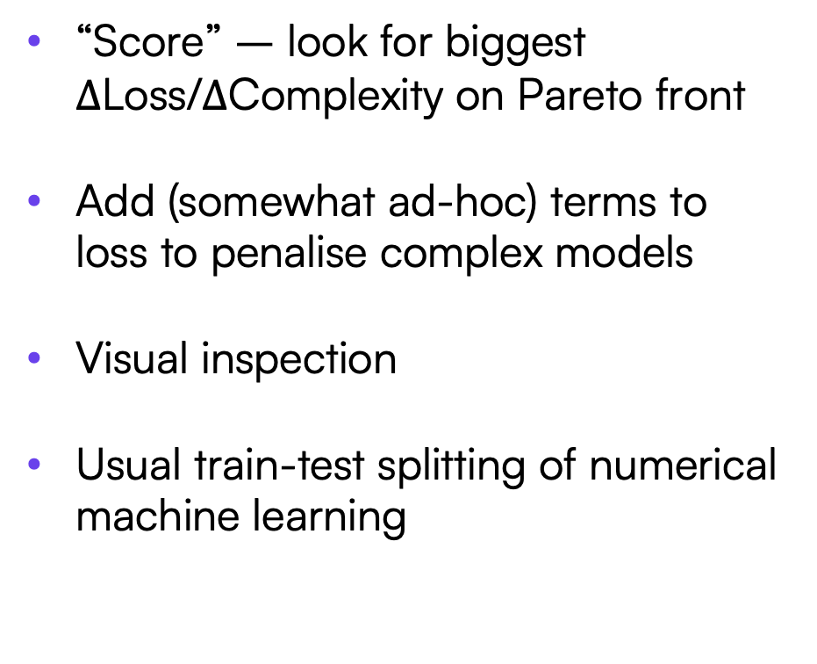
Model Selection
Less principled methods
“Score” – look for biggest $∆$Loss/$∆$Complexity on Pareto front
Add (somewhat ad-hoc) terms to loss to penalise complex models
Visual inspection
Usual train-test splitting of numerical machine learning
Cranmer et al. 2020 (2006.11287); Vladislavleva, Smits & den Hertog 2009; Kommenda et al. 2021 (2109.00238)

Slide 22
Bayesian model comparison
Bayes’ theorem
“Evidence”
Bayes’ theorem
Model comparsion

Slide 23
Evidence is not enough for SR – Not all models are equally likely a priori
Normally just compute the Bayes factor:
Consider two models
If f₁ and f₂￼are indistinguishable in the range of our data, they will have the same evidence
But f₁ may be more “complex” than f₂
The evidence won’t prefer f₂, although we definitely would
Priors on functions are essential!

Slide 24
Priors on functions

Slide 25
Priors on functions
1. Minimum Description Length
Key idea: Function is there as a form of data compression
How much information do I need to transmit?
Description length
Hypothesis (function)
Residuals
The best function compresses the data the most – Minimise L(D)
Rissanen 1978 (Automatica, vol. 14, no. 5, pp. 465–471)

Slide 26
Priors on functions
1. Minimum Description Length
Shanon-Fano coding
Structure: k nodes of n basis functions
Send p parameters with precision Δ
Integer constants
Choose optimal parameter precision:
This is the same as (an approximation to) the Bayesian evidence with prior
Bartlett, Desmond and Ferreira 2023 (2211.11461)

Slide 27
Priors on functions
1. Minimum Description Length
Combined accuracy and simplicity into a single number to optimise
No longer ad-hoc combination of the two needed
Dual-optimisation no longer required
Favours functions which:
Fit data accurately
Contain only a few parameters
Do not contain many operators
Do not need finely tuned parameters
Bartlett, Desmond and Ferreira 2023 (2211.11461)

Slide 28
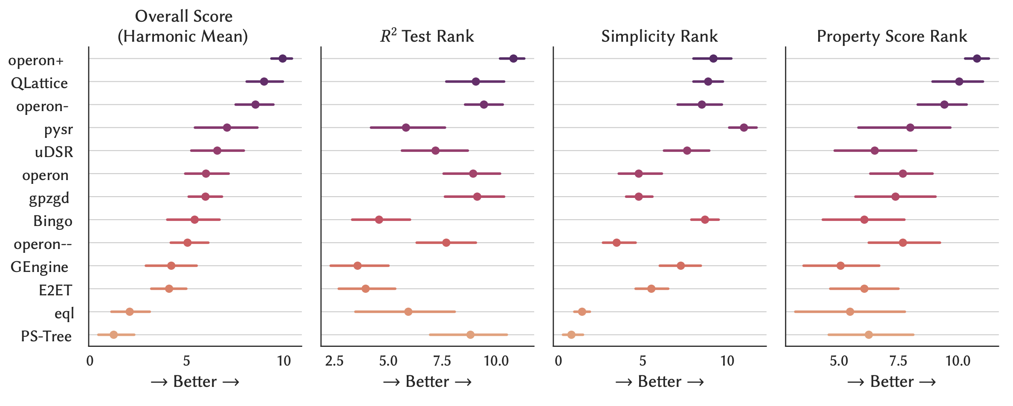
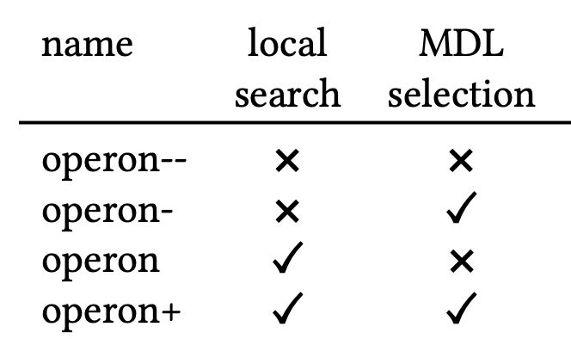
Priors on functions
1. Minimum Description Length – Improves performance greatly
Burlacu 2023

Slide 29
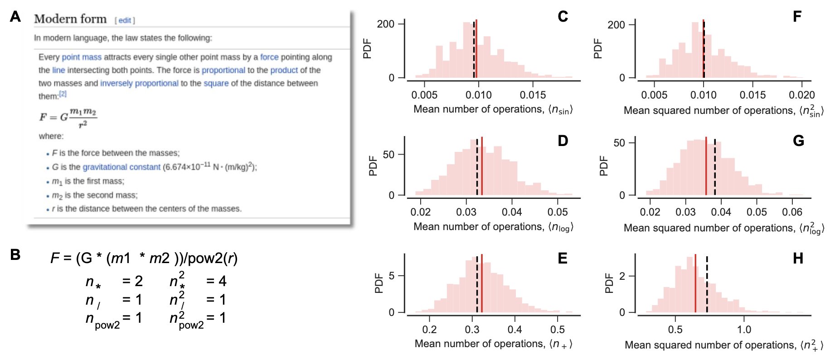
Priors on functions
2. Rank functions based on operator frequency in training corpus (Bayesian Machine Scientist)
Guimera et al. 2020 (2004.12157)

Slide 30
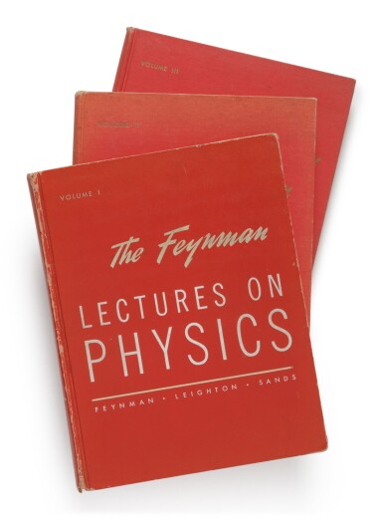

Priors on functions
3. Language models
Which of these seems more reasonable?
Exactly same operators, just arranged differently
Previous methods would have given these same weighting (prior probability)
Clear that the order of operators matters
Language Model
P(next operator | previous ones)
Bartlett, Desmond and Ferreira 2023 (2304.06333), https://github.com/DeaglanBartlett/katz

Slide 31
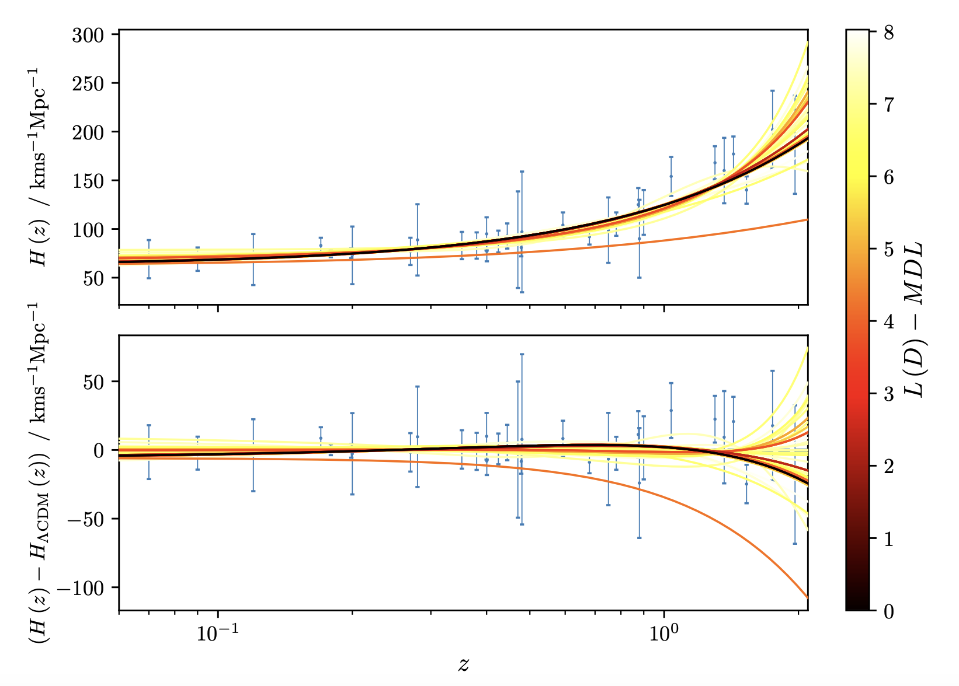
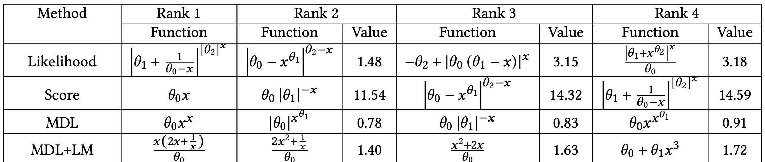
Priors on functions
3. Language models
Cosmic Chronometers
Can we learn H(z) directly from data?
SR can have a tendency to give nested operators
Adding language model gives more physically reasonable functions
ΛCDM now in top four!
Bartlett, Desmond and Ferreira 2023 (2211.11461); Bartlett, Desmond and Ferreira 2023 (2304.06333),

Slide 32
04
benchmarking

Slide 33
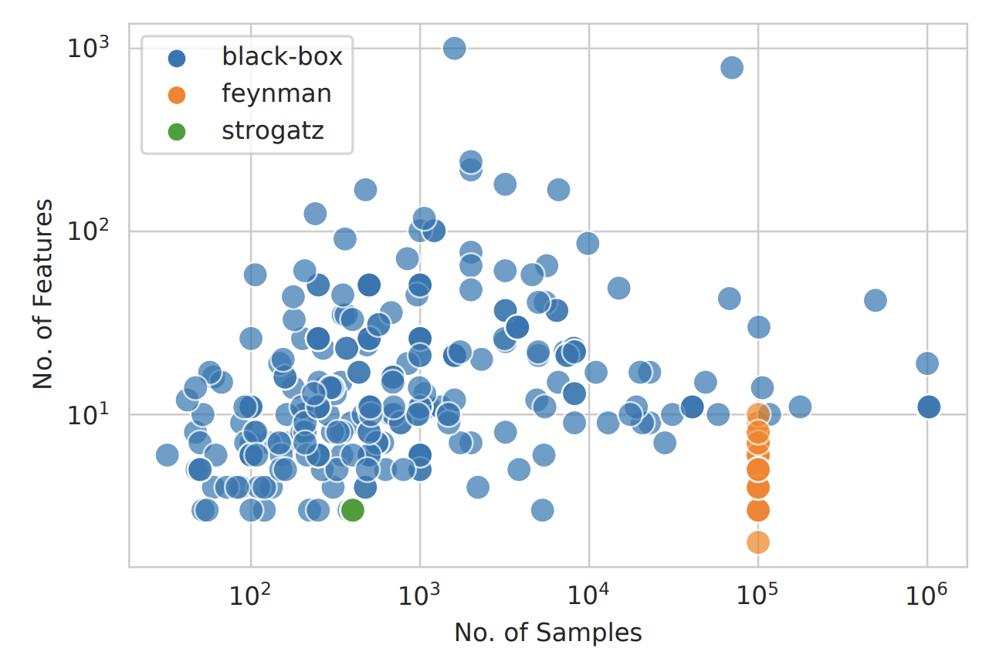
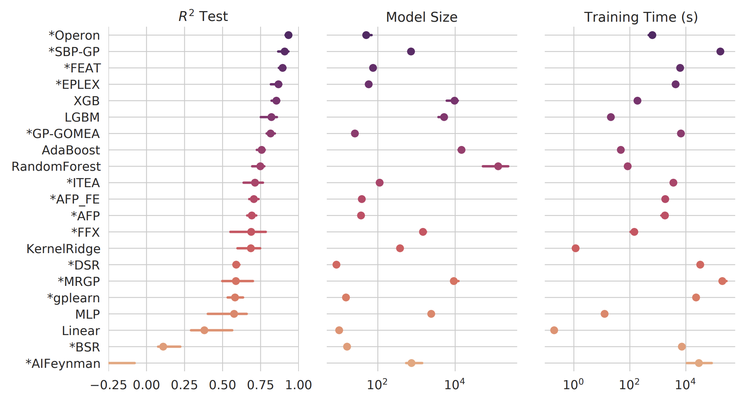
Benchmarking
SRBench – The standard benchmarking framework
252 datasets from PMLB
Real-world and sythetic
Simply upload a sklearn-compatible wrapper and a conda environment
La Cava et al. 2021 (2107.14351), https://cavalab.org/srbench/

Slide 34
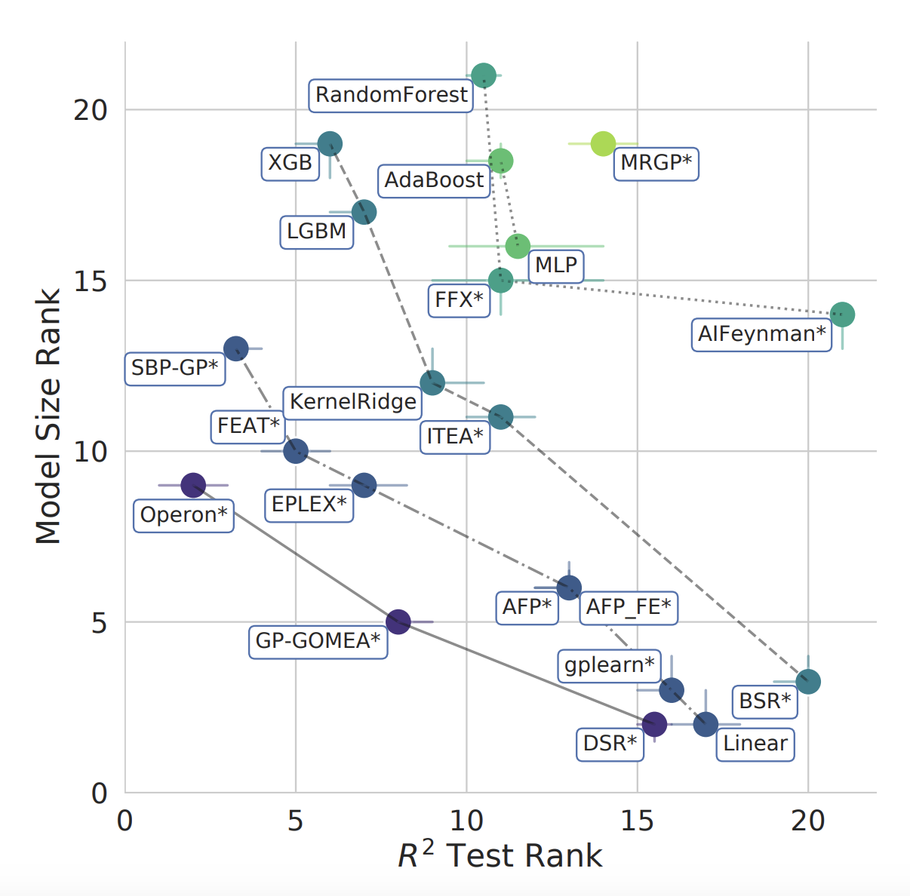
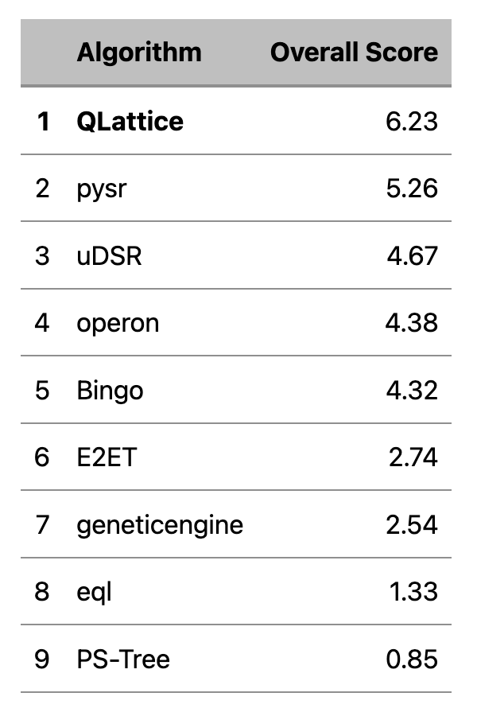
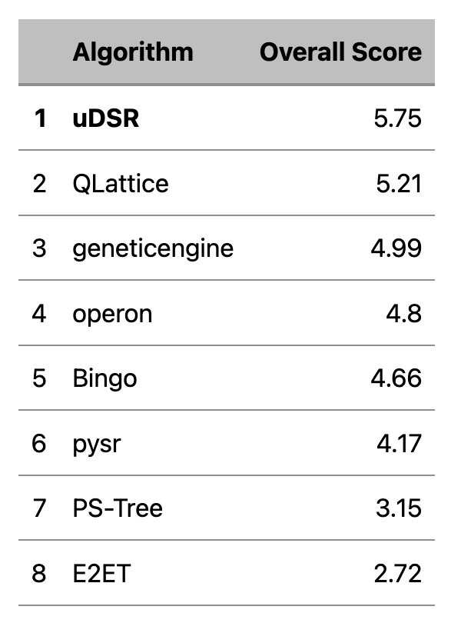
Benchmarking
SRBench – The standard benchmarking framework
Synthetic (2022)
Real World (2022)
La Cava et al. 2021 (2107.14351), https://cavalab.org/srbench/

Slide 35
Benchmarking
Not all codes perform equally
- some cannot find a standard Gaussian from noiseless data!
Let us fit this with SR codes and following basis:
➕, ➖,➗, ✖️, pow, x, θ
Bartlett, Desmond and Ferreira 2023 (2211.11461)

Slide 36
05
Sr in astrophysics and cosmology

Slide 37
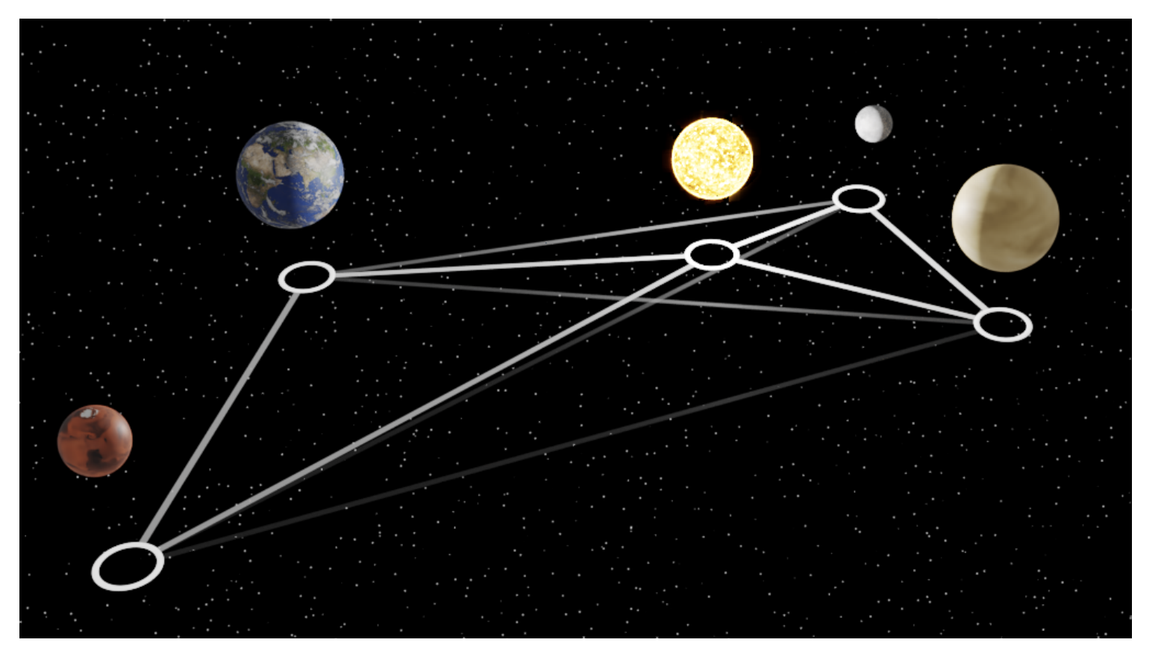
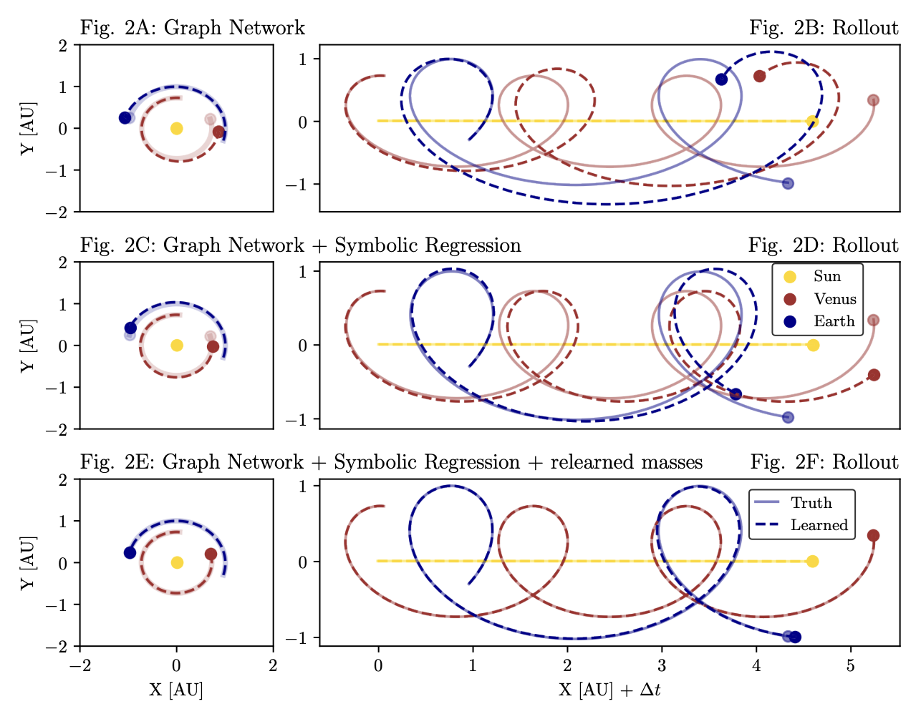
(Re)discovery of Physical Laws
Automating Kepler – Gravity from solar system observations
Train graph neural network to learn forces between objects
Node scalar parameter (mass) and edges give forces
SR (PySR) to find out what the GNN found
Lemos et al. 2022 (2202.02306)

Slide 38
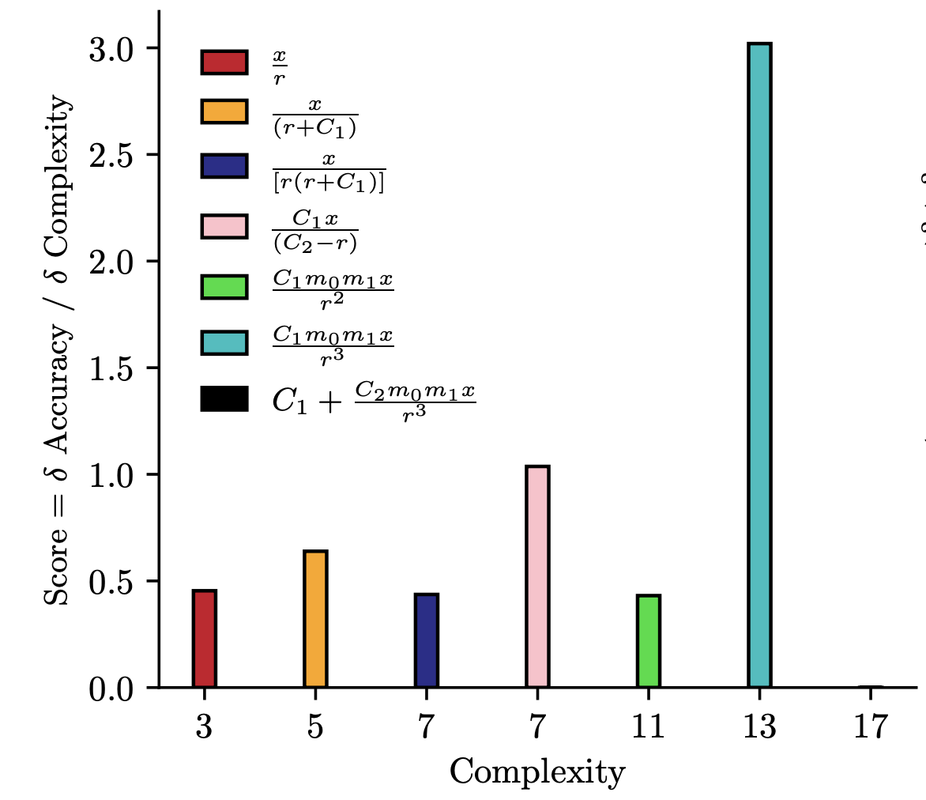
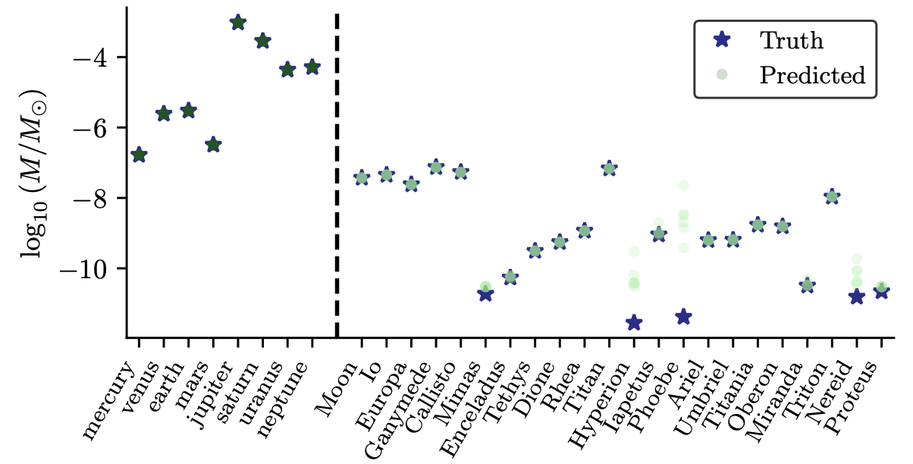
(Re)discovery of Physical Laws
Automating Kepler – Gravity from solar system observations
Rediscovered Newton’s law of gravitation
Inferred masses match measured values
Lemos et al. 2022 (2202.02306)

Slide 39
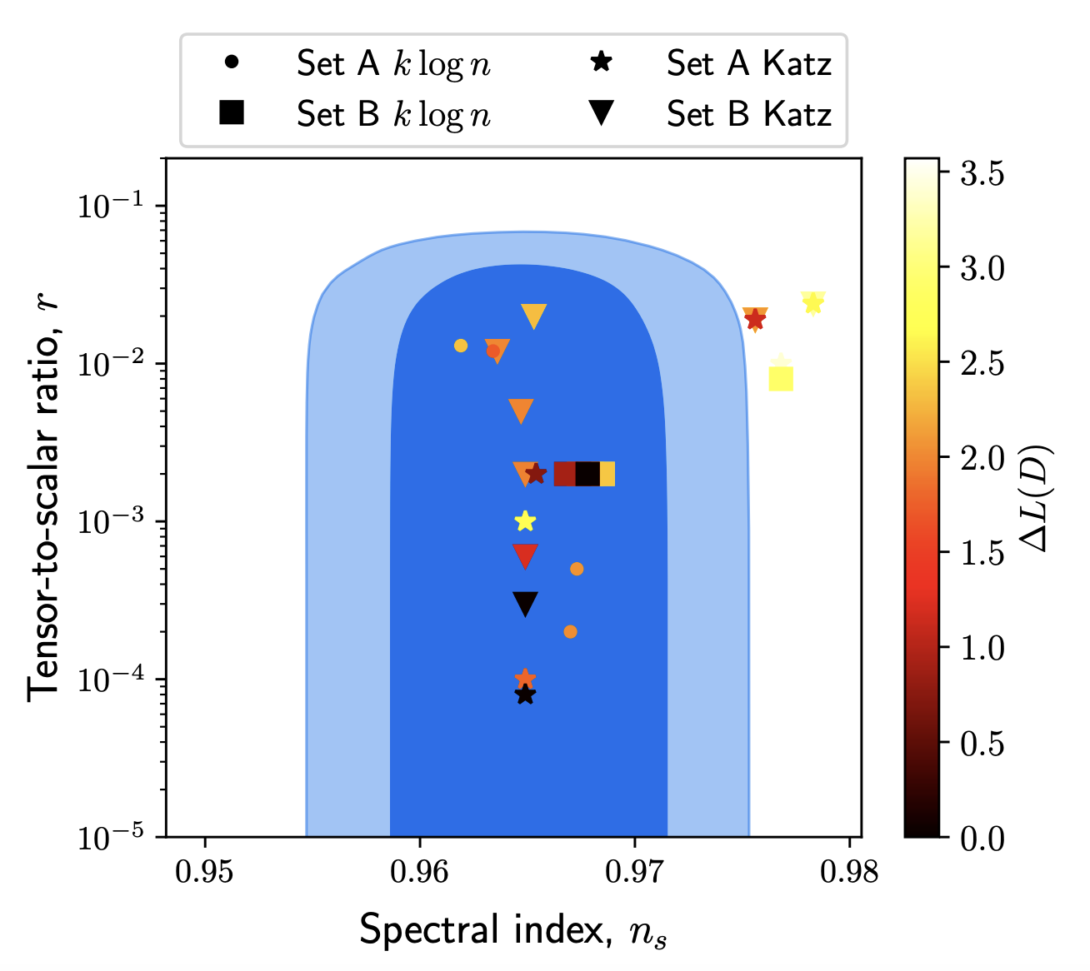
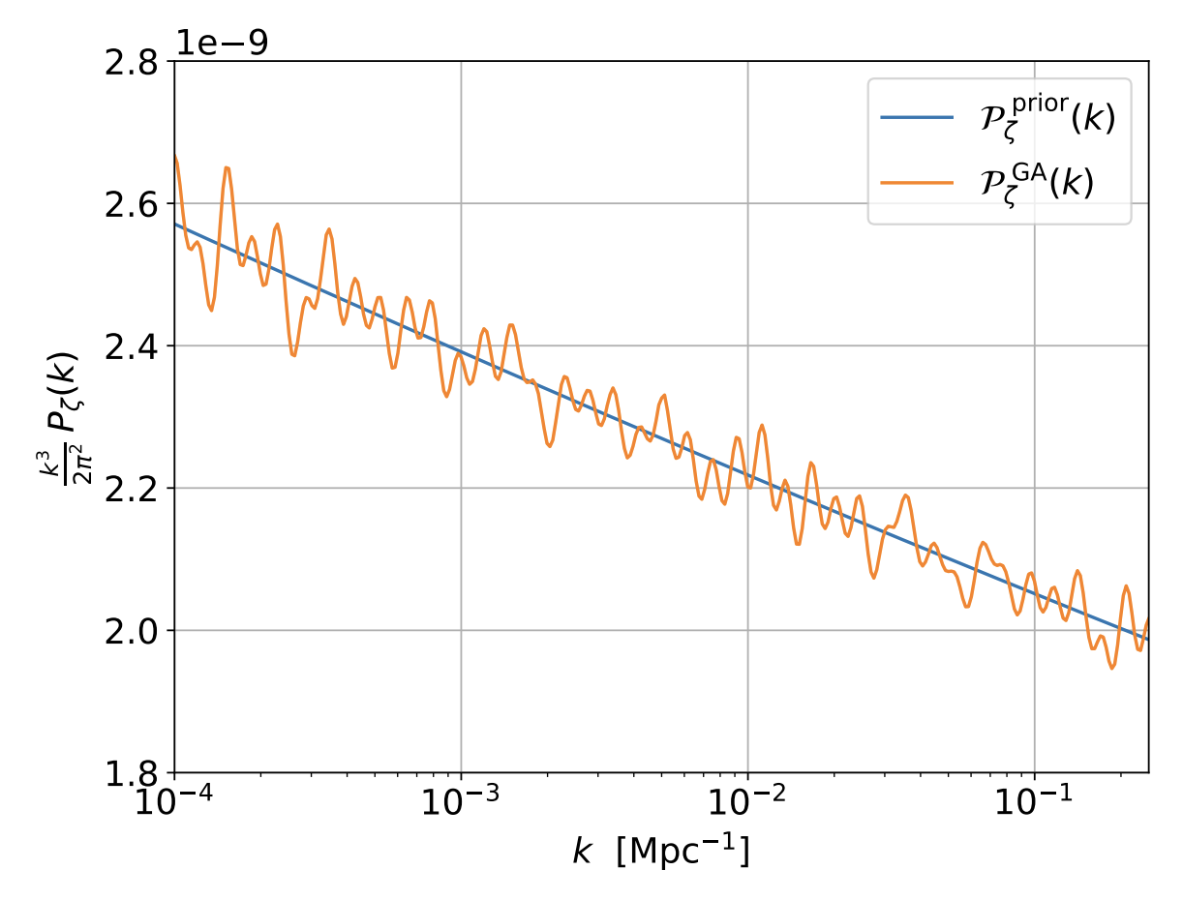
Discovery of physical laws
Inflation
Find information-theoretically optimal inflationary potentials which can describe CMB data (ESR)
Apply language model prior according to previously suggested inflation models
Find inflationary potentials which give rise to CMB spectra which are compatible with Planck (Custom GA code)
Kamerkar, Nesseris & Pinol 2022 (2211.14142); Sousa et al. 2023 (2310.16786)

Slide 40
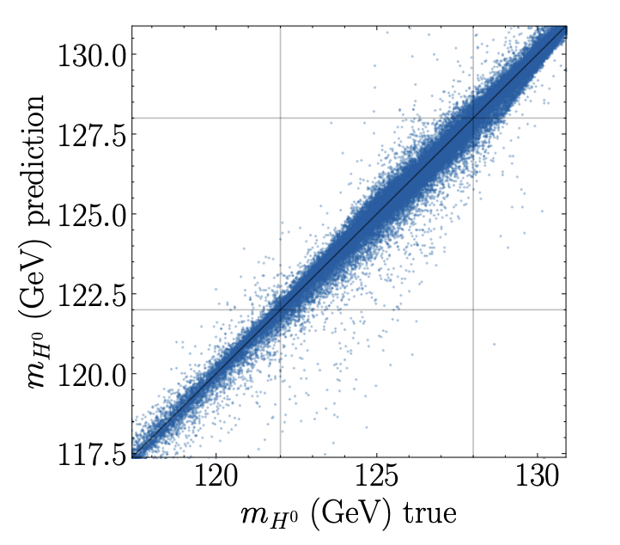
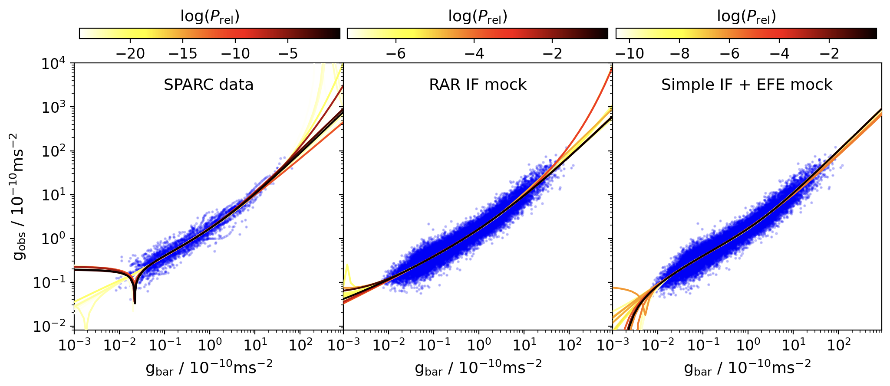
Discovery of physical laws
Radial acceleration relation of galaxies: total acceleration vs that from visible matter
Not y=x, so either dark matter or new physics
Use SR (ESR) to assess MOND hypothesis for this relation – is it the best fit?
Searches for New Physics
Fitting functions for observables given Beyond-Standard-Model parameters (Operon)
AbdusSalam, Abel & Crispim Romão 2024 (2405.18471); Desmond, Bartlett & Ferreira 2023 (2301.04368)

Slide 41
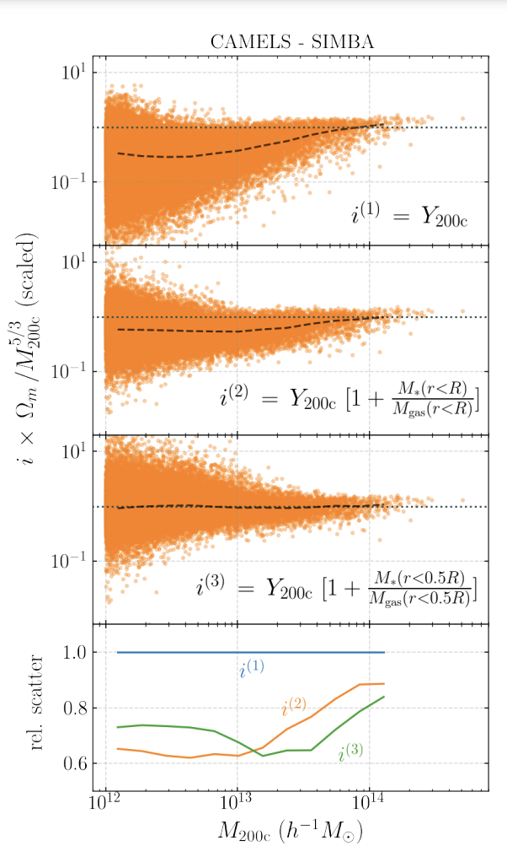
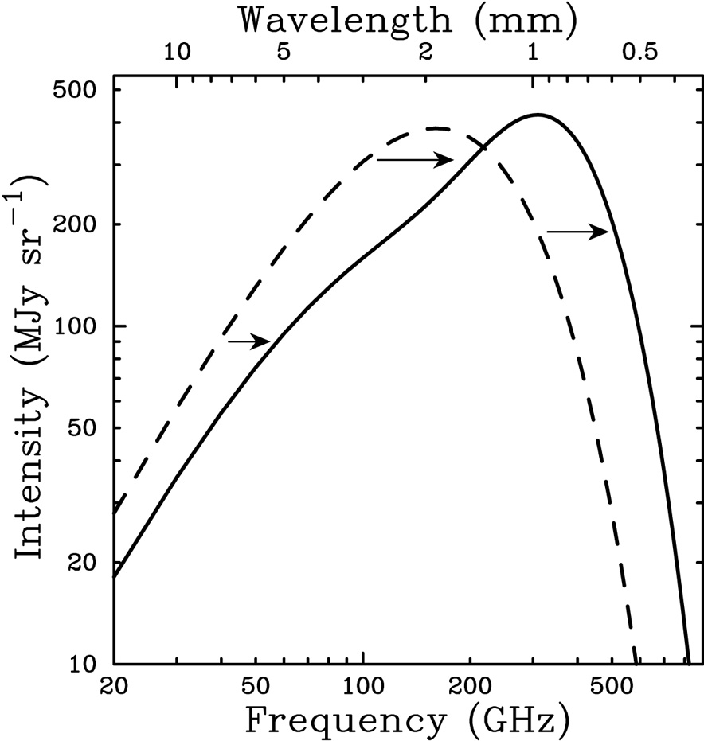
Effective descriptions of complex systems
Sunyaev-Zel'dovich effect in presence of feedback
Scattering of CMB photons off high energy electrons causes spectral distortions
If only gravity, use virial theorem to find
So expect that Y parameter scales as
What happens when there is not just gravity? Fit with SR (PySR).
Sunyaev & Zel'dovich, 1970; Wadekar et al., 2022 (2209.02075)

Slide 42
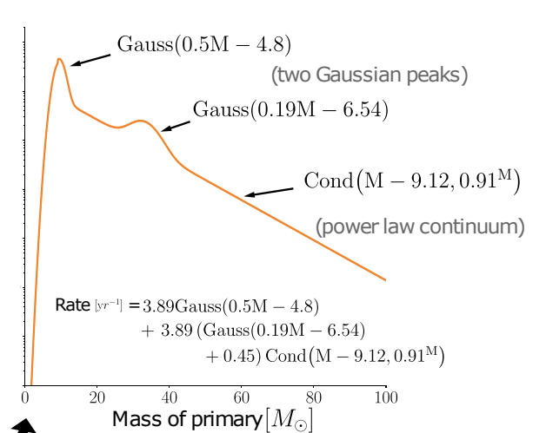
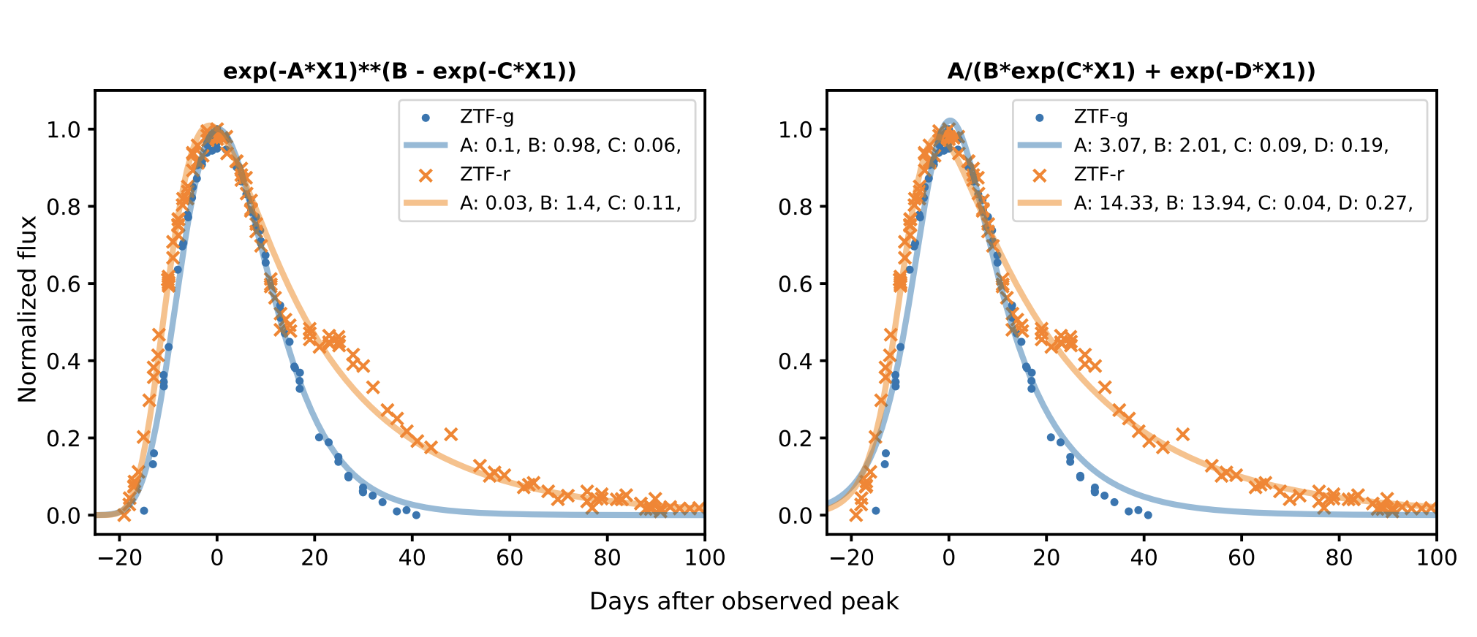
Effective descriptions of complex systems
Transient Physics
Obtain templates for transients which can be used in searches
Requires fitting same equation but different parameters to many objects:
Multi-View Symbolic Regression – Russeil et al. 2024 (2402.04298)
Class Symbolic Regression – Tenachi et al. 2023 (2312.01816)
Infer population source models from gravitational wave events
Wong & Cranmer 2022 (2207.12409); Russeil et al. 2024 (2402.04298)

Slide 43
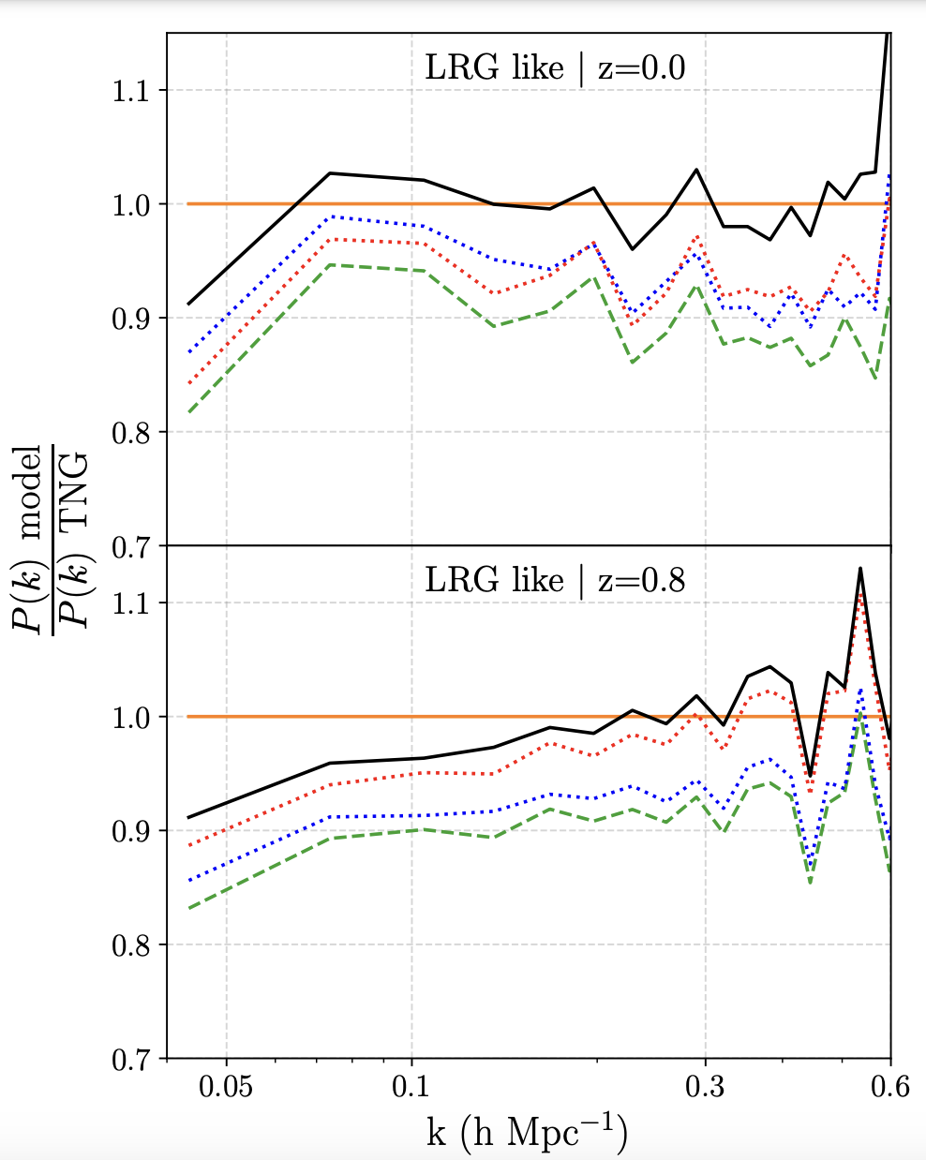
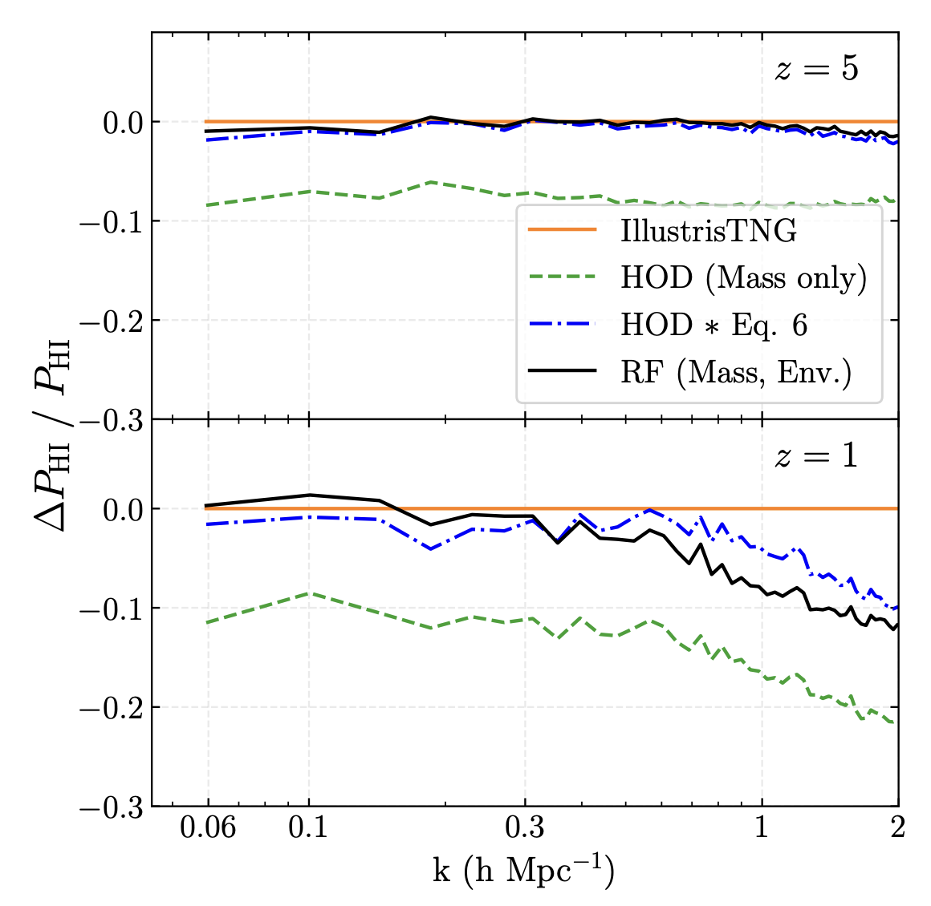
Effective descriptions of complex systems
Galaxy-Halo Connection
Add galaxies to dark matter only simulations using Halo Occupation Distribution (HOD) model
Typically assume baryonic properties of halos only depend on mass
Use SR (PySR) to see how to augment with additional variables
Standard
SR-enhanced
Delgado et al. 2021 (2111.02422); Wadekar et al. 2020 (2012.00111)

Slide 44
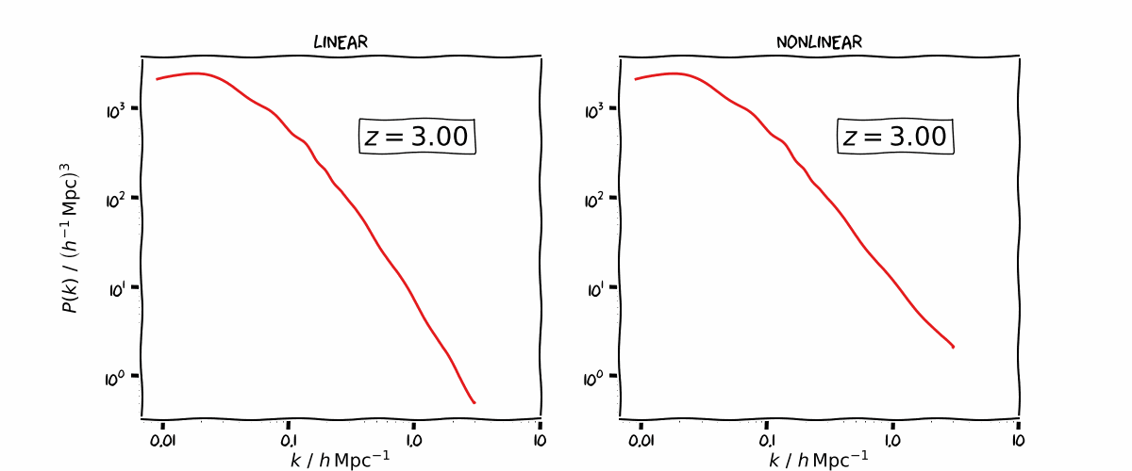
Emulators
Matter Power Spectrum of Cosmology

Slide 45
Emulators
SYREN-HALOFT: Percent-level Linear & Nonlinear Matter Power Spectra of Cosmology
Linear
SR (Operon) of P(k) over wide range of k, redshift and cosmological paraeters
Nonlinear
Bartlett et al. 2024 (2311.15865); Bartlett et al. 2024 (2402.17492), https://github.com/DeaglanBartlett/symbolic_pofk/

Slide 46
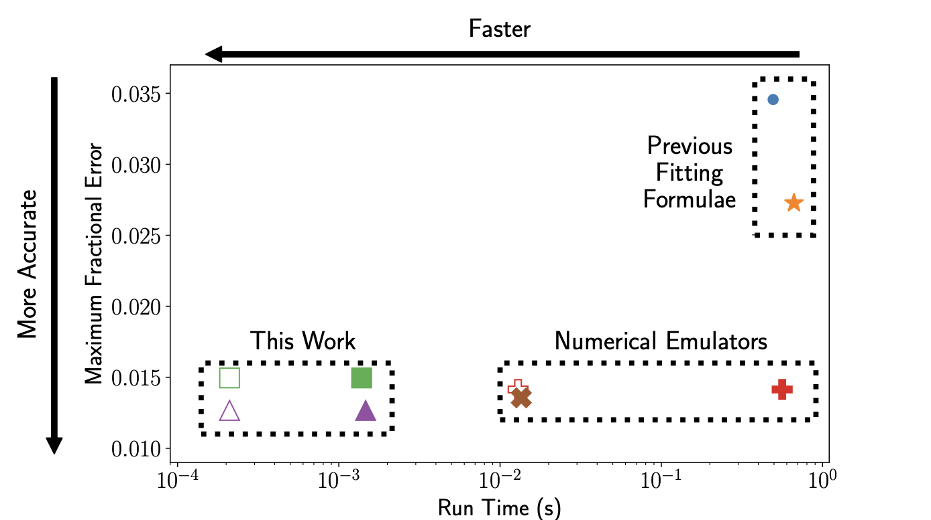
Emulators
Symbolic Emulators – Faster than neural networks, just as accurate
Bartlett et al. 2024 (2402.17492), https://github.com/DeaglanBartlett/symbolic_pofk/

Slide 47
Conclusions
Simple and Accurate functions directly from data
Many methods, many codes
Model selection integral part of the process
Many applications:
  Discover physical laws
  Obtain effective descriptions/fitting functions
  Emulators
Why?
  Fast (faster than deep neural networks)
  Interpretable (explainability)
  Clear and controllable extrapolation behaviour
  Portable (easy to change programming language, no reliance on packages which could become deprecated)

