Slide 1
Galaxy spectroscopy without spectra:
Galaxy properties from photometric images with conditional diffusion models
Lars Doorenbos (UniBE) and Eva Sextl (LMU) in collaboration with: Kevin Heng (LMU), Stefano Cavuoti (INAF-OACN), Massimo Brescia (UNINA), Olena Torbaniuk (UNIBO), Giuseppe Longo (UNINA), Raphael Sznitman (UniBE), Pablo Márquez-Neila (UniBE)
International Conference on Machine Learning for Astrophysics (ML4ASTRO2), 8–12 July 2024, Catania

Slide 2
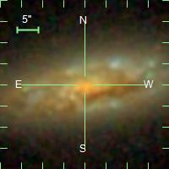
Motivation
Photometry: fast, but low-detail

Slide 3
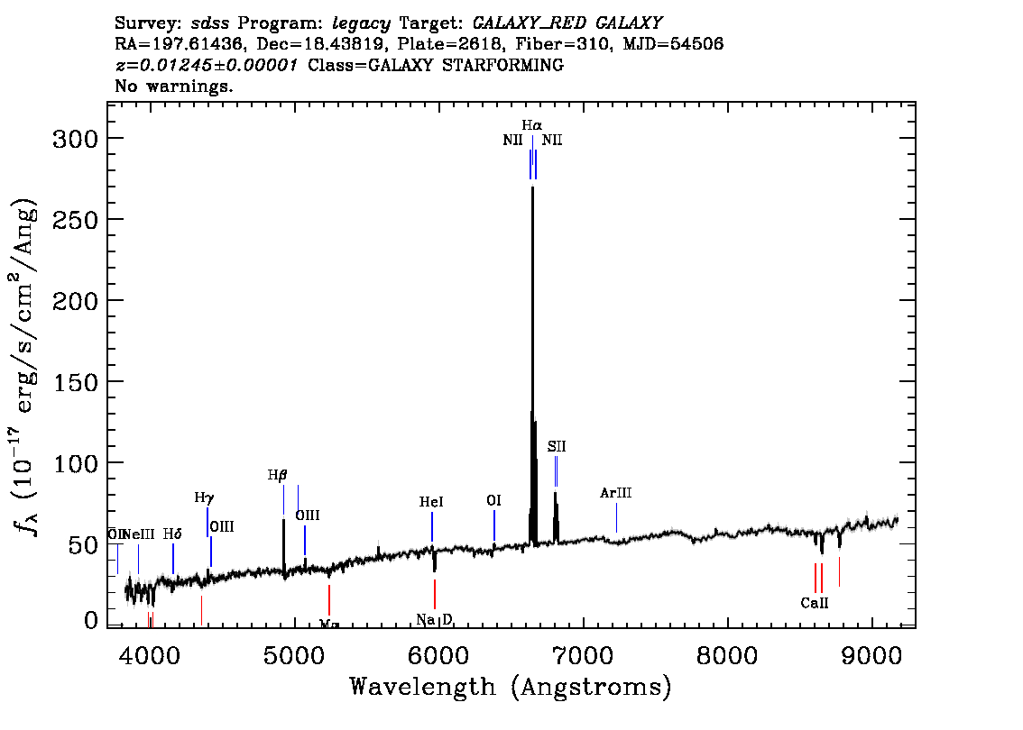
Motivation
Photometry: fast, but low-detail
Spectroscopy: slow, but high-detail

Slide 4
Motivation
Photometry: fast, but low-detail
Spectroscopy: slow, but high-detail
Can we combine the speed of photometry with the detail of spectra?

Slide 5
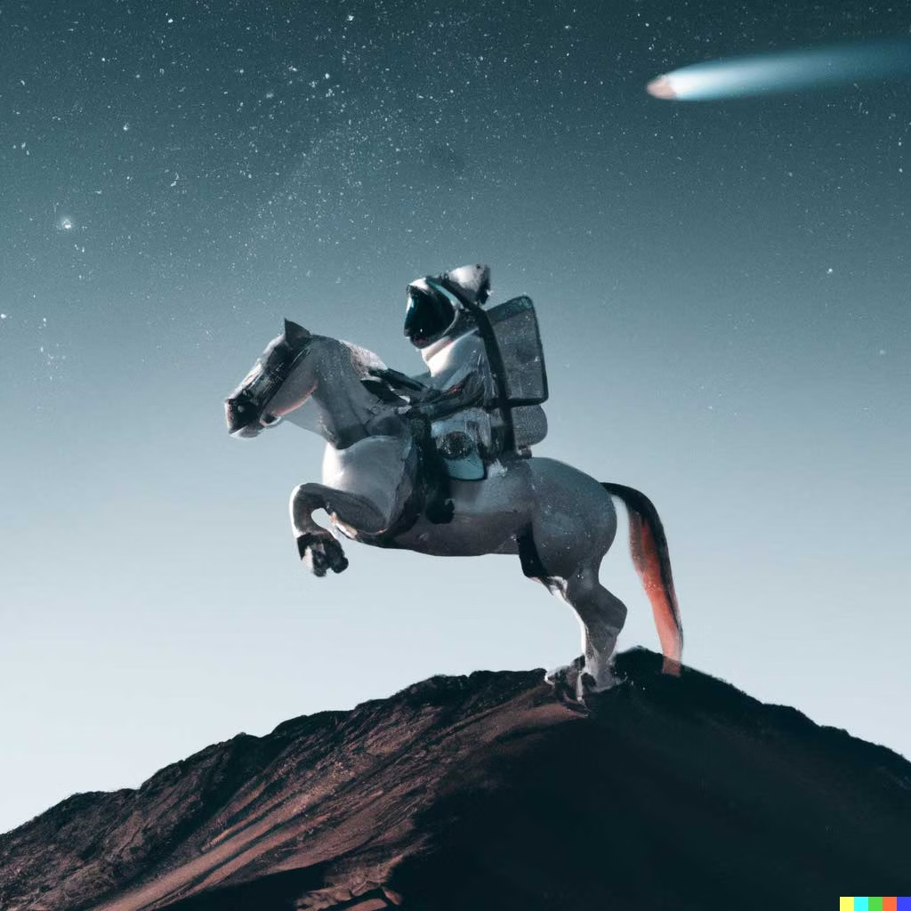
Method
An astronaut riding a horse in photorealistic style.
https://openai.com/product/dall-e-2

Slide 6
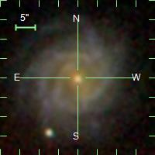
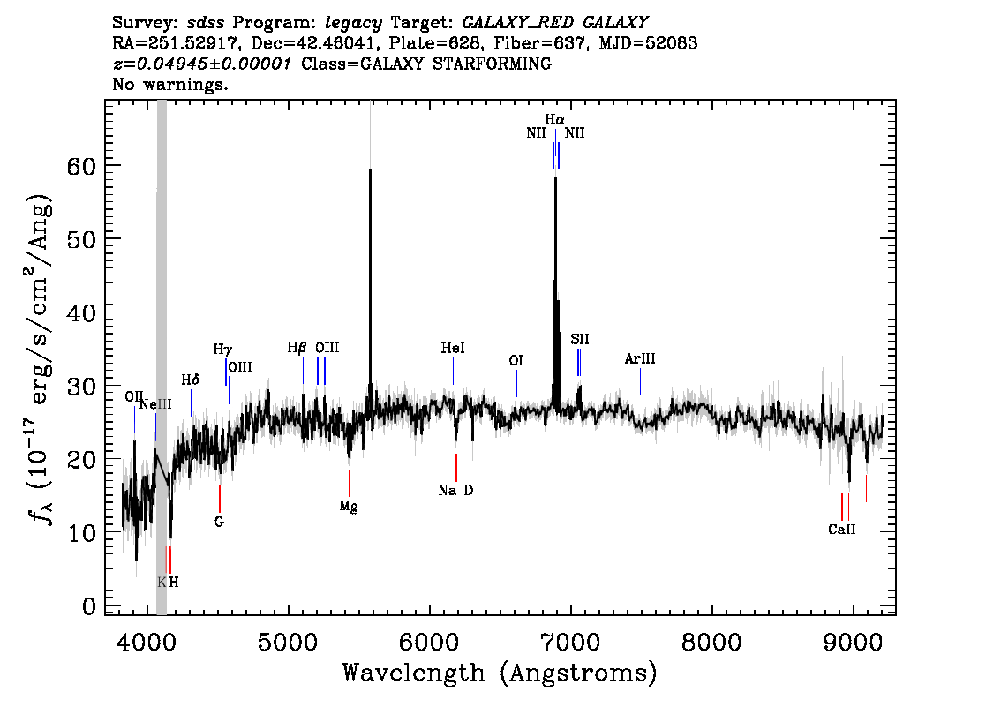
Method
An astronaut riding a horse in photorealistic style.
https://openai.com/product/dall-e-2

Slide 7
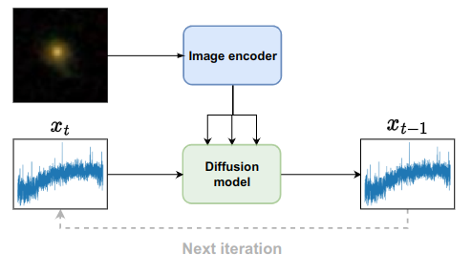
Method
We learn the distribution with a conditional diffusion model

Slide 8
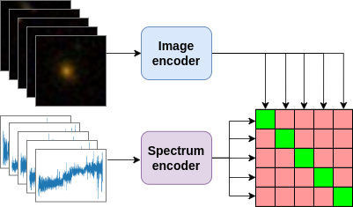
Method
We learn the distribution with a conditional diffusion model
We learn a multi-modal latent space with a contrastive network

Slide 9
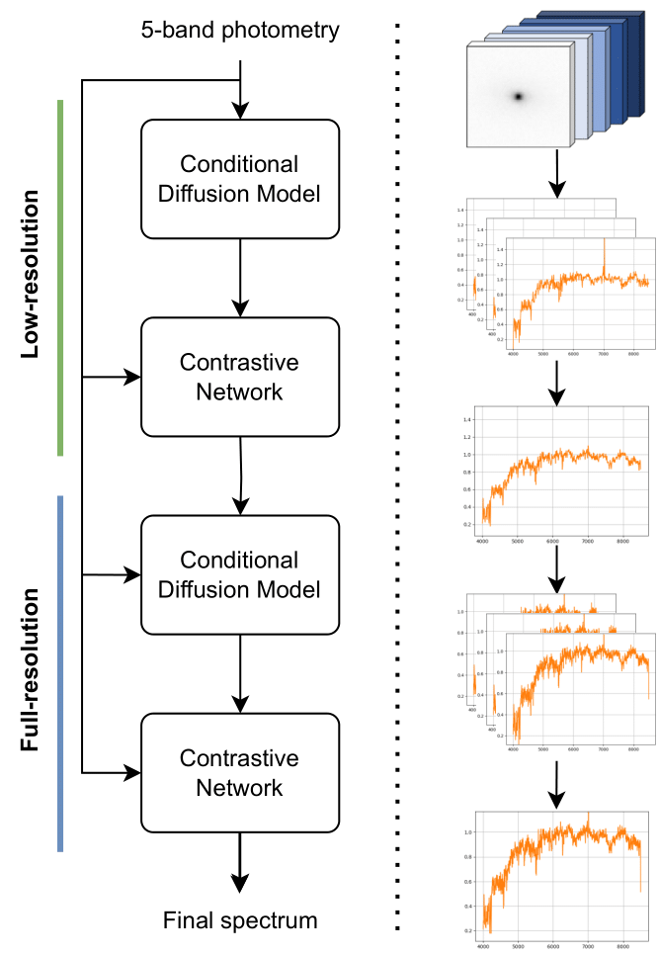
Method
We want to approximate
p(spectrum | image)
Rather than learning the distribution directly, we use a cascade of models:
First, we learn the distribution over low-resolution spectra,
p(low-res spectrum | image)
Then, we learn to upsample low-resolution spectra to the full resolution;
p(spectrum | image, low-res spectrum)
We select the spectra for the next steps with the contrastive networks

Slide 10
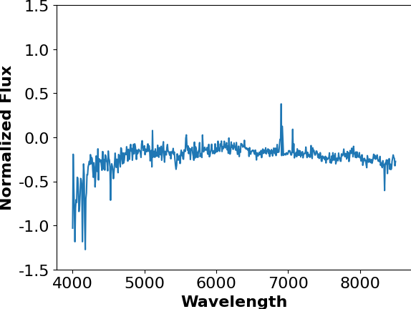
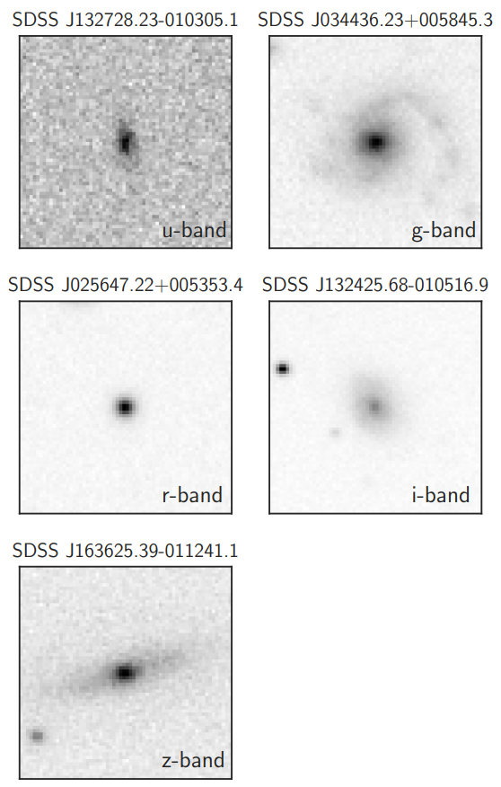
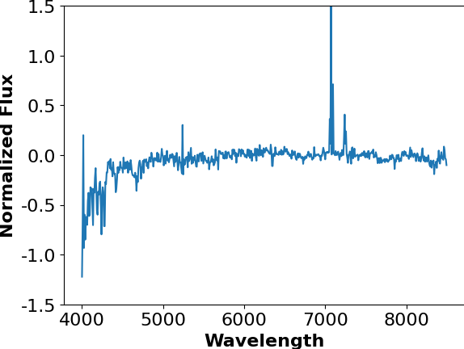
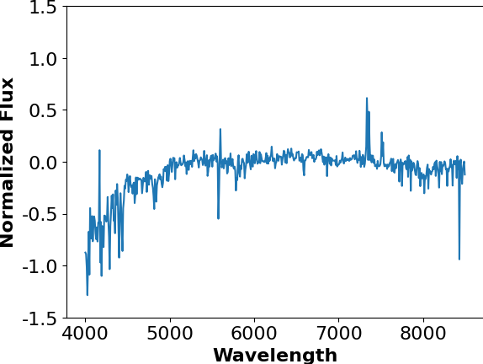
Data
Pre-processed 64x64x5 (ugriz) broadband SDSS images from Pasquet et al. (2019)
We select objects in the redshift range 0.05 < z < 0.15 with available spectra and remove objects with problematic flags or other issues Spectra in the range 4000-8499 Å with 1 Å steps
Normalized to 1 between 6900-6950 Å
Our final sample has 270 621 photometry-spectra pairs

Slide 11
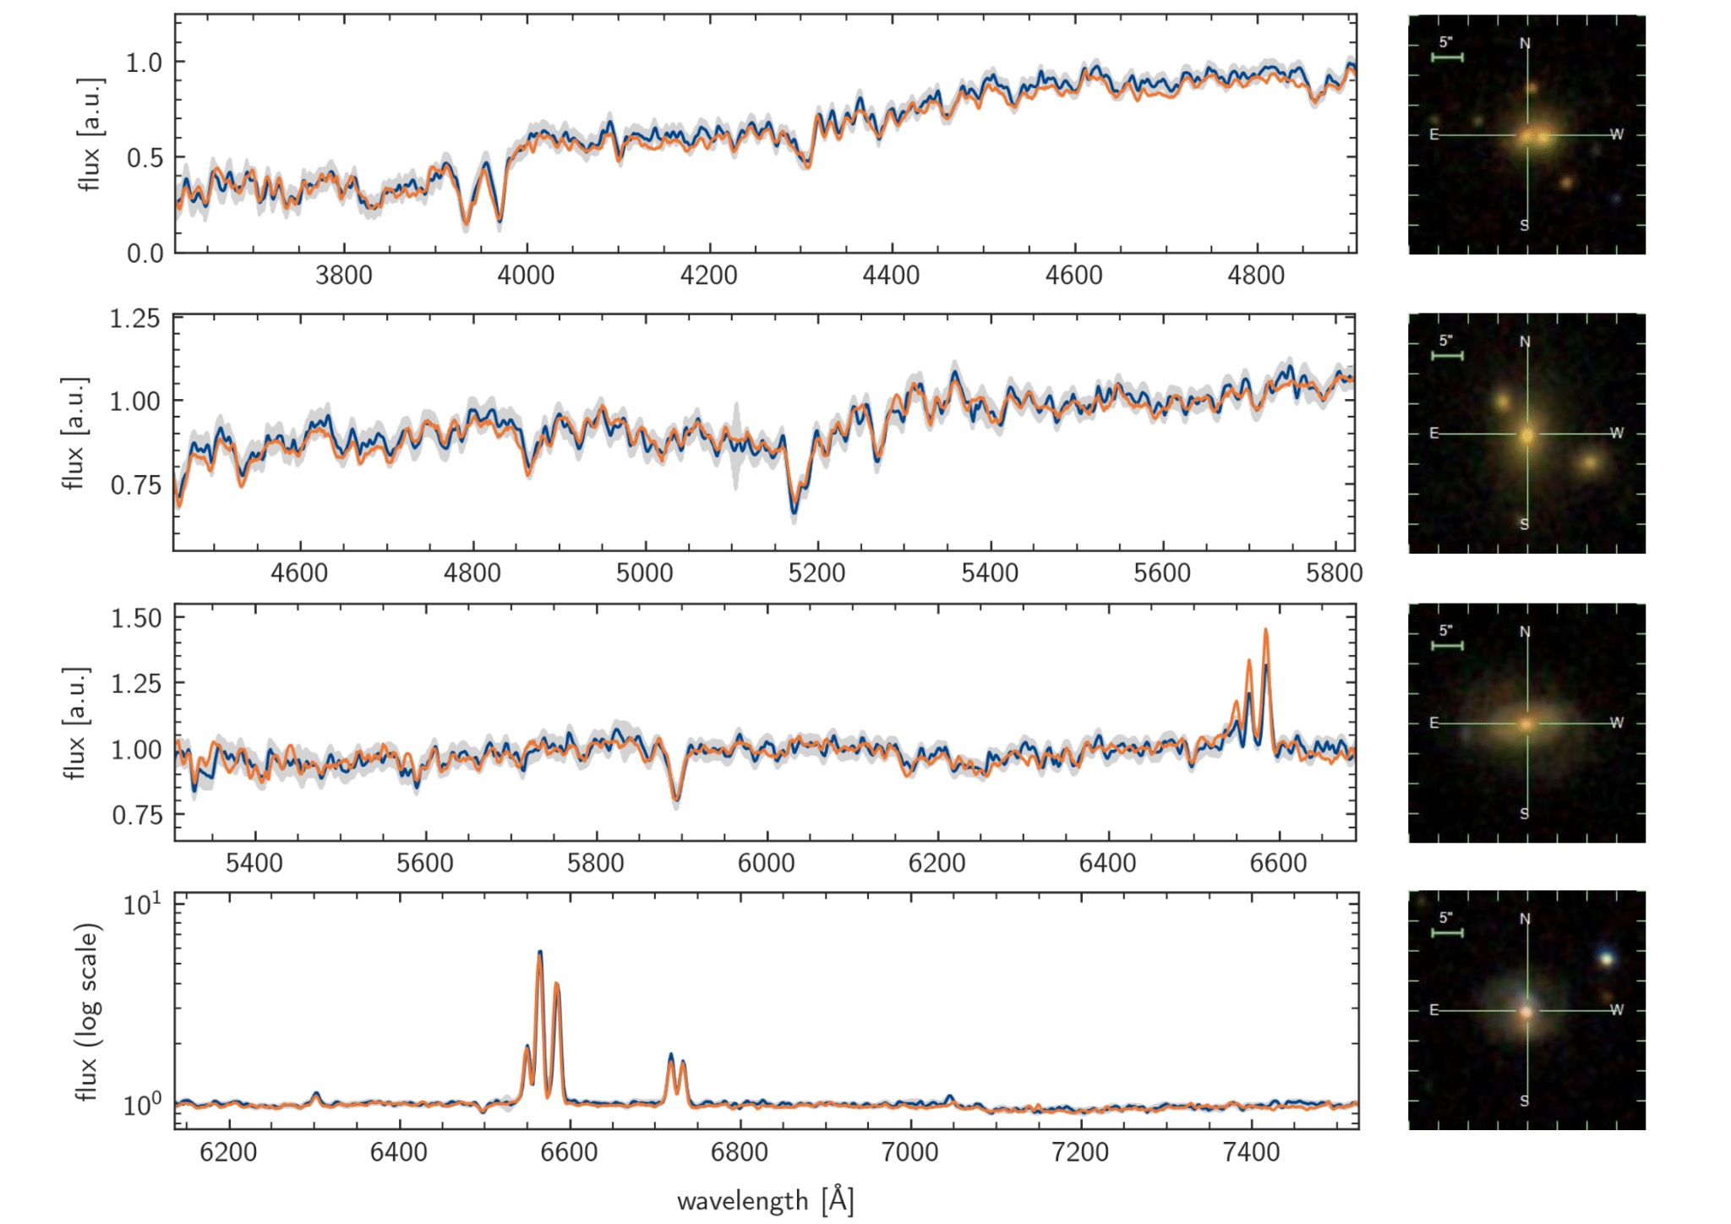
Comparison to observed spectra
SDSS J205600.32-053137.8
Redshift: 0.121 GZ2 morphology: Uncertain
SDSS J150109.86+472039.6
Redshift: 0.095 GZ2 morphology: Elliptical
SDSS J105728.22+065954.4
Redshift: 0.084 GZ2 morphology: Uncertain
SDSS J025019.52-070223.4
Redshift: 0.080 GZ2 morphology: Spiral

Slide 12
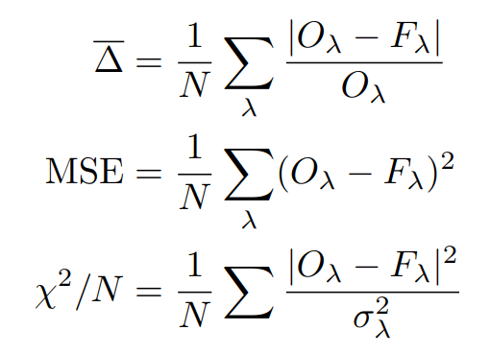
Evaluation
Initial assessment of the results with ML metrics on an unseen test set.
When taking into account the uncertainty of the observed spectra (χ²/N), all three groups perform equally well.

Slide 13
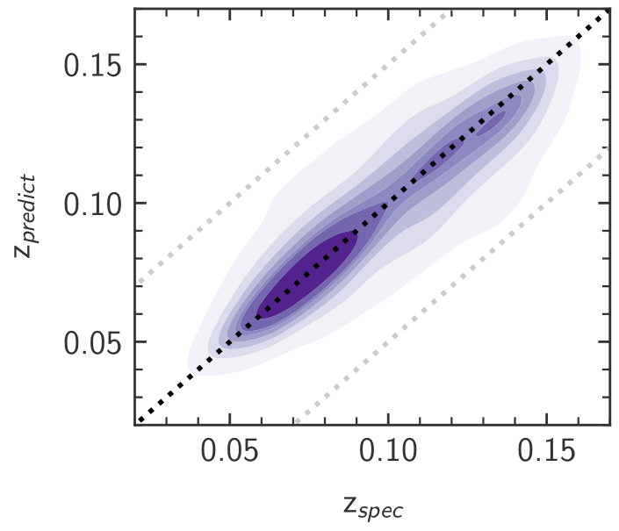
Photometric redshift prediction
Only two out of 1506 spectra have ‘catastrophic outlier’ redshift predictions.
We achieve a σ_{MAD} of 0.01177 on our sample
Specialized photometric redshift methods reach a σ_{MAD} of 0.00912 on the same dataset, but a wider redshift range

Slide 14
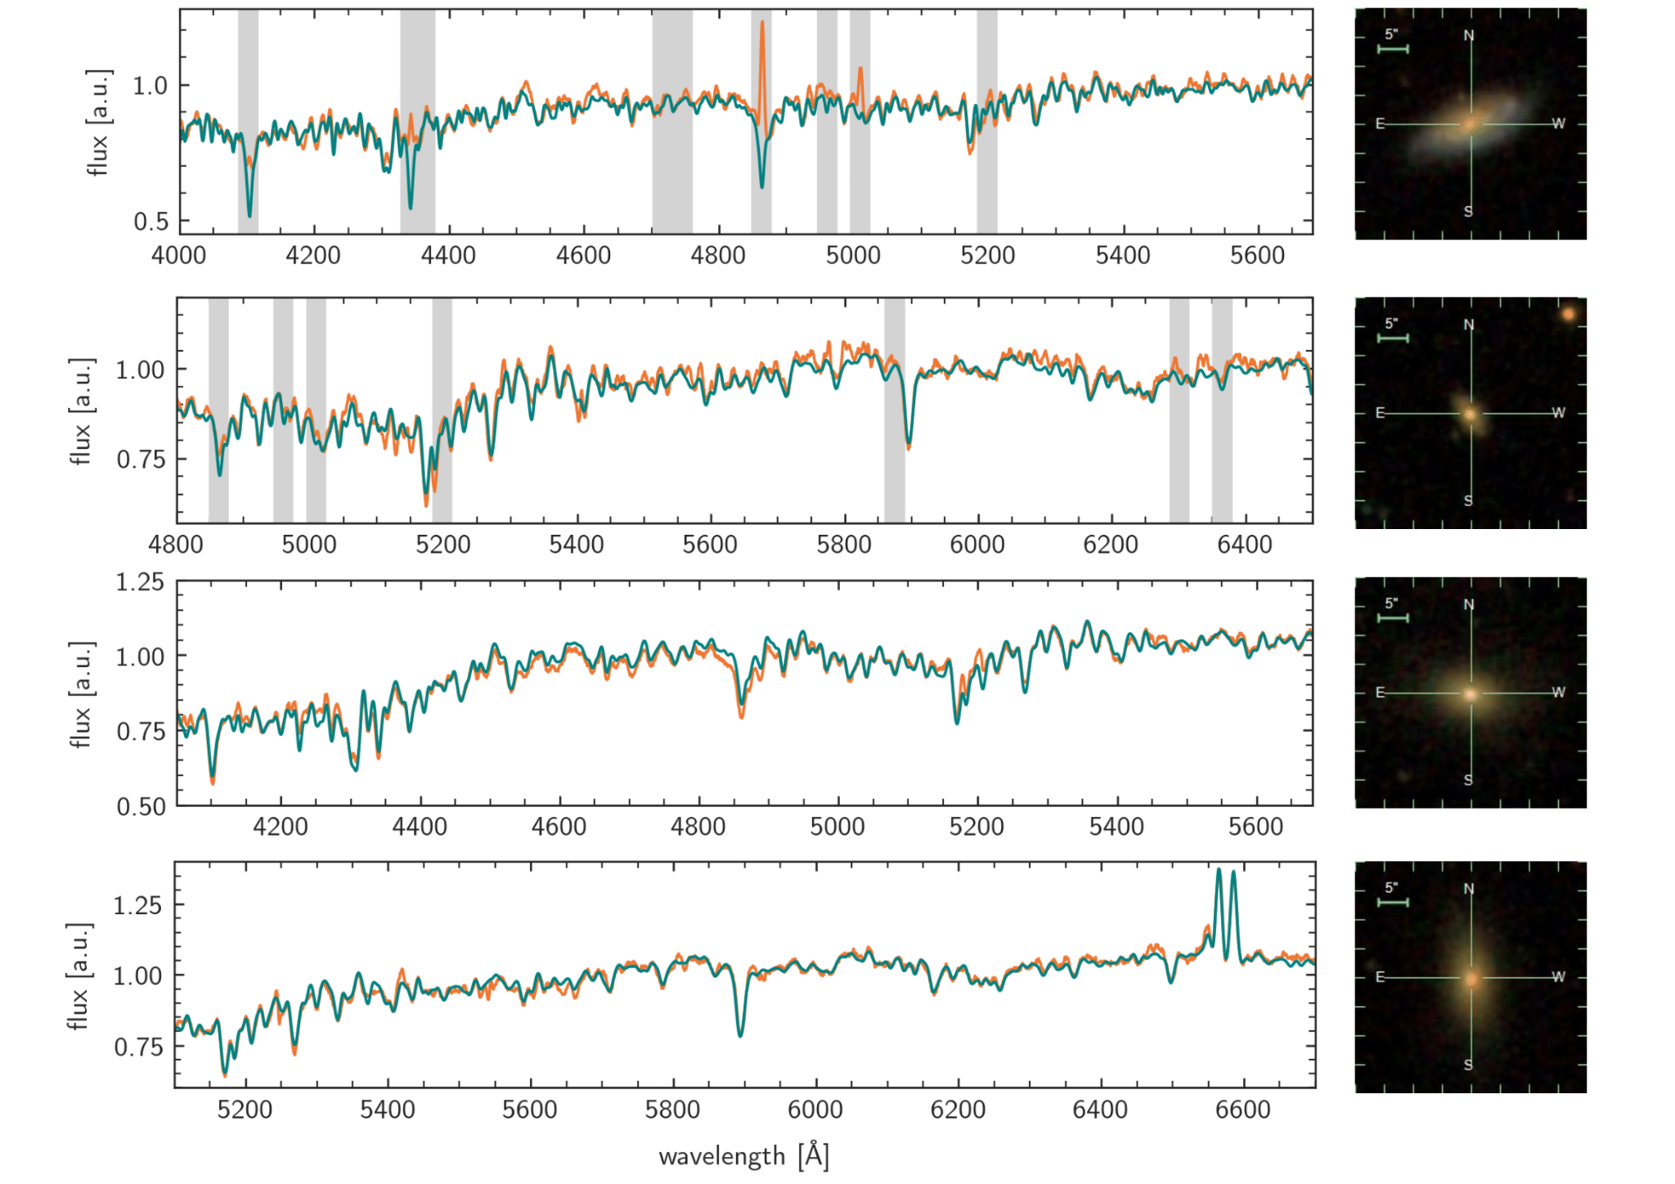
Full spectral fitting
FIREFLY
Predicted spectra and their full-spectrum fits with two spectral fitting procedures
pPXF

Slide 15
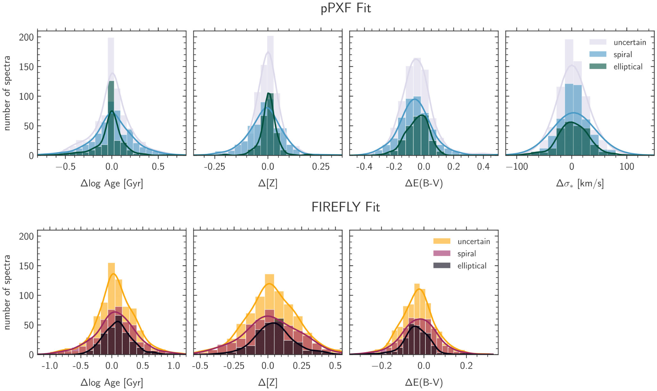
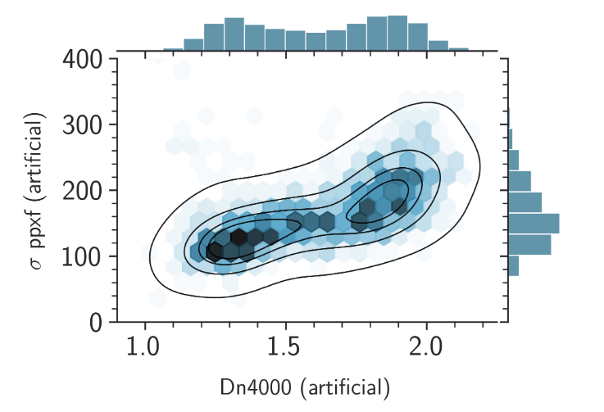
Full spectral fitting - galaxy properties
We can successfully recover physical properties such as age, metallicity, and velocity dispersion from the fits of our artificial spectra with both procedures.
Our generated spectra also shows the expected bimodality between Dn4000 and velocity dispersion.

Slide 16
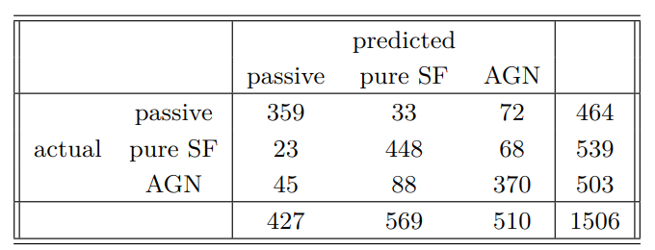
AGN detection
We can detect AGNs from our artificial spectra with an accuracy of ~82%
Real spectra
Generated spectra

Slide 17
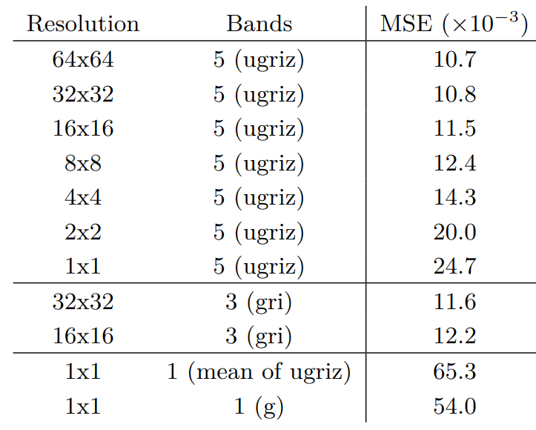
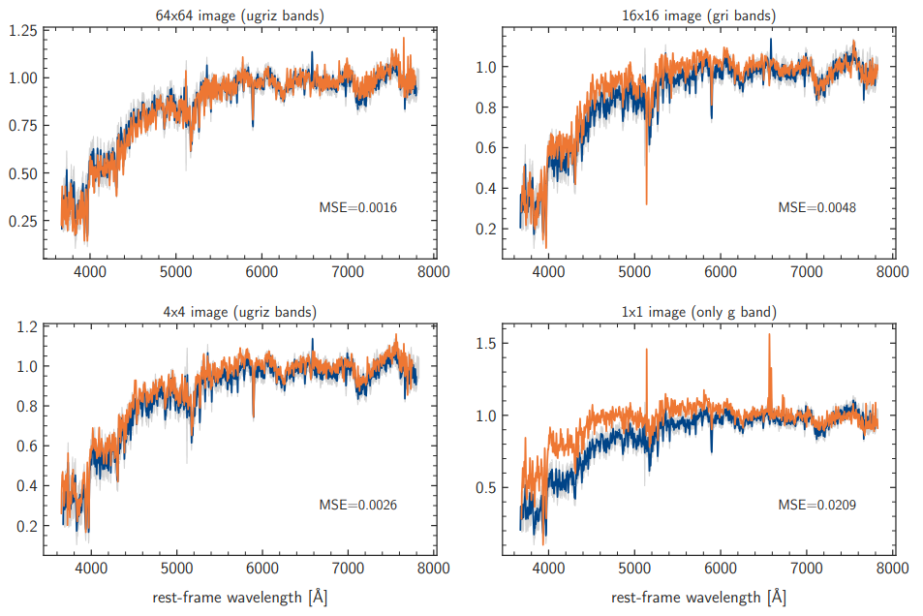
Morphology or colors
Both spatial information and magnitudes are important for the successful generation of spectra.
Removing the two outermost bands ≅ quartering the number of pixels in an image.

Slide 18
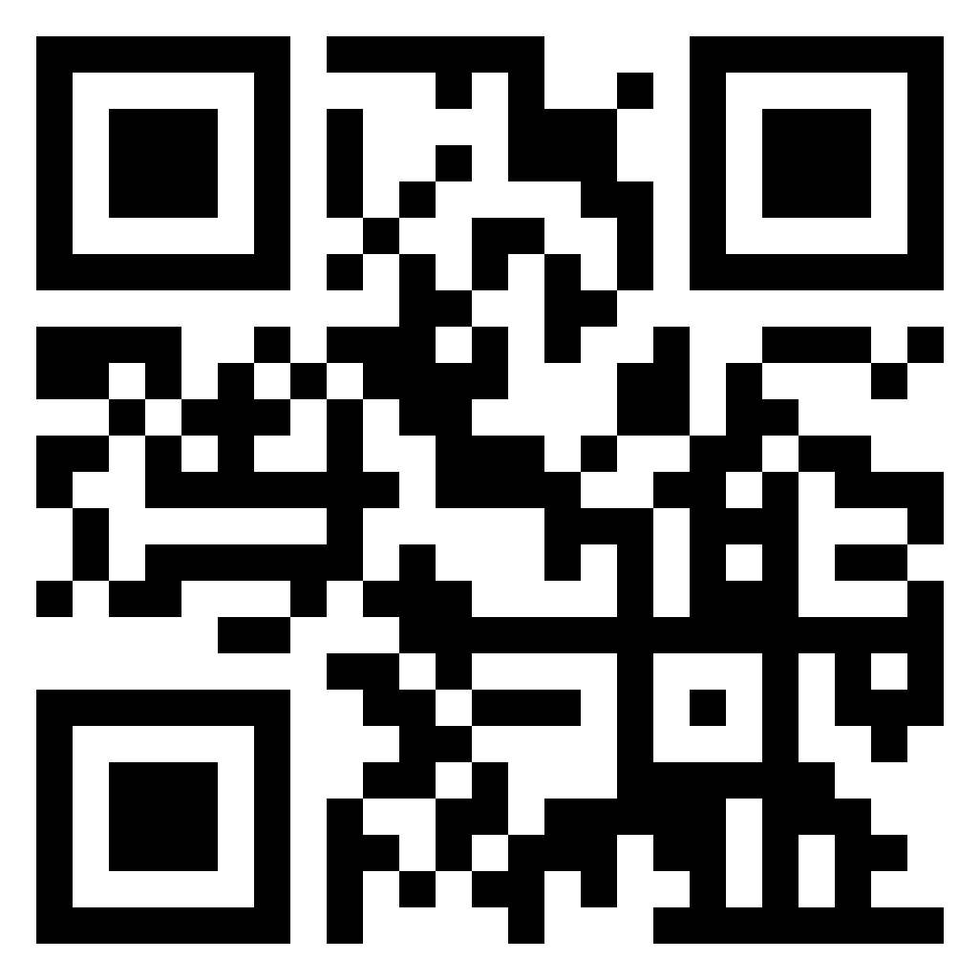
Conclusions
We are able to generate spectra from photometry with high quality - sufficient for several astrophysical analyses.
Our artificial spectra accurately capture the redshift of the objects
Through full spectral fitting codes we can retrieve galaxy properties that are very close to the observed values.
We can identify AGN candidates from the artificial spectra with an accuracy of 82%
Most importantly, our spectra can be analyzed in many more ways, removing the need to collect data and train specialized models for individual tasks.
Overall, we can predict scientifically interesting galaxy properties, normally requiring spectroscopy, from large-scale photometric surveys alone. By generating artificial spectra we can, for instance, determine objects that are likely to be interesting and perform more targeted spectroscopic follow-ups.
Find the paper here!
Write us if you have questions on the:
technical part: lars.doorenbos@unibe.ch
astrophysical part: sextl@usm.lmu.de
Thank you for your attention!

