Slide 1
WALLABY Pilot Survey: HI source-finding with a machine learning framework
Innovating Astronomical Source Finding Methods
Li Wang, Ivy Wong, Tobias Westmeier, Karen Lee-Waddell et. al. | 08 Jul 2024
Notes:
Good afternoon everyone. My name is [Your Name], and today I will be presenting our work on the WALLABY Pilot Survey and our novel approach to HI source-finding using a machine learning framework. This work has been a collaborative effort with Ivy Wong, Tobias Westmeier, and Karen Lee-Waddell

Slide 2

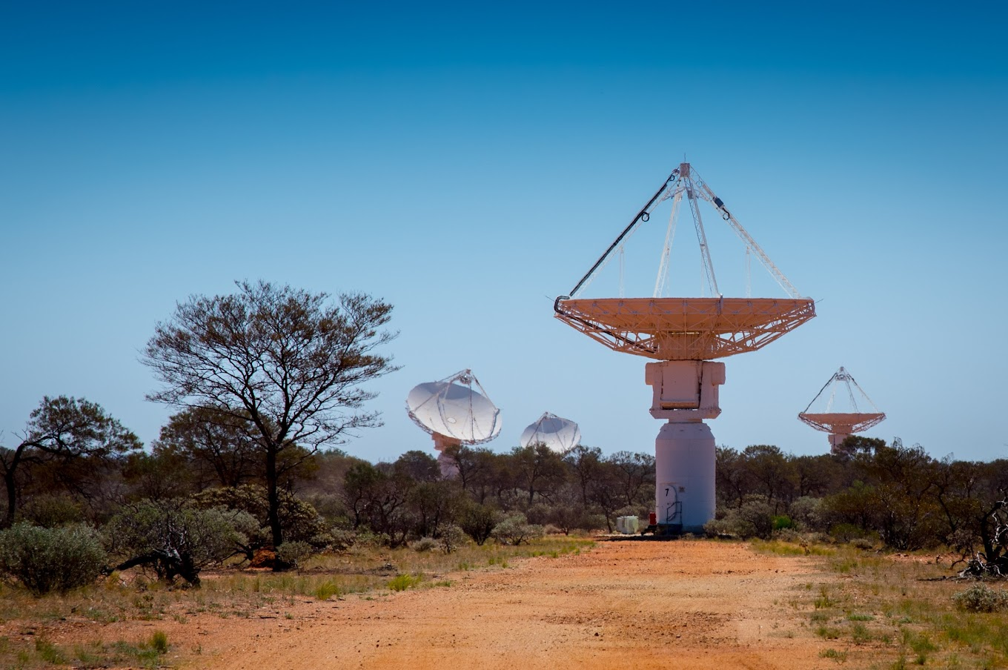
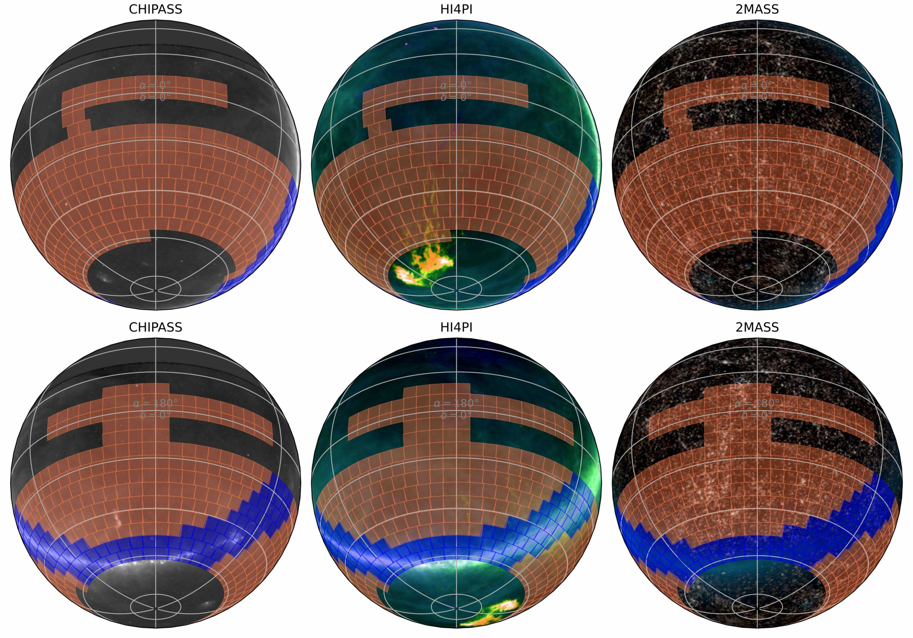
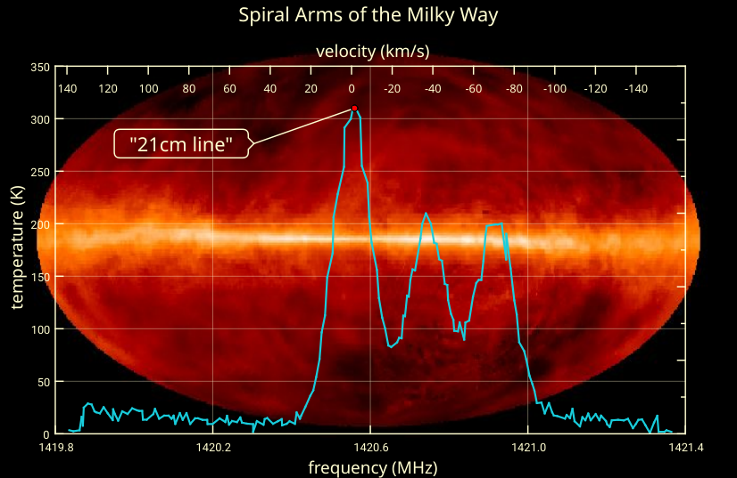
Introduction
Brief introduction to the WALLABY survey.
Importance of automated source-finding in large datasets.
Notes:
"The WALLABY survey aims to map a large portion of the southern sky in the 21-cm line emission of neutral hydrogen. This survey will help us understand galaxy formation and evolution by detecting and mapping HI in galaxies. Given the large data volumes expected, efficient and automated source-finding methods are crucial. Manual intervention is no longer feasible due to the large scale of the data."

Slide 3
Motivation
Source-finding workflow
WALLABY data
SoFiA2‘s Findings in DR2:
  Identifies 11,121 candidate sources from the data.
  Only 1,326 of these are confirmed as actual galaxies.
The Need for Efficiency:
  Manual verification is time-consuming yet not complex.
  Astronomers' valuable time should focus on more challenging and insightful tasks.
SOFIA source finder
Candidate source list
Human Rejection
Final Catalogue
Notes:
The automated tool currently using by our WALLABY team is SoFiA and its improved version SoFiA2. In case some of you don’t know the source-finding workflow, here is a workflow diagram. The WALLABY image cube will be send to the soifa software and SoFiA will generate a candidate list which contains both targe object and some false positive. Then, the human astronomer will be involved for distinguish the object and reject the false positives.
In this Human Rejection part, it is kind of labor-intensive. Take DR2 as an example, SoFiA generated 11k candidate sources which may potentially contain the targe objects. Then, the human experts need to look through the list and verify it one by one. After that, only around 10 percent objects are confirmed by the human expert as true galaxies. We believe that this manual verification process is time-consuming and is a repeated task. And I believe that astronomers should focus on more challenging and complex tasks.

Slide 4
Method: Machine Learning
Source-finding workflow
WALLABY data
Incorporates Traditional Strengths
Adaptive Learning: ML algorithms evolve by continuously learning from new data.
Pattern Recognition: Unravels intricate patterns within data that traditional algorithms may overlook.
Parallel Computing: GPUs, designed for parallel processing, greatly outperform CPUs in computational power, speeding up ML tasks.
SOFIA source finder
Candidate source list
The ML method rejection
Human Rejection
Human Rejection
Final Catalogue
Notes:
On the other hand, machine learning was born to solve these repetitive tasks. Apart from the traditional advantages that the SoFiA has, such as consistency and efficiency, machine learning have its unique strengths. First, ML model can continuously learning form the new data, when new training data is arrived, we retrain the model and it will become more powerful. In addition, it can discover complex patterns that rule-based method may ignored. Sometimes these patterns are non-explainable and even human experts cannot understand. Lastly, machine learning methods usually run on the GPU. And GPUs are designed for parallel computing. And the GPUs are greatly outperform CPUs in computational power. All these advantages made ML suitable for processing extensive astronomical data.
Thus, we have proposed a ML method to bypass the human rejection.
I7 12700 768GFLOPS
82.58 TFLOPS
Automation Advantages: Consistency: Delivers uniform analysis across vast datasets.
Efficiency: Operates continuously, processing data faster than manual methods.
Focus: Frees astronomers to tackle more complex research challenges.

Slide 5
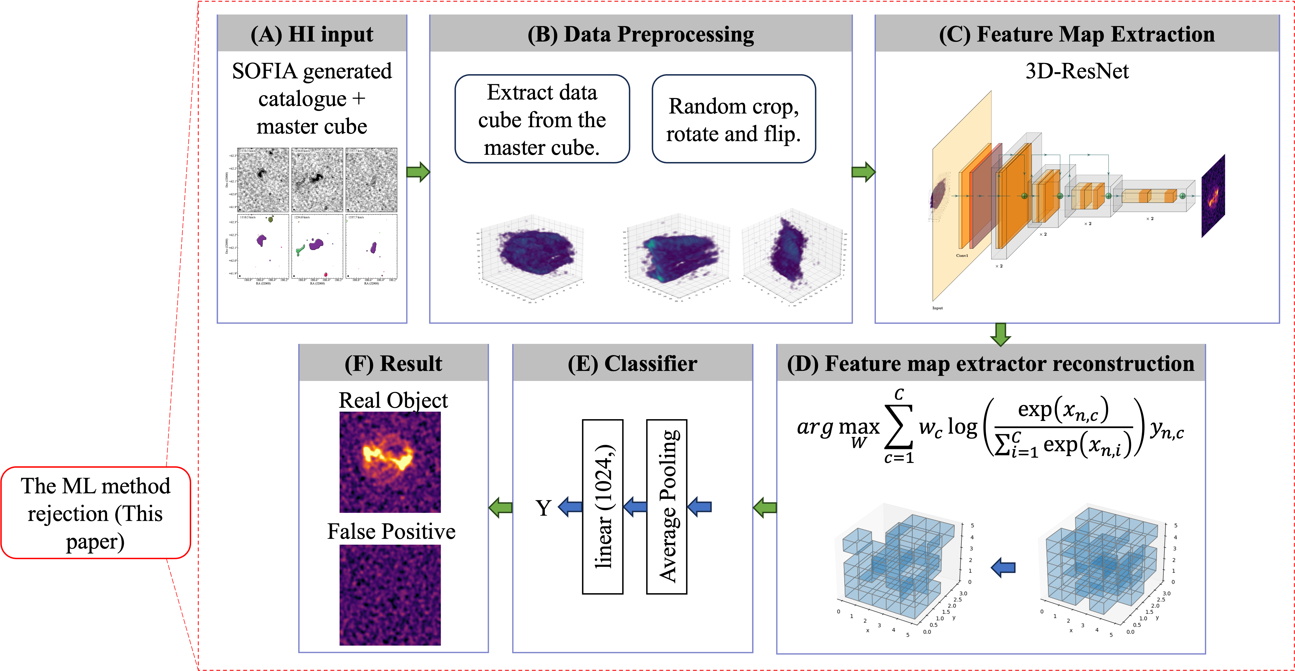
Method
The ML method rejection
Figure. The proposed machine learning framework.
Notes:
Here is our proposed ML method for the rejection task. The method takes the SoFiA candidate catalogue and the master image data cube as an input. Then, it will prepocess the data. It will extract the mini cube from the master cube accounding to the SoFiA bounding box following by some data argumentations. The mini cube will be send to the neural network to extract the features. The network will be train based on the loss function. The extacted feature map will be sent to the classifier and the final output is whether this mini cube is a real object or a false positive.

Slide 6
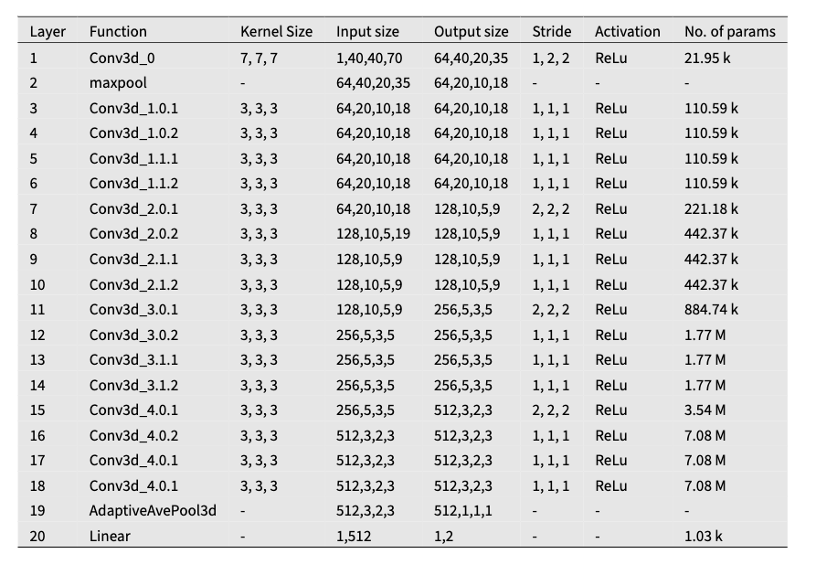
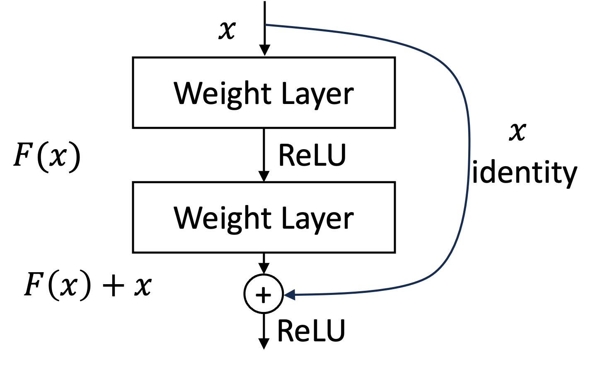
Neural Network Architecture
3D ResNet architecture.
Residual connections
Notes:
Our model is based on a 3D ResNet architecture, which allows us to fully exploit the spatial and spectral dimensions of the data. The network includes several layers of 3D convolutions and pooling operations, enabling it to capture complex patterns in the data. The use of residual connections helps in training deeper networks by mitigating the vanishing gradient problem."

Slide 7
Training Process
Implementation:
  Utilized PyTorch for model implementation.
  Training and testing on NVIDIA RTX A5000 GPU (16GB RAM).
Training Methodology:
  SGD with momentum.
  Learning rate set to 0.001.
Testing Efficiency:
  Testing time: 45--220 milliseconds per subject. Dependent on I/O performance.
Dataset Splitting:
  Training: 80%
  Validation: 15%
  Test: 5%
Notes:
We implemented our method using PyTorch and trained our model on an NVIDIA RTX A5000 GPU with 16GB of RAM. We used stochastic gradient descent with momentum, starting with a learning rate of 0.001. We split our dataset into 80% for training, 15% for validation, and 5% for testing.

Slide 8
Evaluation
Simulated Data
Real ASKAP Data
Train 80%
Val 15%
Test 5%
Train 80%
Val 15%
Test 5%
Train
Train
Model_1
Model_2
Test
Test
Model_1
Model_2
Test Results
Test Results
Notes:
We validated our model's effectiveness using both simulated and real data. The datasets were split according to the showed portion. This ensured that the model had ample data to learn from, while keeping a separate set of data for unbiased testing.
During the training process, the model was never exposed to the test data. This approach was applied to both simulated and real data, with independent models trained and tested for each dataset.
By keeping the test data isolated, we ensured that our evaluation was fair and reflective of the model's real-world performance."

Slide 9
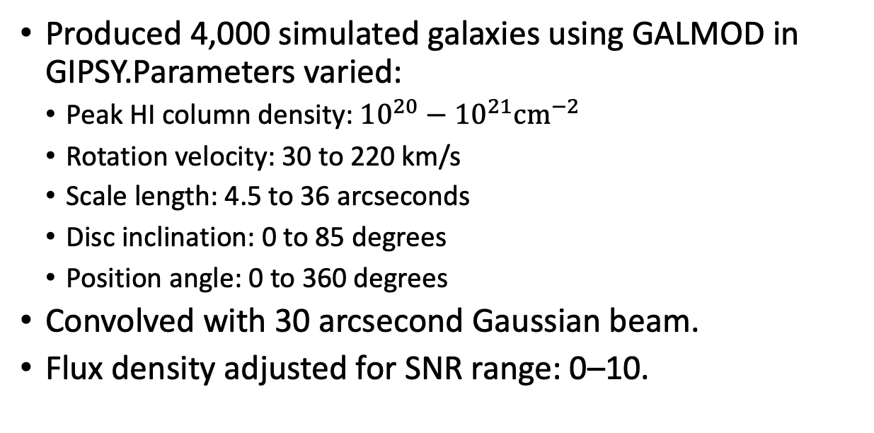
Simulated Data Generation
Produced 4,000 simulated galaxies using GALMOD in GIPSY.Parameters varied:
  Peak HI column density: ${10}^{20}−{10}^{21}{cm}^{−2}$
  Rotation velocity: 30 to 220 km/s
  Scale length: 4.5 to 36 arcseconds
  Disc inclination: 0 to 85 degrees
  Position angle: 0 to 360 degrees
Convolved with 30 arcsecond Gaussian beam.
Flux density adjusted for SNR range: 0–10.
Notes:
We produced 4,000 simulated galaxies using an open source library, with different parameters such as peak HI column density, rotation velocity, etc. These galaxies were convolved with a 30 arcsecond Gaussian beam, and flux density was adjusted for an SNR range of 0–10.
The simulated galaxies are injected into a noise cube containing genuine ASKAP noise, which forms the positive samples.
We also generated 4,000 negative samples from an ASKAP WALLABY noise cube, ensuring a balanced dataset.

Slide 10
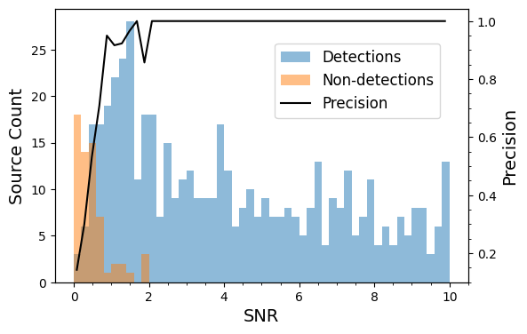
Results on Simulated Data
Figure. The confusion matrix illustrates the model's performance in classifying data as either 'Galaxy' or 'Noise.'
Figure. Histogram of detected (blue) and undetected (orange) mock galaxies and the completeness (black) as a function of SNR, demonstrating that the model is able to achieve 100 percent completeness at SNR$\gtrsim$2
Notes:
Then, we test our method using two datasets. The first one is the mocked dataset. We can see that our model achieved a relatively high accuracy shown on this confusion matrix. Both the true positive and true negative rate are over 90% indicating out model can distinguish whether the mini cube is a real object or a false positive. We can also see the SNR distribution of the detected and undetected galaxies on the left figure. The model achieves 100% precision on the data with SNR greater than 2. Even when SNR is aroud 1, our model still have a precision over 80 %.

Slide 11
Real Data Preparation
Source Data:
  Utilized SoFiA‘s candidate list, total candidate sources: 11,121.
Mini Cube Extraction:
  SoFiA provides boundary boxes, extracted mini cubes from the master cube using these boxes.
  Prepared the data for neural network input.
Data Cleaning:
  Applied DBSCAN to clean closely spaced objects, removed redundant objects within 30 arcseconds.
Normalization:
  Standardized the cleaned data.
  Prepared the data for neural network input.
Notes:
For the real data, we started with SoFiA's candidate list, which included 11,121 sources. Using boundary boxes provided by SoFiA, we extracted mini cubes from the master cube.
To clean the data, we remove redundant objects within 30 arcseconds of each other. This ensured that only one point was saved for each close group of objects.
Finally, we standardized the cleaned data through normalization, preparing it for neural network input."

Slide 12
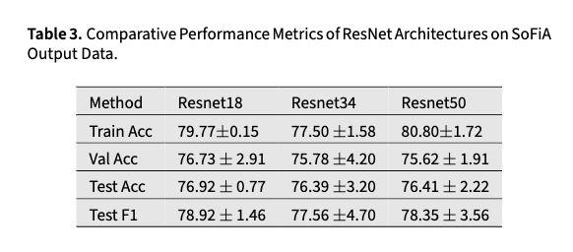
Application to Real Data
Figure. Confusion Matrix showcasing the performance of our model on real astronomical data.
Notes:
When it comes to real dataset from DR2, our model can still have an accuracy rate around 75%.
We compared performance across different three ResNet versions. In general, without sufficient data, the model may struggle to learn more complex patterns, even as its capacity increases with more layers.
We hypothesise that this source rarer properties that have not been modelled well by our current model.

Slide 13
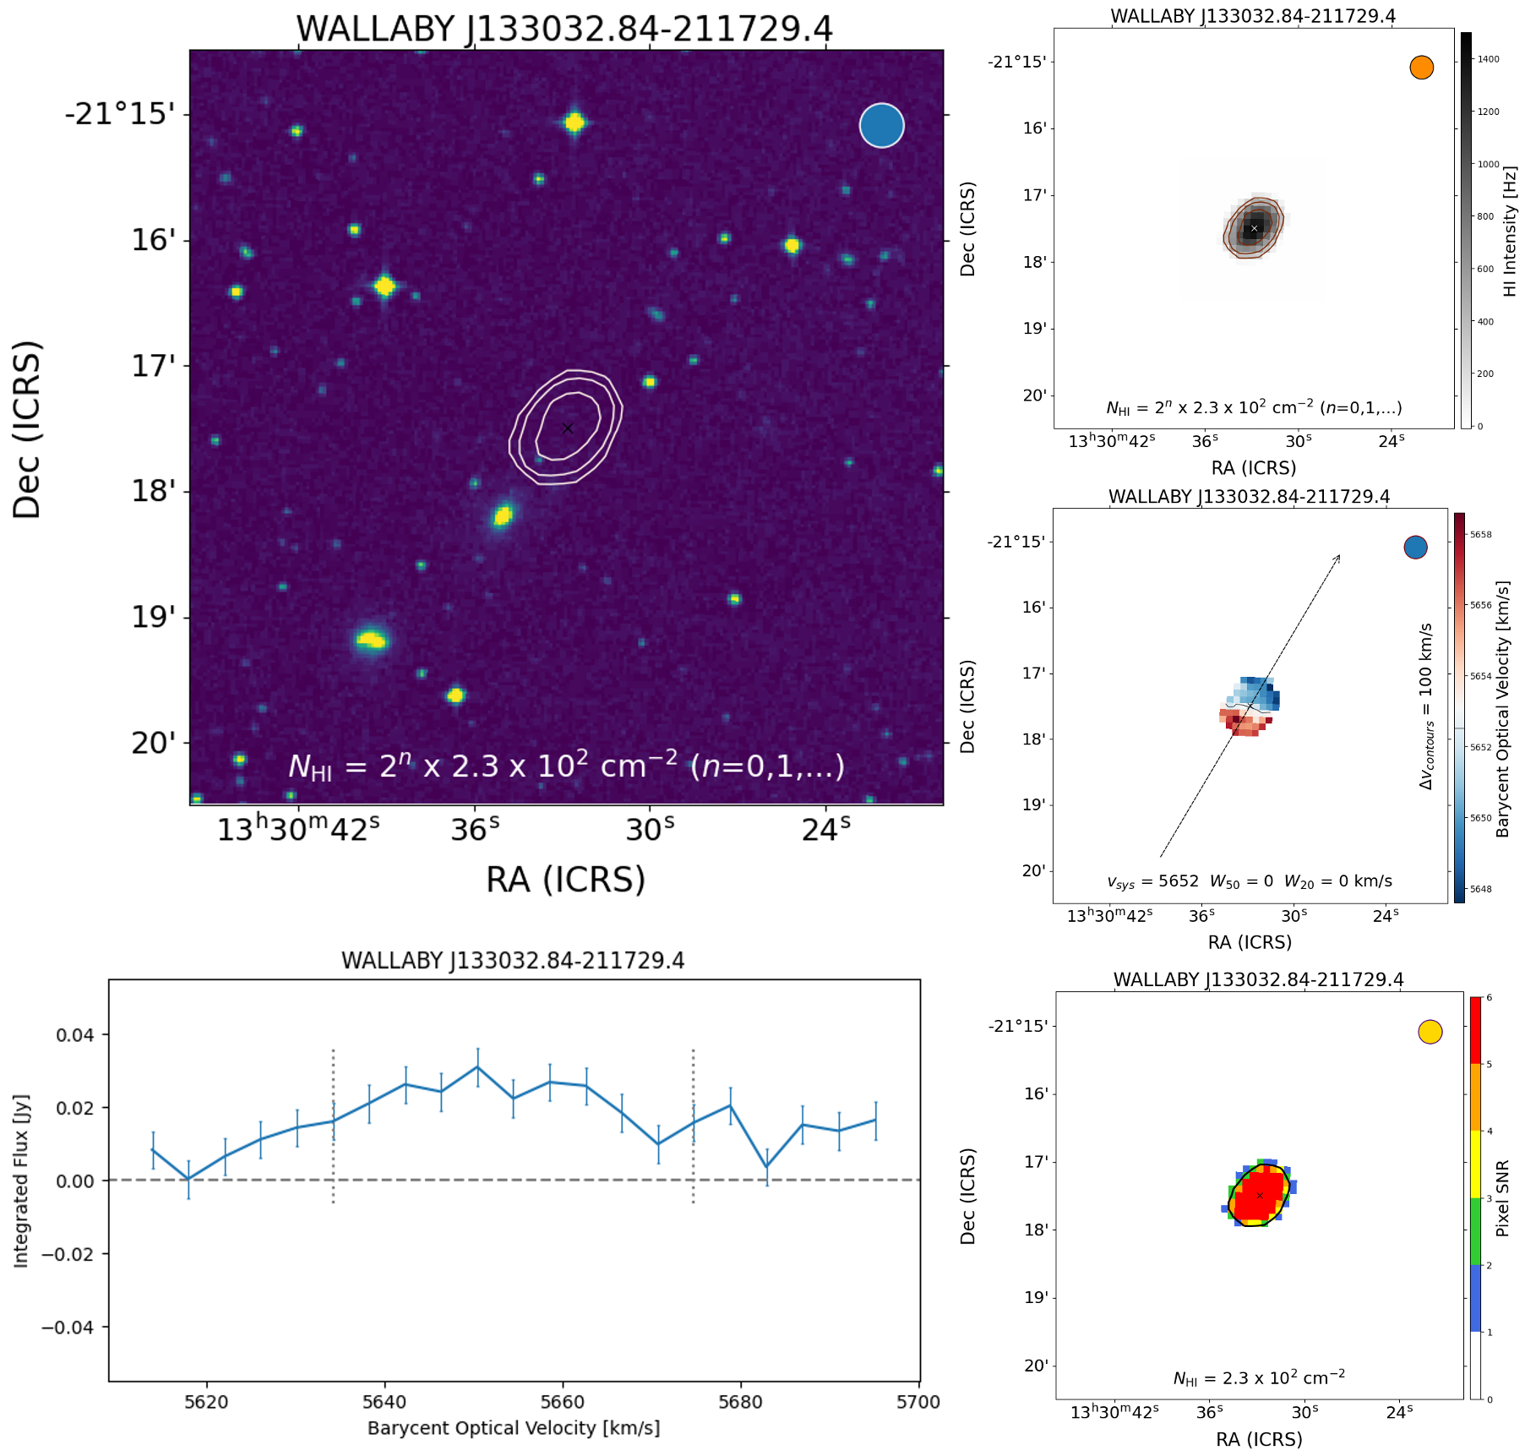
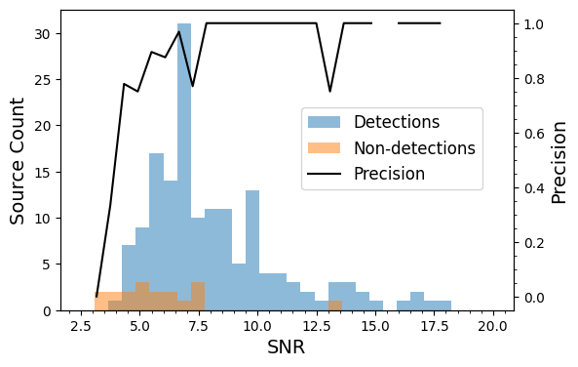
Visualizing Model Performance
Figure. Histogram of detected (blue) and undetected (orange) real galaxies as a function of SNR.
Figure. Missed source with SNR = 11.
Notes:
"Visualizing the model's accuracy as a function of SNR,
we can find that there is no objects with SNR lower than 3 in our test dataset and our model is able to achieve reliable accuracy at SNR > 7.5. However, we did miss a source with SNR = 11, as shown in the right example. This highlights the need for further refinement of our model to capture all true sources."

Slide 14
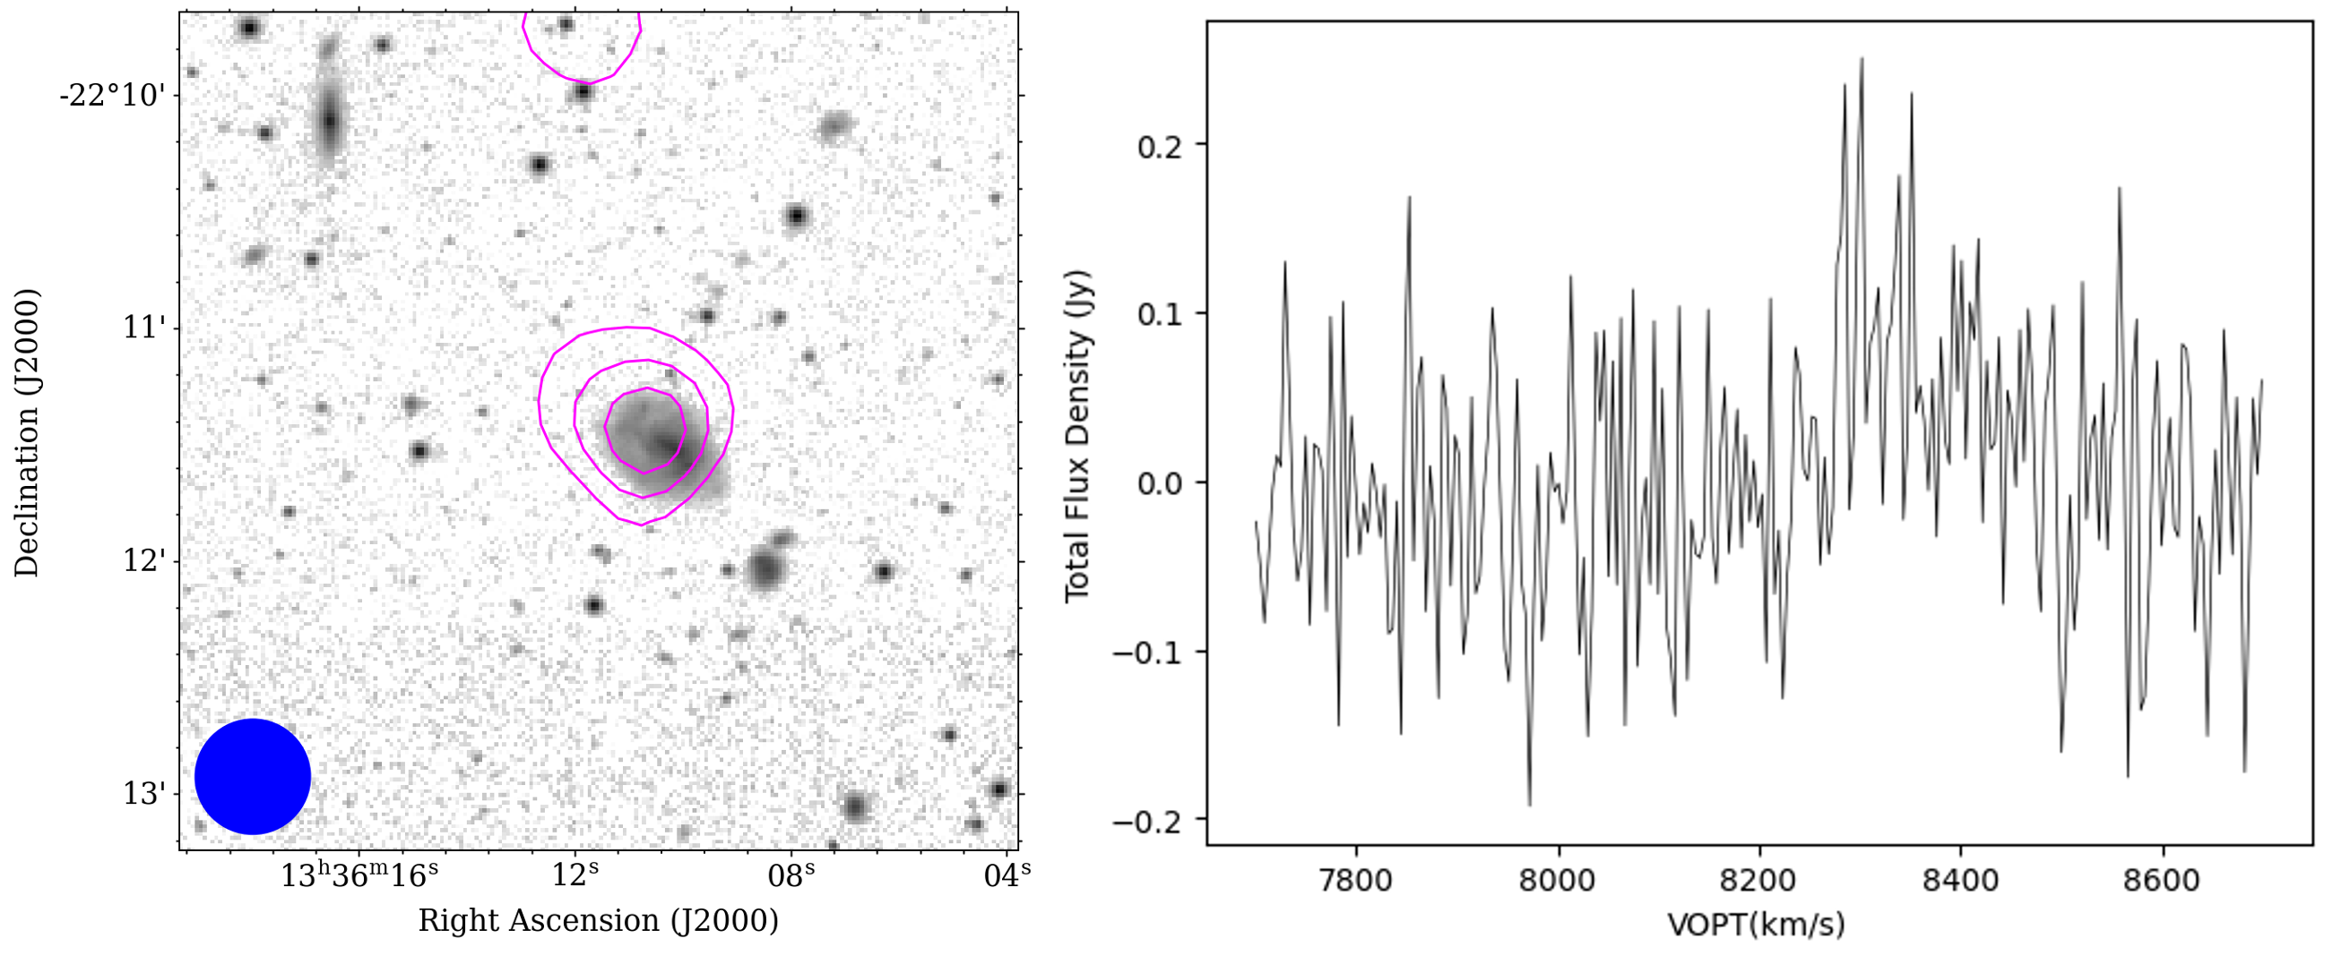
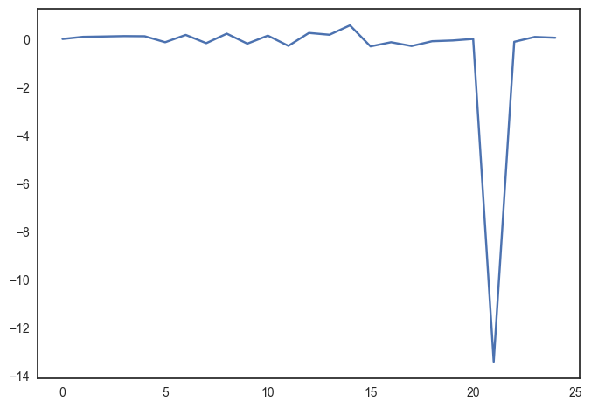
Results – Additional galaxy
Figure. H₁ source identified by our model that are not catalogued in the WALLABY DR2 catalogue.
Notes:
Apart from the accuracies, a supervise of our current model is that we found some sources that are not catalogued in the DR2 catalogue. Here is an example of new galaxy found by our ML model. This galaxy is re-verifiied by a few human experts and it is confirmed as a real galaxy. So, why this object is missing previously?
Here is the integrated HI spectrum of this source. We can see that there is a sharp pit in it. The signal of the object is submerged in this large range. Human experts will think SoFiA have captured this pit and report a false positive. So the human expert reject this detection. Considering that human experts have to look at 11,000 candidates one by one, this situation is very likely to happened. On the controry, ML method can ignore the sharp pit and capture the feature of the target object.

Slide 15
Conclusion
Limitations:
  Data Quality: Training data relies on human-labeled data. Low SNR cases may be mislabeled, reducing model accuracy.
  Complexity: Using a 3D CNN increases gradient descent dimensionality, making optimization more challenging.
  Insufficient Training Data: 1,300 positive samples are not enough for a network with 33 million parameters.
Future Plans:
  Increase Data Samples: Gather more data samples, especially for low SNR objects.
  Unsupervised Learning: Explore methods that do not rely on labeled data.
  Domain Adaptation: Train on simulated data and adapt to real data for better accuracy.
Notes:
In conclusion
Despite our model's successes, there are several limitations. First, our training data relies heavily on human-labeled data. In low SNR cases, mislabeling can occur, reducing model accuracy. Additionally, using a 3D CNN increases the complexity of gradient descent, making optimization more challenging. Lastly, our current dataset of 1,300 positive samples is insufficient for a network with 33 million parameters.
Looking forward, we plan to increase the number of data samples, especially focusing on low SNR objects. We also aim to explore unsupervised learning methods that do not rely on labeled data. Moreover, we will work on domain adaptation techniques, training on simulated data and adapting to real data to improve accuracy."

Slide 16
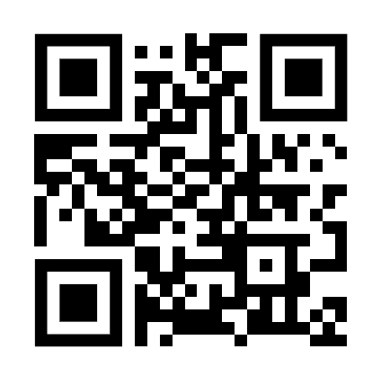
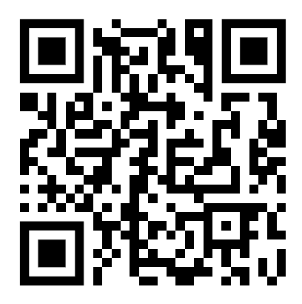
Thank you
WALLABY Survey
The Australian Square Kilometre Array Pathfinder (ASKAP)
Space and Astronomy
  Li WANG
  CERC Fellow
    li.wang1@csiro.au
Notes:
That's all for my presentation. I'll leave the time for discussions and commons.

