Slide 1



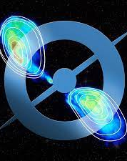
Radio Galaxy Zoo: EMU
paving the way for EMU cataloguing using AI and citizen science
ML4ASTRO2, Catania, Italy
Hongming Tang （DoA, Tsinghua Uni.)
On behalf of RGZ EMU collaboration (65 members)
Email: hongmingt@mail.tsinghua.edu.cn
Notes:
Thank RGZ EMU collaboration

Slide 2
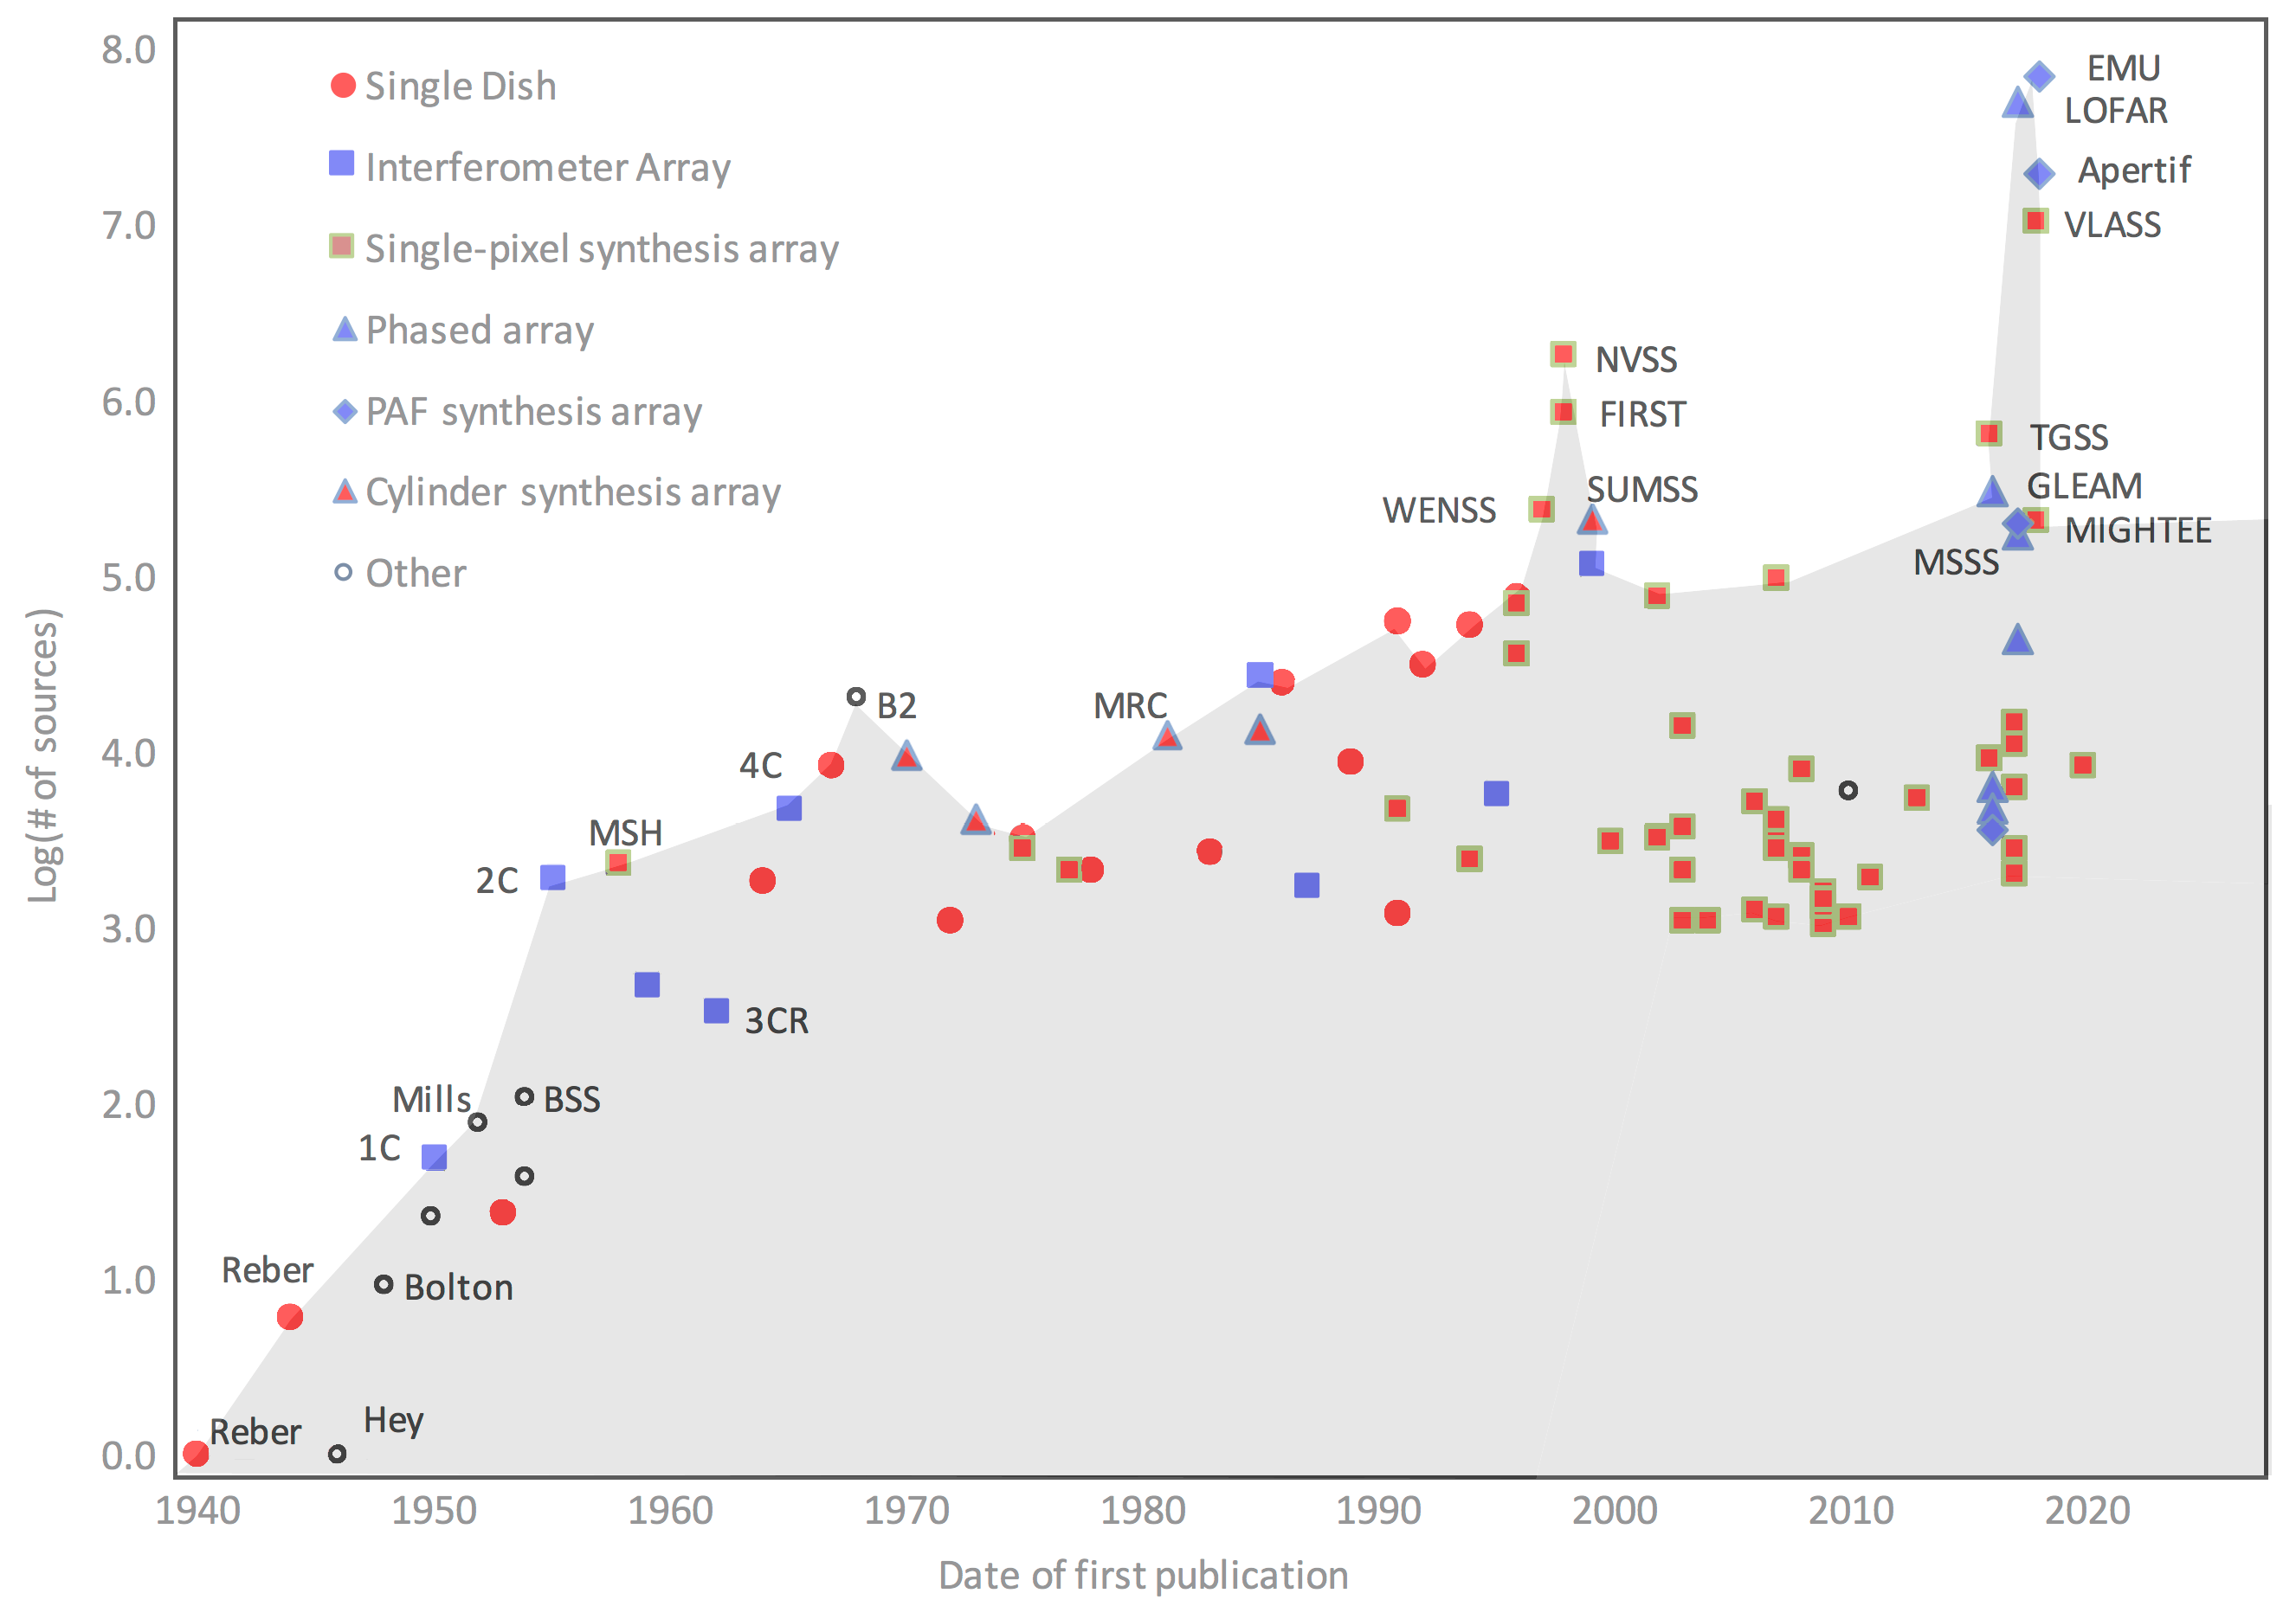
Large survey data challenge
Norris et al. 2021
Notes:
Challenge brought by big data: a timeline.

Slide 3
Large survey data challenge
EMU: ~ 40M sources
LoTSS DR 2: ~4.4 M sources
Cataloguing Techniques:
Source Finder (SF; handled most sources)
Cross-Matching methods
Visual Sorting (handled complex sources)
And more

Slide 4
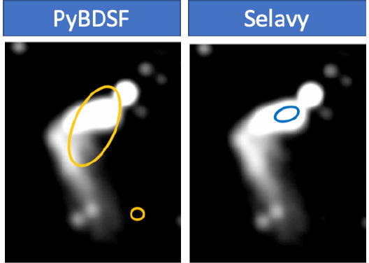
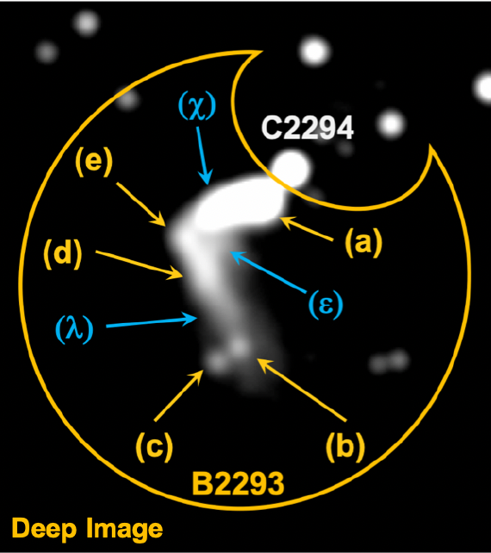
SF vs. complex source
For LoTSS
For EMU
Usually 5-20% in a survey cannot be handled by gaussian-fitting based SF easily
For EMU survey, that yields ~4,000,000 (10%)
Boyce et al. 2023a,b
We need alternative methods to handle them!
Notes:
Planned P3

Slide 5
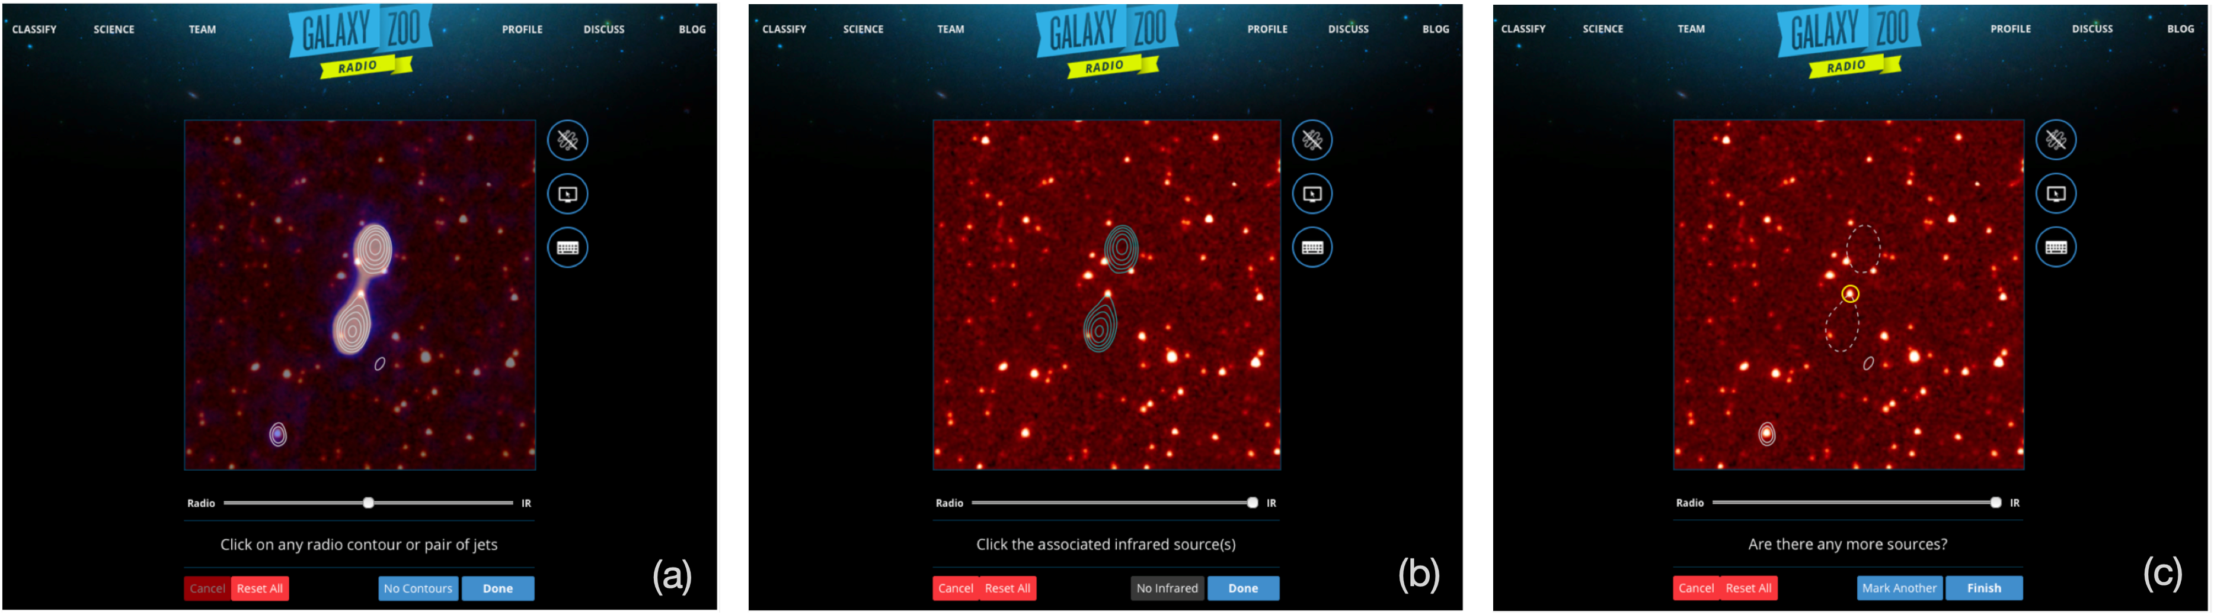
RGZ workflow
2. Mark radio emission regions that are interconnected to the same hosting galaxy
Banfield+2015; Wong et al. submitted
1. Examine both radio (VLA FIRST) and IR (WISE) identity location of radio emission regions w.r.t. galaxy
3. Identify its infrared hosting galaxy
yes
4. More radio galaxy?
Optional: Comment/Discuss

Slide 6
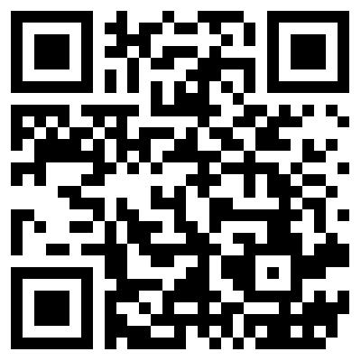
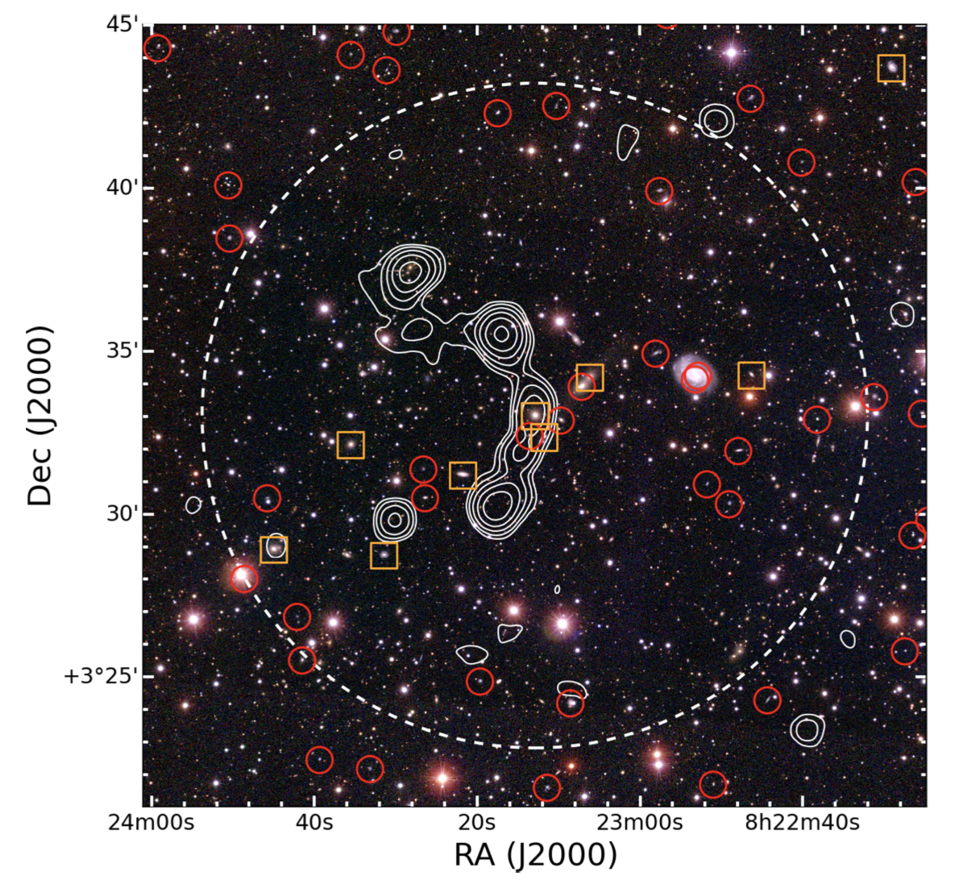
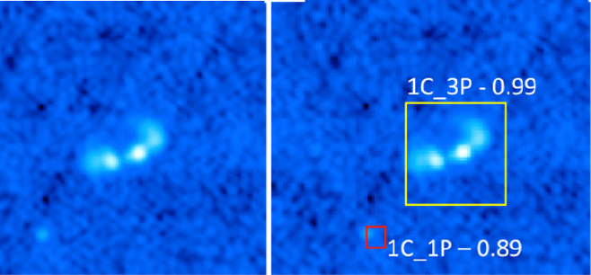
Decade effort 100,586 sources
7 science papers + 10 ML papers
Hunt Complex/Unusual Sources
  (I.e., Banfield et al. 2016)
SF/host iden. tools
(I.e., Wu et al. 19)
Publication List
RGZ DR1: Wong et al., submitted. Coming soon ☺

Slide 7
Merging into cataloguing pipeline, how?
RGZ LOFAR -> LoTSS
Hardcastle et al. 2023
RGZ EMU -> EMU
Segal et al.19, 23; Bowles, Tang et al. 22, 23

Slide 8
ML and citizen science for EMu
The latest RGZ offshoot
1. Hunt and identify radio sources with well-extended/complex structures
2. Build pilot ML datasets and develop algorithms for source detection, radio component association, hosting galaxy cross-matching, unusual source identification and source sub-structure recognition.
3. Gradually convince catalogue users deep learning/citizen science based results can be used and trusted in their successive projects. [I wish]

Slide 9
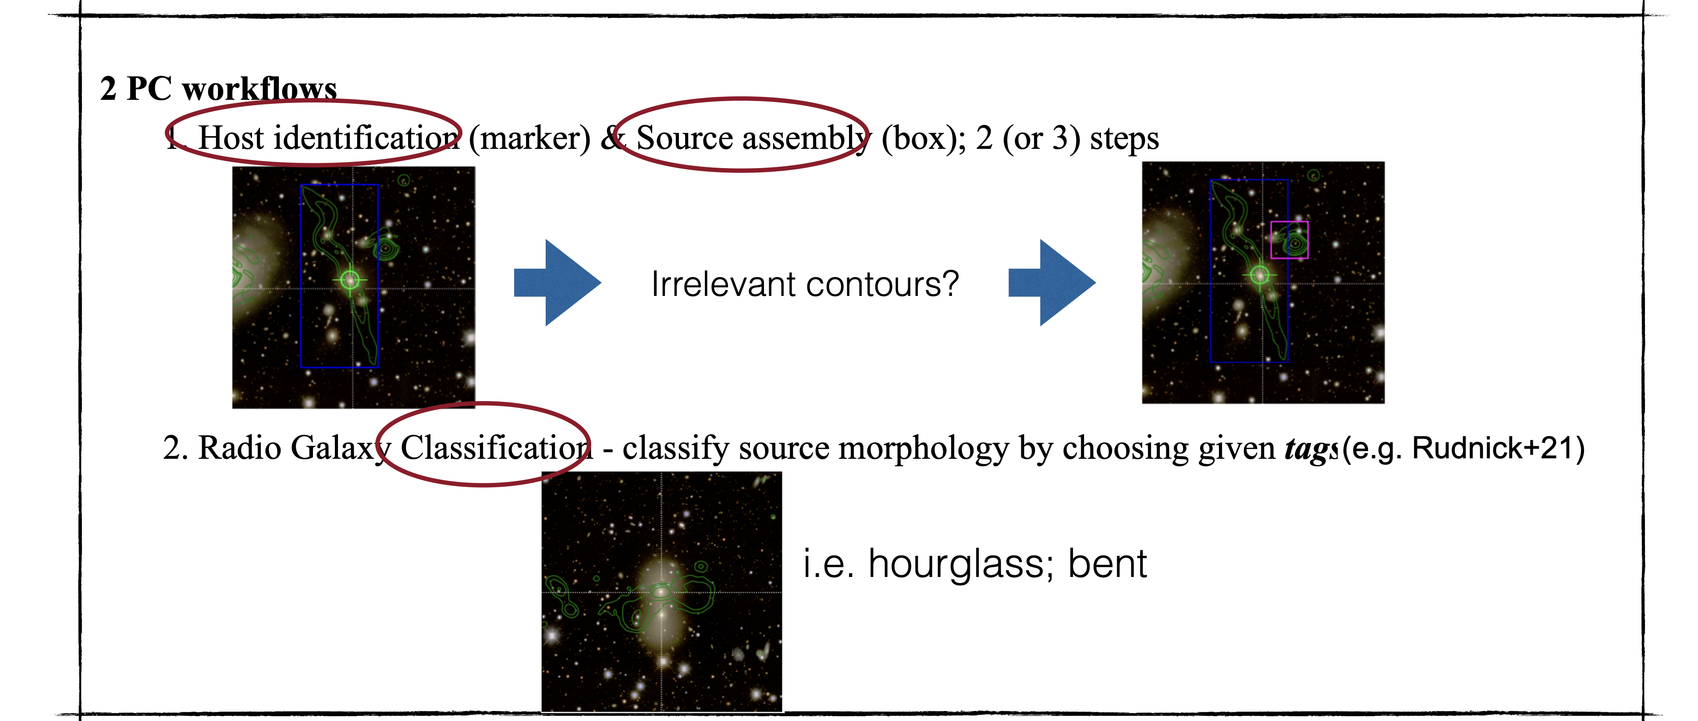
Project setup
1 workflow
https://www.zooniverse.org/projects/hongming-tang/radio-galaxy-zoo-emu

Slide 10
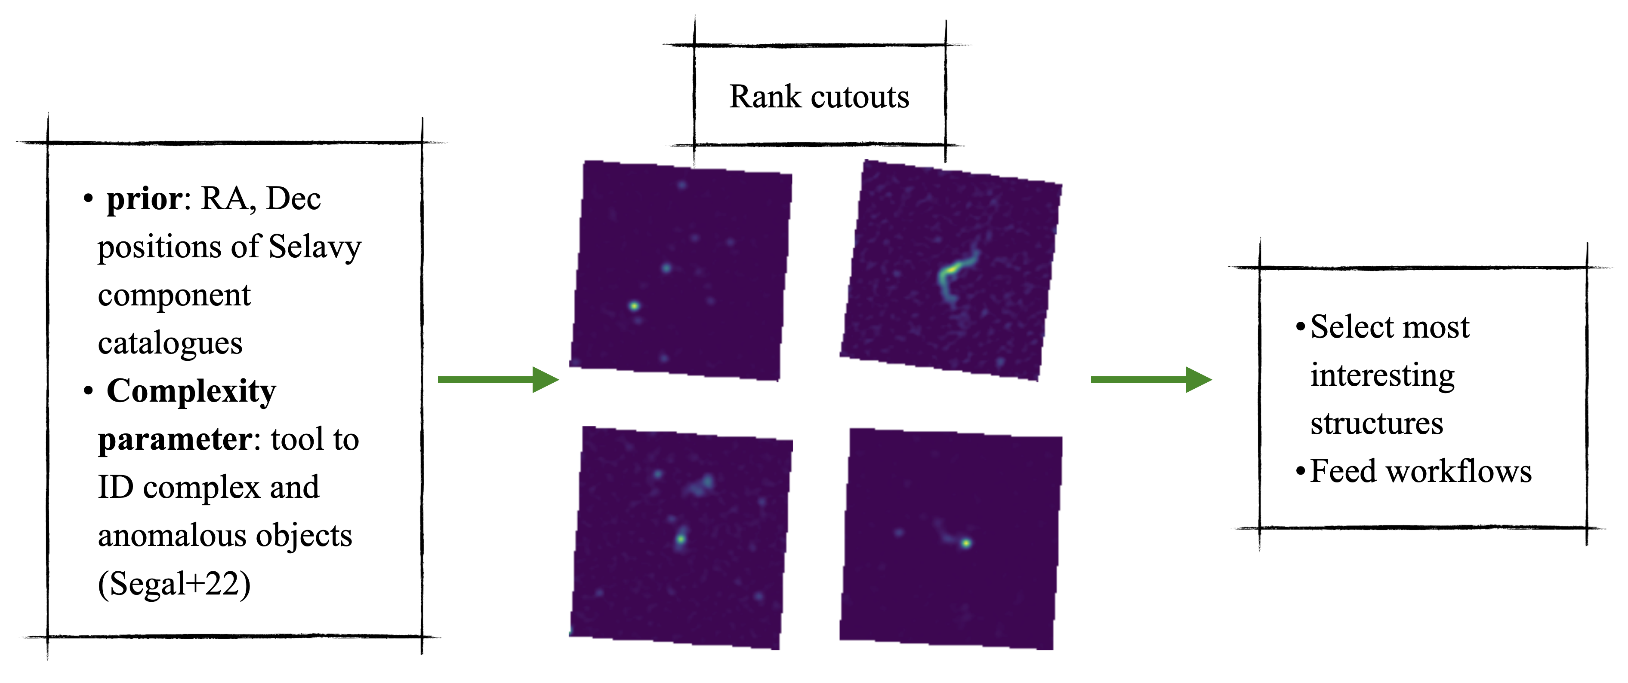
Hunt complex objects using complexity
Complexity: The more complex a system is, the more gradually it will settle down due to preservation of information
Credit: Eleni Vardoulaki; Segal et al19, 23

Slide 11
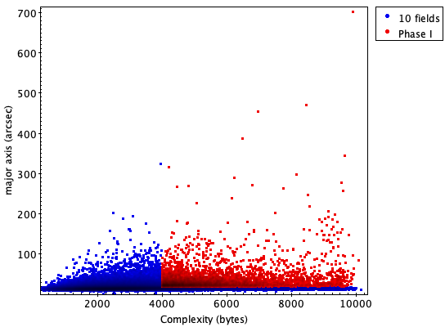
PhaSe I Sample selection
Credit: Eleni Vardoulaki

Slide 12
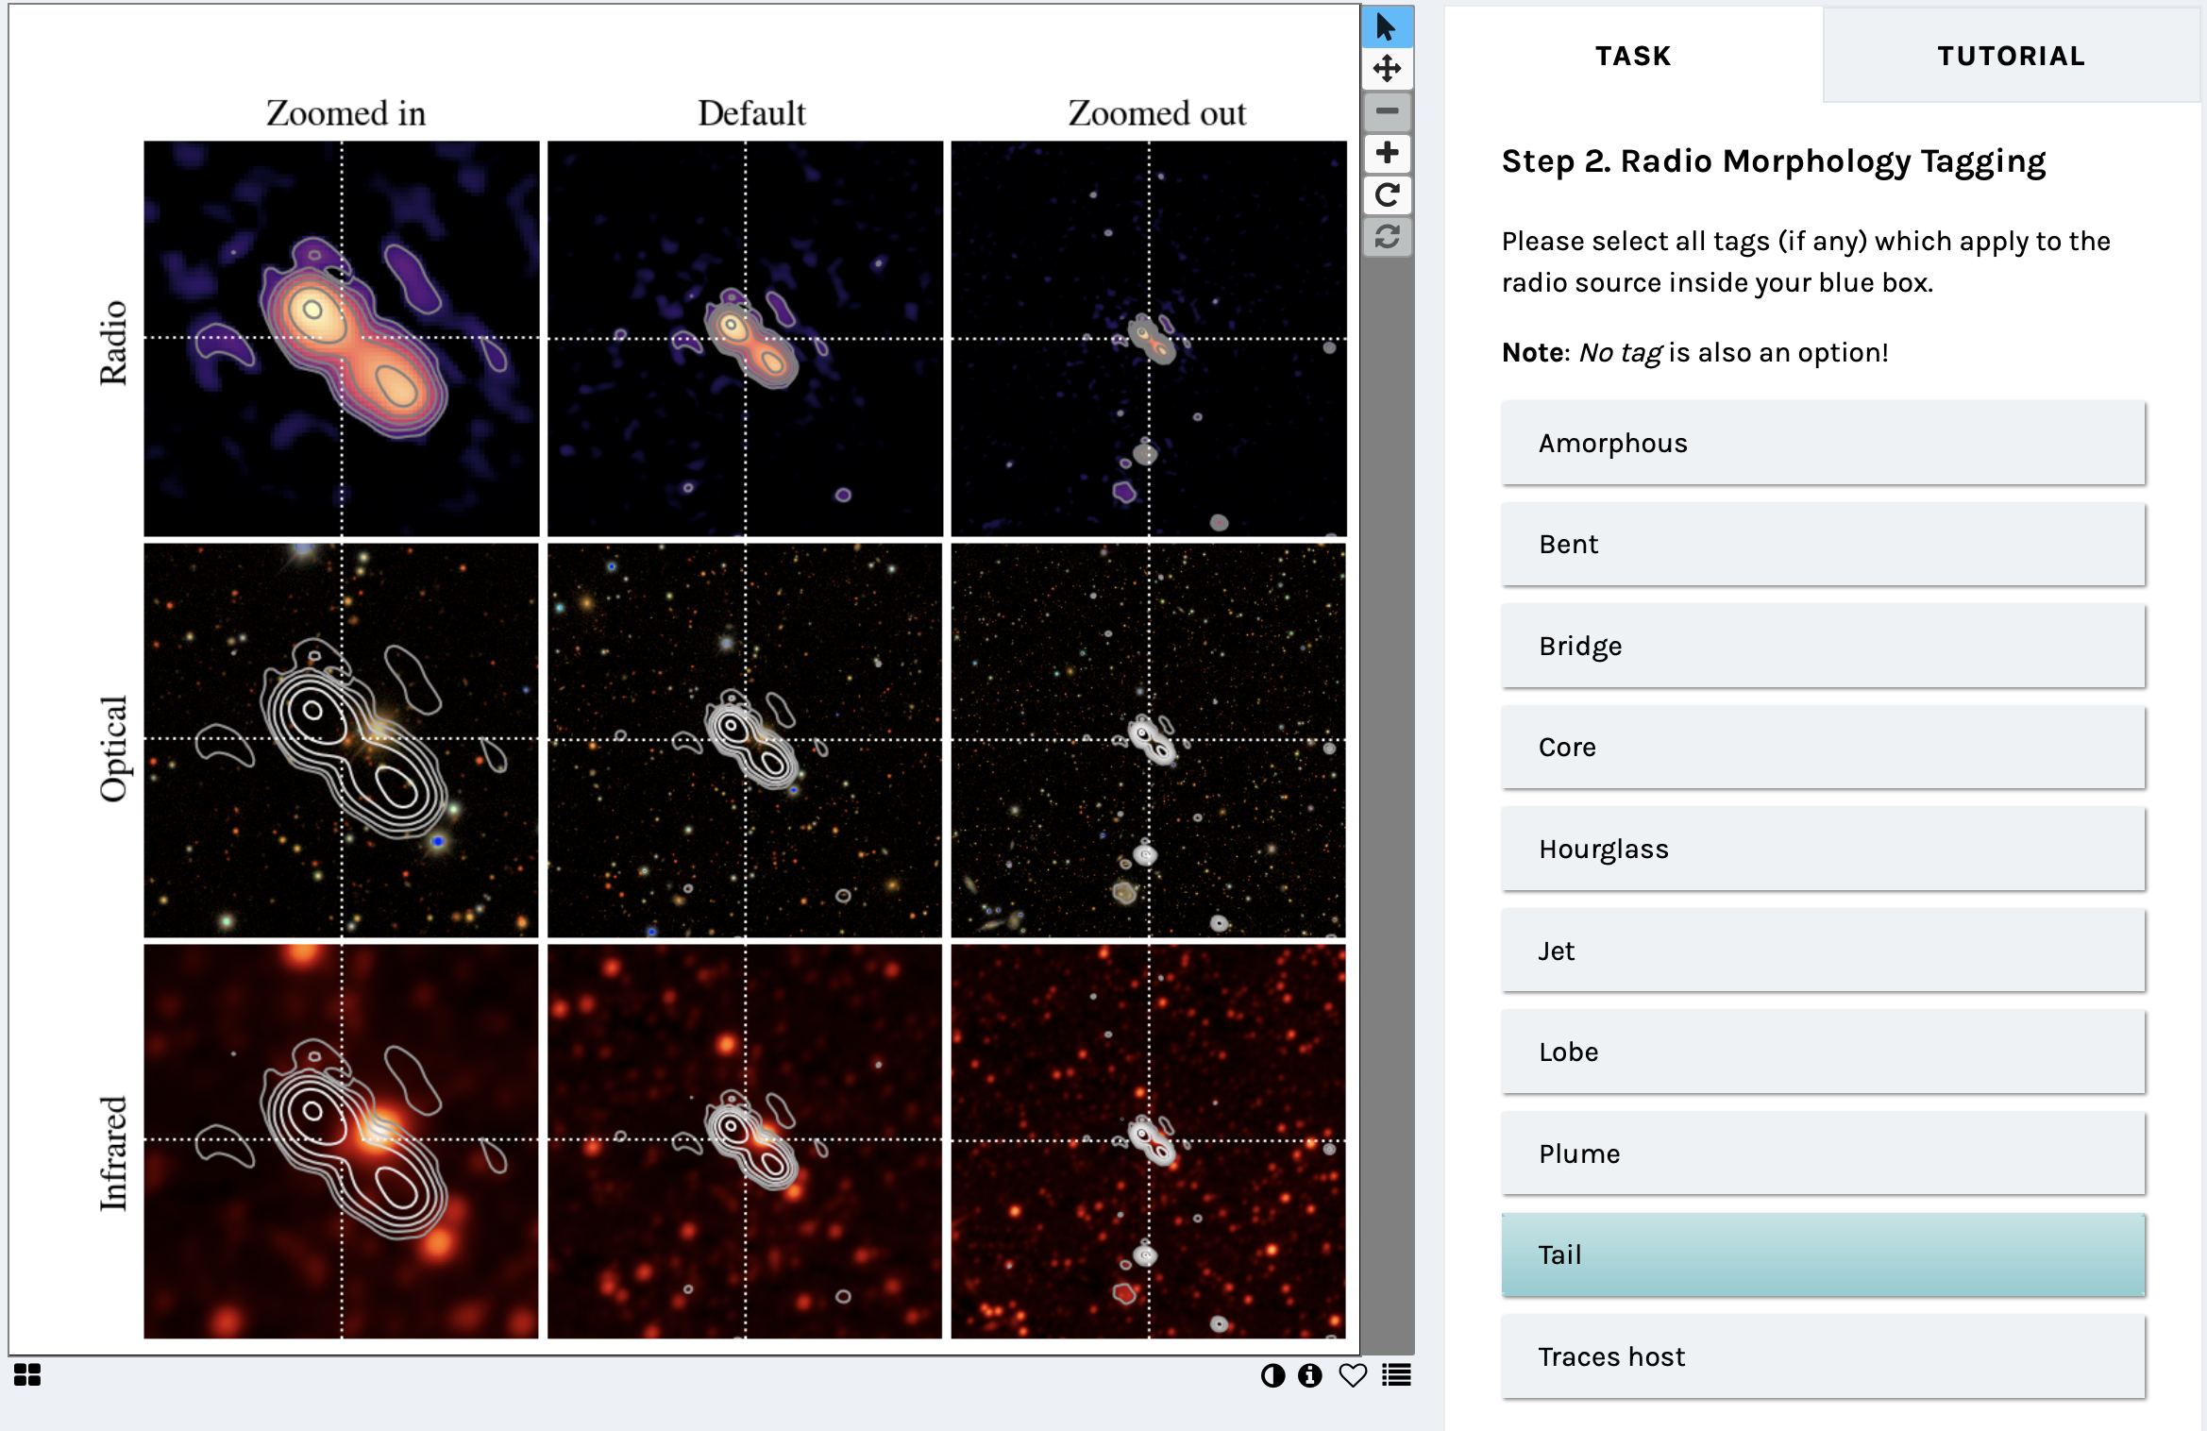
Tagging source sub-structure
What to do: Tag source morphology
Where’re the tags come from:
  Members and Zooters described sample radio morphology with PLAIN ENGLISH
  NLP techniques implemented, 10 tags with highest frequency selected
This is WRONG!

Slide 13
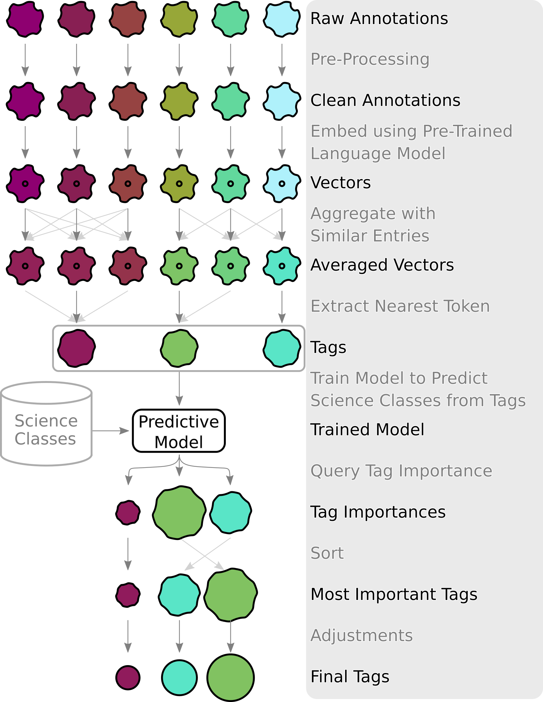
How tags are selected
Bowles, Tang et al 22, 23
Notes:
Bowles+22,23 was inspired by Larry+21 that pointed out the big number of tags used to describe radio galaxies and the issue of using “class” instead of “tag” in the era of machine learning.

Slide 14
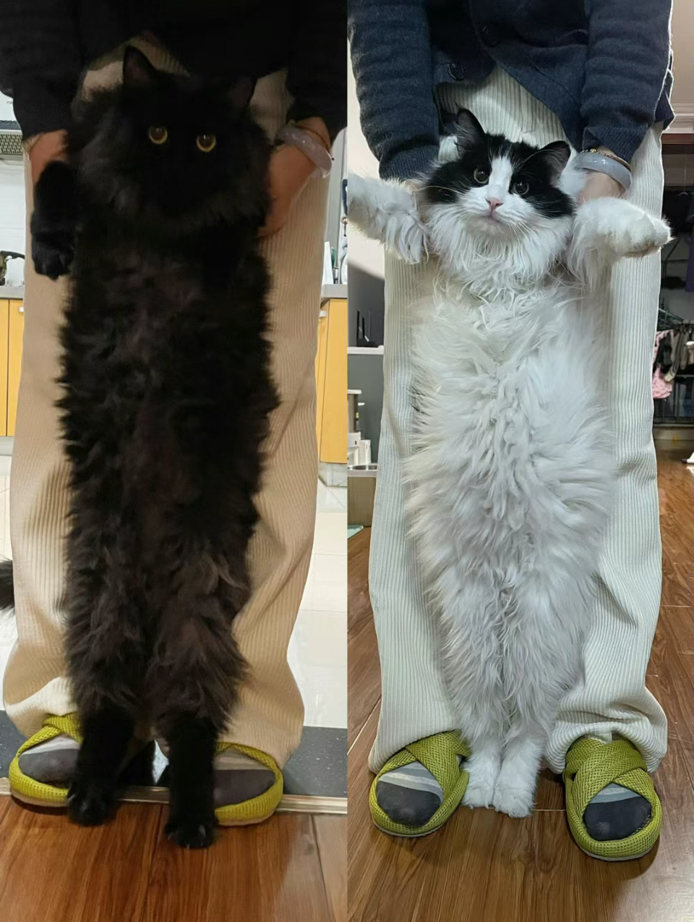





Explain black box model
Black Box Model
Mooncake (left)
Autumn Tea (right)
white fur
Black fur
Okay, make sense
XAI “glass”
Notes:
Mooncake or Autumn Tea classification

Slide 15
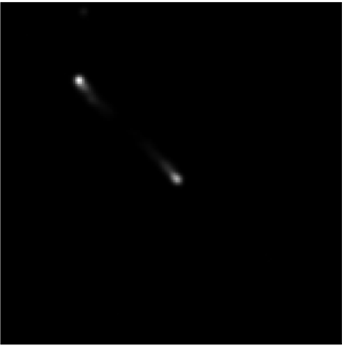
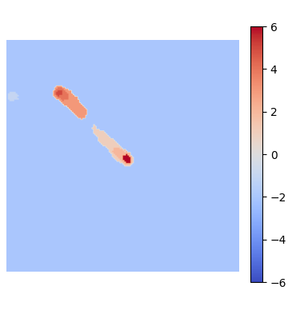
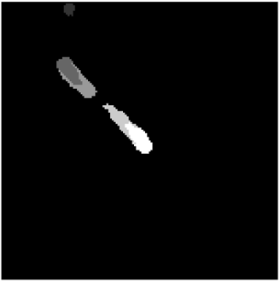
Explain black box model
Black Box Model
FR II
Turn on/off segments
Visual. Seg. weights
Linear Model
segmentation
Approximate the CNN
Tang & Yue et al. 2023
Tang & Yue et al. in prep.

Slide 16
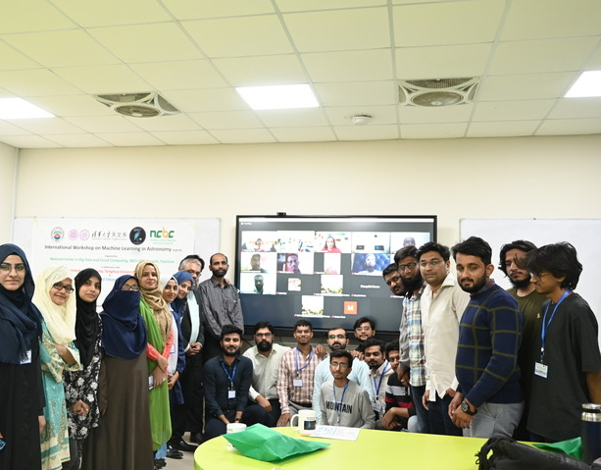
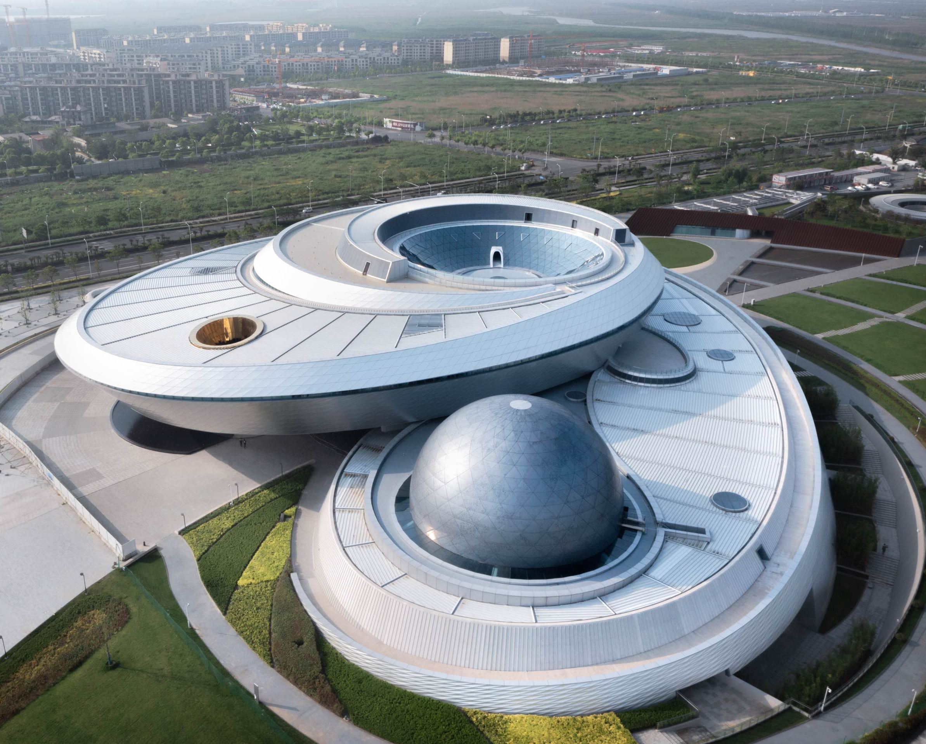
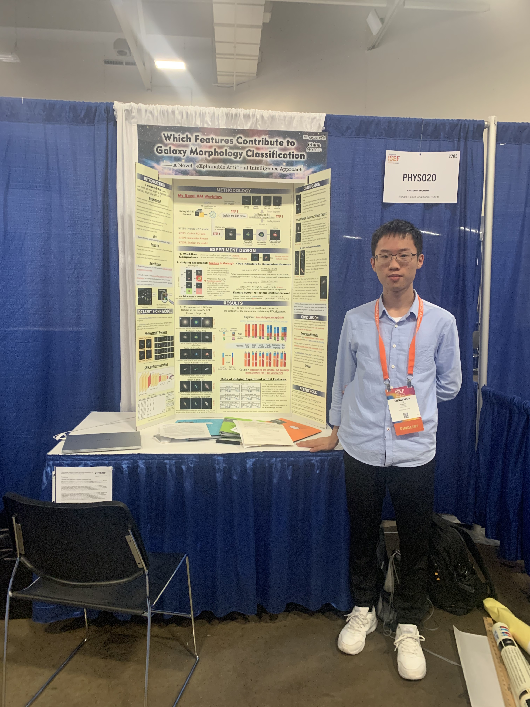
Outreach, education, and oad
International ML in Astronomy Workshop
  Karachi
  150 participants from 6 continents
High School Student PBL
  Guangzhou
  Mingxuan: ISEF finalist
Radio Telescope building training camp
  Shanghai
  This fall 2024: Shanghai Planetarium

Slide 17

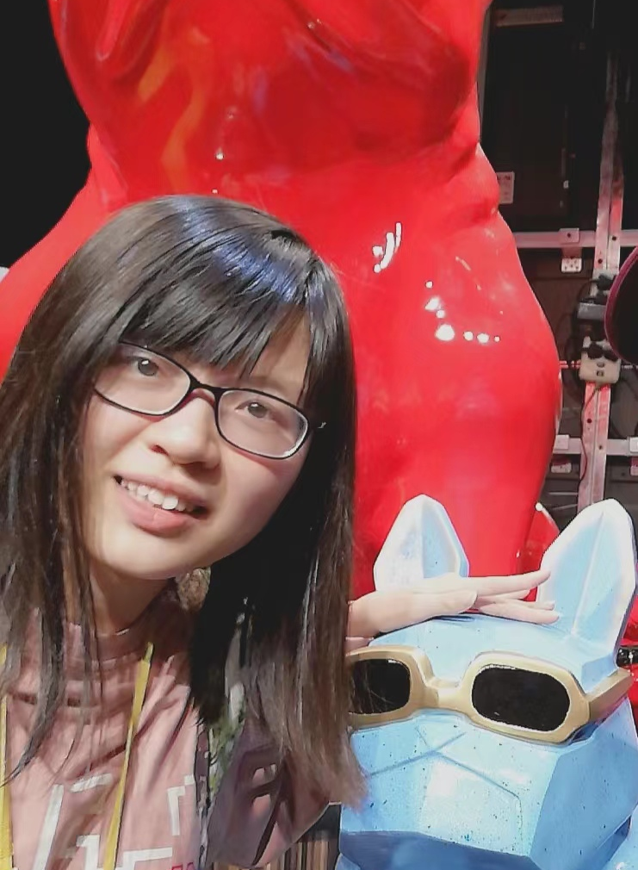


OAD: Reduce Inequality through citizen science based education program
Shiyu Yue
(Joining CUHK))
Yan Luo
(Joining Peking Uni.)
Leyao Wei
(joined Tsinghua Uni.)
Chuni Liang
(new intern student)
OAD recommanded project 2023
  PBL supervision towards high school female students (i.e. Kexin Wu)
  Summer internship opportunities for female undergrads
  Free career consultation service towards local female students (collaborating with Yanxing program (妍星), covering > 100 members)

Slide 18
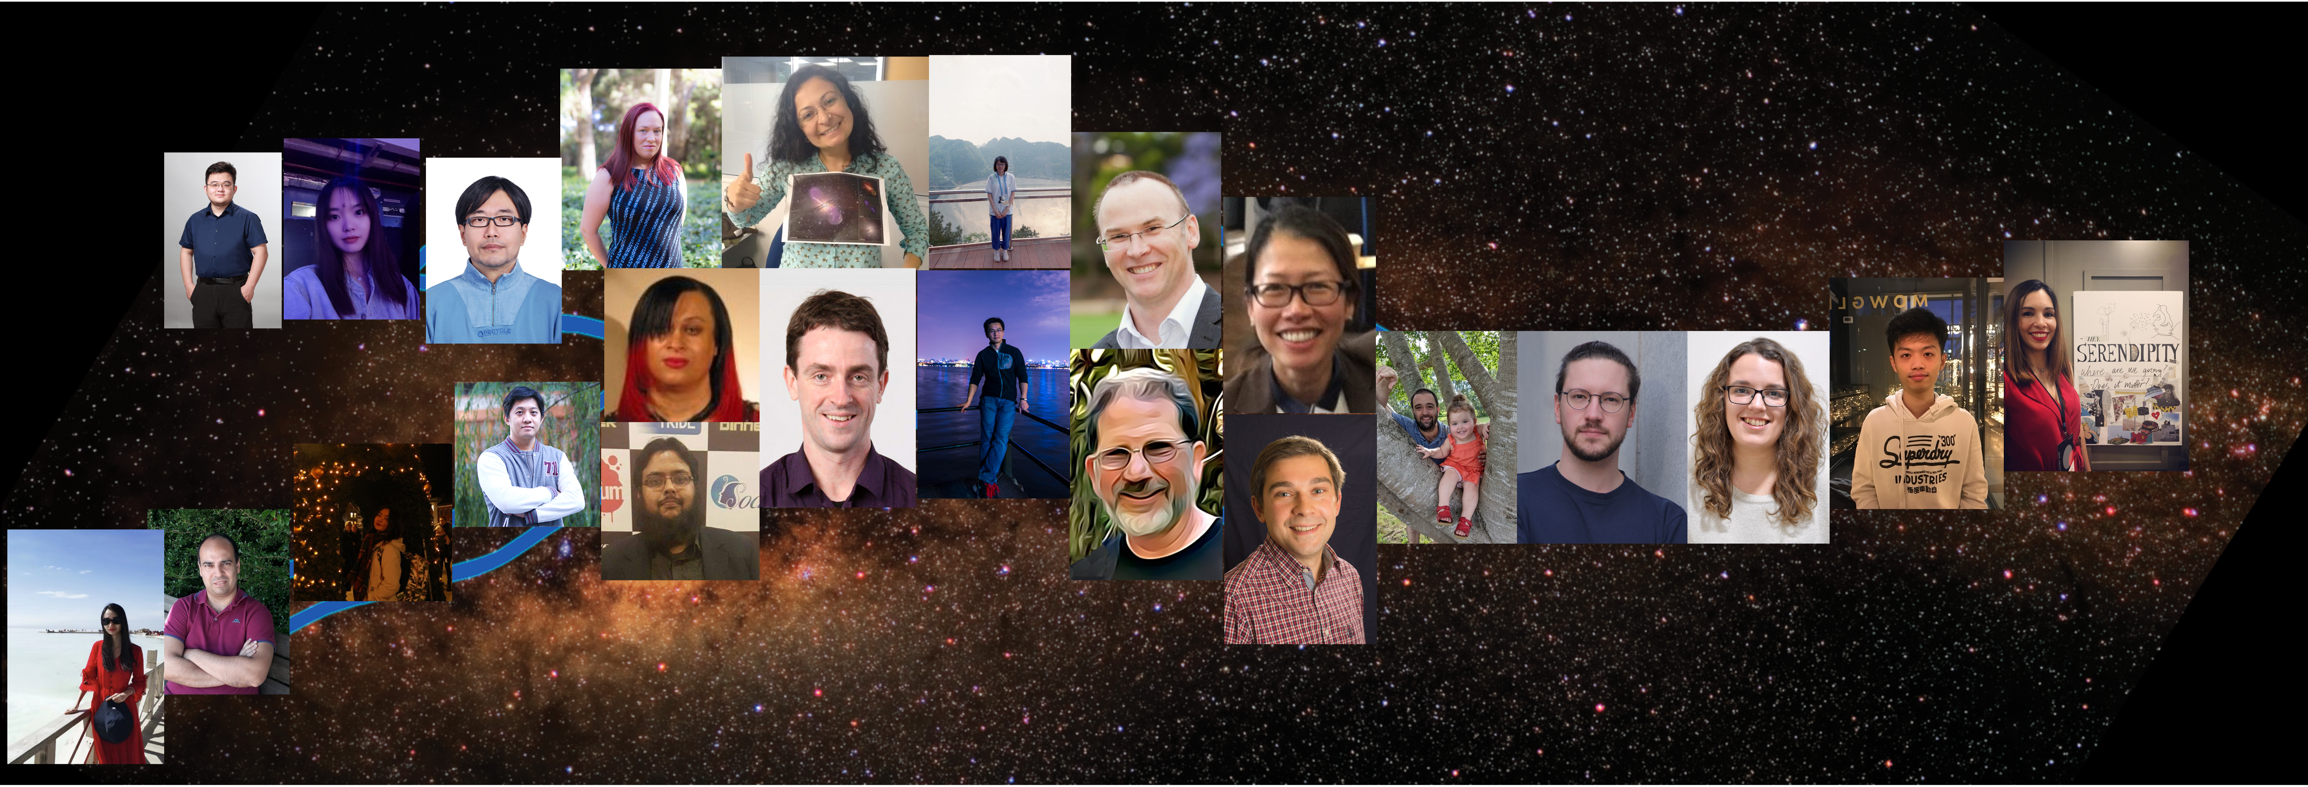
Many thanks for listening,
AND See you in the zoo in 15 mins!

