Slide 1
Classifying complex radio sources in Rapid ASKAP Continuum Survey using a Self-Organising Map
Afrida Alam
ML4ASTRO2

Slide 2
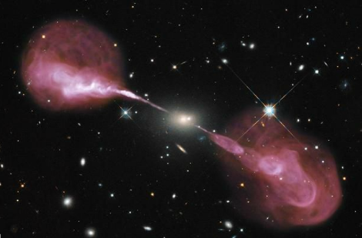
WHAT ARE RADIO GALAXIES
Active Galactic Nuclei (AGN) are energetic sources which have a supermassive black hole (SMBH) at its center accreting matter.
Radio galaxies are a type of AGN that emit strong radio emission.
Hercules A radio galaxy Image Credit: VLA

Slide 3
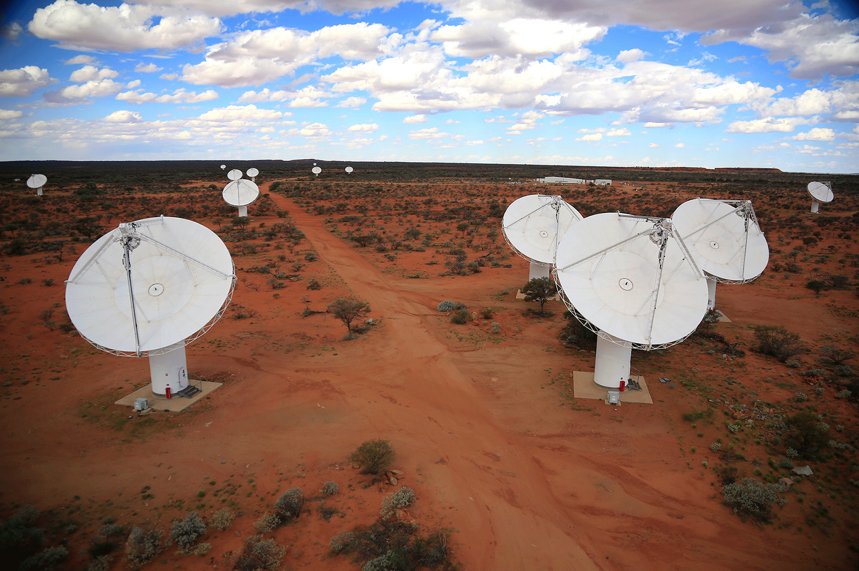
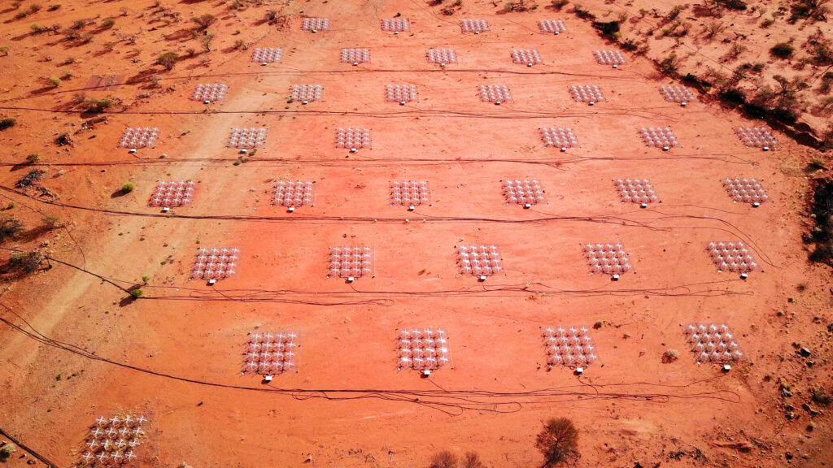
NEXT GENERATION RADIO SURVEYS
Next generation radio surveys aim to explore the radio sky with unprecedented resolution, sensitivity, and coverage.
Australian SKA Pathfinder (ASKAP) Image Credit: CSIRO
Murchison Widefield Array (MWA) Image Credit: ICRAR/Curtin
LOw Frequency ARray (LOFAR) Image Credit: ASTRON

Slide 4
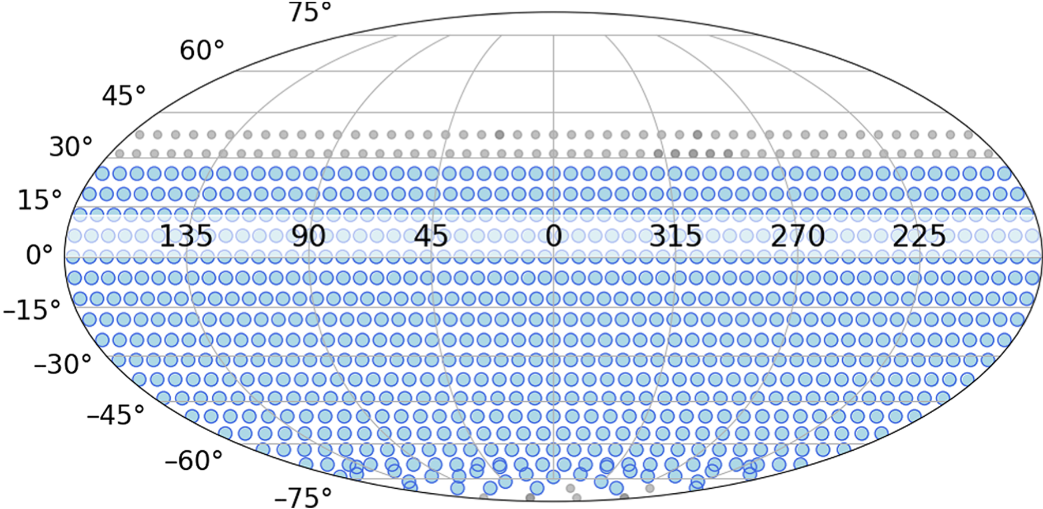
RAPID ASKAP CONTINUUM SURVEY (RACS)
RACS: the first large sky survey using Australian Square Kilometre Array Pathfinder (ASKAP).
RACS-low covered the sky south of +41° declination at a central frequency of 887.5 MHz.
The catalogue contains around ~2.1 million sources derived from 799 tiles which covered most of the sky in the declination region δ = -80° to +30°, excluding the region | b | < 5° around the Galactic plane.
Hale et al. (2021)

Slide 5
COMPLEX RADIO SOURCES
Complex radio sources have multiple components, where component refers to an output (generally a 2D Gaussian) from a source finding algorithm. These sources cannot be as easily resolved as simple sources.
Complex radio sources with multiple components
Simple radio sources
Segal et al. (2019)

Slide 6
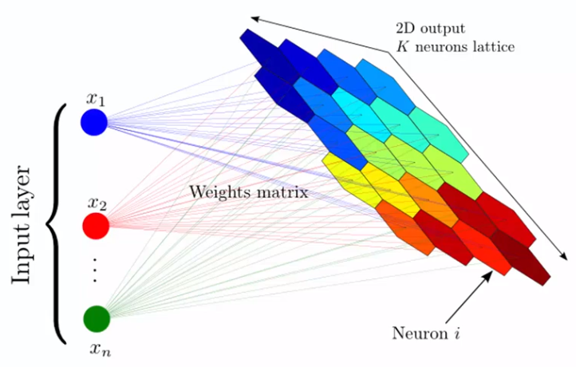
SELF-ORGANISING MAP (SOM)
Self-organizing maps (SOMs) are unsupervised machine learning algorithms which use a competitive learning process to output a low-dimensional, usually two-dimensional, representation of the input dataset.

Slide 7
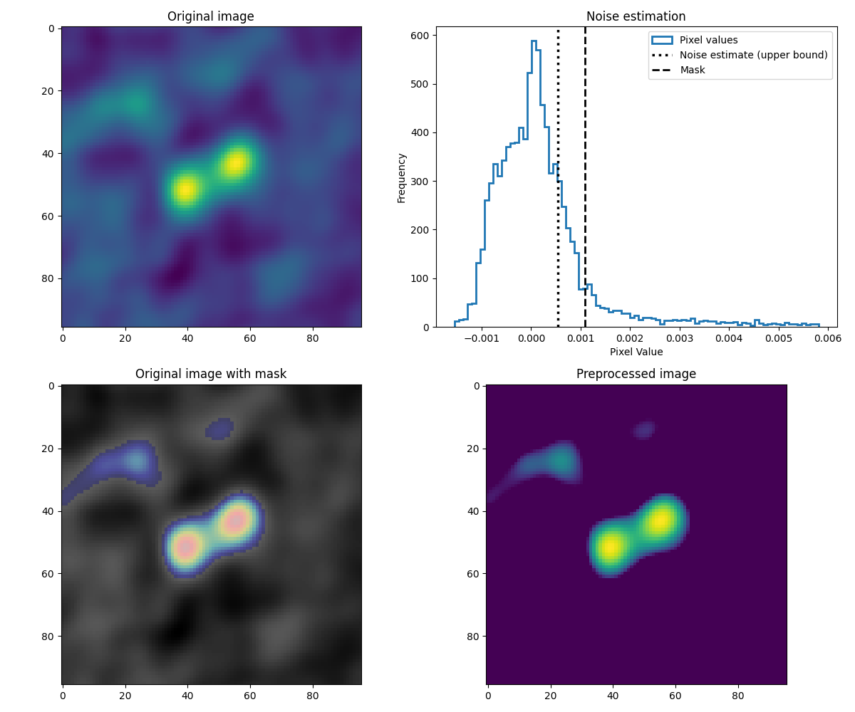
PREPROCESSING IMAGES
Filter RACS-low catalogue to select multi-Gaussian sources which gives 251277 sources.
Generate 4′ cutouts from the survey image tiles centered around the coordinates of each source.
For each cutout: estimate the noise and create a mask by multiplying the noise estimate and the minimum signal-to-noise ratio.

Slide 8
PREPROCESSING IMAGES
The minimum signal-to-noise ratio (minsnr) value was set to 2 as it was sufficient to mask most of the noise while capturing the important structures present in the cutout.
After the mask is implemented, we apply a log scaling to the remaining pixels and scale them from 0 to 1.

Slide 9
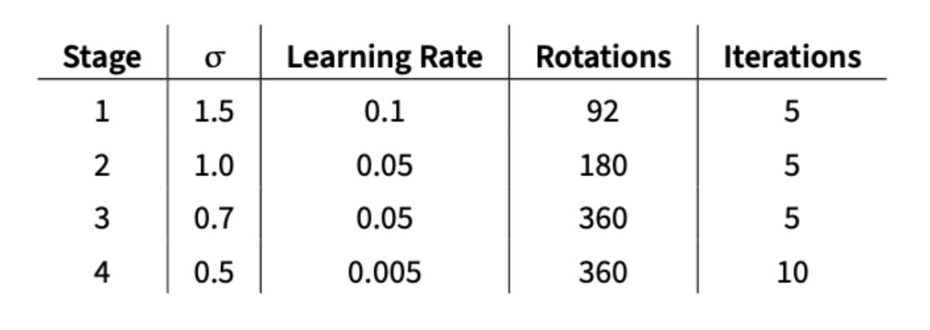
SOM TRAINING: PARAMETERS
Following the preprocessing, we train a 10 x 10 SOM using PINK with four training stages.
Establish certain parameters for each stage: the neighbourhood function (σ), learning rate, rotations and iterations.
The SOM parameters used across the four training stages.

Slide 10
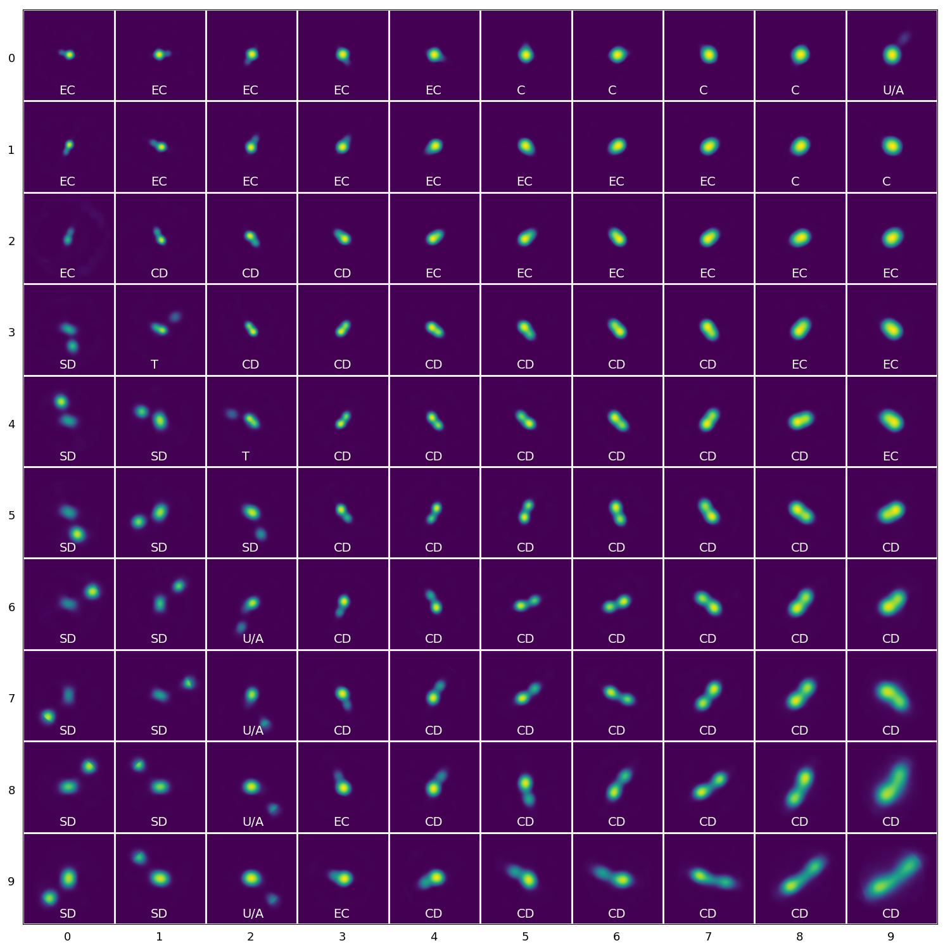
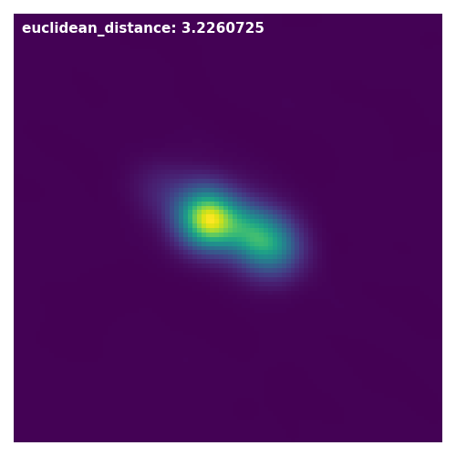
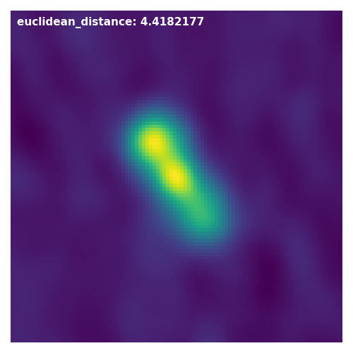
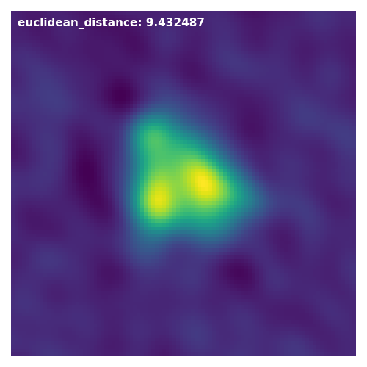
Trained som
Trained SOM of 100 neuron which represents the dominant structures and morphologies present in the data.

Slide 11
EUCLIDEAN DISTANCE
A similarity metric, such as Euclidean distance, can be used to quantify the similarity between the input images and the neurons in the SOM.
Neuron with the shortest distance to a given input image is its best matching neuron or unit (BMU).

Slide 12
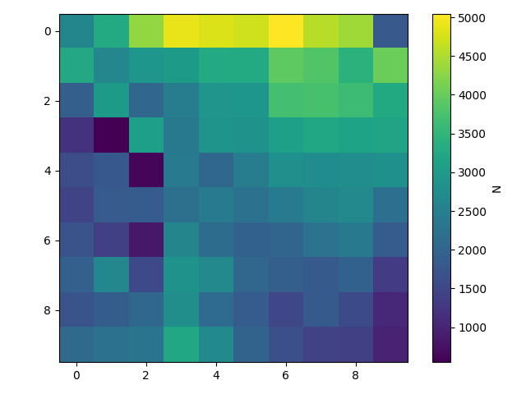
Density map
Density map showing which neurons were most frequently selected as the BMU.
Even for 'multi-Gaussian' sources relatively simple morphologies are dominant.

Slide 13
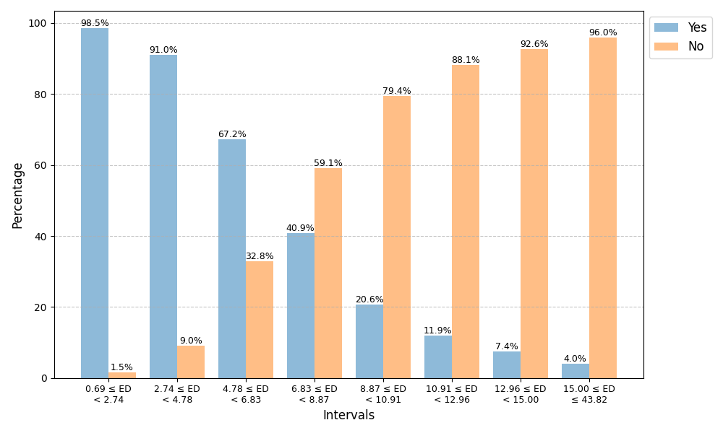
RELIABILITY THRESHOLD
Establish a reliability threshold by visually inspecting a subset of input images and their corresponding BMU to see how well they ‘matched’.

Slide 14
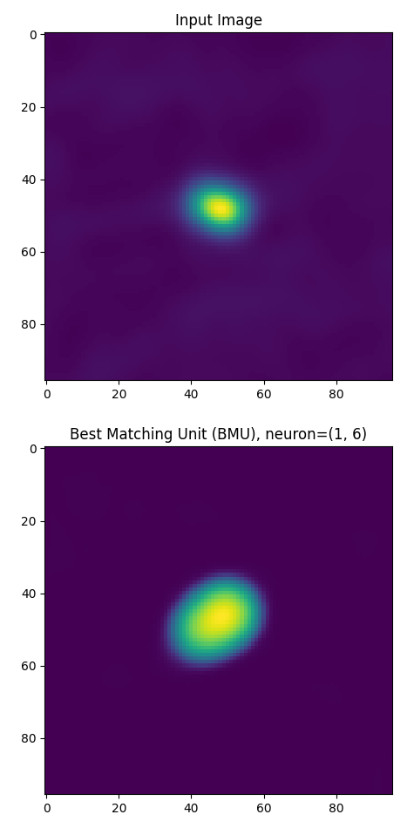
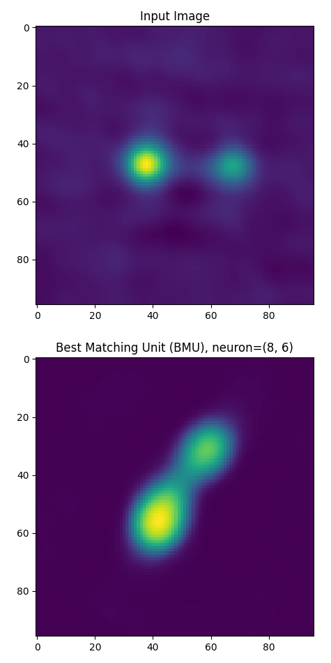
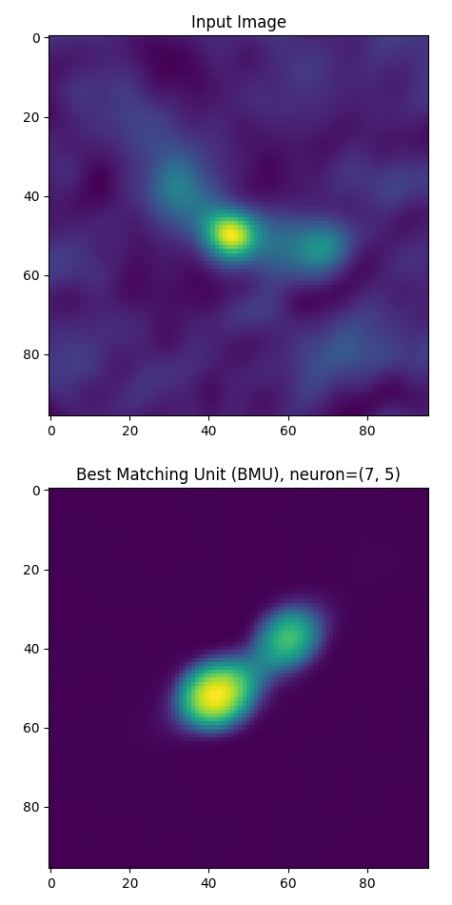
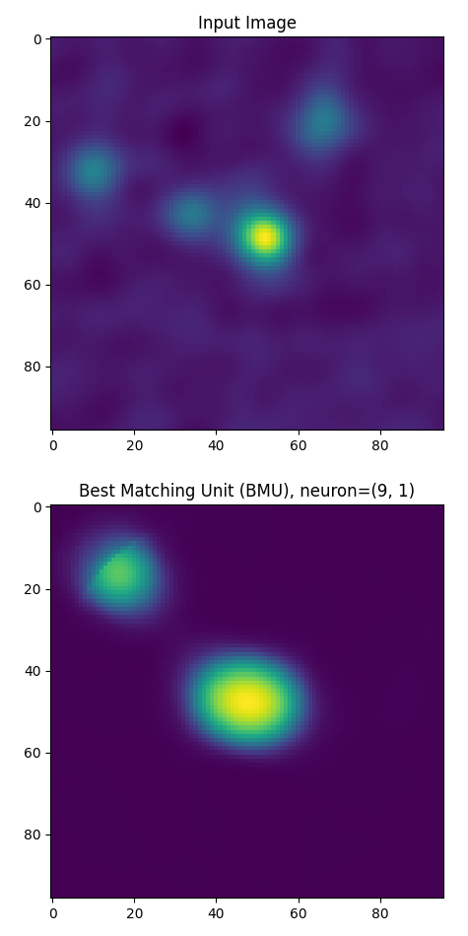
Yes examples
NO examples

Slide 15
RELIABILITY THRESHOLD
Establish a reliability threshold by visually inspecting a subset of input images and their corresponding BMU to see how well they ‘matched’.
Sources for which the Euclidean distance to its BMU were ≲ 5 (approximately 79% of sources) the reliability is estimated to be > 90%, and this reliability drops down to less than 70% at Euclidean distances ≳ 7.

Slide 16
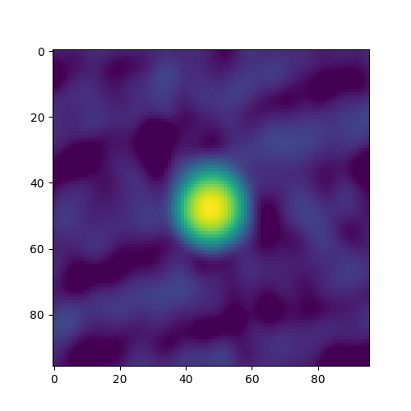
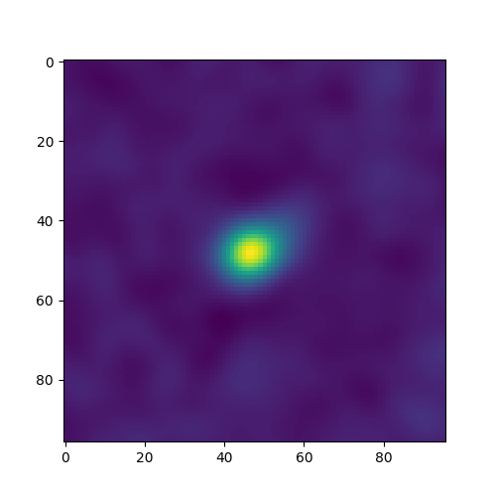
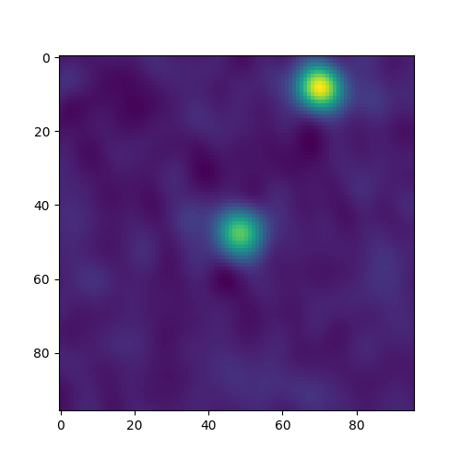
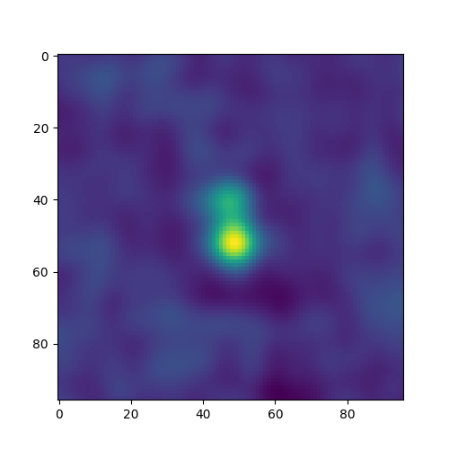
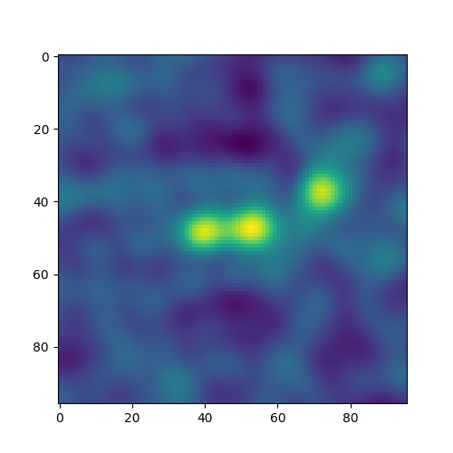
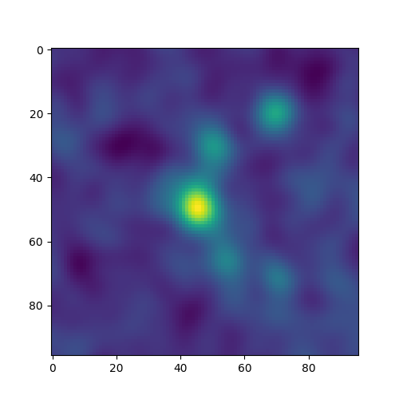
compact
EXTENDED compact
Split double
CONNTECTED DOUBLE
triple
UNCERTAIN / AMBIGUOUS

Slide 17
CONCLUSION
Current and next-generation radio surveys are expected to identify vast number of sources, including complex radio sources. ML techniques such as SOMs can be used to efficiently identify and classify their morphologies.
Trained a SOM on complex (i.e. multi-Gaussian) sources from RACS-low. The individual neurons were labelled based on their observed morphologies, and these labels were transferred back to the catalogue by cross-matching the sources with their BMU.
Established a reliability threshold by visually inspecting a subset of input images and their corresponding BMU. Beyond this threshold it becomes unlikely that the morphological label will be a good fit for a given source.
Created a catalogue of 251,259 complex sources from RACS-low with their SOM-derived morphological labels.
Future work: conduct further statistical analysis on the rarest and most unique sources in RACS found through the SOM analysis.

Slide 18
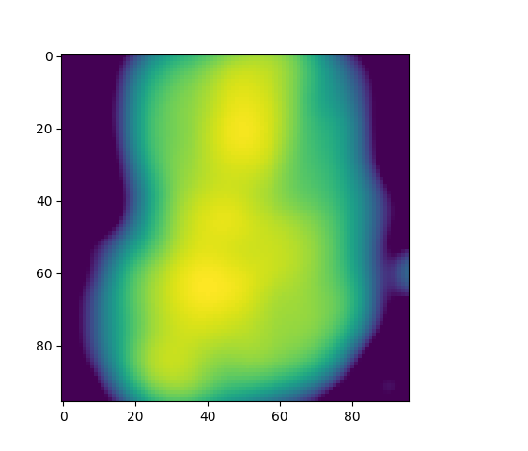
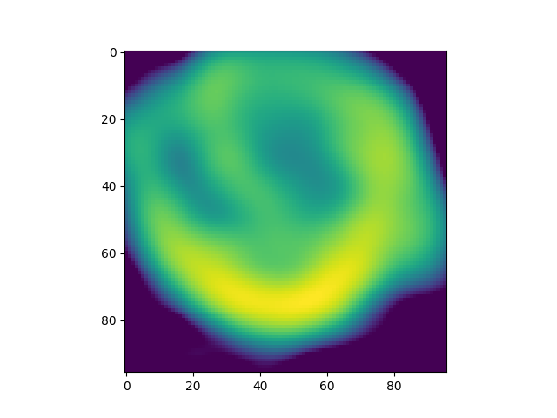
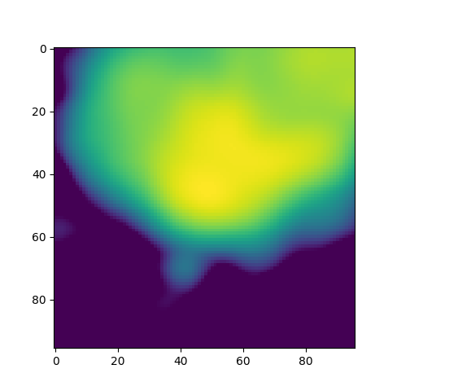
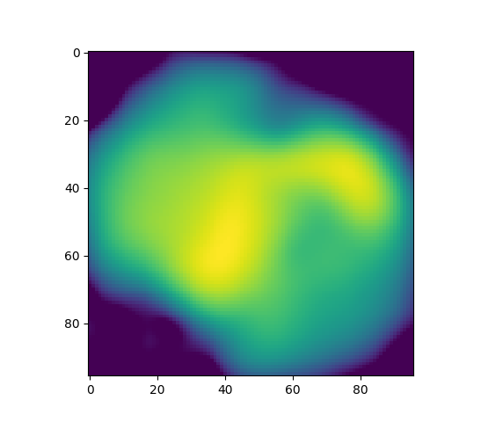
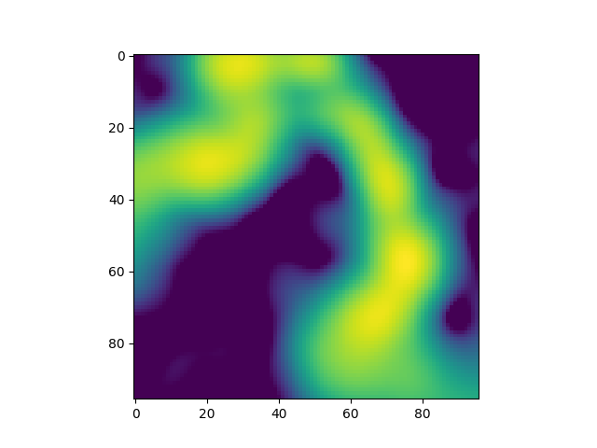
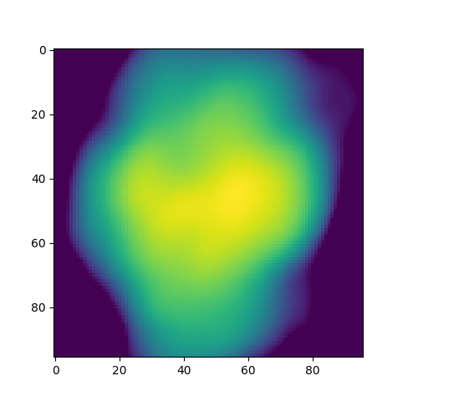
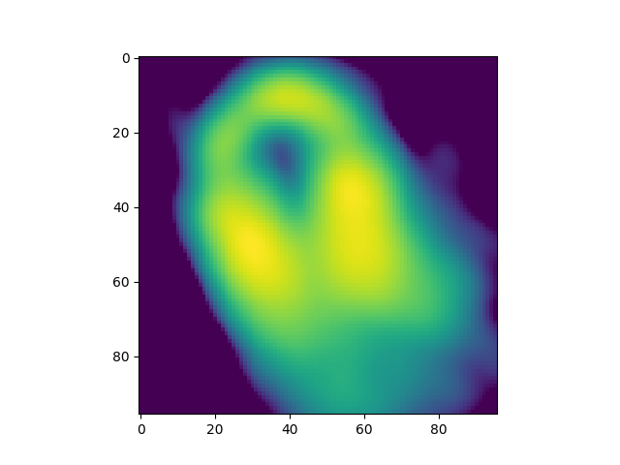
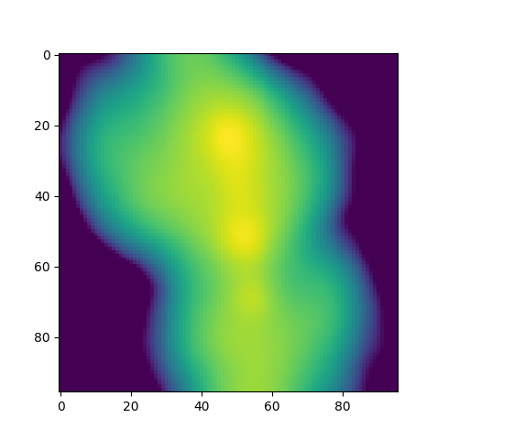
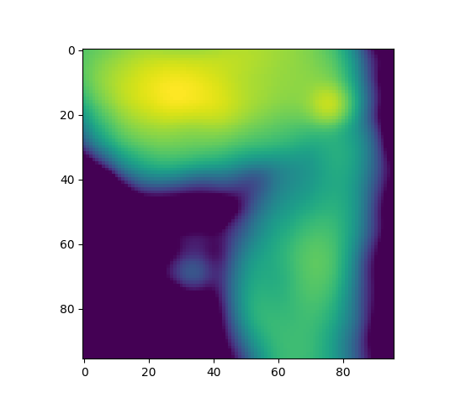
Rare and unique sources

Slide 19
Thank you for listening

Slide 20
SELF-ORGANISING MAP (SOM)
$$w_{i}^{′}= w_{i}+ α\left(t\right)∙ G_{ij} ∙\left(∅\left(d\right)−w_{i}\right)$$
where: • $w_{i}$ is the initial weight vector of neuron $i$
• $w_{i}^{′}$ is the change in the weight vector of neuron $i$ • $α\left(t\right)$is the learning rate at time $t$
• $G_{ij}$is the neighbourhood function
• $d$is the current input data • $\left(∅\left(d\right)−w_{i}\right)$ aligns $d$ onto $w_{i}$

