Slide 1
Unsupervised Machine Learning Techniques for Young Stellar Object Light Curve Characterization
Máté Madarász, Gábor Marton
HUN-REN CSFK, Konkoly Observatory
ML4ASTRO2, Catania

Slide 2
Introduction
Task:
Identifying various distinct YSO behavior patterns from light curve data.
Recent classification schemes for YSOs use SED data.
Problems:
Variability in data lengths, noisy points, complex patterns.
Our Solution:
Long Short-Term Memory (LSTM) based Variational Autoencoder.
Gaussian Mixture Models (GMMs) / k-means, DBSCAN, HDBSCAN.
t-Distributed Stochastic Neighbor Embedding (t-SNE).
Results:
Ability to query the most similar samples based on input light curves.
YSO behaviour patterns identified within clusters.
Relationship with the alpha index.

Slide 3
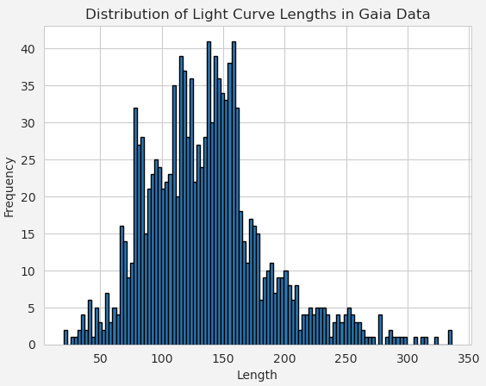
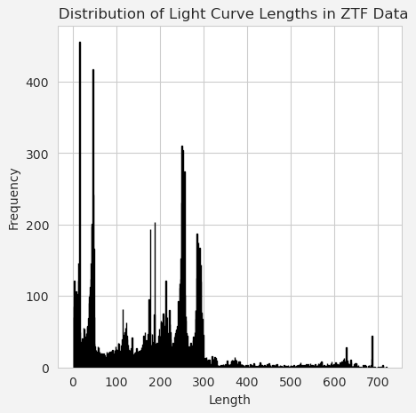
Data
YSO candidate light curves from:
Gaia Photometric Science Alerts.
Zwicky Transient Facility (ZTF).

Slide 4
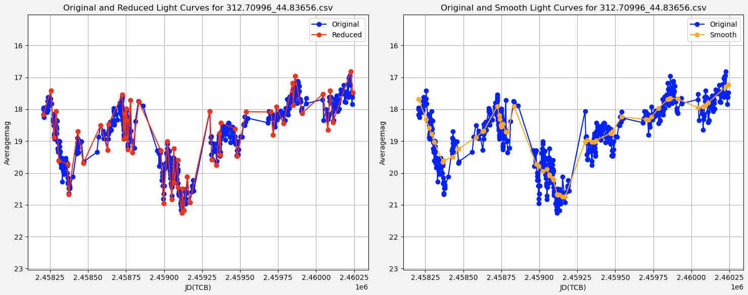
Data Preprocessing
Ramer-Douglas-Peucker Algorithm (RDP)
LOcally WEighted Scatterplot Smoothing (LOWESS)
630 -> 58

Slide 5
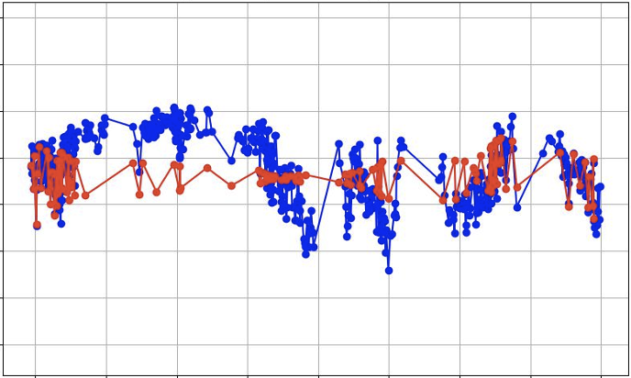
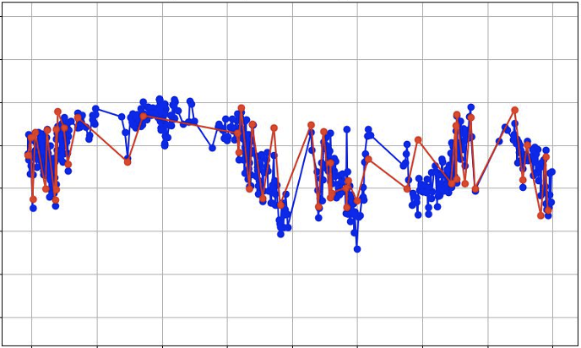
Why Reduce the Number of Points?
Same Architecture
Number of points: 118
Number of points: 50

Slide 6
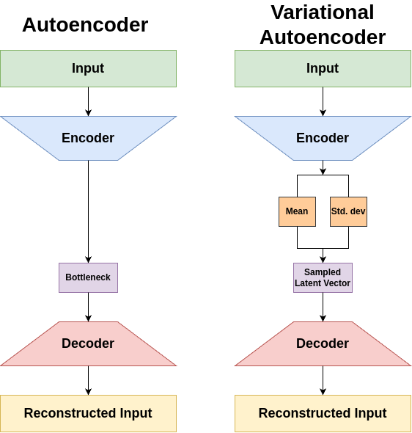
Autoencoder vs. Variational Autoencoder
Autoencoder (AE):
Encoder and Decoder.
Compress and Reconstruct.
Bottleneck.
Variational Autoencoder (VAE):
Encodes into latent distributions.
Gaussian Distribution:
Mean.
Standard Deviation.

Slide 7
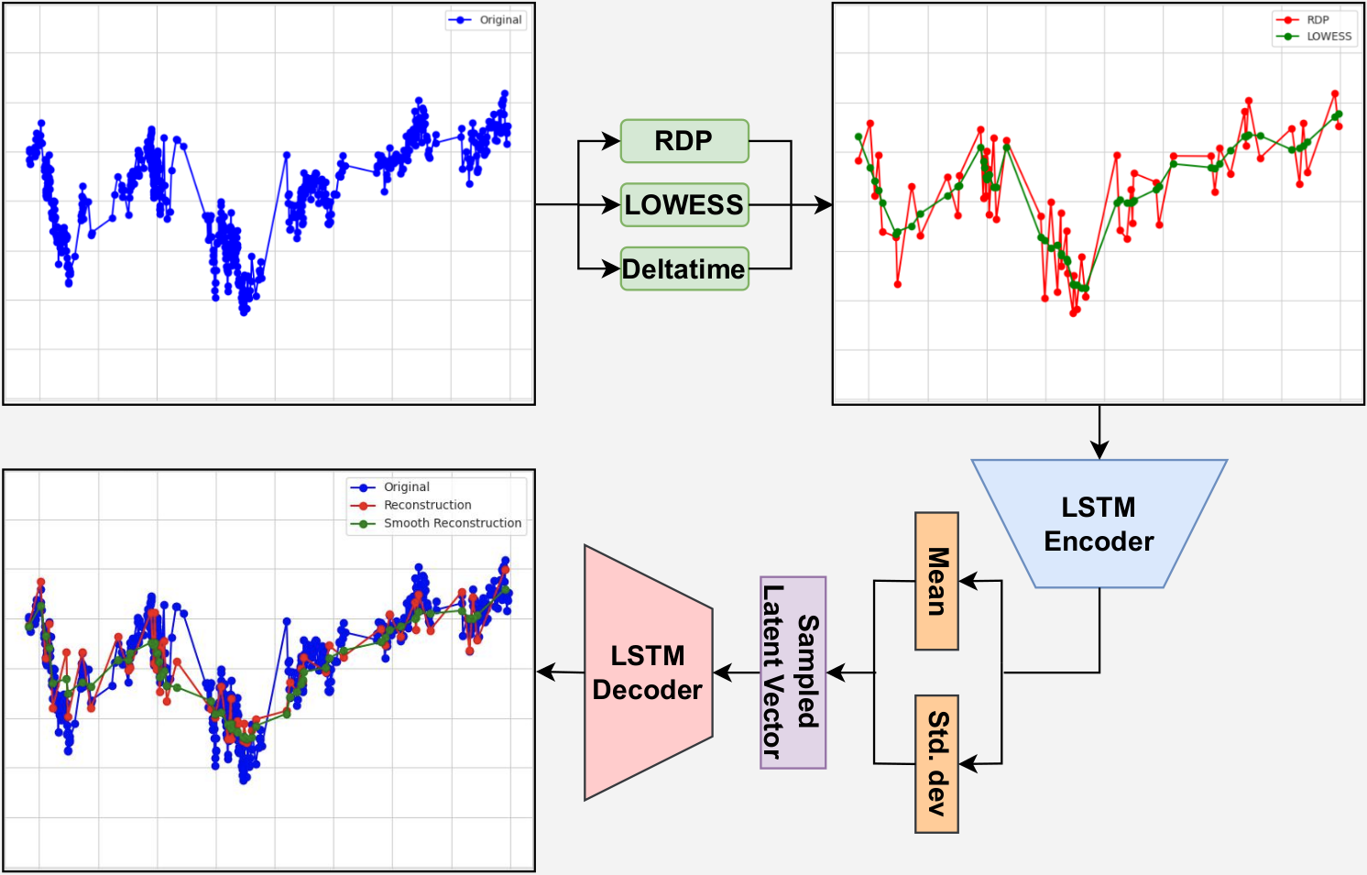
Illustration of Our Architecture

Slide 8
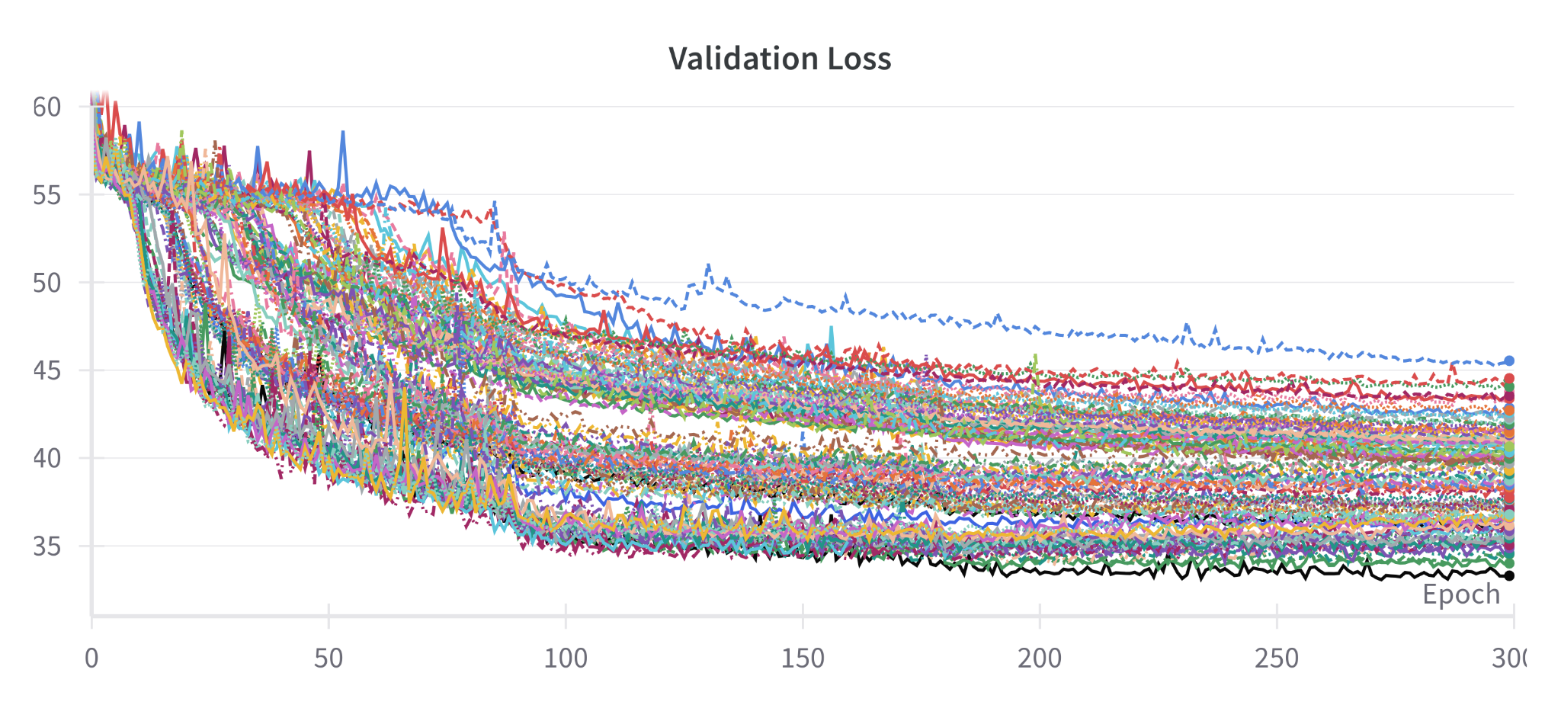
Hyperparameter Search

Slide 9
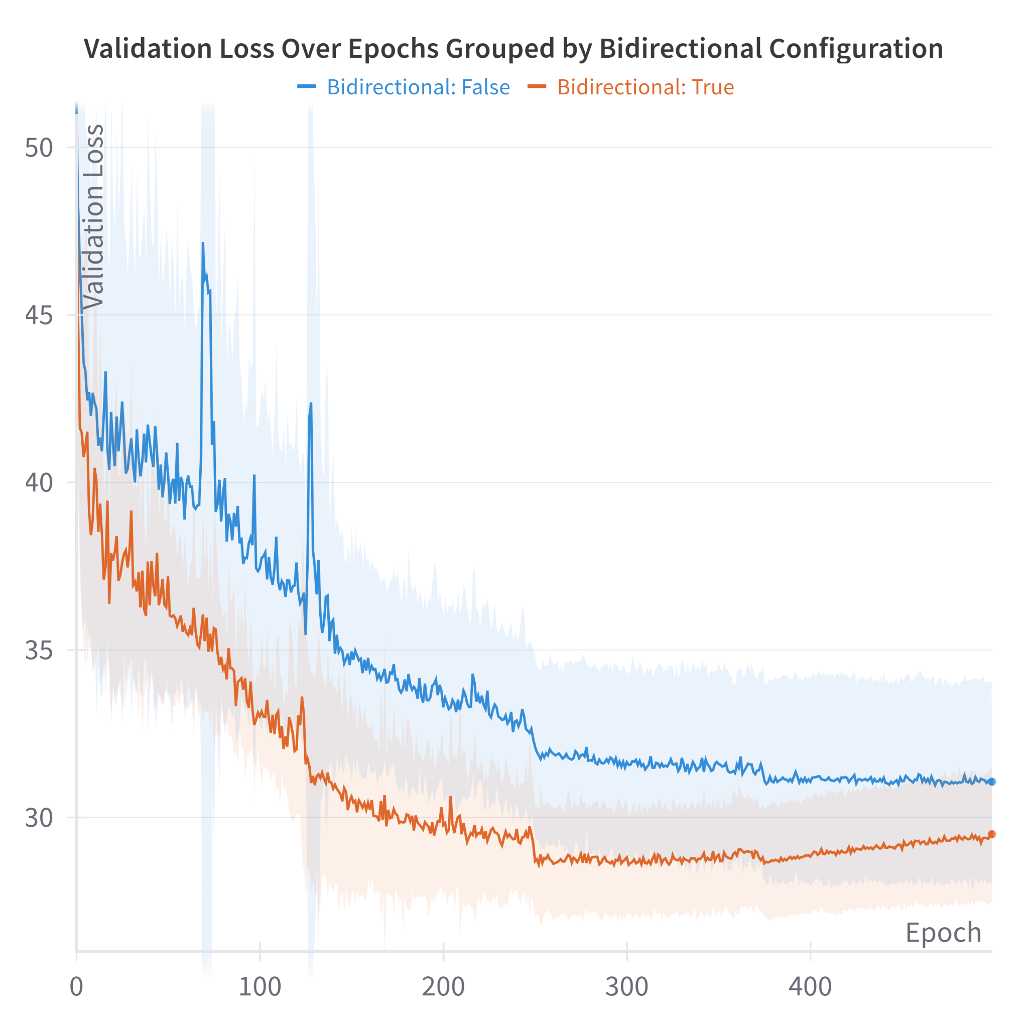
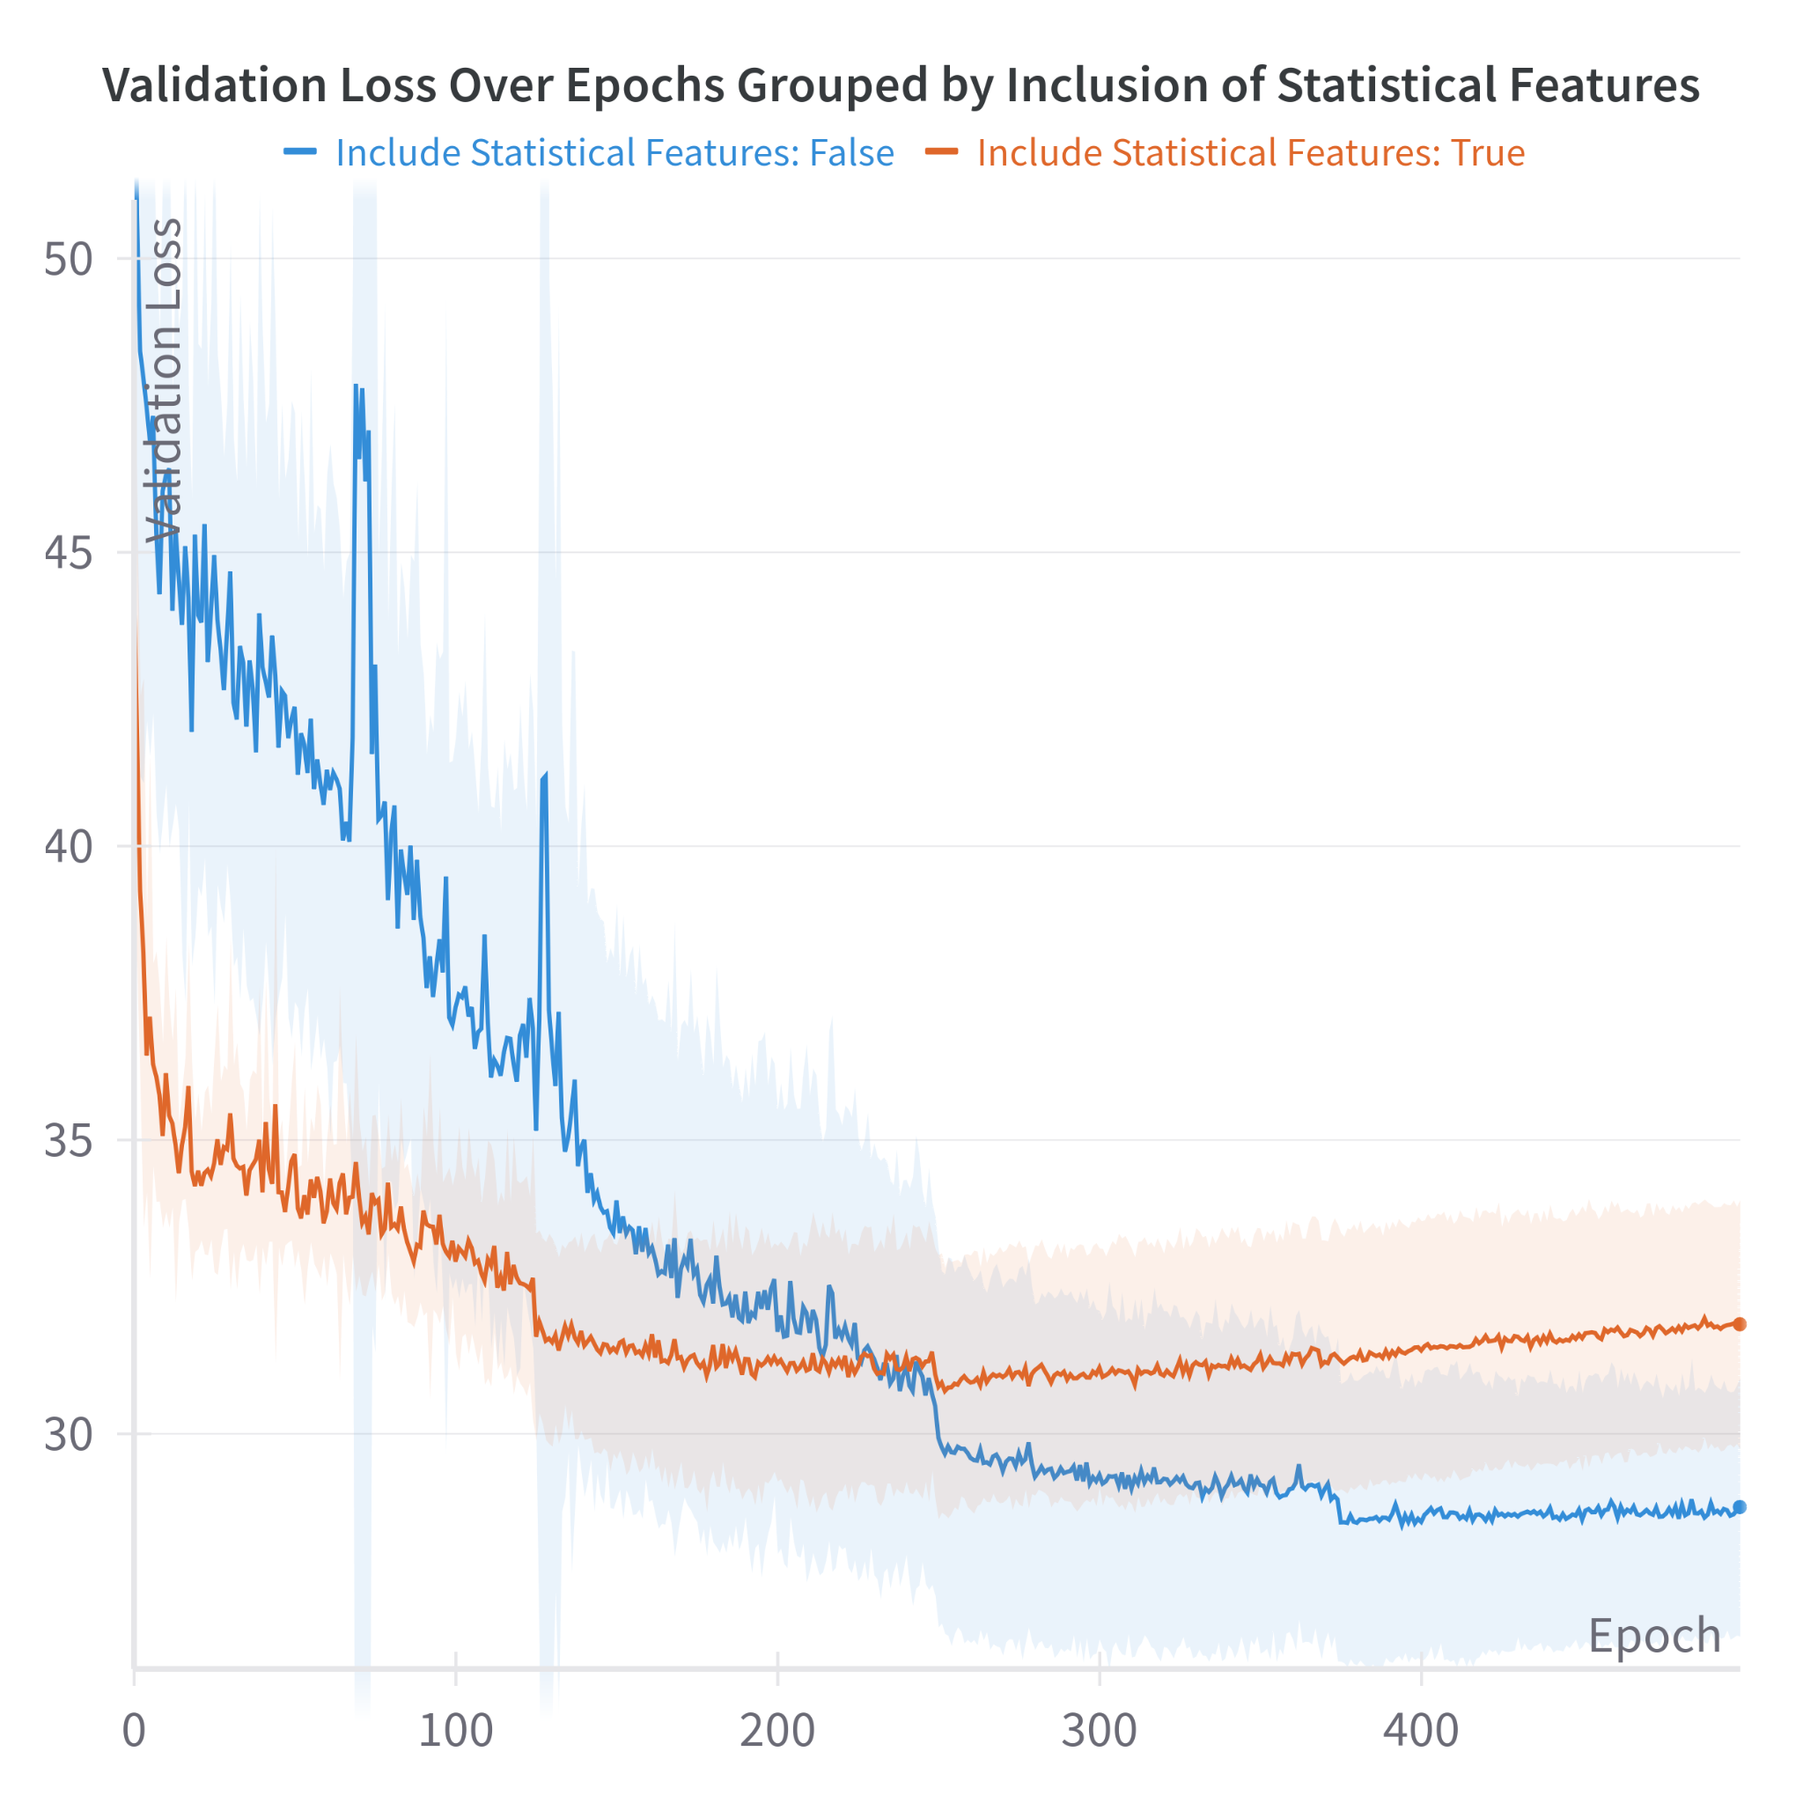
Hyperparameter Search

Slide 10
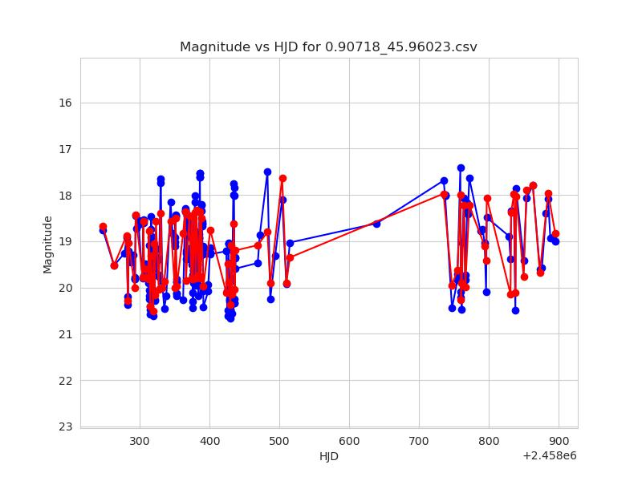
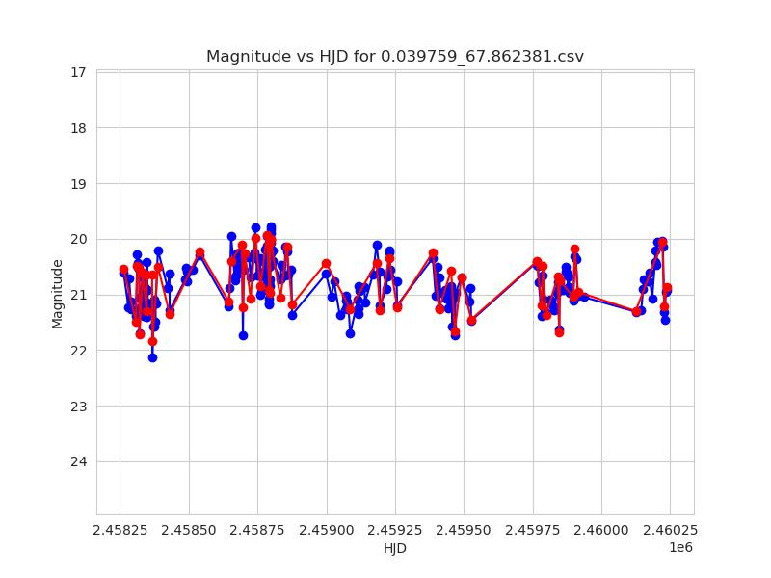
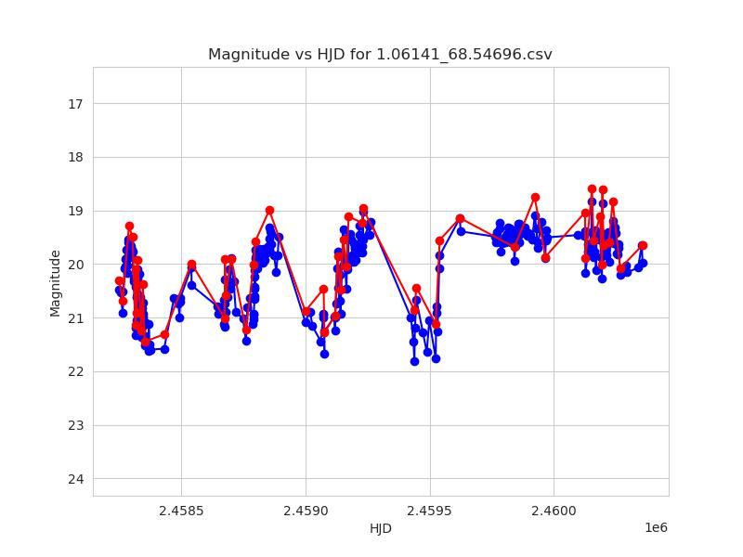
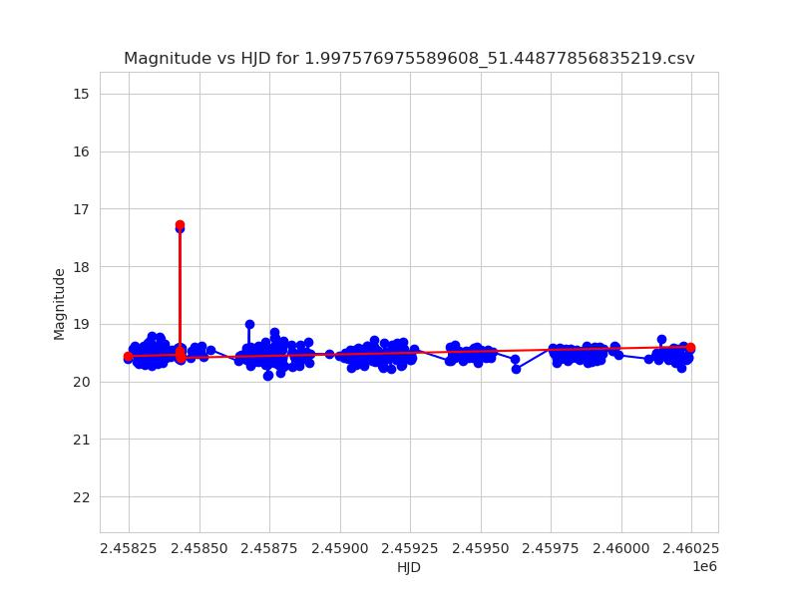
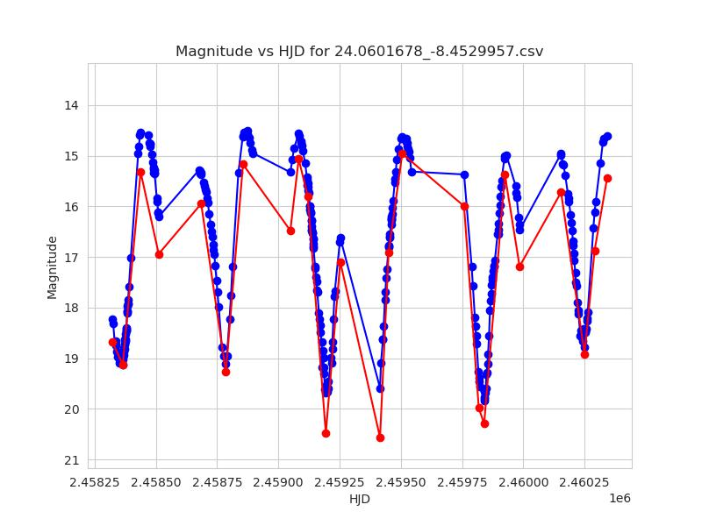
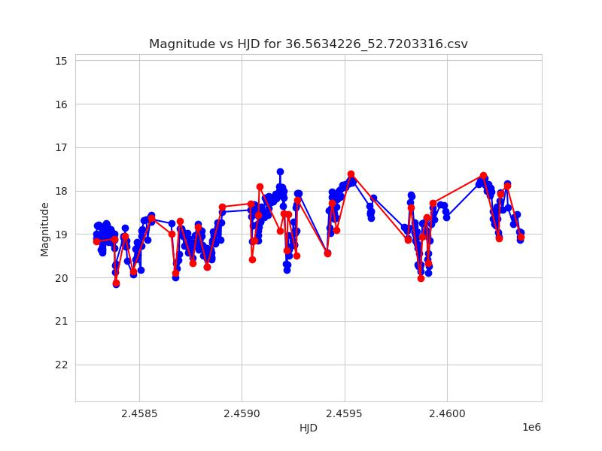
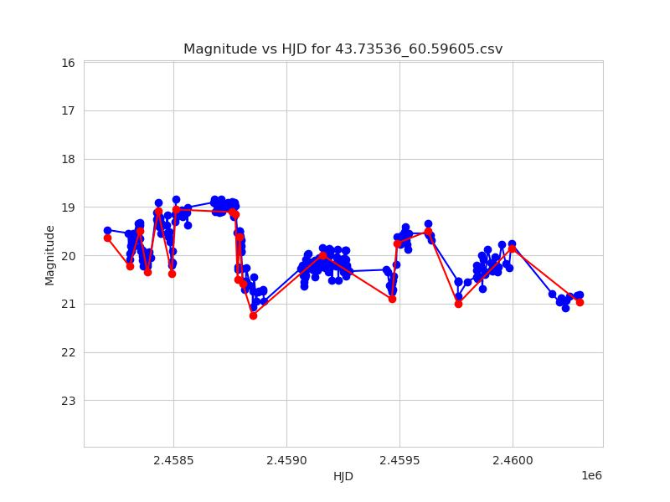
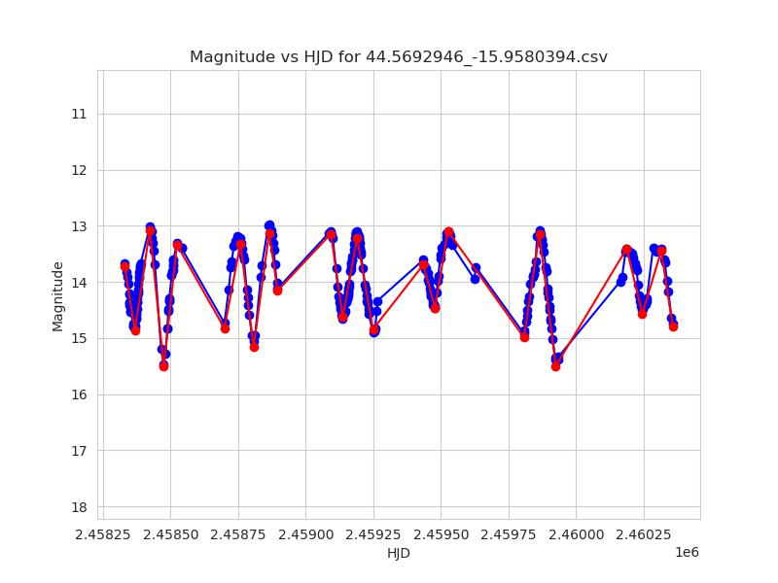
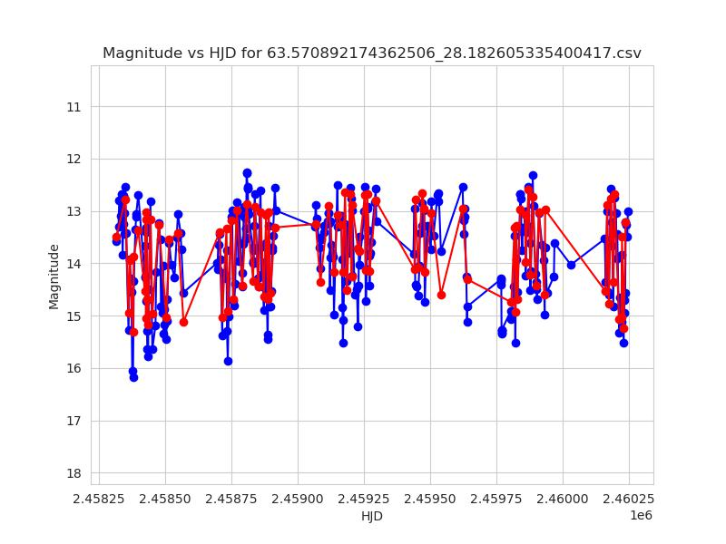
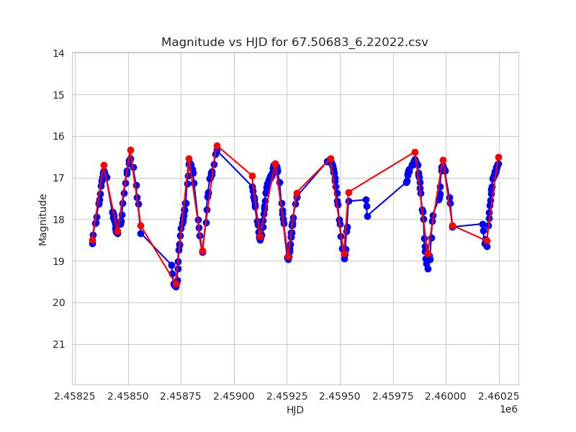
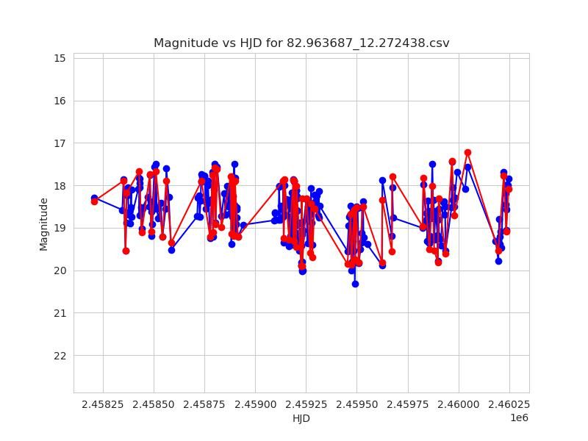
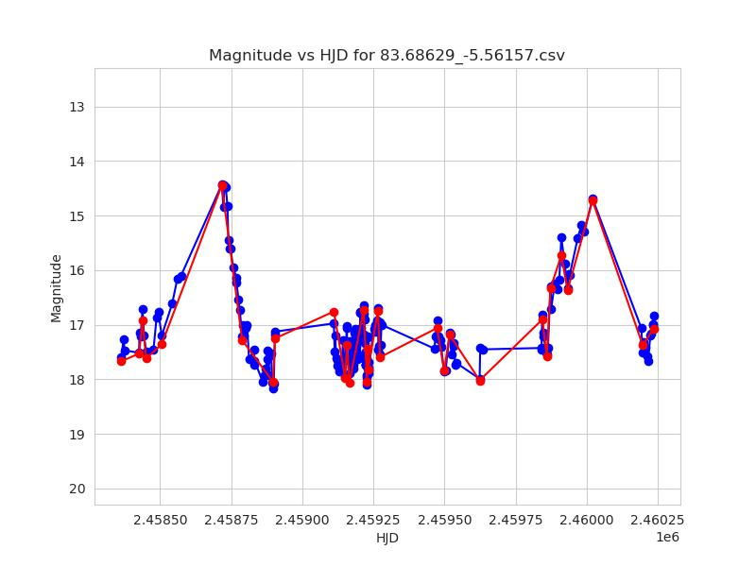
Results - Reconstructions

Slide 11
Nearest Neighbours for Query Light Curves
Query
Closest 1
Closest 2

Slide 12
Nearest Neighbours for Query Light Curves
Query
Closest 1
Closest 2

Slide 13
Nearest Neighbours for Query Light Curves
Query
Closest 1
Closest 2

Slide 14
Nearest Neighbours for Query Light Curves
Query
Closest 1
Closest 2

Slide 15
Nearest Neighbours for Query Light Curves
Query
Closest 1
Closest 2

Slide 16
Nearest Neighbours for Query Light Curves
Query
Closest 1
Closest 2

Slide 17
Nearest Neighbours for Query Light Curves
Query
Closest 1
Closest 2

Slide 18
Nearest Neighbours for Query Light Curves
Query
Closest 1
Closest 2

Slide 19
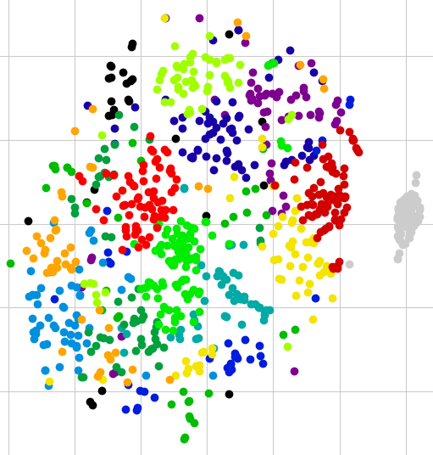
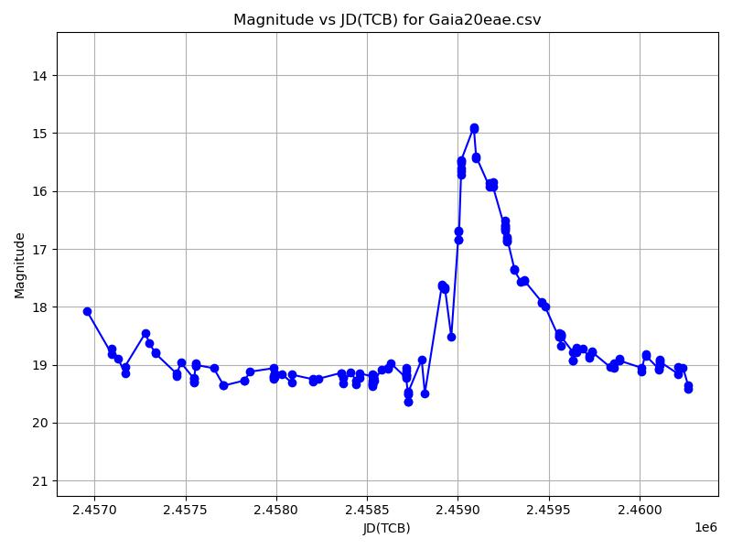
Results (in prep.)
Gaia Data
32-Dimensional Latent Space
k=15 Gaussian Mixture Model
t-SNE downprojection to 2D

Slide 20
Results (in prep.)
Relationship between light curve shape and the alpha-index.
ZTF Data.

Slide 21
Thank you for your attention!

