Slide 1


Classifying ionised nebulae in nearby galaxies with ML
Francesco Belfiore
INAF – Arcetri (Florence, IT)

Slide 2
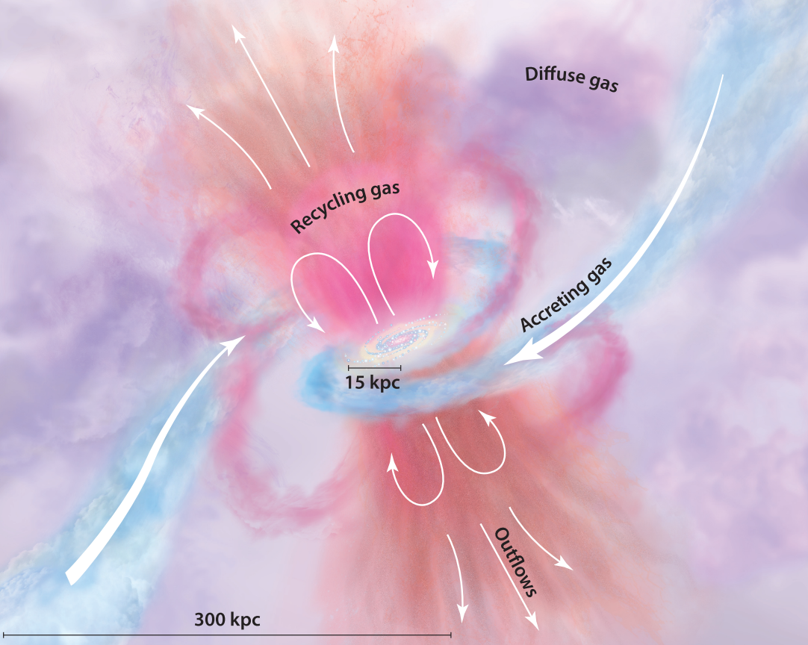
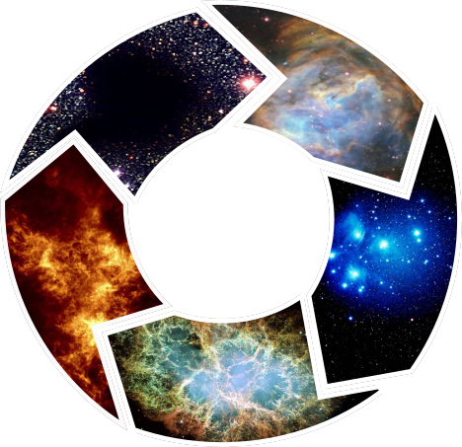
The galactic matter cycle
1
The small-scale matter cycle
Molecular Clouds
HII regions
Atomic
Hydrogen
Star clusters
Supernovae
Ionised interstellar medium

Slide 3
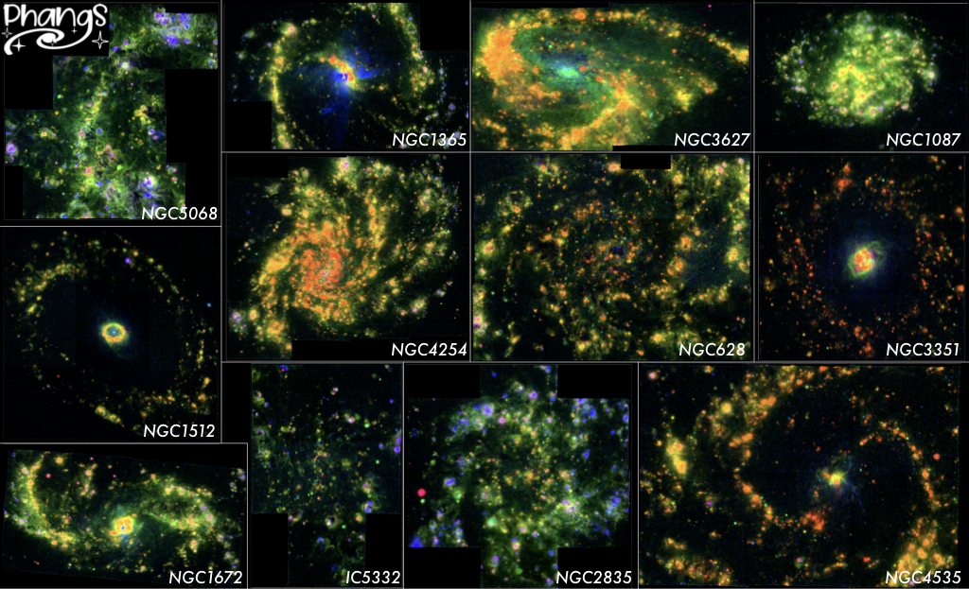
[OIII] Ha [SII]
MUSE pointing
Credit: FB+ F Santoro

Slide 4
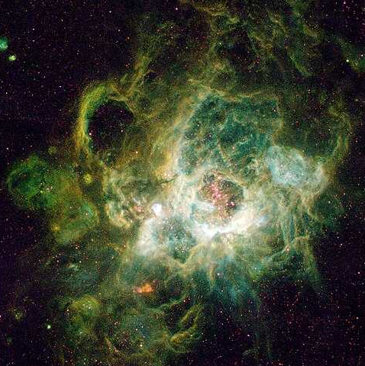
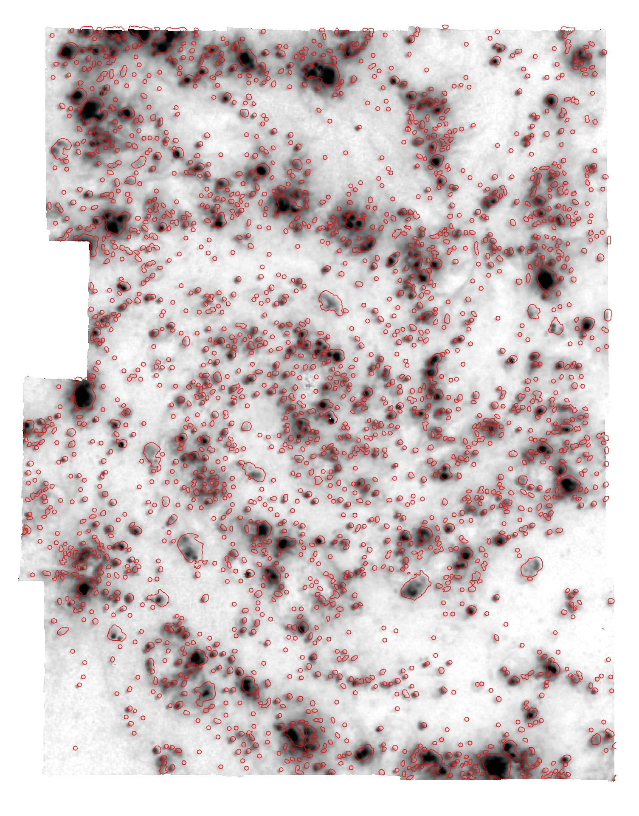
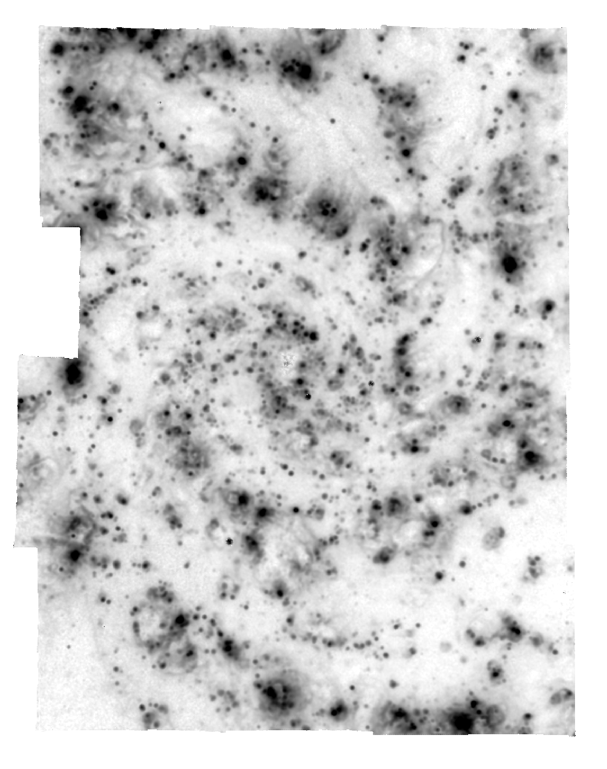
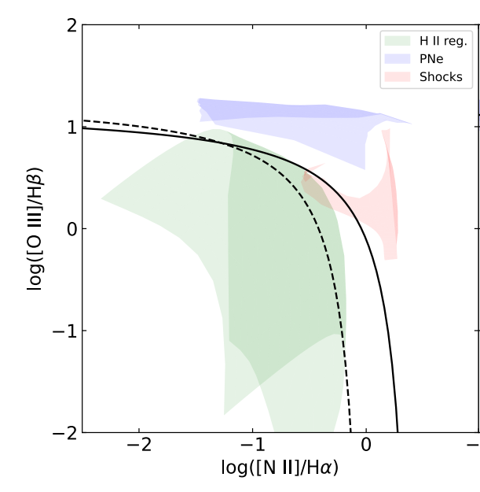
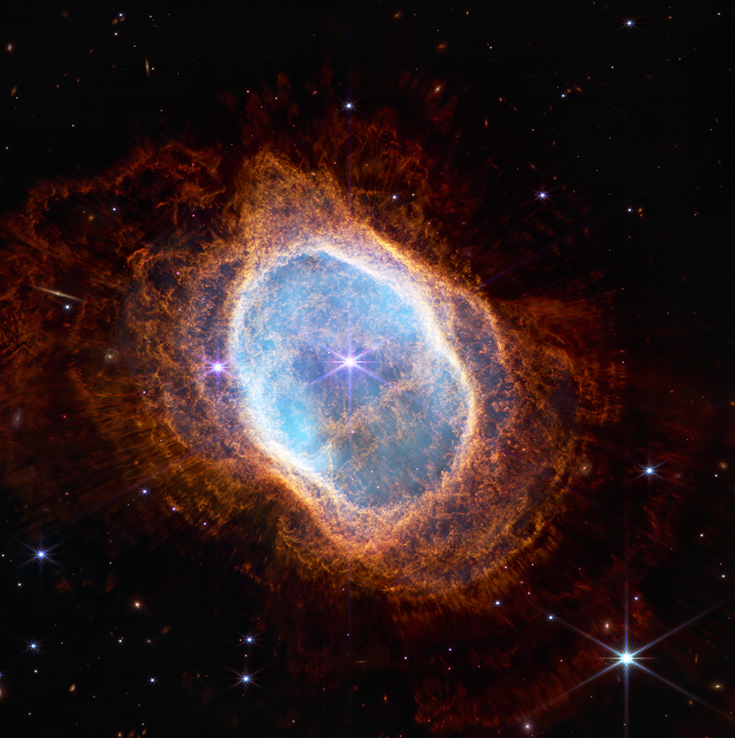
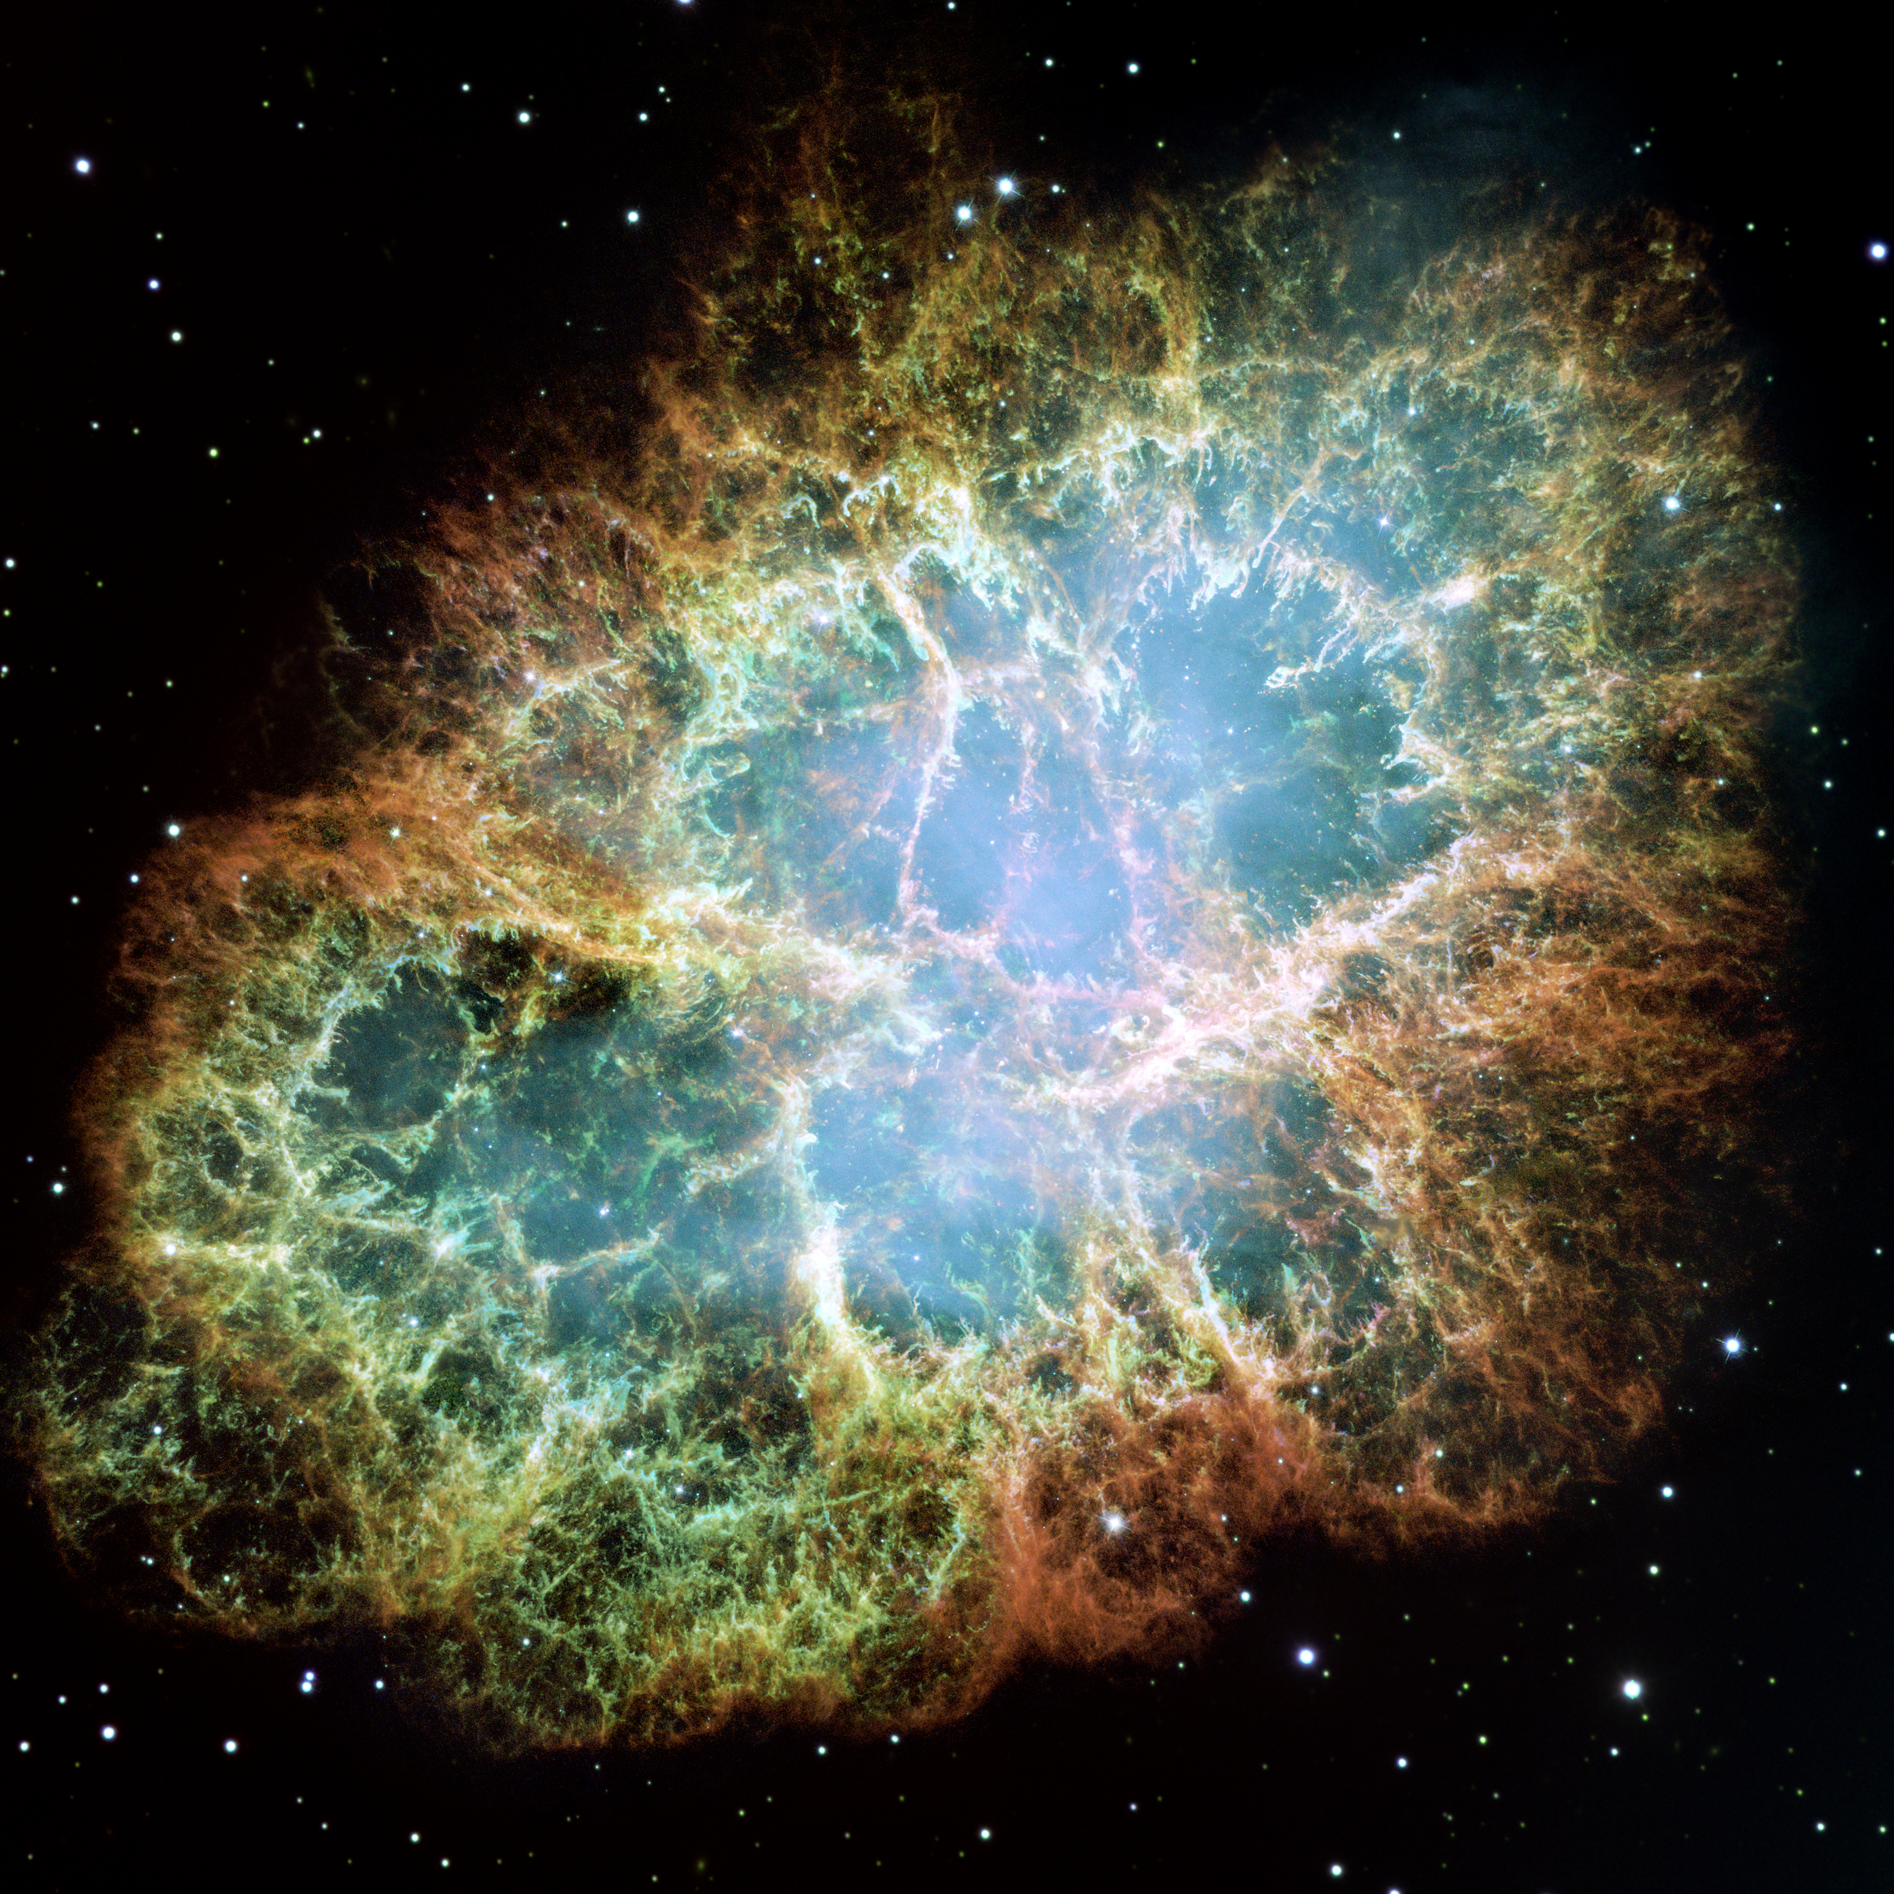
HII regions
Classifying nebulae: the classical approach
2
Photoionisation models
Planetary Nebulae
Log([OIII]/Hβ)
Log([NII]/Hɑ)
Supernova Remnants
Diffuse Ionized Gas

Slide 5
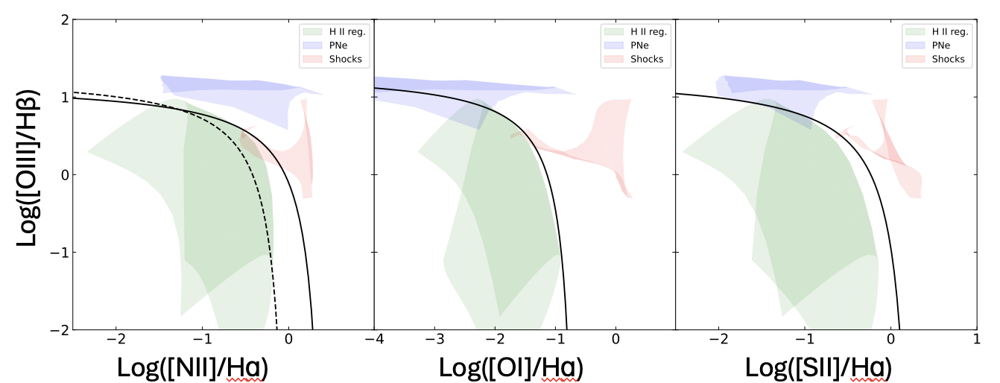
Limitations of the classical approach
2
We are not using the 3D nature of the data to find sources.
Boundaries are painfully arbitrary and algorithm dependant
Ha map
Clumpfind vs Congiu+23
Groves+23 vs Congiu+23
Traditionally only use a small number of strong lines for classification (but see recent Bayesian approach Congiu+23)
No easy way of dealing with upper limits

Slide 6
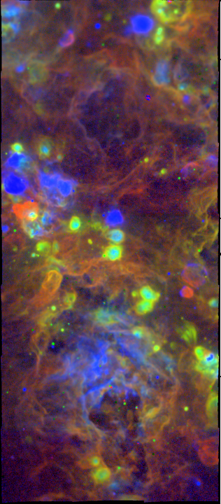
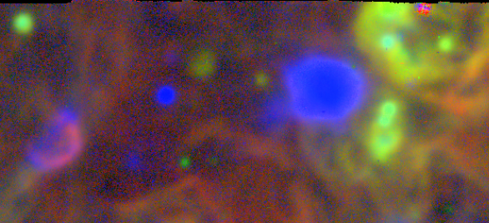
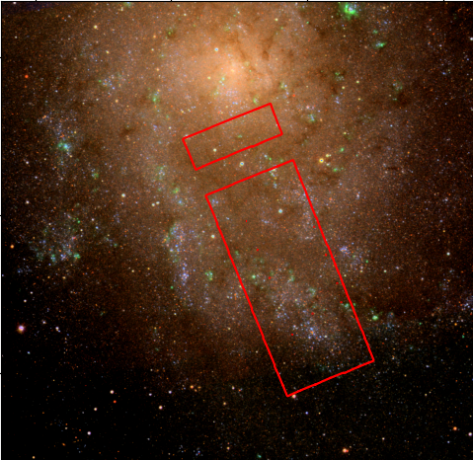
MUSE data, Hɑ [SII] [OIII]
2
HII regions
Let’s learn using a simple case!
PN
SNR
Inter arm
Wolf-Rayet star
WR
PNe are unresolved point sources bright in [OIII]5007
SNR are bright in [SII]6717 and show shell-like morphology
HII regions are generally bright in Hɑ but line ratios also depend on age of ionizing star/cluster
Spiral arm
Nearby galaxy M33
24 MUSE pointings
2×10⁶ spectra
(More than Legacy SDSS)
100 pc

Slide 7
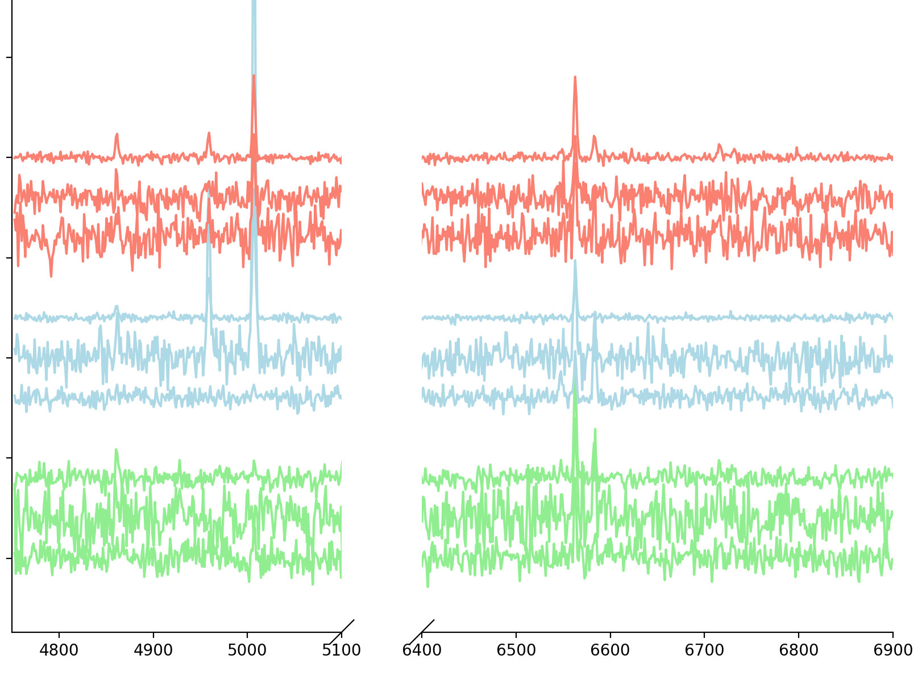
Classifying nebulae: using Machine Learning
2
Start with predictions from photoionisation model calculations
Simulate spectra with observational characteristics (noise, instrument line spread function, etc)
Train a simple network to classify them
HII
Flux
Log([OIII]/Hβ)
PNe
Dropout
Dropout
SNR
DIG
Conv1d
Dense
Conv1d
Log([NII]/Hɑ)
wavelength
input
Caterina Bracci, (MSci student)
Michele Ginolfi (UniFI, also here!)

Slide 8
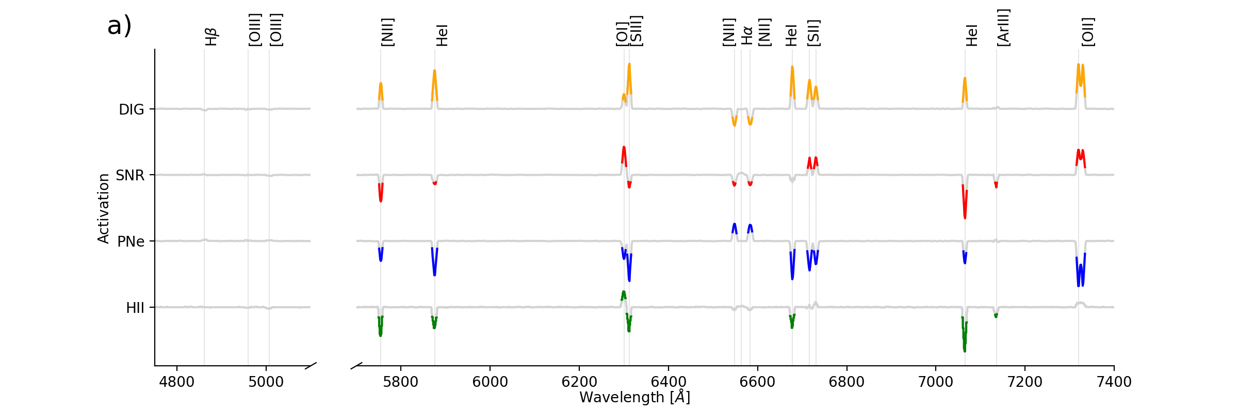
Interpreting the network
2
Activation maximisation of the neurons, model with no noise
Weak lines
Strongest lines
The model learns from weak lines which are strongly predictive of the class

Slide 9
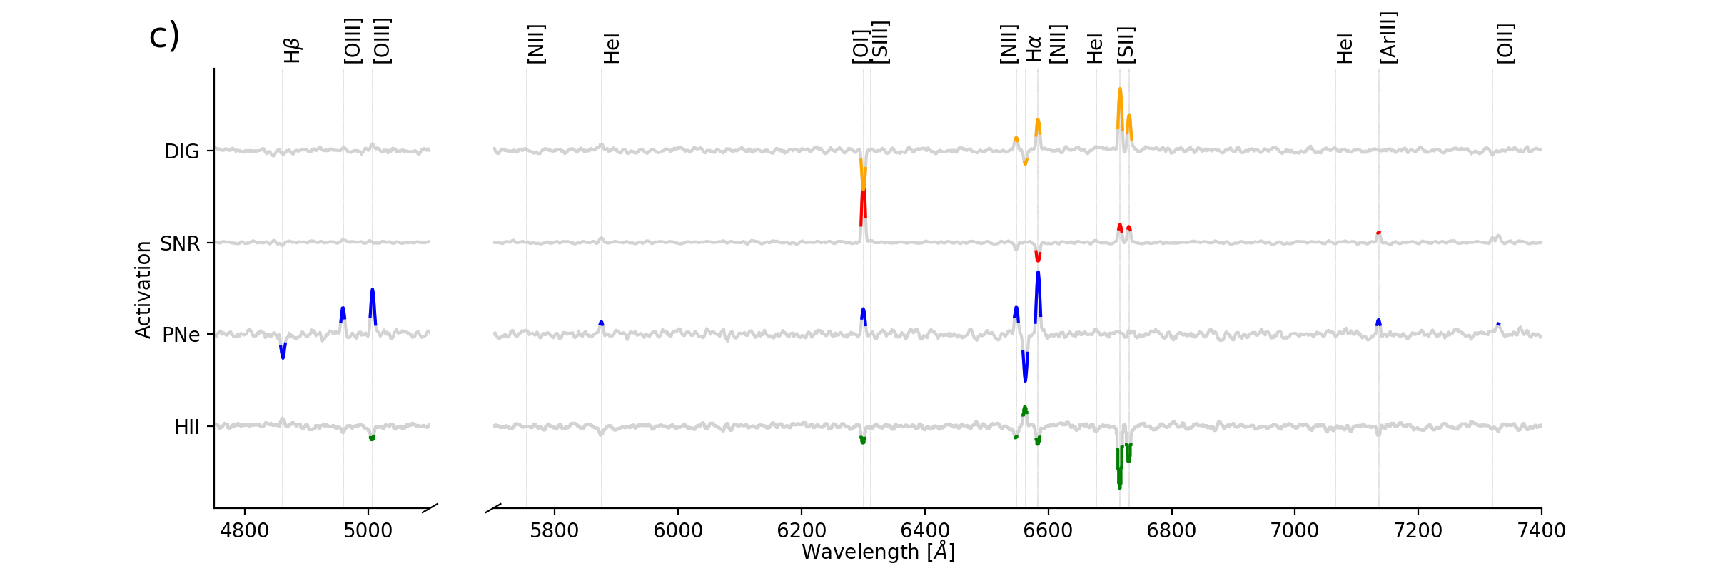
Interpreting the network
2
Let’s add realistic noise
Strongest lines
The model “falls back” on the traditional diagnostics based on (BPT) strong lines

Slide 10
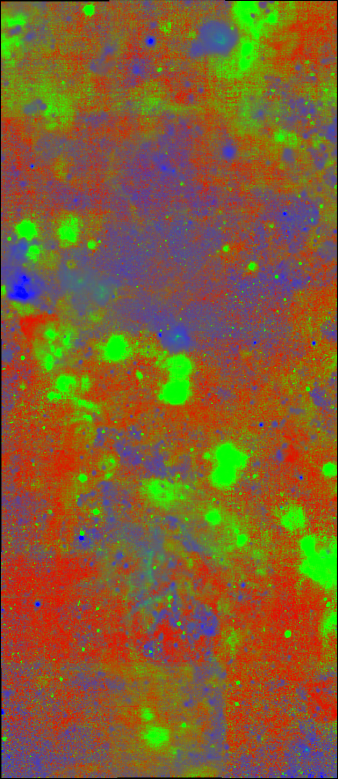
MUSE data, Ha [SII] [OIII]
ML Classifications
HII region
PNe
SNR + DIG
WR
Defines realistic HII region boundaries (agrees with a ‘by eye’ estimate)
Finds all the PNe from the literature (and more)
Does not distinguish SNR from DIG → merge these into a ‘background’ class

Slide 11
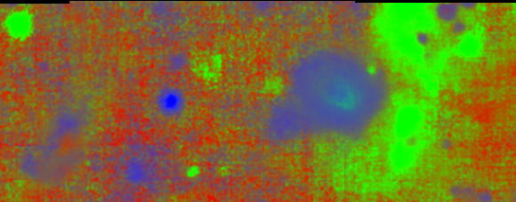
MUSE data, Ha [SII] [OIII]
ML classification, HII SNR/DIG PNe
HII regions
PN
SNR
Wolf-Rayet star
WR

Slide 12
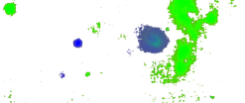
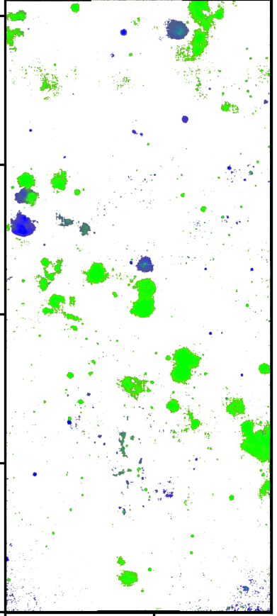
MUSE data, Ha [SII] [OIII]
HII regions
PN
SNR
WR
Select sources with P(bkg) < 0.5
Starting point for future segmentation and source detection algorithm in 3D!

Slide 13
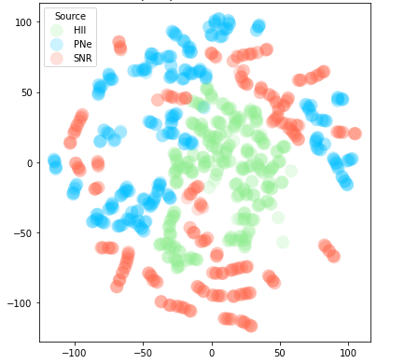
Are theoretical models good enough?
3
Theory
Data
e.g. photoionisation models
Low-dimensional representation (Tsne)
e.g. spectra of observed nebulae
Imperfect modelling of observational effects
Missing or unknown physics
Other simplifying assumptions

Slide 14
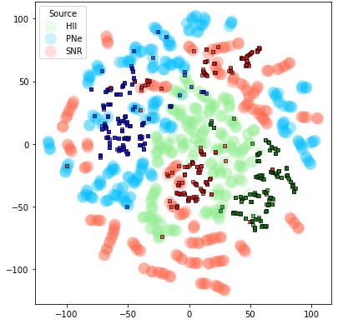
Domain Adaptation
3
Theory
Data
e.g. photoionisation models
e.g. spectra of observed nebulae
Imperfect modelling of observational effects
Missing or unknown physics
Other simplifying assumptions
Domain Adaptation
Aligns the low-dimensional representations of the two “domains”

Slide 15
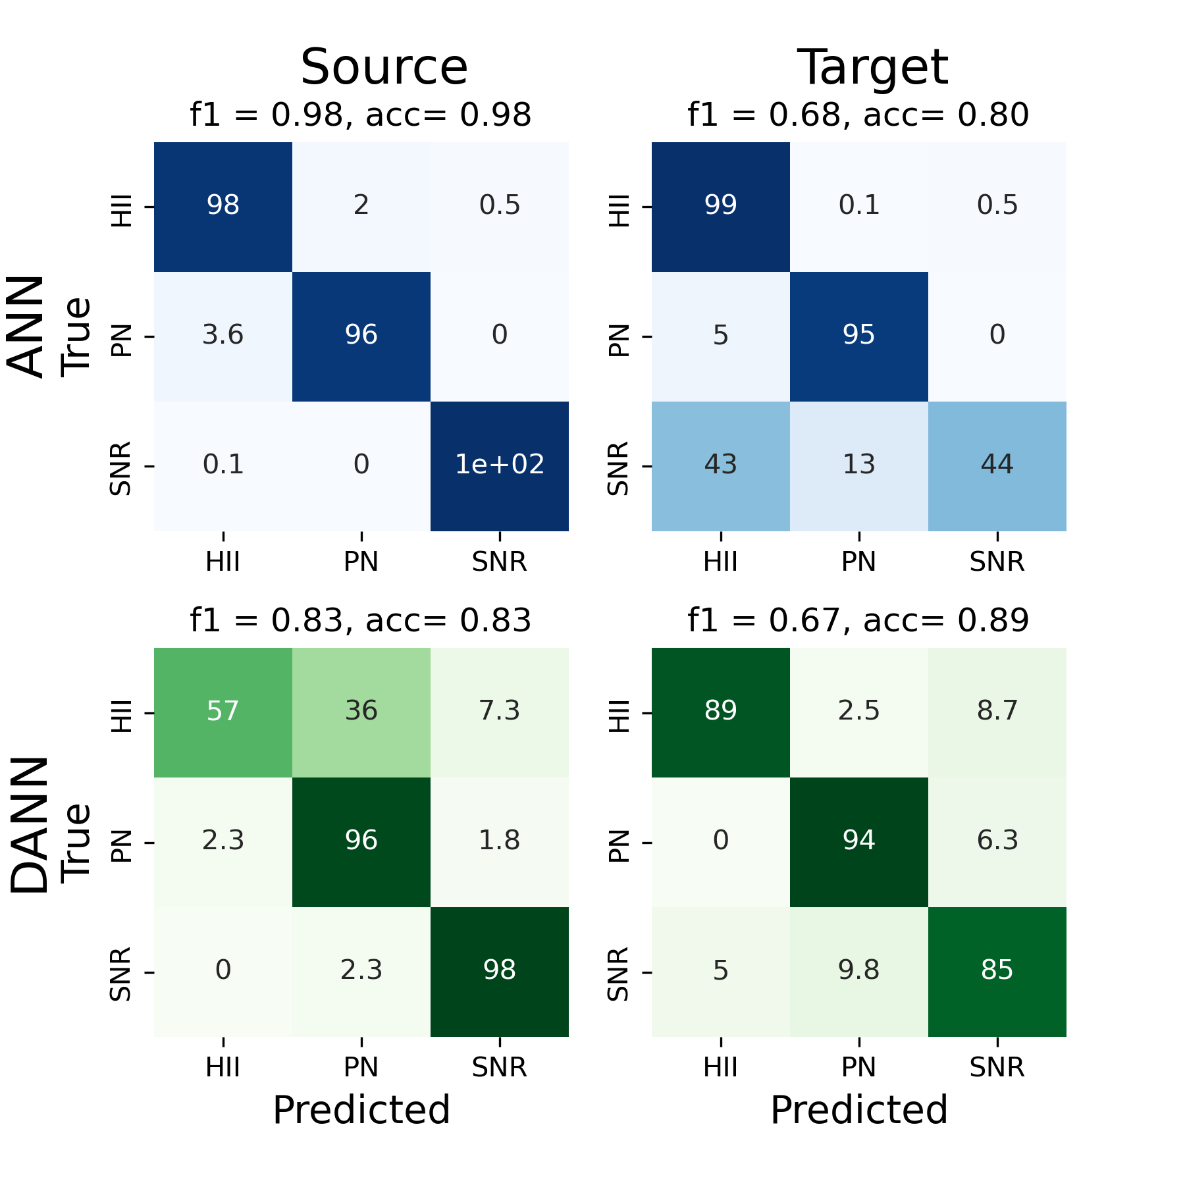
A Domain Adversarial Neural Network
3
Encoder
HII
Source & target domain instances
input
embeddings
PNe
output
SNR
P(source)
Ganin+2014
Discriminator

Slide 16
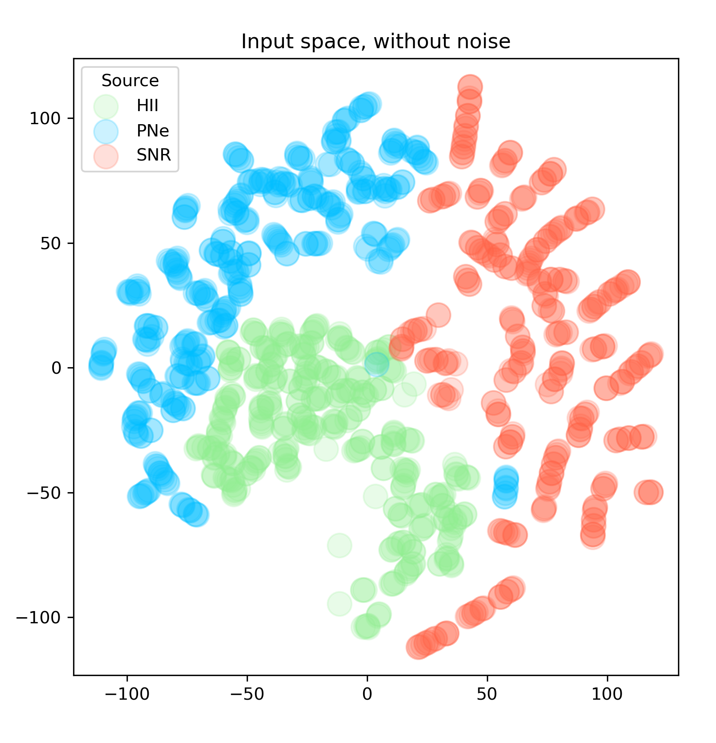
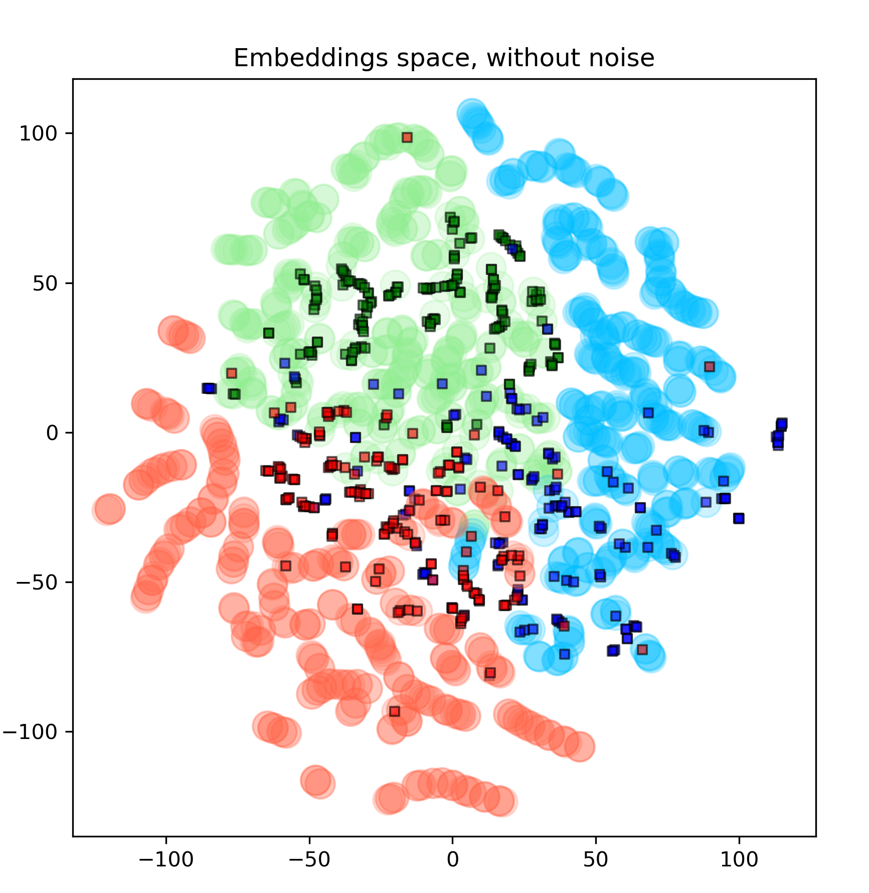
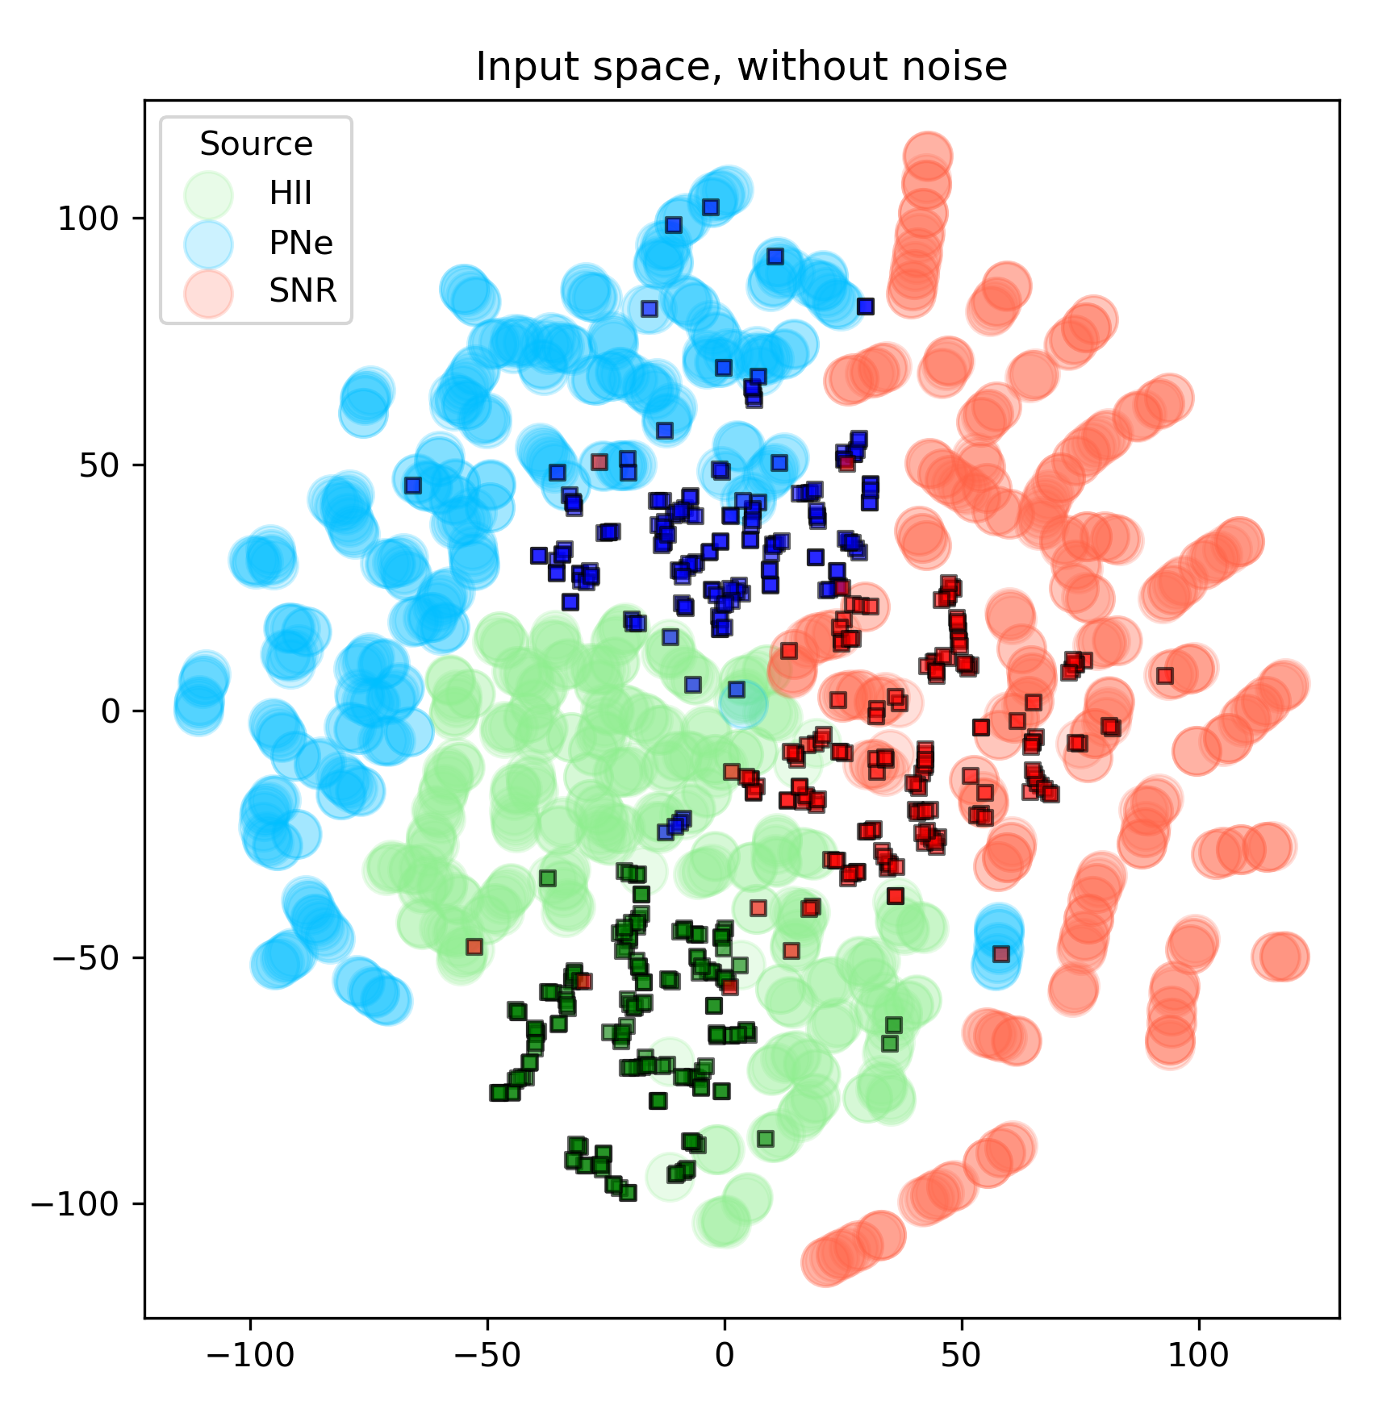
Did we successfully align domains?
3
Tsne representation of the input space
Tsne representation of the embeddings space

Slide 17
Conclusions
Large cloud-scale IFU surveys deliver millions of optical spectra within complex 3D datasets.
Directly modelling the spectra with ML works quite well. Will be used for source detection and segmentation.
Domain adaptation shows potential for crossing the gap between theoretical models and observations.

Slide 19
Limitations of the classical approach
2
We are not using the 3D nature of the data to find sources.
Boundaries are painfully arbitrary and algorithm dependant
Ha map
Clumpfind vs Congiu+23
Groves+23 vs Congiu+23
Traditionally only use a small number of strong lines for classification (but see recent Bayesian approach Congiu+23)
Log([OIII]/Hβ)
Log([NII]/Hɑ)
Log([OI]/Hɑ)
Log([SII]/Hɑ)

Slide 20
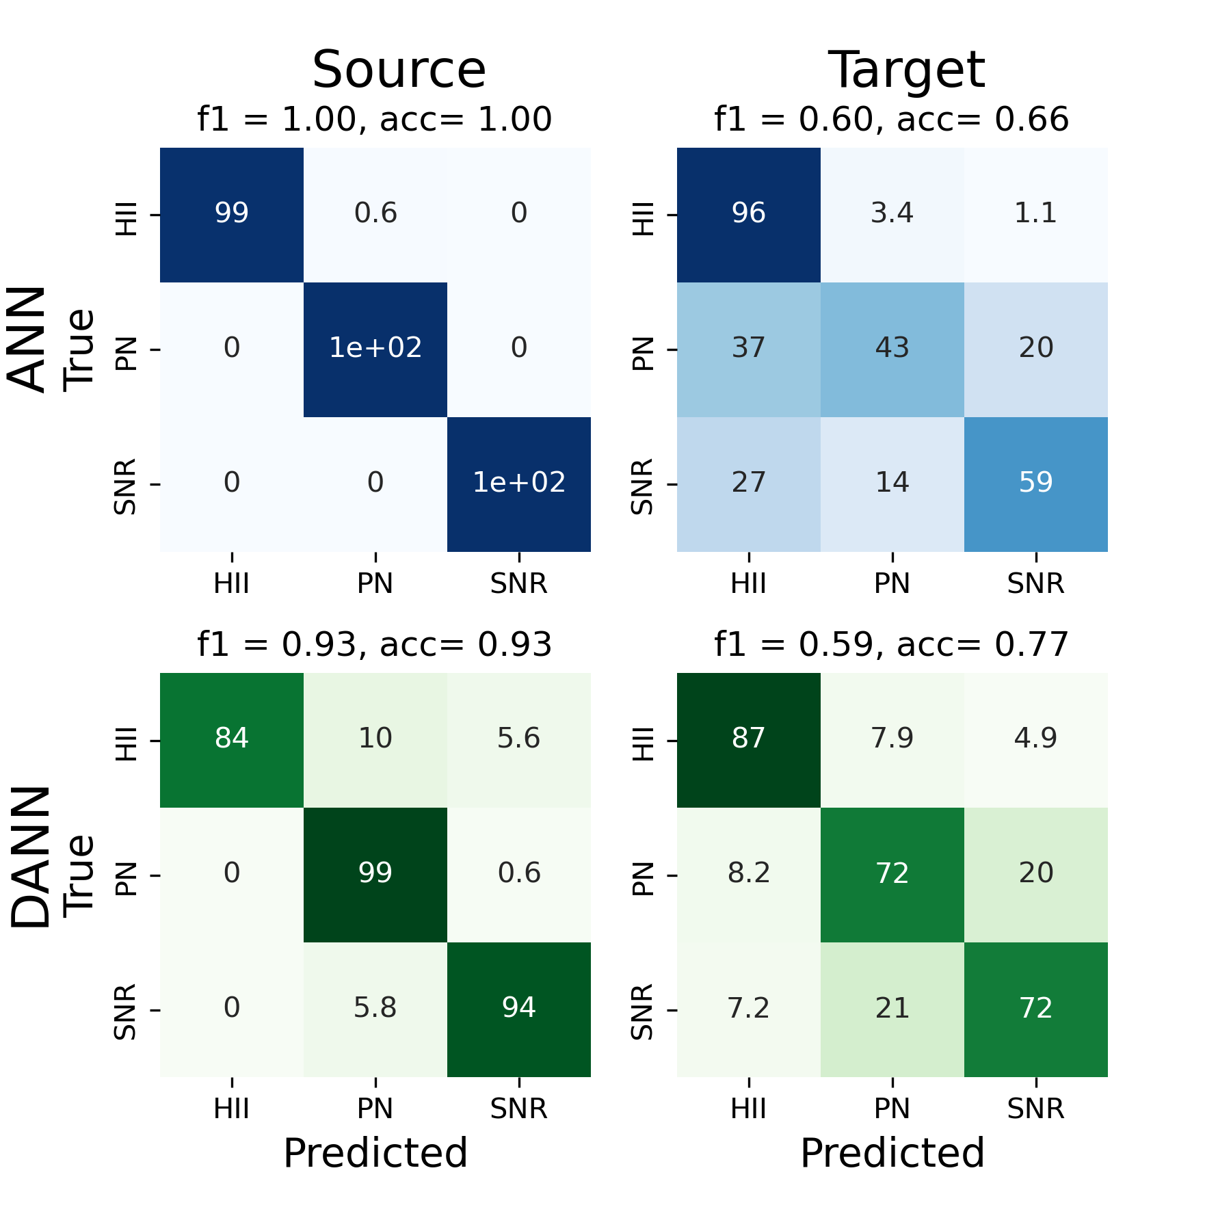

Slide 21
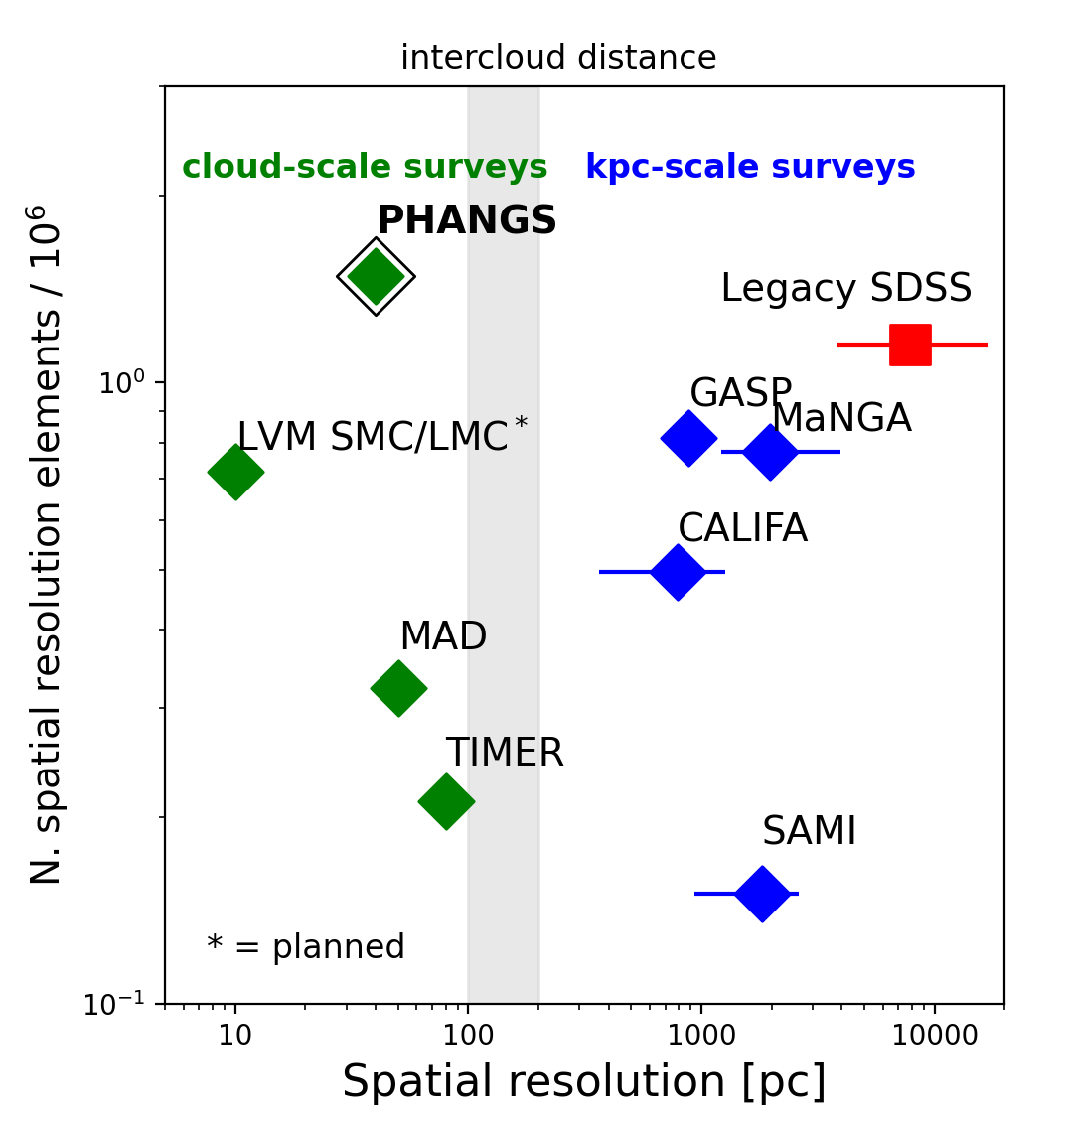
Large, Cloud-scale surveys
1
PHANGS resolve the fundamental units of the star formation cycle: GMCs, HII regions, star clusters
How does local (dynamical) environment affect star formation?
How do ionising radiation and feedback shape the ISM?
How do metals cycle in galaxy discs?

