Slide 1
Machine Learning-Driven Determination of 3D Structures of Molecular Clouds in High-Resolution mm Images
Efe Öztaban
Sabancı University
Emrah Kalemci (Sabanci University)
Ahmed Abdullah Abbasi,
Atakan Saraçyakupoğlu (Sabanci University),
Maria Diaz-Trigo (ESO), Thomas Stanke (MPE)
Tom Maccarone (Texas Tech), John Tomsick (SSL, UC Berkeley) Simone Migliari (ESA), James Miller-Jones (Curtin)

Slide 2
OVERVIEW OF MY TALK
Dust Scattering Halos
Our Method to Determine the Source Distance
Our Test Source: 4U 1630-47 and Our Datasets
Molecular Clouds in the Line of Sight
Objectives and Constraints
High-Resolution mm Images
Finding the 3D Structure of the Clouds
Local Peak Detection
Data Segmentation
Removal of Non-Cloud Regions
Clustering
Results
DSH Simulations
Future Work
ML4ASTRO2 Efe Öztaban

Slide 3
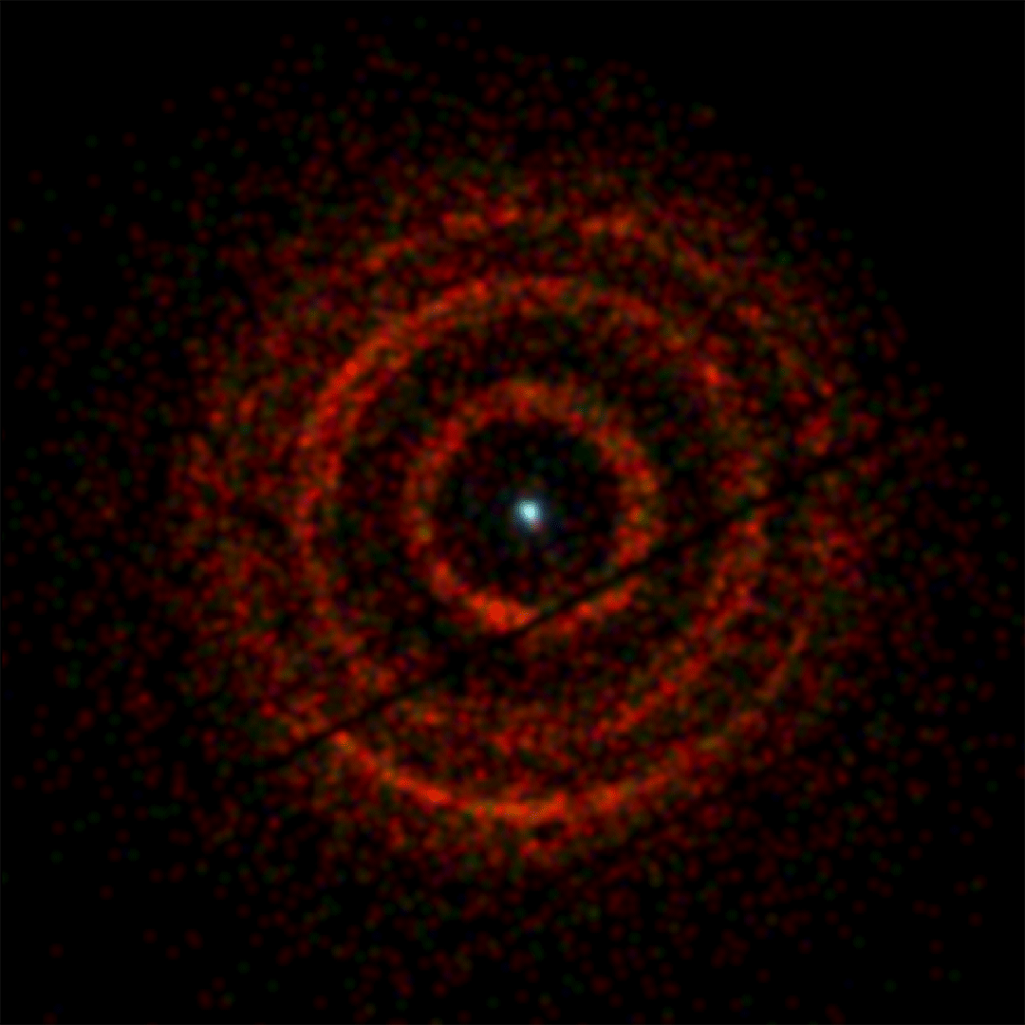
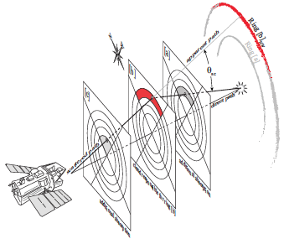
DUST SCATTERING HALOS
V404 Cygni, Andrew Beardmore (Univ. of Leicester)
and NASA/Swift
Heinz et al. 2016
ML4ASTRO2 Efe Öztaban

Slide 4
DUST SCATTERING HALOS
Why to study DSH?
DSH intensity, shape and spectral properties depend on the distance to the source, its intrinsic spectrum and time history, the distribution of dust grains and their size and composition!
So, we can learn about these from studying DSHs
But, how can we determine the distance of the source object by studying it’s DSH?
DSH of 4U 1630-47 from Chandra (2016)
ML4ASTRO2 Efe Öztaban

Slide 5
OUR METHOD TO DETERMINE THE SOURCE DISTANCE
Create 3D cloud shapes using the mm data from APEX.
Determine cloud distances using a standard Galaxy rotation curve.
Place each cloud at either the near distance or the far distance
Using the flux history from the source and the methodology outlined in Kalemci. E, et al., regenerate the scattering halo
A self absorption correction applied to take into account extinction for the clouds in front of the clouds that emitted X-rays.
Best fit to observation data is selected among the simulated DSH images and distance of the source and clouds are determined by used parameters.
So, we need the 3D structure of the molecular clouds in the line of sight!
Kalemci, E., Maccarone, T. J., & Tomsick, J. A. (2018). A dust-scattering halo of 4U 1630–47 observed with chandra and swift: new constraints on the source distance. The Astrophysical Journal, 859(2), 88.
ML4ASTRO2 Efe Öztaban

Slide 6
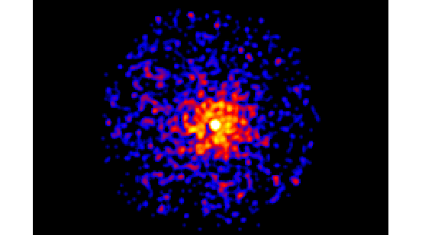
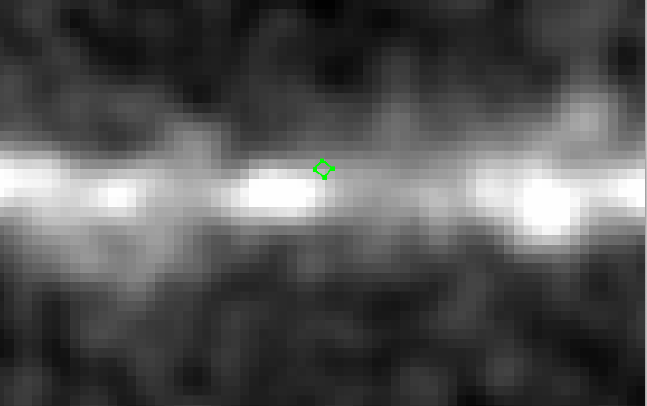
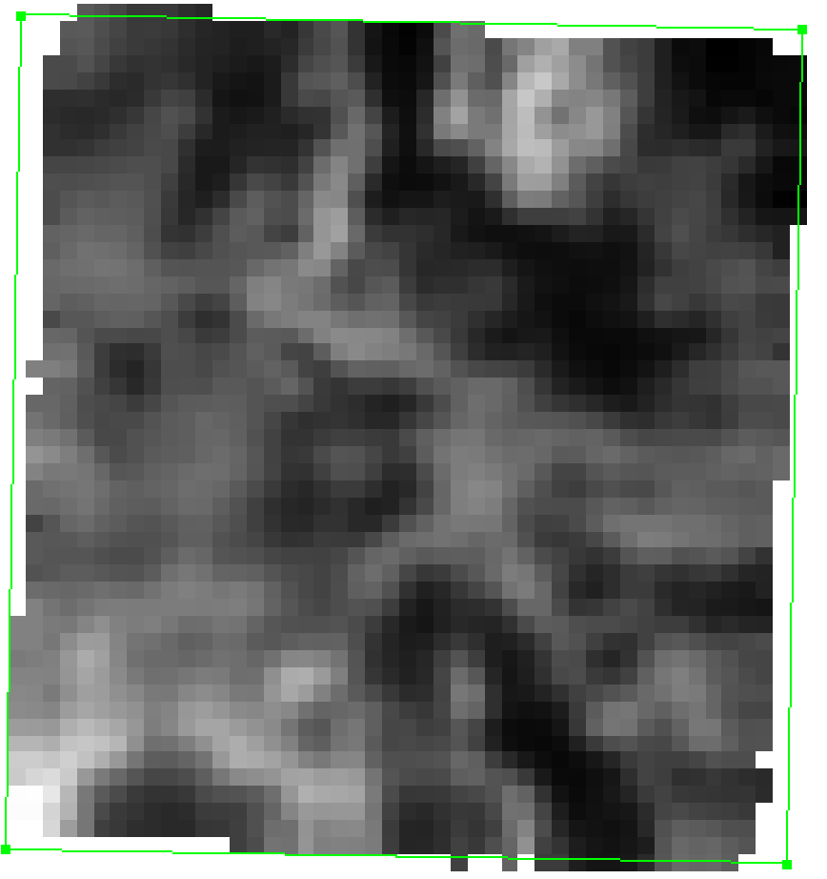
OUR TEST SOURCE: 4U 1630-47 and OUR DATASETS
Source Object: 4U 1630-47
a Galactic black hole transient (GBHT)
Our datasets:
Chandra X-ray image from the outburst decay in 2016
SWIFT XRT images from 2016 decay
SWIFT XRT images from 2023
MAXI and NICER light curves
(required for flux history)
APEX mm images 12CO, 13CO
Other mm surveys (low resolution)
DSH of 4U 1630-47 observed with Chandra on the left and observed with SWIFT on the right
Planck angular resolution: Planck 10’
Bronfman Survey: 7.5’ x 7.5’ resolution
APEX resolution=0.5’
APEX ¹²CO
ML4ASTRO2 Efe Öztaban

Slide 7
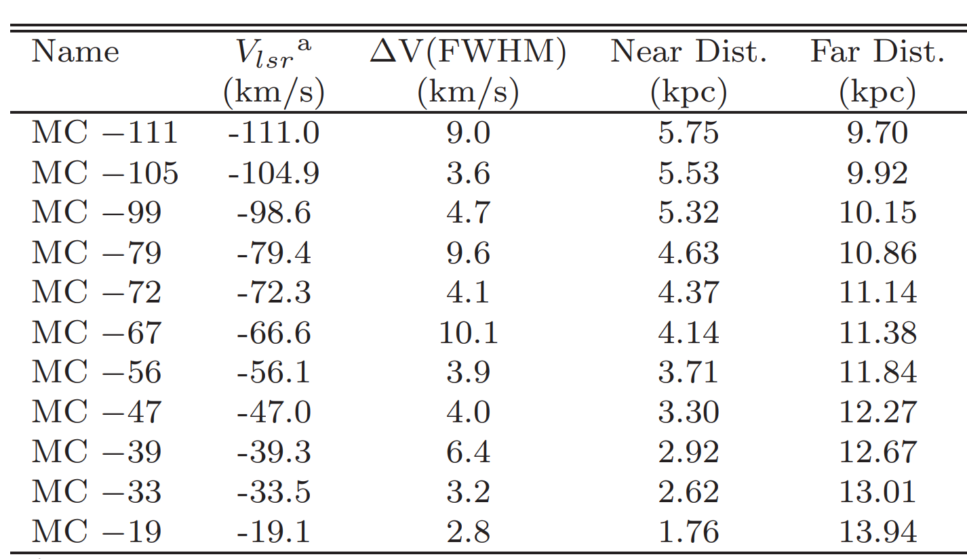
MOLECULAR CLOUDS IN THE LINE OF SIGHT
distance ambiguity
There are 15 molecular clouds in the line of sight.
Molecular emission of clouds (especially ¹²CO and ¹³CO) can be used to determine radial velocities through Doppler shifts.
Each radial velocity implies a far and a near distance (based on galactic rotational curve model)
So, there is a distance ambiguity for each molecular cloud.
ML4ASTRO2 Efe Öztaban

Slide 8
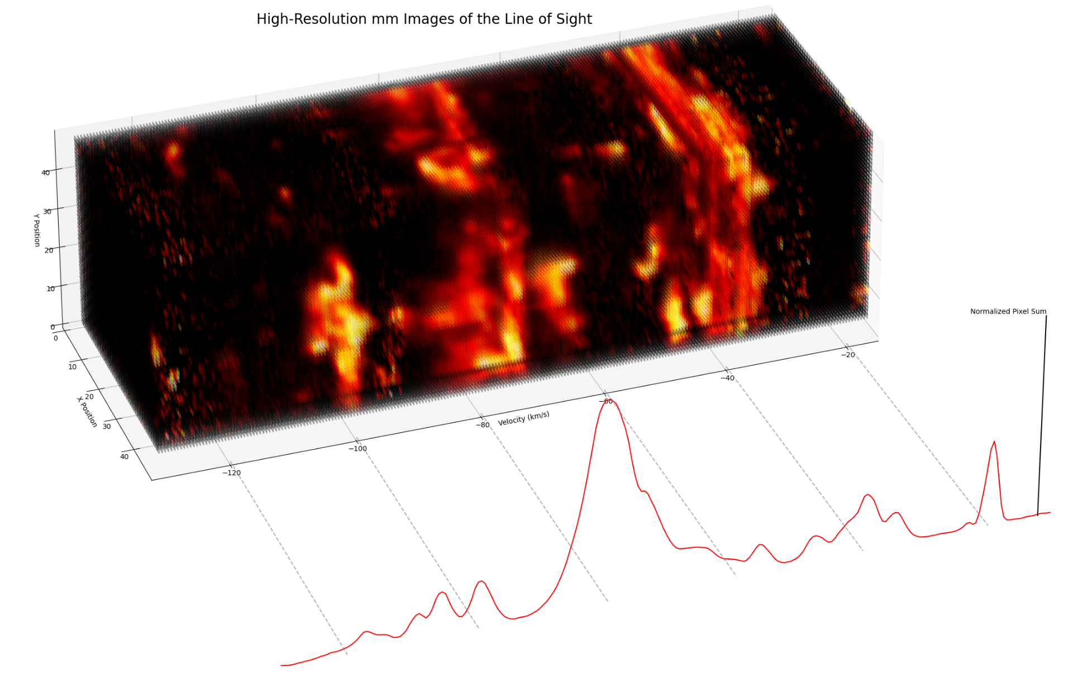
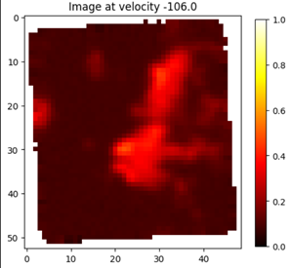
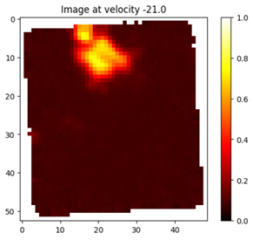
HIGH-RESOLUTION mm IMAGES
From APEX (Atacama Pathfinder EXperiment) telescope
500 mm wave images each with different velocities
2 type of the data (for ¹²CO and ¹³CO molecules)
ML4ASTRO2 Efe Öztaban

Slide 9
PROJECT OBJECTIVES AND CONSTRAINTS
Objective: Determining the 3D structure of interstellar molecular clouds in the line of sight of 4U 1630-47 from the high-resolution mm wave images.
Constraints:
There are spatial overlaps of clouds in the data
requires splitting some data points (pixels in the images) into several clusters
Data has a very narrow field of view
images only capture a limited portion of the some clouds
Literature: There are methods in the literature:
Clumpfind (Stutzki et al. 1990)
Gauss Clumps (Williams et al. 1994)
FellWalker (Berry, D. S. 2015)
Denograms (Rosolowsky et al. 2008)
more…
But, these algorithms did not create meaningful results for our data because of our constraints.
ML4ASTRO2 Efe Öztaban

Slide 10
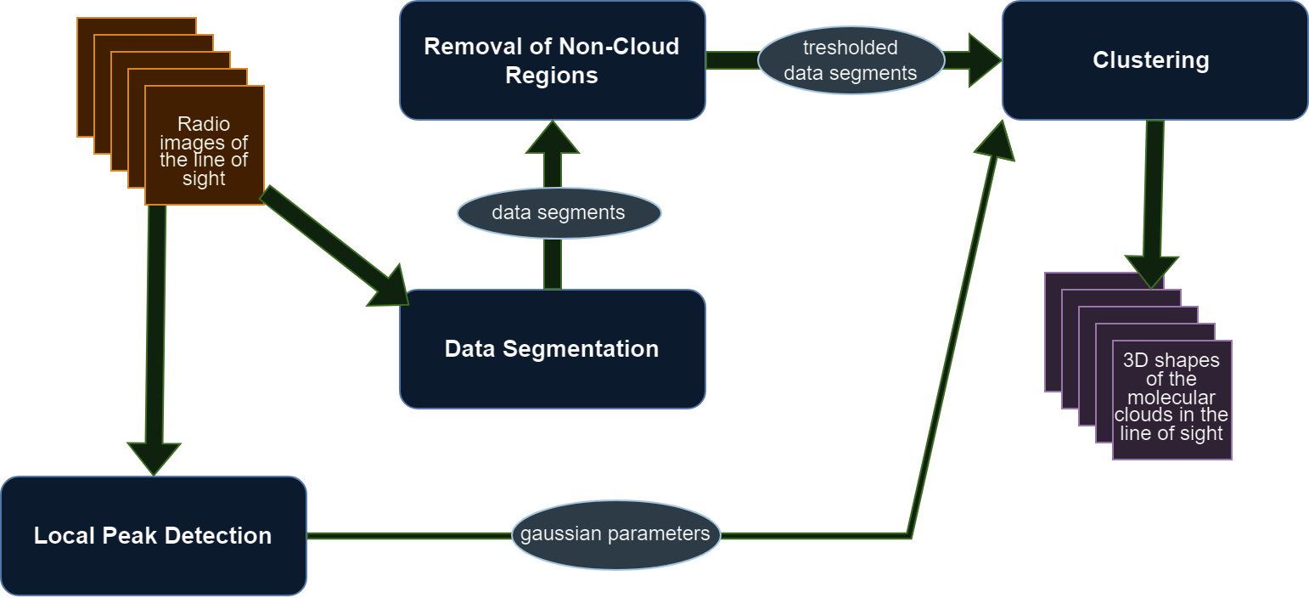
FINDING THE 3D STRUCTURE OF THE CLOUDS
Aim: Constructing 3D shapes of the clouds from 500 APEX mm images
Method: Forming clouds by clustering the data with a ML algorithm and fitted Gaussian centers
ML4ASTRO2 Efe Öztaban

Slide 11
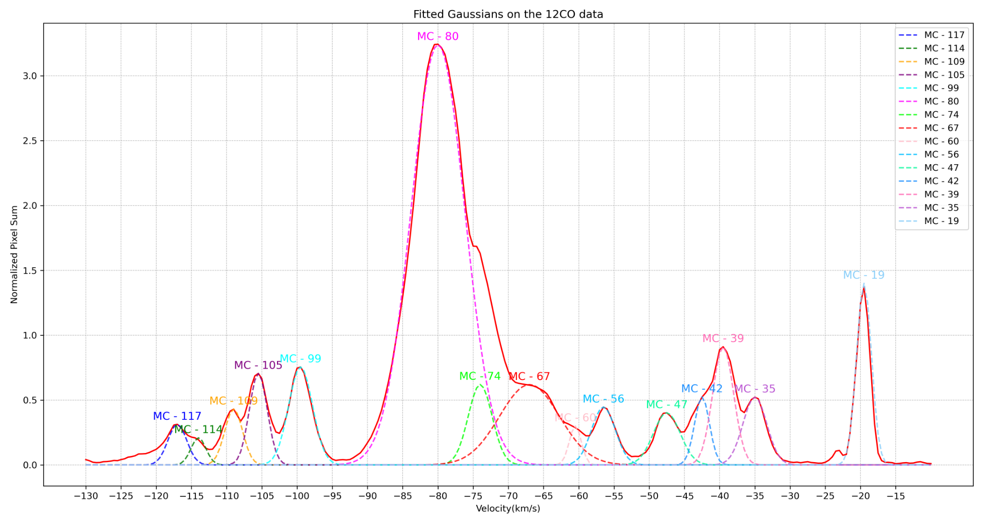
1) LOCAL PEAK DETECTION
Gaussian decomposition to identify local density peaks in the spectral data
Number of the clouds (clusters) and peak velocity of the clouds (cluster centers) are detected
E
ML4ASTRO2 Efe Öztaban

Slide 12
2) DATA SEGMENTATION
ML4ASTRO2 Efe Öztaban

Slide 13
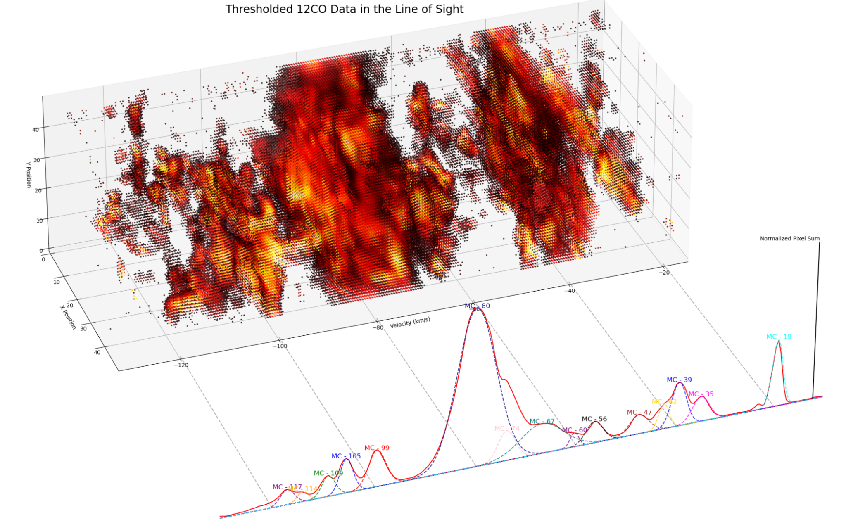
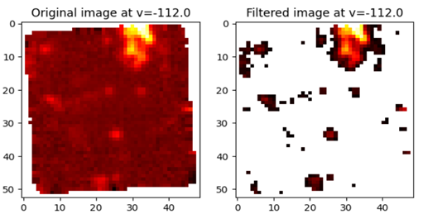
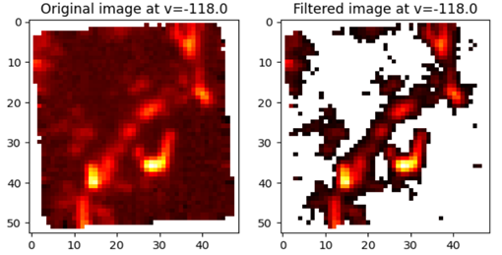
3) REMOVAL OF NON-CLOUD REGIONS
Image processing methods are used
OTSU thresholding applied for every segment
Adaptive filtering for every region
ML4ASTRO2 Efe Öztaban

Slide 14
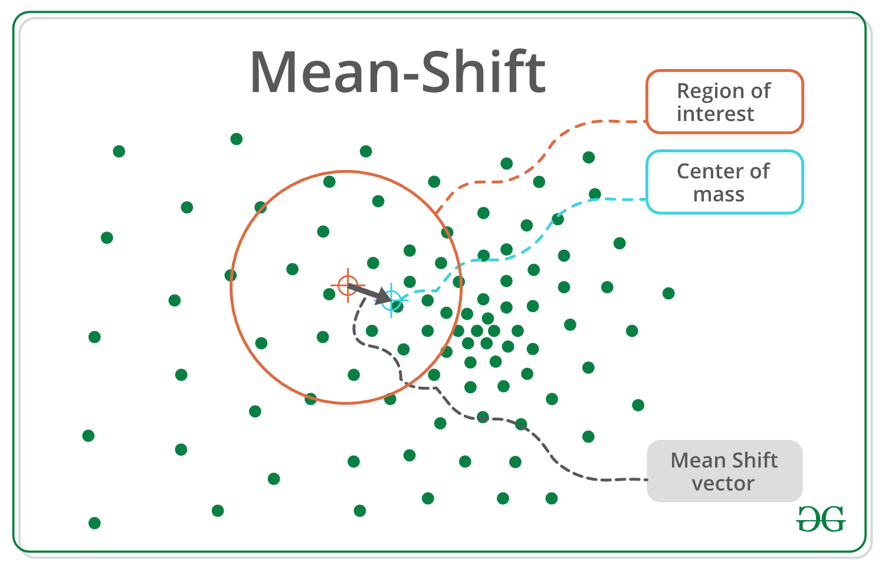
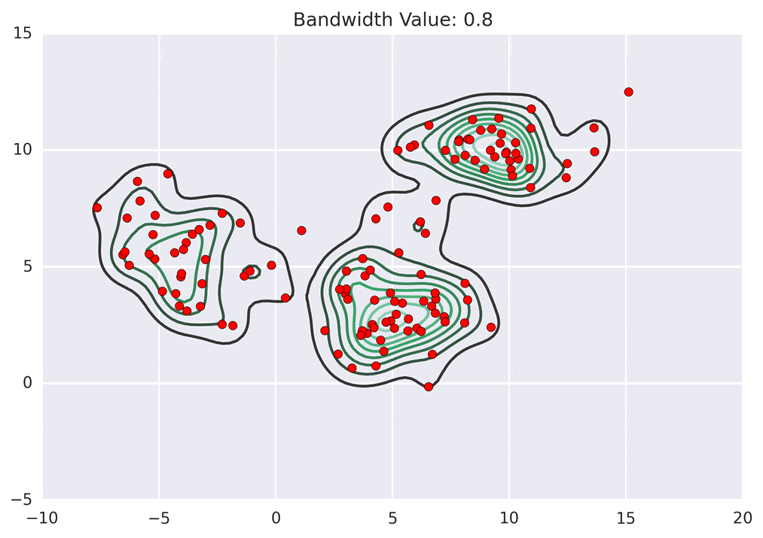
4) CLUSTERING
Mean-Shift Clustering Algorithm is used.
Mean-Shift algorithm is selected due to its effectiveness in image segmentation.
Detected local peak velocities are used as cluster seeds.
Mean-Shift algorithm is modified as:
Modified to soft clustering
Datapoints (pixels) are splitted into different clusters with soft assignment results
Mean-Shift algorithm is modified in order to overcome the clustering in the overlapping regions.
ML4ASTRO2 Efe Öztaban

Slide 15
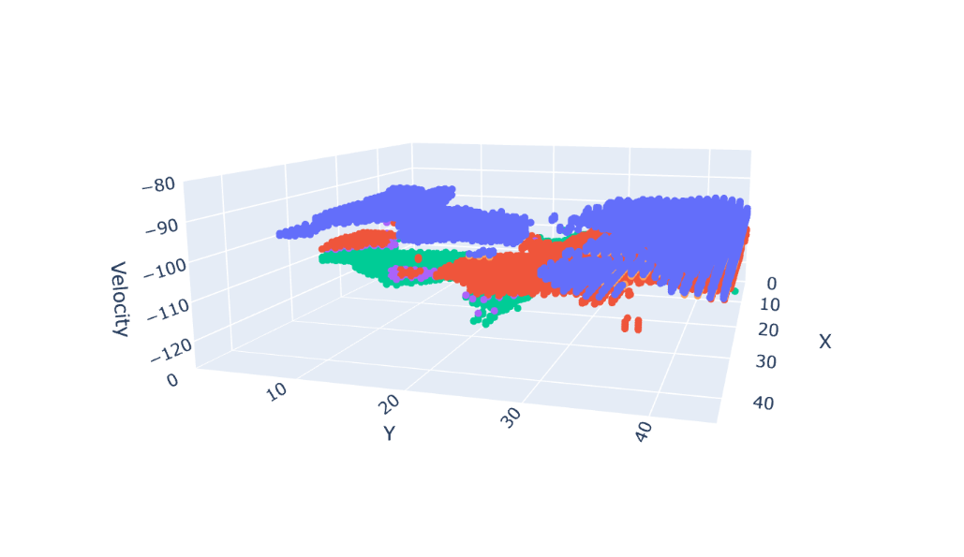
4) CLUSTERING
Parameters of the Clustering algorithm:
Start velocity, End velocity
Seeds
Otsu factor
Weighting method
Alpha, beta (soft clustering thresholds)
Bandwidths (for every cluster)
Feature importance factors
Hyper-parameter tuning is applied.
Firstly, Silhouette coefficient (cohesion and separation) is used to eliminate most of the parameter combinations.
fixed values for the each cloud group determined from Gaussian fits
adjusted for every cloud group
fixed values as gaussian kernel weighting and (0.7,0.2)
Hyperparameters to tune
ML4ASTRO2 Efe Öztaban

Slide 16
4) CLUSTERING
1
upper layer
Then, best parameters are selected with specific error functions.
1) Shape Smoothness Error
Aim: To ensure that the shapes of the clouds are smooth and there are no abrupt changes in shape.
2) Eccentricity Consistency Error
Aim: To determine how consistent the edges of the clouds are with their central portion.
main layer
lower layer
2
arbitrary layer
center
layer
arbitrary layer
ML4ASTRO2 Efe Öztaban

Slide 17
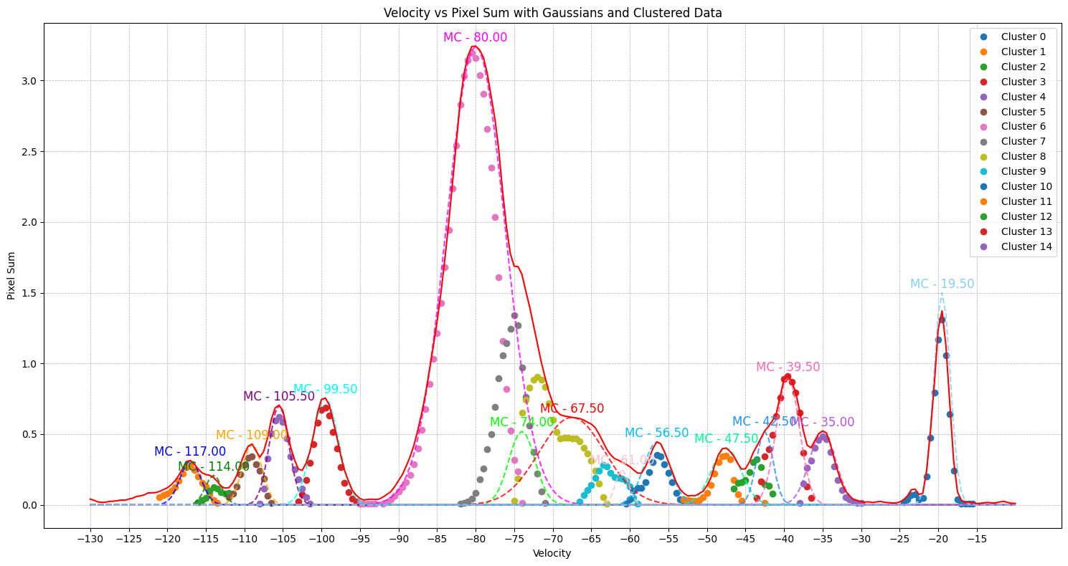
RESULTS
ML4ASTRO2 Efe Öztaban

Slide 18
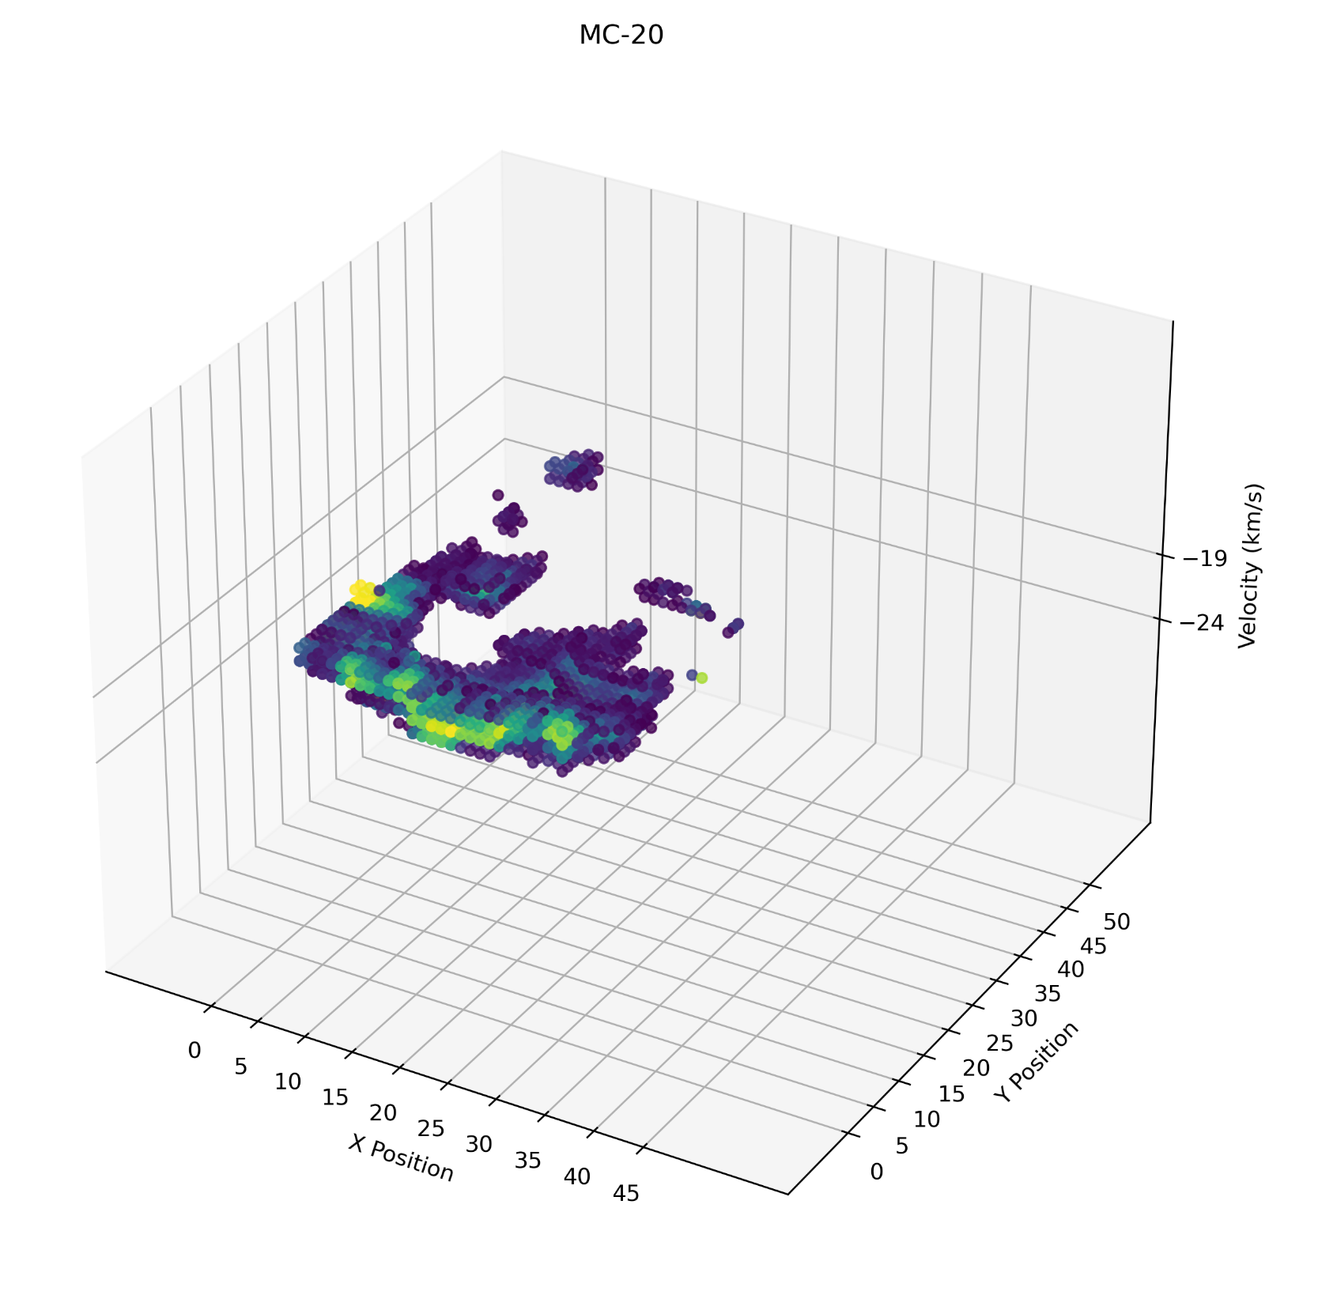
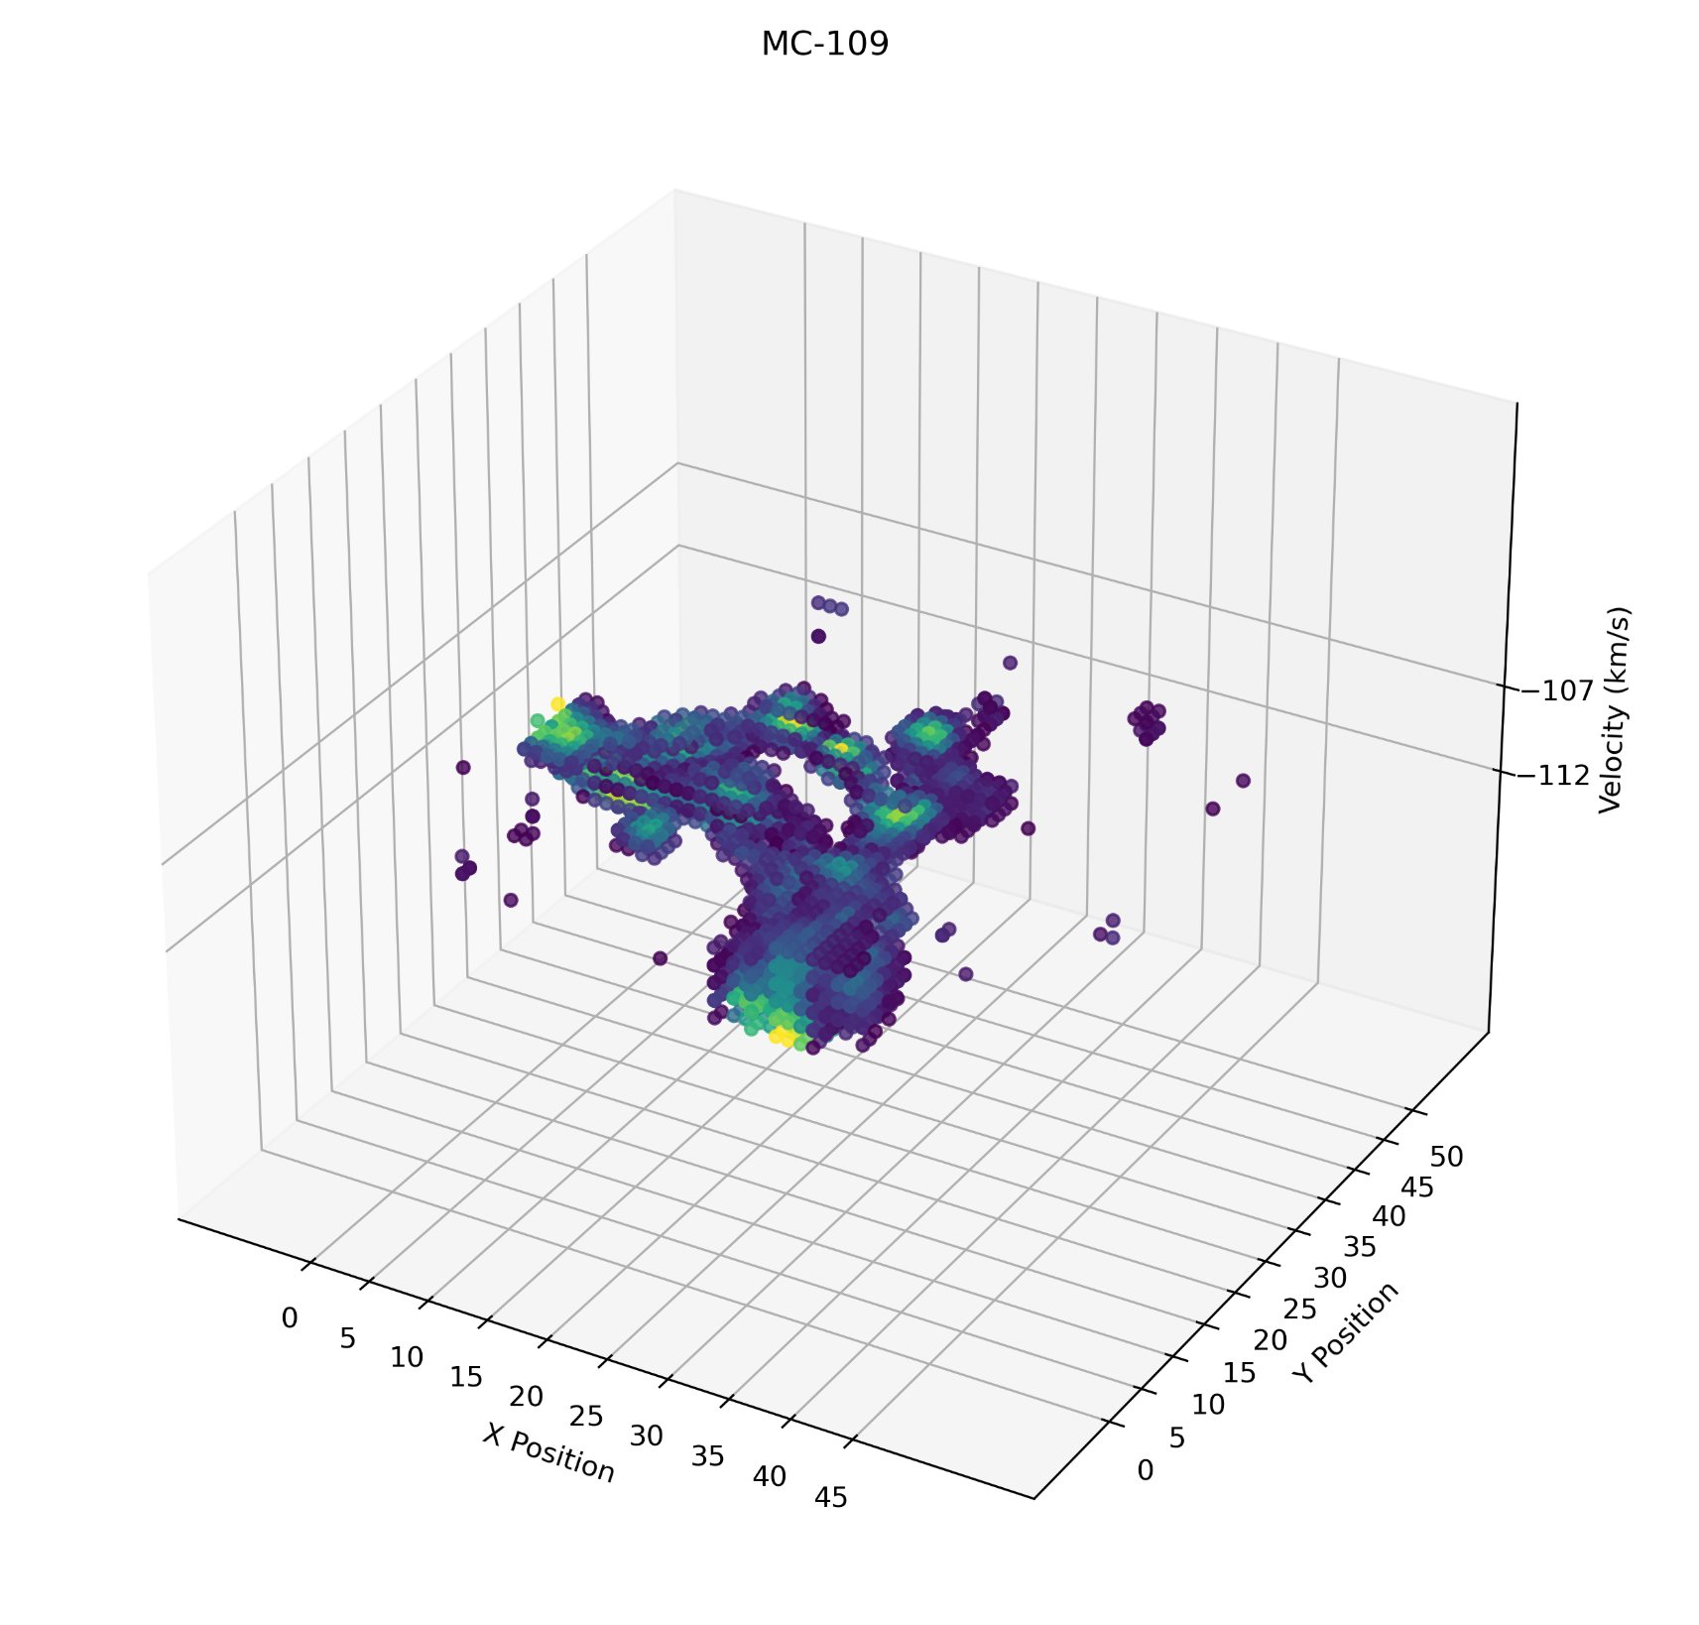
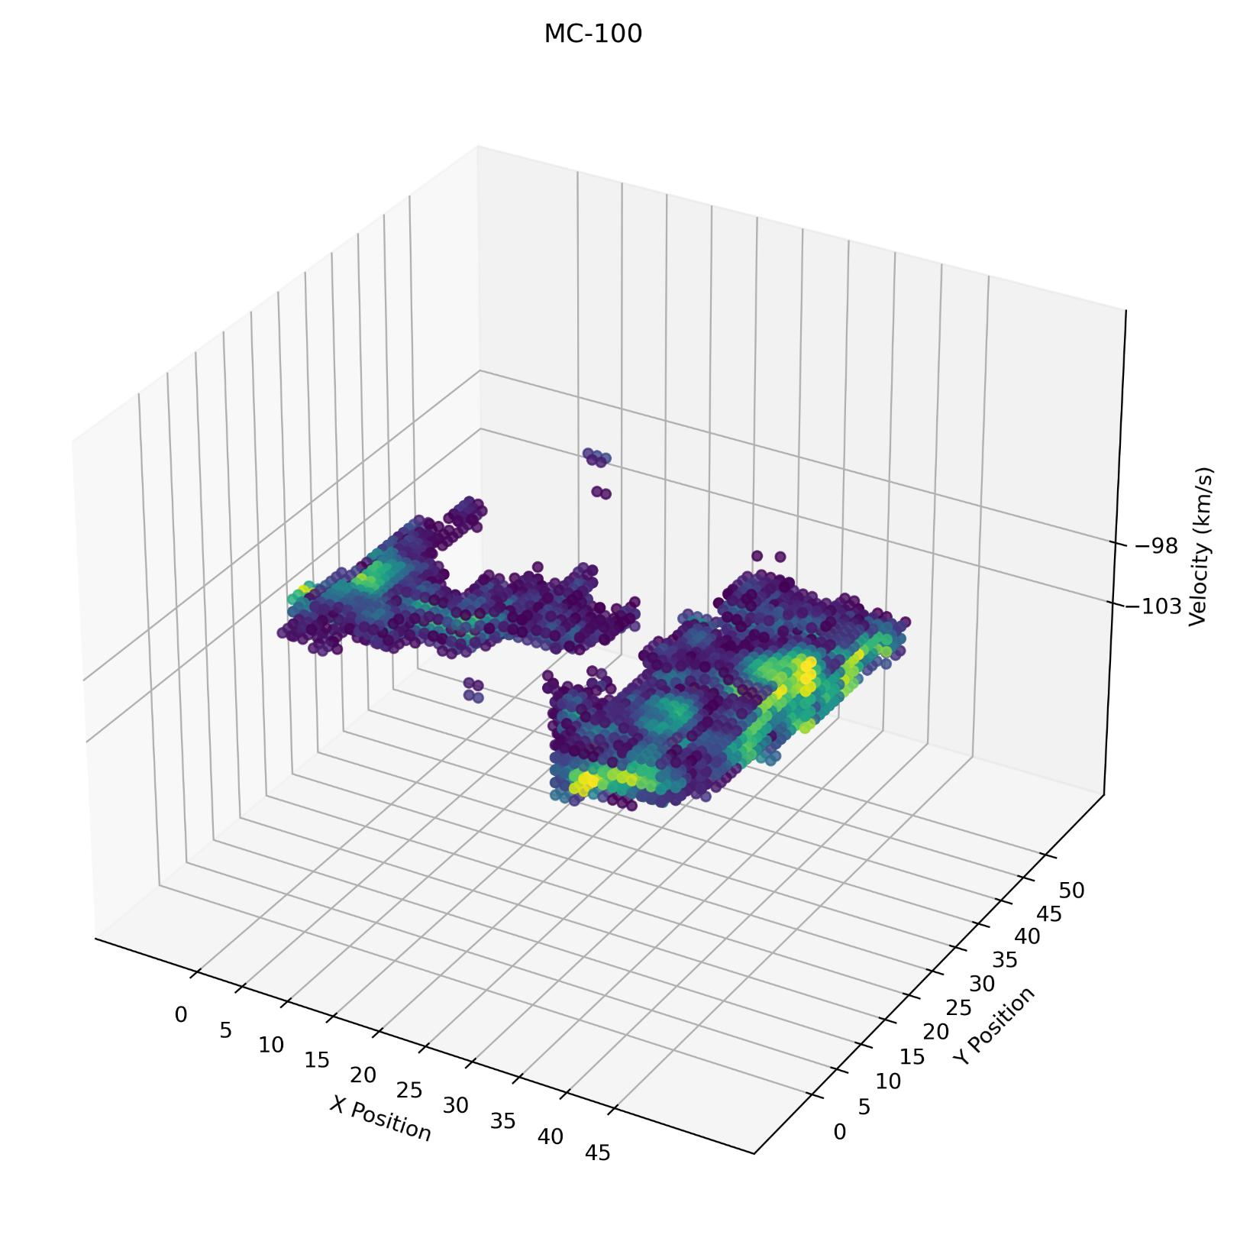
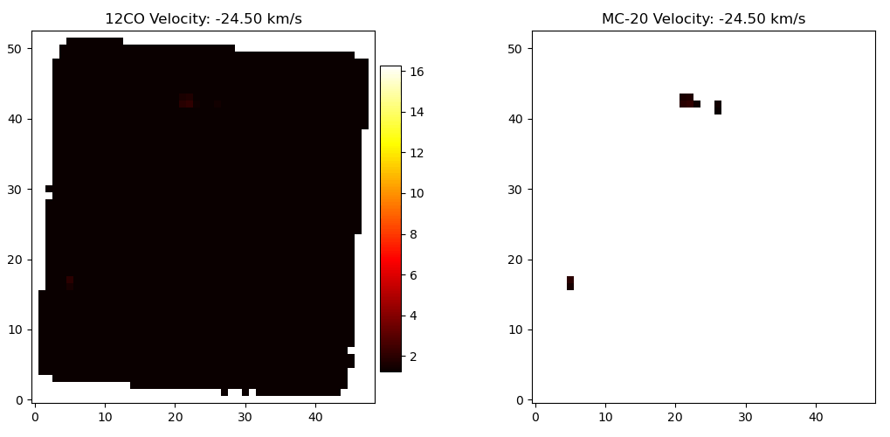
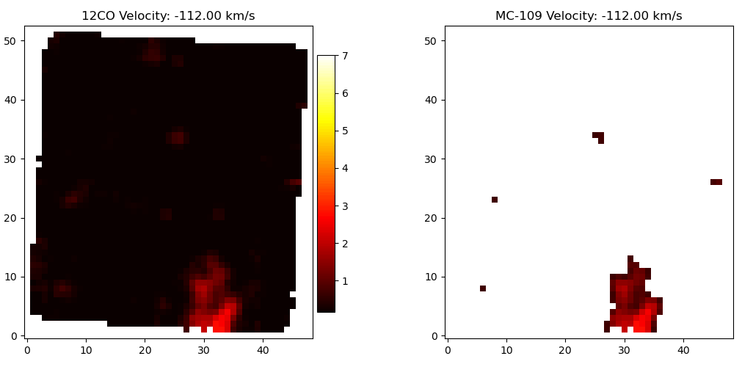
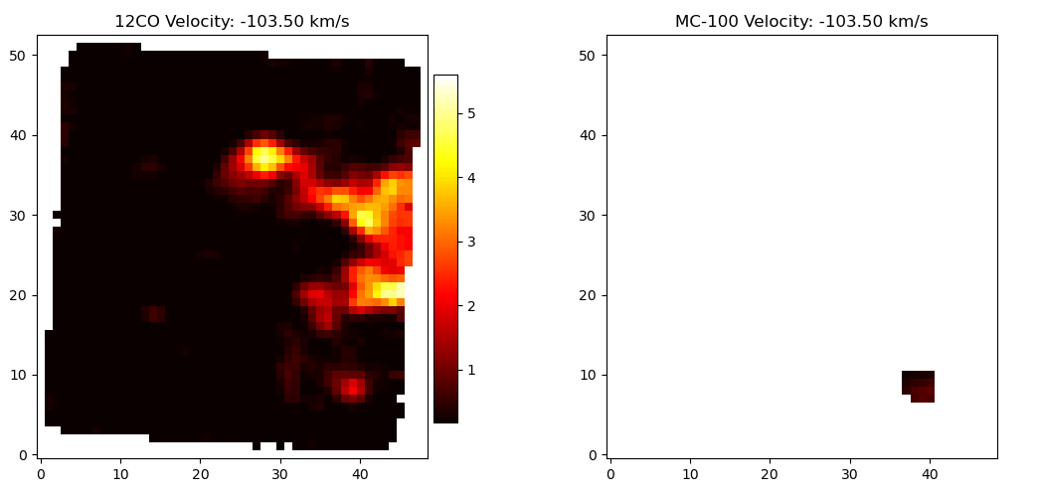
RESULTS
ML4ASTRO2 Efe Öztaban

Slide 19
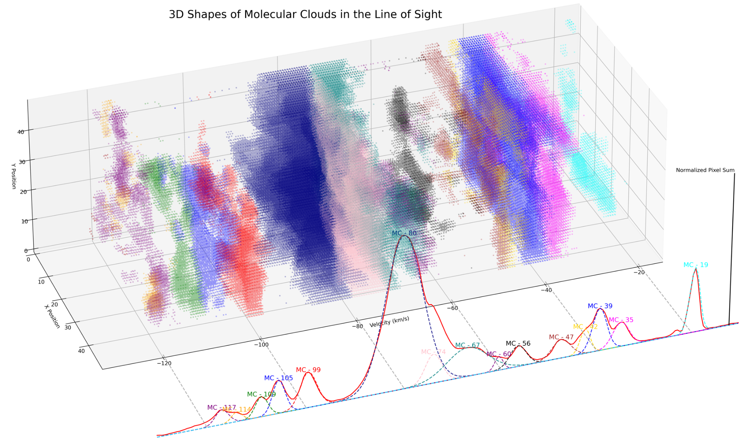
RESULTS
ML4ASTRO2 Efe Öztaban

Slide 20
DSH SIMULATIONS (this part is done by Dr. Emrah Kalemci & Ahmed Abdullah Abbasi)
Free parameters: distance to the source, whether the clouds are at the near or far distance and an overall normalization.
Distance varied 0.1 kpc between 4 - 7 kpc and 10-15 kpc
15 clouds are placed in both near and far distances
Chandra image and generated images are binned radially and axially. A 𝜒2 minimization is applied to the histogram of amplitude of signals in the same radial and axially divided areas to find the best combination of cloud and source distances.
~2.6 million simulated images
ML4ASTRO2 Efe Öztaban

Slide 21
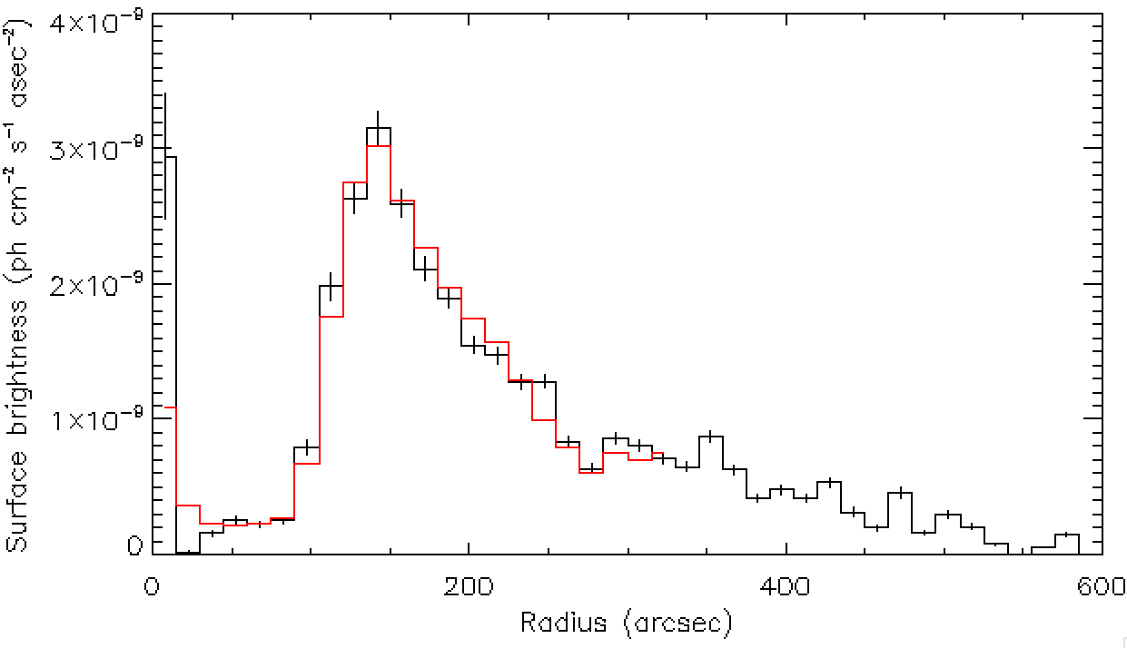
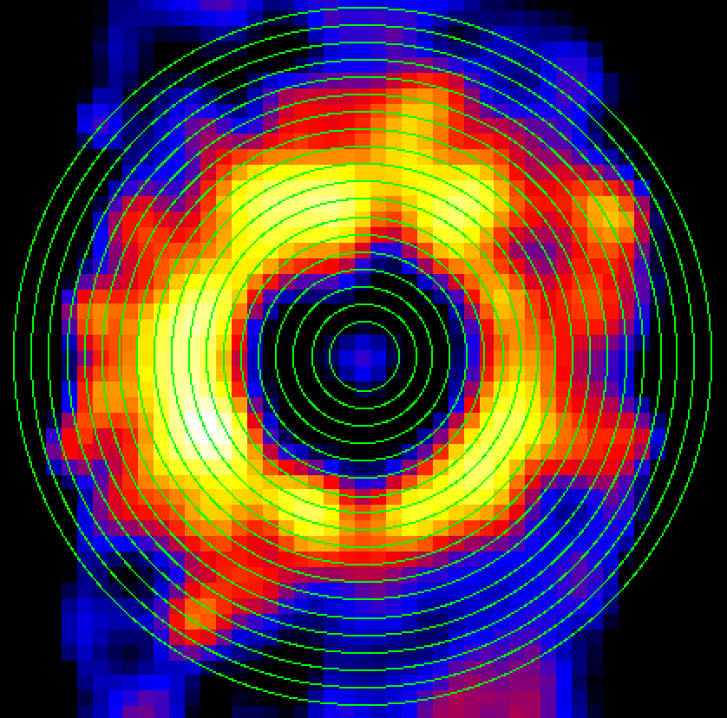
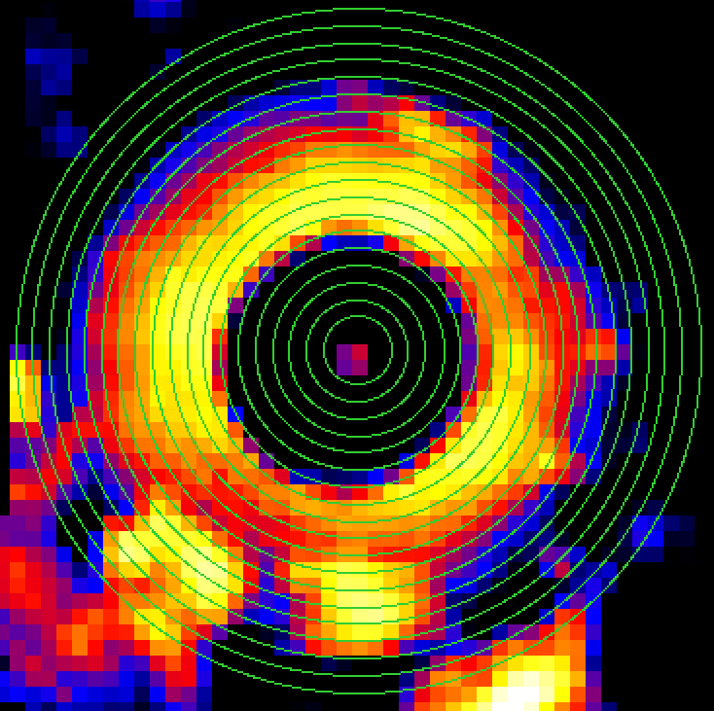
DSH Image fitting, radial (this part is done by Dr. Emrah Kalemci & Ahmed Abdullah Abbasi)
Radial binning best fit: Distance 13.6 kpc
However some features are not present in Chandra image.
CHANDRA
Generated best fit image
ML4ASTRO2 Efe Öztaban

Slide 22
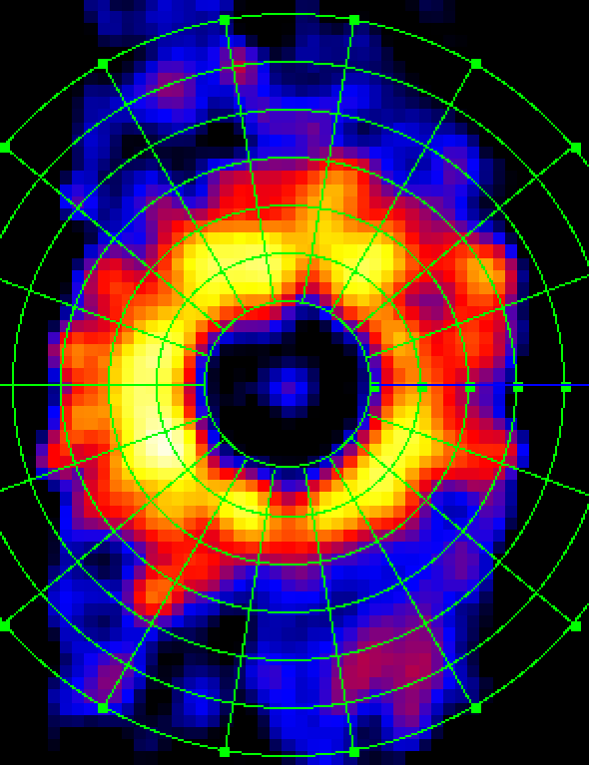
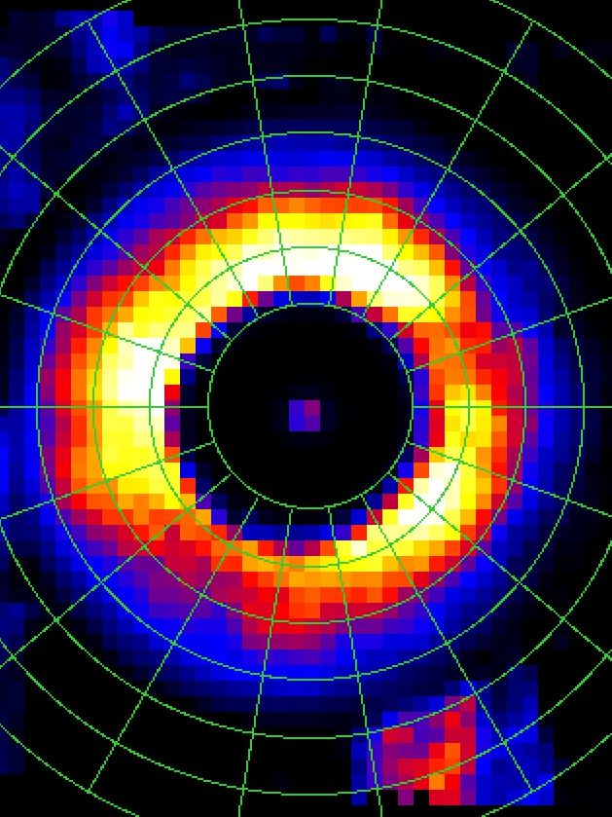
DSH Image fitting, axial (this part is done by Dr. Emrah Kalemci & Ahmed Abdullah Abbasi)
The image is divided into ~90 wedges with similar signal to noise ratio. Fitting the amplitude distribution again yield 13.6 kpc.
Generating images allow us to compare features and determine near/far distances in an alternative manner. Axial fitting produced better results in terms of picking the features.
CHANDRA
Generated best fit image
ML4ASTRO2 Efe Öztaban

Slide 23
FUTURE WORK
Complete generating energy dependent images taking into account energy dependent absorption in clouds.
Once method is confirmed, we will write new proposals for APEX and other mm wave observatories together with imaging X-ray telescopes (Chandra, XRISM, SWIFT, IXPE) to apply the method for other sources.
We will look for relic halos in eROSITA.
We will prepare for future observatories, conduct simulations with ATHENA using REFLEX+SIXTE (Work already started)
We will investigate if we could use Artificial Neural Networks to do the image fitting to obtain cloud parameters and source distance. (Discussions underway on methodology)
ML4ASTRO2 Efe Öztaban

Slide 24
Thank you for your attention.
ANY QUESTIONS?
Efe Öztaban
Sabancı University
efeoztaban@sabanciuniv.edu

Slide 25
Galactic Rotation Curve and Distance Ambiguity
distance ambiguity
ML4ASTRO2 Efe Öztaban

Slide 26
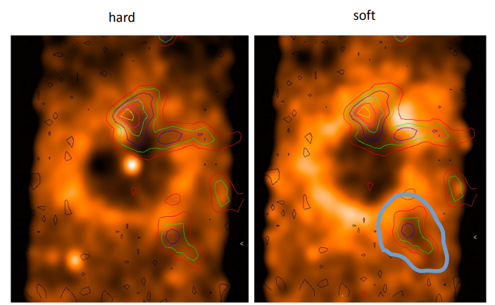
Resolving Distance Ambiguity with Multi-Energy Analysis
(this part is done by Dr. Thomas Stanke and Enno Nussbaum)
“black spot” in soft X-ray image
not visible in hard X-ray image
absorbing cloud at -105 km/s (d= 6.2/8.8 kpc)
scattering cloud must be at far distance
This resolves the near/far distance problem in ApJ paper.
ML4ASTRO2 Efe Öztaban

