Slide 1
Measuring intracluster light with machine learning
Louisa Canepa,
Prof. Sarah Brough & Dr. Francois Lanusse

Slide 2
What is ICL?

Slide 3
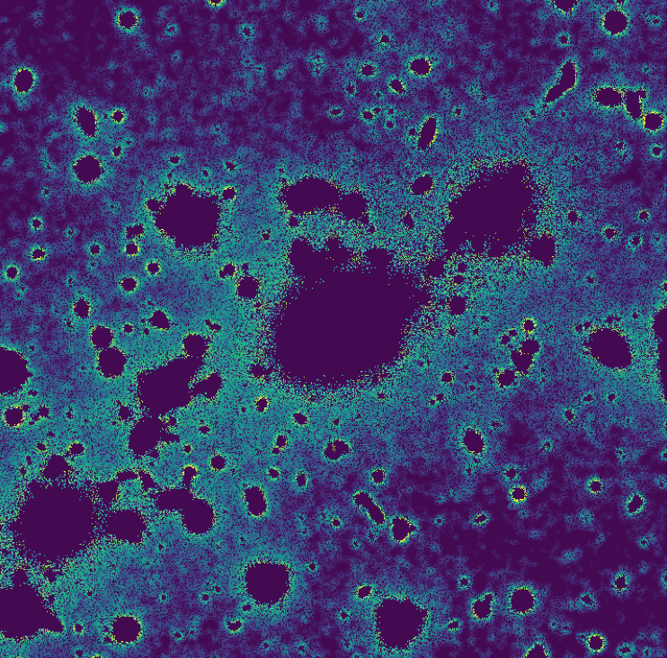
What is ICL?
Diffuse, low surface brightness light in the centres of galaxy clusters
Made up of stars that are not bound to any particular galaxy
(image thresholded and smoothed to make structure more visible)

Slide 4
But what is it?
Produced by tidal stripping and merging of galaxies
Traces the history of interactions within the cluster (e.g. Rudick+11)
Important to study if we want to know about galaxy evolution and cluster assembly!
Notes:
Rudick+ found that amount of ICL traced the dynamical evolution of simulated clusters.

Slide 5
But what is it really?
Progenitors and formation mechanisms?
Tidal stripping (Contini+14), mergers of normal sized galaxies (Murante+07), disruption of dwarf galaxies (Purcell+07), in situ star formation (Puchwein+10)…
Relationship to cluster properties?
Redshift? (e.g. Montes22)
Host halo mass? (e.g. Proctor+23, Contini+18)
We need larger homogeneous samples!

Slide 6
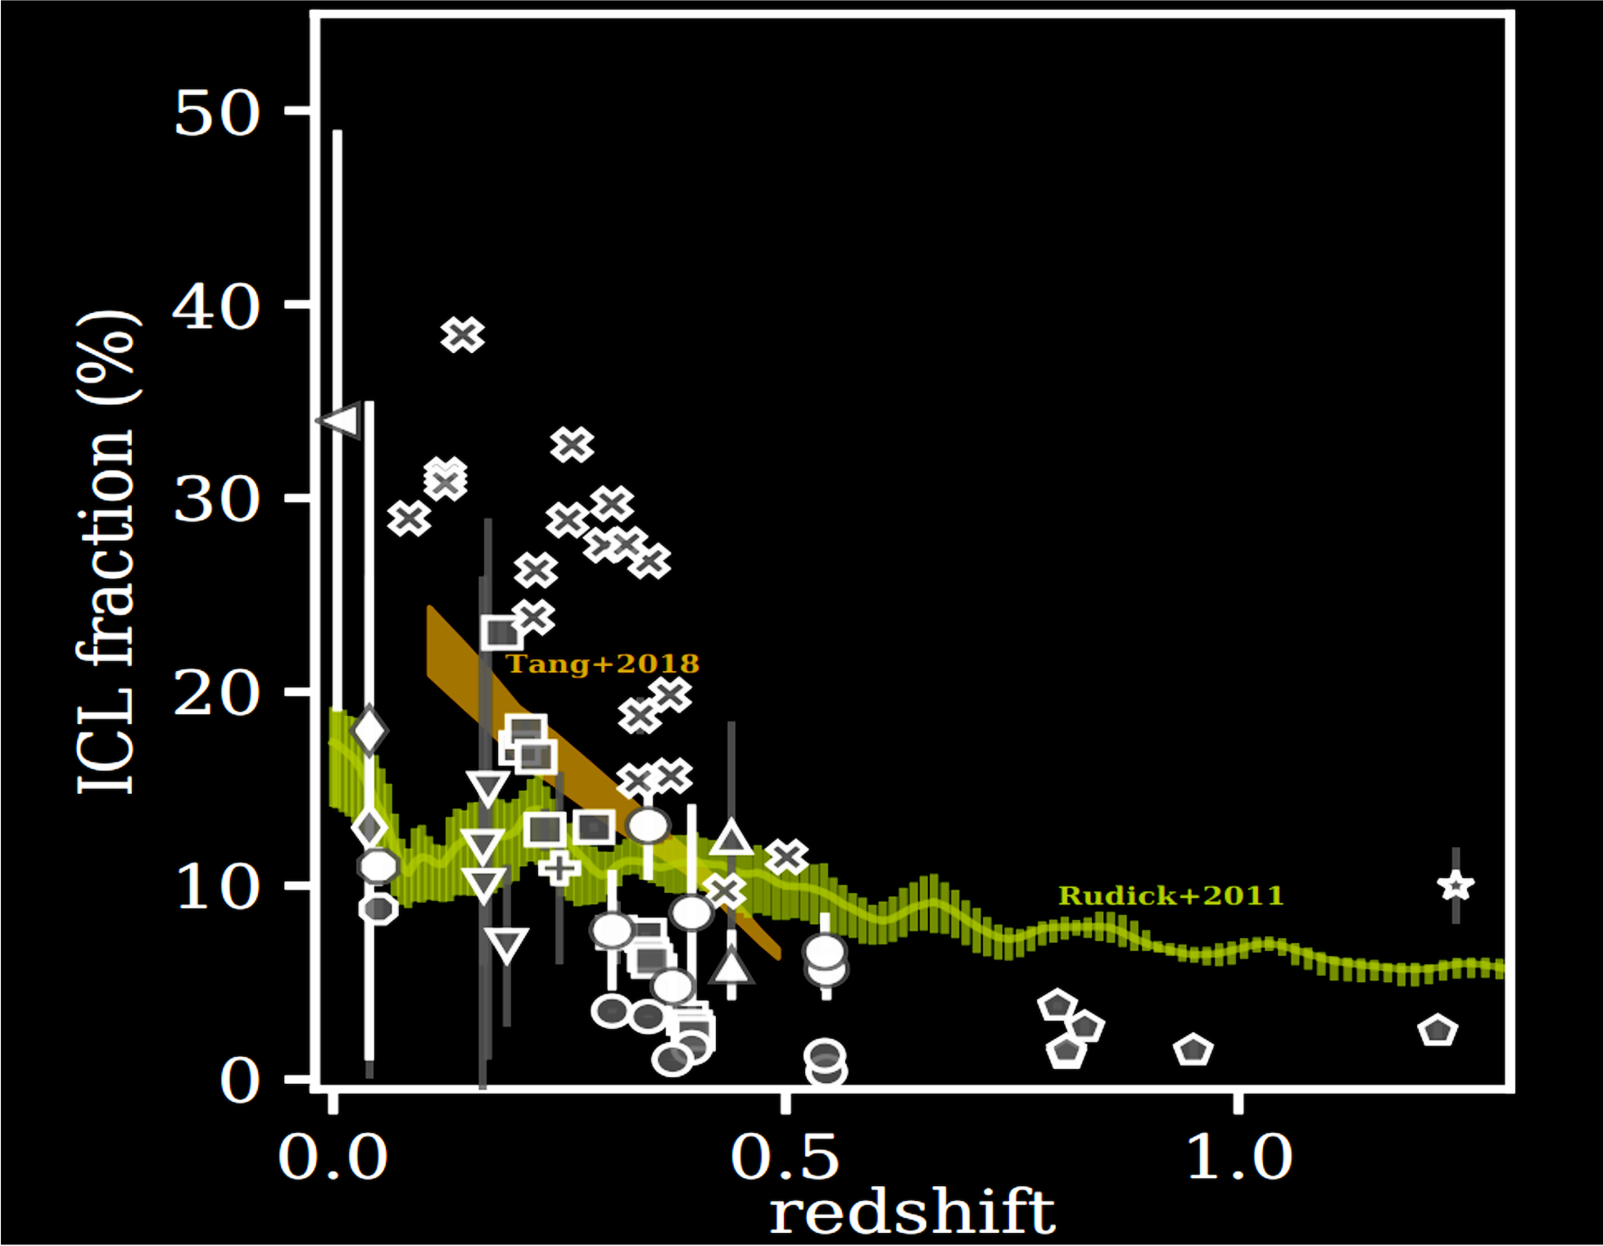
But what is it really?
Montes22

Slide 7
But what is it really?
Progenitors and formation mechanisms?
Tidal stripping (Contini+14), mergers of normal sized galaxies (Murante+07), disruption of dwarf galaxies (Purcell+07), in situ star formation (Puchwein+10)…
Relationship to cluster properties?
Redshift? (e.g. Montes22)
Host halo mass? (e.g. Proctor+23, Contini+18)
We need larger homogeneous samples!

Slide 8
How do we measure it?
Measure the ICL fraction
How to separate the ICL from the BCG?
Not standardised and generally hard to scale :(
Surface brightness cut
(e.g. Montes+21)
Composite model
(e.g. Martinez-Lombilla+23)
Multi-galaxy fitting
(e.g. Jimenez-Teja+16)
Wavelet decomposition
(e.g. Ellien+21)
… + machine learning?

Slide 9
What’s the point?
Big data is coming, and we have better things to do than ultra-repetitive measurement tasks
Machine learning is an option that could help
High throughput
Flexible
Can be applied to many problems with some understanding of its capabilities
But there are some hurdles to applying ML to astronomy

Slide 10
The Model
Encoder
Output layer

Slide 11
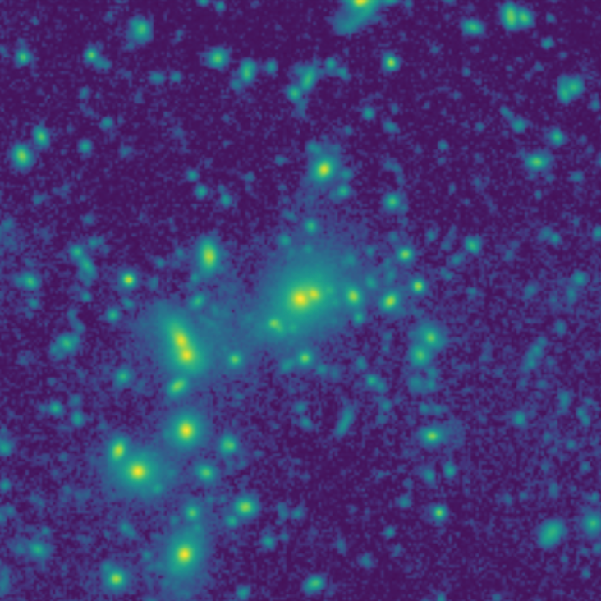
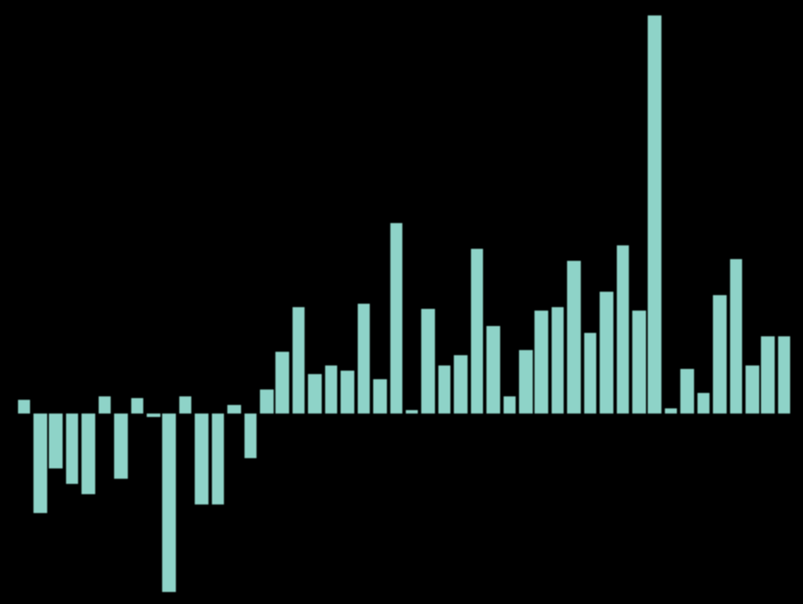
The Model
Encoder
ResNet-50 (CNN) Dense layer (2048)
Output layer

Slide 12
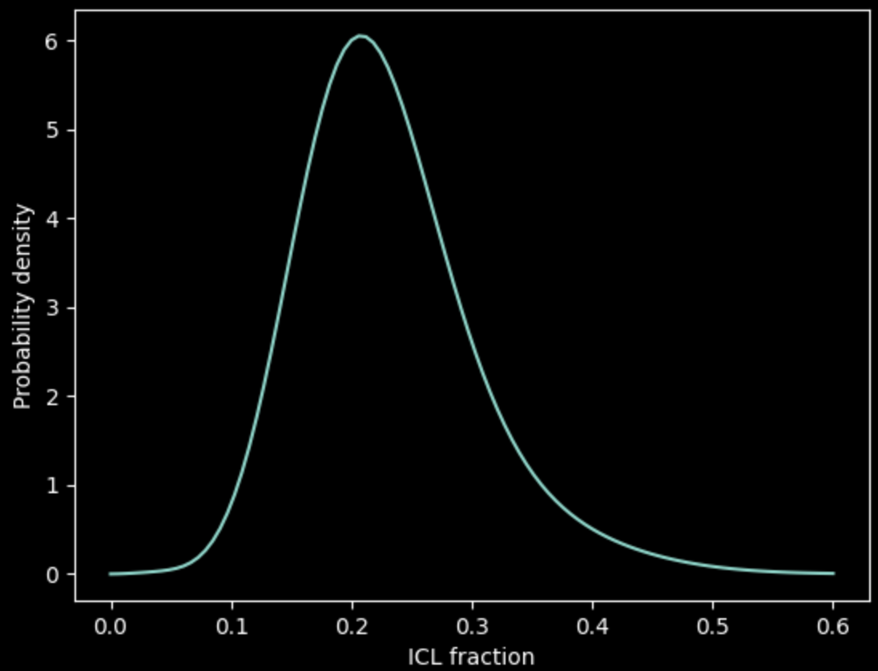
The Model
Output layer
Dense layer (48)
Probability distribution
Encoder

Slide 13
Training data
We need a LOT of training data
Not feasible to manually measure thousands of clusters
Use transfer learning!

Slide 14
Training data
Large dataset
(50 000 examples)
Slightly different data from the target domain, to give the model a general idea.
Finetuning dataset
(~100 examples)
Refine the model’s understanding of the task with real examples

Slide 15
Training data
Large dataset
(50 000 examples)
Slightly different data from the target domain, to give the model a general idea.
Finetuning dataset
(~100 examples)
Refine the model’s understanding of the task with real examples

Slide 16
Training data
Large dataset
(50 000 examples)
Slightly different data from the target domain, to give the model a general idea.
Finetuning dataset
(~100 examples)
Refine the model’s understanding of the task with real examples

Slide 17
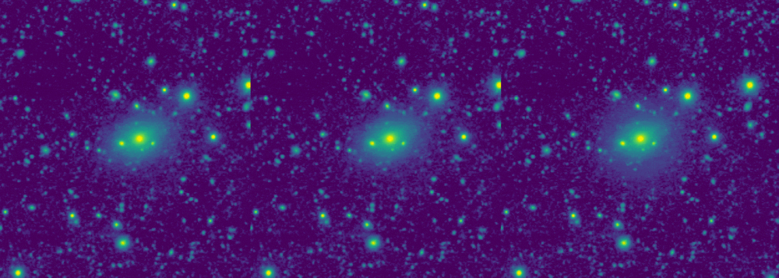
Training data
Large dataset
(50 000 examples)
Finetuning dataset
(~100 examples)
This data will look a bit different to real data, and measurements will be sub-optimal

Slide 18
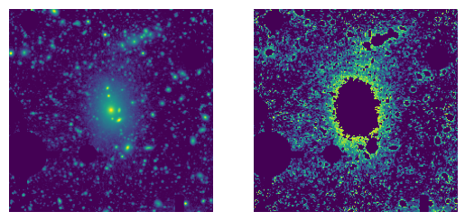
Training data
Large dataset
(50 000 examples)
Finetuning dataset
(~100 examples)
1. Generate the data
2. Measure the data
Manually measure the real, deep cluster images
This data will look a bit different to real data, and measurements will be sub-optimal

Slide 19
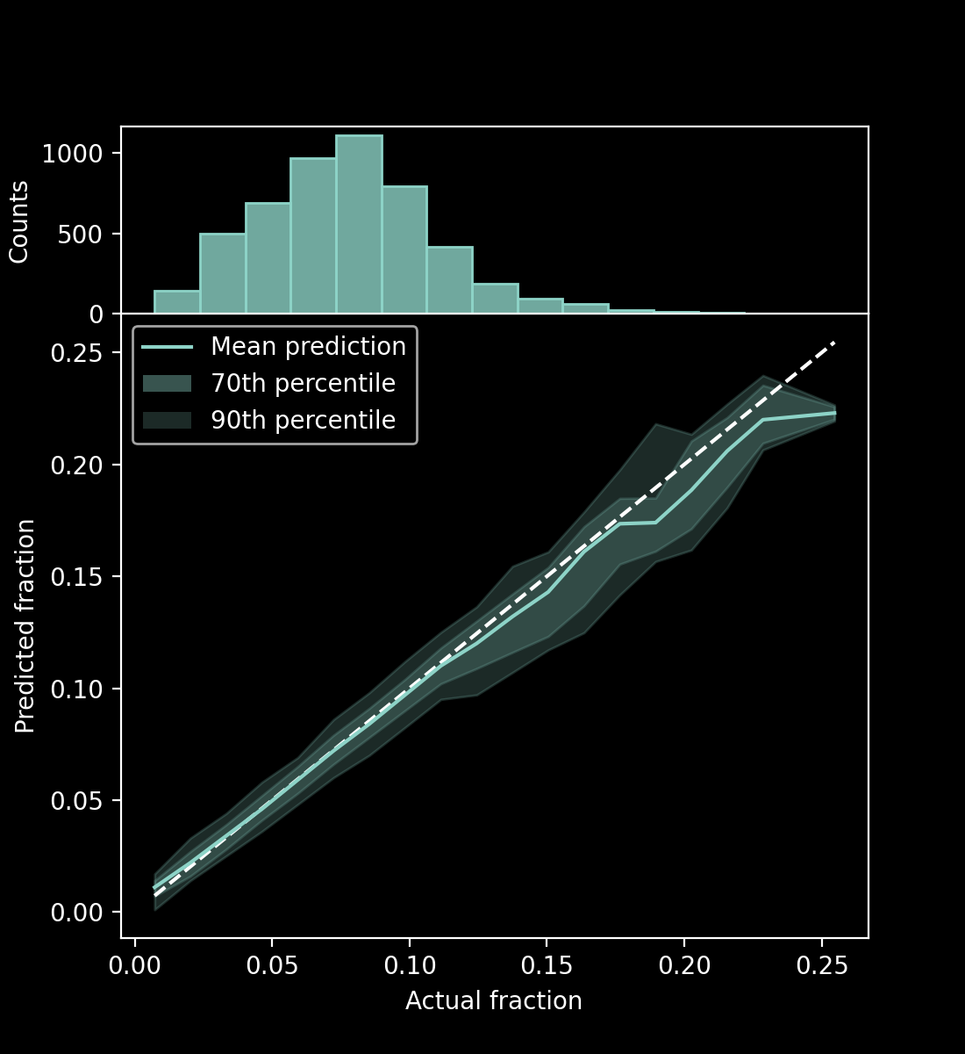
Results – training dataset
Mean Absolute Error (MAE) = 0.00511

Slide 20
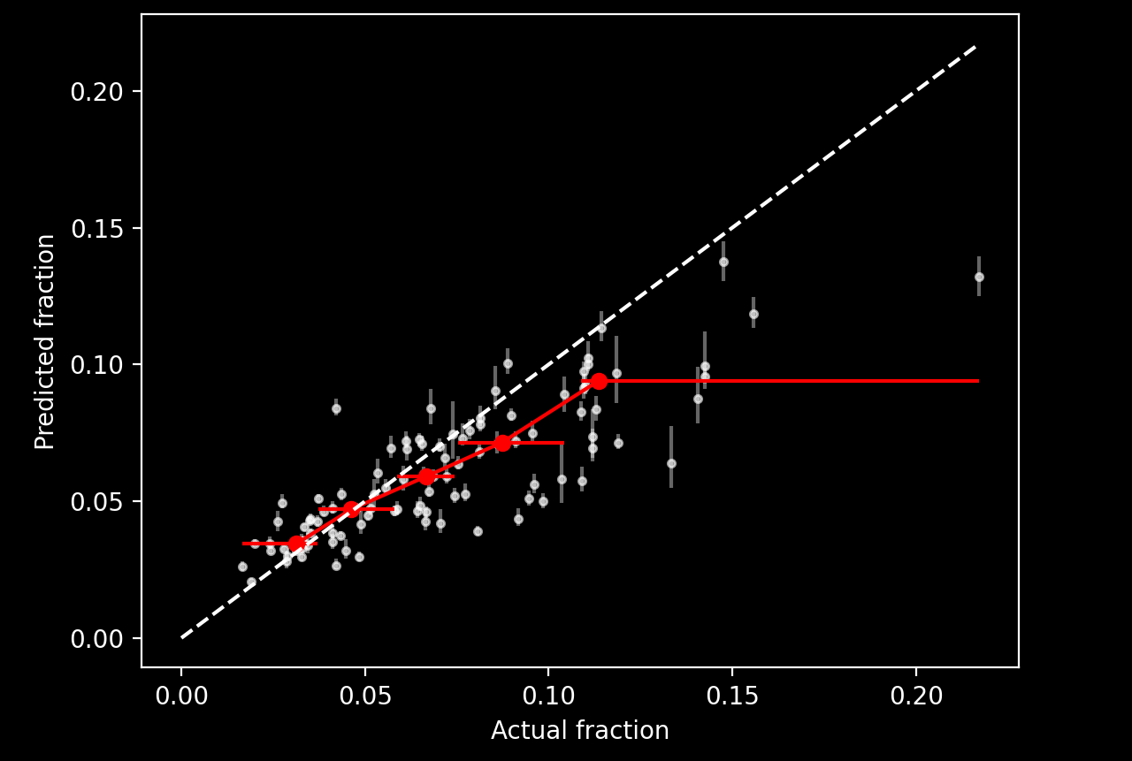
Results – before finetuning
Model’s prediction for each cluster image
Median value for bins (shown by error bars) with equal numbers of points
MAE = 0.0163

Slide 21
K-fold cross-validation
We only have 101 finetuning samples, or ~20 samples for testing
Train the model k times, reserving different data for testing each time
Full dataset
Run 1
Train set
Test set
Run 2
Train set
Test set
Train set
Run 3
Train set
Test set
Train set
Run 4
Train set
Test set
Train set
Run 5
Test set
Train set

Slide 22
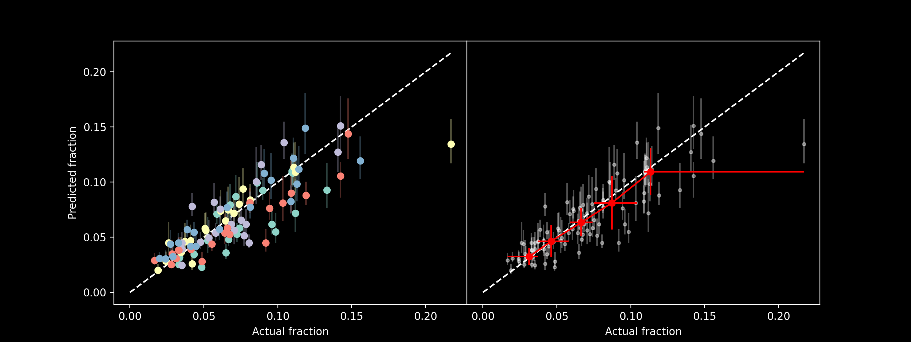
Results – after finetuning
MAE = 0.0139

Slide 23
Explainability
Machine learning is great at exploiting data to find shortcuts
How do we know whether the model is actually doing what we want?
GradCAM (Selvaraju+20) allows us to see what parts of the image the model deems to be important

Slide 24
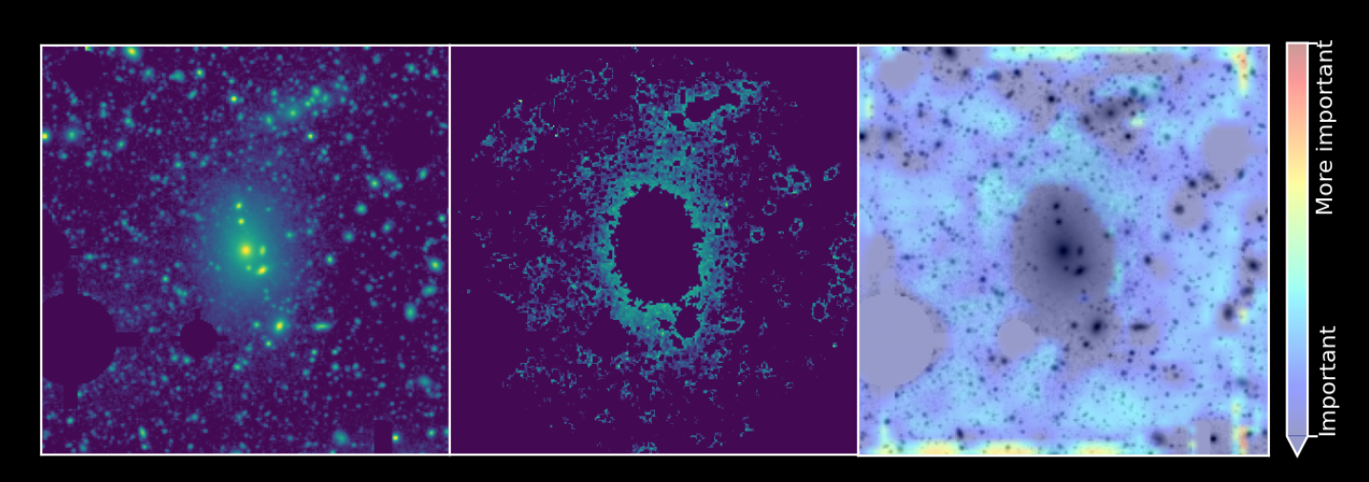
Explainability

Slide 25
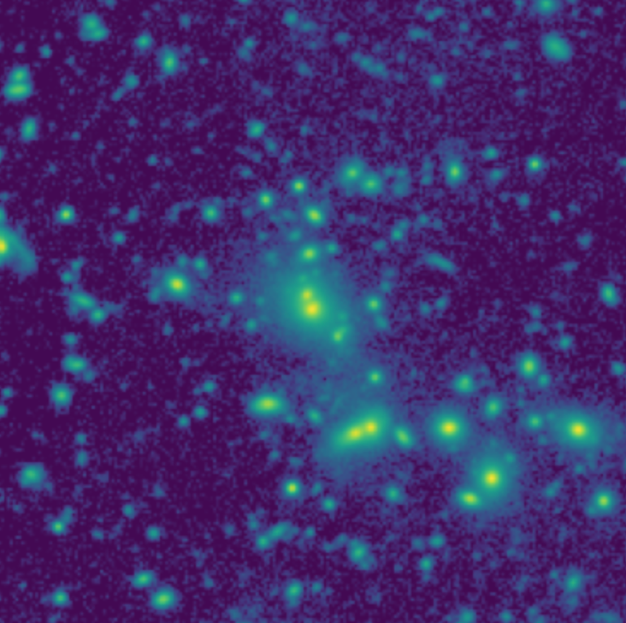
Summary
Results on both datasets
Use GradCAM to verify that the model identifies reasonable parts of the image
An image regression ML model
l.canepa@unsw.edu.au
Trained on mostly artificial data, and only a small amount of real data
lpcan

