Slide 1
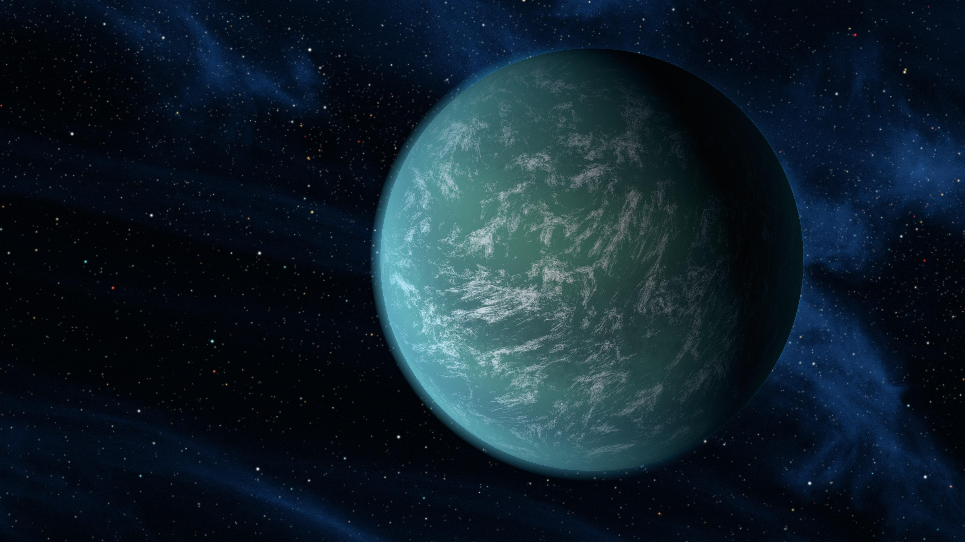
Applying Autoencoders to Exoplanetary Transits
Lucy Smith
Dr David Benoit
ML4ASTRO2

Slide 2
Outline
Basic Autoencoder – explore how well a basic model works.
Convolutional Autoencoder - same again only this time using convolutional layers.
Variational Autoencoder: Exploring generative properties.
Future work

Slide 3
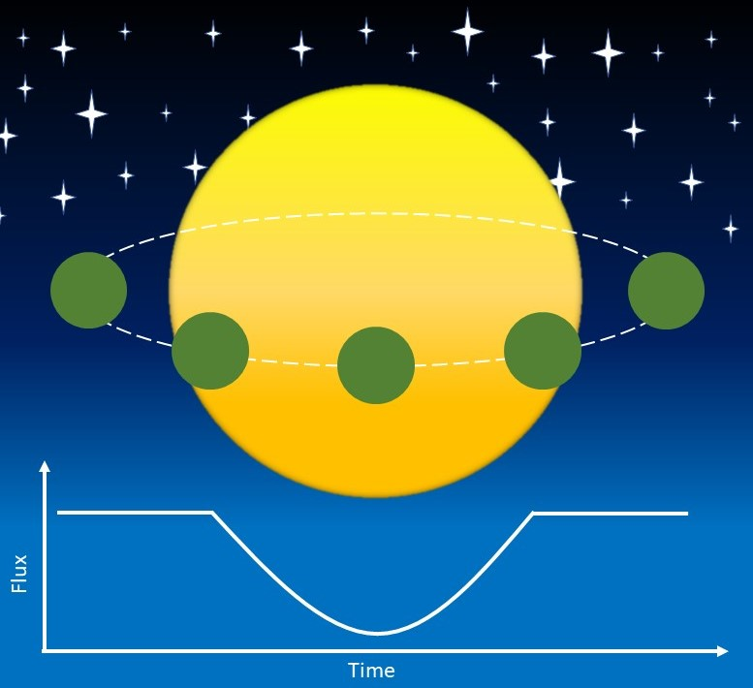
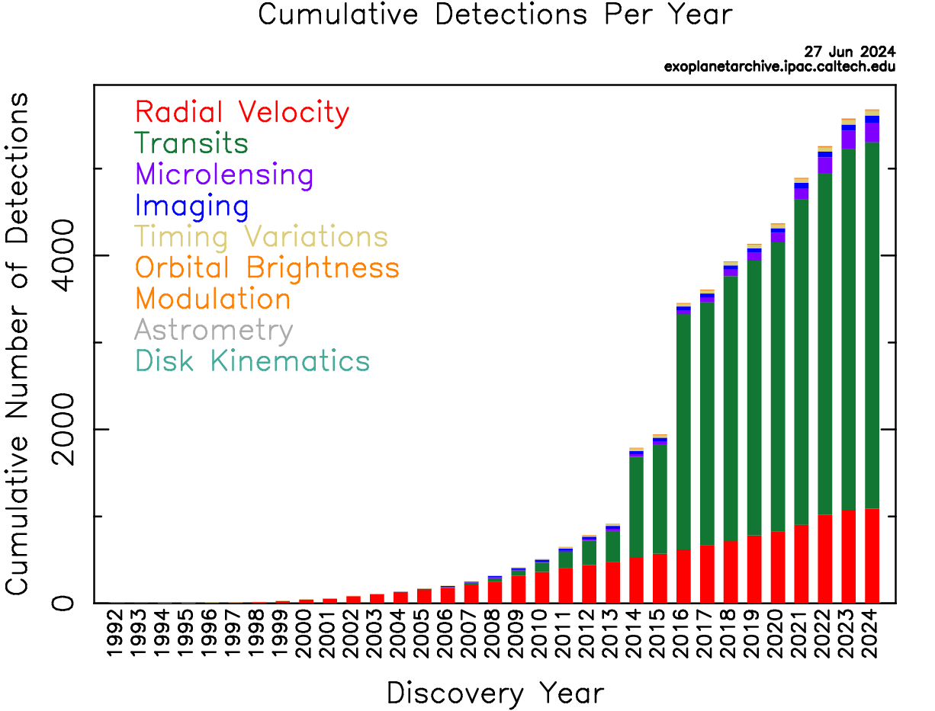
Detecting Exoplanets
Transits have become one of the main ways exoplanets are detected.
When a planet passes between a star and an observer, there is a drop in flux of the star.
Images: https://exoplanetarchive.ipac.caltech.edu/exoplanetplots/

Slide 4
Vetting light curves
Example of Transits
Survey data was manually inspected for transits.
Very few transits have been observed compared to non-transits.
Exoplanet vetting processes are in place, but research into improving the accuracy/speed is ongoing.
Not a lot of real data to train models on.

Slide 5
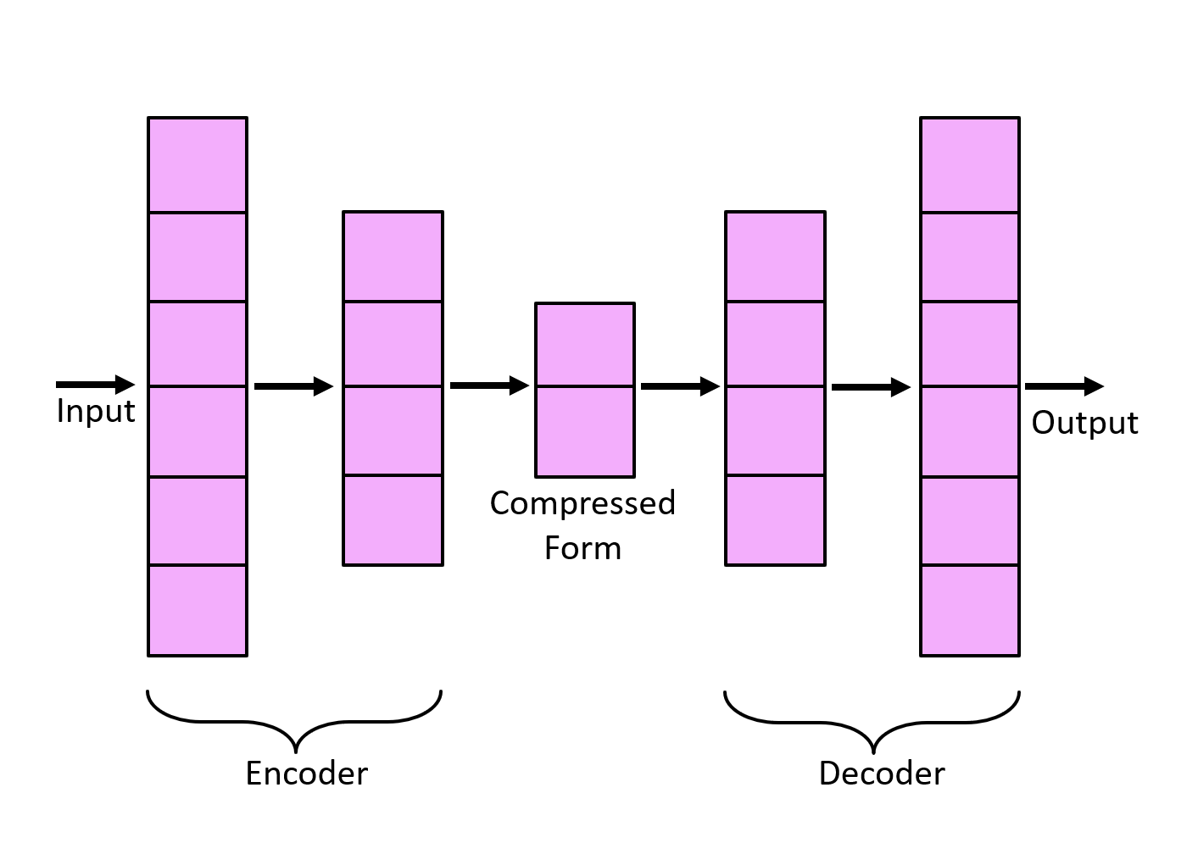
Autoencoders
3197
3197
1600
1600
40/200
Autoencoders deconstruct input data into compressed form.
Compressed latent space is decoded.
Fully-connected layers reduce dimensions.
Model is trained to learn most important features of data.
Pytorch
ELU for hidden layers
Tanh for output
MSE/Adagrad

Slide 6
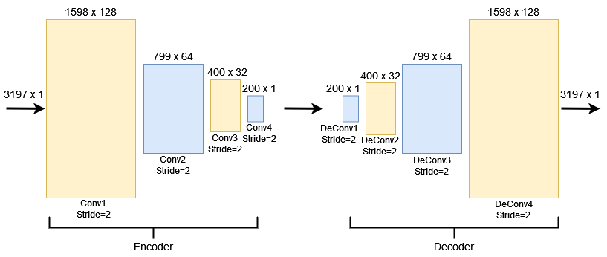
Convolutional Autoencoder
A convolutional autoencoder works the same way as a basic autoencoder.
Makes use of convolutional layers to reduce dimensions.

Slide 7
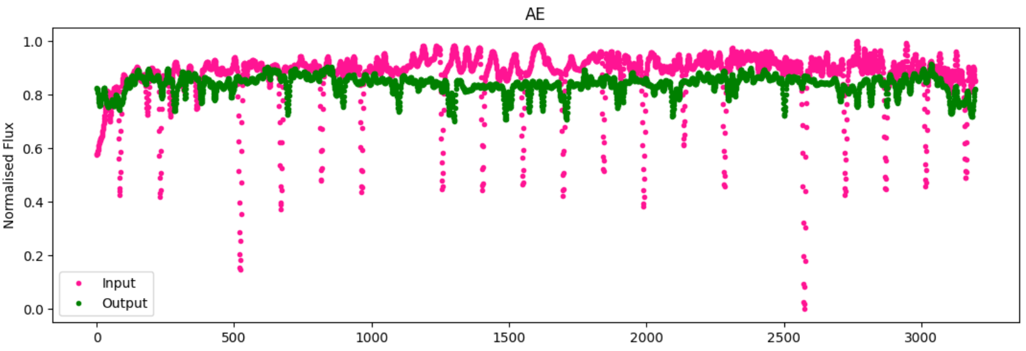
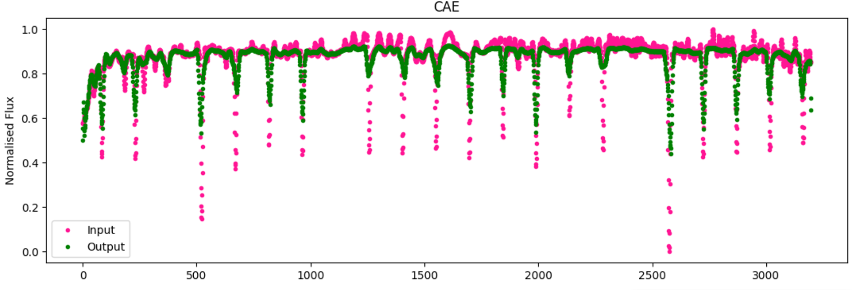
Reconstruction
Despite the low error, the reconstructions are not amazing for the basic AE.
While the CAE is able to learn some features of the data set, it is unable to generate transits from scratch.
AE-40
AE-200
CAE-200

Slide 8
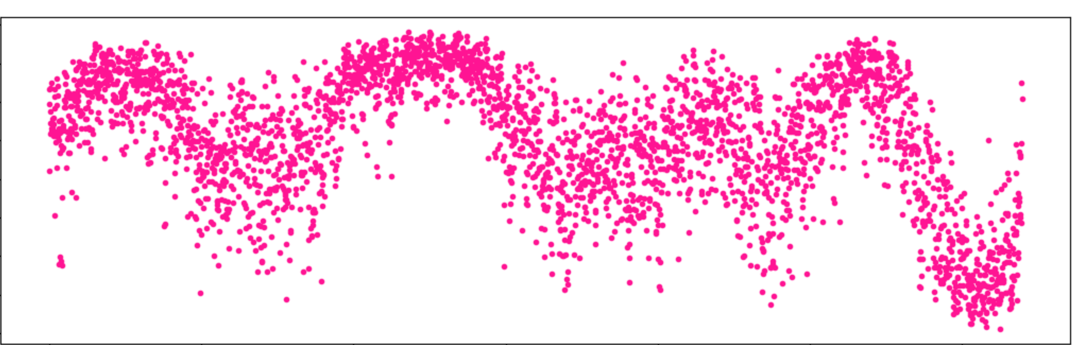
Not very good at being generative…
The latent space can capture some features of the data but is mostly noise.
This was expected, however that doesn’t mean the basic autoencoder completely useless.

Slide 9
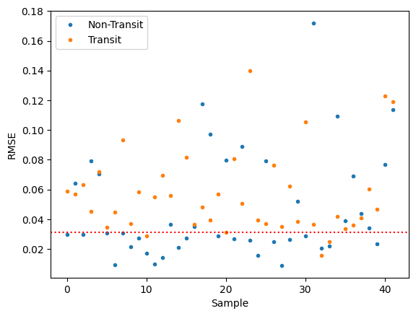
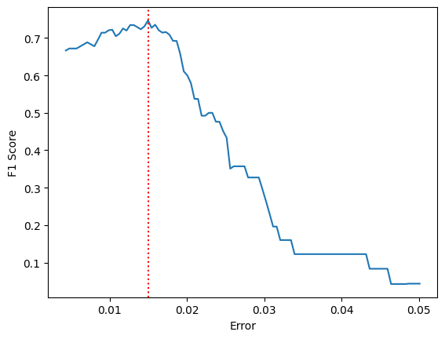
Unsupervised Classification
Using the same technique used in anomaly detection.
A model trained on non-transits should produce a higher reconstruction error for transits.
We get a test accuracy of 75%.
Non-transit
Transit

Slide 10
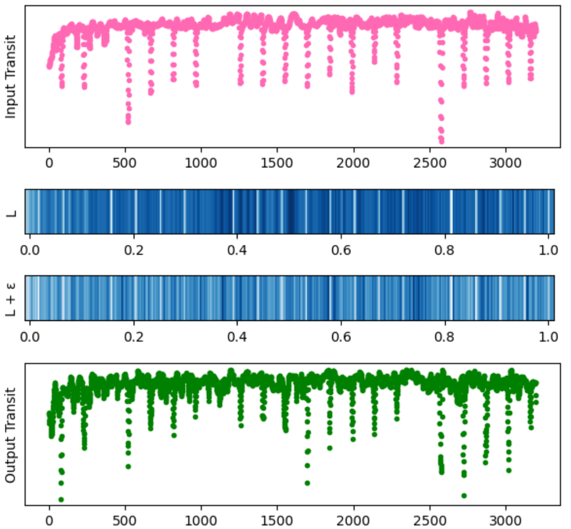
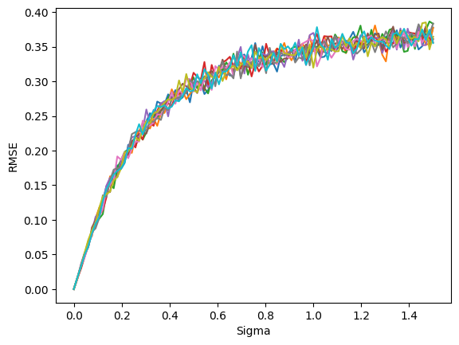
Augmentation
Can use basic autoencoders to augment data by adding a small perturbation to the latent vector.
Features will be based off already existing data but can be a quick way to generate new transits.

Slide 11
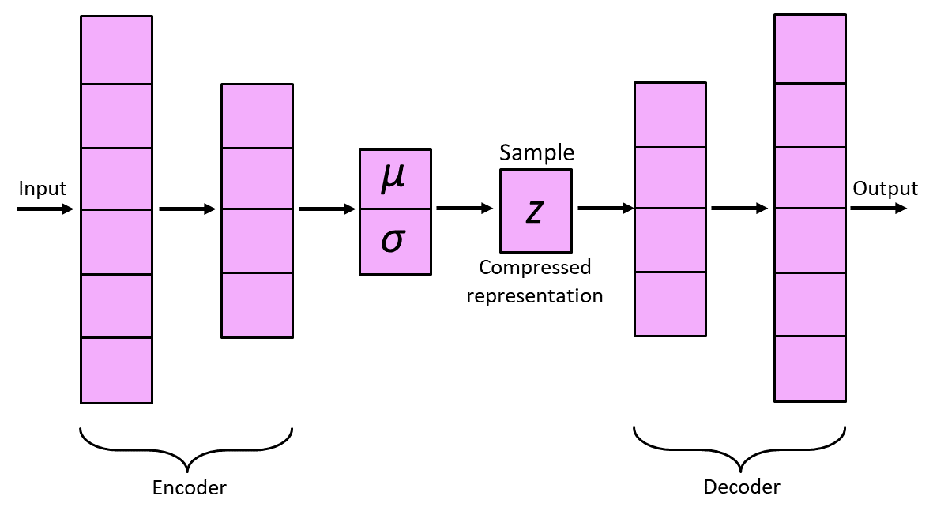
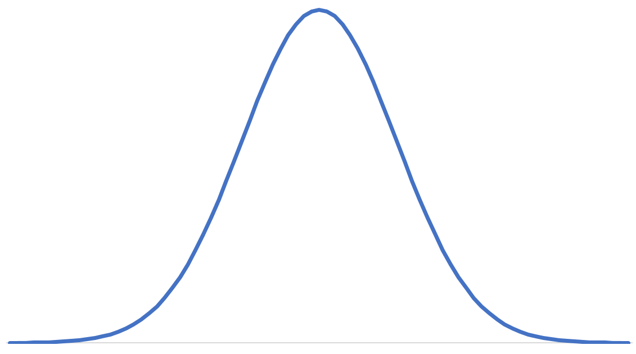
Variational Autoencoder
Similar structure to previous autoencoders.
Latent space is now modelled by a continuous distribution.
The dimension of the latent space was chosen to be 20.
ELU for hidden layers
Tanh for output
MSE/Adam
$$Loss=Reconstruction Loss+KL Divergence$$

Slide 12
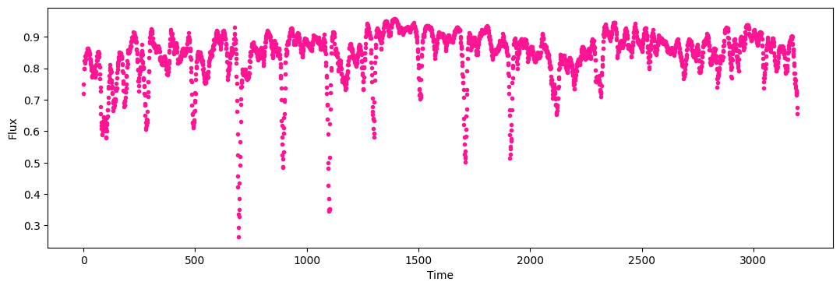
Generated Transits
Examples of generated transits
Synthetic transits generated from the trained VAE model.
Idea is to be able to produce transits containing desired features.
Even though the VAE produces far more convincing results, there still isn’t enough range.

Slide 13
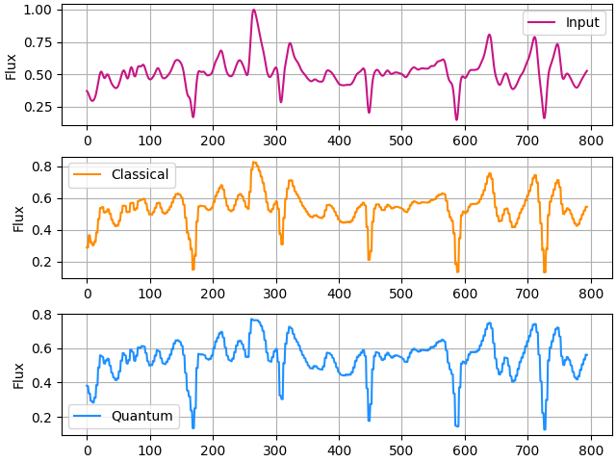
Future Work
(Very) preliminary results
Retrieving more training data from other missions.
Looking into further generative models.
Designing equivalent quantum machine learning models to compare with.
There is evidence that replacing layers in a generative neural network with a quantum circuit can improve the model.

Slide 14
Conclusion
Basic unsupervised autoencoders can be applied to light curves to classify them.
Transits can be generated based on augmentation of existing transits or generating entirely new ones from a VAE.
QML used to explore better/more realistic options for generated light curves.

Slide 15
Thank you for listening!
Email: L.A.SMITH-2017@hull.ac.uk

