Slide 1
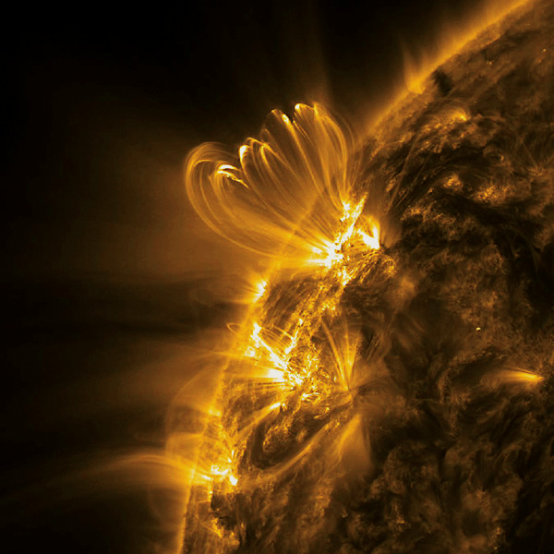

BAYES IN SPACE
Bayesian Deep Learning for Coronal Temperature Estimation
Nikita Balodhi
Richard Morton
Patrick Antolin
Image Credits: AIA/SDO

Slide 2
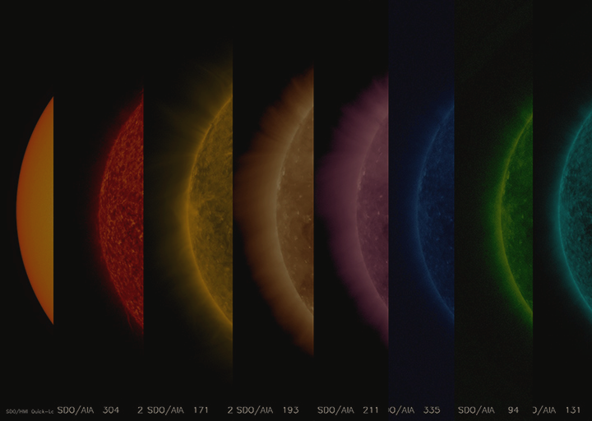
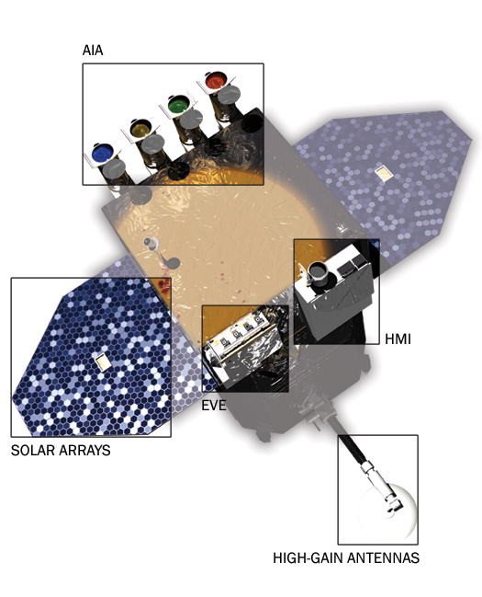
About the Corona
The Corona constitutes hot radiating plasma with temperatures reaching millions of Kelvins.
The coronal temperatures can be studied through photometric observations taken by imaging surveys like the Atmospheric Imaging Assembly onboard the Solar Dynamics Observatory
The SDO is a NASA mission to study solar activity and provides nearly continuous, high-resolution images of the Sun in multiple wavelengths
Background: NASA Mission AIA/SDO

Slide 3
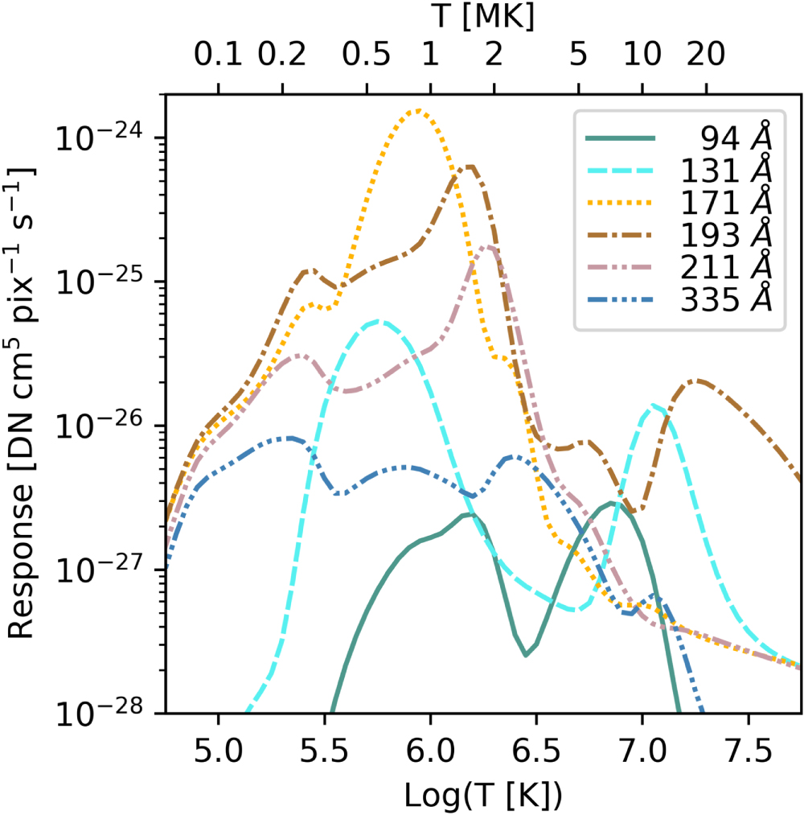
Differential Emission Measures
The Corona is observed in Extreme UV wavelengths
Plasma contributions and instrument response functions for each channel span a range of temperatures
We can map plasma emissions from AIA images at each wavelength for a wide thermal range.
The amount of radiation emitted from the Corona at a certain temperature along a line of sight is called Differential Emission Measure (DEM)
Temperature response for AIA/SDO for EUV lines (Landi et al 2013)

Slide 4
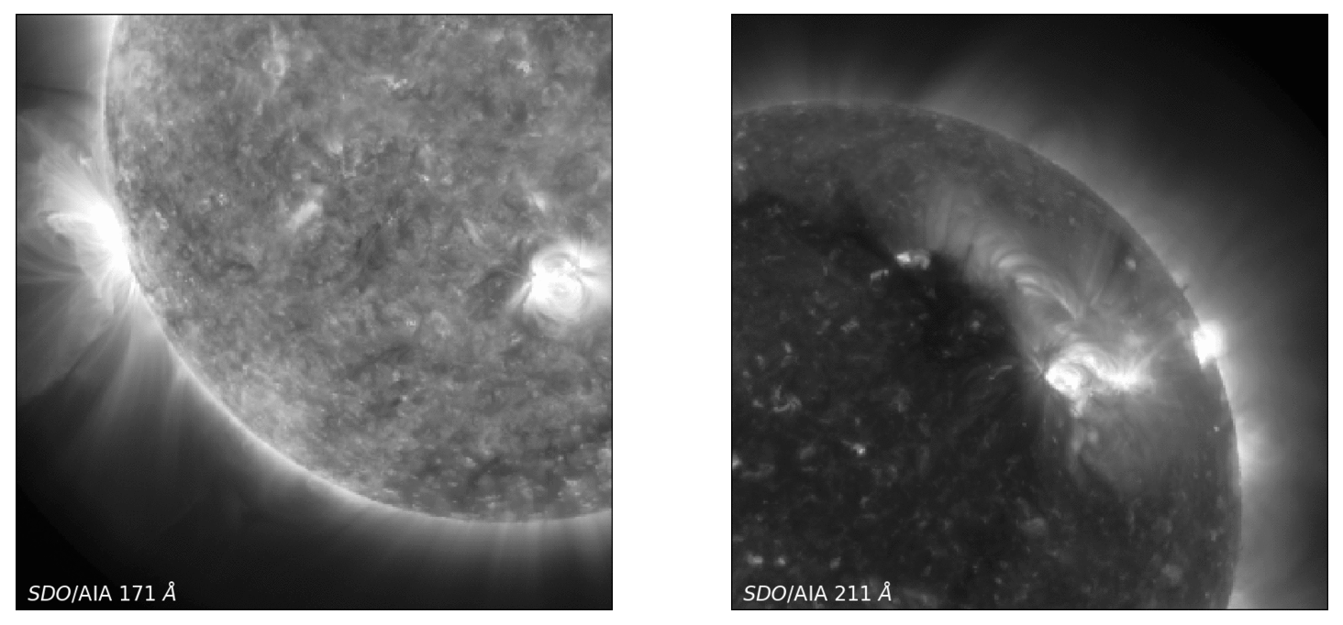
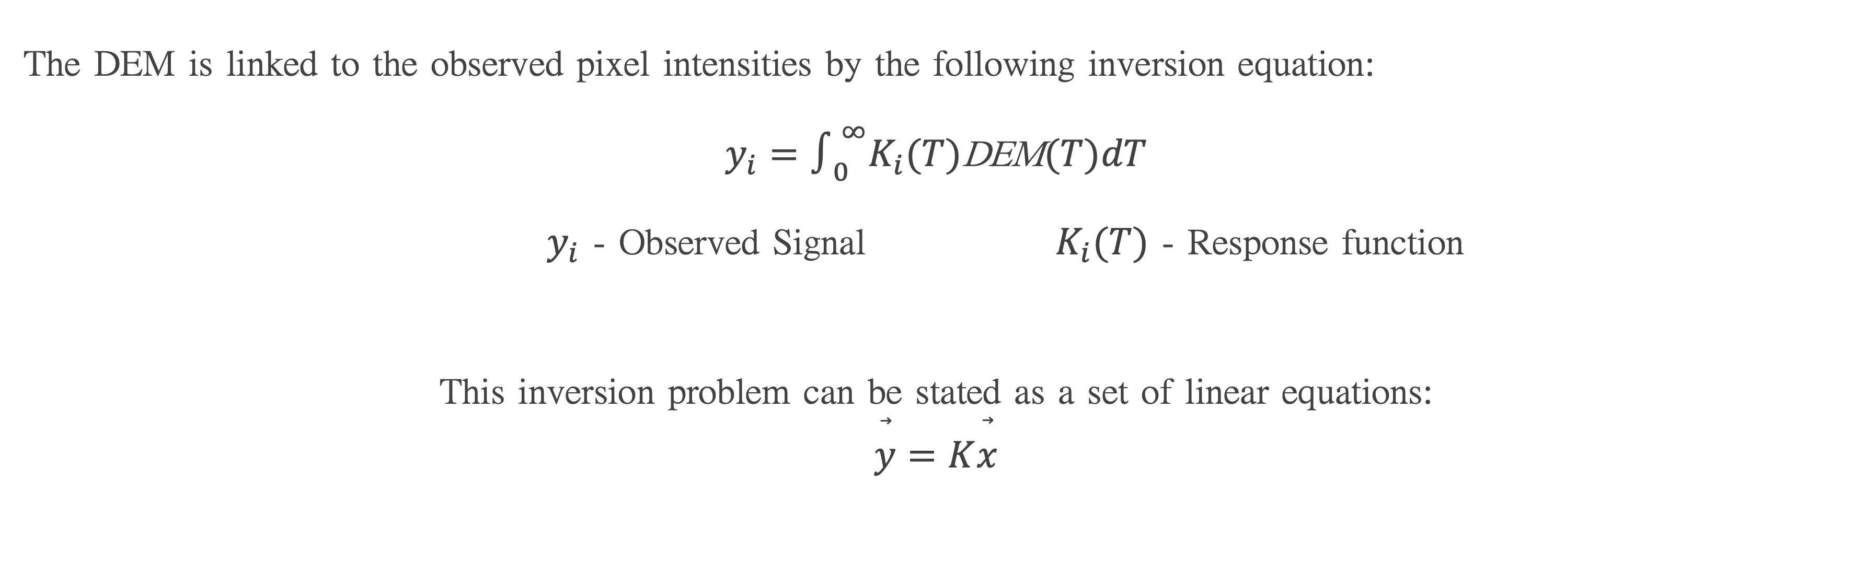
The DEM is linked to the observed pixel intensities by the following inversion equation:
$$y_{i}=∫_{0}^{∞}K_{i}(T)\text{DEM}(T)dT$$
$y_{i}$ - Observed Signal $K_{i}(T)$ - Response function
This inversion problem can be stated as a set of linear equations:
$$\overset{⃗}{y}=K\overset{⃗}{x}$$
AIA/SDO observations from channels 171 Å and 211 Å and their DEM maps at peak sensitivity ~ LogT[K] = 5.9 and 6.3

Slide 5
Methods
  Regularisation methods
Addition of external constraints to solve an underdetermined equation
L1 & L2 regularisation methods add a smoothness constraint to decrease amplification of errors
Deep Learning method
A generative neural network can map the spectral line intensities to the plasma emissions
A network can be trained to read observations in EUV bandpasses and generate Differential Emission Measure maps in a range of temperatures

Slide 6
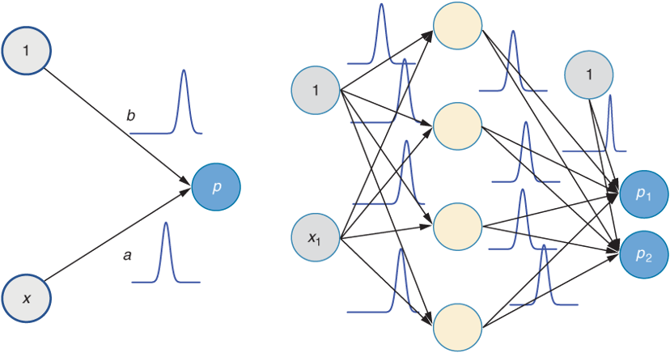
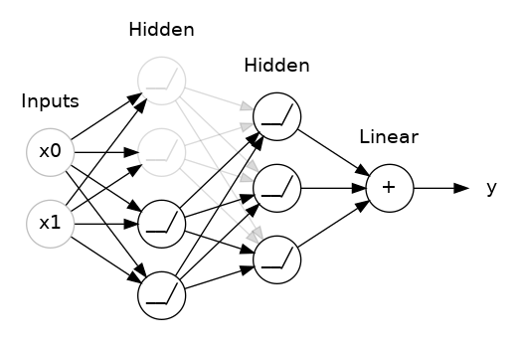
Bayesian Inference in Neural Networks
Neural networks are great function approximators with single value predictions that are highly prone to overfitting
Bayesian modelling allows us to learn probability distributions over neural network weights to capture model uncertainty and biases
Dropout can be used as a way to incorporate uncertainty within the model without additional parameters

Slide 7
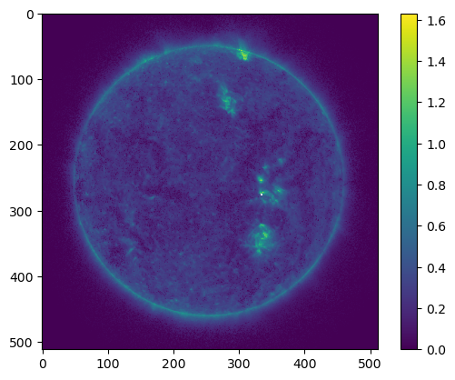
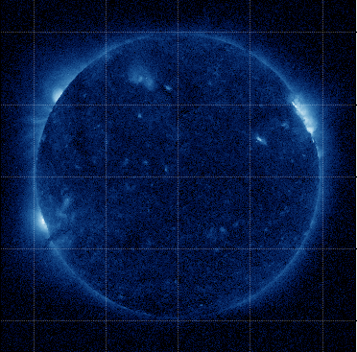
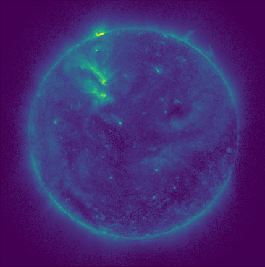
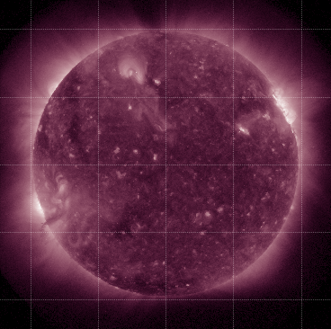
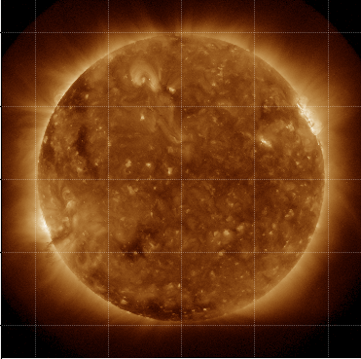
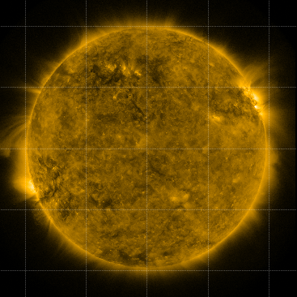
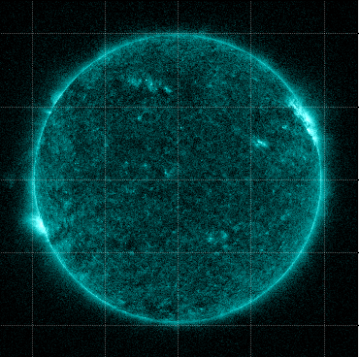
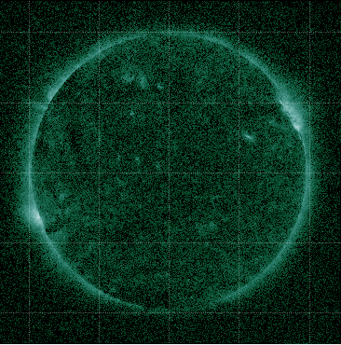
Training Data
64 set of AIA images in 6 optically thin EUV passbands from AIA/SDO - Left
DEM maps in 18 temperatures from the Regularized Inversion methods (L2) - Center
Synthetic images created using the maps and the temperature dependent instrument response function - Right
512 x 512 x 6
512 x 512 x 18
512 x 512 x 6

Slide 8
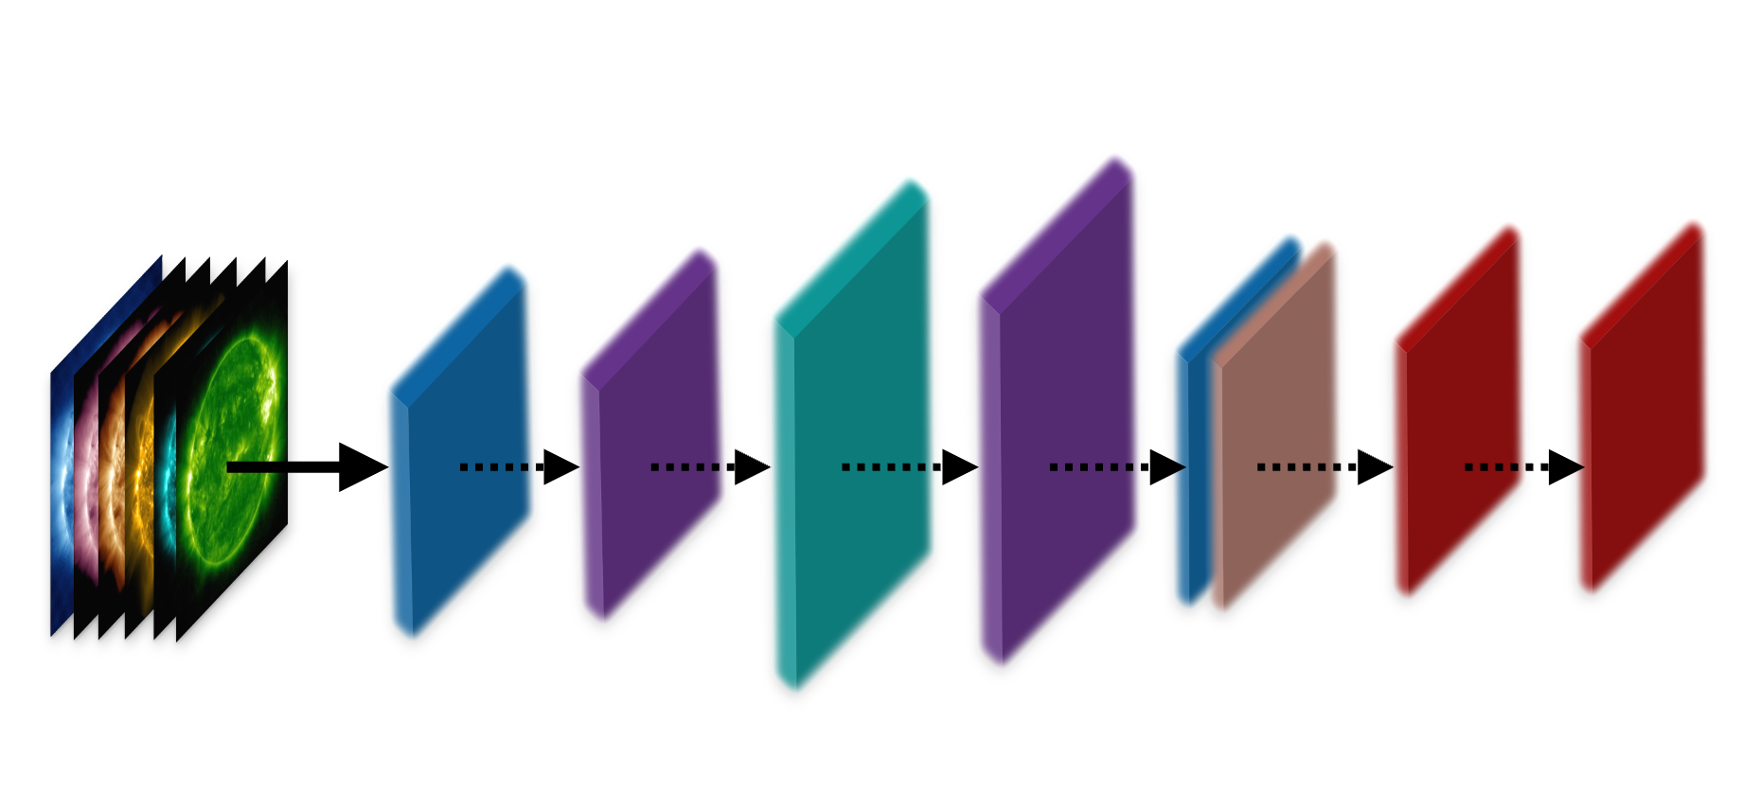
Model Architecture
Two convolutional layers with a kernel size of 1x1 and 3x3
Two variational dropout layers with a dropout rate of 0.5
Transpose convolutional layer to upscale the image
A mask layer to remove data points corresponding to undefined/missing DEM values
Function to reconstruct the observed intensities from the output DEM and response function
514
514
512
512
512
512
512
512
512
514
514
512
512
512
128
18
6
6
512 X 512 X 6
128
64
64
Input Layer
Conv Transpose
Mask for undefined values
Output DEM
Kernel function & scaling
Output Image
Conv
Dropout
Dropout

Slide 9
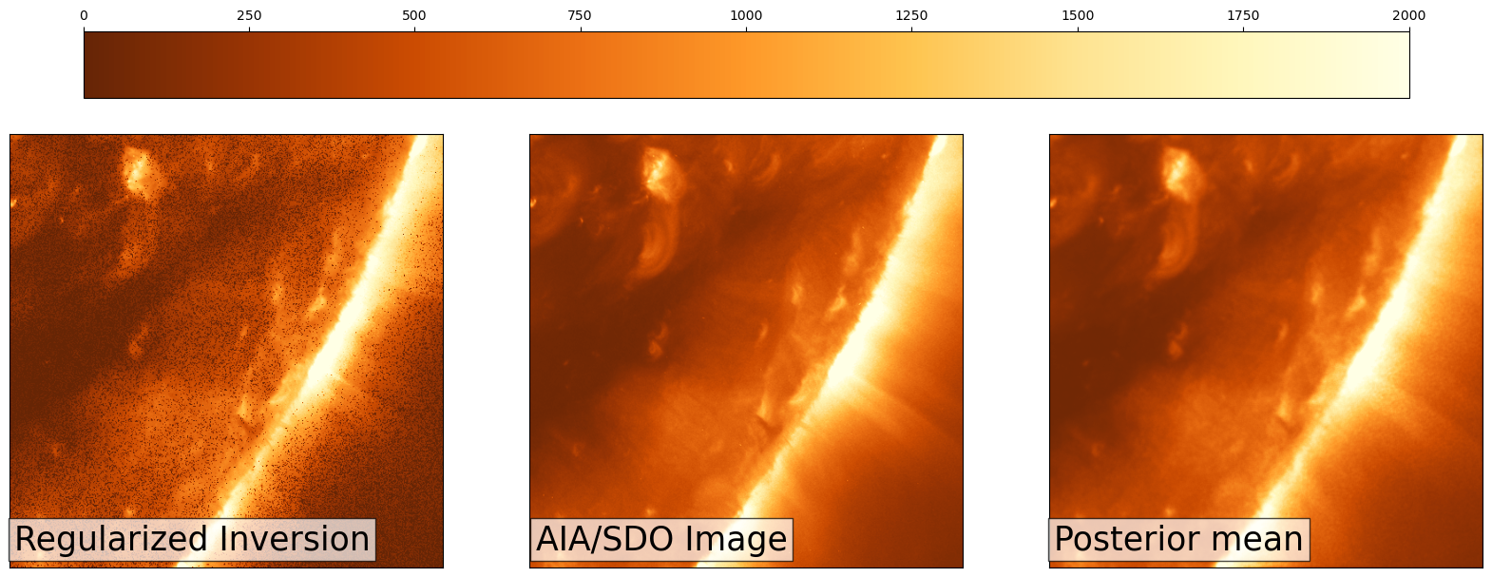
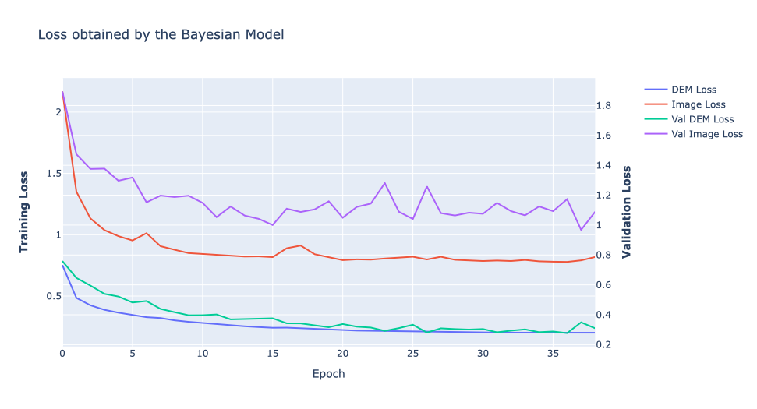
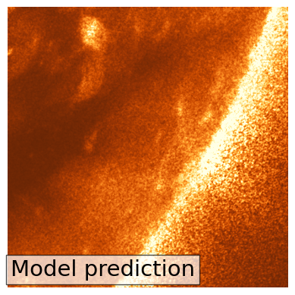
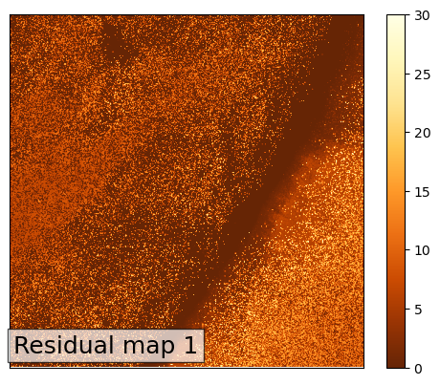
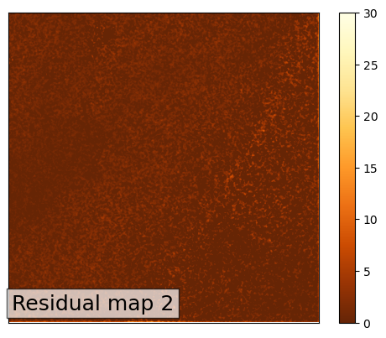
Results
AIA/SDO 193 Å (Middle)
Reconstructed by Regularised Inversion (Left)
Reconstructed by Bayesian Model (Right)
Residual maps for the two reconstructed images as compared with the original

Slide 10
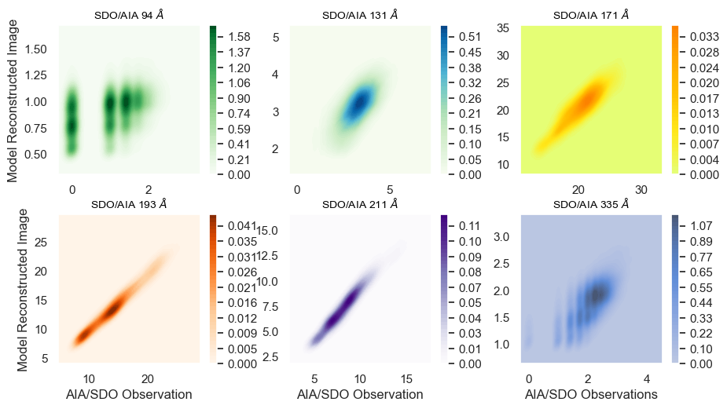
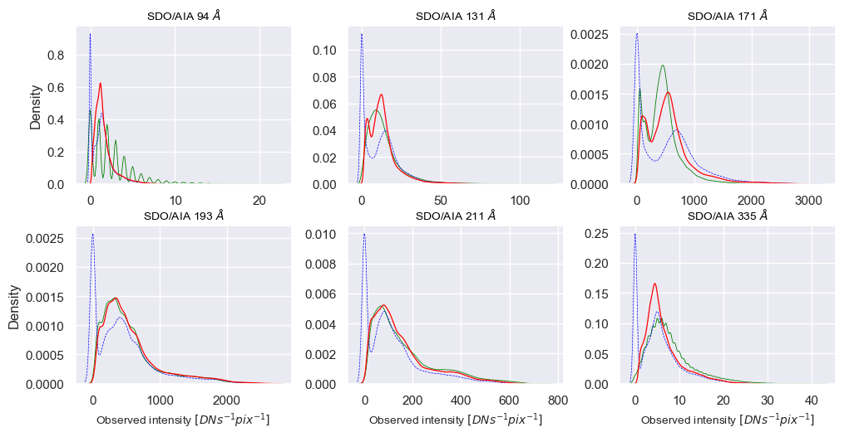
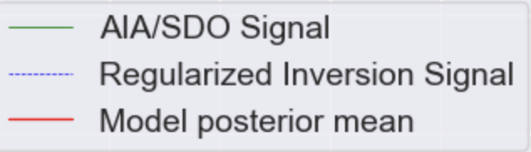
Kernel Density Estimates
The pixel distributions of the observed signals and the synthetic images generated by Regularised Inversion and the Bayesian model (1)
Plotting the pixel distributions of images synthesised by the model with the original observations (2)

Slide 11
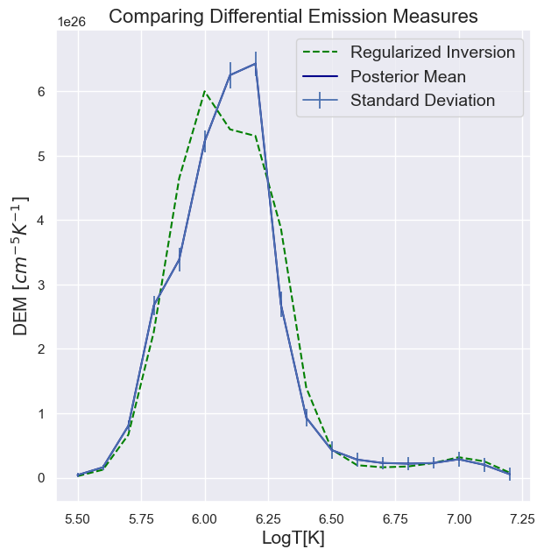
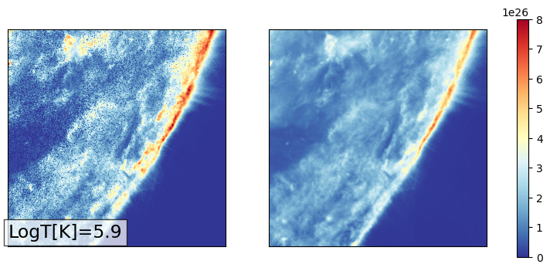
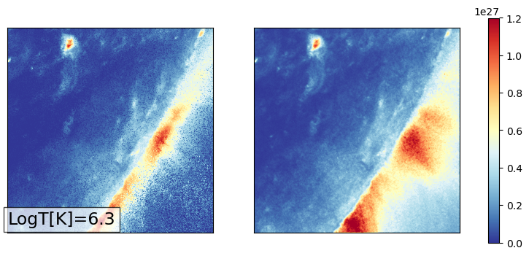
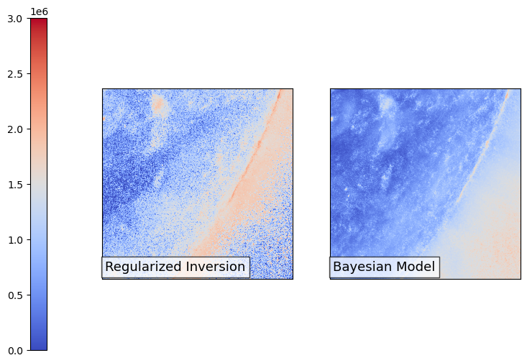
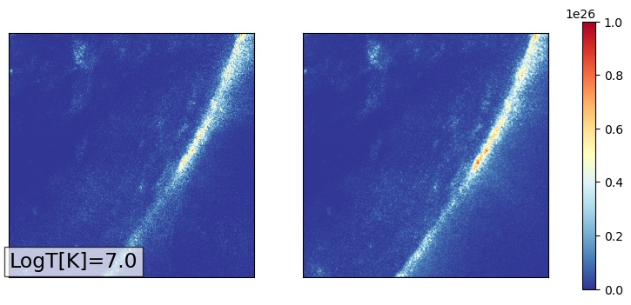
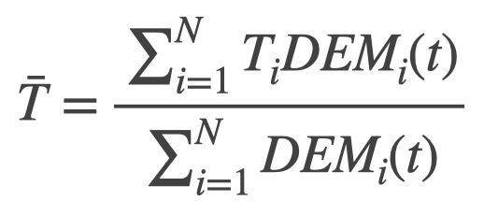

Regularized Inversion
Posterior Mean
Differential Emission Measures [${cm}^{−5}K^{−1}$]
DEM weighted Average Temperatures
Temperature [K]
DEM bins chosen at the peak sensitivity of AIA/SDO channels:
171 Å, 211 Å, and 94 Å (top to bottom)

Slide 12
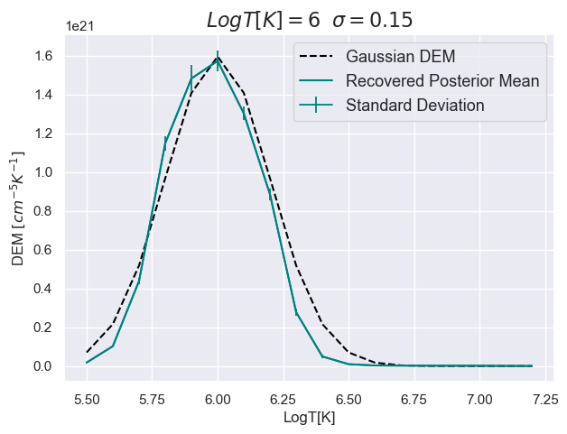
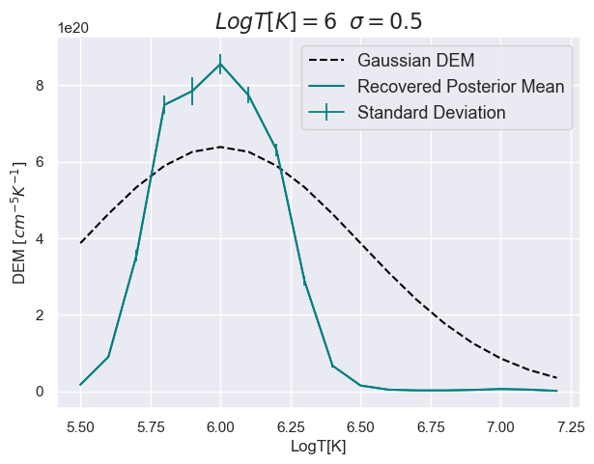
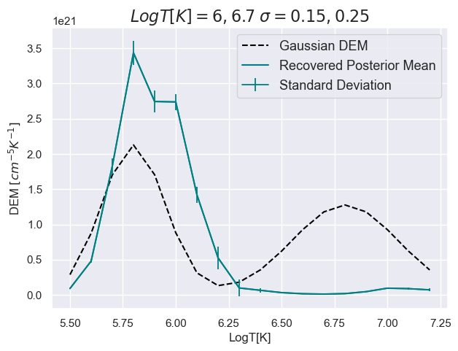
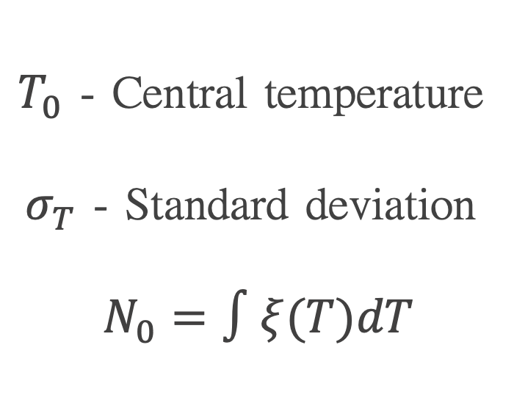
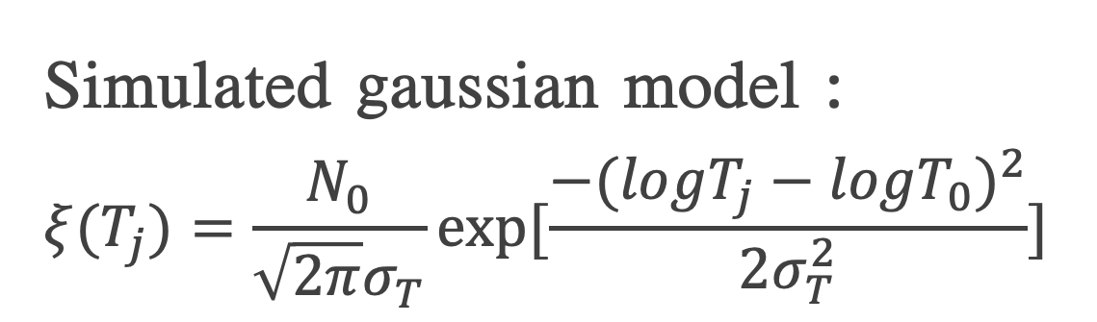
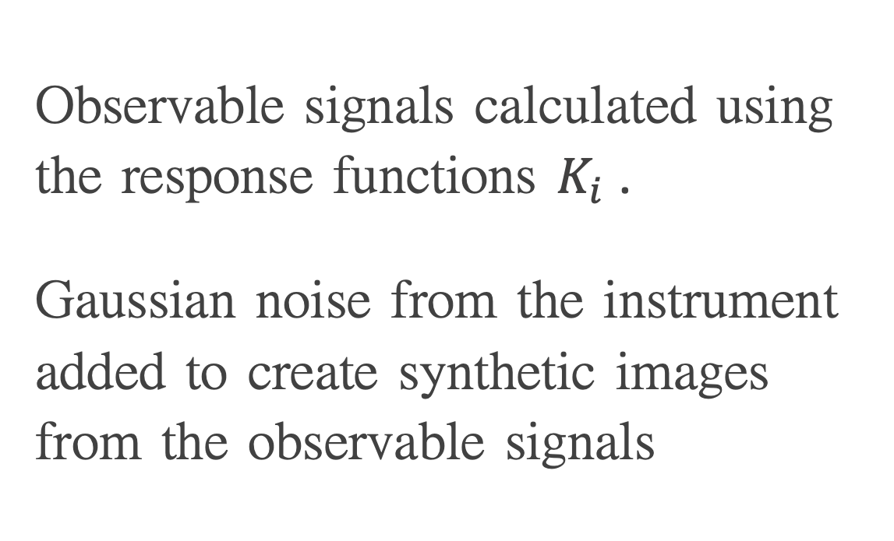
Simulated data
Observable signals calculated using the response functions $K_{i}$.
Gaussian noise from the instrument added to create synthetic images from the observable signals
$T_{0}$ - Central temperature
$σ_{T}$ - Standard deviation
$N_{0}=∫ξ(T)dT$
Simulated gaussian model :
$$ξ(T_{j})=\frac{N_{0}}{\sqrt{2π}σ_{T}}exp[\frac{−(logT_{j}−logT_{0})^{2}}{2σ_{T}^{2}}]$$

Slide 13
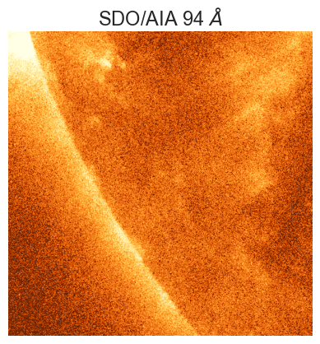
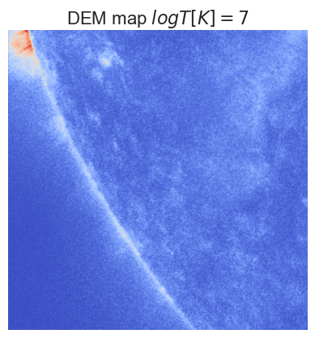
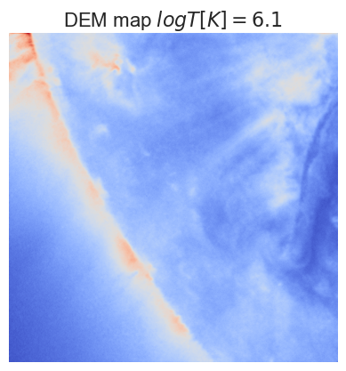
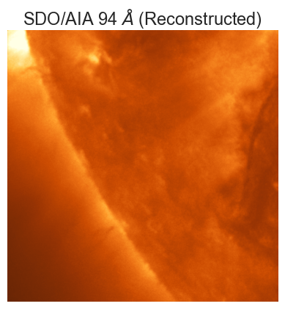
Summary
We developed a machine learning model to generate DEM maps from EUV channel images from AIA/SDO
We used Variational Dropout as a Bayesian technique to incorporate model bias in our predictions without additional parameters
The model is successful in generating temperature maps and reconstructing the observed images from these maps
Future scopes : Results comparable to Bayes by backprop technique
            Model used as a denoising problem for AIA images

