Slide 1
Advancing Solar Flare Forecasting: Predicting Solar Flares via a Deep Learning Approach Using Time Series of SDO/HMI Line-of-Sight Magnetograms
Elizabeth Doria Rosales Prof. Vincenzo Carbone Dtt. Antonio Ielo
(e.doriarosales@unitn.it)
Prof. Mariarosaria Falanga Prof. Angelo Ciaramella Dtt. Enamuel Dinardo

Slide 2
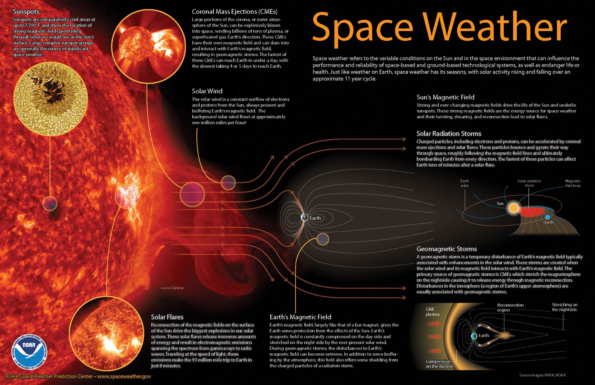
Sources of Space Weather
Credits: National Oceanic and Atmospheric Administration (NOAA)

Slide 3
Sources of Space Weather
Credits: National Oceanic and Atmospheric Administration (NOAA)

Slide 4
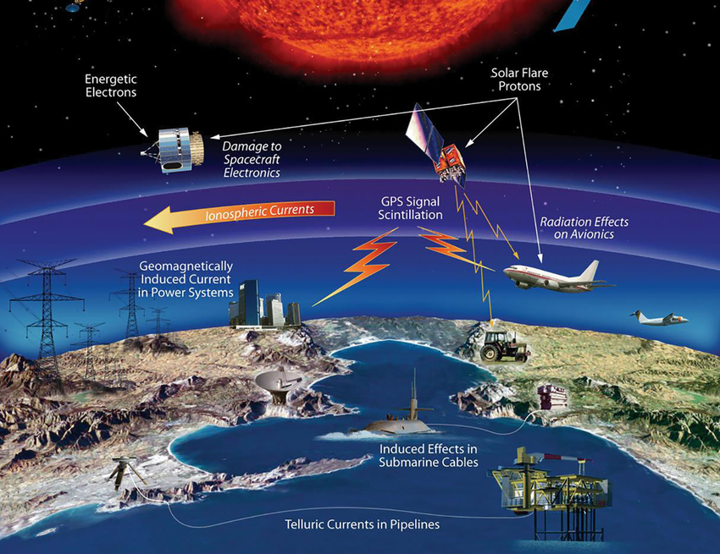
Impact of Space Weather on Earth and Human Technologies
Credits: National Aeronautics and Space Administration (NASA)

Slide 5
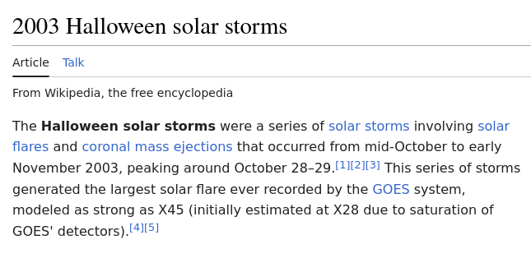
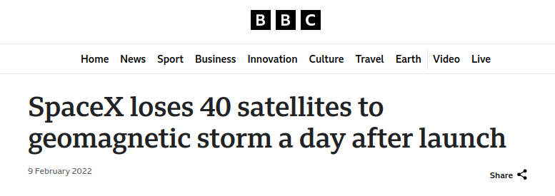
Impact of Space Weather on Earth and Human Technologies
Credits: National Aeronautics and Space Administration (NASA)

Slide 6
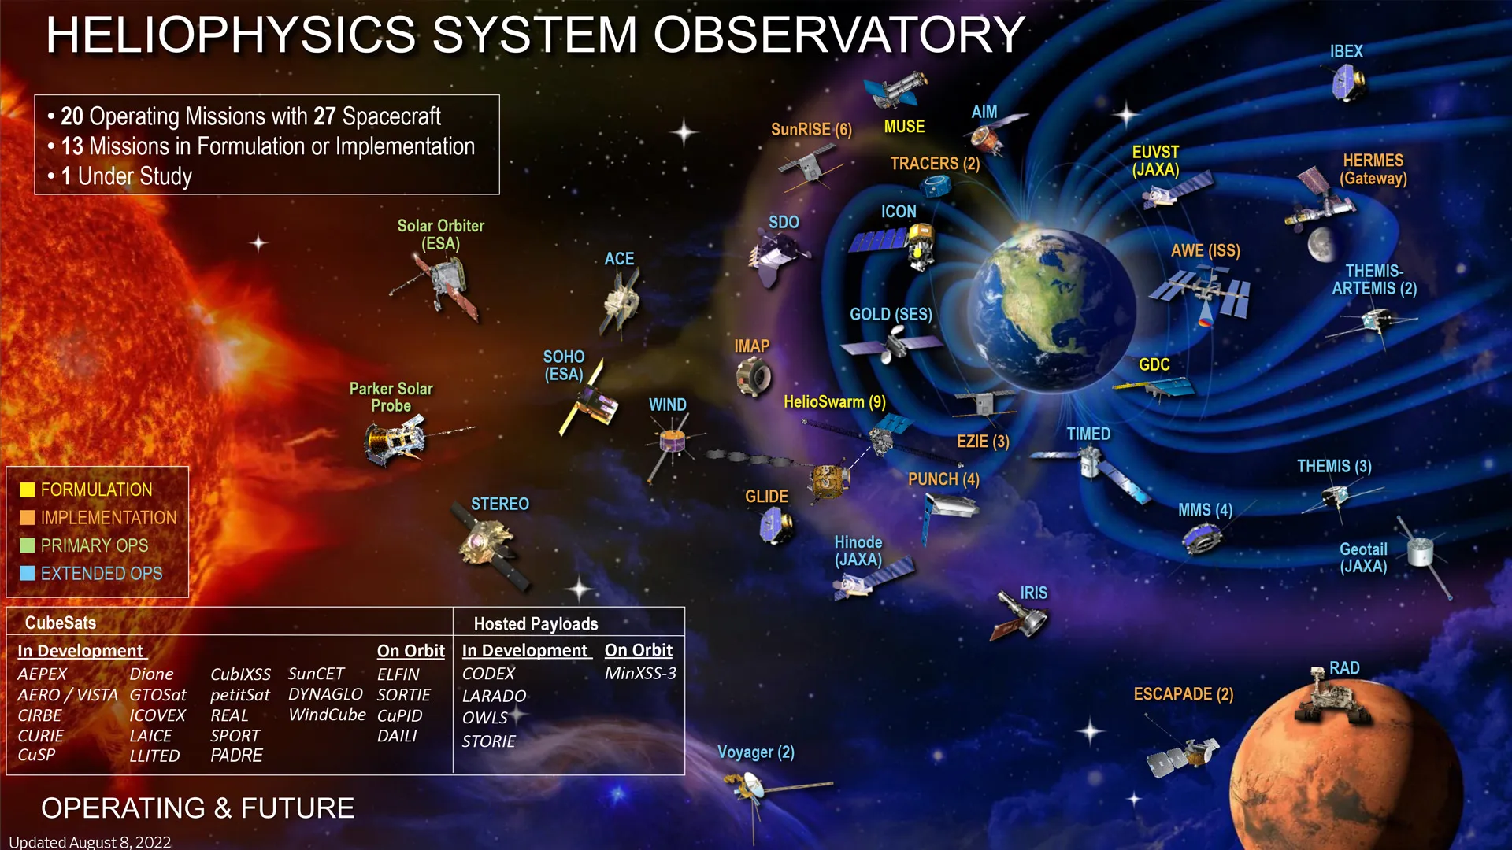
Heliophysics Missions and Programs
The Solar Dynamics Observatory (SDO) was launched on February 11, 2010, 10:23 am EST on an Atlas V from SLC 41 from Cape Canaveral.
After launch, the spacecraft was placed into an orbit around the Earth with an initial perigee of about 2,500 km (1,600 mi). SDO then underwent a series of orbit-raising maneuvers which adjusted its orbit until the spacecraft reached its planned circular, geosynchronous orbit at an altitude of 35,789 km (22,238 mi), at 102° West longitude, inclined at 28.5°.
Credits: NASA's Goddard Space Flight Center

Slide 7
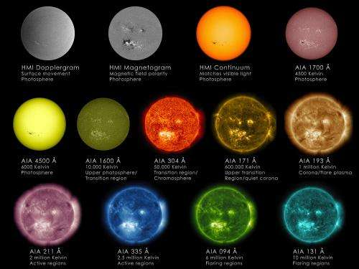
How The Solar Dynamics Observatory (SDO) Sees the Sun
Each of the wavelengths observed by NASA's Solar Dynamics Observatory (SDO) was chosen to emphasize a specific aspect of the Sun's surface or atmosphere.
This image shows imagery both from the Advanced Imaging Assembly (AIA), which helps scientists observe how solar material moves around the Sun's atmosphere, and the Helioseismic and Magnetic Imager (HMI), which focuses on the movement and magnetic properties of the Sun's surface.
Credits: NASA/SDO/Goddard Space Flight Center

Slide 8
Scientific Problem
Our primary objective is to distinguish between active regions likely to produce M- or X-class flares within a 24-hour window and those remaining inactive.
We model the solar flare forecasting problem as a binary time series classification task. We use of line-of-sight (LoS) magnetograms obtained from the Solar Dynamics Observatory's Helioseismic and Magnetic Imager (SDO/HMI).

Slide 9
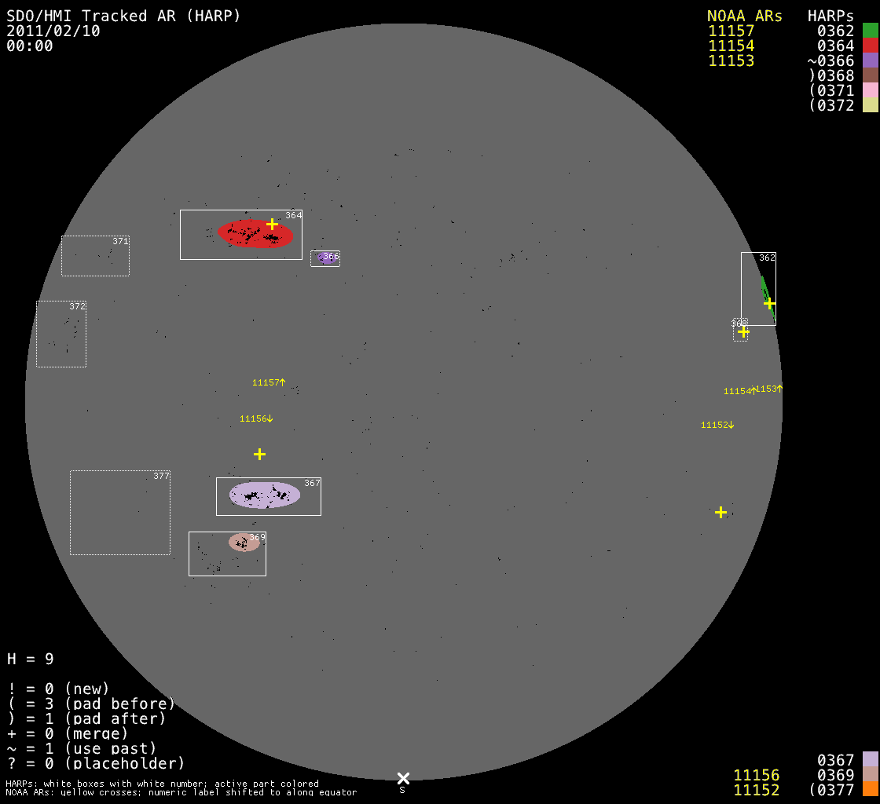
Data: Spaceweather HMI Active Region Patch (SHARP)
The HMI tracking module automatically detects Active Regions (ARs) in photospheric line-of-sight magnetograms and intensity images. This module (i) identifies a patch on the full-disk imagery that encompasses each active region and (ii) tracks every active region as it rotates across the face of the solar disk.
One active region crossing the face of the solar disk is referred to as an HMI Active Region Patch (HARP) and is assigned a HARP number, similar in concept to a NOAA* AR number.
A SHARP series contains (1) various spaceweather quantities calculated from the photospheric vector magnetogram data (2) and components of the vector magnetic field, the line-of-sight magnetic field, continuum intensity, doppler velocity, error maps and bitmaps.
* NOAA stands for National Oceanic and Atmospheric Administration
From January 2010 to December 2022
Total number of HARPs: 5112
Number of HARPs with unique NOAA number: 1404

Slide 10
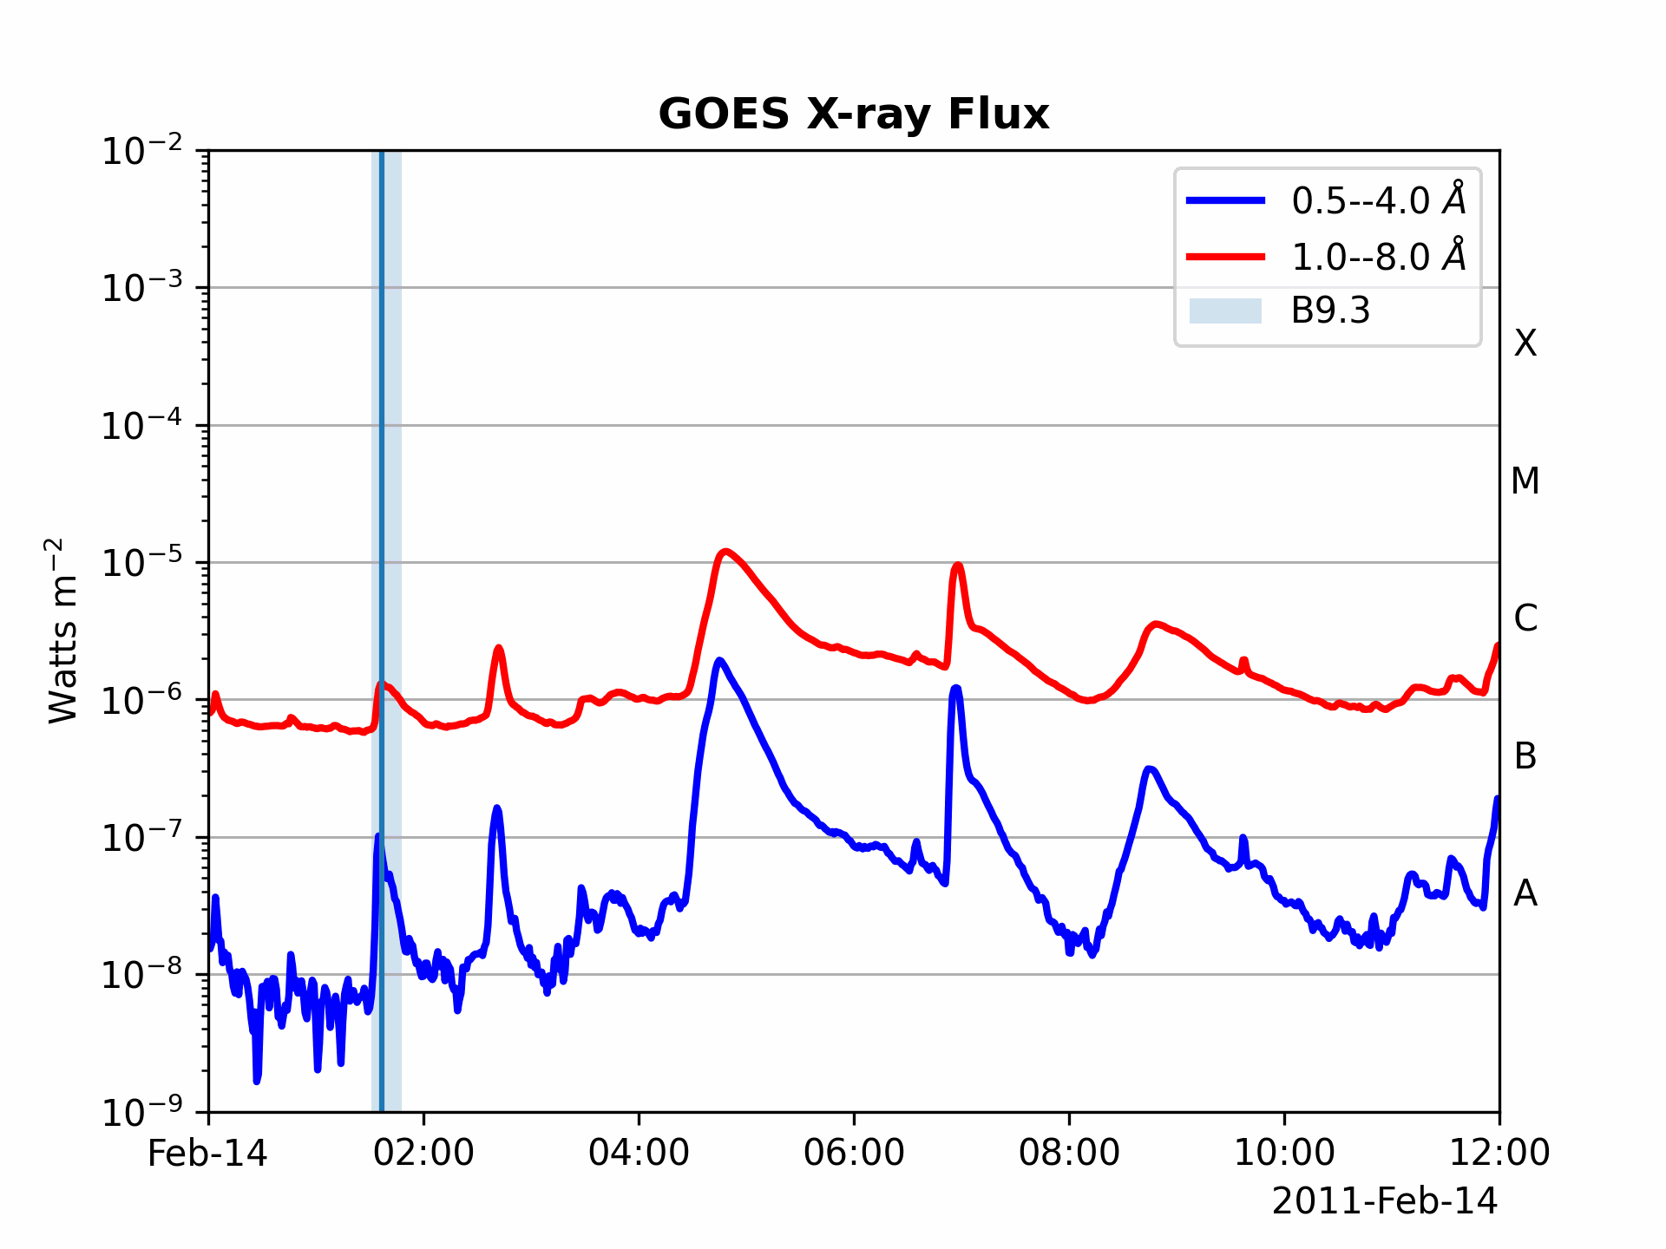
Data: Geostationary Operational Environmental Satellites (GOES) Catalog of Solar Flares
Based on the peak magnitude of 1–8 Å soft X-ray flux measured by GOES, solar flare events are classified into five increasingly intense classes: A, B, C, M, and X, sometimes appended with a number that indicates a finer scale classification. M- and X-class flares are referred to as strong flares.
There are cases in which flares, even the strong ones, are not assigned to any active region. Furthermore, small-sized flares could be buried under the background radiation, a phenomenon frequently observed for A- and B-class flares, especially after a strong flare occurs.
Total Number of Flares: 20942
Total Number of Flares associated to and NOAA AR: 14483
Flaring Active Regions: 809
Weak Flares: 13670
Strong Flares: 813

Slide 11
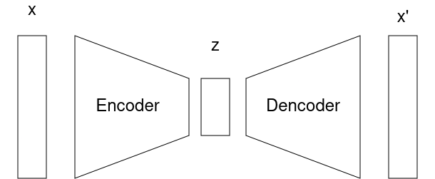
Model overview: Autoencoder
Mean Squared Error

Slide 12
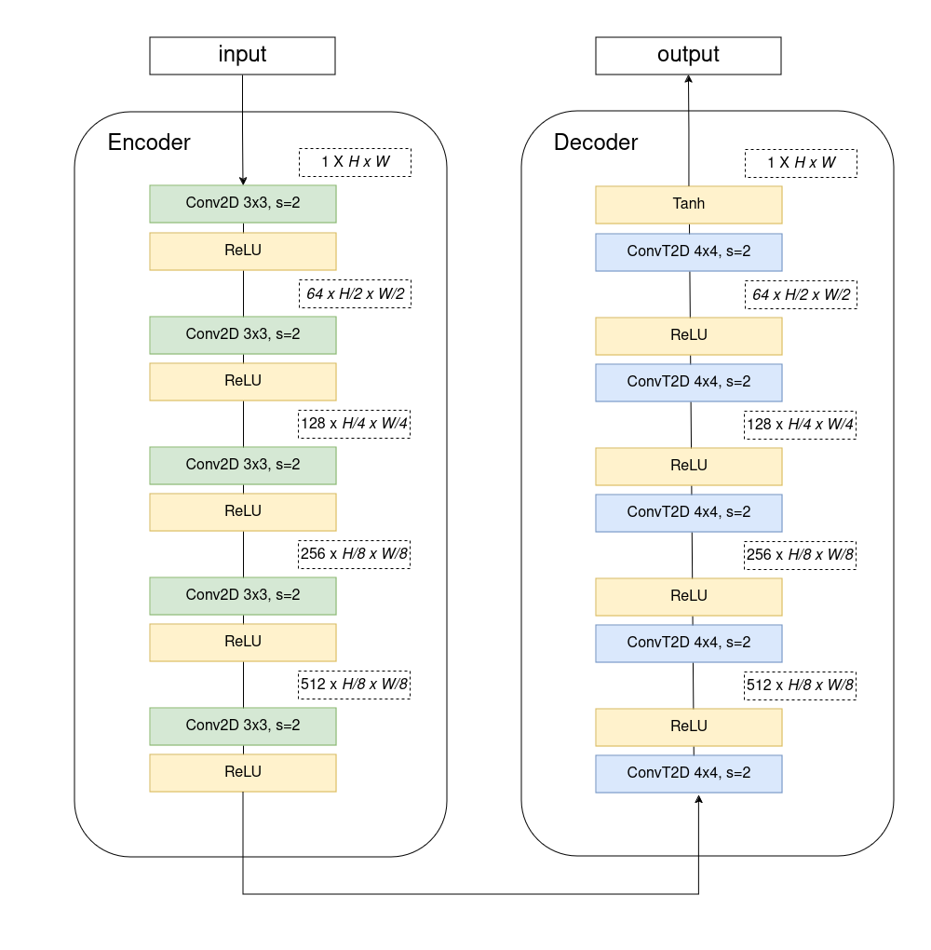
Model overview

Slide 13
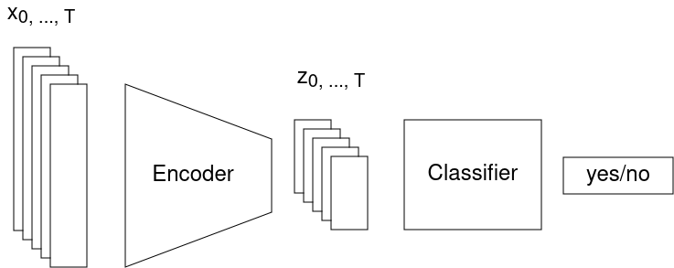
Model overview: Classifier
Binary Cross Entropy

Slide 14
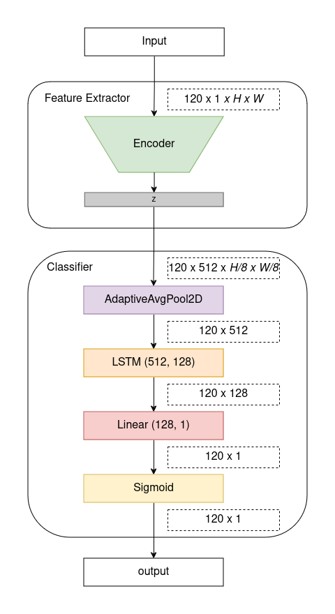

Slide 15
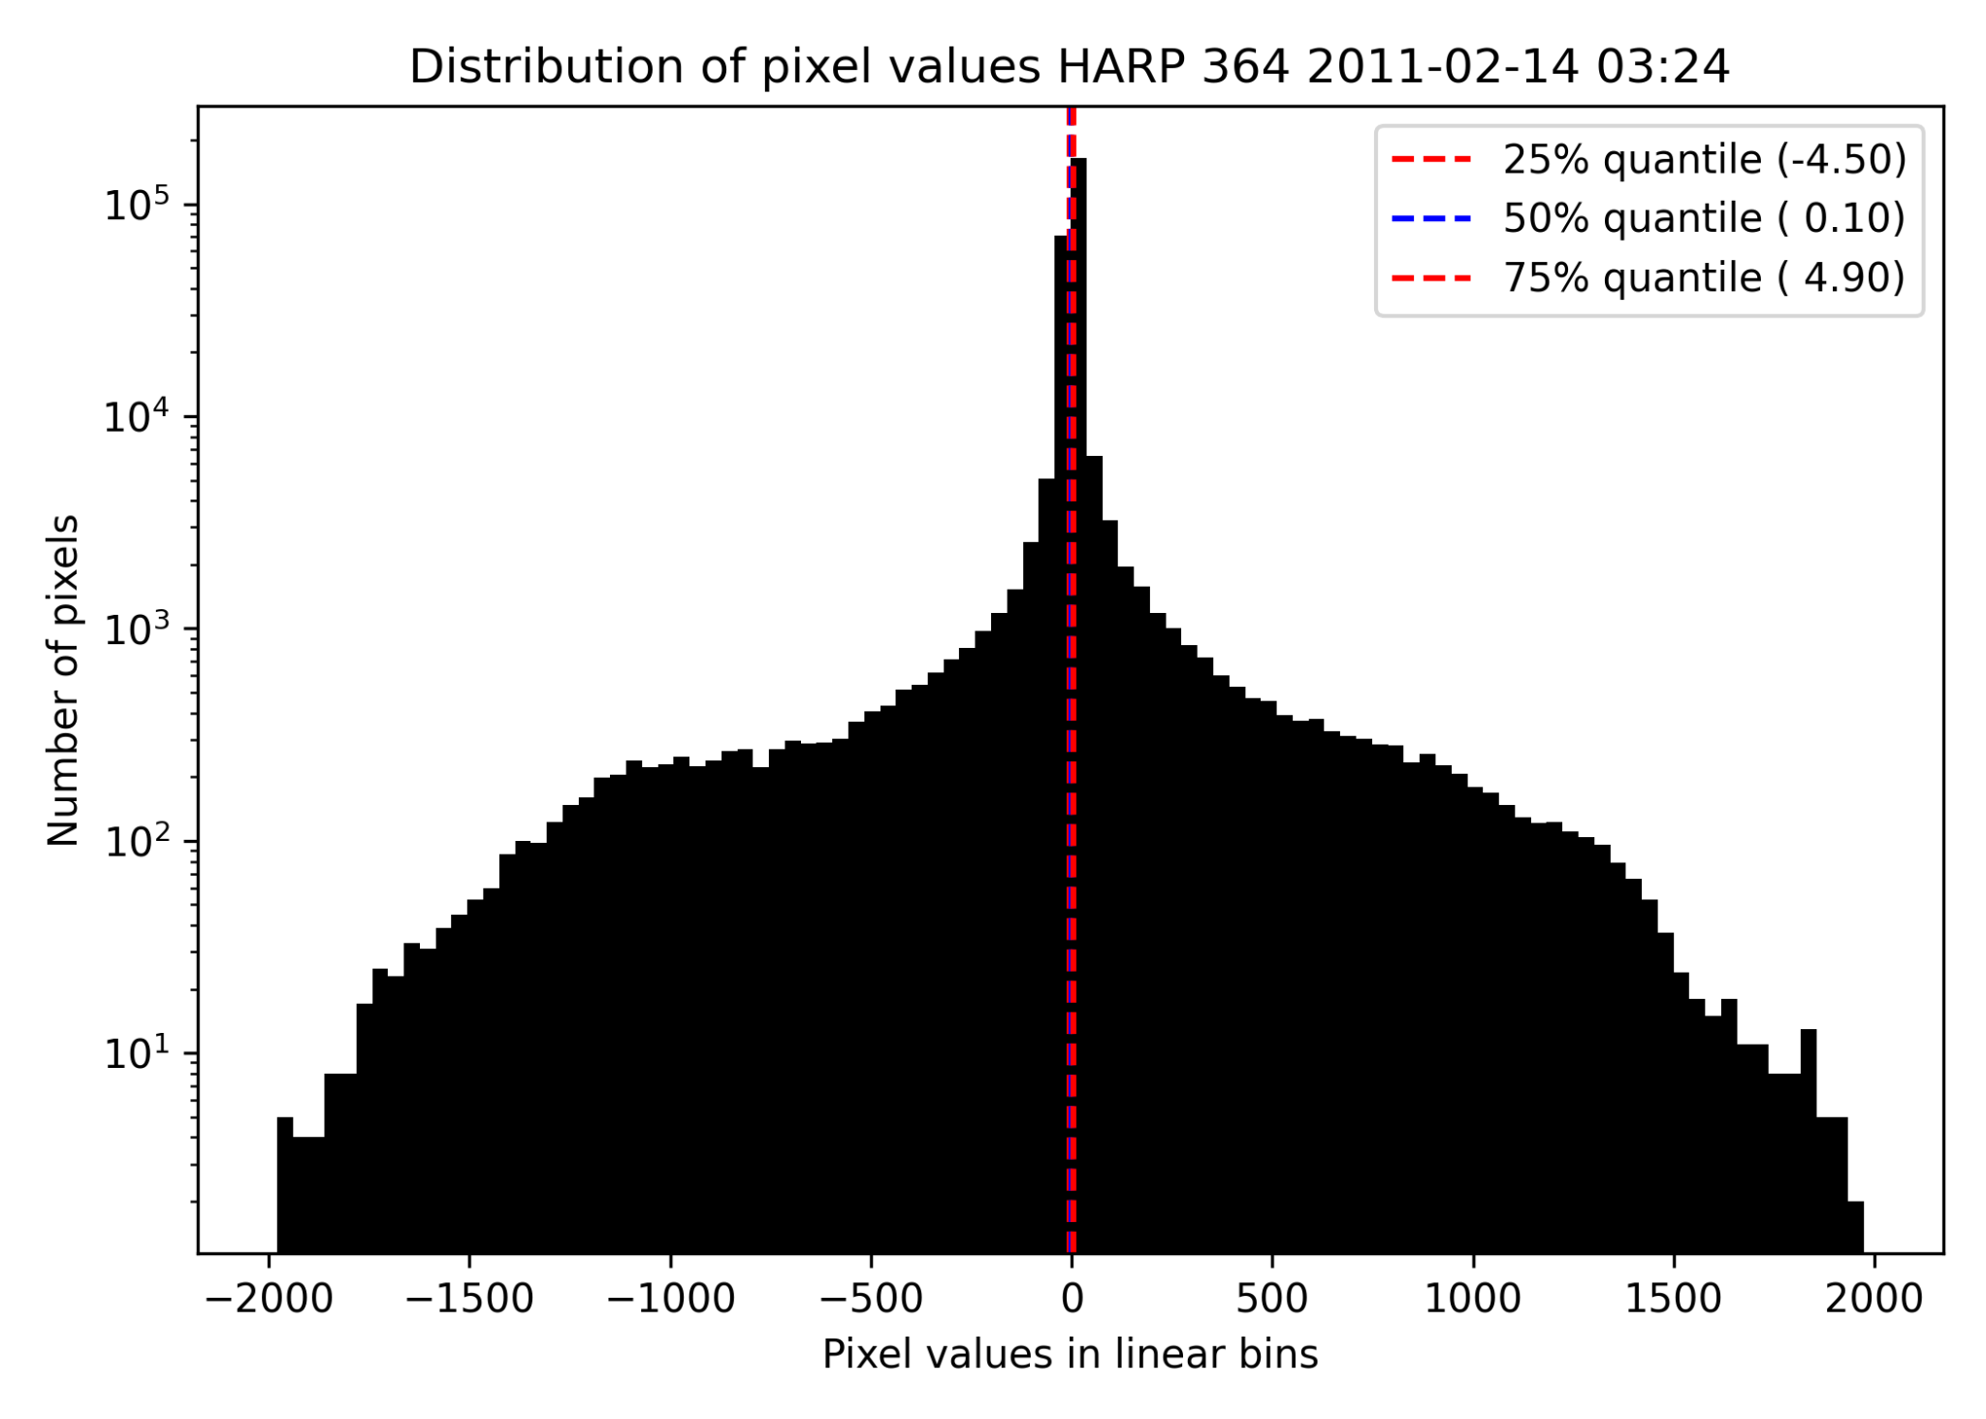
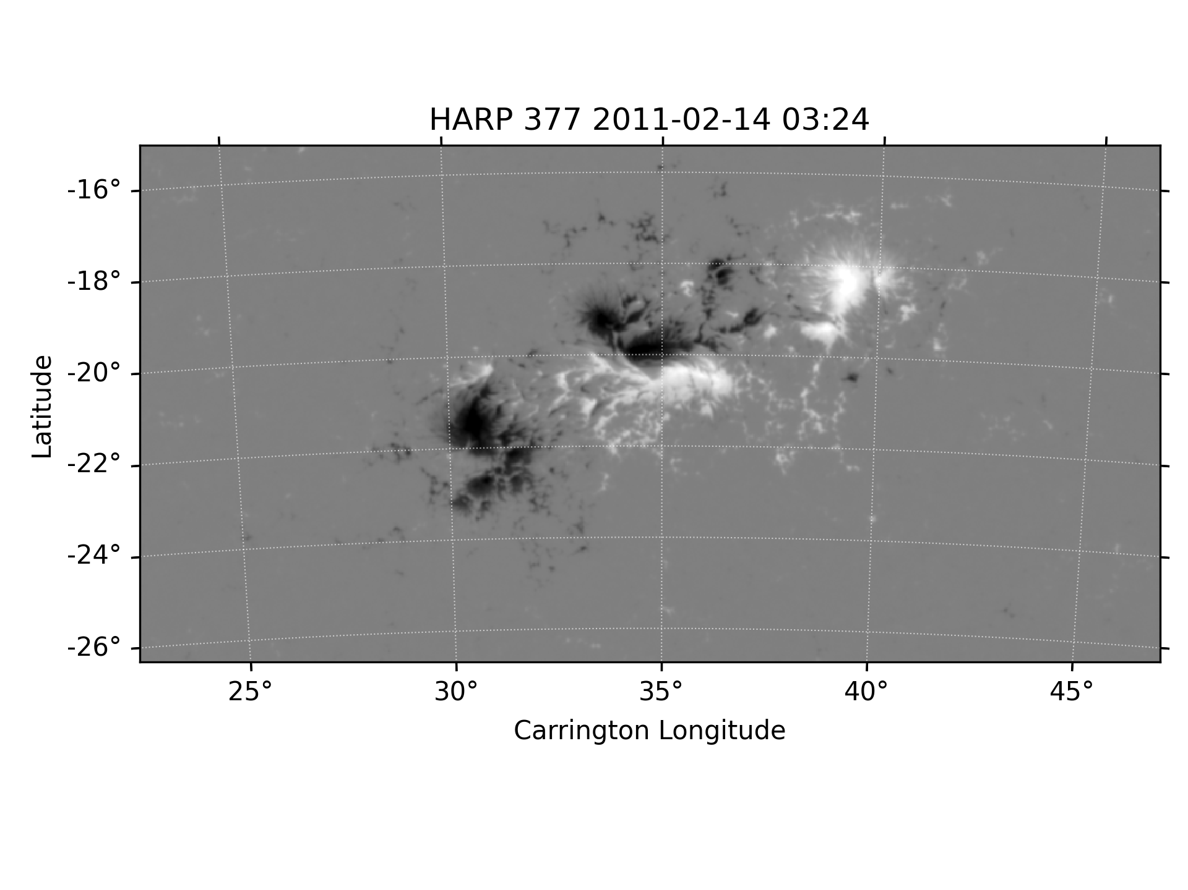
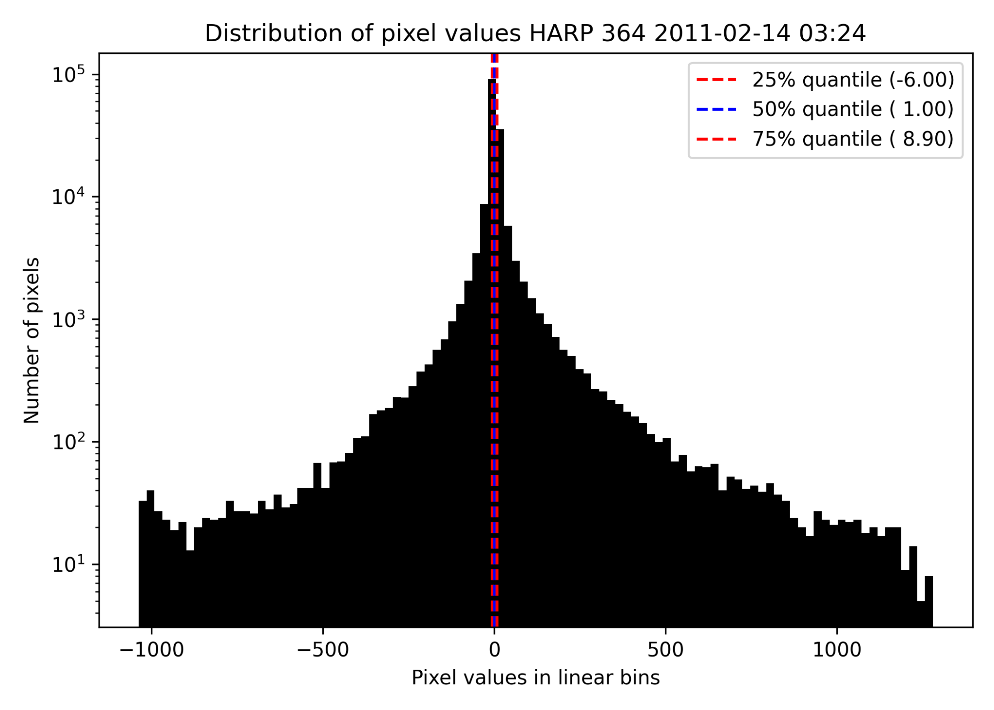
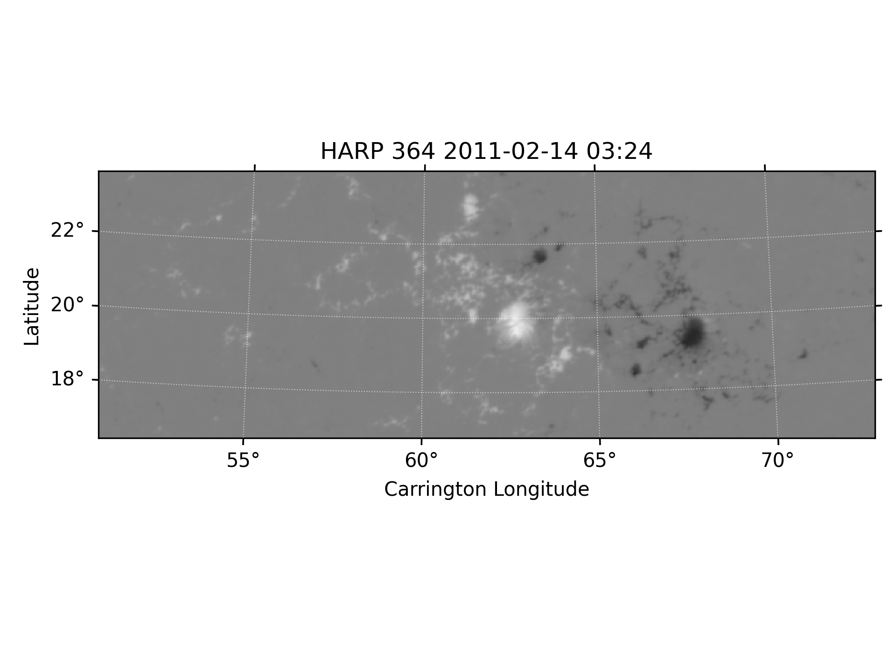
Preprocessing: Image Resizing
Dimension: 377 x 744 pixel
Dimension: 240 x 697 pixel

Slide 16
Preprocessing: Standardization
We compute the global minimum and maximum values from the training set and then scale our images to be between -1 and 1.

Slide 17
Preprocessing: Train/Validation/Test Split
Due to the temporal coherence of an active region in its lifetime, a random split of data samples will have samples coming from the same active region categorized into different splits. Such correlation constitutes an undesirable information leakage among splits. To avoid this we adopt an active-region- based split, where data samples from the same active region must belong to the same split.
This approach has the advantage that active regions in each split are randomly dispersed in different phases of a solar cycle. This distributional consistency between splits comes at the price of an additional source of information leakage due to sympathetic flaring in cotemporal active regions.

Slide 18
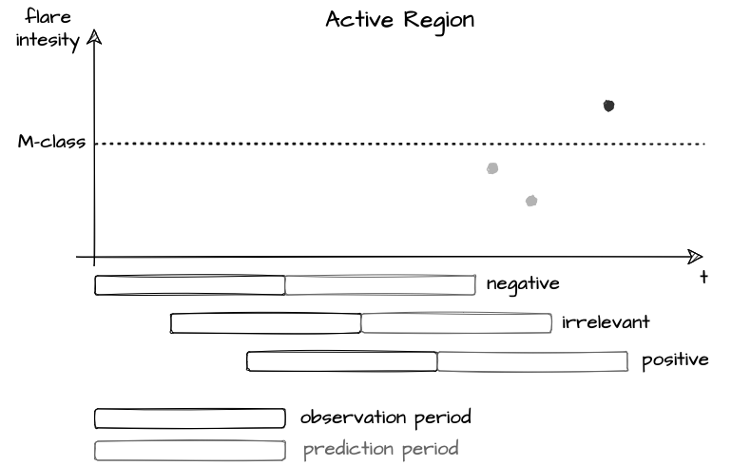
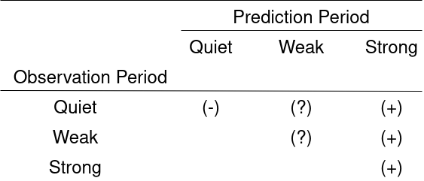
Preprocessing: Sample Extraction and Labeling
Observation and prediction period of 24 hr with a 12 minute step.
 | Training Set | Validation Set | Test Set
negative | 93649 (95.17%) | 23420 (95.66%) | 10418 (95.41%)
positive | 4754 (4.83%) | 1063 (4.34%) | 501 (4.59%)

Slide 19
Preprocessing: Random Undersampling
Solar flare data exhibit prominent class imbalance, with positive (minority class) samples significantly outnumbered by negative (majority class) samples. We handle the class imbalance problem using random undersampling: we randomly remove samples from the majority class until the numbers of positive and negative samples are equalized.
 | Training Set | Validation Set | Test Set
negative | 4754 (50%) | 1063 (50%) | 501 (50%)
positive | 4754 (50%) | 1063 (50%) | 501 (50%)

Slide 20
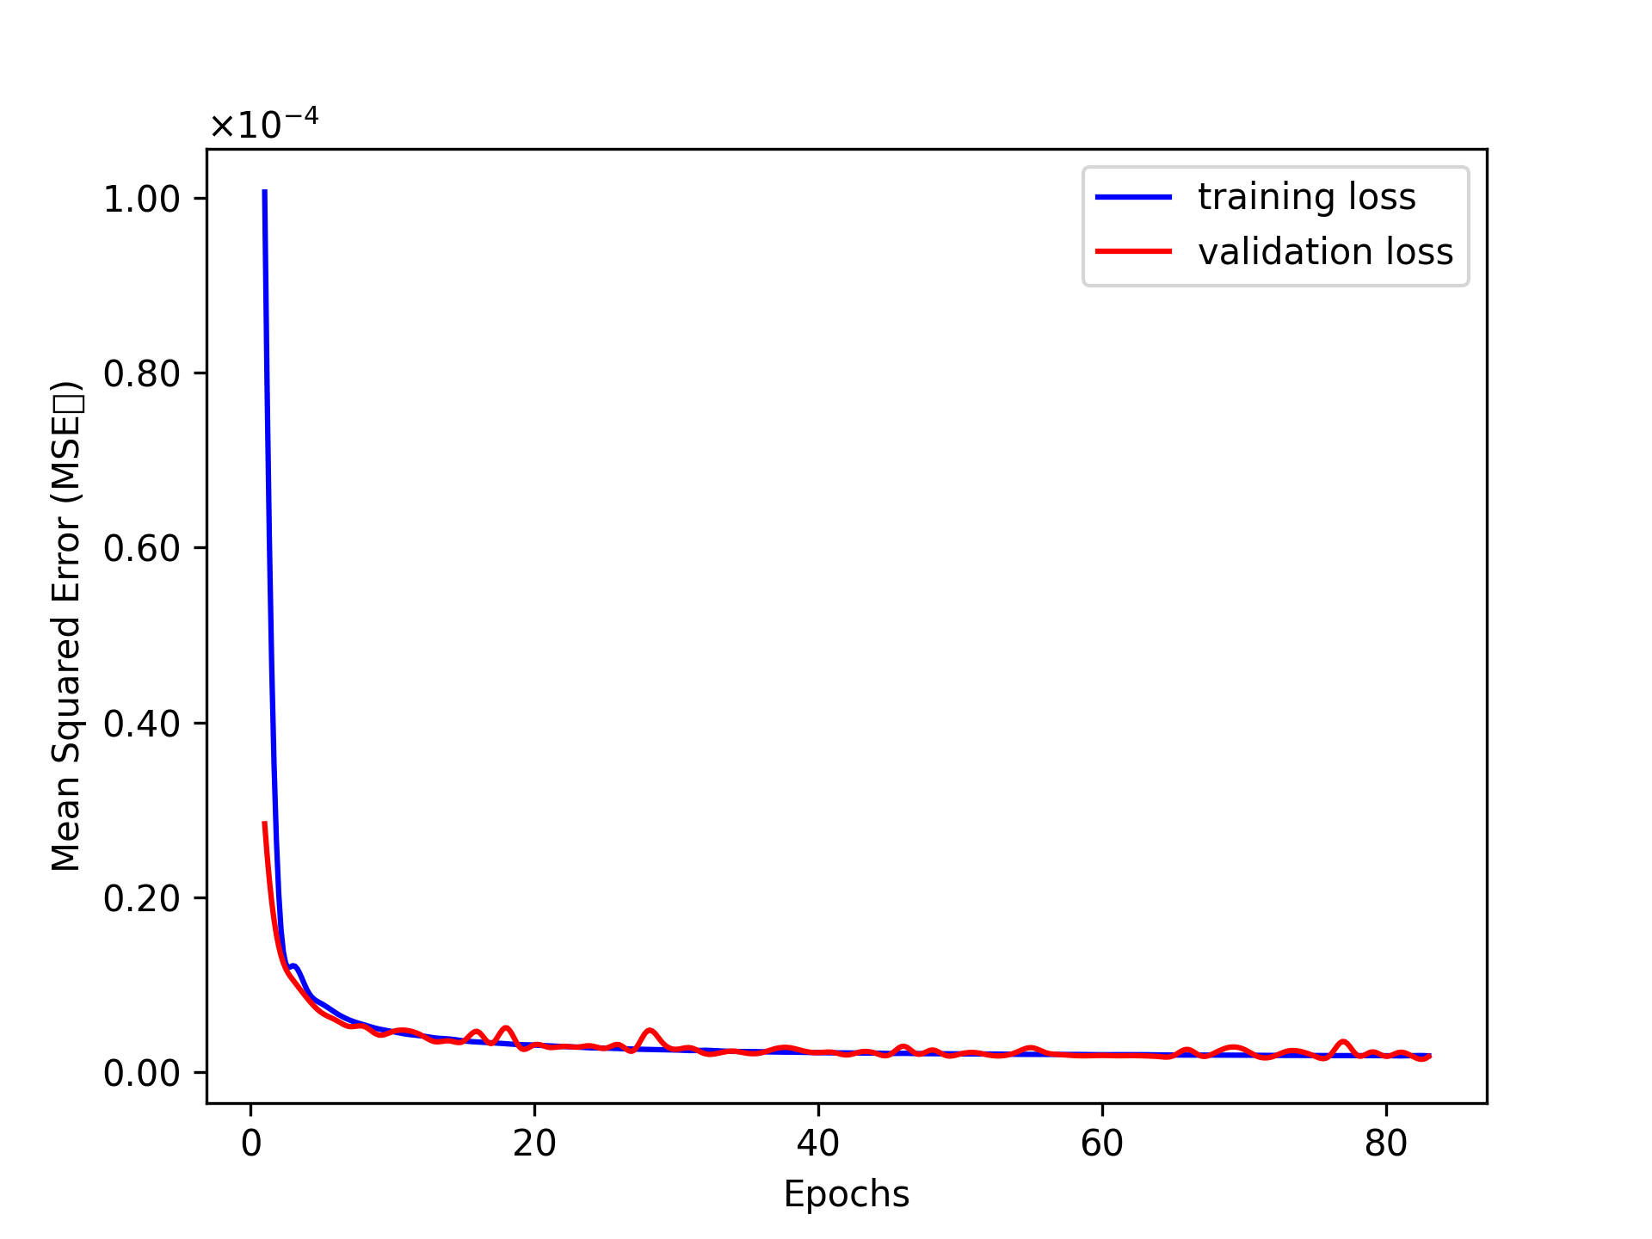
Results: Autoencoder

Slide 21
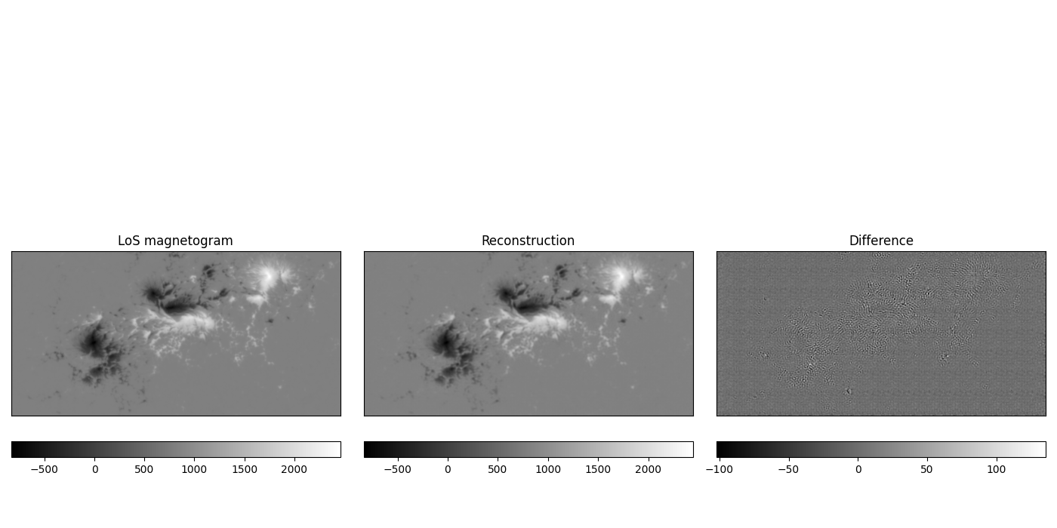
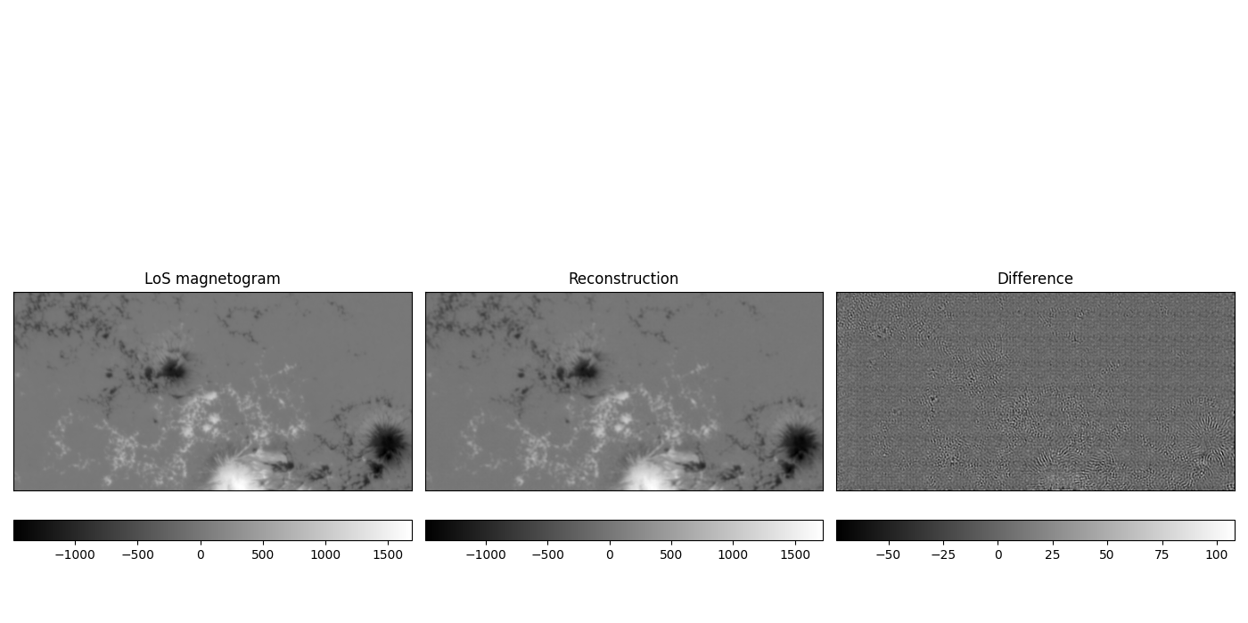
Results: Autoencoder
HARP 377 2011-02-14 03:24
HARP 393 2011-03-02 17:12

Slide 22
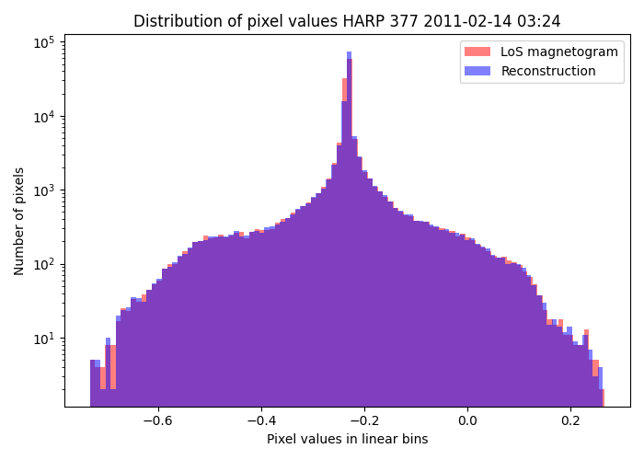
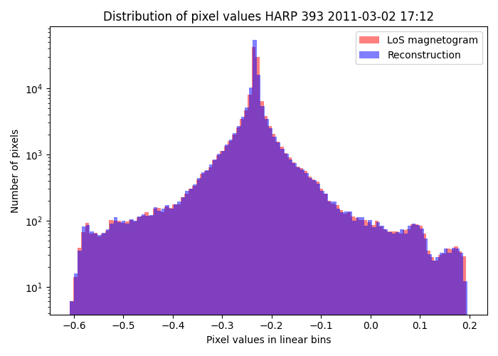
Results: Autoencoder

Slide 23
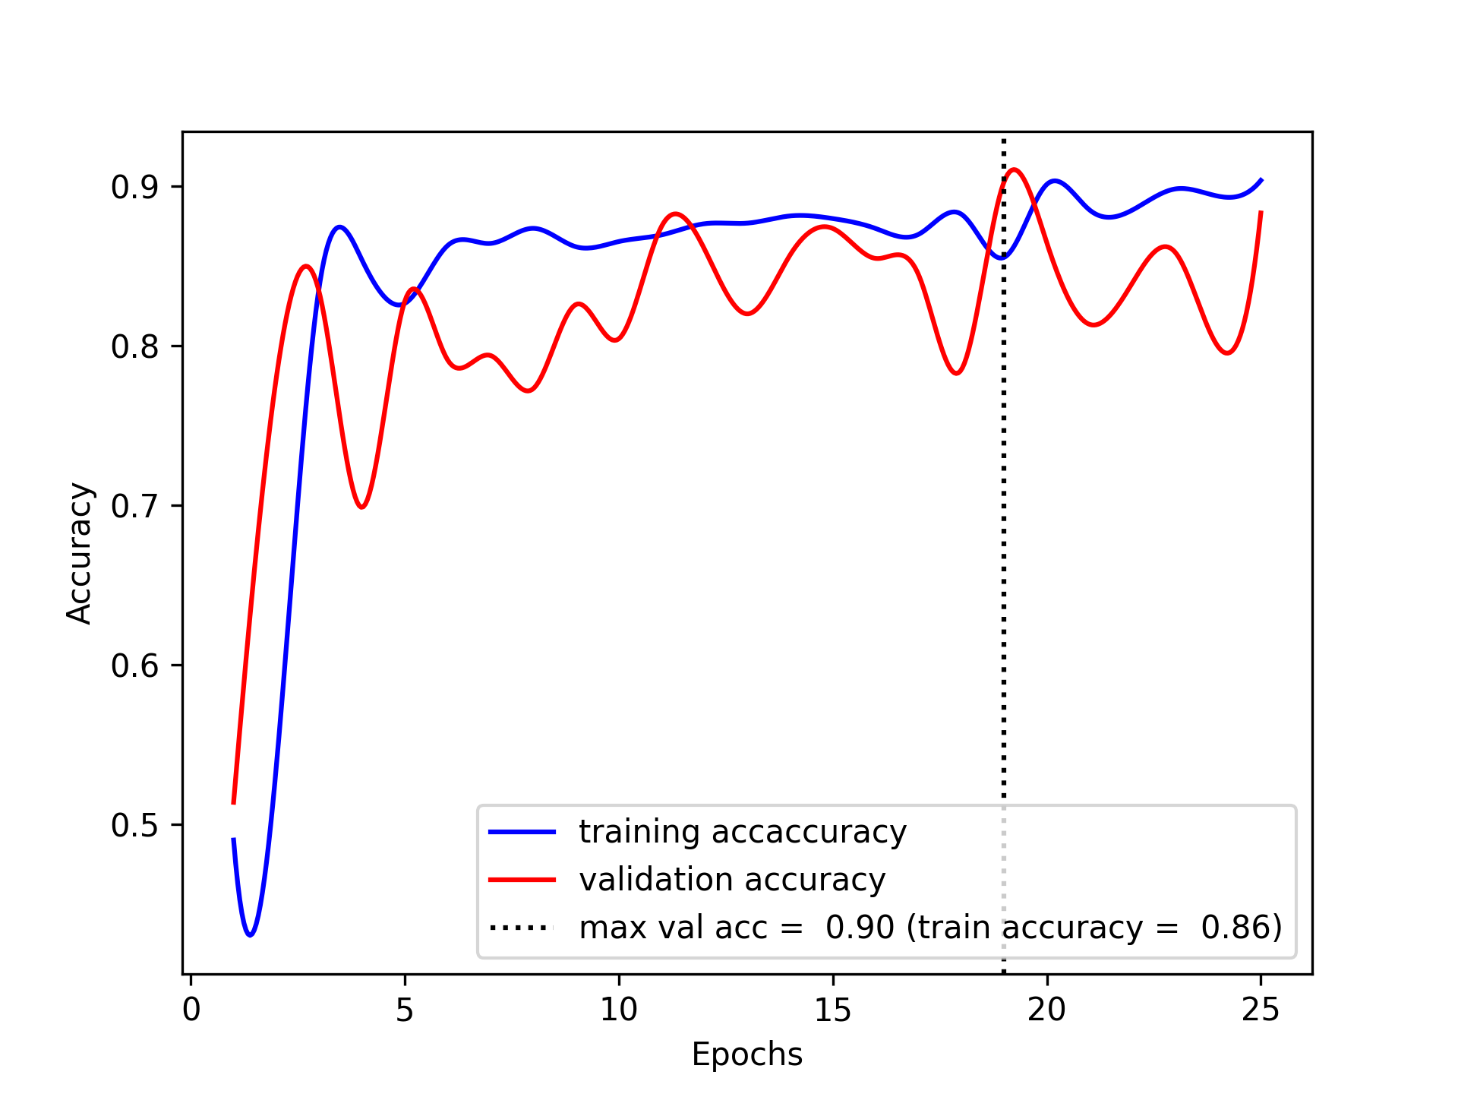
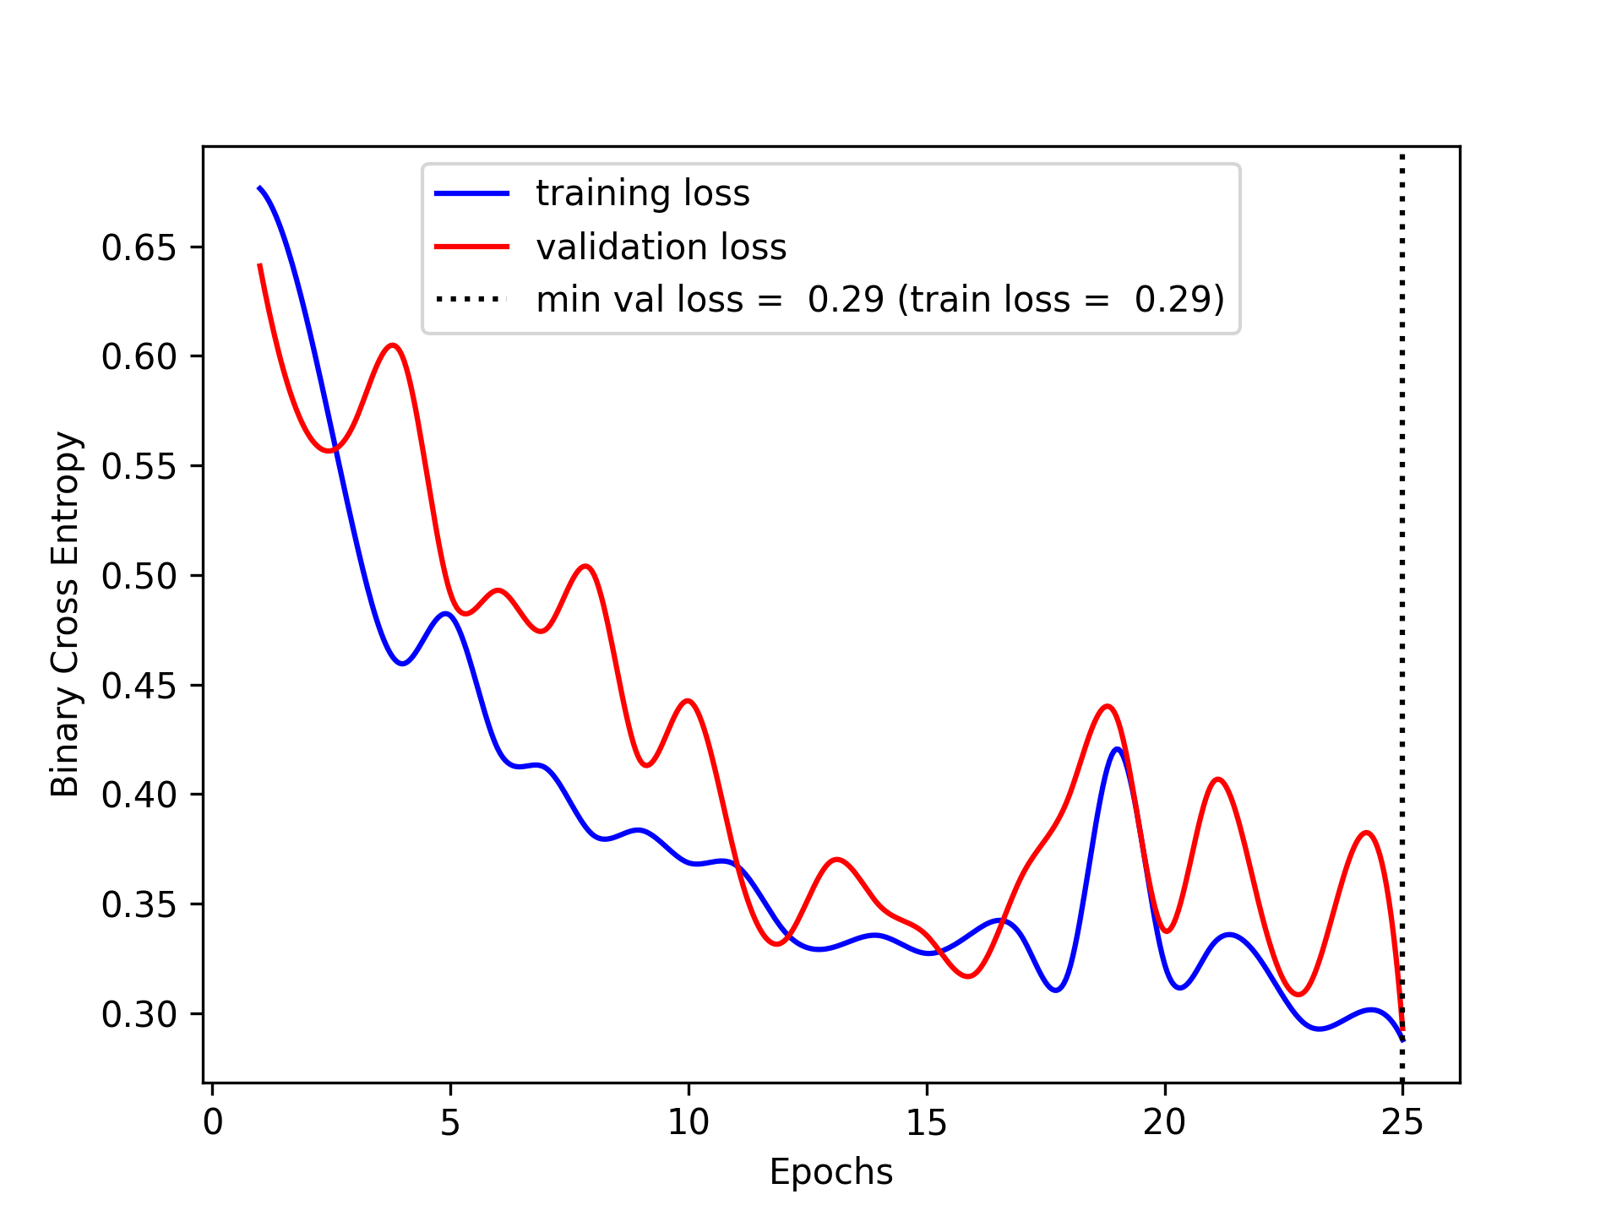
Results: Classifier

Slide 24
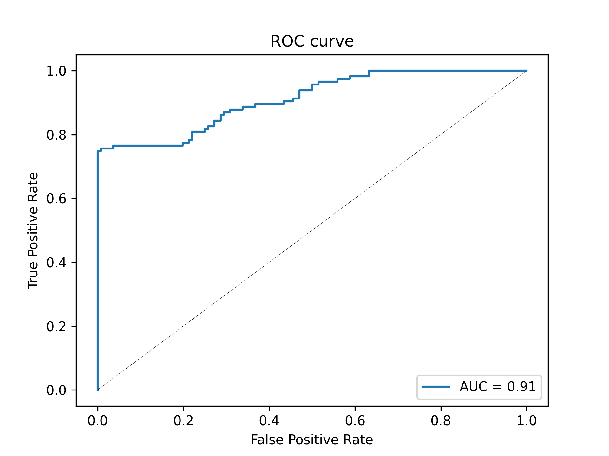
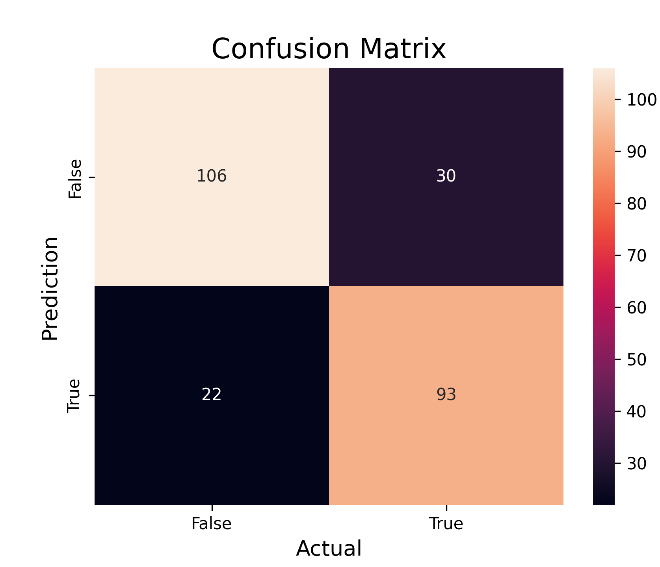
Results: Classifier

Slide 25
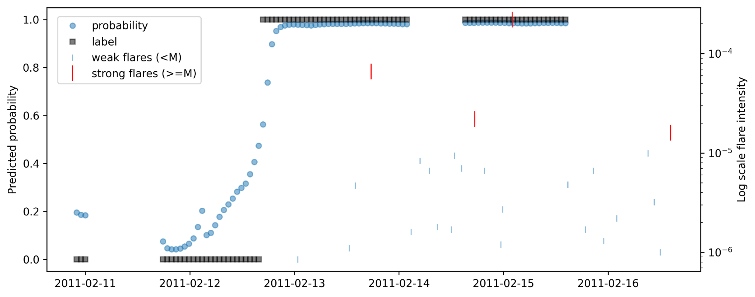
Results: Classifier

Slide 26
Conclusion and Future Perspectives
We have presented a deep learning algorithm for the prediction of strong solar flare using sequences of SDO/HMI line-of-sight magnetograms covering the period from January 2010 to December 2022. We model our problem as a binary classification task that distinguishes M- and X-class flare-producing regions from flare-quiet regions.
We developed a flexible pipeline to merge data from multiple sources (GOES and SDO/HMI) and extract and label sequences of images for the subsequent classification algorithm.
We use sequences of 24 hours of observations and to produce prediction 24 hours ahead, future developments of the present work will evaluate how different time windows improve or deteriorate the accuracy of classification.
We rebalance the training and the validation set to prevent the predictor from biasing toward the majority nonevent class simply due to its volume, and we rebalance the test set to evaluate the predictor’s generalization ability under the same climatological rate as it is trained. Future works will focus on applying more sophisticated methods to learn from imbalanced data while preserving its integrity.
Our proposed methodology achieves a remarkable 90% test accuracy an it is validated against test case AR HARP 377, demonstrating its efficacy in solar flare prediction. Nevertheless the training process of the classifier is not stable, we will try different models and methods like exponential moving average to improve the stability of the training model.

