Slide 1


The application of the Stack-CNN algorithm for the analysis of Mini-EUSO data
International Conference on
MACHINE LEARNING FOR ASTROPHYSICS
2nd edition
ANTONIO GIULIO CORETTI
for the JEM-EUSO Collaboration

Slide 2
overview
1 → Mini-EUSO
2 → Stack-CNN
3 → Optimization
4 → Results
2nd international conference on machine learning for astrophysics

Slide 3
1 → Mini-EUSO
2 → Stack-CNN
3 → Optimization
4 → Results
2nd international conference on machine learning for astrophysics

Slide 4
The detector
Mini-EUSO
MAIN FEATURES
Pathfinder experiment for JEM-EUSO
Onboard the ISS since 2019
To study UHECRs after the interaction with the atmosphere analysing UV light signals
Also able to detect meteors & space debris
~400 km
2nd international conference on machine learning for astrophysics

Slide 5
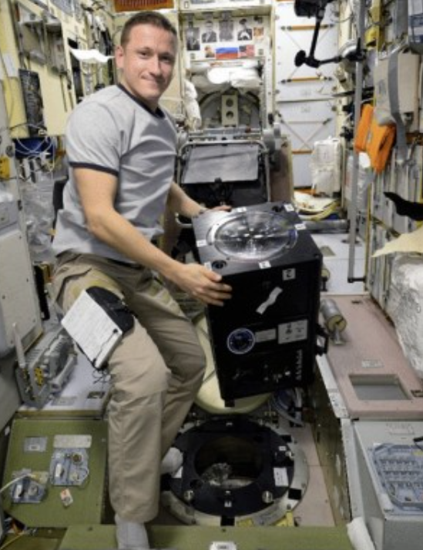
The detector
Mini-EUSO
~400 km
2nd international conference on machine learning for astrophysics

Slide 6
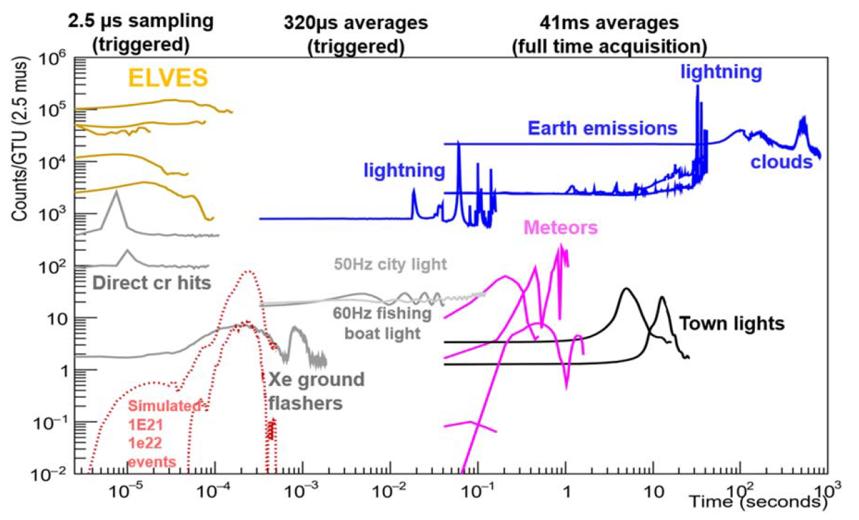
different signals
Mini-EUSO
D1
x 128
D2
x 128
D3
METEORS [1]
(and expected SPACE DEBRIS)
[1] Bacholle+ 2021
2nd international conference on machine learning for astrophysics

Slide 7
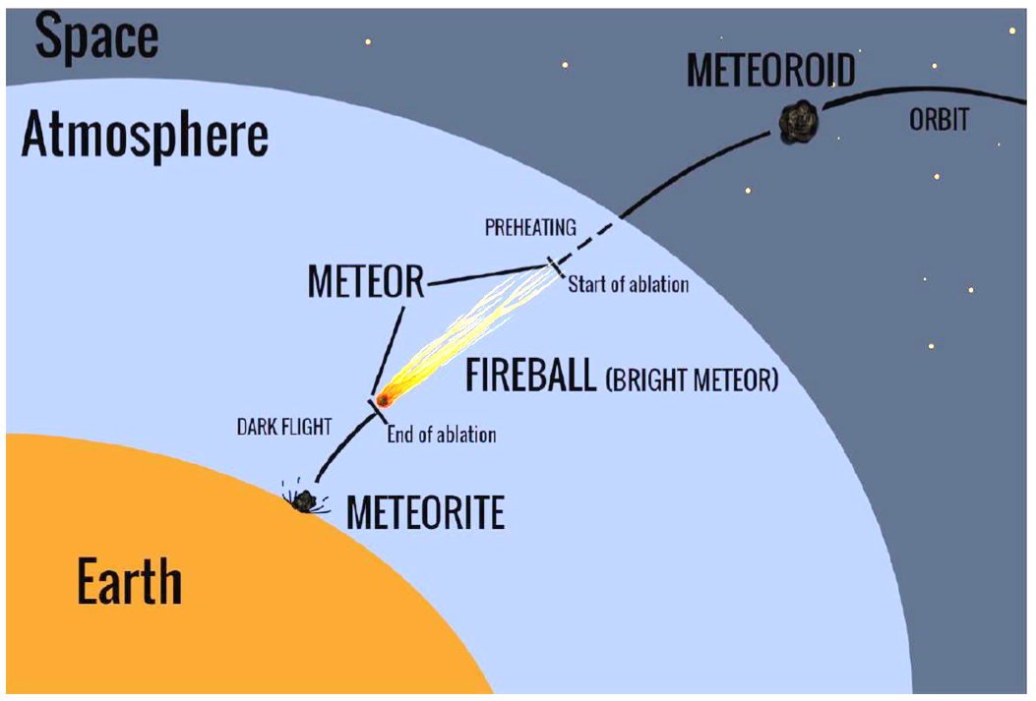
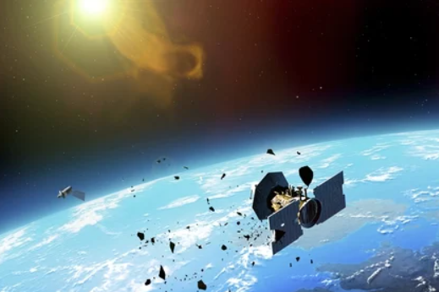
meteors vs Space debris
Mini-EUSO
Small asteroid (meteoroid) entering Earth’s atmosphere
Visible due to the light emission during the ablation phase
Short track in Mini-EUSO data
Artificial and non-functional objects orbiting Earth
Visible due to the Sun albedo
Long track in Mini-EUSO data, crossing all the FOV
METEOR
SPACE DEBRIS (SD)
REFLECTED
SUNLIGHT
2nd international conference on machine learning for astrophysics

Slide 8
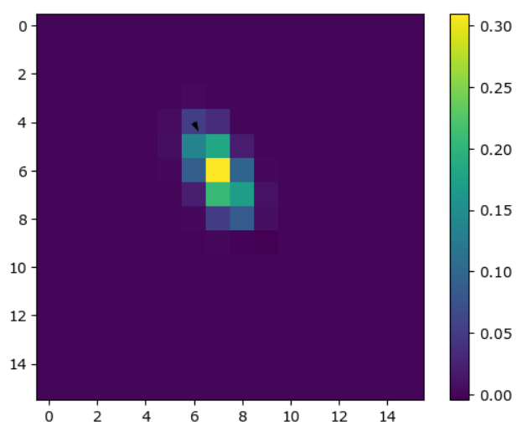
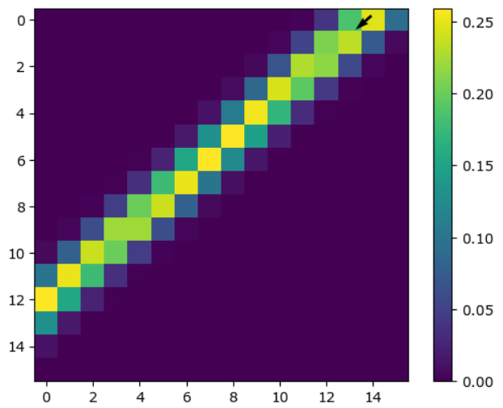
meteors vs Space debris
Mini-EUSO
Small asteroid (meteoroid) entering Earth’s atmosphere
Visible due to the light emission during the ablation phase
Short track in Mini-EUSO data
Artificial and non-functional objects orbiting Earth
Visible due to the Sun albedo
Long track in Mini-EUSO data, crossing all the FOV
METEOR
SPACE DEBRIS (SD)
2nd international conference on machine learning for astrophysics

Slide 9
1 → Mini-EUSO
2 → Stack-CNN
3 → Optimization
4 → Results
2nd international conference on machine learning for astrophysics

Slide 10
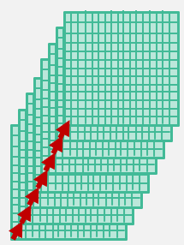
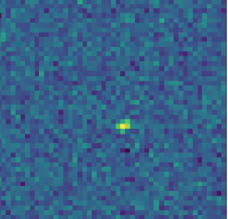

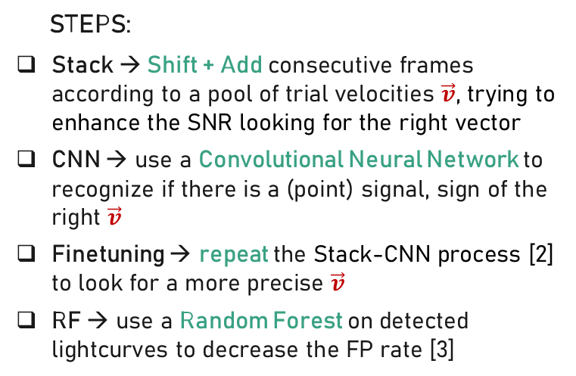
The algorithm
Stack-CNN
Italian patent
N° 102021000009845
TRIAL
VELOCITY VECTOR
STACKING
STEPS:
Stack → Shift + Add consecutive frames according to a pool of trial velocities $\vec{v}$, trying to enhance the SNR looking for the right vector
CNN → use a Convolutional Neural Network to recognize if there is a (point) signal, sign of the right $\vec{v}$
Finetuning → repeat the Stack-CNN process [2] to look for a more precise $\vec{v}$
RF → use a Random Forest on detected lightcurves to decrease the FP rate [3]
$$\vec{v}=(v_{x}, v_{y})$$
CNN
STACKED IMAGE
Convolutional
Dense layer
Max Pooling
Stacked image
Binary classifier
Convolutional
Max Pooling
Dense layer
Convolutional
[2] Montanaro+ 2022
[3] Olivi+ 2024
2nd international conference on machine learning for astrophysics

Slide 11



The flow chart
Stack-CNN
9 fine-tuning $\vec{v}$
Every 8 gtu
2° STACKING
20 frame
96 $\vec{v}$
CNN check?
1° STACKING
8 frame
RF check?
CNN check?
Best $\vec{v}$selection
2nd international conference on machine learning for astrophysics

Slide 12
Run times
Stack-CNN
Detected* meteors: 221
* Meteors in common with a database [5]
Where can we optimize?
2nd international conference on machine learning for astrophysics

Slide 13
1 → Mini-EUSO
2 → Stack-CNN
3 → Optimization
4 → Results
2nd international conference on machine learning for astrophysics

Slide 14
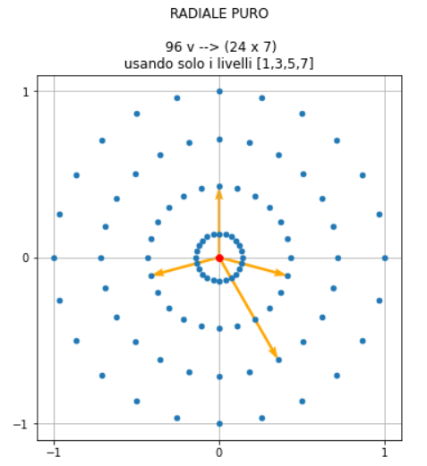
VELOCITIES POOL
Optimization
24 directions
4 magnitudes
ORIGINAL
96 velocities
2nd international conference on machine learning for astrophysics

Slide 15
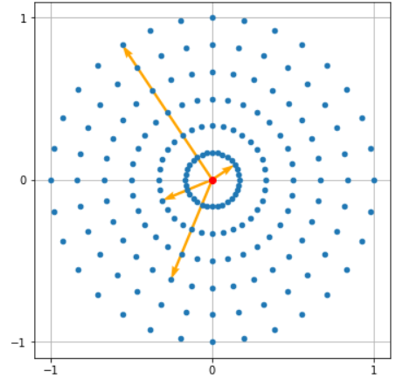
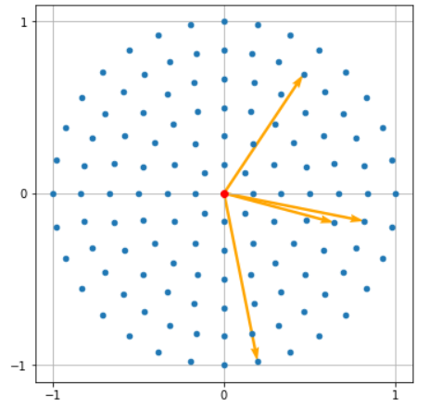
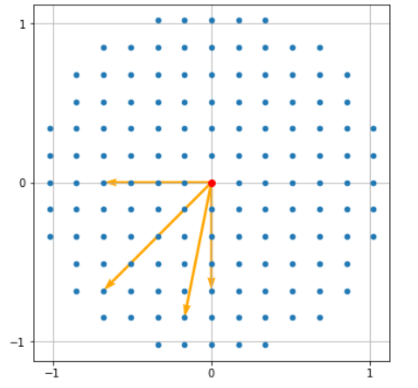
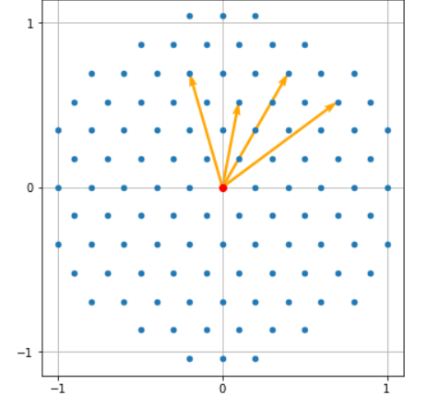
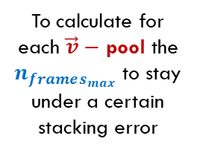
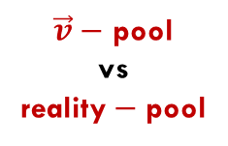
VELOCITIES POOL
Optimization
PURE RADIAL
MODIFIED RADIAL
$\vec{v}−$ pool
vs
reality$−$pool
ORIGINAL
96 velocities
SQUARE GRID
TRIANGULAR GRID
To calculate for each $\vec{v}−$ pool the $n_{frames_{max}}$ to stay under a certain stacking error
2nd international conference on machine learning for astrophysics

Slide 16
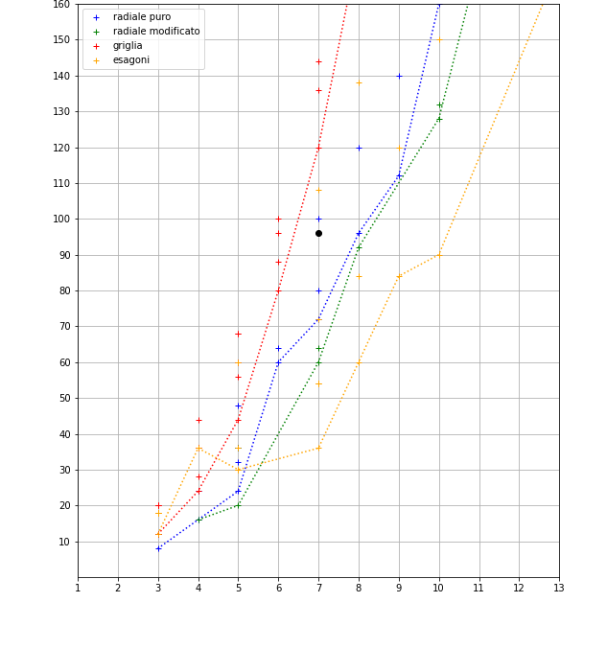
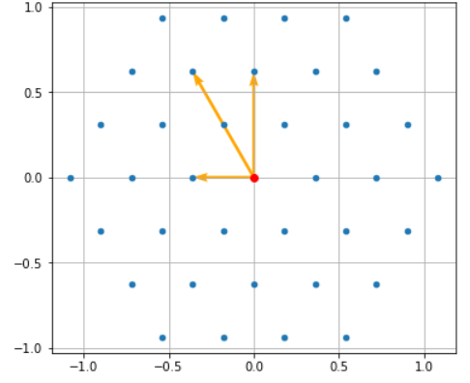




VELOCITIES POOL
Optimization
$$n_{v}$$
ORIGINAL
96 $\vec{v}$
TRIANGULAR GRID
36 $\vec{v}$
$$n_{frames_{max}}$$
2nd international conference on machine learning for astrophysics

Slide 17

The flow chart
Optimization
9 fine-tuning $\vec{v}$
Every 8 gtu
2° STACKING
20 frame
96 $\vec{v}$
CNN check?
1° STACKING
8 frame
RF check?
CNN check?
Best $\vec{v}$ selection
2nd international conference on machine learning for astrophysics

Slide 18



The flow chart
Optimization
7 fine-tuning $\vec{v}$
Every 8 gtu
2° STACKING
20 frame
36 $\vec{v}$
CNN check?
1° STACKING
8 frame
RF check?
CNN check?
Best $\vec{v}$ selection
2nd international conference on machine learning for astrophysics

Slide 19
Run times
Optimization
Detected* meteors: 221
* Meteors in common with a database [5]
2nd international conference on machine learning for astrophysics

Slide 20


Run times
Optimization
$$↓70\%$$
Detected* meteors: 221
Detected* meteors: 211
$$↓5\%$$
* Meteors in common with a database [5]
2nd international conference on machine learning for astrophysics

Slide 21
1 → Mini-EUSO
2 → Stack-CNN
3 → Optimization
4 → Results
2nd international conference on machine learning for astrophysics

Slide 22
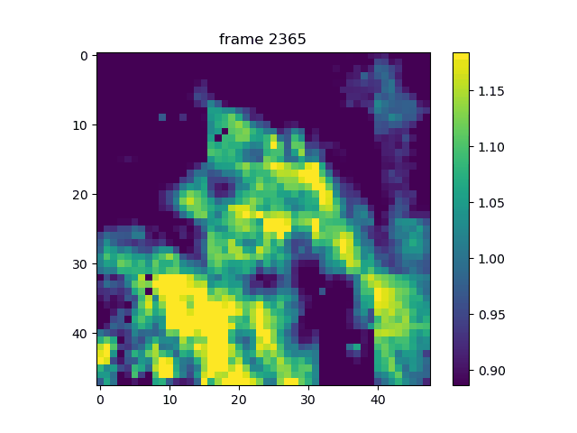
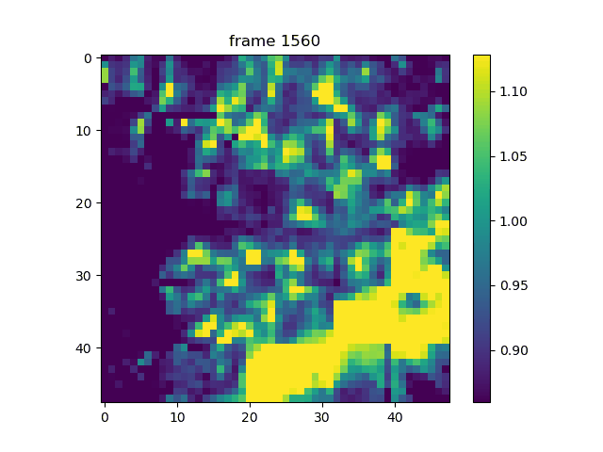
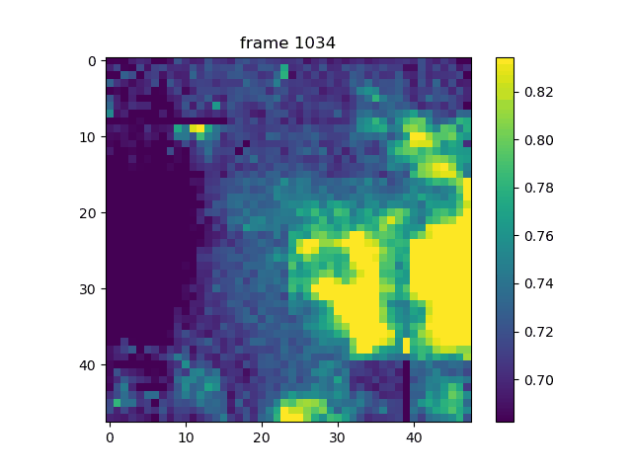
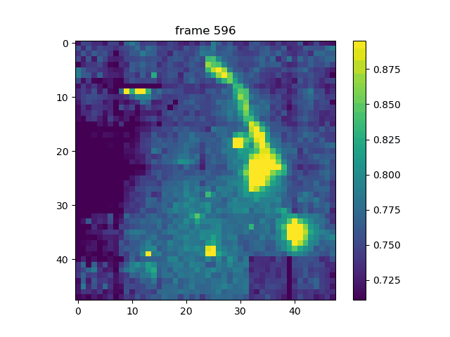
Mini-euso Data
Results
METEORS
M
M?
2nd international conference on machine learning for astrophysics

Slide 23
Mini-euso Data
Results
2nd international conference on machine learning for astrophysics

Slide 24
Mini-euso Data
Results
2nd international conference on machine learning for astrophysics

Slide 25
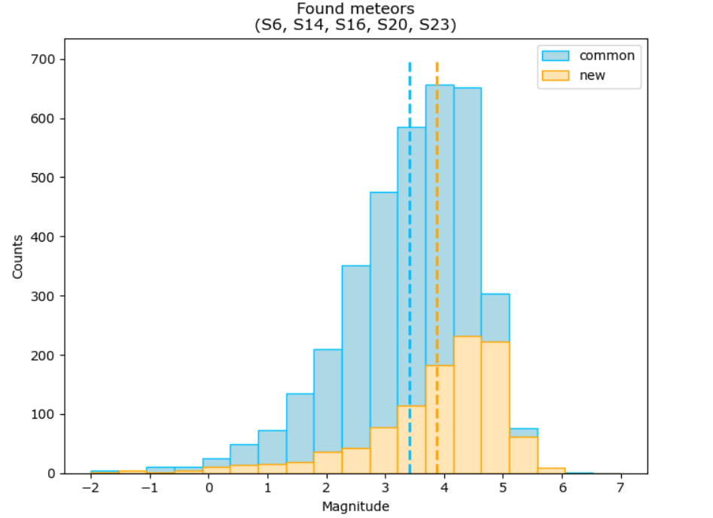
Mini-euso Data
Results
SPACE DEBRIS?
2nd international conference on machine learning for astrophysics

Slide 26
Mini-euso Data
Results
SPACE DEBRIS
OBSERVATION LIMITS
Light pollution from Earth due to the fixed orientation to the nadir direction
Not optimal altitude due to the very low density of space debris below 400 km
Scarce availability of observation windows (need to leave room for other experiments)
~400 km
2nd international conference on machine learning for astrophysics

Slide 27

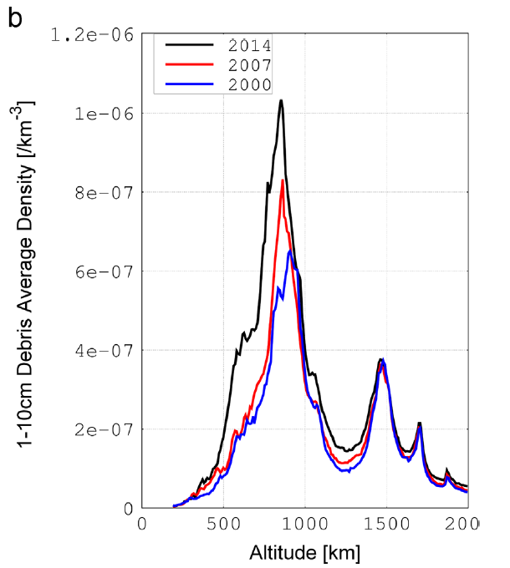
Mini-euso Data
Results
As much debris as possible → LEO satellite at ~ 800 km [4]
As much light as possible during all the year → orbital plane ⊥ sun-vector, and sun-synchrony
~800 km
~400 km
[4] Ebisuzaki, T., et al. 2015.
2nd international conference on machine learning for astrophysics

Slide 28
conclusions
Developed a meant-to-be online ML algorithm to detect moving objects in a variegate background
Better performance on Mini-EUSO data compared to the standard meant-to-be online algorithm
Can be applied to search for space debris or for whatever pixel-size moving object
Potential application for cosmic rays Mini-EUSO data as an offline trigger
Next step:
Put the algorithm in hardware (FPGA or similar) and demonstrate the online trigger potential on meteors/space debris data
2nd international conference on machine learning for astrophysics

Slide 29
REFERENCES
[1] Bacholle, S., et al. “Mini-EUSO mission to study Earth UV emissions on board the ISS”. The Astrophysical Journal Supplement Series 2021, 253.
https://doi.org/10.3847/1538-4365/abd93d.
[2] Montanaro, A., et al. “Stack-CNN algorithm: A new approach for the detection of space objects”. Journal of Space Safety Engineering 2022, 9.
https://doi.org/10.1016/j.jsse.2022.01.001.
[3] Olivi, L., et al. “Refined STACK-CNN for Meteor and Space Debris Detection in Highly Variable Backgrounds”. IEEE Journal of Selected Topics in Applied Earth Observations 2024, 17. https://doi.org/10.1109/JSTARS.2024.3397734.
[4] Ebisuzaki, T., et al. “Demonstration designs for the remediation of space debris from the International Space Station”. Acta Astronautica 2015, 112. https://doi.org/10.1016/j.actaastro.2015.03.004.
[5] Barghini, D., et al. “Observation of meteors from space with the Mini-EUSO detector on board the International Space Station”. Astronomy & Astrophysics 2024.
https://doi.org/10.1051/0004-6361/202449236.
2nd international conference on machine learning for astrophysics

Slide 30
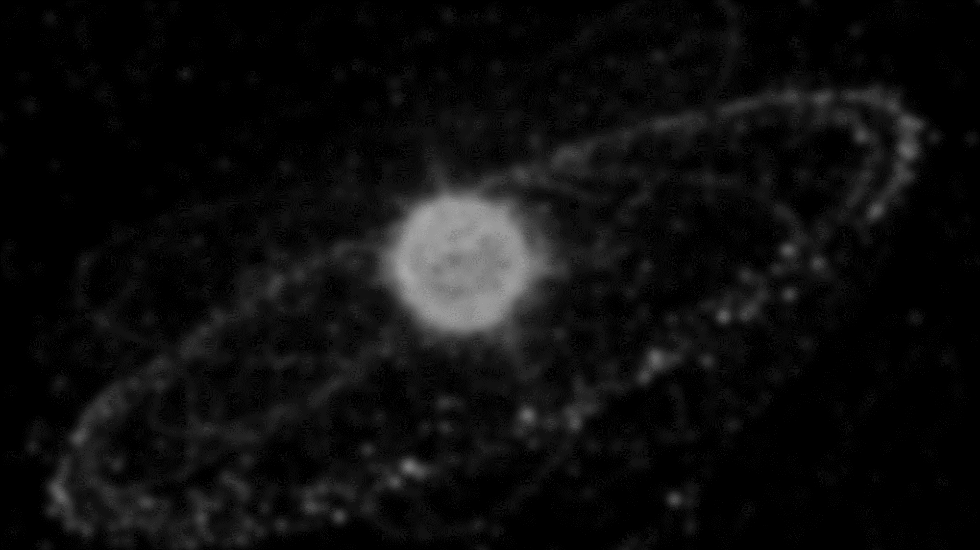

Thanks for the attention!
Questions?
Suggestions?
Antonio Giulio Coretti
University of Turin / INFN
antoniogiulio.coretti@unito.it

