Slide 1
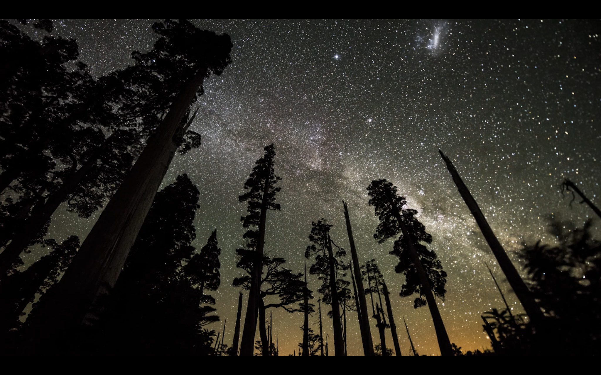

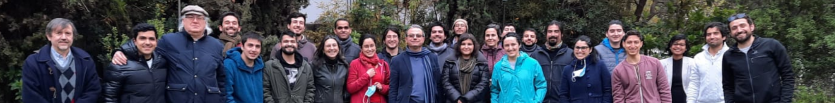


Machine learning in production for astronomy
F. Förster; G. Cabrera-Vives; F. E. Bauer; A. Bayo; M. Catelan; P. A. Estévez; S. Eyheramendy; P. Huijse; G. Pignata; P. Sánchez-Sáez; A. Muñoz-Arancibia; L. Hernández-García; I. Reyes; A. Álvarez; C. Mansilla; E. Pizarro; E. Muñoz; H. Larragaña; K. Medina; B. Gamboa; A. Mourao; J. Borissova; A. Clocchiatti; F. Elorrieta; R. Kurtev; P. Lira; J. Vergara; M. Contreras; R. Dastidar; J. Pineda; J. Silva; D. De Cicco; C. Donoso-Oliva; M. J. Graham; A. Mahabal; W. Palma; M. Pérez-Carrasco; A. Papageorgiou; P. Protopapas; E. Vera; A. Jordán; R. Roa; A. Rodríguez
http://alerce.science/

Slide 2

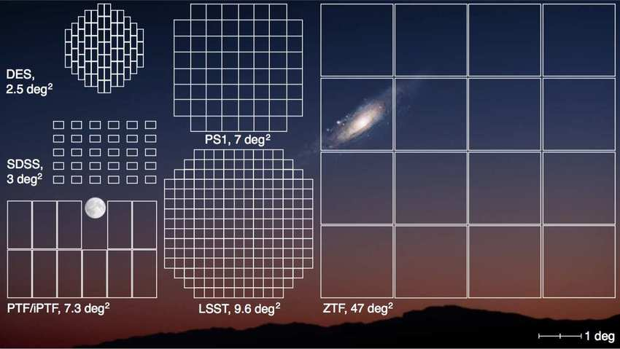
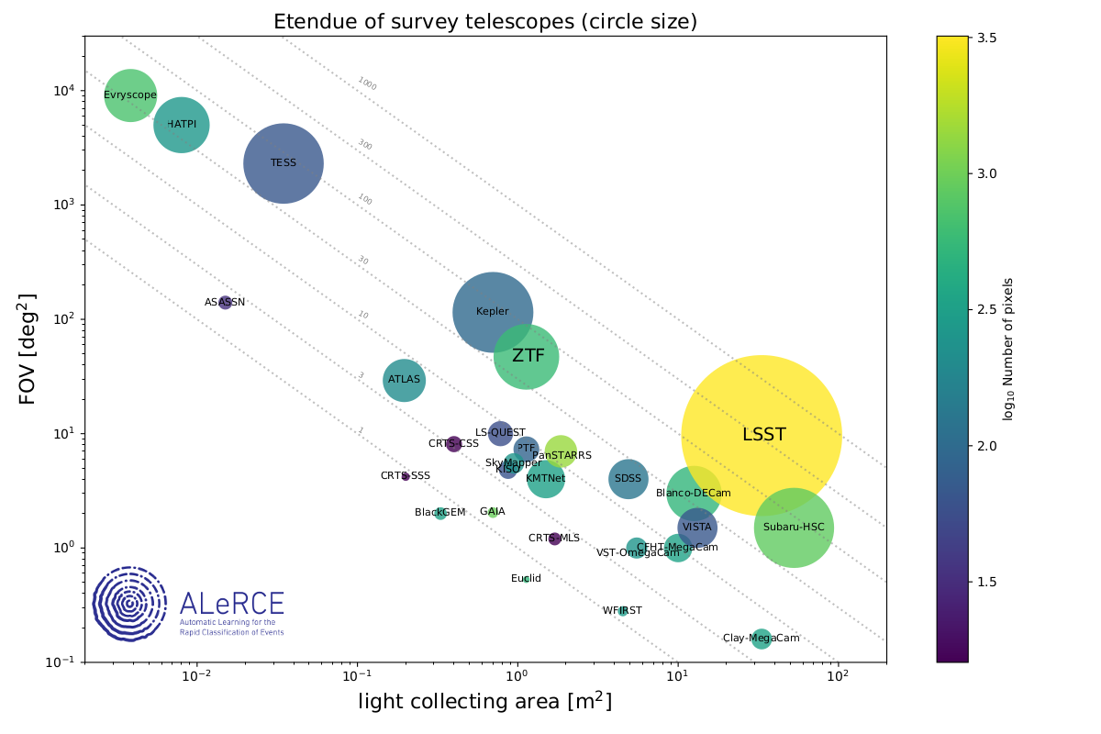
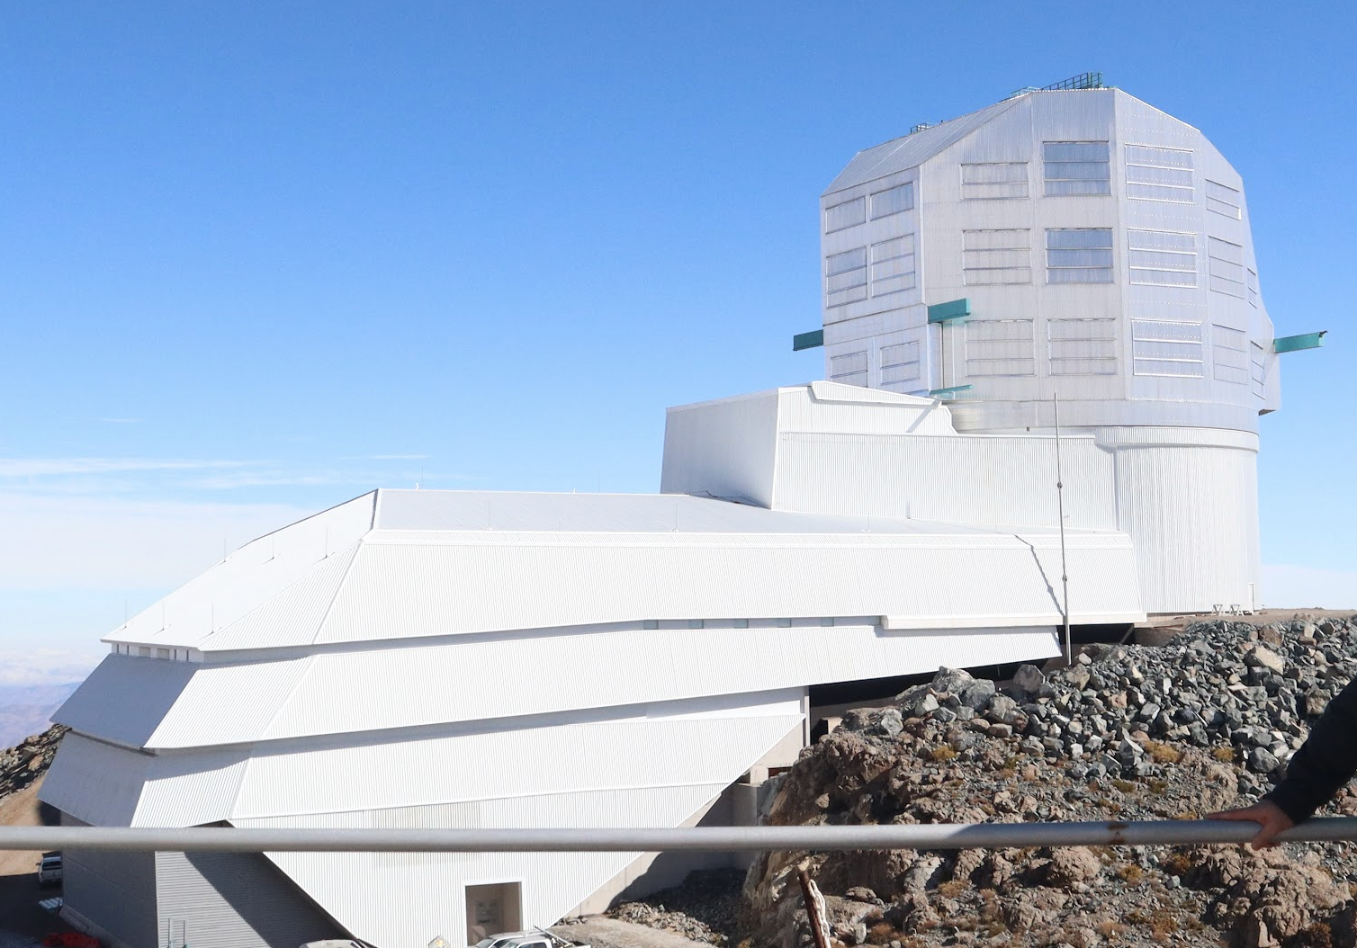
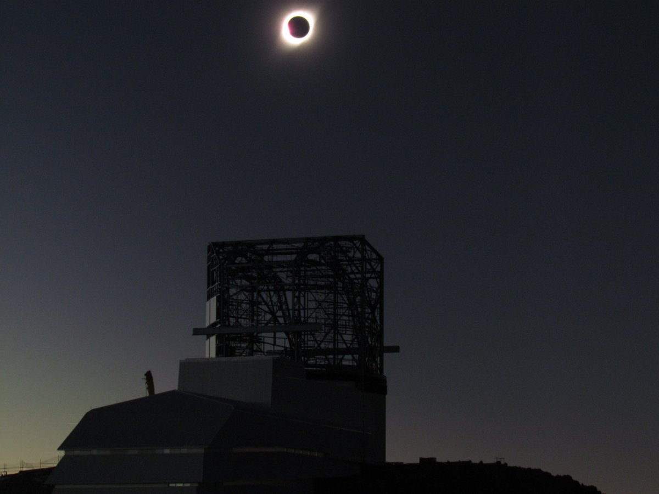
Optical survey telescopes
Circle size: etendue
Field of view [deg²]
log₁₀ Number of Megapixels
Vera C. Rubin Observatory
Collecting area [m²]
Francisco Förster (Universidad de Chile) & ALeRCE broker (MAS / CMM / DO / U. Concepción) SCMA VIII
Francisco Förster (Universidad de Chile) & ALeRCE broker (MAS / CMM / DO / U. Concepción)

Slide 3
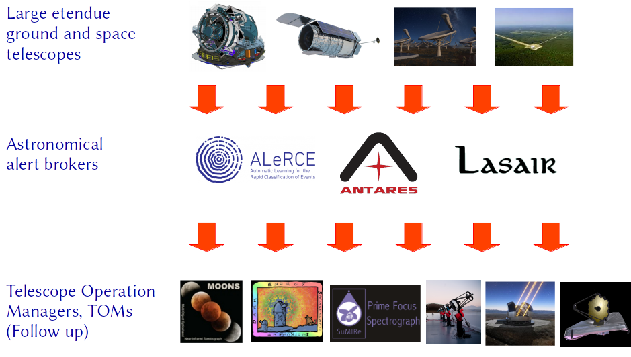











The Future Time Domain Ecosystem
Survey
telescopes
Community
Brokers
Pitt-Google
Downstream
brokers
& TOMs
POI
SNAPS
Follow-up
resources
User
community

Slide 4

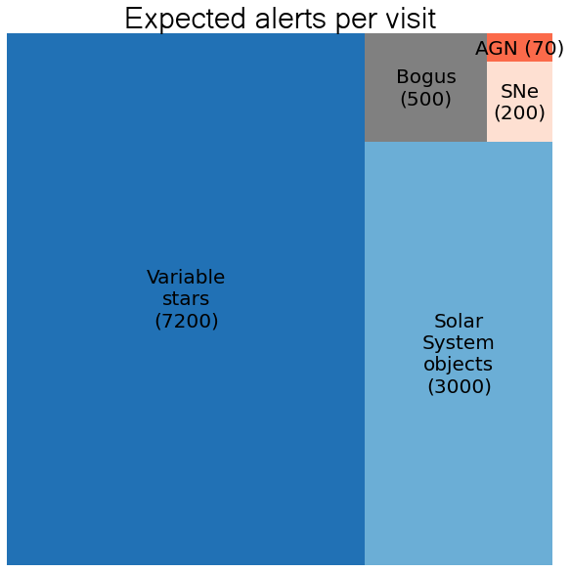
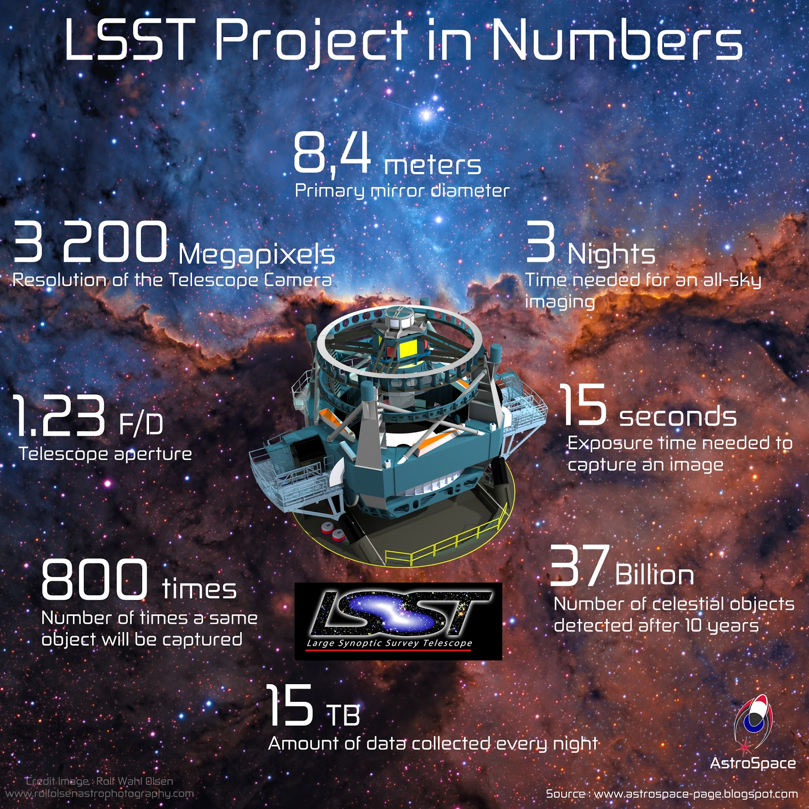
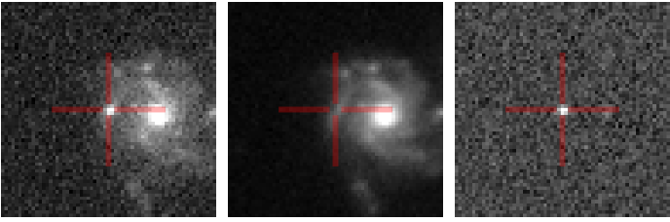

Slide 5
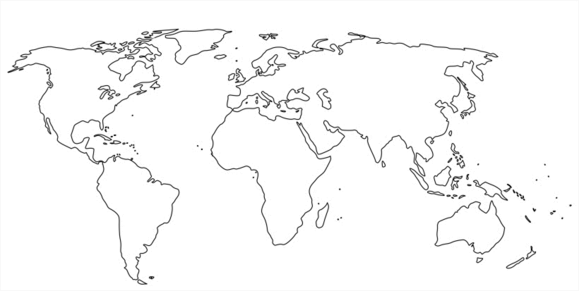
Vera C. Rubin call for community brokers
Call for letters of intent in 2019
Call for full proposals in 2020
Selection made in 2021:
Seven community brokers
Two downstream brokers
https://www.lsst.org/scientists/alert-brokers
Pitt-Google
https://alerce.science/ https://antares.noirlab.edu/ | https://ampelproject.github.io/ https://docs.babamul.dev/ | https://fink-portal.org/ https://lasair-ztf.lsst.ac.uk/ | https://pitt-broker.readthedocs.io/
Pitt-Google

Slide 6



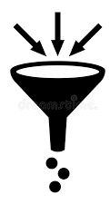






Products / services offered by brokers
Kafka streams
Crossmatch
DB + APIs + client + web interface
Filtering
Classification
Features
Watchlists
Follow up connection
Multi[messenger] streams
Outliers & anomalies
Data releases
Reproducibility

Slide 7

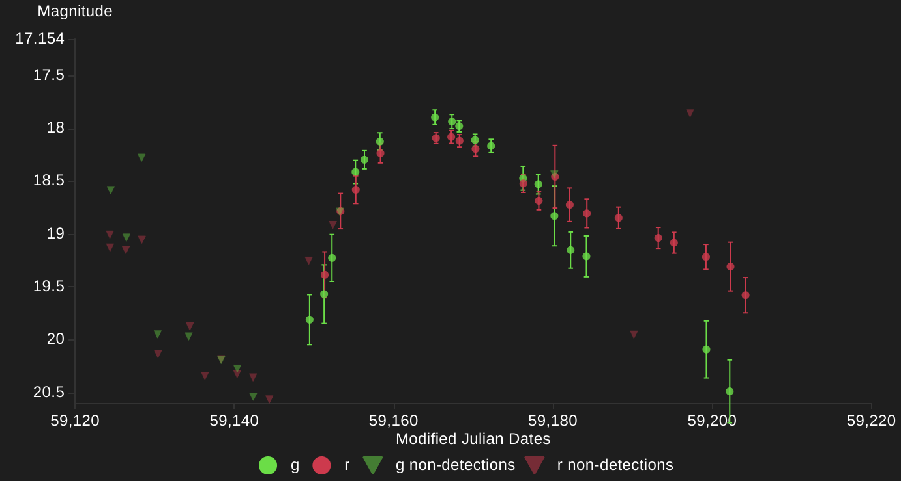
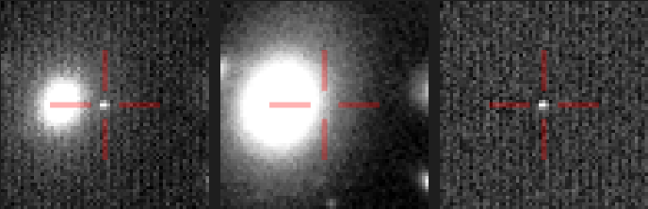
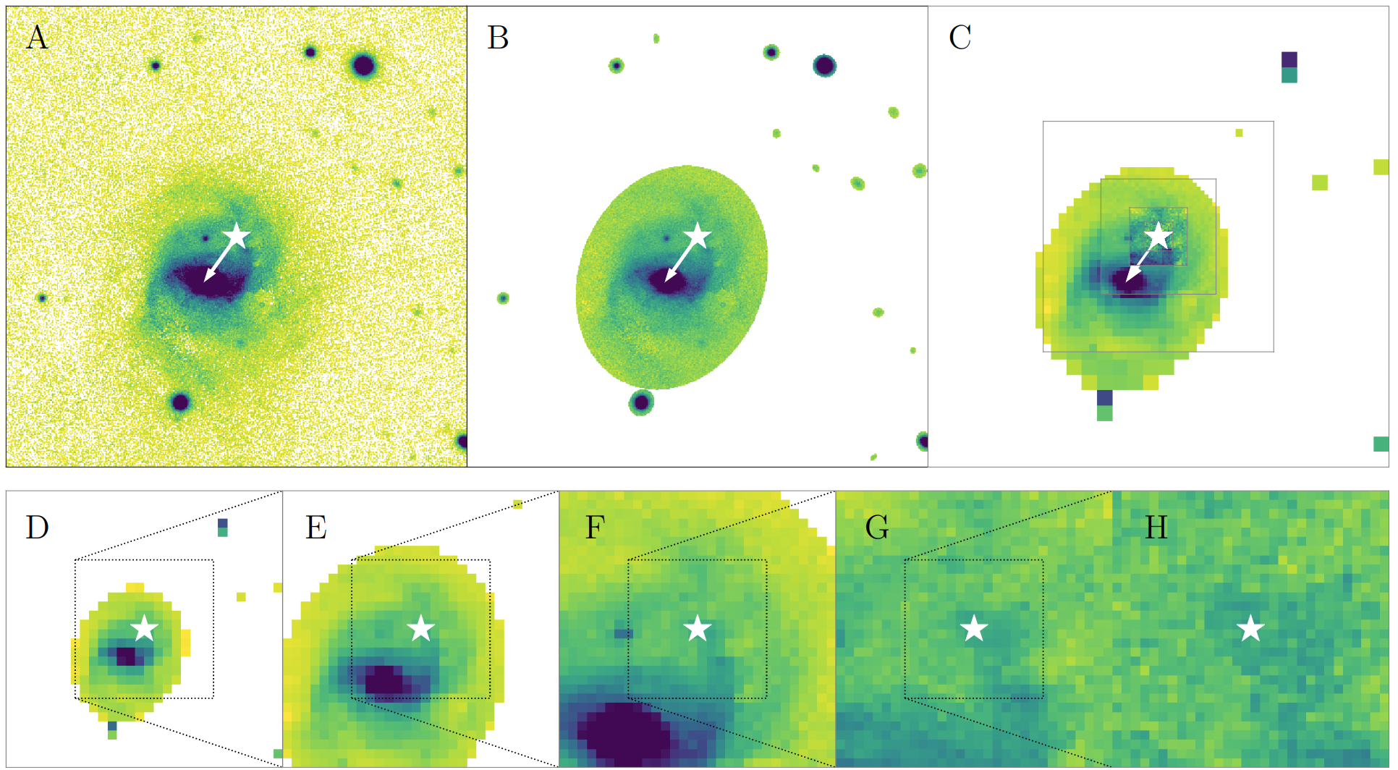
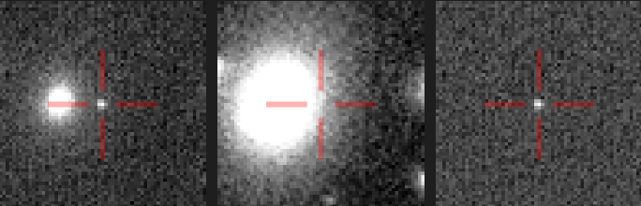
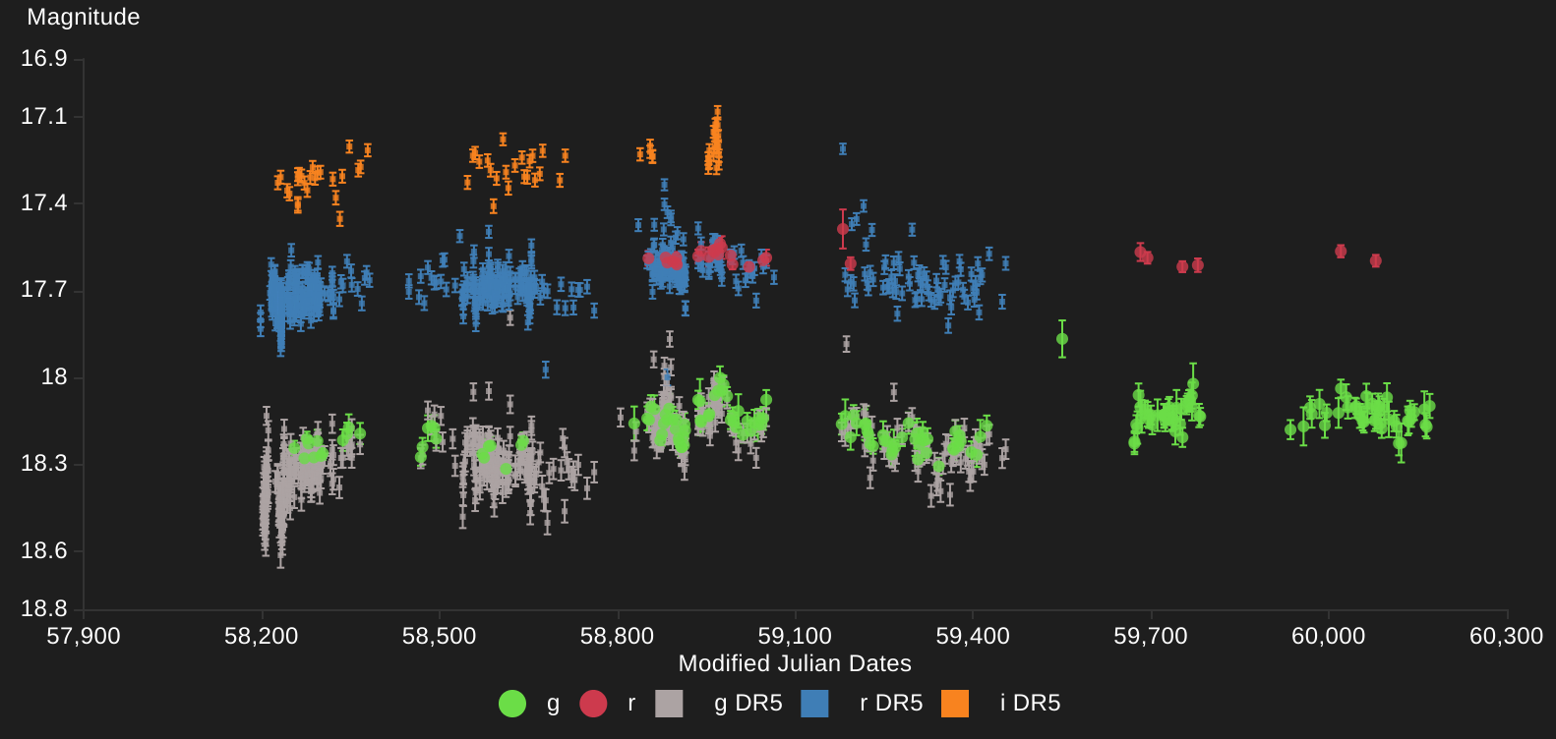
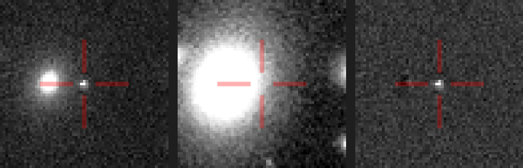
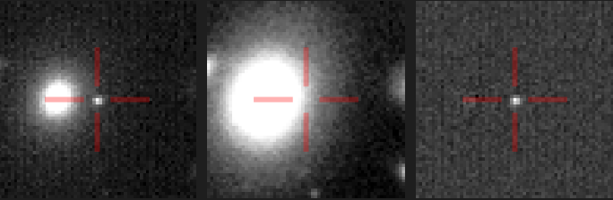
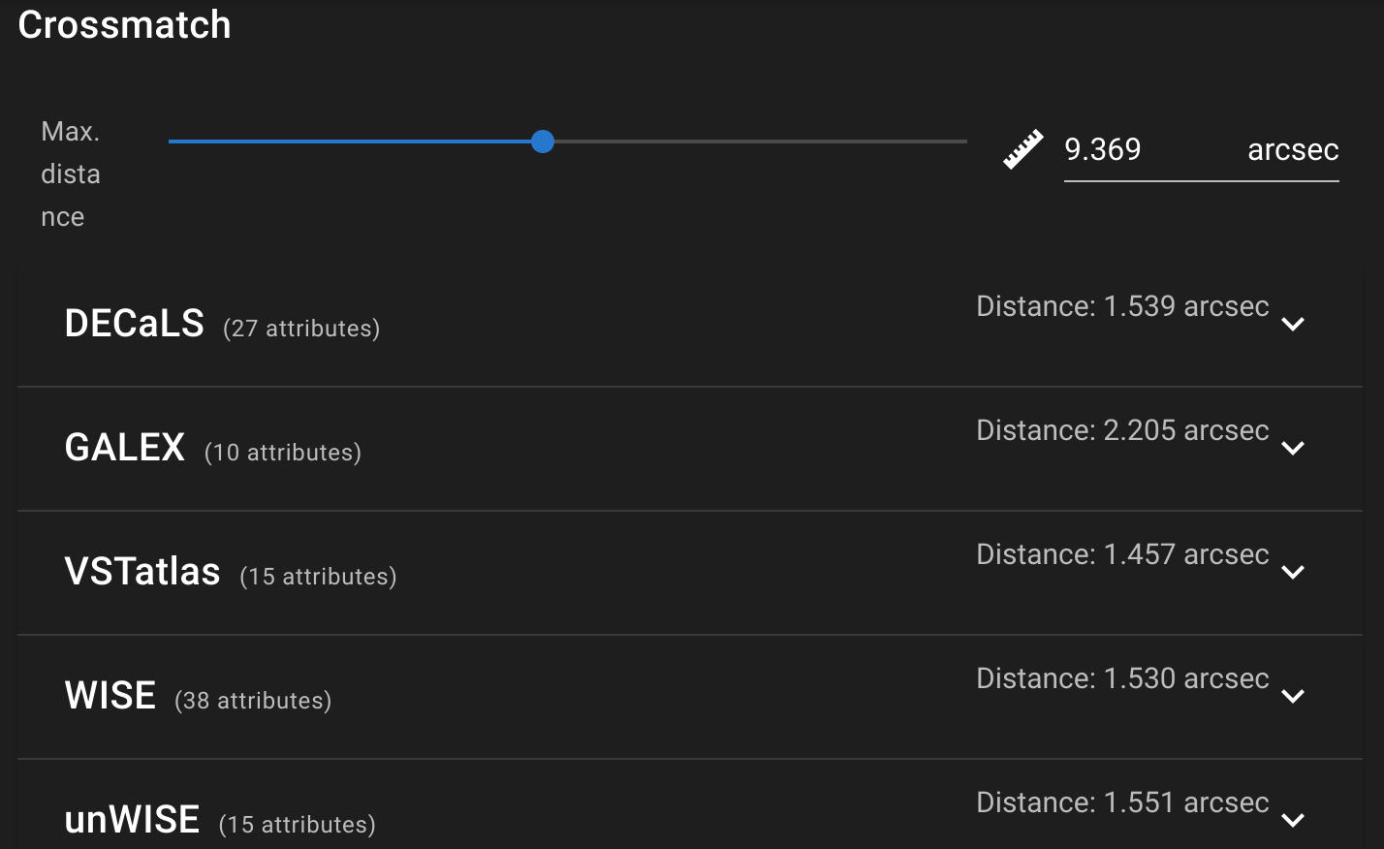
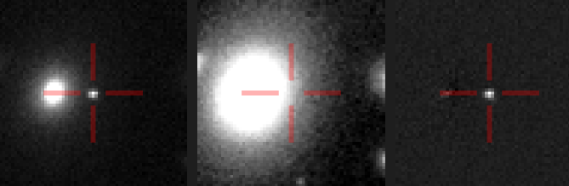
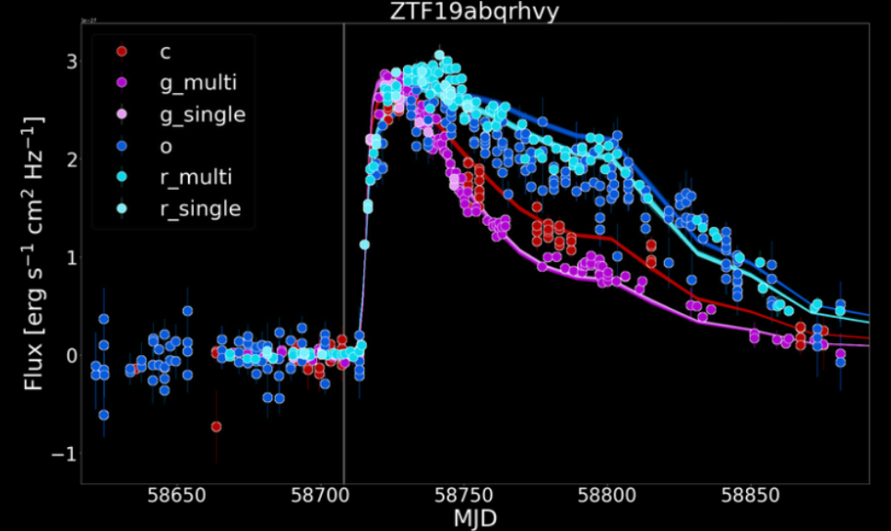
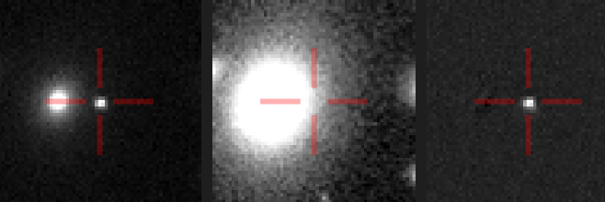
Input data
Multi band time series
Difference images, 5σ (Alert Stream)
Archival images
Image stamps
Science images, 5σ
(Data Releases)
Catalog xmatches (alert stream + external, e.g. WISE)
Difference images, all
(Forced Photometry)

Slide 8
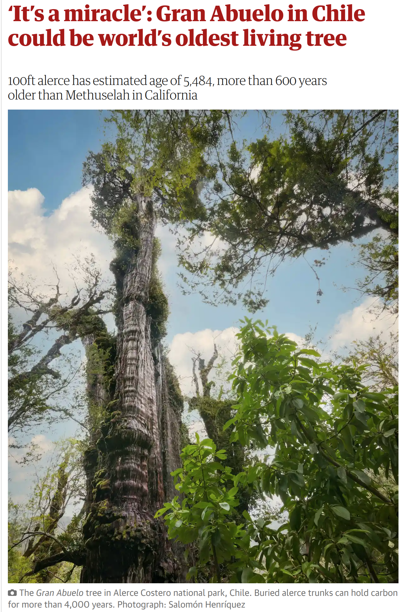
ALeRCE

Slide 9
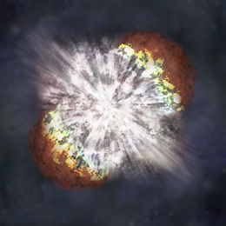
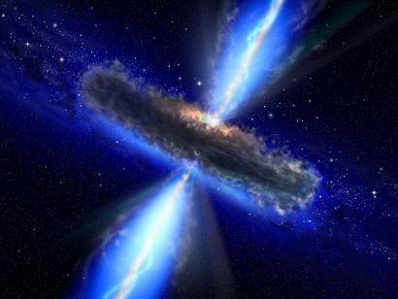
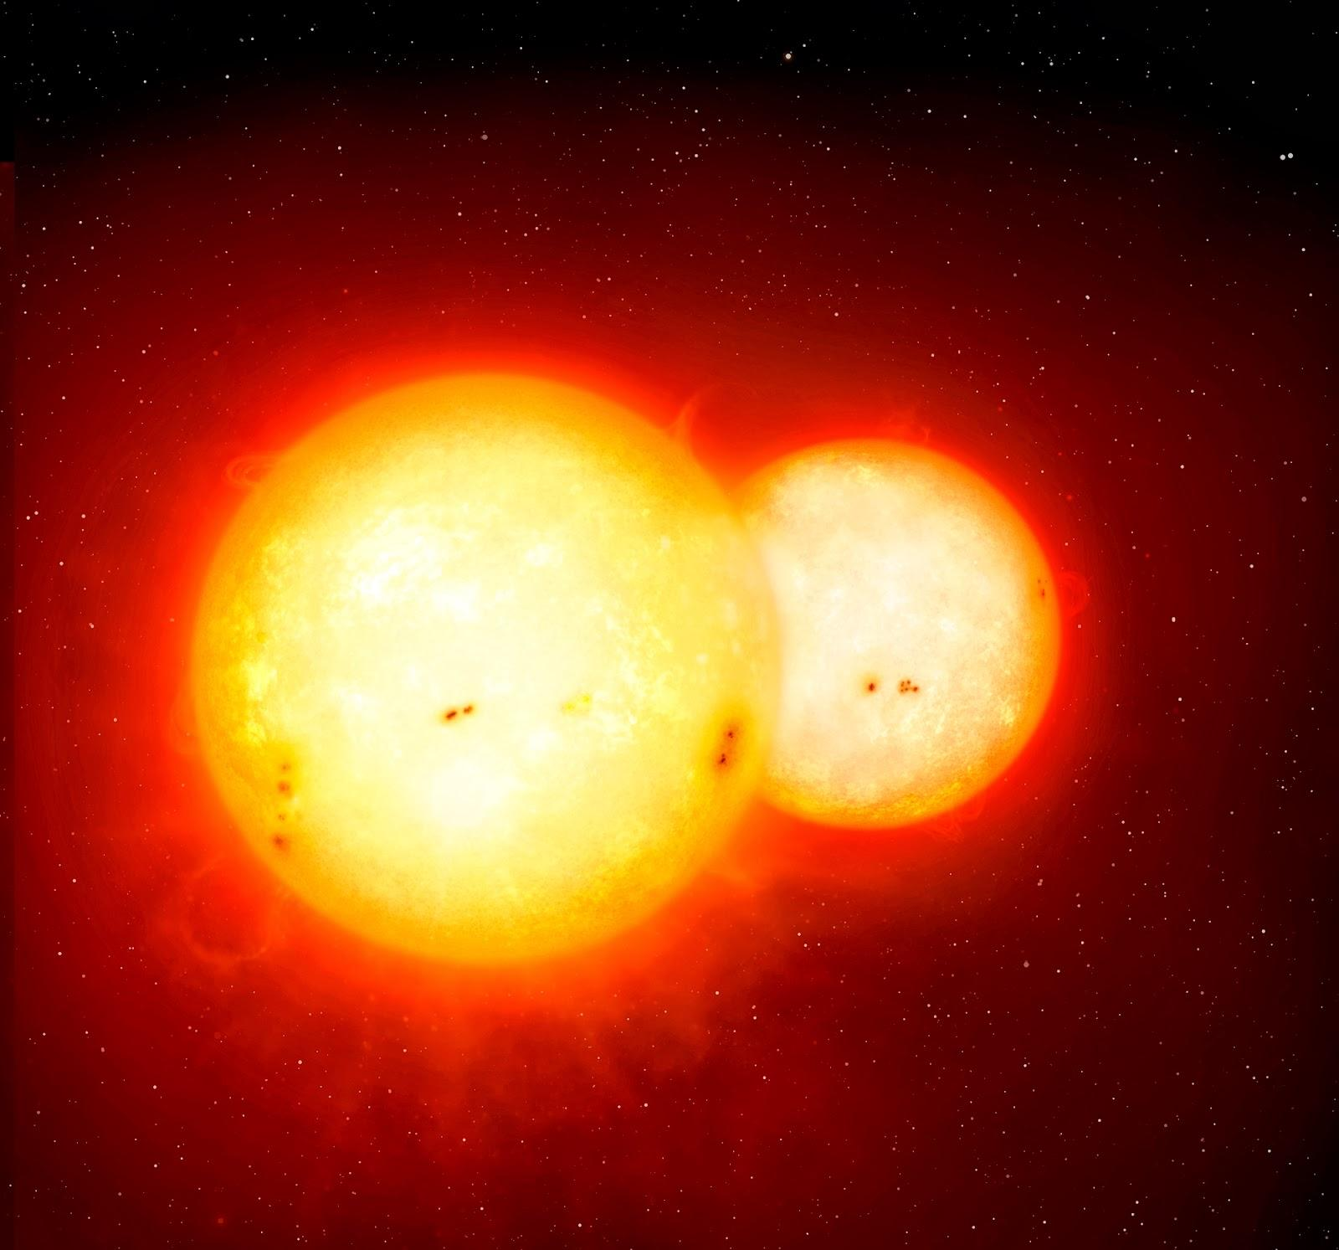
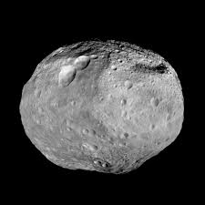
Scientific questions
Transients
Progenitors of stellar explosions (outermost layers) & explosion physics (ejecta structure).
How does the Universe expand?
Active Galactic Nuclei
Changing state AGNs, reverberation mapping, detection of intermediate mass black holes, tidal disruption events.
What is the nature of accretion in supermassive black holes?
Variable stars
Microlensing events, changing mode stellar pulsators, rapid reaction to eclipsing events, eruptive events.
How is matter distributed in our galaxy?
Solar System
Near earth objects, size distribution, collisional or rotational disintegration.
How was the solar system formed?

Slide 10
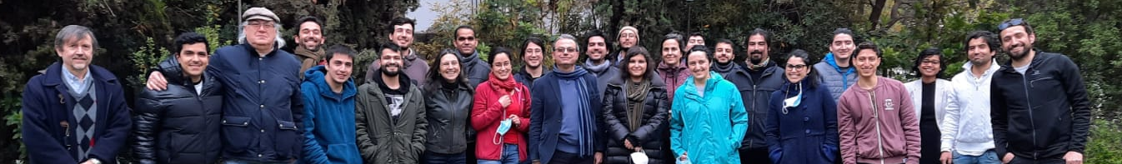
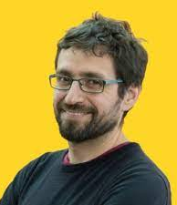
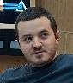
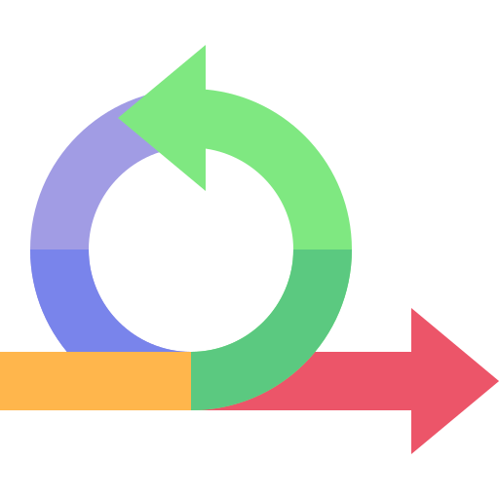
Team
PI: Guillermo
Cabrera-Vives
Astro
Lead engineer: Ignacio Reyes-Jainaga
PI (Guillermo Cabrera-Vives, since july 2024)
+ scientific board (8 researchers) + strategic board (CMM, MAS, Data Observatory & U. de Concepción).
Software engineering + machine learning + astronomy teams working using agile methodologies (8 FTE engineers, 1 FTE postdocs).
Scientific use case based interdisciplinary teams.
SW
ML
Astro
Astro
Users
SW
ML
SW
ML
Astro
Alerts
Platform
SW
ML
Batch processing

Slide 11
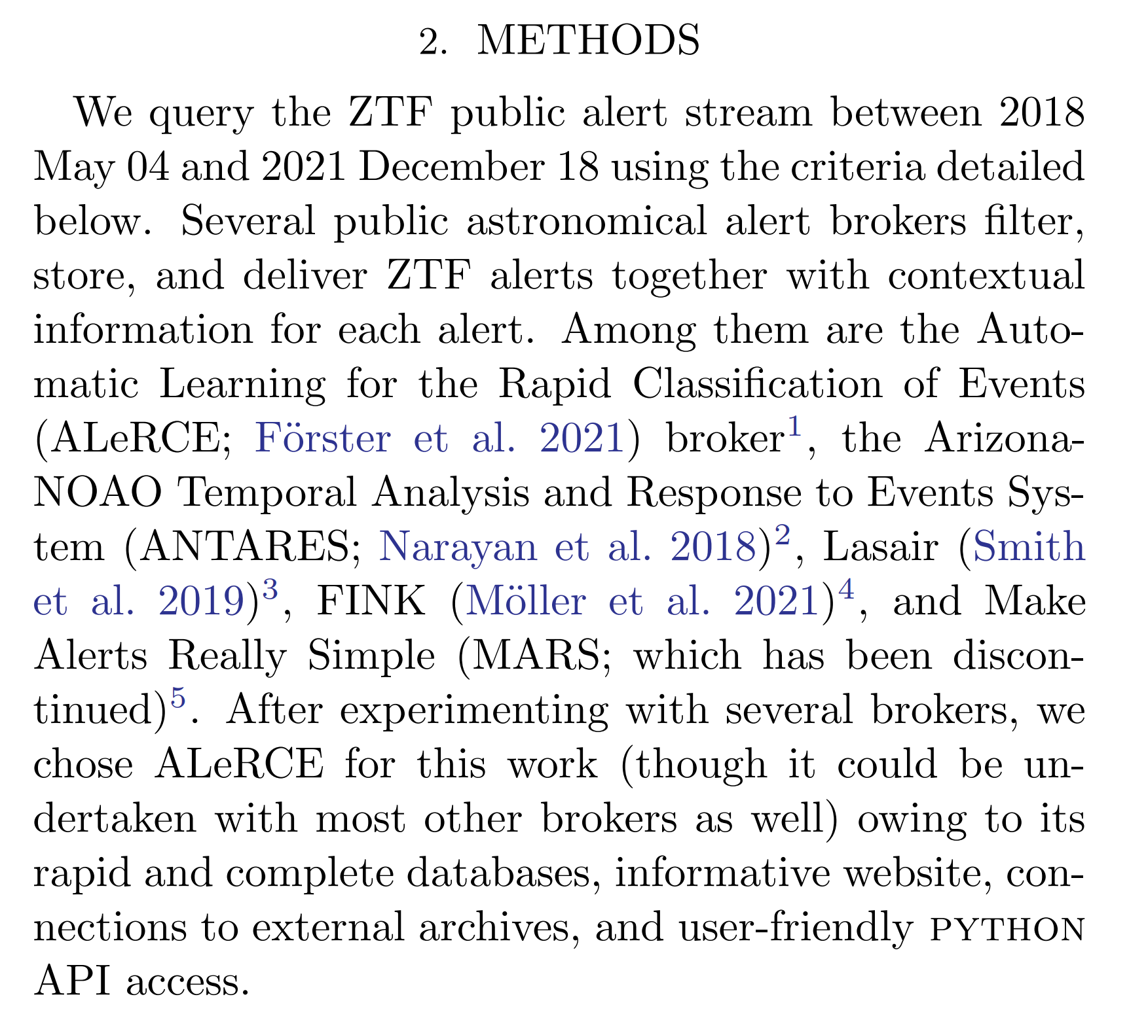
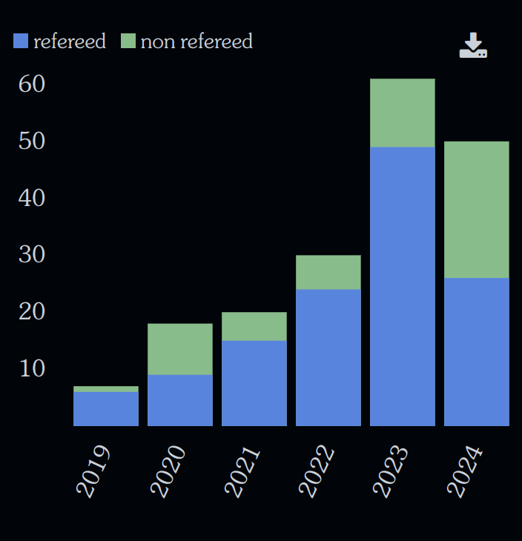
Publications
20 accepted publications
Light curve classifier (Sánchez-Sáez+2021, AJ)
Presentation paper (Förster+2021, AJ)
Stamp classifier (Carrasco-Davis+2021, AJ)
Changing state AGN (Sánchez-Sáez+2021, AJ)
Changing state AGN II (López-Navas+2021, MNRAS)
AGN variability features (López-Navas+2022, MNRAS)
GANs (García+2022, ApJ)
Fractal Development (Rodríguez+IEEE Software)
DELIGHT (Förster+2023, AJ)
Attention based classification (Pimentel+2023, AJ)
API Hell (Cabrera-Vives+2022, PROFES)
Irregular time series (Ojeda+2023, RASTI)
Giant radio galaxy & blazar (Hernández-García+2023, MNRAS)
ZTF DR11 classification (Sánchez-Sáez+2023, AJ)
Outliers (M. Pérez-Carrasco+2023, AJ)
Multi scale stamp classifier (Reyes+2023, AJ)
Domain adaptation for stamps (Cabrera-Vives+2023, AJ)
Physical Properties of Type II SNe (Silva+2024, AJ)
ATAT: Astronomical Transformer (Cabrera-Vives+2024, A&A)
Awakening of 10⁶ black hole (Sánchez-Sáez+2024, A&A)
186 articles
(129 refereed) mention ALeRCE
Source: ADS
Rapidly Evolving Transients in Archival ZTF Public Alerts; Li, W. et al. 2023

Slide 12
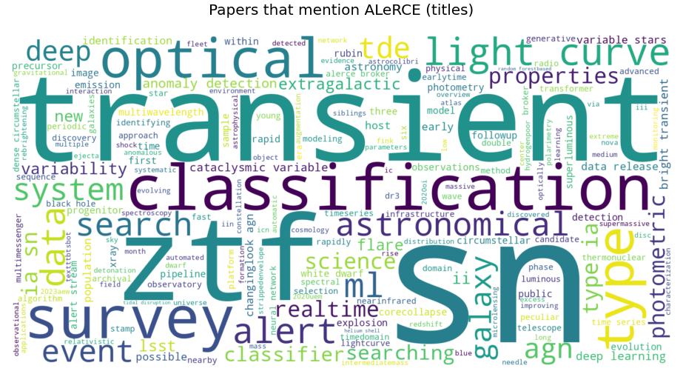
Titles of articles that mention ALeRCE

Slide 13
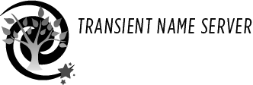
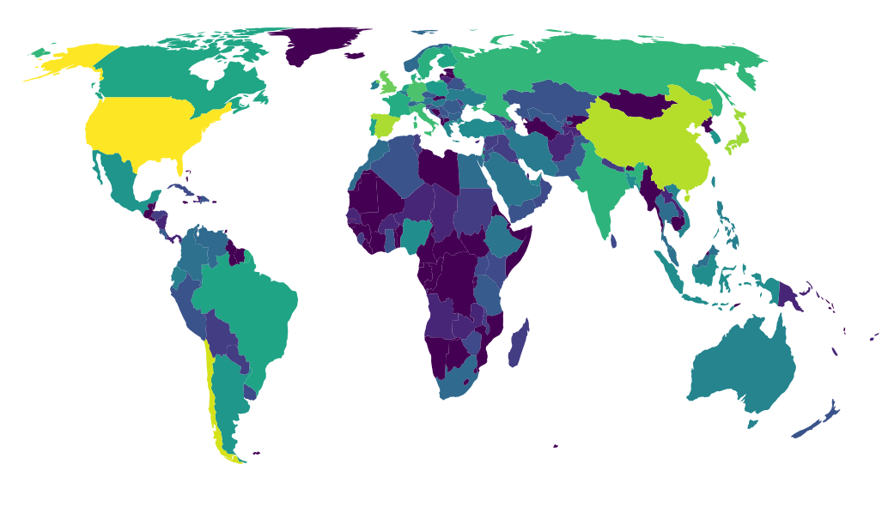
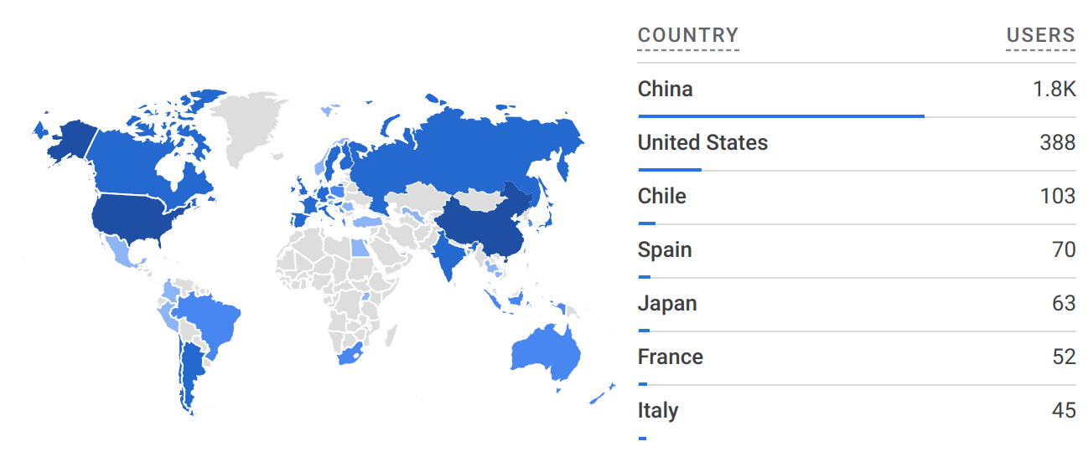
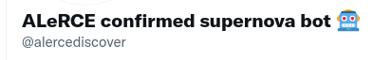
ALeRCE user community
2024
21,706 supernova candidates reported
#3 reporter
2,519 supernova spec. confirmed
~99% purity
#3 reporter
User community from 129 countries!
Notes:
Workshop organized with LSST funds.

Slide 14

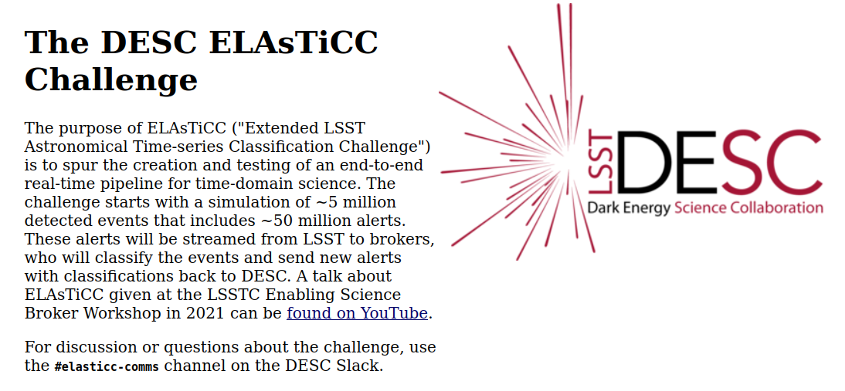
Road to Rubin
2019: Zwicky Transient Facility (ZTF) public alert stream
2022: Asteroid Terrestrial-impact Last Alert System (ATLAS) custom generated alert stream
2022-2023: Simulated Rubin stream in the ELAsTiCC classification challenge (2022 & 2023)
2024: Rubin commissioning alert stream, La Silla Schmidt Survey Telescope
2025: Rubin full operations alert stream!
LS4
https://portal.nersc.gov/cfs/lsst/DESC_TD_PUBLIC/ELASTICC/

Slide 15
Use cases

Slide 16
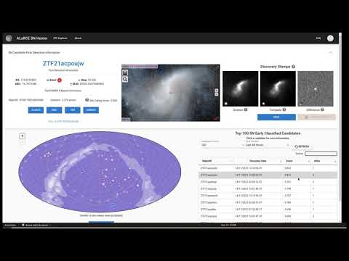
ALeRCE
SN Hunter
Select young SN
candidates
https://snhunter.alerce.online

Slide 17
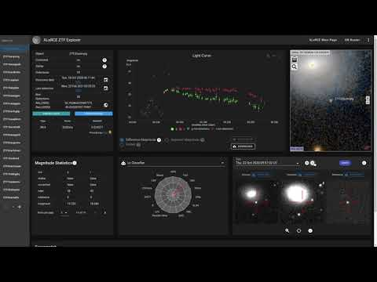
ALeRCE
Explorer
Inspect classes & classifiers
https://alerce.online/

Slide 18
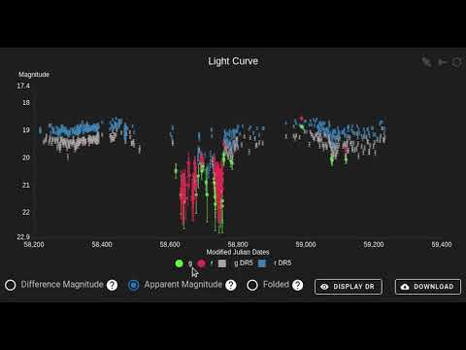
ALeRCE
Explorer
Inspect ZTF
Data Release
https://alerce.online/
Notes:
ZTF DR can also be used to look for precursor activity in transients

Slide 19
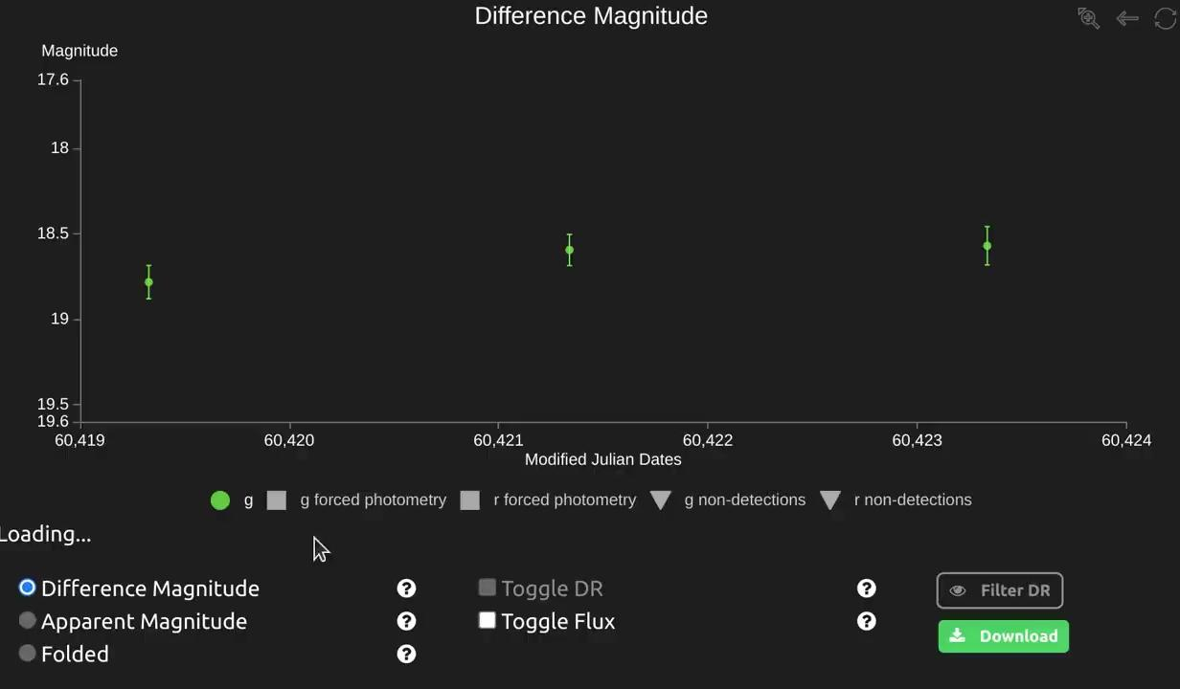
ALeRCE
Explorer
Inspect forced
photometry
https://alerce.online/
https://watchlist.alerce.online
Forced photometry!

Slide 20
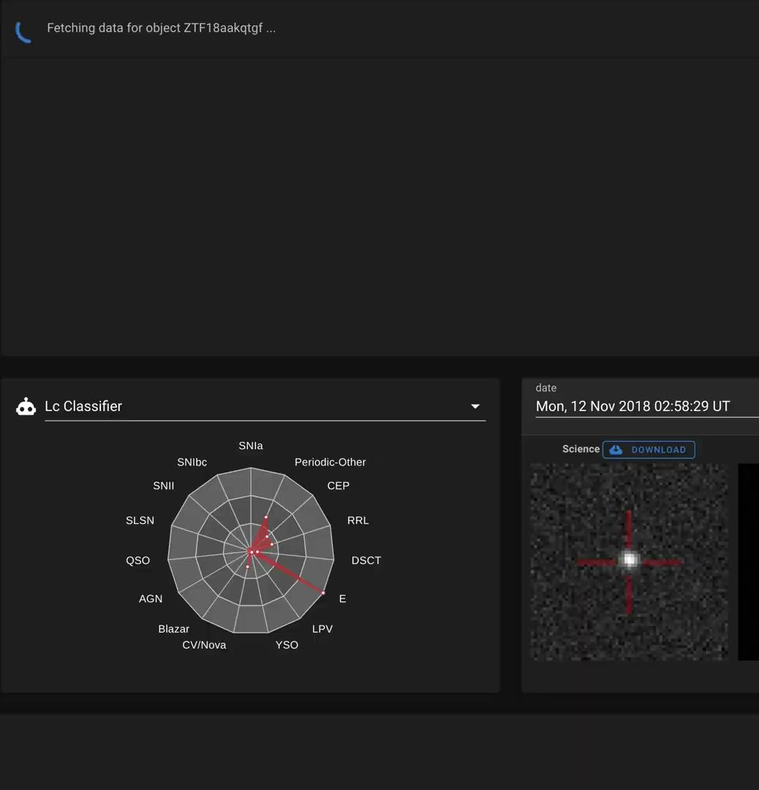
ALeRCE
Explorer
Find best period
https://alerce.online/
Forced photometry!

Slide 21
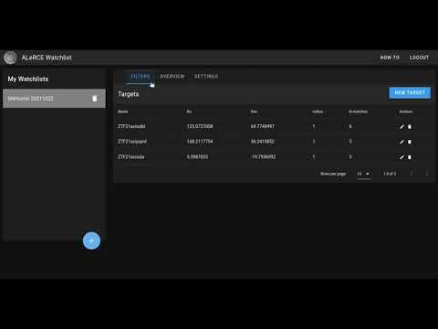
ALeRCE
Watchlist
Get object notifications
https://watchlist.alerce.online

Slide 22
ALeRCE ML models

Slide 23
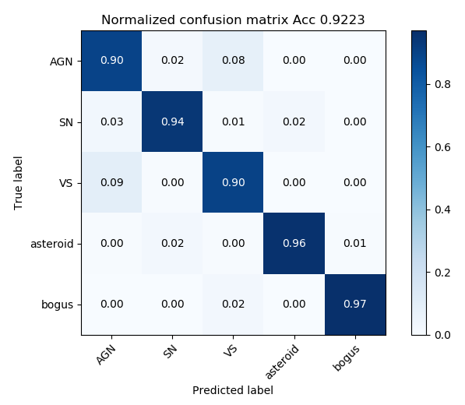
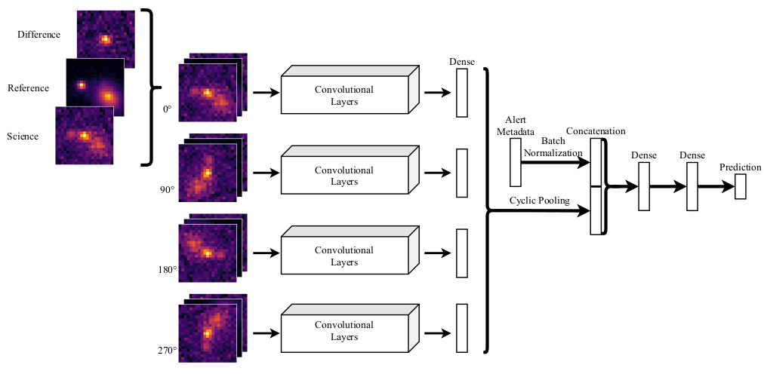
Stamp based classifier (Carrasco-Davis et al. 2021)

Slide 24
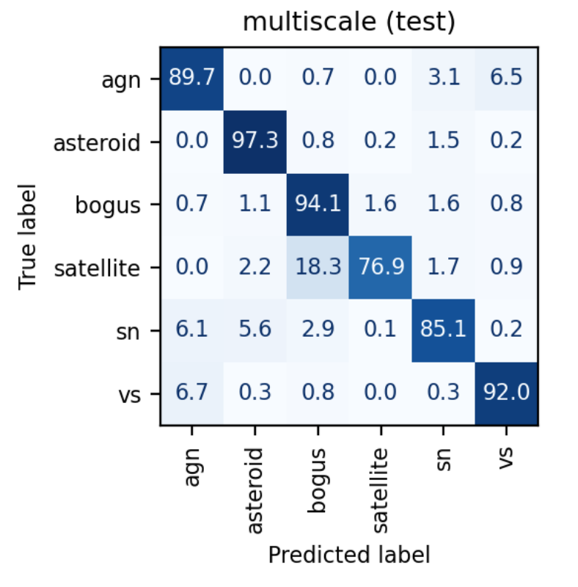
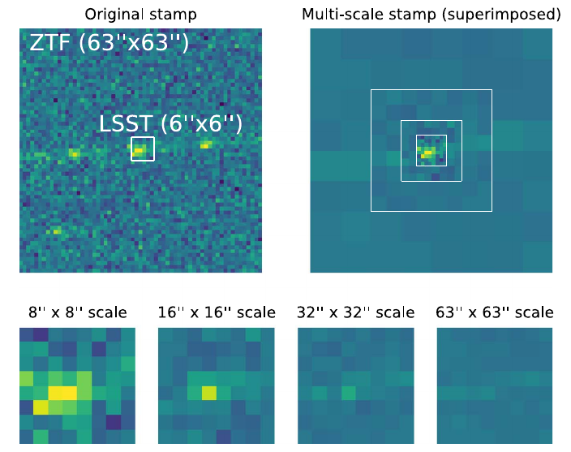
Multi-scale extension (Reyes-Jainaga et al. 2023)

Slide 25


DELIGHT: Host galaxy identification
Animal vision inspired: high resolution only needed near the central regions of the visual system.
pip install astro-delight
Förster et al. 2022

Slide 26

Light Curve based classifier (Sánchez-Sáez et al. 2021)
Notes:
MAGNR, DISNR AND RB REMOVED

Slide 27



Light Curve based classifier (Sánchez-Sáez et al. 2021)
Balanced Hierarchical
Random Forest
SNIa, SNIbc, SNII, SLSNe,
QSO, AGN, Blazar, YSO, CV/Nova,
LPV, E, DSCT, RRL, CEP, Periodic-Other
Pavez+24, in preparation
c.f. stamp classifier

Slide 28







Outlier detection methods
Low probability density
Outlier similarity search
Large reconstruction error
Large forecasting error
Inconsistent data modalities
López-Navas et al. 2022/2023, MNRAS
Hernández-García et al. 2023, MNRAS
Sánchez-Sáez et al. 2024, A&A
Pérez-Carrasco et al. 2023, AJ
Sánchez-Sáez et al. 2021, AJ
Notes:
ZTF DR can also be used to look for precursor activity in transients

Slide 29




Slide 30


Multi-Class Deep Support Vector Data Description
Deep Support Vector Data Description, Ruff et al. 2018
Pérez-Carrasco et al. 2023, AJ
Notes:
ZTF DR can also be used to look for precursor activity in transients

Slide 31




Attention-based models
Supernovae Classification
ASTROMER
Donoso-Oliva+2023
Pimentel+2023
Attention models beat RF models!

Slide 32





Forced photometry classifiers
ATAT
Handsome squidward
Transient
Periodic
Stochastic
Mbappe
185 features
Cabrera-Vives+2024
A&A

Slide 33


Forced photometry classifiers
BHRF
New classes

Slide 34
Data access

Slide 35



API and client
https://api.alerce.online/ztf/v1
https://api.alerce.online/ztf/dr/v1
https://alerce.readthedocs.io/en/latest/

Slide 36



Client / direct DB access examples
Client access
Direct database access
https://alerce.readthedocs.io/en/latest/
https://github.com/alercebroker/usecases

Slide 37
ALeRCE living database
ALeRCE database
PostgreSQL @ production (ZTF)
MongoDB @ staging (ZTF + ATLAS)
102 M unique objects
425 M unique detections
175 M forced photometry data points
3.72 B non-detections
749 M features
571 M probabilities using ML
2.8 M light curve classifications
82 M image stamp classifications
Object, filter & time dependent
Object & filter dependent
Object dependent
detection: light curves & other relevant time dependent information.
forced_photometry:
photometry including low SNR data
non-detection: limiting magnitudes
data_quality: data quality related time dependent information
magstat: statistics per band per object
feature: object computed features
reference: object statistics for every reference image used
object: basic object statistics
xmatch: detailed xmatch tables (allwise, ps1_ztf, gaia_ztf, ss_stf)

Slide 38

Use case notebooks
Client
ALeRCE_Client_starter
ALeRCE_AGN_Starter
ALeRCE_Asteroid_Starter
ALeRCE_SN_Starter
ALeRCE_VS_Starter
ALeRCE_ML_Light_Curve_Classifier
ALeRCE_ML_Stamp_Classifier
ALeRCE_Other_Periodograms
ALeRCE_Other_Watchlist
ALeRCE_SN_Fast
ALeRCE_SN_Forecasting
ALeRCE_API_PanSTARRS_galaxies
ALeRCE_API_check_pixels
Science
use cases
Machine Learning
Miscellaneous
https://github.com/alercebroker/usecases
Notes:
Workshop organized with LSST funds.

Slide 39



Finding Electron Capture SN candidates
(M. Sato)
1) Obtain SN II candidate LCs from ALeRCE
~5 s, ~25 k datapoints
2) Apply function to estimate plateau duration (t_{PT}) and color at the middle of plateau g-r(t_{PT}/2).
3) Populate diagram and produce link to explore EC SNe candidates.

Slide 40
Next step &
challenges

Slide 41



Infrastructure
Machine learning
Astronomy
Multistream pipeline
Multistream services
Scaling up to Rubin stream
Hybrid infrastructure
Serve large user community
Store multimodal data
Embedding DBs
Outliers in production
Multistream classifier
Forecasting
Real-time inference
Zero/one/few shot learning
Multimodal classifiers
Large Language Models
Identify new use cases
Curate multimodal datasets
Improve training sets
Extract new knowledge
Follow up resources
Train astronomers
Active participation in SCs
Increasing complexity

Slide 42



Astronomical time series & machine learning models buzzwords taxonomy
Single band
surveys
Single band models,
feature based
Classification
Multi band models,
RNN based
Real-time
Classification
Multi band
surveys
Multi band models,
transformer based
Outlier detection
Multi band, large etendue surveys
Multi modal models,
transformer based
Explainability
Multi messenger
surveys
Multi modal, foundational models
LLM integration
Causality?

Slide 43













https://alerce.science
ALeRCE and other brokers are exploring a diversity of use cases.
We need many interoperable brokers to prepare for LSST!
Notes:
Workshop organized with LSST funds.

Slide 44



ASTROINFORMATICS 2024
December 9-13, 2024, Puerto Natales, Chile
https://astroinformatics2024.inf.udec.cl/

Slide 45
Extra slides

Slide 46


DELIGHT: Host galaxy identification
Highest efficiency and purity recovering the redshift!
Förster et al. 2022
Francisco Förster (Universidad de Chile) & ALeRCE broker (MAS / CMM / DO / U. Concepción) Transients Down Under, Melbourne, Australia, 2024/02/01

Slide 47


Forced photometry classifiers
BHRF

Slide 48

Attention-based models
Supernovae Classification
Pimentel+2023
Francisco Förster (Universidad de Chile) & ALeRCE broker (MAS / CMM / DO / U. Concepción) Transients Down Under, Swinburne, Australia, 2024/02/01

Slide 49

Distribution of attention scores
All data points
Only high attention scores
Francisco Förster (Universidad de Chile) & ALeRCE broker (MAS / CMM / DO / U. Concepción) Transients Down Under, Swinburne, Australia, 2024/02/01

Slide 50


Why Balanced Random Forest?
Distribution of classes in the training set
RF beats Artificial Neural Networks using REAL data
Francisco Förster (Universidad de Chile) & ALeRCE broker (MAS / CMM / DO / U. Concepción) Transients Down Under, Melbourne, Australia, 2024/02/01

Slide 51


Testing the unlabeled set
Spatial [+color] distribution of galactic [extragalactic] objects
Class distribution in the unlabeled set
Francisco Förster (Universidad de Chile) & ALeRCE broker (MAS / CMM / DO / U. Concepción) Transients Down Under, Swinburne, Australia, 2024/02/01

Slide 52




From relational to non-relational to relational DB?
ELAsTiCC
Relational database, cloud based, hundreds of millions of objects
Non-relational distributed database, cloud based, multiple servers, hundreds of millions of objects
Relational database, on-premise (two mirrored server), billions of objects

Slide 53




Multi stream processing + !
ZTF alerts (production)
ATLAS alerts (production)
ZTF Kafka stream
Sorting hat
Stamp classifier
ATLAS alerts
(development)
ATLAS Kafka stream
Alert Archiving
Cross match
LC update
LC features
LC classifier

Slide 54



Anomaly detector
TDE
Microlensing
event
TDE?
flaring AGN?
Pérez-Carrasco et al. 2023, AJ

Slide 55
Balanced Hierarchical Random Forest
Codename Squidward.
Update from Sánchez-Sáez et al. 2021. Features + Random Forest.
New features:
TDE (thanks to Manuel Pavez): FLEET (Gómez et al 20), tail slope, color variation.
uLens (thanks to Vicente Pedreros; for point sources).
New classes: SNIIb, SNIIn, TDE, uLens, EA, EB/EW, RRLab, RRLc.

Slide 56
ATAT
ATAT: Astronomical Transformer for time series And Tabular data. Cabrera-Vives et al. 2024 (A&A; accepted).
Originally developed for the ELAsTiCC Challenge organized by DESC.
ZTF forced photometry version has codename Mbappe.

Slide 57
ATAT

Slide 58

Science by
ALeRCE users
Explore the ZTF data
AT 2020acak / ZTF18aawxosg

Slide 59

Science by
ALeRCE users
Explore the ZTF data
AT 2020acak / ZTF18aawxosg
Followed up by Li+2023

Slide 60

Science by
ALeRCE users
Explore the ZTF data
AT 2020acak / ZTF18aawxosg
Followed up by Li+2023

Slide 61




Science by
ALeRCE users
Download ZTF data
(e.g. Li+2023, Magee+2023, Kangas+2024, Reguitti+2024 about SNe and rapid transients; Gomez+2023, Hinkle+2024, Pomeroy & Norris 2024, about TDEs; Li+2022, Dgany+2023, about AGNs; Nesci+2024 about HMXBs)

Slide 62


Science by
ALeRCE users
Report transient candidates to TNS

Slide 63

Science by
ALeRCE users
Crossmatch between ZTF transient candidates and spectra from a blind survey

Slide 64


Science by
ALeRCE users
Crossmatch between ZTF transient candidates and spectra from a blind survey
From Vinkó+2023
AT 2020fiz / ZTF20aatpoos
Classified by Vinkó+2023

Slide 65




Science by
ALeRCE users
Select targets for follow up based on ALeRCE classifications
(e.g. Oshikiri+2024 about transients; López-Navas+2022, Arévalo+2024 about AGNs; Ok+2024 about CVs; Esposito+2024 for citizen science)

Slide 66

Science by
ALeRCE users
Select targets for follow up based on ALeRCE classifications
(e.g. Oshikiri+2024 about transients; López-Navas+2022, Arévalo+2024 about AGNs; Ok+2024 about CVs; Esposito+2024 for citizen science)

Slide 67

Science by
ALeRCE users
Use the ALeRCE classifiers for preprocessing of a novel classifier

Slide 68

Science by
ALeRCE users
Use the ALeRCE classifiers for preprocessing of a novel classifier

Slide 69


Science by
ALeRCE users
Use our code for feature computation (Reyes-Jainaga+2021)
Publicly available at https://zenodo.org/records/5275453
From Chaini+2024

Slide 70




ALeRCE public real-time products from ZTF data
Access via
Web interfaces
  Explorer: https://alerce.online/
  SN Hunter: https://snhunter.alerce.online/
  Watchlist: https://watchlist.alerce.online/
Python client, API, direct DB connection
Stream (upon request)
Learn to use these tools!
Use case notebooks: https://github.com/alercebroker/usecases
Workshops (videos, slides & notebooks): https://workshops.alerce.online/
ALeRCE homepage: https://alerce.science

Slide 71

And more
SN
AGN
VS
Asteroid
Bogus
Stamp classifier (Carrasco-Davis+2021)
Alert stream

Slide 72

And more
SN
AGN
VS
Asteroid
Bogus
Stamp classifier (Carrasco-Davis+2021)
Alert stream

Slide 73

And more

Slide 74

And more

Slide 75
And more

Slide 76
And more

Slide 77

And more

Slide 78
And more
Reyes-Jainaga+2023

