Slide 1
EMBER: emulating baryons from dark matter –only simulations over cosmic time

Slide 2
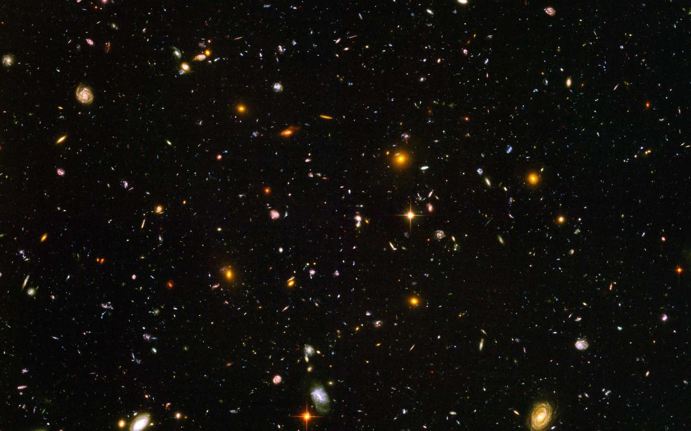

Slide 3
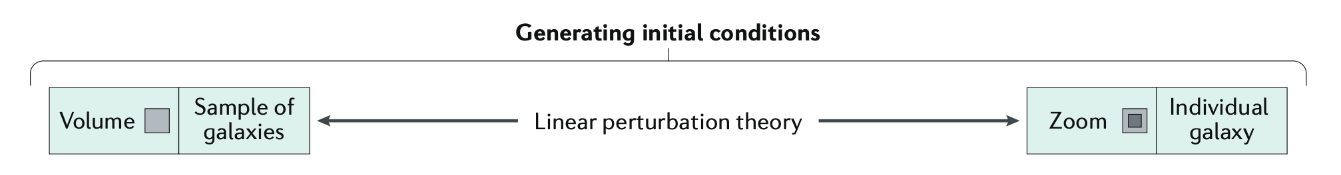
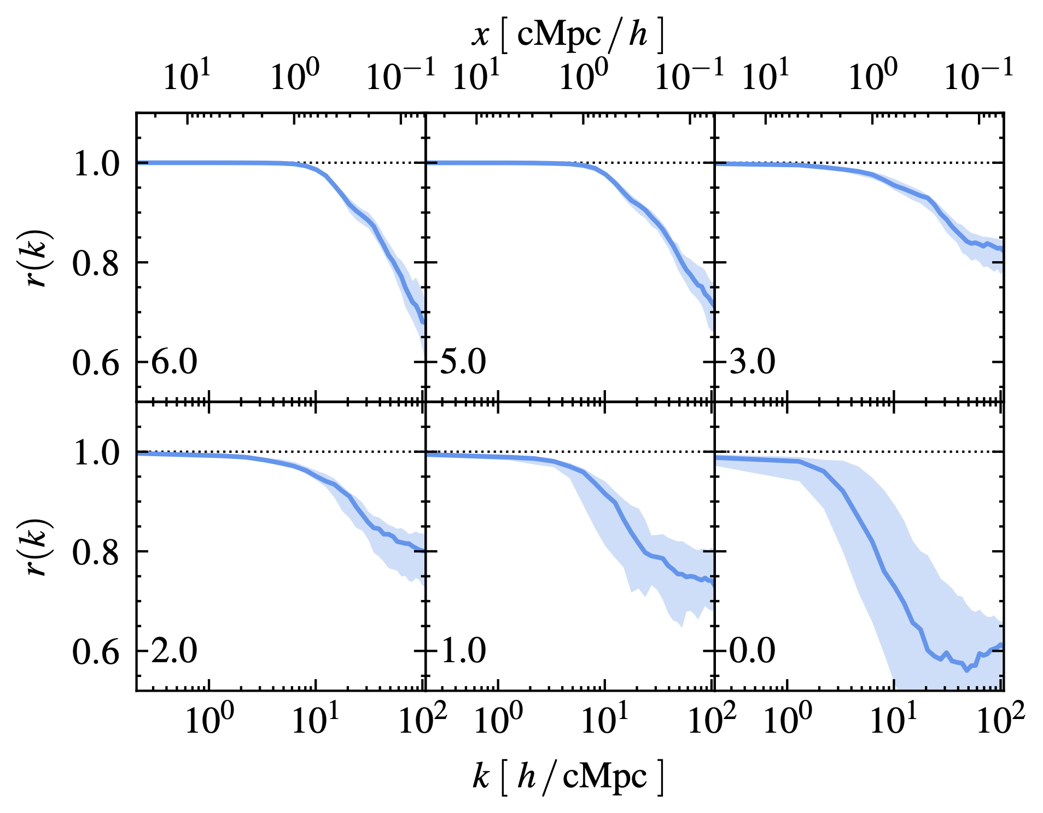
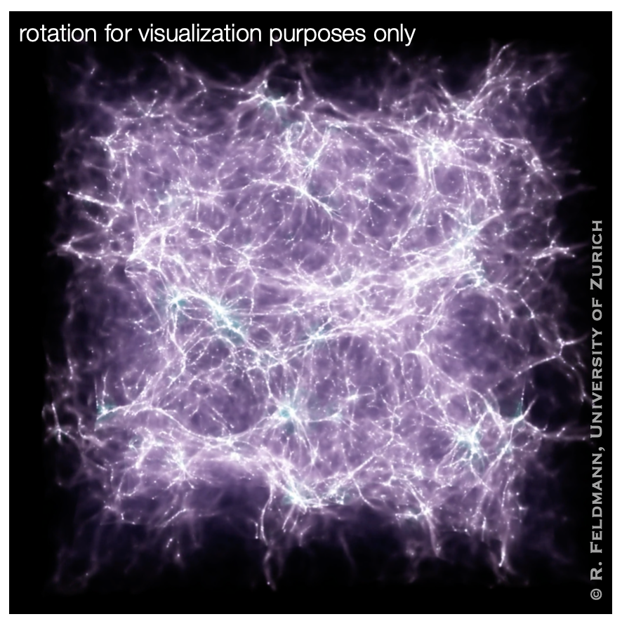
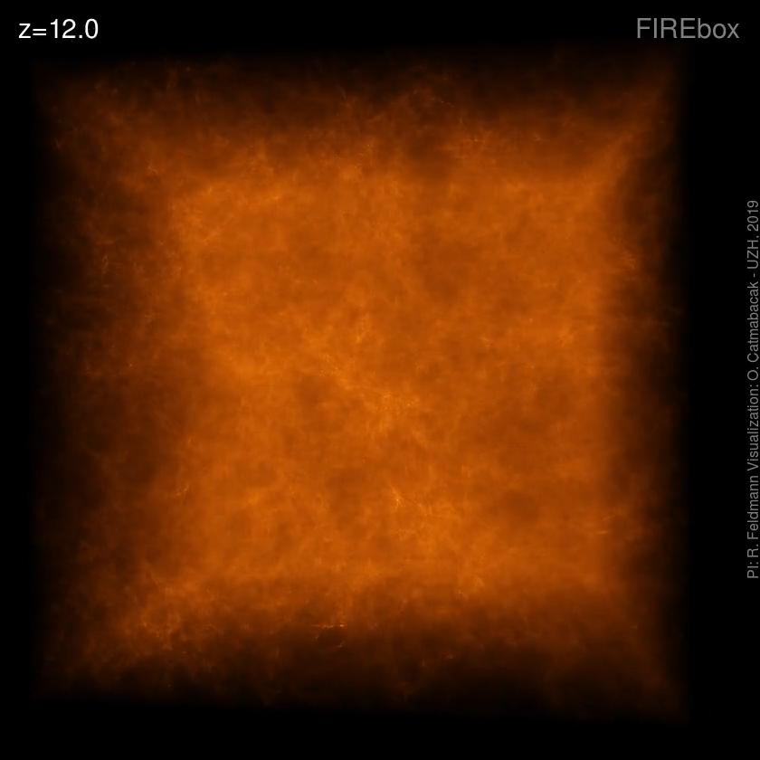
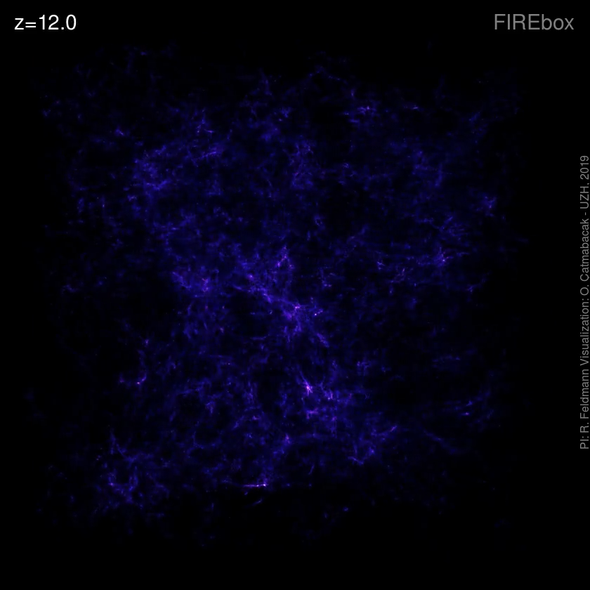
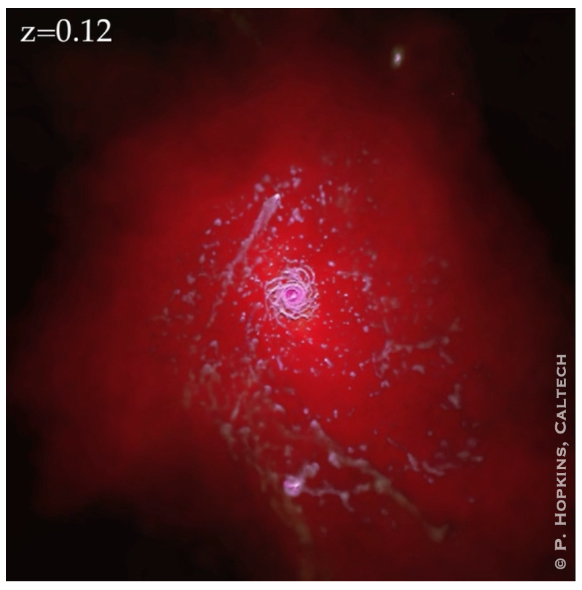
Numerical simulations of galaxy formation
From cosmic structures to galaxies
Dark matter to baryon cross-correlation
Volume
Zoom-in
Feldmann et al. (2022)
Angles-Alcazar et al. (2017)
Dark Matter
Baryons (gas / HI, stars)

Slide 4
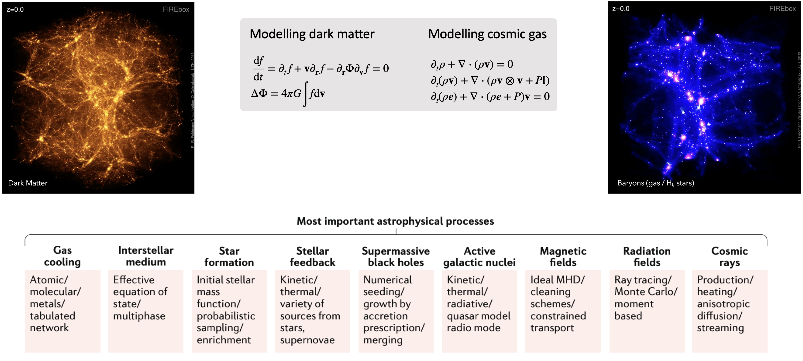
Motivation
Challenges for numerical simulations

Slide 5
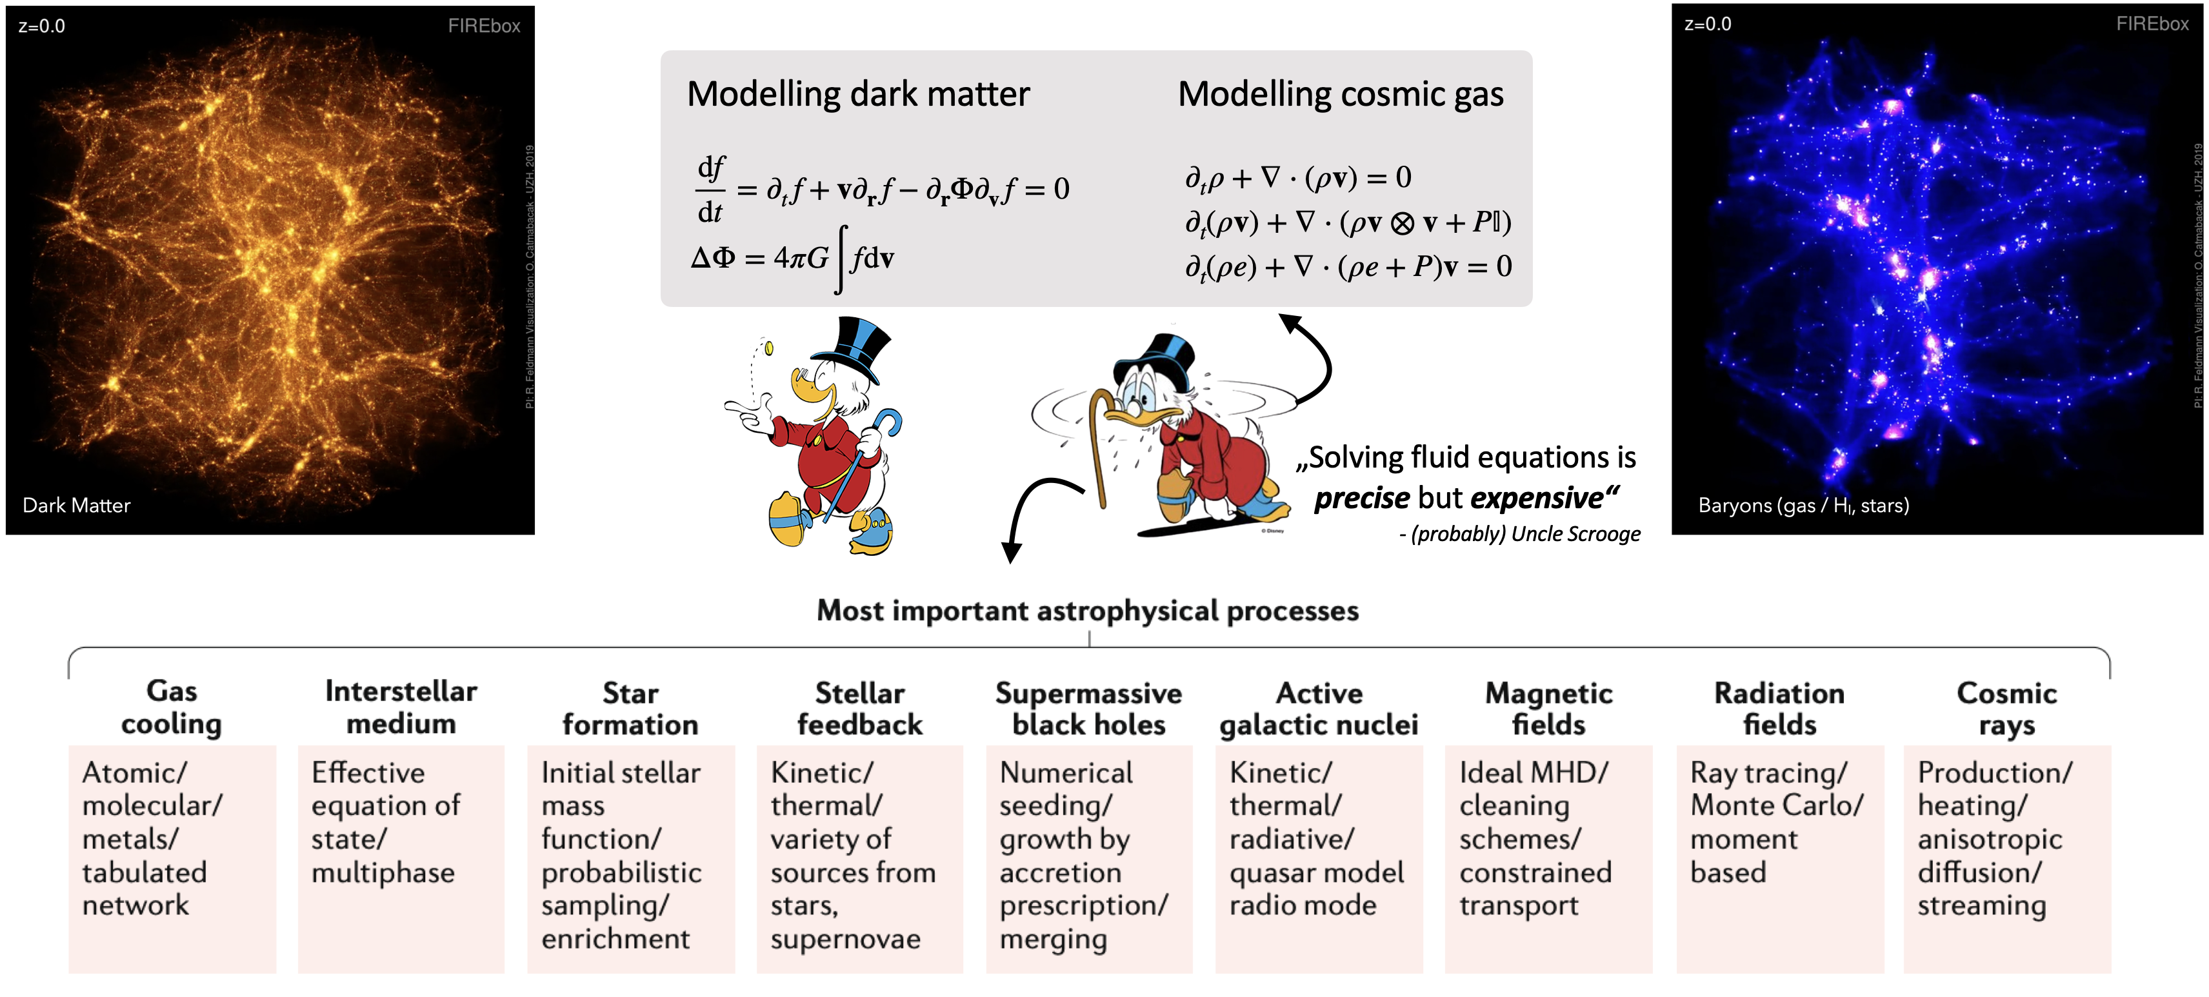
Motivation
Challenges for numerical simulations

Slide 6
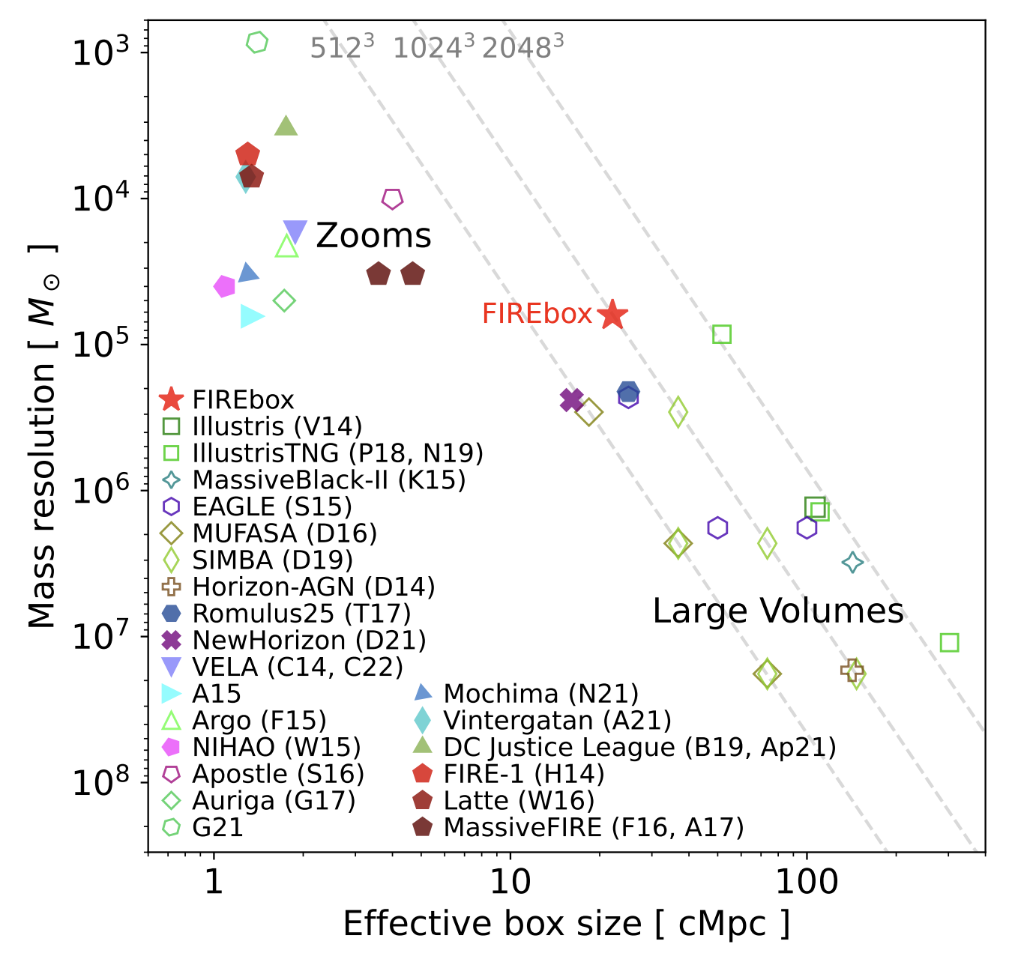
Motivation
Volume-resolution trade-off
Deep Learning
Feldmann+22

Slide 7
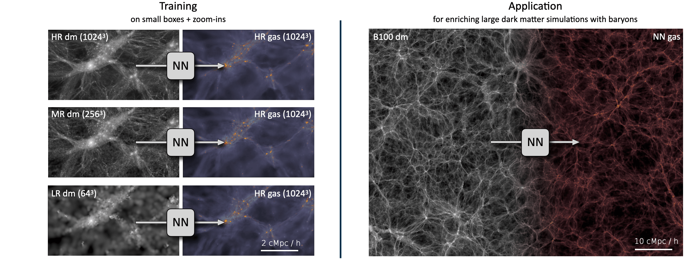
EMulating Baryonic EnRichment (EMBER)
Emulating instead of simulating
Idea: encapsulate simulation results by training NNs
Learning requires training data (i.e. simulations), so how does this help?
  Once trained, prediction is inexpensive → emulator
  Predict baryons for new dm simulations
  Upscale to much larger volumes while preserving high resolution

Slide 8
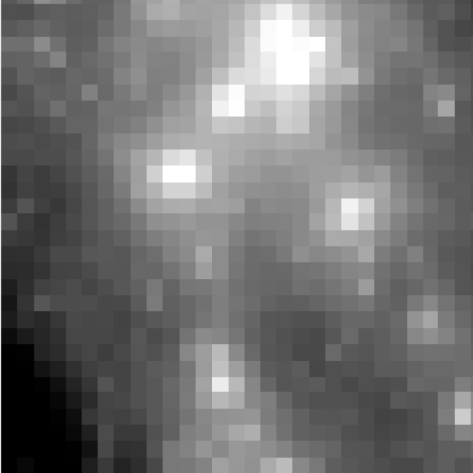
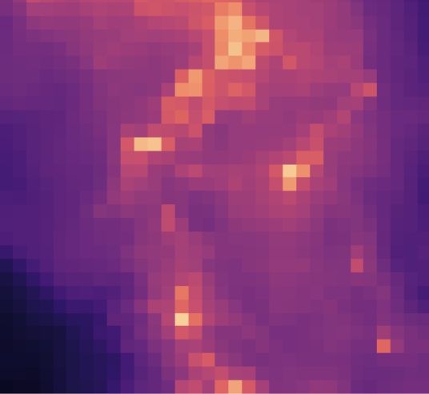
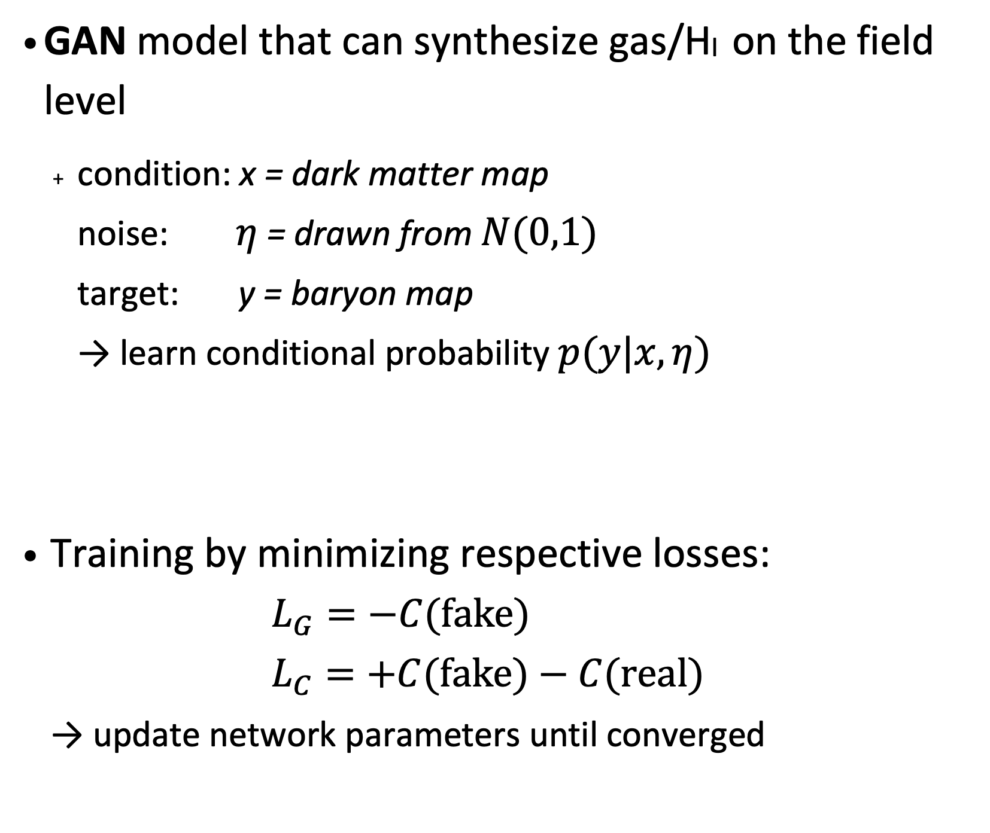


Ember
A framework for simulation-based baryon emulation
GAN model that can synthesize gas/HI on the field level
  condition: x = dark matter map
  noise: $η$ = drawn from $N(0,1)$
  target: y = baryon map
  → learn conditional probability $p(y|x,η)$
Training by minimizing respective losses:
$L_{G}=−C(fake)$
$L_{C}=+C(fake)−C(real)$
→ update network parameters until converged
Generator
Critic
x
y
x
y
fake
real
2x
Conv2d
2x
Conv2d
$$η$$
2x
Conv2d
Pool2d
Up
Pool2d
2x
Conv2d
2x
Conv2d
$$η$$
2x
Conv2d
Pool2d
Up
Conv2d
Dense
2x
Conv2d
2x
Conv2d
$$η$$
C(fake) = 0.1
C(real) = 0.8

Slide 9

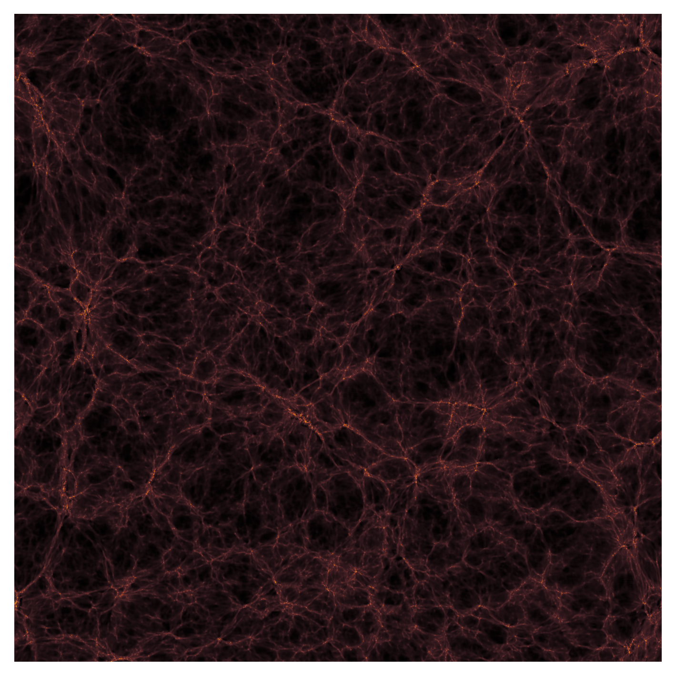
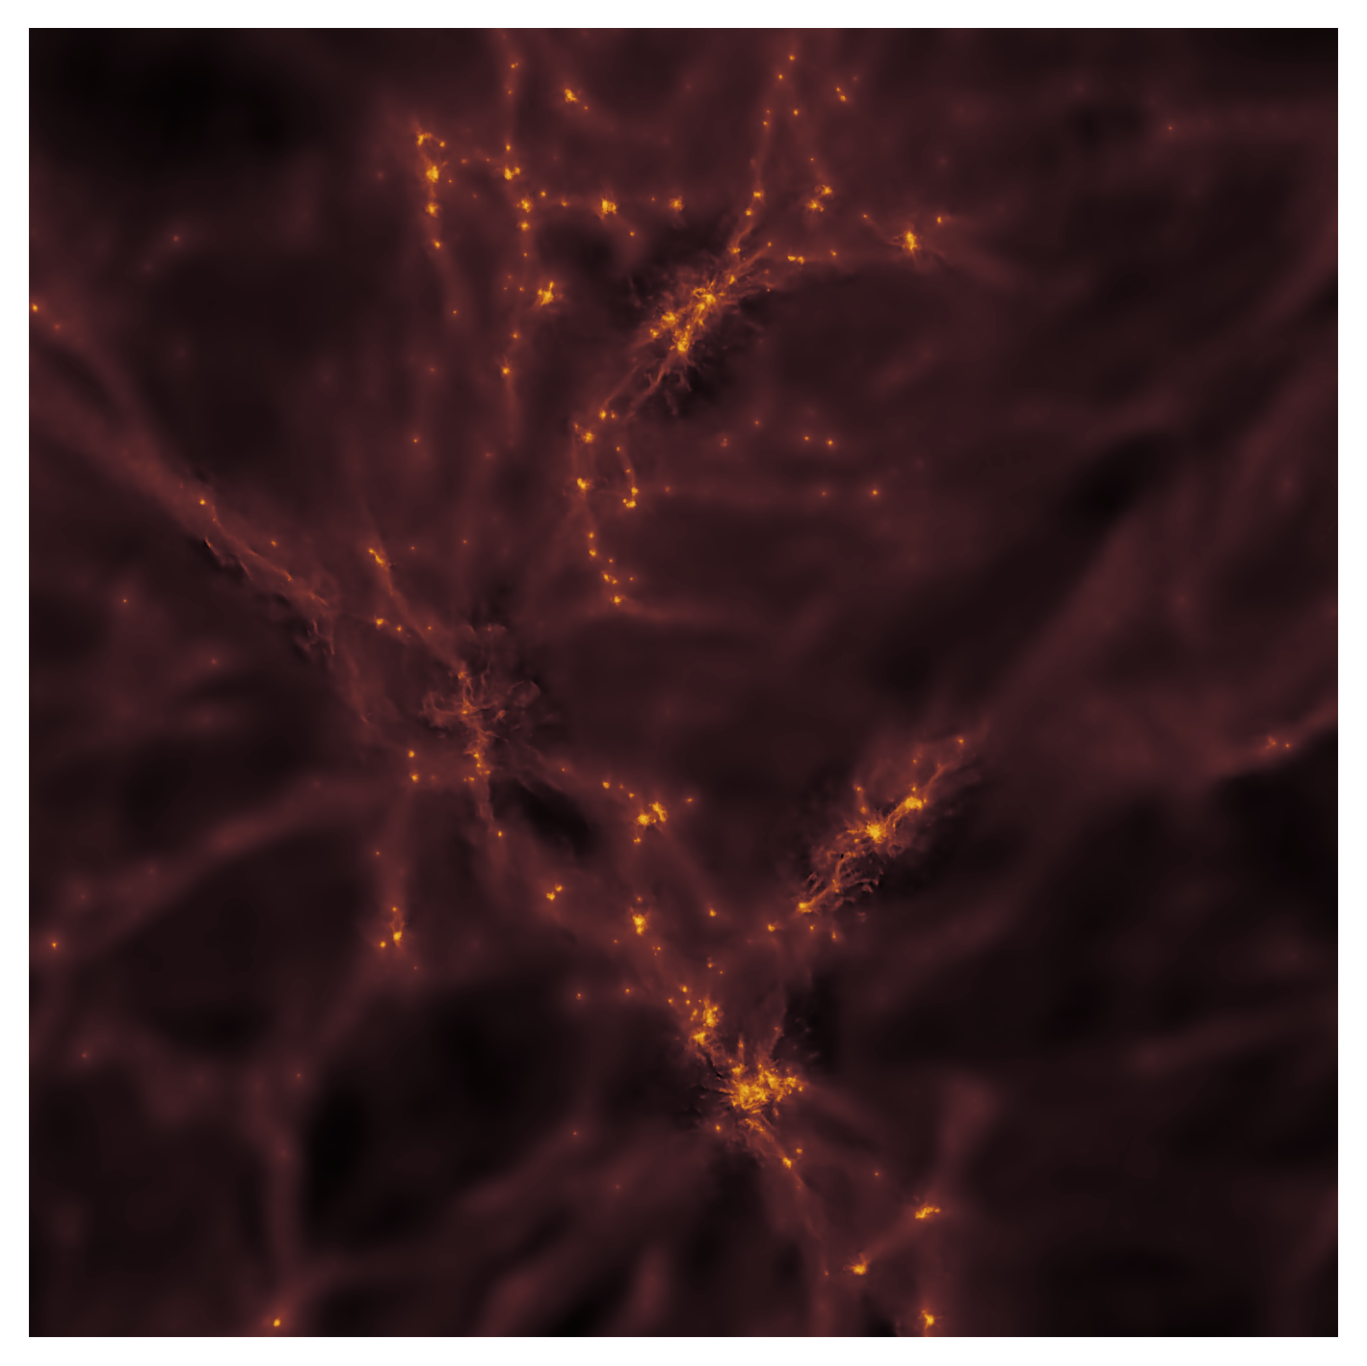
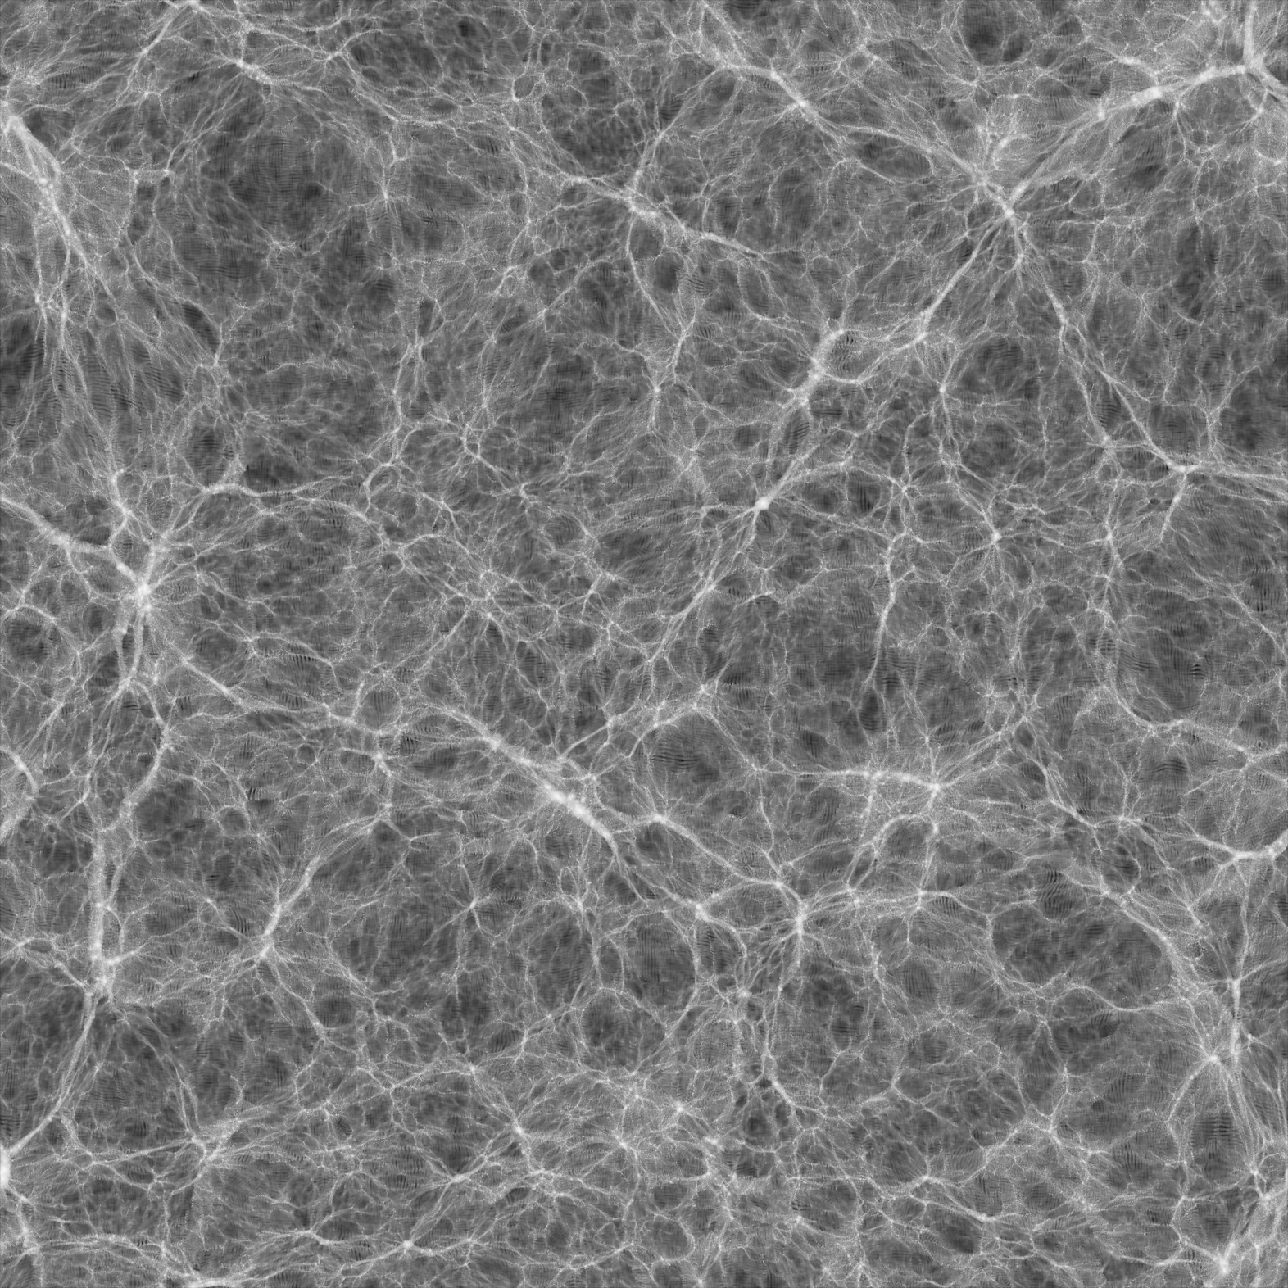
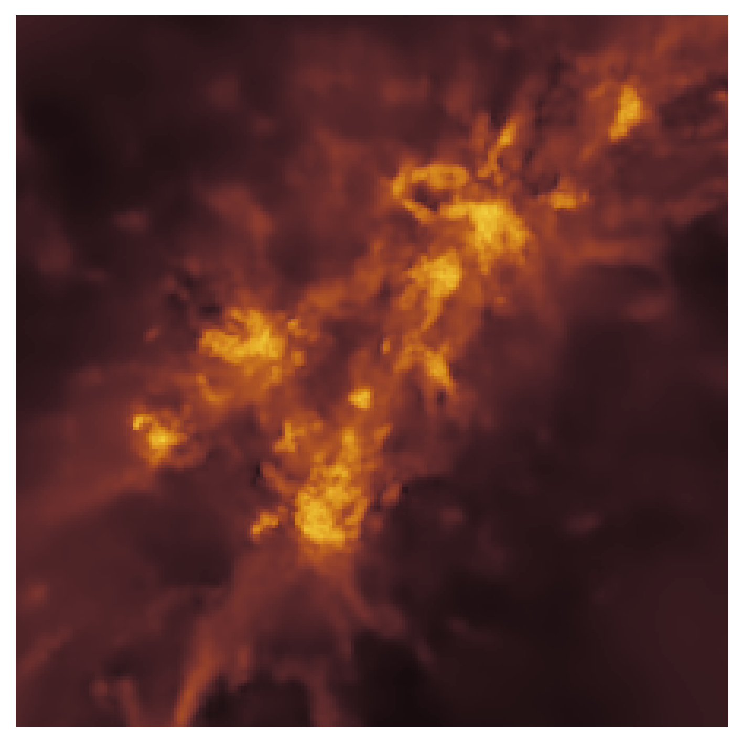
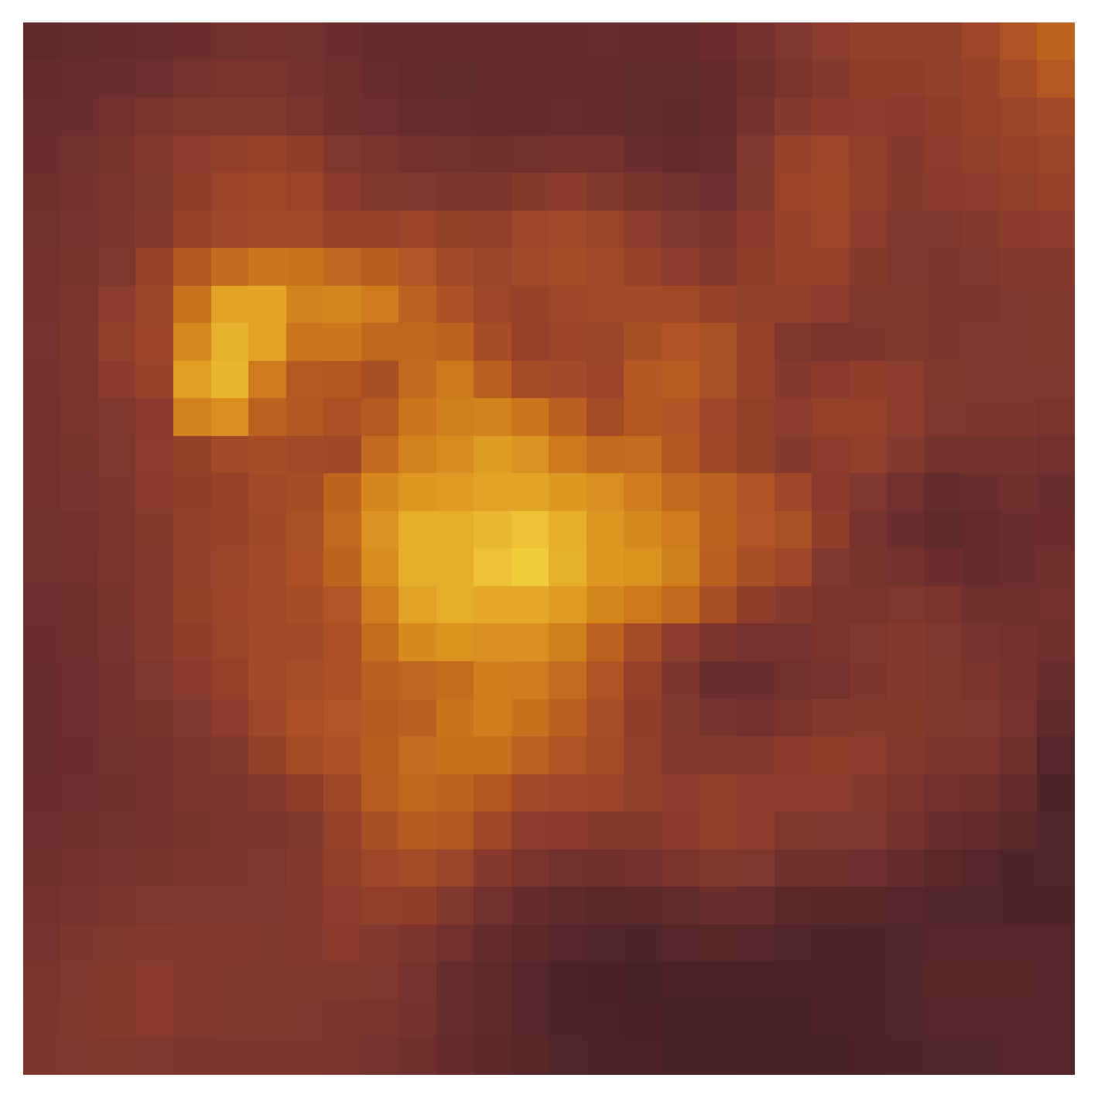
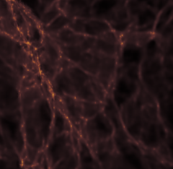
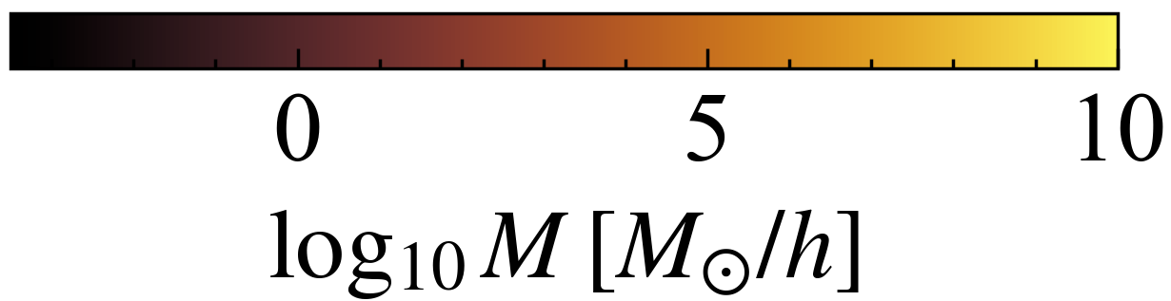




Ember
Apply
HR
HI
$$2.5cMpch^{−1}$$
$$250ckpch^{−1}$$
Train
$$10cMpch^{−1}$$
LR → HR
$$30ckpch^{−1}$$

Slide 10
Ember
Breaking the volume-resolution trade-off
16'500³
x 30000
EMBER
ML
Feldmann+22

Slide 11
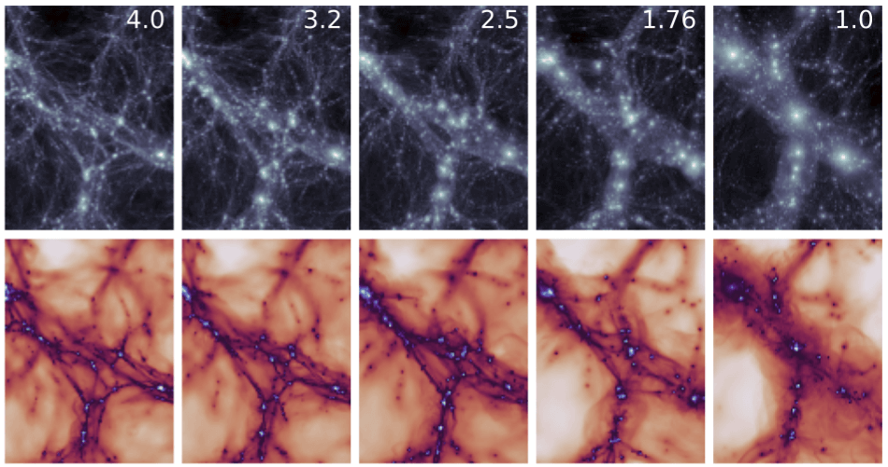
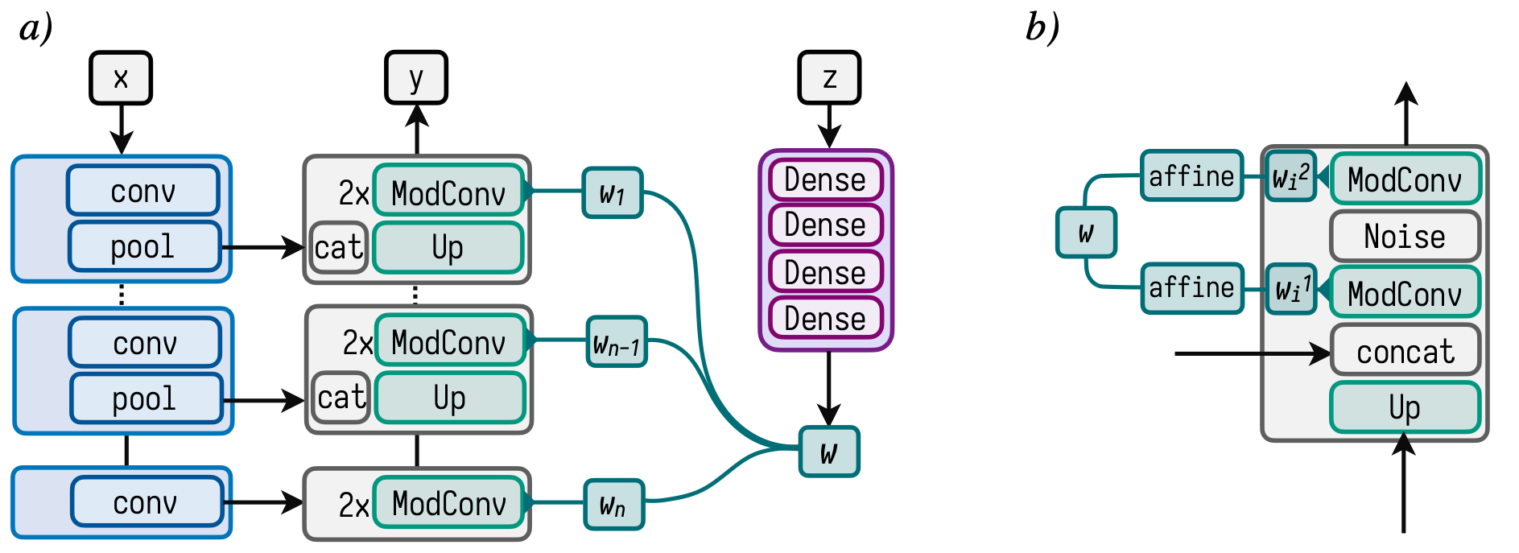
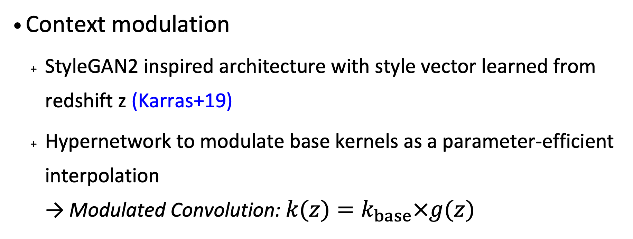
Ember-2
Learning across redshift
Learning across redshift
  EMBER: fit at single redshift
  Naively expect number of parameters to scale linearly with number of redshifts → expensive
Context modulation
  StyleGAN2 inspired architecture with style vector learned from redshift z (Karras+19)
  Hypernetwork to modulate base kernels as a parameter-efficient interpolation
  → Modulated Convolution: $k(z)=k_{base}×g(z)$

Slide 12
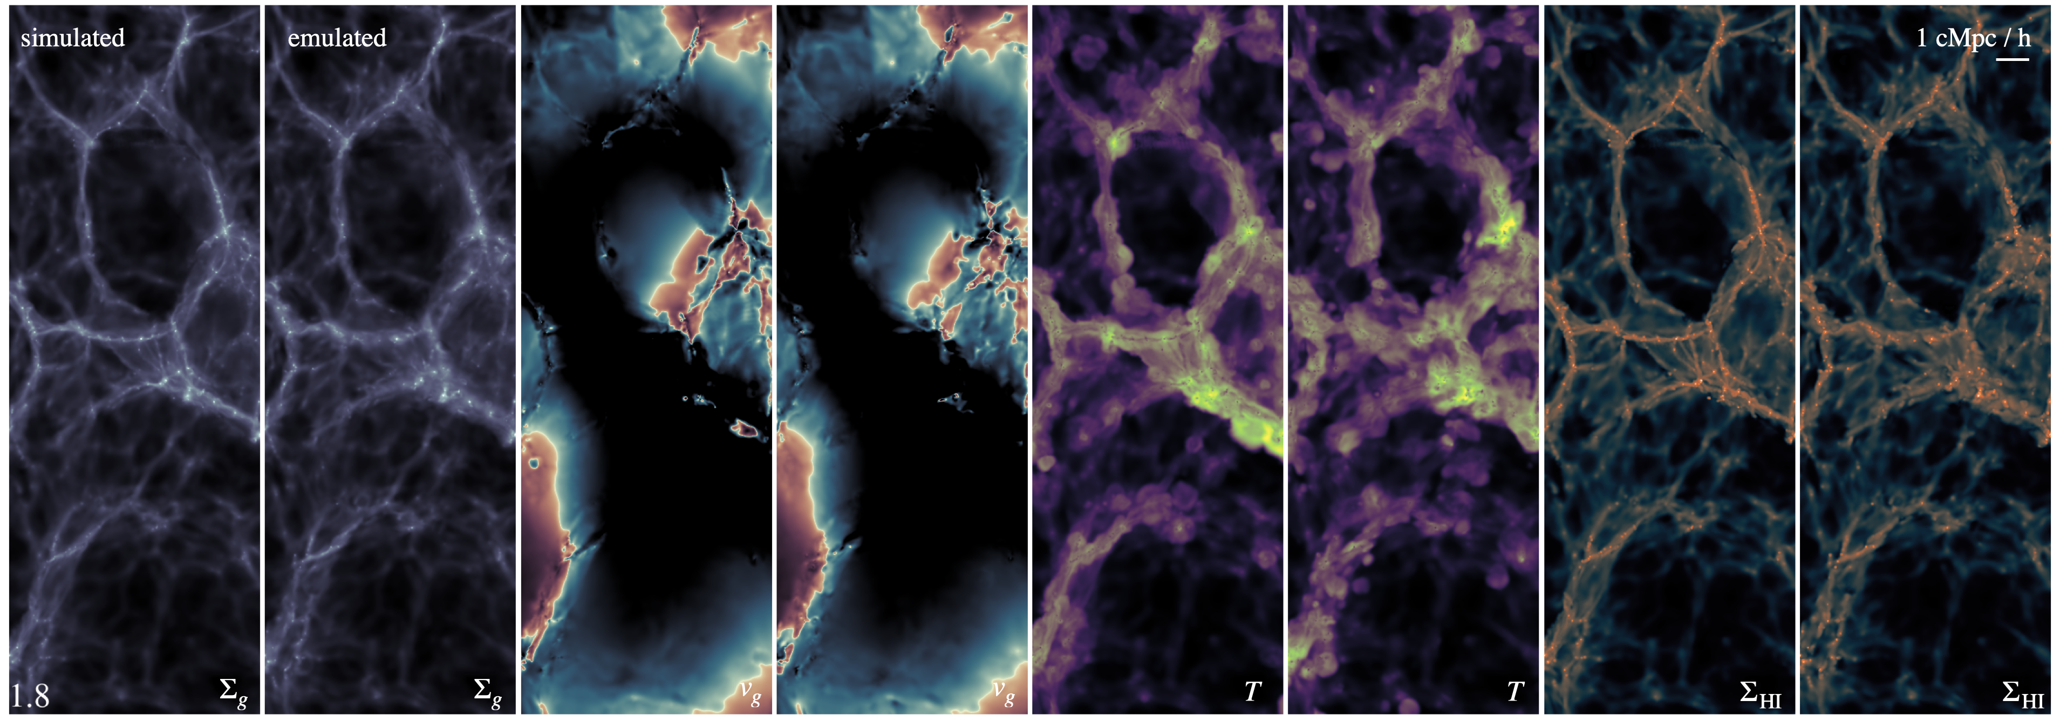




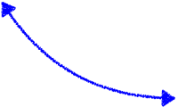

Ember multi-fields
Extending to multiple fields
Motivation: observations typically target a specific fraction of the phase space diagram
(e.g. cold gas HI, hot X-ray gas in clusters, etc.)
→ extend the emulation to multiple fields
Additional challenge due to
  physical accordance across channels
  the need to learn correct cross-correlations
gas
collapse
star formation
HI
galaxy formation
v
cooling
feedback
phase-space
T
in-/outflows

Slide 13
Ember-2 multi-fields
Extending to multiple fields

Slide 14
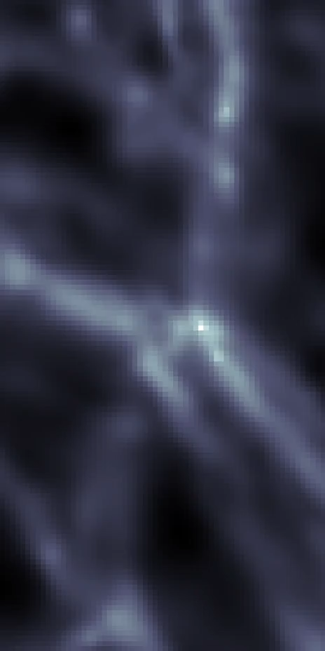
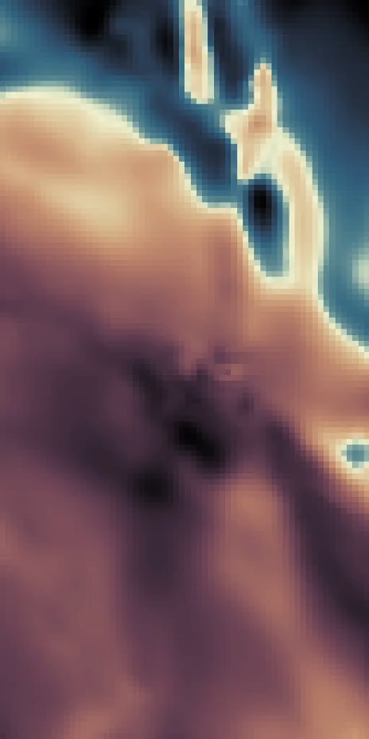
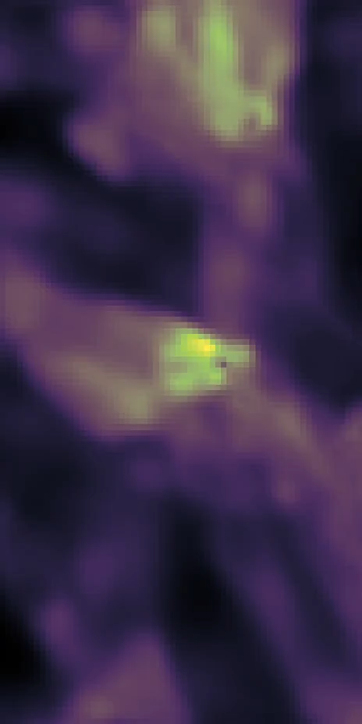
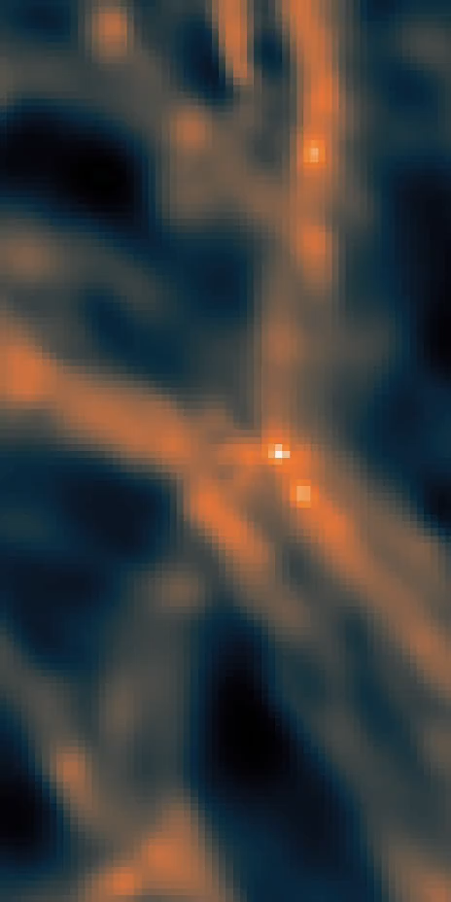
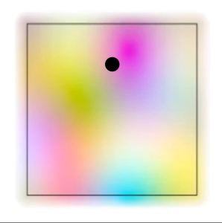

Ember multi-fields
Walking noisy circles…
$$y∼p(x,η,z)$$

Slide 15
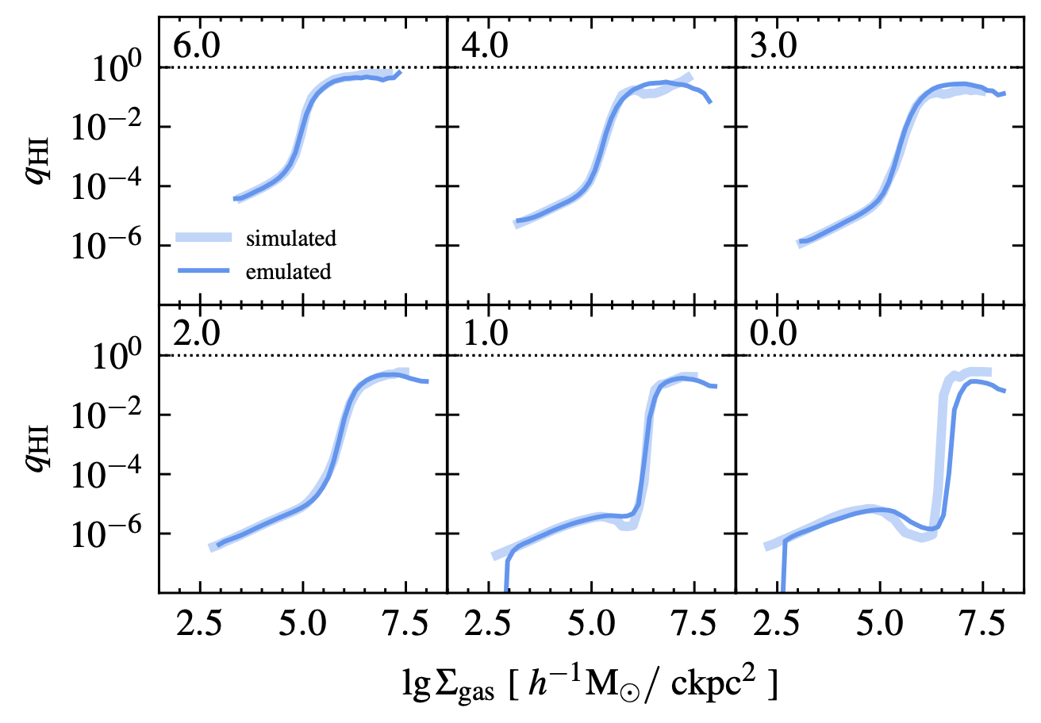
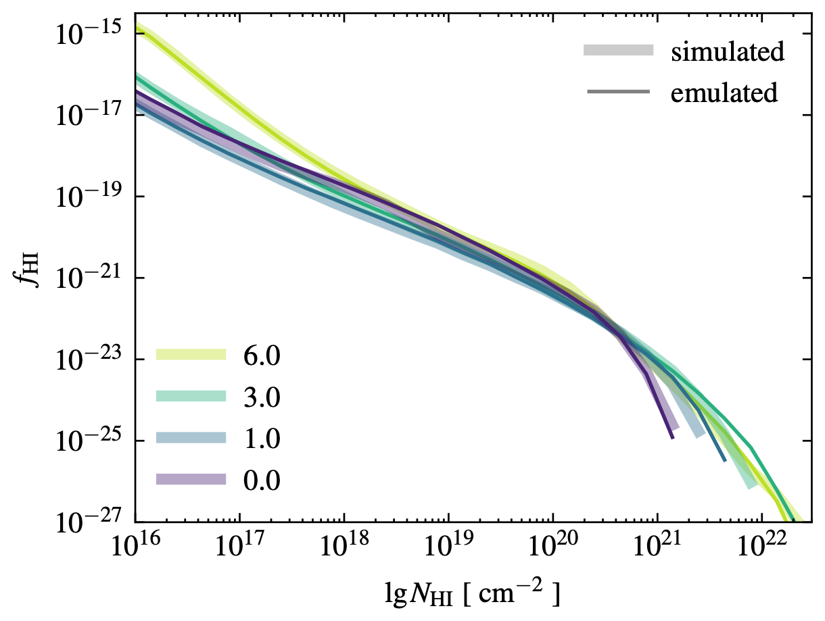
Ember multi-fields
Basic metrics
Phase-diagram
HI to gas fractions
Cosmic HI distributions

Slide 16
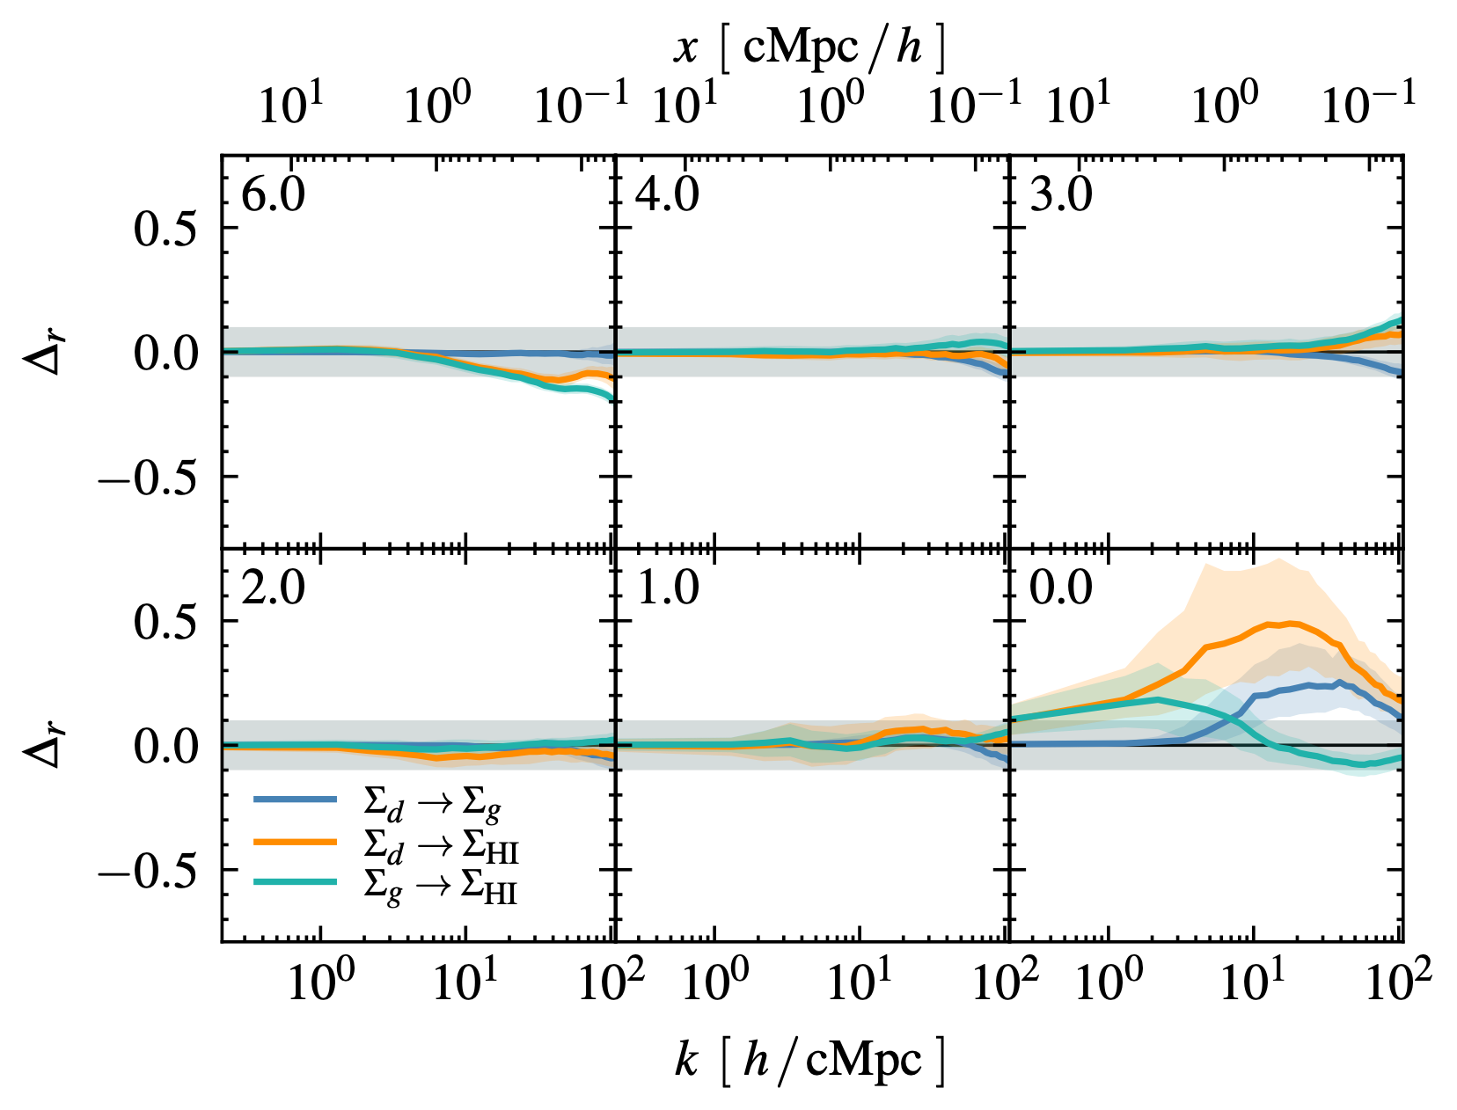
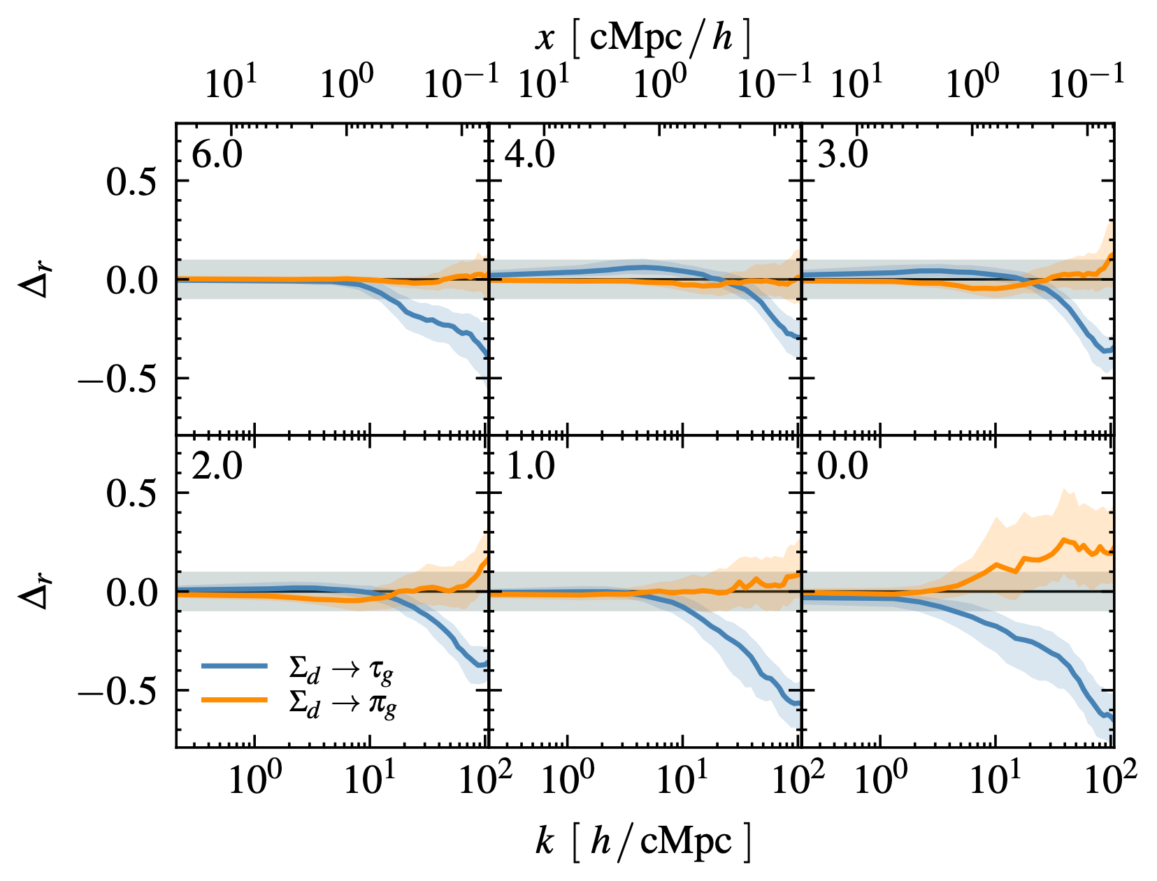
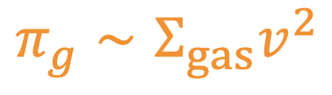
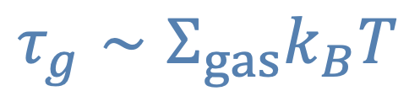
Ember multi-fields
Spectral analysis
$$τ_{g}∼Σ_{gas}k_{B}T$$
$$π_{g}∼Σ_{gas}v^{2}$$
Input/output cross-correlations
Cross-correlations of derived fields

Slide 17
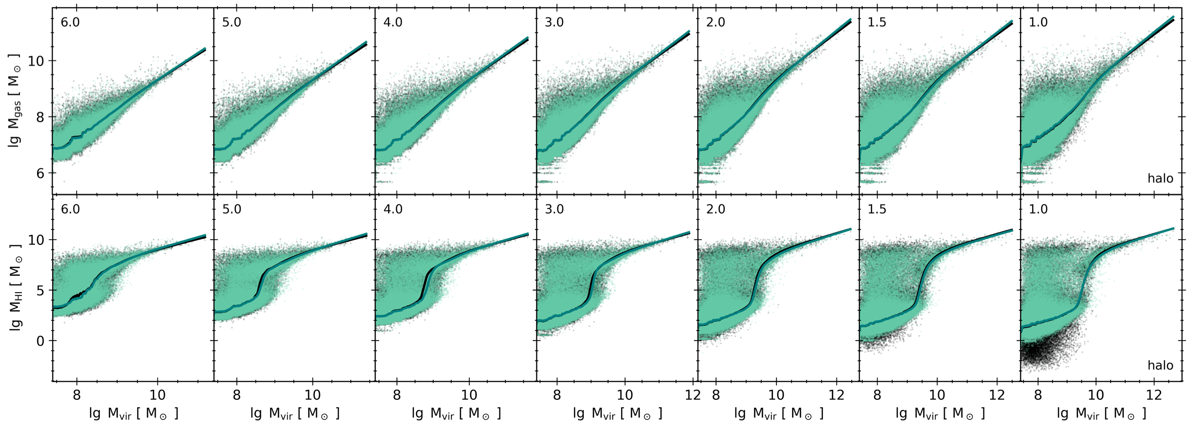
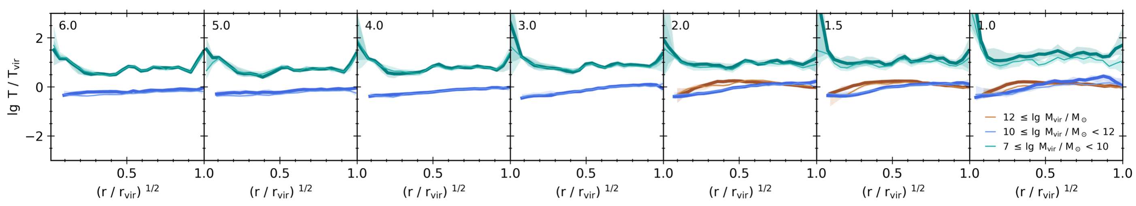
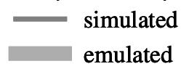
Ember multi-fields
Piercing into halos
total gas
HI
MB+24, in prep.
Gas-to-Halo mass relations
Temperature profiles

Slide 18
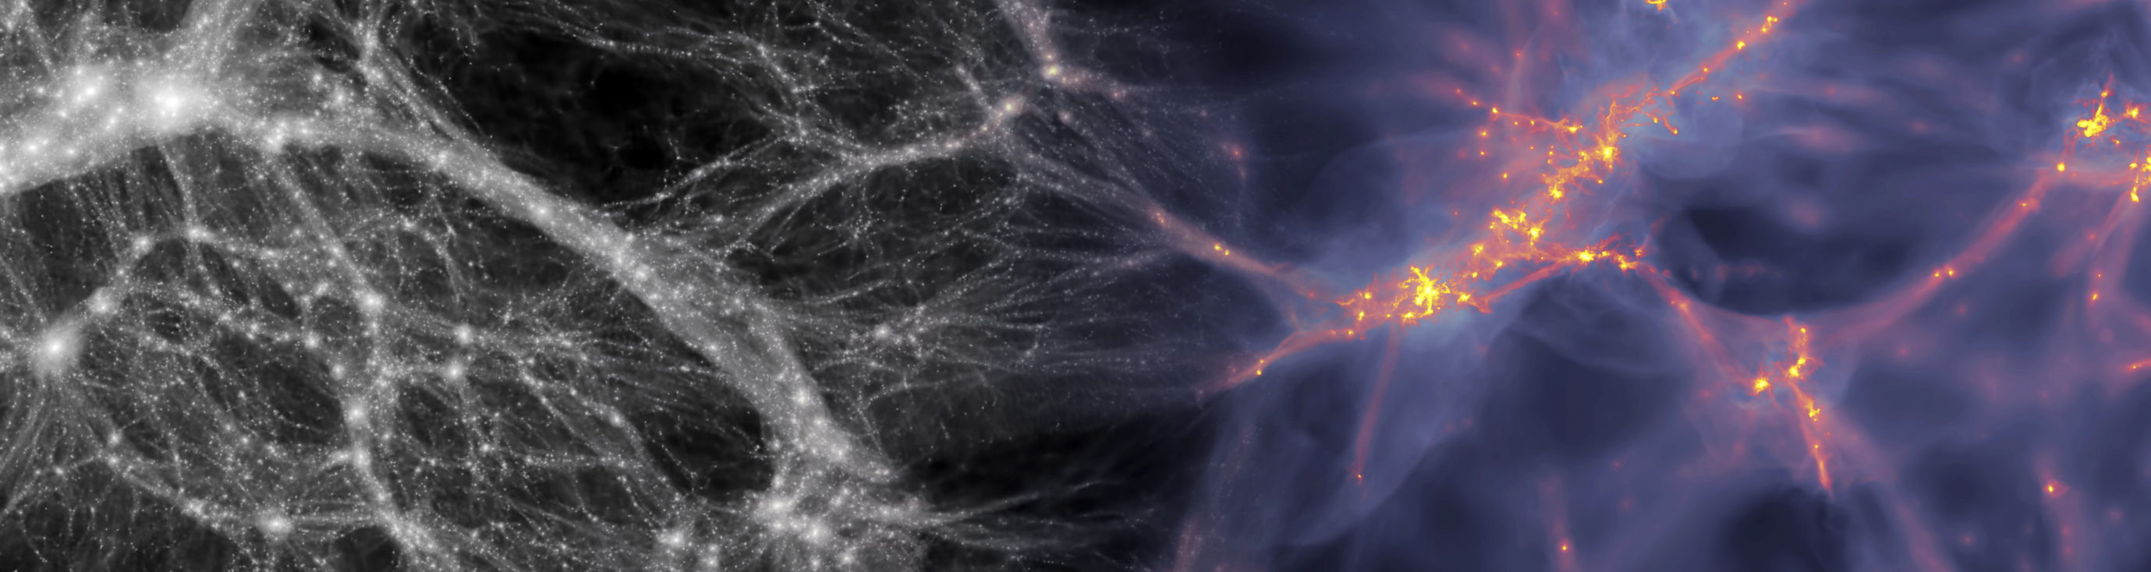


Further information
MB+2021: From EMBER to FIRE: predicting high resolution baryon fields
from dark matter simulations with Deep Learning, arxiv.org/abs/2110.11970
MB+2024: EMBER-2: Emulating baryons from dark matter over cosmic time
with deep modulation networks, in prep.
Feldmann+2022: FIREbox: Simulating galaxies at high dynamic range in a cosmological volume,
arxiv.org/abs/2205.15325
Thank you!
maurbe/ember
maurbe/ember2

Slide 19
Backup slides

Slide 20
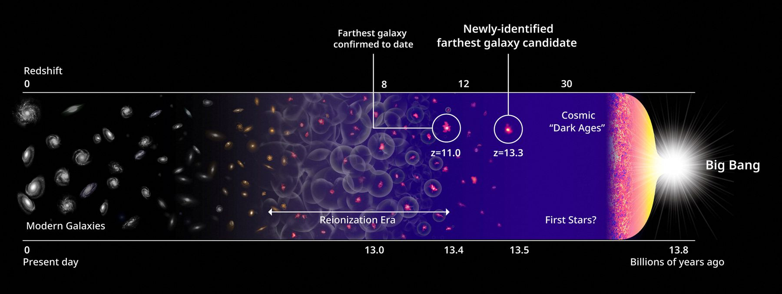
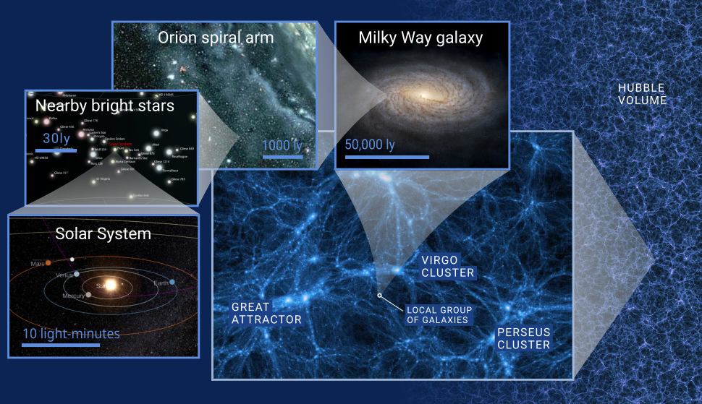
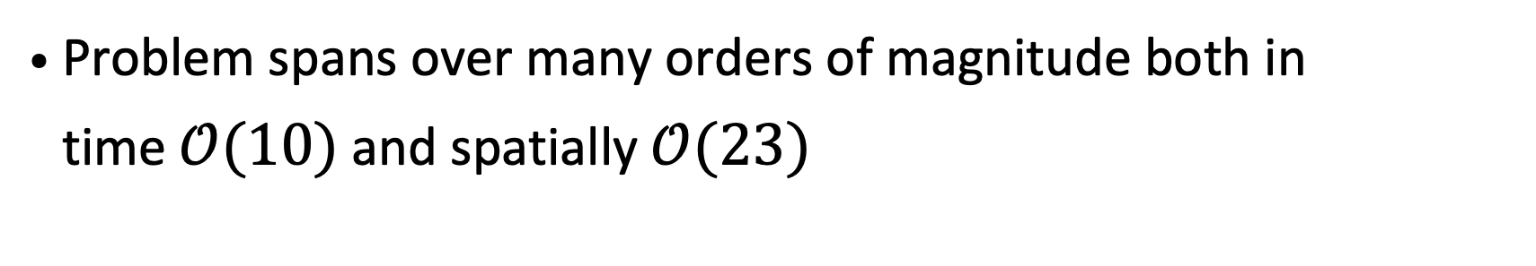

$Λ$CDM Cosmology
The current structure formation paradigm
Current paradigm of structure formation
Cosmology
$Λ$CDM model with 6 parameters $(H_{0},Ω_{b},Ω_{m},τ,A_{s},n_{s})$
predicts a cosmic web structure with filaments and halos
→ sets the large scale canvas of structure formation
Astrophysics
Pristine gas accretion to haloes
Gas cooling onto galaxies
Baryonic feedback channels
→ important for small scale structure formation
Problem spans over many orders of magnitude both in
time $𝒪(10)$ and spatially $𝒪(23)$

Slide 21
Dark matter to baryon cross-correlation
Volume resolution trade-off
name | cost [million cpu hrs] | mass resolution [10⁴ Msun] | volume [cMpc/h] | reference
FIREbox | 5 | 6.26 | 15 | Feldmann+22
IllustrisTNG50 | 130 | 8 | 50 | Nelson+18
EAGLE | 4.5 | 160 | 100 | Schaye+15
HorizonAGN | 6 | 1000 | 142 | Dubois+16

Slide 22
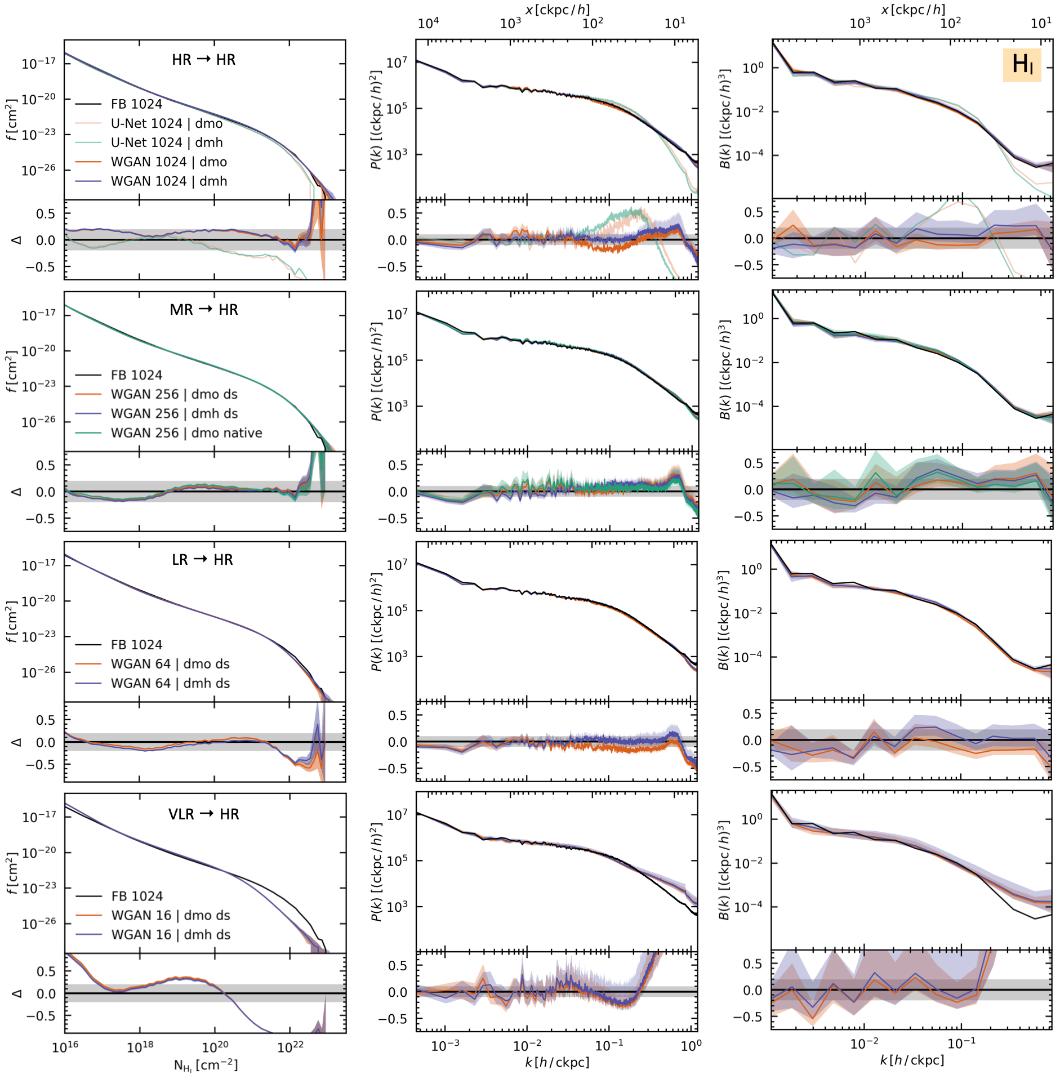
Ember
A framework for baryon emulation
CDDF
Power spectrum
Bispectrum

Slide 23
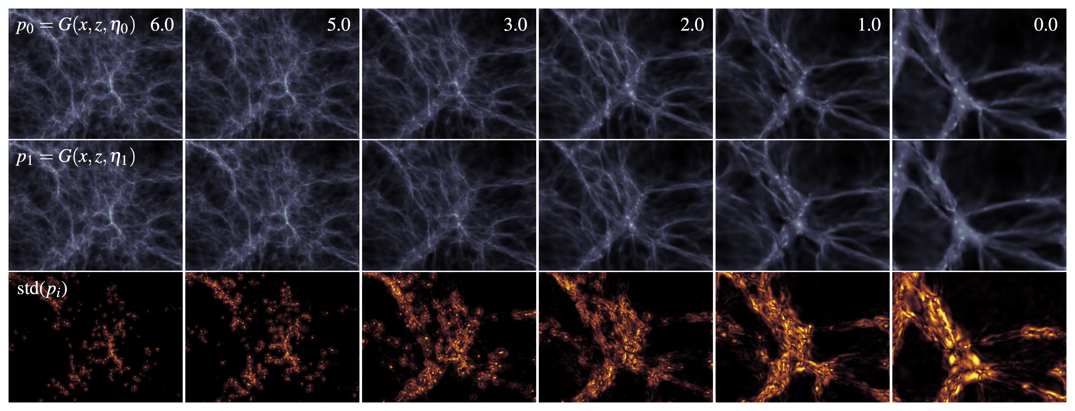
Ember multi-fields
Probing the distribution

