Slide 1
Inferring Galaxy Baryonic Properties from Dark Matter Merger Trees with Graph Neural Networks
Nick Andreadis
PhD student – Ghent University
with: D. Nelson, A. Pillepich, and M. Baes
Machine Learning for Astrophysics (ML4ASTRO2)
Catania, 10 July 2024

Slide 2
Cosmological simulations
© TNG Collaboration

Slide 3
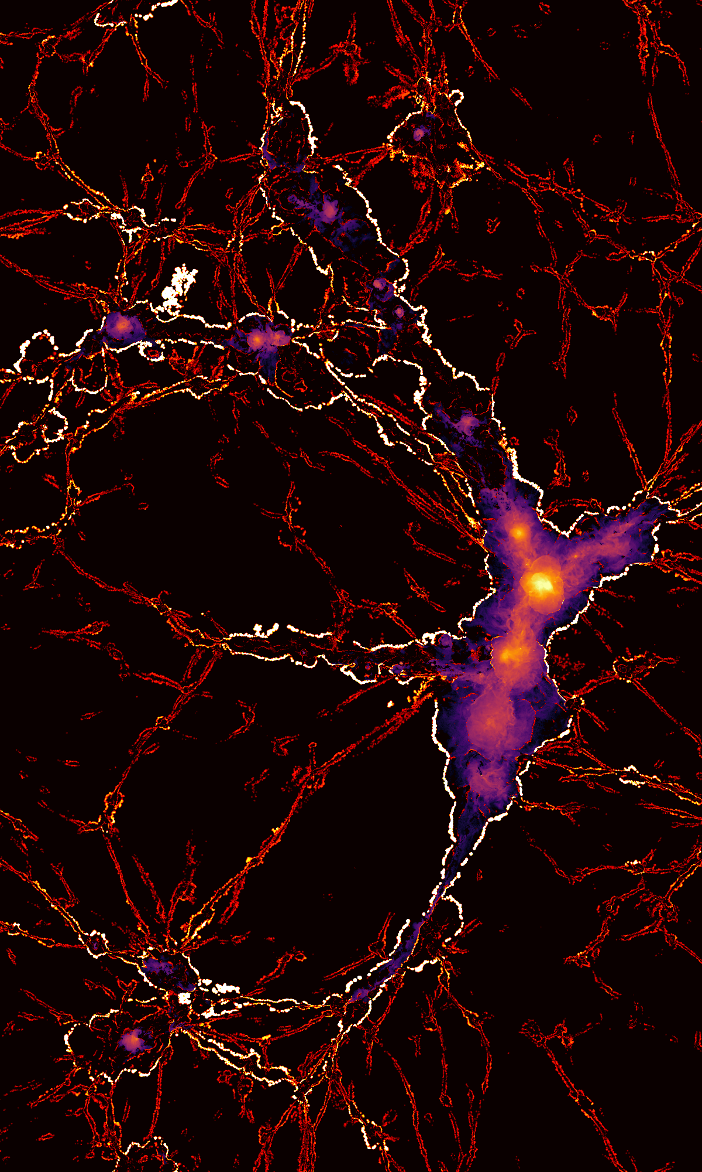
The need for more cosmological simulations
Astrophysics is entering a “big data” epoch
DESI, eROSITA, EUCLID, SKA…
Match theory to observations
volume
expensive
Predicted X-ray emission © TNG Collaboration

Slide 4
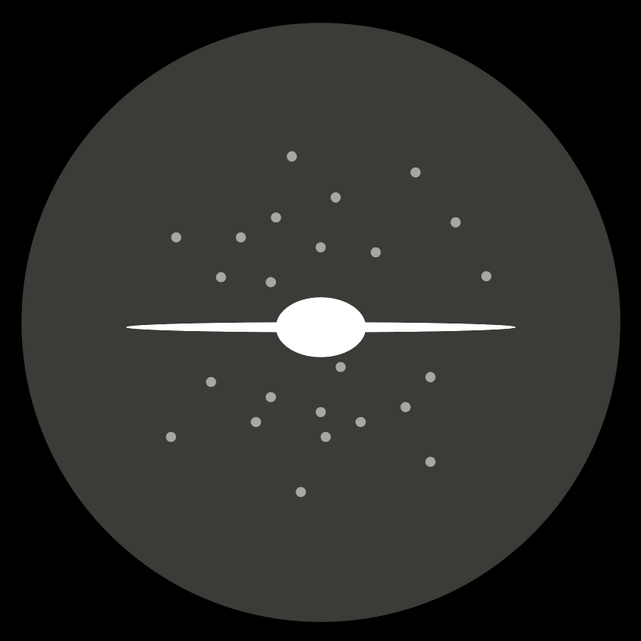
The galaxy – halo connection
Empirical models
(Sub)halo abundance matching, Halo Occupation Distribution…
No galaxy assembly bias
Semi-analytic models

Slide 5
The role of Machine Learning
Handling complex data
Mapping galaxy baryonic physics on top of DM
“Paint” galaxies on top of DM-only simulations
“Learn” about the galaxy – halo connection
cheap

Slide 6
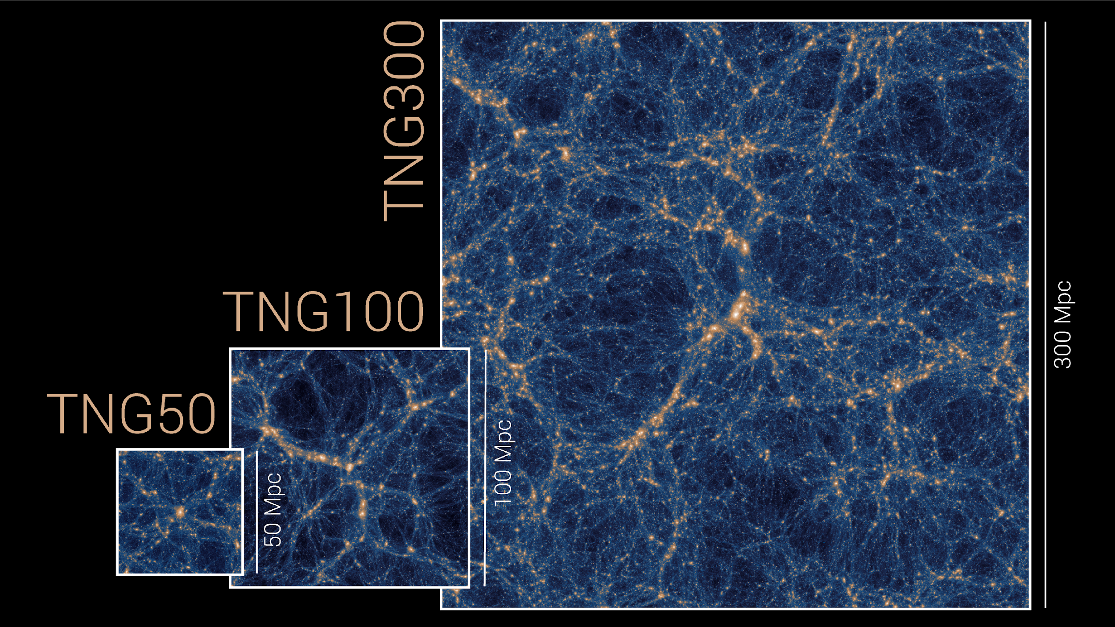
The IllustrisTNG suite
Large cosmological magneto- hydrodynamical simulations of galaxy formation
3 simulated volumes
3 resolutions

Slide 7
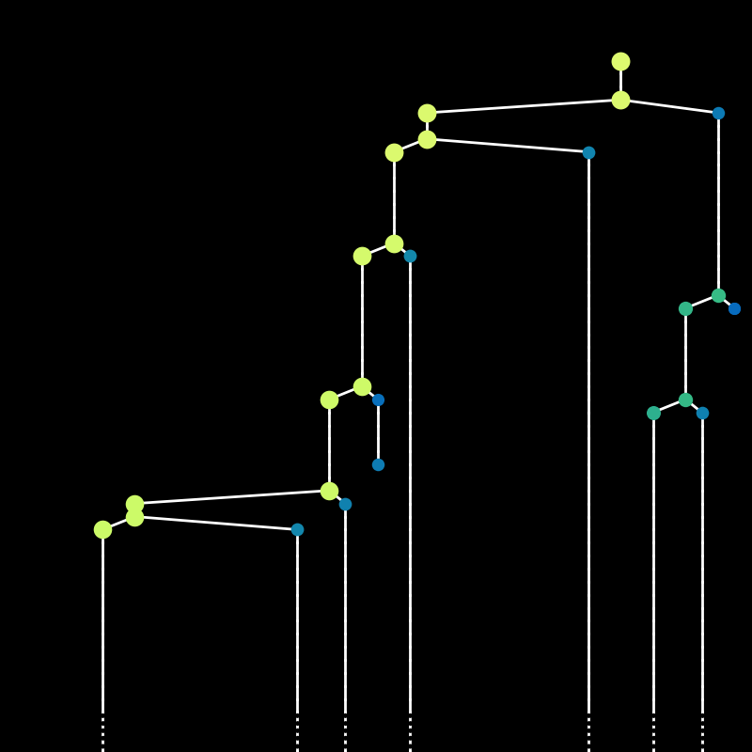
Inferring baryonic properties from DM merger trees w/ GNNs
Merger
trees:
Graphs
cosmic time

Slide 8
Inferring baryonic properties from DM merger trees w/ GNNs
Merger
trees:
Graphs
cosmic time

Slide 9
Inferring baryonic properties from DM merger trees w/ GNNs
Merger
trees:
Graph Neural Networks
cosmic time

Slide 10
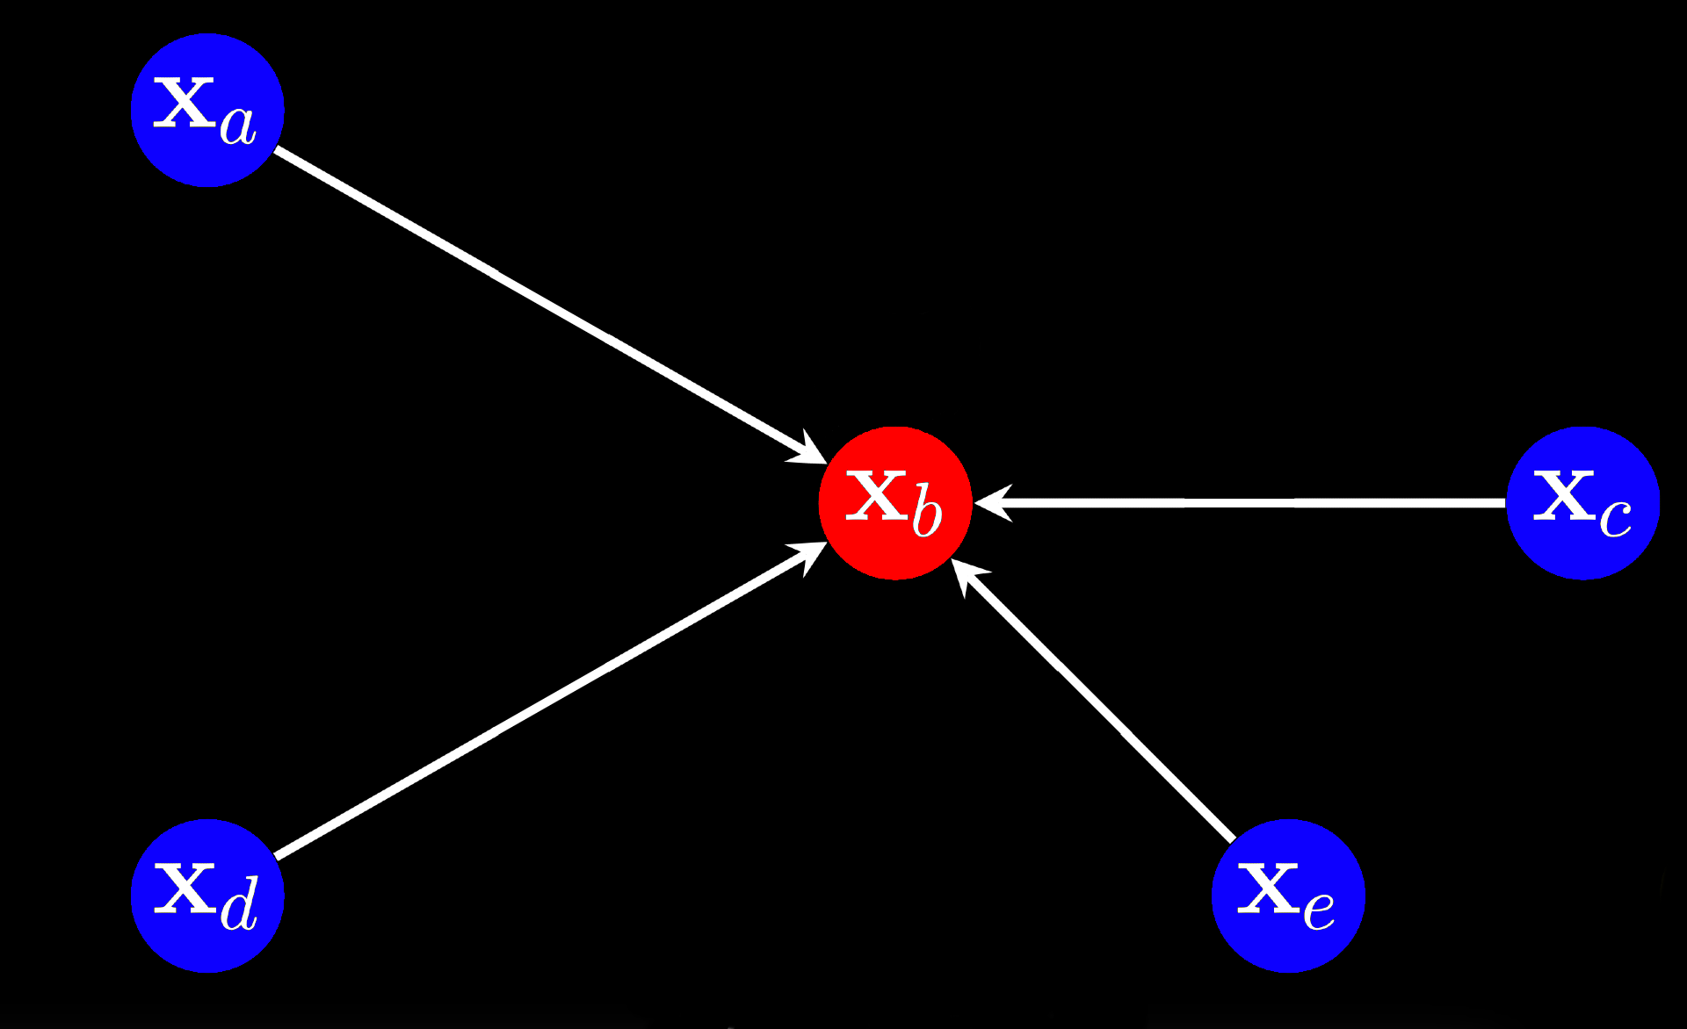
Inferring baryonic properties from DM merger trees w/ GNNs
Graph Neural Networks

Slide 11
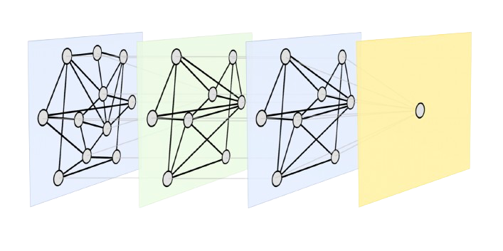
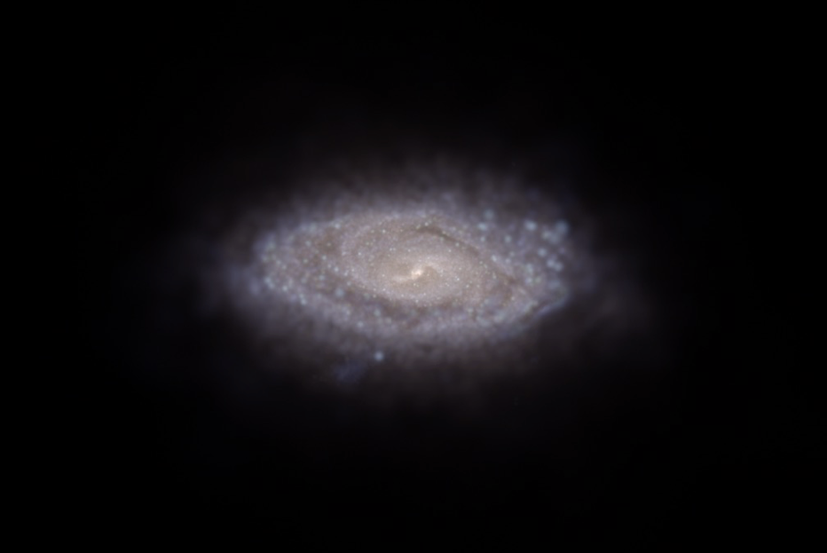
Inferring baryonic properties from DM merger trees w/ GNNs
Stellar mass
Gas, BH mass, SFR…

Slide 12
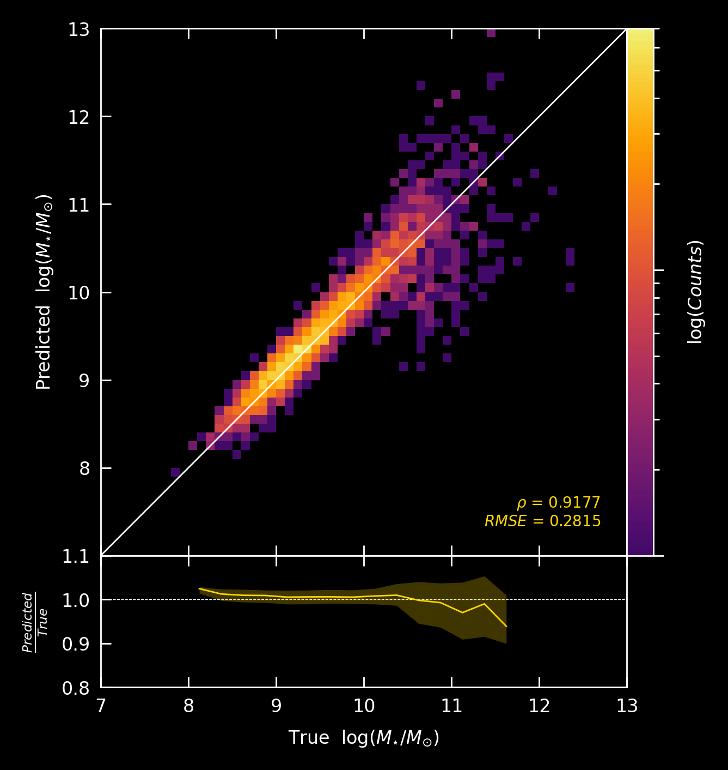
Captures galaxy – halo connection
Handles the entire merger trees
Training: ~ 24h (40gb GPU)
Applying: ~ min

Slide 13
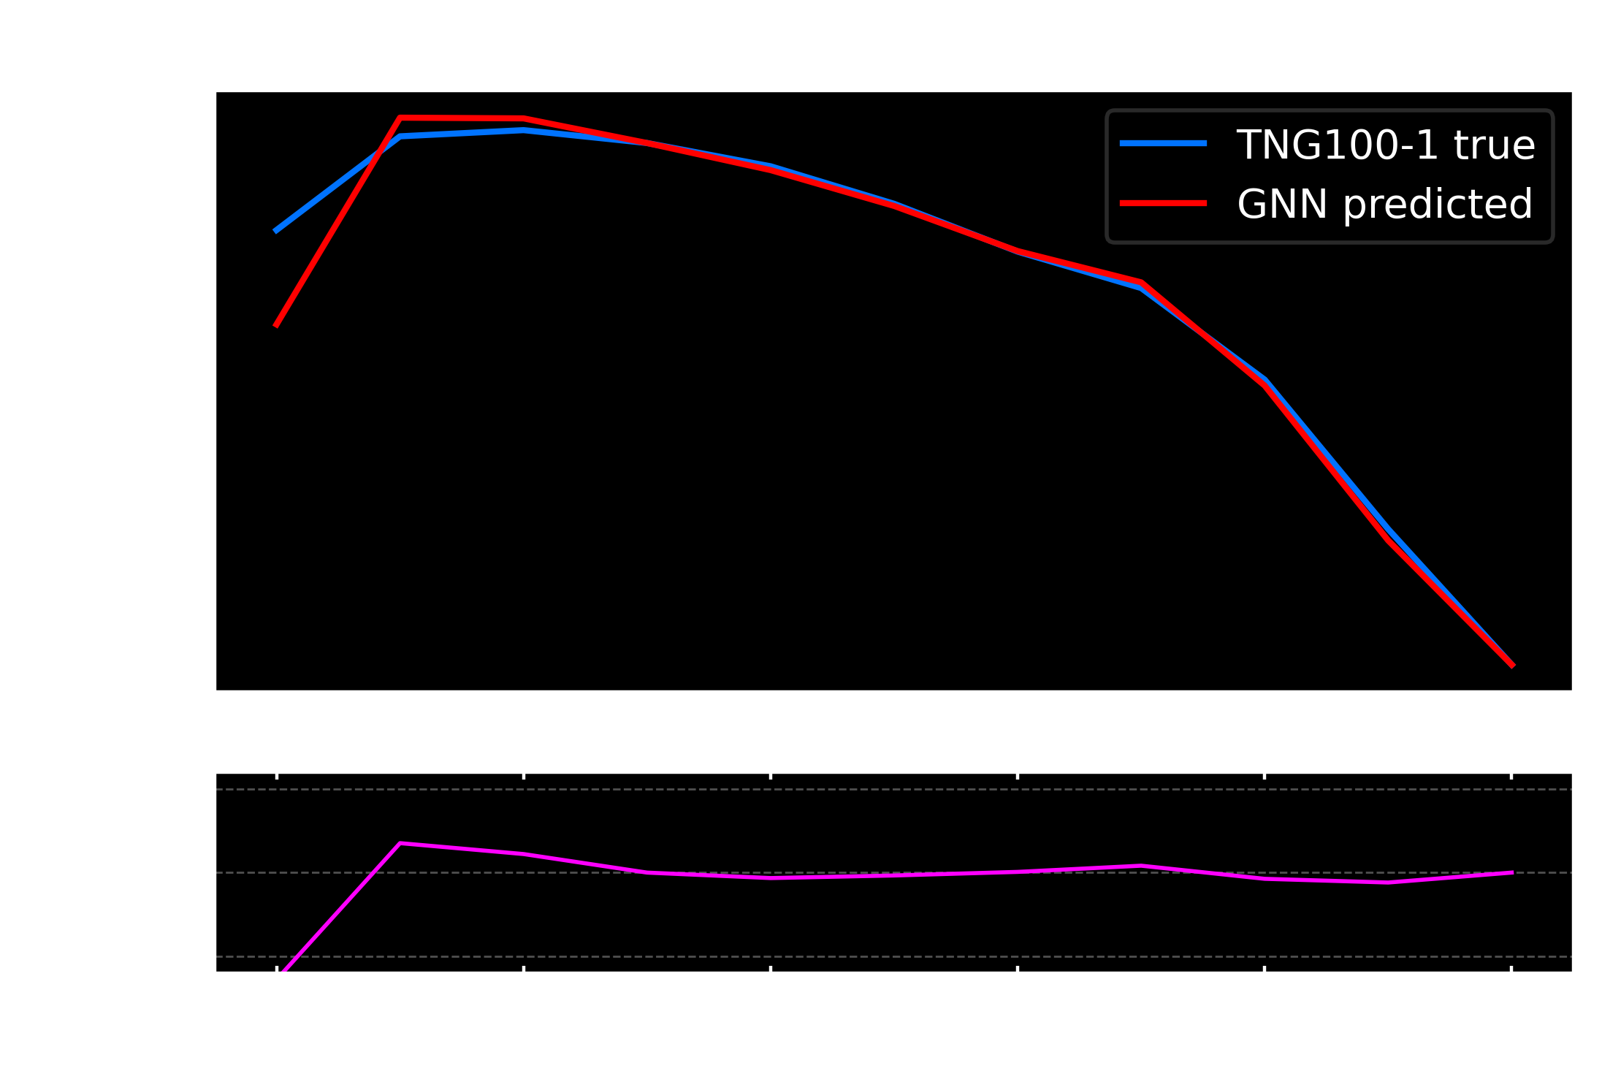

Slide 14
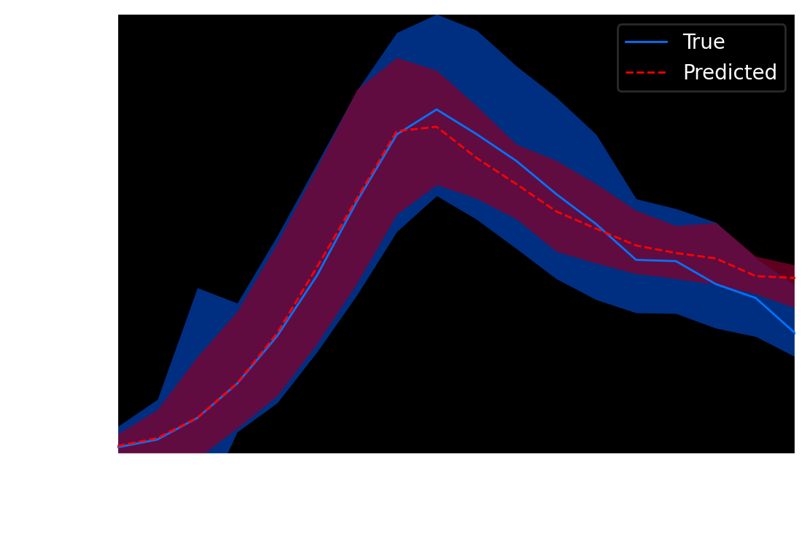

Slide 15
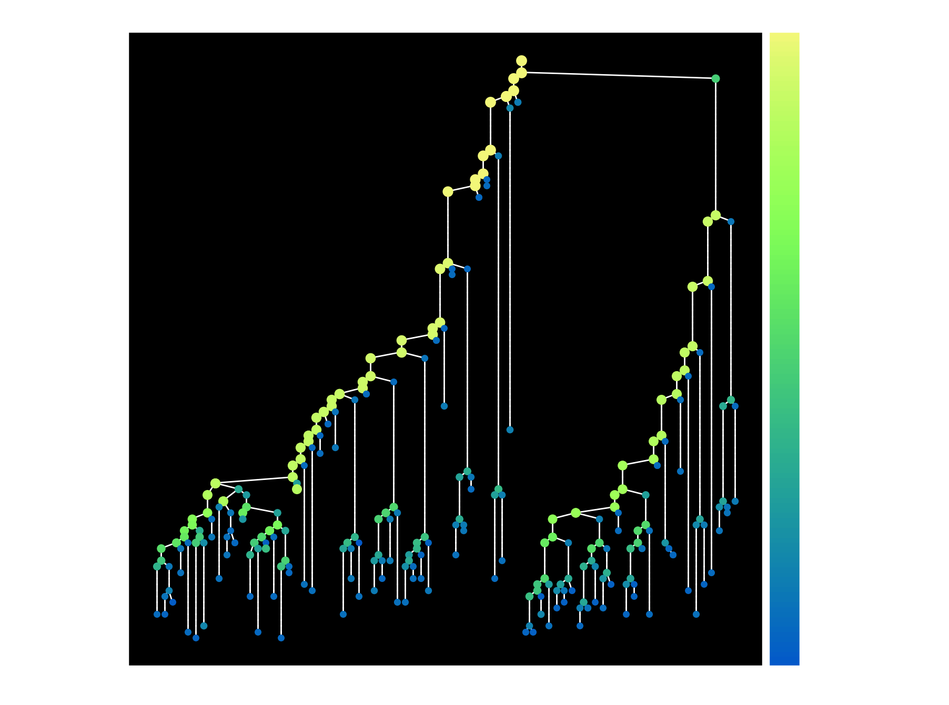
Graph Attention (Veličković+ 2017)

Slide 16
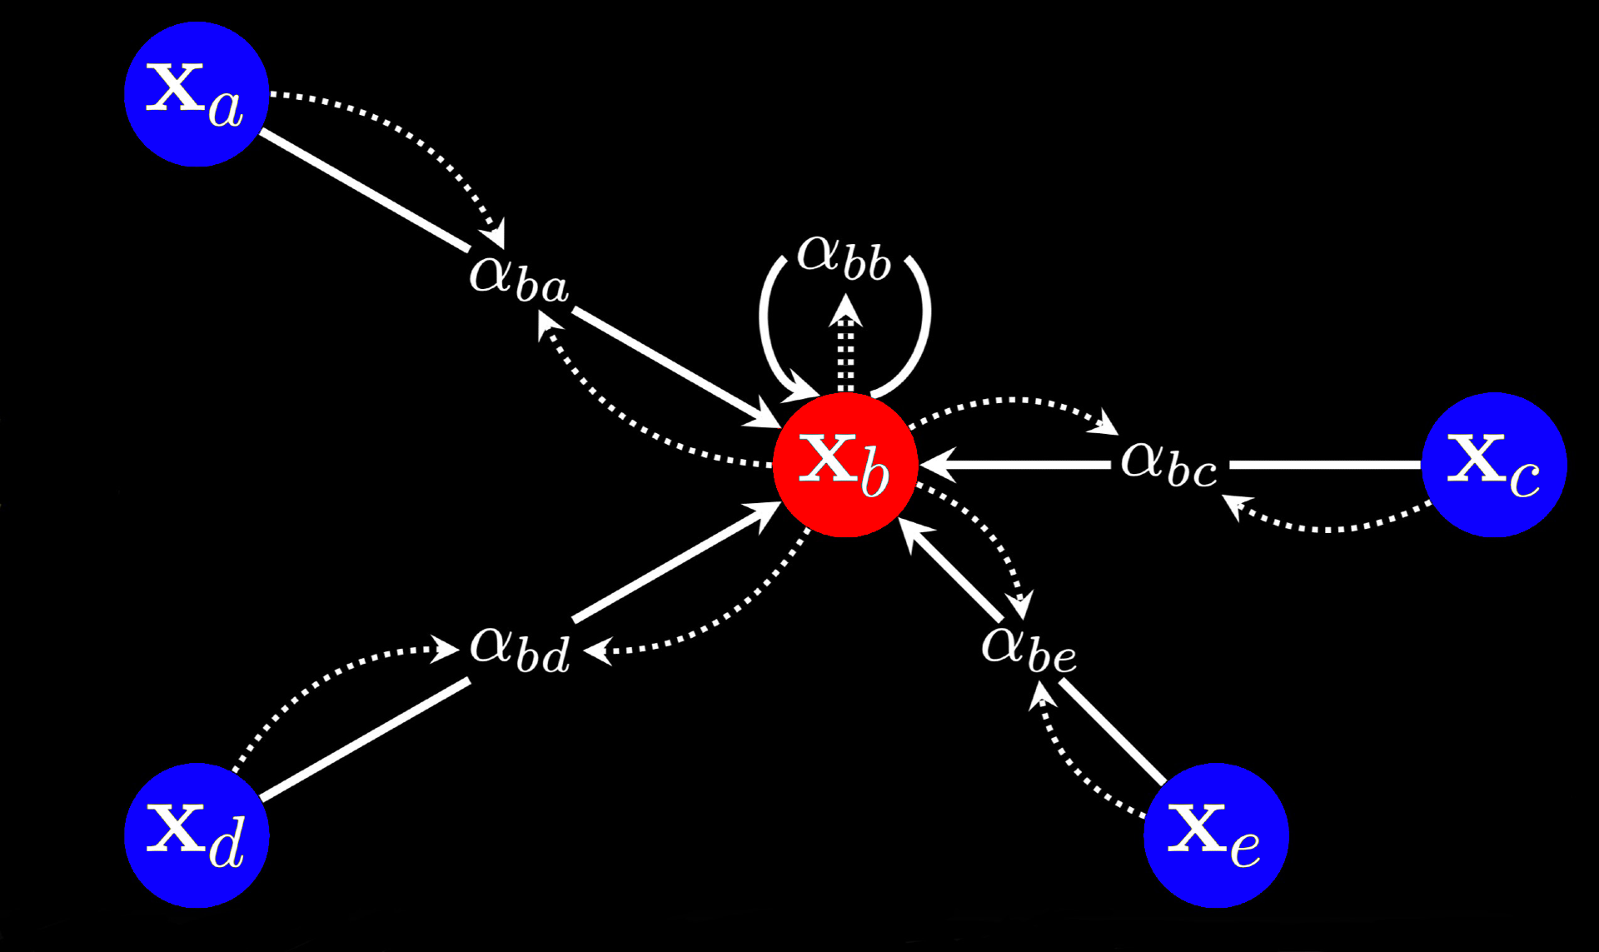

Slide 17
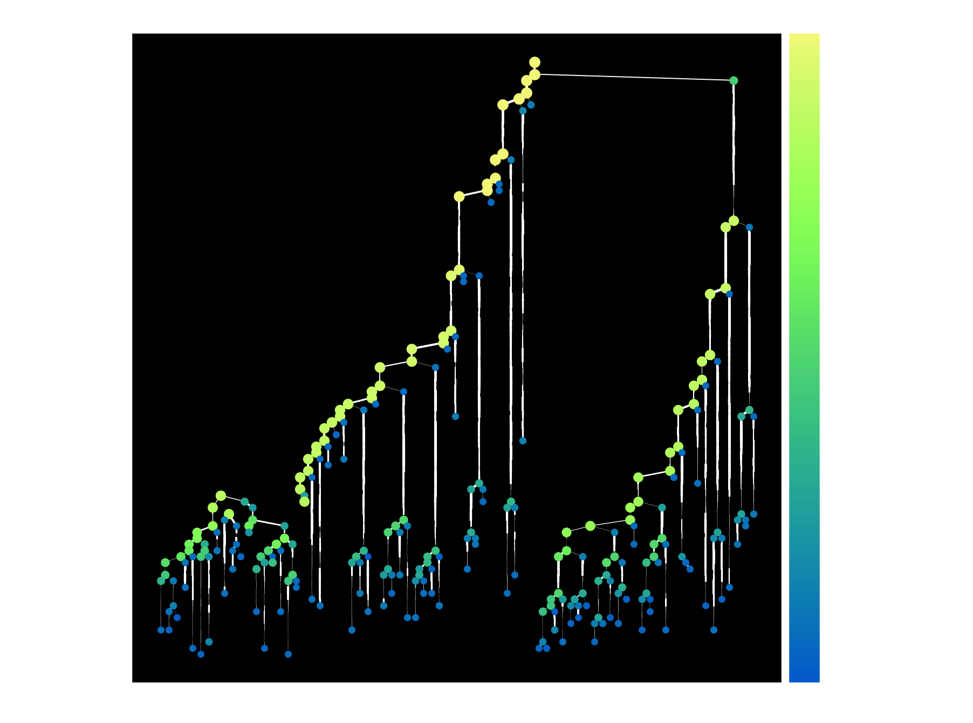

Slide 18
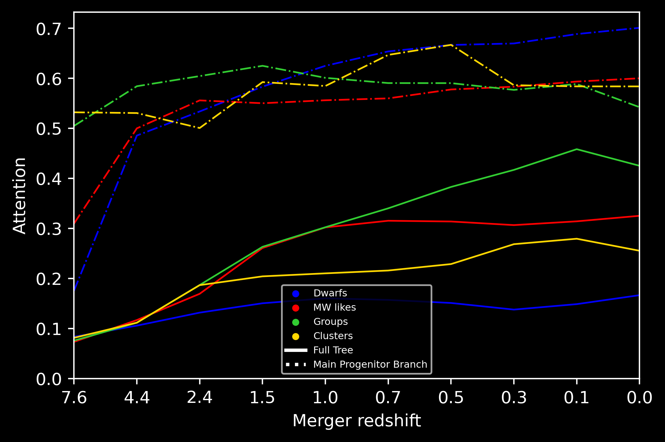

Slide 19
Conclusions
Our GNN model:
Accurately reproduces realistic galaxy populations from DMO sims
Gives us statistics about the galaxy – halo connection
Future work
Extend the statistical analysis of the attention coefficients
Augment the training dataset using TNG50 & TNG300

Slide 20
Resolution
resolution

Slide 21
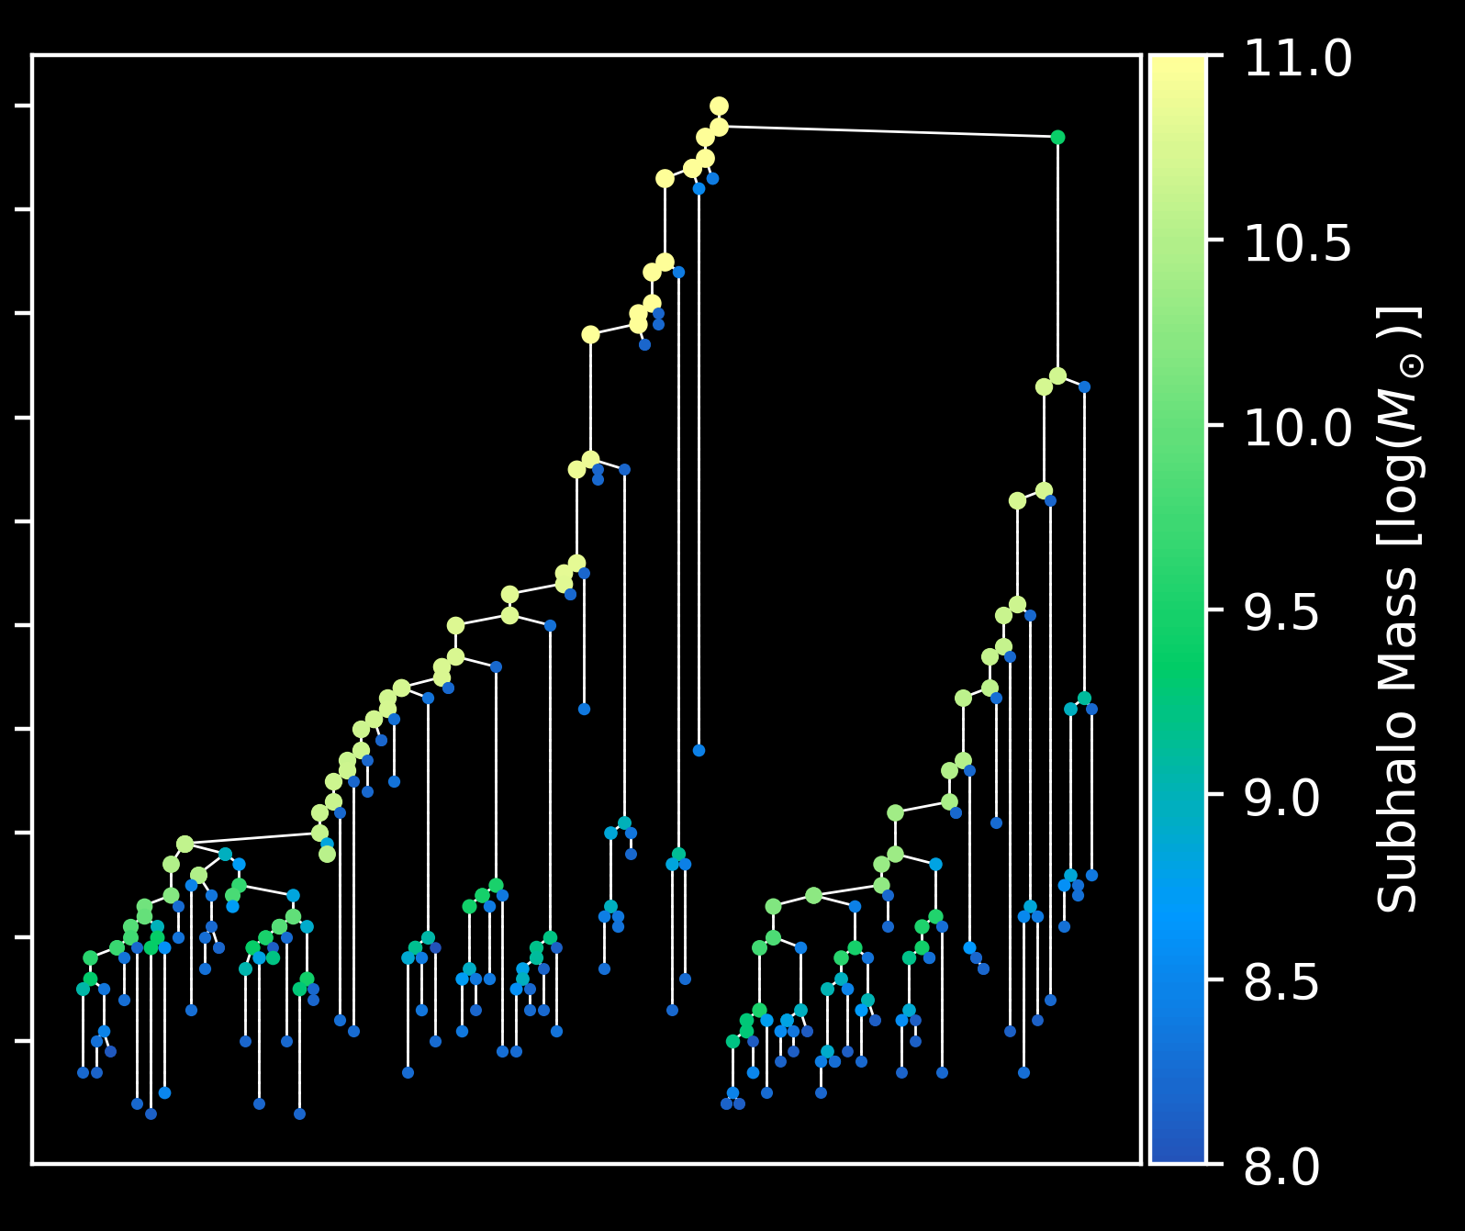
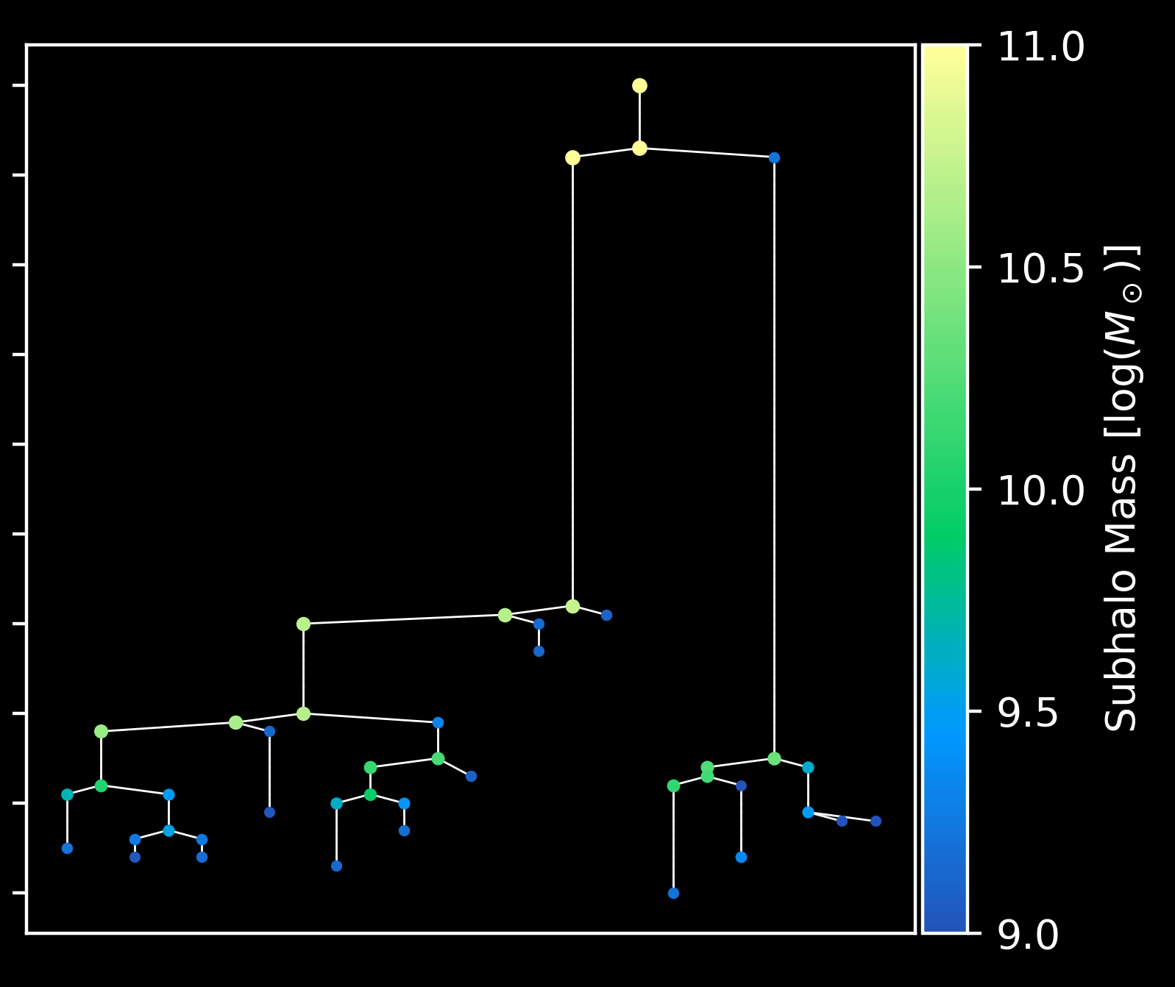
Resolution
TNG100 –1
TNG100 –2

Slide 22
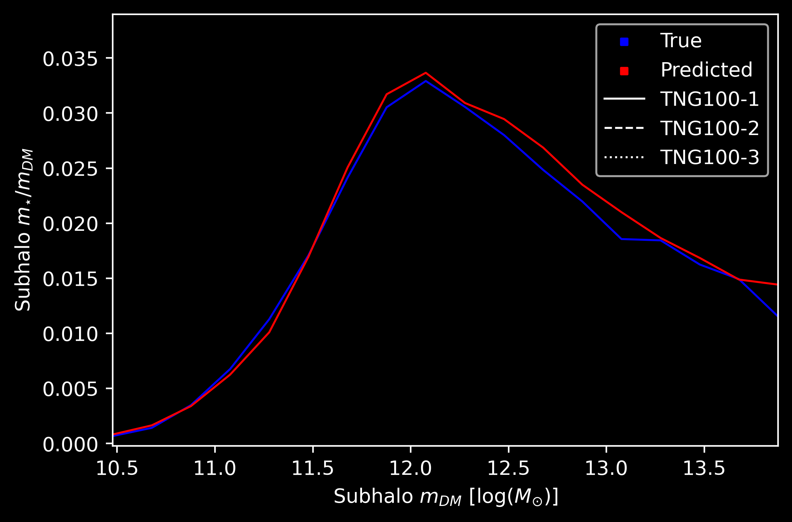
Train:
TNG100 –1
TNG100 –2
TNG100 –3
no resolution
as input

Slide 23
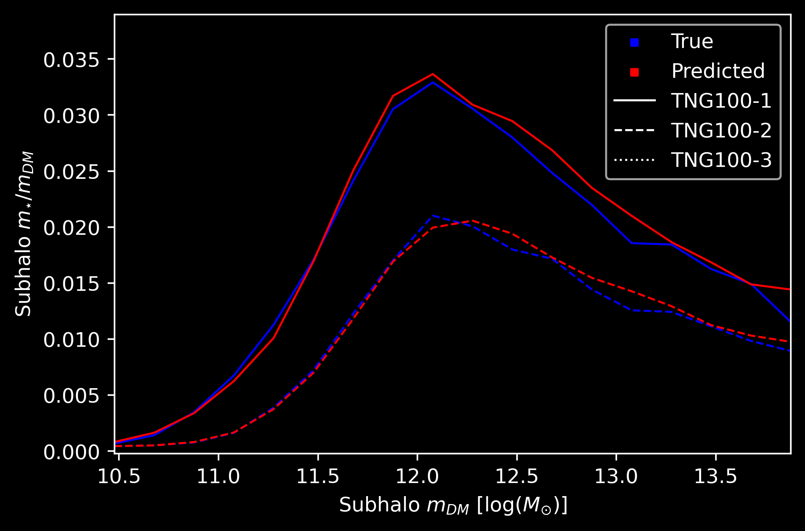
Train:
TNG100 –1
TNG100 –2
TNG100 –3
no resolution
as input

Slide 24
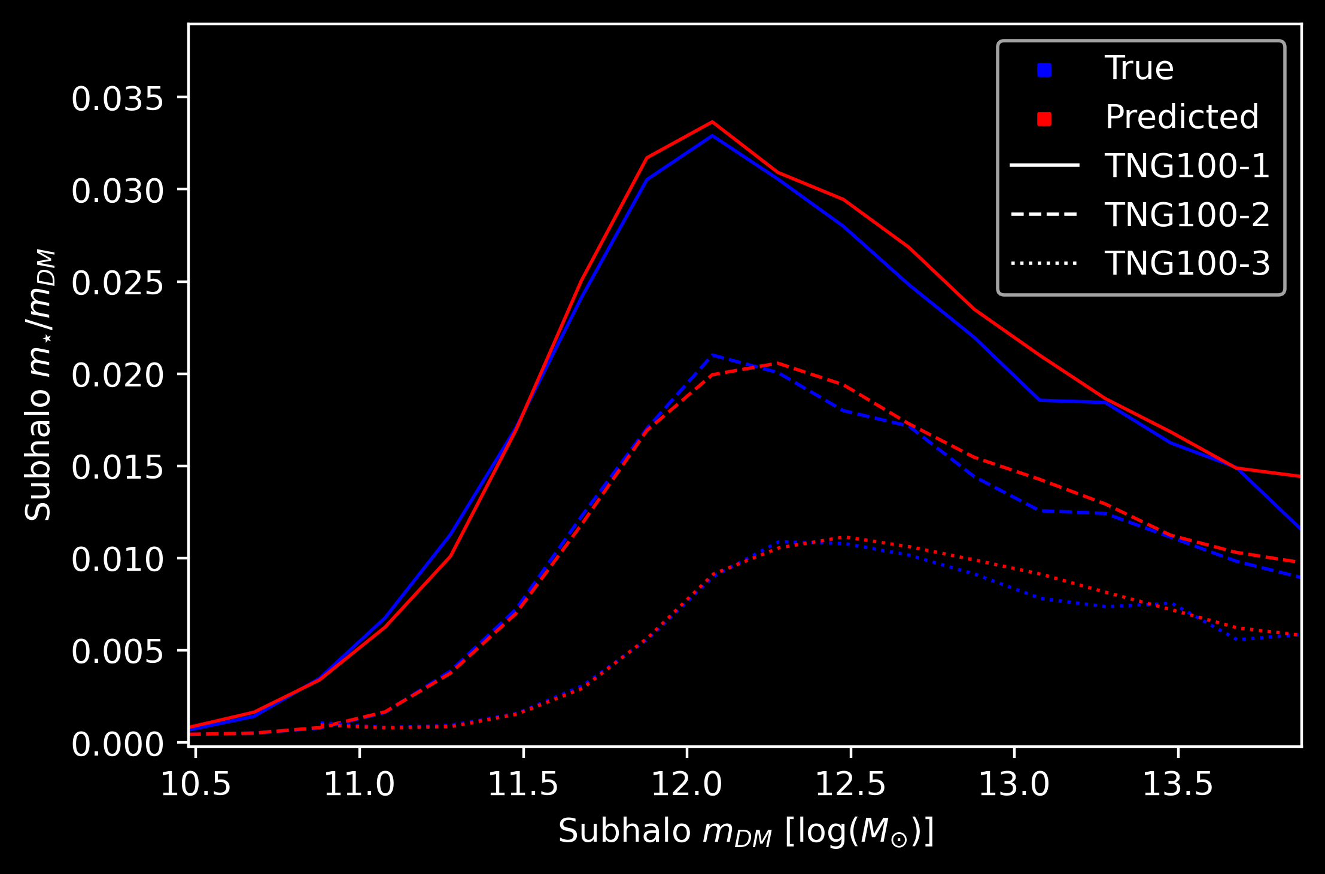
The network distinguishes between trees coming from different resolution runs
Train:
TNG100 –1
TNG100 –2
TNG100 –3
no resolution
as input

Slide 25
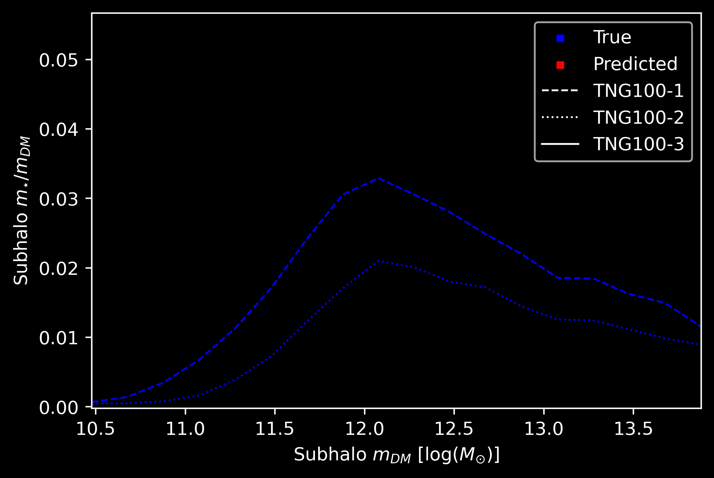
Train:
TNG100 –1
TNG100 –2
Test:
TNG100 –3
no resolution
as input

Slide 26
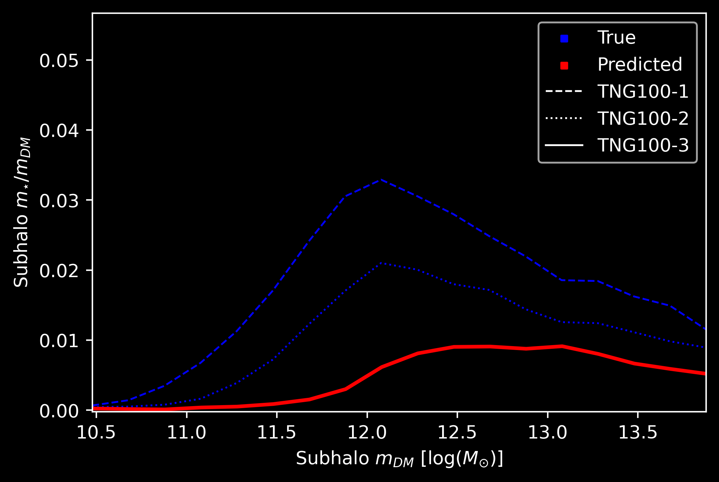
Train:
TNG100 –1
TNG100 –2
Test:
TNG100 –3
no resolution
as input

Slide 27
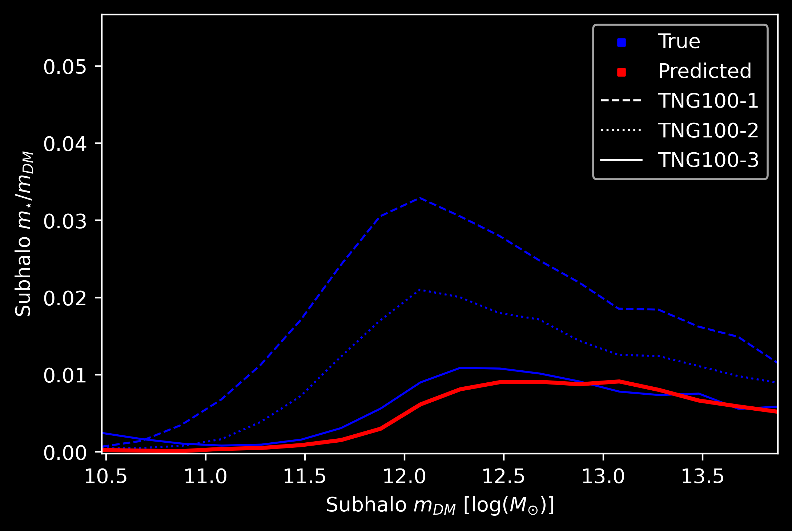
Train:
TNG100 –1
TNG100 –2
Test:
TNG100 –3
no resolution
as input
Use to train on TNG50, TNG100 & TNG300
simultaneously
↓
Data augmentation

