Slide 1
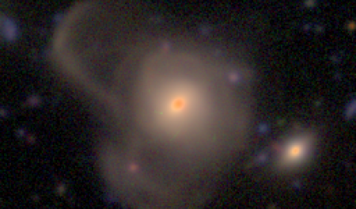
Detection of Galaxy Tidal Features using Self-Supervised Machine Learning
Alice Desmons (UNSW), Sarah Brough (UNSW), Francois Lanusse (CNRS, Université Paris-Saclay)

Slide 2
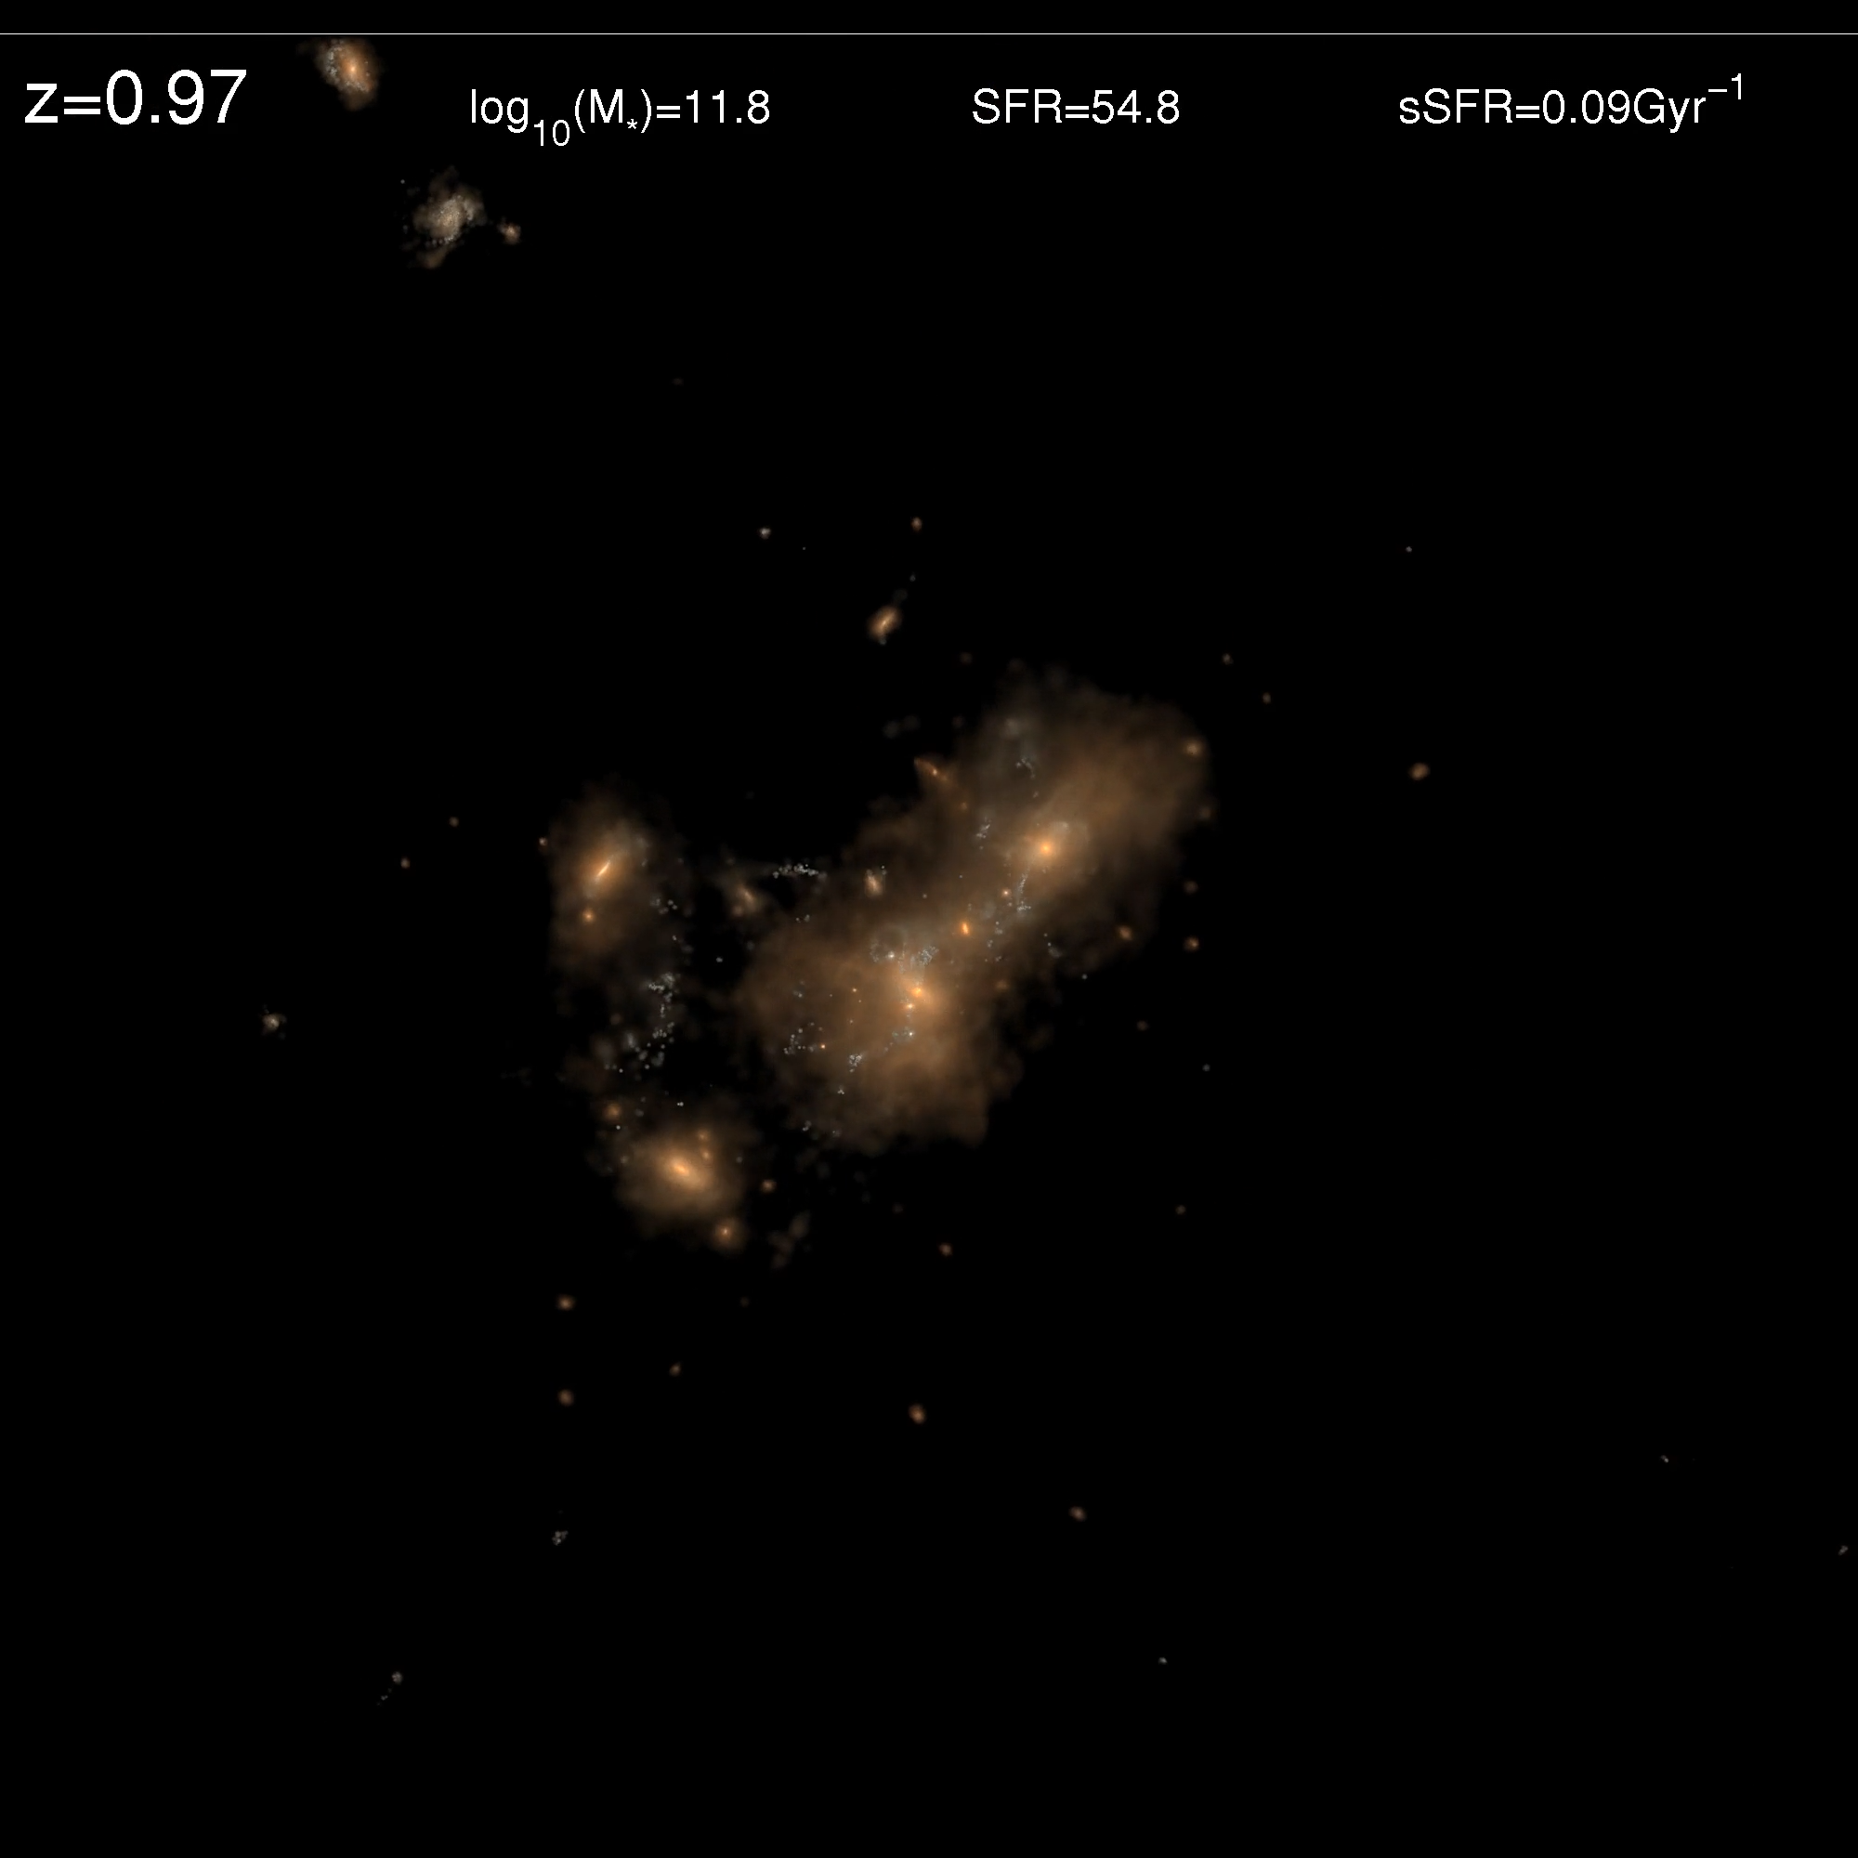
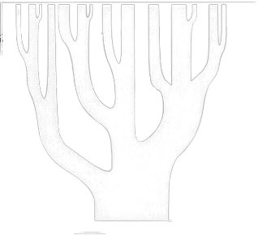
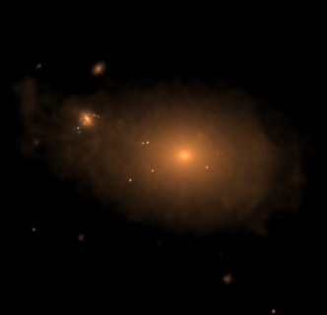
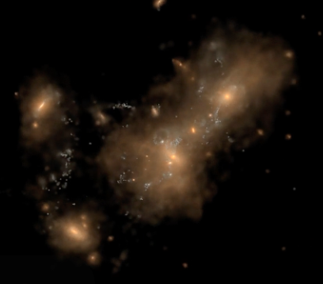
Tidal Features
t
t₀
t_{f}

Slide 3
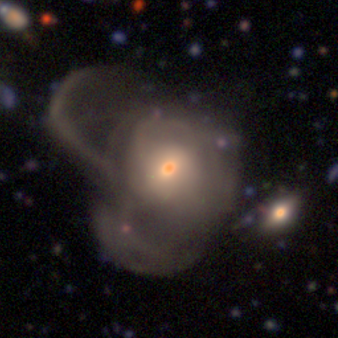
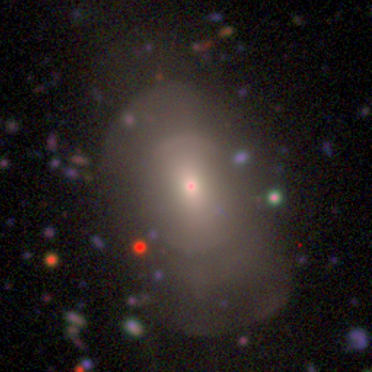
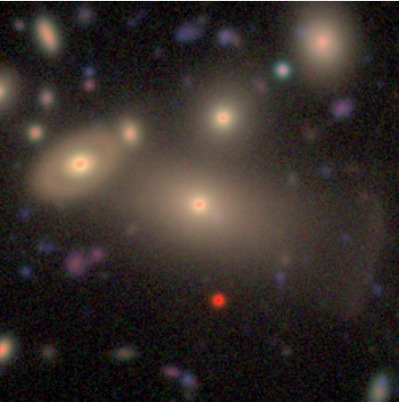
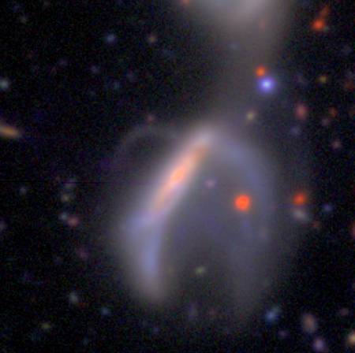
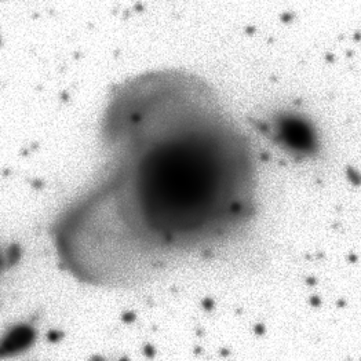
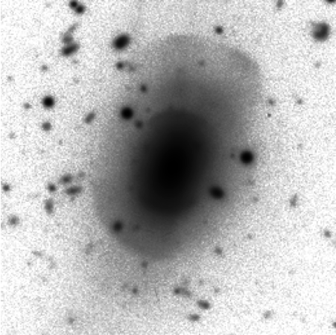
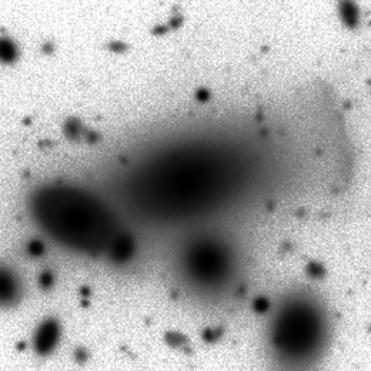
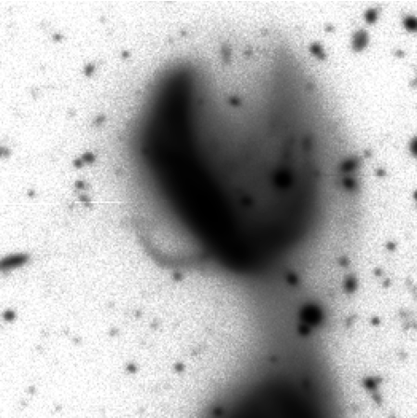


Detection Challenges
Tidal Feature Surface Brightness:
$$μ_{r} ≥ 27 \text{mag} {\text{arcsec}}^{−2}$$
SDSS brightness limit:
$$μ_{r} \sim 23.5 \text{mag} {\text{arcsec}}^{−2}$$
Vera C. Rubin Observatory’s Legacy Survey of Space and Time:
  2024 – 2034
  ∼60 petabytes of images
Hyper Suprime-Cam Subaru Strategic Program (HSC-SSP)

Slide 4
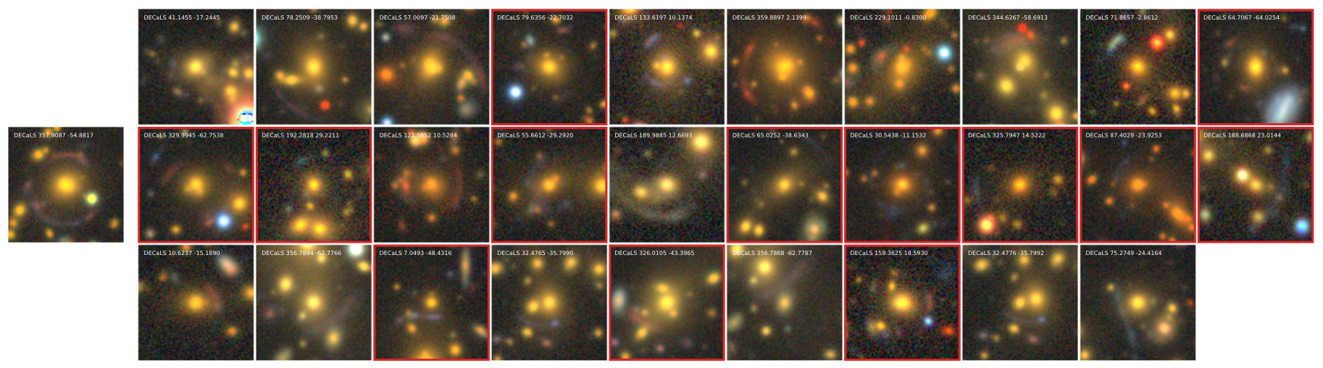
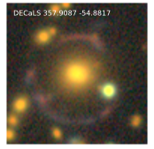

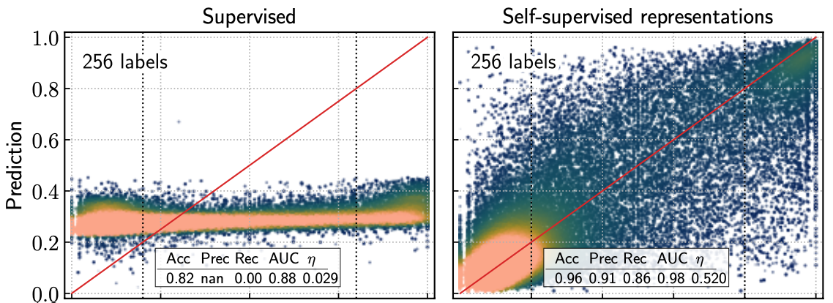
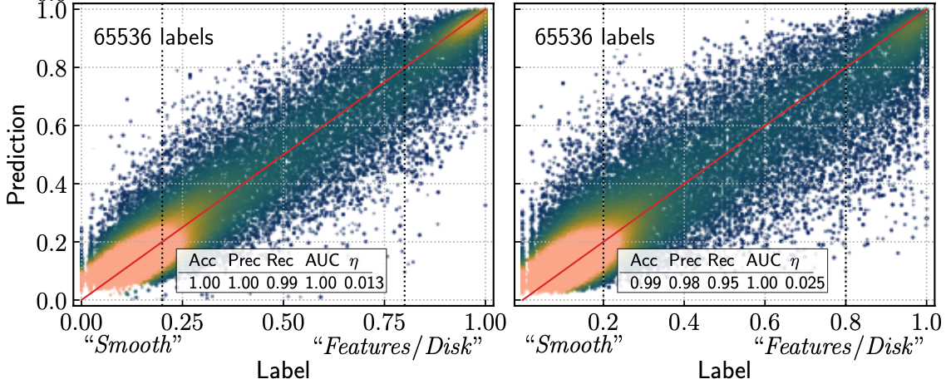
Type of ML
Requirements
Classification
Few labels
Easy to retrain
Figure from Stein et al. (2021)
Self-Supervised ML in Astronomy
Hayat +21 | Wei +22
Stein +21 | Slijepcevic + 22
Walmsley +22 | Ćiprijanović + 23
Figure from Hayat et al. (2021)

Slide 5
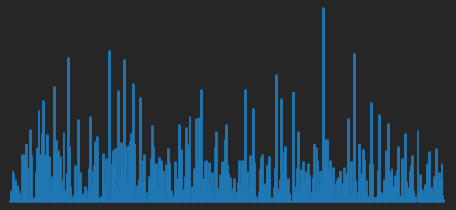
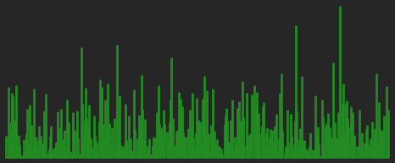
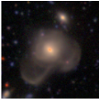
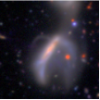
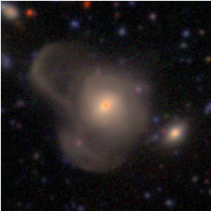
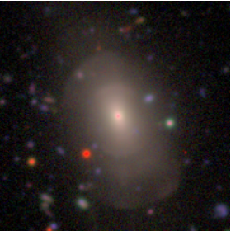
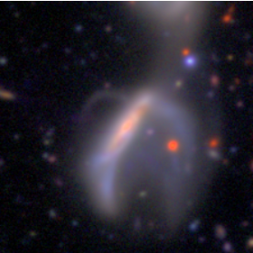
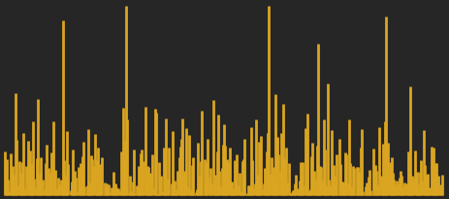
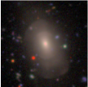
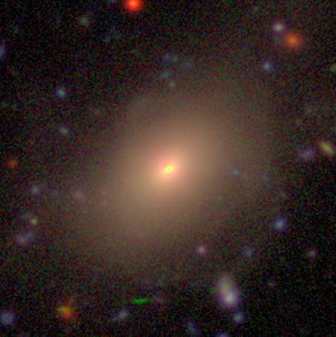
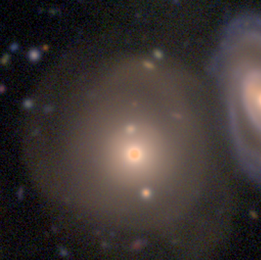
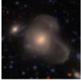
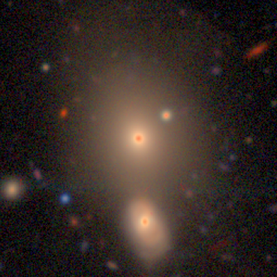
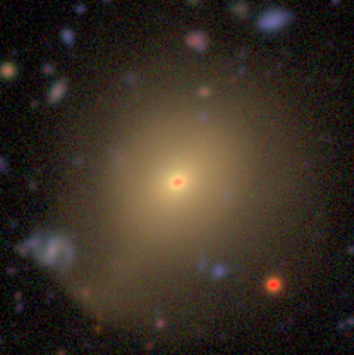
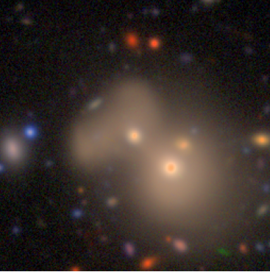
The Model
Galaxy Images
Neural Network (ResNet-20)
Encoding
Similar images have similar encodings
Similarity Search
Nearest Neighbour Contrastive Learning of Visual Representations
(NNCLR)
Foundation Model
Anomaly Detection
Downstream Tasks
Galaxy Property Estimation

Slide 6
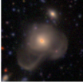









The Model: Encoder
Our Augmentations
Flipping
Gaussian noise
Random cropping
128 x 128 pixels
Input batch of images
45,000 images
Random augmentation
Random augmentation
$$ℒ=−\log\left(\frac{\exp\left(NN\left(z_{i},Q\right)∙\frac{z_{i}^{+}}{τ}\right)}{\sum_{k}{\exp\left(NN\left(z_{i},Q\right)∙\frac{z_{k}^{+}}{τ}\right)}}\right)$$
Encoder
Encoder
$$−\log\left(\frac{\exp\left(NN\left(z_{i},Q\right)∙\frac{z_{i}^{+}}{τ}\right)}{\sum_{k}{\exp\left(NN\left(z_{k},Q\right)∙\frac{z_{i}^{+}}{τ}\right)}}\right)$$
Contrastive Loss
Example Queue
Nearest Neighbour of view 1
$$NN\left(z,Q\right)=\underset{i∈Q}{arg min}{{\left\|z\right.− \left.i\right\|}_{2}}$$
View 1
View 2

Slide 7
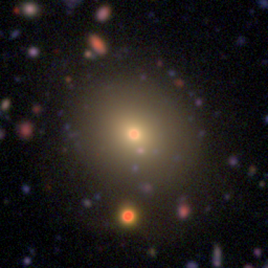






The Model: Classifier
$$z_{input}$$
$$y_{input}$$
$$x_{input}$$
Linear
Classifier
Training Sets
Encoder: ~45,000 unlabelled
Classifier: 300 tidal galaxies + 300 non-tidal
No tidal features
Tidal features
0
1
$$y_{output}$$
$$z_{output}$$
$$x_{output}$$

Slide 8
Model Evaluation
Model | SDSS |  | HSC-SSP
 | ROC AUC | TPR for FPR = 0.2 | ROC AUC | TPR for FPR = 0.2
Self-Supervised | 0.96 | 0.96 | 0.91 | 0.94
Supervised | 0.96 | 0.97 | 0.87 | 0.81

Slide 9
Model Evaluation
Model | SDSS |  | HSC-SSP
 | ROC AUC | TPR for FPR = 0.2 | ROC AUC | TPR for FPR = 0.2
Self-Supervised | 0.96 | 0.96 | 0.91 | 0.94
Supervised | 0.96 | 0.97 | 0.87 | 0.81

Slide 10
Model Evaluation
Model | SDSS |  | HSC-SSP
 | ROC AUC | TPR for FPR = 0.2 | ROC AUC | TPR for FPR = 0.2
Self-Supervised | 0.96 | 0.96 | 0.91 | 0.94
Supervised | 0.96 | 0.97 | 0.87 | 0.81

Slide 11
Model Evaluation
Model | SDSS |  | HSC-SSP
 | ROC AUC | TPR for FPR = 0.2 | ROC AUC | TPR for FPR = 0.2
Self-Supervised | 0.96 | 0.96 | 0.91 | 0.94
Supervised | 0.96 | 0.97 | 0.87 | 0.81

Slide 12
Model Evaluation
Model | SDSS |  | HSC-SSP
 | ROC AUC | TPR for FPR = 0.2 | ROC AUC | TPR for FPR = 0.2
Self-Supervised | 0.96 | 0.96 | 0.91 | 0.94
Supervised | 0.96 | 0.97 | 0.87 | 0.81
Comparison with fully supervised model from Pearson et al. (2019)

Slide 13
Model Evaluation
Model | SDSS |  | HSC-SSP
 | ROC AUC | TPR for FPR = 0.2 | ROC AUC | TPR for FPR = 0.2
Self-Supervised | 0.96 | 0.96 | 0.91 | 0.94
Supervised | 0.96 | 0.97 | 0.87 | 0.81
Comparison with fully supervised model from Pearson et al. (2019)
Run both models on our HSC-SSP dataset and SDSS dataset from Pearson et al. (2019)

Slide 14
Model Evaluation
Model | SDSS |  | HSC-SSP
 | ROC AUC | TPR for FPR = 0.2 | ROC AUC | TPR for FPR = 0.2
Self-Supervised | 0.96 | 0.96 | 0.91 | 0.94
Supervised | 0.96 | 0.97 | 0.87 | 0.81
Comparison with fully supervised model from Pearson et al. (2019)
Run both models on our HSC-SSP dataset and SDSS dataset from Pearson et al. (2019)

Slide 15

Model Evaluation
Model | SDSS |  | HSC-SSP
 | ROC AUC | TPR for FPR = 0.2 | ROC AUC | TPR for FPR = 0.2
Self-Supervised | 0.96 | 0.96 | 0.91 | 0.94
Supervised | 0.96 | 0.97 | 0.87 | 0.81
0.91
0.94
Comparison with fully supervised model from Pearson et al. (2019)
Run both models on our HSC-SSP dataset and SDSS dataset from Pearson et al. (2019)
On HSC-SSP data the self-supervised model has a higher area under the ROC curve
Also has a higher TPR for FPR = 0.2

Slide 16
Similarity Search
Query Image
Most Similar Images

Slide 17
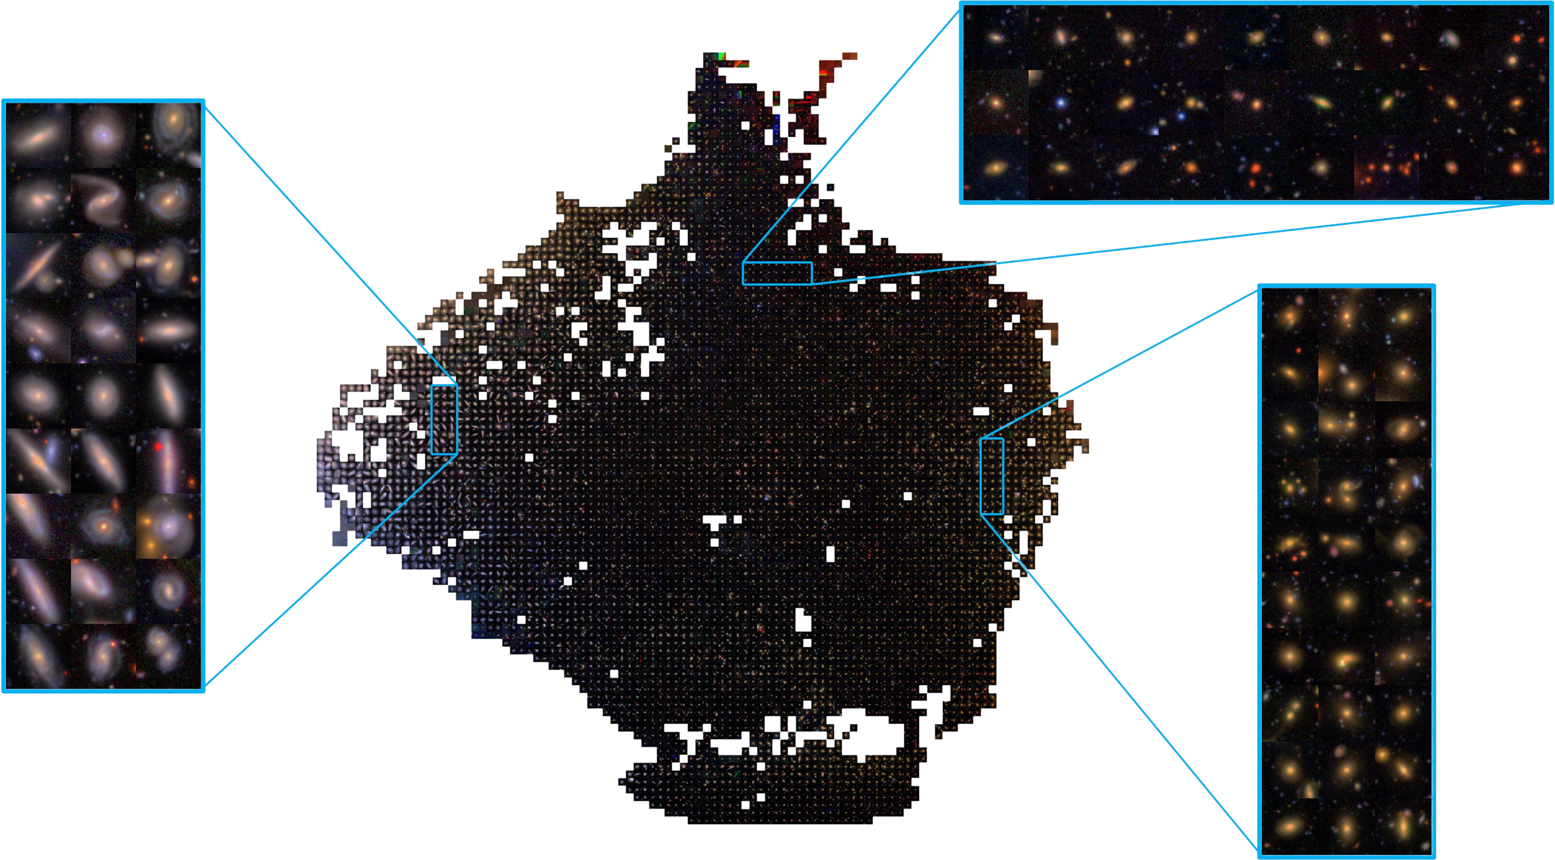

UMAP

Slide 18
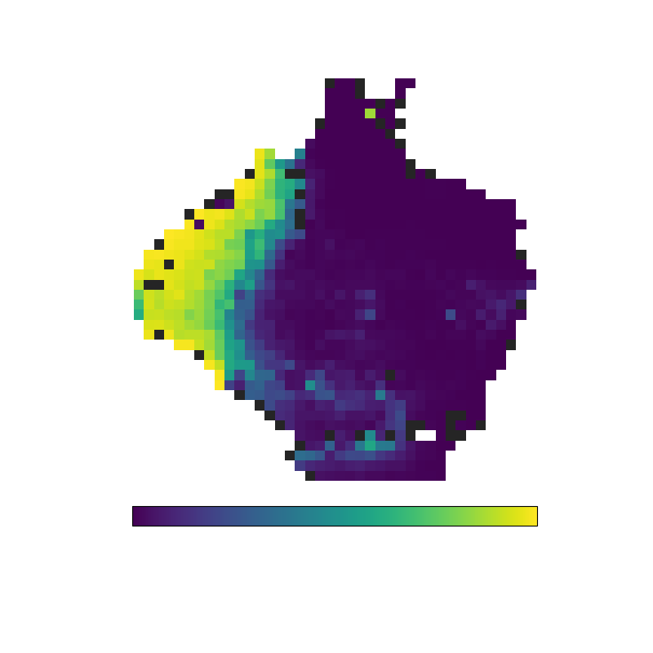
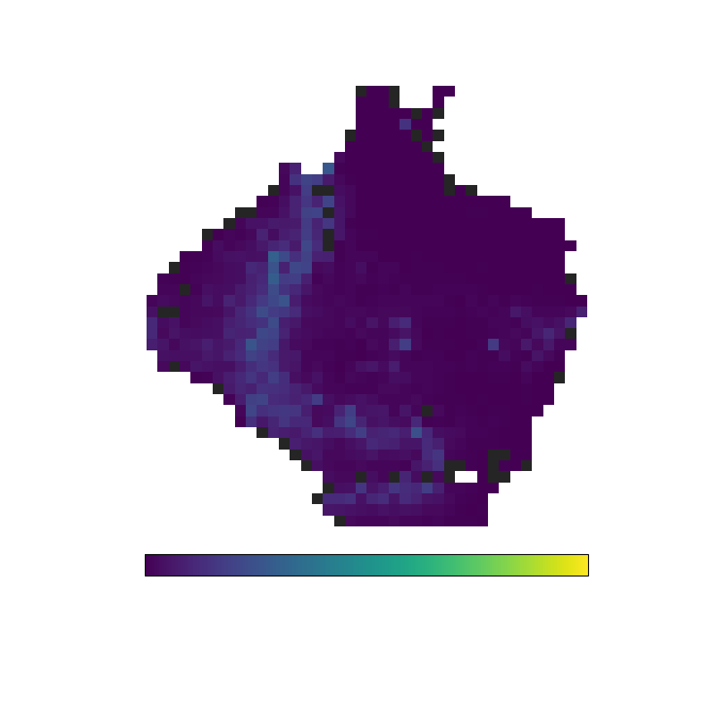
UMAP + Classifier

Slide 19
Model Application: Dataset
Galaxy Property | Range
Stellar Mass | Log₁₀(M/M⊙) > 9.5
Redshift | z ≤ 0.4
i-band mag | 15 < i < 20
Remove galaxies affected by shredding
Total Galaxies: 34, 331

Slide 20
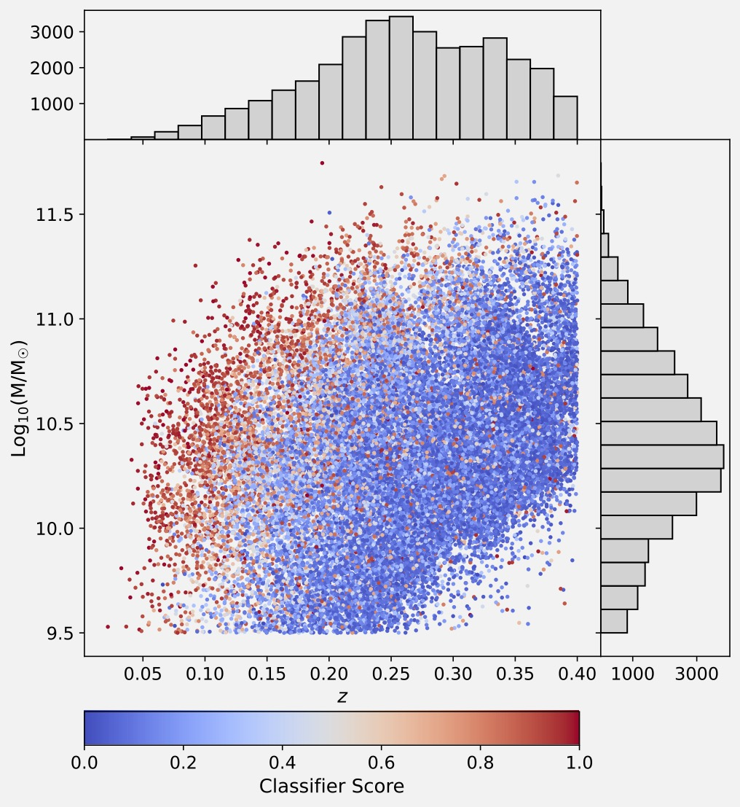
Model Application: Dataset
Galaxy Property | Range
Stellar Mass | Log₁₀(M/M⊙) > 9.5
Redshift | z ≤ 0.4
i-band mag | 15 < i < 20
Remove galaxies affected by shredding
Total Galaxies: 34, 331

Slide 21

Model Application: Visual Classification
Combine model outputs with visual classification to obtain pure tidal feature sample
Classify top-scored galaxies until tidal feature level stabilises
Upper bound
Middle point
Lower bound

Slide 22
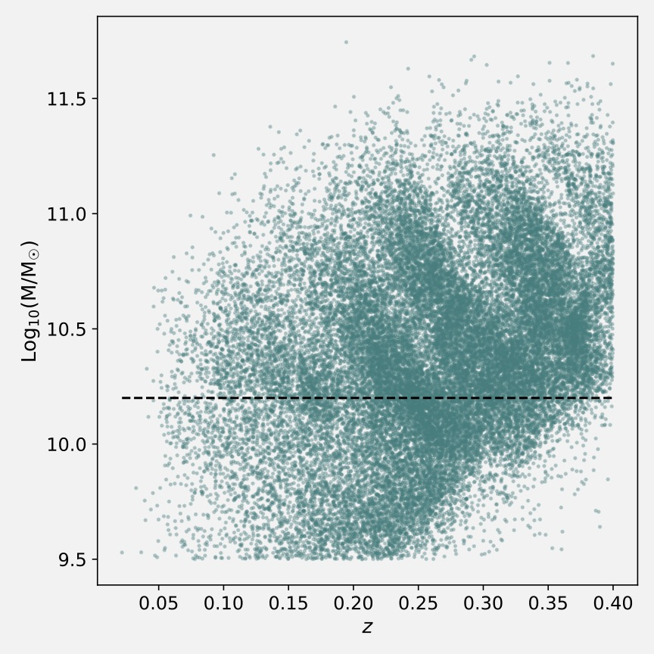
Results: Stellar Mass
Apply stellar mass cut to avoid being affected by completeness
Tidal feature fraction systematically increases with increasing stellar mass

Slide 23
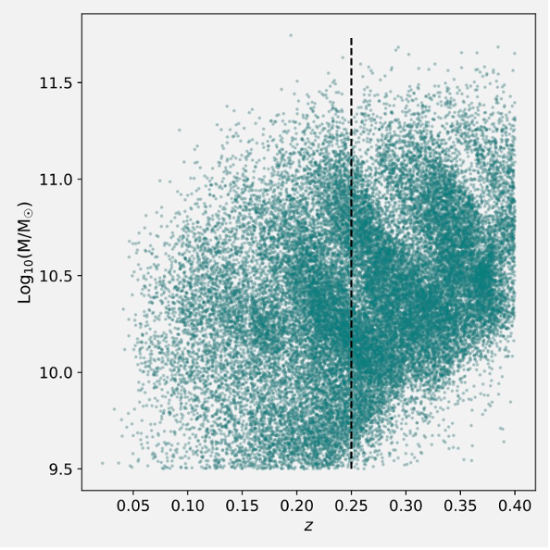
Results: Redshift
Apply redshift cut to avoid being affected by completeness
Tidal feature fraction systematically decreases with increasing redshift

Slide 24
Results: Stellar Mass and Redshift
Relationship with redshift likely a result of visibility
Relationship with mass likely a combination of gravitational attraction and visibility

Slide 25

Future Work & Summary
Future Work
Investigate relationship between tidal features and stellar mass, redshift, galaxy size, and galaxy/tidal feature colour to further understanding of galaxy evolution
When LSST data is released – retrain and apply model to this data and repeat our analysis on an even larger sample
Summary
Built a self-supervised model to partially automate tidal feature detection
Compared performance to fully supervised model
Showed some cool self-supervised features: Similarity search, UMAP
Combined model outputs with visual classification to obtain pure tidal feature sample
Preliminary look at how tidal feature fraction varies with stellar mass and redshift
Check out our published paper!

Slide 26
Summary
Built a self-supervised model to partially automate tidal feature detection
Compared performance to fully supervised model
Showed some cool self-supervised features: Similarity search, UMAP
Combined model outputs with visual classification to obtain pure tidal feature sample
Preliminary look at how tidal feature fraction varies with stellar mass and redshift
Check out our published paper!

