Slide 1
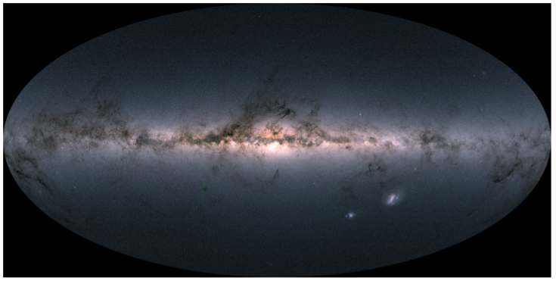



GaiaNIR: a pathway to the dark side of the Milky Way
G. Bono, V. D’Orazi (TOV) + V. F. Braga, M. Fabrizio, G. Fiorentino, R. da Silva (OAR), + A. Nunnari, V. Pipwala, K. B. Villagra + many others
Bologna, January 17 2024

Slide 2
OUTLINE OF THE LECTURE
Why variables stars?
→ Why the bulge?
Why GaiaNIR?
Conclusions
Bologna, January 17 2024

Slide 3
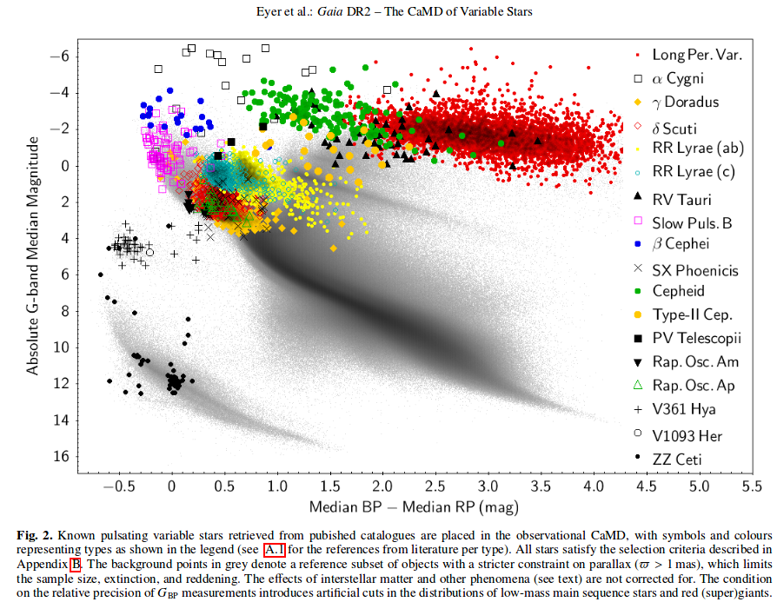
Why Variables?
RR Lyrae,
Type II Cepheids,
Anomalous Cepheids,
Miras,
Classical Cepheids,
Accurate standard candles
Solid tracers of old (RRLs, TIICs), intermediate (ACs, Miras) and young (Classical Cepheids).

Slide 4
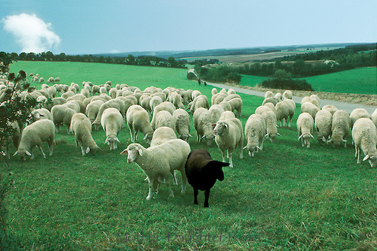
Cepheids &
RR Lyrae
Added values
They can be easily identified
Individual distances better than ~1-3%
Reddening estimates
Age constraints
Cepheids → young [5-300 Myr] individual ages
RR Lyrae → old [> 10 Gyr]
→ Demanding targets!

Slide 5
Distribution of variable stars across the MW

Slide 6
186,000 RRLs
86,000 by Gaia
Braga Fecit

Slide 7
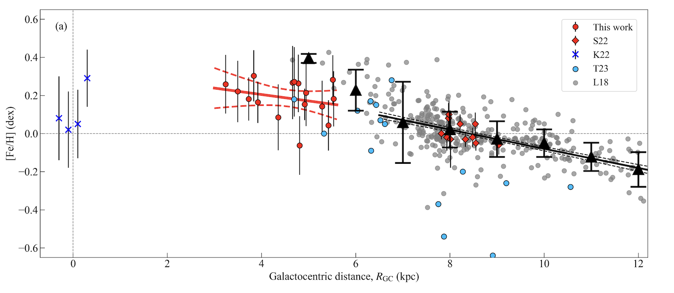
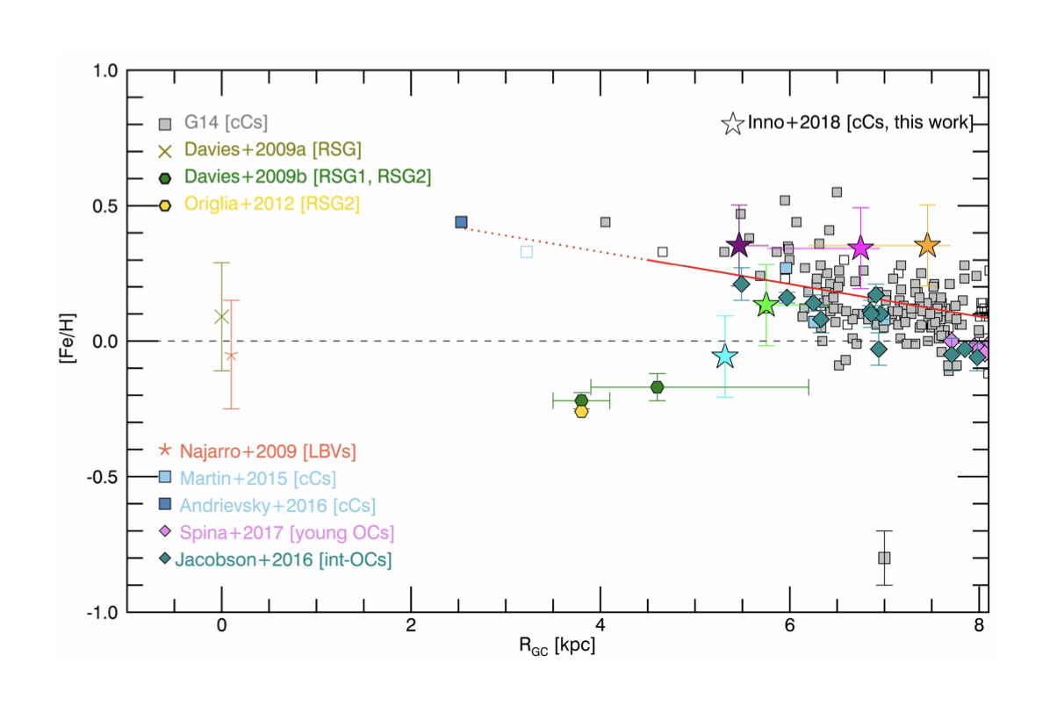
CCs in the inner disk & Galactic center
Evidence of a flattening (break) in the inner disk and in the Galactic center
High resolution NIR spectra collected with
WINERED@Magellan
Exactly one century CCs in M31!
Matsunaga + 2023

Slide 8
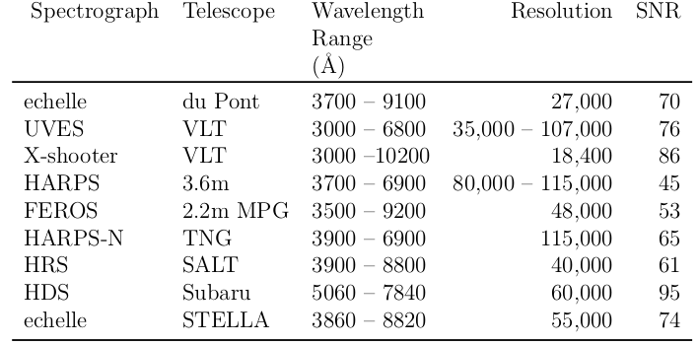
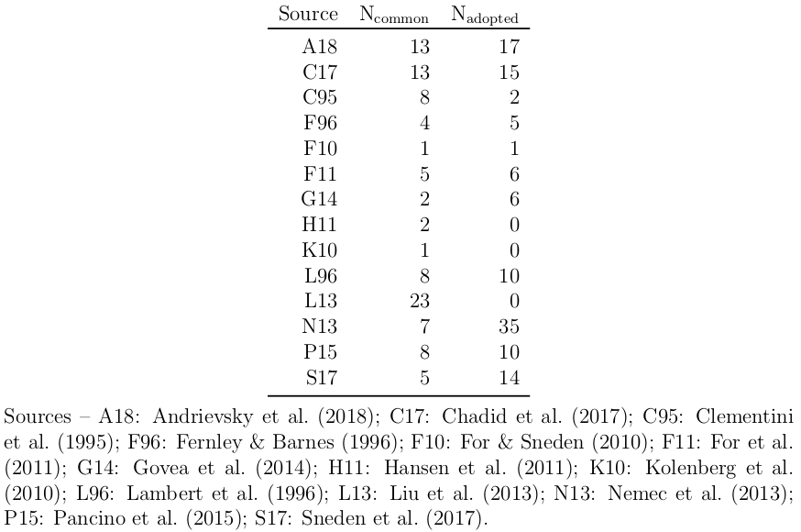
High resolution data set
407 HR spectra for 162 field RRLs (138 RRab, 23 RRc, 1 RRd)→ ~8 times larger than previous inv.
85 HR measurements for literature RRLs brought to our scale with stars in common. As a whole ~10X larger than previous inv.

Slide 9
Low resolution data set
~6000 HR spectra for 186 field RRLs with low SNR they were degraded to low resolution
~6,300 LR spectra for 4,876 RRLs (3,378 RRab, 1,498 RRc) collected by SEGUE-SDSS
~5,100 LR spectra for 3,672 RRLs (2,479 RRab, 1,193 RRc) collected by LAMOST.

Slide 10
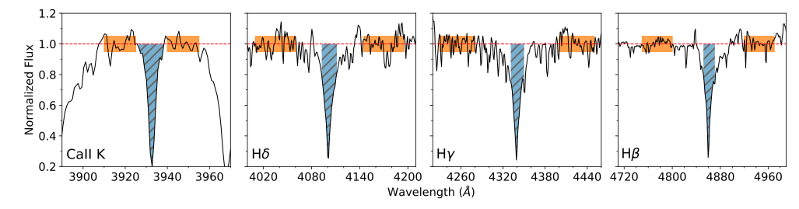
Low resolution sample (~6500 spectra, 5000 RRLs)
New EW range definitions
No EW system transformation necessary
Equation parameters based on all combinations of the 3 Balmer lines.
All phases & modes, one calibration, accurate uncertainty estimates.
No extrapolations, no scale transformations,
No light curves nor timed observations required!
Crestani + 2021a

Slide 11
Homogeneous metallicities in HR and LR
Full sample of RRLs: 247 in HR (full analysis), 7,768 in LR (metallicities)
TW-RRL: 162 RRLs (138 RRab, 23 RRc, 1 RRd) for which the atmospheric parameters and chemical abundances based on HR spectra.
Lit-RRL: 85 RRLs (65 RRab, 20 RRc) for which the HR chemical abundance values brought into our scale.
∆S: 7,768 RRL (5,196 RRab, 2,572 RRc) for which only ∆S metallicities (new calibration).
Crestani + 2021a

Slide 12
~11,000 RRL Vr
Blue RRc
Red RRab
~24,000 spectra
~9000 RRL abundances
Vittorio Fecit

Slide 13
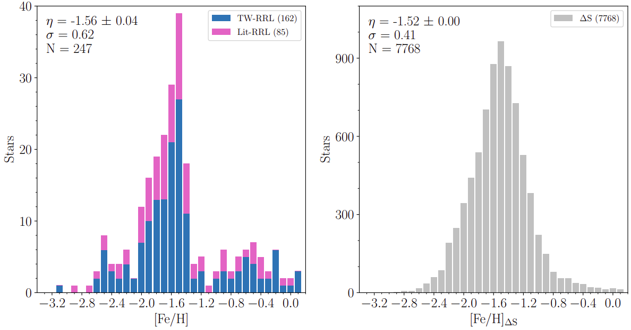
Homogeneous metallicities in HR and LR
Solid evidence of RRLs at solar metallicity!!!
Preliminary evidence from For + 2011, Sneden + 2017 &
Walker & Terndrup (1991)
Crestani + 2021a

Slide 14
The transition from discrete to continuous distributions!!!

Slide 15
The more you get the more you want!!
Solid evidence of metal-rich
alpha-poor RRLs
The trend is clear in Ca & Ti
Milder in Mg
If supported by independent
investigations → implications
on the early SNIa enrichment
A new spin Spitoni + (19,20,21)
delayed infall
Crestani + 2021b

Slide 16
Period distribution of MW RRLs
halo
bulge
disk
Nunnari + 2024

Slide 17
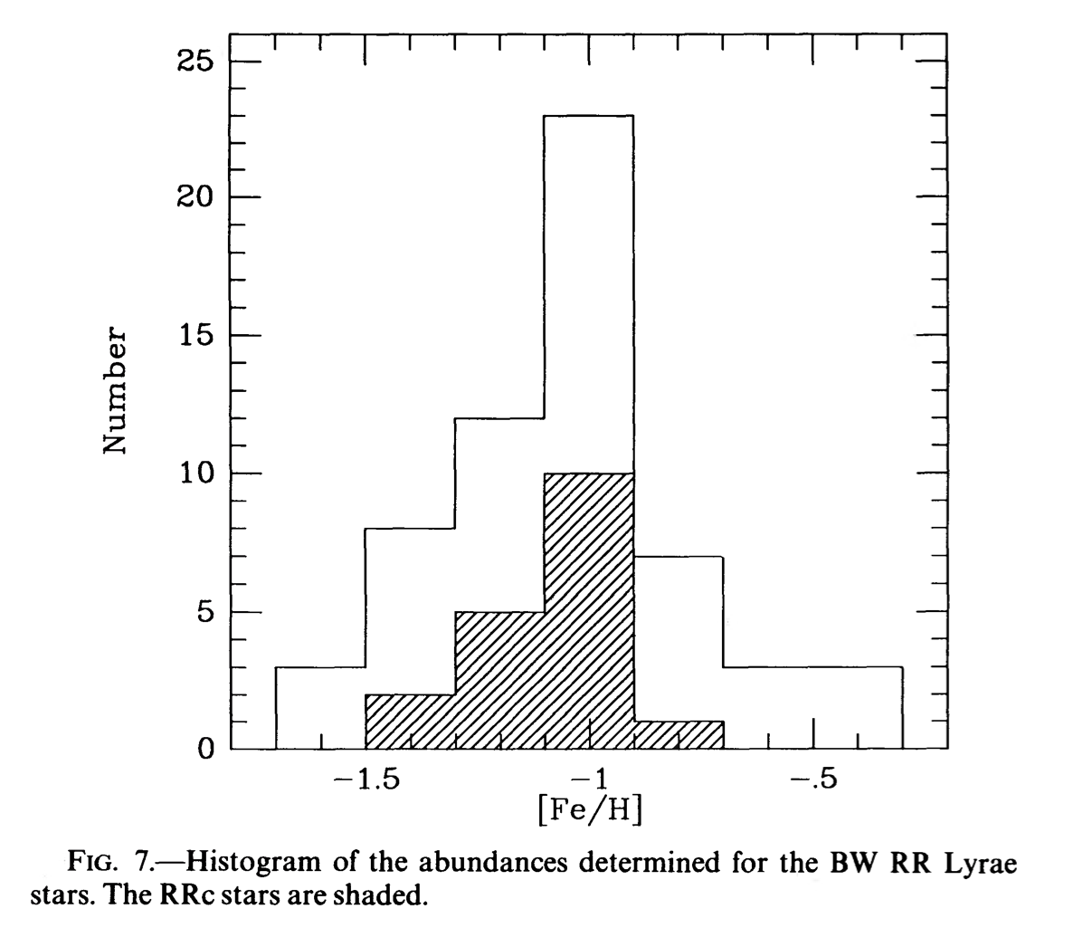
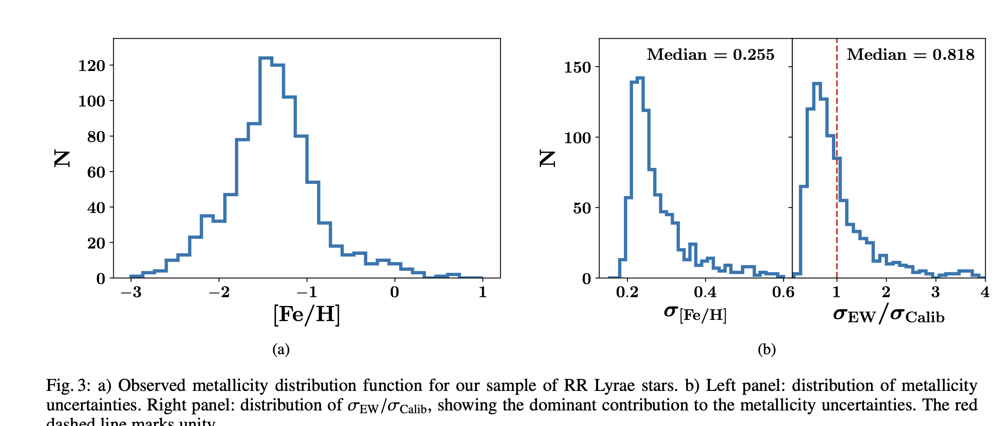
Metallicity distribution Bulge RRLs
Walker & Terndrup (1991)
Savino + 2020

Slide 18

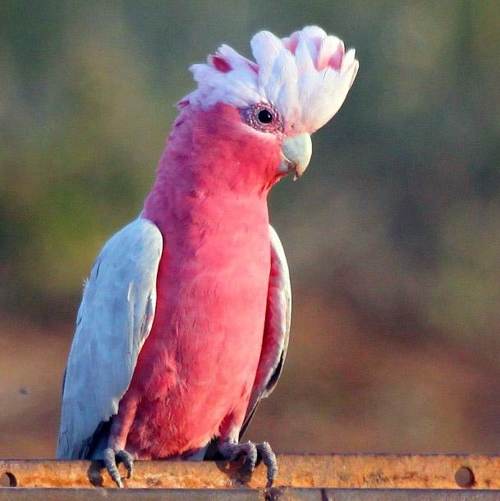
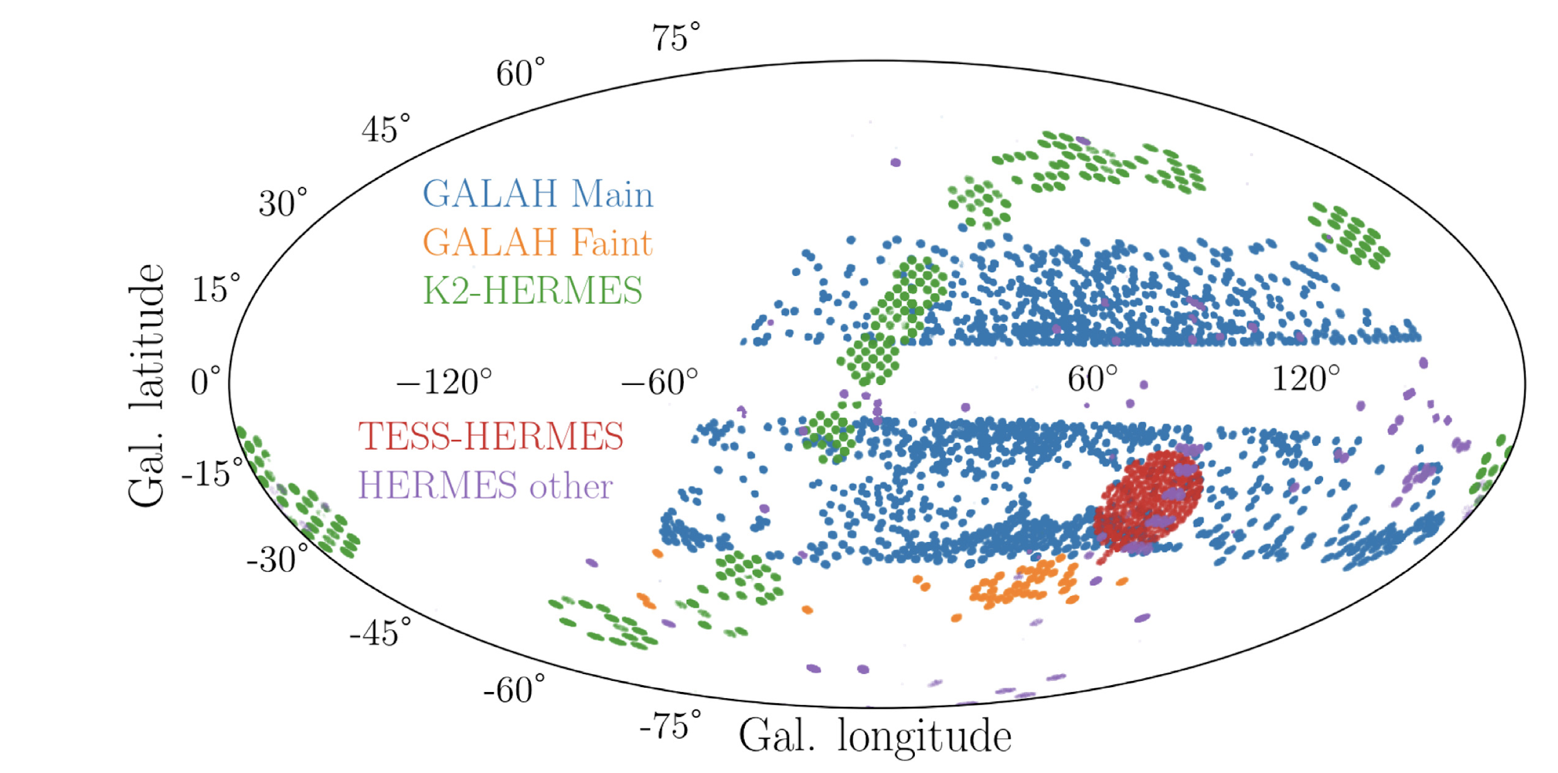
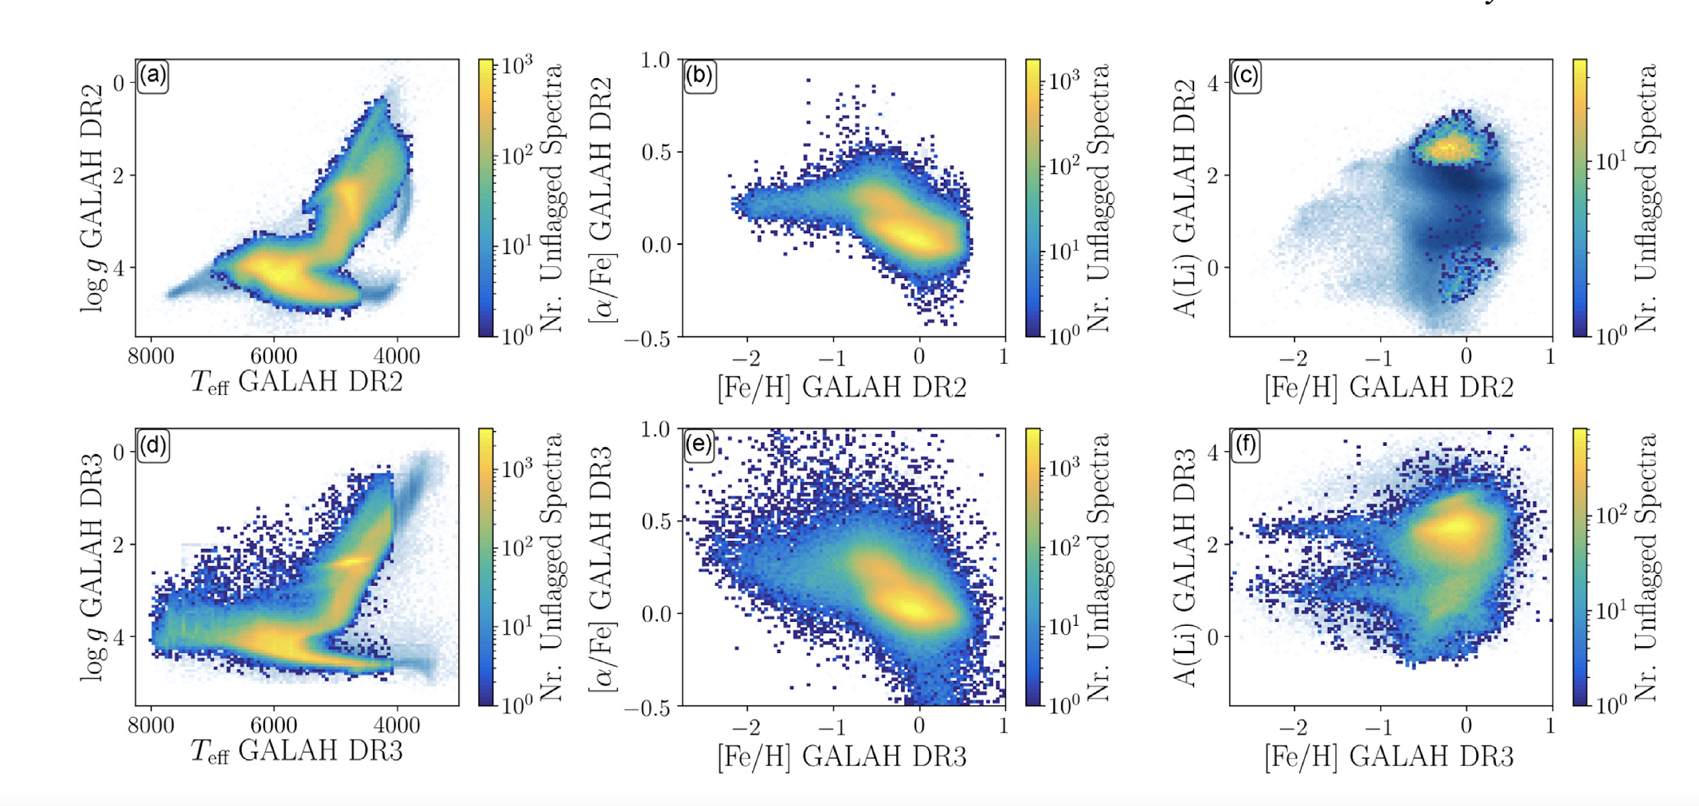
The GALAH Survey
> 1 million stars
Spectral resolution: R = 28 000
Multi-plexing: 400 stars at a time
Lambda coverage: 470-790 nm (with gaps)
4-m class telescope (mag G up to ~14.5) HERMES @ AAT (AU)
De Silva+ 2015
Buder+ 2018, 2021

Slide 19
A new spin on field RR Lyrae: GALAH
D’Orazi + 2024

Slide 20
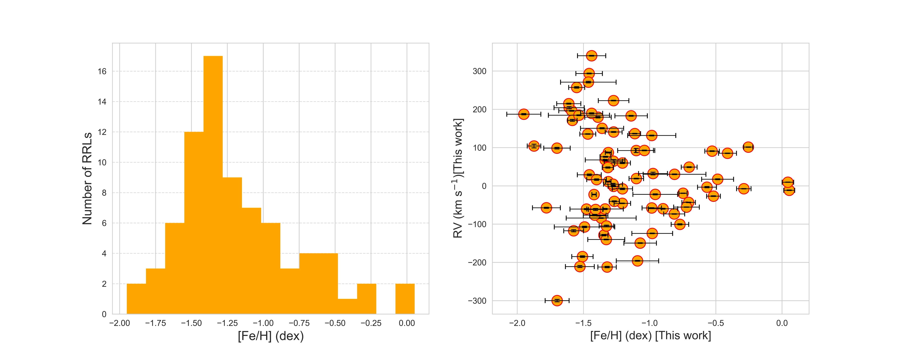
A new spin on field RR Lyrae: GALAH
D’Orazi + 2024

Slide 21
A new spin on field RR Lyrae: GALAH
D’Orazi + 2024

Slide 22
A new spin on field RR Lyrae: GALAH
D’Orazi + 2024

Slide 23
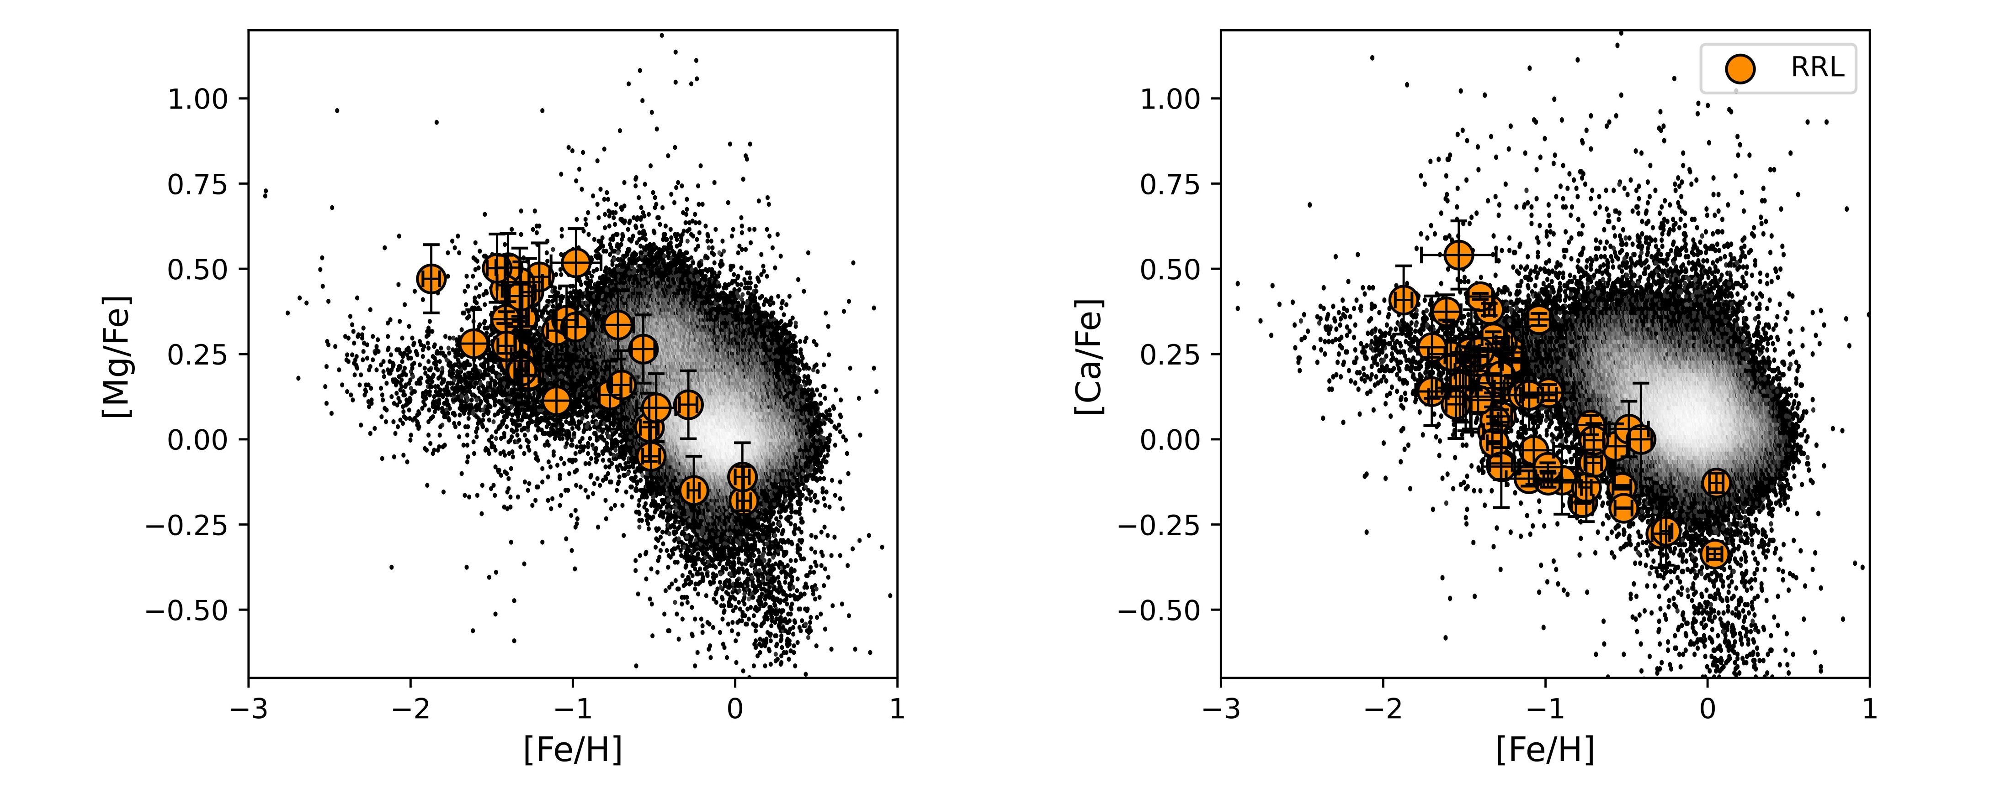
A new spin on field RR Lyrae: GALAH
D’Orazi + 2024

Slide 24
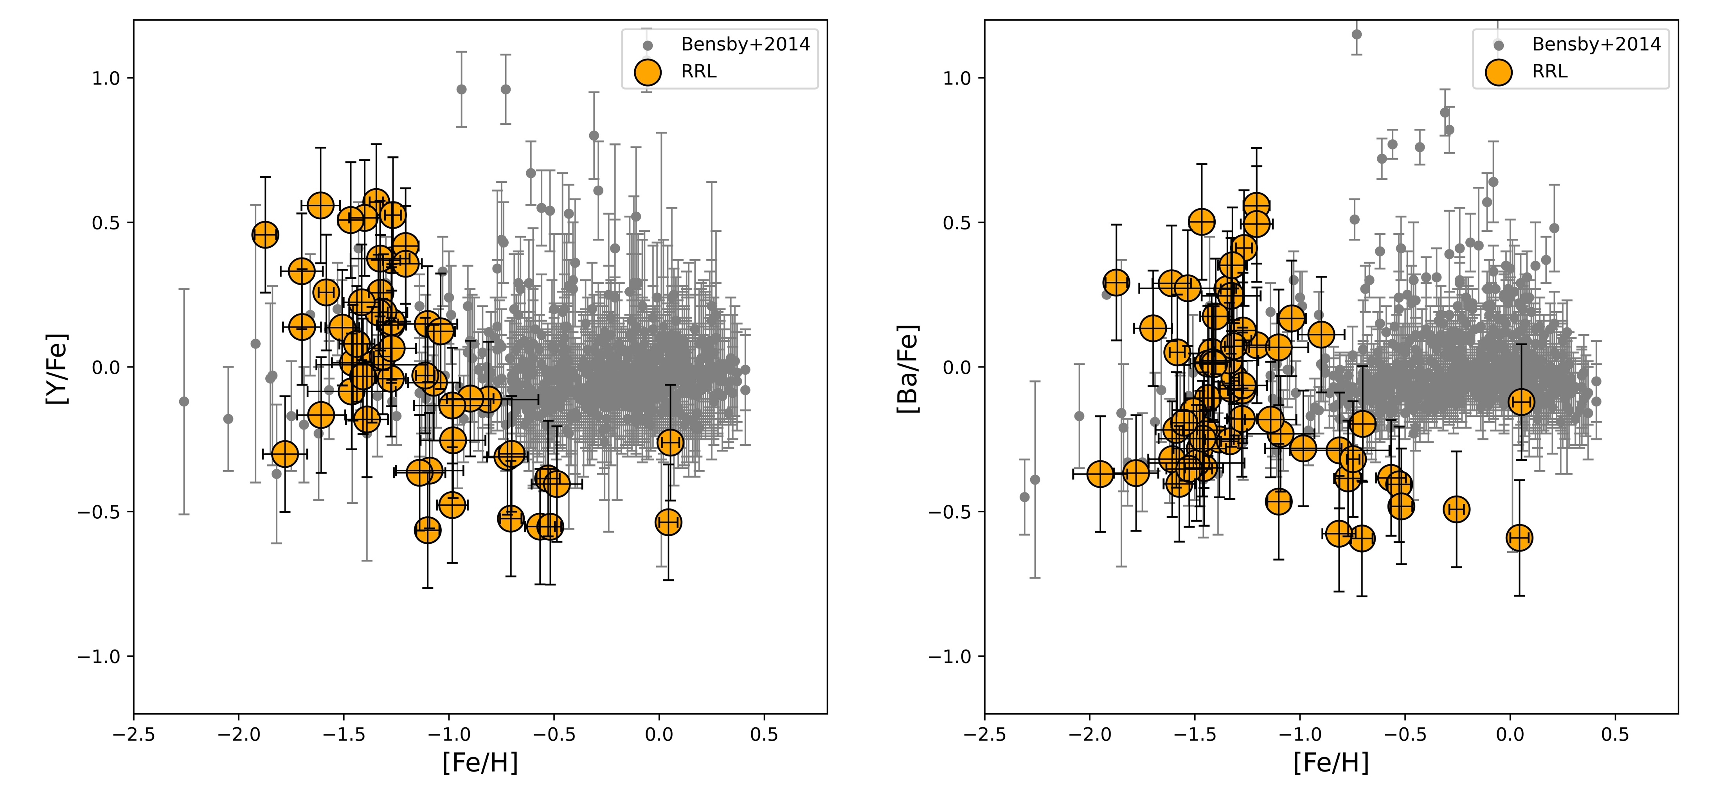
A new spin on field RR Lyrae: GALAH
A lot of food for thought:
hierarchical formation →
Quantitative constraints on in situ & accreted components
D’Orazi + 2024

Slide 25
CONCLUSIONS I
→ The new HR sample provided the opportunity
to calibrate LR spectroscopic diagnostics
RRLs are unique beacons to investigate the early MW formation (age constraints) + chemical tagging
Limiting mag. J˜H˜K=24.5—25.0
→ HB & RRLs M31/M32/M33 (IC10)
→ old MSTO across Galactic center
both heavily affected by crowding!

Slide 26
CONCLUSIONS II
-→ Golden age for stellar spectroscopy
Ground-based follow up spectroscopy: MUSE + MOONS + 4MOST
MAVIS → Halo outskirts
ERIS → Galactic Bulge
Ground-based multi-band photometry: LSST
from 20-21 to 25-26 mag → JWST/WFIRST?
ELT: MICADO, HARMONI, ANDES …..
→ WST (!!!) ++++ GaiaNIR

Slide 27
Credits
To young, differently young & senior colleagues with whom I have the pleasure to share this wonderful adventure
THANKS!!!

