Slide 1

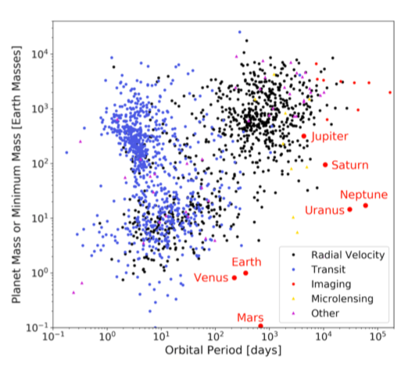
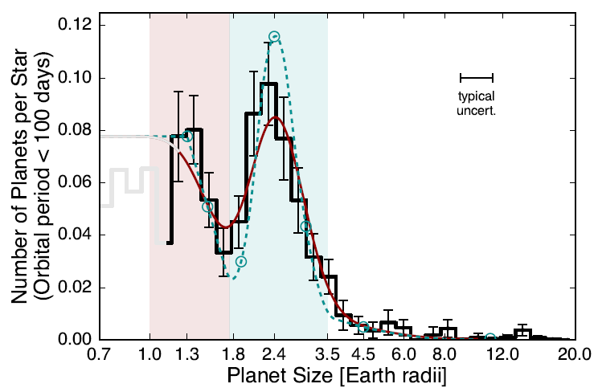
Exoplanet
Demographics
Alessandro Sozzetti
(INAF – Osservatorio Astrofisico di Torino)

Slide 2
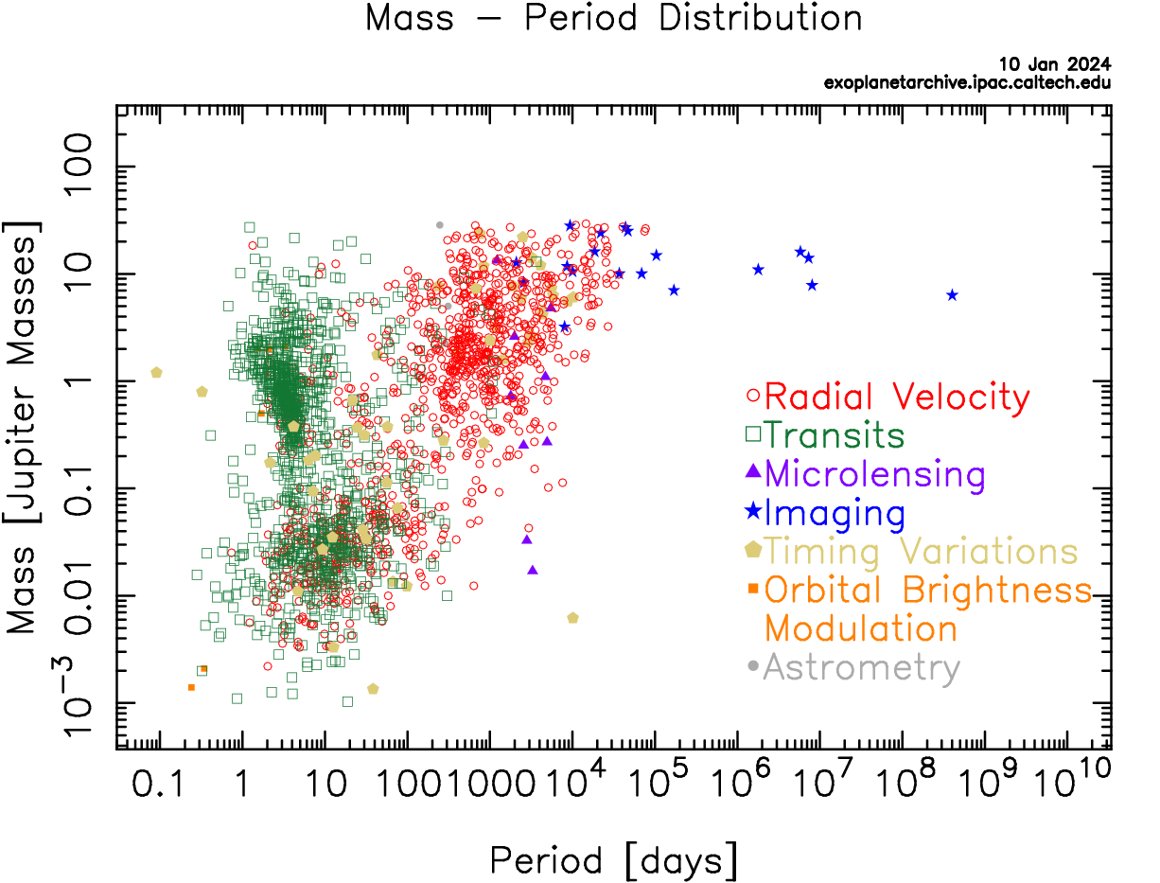
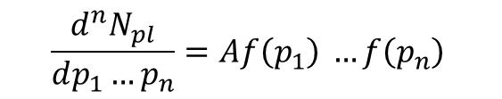
What is Exoplanet Demographics?
$$\frac{d^{n}N_{pl}}{dp_{1}…p_{n}}=A{f\left(p_{1}\right)}^{ }…{f\left(p_{n}\right)}^{ }$$
WARNING!
Accounting for:
- Completeness (missing planets)
- Reliability (false positives)
- Incorrect parameter estimates
NOT TRIVIAL!
Distribution functions retain imprints of planet formation and evolution processes
They allow to address key questions of Planetary Systems Demographics:
A) What is the diversity of planets and planetary system architectures? B) How do they depend on stellar and environmental properties? C) How common are true Solar System analogs?

Slide 3
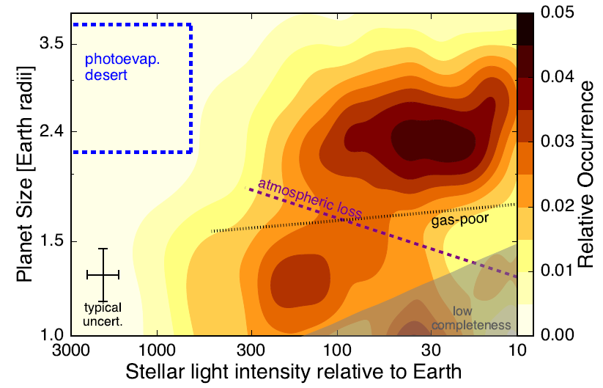
Radius Distribution
Fulton et al. 2018
Clearly bimodal: Radius ‘Valley’ or ‘Gap’
The gap in the planet size distribution separates two classes of small planets:
a) rocky super-Earths (pink) and
b) volatile-rich or/ gas-dominated sub-Neptunes (light blue).
A direct evidence of evolutionary processes (photoevaporation) of planetary systems

Slide 4
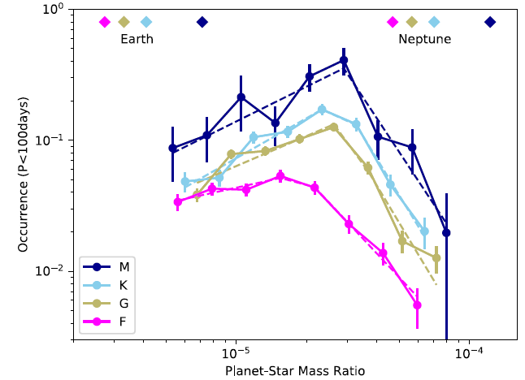
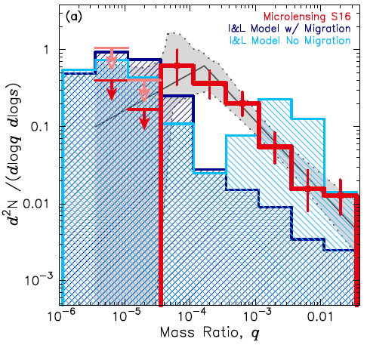
Mass Distribution
Pascucci et al. 2018
Suzuki et al. 2018
a > 2 au
P< 100 days
Is the possible break (for close-in planets) a universal feature?
Is mass ratio the most fundamental quantity?
Are cool Saturns and sub-Saturn-type planets more common than expected?

Slide 5
Same technique, different surveys:
Different answers!
Separation Distribution
Giant planet frequency declines beyond the snowline
Or does it?
Lagrange et al. 2023
Fulton et al. 2021

Slide 6
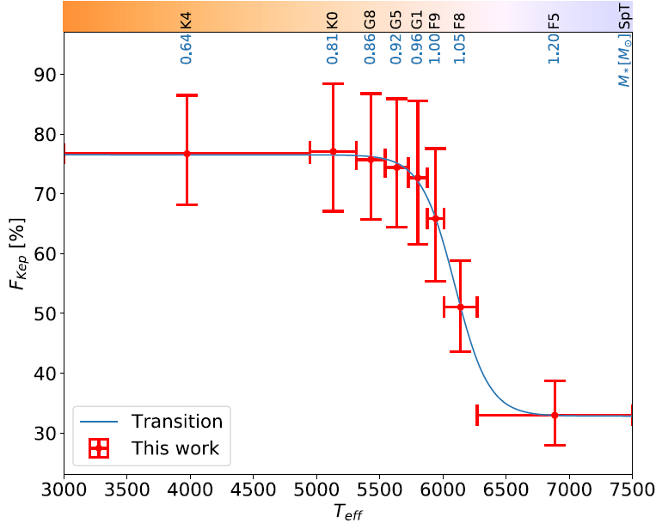
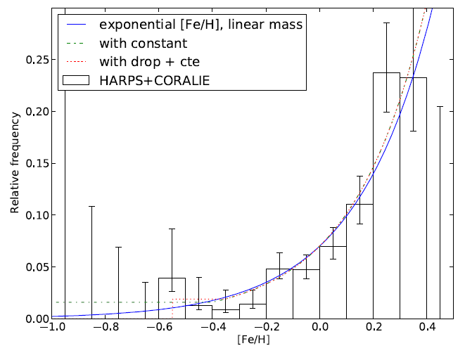
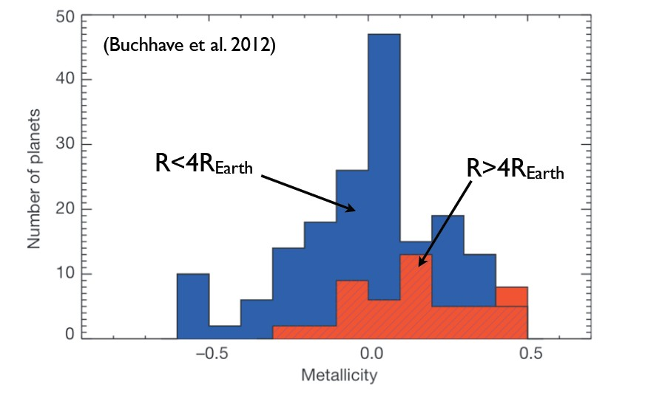
The Planet-Star Connection
Johnson et al. 2010
F_{p} vs M*
Giant planets
Small planets
Yang et al. 2020
a < 3-4 au
P < 100 d
Small planets
Giant planets
F_{p} vs [Fe/H]
Mortier et al. 2012

Slide 7
Young ages, wide separations
M= 1-75 M_{Jup}, a = 10-300 au
Vigan et al. 2021
Typically probing the high-mass tail of the planetary mass function
(or is it the low-mass tail of the brown dwarf mass function?)
- Confirmed trend of increasing frequency with stellar host mass

Slide 8
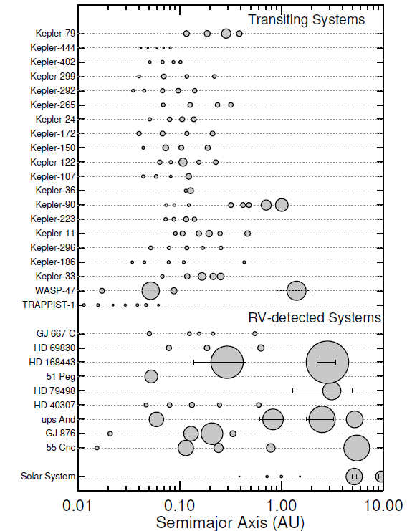
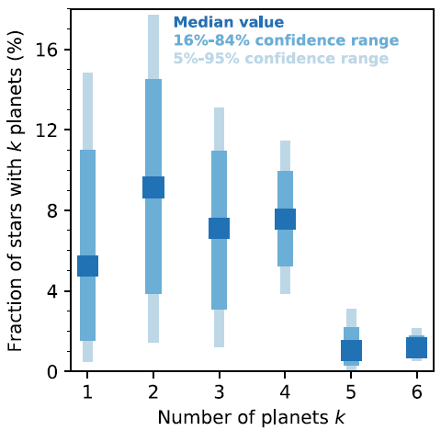
Multi-planet Systems
Zhu et al. 2018
Transiting multis are very
‘flat’ and compact systems,
with similar sizes
None yet like the Solar System!

Slide 9
‘Ordered’ Architectures: Occurrence
Solar-System-type: inner Super-Earths (SE) and Neptunes (N), outer Jupiters (CJ)
Barbato et al. 2018
Zhu & Wu 2018
Bryan et al. 2019
Rosenthal et al. 2022
Pinamonti et al. 2023
Bonomo et al. 2023
BEWARE: f_{p}(CJ|SE,N) not necessarily the same as f_{p} (SE,N|CJ) !
More: A. Bonomo’s talk

Slide 10
Earth Twins:
Occurrence Rates
Kopparapu et al. 2013

Slide 11
Exoplanet Demographics:
Now, and Beyond
CURRENT:
Ground-based Transit Surveys
Kepler
Ground-based Microlensing Surveys
Direct detection Surveys
Credits:
C. Clanton, S. Gaudi

Slide 12
Exoplanet Demographics:
Now, and Beyond
FUTURE/WILL HAPPEN
TESS
Gaia
PLATO
Roman
NextGen EPRV
Credits:
C. Clanton, S. Gaudi

Slide 13

Exoplanet Demographics:
Now, and Beyond
FUTURE/MIGHT HAPPEN
Space-based Direct Imaging Missions?
Sub-10 cm/s EPRV?
Sub-𝜇as astrometry?
GaiaNIR
Credits:
C. Clanton, S. Gaudi

Slide 14
GaiaNIR – Impact (some of it)
Cold giant planets around stars Gaia can hardly see (heavily
reddened young stars within 200-300 pc) or cannot see at all
(Y, L and T dwarfs within tens of pc)
Detection of gas giants at Saturn-like distances, combined with Gaia:
the demographics of planetary systems at 5-10 au around solar-type
stars in the Solar neighborhood is still vastly unexplored/uncertain
First-ever estimate of the frequency of planetary systems with
BOTH Jupiters AND Saturns
Neptunes and Super Earths beyond the snowline around the
nearest low-mass M dwarfs (proper motion anomaly)

Slide 15
Planet Formation Around BDs
SPHERE@VLT
GaiaNIR Sensitivity:
- M = 35 M_{Jup}, L7 dwarf
(Luhman16A-like)
- J = 16 mag
- d = 20 pc
PCS@ELT
More: S. Desidera’s talk

Slide 16
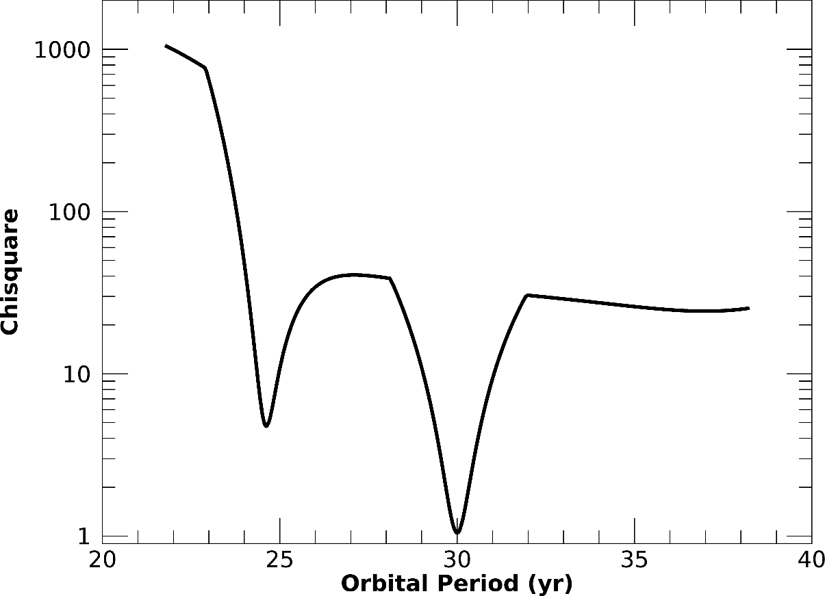
Gaia+GaiaNIR: Saturn-like orbits
1 M_{SUN} @ 30 pc
1 M_{Sat} planet
30-yr period
Averaging: e, T₀, i, Ω, ω
Gaia+GaiaNIR= 2x10-yr
More: M. Pinamonti’s talk
- Robustness of orbit fitting algorithms a key
- Multiples a likely interpretative complications: to be investigated
KEY REQUIREMENT: σ_{ξ} (GaiaNIR) = σ_{ξ} (Gaia) for V< 13 F-G-K dwarfs at d<200 pc

Slide 17
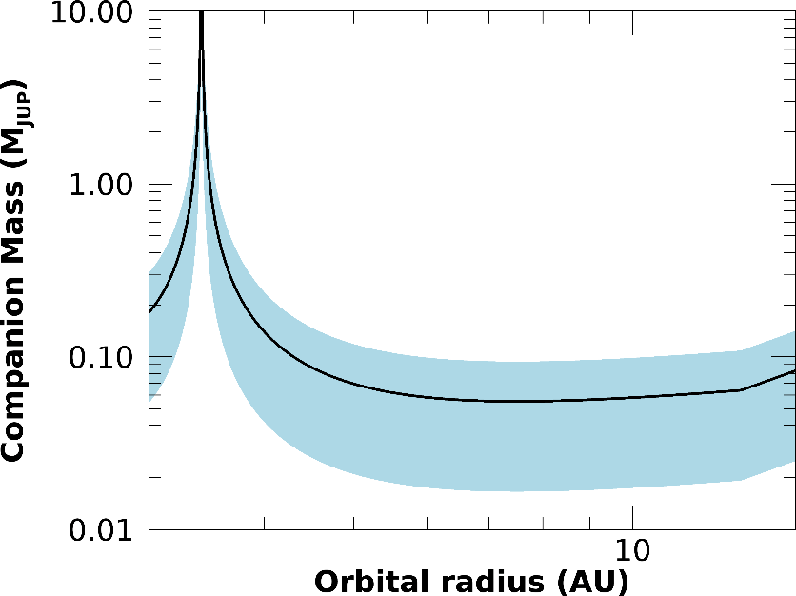
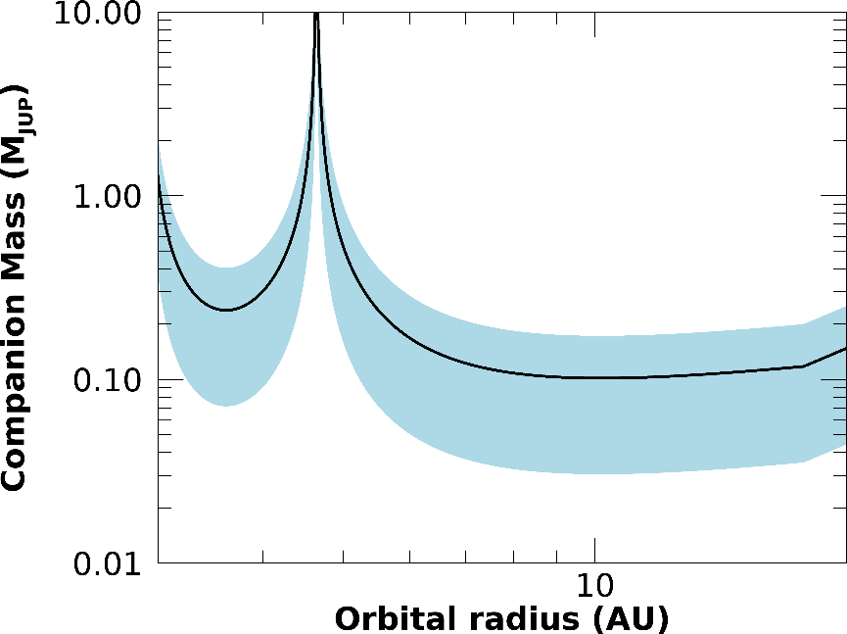
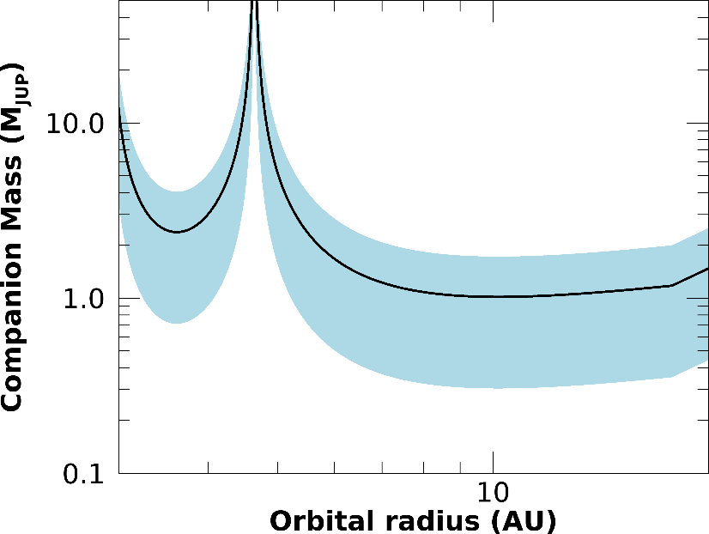
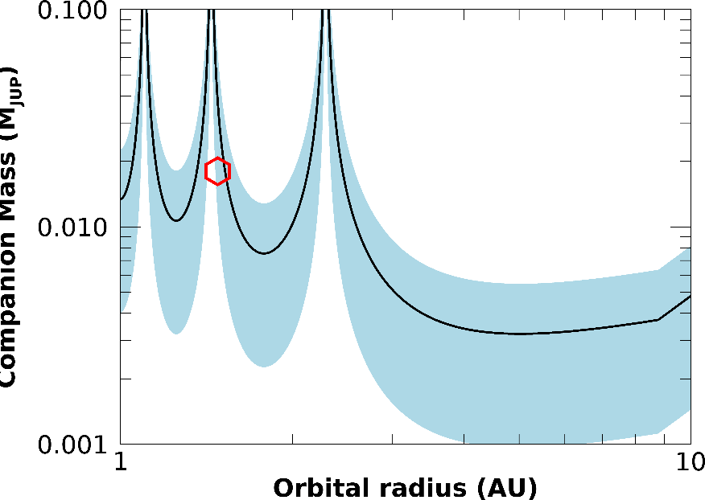
Gaia + GaiaNIR: PMA
0.4 M_{SUN} @ 10pc
1 M_{SUN} @ 10pc
1 M_{SUN} @ 100pc
Proxima
More: D. Barbato’s talk

Slide 18
Synergies
Transit surveys, Kepler, TESS, PLATO:
Outer regions of transiting systems (ordered architectures,
coplanarity) -> Occurrence Rates, Demographics
RV surveys, sub-µas relative astrometry:
Outer regions of close-in, small RV planets (ordered architectures,
coplanarity, true masses) -> Occurrence Rates, Demographics
Direct imaging surveys (ground-based, Roman):
orbital architectures, masses -> Occurrence Rates, Demographics
Microlensing surveys (ground- and space-based):
concordance (or lack thereof) with occurrence rates of cold planets
around M dwarfs
V. Nascimbeni’s talk
M. Pinamonti, A. Bonomo, S. Desidera’s talk
D. Barbato, S. Desidera’s talk

