Slide 1
Gaia-NIR: next astrometric mission, Bologna, 17-18 January 2024
Photometry: a few lessons from Gaia seen in perspective
M. Bellazzini (INAF – OAS Bologna)

Slide 2
Gaia-NIR: next astrometric mission, Bologna, 17-18 January 2024
some remarks on Gaia spectrophotometry
some brainstorming (in hard info-starvation regime) in view of Gaia-NIR
a purely photometric point of view
also thanks to discussions / chats with:
Paolo Montegriffo, Livia Origlia and the Gaia DPAC CU5 members
Also inspired by: Hobbs et al. 2021; ESA CDF study 2017; Høg 2023

Slide 3
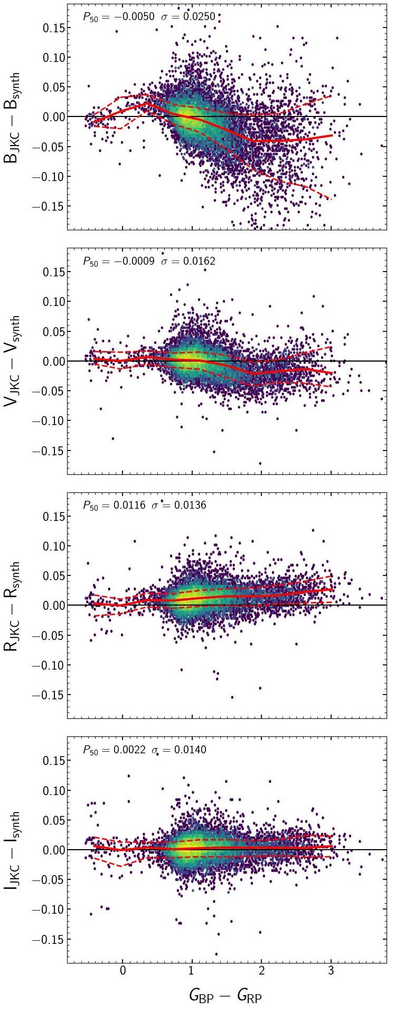
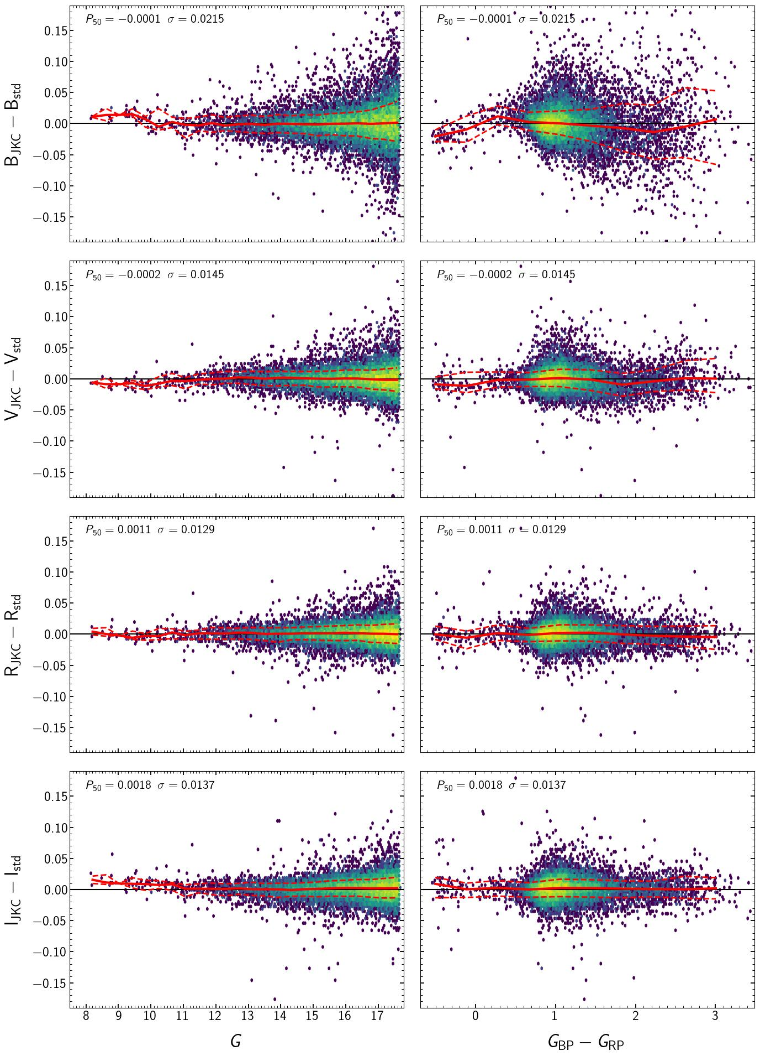
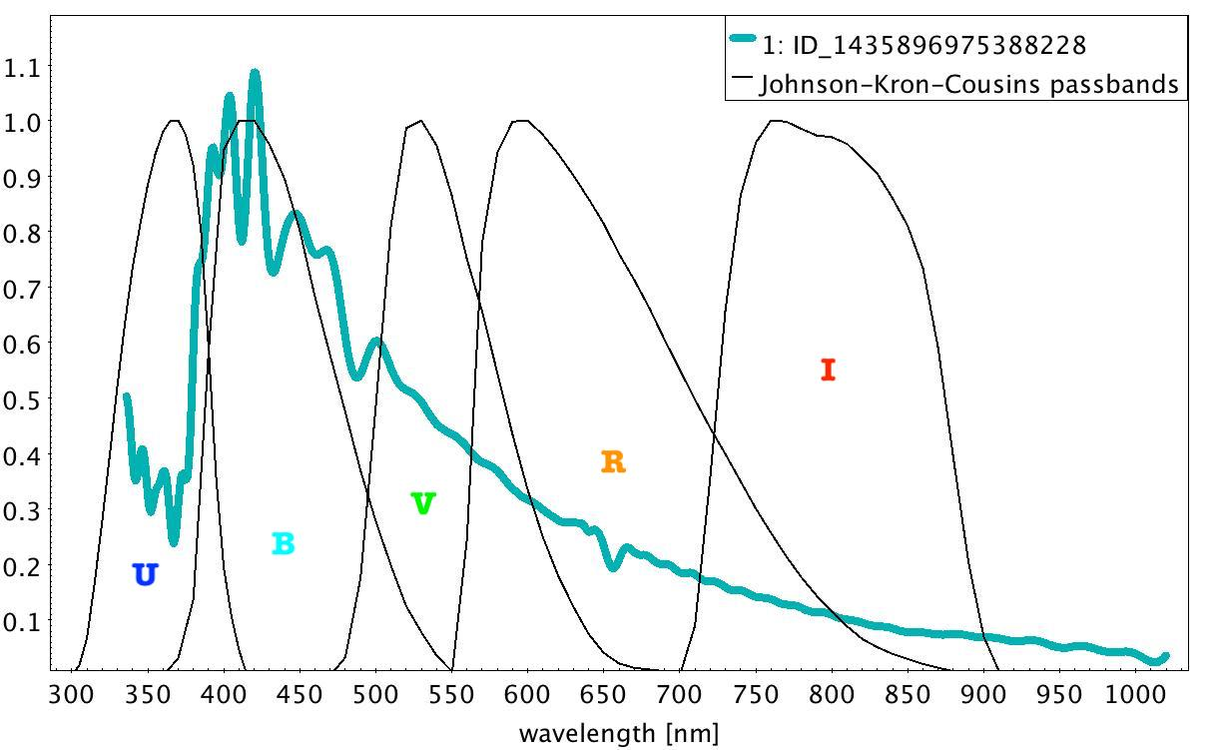
Gaia-NIR: next astrometric mission, Bologna, 17-18 January 2024
In the DR3 PVP on synthetic photometry we demonstrated the power of synthetic photometry from BP/RP=XP spectra (XPSP) as (a) a tool for extensive external validation of XP spectra, (b) an accurate and precise source of photometry in a variety of optical bands, (b) as an alternative way to extract astrophysical information from XP spectra.
Raw XPSP
Standardised XPSP
Raw XPSP (for passbands whose TC is redder than ≈ 400nm):
accuracy ⪝ 0.03 mag, precision ⪝ 0.01- 0.02 mag
Standardised XPSP :
accuracy ⪝ 0.005 mag, precision ⪝ 0.01- 0.02 mag
Standardisation: strong mitigation of systematics that XPSP
inherits from XP spectra by second-round calibration against
a large set of reliable photometric standards (e.g., Landolt’s
Standard, SDSS standards (Thanjavur et al. 2021).

Slide 4
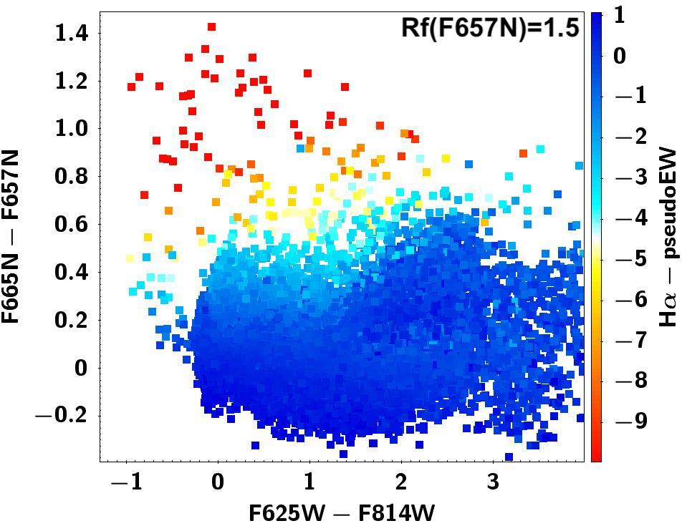
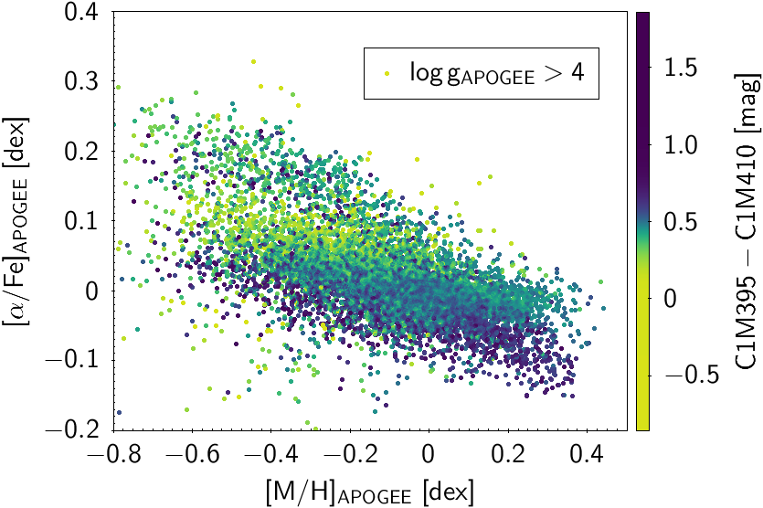
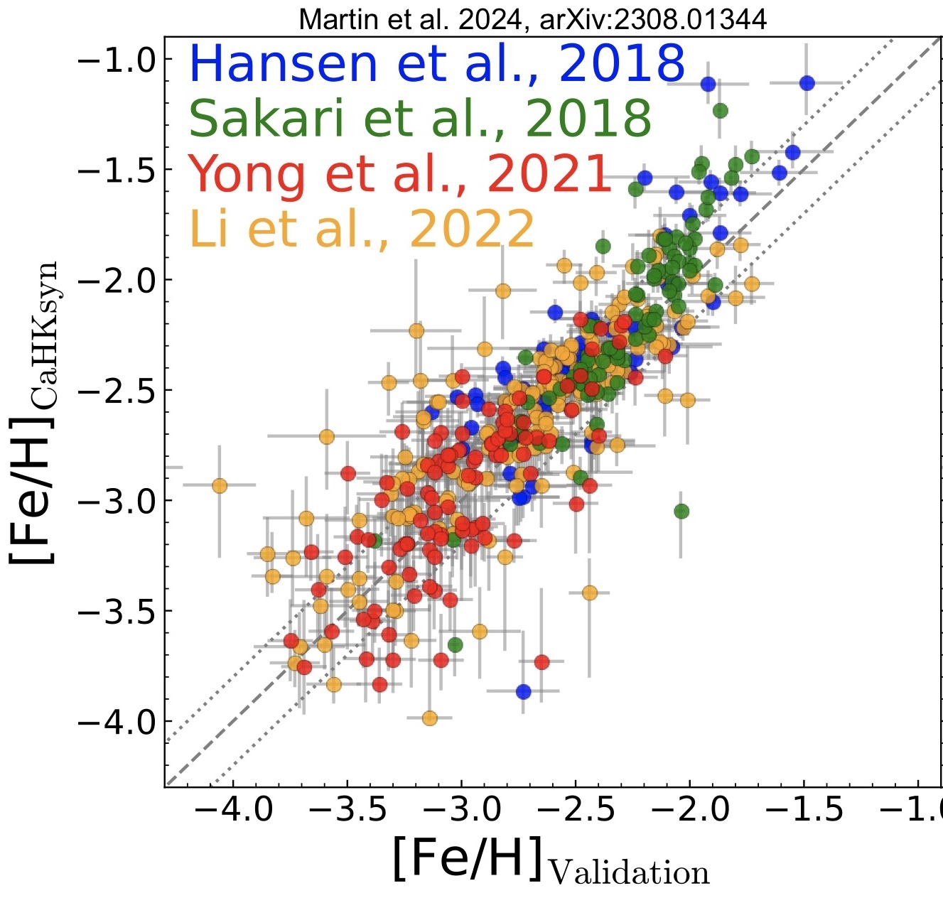
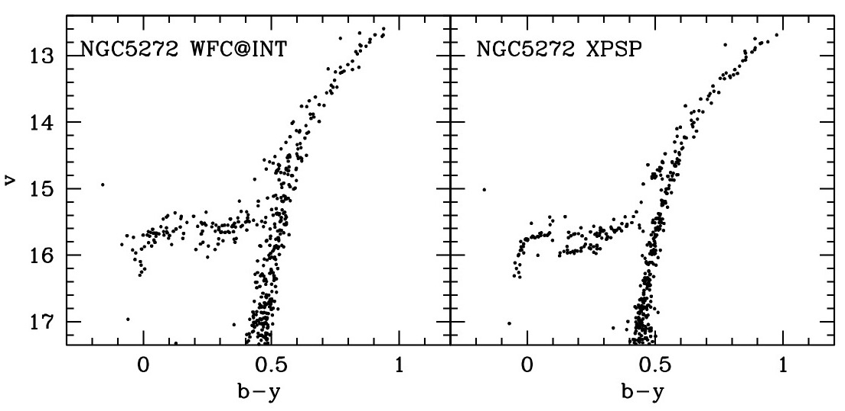
Gaia-NIR: next astrometric mission, Bologna, 17-18 January 2024
Extracting astrophysical info from XPSP /
Scientific return of high photometric precision: a few examples
Extracting astrophysical info:
Strength of Hα emission
Extracting astrophysical info: [Fe/H] and [α/Fe]
Tracing [Fe/H] down to <-3.5
Precision in sub-optimal conditions
Precision in sub-optimal conditions

Slide 5
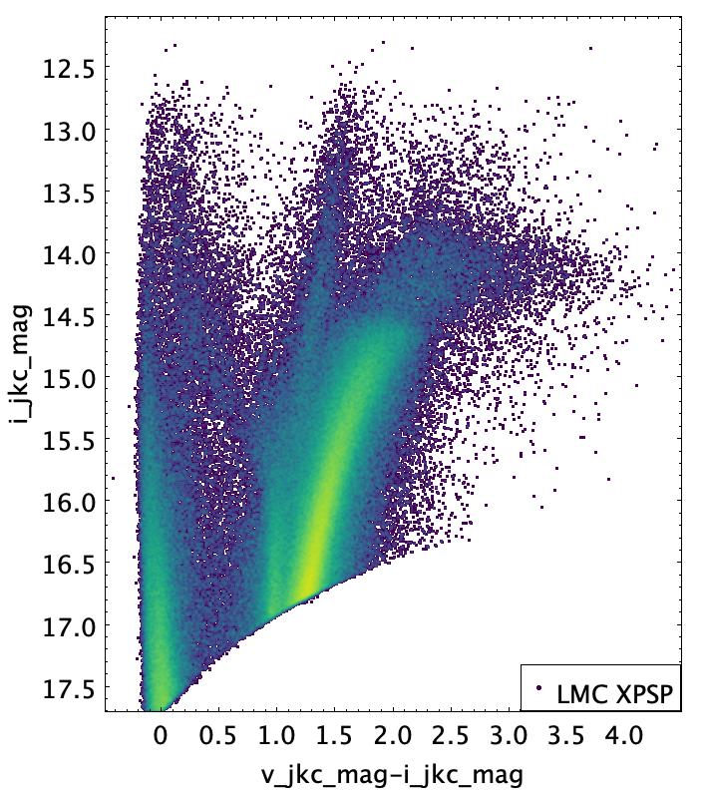
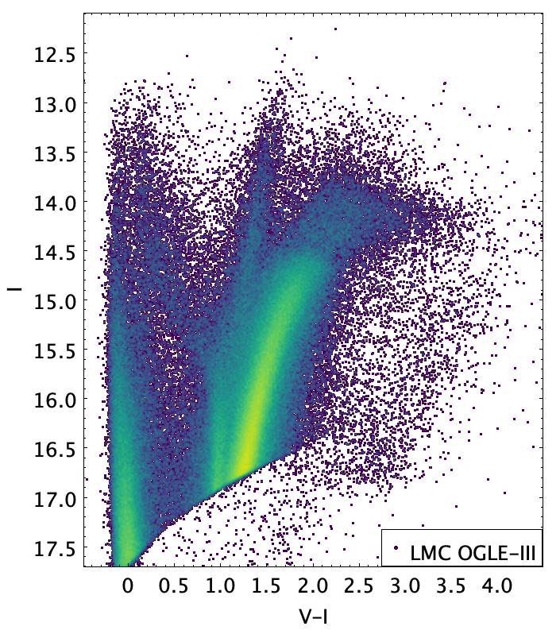
Gaia-NIR: next astrometric mission, Bologna, 17-18 January 2024
But let’s focus on the pure photometric heritage: an example
OGLE-III (Udalski et al. 2008, Szimansky et al. 2011). State-of-the-art V,I ground-based photometry that is a reference for the distance ladder (calibration of standard candles within two essential pillars: the MC)
Comparison with a selected sample of XPSP – only stars in common between the two samples

Slide 6
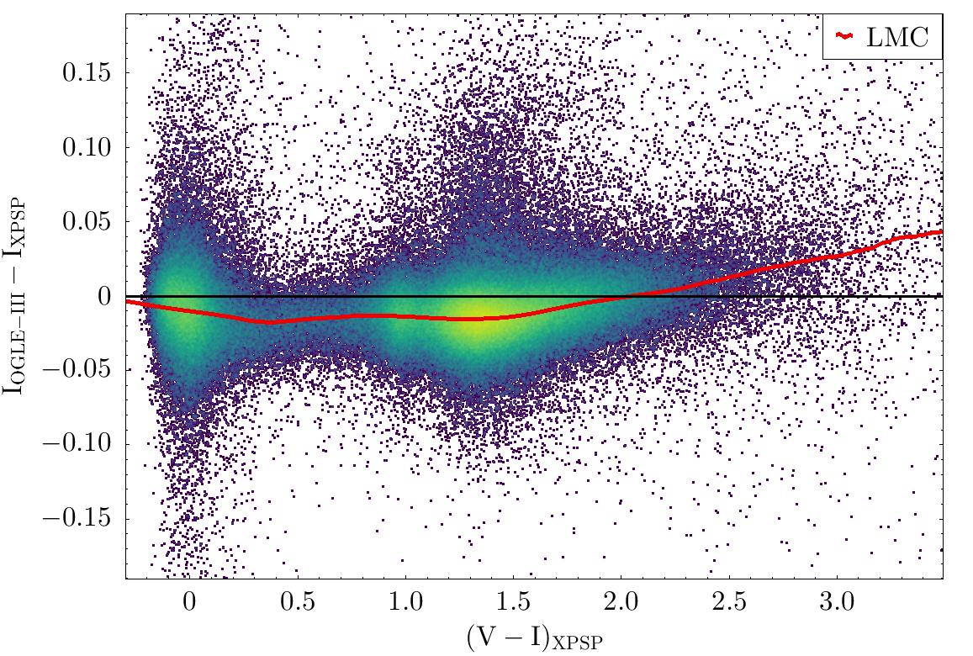
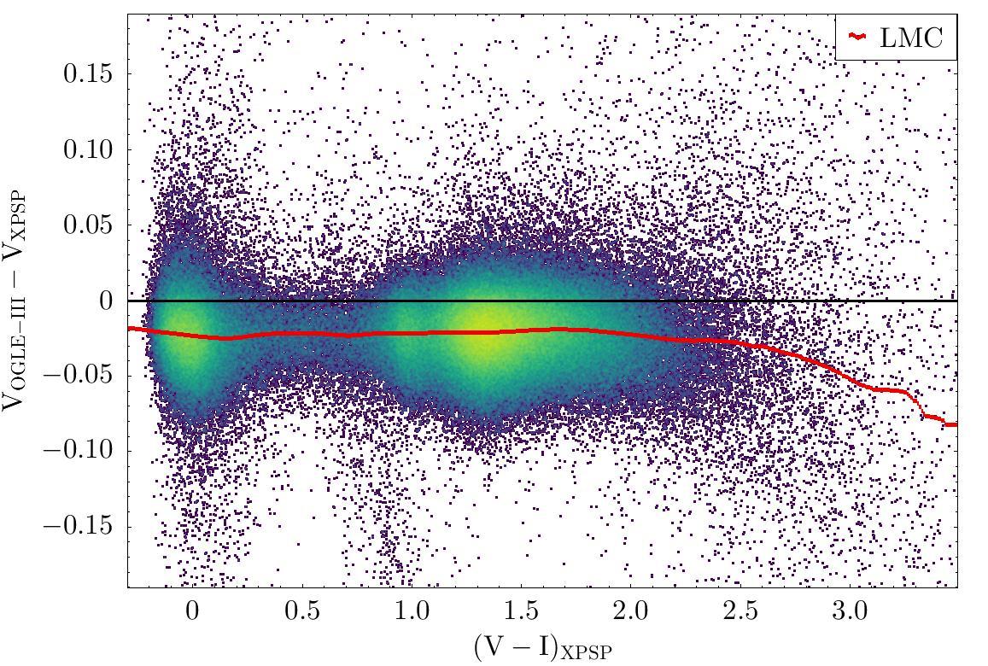
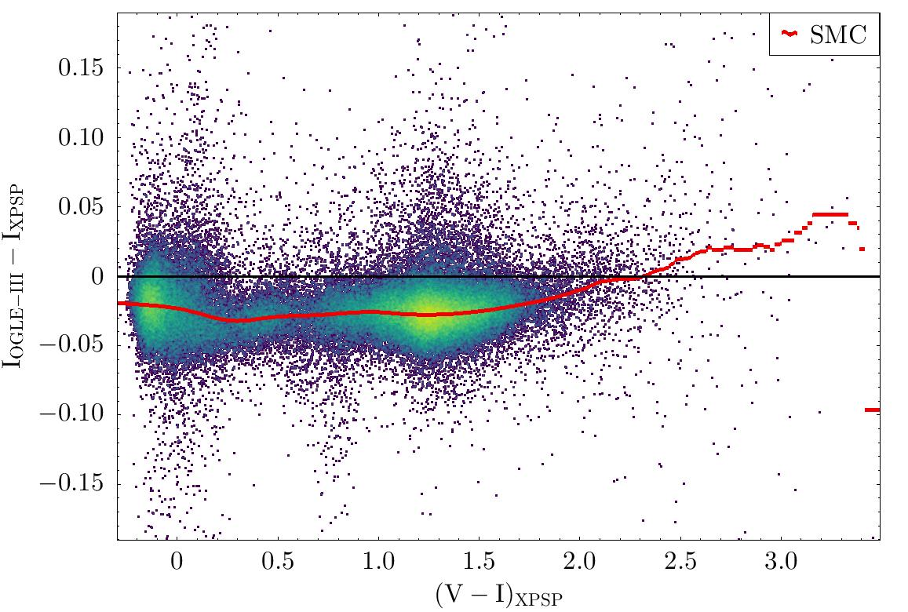
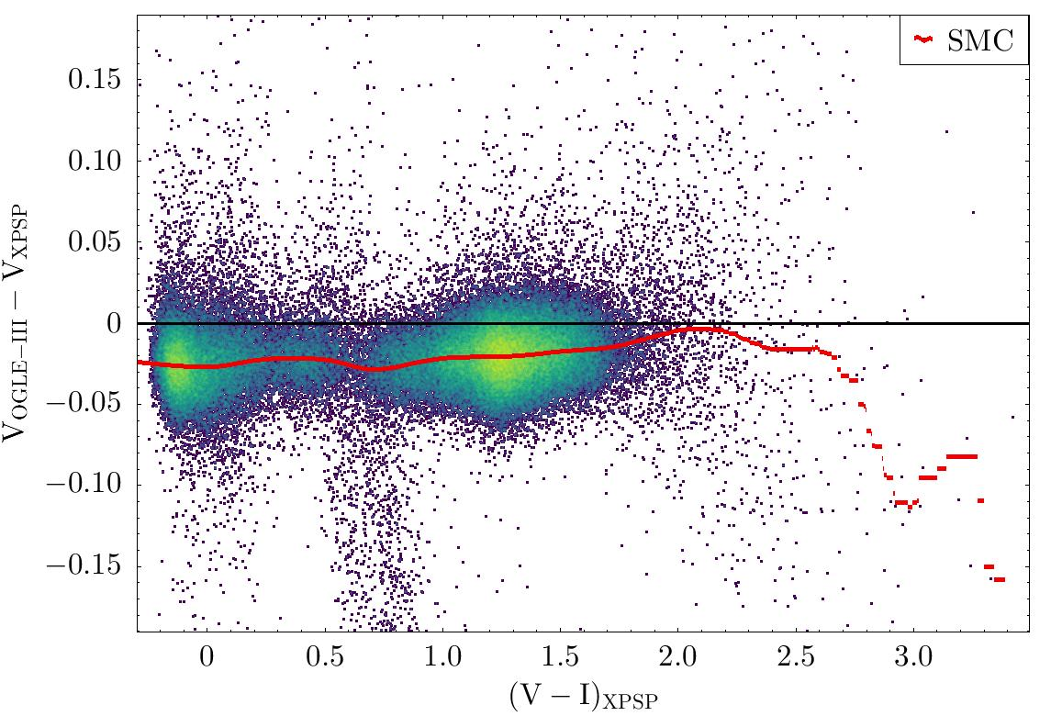
Gaia-NIR: next astrometric mission, Bologna, 17-18 January 2024
But let’s focus on the pure photometric heritage
OGLE-III (Udalski et al. 2008, Szimansky et al. 2011). State-of-the-art V,I ground-based photometry that is a reference for the distance ladder (calibration of standard candles within two essential pillars: the MC)
Comparison with a selected sample of XPSP – only stars in common between the two samples
0.02-0.03 mag ZP
differences and trends
with colour
Which is the most accurate
source?
It is XPSP photometry

Slide 7
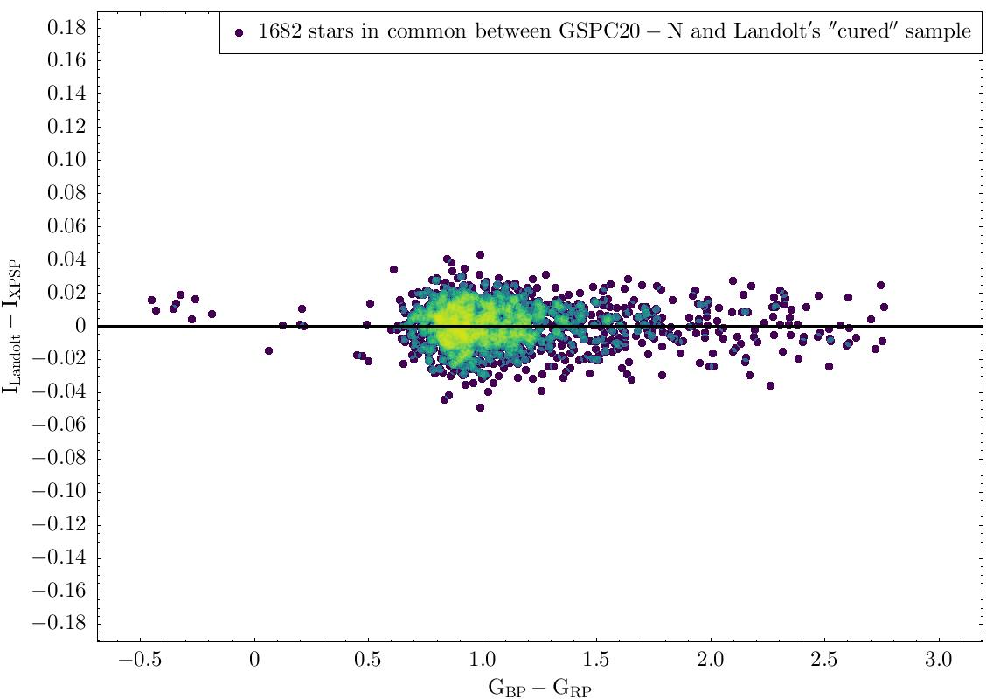
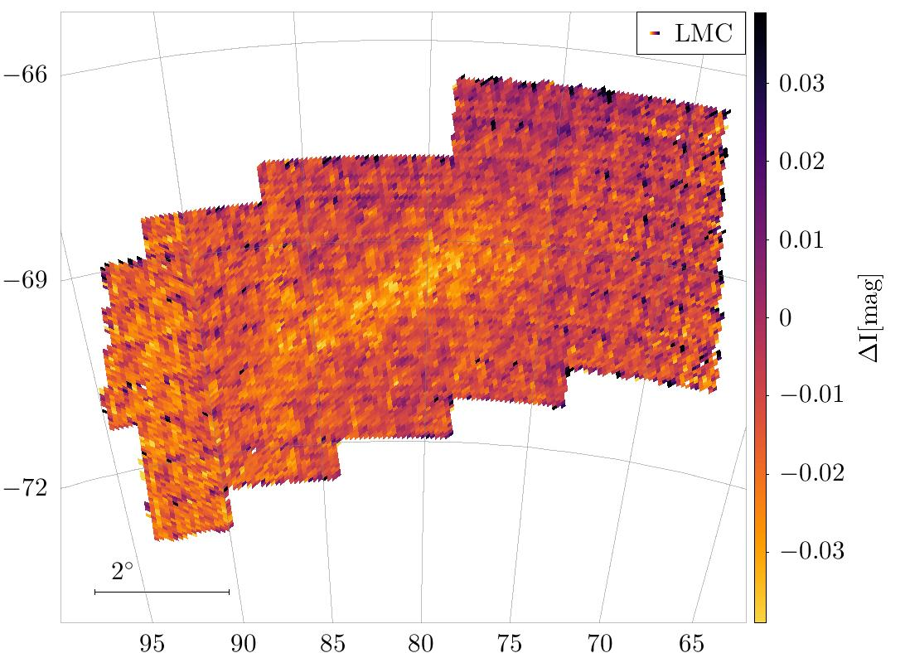
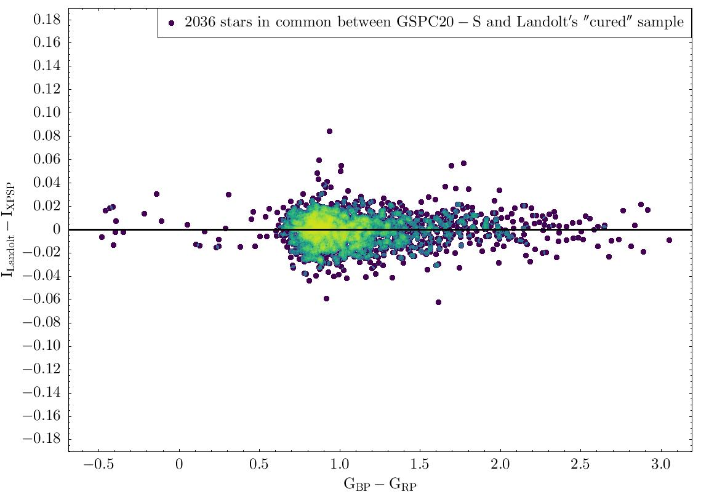
Gaia-NIR: next astrometric mission, Bologna, 17-18 January 2024
But let’s focus on the pure photometric heritage
OGLE-III (Udalski et al. 2008, Szimansky et al. 2011). State-of-the-art V,I ground-based photometry that is a reference for the distance ladder (calibration of standard candles within two essential pillars: the MC)
Comparison with a selected sample of XPSP – only stars in common between the two samples
XPSP vs Landolt “cured”
Pancino et al. (2022)
Healpix map of the median I_OGLE3-I_XPSP of the stars in each pixel
Median difference correates with OGLE-III tiles

Slide 8
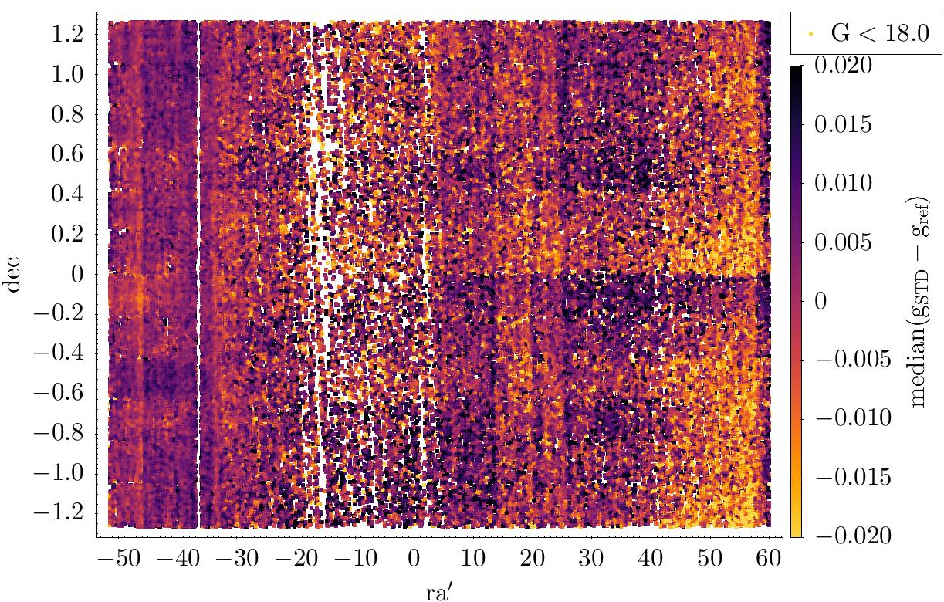
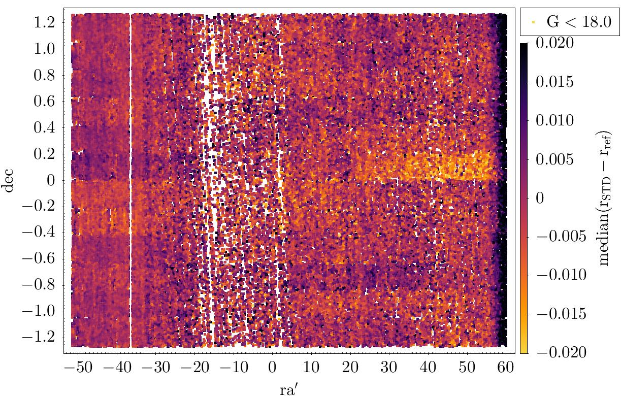
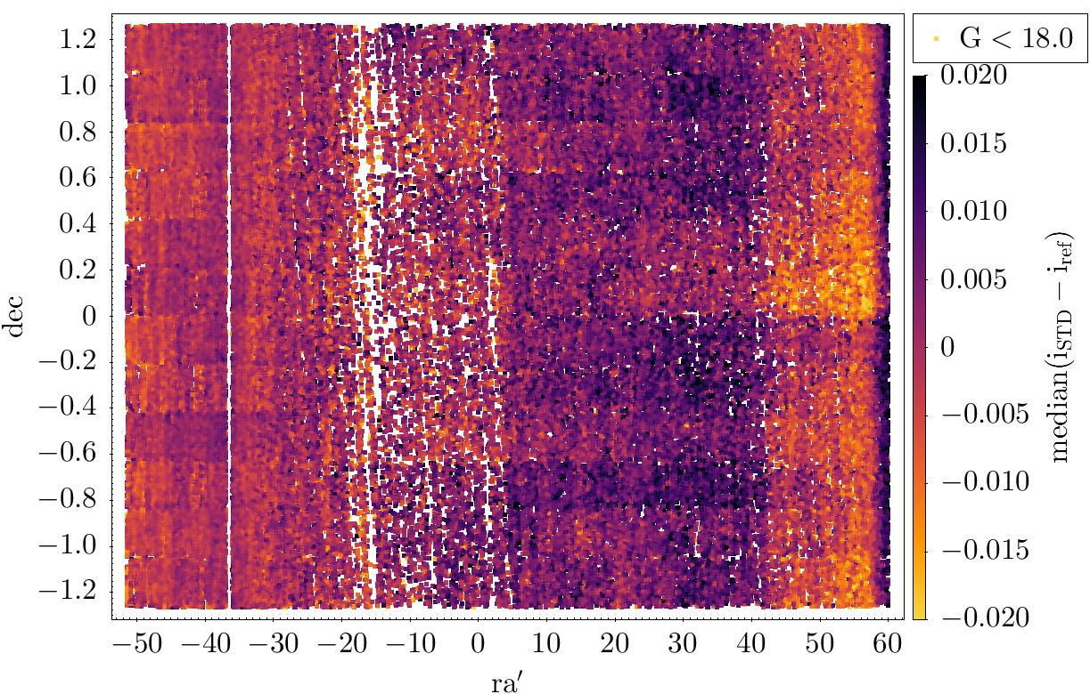
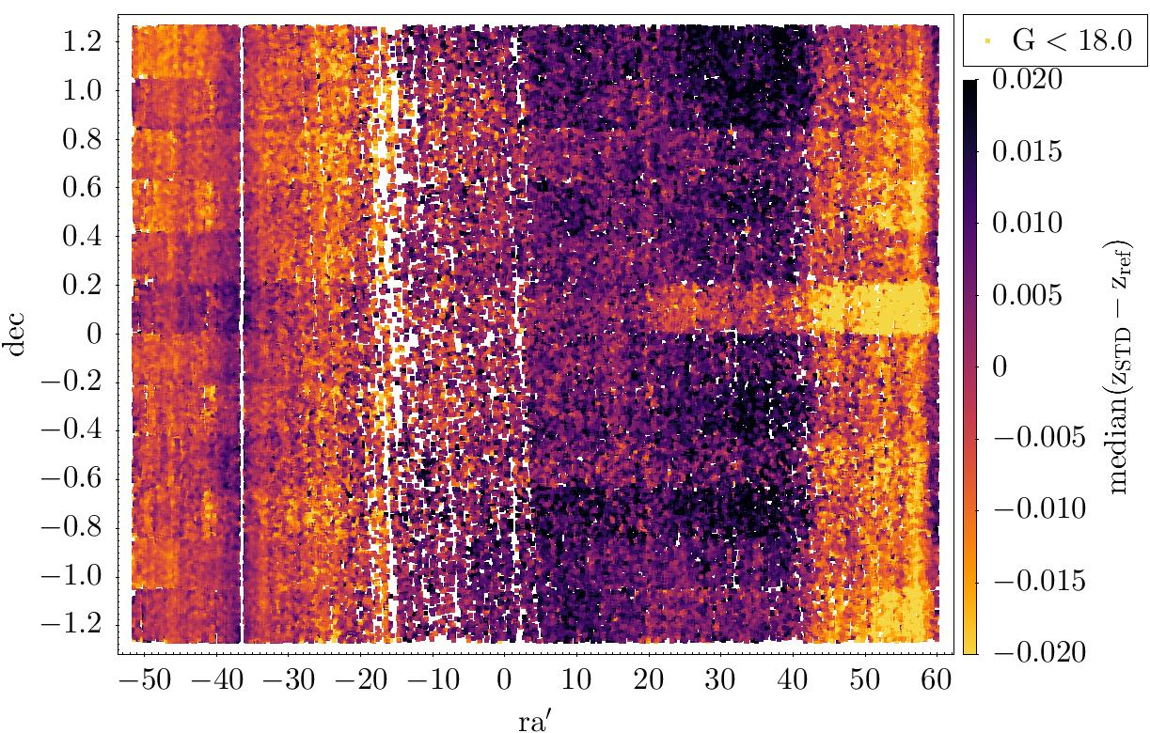
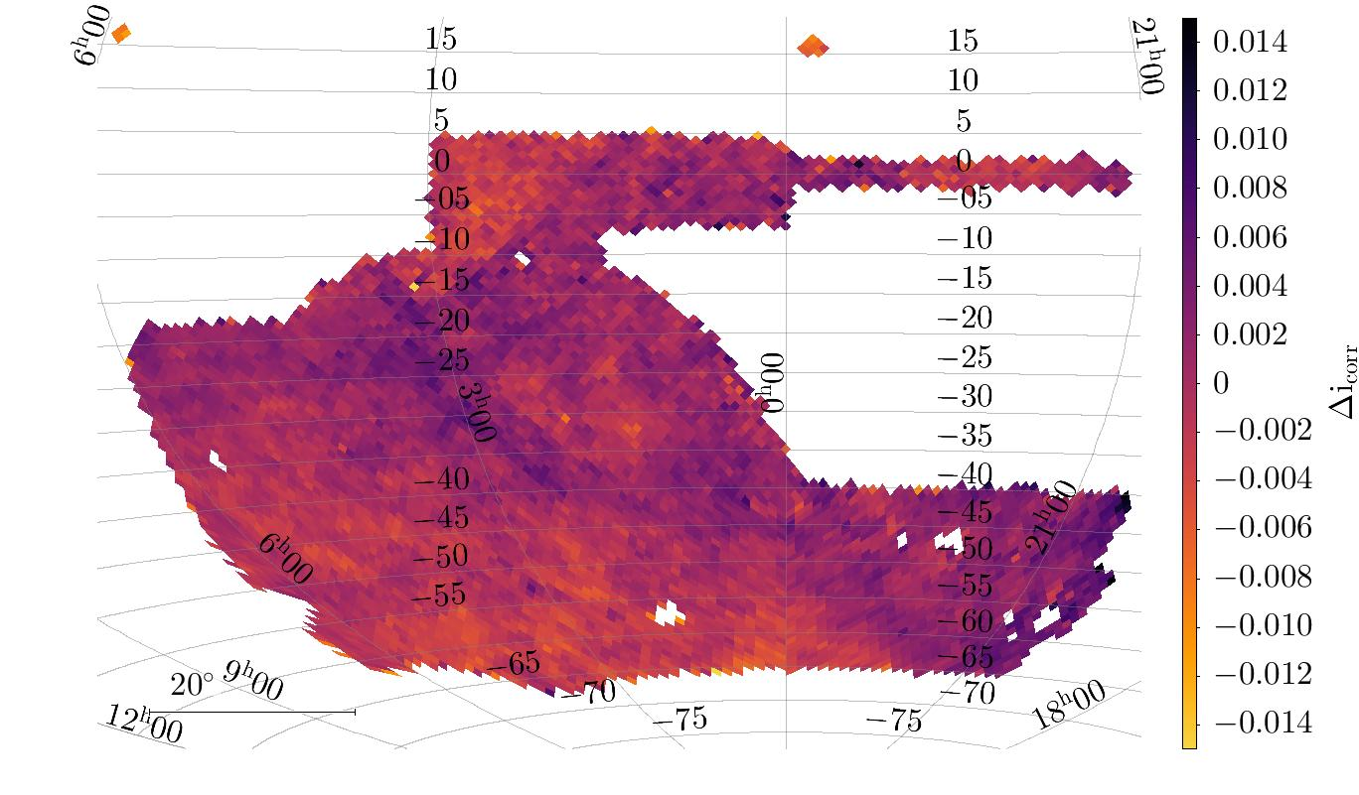
Gaia-NIR: next astrometric mission, Bologna, 17-18 January 2024
But let’s focus on the pure photometric heritage
This is the typical behaviour of any ground-based survey when compared with XPSP
An example: SDSS (Thanjavur et al. 2021)
We saw the same kind of behaviour in any wide field photometric set we looked at
except DES Y6 calibration star catalogue where ≈ 1 millimag
median differences correlates with
Gaia scanning law
How they can know they were so good? Only by comparison with
XPSP

Slide 9
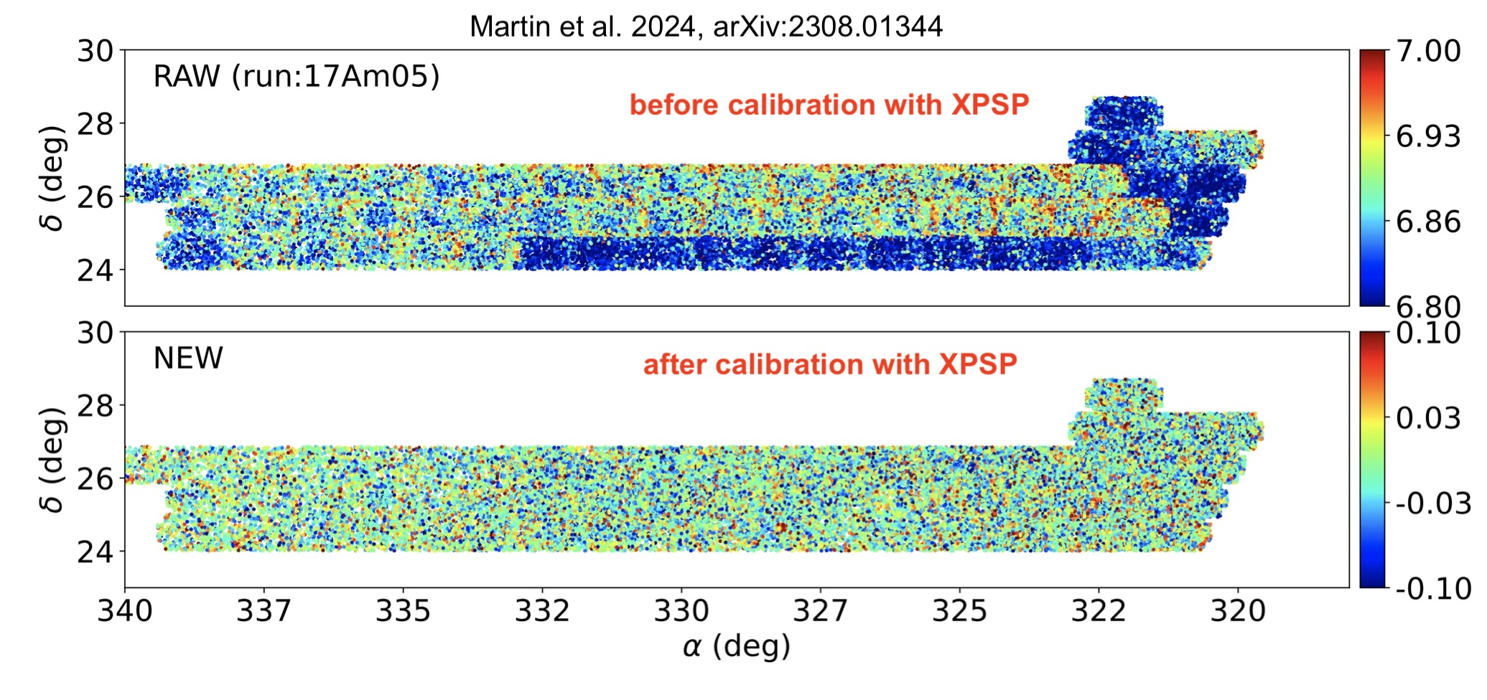
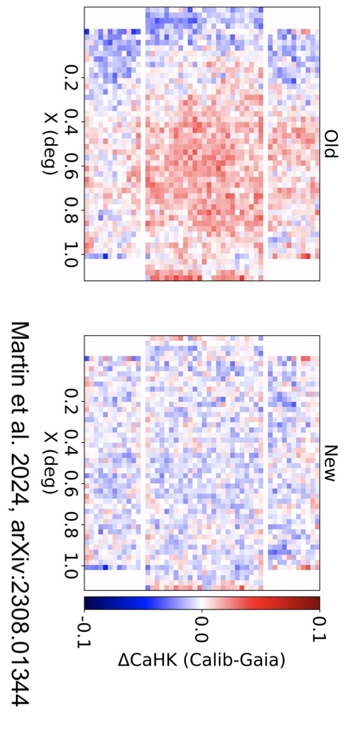
Gaia-NIR: next astrometric mission, Bologna, 17-18 January 2024
But let’s focus on the pure photometric heritage
Hence: XPSP is a precious asset, allowing to calibrate – recalibrate all photometric surveys / observations (especially those ground-based) greatly improving their internal consistency, removing spatial trends.
A remarkable example: Pristine
small scale
(within tiles)
large scale (across tiles)
Many other surveys are using Gaia XPSP to recalibrate or to calibrate their photometry: reducing
spatial trends from 0.02-0.05 mag to ⪝0.01 mag (precision!). Achieving ⪝0.03-0.05 mag (non-standardised XPSP)
to ⪝0.01 mag (standardised XPSP) accuracy, relative to the Gaia spectrophotometric standard stars (SPSS).

Slide 10
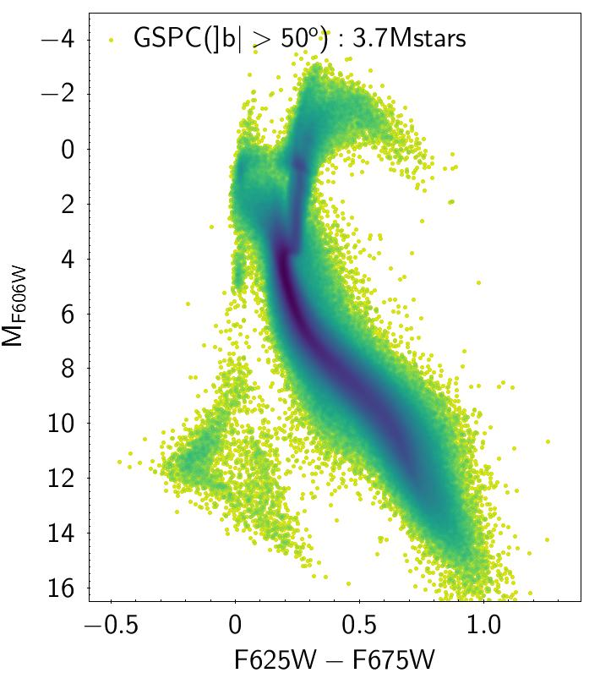
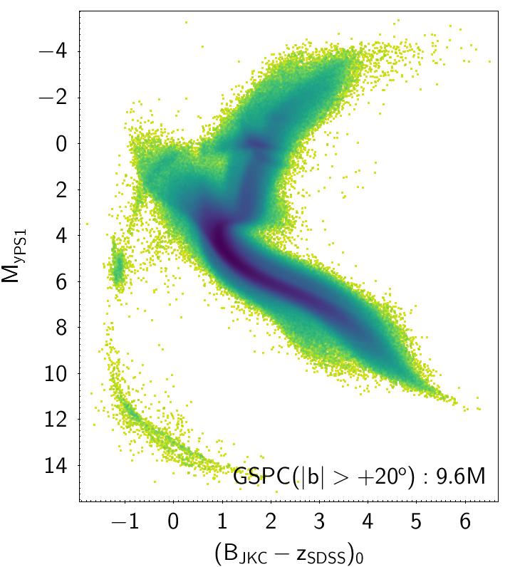
Gaia-NIR: next astrometric mission, Bologna, 17-18 January 2024
An additional (and somehow unexpected) huge and long lasting heritage from Gaia:
the basis for a new foundation of optical photometry
Key factors for this achievement:
Space based
All-sky
High multiplicity of measures ➔ robust internal calibration
Huge flexibility in reproducing photometric system thanks to XP spectrophotometry
This should be taken into account in planning the Gaia-NIR mission. A great opportunity to provide the basis for accurate and precise photometric calibrations in the near infrared.
This could be one of the ancillary goals of the mission

Slide 11
Gaia-NIR: next astrometric mission, Bologna, 17-18 January 2024
Now let’s enter into pure brainstorming: Gaia-NIR as a photometric calibration tool
Clearly this cannot be a primary goal: we want astrometry and astrophysical parameters but ….
can we have also photometry that is useful for calibration of other surveys?
The ideal option seems to be having a NIR-spectrophotometer on board, similar to
Gaia XP, covering the NIR range up to 2400 nm and possibly with some overlap with GAIA XP, for cross validation/calibration. This will probably maximise the amount of astrophysical info that can be extracted for each individual stars that can be properly observed
however… (neglecting cost and technical issues for the time being)
Crowding 1: spectra are extended in the focal plane (3.5”⨉2.1” aperture in Gaia) and GaiaNIR prime target are the regions of the galaxy with the highest surface density (disc and bulge) – see, e.g., Høg 2023
Crowding 2: for fixed primary mirror size the PSF width grows with λ. At 1800 nm is 3 times wider than at 600 nm ➔ impact on LSF width and photon mixing in wavelength

Slide 12
Gaia-NIR: next astrometric mission, Bologna, 17-18 January 2024
Now let’s enter into pure brainstorming: Gaia-NIR as a photometric calibration tool
An “additional however”…
Calibration is a nightmare
Still, we can think that, building up on the experience acquired with Gaia, with
smarter ideas and algorithms and more powerful computers someone will cope with this
as we managed to do for Gaia

Slide 13
Gaia-NIR: next astrometric mission, Bologna, 17-18 January 2024
brainstorming²: Gaia-NIR photometric heritage - my personal view in the realm of dreams
Ideal configuration
NIR spectrophotometry analogous to Gaia XP spectra [for optimal extraction of astrophysical parameters and long-standing re-foundation of NIR photometry for the large subset of stars that can be properly observed]
AND
“normal” photometry in at least two wide NIR passbands to get astrometry and at least one colour for as many stars as possible also in the most crowded regions of the sky (core business of Gaia-NIR)
Sub-optimal configuration
“normal” photometry in 4-5 wide/medium NIR passbands to get astrometry and colours for as many stars as possible also in the most crowded region of the sky (core business of Gaia-NIR)
But
Choosing (at least some of) the NIR passbands to be close to ground based passbands➔ to be used for exquisite photometric calibration of past and future ground-based NIR observations with minimal transformations (small and easy to model colour terms)

Slide 14
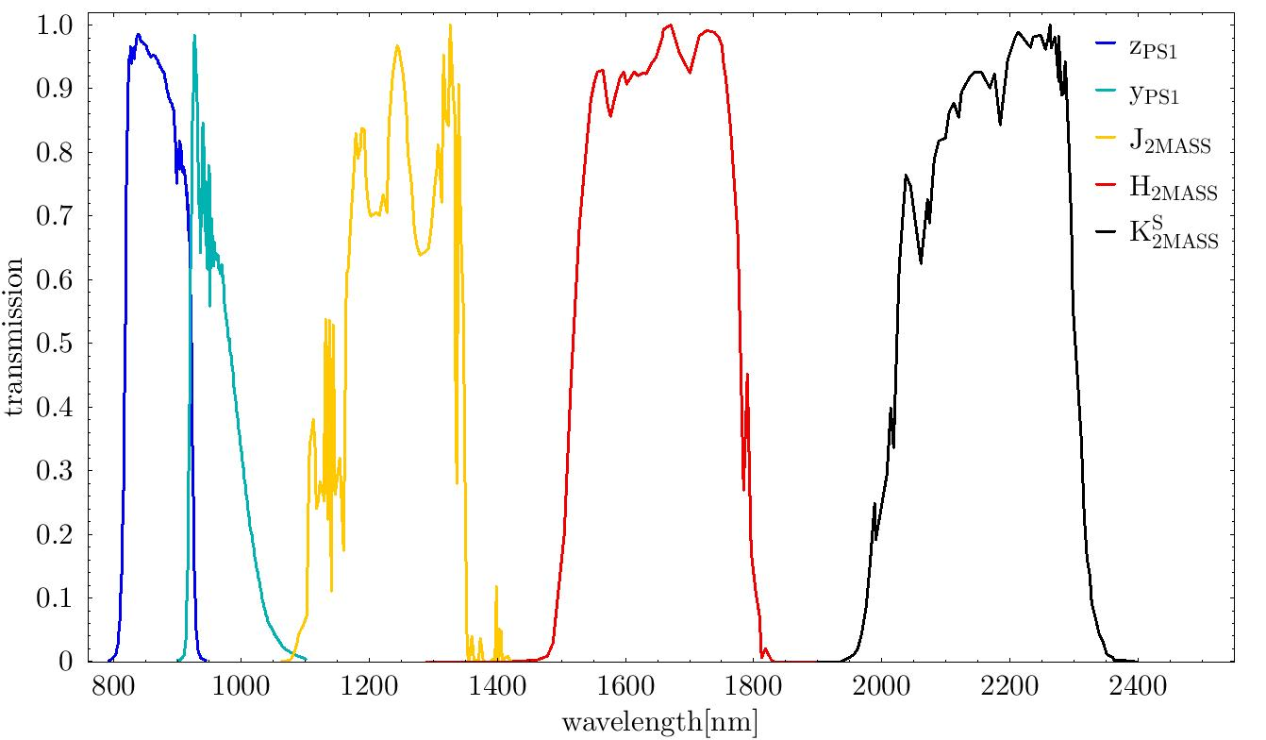
Gaia-NIR: next astrometric mission, Bologna, 17-18 January 2024
Sub-optimal configuration
“normal” photometry in 4-5 wide/medium NIR passbands to get astrometry and colours for as many stars as possible also in the most crowded region of the sky (core business of Gaia-NIR)
But
Choosing (at least some of) the NIR passbands to be close to ground based passbands➔ to be used for exquisite photometric calibration of past and future ground-based NIR observations with minimal transformations (small and easy to model colour terms)
Drawback: throwing away info from spectral ranges that are inaccessible from the ground
Advantage: enabling better science from the ground – may be very useful in the era of ELTs

Slide 15
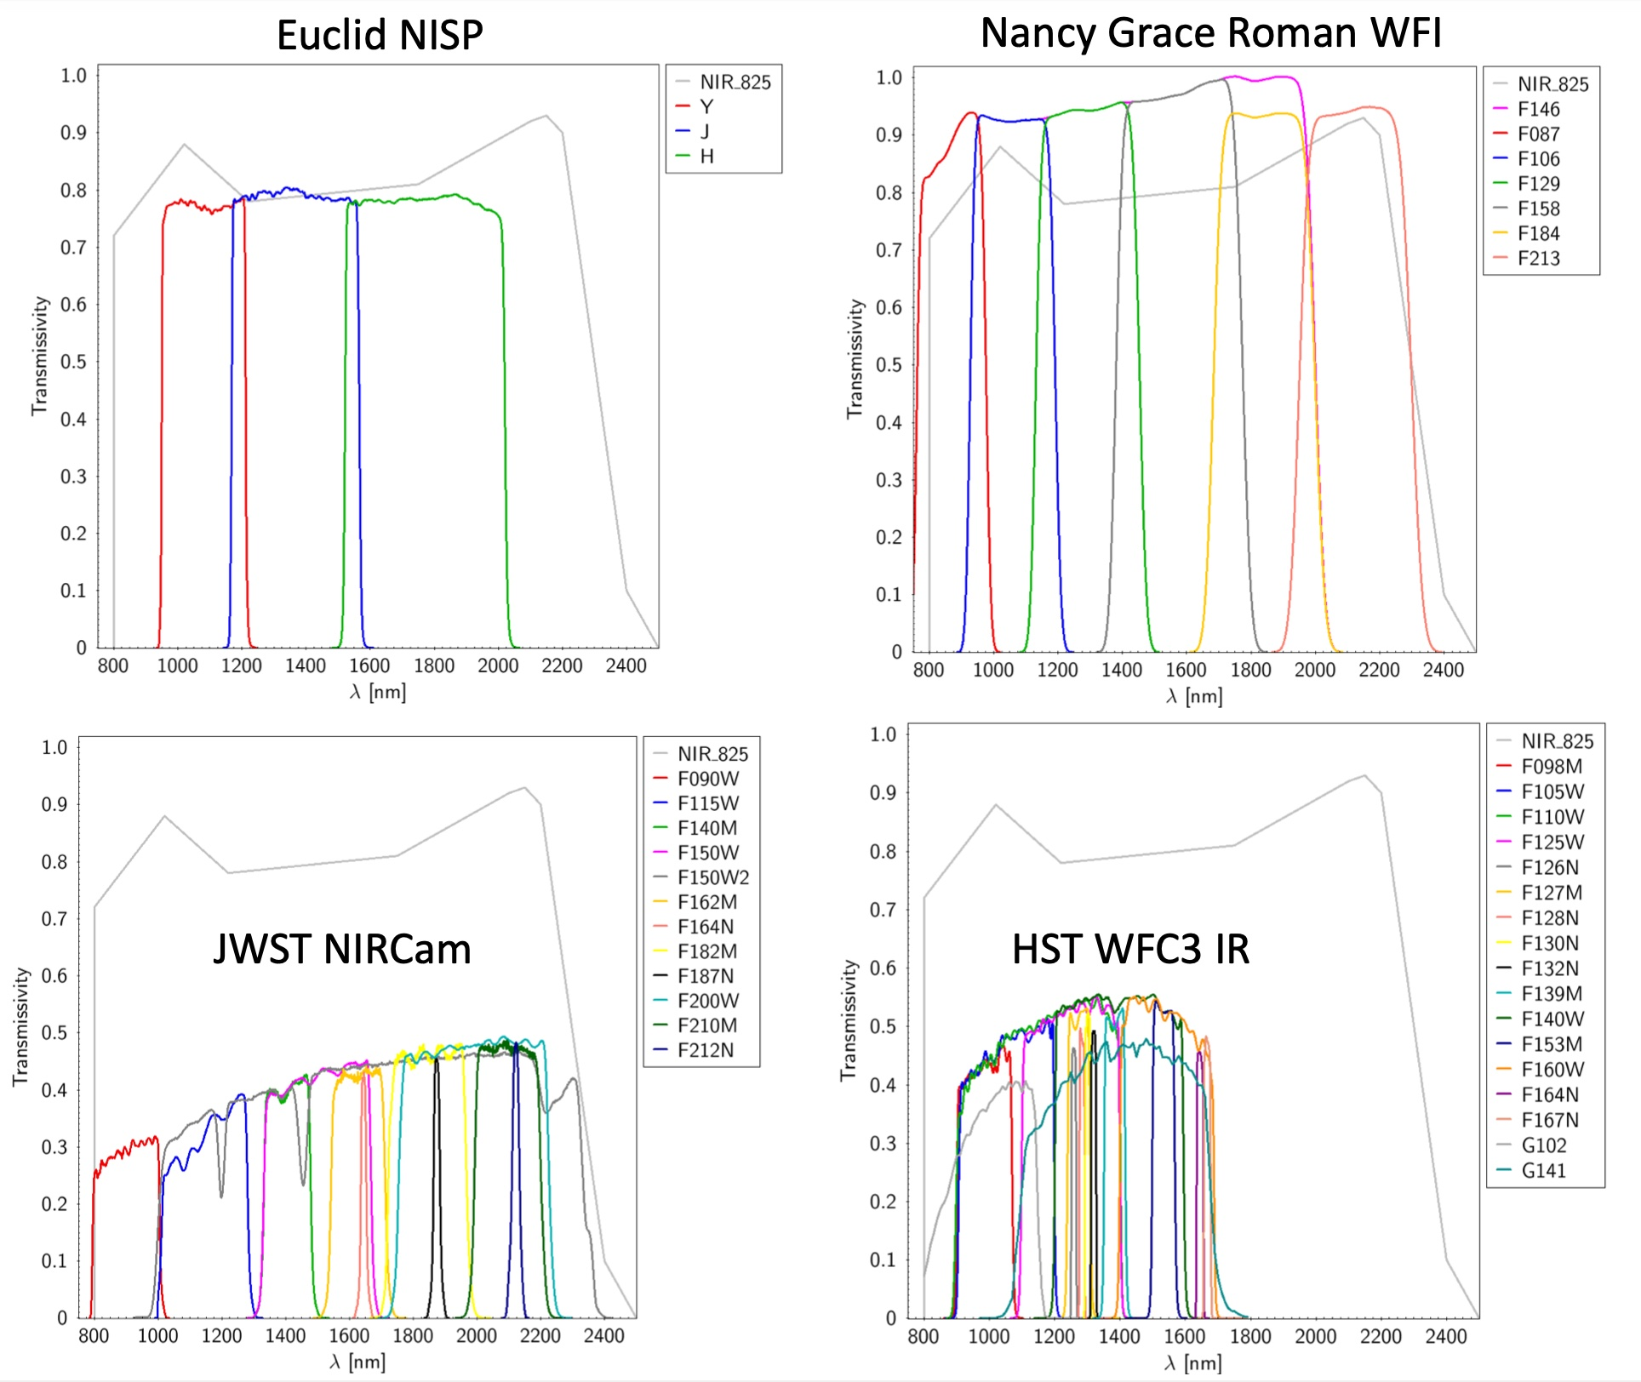
Gaia-NIR: next astrometric mission, Bologna, 17-18 January 2024
Sub-sub-optimal configuration
“normal” photometry in 4-5 wide/medium NIR passbands to get astrometry and colours for as many stars as possible also in the most crowded region of the sky (core business of Gaia-NIR)
but
choosing the NIR passbands from a set already used by a space observatory (preferentially from a mission performing wide field surveys ) ➔ cross-validation
Also medium/narrow passband to get, e.g., metallicity-sensitive
colour indices
From Carrasco et al. 2023

Slide 16
Gaia-NIR: next astrometric mission, Bologna, 17-18 January 2024
brainstorming³:minimal thoughts on extracting astrophysical info from Gaia-NIR photometry
To be able to trace metallicity with very low res spectrophotometry you need strong features (e.g. Ca HK)
Livia: strong spectral features in NIR tracing metallicity are (a) mainly sensitive to α elements, (b) molecular
features ➔ significant in pretty cold stars
High-precision NIR wide band photometry in a few bands may be very helpful in constraining astrophysical parameters when coupled with info from Gaia XP spectra ➔ great improvement for some 2 billion stars in common
In general Gaia and Gaia-NIR photometry can/should be nicely complementary. Do we really need Gaia-NIR to cover the optical domain?

Slide 17
Gaia-NIR: next astrometric mission, Bologna, 17-18 January 2024
brainstorming⁴:minimal thoughts (out of the box?)
Let me go fully heretical: 2 of the 3 main goals of Gaia-NIR can be accomplished with a replica of optical Gaia (strong improvement in astrometry due to the 20 yr baseline and refurbishment of Celestial reference frame). (a) you don’t have to invent NIR TDI detectors from scratch, (b) costs are beaten down, (c) you can take advantage of improved technology, (d) you can even consider a simplified version of Gaia (e.g., no spectrophotometry), (e) you can think about boosting the spectroscopic capabilities (e.g. much more RV and metallicities from spectra; 33M stars in DR3, imagine to go for 1 billion RV), (f) you can include the reddest passband to which your TDI-compliant detectors are sensitive to improve your performances in high extinction regions. In my view it would be crazy to neglect such an option.
From my very partial and uninformed perspective the main competitor is NGRST: larger mirror, higher spatial resolution in NIR, takes IMAGES.
Han et al. 2023 in a NGRST white paper proposed an all sky survey (NANCY, in F140W) whose prime goal is astrometry, planned to get 200 μas/yr PMs for ant star brighter than F140W=21.8 with two epochs.
The Galactic Bulge Time Domain Survey may serve as a seed for a more extended study of the bulge, including PMs
Overlap/sinergies with Euclid (NIR) and Xuntian (CSST uv-optical + sitless spectroscopy) for astrometry in large portions of the sky

Slide 18
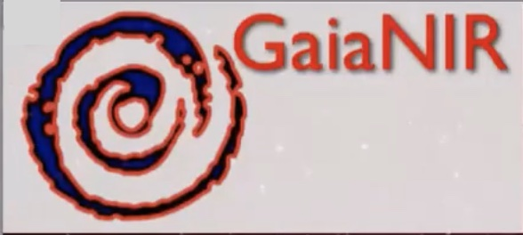
Gaia-NIR: next astrometric mission, Bologna, 17-18 January 2024
Summary of a wild brainstorming on photometry
Gaia-NIR photometry: consider the possibility of providing an unique and long-standing heritage for NIR photometry as Gaia is doing for optical photometry. This issue can be considered also in the choice of passbands. It will enable new science for decades after the mission
Pros and cons of spectrophotometry should be assessed with proper simulations but my guess, from a science-driven point of view, is that this option is viable only in addition to passband photometry
Are we sure that a Next Generation Optical Gaia is not a valuable option?
Thanks

