Slide 1


Towards the boundaries of the Galactic disc
Laura Magrini
INAF-Osservatorio Astrofisico di Arcetri

Slide 2
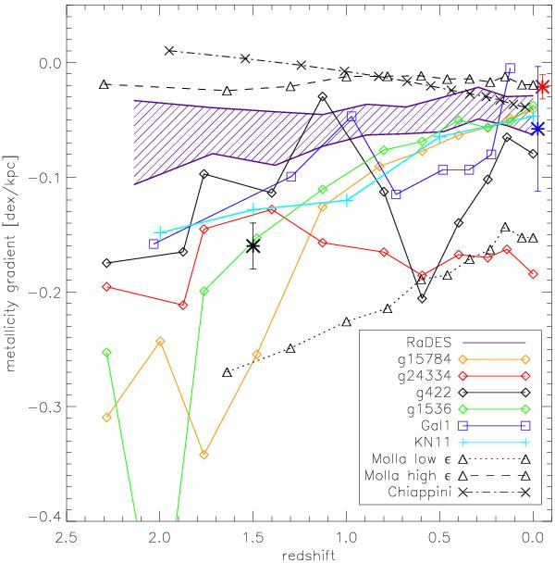
Constraining scenarios of galaxy formation and evolution
Disc galaxies form inside-out
As a consequence, they show radial variations in their chemical abundances
The slope of the radial metallicity gradient (in the gas phase) changes with time (and redshift)
Different scenarios of galaxy formation and evolution predict different evolution with time
    SN feedback and gas outflow
    Pre-enriched gas infall in the thin disc
Pilkington et al. 2012
2

Slide 3
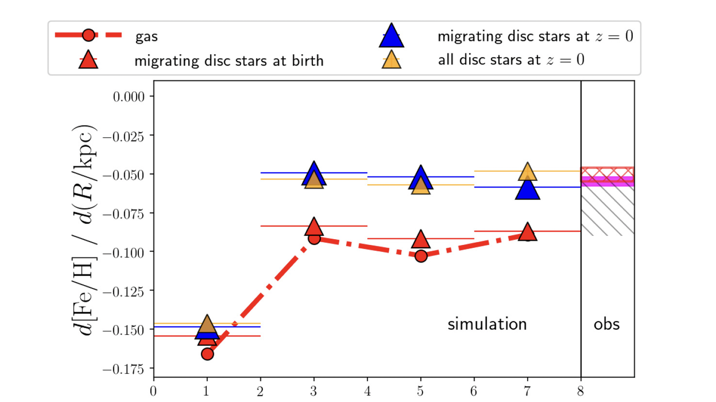
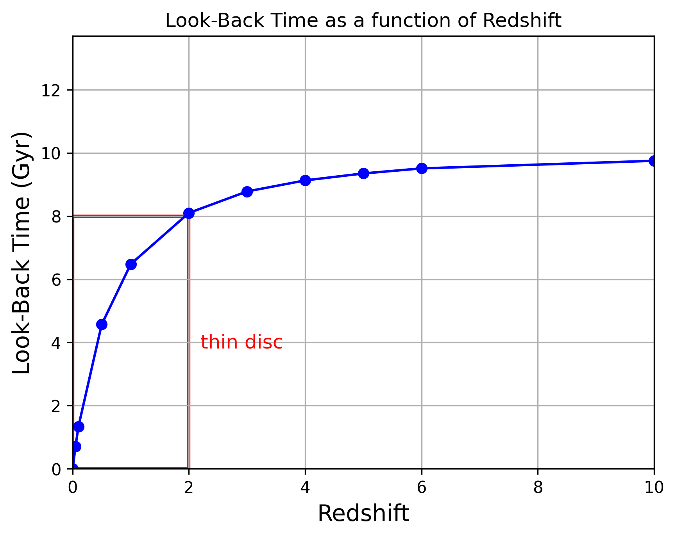
The approach of the Galactic Archaeologist
Vincenzo & Kobayashi 2020
  Mapping the Galactic gradient at different past epochs
  Using fossils records based on stars with well-known ages → stars in the thin disc can probe up to z=2
  Old stars migrate (already after 3 Gyr)
  Young stars might present difficulties in their analysis
Lookback time (Gyr) → Stellar ages
  Simulations of the time evolution of the gradient:
  correcting for the effect of migration (red)
  Measuring the gradient with migrated stars (blue)
  Measuring the gradient with migrated and accreted stars (yellow)
3

Slide 4
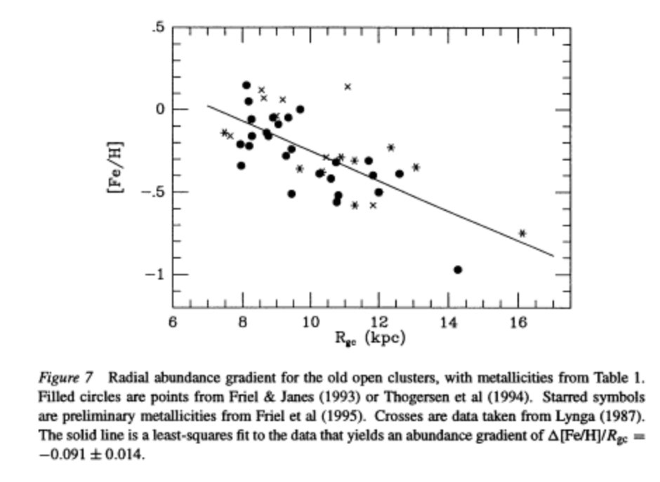
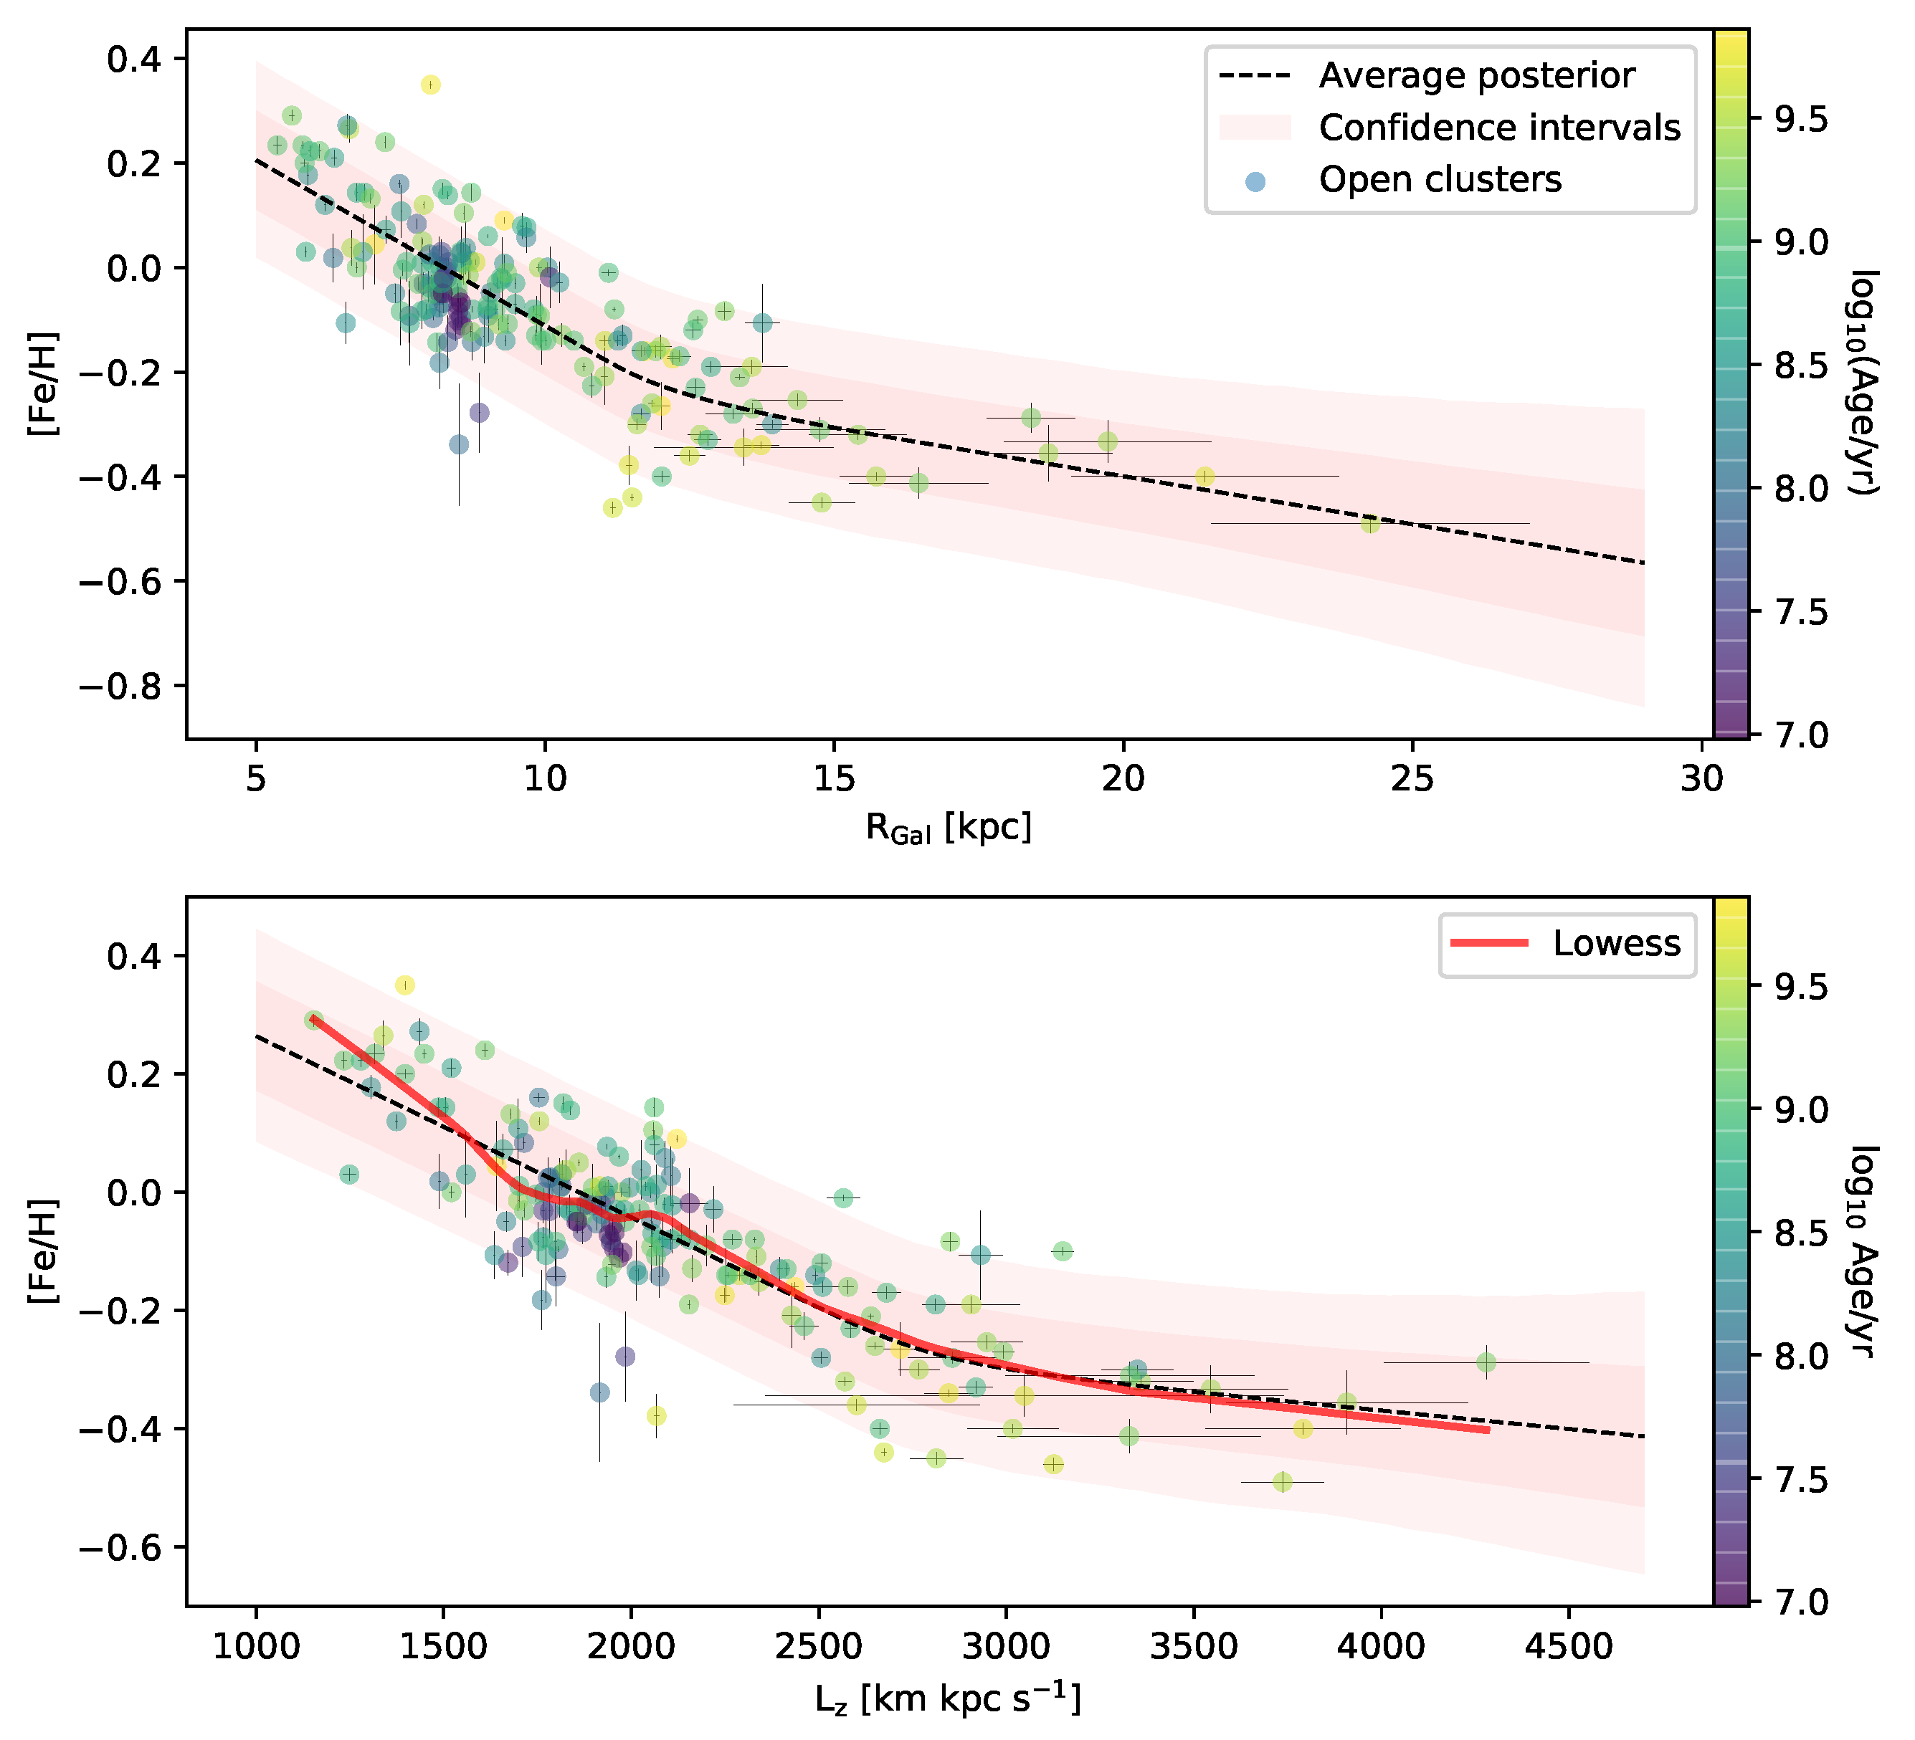
Putting constraints to the gradient with open clusters: an well-known approach applied for decades
Randich et al. 2022
  Friel et al. 1995 → Spina, LM, Cunha 2022
4

Slide 5
Putting constraints to the gradient with open clusters: with the contribution of Gaia DR3 spectroscopy
  Gaia Collaboration, Recio-Blanco et al. 2023
4

Slide 6
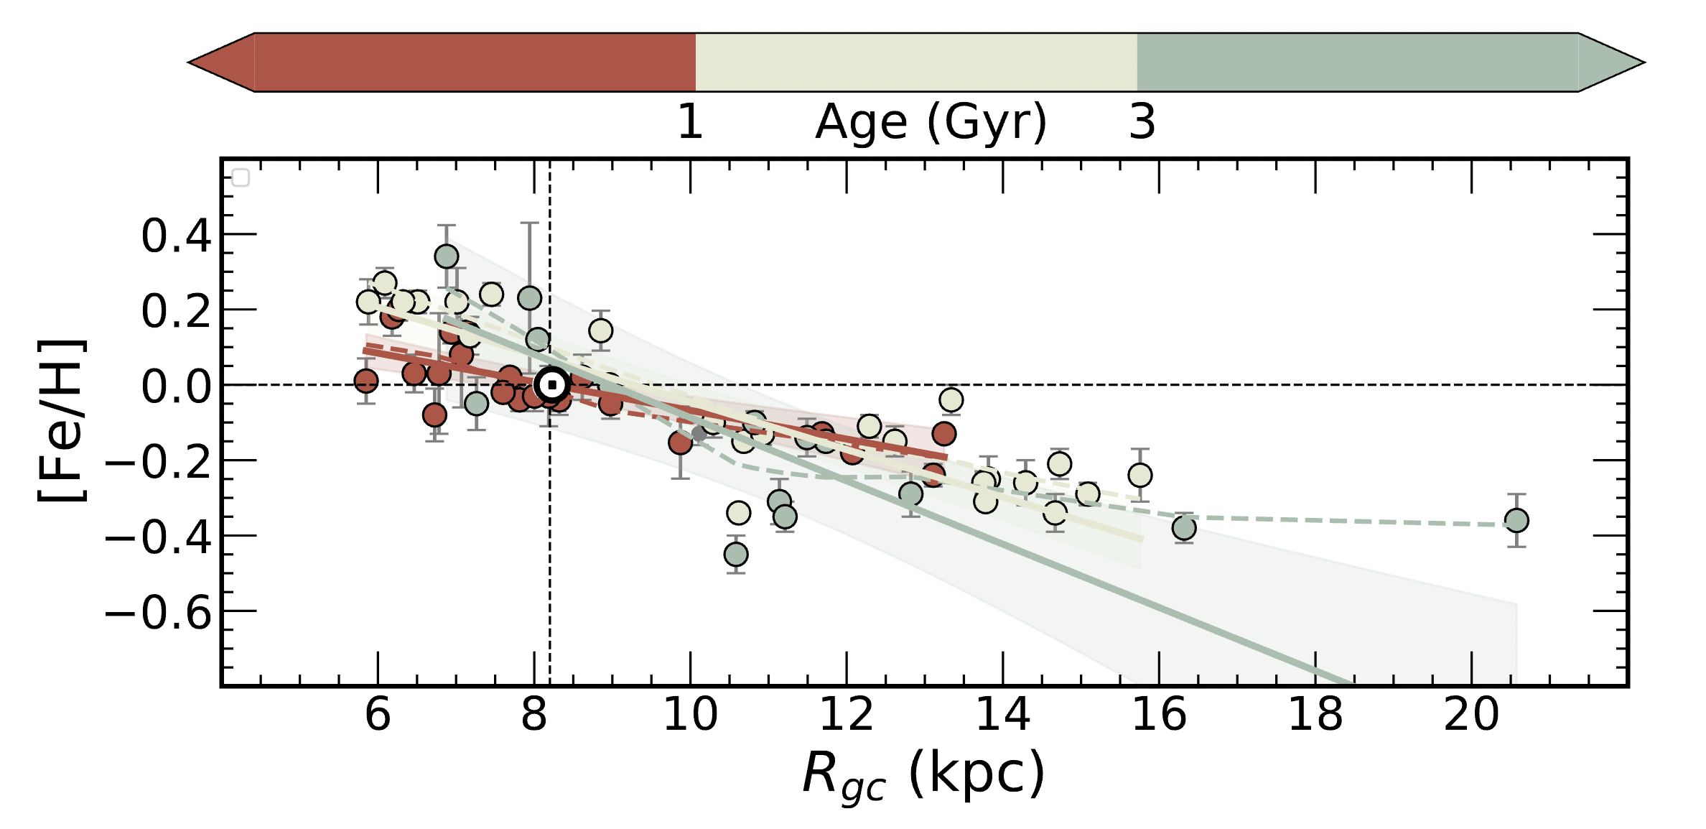
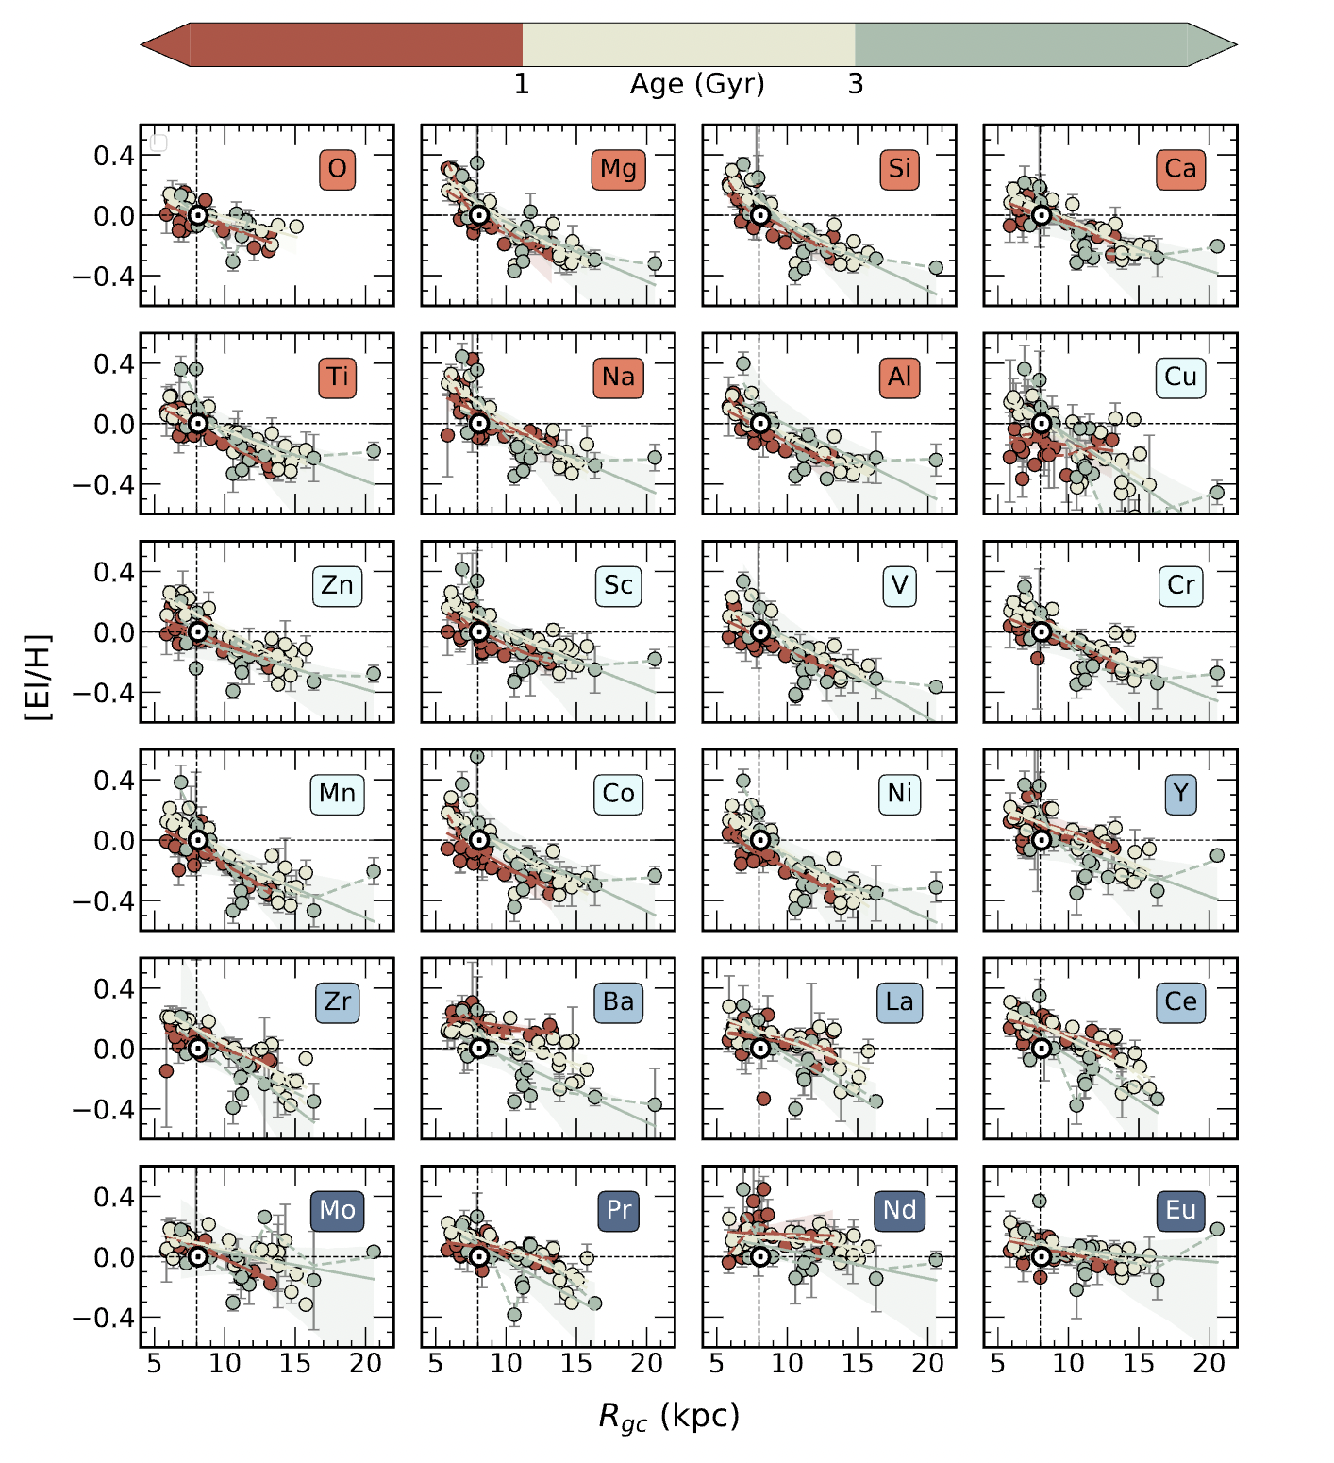
Putting constraints to the gradient with open clusters: enhancing the results using high-resolution spectroscopy, e.g. Gaia-ESO
Multi-channel time evolution
ML et al. 2023
4

Slide 7
  Time-evolution depends also on the element
  Effect of the analysis?
  Time scales of the nucleosynthesis?
4

Slide 8
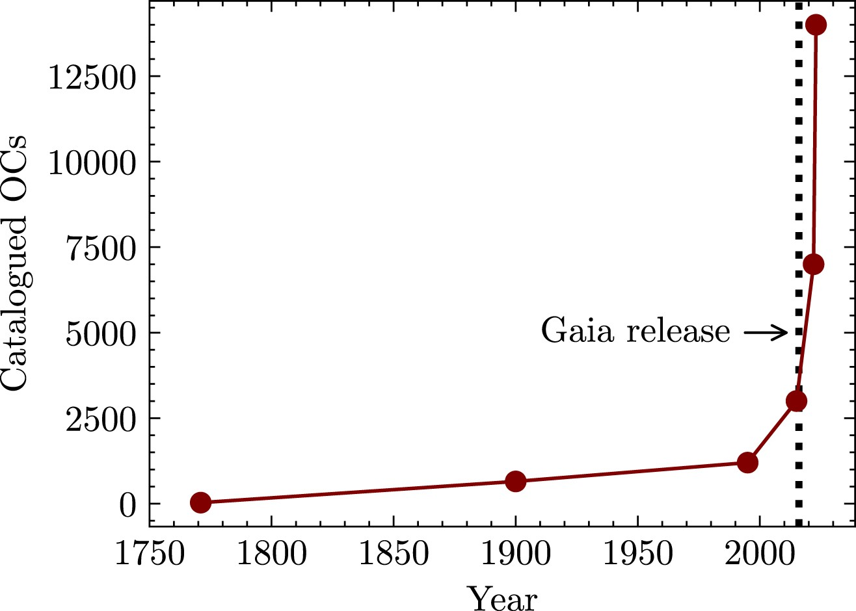
The Gaia Revolution: increasing exponentially the number of clusters
Perren et al. 2023
→ Combining several catalogues from the literature, most of them based on Gaia
Estimates for the total number of OCs in the Galaxy locate the upper limit over 10⁵ (Bonatto et al. 2006), which means that there remain still a lot of objects waiting to be found → in particular in the most extincted regions, both in the inner and outer disc.
3

Slide 9
The Gaia Revolution: in a region of Radius~4 kpc from the Sun
Hunt & Reffert 2023
3

Slide 10
Enhancing the revolution going in the NIR: extending the sample towards the Galaxy centre
In external spiral galaxies, e.g.:
There are often an inner drop and outer flattening in the radial profile of the oxygen abundance (Sánchez-Menguiano et al. 2016, 2018)
The shape of the gradient is a function of the stellar mass of the galaxy with the most massive galaxies (M⋆ >∼ 3×10¹⁰ M⊙) characterised by a flattening of the metallicity gradient in the central regions (Belfiore et al. 2017, 2019)
For the MW the inner part of the gradient is still unclear
3

Slide 11
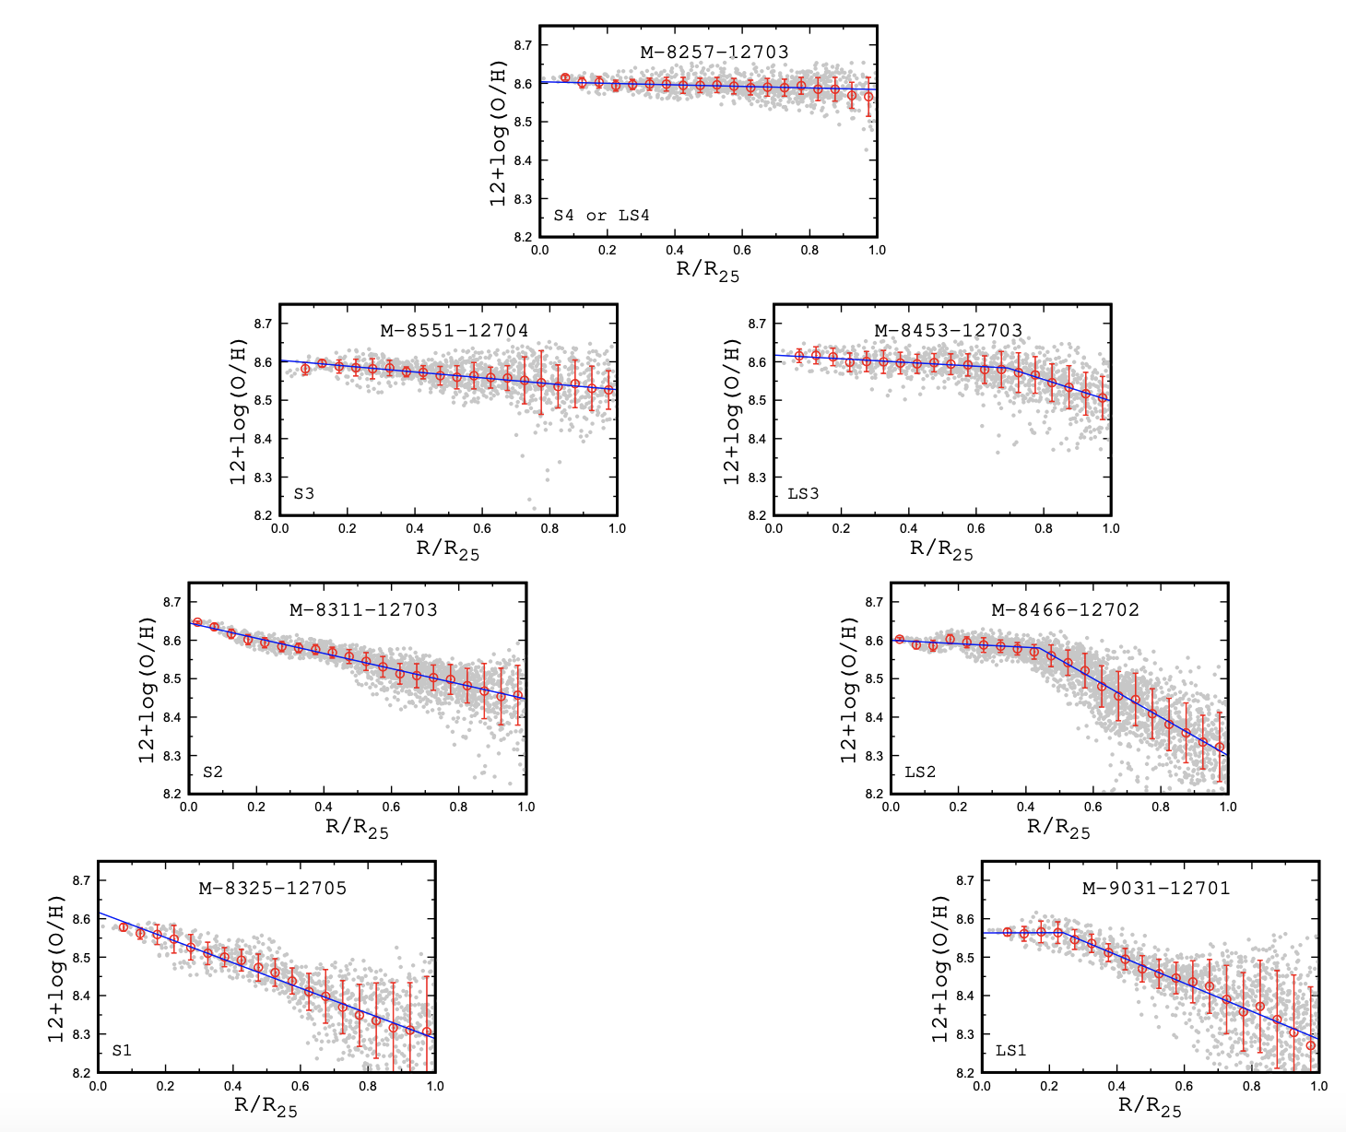
Where the MW is located in the extragalactic context?
  Two sequences of spiral galaxies based on the shape of their radial gradient
  Pilyugin & Tautvaisiene 2023
3

Slide 12
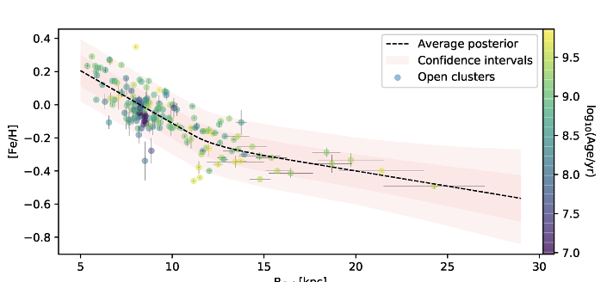
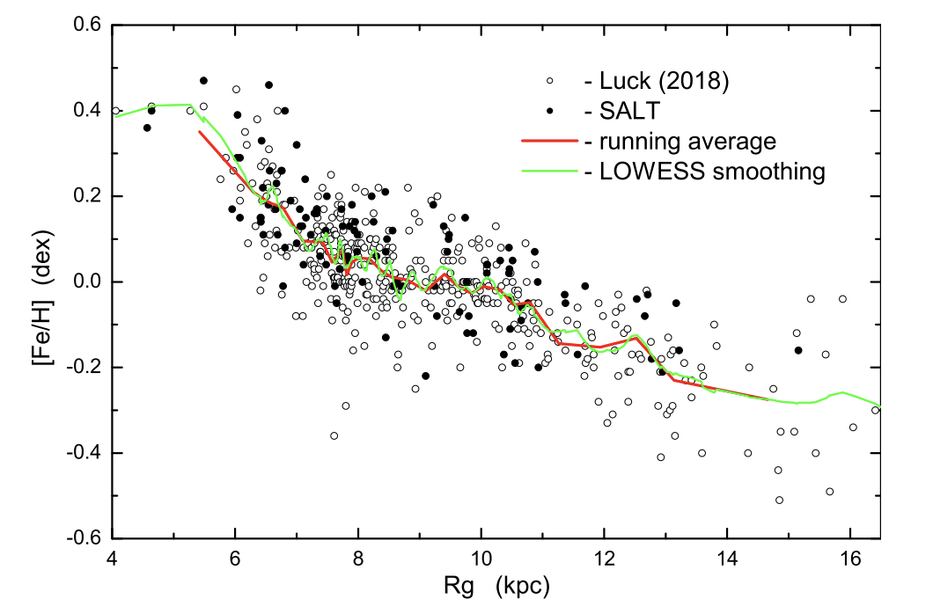
Where the MW is located in the extragalactic context?
  Open clusters (Spina+21)
?
  0-5 kpc?
  Cepheids
  (Kovtyukh+22)
?
3
  0-4 kpc?

Slide 13
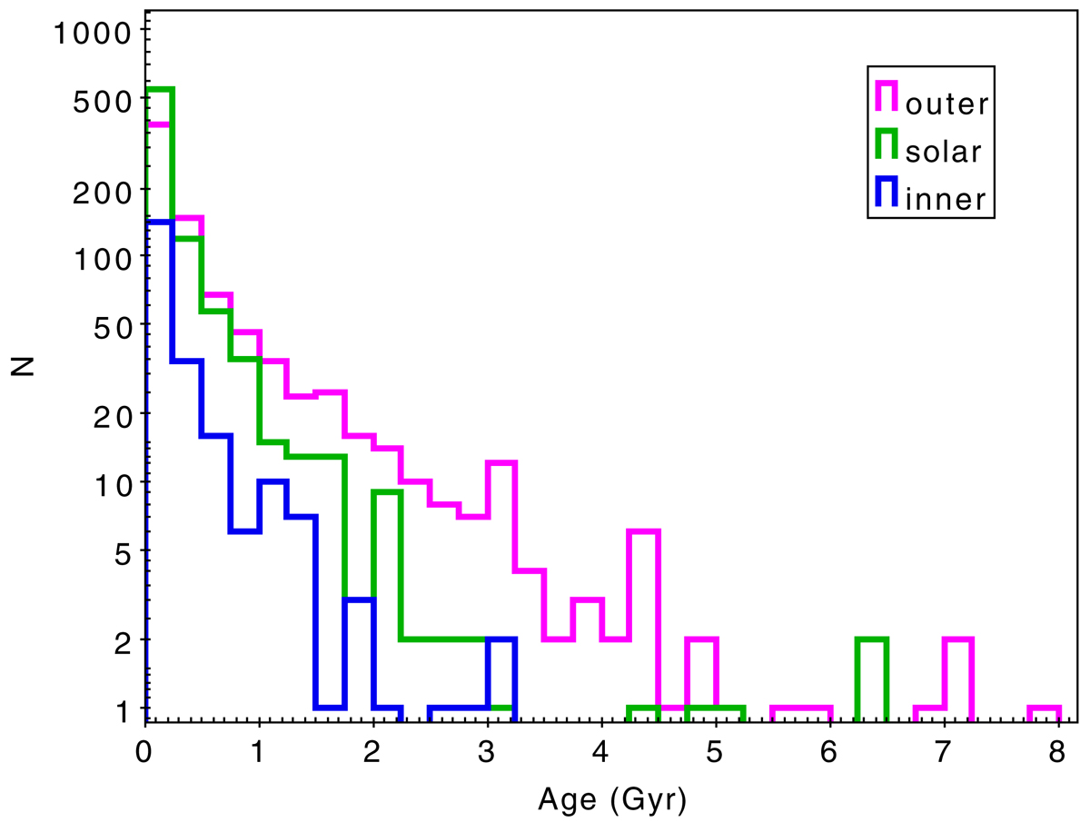
Why we should care about inner disc?
  Not only gradient, but also:
  Cluster disruption as a function of Galactocetric distance→ improve the sampling for Rgc < 5 kpc
  Impact of radial migration close to the Galactic bar (extending as far as 5 kpc from the GC, Wegg+15)→ new NIR observations to provide proper motions and parallaxes to disentangle bar, disc and bulge populations
Viscasillas, LM et al. 2022
3

Slide 14
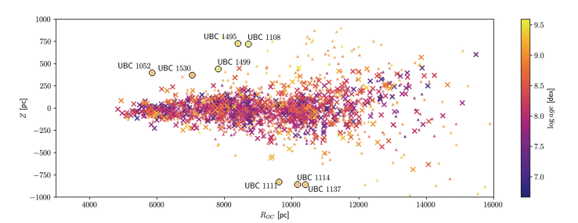
Not only inner, but also outer disc
  Are there clusters close to the Galactic Plane in the outer disc?
  Is it the outer plateau in the radial metallicity gradient just an effect of migration?
3

Slide 15
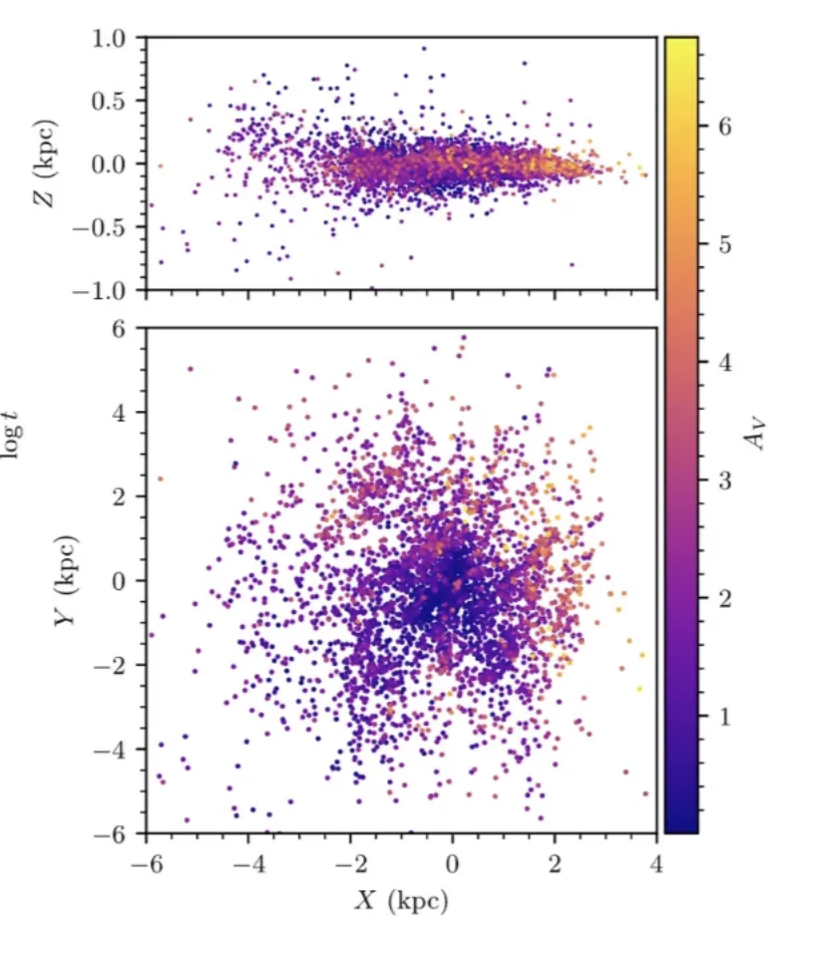
Benefits of survyes in the most extinct regions of our Galaxy
  Detection of clusters to map the disc in the inner regions and outside, at low z
  Stellar parameters and metallicity from photometry
  No spectroscopic facilities at all?
3

Slide 16
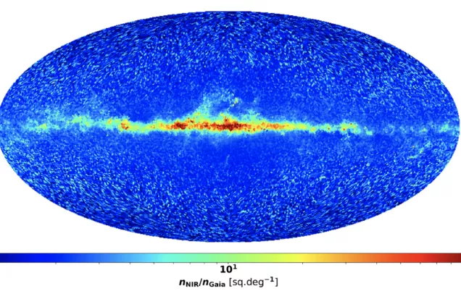
  Thanks

