Slide 1
Vocabulary and DMP in practice
Cristina Knapic

Slide 2
General definitions
Collection:
collection of objects gathered together according to strict selection criteria and intended for conservation for their intrinsic value or interest or for simple passion or personal pastime.
(publishing) series of literary works by a given author or on a given topic, theme or genre published by a publishing house
(fashion) the set of sartorial creations of a given designer or fashion house relating to a specific season
The collection is a group of resources that are related to each other in some identifiable way. The relationship might be through a topic, a place, a person etc.. The relation depends on the human logic and in astrophysics usually depends on field of investigation (cosmology, stellar physics, transients…), instrument characteristics and scientific purpose.
A collection is an aggregation of physical or digital items i.e. library or museum collections; library, museum or archive catalogues; digital archives; internet directories; internet subject gateways; collection of texts, images, sounds, datasets, software etc…
A collection may be made up of any number of items, from one to many.
A collection is a set of resources brought together for a particular audience or to serve a specific function.

Slide 3
General definitions
A Collection is a growing organism: in particular in Astrophysics, all the items related to observations, simulations, ancillary information, calibrations, software for calibration and data analysis, visualization etc… might increase in number and type.
Three concepts:
A collection is a single entity
A collection is a entity that exists to serve a specific mission
Several collections should be a unique part of a more larger collection (see lesson on Interoperability)

Slide 4
General Definitions
Dataset:
A data set or dataset is a collection of data.
More commonly, a dataset constitutes a set of data structured in relational form, that corresponds to the content of a single database table, or to a single matrix of statistical data, in which each column of the table represents a particular variable, and each row corresponds to a specific member of the dataset in question. The size of the dataset is given by the number of members present, which form the rows, and by the number of variables of which it is composed, which form the columns.
The term dataset can also be used more generically to indicate data in a set of closely connected items relating to a particular experiment or event.

Slide 5
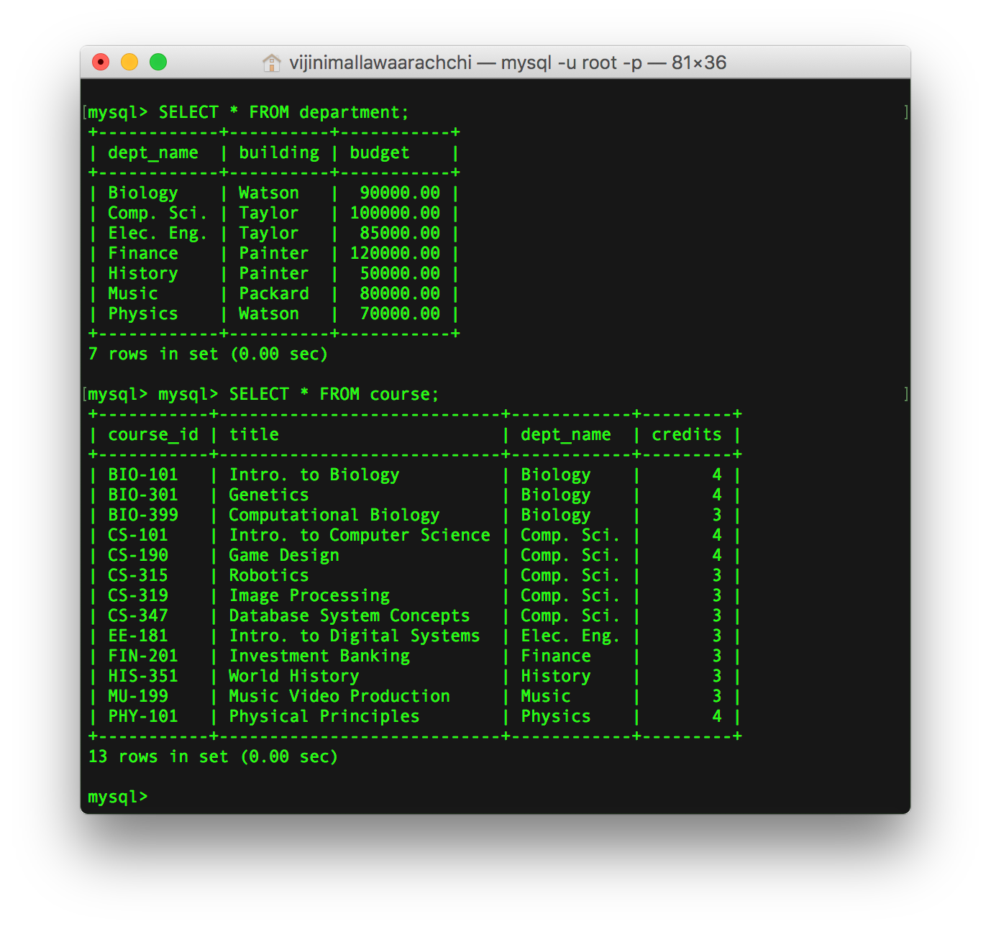
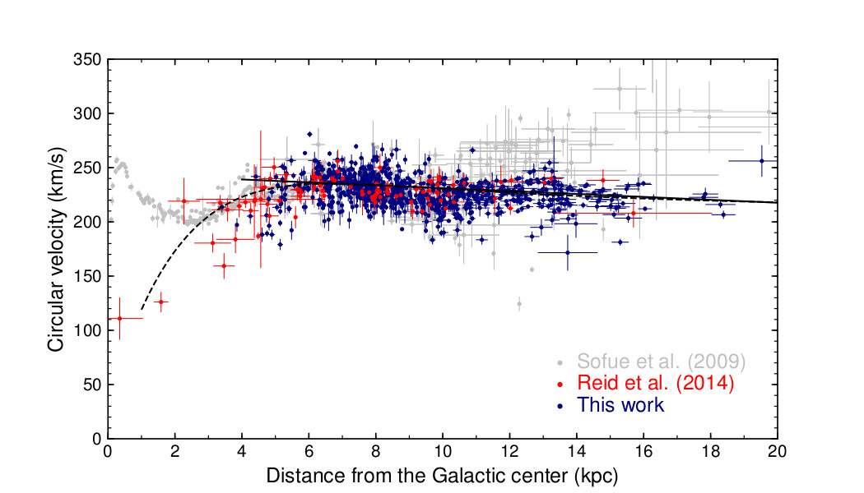
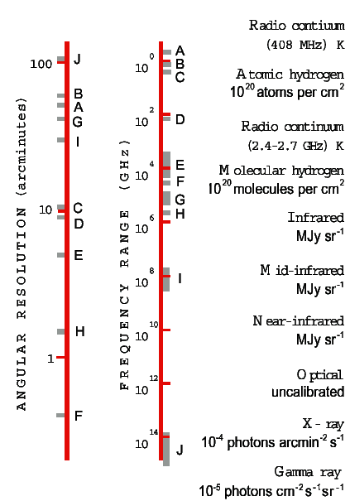
General definitions
Dataset

Slide 6
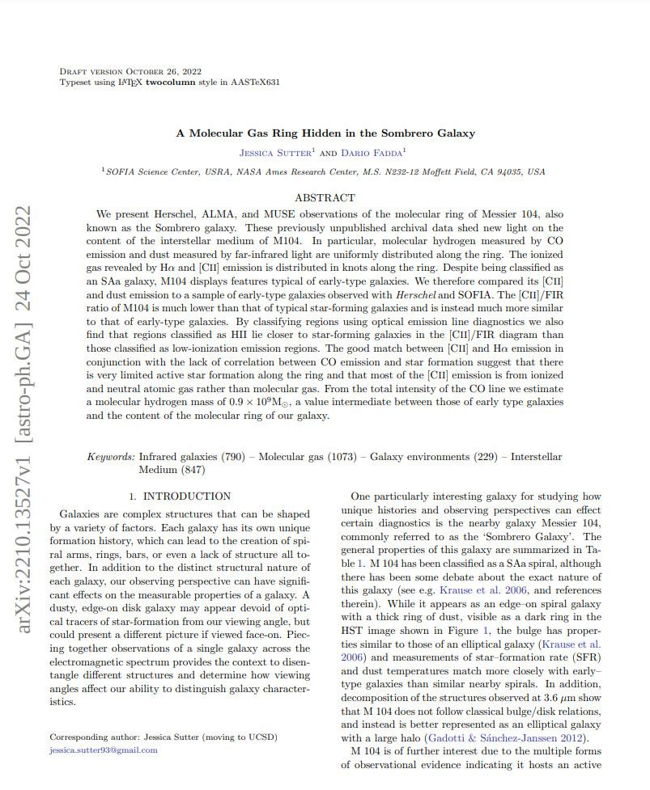
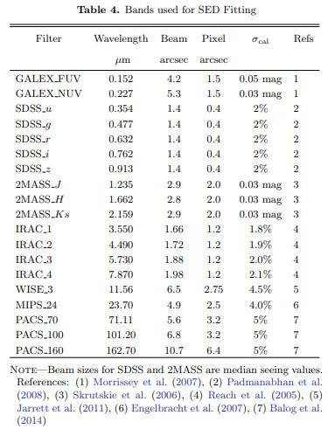
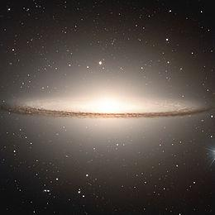
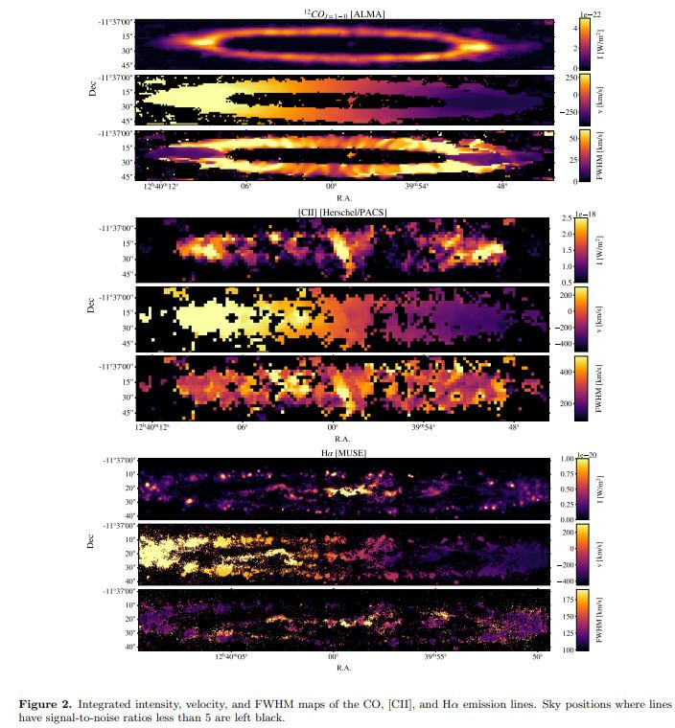
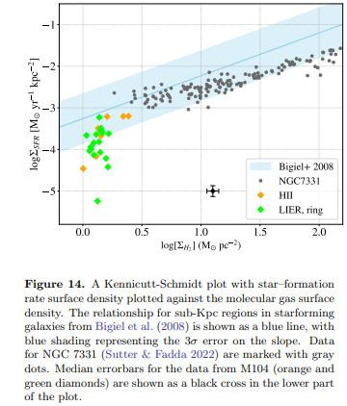
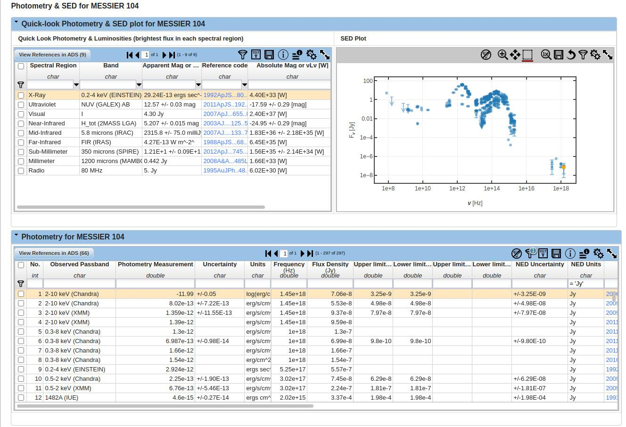
General definitions
What a dataset might look like
Paper
Observations
Calibrated Data
Boundary Conditions
Comparison
Results

Slide 7
Open Archival Information System
The OAIS refers to the ISO OAIS Reference Model [1]. This reference model is defined by recommendation CCSDS 650.0-B-2 of the Consultative Committee for Space Data Systems. The CCSDS's purview is space agencies, but the OAIS model it developed has proved useful to other organizations and institutions with digital archiving needs. OAIS is widely accepted and utilized by various organizations and disciplines, both national and international, and was designed to ensure preservation. The OAIS standard, published in 2005, is considered the optimum standard to create and maintain a digital repository over a long period of time.
The OAIS model can be applied to various archives, e.g., open access, closed, restricted, "dark", or proprietary.
The information being maintained has been deemed to need "long term preservation", even if the OAIS itself is not permanent. "Long term" is long enough to be concerned with the impacts of changing technologies, including support for new media and data formats, or with a changing user community. "Long term" may extend indefinitely.
The archive defines the community and that definition is not fixed.
The "O" in OAIS represents the "open way the standard was developed", and does not represent "open access", or the usage of the term open in the Open Definition or Open Archives Initiative. The "I" in OAIS represents "information", meaning data that can be shared or exchanged.
[1]-https://public.ccsds.org/pubs/650x0m2.pdf

Slide 8
Open Archival Information System
The OAIS environment involves the interaction of four entities:
producers of information;
consumers of information (or the designated community);
management (person or group that sets policies for the content contained in the archive);
archive.

Slide 9
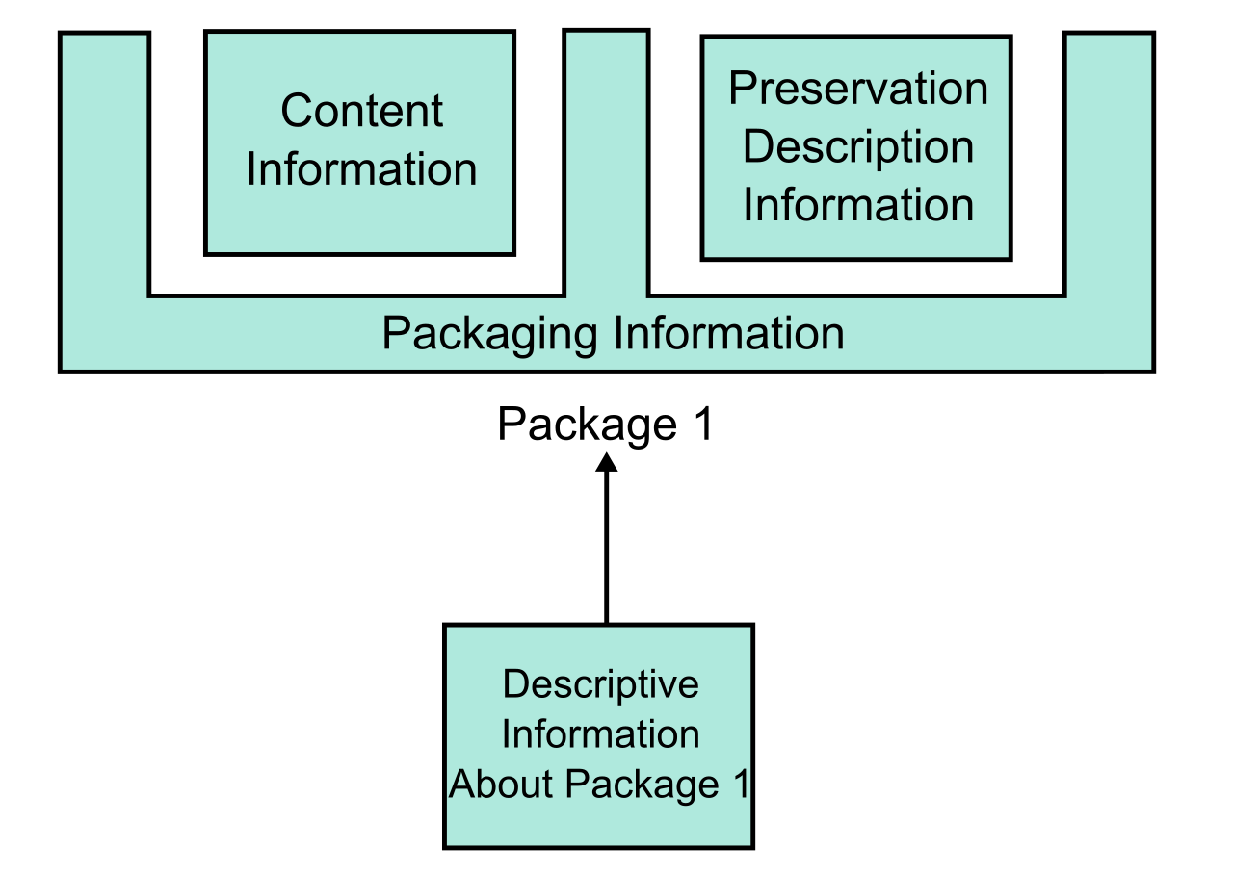
Open Archival Information System
The OAIS model also defines an information model. Physical or digital items which contain information are known as data objects. Members of the Designated Community for an archive should be able to interpret and understand the information contained in a data object either because of their established knowledge base or with the assistance of supplementary "representation information" that is included with the data object.
An information package includes the following information objects:
Content Information: this includes the data object and its representation information
Preservation Description Information: contains information necessary to preserve its affiliated content information (such as information about the item's provenance, unique identifiers, a Checksum or other authentication data, etc.)
Packaging Information: holds the components of the information package together
Descriptive Information: metadata about the object which allows the object to be located at a later time using the archive's search or retrieval functions

Slide 10
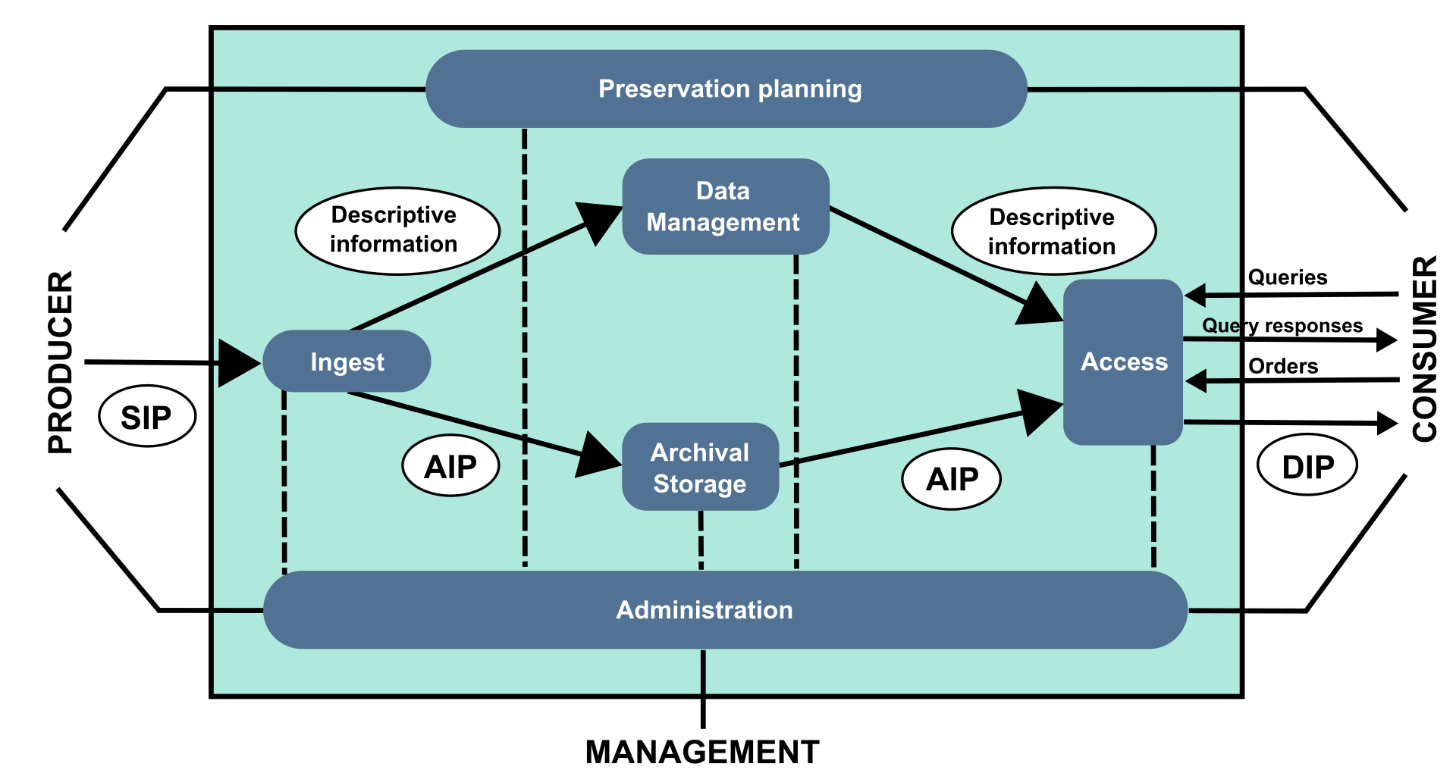
Open Archival Information System
There are three types of information package in the OAIS reference model:
Submission Information Package (SIP): which is the information sent from the producer to the archive
Archival Information Package (AIP): which is the information stored by the archive
Dissemination Information Package (DIP): which is the information sent to a user when requested
These three information packages may or may not be identical to each other.

Slide 11
Open Archival Information System
There are six functional entities in an OAIS:
Ingest function: receives information from producers and packages it for storage. It accepts a SIP, verifies it, creates an AIP from the SIP, and transfers the newly created AIP to archival storage;
Archival Storage function: stores, maintains, and retrieves AIPs. It accepts AIPs submitted from the Ingest function, assigns them to long term storage, migrates AIPs as needed, checks for errors, and provides requested AIPs to the Access function;
Data Management function: coordinates the Descriptive Information of the AIPs and the system information that supports the archive. It maintains the database that contains the archive's information by executing query requests and generating results, reports in support of other functions and updating the database;
Administration function: manages the daily operations of the archive. This function attains submission agreements from information producers, performs system engineering, audits SIPs to ensure compliance with submission agreements, develops policies and standards. It handles customer service and acts as the interface between Management and the Designated Community in the OAIS environment;
Preservation Planning function: supports all tasks to keep the archive material accessible and understandable over long terms even if the original computing system becomes obsolete, e.g. development of detailed preservation/ migration plans, technology watch, evaluation and risk analysis of content and recommendation of update and migration.
Access function: This function includes the user interface that allows users to retrieve information from the archive. It generates a DIP from the relevant AIP and delivers it to the customer who has requested the information

Slide 12
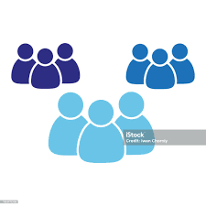
D-Identity, Users, Groups, Organizations
Digital Identity: is the set of digital resources uniquely associated with a natural person that identifies him, representing his will, during his digital activities;
User : person or device that uses data processing systems to obtain or process data and to exchange information;
Group: a set of people who have similar interests, goals or concerns (i.e. transients, exoplanets, cosmology…) ;
Group of groups: several set of people who have similar interests and are part of a more extensive group (national observers at a telescope);
Organization: several set of groups that share an high level topic like a discipline or a scientific domain (i.e. INAF, SKA, CTA, CERN, INFN…);

Slide 13
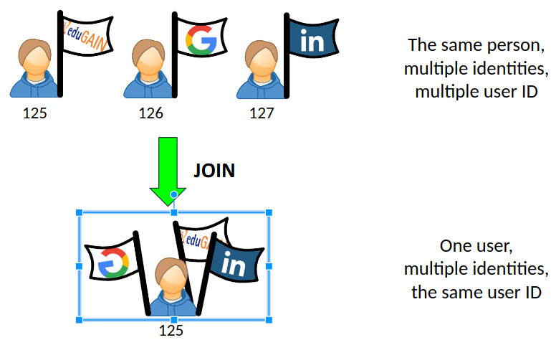
Remote Authentication Portal
+
Courtesy of F. Tinarelli

Slide 14
Permissions and Roles
Permissions: define the actions that a user can perform in a community application (i.e. can write, read, delete, create, can execute digital items ,can see metadata, can retrieve data….);
Roles: provide a way for community administrators to group permissions and assign them to users or user groups (i.e. an administrator can do everything on an archive like store,delete, move, modify data; a PI user can retrieve only his/her own or public data and can execute routines on accessed data; a user can access only public data).
Roles definition as well as sharing necessities identification with the use of groups have particular relevance in data handling and in archive set up.

Slide 15
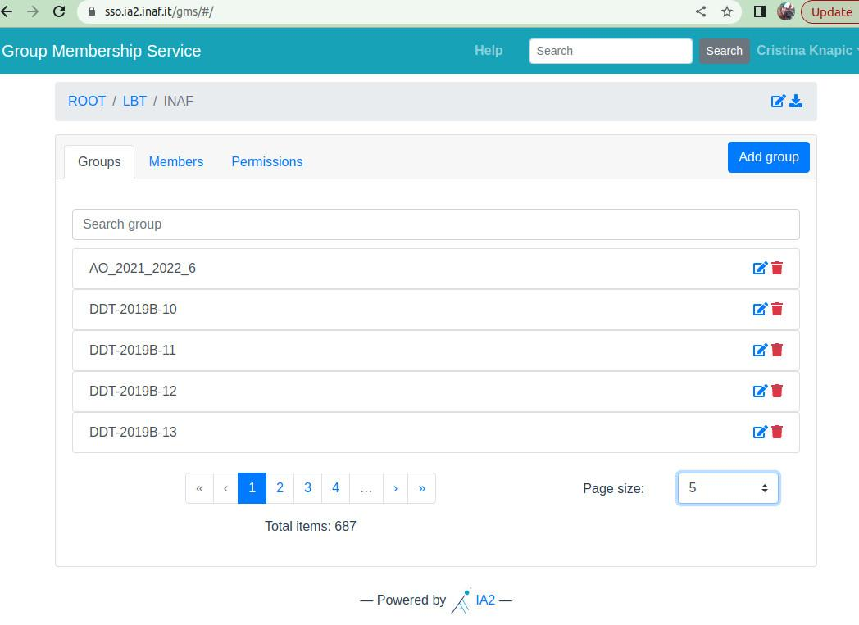
Group Membership Service
Archive (V-O)
Group of groups
Group

Slide 16
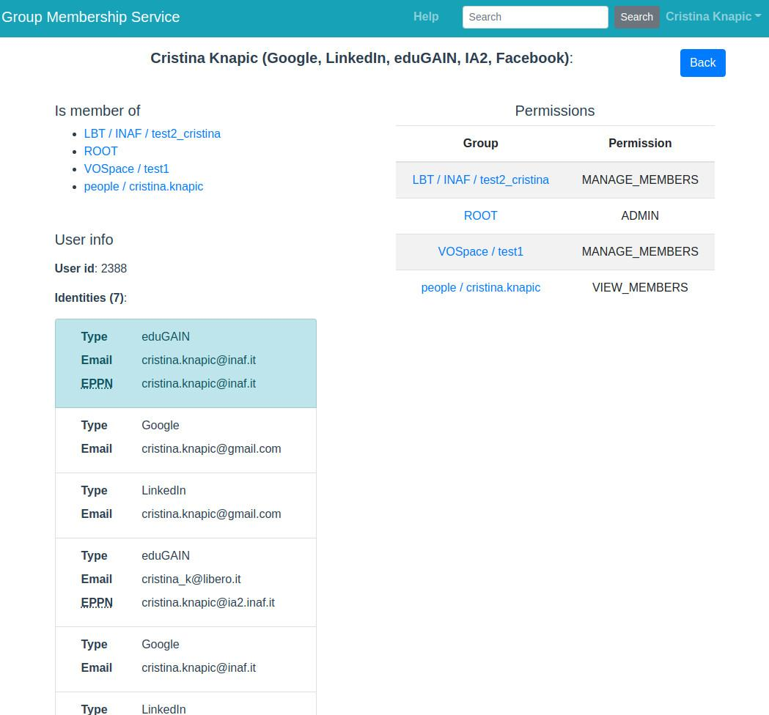
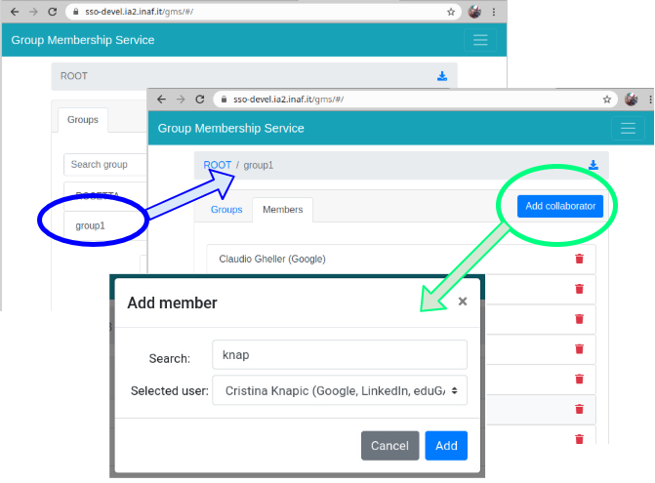
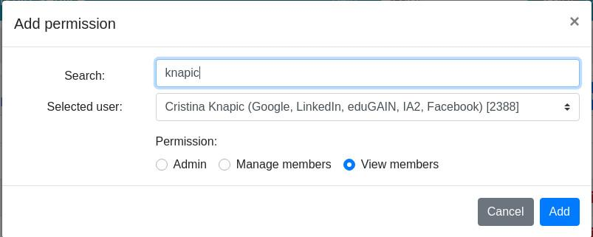
Group Membership System

Slide 17
Privacy policy
In European Public Research Institutes, all products of science research should be public since they are financed by government funds, in the perspective of applying the Open Science concepts (see E. Giglia talk [2]).
In INAF, for observational data, this is true for calibration data intake and data of the previous years, with one -or more in case of long observing programs- year of embargo in order to guarantee a reserved time of exclusive access to the PI and his/her group of collaborators for publishing paper/s.
Open Science foreseen the embargo period but strongly suggest the shortest duration as possible.
Moreover privacy policy can interest different part of the archive:
partial or full metadata description:
only selected users can see full metadata body (admin or PI);
privileged users can see a subset of metadata (PI collaborators);
public users can see a basic subset of metadata (user not part of the collaboration);
partial or full data sets:
only collaboration users can access and download scientific data;
public user can download only calibration data;
partial or full collection:
users involved in an V-Organization can access only partially the collection both in metadata and data access;
collection administrator can access full collection;
system admin can do everything.
[2]- https://indico.ict.inaf.it/event/2526/contributions/16397/
Open Science states full metadata body should be public

Slide 18
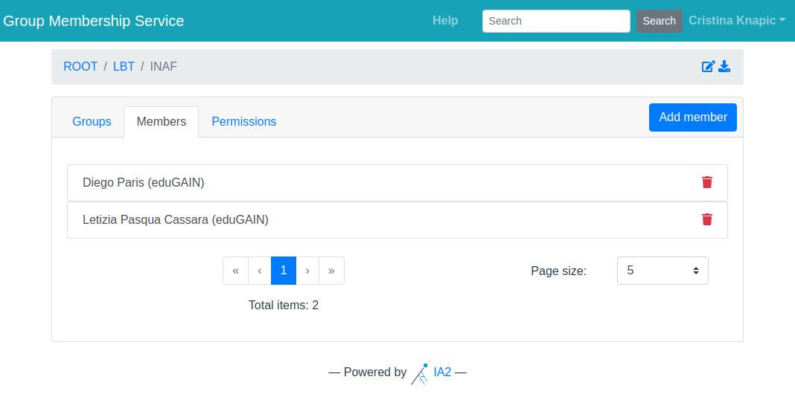
Privacy policy
Moreover, the privacy policy interests to different number of users, groups, groups of groups and (v-)organizations with different member roles. As previously mentioned, some types of permissions define a role, and different roles can be applied to aggregation of users.
Example:
public user can see only metadata but can’t download data;
members of a group of researchers can see and download data;
PI of observations can see, download data and assign privileges to other users;
administrator of the archive/group of groups can see and manage all permissions;
system administrator can do everything including delete the archive!!

Slide 19
Data
Definition:
originally Data is plural for “datum”, a Latin word;
a “datum” is a single factual, a single entity, a single point of matter;
Datums are most often called “data points”;
Data represent a collection of data points;
Data contains the scientific content, the research topic (i.e. a image, a spectrum, a sensor output) and often are described by other information, called metadata

Slide 20
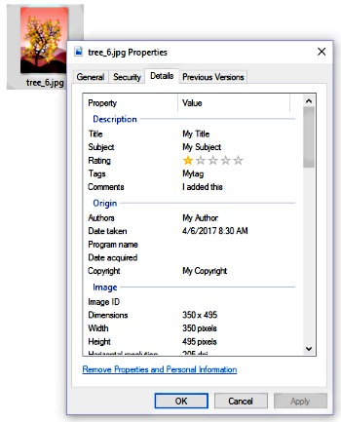
MetaData
Metadata (or metainformation) is "data that provides information about other data", but not the content of the data itself, such as the text of a message or the image itself. There are many distinct types of metadata, including:
Descriptive metadata – the descriptive information about a resource. It is used for discovery and identification. It includes elements such as title, abstract, author, and keywords.
Structural metadata – metadata about containers of data and indicates how compound objects are put together, for example, how pages are ordered to form chapters. It describes the types, versions, relationships, and other characteristics of digital materials.
Administrative metadata – the information to help manage a resource, like resource type, permissions, and when and how it was created.
Reference metadata – the information about the contents and quality of statistical data.
Statistical metadata – also called process data, may describe processes that collect, process, or produce statistical data.
Legal metadata – provides information about the creator, copyright holder, and public licensing, if provided.
Metadata is not strictly bound to one of these categories, as it can describe a piece of data in many other ways.

Slide 21
MetaData

Slide 22
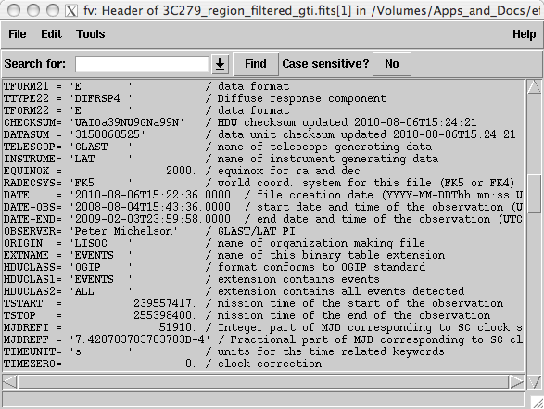
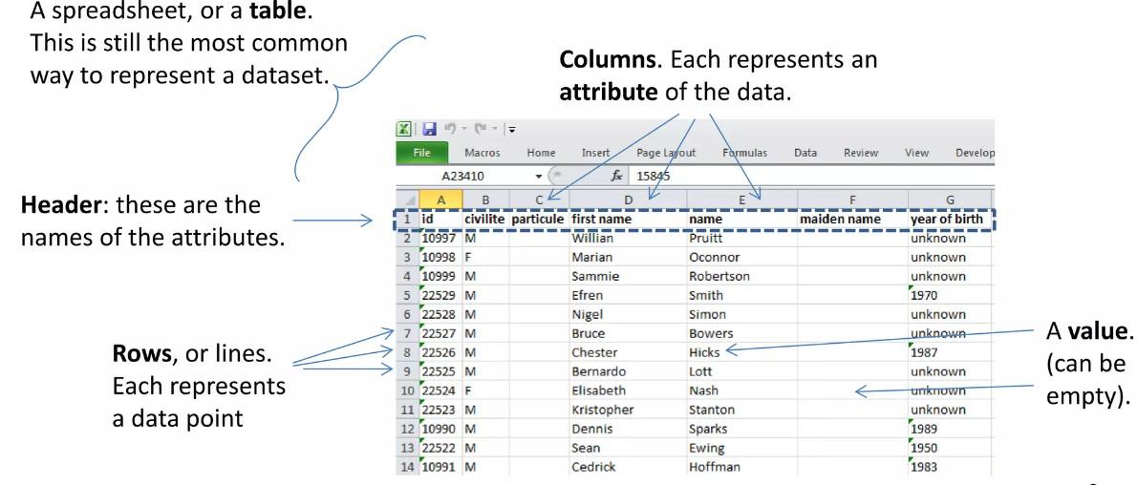
Metadata
KEY
VALUE
COMMENT

Slide 23
DataSet and Digital Object Identifiers
The digital object identifier (acronym DOI) is a standard that allows the lasting and unique identification of objects of any type within a digital network and the association with them of the relevant reference data - the metadata -, according to a structured and extensible scheme.
The DOI differs from common Internet indicators, such as URLs, in identifying an object directly, as a first-class entity, and not simply through some attribute, such as the place where the object is located.
The DOI is also distinguished from identifiers such as those linked to bibliographic standards (ISBN, ISSN, ISRC, etc.), as it can be immediately activated online and used for the development of specific services such as search engines, certifications of authenticity, etc.
A DOI identifier can be recorded on objects of any material form (digital or physical) or on abstract entities (such as textual works) when there is a functional need to distinguish them from other objects.
An object can be arbitrarily identified at any level of granularity. This means that, for example, a DOI can be registered on the title of a journal, on its single issue, on the single article of a given issue, on the single table of a given article
The problem of granularity is not still codified, but follows the rational sense of opportunity to be consumed by the reference community.

Slide 24
DataSet and Digital Object Identifiers
In INAF there are two ways to create a Unique Identifier for data:
DOI request
https://www.ict.inaf.it/index.php/ict-inaf/doi;
there is no limit in space;
the data are checked before DOI registration, so useful suggestions can be given on data structure and granularity;
Open Access handle for datasets request
https://openaccess-info.inaf.it/oa-in-inaf
in case of software there is the possibility to attach user manuals or documentations;
in the case of databases it is possible to attach user manuals or other supporting material;
for what concern Vizier, a read.me file can be uploaded with the link and indication of using Vizier;
for other systems, add e read.me file with the link to dataset.

Slide 25
General Definitions
Storage: physical or digital space where items are collected. Digital storage can be redundant for preservation purposes.
Repository: digital storage that offer a way to store, manage and retrieve information in a organized manner. Each user organizes data by her/him selves. In INAF institutional repositories are:
OwnCloud (https://owncloud.ia2.inaf.it/index.php/login)
VOSpace (http://vospace.ia2.inaf.it/ui/)
Google Drive (https://drive.google.com)
Archive: repository managed in a way the search capabilities are well enhanced, there is a reach description of content, users are able to retrieve data after filtering them via computer applications. In INAF there are several scientific archives:
Astrophysical Observatory Archives;
Scientific high level products Archives;
Simulated Data Archives;
Survey Archives;
Catalogues
….

Slide 26
Archives, Repositories and storage space
As defined in OAIS, an archive is a complex infrastructure, growing and involving four main actors:
data providers;
user community;
management;
archive itself.
Data providers, as the term suggests, are the entities that produce and procure data (scientific items, content and their description). Moreover Data Providers suggest the important relationship between single datum (file, tuple), component and subcomponents relevant for successive data handling, calibration, analysis, publication and sharing policies.
Data Provider role is crucial and fundamental for a good understanding of scientific products. In DP duties are:
definition of the Data Model (see A. Bignamini session);
definition of the whole services:
storage space required;
type of access (web, ssh, both, email request..)
preservation mechanisms: depending on the data (custom or standard) a policy to prevent the obsolescence has to be foreseen;
sharing policies (who can access the collection? With which roles?);
privacy policy: definition of the level of privacy in time and related to showed meta/data information;
number of accesses foreseen on daily bases;
typical dimension of one dataset and how many dataset are reasonably downloaded at time (how many files do compose each observation?);
format conversion;
responsibilities on data integrity;
backup policies;
services to solve inconsistencies issues;

Slide 27
Preservation in INAF
INAF - Italian Astronomical Archives (IA2) facility manage all archives and internal data repositories:
Open Access (https://openaccess-info.inaf.it);
OwnCloud (https://owncloud.ia2.inaf.it);
VOSpace (http://vospace.ia2.inaf.it);
Moreover, IA2 hosts temporary and permanent repositories and archives in on-line (1.6PB) and cold storage system (2PB).
The IA2 cold storage system is used to store and preserve checked data and to provide a permanent storage for DOIs. The cold storage system is a tape library IBM TS4500 equipped with a IBM Spectrum Archive control system (under upgrade to Spectrum Protect for backup purposes).
The main features of this system are:
long persistent storage;
low power consumption for non frequently used data;
big data storage;
unique filesystem for each V-Organization;
cheapest solution;
write once, read more;
Drawback:
difficulties on data update, remove or reorganize;

Slide 28
Data Management Plan
Why develop a data plan?
There are many benefits to managing and sharing your data:
you can find and understand your data when you need to use it
there is continuity if project staff leave or new researchers join
you can avoid unnecessary duplication e.g. re-collecting or re-working data
the data underlying publications are maintained, allowing for validation of results
data sharing leads to more collaboration and advances research
your research is more visible and has greater impact
other researchers can cite your data so you gain credit
Funders expect data plans to outline how data will be created, managed, shared and preserved, justifying any restrictions that need to be applied. The plans are an opportunity to demonstrate your awareness of good practice and reassure funders that your proposal is in line with their data policy.

Slide 29
DMP and metadata
While data curators, and increasingly researchers, know that good metadata is key for research data access and re-use, figuring out precisely what metadata to capture and how to capture it is a complex task. Fortunately, many academic disciplines have supported initiatives to formalise the metadata specifications the community deems to be required for data re-use.
In particular tomorrow there will held two specific presentations on Data Models and Interoperability standards, so to have a strong base and references on already developed work on Astrophysic (and more).
Let's proceed: what are the FAQ about DMP?

Slide 30
1. Data Types, Formats, Standards and Capture Methods
Questions
What data outputs will your research generate?
outline volume, type, content, quality and format of the final dataset
useful to capture your data in (or convert it to) community-accepted data formats;
Open or non-proprietary formats are preferable
Outline the metadata, documentation or other supporting material that should accompany the data for it to be interpreted correctly
allow your data to be understood and discovered by others using a rich set of metadata and contextual details;
What standards and methodologies will be utilised for data collection and management?
standards defined on disciplines base;
help in optimize existing standard;
refer to RDA for exhaustive list of multidisciplinary scientific standards;
State the relationship to other data available in public repositories e.g.
existing data sources that will be used by the research project
gaps between available data and that required for the research
the added value that new data would provide in relation to existing data

Slide 31
2. Ethics and Intellectual Property
Questions:
Demonstrate that you have sought advice on and addressed all copyright and rights management issues that apply to the resource;
note that INAF data is property of the institute and not of the PIs;
Make explicit mention of consent, confidentiality, anonymisation and other ethical considerations, where appropriate
astrophysical data do not need anonymization or other ethical considerations;
GDPR is not necessary in astrophysical data like is for example in other disciplines;
Are any restrictions on data sharing required – for example to safeguard research participants or to gain appropriate intellectual property protection?
embargo for PI data confidentiality is foreseen and last one year;
data sharing have to be formalized in order to create the appropriate groups in GMS;
restrictions on data (and also metadata) should be defined beforehands.

Slide 32
3. Access, Data Sharing and Reuse
What are the further intended and/or foreseeable research uses for the completed dataset(s)?
brief description of the scientific goal and research purposes;
plan for data reuse;
How you will make the resource accessible to the potential audience(s) identified.
Where will you make the data available?
web portal;
private repository;
…..
How will other researchers be able to access the data?
authorization and permissions - > roles!
Will a data sharing agreement be required? -> licencing
What is the timescale for public release of the data? -> publication and reuse
Using existing infrastructure avoid to reinvent the will (standards, formats,hardware..)
State any expected difficulties in data sharing, along with causes and possible measures to overcome these difficulties.
How will data sharing provide opportunities for coordination or collaboration?
sharing between collaborators;
sharing with community members;
sharing with all: citizen science, open science…

Slide 33
4. Short-Term Storage and Data Management
Describe the planned quality assurance and back-up procedures (security/storage)
data integrity checking;
data recovery;
Define data management support: outline what provision is available to you within your institution and any additional skills or resources that you need to secure;
Specify the responsibilities for data management and curation within research teams at all participating institutions
Be clear about who will be responsible for different tasks
Strong file-naming conventions and versioning applications may be of use to keep track of the development process, particularly when several people are working together;
prefer the use of personal access method to facility instead of group account, to be able to reconstruct issues;
Apply appropriate levels of data management:
encrypting data or using secure online storage;
check data integrity after data transfer;
check the timescale for data transfer related to the net bandwidth used;
foreseen the right space required after elaboration;

Slide 34
5. Deposit and Long-Term Preservation
Identify which of the data sets produced are considered to be of long-term value:
Select data of long-term value since not all data are scientifically valuable in particular in observations (i.e. bad pointing, achievement of target precision, errors..);
Safeguard the data behind the graph: tables and graphs in papers are of interest for preservation;
Outline the plans for preparing and documenting data for preservation and sharing:
Assure that your data will remain accessible;
assure datacenter is trustable;
Explain your archiving/preservation plan to ensure the long-term value of key datasets

Slide 35
6. Resourcing
What resources will you require to deliver your plan?
Outline and justify costs:
outsource services;
pay for data management support;
link resources with roles and responsibilities;
Outline additional hardware, software and technical expertise, support and training that is likely to be required and how it will be acquired
Don’t underestimate the human effort required;
Use as much as possible already existing infrastructure and expertise, it will reduce costs.

Slide 36
DMP final considerations:
Data plans are an integral part of grant applications – not an afterthought
Data plans are enhanced through collaboration
Data plans are living documents – they will change
The short list:
https://www.dcc.ac.uk/sites/default/files/documents/resource/DMP/DMP_Checklist_2013.pdf

Slide 37
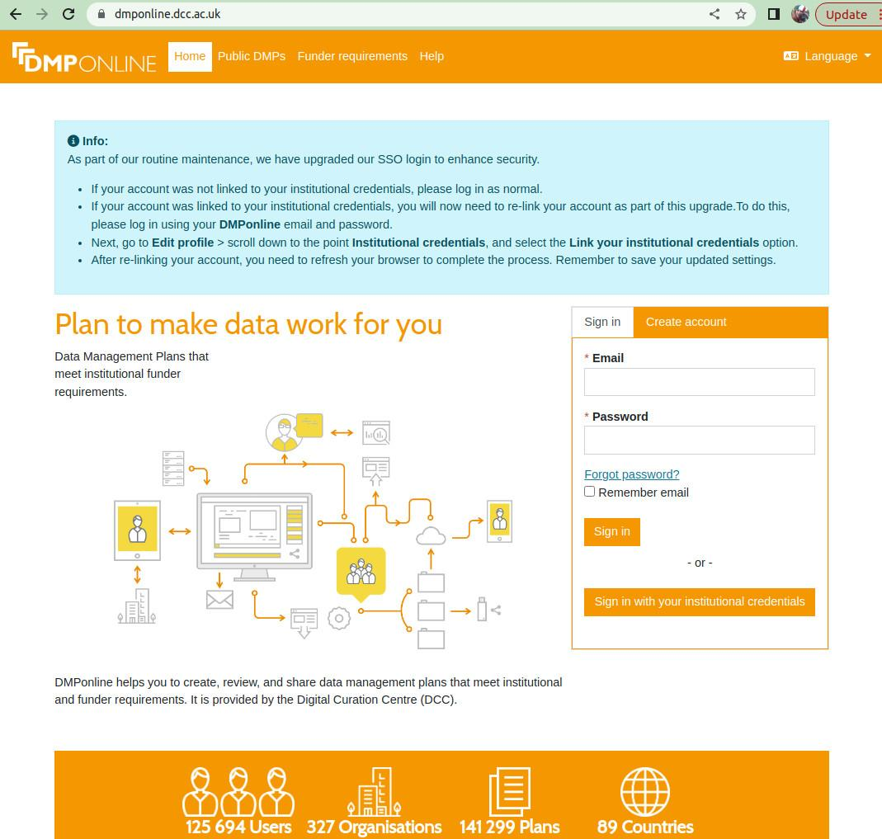
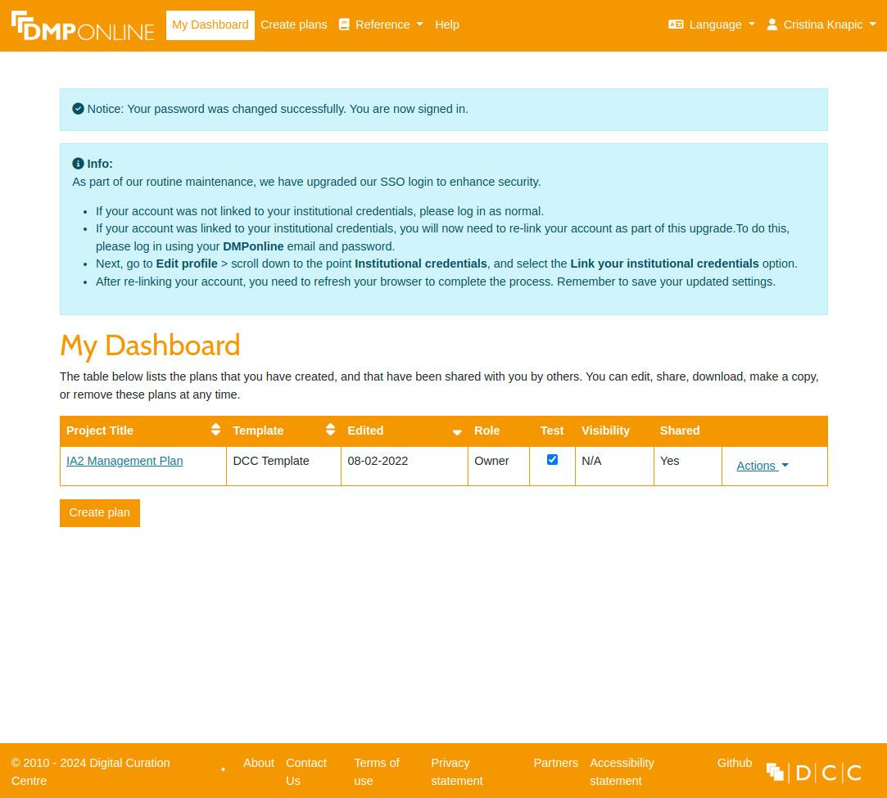
An Example
Try by yourself to generate a DMP with a web tool originally developed by Digital Curation Center :
https://www.dcc.ac.uk/dmponline
A descriptive manual:
https://dmponline.dcc.ac.uk/help

Slide 38
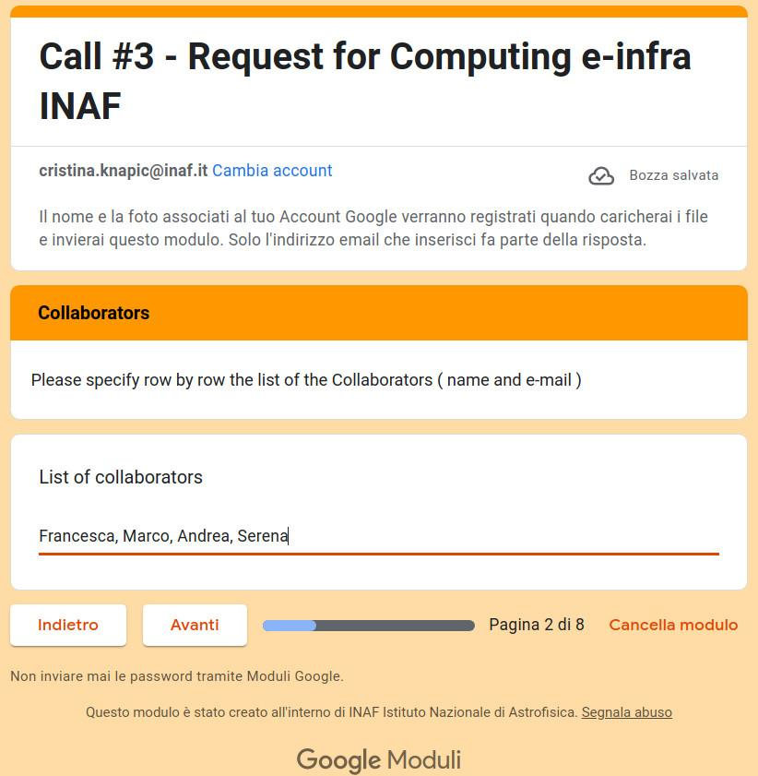
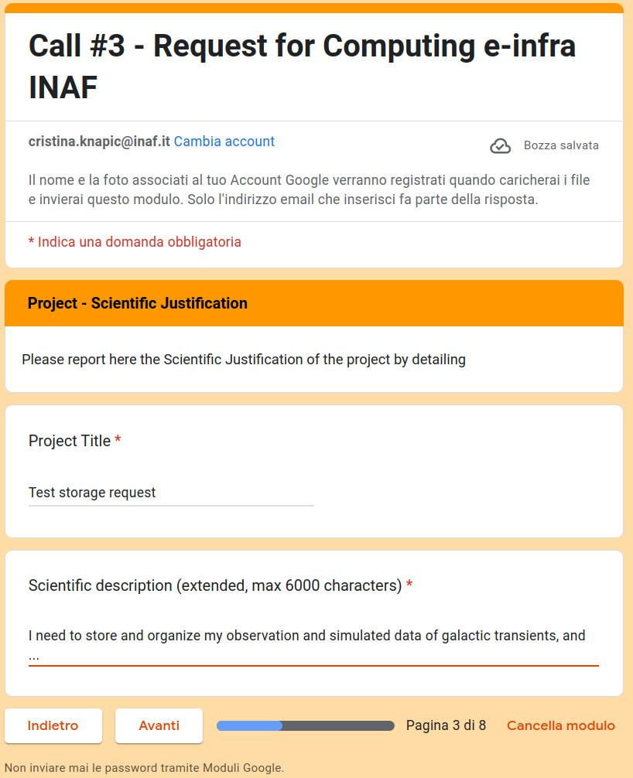
Call for space request

Slide 39
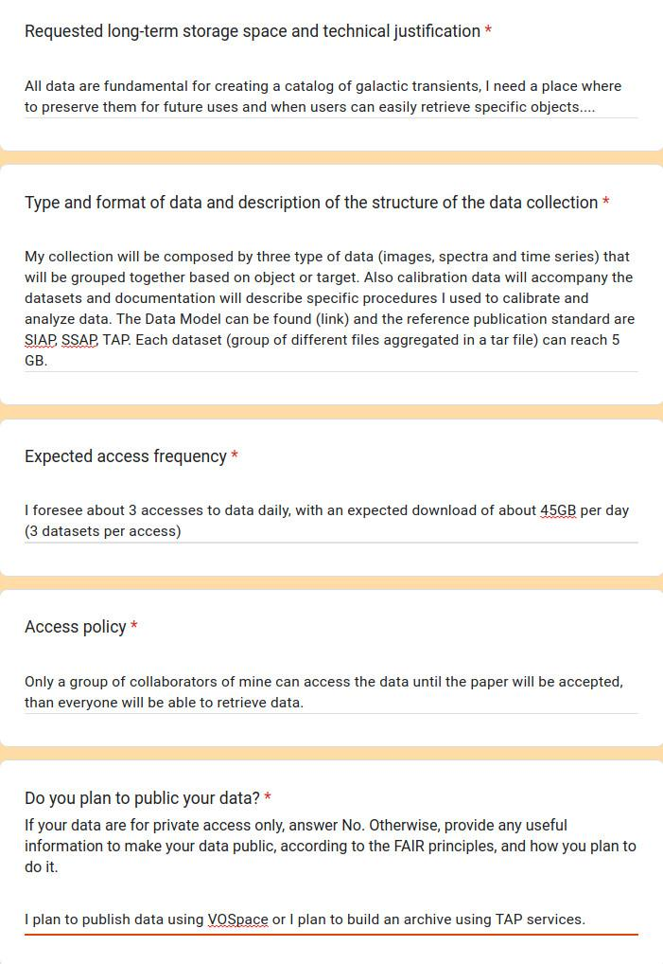
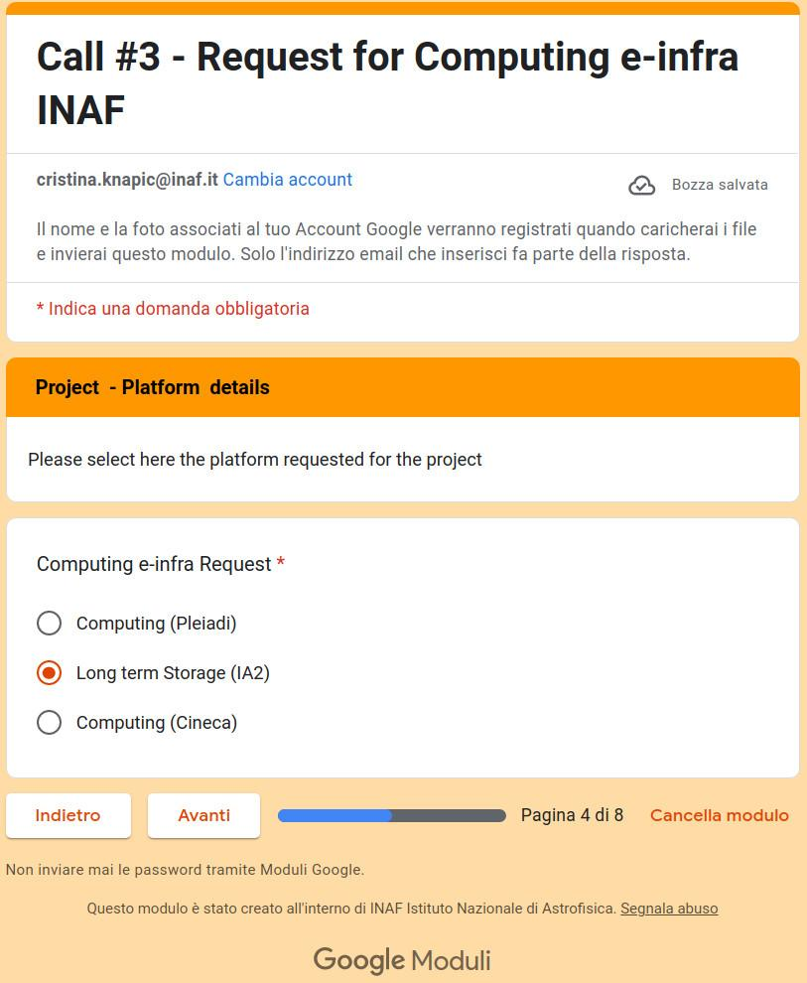
Call for space request

Slide 40
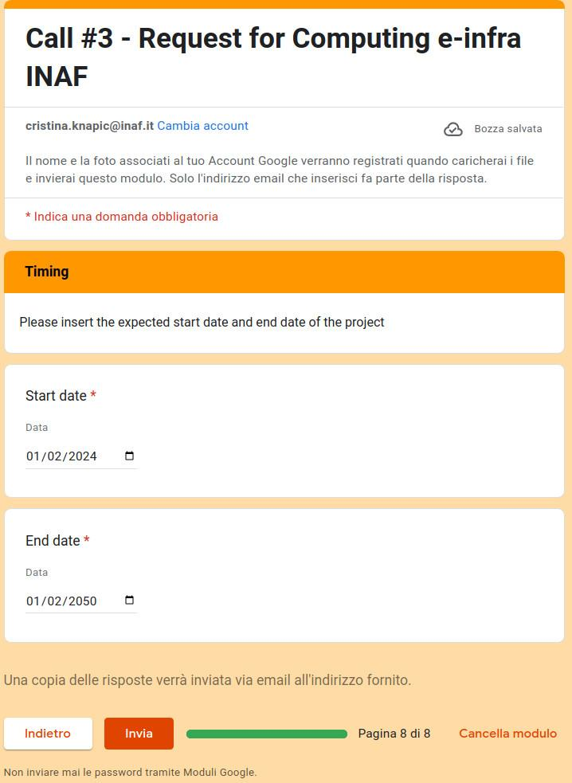
Call for space request

Slide 41
Long term storage
https://www.ia2.inaf.it/index.php/ia2-services/data-sharing-preservation/long-term-preservation
At this page you can find useful information to request data preservation:
how the tape library works;
how to request an account;
how to write a data management plan (in brief!);
how to ingest data;
how to retrieve data;

Slide 42
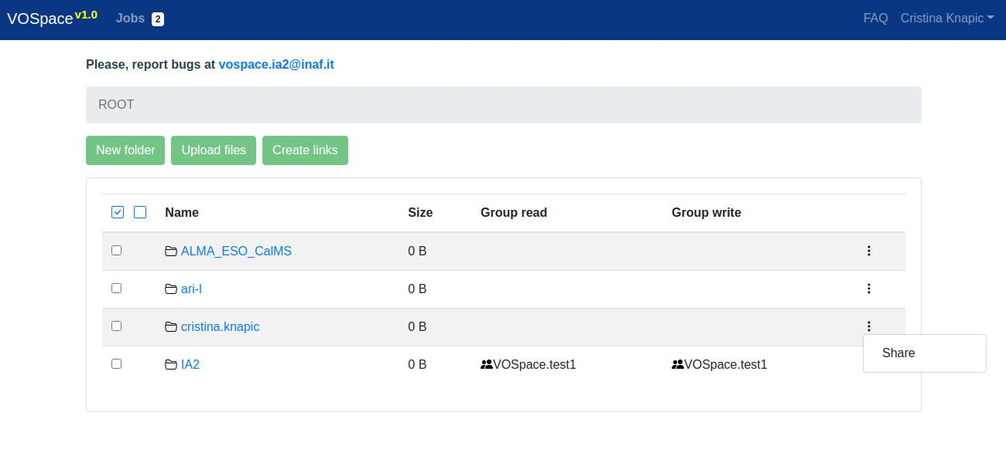
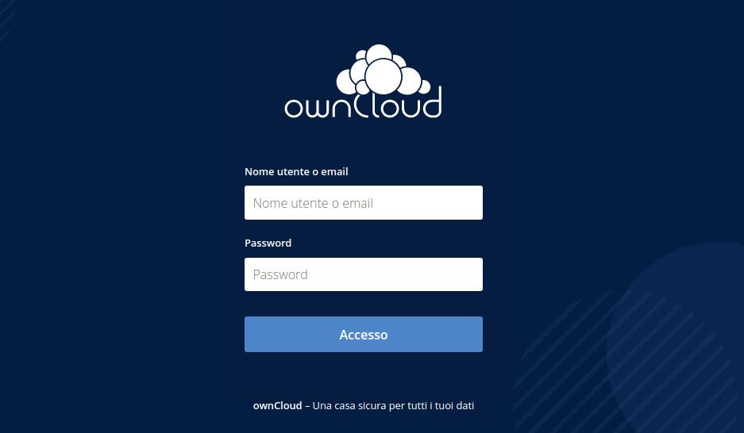
Data sharing
More details on data sharing and preservation can be found at
https://www.ia2.inaf.it/index.php/ia2-services/data-sharing-preservation
https://owncloud.ia2.inaf.it/index.php/login
http://vospace.ia2.inaf.it/ui/

Slide 43
Thanks for attention!
Questions?

