Slide 1
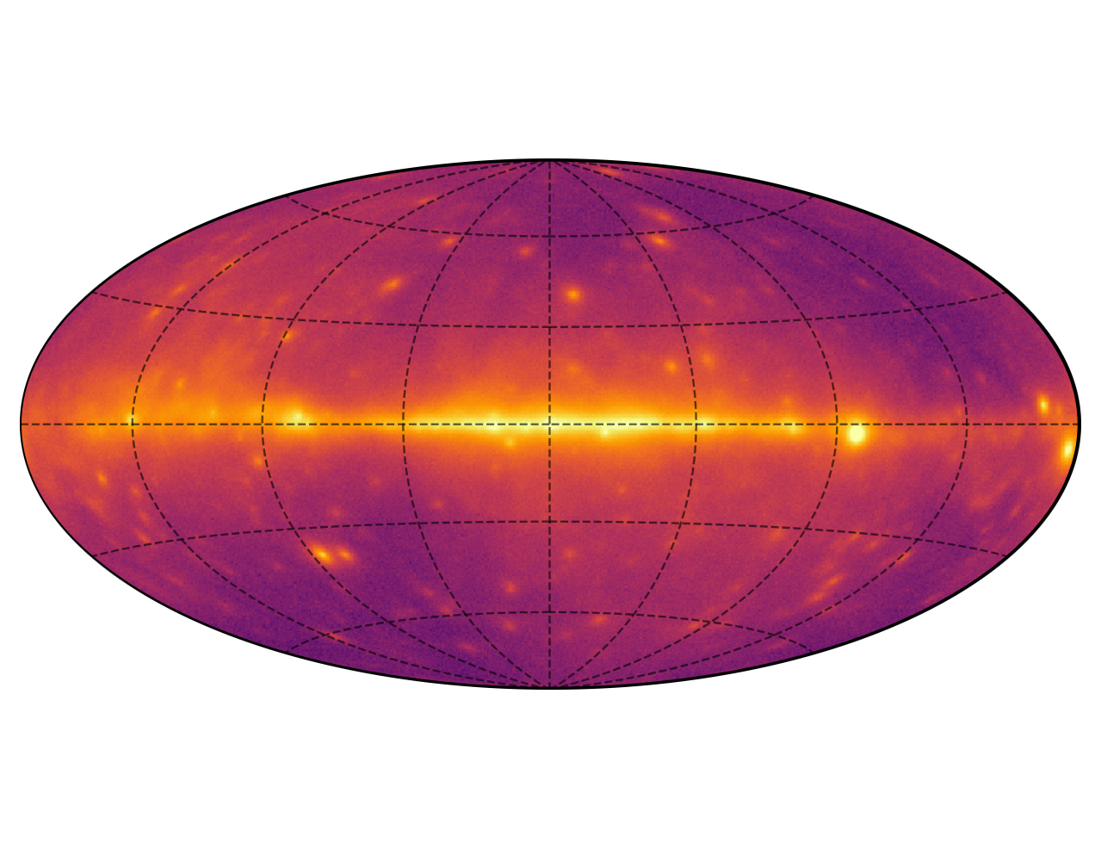
The Second Fermi-LAT Low Energy Catalog (2FLE)
Scott D. Joffre, Lea Marcotulli, Chris Karwin, Marco Ajello, on behalf of the LAT-Collaboration
Clemson University, Yale University, NASA Goddard Space Flight Center

Slide 2
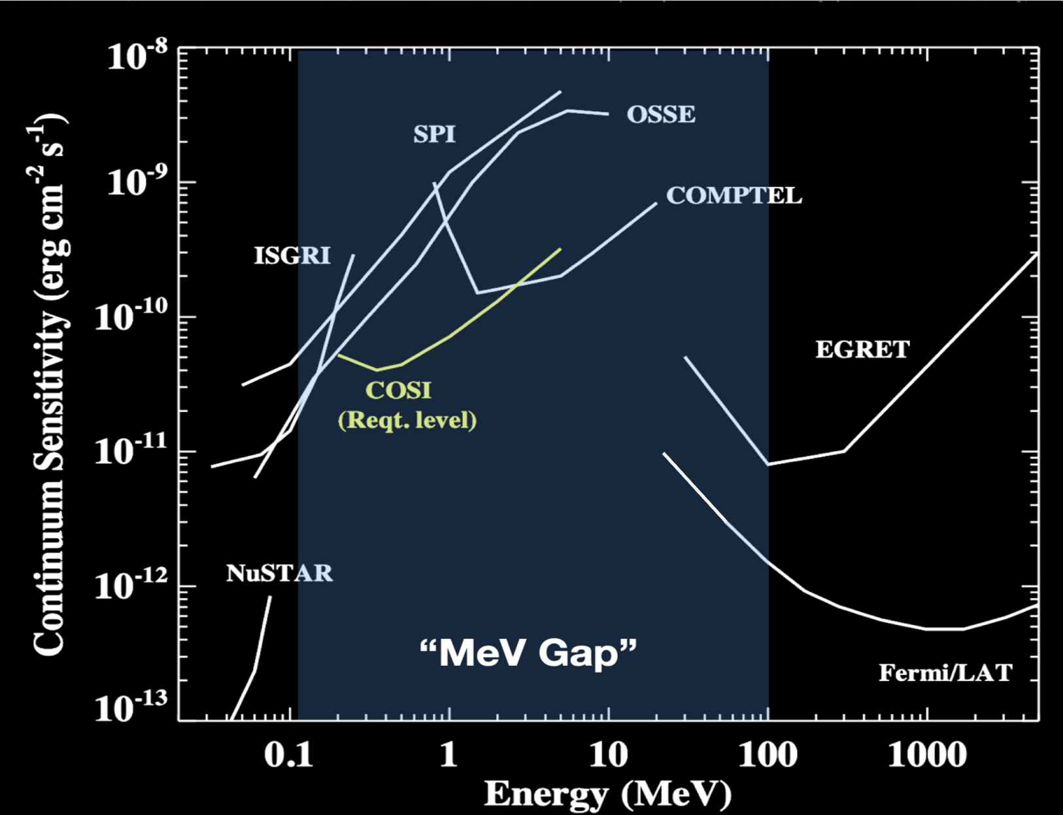
The MeV Band
2FLE
COSI selected for launch in 2027!
2FLE Impact:
For the first time sensitively study the MeV band and begin to bridge the “MeV Gap” which will be advanced by COSI
Notes:
The MeV band is a crucial energy band for advancing the science of high-energy astrophysics
Evolution of MeV blazars is stronger than any other source class: i.e. their maximum density may be very early on

Slide 3
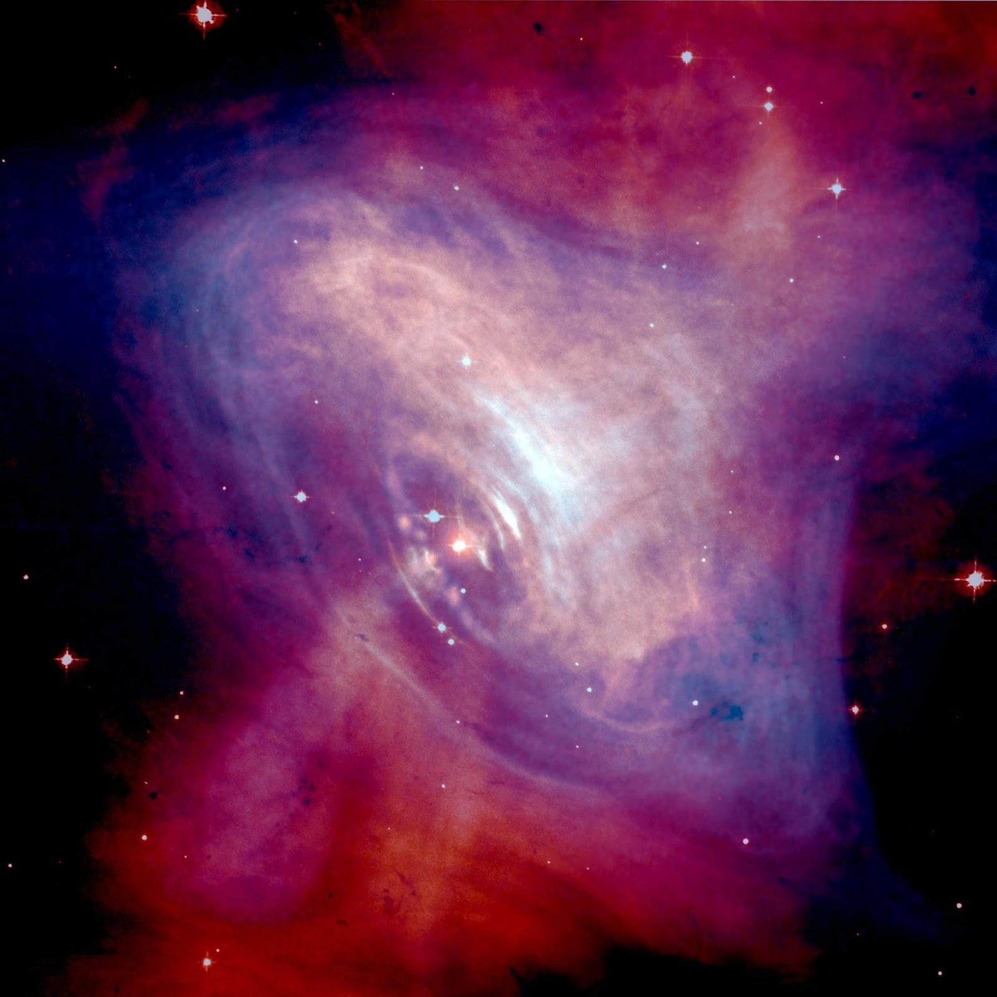
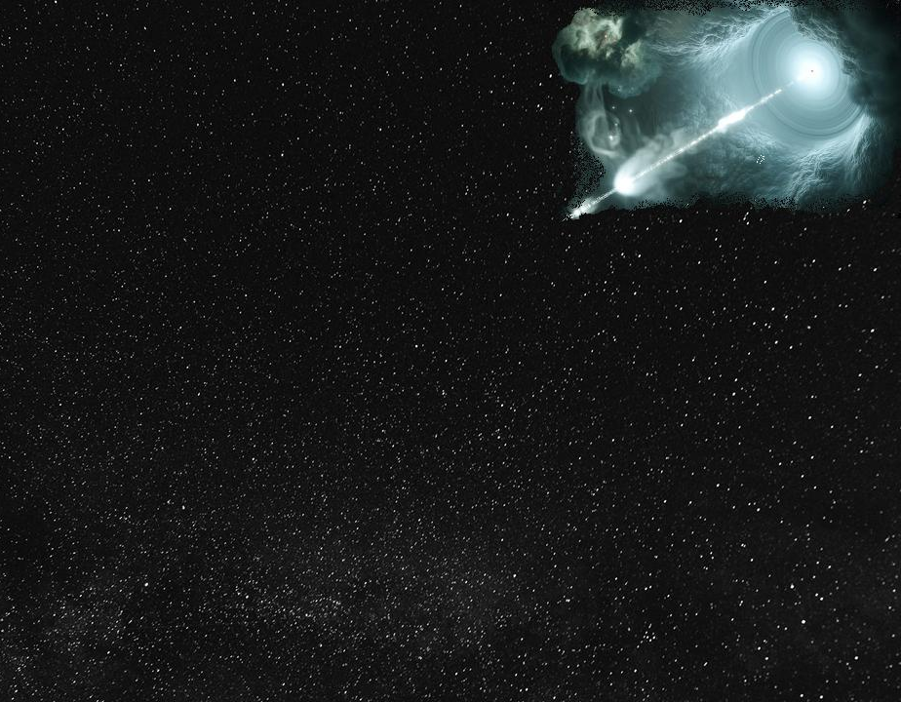
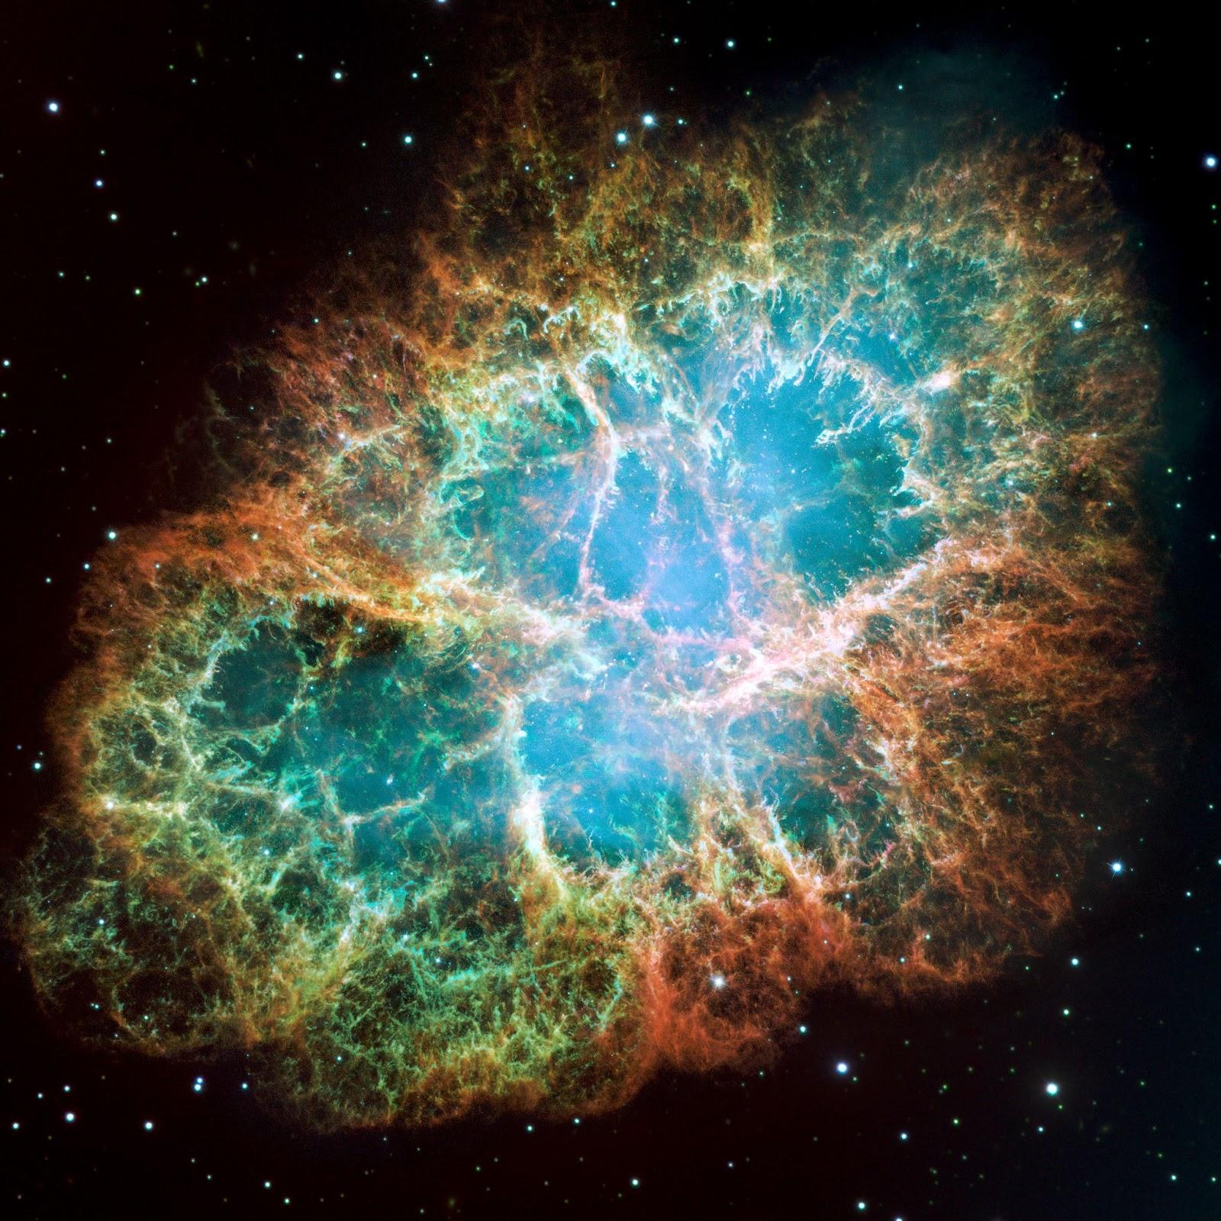
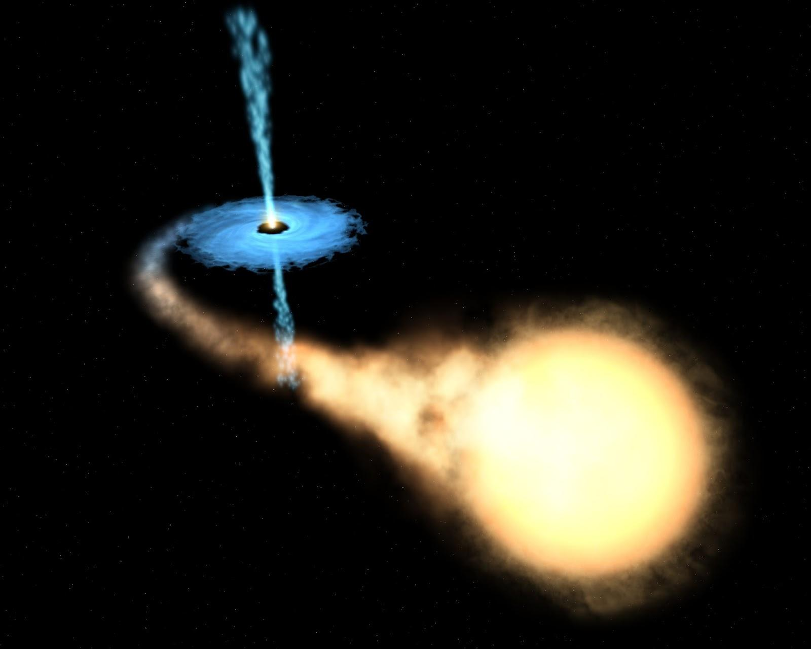
High Mass binaries (HMB)
Pulsars
The Gamma-ray Sky
θ_{V}
Blazars
2FLE Impact:
Constrain models
Contribute to high-z population studies
Potentially discover new types of sources
Credit: Hubble
Supernova Remnants (SNRs)
?
Low Mass binaries (LMB)
Credit: Hubble
Credit: NASA-ESA
3
Notes:
Constraint of models – new energy band means you can constrain the peak of the model
Population studies – number of FSRQs, BLLs at given redshifts – use in cosmological studies – more high
Evolution of MeV blazars is stronger than any other source class: i.e. their maximum density may be very early on
MeV pulsars – why interesting?
High-z MeV blazars –
Sampling

Slide 4
1FLE vs. 2FLE
2FLE Analysis – Maximum Likelihood Algorithm
E = [20, 200] MeV
Time coverage - 14 years
GRBs and Solar flares cut (matches 4FGL-DR4)
Event type = PSF3 (32)
Event Class = P8R3 Source (128)
Galactic diffuse model - gll_iem_v07
Isotropic emission - iso_P8R3_SOURCE_v3_PSF3_v1
Sun (Disk + IC) and Moon Models
Starting catalog = 4FGL-DR4 extended sources
ROI width = 20º (All ROIs - 265)
zmax = 80º
IRF: P8R3_SOURCE_V3
Weighted Likelihoods
1FLE Analysis - PGWave
E = [31.6, 100] MeV
Time coverage – 8.7 years
Event type = PSF3 (32)
Event Class = P8R3 Source (128)
Starting catalog = NONE
ROI width = 180º x 90º (12 ROIs)
IRF: P8R2_SOURCE_V6
Notes:
1FLE uses a simple wavelet analysis, the other one uses the full Maximum likelihood algorithm developed to analyze Fermi-LAT data and goes to even lower energies and as a result detects quite a few more sources (and can characterize their spectra).

Slide 5
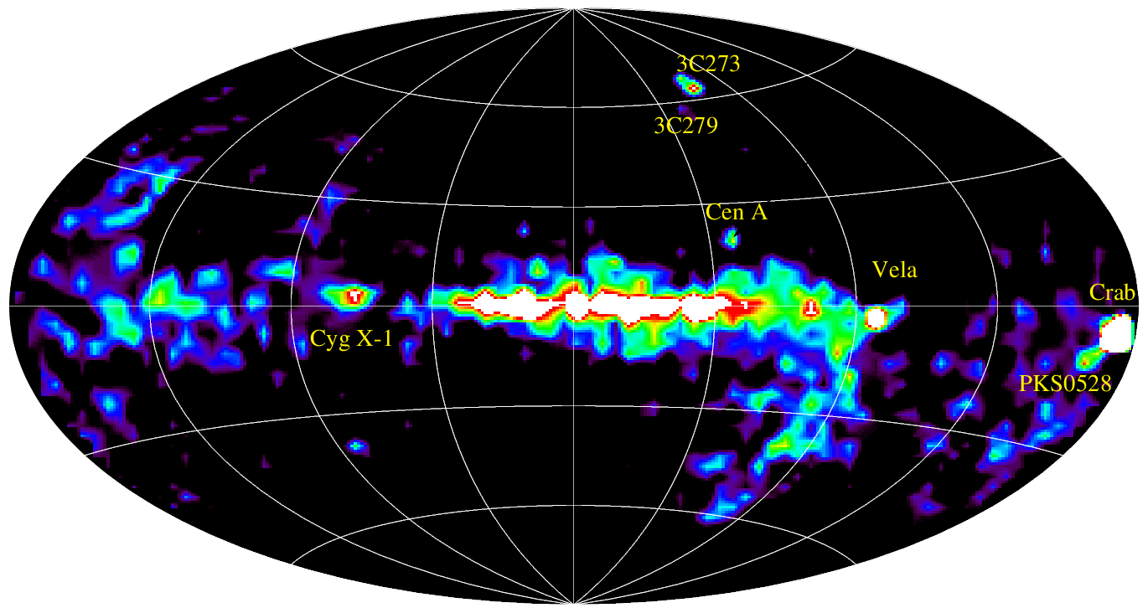
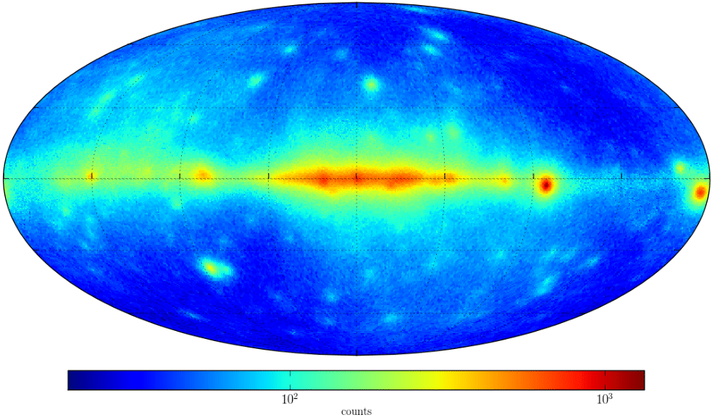
Schoenfelder (2000)
Principe et al. 2018
COMPTEL (1-30 MeV)
32 steady sources
68 total sources
1FLE (30 - 100 MeV)
126 sources at > 5σ
5% Unassociated
PRELIMINARY
2FLE (20 - 200 MeV)
450 sources > 5σ
64 at |b|<10°
~11% Unassociated
5
Notes:
PUT YELLOW BLOCK here!

Slide 6
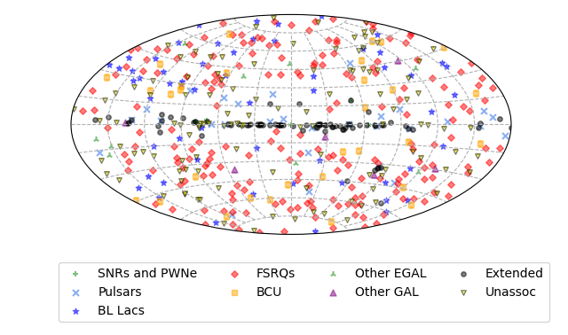
2FLE - Results
2FLE (20 - 200 MeV)
450 sources > 5σ
64 at |b|<10°
~11% Unassociated
Associations done with the same procedure as the 4FGL

Slide 7
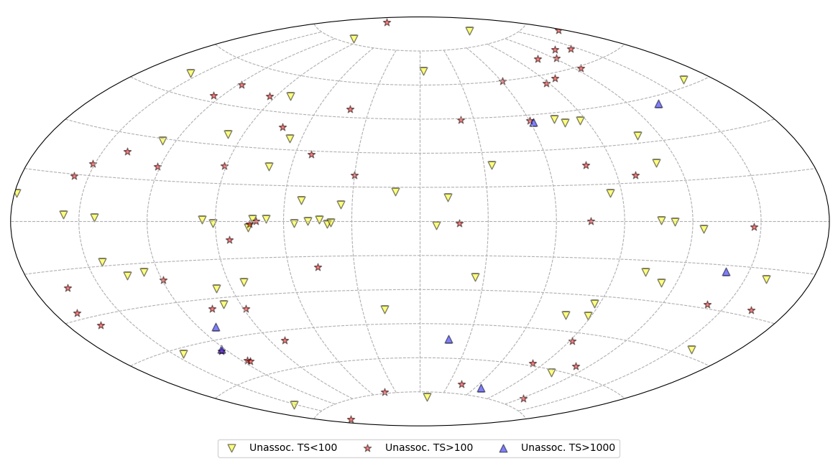
2FLE – Results: Unassociated Sources
116 Unassociated Sources Composed of:
- 62 Low prob. associations (P<0.8)
- Considered unassociated due to low-confidence
- 54 Unassociations (no association found)
Of the 116 Unassociated Sources:
- 25 low lat. (|b|<10°)
- 59 with TS>100
- 7 at TS>1000
All require additional follow-up!

Slide 8
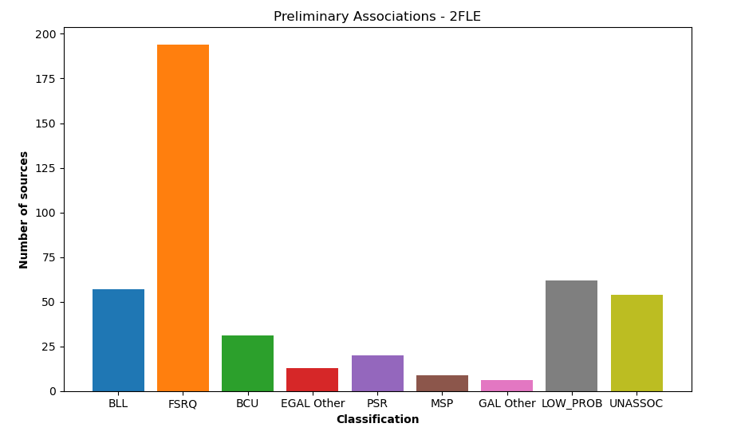
2FLE – Results: Classification
2FLE Association Classifications
450 Sources
334 Associated Sources (74%)
- 93 Assoc. obtained via corresponding 4FGL-DR4 source
- 194 are assoc. with FSRQs (58%)

Slide 9
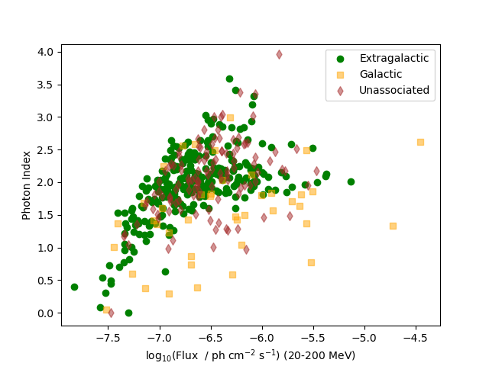
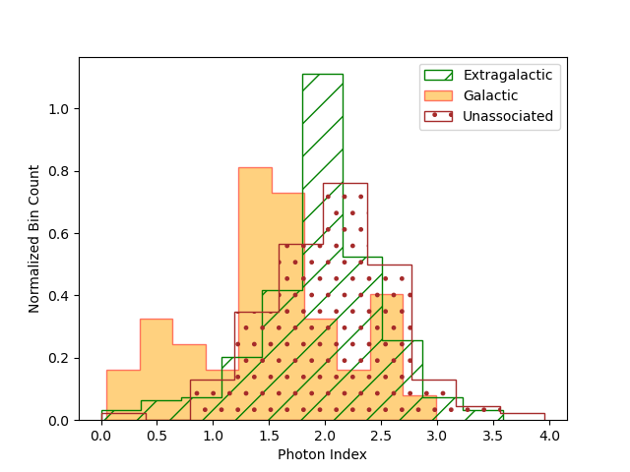
2FLE Photon Index and Photon Flux
20-200 MeV Flux Comparison
2FLE Photon Index

Slide 10
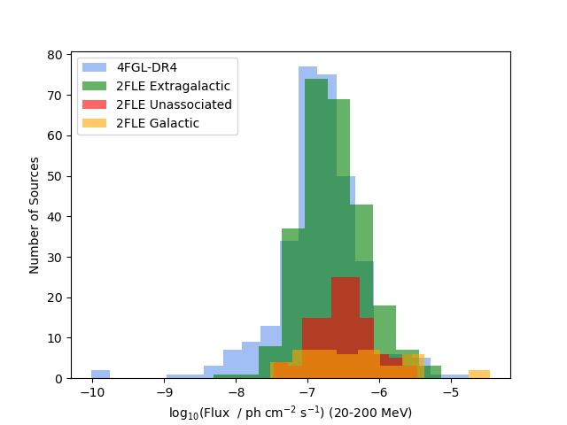
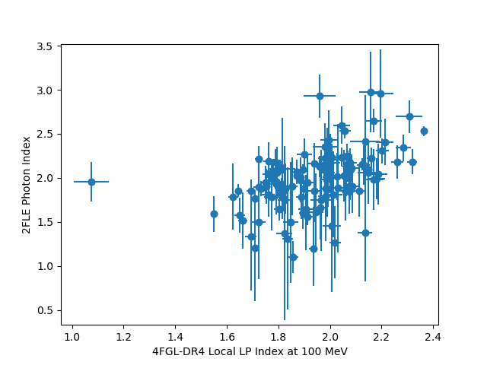
2FLE vs. 4FGL: Photon Flux and Photon Index
20-200 MeV Photon Flux Comparison
4FGL vs. 2FLE Photon Index
324 sources Associated with the 4FGL (72%)
Notes:
For scatter plot - outlier
That 4FGL J0340.4+5302 source is bright and very soft so you should definitely see it in 2FLE. It is actually a strongly curved GU peaking around 200 MeV, so the 100 MeV index can be hard. But indeed the curvature is constrained from above 200 MeV in DR4 (Pivot_Energy is 560 MeV), and the extrapolation to 100 MeV can be quite uncertain.

Slide 11
Summary and Follow-up
450 Detected Sources
116 Unassociated sources detected
59 with TS>100
Anticipate new high-z MeV blazars
Multiwavelength follow-ups to classify sources
Some X-ray follow-ups currently underway!
Bright prospects for the MeV!
Positional Coincidences of Unassociated Sources
2 LHAASO detections (1LHAASO J2238+5900 and 1LHAASO J0343+5254u*)
Follow-up analysis still necessary
Statistical analysis required for transient sources
Pave the way for COSI
Notes:
High-z mev for logN-logS studies, etc.
U = UHE source
* = dubiously merged sources

Slide 12
BACKUP

Slide 13
Original Source Finding Method
Galactic+Isotropic Diffuse
Identify Source Locations
Optimize Index
Low TS
High TS
Localizing the most significant sources with a poor understanding of how the rest of the ROI is populated.
5
Notes:
Think in terms of Ts map/counts map

Slide 14
1.
Initialization of ROI
gta.setup()
Preliminary Fit of Diffuse
Gal: Power law
Iso: Broken Power law
Fermipy v 1.2.0
fermitools 2.2.0
Notes: Index2 on isodiff , Sun+Moon, Extended srcs are always frozen
2.
Delete TS<25
TS = 64, 36, 16
Initial Source Finding
- gta.find_sources() - updated by Lea
- Model src: PointSource, 𝚪=2.0
- 3 Iterations -> TS = [64, 36, 16]
- Min Sep. = 0.5°
- Free gal/iso diffuse
Final Cuts
- Remove sources within 2.5° of the edge of the ROI
- Remove all TS<25 sources
Global Fit
Relocalization
+
Spectral Re-optimization
Global Fit
Global fit
Relocalization
+
Spectral Re-optimization
Order Set by TS
Delete Src
Set 𝚪=2.0
Free Gal/Iso gta.find_sources()
𝚪= previous value
Free Gal/Iso Diffuse
Free norm of detected srcs
gta.fit()
No
Yes
Does it converge?
gta.fit()
Free norm of all sources
Free Detected Sources
(norm + 𝚪)
gta.fit()
Iterate 𝚪
[-0.5, -4.5, 0.5]
No
Does it converge?
8
Notes:
Backup:
run 4 - final run
Simulate ROI (just isotropic + galactic diffuse)
Determine number of spurious sources for a given ROI

Slide 15
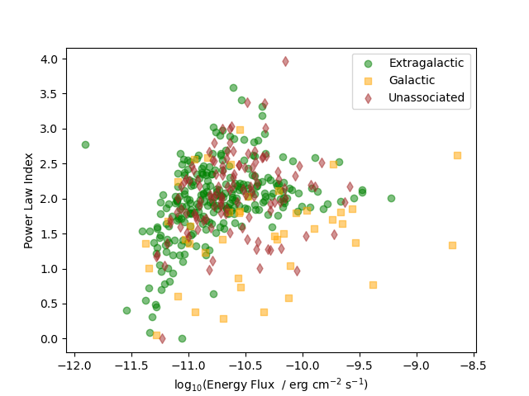
2FLE Photon Index and Photon Flux
20-200 MeV Flux Comparison
2FLE Photon Index

Slide 16
Photon Flux compared to DR4 Extrapolations

Slide 17
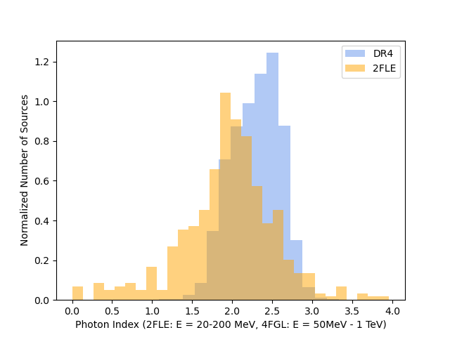
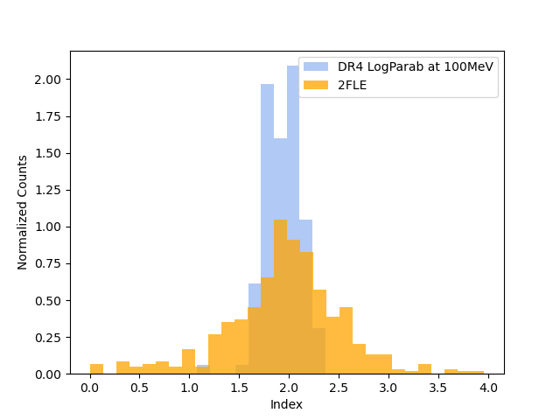
Photon Index Comparison: 2FLE vs. 4FGL
Number of Sources with a DR4 counterpart

Slide 18
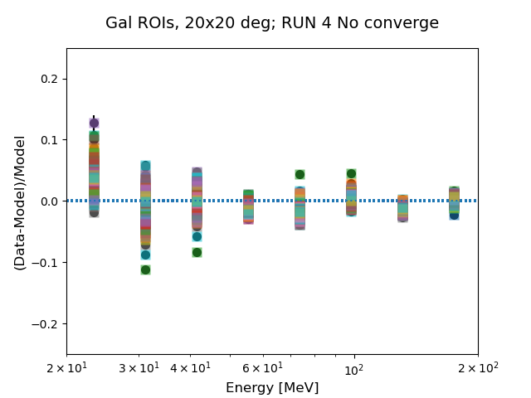
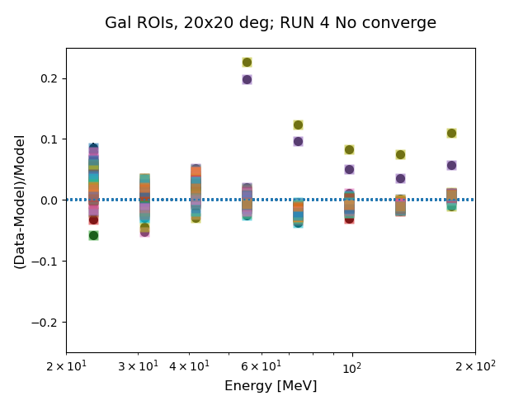
Run5 Energy Residuals
Energy Residuals
EGAL – Energy residuals
GAL
EGAL
8
Notes:
Backup:
run 4 - final run
Simulate ROI (just isotropic + galactic diffuse)
Determine number of spurious sources for a given ROI

Slide 19
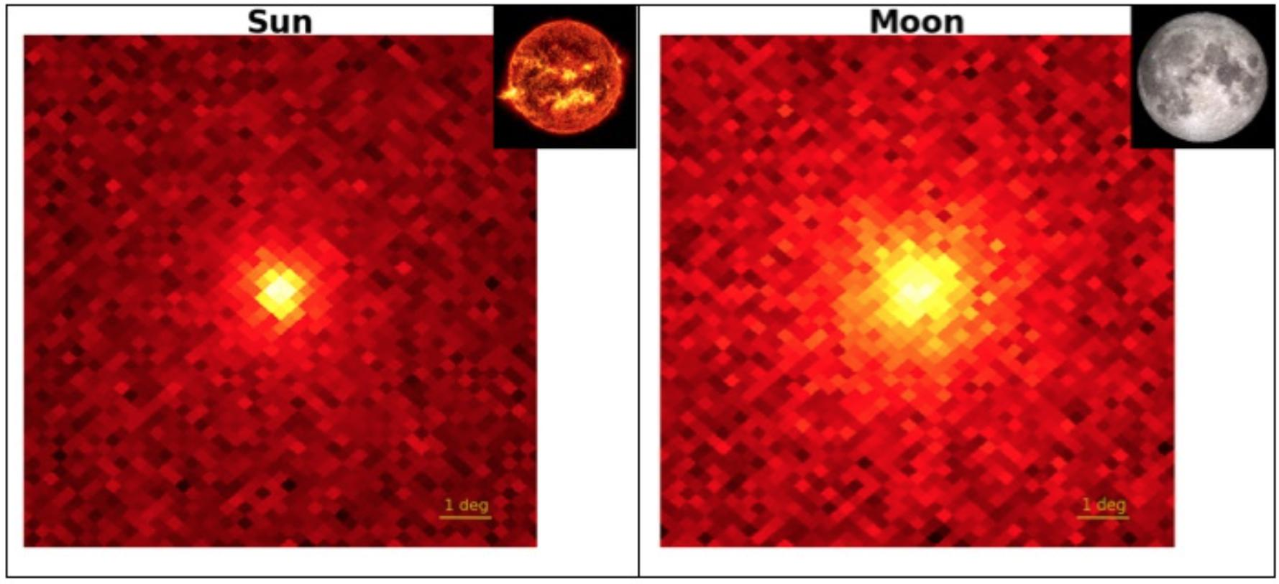
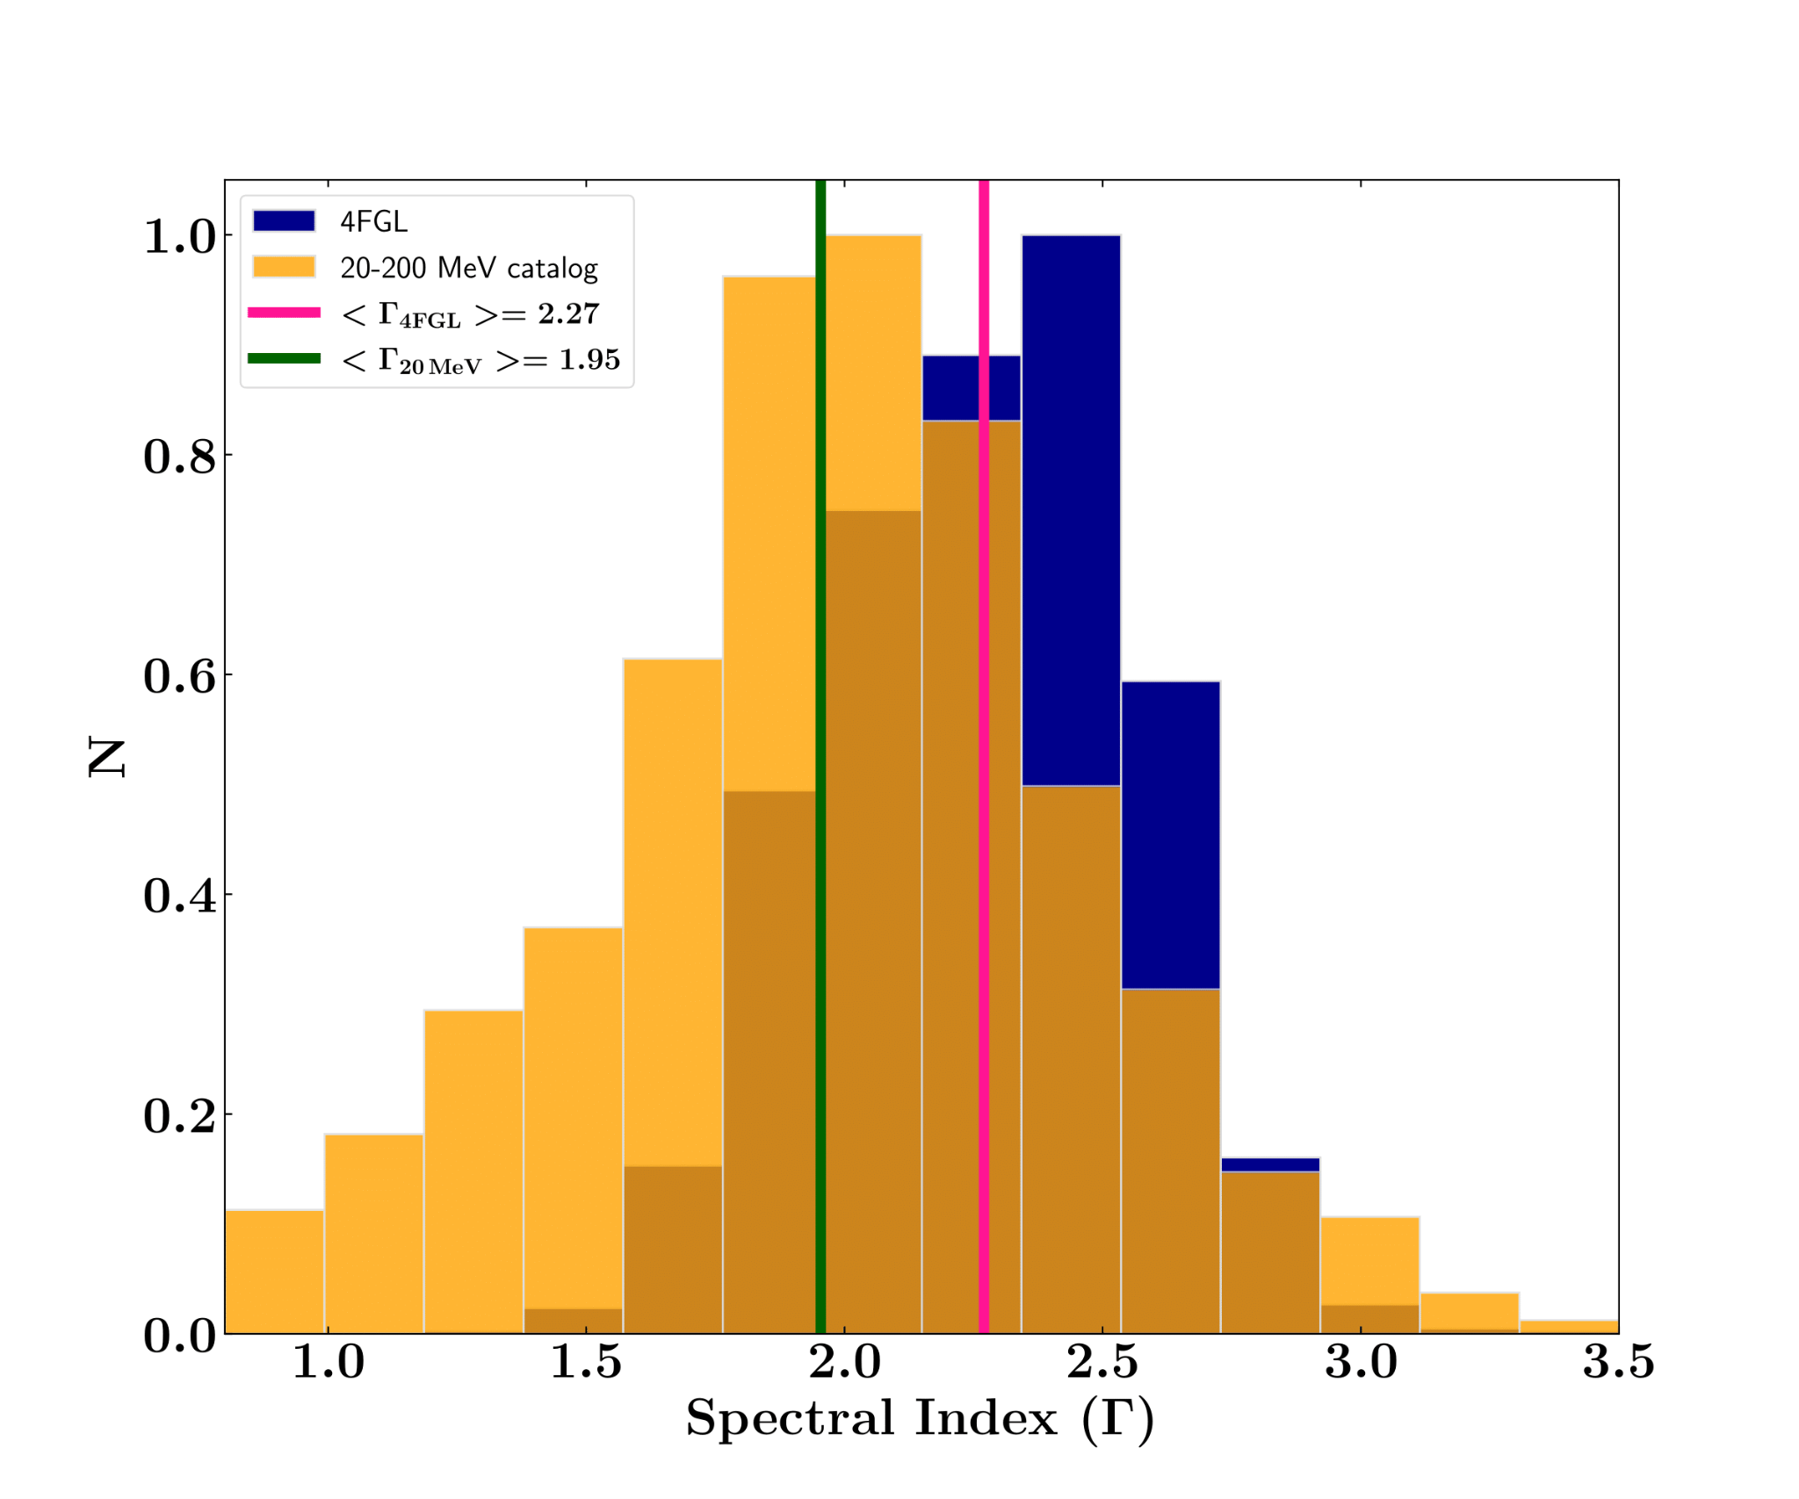
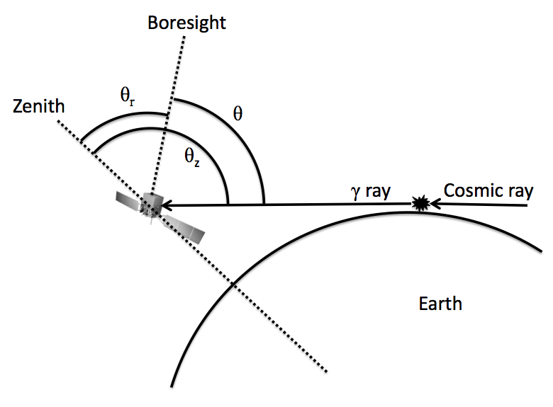
🟦 4FGL
🟧 20-200 MeV
𝚪_{4FGL avg} = 2.27
𝚪_{2FLE avg} = 1.95
1°
1°
Adapted from Elena Orlando (Stanford University)
80°
Accomplished
Tested for best Galactic + Isotropic diffuse parameter space
Thorough testing of ROI distribution and sizes
~50 MeV
Adapted from fermi-hero.readthedocs.io

Slide 20
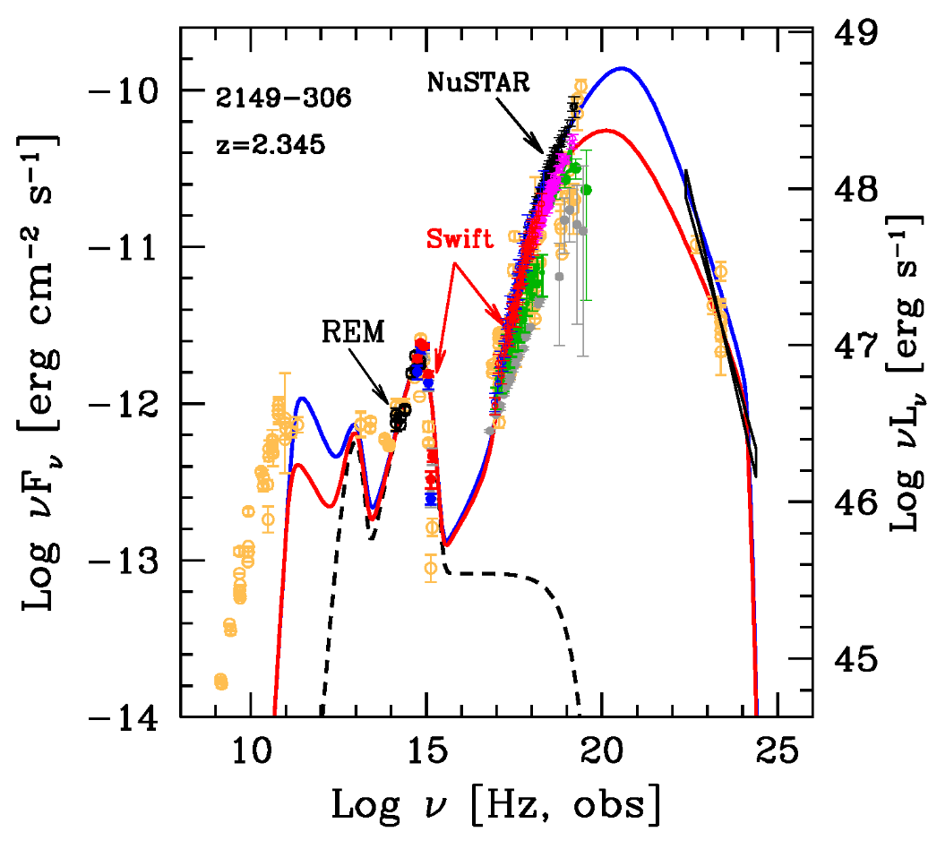
What is the Evolutionary History of Blazars?
Jet dominated
MeV
High-z Blazars
Furthest -> brightest (10⁴⁶ ergs/s) blazars -> peak in the MeV (Ajello et al. 2009, Ghisellini et al. 2010)
M_{BH}~10⁹ M_{ⵙ} (Sbarrato 2022)
Detected at z>5 (Romani 2006)
Accretion disc emission is visible
Questions
How do blazars evolve with time?
How did such large SMBHs form so early in the Universe? (<1 billion years)
Is the emission leptonic or hadronic?
Helping answer a current science question
2FLE Impact:
Detection of new MeV blazars
Sample high-energy peak + AD emission
Blue + Red: Leptonic models with different parameters
Adapted from Tagliaferri et al. ApJ, 2015
Notes:
P_jet > dot{M}c^2
Large jet power (Ghisellini et al. 2014)
SMBH formation -> equations and timelines
in pracrtice -> much FASTER!
Leptonic emission
BH mass seems to be connected to jet - accretes faster as well…
BASS Paper (Marcotulli et al 2022)
more or more luminous sources at earlier cosmic time.
peak in space density of population is z~4
lower number densities compared to previous works
X-ray luminosity function - lack of spectral break does not allow confirmation if evolution is due to L or density
flattening from beaming at closer times.
BAT FSRQs can be 70-100% of MeV background
average bulk lorentz factor is 8-12
BAT vs LAT are more luminous and host more massive black holes. -> smae parent populaion -
LAT likely undergo density evolution and peak at z~2
Hundreds - 1000s of sources up to z~5-6

Slide 21
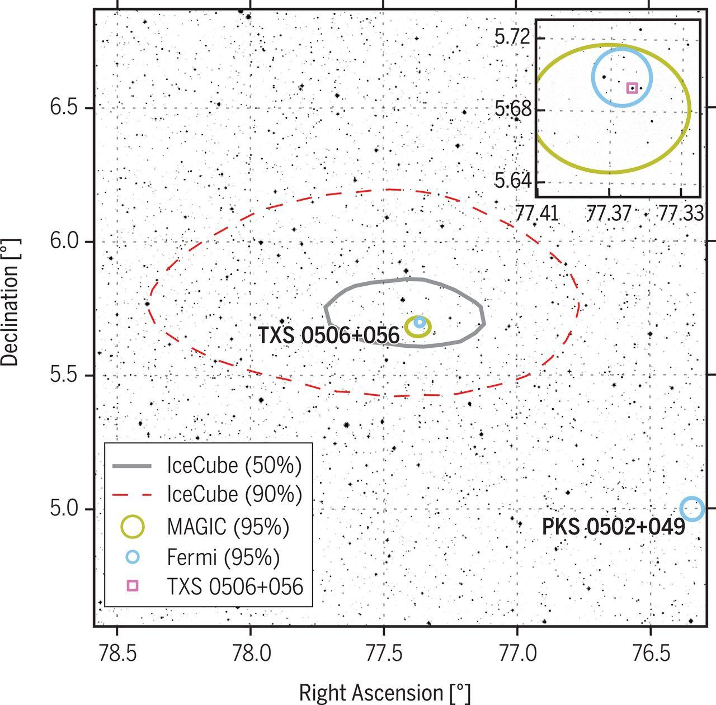
Where are the High-Energy Neutrino Sources?
Detected during a 𝛾-ray flare!
Flaring Blazars and MeV Sources as Tracers for Neutrino Production
Neutrino detection -> hadronic emission
Detected in 𝛾-ray flare of TXS 0506+056 (blazar) (IceCube Collaboration et al. 2018)
GeV energies absorbed by the originating source (Murase 2015), Costamante 2019, Inoue 2019)
Hadronic cascade MeV emission processes can be united to 10-100 TeV neutrinos (Murase, Kimura, and Mészáros 2020)
Questions
What sources are responsible for high-energy cosmic neutrinos?
Is there a population of undetected GeV-faint blazars?
3𝜎 detection in GeV-faint state
Helping answer a current science question
Adapted from: IceCube Collaboration et al. 2018
2FLE Impact: Identify MeV bright sources as potential neutrino producers
Notes:
READ MURASE papers -> be precise as to what is happening in this scenario!!!!
hadronic emission
specifically - polarization in MeV band -> (IXPE look at it) hadronic more highly polarized (why?)
neutrino production
Attenuated as photons travel across cosmic distances (Inoue 2019)
GeV a poor estimate for neutrino flux (Krauß 2018)
You need to clarify this - is it just hadrons when this happens or both cases? (Murase 2015 says both cases)

Slide 22
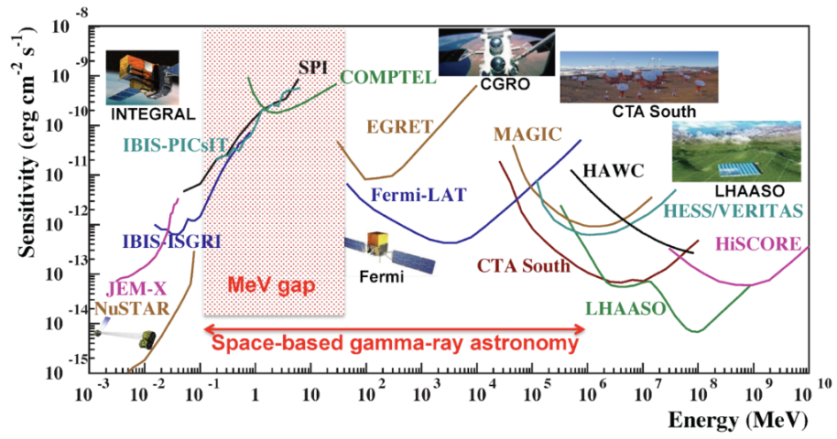
A New Census of the MeV Sky
Produce a Fermi-LAT Low Energy Catalog to bridge the MeV gap by pushing the instrument to its limit
20 - 200 MeV Catalog
Pave the way for COSI and future MeV missions
Identify MeV blazars for future studies
Flag potential neutrino emitters
Analyze MeV spectra of SNR for identifying pion bumps
Unknown unknowns!

Slide 23
Finishing Touches and Follow Up Work
Unassociated sources
4FGL typically assumes these to be BL Lacs
Multiwavelength Machine Learning Predictions (Issue: smaller data set)
X-ray follow-up for counterpart identification
High-z MeV blazar
New source type?
COSI detection predictions
Model constraints from 20-200 MeV band

Slide 25
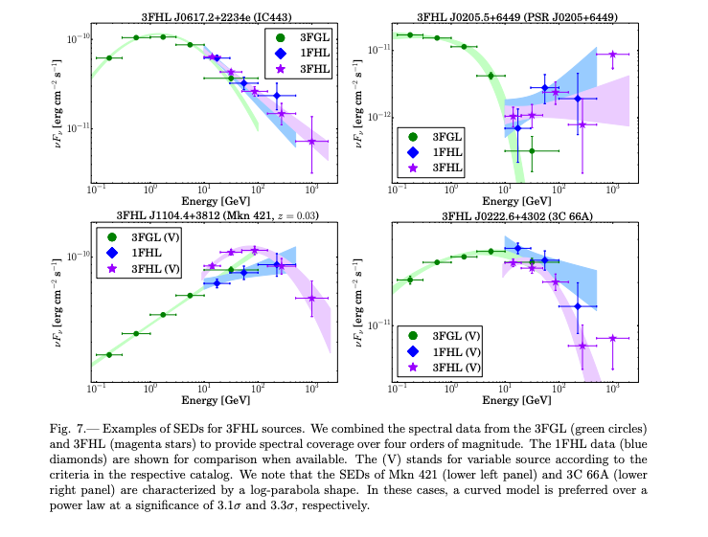
Generate 1 SED to show the example of the curve/data with/without MeV data and previous fits from 4FGL or 3FHL, etc.

Slide 26
Cooler things?
Transient Source Catalogs
1 2FAV source: 2FAV J1634+38.9
3 1FLT sources: 1FLT J0855-1233, 1FLT J1022-3140, 1FLT J1202-2144
2 non-repeating Chime FRB sources (FRB20181119E, FRB20190420C)

