Slide 1
Observational Evidence for Magnetic Field Amplification in SN 1006
Moeri Tao (Waseda Univ.),
Jun Kataoka (Waseda Univ.), Takaaki Tanaka (Konan Univ.)
Tao et al. 2024 ApJL

Slide 2
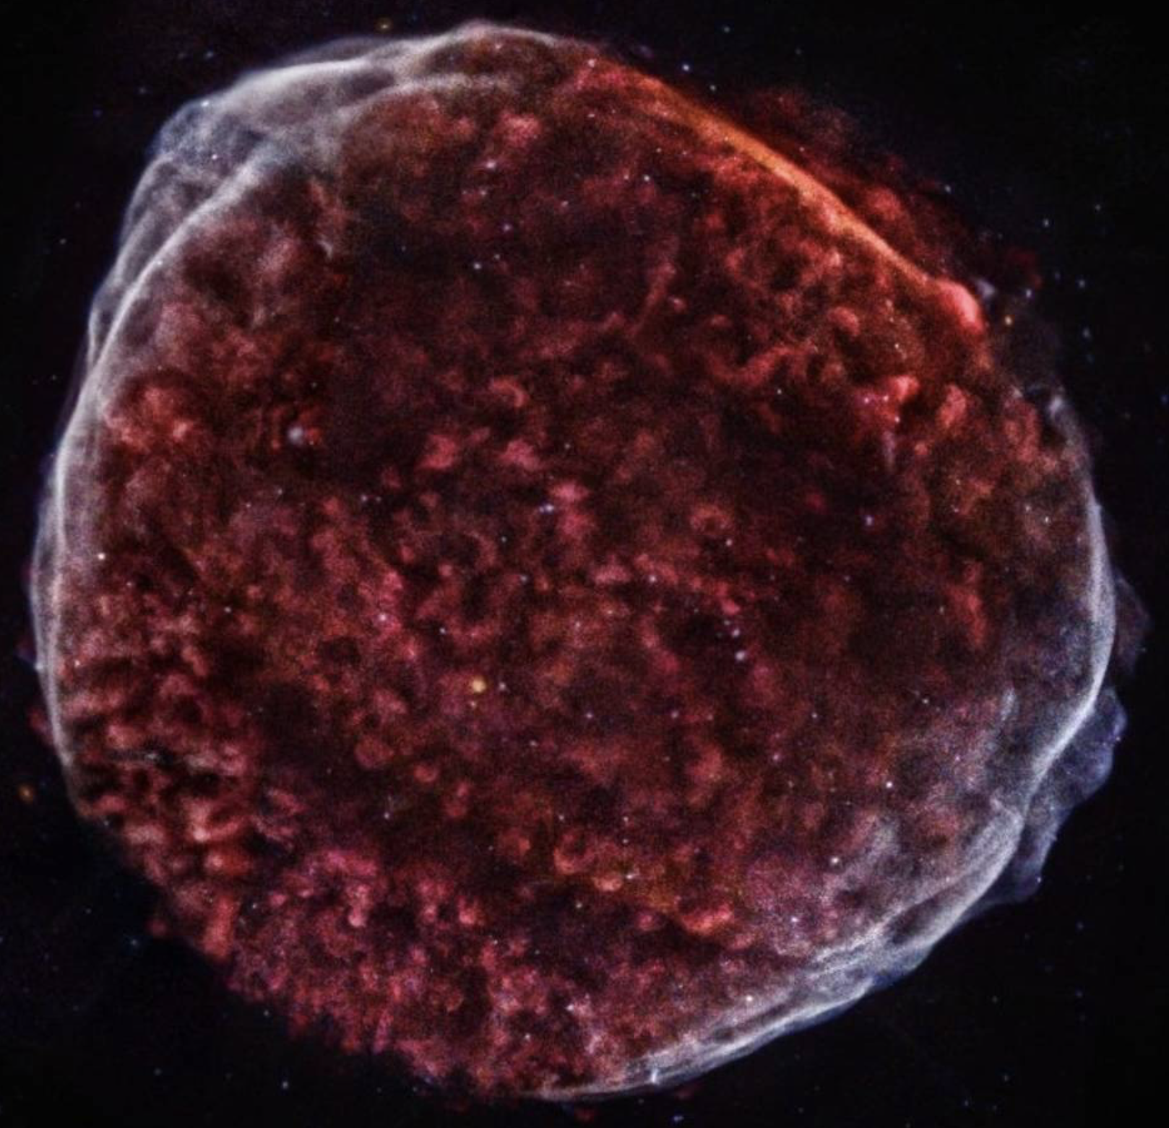
Supernova remnant SN 1006
1
SN 1006
- Distance : 1.8 kpc
- Radius : 15 arcmin
- Type Ia
North-East (NE)
・Koyama et al. (1995) discovered synchrotron X-rays
from the NE / SW shells
→ Indication of $≥$ 100 TeV electrons
→ Cosmic ray accelerator
South-West (SW)
・accelerate particles up to “knee” energy at ${10}^{15}$ eV
→ strong magnetic field of $≥$ 100$μG$ are required
Chandra image of SN 1006 (ⒸNASA)
Notes:
Let me begin by talking about SN 1006. SN 1006 is a prototypical example wherein synchrotron X-ray emissions along the outer north-east and south-west.. Koyama et al found that electrons of more than 100 TeV were being accelerated in the shock of SN 1006. Therefore, the young supernova remnant including SN 1006 are considered to be promising sites for the production of galactic cosmic ray through diffusive shock acceleration; DSA. However, the detailed process is not well understood. In particular, but for a supernova remnant to accelerate particles up to knee energy of the CR spectrum at 10^15 eV, strong magnetic field of >100 μ G are required and this is much stronger than the previous study.

Slide 3
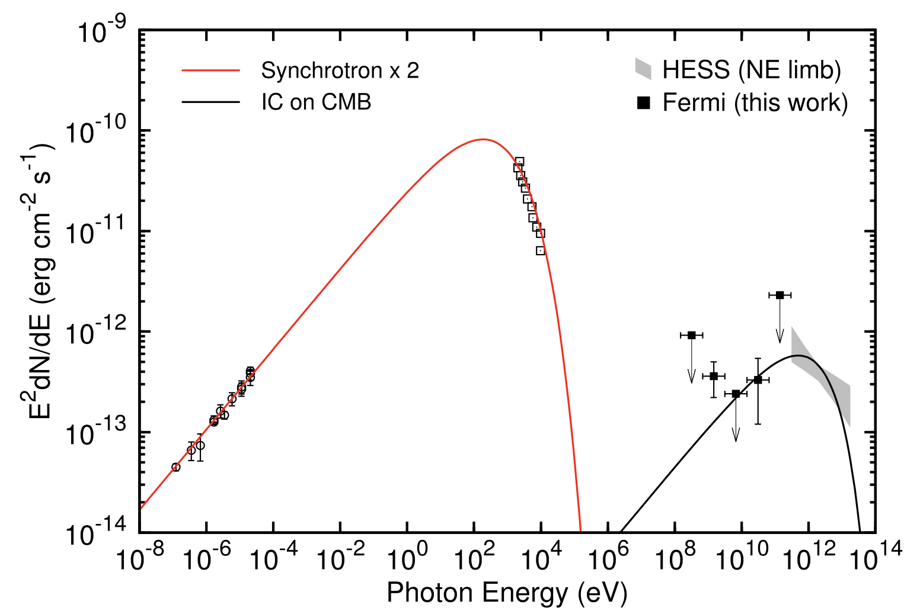
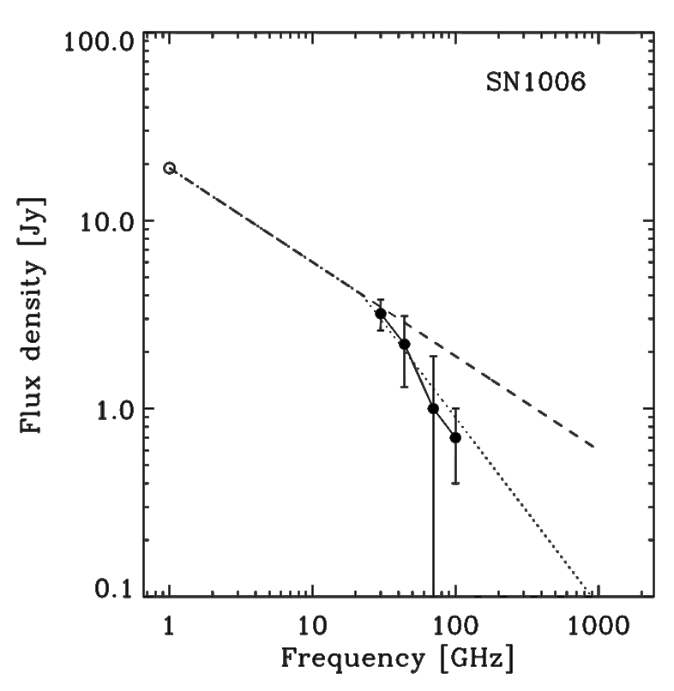
Broadband SED of SN 1006
2
Xing et al. (2016)
・Xing et al. (2016) suggested that the SED was
well represented by one-zone leptonic model.
→ $B_{SED}≈24μG/30μG$ (NE/SW)
Synchrotron
Arnaud et al. (2016)
Inverse Compton on CMB
・Recent Planck observations indicated a spectral break
above 10 GHz.
→ The radio-to-X-ray spectrum may not connect?
Notes:
This slide shows the previous study of spectrum energy distribution. Radio to very high energy gamma ray emission are detected from SN 1006. Xing et al. (2016) suggested that the SED was well represented by one-zone leptonic model, where in synchrotron emission constituted the low energy bump from radio to X-rays, whereas inverse compton emission on cosmic microwave background accounts for the high energy bump in GeV and TeV gamma rays. Based on SED modeling the magnetic field strengths were estimated to be 24μG and 30μG for NE and SW shells, respectively.
However, recent Planck observation indicated a spectral curvature above 10 GHz; thus the radio-to-Xray spectrum may not connect smoothly as opposed to that determined by SED models by various authors. This is supported by the fact that the optical and UV counterpart of SN 1006 is extremely faint except for the bright filament in the NW shell.

Slide 4
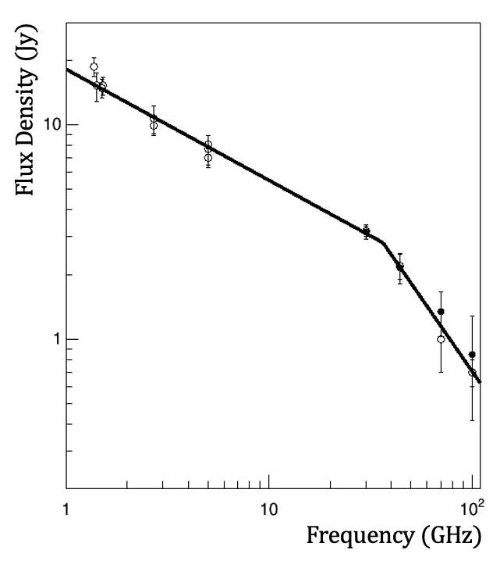
Broadband Radio Spectrum
3
Planck 30 GHz all sky map (ⒸESA)
$$α_{1}=0.52±0.02$$
Analyzed the Planck data (30, 44, 70, and 100 GHz)
+
Archival radio flux densities
break
$$α_{2}=1.34±0.21$$
The spectrum can be well represented by a broken
power law with a break frequency $ν_{brk}=36±6 GHz.$
Notes:
Next, let me talk about analysis and result. First, we analyzed the Planck data, 30, 44, 70, and 100 Ghz. This is the broadband radio spectrum of SN 1006 as measured with Planck, along with previous measurements ranging to 1.4 GHz to 100GHz. The filled circles represent the flux densities analyzed in this study and the open circles represent the previous measurements.Rather it can be well represented by a broken power law with a break frequency of 36 plus minus 6Ghz, above which the spectral index steepens from 0.52 pm 0.02 to 1.34 pm 0.21.
(The reduced chi-squared for the fitting is 6.74/13 and the confidence level that the broken power law is a better representation of the data than a single power law is 3.58 sigma based on the F test.)

Slide 5
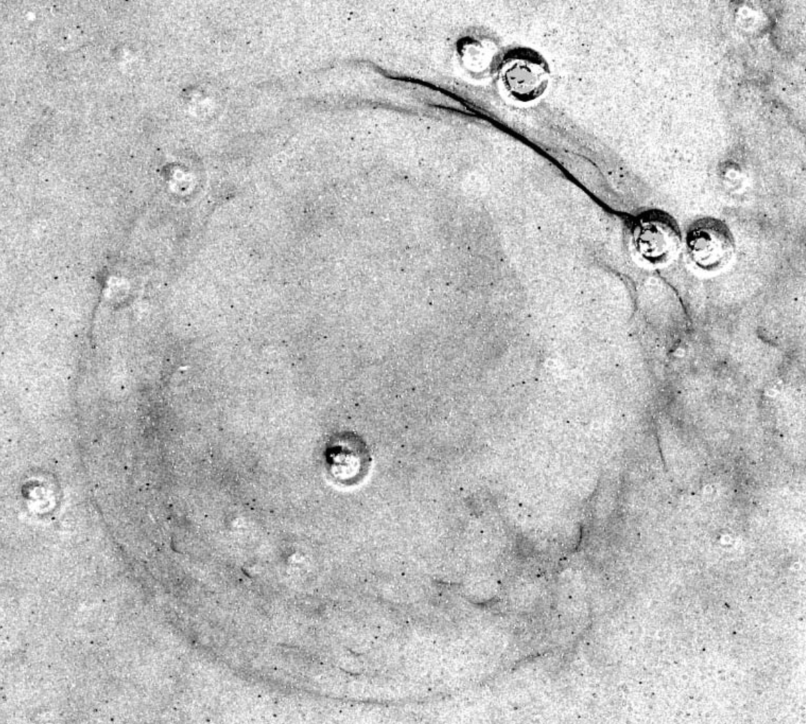
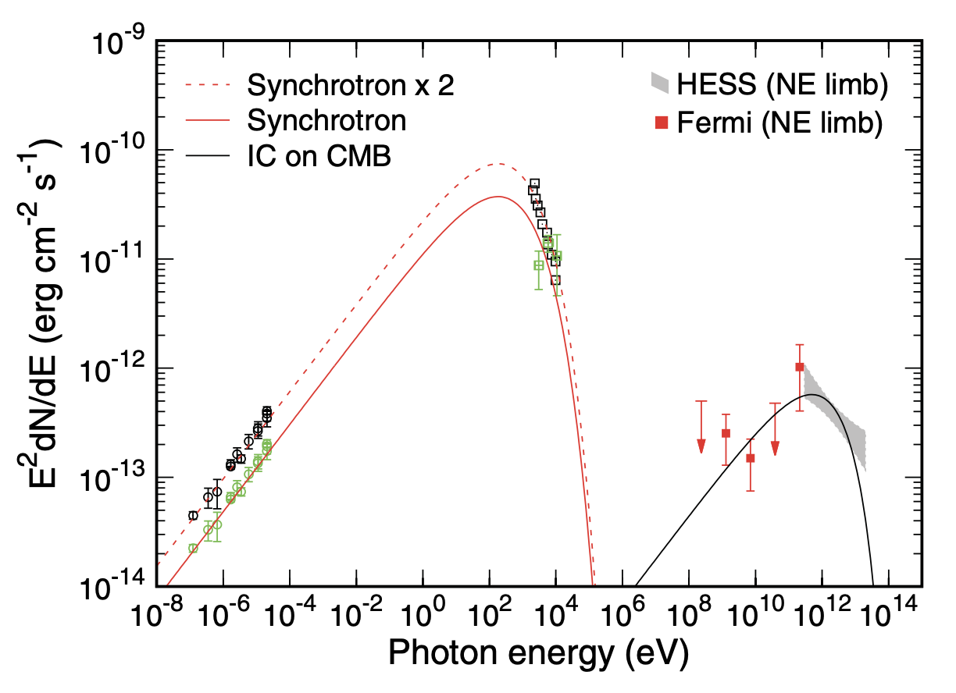
Estimation of the Optical and UV fluxes
4
NE
SW
Deep $H_{α}$ image of SN 1006 (Winkler et al. (2003))
・The optical emission of SN 1006 is extremely faint except for the bright NW shell.
The flux of NE would be $≈\left(1.6−2.5\right)×{10}^{−12}erg{ cm}^{−2}{ s}^{−1}$.
・The UV flux is also faint ($\left(1.1−2.2\right)×{10}^{−11}erg{ cm}^{−2}{ s}^{−1}$).
→ The radio-to-X-ray spectrum may not connect?
Notes:
Second, we estimated the optical and UV fluxes. The optical emission of SN 1006 is extremely faint except for the bright H alpha filament as observed in the NW shell. Compared with the maximum surface brightness for the filament, the flux of NE shells would be 3.2-5.0×10^-12 erg cm^-2 s^-1. The UV flux is also faint. Let's apply these fluxes to the SED. Then we see that these fluxes may not on this synchrotron emission from radio to X-rays. (10 to the minus 12 erg per square centimeter per seconds)

Slide 6
Direct Comparison of radio / X-ray shells
5
1335 MHz ; MeerKAT
$$∆θ=8”$$
2.0-7.0 keV ; Chandra
$$∆θ=0.5”$$
・The width of the radio shells was broader than that of the X-ray by a factor of only 3-23.
Notes:
Third, we compared radio and X-ray shells. The left images are Radio and X-ray images in NE. The right figures show the radial profiles of NE shell. These are made across the various parts of the shells along the white lines. Green and red line represent the radio/x-rays , respectively. The same analysis was also done for SW. The important point here is that the with of the radio shells was broader than that of the X-rays by a factor of only 3-23.

Slide 7
Estimation of the magnetic field strength
6
・The spectral break：a result of synchrotron losses
・Cooling time：$t_{cool}\sim 5.1×{10}^{8}{B_{cool}}^{2}{γ_{brk}}^{−1}$
$B_{cool}$ : magnetic field
$γ_{brk}$ : Lorentz factor ($ν_{brk}\sim 1.2×{10}^{6}B_{cool}{γ_{brk}}^{2}$)
$$B_{cool}[μG]=6.8×{10}^{3}{t_{cool} [kyr]}^{−\frac{2}{3}}{ν_{brk}[GHz]}^{−\frac{1}{3}}$$
→
Break＠36±6 GHz
・Substituting the age of SN 1006 for $t_{cool}$, we obtain
Lower limit : $B_{cool}≥2mG$
・The magnetic field estimated from equipartition, we obtain $B_{min}$ ~ 5-10 $μG$
→ $B_{min}$ $≪$ $B_{cool}$
Notes:
Now, let's move on to the discussion. We reported that the radio spectrum showed the spectral break at almost 36 GHz, at which the spectrum steepened approximately from 0.52 to 1.34. Such a break in the spectral index is often seen as a result of synchrotron losses in various active galactic nuclei. For the synchrotron emission, the cooling time of electrons can be expressed as this equation. (the gamma_brk is the Lorentz factor of electrons emitting nu_brk photons in the magnetic field B_cool.) Subsequently, we can obtain the B_cool as a function of t_cool and nu_brk. The dynamical timescale of SNR can be regarded as the advection time of electrons across the shock, which should be shorter than the age of the SNR. Substituting the age of SN 1006 for tcool, we can obtain a lower limit, B_cool is stronger than 2 mG for νbrk = 36 GHz. Another way of estimating the magnetic field from the observed radio flux is to assume an equipartition between the electron and magnetic field energy densities. In this condition, we obtain that the magnetic field approximately 5-10 μG. This is consistent with the magnetic field from SED. I’d like to stress the magnetic field from the cooling break is much stronger than that from the assuming equipartition and SED. How can we explain this? We’ll propose the scenario for two very different magnetic fields.

Slide 8
Implication from SED
7
hot spots
$$NE+SW$$
$$(Entire)$$
hot spots
$$NE alone$$
average
average
hot spots
Magnetic field | NE+SW | NE alone
hot spots | 2.5 mG | 2.5 mG
average | 25 μG | 18 μG
amplification factor
a ~ 100
average
Notes:
We constructed the SED from radio to TeV gamma rays, include the radio spectrum and estimated optical and UV fluxes in this study. Please look at the figures. The left figure shows the SED of the entire SN 1006 and the right one shows that of NE alone In previous studies, the overall SED was modeled by one-zone synchrotron/IC (CMB) emissions with a moderate magnetic field of 25 μG. However, according to our results, two components are necessary to account for the radio-to- X-ray spectrum. Notably, the first synchrotron component dominates the radio emissions but flattens above the break frequency. The second one appears weak in the radio band but accounts for most of the optical-UV–X-ray emission without turnover. Therefore, we assumed “double” electron populations to reproduce the overall structure of the SED; the first population is responsible for the synchrotron emission in compact regions or hot spots where the magnetic field is enhanced by a factor of approximately 100. Conversely, the second population radiates another synchrotron emission in the “average” magnetic field of approximately 20 μG Although the geometry of the magnetic enhanced regions is still unknown, the similarity of the radio and X-ray images, may imply that such regions are almost uniformly distributed along the shock as either compact patches, like hotspots. Hereafter, we call such magnetically enhanced regions “hot spots” for simplicity.

Slide 9
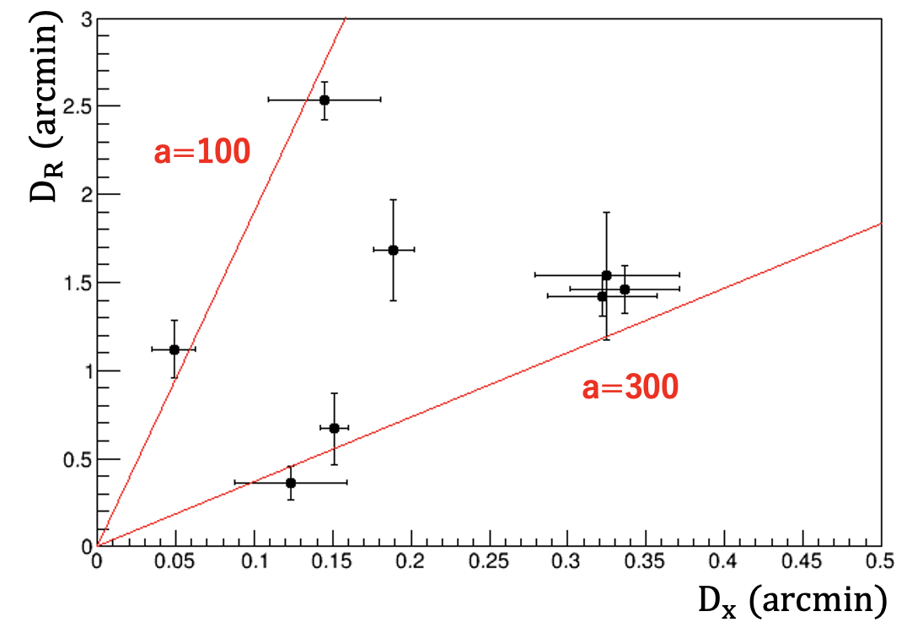
Comparison between Radio/X-ray of the shells
8
$$D \sim v_{shock}t_{cool}$$
→
$$D_{R}$$
$$\frac{D_{R}}{D_{X}}={\left(\frac{B_{R}}{B_{X}}\right)}^{−\frac{3}{2}}{\left(\frac{ν_{R}}{ν_{X}}\right)}^{−\frac{1}{2}}$$
$$D_{X}$$
・If the magnetic field for radio and X-ray emissions are the same, ${D_{R}}/{D_{X}}≈2×{10}^{4}$.
→ Magnetic fields, which contributed to the radio and X-ray emissions, can’t be the same
・The observed ratio of ${{3≤D}_{R}}/{D_{X}≤23}$, can be converted to the amplification factor
of the magnetic field as $88≤a≤348$.
→ consistent with the magnetic field amplification in the hot spot ($a$ ~ 100)
Notes:
On the other hand, what can we say about the comparison of radio and X-ray shells? In general, the thickness of the shell can roughly be estimated to be the product of the shock speed and the cooling time of electrons that emit photons of certain energies. Therefore, if the magnetic fields for radio and X-ray emissions are the same, the thickness of the shell measured in radio and X-rays reflects the difference of cooling time; thus be proportional to the minus square root of frequency ν. Hence, the excepted DR/DX ; 2 × 10^4(10 to the power of 4). This is far from the observed images, recalling that the with of the radio shells was broader than that of the X-rays by a factor of only 3-23. The observed D_R/D_X also indicates that the magnetic fields, which mainly contribute to the observed radio and X-ray emissions, cannot be the same. In such a case, the D_R/D_x can expresses like this. B_R and B_X are the magnetic fields responsible for the radio and X-ray emissions, respectively. The observed ratio of  DR/DX  can be converted to the amplification factor of the magnetic field as 88  to  348. This is consistent with magnetic field amplification in the hot spots, namely, 100, which is independently estimated from the SED.

Slide 10
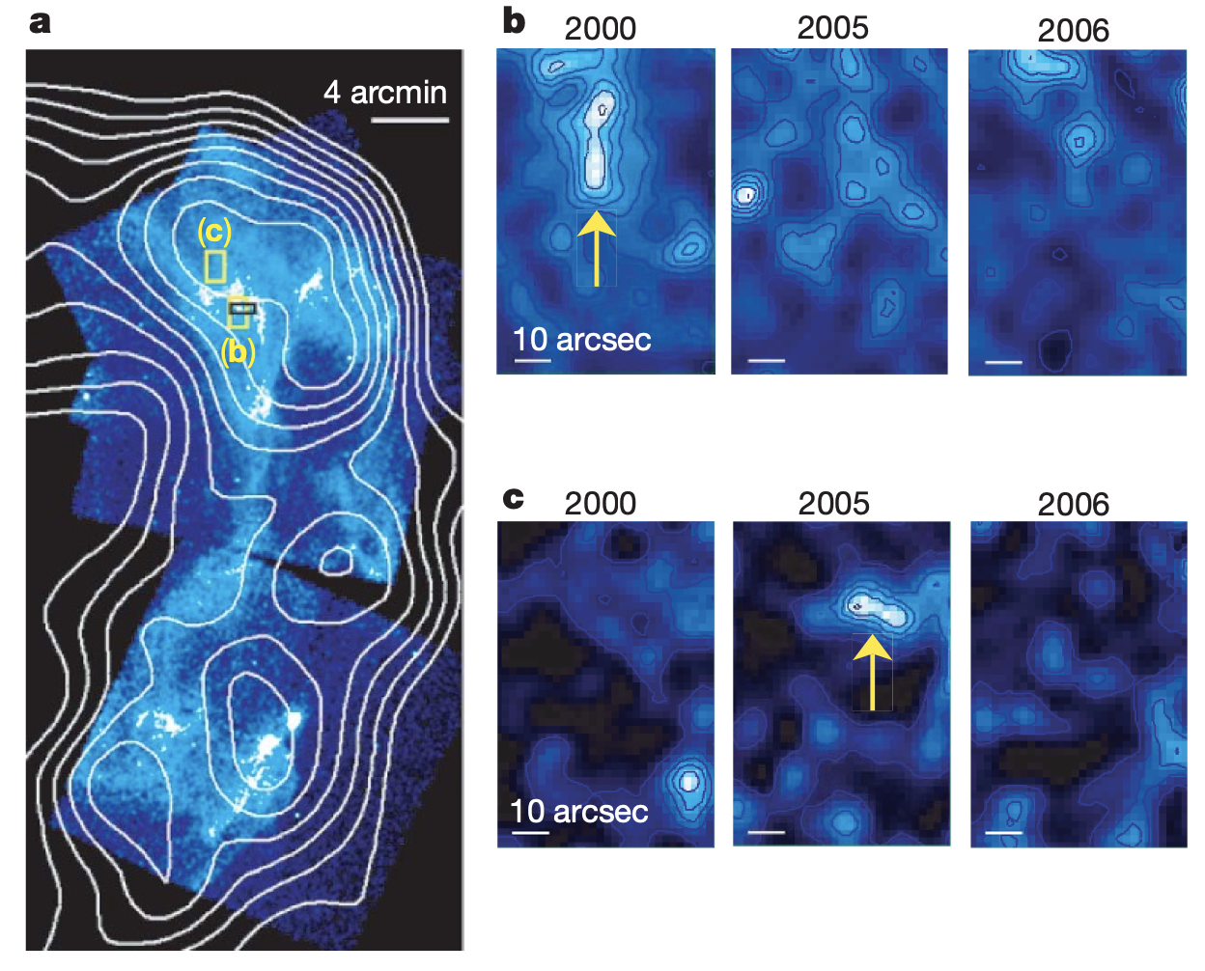
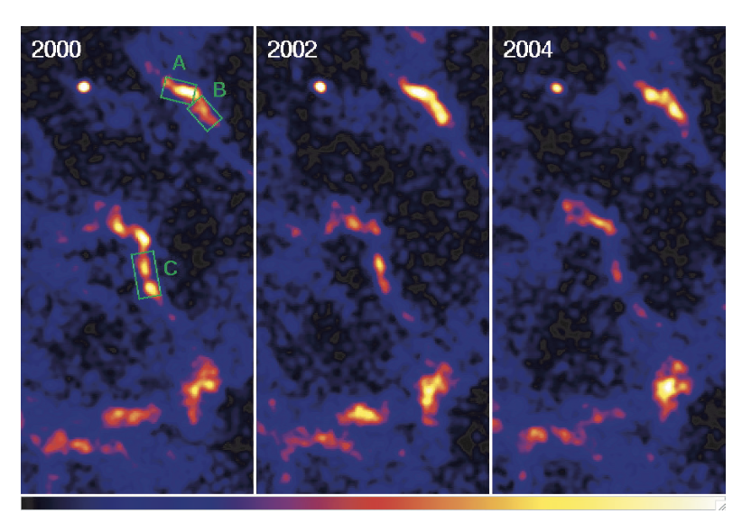
Comparison with other SNRs
9
Uchiyama et al. (2007)
Uchiyama & Aharonian (2008)
・The short time variability on a 1yr timescale was found in RX J1713.7-3946 and
Cassiopeia A.
→ hot spots with a strong magnetic field ($B_{H}\sim 1mG$)
・The X-ray emission from the hot spot is less than ~100 of that of the entire SNR.
Notes:
For example, the short time variability on a 1yr timescale was found in the shell of RX J1713.7−3946. This rapid variability shows that the X-rays are produced by ultra relativistic electrons through a synchrotron process and that electron acceleration does indeed take place in a strongly magnetized environment, indicating amplification of the magnetic field by a factor of more than 100. Similar to this, the fast variability was found in Cassiopeia A, which also suggests the amplification of the magnetic field to 1mG. Moreover, the X-ray emission from the hot spots is less than approximately 100 of that of the entire RX J1713.7-3946. These are consistent with the present observation of SN 1006.

Slide 11
Summary
10
・The spectral break in the radio spectrum (due to synchrotron cooling)
→ $B_{cool}≥2mG$
・The broadband SED (consider the radio break and faint optical/UV fluxes)
→ ‘double’ electron populations; hot spots and average region
・Comparison between Radio/X-ray of NE/SW shells (${{3≤D}_{R}}/{D_{X}≤23}$)
→ $88≤a≤348$
Hot spots ($B_{H}≥2mG$)
$a$ ~ 100
Average ($B \sim 20 μG$)
・The manifestation of hot spots with a strong magnetic field of $B_{H}\sim 1mG$ has been
reported in similar young SNRs
Notes:
Finally, I’d like to summarize my presentation. First, we found the spectral break in the radio spectrum. This is naturally interpreted as a cooling break under strong magnetic field of more than 2mG. Second, we constructed the SED which consider the break and the faint optical/UV fluxes. We assumed double electron populations; which represent the emission from hot spots and average region, where the magnetic field is amplified 100 times more than the average region. Third, we compared between radio/X-ray of NE/SW shells. The width of the radio shells was broader than that of the X-ray shell by a factor of only 3−23, therefore, the amplification factor of the magnetic field would be 88 to 348. This is consistent with magnetic field amplification in the hot spots, namely, a ; 100, which is independently estimated from the SED.
In addition, the manifestation of hot spots with a strong magnetic field of approximately 1mG has been reported in similar young SNRs such as RXJ1713.7−3946 and CassiopeiaA.
However, the physical mechanism of magnetic amplification in the hot spots remains quite uncertain in all the SNRs. Additional analysis is required to understand the detailed mechanism.

Slide 12
Appendix

Slide 13
A Proposed scenario
10
Hot spots：$B_{HS}≥2mG$
Average：$B \sim 20 μG$
Filling factor：$k=2.5×{10}^{−5}$
・The radio flux in the hot spots $f_{HS}$ is expressed as $f_{HS}∝U_{e, HS}U_{B, HS}kV$.
・Assuming the radio emissions of hot spots is 10-100 times brighter than that of
the average region of the SNR, $f∝U_{e}U_{B}\left(1−k\right)V$, we obtain ${f_{HS}}/f\sim k×a^{3}$
→${10}^{−5}≤k≤{10}^{−4}.$

Slide 14
Planck data analysis
Planck data analysis is based on Arnaud et al. (2016)
$$θ_{out}$$
Source size ${ θ}_{s}=1.5\sqrt{{θ_{SNR}}^{2}+{θ_{beam}}^{2}}$
Background inner radii $θ_{in}=1.5θ_{src}$
Background outer radii $θ_{out}=2.0θ_{src}$
$$θ_{in}$$
$$θ_{s}$$
($θ_{s}$ : spatial distribution of SN 1006 $θ_{b}$ : Planck beam size)
・An aperture correction was applied to correct for the loss of flux density outside the aperture.
・The uncertainties for the flux densities were the root-sum-square of calibration uncertainty and
propagated statistical errors.
・The confidence level that the broken power law is a better representation of the data than single
power law is 99.9% (3.59$σ$) based on F-test.

Slide 15
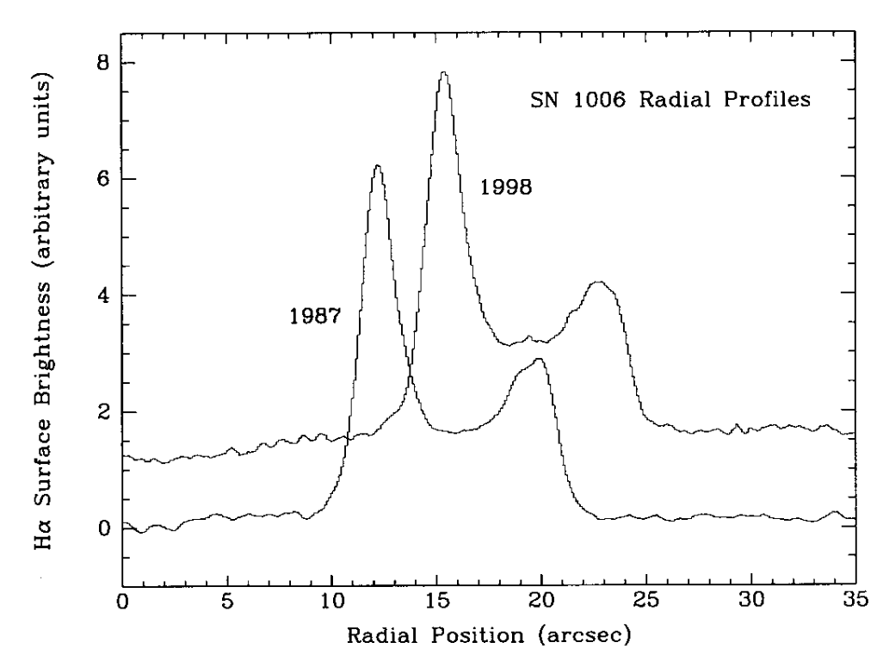
Estimation of the Optical flux
Fig.3 of Winkler et al. (2003)
・Compared with the maximum surface brightness for the filament, $2.0×{10}^{−16}erg{ cm}^{−2}{ s}^{−1}{arcsec}^{−2}$,
the intensity of the diffuse emission associated with NE/SW shells of SN 1006 is fainter than a factor
of 20-25. (see Fig.3 of Winkler et al. (2003))
・For the NE shell, the integrated flux would be $≈$ $\left(1.6−2.5\right)×{10}^{−16}erg{ cm}^{−2}{ s}^{−1}$.
(Assuming a region size of 70 ${arcmin}^{2}$)

Slide 16
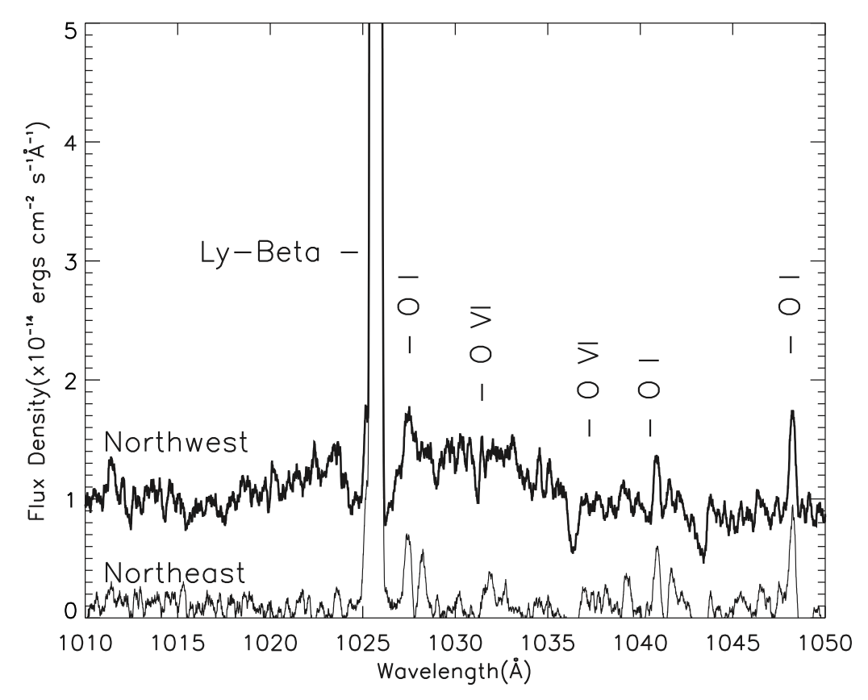
Estimation of the UV flux
Fig.2 of Korreck et al. (2004)
・The flux density in the NE shell in the UV range is $≈\left(1.6−2.5\right)×{10}^{−16}erg{ cm}^{−2}{ s}^{−1}{\text{Å} }^{−1}$ between
1010 and 1050 $\text{Å}$ (see Fig.2 of Korreck et al. (2004)).
・Considering the relatively narrow field of view of FUSE, the integrated NE flux is estimated to be
$\left(1.1−2.2\right)×{10}^{−16}erg{ cm}^{−2}{ s}^{−1}$ for the assumed region.

Slide 17
The magnetic field estimated from equipartition
・Another way of estimating the magnetic field from the observed radio flux is to assume an
equipartition (i.e., minimum energy) between the electron and magnetic field energy densities.
$$B_{min}[μG]=27{\left(\frac{{d\left[kpc\right]}^{2}f_{ν}[Jy]}{V[{pc}^{3}]}\right)}^{\frac{2}{7}}{ν[GHz]}^{\frac{1}{7}}$$
($d$ and $V$ : distance and volume of the SNR $f_{ν}$ : flux density at frequency $ν$)
・$η$ is the ratio of the energy stored in electrons and protons, where $η=1$ for $e^{−}$- $e^{+}$ plasma.
Consequently, we obtained $B_{min}≈5μG$. Instead, if we assume a typical CR composition, $η≈100$,
$B_{min}≈10μG$ is obtained.

Slide 18
Implication from SED
・Filling factor $k :$ the volume ratio of magnetically enhanced regions to the entire shell
・The radio flux in the hot spots $f_{HS}$ is expressed as $f_{HS}∝U_{e, HS}U_{B, HS}kV$.
・Assuming the radio emissions of hot spots is 10-100 times brighter than that of the average region of
the SNR, $f∝U_{e, HS}U_{B, HS}\left(1−k\right)V$, we obtain ${f_{HS}}/f\sim k×a^{3}\sim 10$-$100$; thus, ${10}^{−5}≤k≤{10}^{−4}.$
・As for an electron population in the hot spots, we assumed a broken power law function with an
exponential cut-off,
$$N_{e}\left(γ\right)=\left\{\begin{aligned}N_{0}γ^{−s}exp⁡(−γ/{γ_{max}}) \\ N_{0}{γ_{brk}^{}γ}^{−(s+1)}\exp\left(−γ/{γ_{max}}\right)\end{aligned}\right.$$
($γ_{min}<γ<γ_{brk}$)
($γ_{brk} <γ<γ_{max}$)
・For remaining average region, we assumed a simple power law function with an exponential cutoff,
$$N_{0}γ^{−s}exp⁡(−γ/{γ_{max}})$$

Slide 19
Comparisons with similar young SNRs
Uchiyama et al. (2007)
Uchiyama & Aharonian (2008)
・The anticipated linear size of the hot spots would be $k^{\frac{1}{3}}=2.9×{10}^{−2}$ times smaller than the typical
shell thickness of 10”
→ difficult to resolve even with Chandra

Slide 20
The physical mechanism of amplification
・In the standard theory of shock compression, $a={B_{d}}/{B_{u}={U_{d}}/{U_{u}=4}}$. (d/u : down/up stream)
→ $a\sim 100$ is hardly explained by the classical shock theory
・For RX J1713.7-3946, such a strong magnetic field may be produced owing to the turbulent dynamo
action through shock-cloud interaction. (Inoue et al. (2011))
→ However, this can not be the case for a relatively “clean” environment as in SN 1006 and Cas A
・In this context, some particle-in-cell simulations of nonrelativistic perpendicular shocks in the
high-Mach number ($M_{A}$) suggest magnetic amplification of $a=5.5(\sqrt{M_{A}}−2)$. (Bohdan et al. (2021)).
→ $a≈100$ for $M_{A}≈400$ or $v_{sh}≈4000 km s^{−1}$
・However, whether similar efficient amplification is possible even in parallel shocks is uncertain, as
observed in SN1006.

