Slide 1
Current work and AGN intrests in the LST comunity
Giuseppe Silvestri
giuseppe.silvestri@studenti.unipd.it
$1^{st}$ VHEgam meeting, 16/01/2024

Slide 2
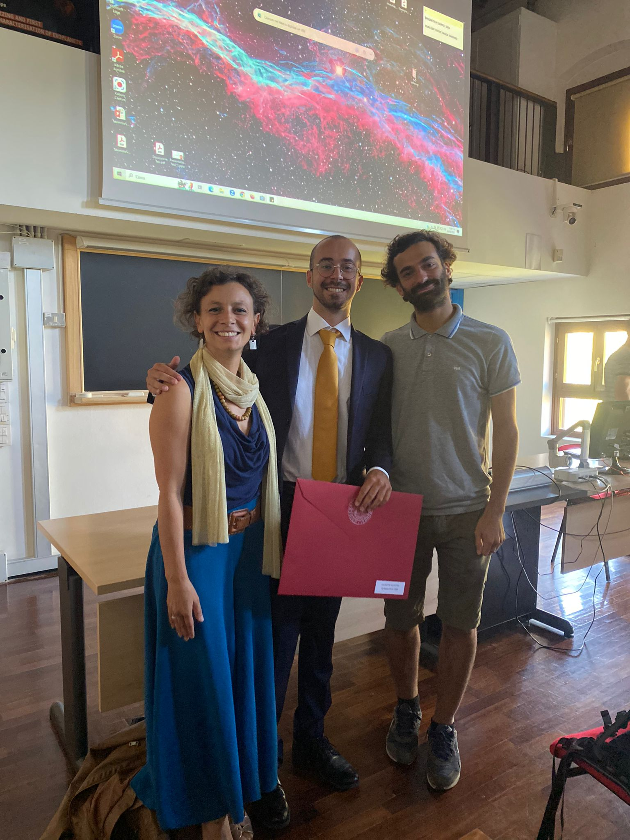
About me
Born in Palermo in 1999.
Bachelor in Physics and master degree in Astrophysics done at the University of Padova
Master degree thesis: «Modeling of the broad band emission of the AGN PG 1553+113» supervisor Elisa Prandini, cosupervisors: Davide Miceli, Axel Arbet Engels
PhD cycle: XXXIX
PhD Thesis title: «Testing high energy emission from blazars in a multiwavelength and multimessenger context»

Slide 3
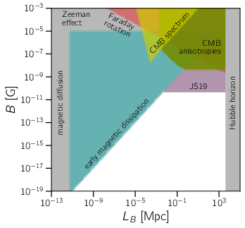
Current work: IGMF + Machine Learning
Started working on IGMF
CRPropa simulations on GRB and Blazars
Focus on blazar sources like TXS 0210+515
Machine Learning is an hot topic in Padova: several postdocs + Elisa’s PRIN
From R. Alves Batista 2021

Slide 4
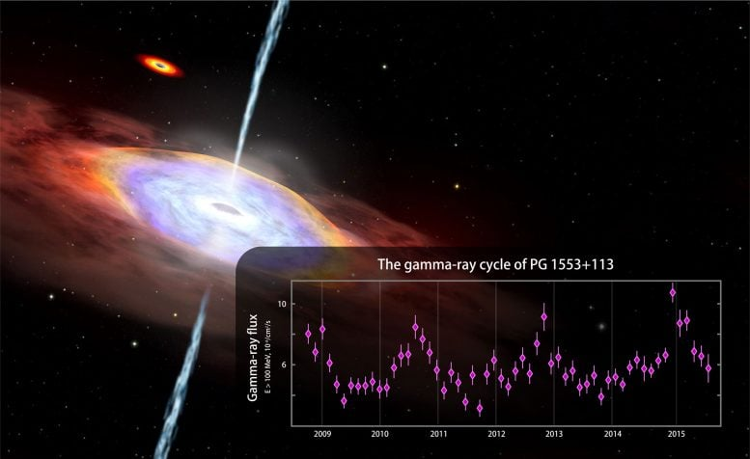
Current work: PG 1553+113
Continuing master thesis project on PG 1553+113
Extending the analysis to other periods
Including new MWL data
Applying new models
New students coming!!!

Slide 5
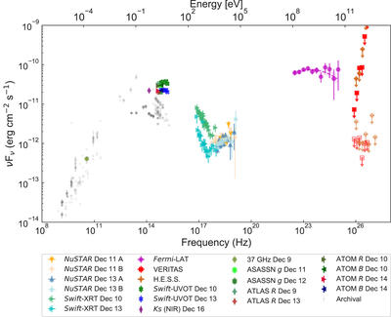
LST EGAL
Extragalactic analysis expertise in LST collaboration.
Two sources:
PKS 0735+17
NGC1068
Both possible candidates as neutrino sources.
Available in the future for fast analysis
From Acharyya A. et al. 2023

Slide 6
THANK YOU
FOR YOUR ATTENTION

