Slide 1
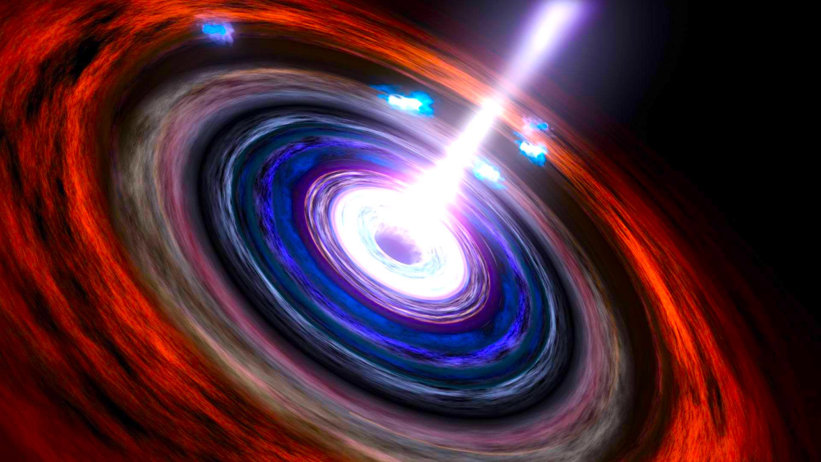





A temporal resolved SED study of the
TeV radio galaxy 3C 264
Ettore Bronzini^{1,2}
on behalf of the MAGIC collaboration
¹Department of Physics and Astronomy, University of Bologna
²INAF, Astrophysics and Space Science Observatory Bologna
ettore.bronzini@inaf.it
E. Torresi, P. Grandi, C. Vignali, R. Zanin, G. Migliori, A. Arbet-Engels, B. Boccardi, L. Di Venere, A. Tramacere + other coll.
1st VEGHAM, Bologna
Jan. 16, 2024
Image credits: NASA/Goddard Space Flight Center Conceptual Image Lab

Slide 2
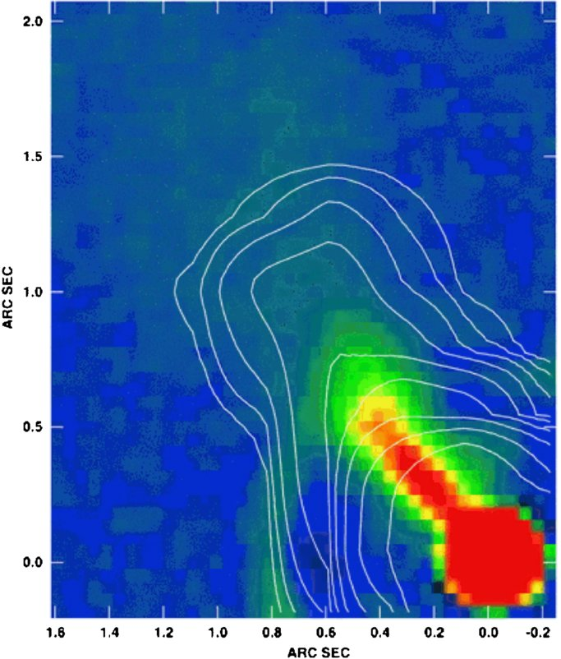
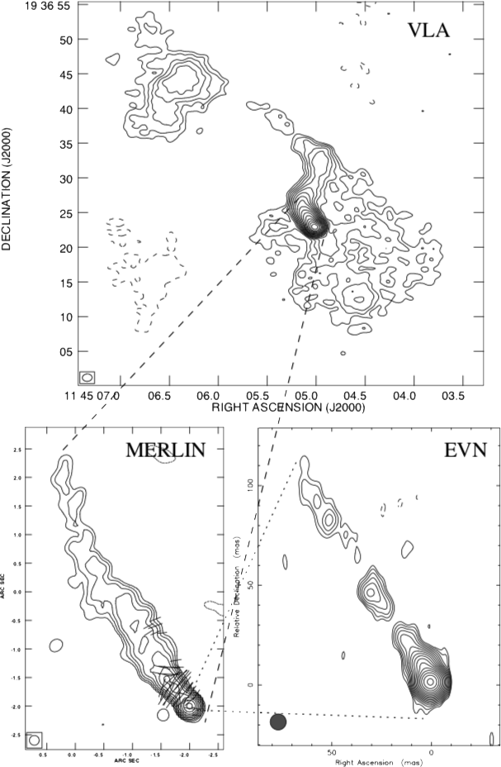
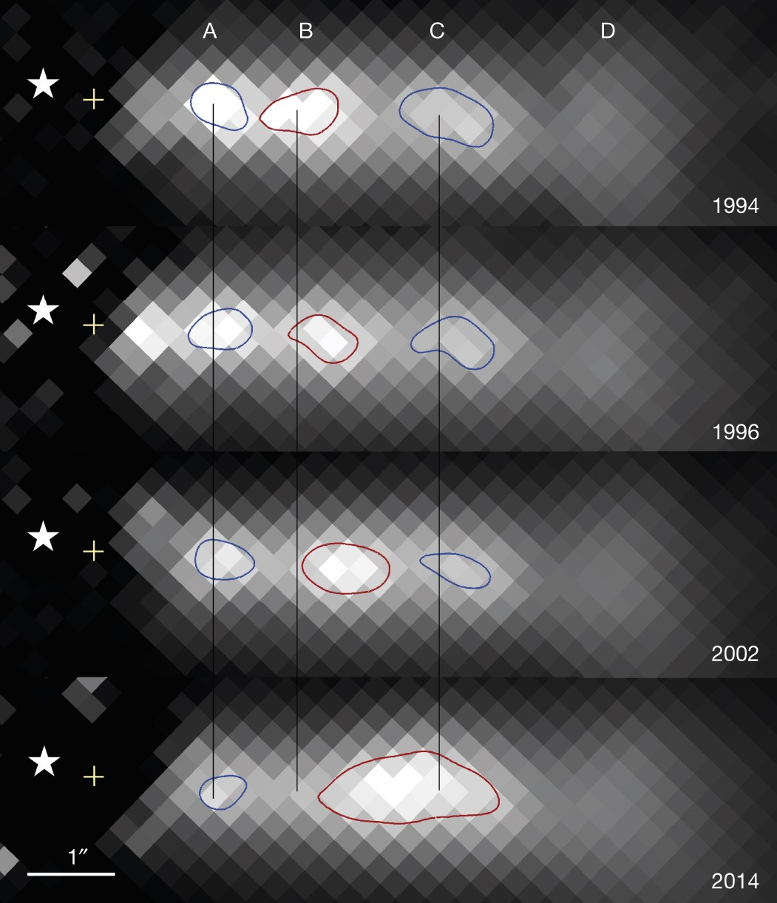
3C 264: source properties
Perlman+10
HST+Chandra
@1.6 GHz
FRI radio galaxy (z=0.0216) in Abell 1367 cluster (RA: 176.27, Dec: 19.61)
Head-tail kpc structure with extended radio, optical, X-ray jet (Lara+97, Perlman+10, Meyer+15);
𝛾-ray source:
  3FGL J1145.1+1935 (Acero+15)
  4FGL J1144.9+1937 (Abdollahi+22)
    ΓLAT =2.02 ± 0.08
    FluxLAT = (2.95 ± 0.34)×10⁻¹⁰ ph s⁻¹ cm⁻²
  The second most distant TeV-emitting radio galaxy (TeVCat)
Lara+04
Meyer+15
HST
@1.6 GHz
@1.6 GHz
2/13

Slide 3
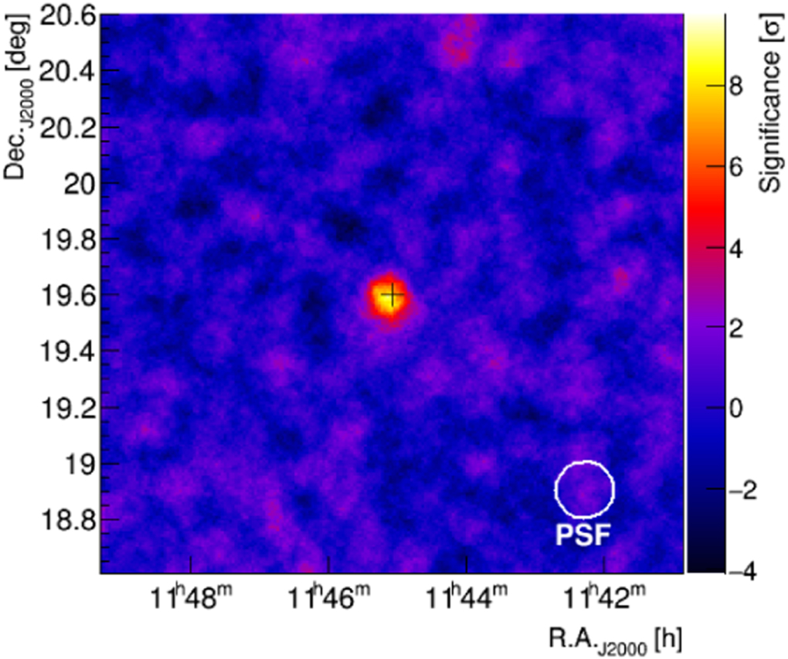
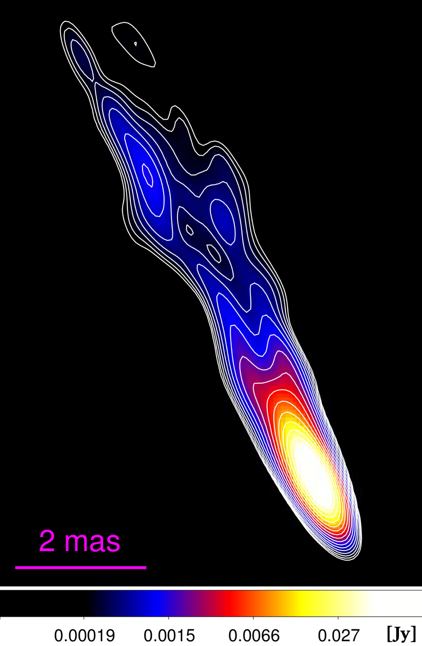
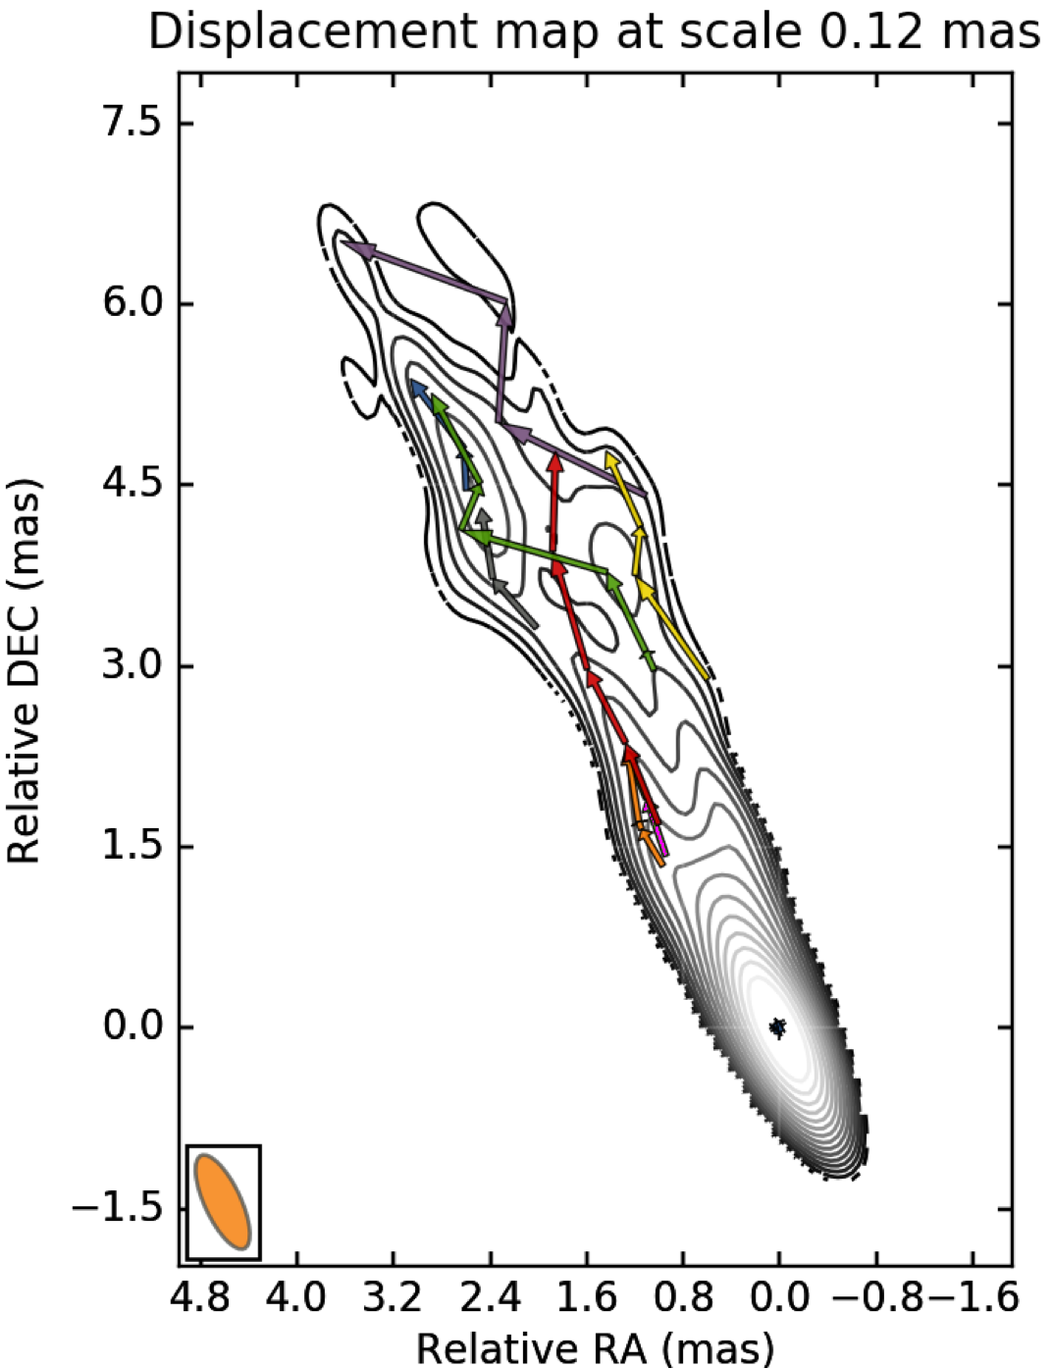
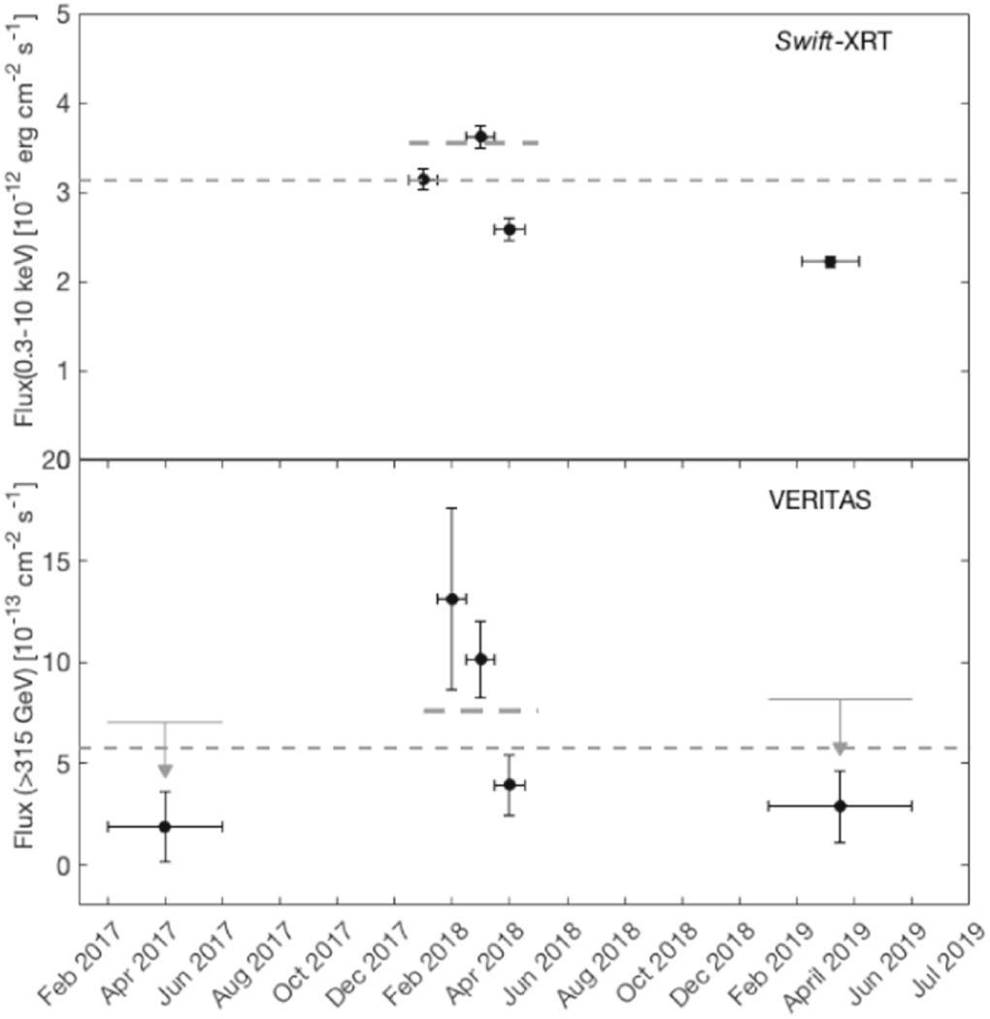

TeV flare
VERITAS detection (ATel #11436) by Mukherjee18
  VERITAS paper by Archer+20
Paper by Boccardi+19:
  unprecedented VLBI study of the jet components of 3C 264
  X-ray high state contemporary to TeV enhanced activity
$$significance=7.8σ$$
Boccardi+19
Abdo+10
3/13

Slide 4
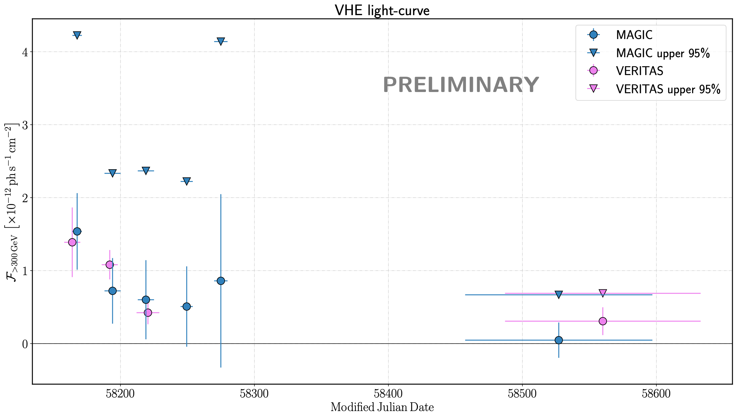
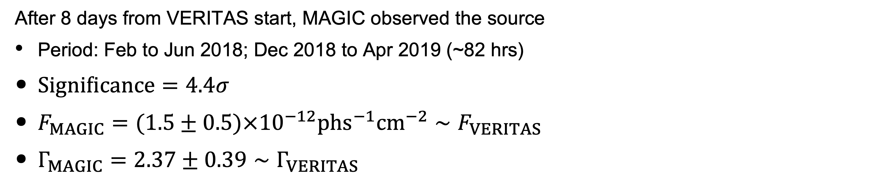
MAGIC campaign
After 8 days from VERITAS start, MAGIC observed the source
Period: Feb to Jun 2018; Dec 2018 to Apr 2019 (~82 hrs)
$Significance=4.4σ$
$F_{MAGIC}=(1.5±0.5)×{10}^{−12}phs^{−1}{cm}^{−2}∼F_{VERITAS}$
$Γ_{MAGIC}=2.37±0.39∼Γ_{VERITAS}$
4/13

Slide 5
MAGIC campaign
After 8 days from VERITAS start, MAGIC observed the source
Period: Feb to Jun 2018; Dec 2018 to Apr 2019 (~82 hrs)
$Significance=4.4σ$
$F_{MAGIC}=(1.5±0.5)×{10}^{−12}phs^{−1}{cm}^{−2}∼F_{VERITAS}$
$Γ_{MAGIC}=2.37±0.39∼Γ_{VERITAS}$
FADING TREND
TRIGGER FOR MULTI-WAVELENGTH VARIABILITY ANALYSIS
4/13

Slide 6

MWL results
  No statistically significant variability in GeV band (likely limited by the statistics)
  X-ray high state contemporary to TeV flare (2018)
  Softening when fading trend in X-ray after 2018
5/13

Slide 7
SED modeling
Boccardi+19 suggest a multi-zone leptonic model to explain the observed SED in the high-state
(steady core emission + transient component)
Softening when fading trend in X-rays after 2018
+
TeV fading after 2018
NEW APPROACH
Self-consistent time-dependent modelling of the source from the high to the low state
6/13

Slide 8
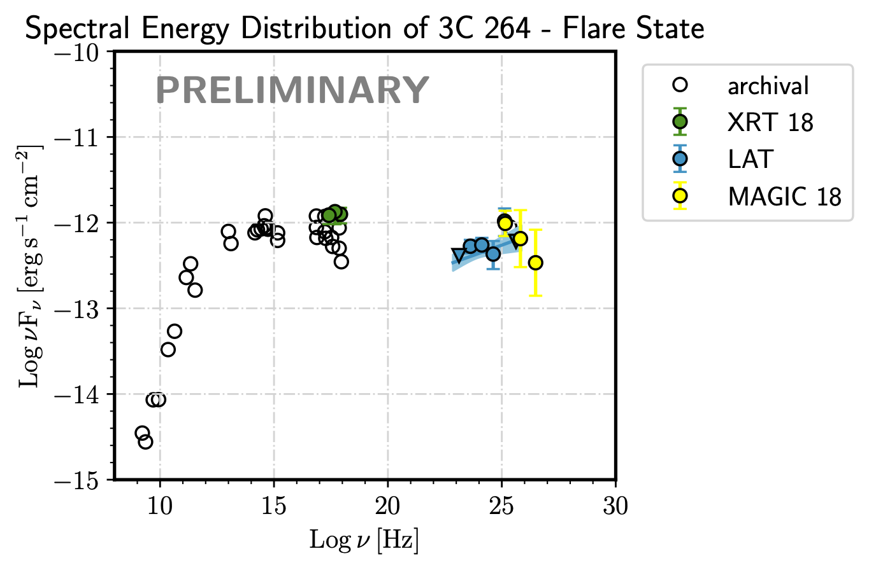

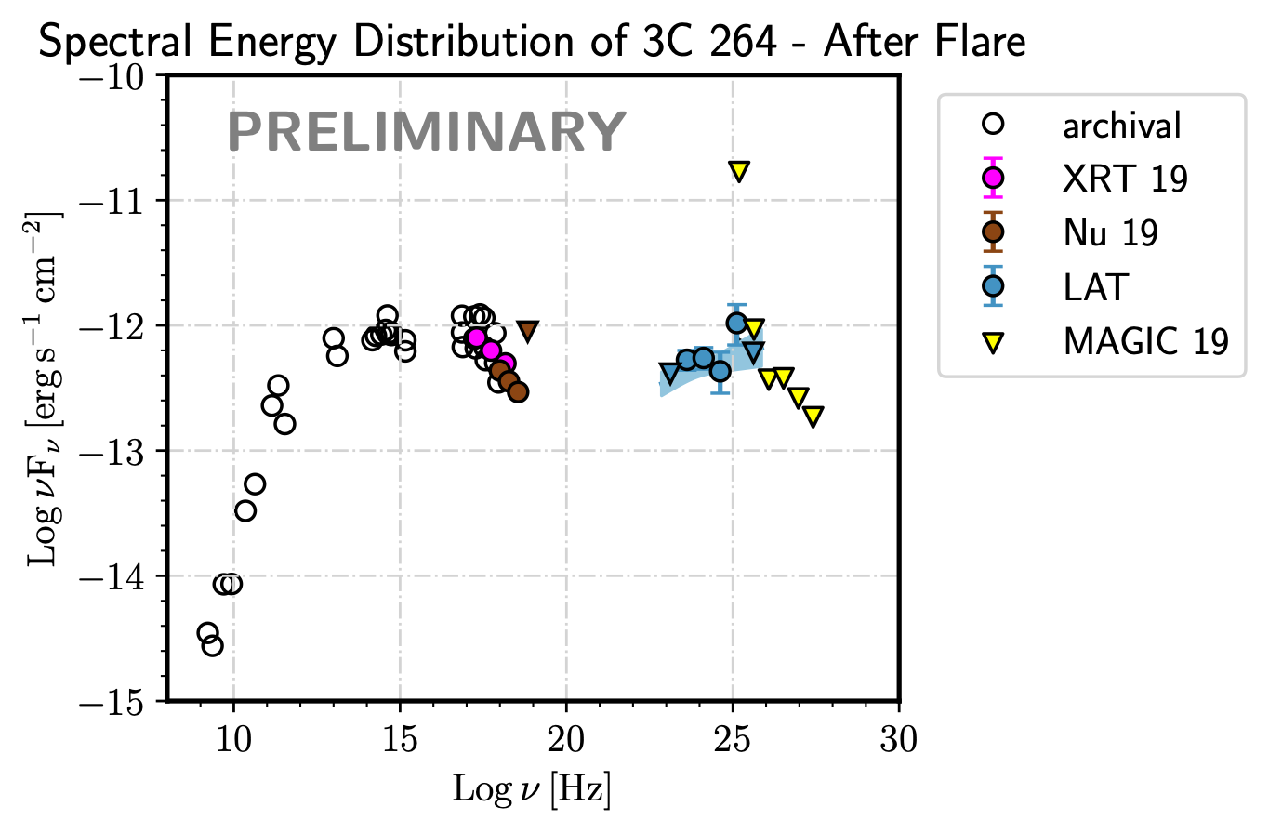
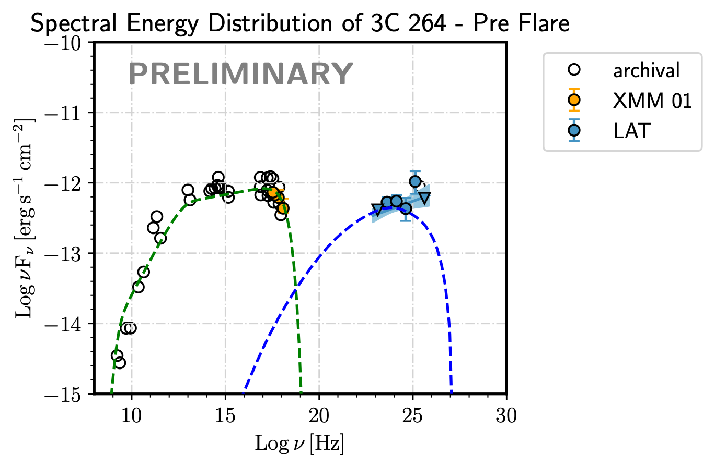
SED modelling
steady emission from the core
sync
SSC
TIME
8/15

Slide 9



SED modelling
steady emission from the core
INJECTION OF NEW ENERGETIC PARTICLES IN THE EJECTION FLOW
sync
SSC
TIME
8/15

Slide 10

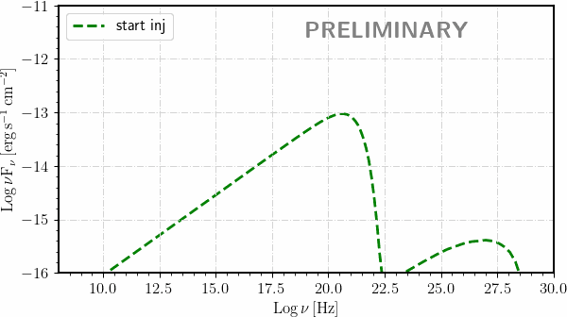
SED modeling
ARTISTIC VIEW BY A NON-ARTIST
BOLOGNA
INJECTION PHASE
accretion
flow
injection
base
SMBH
jet
steady emission from the core not shown!
7/13

Slide 11



SED modelling
RADIATIVE COOLING OF INJECTED ELECTRONS
steady emission from the core
INJECTION OF NEW ENERGETIC PARTICLES IN THE EJECTION FLOW
sync
SSC
TIME
10/15

Slide 12

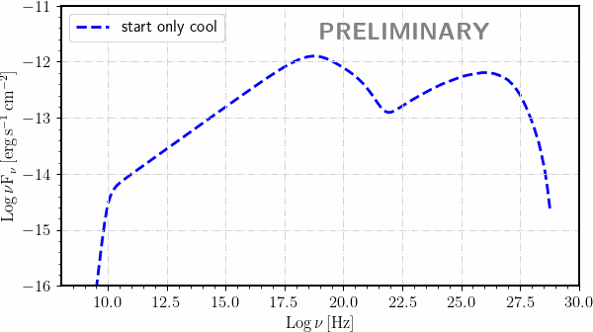
SED modeling
ARTISTIC VIEW BY A NON-ARTIST
BOLOGNA
ONLY COOLING PHASE
accretion
flow
injection
base
SMBH
jet
steady emission from the core not shown!
8/13

Slide 13
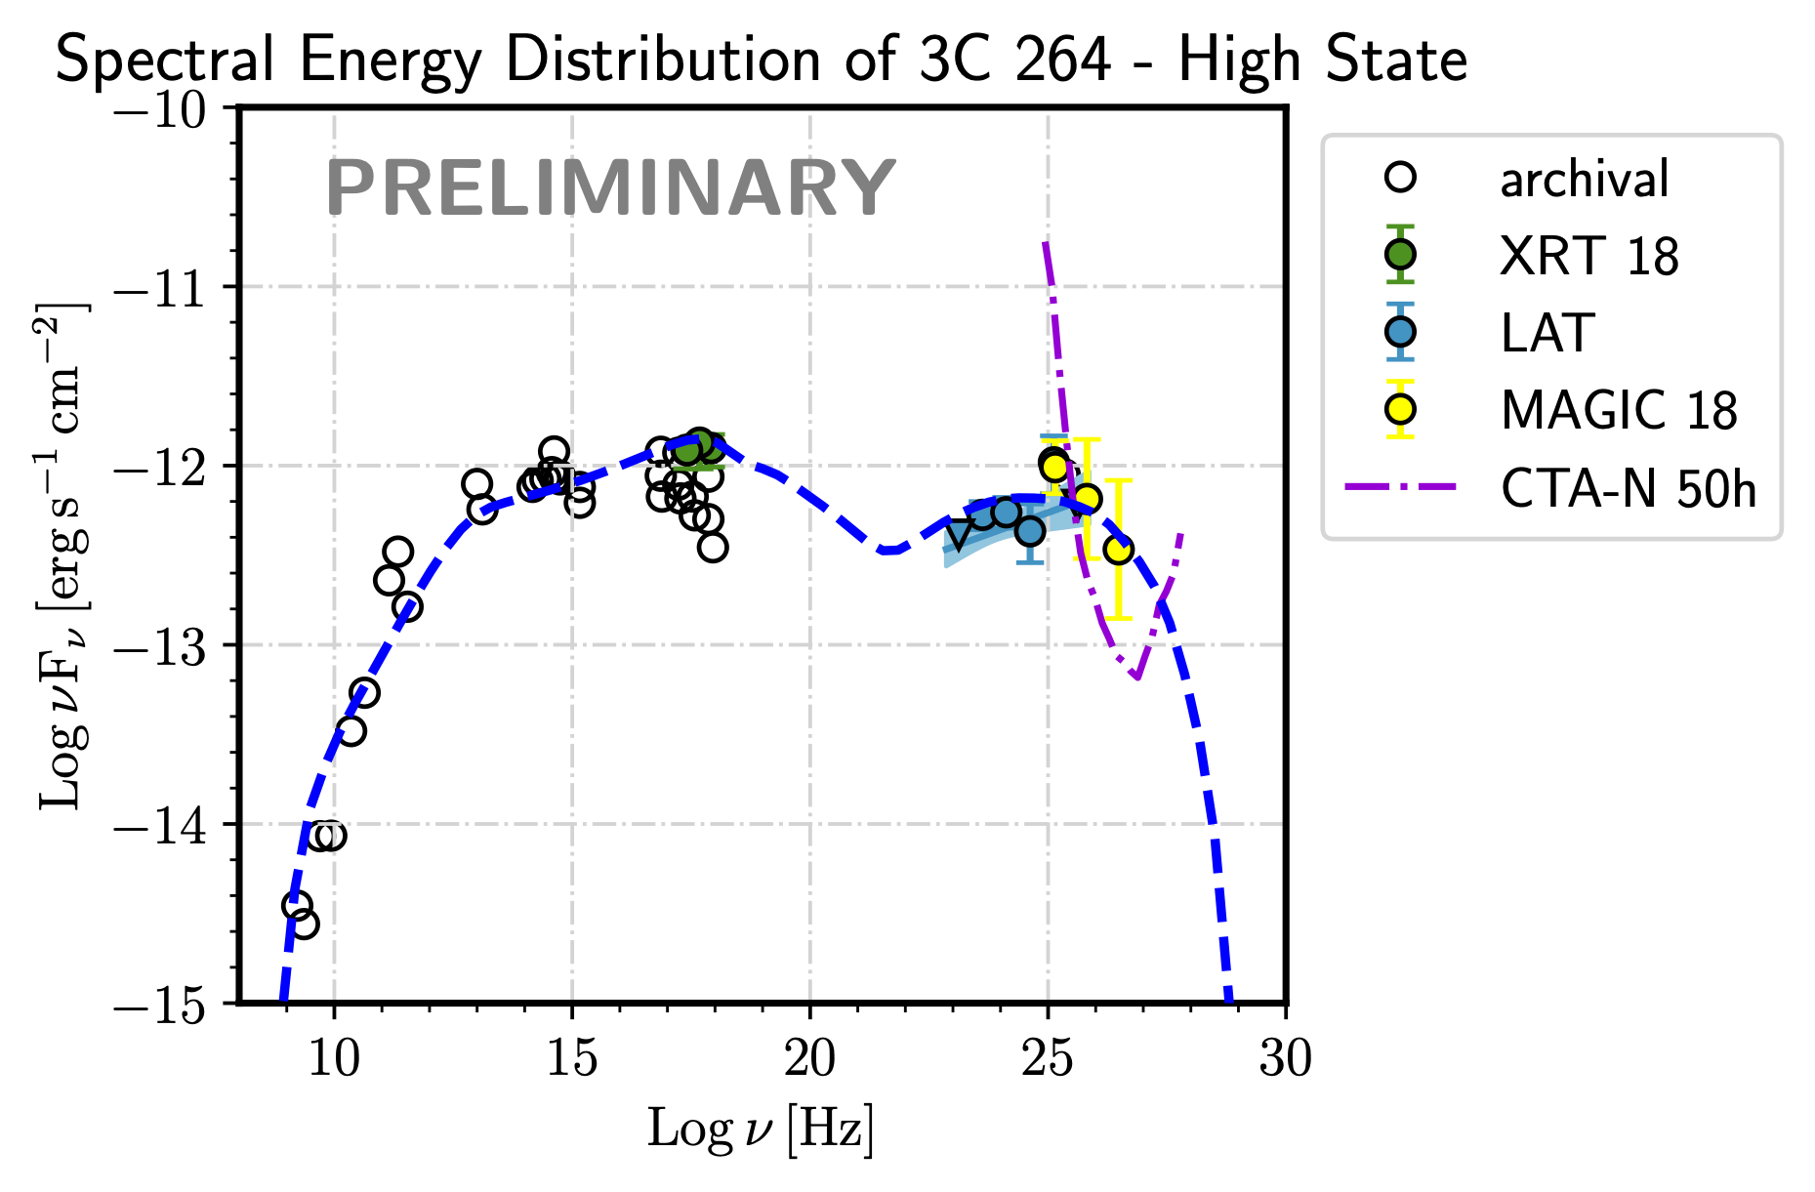
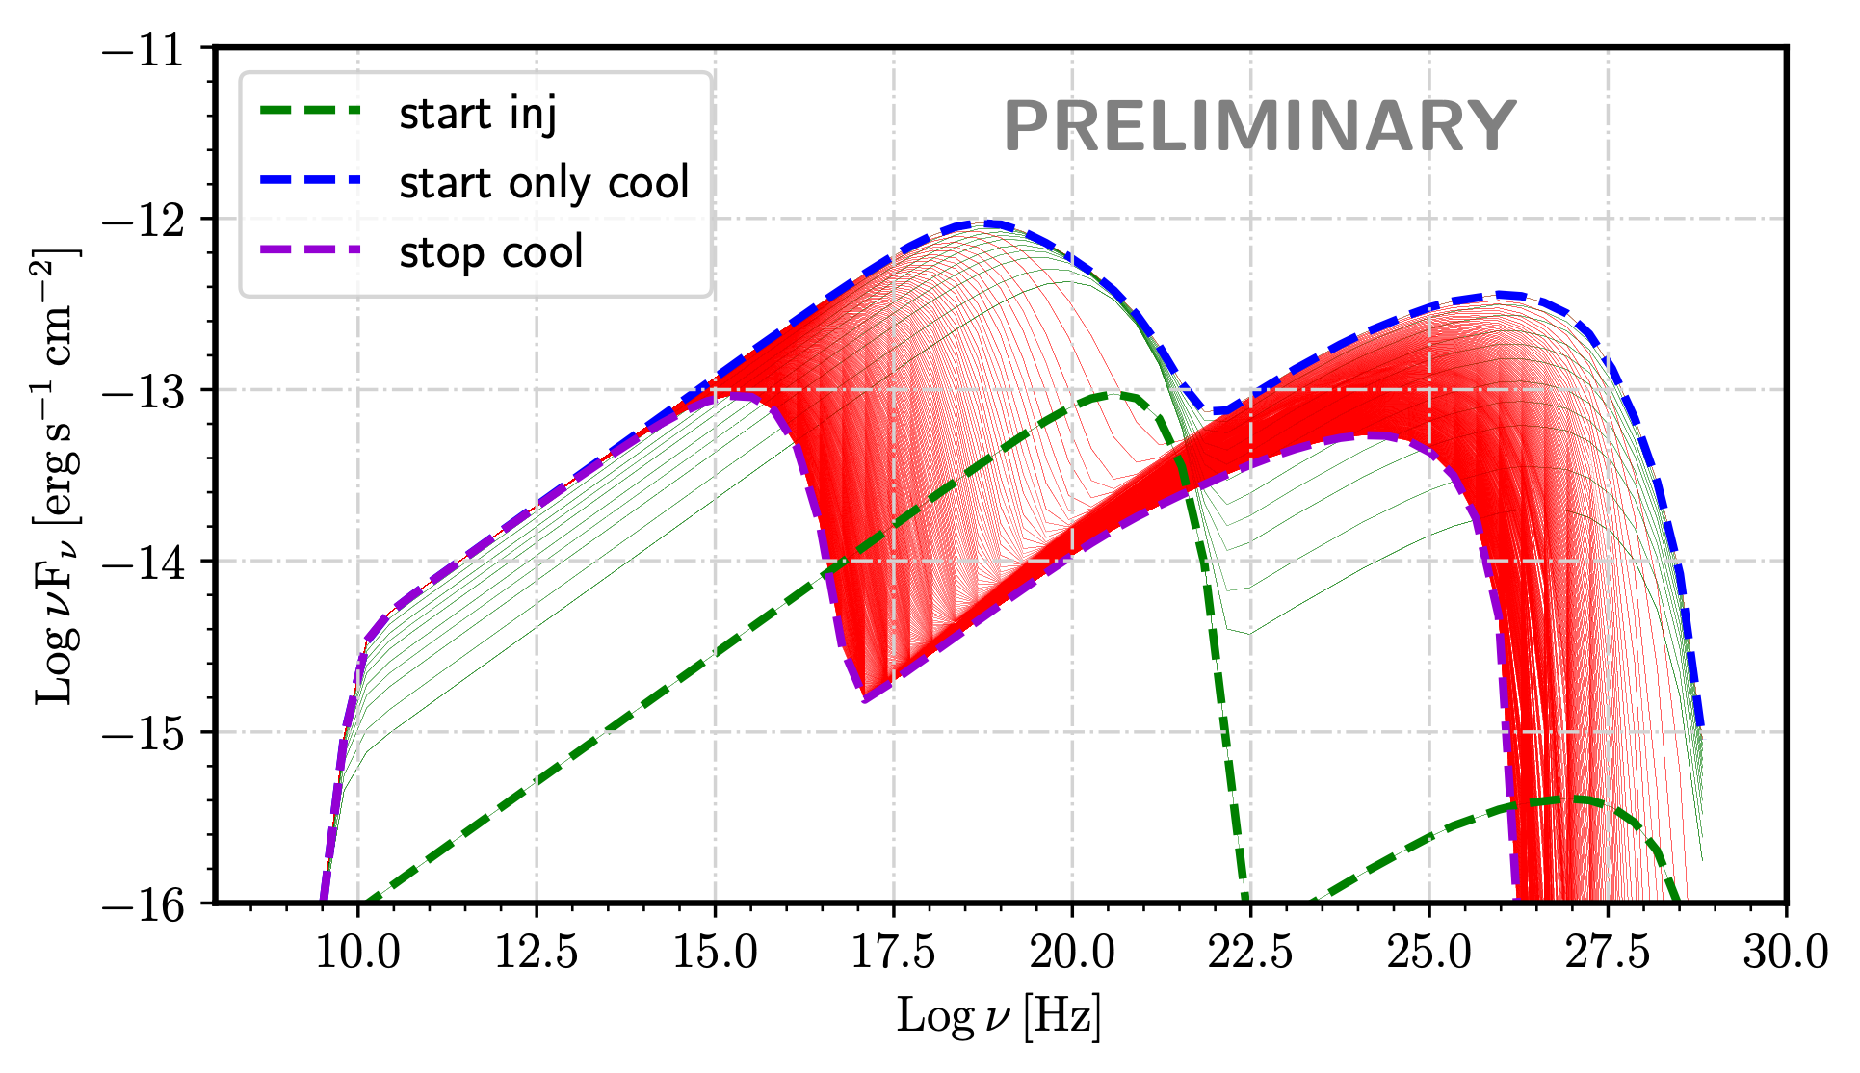


3C 264: SED modeling of the highest state
$R={10}^{16}cm$
$B∼{10}^{−2}G$
$p=2.4$
$γ_{min}=1$
$γ_{max}={10}^{6}$
$Δt_{inj}=2.5×{10}^{6}s$ (blob rest frame)
$L_{inj}=3×{10}^{41}erg/s$
t = t(start only cooling)
9/13

Slide 14
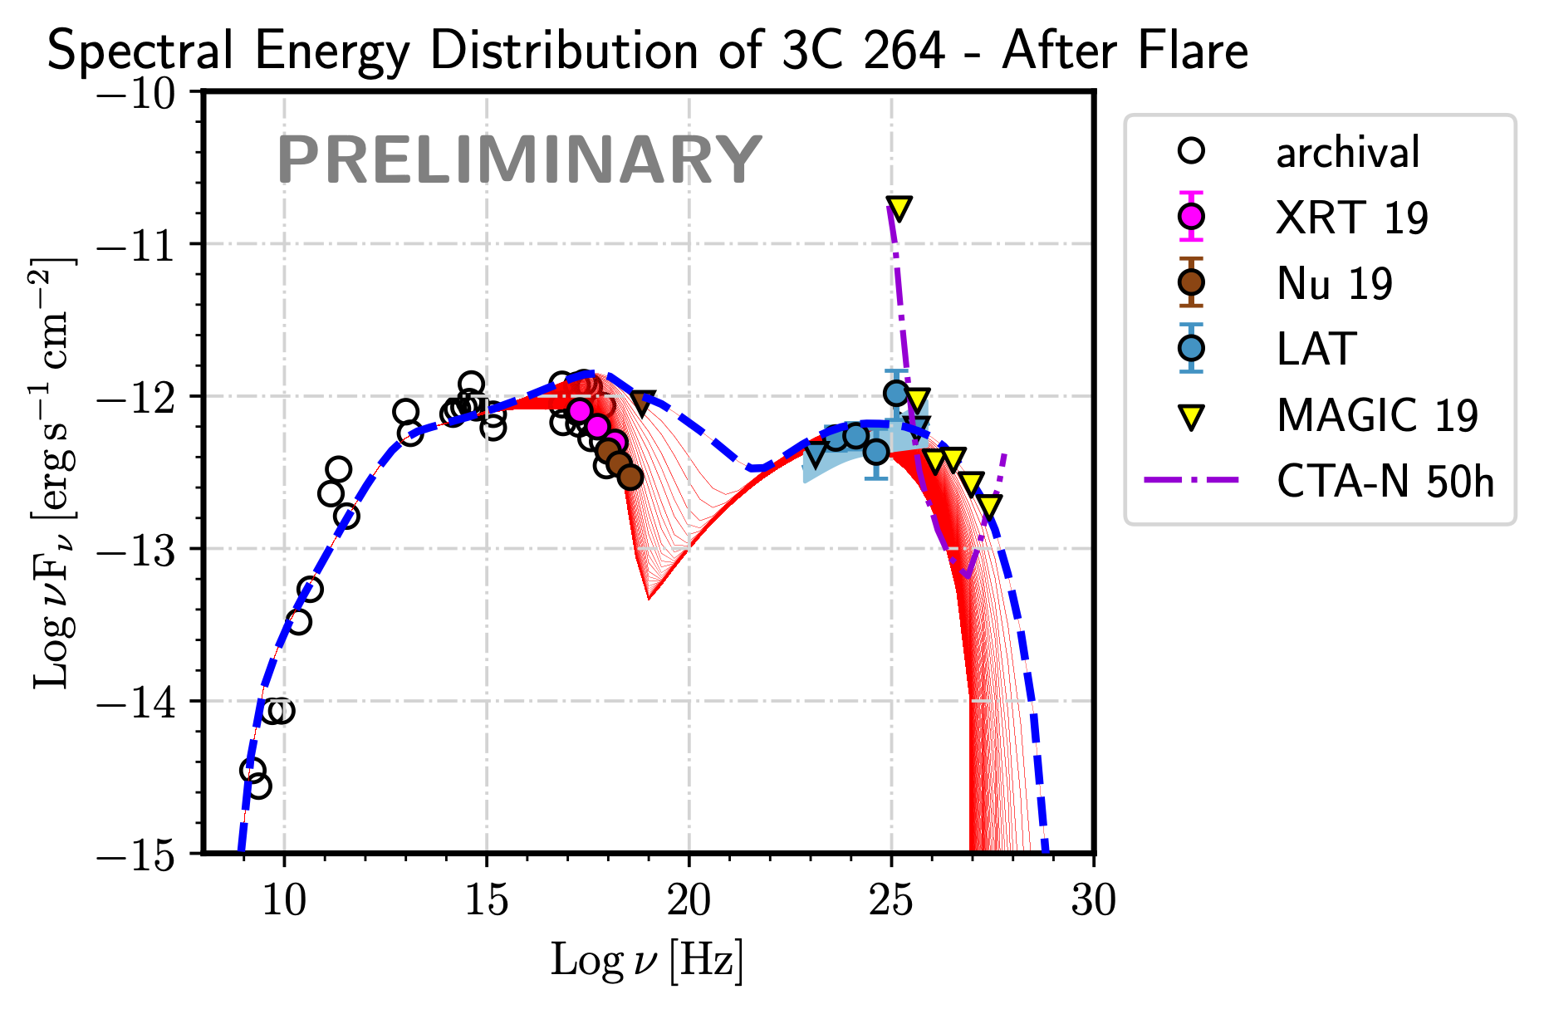
3C 264: SED modeling after flare
$R={10}^{16}cm$
$B∼{10}^{−2}G$
$p=2.4$
$γ_{min}=1$
$γ_{max}={10}^{6}$
$Δt_{inj}=2.5×{10}^{6}s$ (blob rest frame)
$L_{inj}=3×{10}^{41}erg/s$
t > t(start only cooling)
10/13

Slide 15
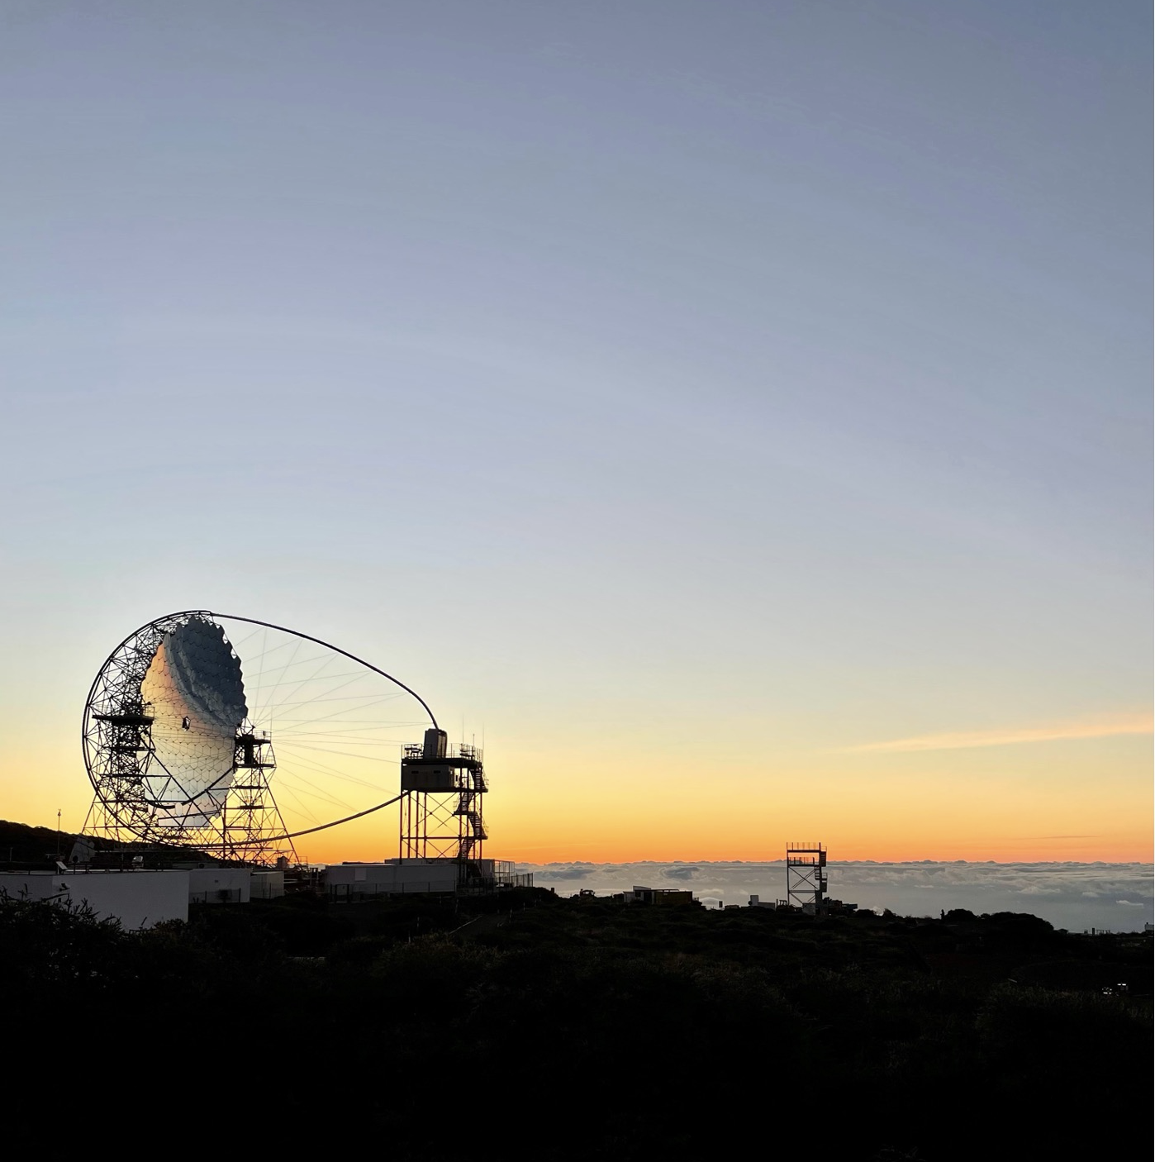
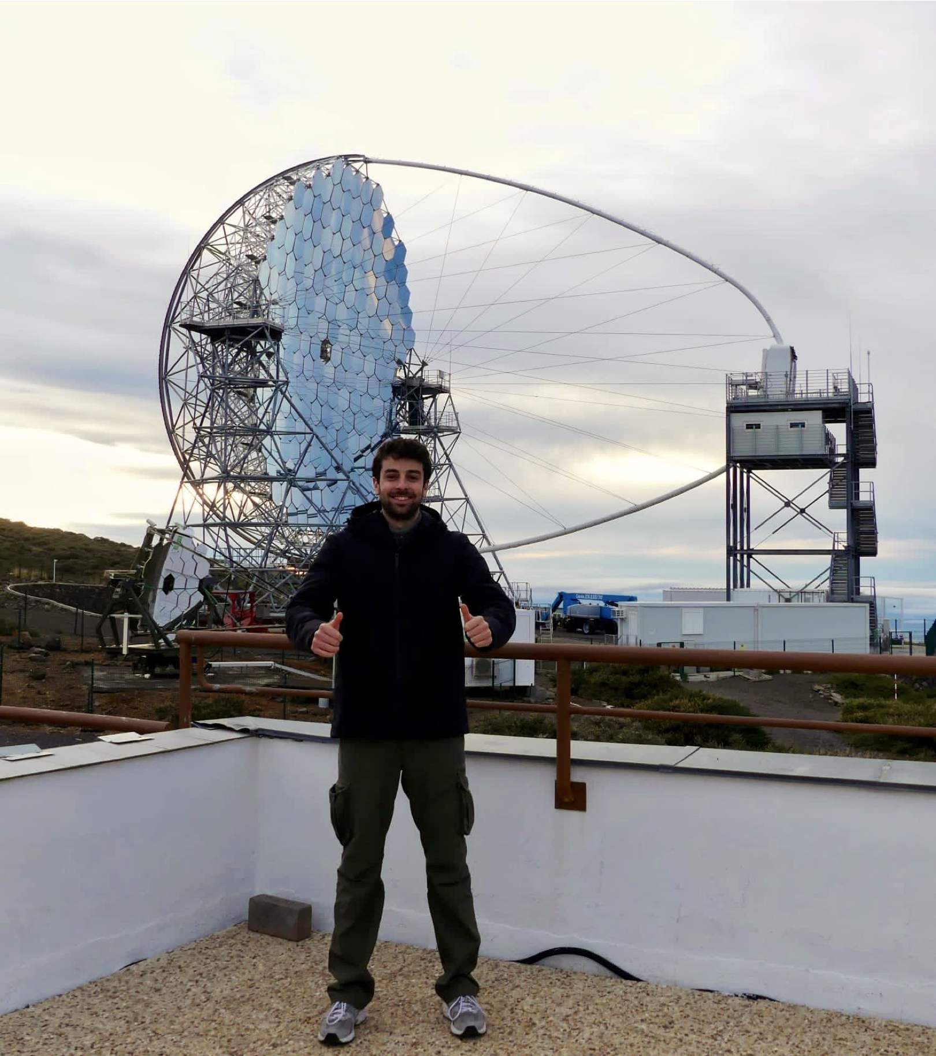
Future perspectives
3C 264 represents the first radio galaxy to which this original and innovative approach has been applied.
Similar studies could be performed on other highly promising sources by MAGIC+LST1.
In the future, such models may be applied to a larger sample of sources, thanks to the CTA-N site
MAGIC-I view of LST1
MY view of LST1
Image credits: E. Bronzini
Image credits: I. Burelli
11/13

Slide 16
Future perspectives
3C 264 represents the first radio galaxy to which this original and innovative approach has been applied.
Similar studies could be performed on other highly promising sources by MAGIC+LST1.
In the future, such models may be applied to a larger sample of sources, thanks to the CTA-N site
MAGIC-I view of LST1
MY view of LST1
MY view of LST1
Image credits: E. Bronzini
Image credits: I. Burelli
Image credits: I. Burelli
11/13

Slide 17
Summary
To sum up:
3C 264: second most distant TeV detected radio galaxy observed by VERITAS and MAGIC
X-TeV common behaviours (low/high in 2018/2019)
no statistically significant GeV variability
“softening when fading” trend after 2018
Self-consistent time-dependent model to explain the observations:
  steady emission from the core
  injection (flare) and cooling (after flare) of new energetic particles in the ejection flow
12/13

Slide 18

Image credits: G. De Palma

Slide 19
BACKUP SLIDES
Investigating the Quiescent State of the TeV-Emitting Radio Galaxy 3C 264

Slide 20
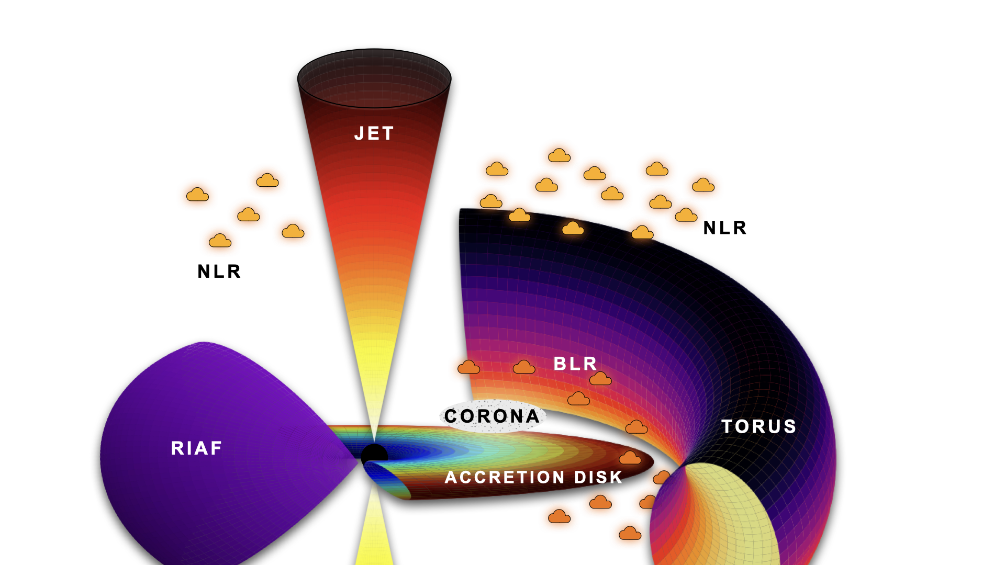
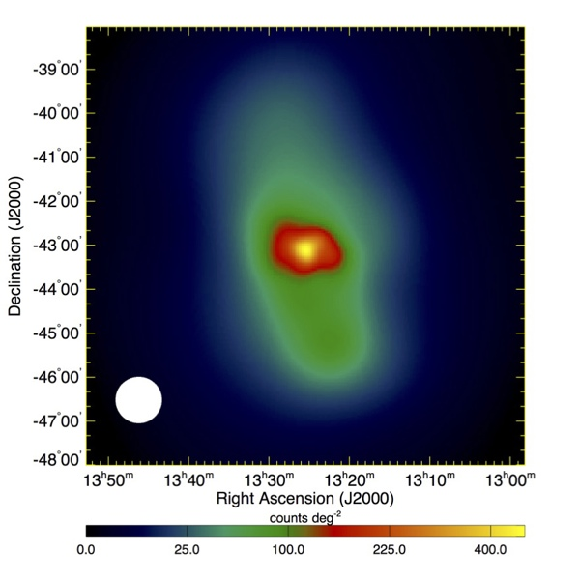
Radio Galaxies (I): a general overview
Why radio galaxies?
accretion and ejection processes: less jet-dominated SED in radio galaxies wrt blazars
radio galaxies complementary to blazars => unique opportunity to study 𝛾-ray emission processes at different sites from sub-pc up to kpc scales (e.g., from the radio lobes in Cen A (Abdo+10), Fornax A (Ackermann+16) )
According to Unification Models (Antonucci93, Urry&Padovani+95), jetted AGN are split into two main classes on the base of the jet angle:
  blazars
  radio galaxies
Image credits: E. Bronzini
Cen A
Abdo+10
Fermi-LAT 𝛾-ray (>200 MeV)

Slide 21
Radio Galaxies (I): a general overview

Slide 22
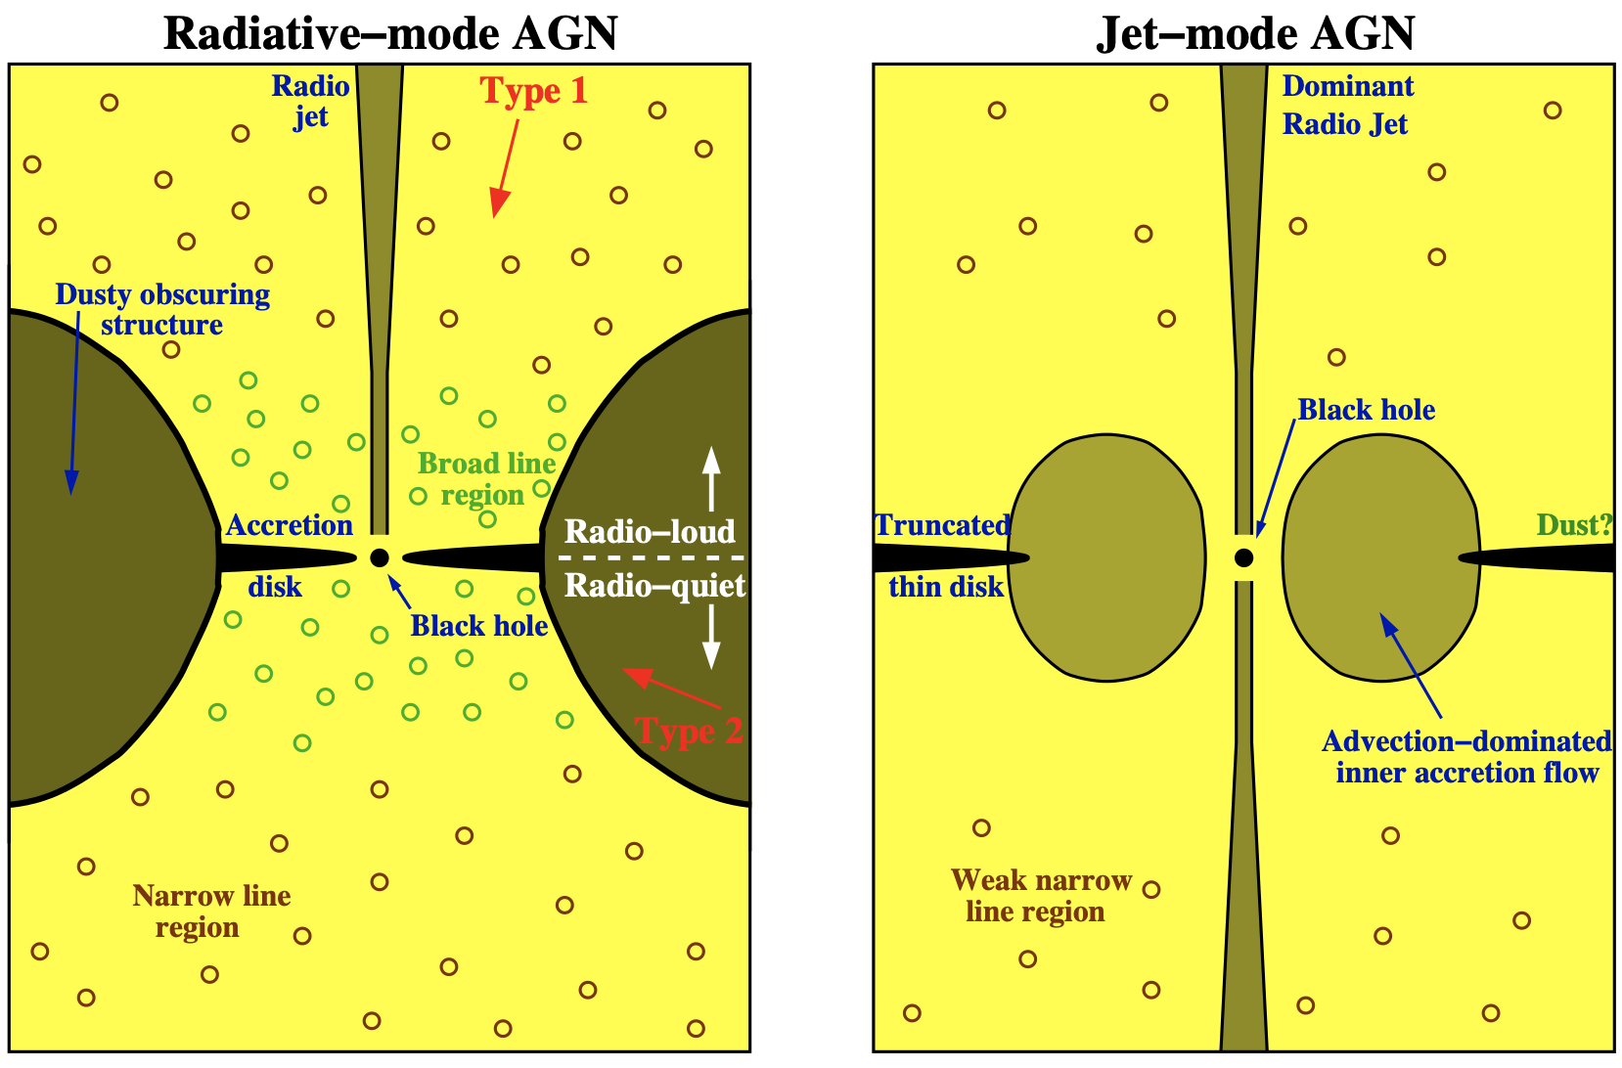
Radio Galaxies (I): a general overview
Why radio galaxies?
accretion and ejection processes: less jet-dominated SED in radio galaxies wrt blazars
radio galaxies complementary to blazars => unique opportunity to study 𝛾-ray emission processes at different sites from sub-pc up to kpc scales (e.g., from the radio lobes in Cen A (Abdo+10), Fornax A (Ackermann+16) )
According to Unification Models (Antonucci93, Urry&Padovani+95), jetted AGN are split into two main classes on the base of the jet angle:
  blazars
  radio galaxies
but.. what about accretion?
Heckman&Best14
HERG
LERG
Cen A
Abdo+10
Fermi-LAT 𝛾-ray (>200 MeV)

Slide 23
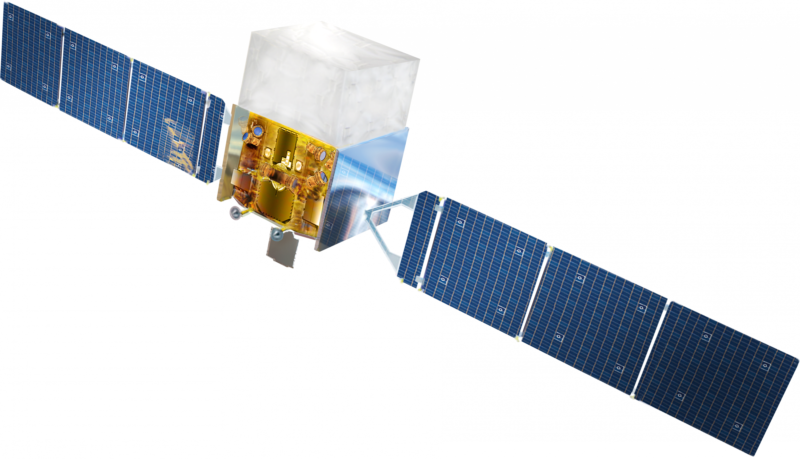
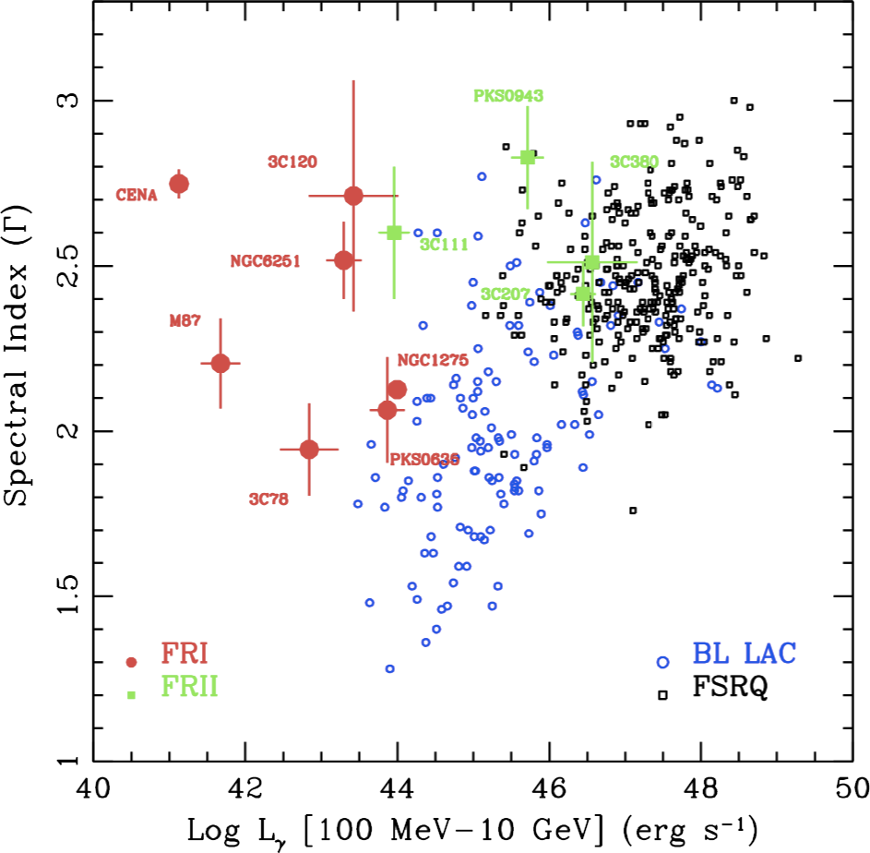
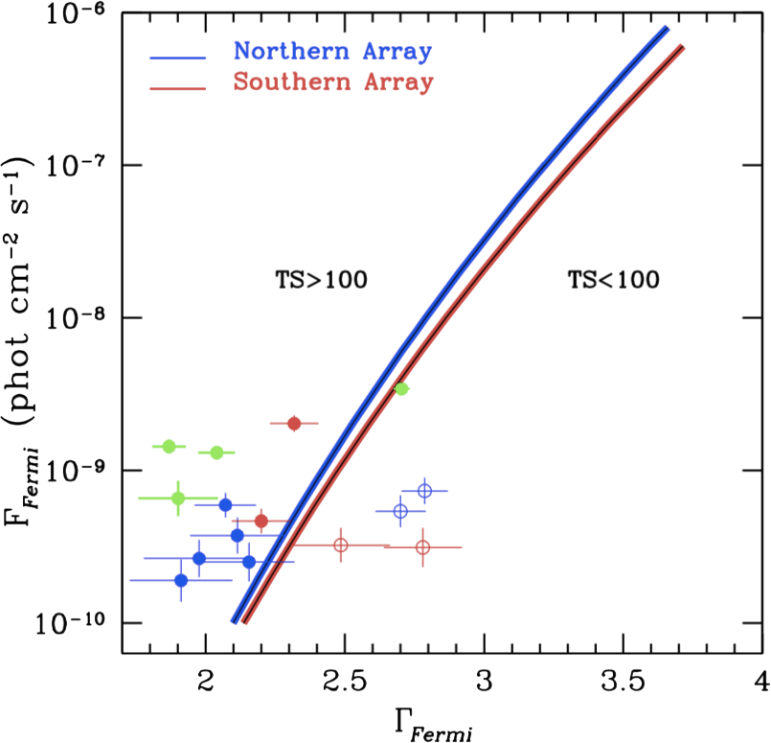

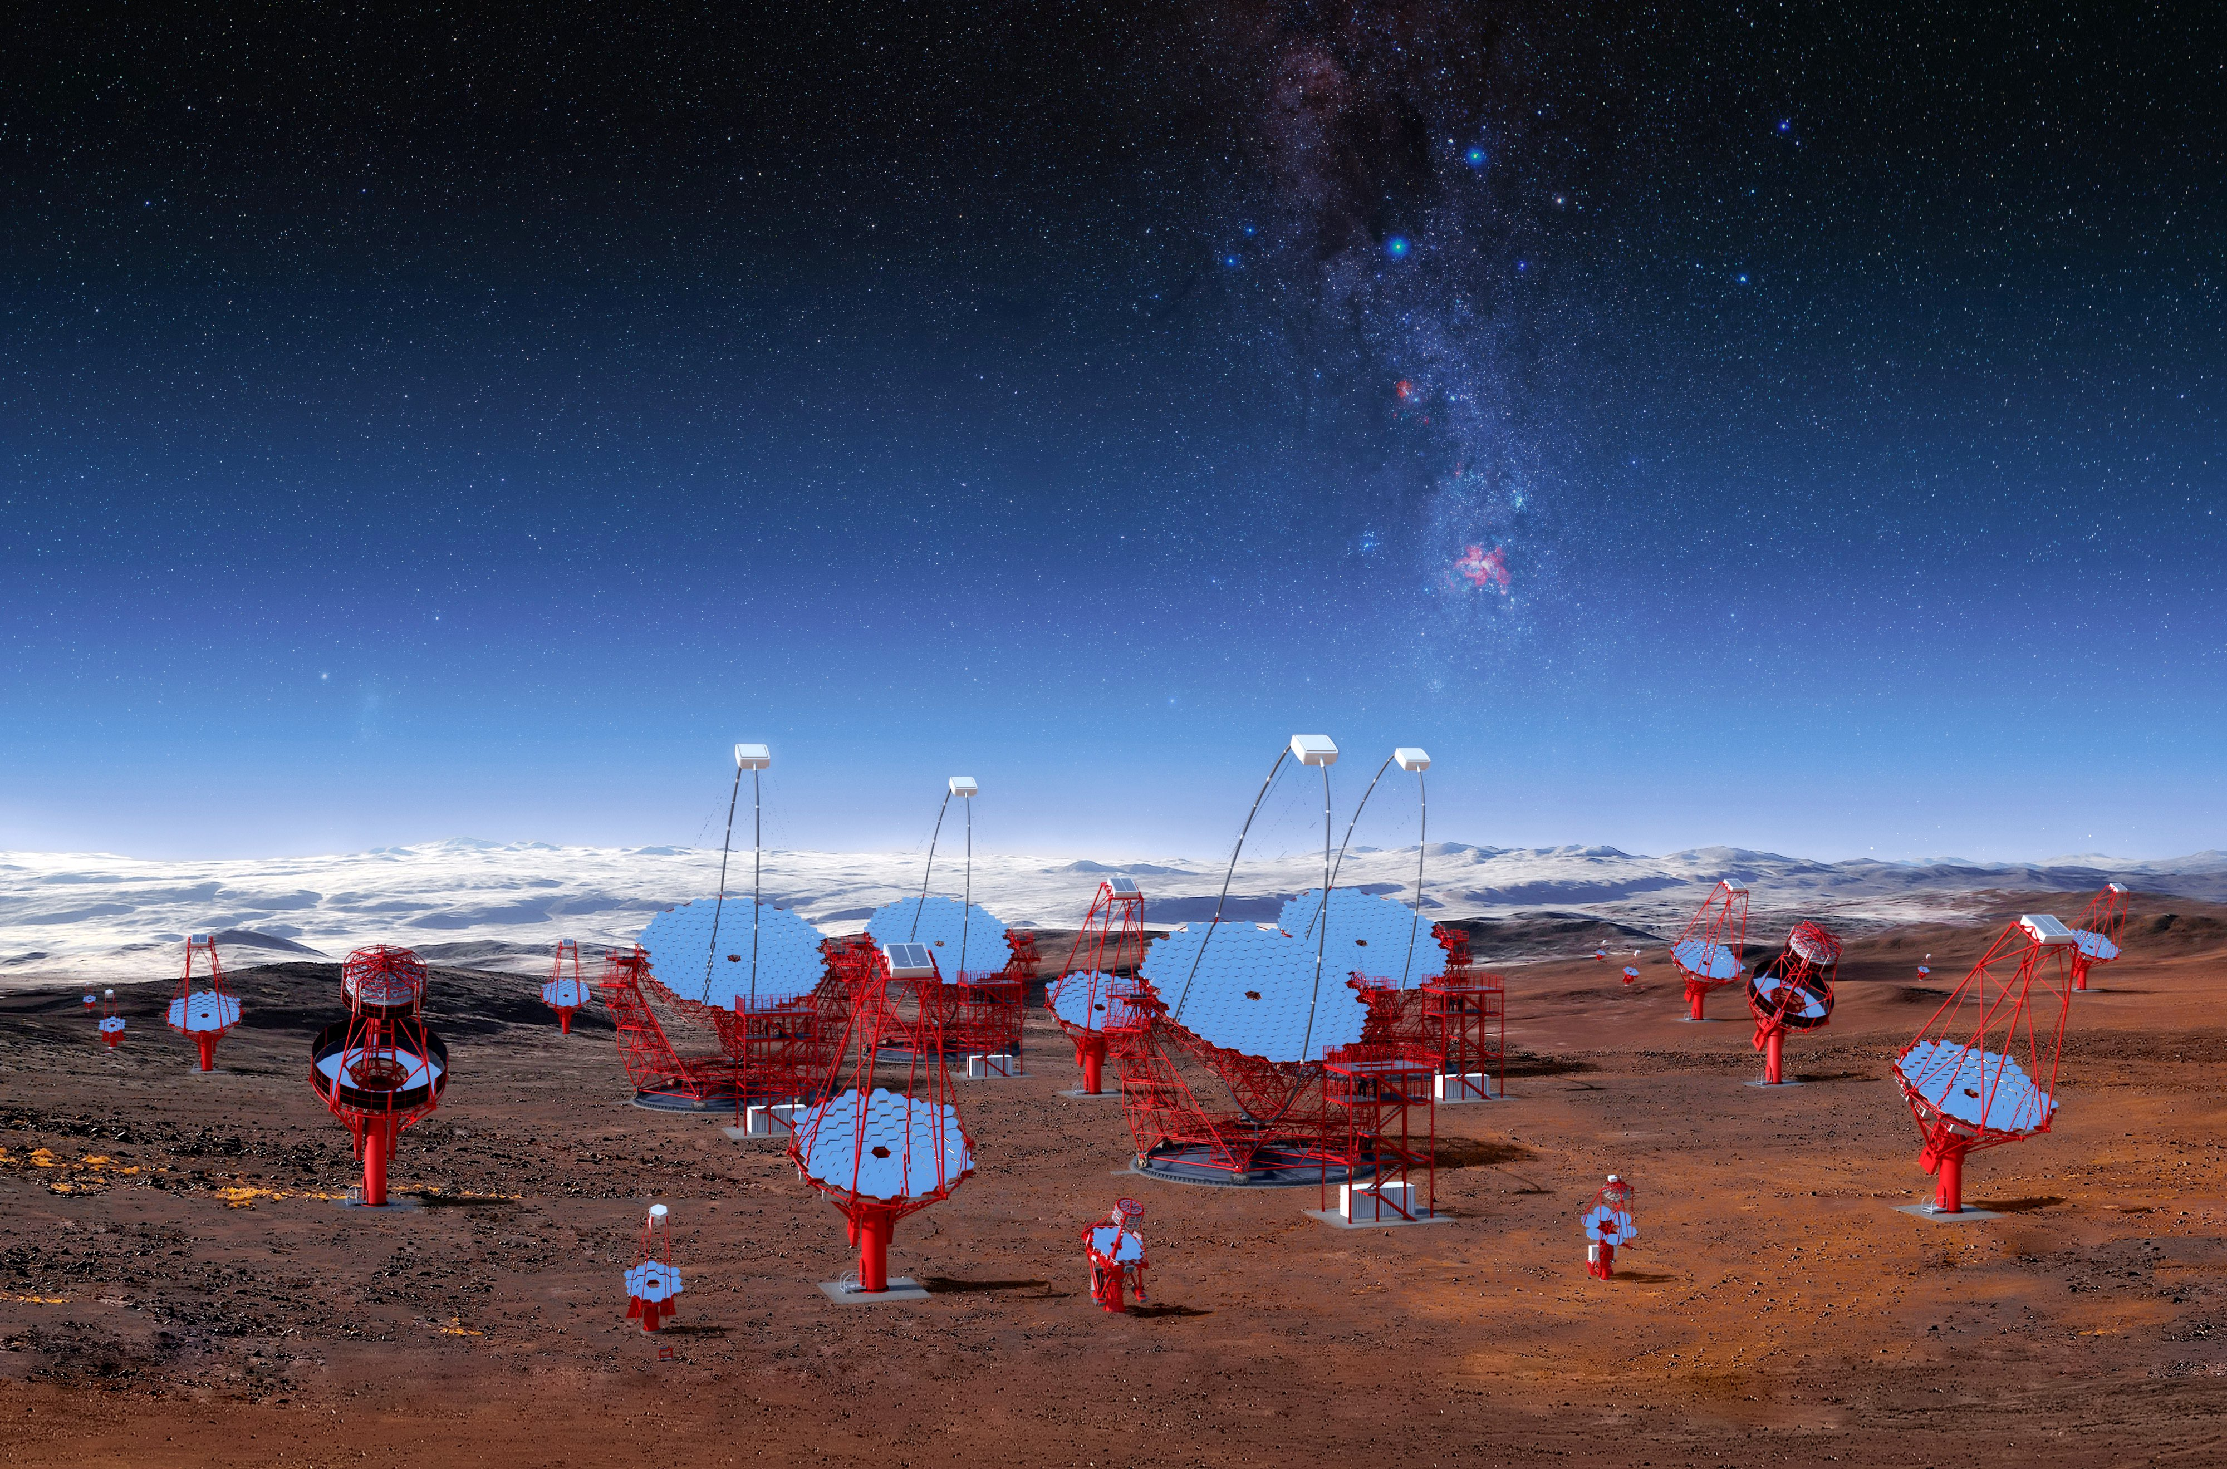

Radio Galaxies: $γ$-ray view
GeV view
TeV view
The extragalactic 𝛾-ray sky seen by Fermi-LAT is dominated by blazars and radio galaxies represent a small percentage (~2%) of the 4FGL-DR4 (Ballet+23) (see also Foschini+22)
Only 6 RGs observed at TeV energies (TeVCat): Centaurus A, M 87, NGC 1275, IC 310, 3C 264, PKS 0625-35
All nearby FR I (z≲0.05)
3C 264: VHE-emitter candidate since 2017 (Angioni+17)
Abdo+10
Angioni+17
first ~15 months
CTA prospects
50 hrs
3C 264

Slide 24
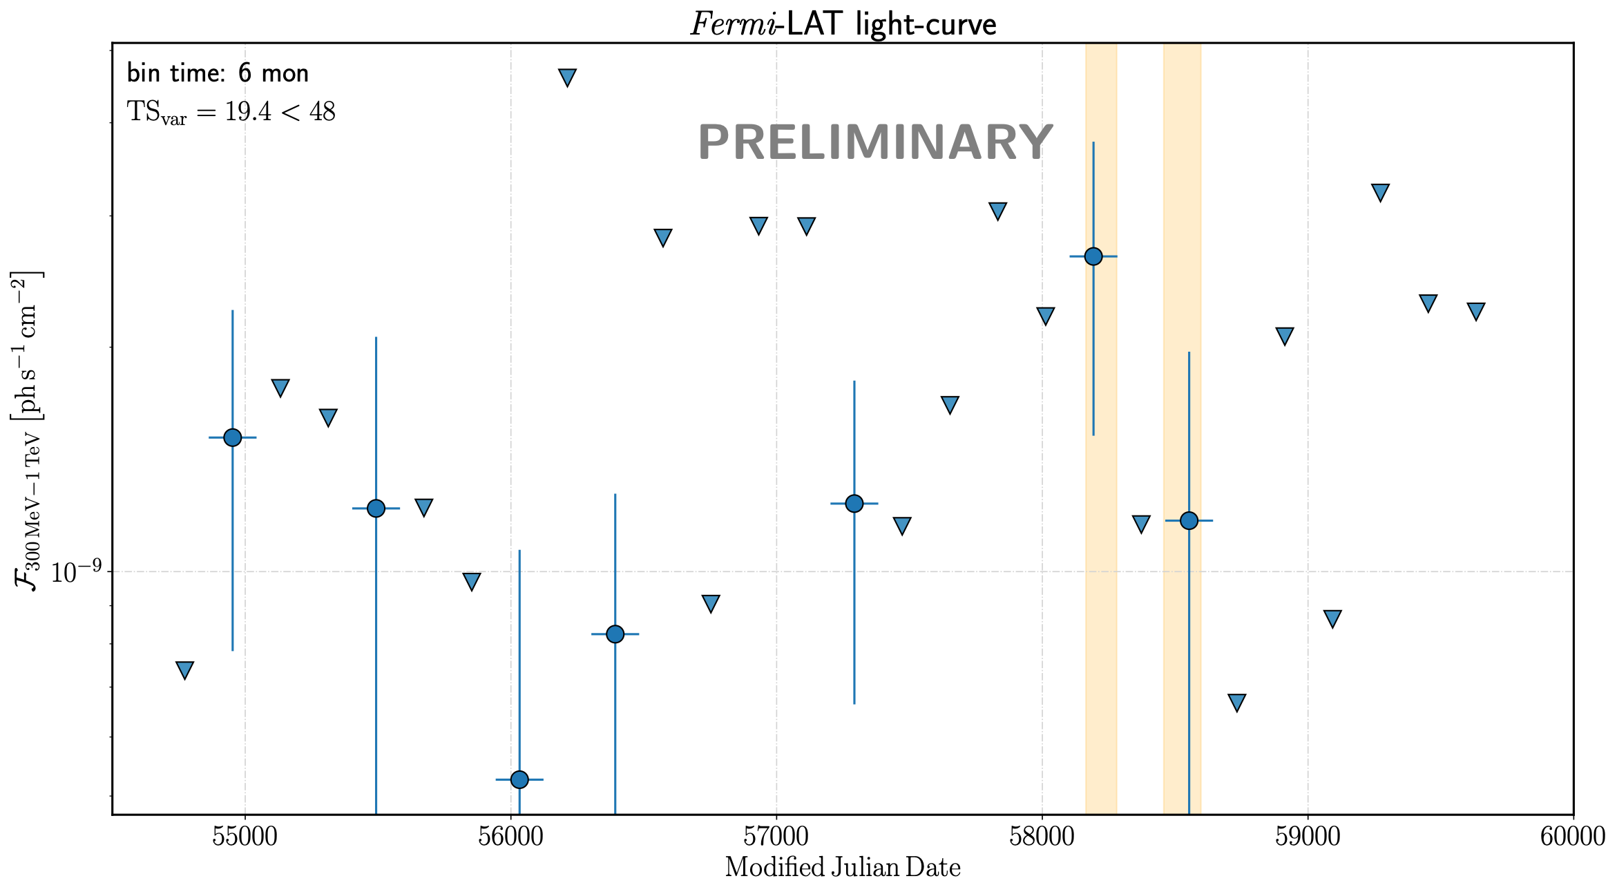
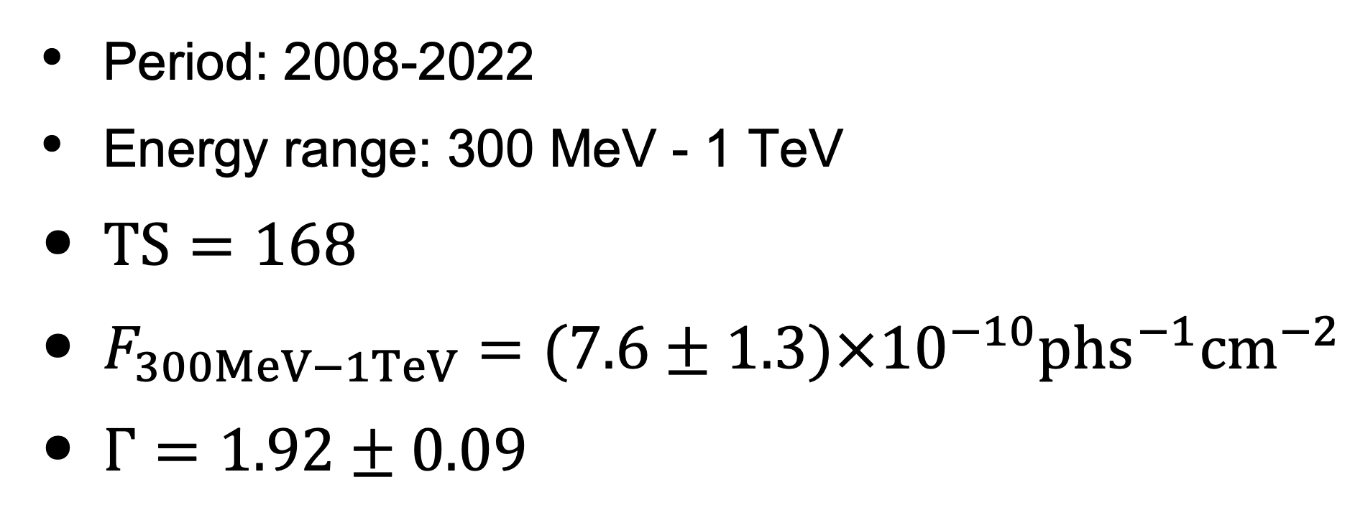
Fermi-LAT
Period: 2008-2022
Energy range: 300 MeV - 1 TeV
$TS=168$
$F_{300MeV−1TeV}=(7.6±1.3)×{10}^{−10}phs^{−1}{cm}^{−2}$
$Γ=1.92±0.09$
MAGIC campaign
NO STATISTICALLY SIGNIFICANT GeV-VARIABILITY

Slide 25
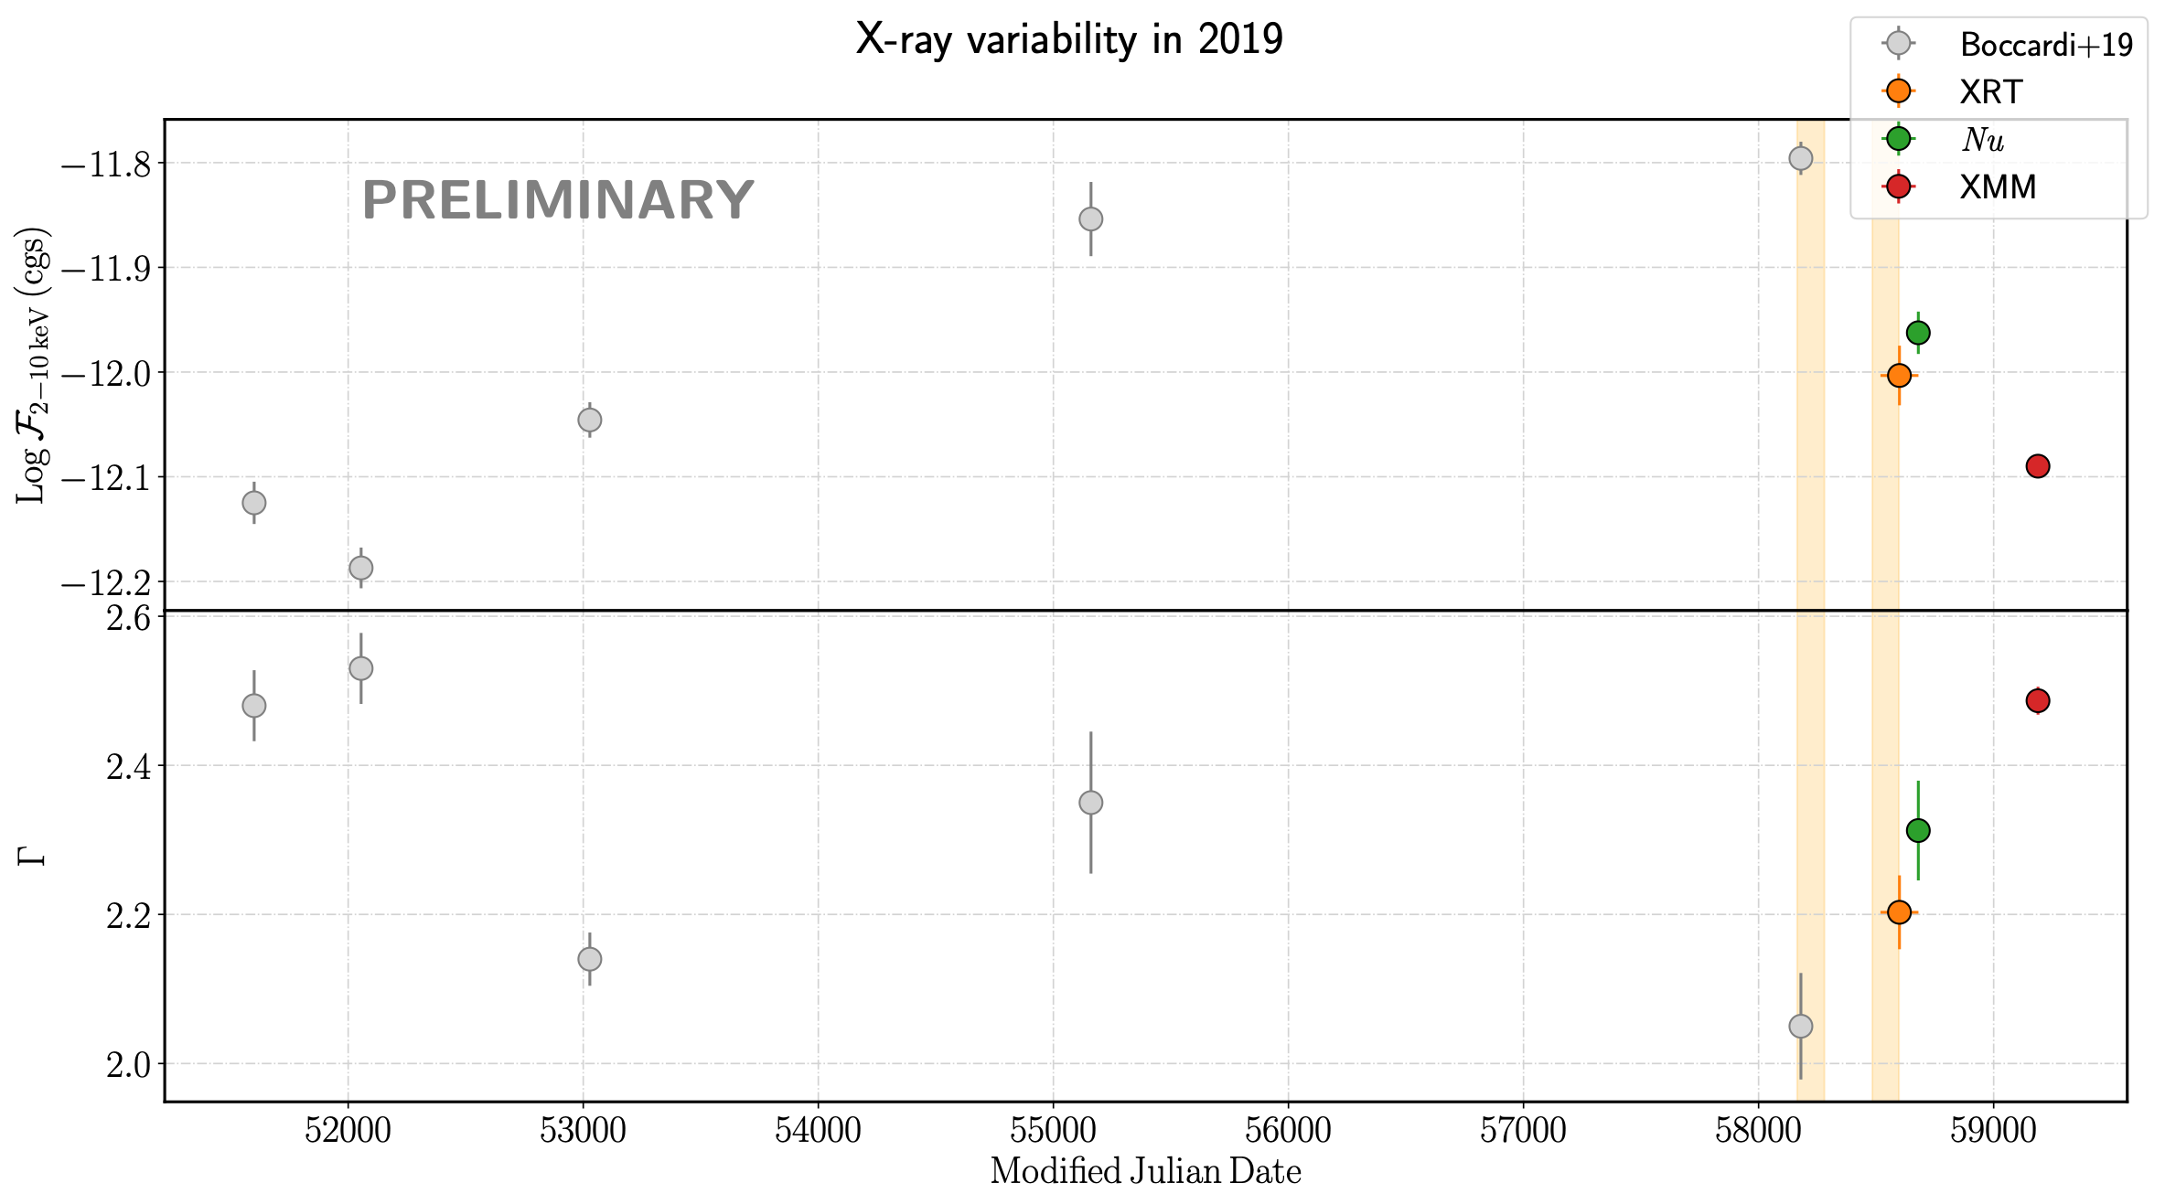
3C 264: X-ray
Best-fit model: power-law model
No statistically significant X-ray variability in 2019
Flux decrease from 2018 to 2020 of a factor of ~2
“Hardening when brightening” trend

Slide 26
3C 264: X-ray
Lightcurve from 2000 to 2020
New data from XMM-Newton, Swift, NuSTAR
(15 new obs)
Flux decrease from 2018 to 2020 of a factor of ~2
“Softening when fading” after 2018

Slide 27
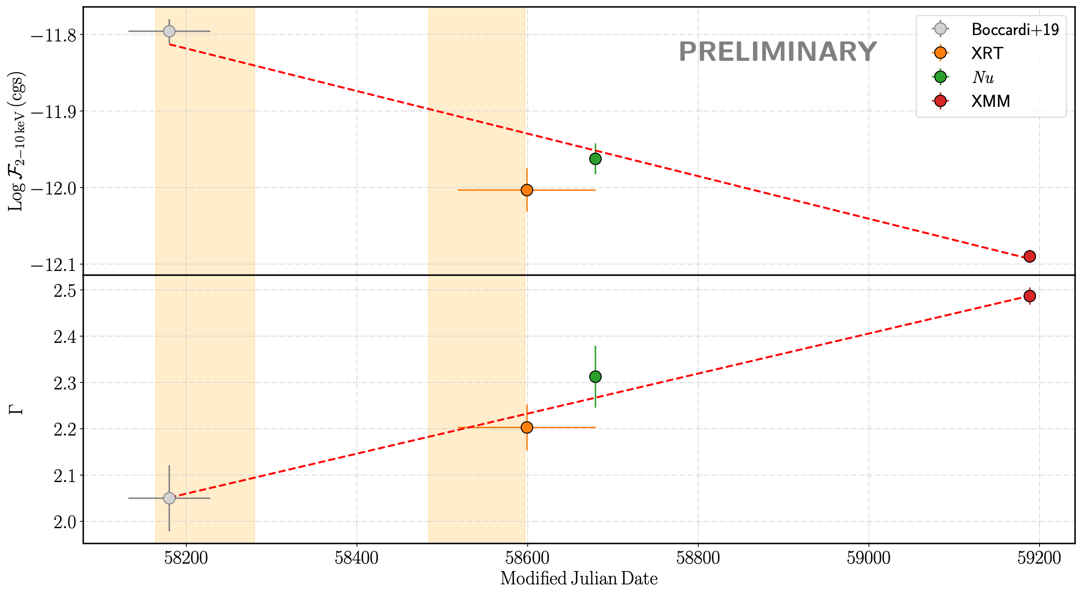
3C 264: X-ray
Lightcurve from 2000 to 2020
New data from XMM-Newton, Swift, NuSTAR
(15 new obs)
Flux decrease from 2018 to 2020 of a factor of ~2
“Softening when fading” trend after 2018
TeV flare
MAGIC campaign

Slide 28

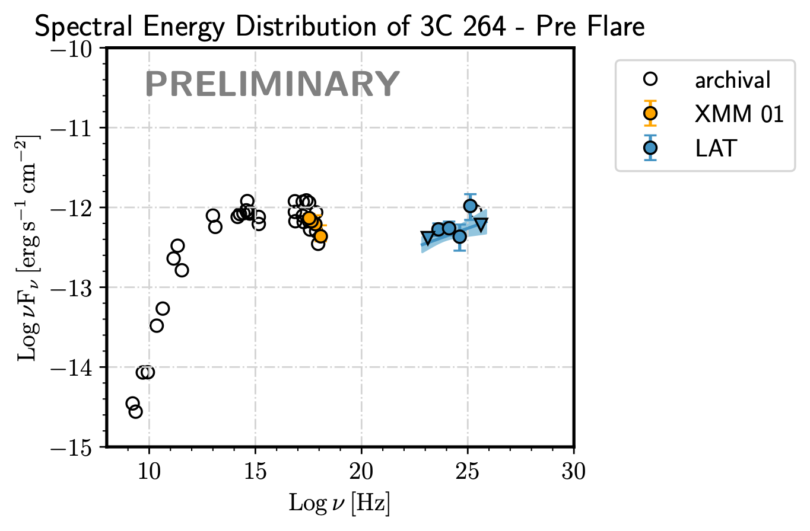
SED modelling
TIME

Slide 29
SED modelling
sync
steady emission from the core
SSC
TIME

Slide 30
SED modelling
WHY SOFTENING WHEN FADING AFTER 2018?
sync
SSC
ORIGIN OF TEV EMISSION?
TIME

Slide 31

SED modelling
WHY SOFTENING WHEN FADING AFTER 2018?
sync
SSC
INJECTION OF NEW ENERGETIC PARTICLES IN THE EJECTION FLOW
ORIGIN OF TEV EMISSION?
TIME

Slide 32
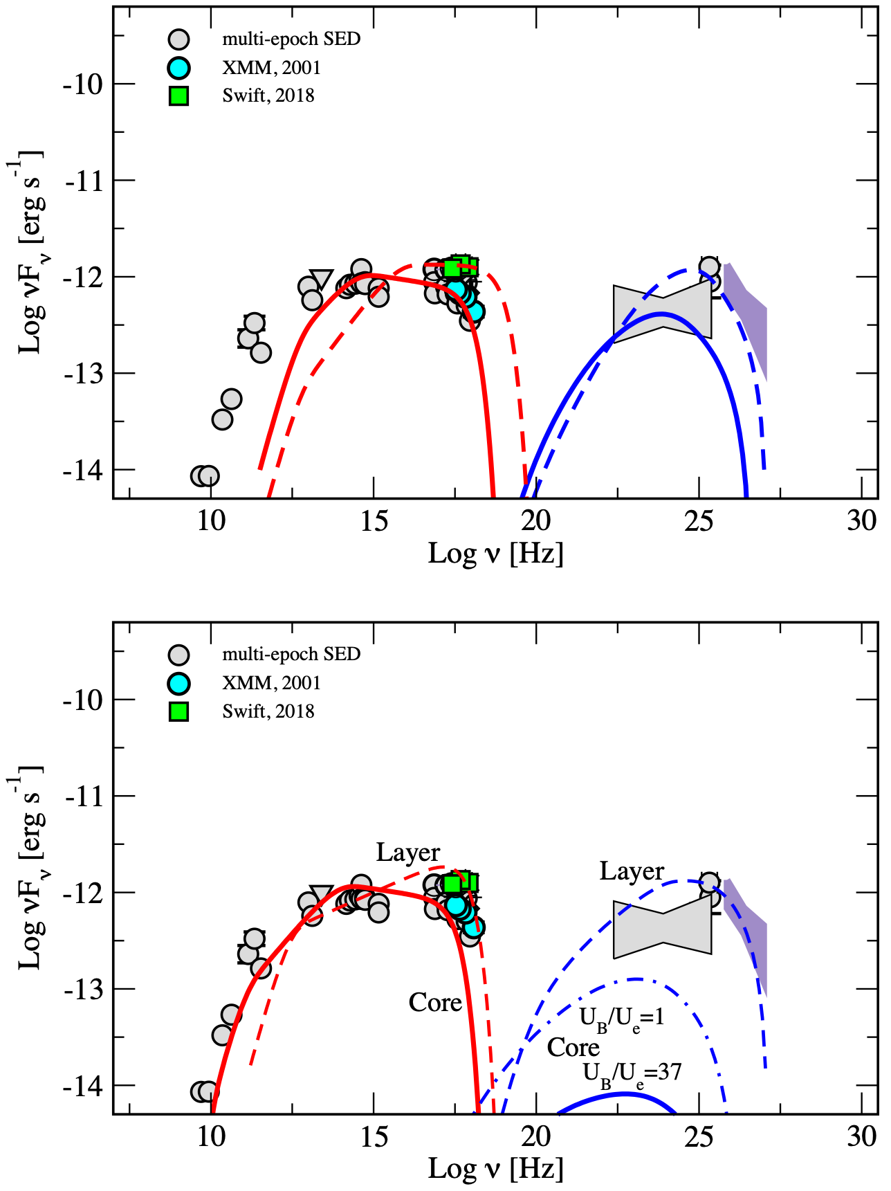
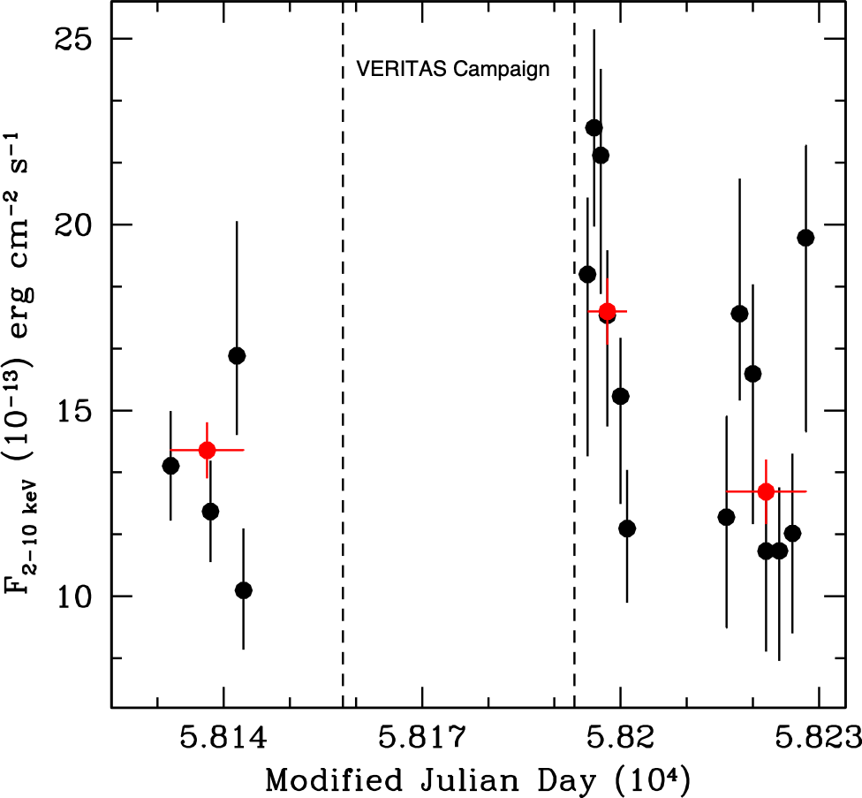
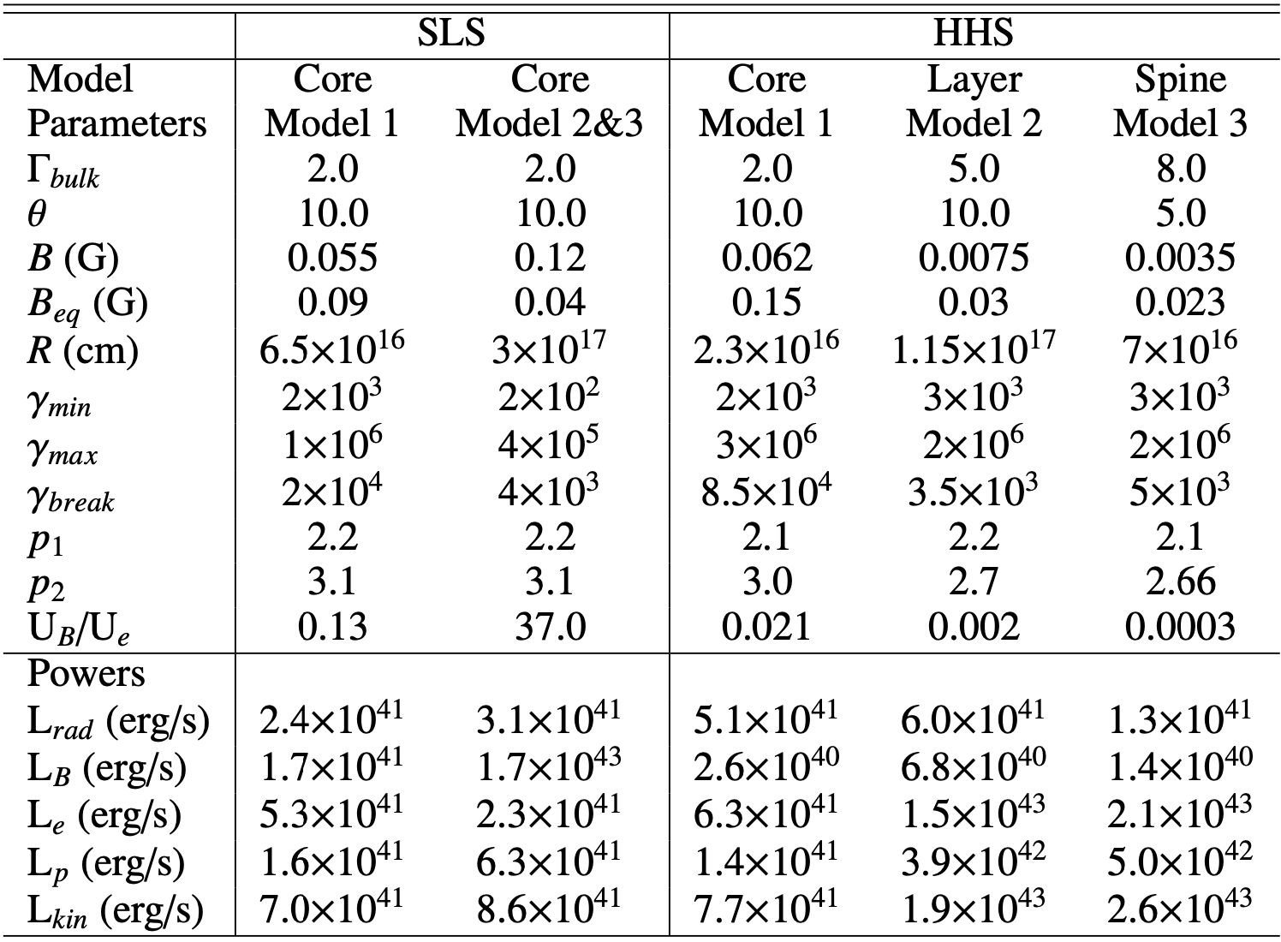
Boccardi+19

Slide 33
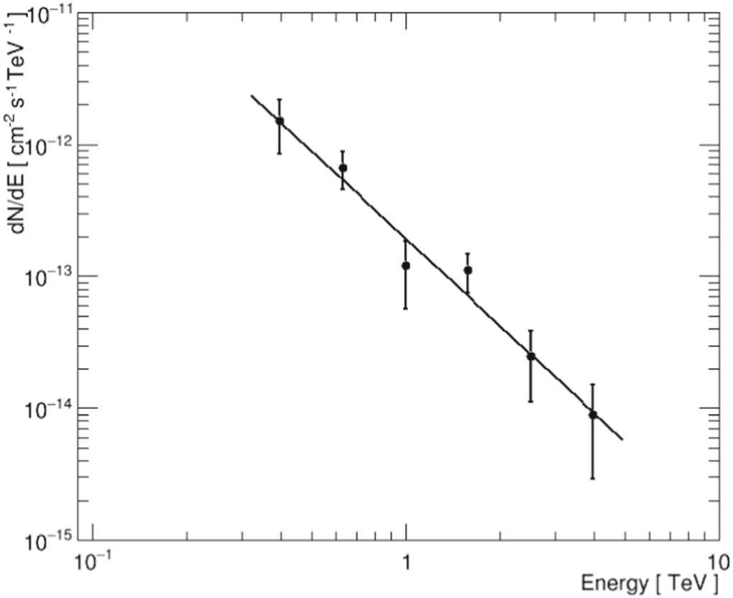
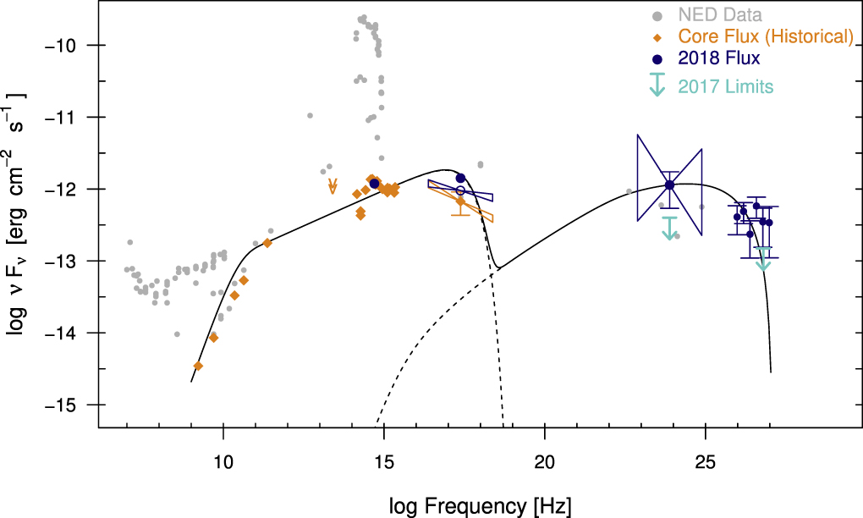
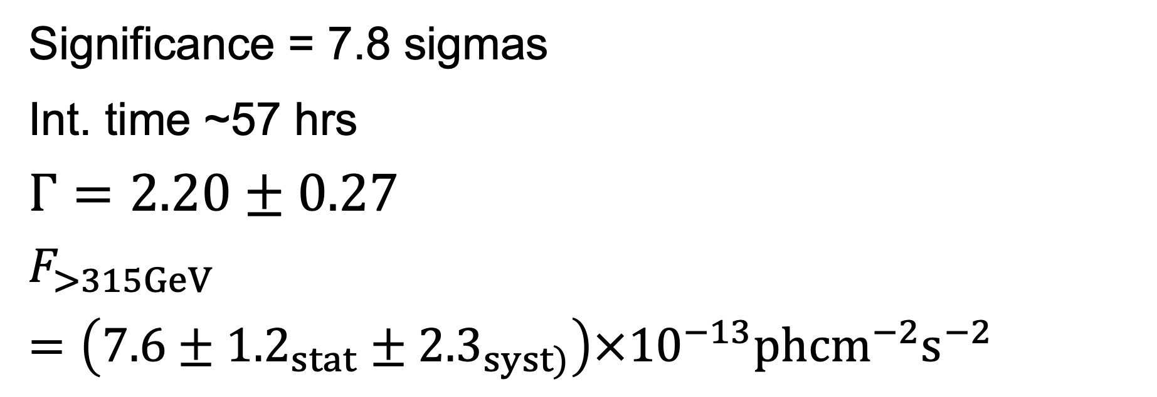
VERITAS
Significance = 7.8 sigmas
Int. time ~57 hrs
$$Γ=2.20±0.27$$
$$F_{>315GeV}=\left(7.6±{1.2}_{stat}±{2.3}_{syst)}\right)×{10}^{−13}ph{cm}^{−2}s^{−2}$$

Slide 34
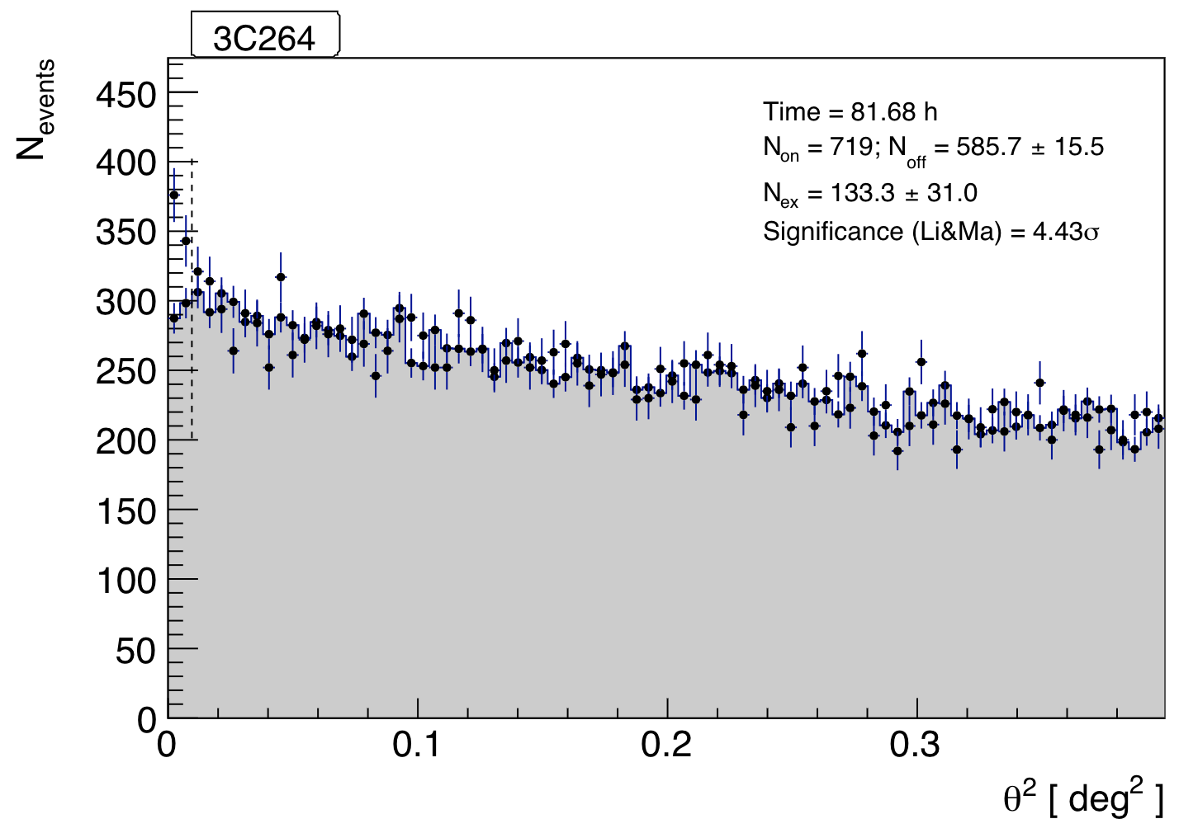
MAGIC
PRELIMINARY

Slide 35
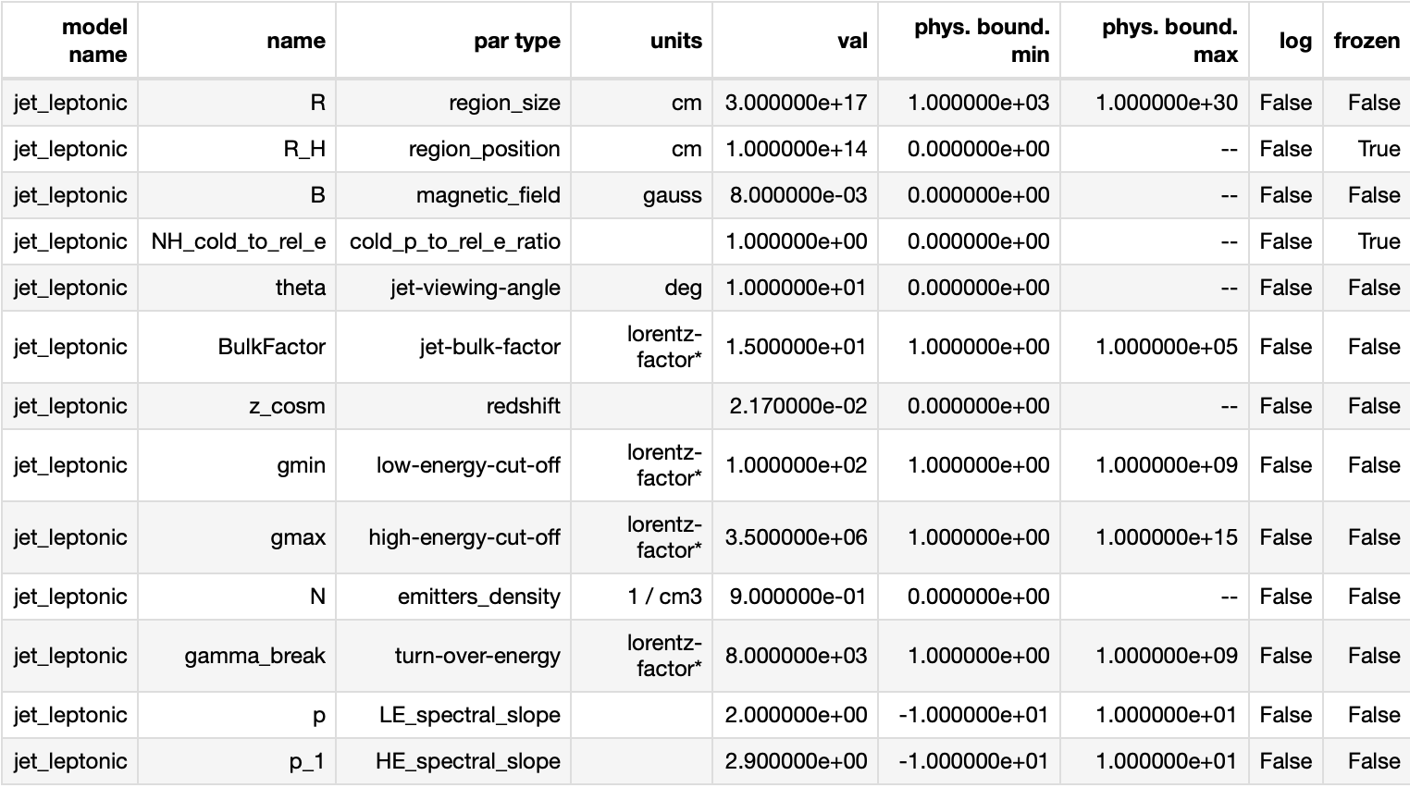
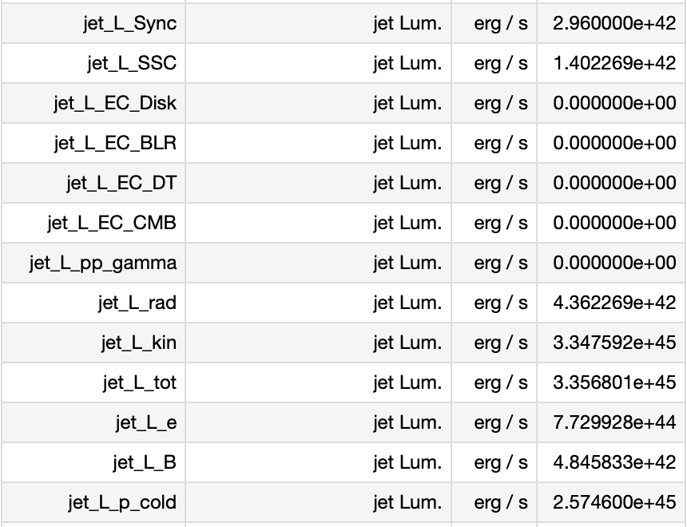
Core emission
delta=3.84
Core -> U_B/U_e=0.006

Slide 36
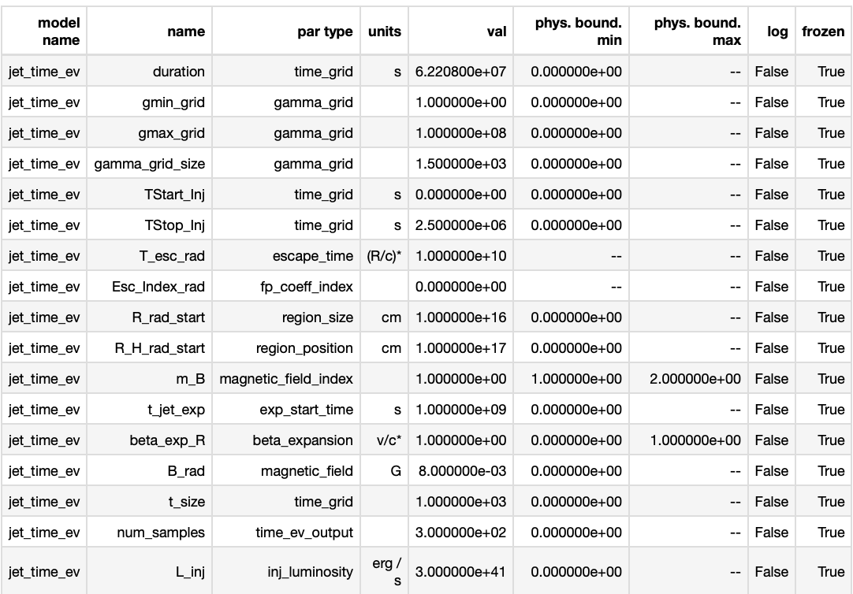
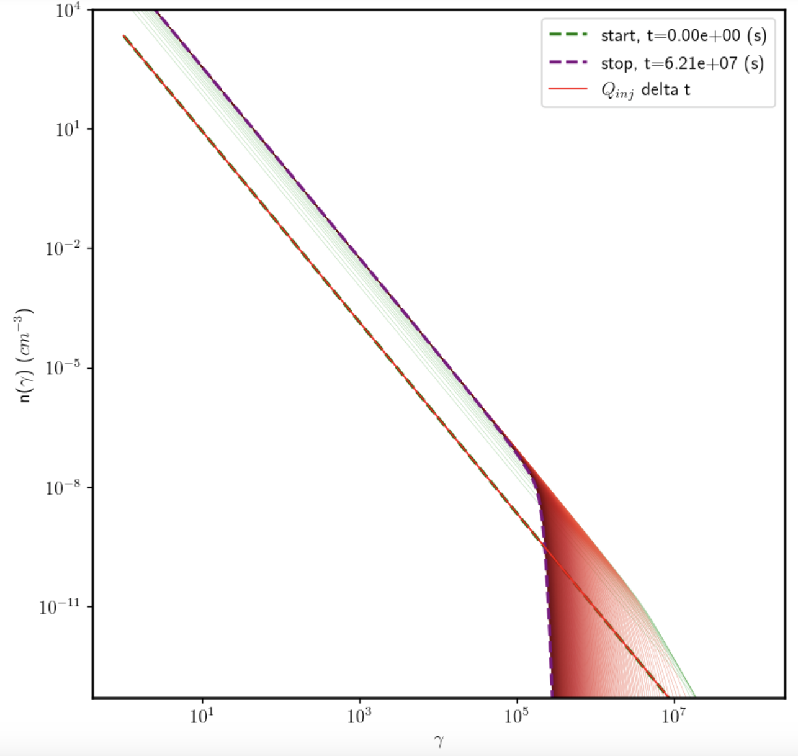

Injection of particles

