Slide 1
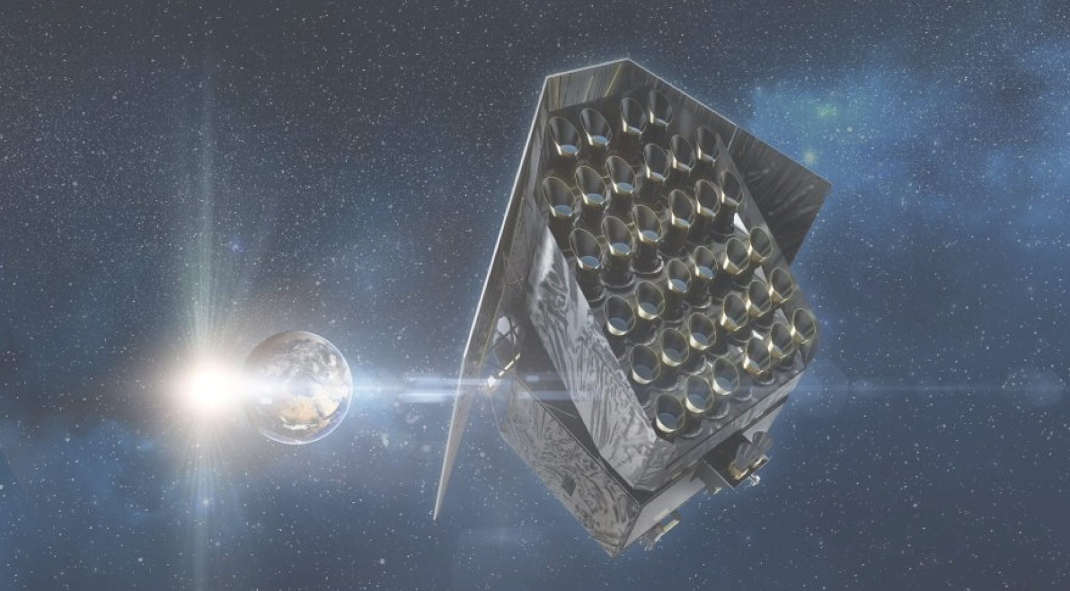





The Milky Way Assembly Tale: the Plato era
Saskia Hekker
Heidelberg Institute for Theoretical Studies
Heidelberg University

Slide 2
If you want to use PLATO for Galactic Archaeology
Apply for your targets!

Slide 3
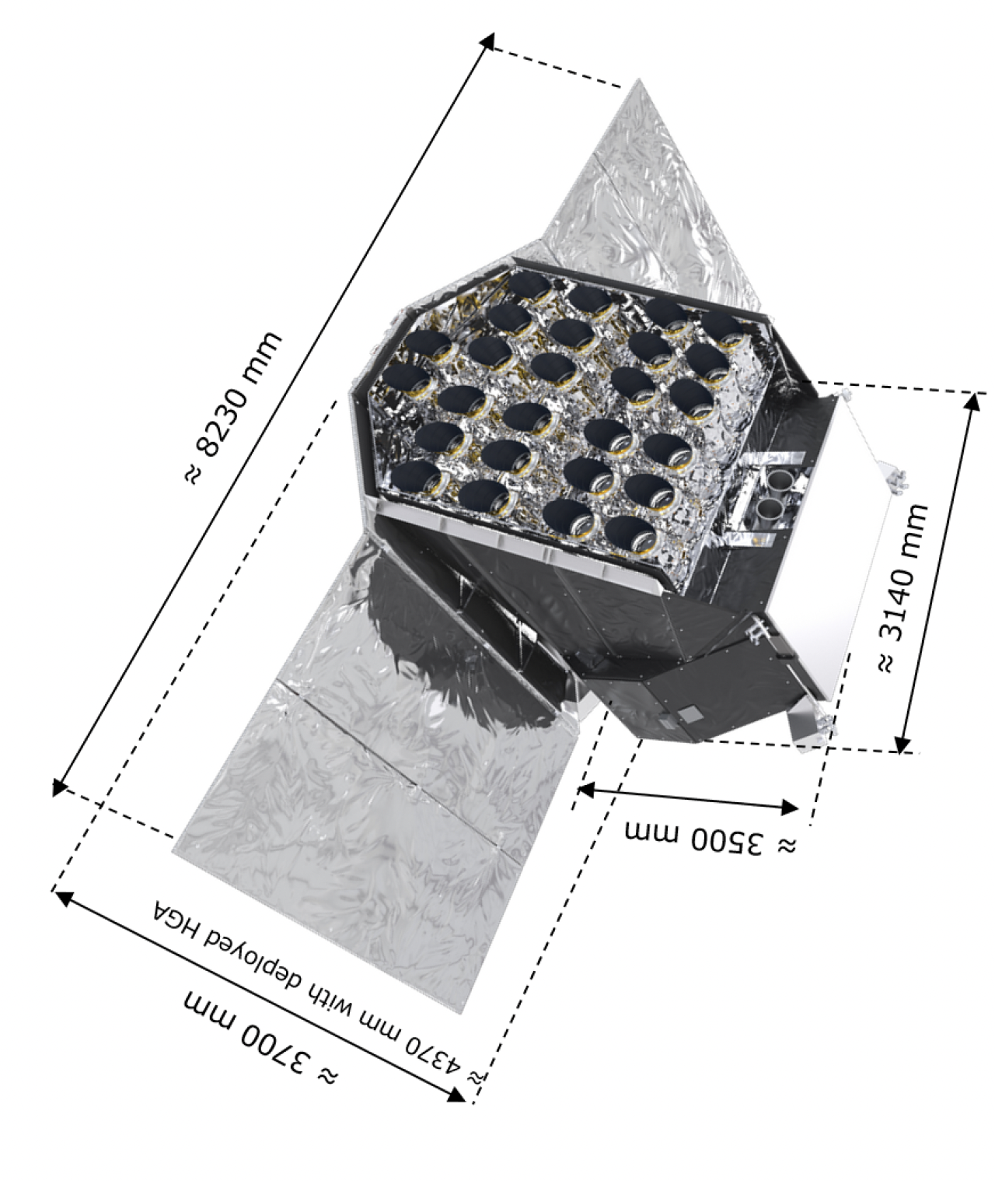
Plato (PLAnetary Transits and Oscillations of stars) mission
main goal: studying terrestrial planets in orbits up to the habitable zone of Sun-like stars, and characterising these stars
10th of thousands of stars via GO program
600s & 50s cadence
nominal lifetime 4 years
launch date: end of 2026

Slide 4
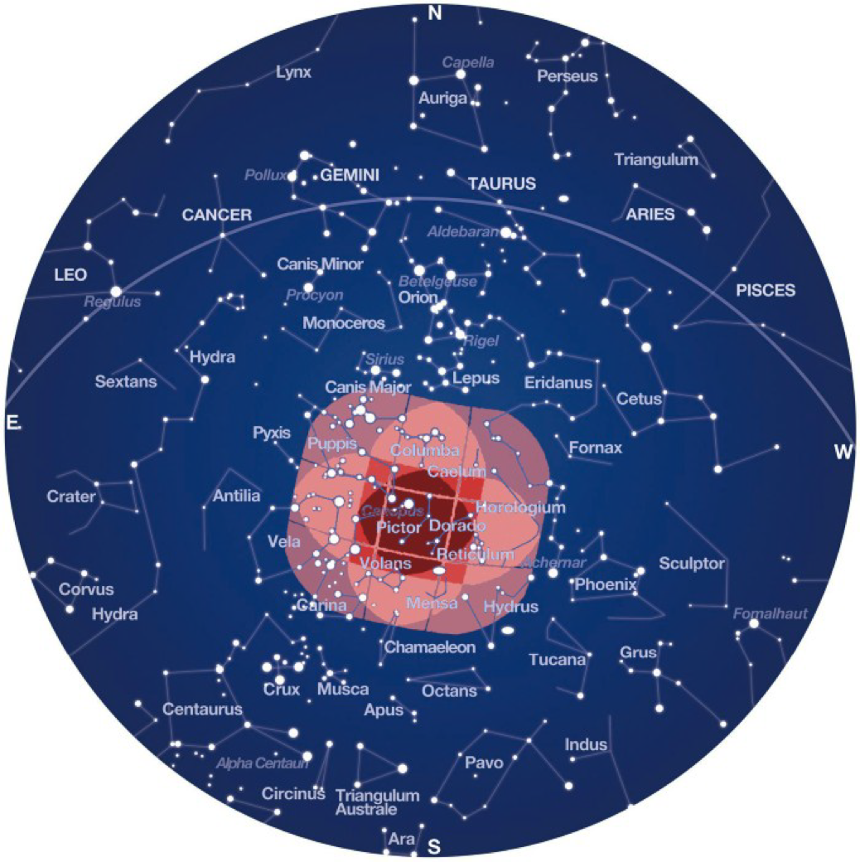
Plato (PLAnetary Transits and Oscillations of stars) mission

Slide 5
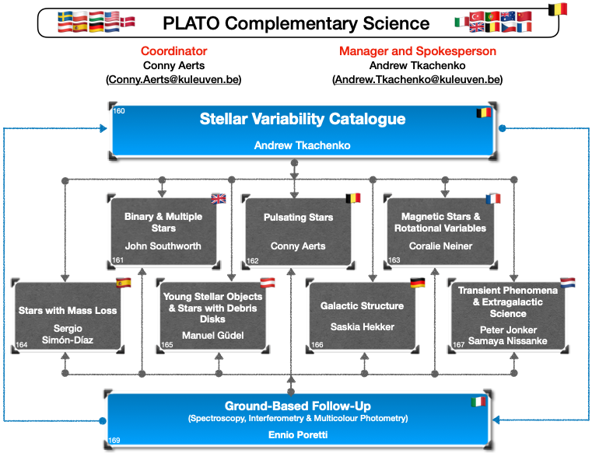
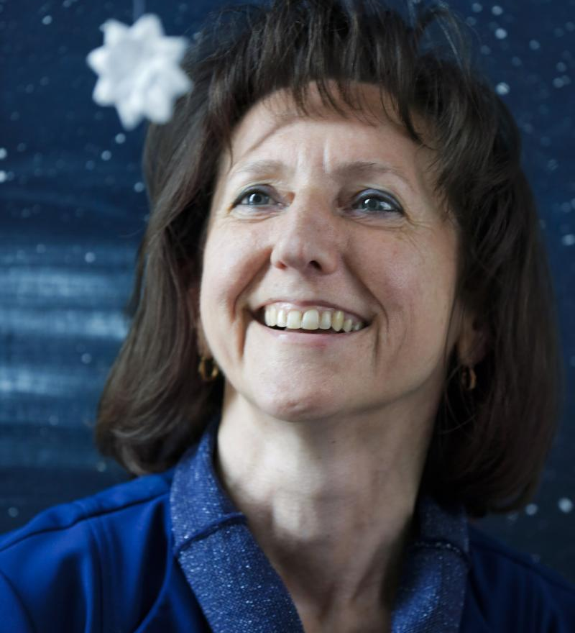
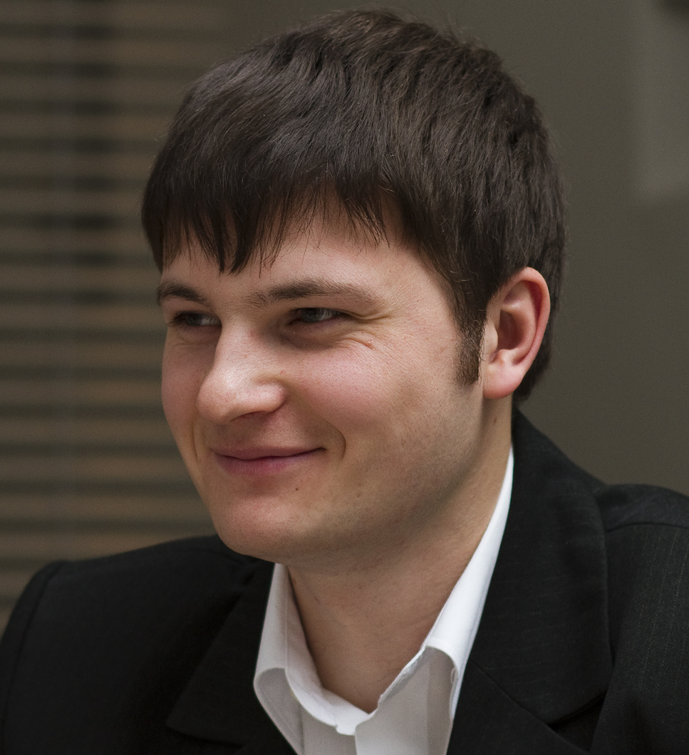
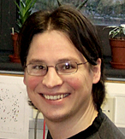
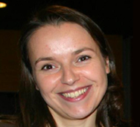
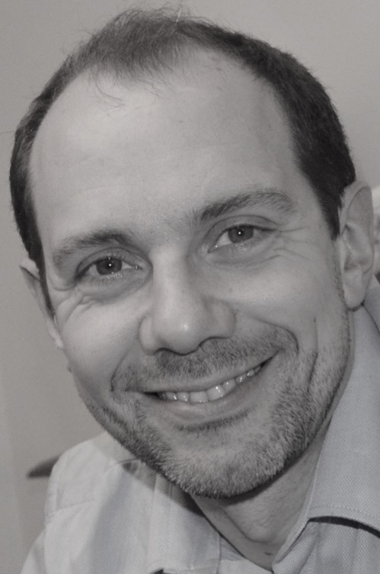
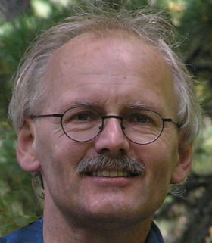
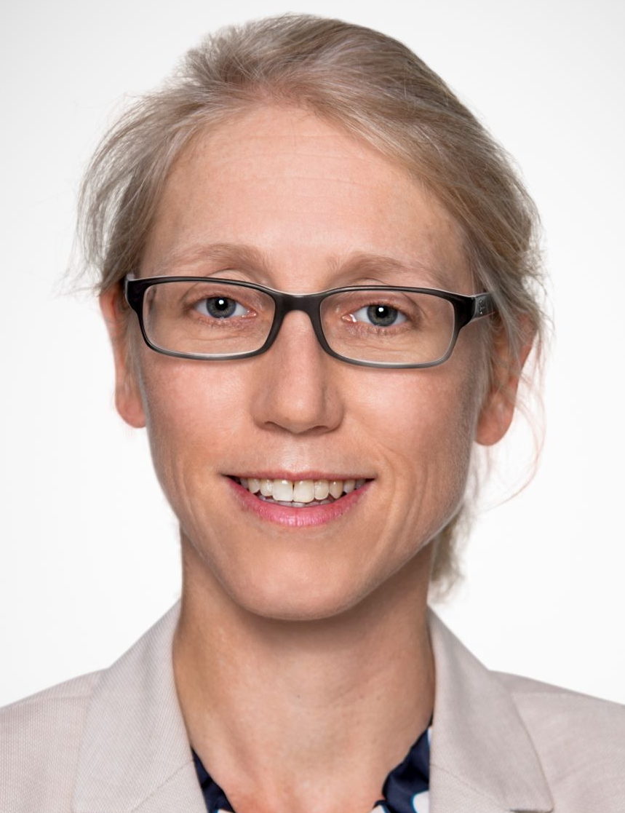
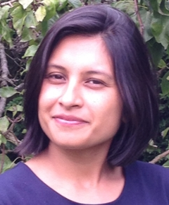
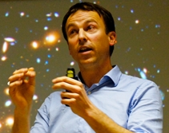
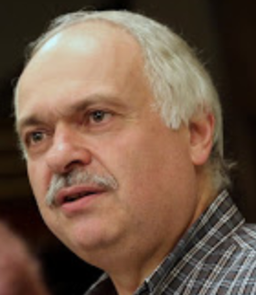
Plato complementary science program
slide courtesy Conny Aerts & Andrew Tkachenko

Slide 6
Plato complementary science program
slide courtesy Conny Aerts & Andrew Tkachenko

Slide 7
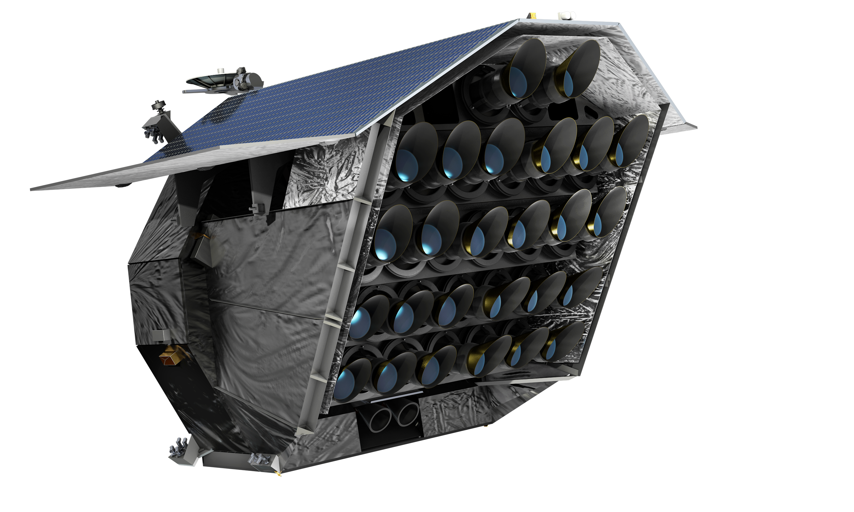
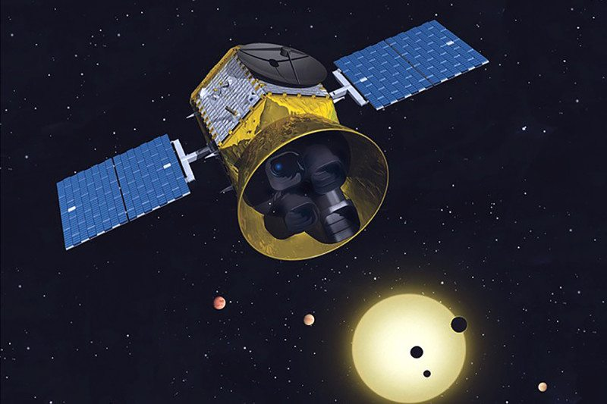
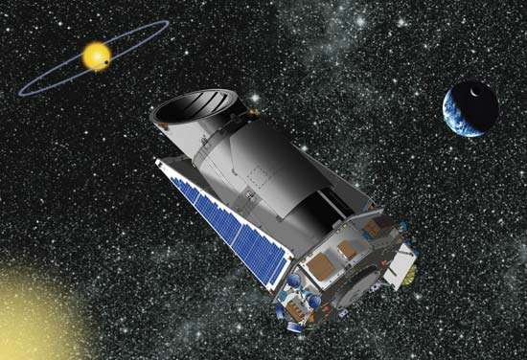
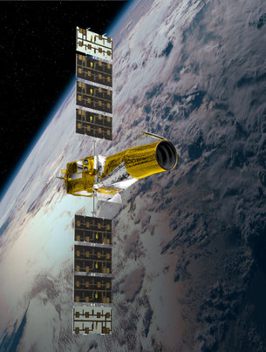
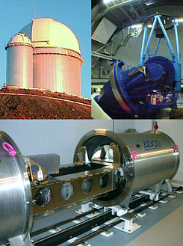
Wealth of data: past, present and future
ET
Nancy Grace Roman
Plato
TESS
K2
Kepler
2024
CoRoT
ground-based
observations
?
Notes:
# of MS stars is small compared to the number of RGs→ technical issues
Just an idea of what is around.

Slide 8
What would Plato add?
Plato points into a different direction (one more ‘pencil beam’), note that observing strategy is not decided;
Brightness between TESS and Kepler;
Many clusters and moving groups in the field of view (see poster # 9)
Now that we have Gaia not many giants that slip into the sample…. Though there will be a set of 24 000 red-giant calibrators.
Possibility to ask for specific targets outside the parameter space of earlier missions: high-mass red giants; GES stars; very metal poor stars;
stars with s- / r- process elements; other types of stars, etc.

Slide 9
What can asteroseismology contribute to Galactic Archaeology?
asteroseismic ages (precision > 20-25%)
evolutionary phases of red-giant stars
improve our knowledge of physics to include in stellar evolution models
identify stars with non-canonical evolution
…….

Slide 10
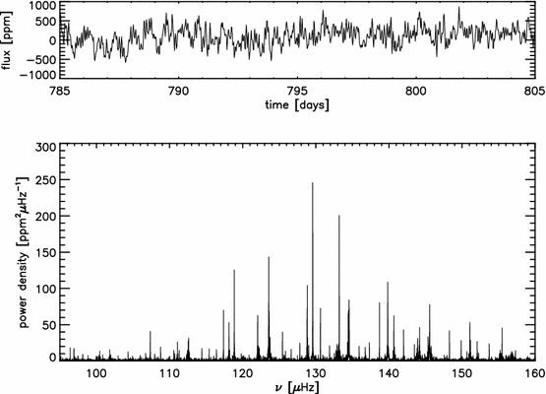

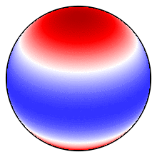
Timeseries data & Fourier transform of an oscillation red-giant star
Fourier transform
𝝂_{max}
2
0
0
0
2
𝜟𝝂
0
2
2
Animation credit: Keaton Bell
Hekker & Christensen-Dalsgaard, A&ARv, 2017
Notes:
In words the dipole modes + dat het mixed modes zijn.

Slide 11

Ages from Asteroseismology
$$ν_{\text{max}}∝\frac{g}{\sqrt{T}} ∝ \frac{M}{R^{2}\sqrt{T_{\text{eff}}}}$$
$∆ν∝{\left(\frac{M}{R^{3}}\right)}^{1/2}=\sqrt{\overline{ρ}}$
mass + stellar models → age
age precision ~ 20-25%
APOKASC DR1 (Pinsonneault et al. 2014)
APOKASC DR2 (Pinsonneault et al. 2018)
APOKASC DR3 (Pinsonneault et al. in prep.)
Catalogues by Yu et al. 2018, Willett et al. 2023, etc.

Slide 12
Ages from Asteroseismology
Ages with ~10% precision using individual frequencies: talk Montalban.
Catalogue with individual frequencies of > 10⁴ red giants in preparation:
Poster # 64 by Francisca Espinoza-Rojas.

Slide 13
Red-giant-branch stars vs. core-helium burning (CHeB) stars
RGB stars
CHeB stars
H burning shell
H burning shell
He burning
core
Inert
He core
Hekker & Christensen-Dalsgaard, A&ARv, 2017
Notes:
Discuss overlap: diversity of mass and metallicity

Slide 14
Red-giant-branch stars vs. core-helium burning (CHeB) stars
CHeB stars
RGB stars
obs
obs
Bedding et al., Nature, 2011
Notes:
Put obs a bit higher

Slide 15
Red-giant-branch stars vs. core-helium burning (CHeB) stars
𝛥𝜈 ∾ 𝜚^{0.5}
CHeB stars
RGB stars
obs
obs
Bedding et al. (including Hekker), Nature, 2011

Slide 16
Red-giant-branch stars vs. core-helium burning (CHeB) stars
CHeB stars
RGB stars
𝚫P
𝚫P measure of core structure
𝚫P

Slide 17
Red-giant-branch stars vs. core-helium burning (CHeB) stars
CHeB stars
RGB stars
Bedding et al., Nature, 2011

Slide 18
If you want to use PLATO for Galactic Archaeology
Apply for your targets!
contact me (saskia.hekker@h-its.org)

Slide 19
Buchele, Bellinger, Hekker et al., ApJ, 2024
Notes:
U= p/rho = squared isothermal soundspeed (c^2 is adiabatic sound speed)
U_hat=uR/GM
Isothermal processes are slow (so that there is enough time to exchange energy with the environment to keep the temperature constant) while in the adiabtic case, the speed is high so that no heat is exchanged (but the temperature can change)

Slide 20
Buchele, Bellinger, Hekker et al., ApJ, 2024
Notes:
Top left panel on a separate slide to introduce

Slide 21
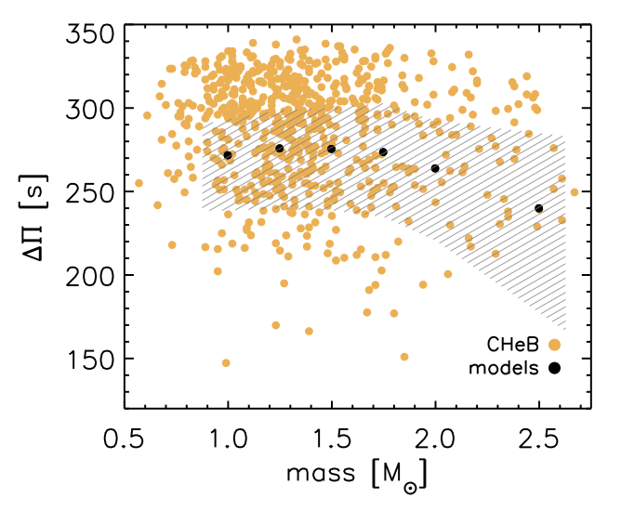
CHeB stars: mismatch observations and models
Range in 𝚫𝚷 NOT matched by current models!
Figure from ERC Consolidator Grant proposal ‘DipolarSound’, PI Hekker

Slide 22
CHeB stars: mismatch observations and models
[Fe/H]:
- 0.5
0.0
+0.2
Observations
of ensemble
opacity of bar indicates number of stars observed
opacity of bar indicates time of model spend at that 𝚫𝚷
¹²C(𝛂,𝛄)¹⁶O factor
Noll, Basu & Hekker, A&A, 2024
Notes:
Observations of ensemble
The Carbon alpha reaction rate has the largest uncertainty.

Slide 23
CHeB stars: mismatch observations and models
[Fe/H]:
- 0.5
0.0
+0.2
Observations
of ensemble
opacity of bar indicates number of stars observed
opacity of bar indicates time of model spend at that 𝚫𝚷
¹²C(𝛂,𝛄)¹⁶O factor
¹²C(𝛂,𝛄)¹⁶O factor
Noll, Basu & Hekker, A&A, 2024
Notes:
Observations of ensemble

Slide 24
If you want to use PLATO for Galactic Archaeology
Apply for your targets!
contact me (saskia.hekker@h-its.org)

Slide 25
Stars with non-canonical evolution
Originally intermediate mass red-giant stars (2-3 M⦿) that have lost their outer parts in a fast mass-loss event just before the onset of He core burning.
clump
2nd clump
Hekker et al. in prep, see also e.g. Rui & Fuller 2021; Deheuvels et al. 2021

