Slide 1
Uncertainties on stellar models and methods of age estimates
Georges Meynet (University of Geneva)
Stellar models
Isochrone fitting
Sibony et al. (submitted)
Georgy et al. (2014)
Notes:
Logo to add

Slide 2
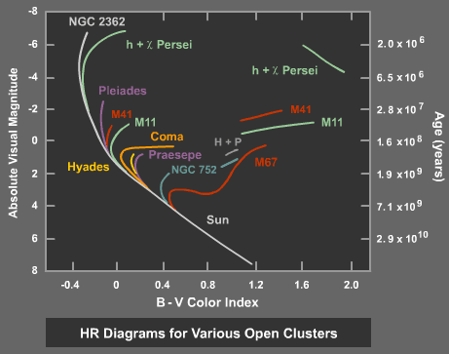
THE METHODS
OF AGE
DETERMINATION
See Soderblom 2010 (Ann. Rev of A&A)

Slide 3
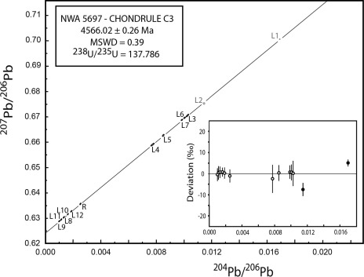
Age determination from evolving star properties
Identify
Observable properties
that evolve
with the star
Observation for deducing these observable properties
Models that link the values of these observable properties with age
Age
(model dependent)
radioactive dating
Stellat remnant
Dynamic
Meteorite
and solar age
Thorium
at surface
Connelly et al. 2017
Bandyopadhyay et al. 2024
Manser et al. 2023
Ferraro et al. 2012;2020

Slide 4
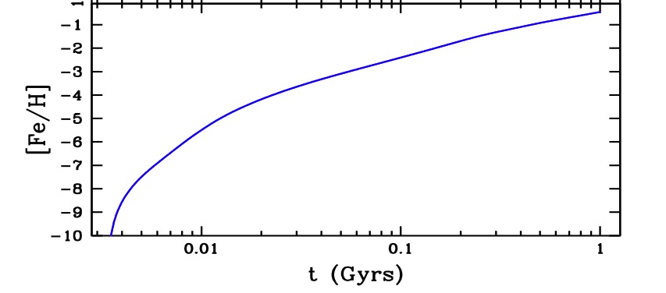
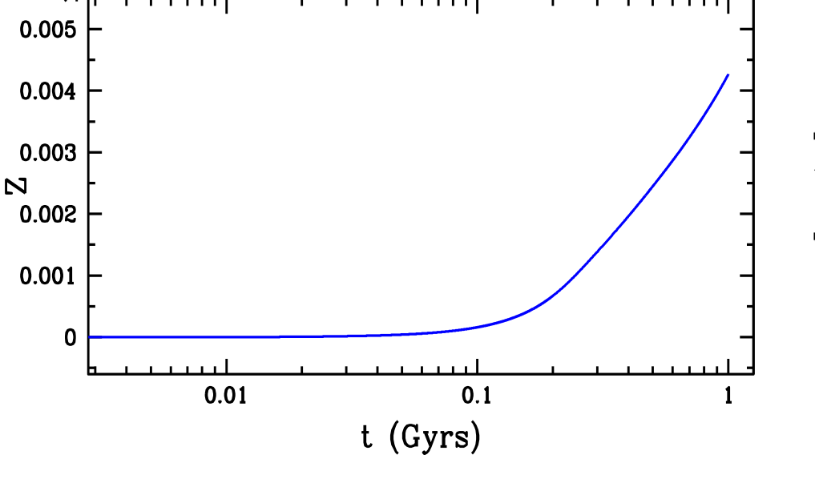
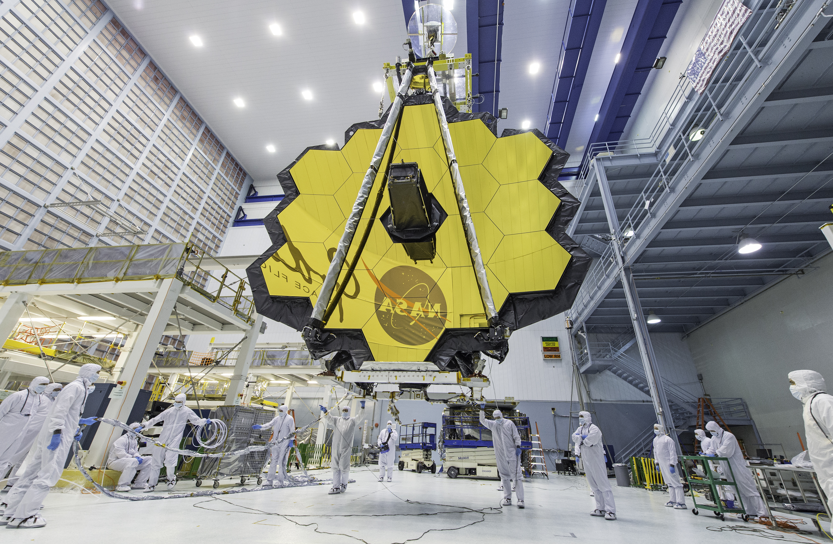
AGE FROM
REDSHIFT
To date, no oxygen
abundances below a few
Percents of the solar value
have been measured with
the JWST
From model of halo by Chiappini et al. 2006
45 My.,
stars more
massive
than 7 M_{sol}
Z=13.2
20 My., stars more massive than 10 M_{sol}

Slide 5
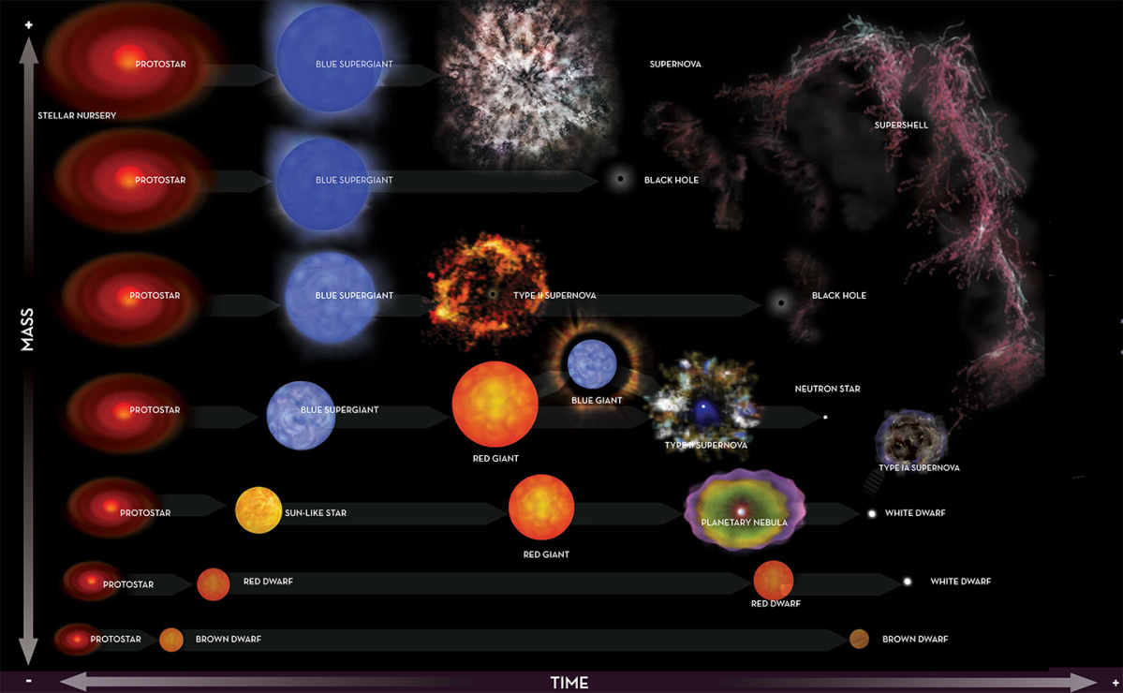
WHERE DO MODELS GO INTO PLAY?

Slide 6
A SIMPLE EQUATION FOR AGE DURING THE MS PHASE
Three basic features of stellar physics
1.- Origin of luminosity→ hydrostatic equilibrium (L scales as $μ^{4}M^{3}$/$κ$)
2.- The energy lost extracted from the nuclear reservoir (nuclear timescale)
3.- During the nuclear burning phases, stars are in radiative (thermal) equilibrium
The rate of energy production in the central region = the rate of the energy lost at the surface
Luminosity as a radiative mode
If nuclear reaction rates changes→Luminosity will change only on a Kelvin-Helholtz timescale
$$Age=\frac{∆M\left(H→He\right)0.007c2}{<L>}$$
$∆M\left(H→He\right)$=$\int_{0}^{M}{(X0−X{(m}_{r},Age))dm_{r}}$
$<L> =\int_{ZAMS}^{Age}{L}$ dt. (note that $L(Age))$
$$M, L\left(age\right),X0$$
→ Spectroscopy, parallaxe, asteroseismology
$$X{(m}_{r},Age), L\left(t\right)→models$$
Notes:
L is a consequence of hydrosatic structure
Nuclear reactions imposes the long lifetime
Duringcore H radiative equilibrium

Slide 7
STELLAR MODELS ARE CALIBRATED
ONE example here
A good agreement between models
may sometimes be due to the
similar process of calibration used
rather than a confirmation of the physic
CHECK OF THE MODELS WITH BINARIES
See also e.g
Costa et al. 2019;
Knudstrup et al. 2020
Martinet et al. 2021
Torres et al. 2024;
Jennings et al. 2024
Ekström et al. 2012
Hussein et al. 2024
Notes:
Evolutionary tracks for non-rotating (dashed lines) and rotating
(solid lines) models in the colour-magnitude diagram. The ZAMS and
the minimalMS Teff are indicated as well as the initial mass considered.
The crosses are observed MS intermediate mass stars from Tables 1
and 2 of Wolff & Simon (1997).

Slide 8
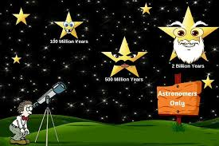
AGE SENSITIVITY ON M, [Fe/H],rot
(from models)
A VERY SIMPLE
APPROACH
https://www.scienceabc.com/nature/universe/how-do-scientists-determine-the-age-of-a-star.html

Slide 9
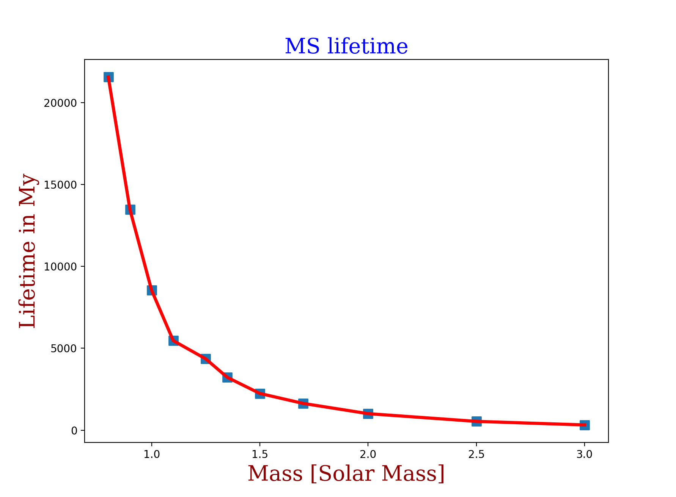
MS LIFETIME-MASS RELATION AT SOLAR METALLICITY
Age shows a larger
range of values than
the mass
Age of solar metallicity stellar models at
the end of the core H-burning phase (0.8-3 M_{sol})
To get an age
better than
10% at turn-off
Value of mass
better than
4% for
masses
above 1.1 M_{sol}
2% for
masses
below 1.1 M_{sol}
Mass needs
be known with
great accuracy
to produce
accurate age
Age of the Universe
Transition
$$\frac{Δage}{age}=−2.83\frac{∆M}{M}$$
Convective core
$$\frac{Δage}{age}=−2.82\frac{∆M}{M}$$
$$\frac{Δage}{age}=−4.3\frac{∆M}{M}$$
Radiative core
Notes:
Mass should be known
with a precision better than
4% for
masses above 1.1 M_{sol}
2% for
masses below 1.1 M_{sol}
to get an age better than
10%

Slide 10
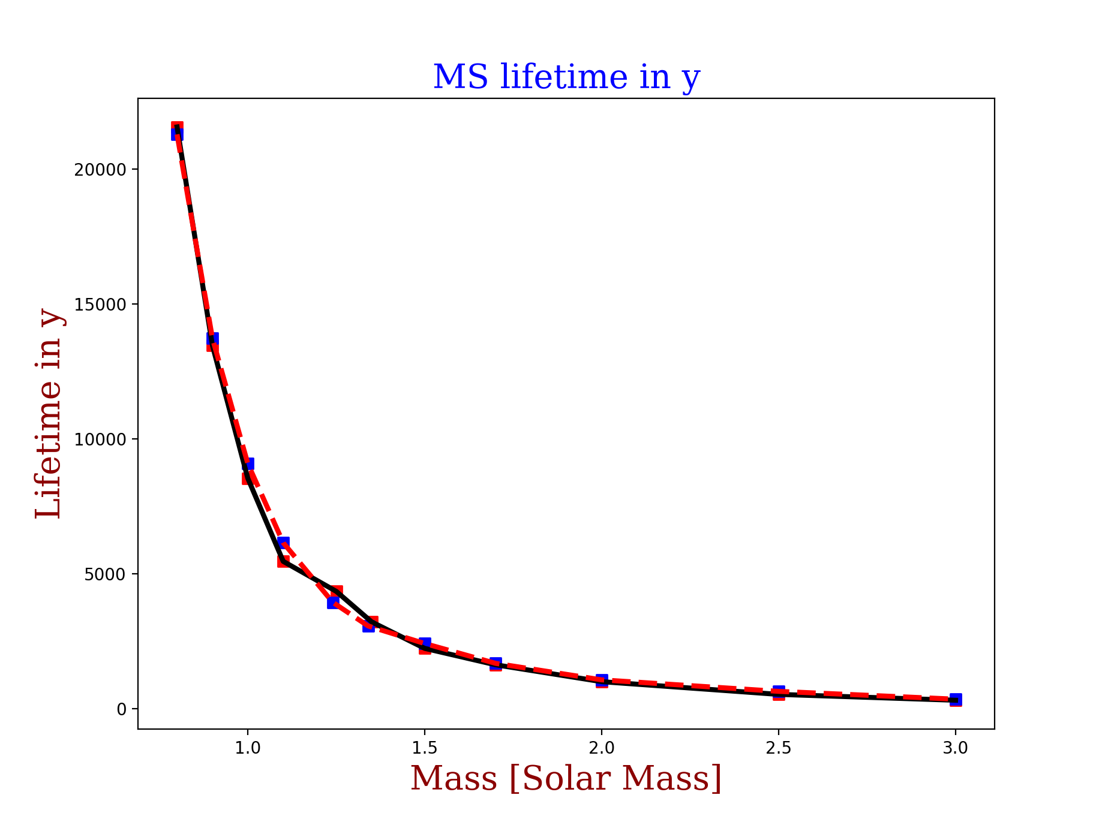
COMPARISON OF MODELS AT SOLAR METALLICITY
Continuous black line: GENEC (Z=0.014)
Dashed red line: PARSEC (Z=0.014)
No rotation
Models from Ekström et al. 2012, Nguyen et al. 2022

Slide 11
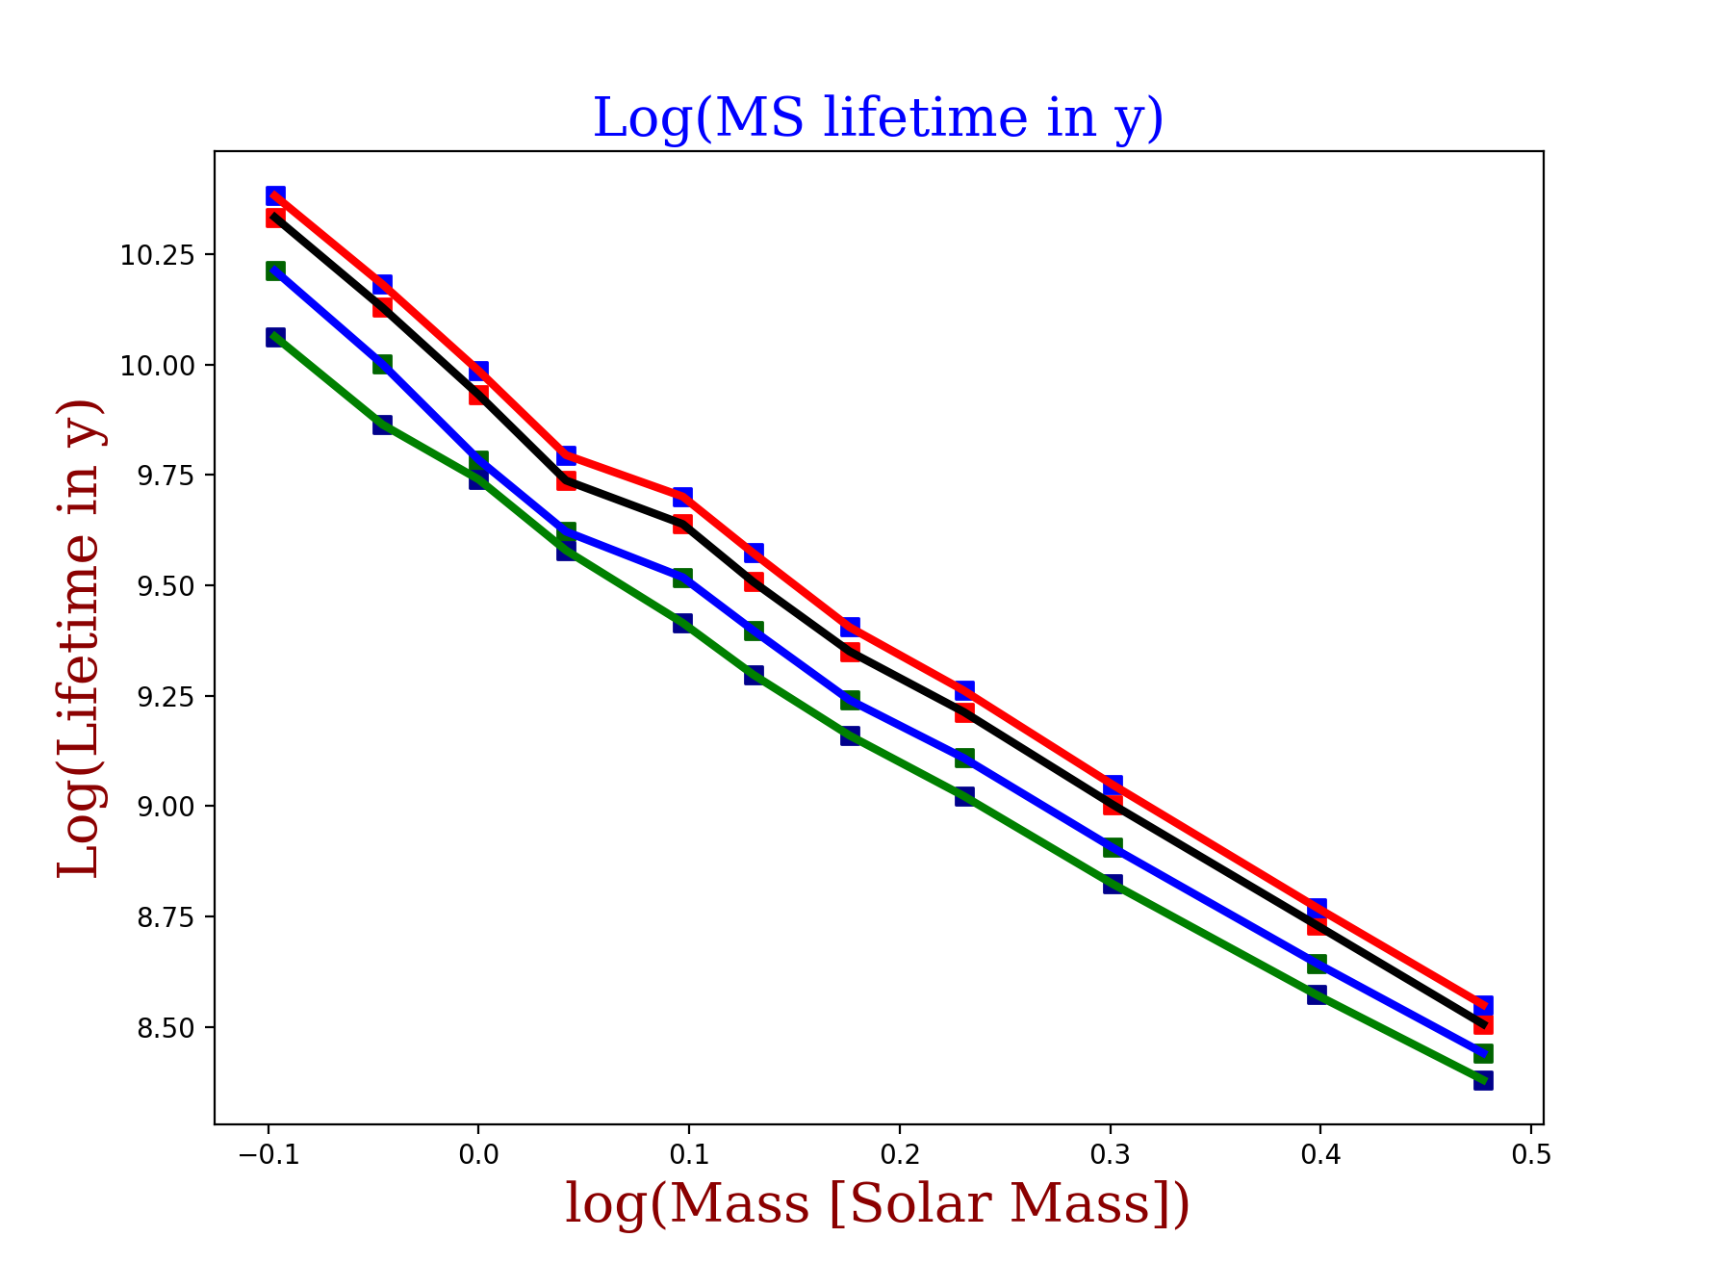
MS LIFETIME-MASS RELATION AT DIFFERENT METALLICITIES
[Fe/H] should be known
with a precision better than about
0.12 dex for
getting an age with a precision
better than 10%
Z=0.020
[Fe/H]~+0.15
Z=0.006
[Fe/H]=-0.37
Z=0.002
[Fe/H]=-0.85

Slide 12
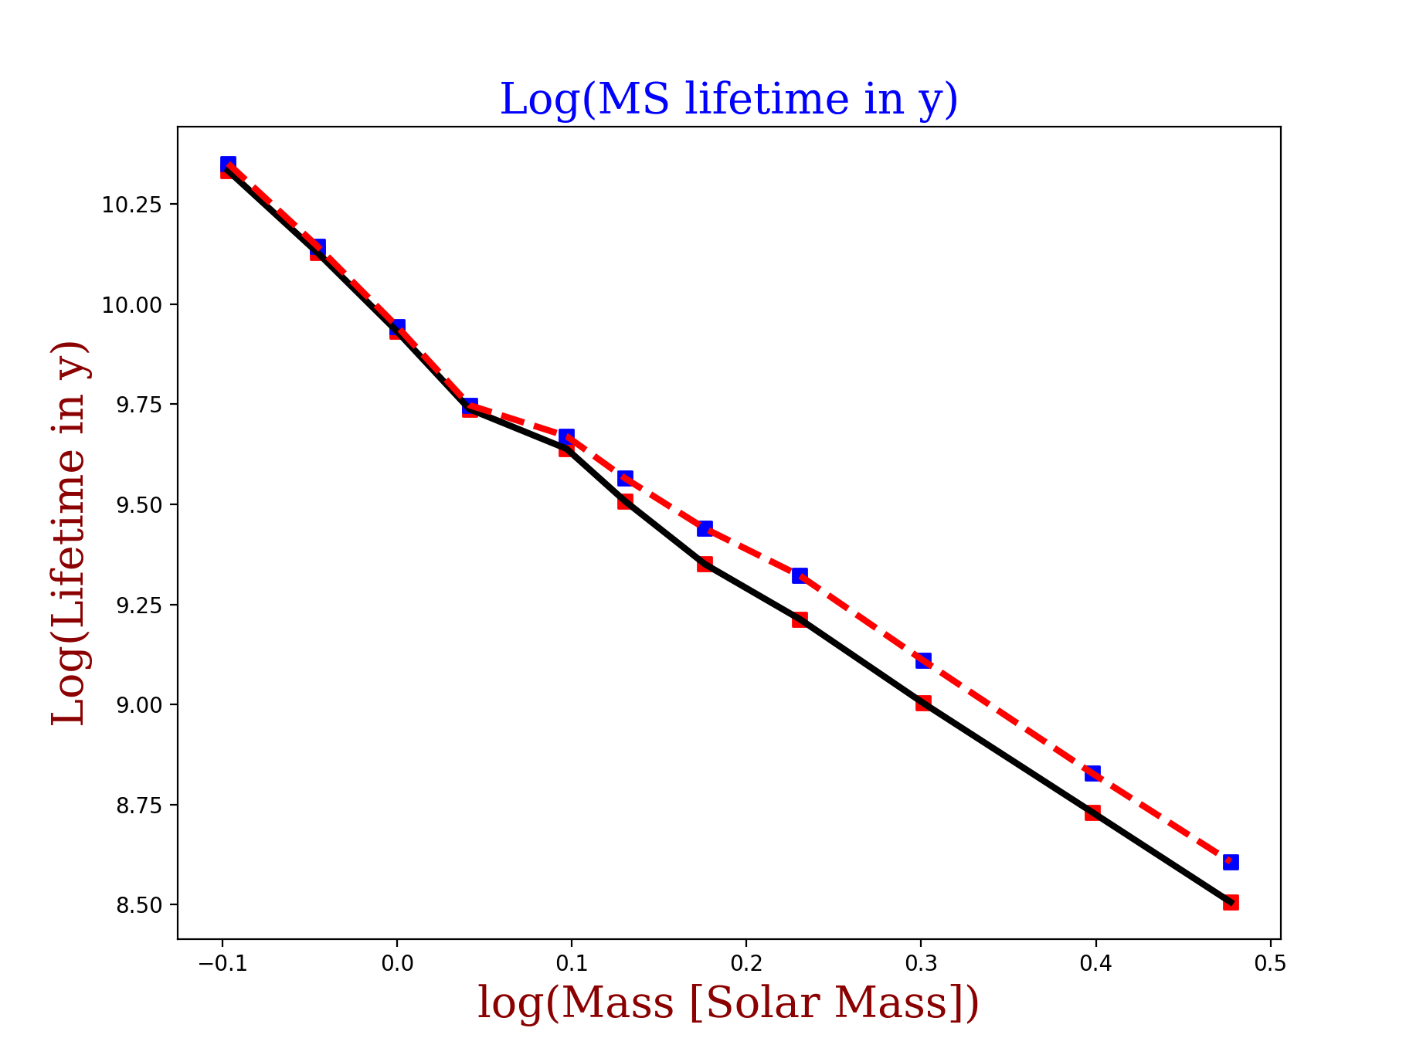
IMPACT OF ROTATION:MS LIFETIME-MASS RELATION AT Z_{solar}
0.8M_{sun}
Black continuous line: V_{ini}=0
Red dashed line. : V_{ini}=0.4 V_{crit} (ZAMS)
0.9M_{sun}
1.0M_{sun}
1.25M_{sun}
1.1M_{sun}
1.5M_{sun}
1.35M_{sun}
1.7M_{sun}
2.0M_{sun}
3.0M_{sun}
2.5M_{sun}

Slide 13
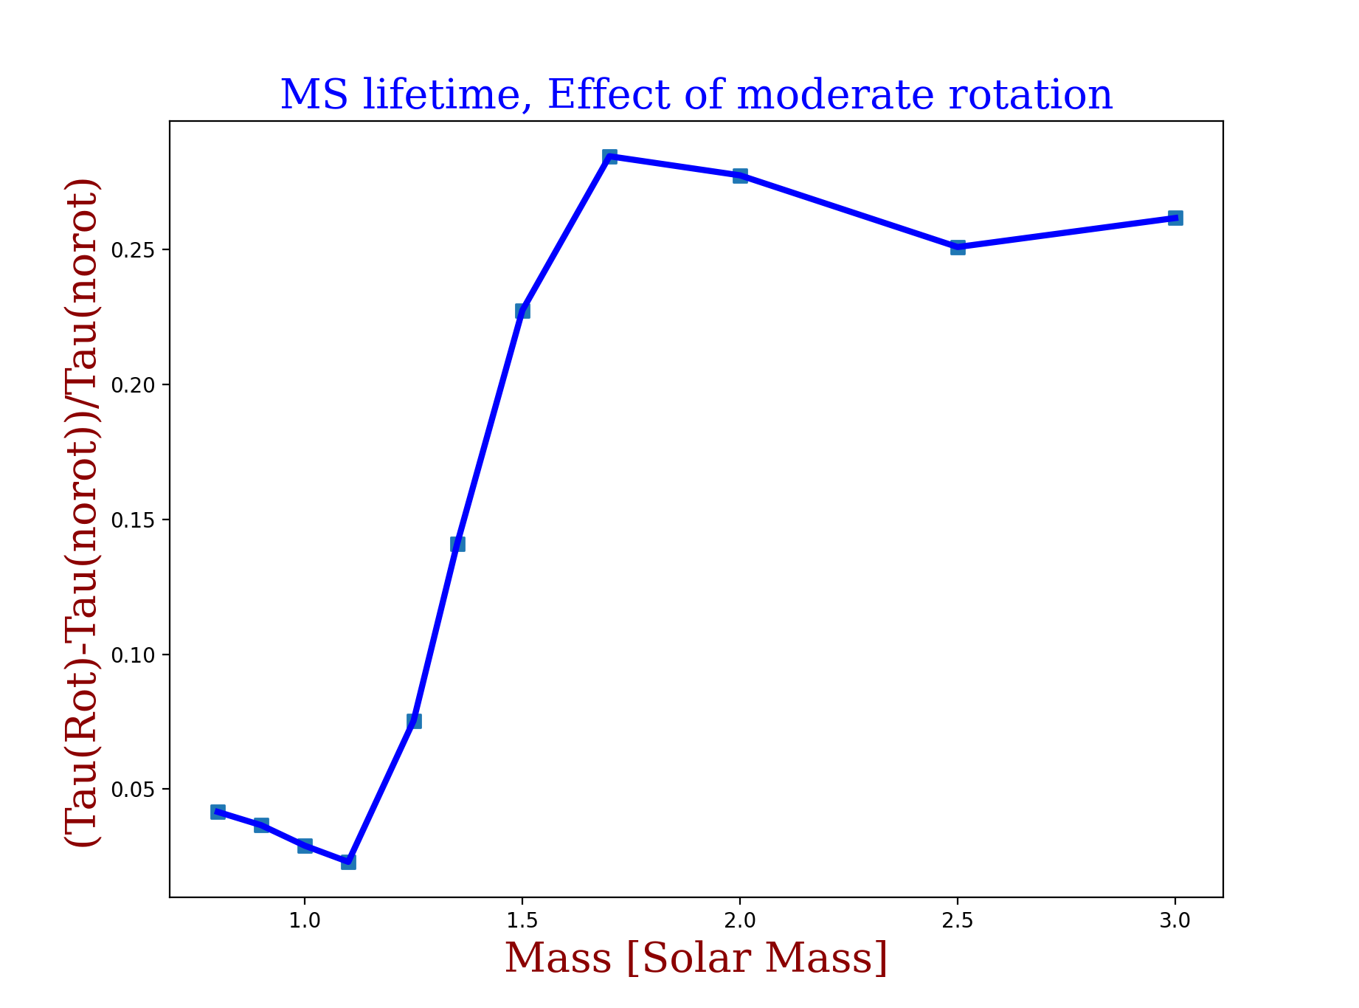
IMPACT OF ROTATION:MS LIFETIME-MASS RELATION AT Z_{solar}
For masses above 1.7 M_{sol}
One has
$\frac{Δage}{age}$=0.62 $\frac{Vini}{Vcrit}$
$$\frac{τ\left(ROT\right)−τ\left(noROT\right)}{τ\left(noROT\right)}$$

Slide 14
ERROR BUDGET FOR AGES OF TURN-OFF MS STARS
For masses above 1.7 M_{sol}
$\frac{Δage}{age}$~$2.8\frac{∆M }{M}$ +0.85 $∆$[Fe/H]+0.62$∆(\frac{Vini}{Vcrit}$)
$$\frac{∆M }{M}$$
=0.15
$∆$[Fe/H]=0.1
$∆$(V_{ini}/V_{crit})
=0.1
14%
75%
11%
$\frac{Δage}{age}$ $=0.42+0.08+0.06=0.56$
The change on the mass dominates the age variation

Slide 15
Age determination from evolving star properties
Identify
Observable properties
that evolve
with the star
Observation for deducing these observable properties
Models that link the values of these observable properties with age
Age
(model dependent)
Position in HR diagram
Pulsations/oscillations
METHODS
Surface rotation/activity/surface magnetic field
Surface chemical composition

Slide 16
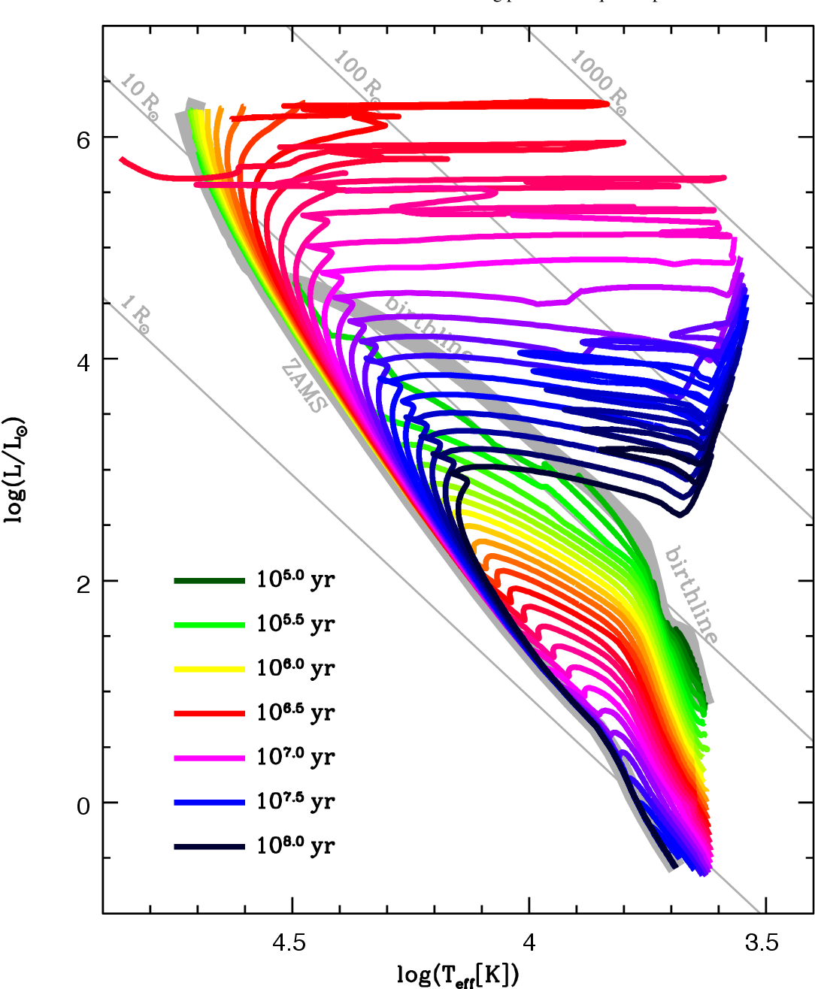
ISOCHRONE FITTING
Haemmerlé et al. 2019

Slide 17
Position in HR diagram
Extended Main-Sequence
turn off as evidence
for multi-age populations?
But some authors
have suggested
rotation might be
the culprit,
see e.g.
de Juan Ovelar et al. 2020
Goudfrooij et al. 2015

Slide 18
Effect of rotation(Hydrodynamical instablities)/inclination
Isocrones based for different initial rotations
Synthetic cluster
Initial velocity distribution of Huang et al. 2010
Gaussian noise 0.15 mag in Mv, 0.1 Mag in B and V
Single star circles/unresolved binaries triangles
Current ω < 0.85 (red); > 0.85 (blue); ω_{ini} >0.85 (blue filled)
$− pole on i<100 ,∕$ intermediate, $Ι i>70 degrees$
Georgy et al. (2014)
Notes:
Synthetic CMD for a 100 Myr old cluster at Z , computed with
the initial velocity distribution of Huang et al. (2010). A Gaussian noise
with a standard deviation of 0:15 mag in MV and 0:1 mag in B 􀀀 V has
been added. Di erent characteristics are indicated by di erent symbols.
Multiplicity: single stars (circles) or unresolved binaries (triangles); velocity:
current ! < 0:85 (red), or ! 0:85 (blue), with filled symbols
for !ini 0:85; inclination angle: i 70 (horizontal stroke),
i < 10 (vertical stroke), intermediate inclinations (diagonal stroke);
surface chemical enrichment: (N/C)/(N/C)ini 3 (surrounding square).
The labelled stars are listed in Table 1.

Slide 19
PARSEC models
BaSTI models
Dresbach et al. (2023)
For effect of Helium on star distribution in CMD see also Chantereau et al. 2016
Notes:
the radial
distribution of kinematically selected member stars in di erent eMSTO subregions.
The absence of segregation supports the rotation
scenario as the cause for the turno color extension and disfavors the presence of a prolonged period of star formation in the cluster.
A similar analysis on the eRC of NGC419 confirms the absence of segregation, providing further evidence against an age spread,
which is at odds with previous investigations. Even so, the currently available evolutionary models including stellar rotation fail at
reproducing the two photometric features simultaneously. We argue that either shortcomings in these models or a di erent origin for
the red clump feature, such as a nonstandard di erential mass loss along the red giant branch phase, are the only way to reconcile our
observational findings with theoretical expectations.
Conclusion of my own
Interesting problem
Two age indicators not same answer
If rotation effect no agreement with models

Slide 20
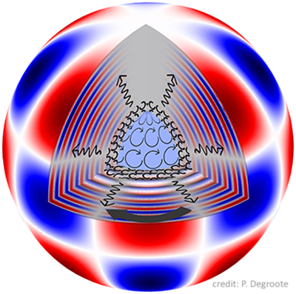
ASTEROSEIS-MOLOGY
P. Degroote

Slide 21
Pulsations/oscillations
Farrell et al. (2024)
Notes:
Example of degeneracy: three different stellar structure models with similar period spacing patterns. All three models have the same
values for Hslope, metallicity Z, Xs. They differ in their values of mass M, Xc, Ω/Ωcrit, Mμ and curvature α and mode classification (the lower order
modes plotted in the period spacing pattern have radial orders n = 14, 15, and 16, respectively, for the red, blue, and green lines). Quantities plotted
are the same as Fig. H.1

Slide 22
Pulsations/oscillations
1.26 M_{sun}
model
X_{c}=0.24
X_{c}=0.45
X_{c}=0.24
X_{c}=0.27
X_{c}=0.47
X_{c}=0.43
X_{c}=0.21
X_{c}=0.30
PhD Thesis of Jérôme Bétrisey (2024): target 2 of Bétrisey & Buldgen (2022)
Notes:
Impact of convective core uncertainties on stellar age of Target 2 from Bétrisey &
Buldgen (2022). The size of the convective core is indicated by the numbers located above
the error bars. As Target 2 is a synthetic ‘observed’ target, the exact age is known and indicated
by the orange dashed line. From bottom to top, the central hydrogen fraction Xc is:
0.24, 0.45, 0.24, 0.27, 0.47, 0.43, 0.21, 0.30. Target 2 has an ‘observed’ Xc = 0.33. qualité et
Two physics
were tested, including overshooting or not, and the models were generated by conducting global
MCMC minimisations and local minimisations, and using different sets of seismic constraints. The
figure illustrates that uncertainties in the determination of the convective core properties significantly
affect the estimation of the stellar age. Although we acknowledge that these uncertainties
could be reduced by implementing a more extensive and robust modelling procedure, these results
still indicate that for F-type stars, which are notably more challenging to model than Sun-like
stars, the uncertainties resulting from the choice of the physical ingredients will be larger (and
likely significantly larger) than for Sun-like stars such as Kepler-93. This is an important aspect
that requires further investigation as PLATO will detect a large number of stars that are brighter
(and therefore more massive) than the Sun.

Slide 23
Pulsations/oscillations
Li et al. (2024)
See also Brogaard et al. 2023
Notes:
Locations of three M67 cluster members on the T eff –νdiagram. The Grey square indicates the subgiant EPIC 211411922; and two red giants, EPIC 211409560 and EPIC 211416749, are shown by the Grey triangle and the Grey circle. As a comparison, the Kepler seismic targets at the main sequence and the subgiant phase studied by Lund et al. ( 2017 ) and Li et al. ( 2020b ) are plotted as open grey stars. The Sun is represented by . Grey lines are theoretical evolutionary tracks ranging from 0.8 to 1.9 M , with solar metallicity.
Mass and age estimates for three targets. Squares, triangles, and circles represent SG, RG1, and RG2, respectively. Black symbols indicate seismic inferences with radial modes and red symbols are those determined with all individual modes. The light blue shade points the turn-off mass of the open cluster that was determined with isochrone fitting and binary systems. The grey shade presents the cluster age range that was estimated in previous studies (as mentioned in Section 1 ).
Conclusion
I do not understand size of blue and grey zone not very consistent.
Asteroseismic age span a domain even larger than grey zone and a much larger mass domain.

Slide 24
Pulsations/oscillations
Blue TO. Red TO
Li et al. (2024)
Meynet et al. 1993
Notes:
Locations of three M67 cluster members on the T eff –νdiagram. The Grey square indicates the subgiant EPIC 211411922; and two red giants, EPIC 211409560 and EPIC 211416749, are shown by the Grey triangle and the Grey circle. As a comparison, the Kepler seismic targets at the main sequence and the subgiant phase studied by Lund et al. ( 2017 ) and Li et al. ( 2020b ) are plotted as open grey stars. The Sun is represented by . Grey lines are theoretical evolutionary tracks ranging from 0.8 to 1.9 M , with solar metallicity.
Mass and age estimates for three targets. Squares, triangles, and circles represent SG, RG1, and RG2, respectively. Black symbols indicate seismic inferences with radial modes and red symbols are those determined with all individual modes. The light blue shade points the turn-off mass of the open cluster that was determined with isochrone fitting and binary systems. The grey shade presents the cluster age range that was estimated in previous studies (as mentioned in Section 1 ).
Conclusion
I do not understand size of blue and grey zone not very consistent.
Asteroseismic age span a domain even larger than grey zone and a much larger mass domain.

Slide 25
Pulsations/oscillations
Continuous black line: GENEC (Z=0.014)
Dashed red line: PARSEC (Z=0.014)
No rotation
Models from Ekström et al. 2012, Nguyen et al. 2022
Li et al. (2024)
Notes:
Locations of three M67 cluster members on the T eff –νdiagram. The Grey square indicates the subgiant EPIC 211411922; and two red giants, EPIC 211409560 and EPIC 211416749, are shown by the Grey triangle and the Grey circle. As a comparison, the Kepler seismic targets at the main sequence and the subgiant phase studied by Lund et al. ( 2017 ) and Li et al. ( 2020b ) are plotted as open grey stars. The Sun is represented by . Grey lines are theoretical evolutionary tracks ranging from 0.8 to 1.9 M , with solar metallicity.
Mass and age estimates for three targets. Squares, triangles, and circles represent SG, RG1, and RG2, respectively. Black symbols indicate seismic inferences with radial modes and red symbols are those determined with all individual modes. The light blue shade points the turn-off mass of the open cluster that was determined with isochrone fitting and binary systems. The grey shade presents the cluster age range that was estimated in previous studies (as mentioned in Section 1 ).
Conclusion
I do not understand size of blue and grey zone not very consistent.
Asteroseismic age span a domain even larger than grey zone and a much larger mass domain.

Slide 26
For accurate ages, accurate mass
determination is needed
When possible check the consistency
of the results
Isochrone fitting: aware that
clusters may be complexe
→ star formation history
→ distribution of initial rotation
→ different chemical composition
Asteroseismology needs to be
complemented with other constraints
and use the largest numbers of seismic
constraints
CONCLUSIONS

Slide 28
- EFFECT OF DIFFERENT alpha/Metals ratios
Warfield et al. 2024
TWO REMARKS
- CHECK OF THE MODELS WITH BINARIES
Hussein et al. 2024
See also e.g
Costa et al. 2019;
Knudstrup et al. 2020
Martinet et al. 2021
Torres et al. 2024;
Jennings et al. 2024

Slide 29
Models are needed for describing the previous evolution
For accurate ages, accurate mass determination is needed
When possible check the consistency of the results
Isochrone fitting: aware that clusters may be complexe
→ star formation history
→ distribution of initial rotation
→ different chemical composition
Asteroseismology needs to be complemented with other
constraints.
Gyrochronology: aware of processes impacting this feature
→ initial velocity (for young systems)
→ physics of the angular momentum transport
→ star-planet interactions
Surface composition: Lithium boundary depletion appears
to be an interesting age indicator (only young ages)
CONCLUSIONS

Slide 30
SURFACE COMPOSITION
Cargile et al. 2010;
Lee et al. 2024
Vernekar et al. 2024 ([Y/Mg], [C/N])
Tognelli et al. 2015
Notes:
The reasoning behind
using the first of the two combinations is that magnesium is an
-element, while yttrium is a slow neutron-capture process element.
The main process of Mg formation are type II supernovae,
that is, massive stars (with mass 8 M ). As massive stars live
much shorter lives than low-mass stars, the abundance of Mg
is expected to increase quickly. On the other hand, Y is produced
through slow neutron capture during the AGB phase of
intermediate-mass stars. This process takes a long time as the
evolutionary timescale of intermediate-mass star is much longer
than that of massive stars. We then expect [Y/Mg] to increase
with time, which allows us to probe the stellar ages.
As a star
enters the RGB, the increasing depth of the convective zone carries
much material from the inner regions into the outer atmosphere.
This causes variations in chemical abundances of many
elements, specifically, the [C/N] ratio. The dept of the convective
zone is directly correlated to the mass of the star and the mass of
the star with the age.

Slide 31
But effects of initial rotation (for young ages)
of the angular momentum transport
mechanisms
of star-planet inetractions
GYROCHRO-NOLOGY
Angus et al. 2015,
Boyle & Bouma 2023
Engle 2024
Bouma et al. 2023

Slide 32
A SIMPLE EQUATION FOR AGE DURING THE MS PHASE
Age _{MS}$=$(M<q>[X_{c}(Age=0)-X_{c}(Age)]0.007c²)/(<L>)
Spectroscopy+distance
Dynamics
Asterosesimology
spectroscopy
For given M and X(Age=0)
Uncertainties are in <q>, X_{c} (Age), <L>
Asterosesimology+ models
Asterosesimology
+models
Spectroscopy+distance
+models
MODELS NEEDS BE CHECKED ON WELL OBSERVED FEATURES
AND ACCOUNT FOR THE BEST PHYSICS

Slide 33
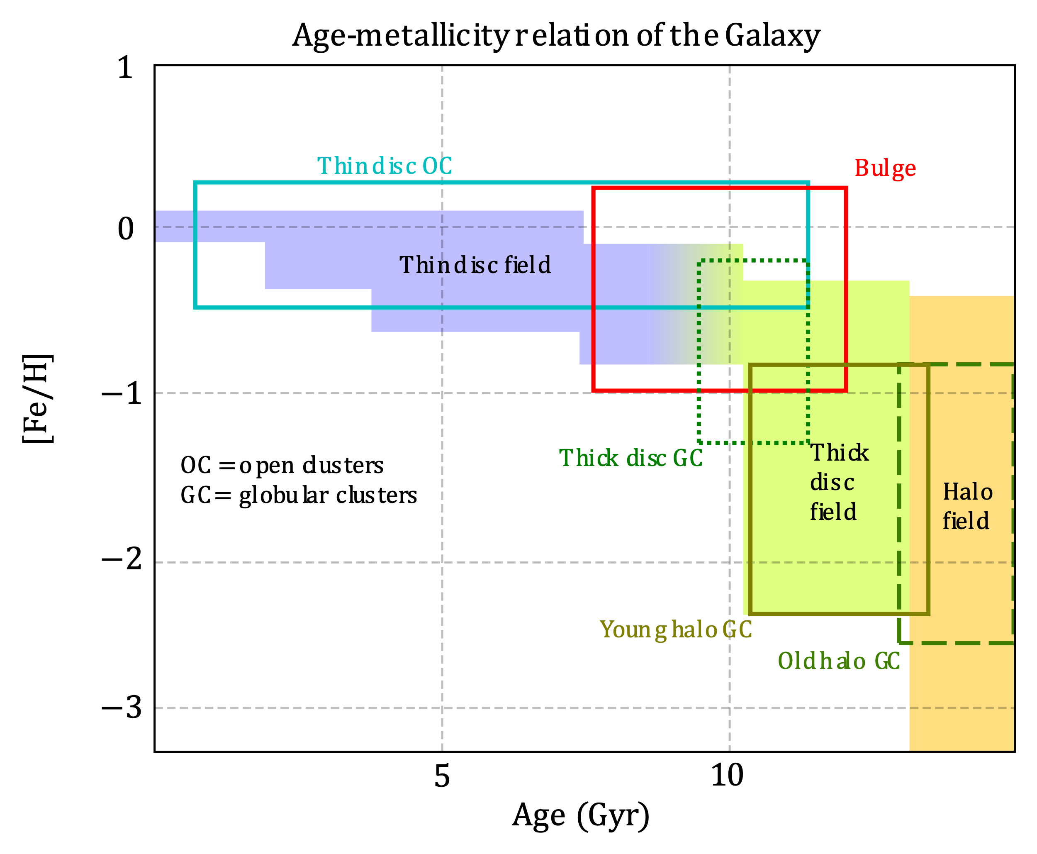
Age determination from evolving star properties
Identify
Observable properties
that evolve
with the star
Observation for deducing these observable properties
Models that link the values of these observable properties with age
Age
(model dependent)
radioactive dating
Age-Metallicity
Dynamic
Meteorite
and solar age
Thorium
at surface
Connelly et al. 2017
Bandyopadhyay et al. 2024
Saas Fee Advanced
course 2014
Ferraro et al. 2020

Slide 34
Age determination from evolving stellar remnant properties
Manser et al. 2023
Notes:
The Gaia Hertzsprung-Russell Diagram (HRD) showing the metal-enriched (orange and magenta triangles) and non-enriched (blue stars
and cyan squares) systems used in the calculation of the frequency of planetary systems around cool, helium-atmosphere white dwarfs, 𝑓 (see Section 3).
Cooling tracks from B.dard et al. (2020) for pure helium-atmosphere white dwarfs with masses from top to bottom of 0.4M⊙, 0.6M⊙, 0.8M⊙ and 1.0M⊙
are plotted as dashed lines on the Gaia HRD, with vertical tabs highlighting 𝑇eff values in steps of 1000 K. These cooling tracks are only strictly applicable
to helium-atmosphere white dwarfs with no traces of metals or carbon. The red shaded regions shows the ranges excluded from the 0 < (𝐺BP − 𝐺RP) < 1
selection used in our 𝑓 calculations. One DC, WDJ095106.36+645400.46, sits far below the cooling track with 𝐺Abs > 16 and is thought to have a spectrum
dominated by collisionally-induced absorption (Kilic et al. 2020; Bergeron et al. 2022).We still include this system in our analyses. Bottom panel: The fraction
of metal-enriched helium-dominated white dwarfs with no trace hydrogen detectable as a function of 𝐺BP – 𝐺RP is shown in six, equal sized bins of 39 white
dwarfs. Vertical lines on the gray points represent 1 𝜎 errors on the value of 𝑓 in the bin, while the horizontal lines represent the span of the (𝐺BP − 𝐺RP)
values for each bin. The horizontal dashed line and shaded region is set to the average value and uncertainty of 𝑓 = 0.21 °æ 0.03 calculated using all 234 white
dwarfs in the range 0 < (𝐺BP − 𝐺RP) < 1.

Slide 35
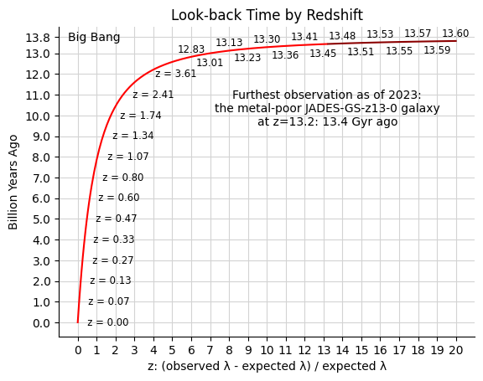
Age from redshift

Slide 36
Between 2020 and now: 4430 papers, 87 000 citations

Slide 37
Surface composition (Li)
Young clusters
Cargile et al. 2010
Notes:
Figure 1. Intrinsic I/I − Ks CMD for 15 Blanco 1 candidates. Stars rejected
as single-star cluster members are identified as black crosses. Photometric error
bars are 1σ. VLM cluster members with significant Li absorption are indicated
as filled red squares, and Li-poor members are shown as open blue circles.
The Pleiades single-star locus is plotted as a purple solid line. A zoomed-in
region around the LDB is plotted in the inset. The solid box shows the probable
region of the LDB for Blanco 1. Also plotted are BCAH98 predicted constant
luminosity loci (dotted lines) corresponding to the given LDB ages.
LDB vs. UMS age for four clusters with UMS ages found using the τ 2
fitting technique and the Geneva stellar evolutionary models. The black dashed
line represents equality between the two age determination methods and is not
a fit to the data.

Slide 38
Surface composition (Li)
Comparisons of different methods
Lee et al. 2024
Notes:
Estimates of the age of the BPMG in the literature, i.e. table 6 of Miret-Roig et al. ( 2020 ), updated from table 1 of Mamajek & Bell ( 2014 ), along with the CMD- and LDB-based ages from this study. The best-fitting ages for each of three methods used in this work are circled. Estimated ages of other young stellar associations Taurus (TAU), Upper Scorpius (USCO), Carina (CAR), and Columba (COL) from table 1 in Gagn ´e & Faherty ( 2018 ) have been plotted for comparison and context. The sources for ages marked with an ‘ ∗’ do not report errors for their ages.

Slide 39
Surface composition: [Y/Mg],[C/N]
Vernekar et al. 2024
Detailed spectroscopic analysis of 16 stars on the red giant and red clump branch.
The values based on asteroseismology for the ages agree excellently with those derived from theoretical evolutionary tracks, but they disagree with ages derived from the chemical clocks [Y/Mg] and [C/N].
Notes:
detailed spectroscopic analysis of 16 stars that were photometrically selected to be on the red giant and red clump branch. Stellar
parameters and chemical abundances for light elements (Li, C, N, and F), Fe peak, and n-capture elements were derived using a
combination of equivalent widths and spectral synthesis techniques based on atomic and molecular features. Ages were determined
through asteroseismic scaling relations and were compared with ages based on chemical clocks, [Y/Mg] and [C/N].

Slide 40
Surface rotation/activity/surface magnetic field
For cool dwarfs stars
16 Cyg B
18 Sco
Cen A
SUN
Cluster stars
Kepler asteroseismic
star
Angus et al. 2015
Notes:
Rotation period vs age for cool dwarfs with colour within 0.1 of the Sun’s: 0.65, with gyrochronology relations of Barnes (2007), Mamajek &
Hillenbrand (2008) and this work. The Sun is shown in red and the field stars, Cen A, 18 Sco and 16 Cyg B from left to right, are shown in blue. The black
points towards the lower left are cluster stars and those towards the upper right are Kepler asteroseismic stars. Each of the faint grey lines represents a sample
drawn from the posterior probability distributions of a, b and n. Whilst most of these draws come from the large peak in the posterior PDF and fall through the
Sun and field stars, some describe the period-age relation of the Kepler asteroseismic stars. These lines are drawn from the smaller peak in the posterior PDF.
Among the available methods for dating stars, gyrochronology is a powerful one because it requires knowledge of only the star’s mass and rotation period. Gyrochronology relations have previously been calibrated using young clusters, with the Sun providing the only age dependence, and are therefore poorly calibrated at late ages. We used rotation period measurements of 310 Kepler stars with asteroseismic ages, 50 stars from the Hyades and Coma Berenices clusters and 6 field stars (including the Sun) with precise age measurements to calibrate the gyrochronology relation, whilst fully accounting for measurement uncertainties in all observable quantities. We calibrated a relation of the form P = An ×(B −V −c) b , where P is rotation period in days, A is age in Myr, B and V are magnitudes and a, b and n are the free parameters of our model. We found a = 0.40+0.3 −0.05, b = 0.31+0.05 −0.02 and n = 0.55+0.02 −0.09. Markov Chain Monte Carlo methods were used to explore the posterior probability distribution functions of the gyrochronology parameters and we carefully checked the effects of leaving out parts of our sample, leading us to find that no single relation beween rotation period, colour and age can adequately describe all the subsets of our data. The Kepler asteroseismic stars, cluster stars and local field stars cannot all be described by the same gyrochronology relation. The Kepler asteroseismic stars may be subject to observational biases, however the clusters show unexpected deviations from the predicted behaviour, providing concerns for the overall reliability of gyrochronology as a dating method.

Slide 41
Surface rotation/activity/surface magnetic field
X–UV activity–age: relationships for M0–M6.5 dwarfs
Engle 2024
Notes:
The evolution of M dwarf X-ray activity over time is again plotted, but now the ratio of X-ray to bolometric luminosity is used to normalize the stars better.
Again, lighter-colored error bars indicate when the “average” uncertainty value was applied to a target for fitting purposes. As revealed by the segmented fits to the
data, both subsets begin their saturation phases at essentially equal activity levels (log(LX Lbol) » -3), and decline by ∼2.5 orders of magnitude. The length of the
saturation phase is found to be ∼450 Myr for the early M dwarfs and ∼2.3 Gyr for the mid–late M dwarfs.

Slide 42
Surface rotation/activity/surface magnetic field
Dependence on initial rotation (here after 27 Myr)
Rao et al. 2021
Notes:
Left panel: evolution of the Rossby number for an isolated 1 M stellar model during the PMS phase and the very early MS phase for
different values of the initial rotation. The initial rotation periods and velocities can be seen in Fig. A.1. The Rossby number corresponding to the
slowest initial rotation is the upper curve. Right panel: evolution of the X-ray, EUV luminosities and of their sum for a slow (in blue) and a fast (in
red) rotating 1 M model. The slow and fast rotations correspond, respectively, to the slowest and fastest model shown in Fig. A.1.

Slide 43
Surface rotation/activity/surface magnetic field
Dependence on the angular momentum transport process
Rao et al. 2021
Notes:
Evolution of the XUV irradiation flux and of the Rossby number. Left panel: red continuous line shows the evolution as a function of time
of the XUV flux on the planet beginning its evolution at a distance of 0.05 au. The blue continuous line shows the evolution of the Rossby number
obtained from the solid body stellar rotation model. The dotted blue line is the Rossby number obtained from the differentially rotating model.
Below the horizontal line at 0.196, the X-ray luminosity is a constant fraction (0.00074) of the bolometric luminosity. When the curve is above the
horizontal line, the X-ray luminosity decreases rapidly as the Rossby number increases (see text). Right panel: evolution of the surface velocity of
the 1 M model. The red line shows the surface velocity assuming solid body rotation. The blue line is the surface velocity obtained from the model
used in Rao et al. (2018) where differential rotation occurs due to the internal angular momentum redistribution resulting from shear instability and
meridional currents.

Slide 44
Surface rotation/activity/surface magnetic field
Impact of star-planet interactions
Rao et al. 2021

Slide 45
Effects of initial composition
Warfield et al. 2024
Notes:
We present stellar age determinations for 4661 red giant branch stars in the APO-K2 catalog, derived using mass
estimates from K2 asteroseismology from the K2 Galactic Archaeology Program and elemental abundances from
the Apache Point Galactic Evolution Experiment survey. Our sample includes 17 of the 19 fields observed by K2,
making it one of the most comprehensive catalogs of accurate stellar ages across the Galaxy in terms of the wide
range of populations spanned by its stars, enabling rigorous tests of Galactic chemical evolution models.
Taking
into account the selection functions of the K2 sample, the data appear to support the age−chemistry morphology of
stellar populations predicted by both inside-out and late-burst scenarios.
We also investigate trends in age versus
stellar chemistry and Galactic position, which are consistent with previous findings.
Comparisons against
APOKASC-3 asteroseismic ages show agreement to within ∼3%.
We also discuss offsets between our ages and
spectroscopic ages.
Finally, we note that ignoring the effects of α-enhancement on stellar opacity (either directly or
with the Salaris metallicity correction) results in an ∼10% offset in age estimates for the most α-enhanced stars,
which is an important consideration for continued tests of Galactic models with this and other asteroseismic age
samples.
[α/M] vs. [Fe/H] for all stars in the K2 GAP sample. The black
dashed line represents our by-eye ridgeline to separate the α-poor (cyan) from
the α-rich (orange) populations. The black open circles represent stars that
cannot be classified as either α-poor or α-rich with >95% confidence, due to
the uncertainties in their chemical abundances.
The left column of panels compares the ages for stars given in this work to the ages that would be obtained if interior opacity variations due to nonsolar [α/
M] are not considered in the underlying evolutionary tracks, but rather each star’s metallicity is corrected using the formula from Salaris et al. (1993). The right column
has the same x-axis, but the y-axis shows the ages inferred if the metallicities of stars are given no correction. The bottom panels compare these ages one-to-one, and
the top panels show the fractional offset of these ages vs. ours. Each individual star in our data set is represented by an orange point, and we plot rolling medians with
1.5 Gyr bin widths for stars with 0.0 < [α/M] < 0.2 (blue dashed line) and 0.2 < [α/M] < 0.4 (blue solid line). The excellent agreement in this left column indicates
that the Salaris et al. (1993) approximation captures the effect of nonsolar α-abundances on age even using updated microphysics prescriptions. The large age
disagreement shown in this right column demonstrates that the ages of α-rich stars are strongly systematically biased by assuming solar α-abundance.

Slide 46
MASS ESTIMATES BY THE ORBITAL PROPERTIES
Hussein et al. 2024
See also e.g Torres et al. 2024; Jennongs et al. 2024

Slide 47
Surface rotation/activity/surface magnetic field
Engle and Guinan 2023
Notes:
M dwarf age–rotation relationships from the Living with a Red Dwarf program (Engle & Guinan 2023). With the exception of cluster or galactic population
members, these relationships were used to calculate the stellar ages used in this study and presented in the tables. Each row of plots is devoted to a specific subset of M
dwarfs. The “early” M dwarfs, M0–2 dwarfs, are plotted in the top row. The “mid–late” M dwarfs are plotted in the middle row. For the “older” track, M2.5–6.5
dwarfs are plotted together since they have all settled onto a common evolutionary path. However, only M2.5–3.5 dwarfs are plotted on the “young” track due to the
large differences in pre–main-sequence lifetimes that are encountered within this mass range. Consequently, a third subset was created and shown in the bottom row.
Here, only M4 (and later) dwarfs are plotted. As seen, there is a large difference between the young tracks of the middle and bottom rows, but any difference between
the older tracks is well within the uncertainties of the fits.

Slide 48
CHECK OF STELLAR MODELS
Middle MS
ZAMS
TAMS
Continuous lines:
GENEC with 0.2Hp
Dashed lines
Convective Boundary Mixing
Tkachenko et al. 2020
Eclipsing binaries
Tkachenko et al. 2020
Martinet et al. 2020
Notes:
Variation of the convective core size at di erent stages during
the core H-burning phase, as a function of the initial mass. The dashed
lines are the models of Tkachenko et al. (2020) with strong convective
boundary mixing, the solid ones are the present GENEC models with
= 0.2. The tracks in black correspond to the ZAMS stage, while the
red tracks correspond to a stage where the mass fraction of hydrogen in
the convective core (Xc) is 0.35, and the blue tracks to Xc = 0.1. The grey
points show observed eclipsing binaries and their core mass estimates
from Tkachenko et al. (2020). In the left panel, the GENEC models are
the non-rotating ones. In the right panel, they are the = crit = 0.4 rotating
ones.

Slide 49
Comparison between two age estimates
Work by Warfielf et al 2024
Ages derived using mass
estimates from
K2 asteroseismology
Work by Mackereth et al 2024
Ages derived using a Bayesian
neural network model trained
on asteroseismic ages
Warfield et al. 2024
Notes:
comparison between age estimates for RGB stars in the APO-K2
sample produced using the method described in this work and War21 vs. those
produced by Mackereth et al. (2019) with AstroNN. The bottom panel
compares these ages directly, and the top panel shows the age offsets,
Δage = τNN − τ. The gray dashed line represents the one-to-one line, and the
blue solid curve tracks the rolling inverse-variance-weighted mean of the data
with a bin width of 2 Gyr. Orange circles are stars classified as α-poor, and
green triangles are for α-rich stars. In order to not overcrowd the plots, error
bars are shown for a random 1% of the sample.
AstroNN
we estimate ages using a Bayesian neural network model trained on asteroseismic ages

