Slide 1
Machine Learning Techniques for Accreted vs In-situ classification
Andrea Sante¹, Andreea S. Font^{1,2}, Sandra Ortega-Martorell², Ivan Olier², Ian G. McCarthy^{1,2}
The Milky Way Assembly Tale - Bologna - 30/05/2024
¹Astrophysics Research Institute, Liverpool John Moores University, 146 Brownlow Hill, Liverpool, L35RF, UK
²Data Science Research Centre, Liverpool John Moores University, 3 Byrom Street, Liverpool, L33AF, UK

Slide 2
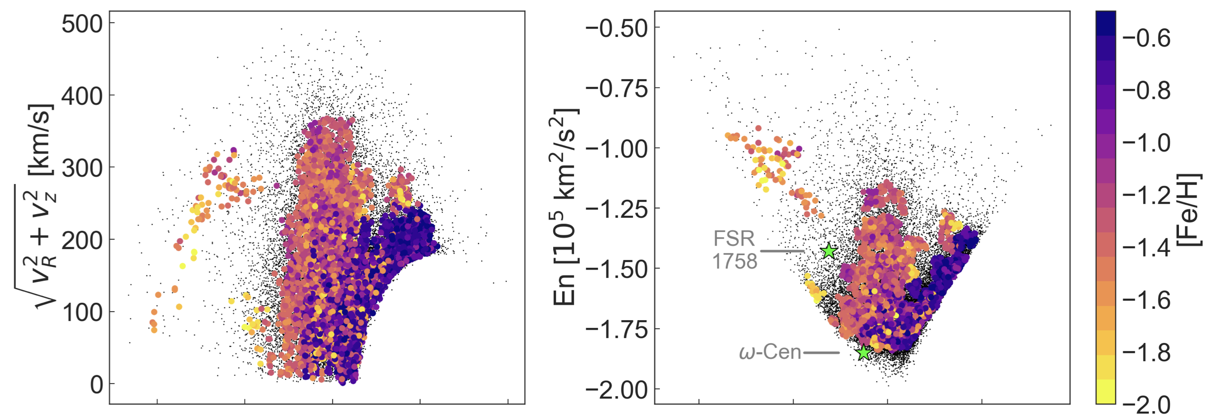
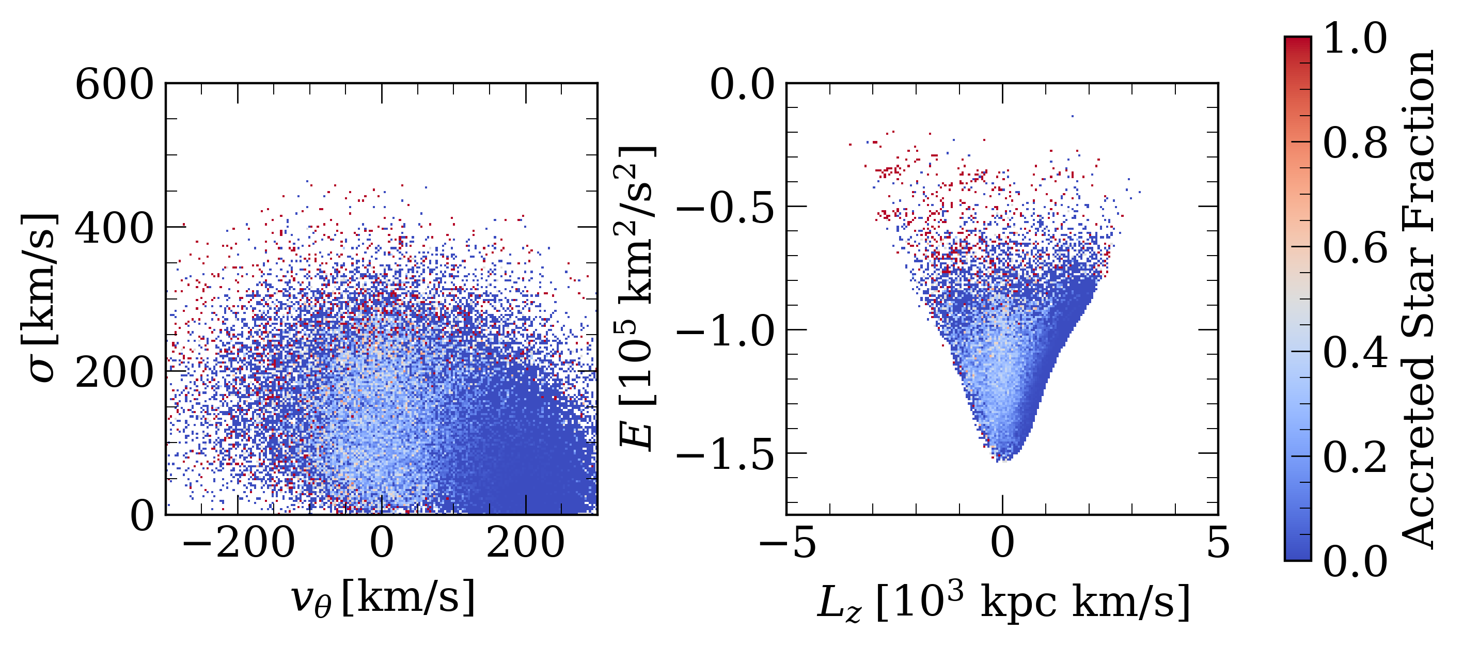
Accreted vs In-situ stars
Observations Koppelman et al. (2019)
Need non-trivial separation methods
Machine Learning
Simulations
SN Volume in G29, ARTEMIS
A.Sante@2022.ljmu.ac.uk
Notes:
Difference between accreted and in-situ stars becomes more subtle in inner region of the galaxy like the sn where accreted stars make up less 10% of the overall stellar content. Traditionally, the two populations are separated analytically using selection cuts in kinematics and chemistry. But simulations tell us that the difference is not so explicit. Hence, we tried to apply ml to leverage the information in the prop of accreted stars to develop non-trivial methods

Slide 3
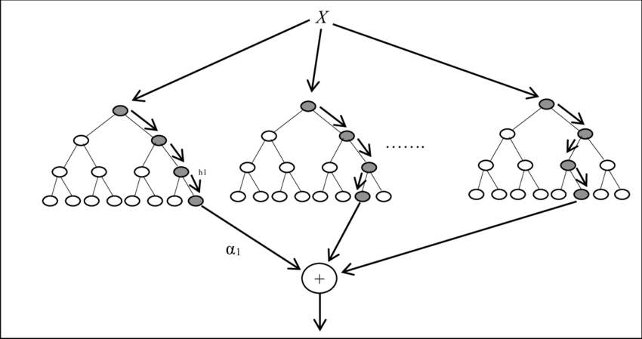
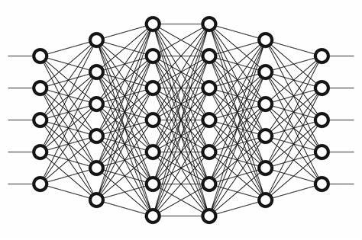
The Machine Learning recipe
$$R$$
0 - 1
$$z$$
Output
(prediction)
$$R$$
$$v_{θ}$$
$$z$$
$$σ$$
$$v_{θ}$$
$$[α/Fe]$$
0 or 1
Error
function
$$σ$$
$$….$$
$$[α/Fe]$$
Label
Properties vector
$$….$$
Input
(features)
0 or 1
Star
Label
Machine learning model
(artificial neural networks, decision trees, instance-based, …)
Machine learning model
(artificial neural networks, decision trees, instance-based, …)
A.Sante@2022.ljmu.ac.uk
Notes:
Ingredients:
Recipe: feed to the model -> model makes prediction -> predictions is compared to the label – model updates its internal parameters to minimize the loss

Slide 4
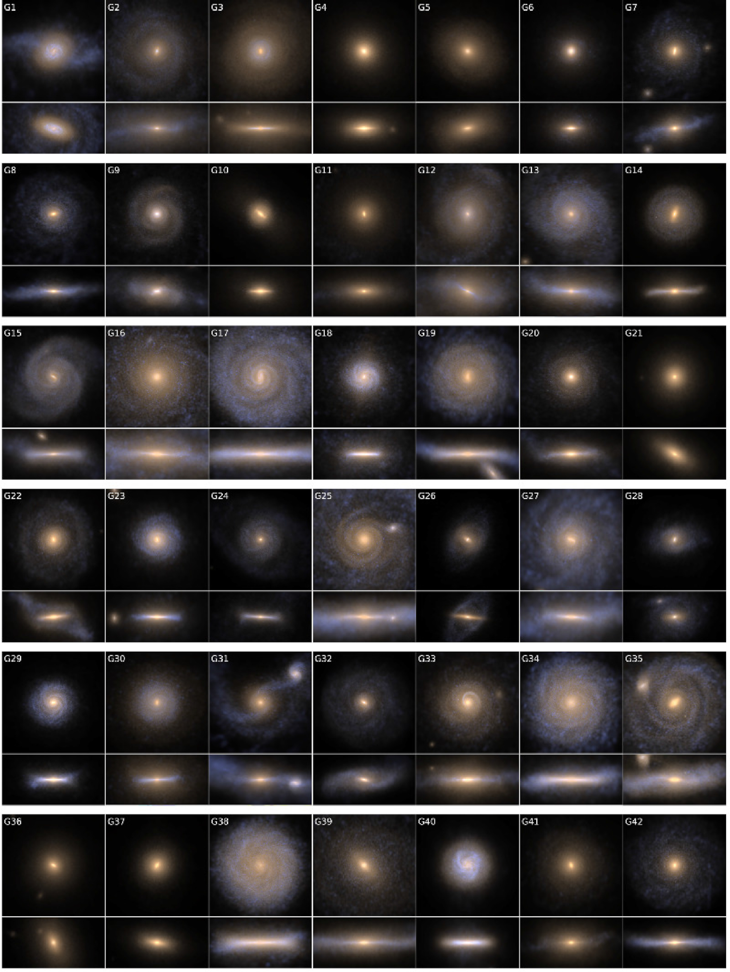
The ARTEMIS simulations suite
Font et al. (2020)
45 EAGLE zoom-in hydrodynamical simulations of MW-mass galaxies - baryon mass $≈2×{10}^{4} M_{\text{☉}}h^{−1}$
16 “most-disky” galaxies ${(k}_{co}>0.50)$
12
Training set
~17 million stars
4
Test set
(all with a GES merger)
~4 million stars
A.Sante@2022.ljmu.ac.uk
Notes:
To be able to train and test our models, we need to know the galaxy in which each star formed. This information is available in simulations.

Slide 5
The Machine Learning recipe
$$R$$
$$z$$
$$v_{θ}$$
$$σ$$
$$[α/Fe]$$
0 or 1
$$….$$
Label
Properties vector
Star
Machine learning model
(artificial neural networks, decision trees, instance-based, …)
A.Sante@2022.ljmu.ac.uk

Slide 6
Finding the best set of features
Sante et al. (2024), submitted
Pick a machine learning model:
Artificial neural network from Tronrud et al. (2022)
Pick a set of stellar properties:
$$R, z, v_{θ}, σ, \left[Fe/H\right],$$
$$\left[α/Fe\right], Age, M_{G}, BP−RP$$
A.Sante@2022.ljmu.ac.uk
Notes:
Explain strategy. Explain comparison metric. Kin Chem Phot. Kin+Phot has comparative performance which bodes well for observations

Slide 7
The Machine Learning recipe
$$R$$
$$z$$
$$v_{θ}$$
$$σ$$
$$[α/Fe]$$
0 or 1
$$….$$
Label
Properties vector
Star
Machine learning model
(artificial neural networks, decision trees, instance-based, …)
A.Sante@2022.ljmu.ac.uk
Notes:
Explain strategy

Slide 8
Selected Machine Learning algorithms
$$v_{θ}$$
$$w_{ki}$$
$$k$$
$$f \left(\sum{w_{ki} x_{i}}+b_{k}\right)$$
Multilayer perceptron (MLP)
MLP with galaxy features
Transformational Machine Learning
(TML) – Olier et al (2021)
Ensemble learning
XGBoost - Chen et al. (2016)
Decision tree + Gradient Boosting
$$[Fe/H]$$
$$[Fe/H]$$
…
…
…
…
$$y$$
Compare with
True label
$$M_{G}$$
$$[0,1]$$
$$z$$
$${𝓛 (y}_{true},y)$$
$$𝓛 ≡𝓛 \left(w\right)$$
$Δw ∝\frac{∂𝓛}{∂w}$
A.Sante@2022.ljmu.ac.uk
Notes:
ANNs in a nutshell Tried to add info on the assembly history of each galaxy to favour generalisation

Slide 9
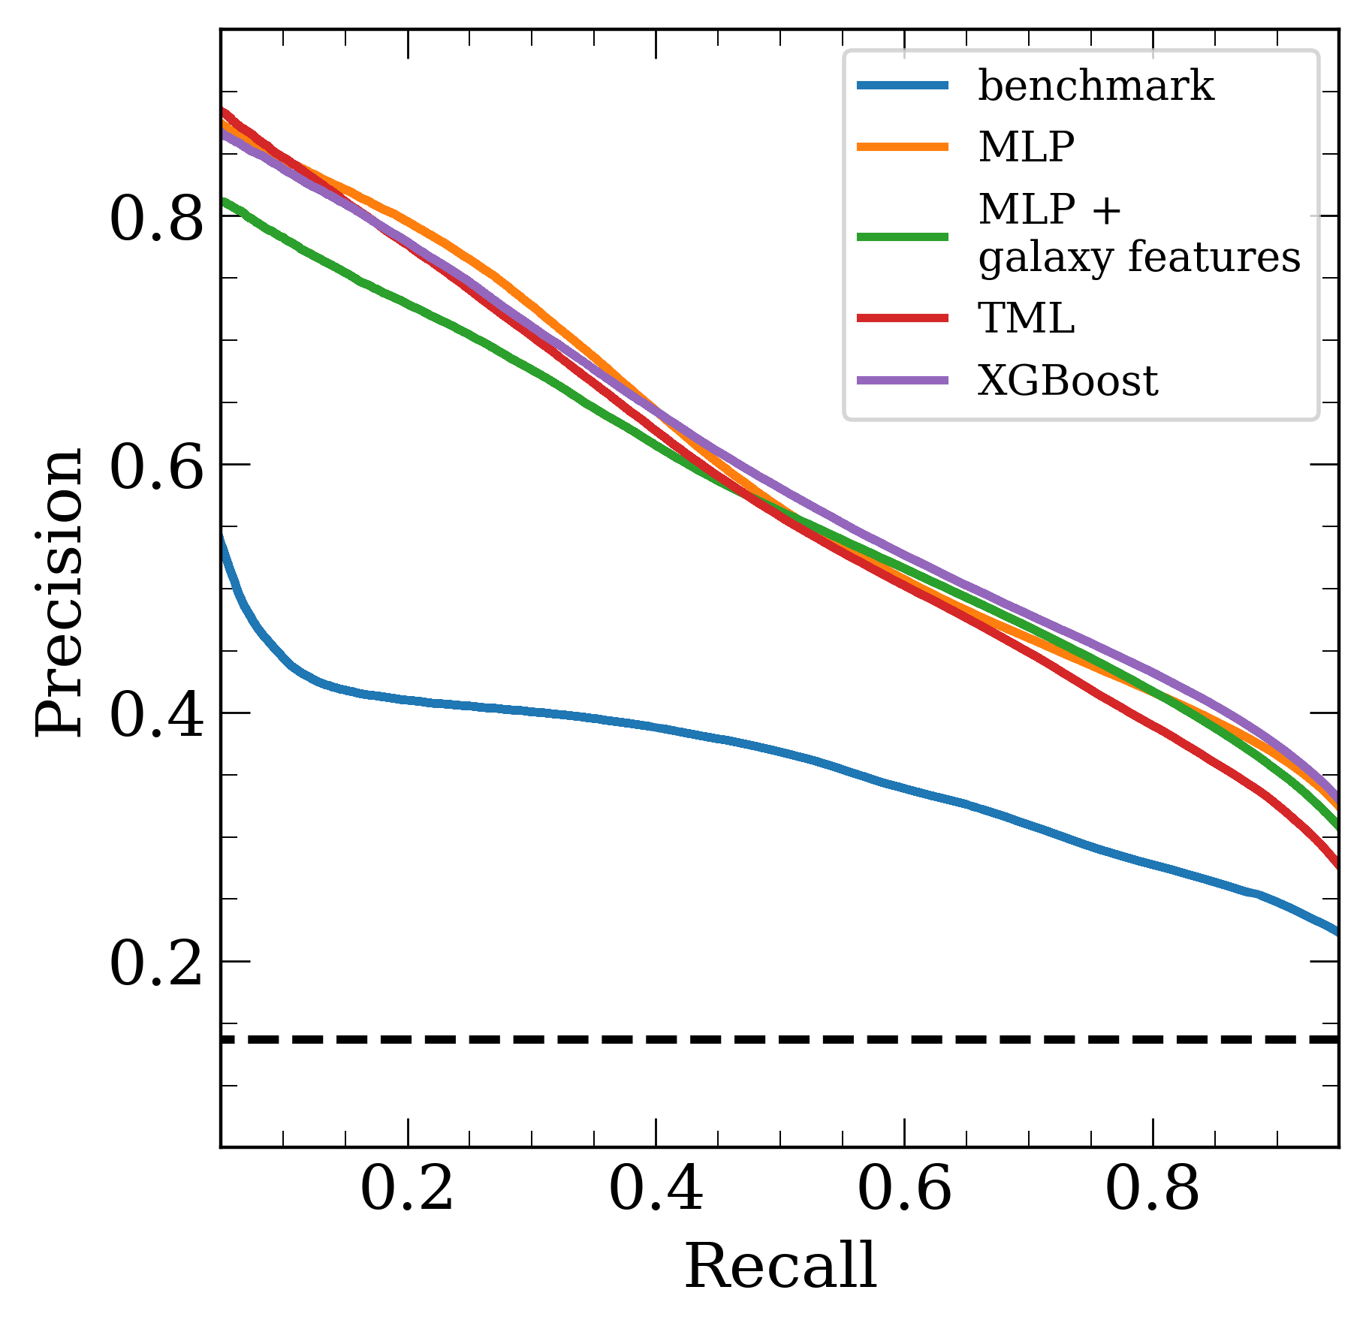
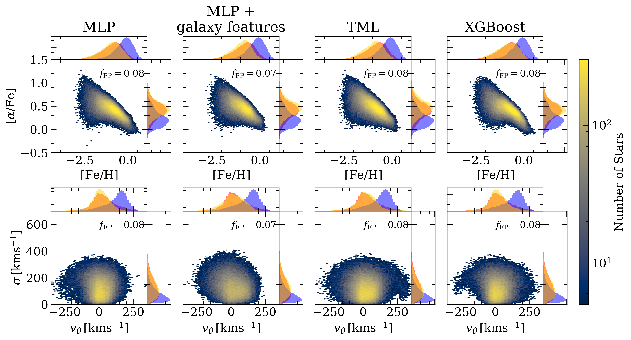
Comparing the performance of different ML Models
Comparison with ML metrics
Mis-classified In-situ stars
Sante et al. (2024), submitted
Sante et al. (2024), submitted
A.Sante@2022.ljmu.ac.uk

Slide 10
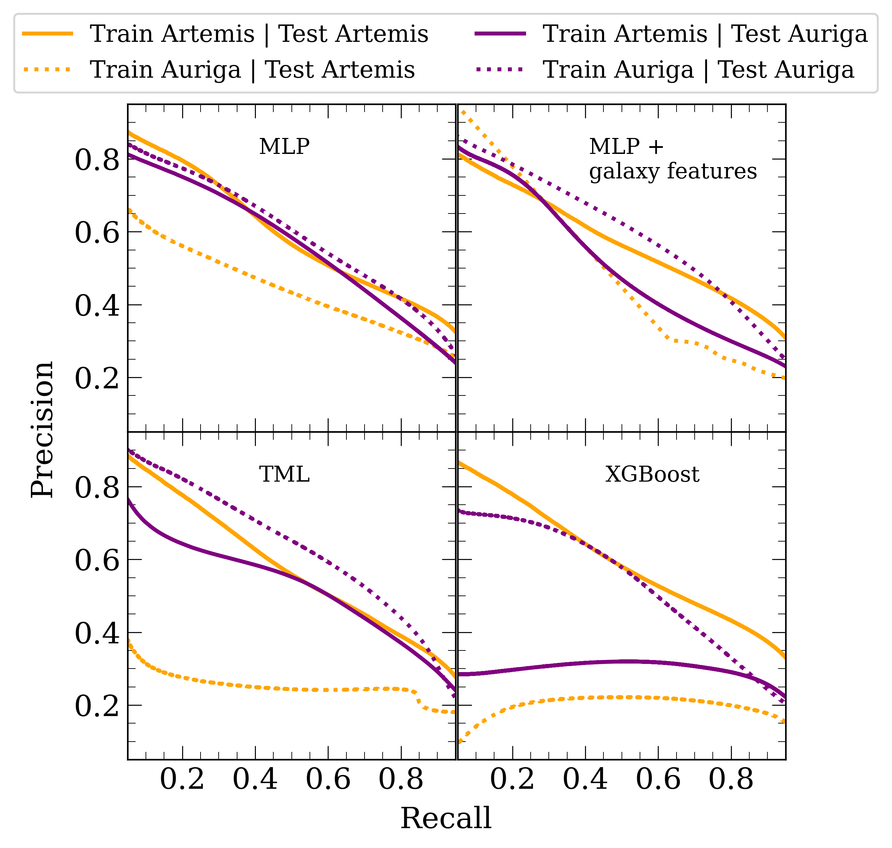
Cross-simulation comparison
Sante et al. (2024), submitted
Trained and tested models on “level 3” Auriga* galaxies
Different code
Different galaxy formation model
Higher resolution
*Grand et al. (2024)
A.Sante@2022.ljmu.ac.uk
Notes:
Intro simulation (different galaxy formation code, different resolution)

Slide 11
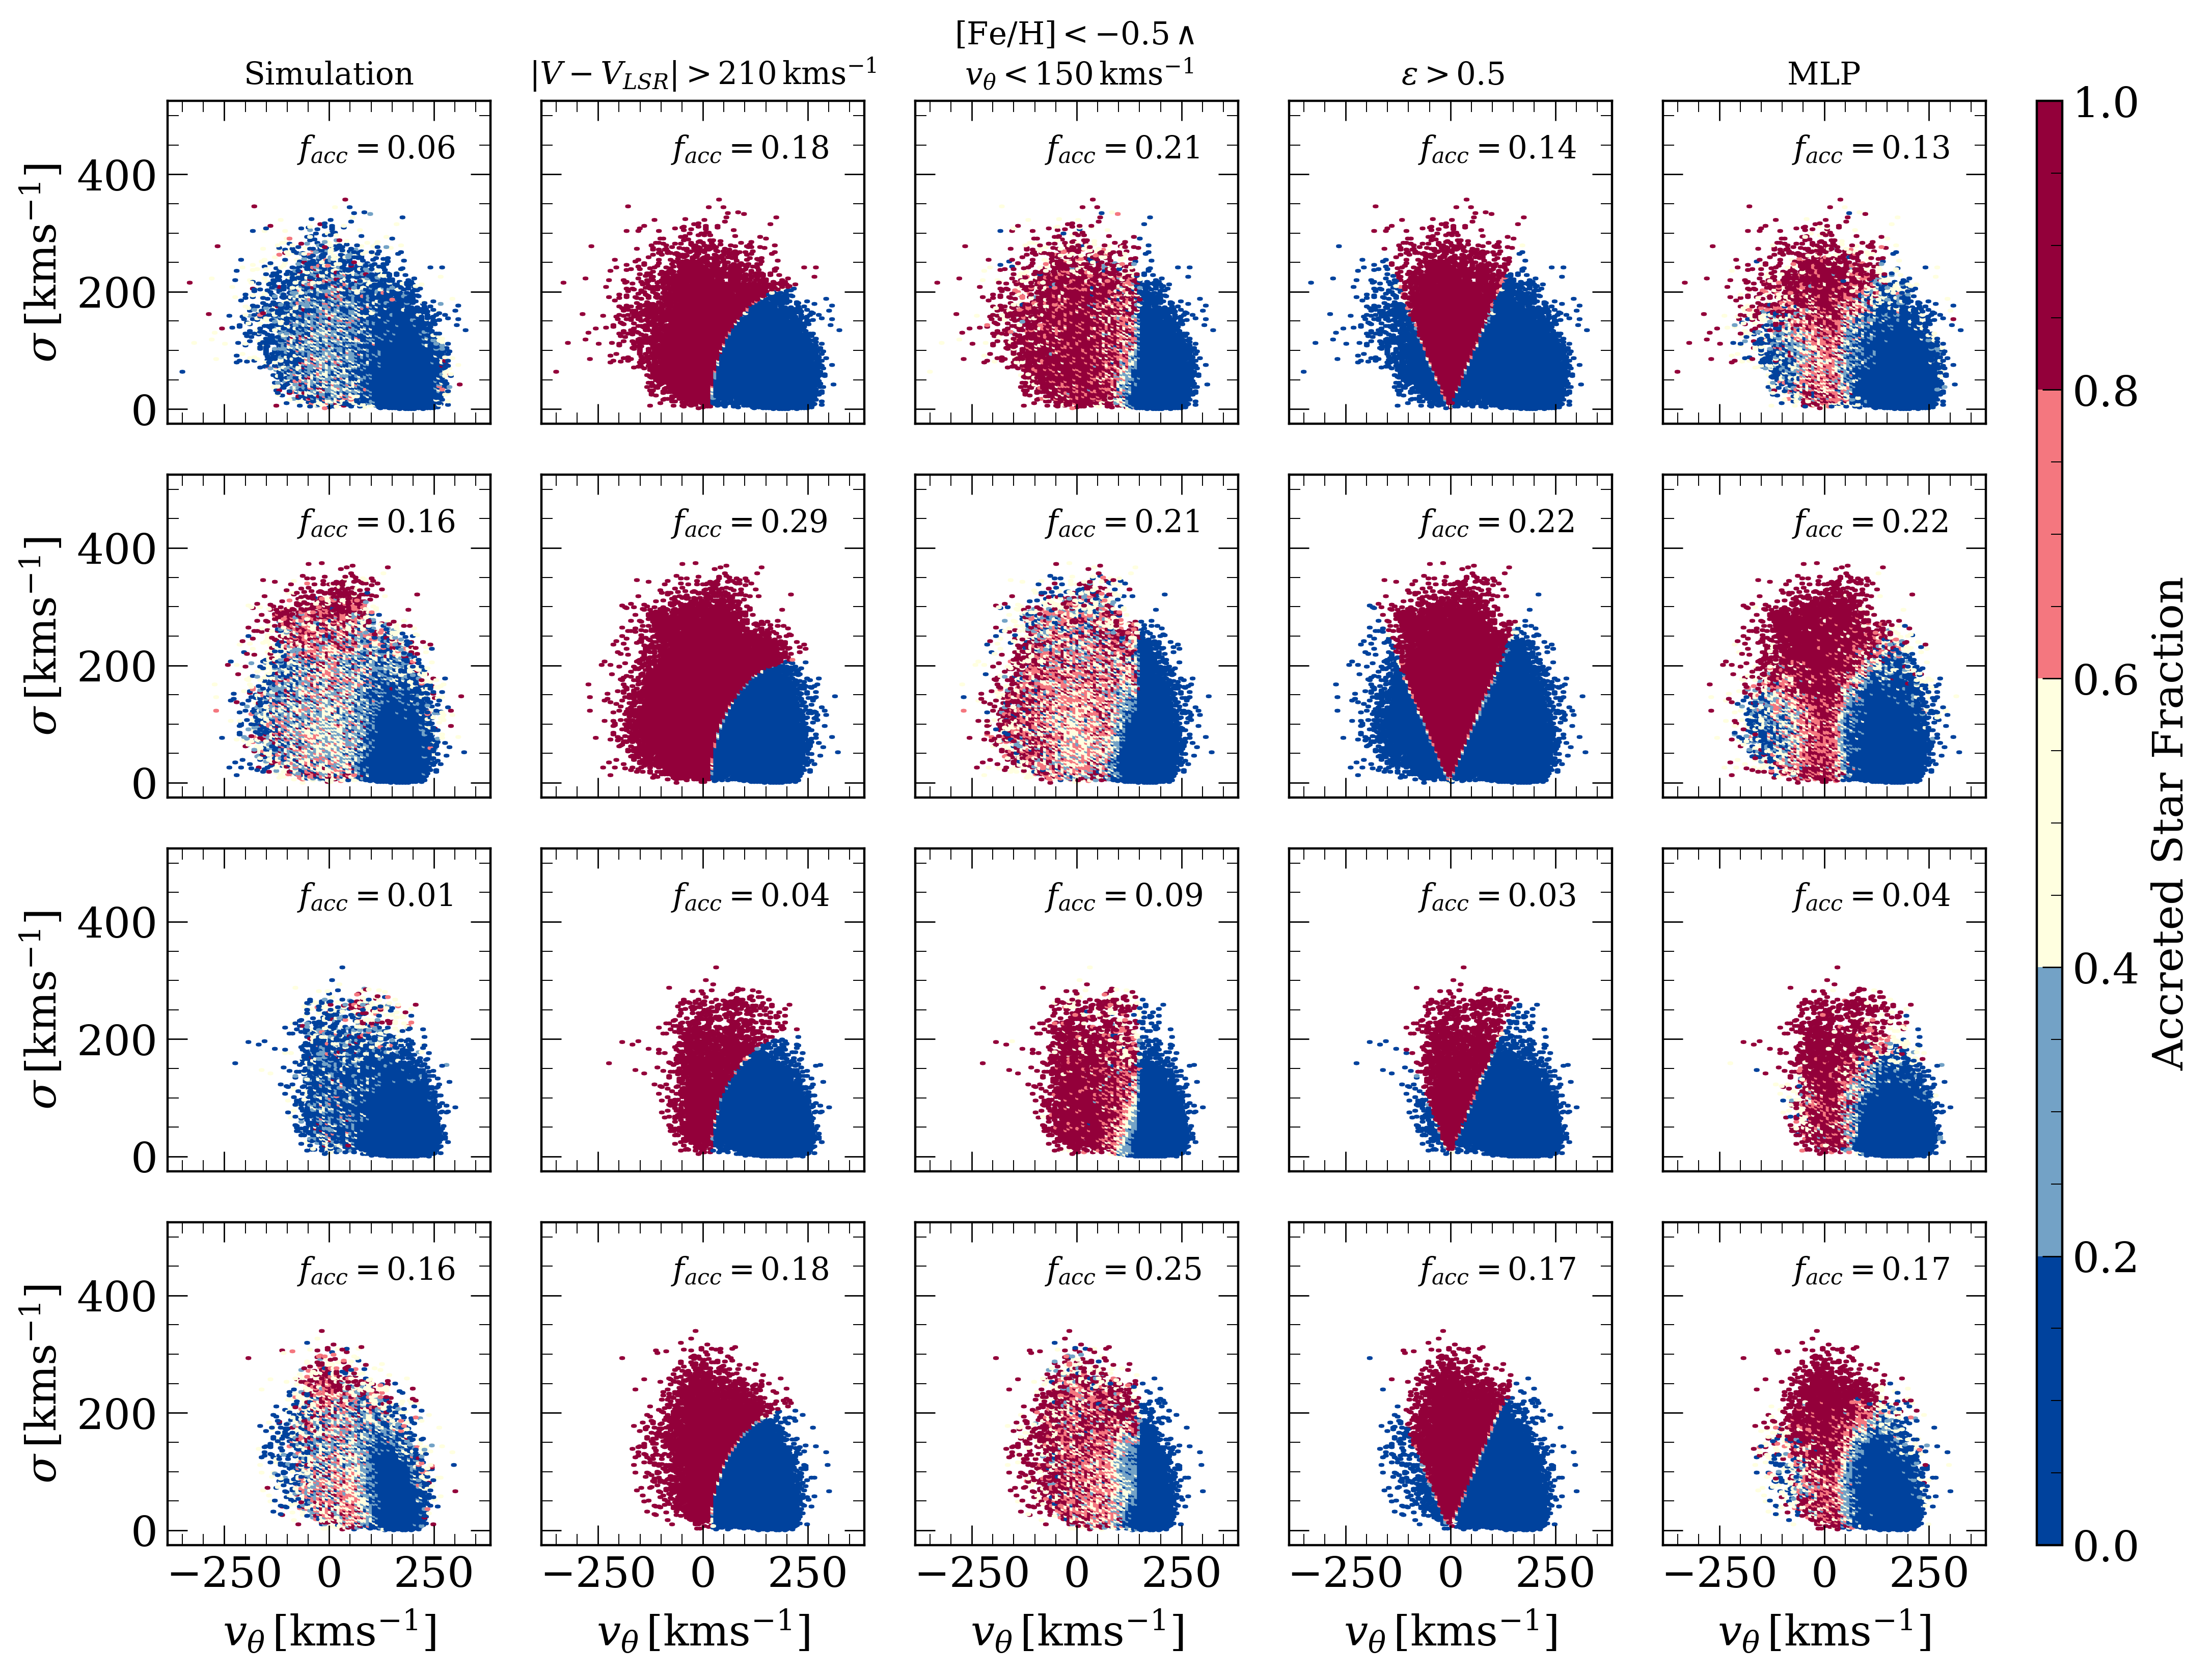
Comparison with observational cuts
Sante et al. (2024)
Analysis on Solar Neighbourhood tori
in the 4 test galaxies
$$z$$
$$GC$$
2.5$kpc$
$$\frac{R_{d}}{R_{d, MW}}× 8 kpc$$
MLP retrieves the purest sample of accreted stars.
A.Sante@2022.ljmu.ac.uk
Notes:
Tested against observational cuts usually adopted before finding substructures

Slide 12
Conclusions and future work
Combination of different probes (KIN+CHEM+PHOT) are better indicated for separating accreted and in-situ stars (KIN+PHOT shows promising results)
Different ML algorithms achieve similar classification performances. MLP generalises better on unseen data.
ML models retrieve purer samples of accreted stars than traditional methods
Next step and possible extensions:
Partially repeat analysis on single stars
Improve models --> classification performance & generalisation
Application to observational data!
A.Sante@2022.ljmu.ac.uk

Slide 13
Paper!
Thank you!
Andrea Sante - A.Sante@2022.ljmu.ac.uk

