Slide 1
Andromeda as a Stepping Stone to the Local Volume: Resolved Stellar Chemodynamics of Extragalactic Streams, Shells, and Disks
Ivanna Escala
Carnegie-Princeton Fellow (Princeton)
Institut de Ciències del Cosmos
Universitat de Barcelona
January 24, 2024
Collaborators: Karoline Gilbert (STScI), J. Leigh Wojno (MPIA), Raja Guhathakurta (UCSC), Amanda Quirk (Columbia), Lara Cullinane (JHU), Mark Fardal (Eureka), Robyn Sanderson (UPenn), Emily Cunningham (CCA),
Ben Williams (UW), Julianne Dalcanton (CCA), David Nidever (Montana), Evan Kirby (Notre Dame)
Image credit: GALEX, NASA/JPL-Caltech
Notes:
Introduce self
Happy to visit in-person
Talk title summary + collaborators
I work on M31 => LV

Slide 2
A SPLASH of Kicked Up Disk Stars in Andromeda’s PHAT Stellar Halo
Ivanna Escala, Carnegie-Princeton Fellow, Princeton University / Carnegie Observatories
The Milky Way Assembly Tale, Bologna, Italy, May 29, 2024
Raja Guhathakurta (UC Santa Cruz), Amanda Quirk (Columbia University), Karoline Gilbert (Space Telescope Science Institute),
Lara Cullinane (Max Planck Institute for Astrophysics, Johns Hopkins University), Douglas Grion Filho (UC Santa Cruz),
David Nidever (Montana State University), Benjamin Williams (University of Washington), Julianne Dalcanton (Flatiron Institute)

Slide 3
Hierarchical assembly influences disk formation and evolution
Koppelman, Villalobos, & Helmi
I. Escala (Princeton)

Slide 4
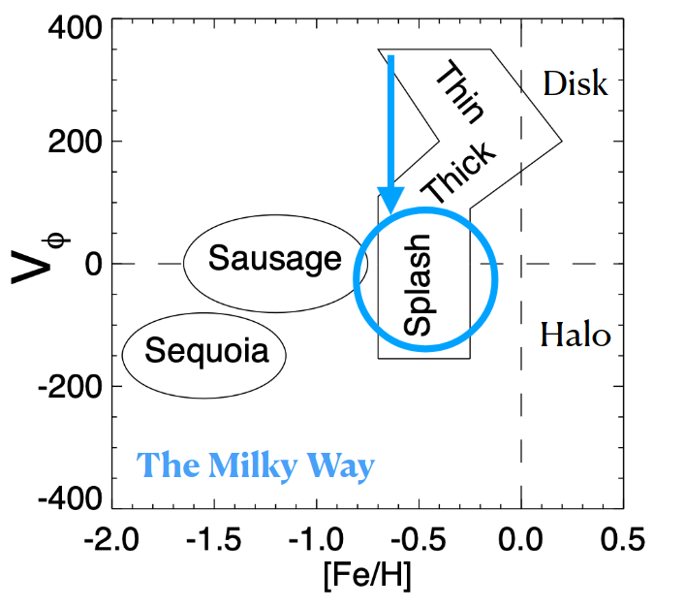
How do significant mergers impact the detailed chemodynamical properties of stellar disks?
Sotillo-Ramos et al. 2022
Belokurov et al. 2020
I. Escala (Princeton)

Slide 5
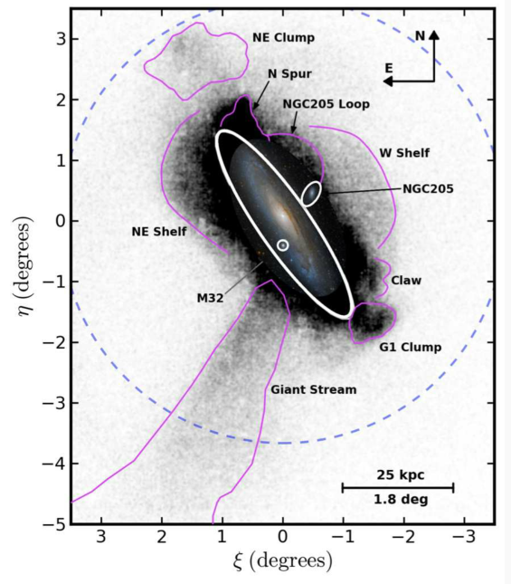
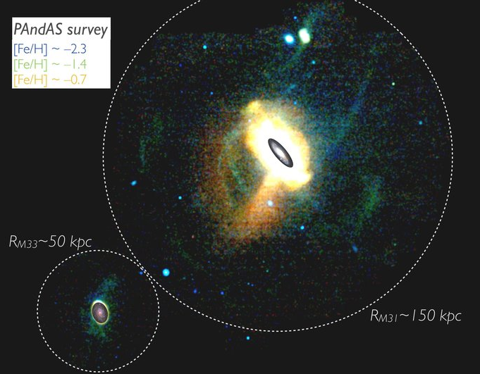
M31 is ideal for studies of disk galaxy assembly beyond the MW
PAndAS collaboration A. Ferguson & D. Mackey 2016 Martin et al. 2013
I. Escala (Princeton)

Slide 6
Outstanding questions for the hierarchical assembly of disk galaxies
5/30
What is the mass function of destroyed galaxies? e.g., Font+06, Deason+16, D’Souza & Bell 2018a, Fattahi+20
What is the in-situ vs. accreted halo fraction? e.g., Carollo+07, Harmsen+17, Naidu+20, Belokurov+20 Zolotov+09, Font+11, Tissera+13, Cooper+15
What are the formation channels for the in-situ halo? e.g., Purcell+10, McCarthy+12
How do disks survive significant late-time mergers (and how common are they)? e.g., Stewart+08, Hopkins+09, Purcell+09
Image credit: SDSS DR8 / Bonaca, Giguere, Geha
I. Escala (Princeton)
Notes:
STUDYING MERGER REMANANTS CAN HELP US ADDRESS THESE QUESTIONS
Most of these constraints come from the MW. Difficult to do in LV galaxies with only photometry or IL info for entire stellar pops instead of resolved stars
Theory depends on numerical details and predict large variation (30-40 percent, although agree that it should dominate within inner 20-30 kpc) or recently focused on reproducing MW properties
Kicked up disk stars? Or a more classical scenario?
General consensus is that massive dwarf galaxies (>10^8 Msun, distinct from present-day galaxies) are the dominant progenitors
And what are the effects on the disk (scale height, velocity dispersion?) — related question, what is the effect of mergers on disks (disk-halo interface)
Some of these questions also apply to smaller scales (e.g. does M33 have a stellar halo, and if so, what type of galaxy is it composed of?)
We can learn about these questions by studying M31’s merger history
Show Harmsen+17 plot?
Acknowledge Tim Beer’s studies of the MW halo here (papers he is a co-author on? Gallart+19?)
Look at the discussion of Claire’s 2015 paper for more disk inspiriation

Slide 7
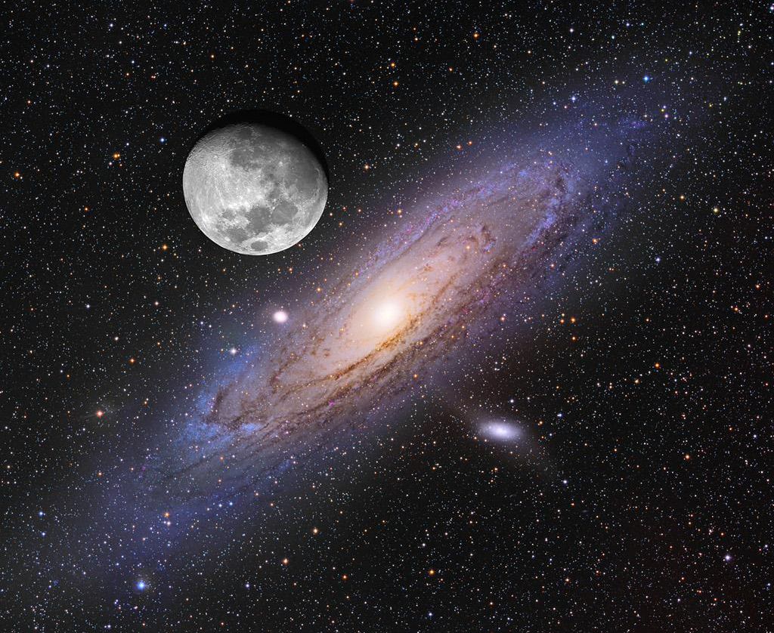
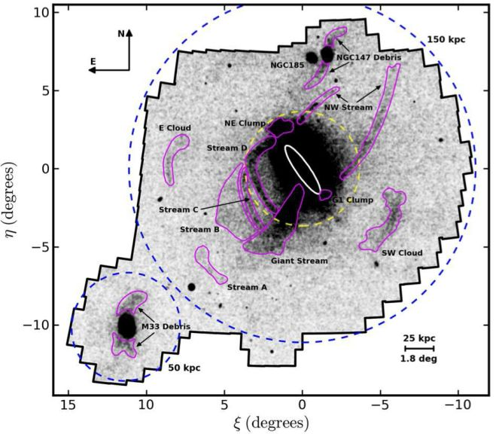
M31 is ideal for studies of galaxy assembly beyond the MW
7/30
PAndAS collaboration: A. Ferguson & D. Mackey
Image credit: NASA APOD, A. Block & T. Puckett
I. Escala (Princeton)
Notes:
So going back to M31, it is the only massive MW-like galaxy that we can currently hope to study in a level of detail comparable to what we have achieved in the MW. In this way, it can be used as a complementary template to the MW.
So to further motivate studies of M31, I want to emphasize the sheer scale of M31, where its visible disk alone spans a few times the diameter of the moon on the sky. If we embed this optical image of M31 in a star count map of its stellar halo from the Pan-Andromeda Archaeological Survey, its true extent and structural complexity become clear.

Slide 8
M31 is ideal for studies of galaxy assembly beyond the MW
3/10
7/30
PAndAS collaboration: A. Ferguson & D. Mackey
McConnachie et al. 2018
Disk
Stellar Streams
Intact Satellite Galaxies
“Smooth” Stellar Halo
I. Escala (Carnegie) 2021 GALAH Science Meeting
I. Escala (Princeton)
Notes:
Because similar data quality / techniques will be used, present-day studies are crucial for the calibration of future observations M31’s merger history will serve as the foundation on which we interpret future observations
We will be able to observe all stages of the minor merging process in these external galaxies, in which we can perform spectroscopic studies of extragalactic streams, halos, disks, and satellite systems
So, what have we learned about these various components in M31, and what can we learn in the LV?

Slide 9
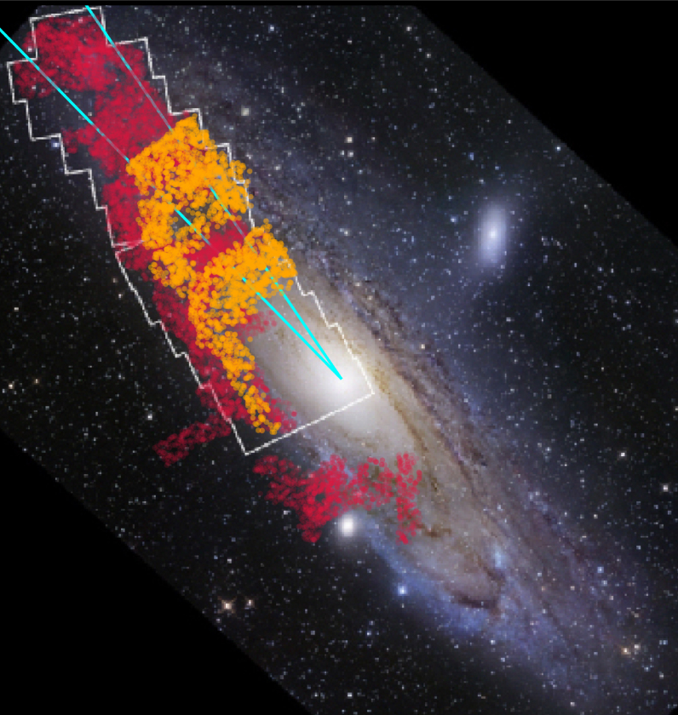
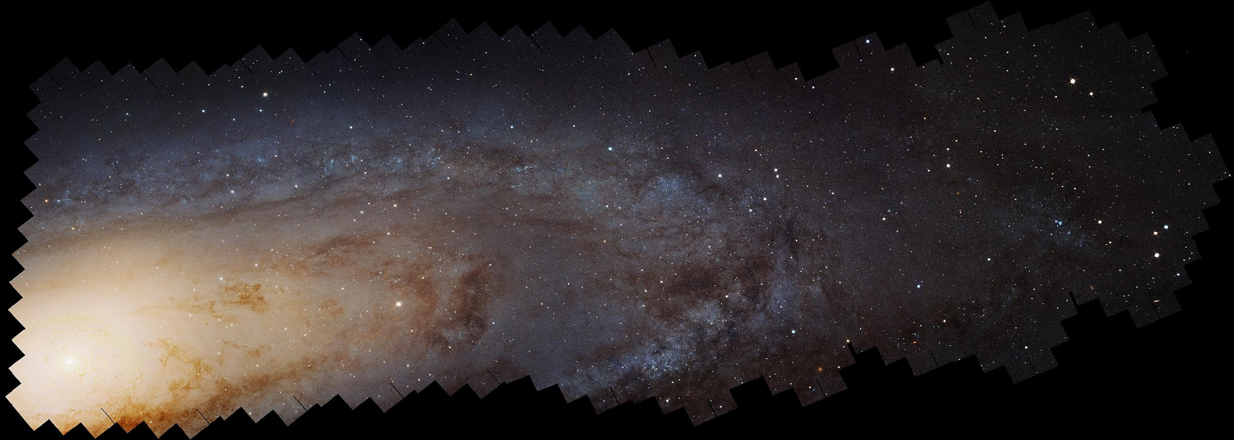
M31’s merger history involves the recent accretion of a relatively massive galaxy
Quirk et al. 2019
Global burst of star formation 2-4 Gyr ago (Williams+15, Bernard+15)
Steep age-velocity dispersion relation in disk (Dorman+15)
Asymmetric drift in disk (Quirk+19, Quirk & Patel 20)
Slowly rotating inner halo (Dorman+12) and statistical evidence for kicked-up disk stars (Dorman+13)
Dominant RGB population in thick disk (Dalcanton+12,15)
Dalcanton et al. 2012
CO + HI
HI
I. Escala (Princeton)
Notes:
Evidence independent of the system of tidal structures
Project AMIGA CGM papers: Metals in CGM beyond 200 kpc around M31 suggest long history of outflows (not just the 2 Gyr ago burst, which would be largely limited to within this radius. More variation in CGM within 0.5 Rvir suggests recent outflows? The CGM of M31 could have half the total present-day metal mass of the disk, or more (also Telford+19).

Slide 10
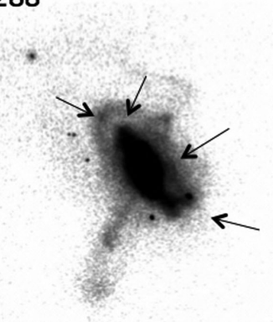
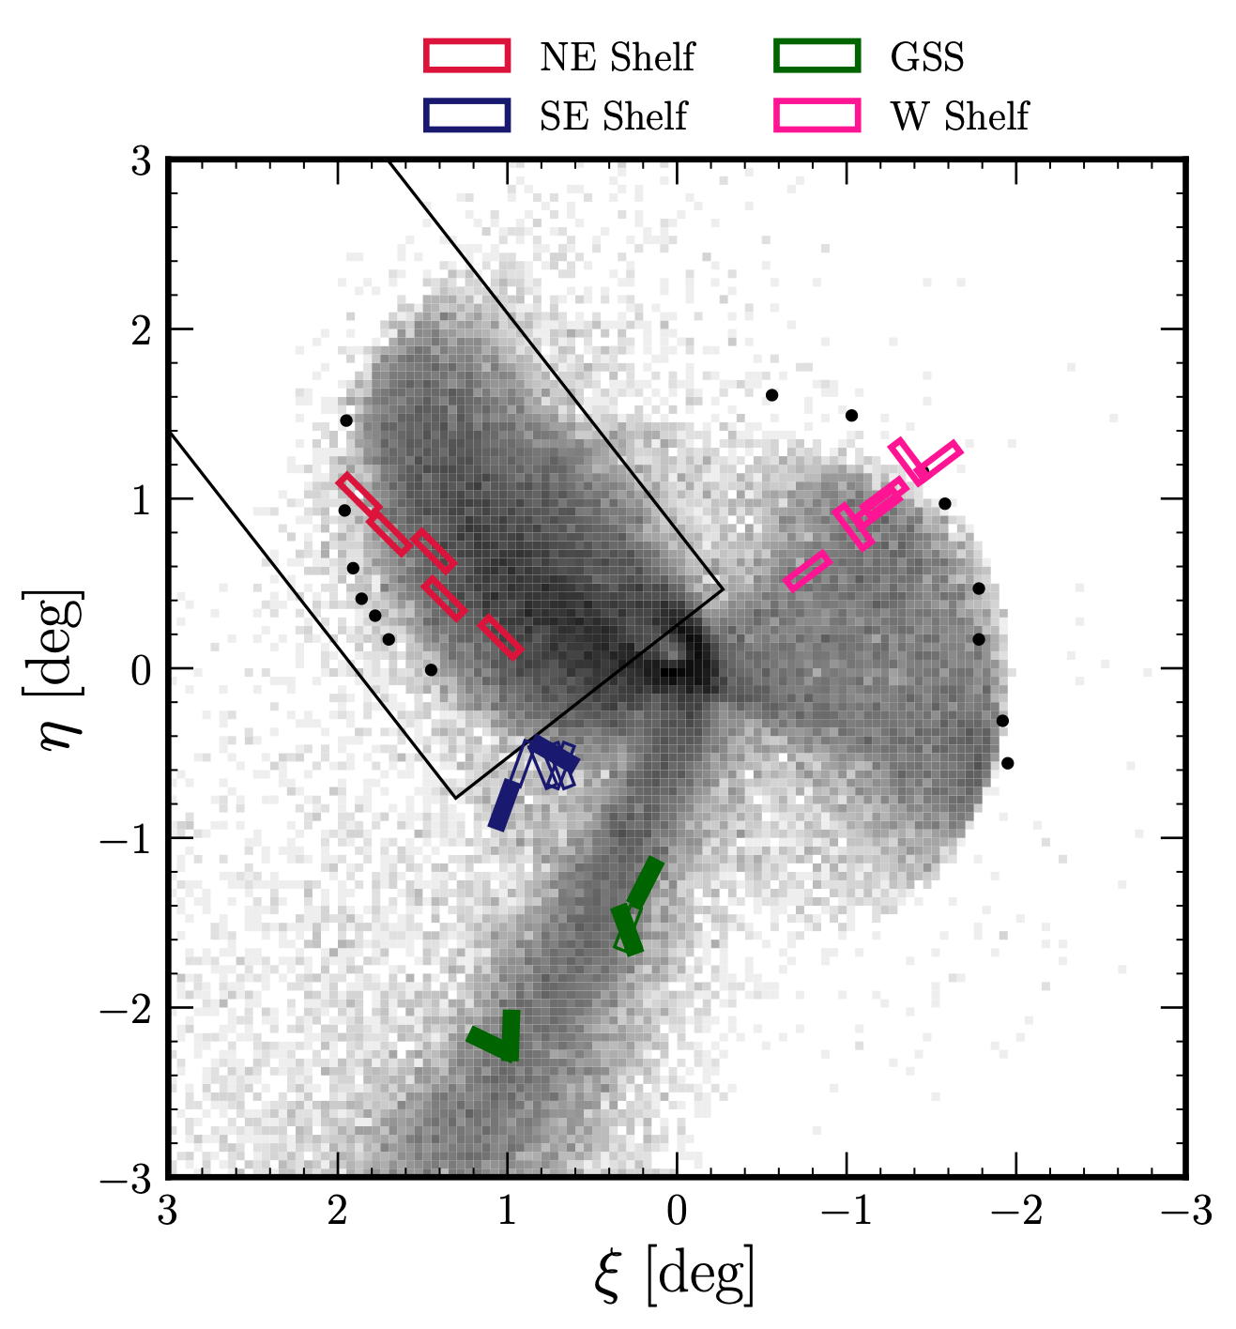
4/10
9/30
Did M31’s last significant merger produce its tidal features and disturbed disk?
Fardal et al. 2012
Hammer et al. 2018
Simulation: Fardal et al. 2007
Figure: Escala et al. 2022
See also Fardal+08,13, Mori & Rich 08, Sadoun+14, Miki+16, Kirihara+17, Hammer+10, D’Souza & Bell 18b
I. Escala (Carnegie) 2021 GALAH Science Meeting
I. Escala (Princeton)
Notes:
One of the outstanding questions — the major merger scenario raises the question of how the disk survived, but it has the advantage of being able to explain the tidal features + other observations simultaneously (and being perhaps more in accordance with merger histories for galaxies of M31’s size based on expectations from cosmological simulations)
Photometric and spectroscopic studies of M31’s disk and halo suggest that suggest that the galaxy experienced a recent, significant disturbance consistent with an interaction with a galaxy at least 20% of the pre-merger mass of M31. Such a massive galaxy could potentially be the progenitor of the Giant Stellar Stream. However, recent simulations hav shown that its origin in a major or minor merger is currently unknown. (4:1 ratio, gas-rich merger occurring within the last few Gyr)

Slide 11
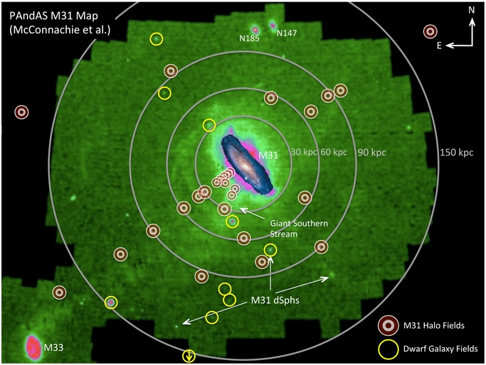
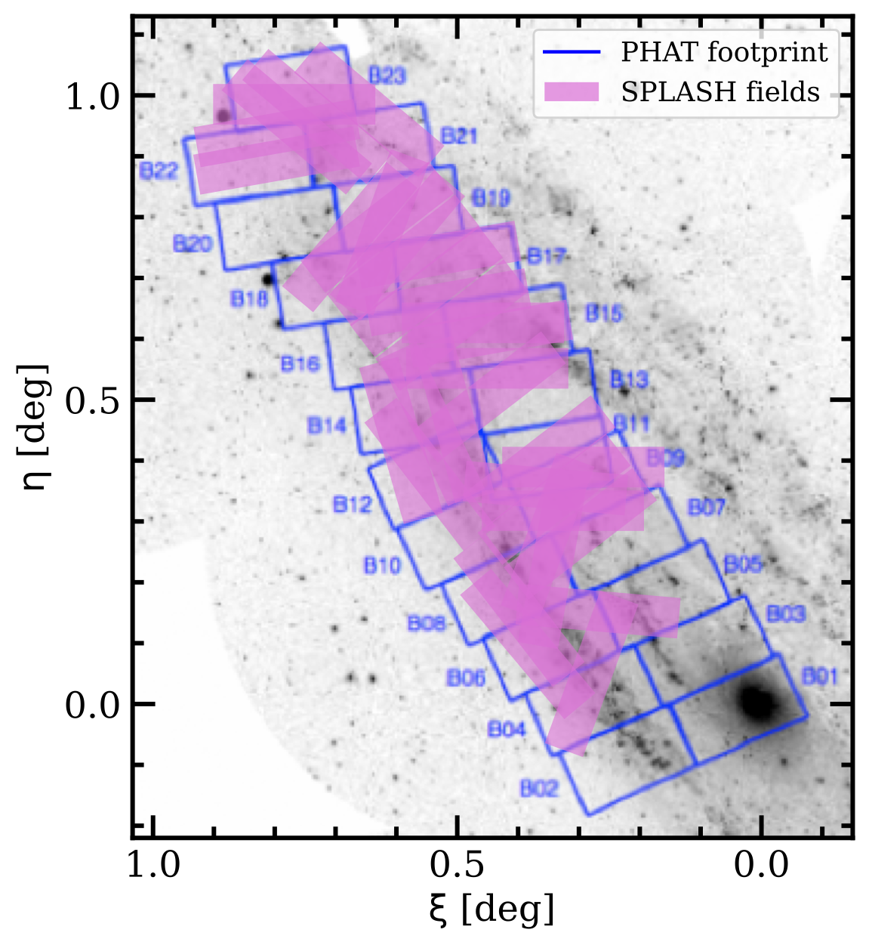
Constraints on the disk-halo connection from chemodynamics along the line-of-sight to M31’s disk
Gilbert et al. 2014 SPLASH: Dorman+12,13,15 PHAT: Dalcanton+12, Williams+14
Escala et al. 2023
I. Escala (Princeton)
Notes:
Take a step back to discuss disk chemodynamics
Goal to explore disk-halo connection with SPLASH
Using a combination of this spectroscopy with photometry from PHAT (explain PHAT)
Showing DEIMOS fields vs. PHAT footprint
Sample of ~3500 RGB stars that is useful probe of both disk and halo (4-20 projected kpc)

Slide 12
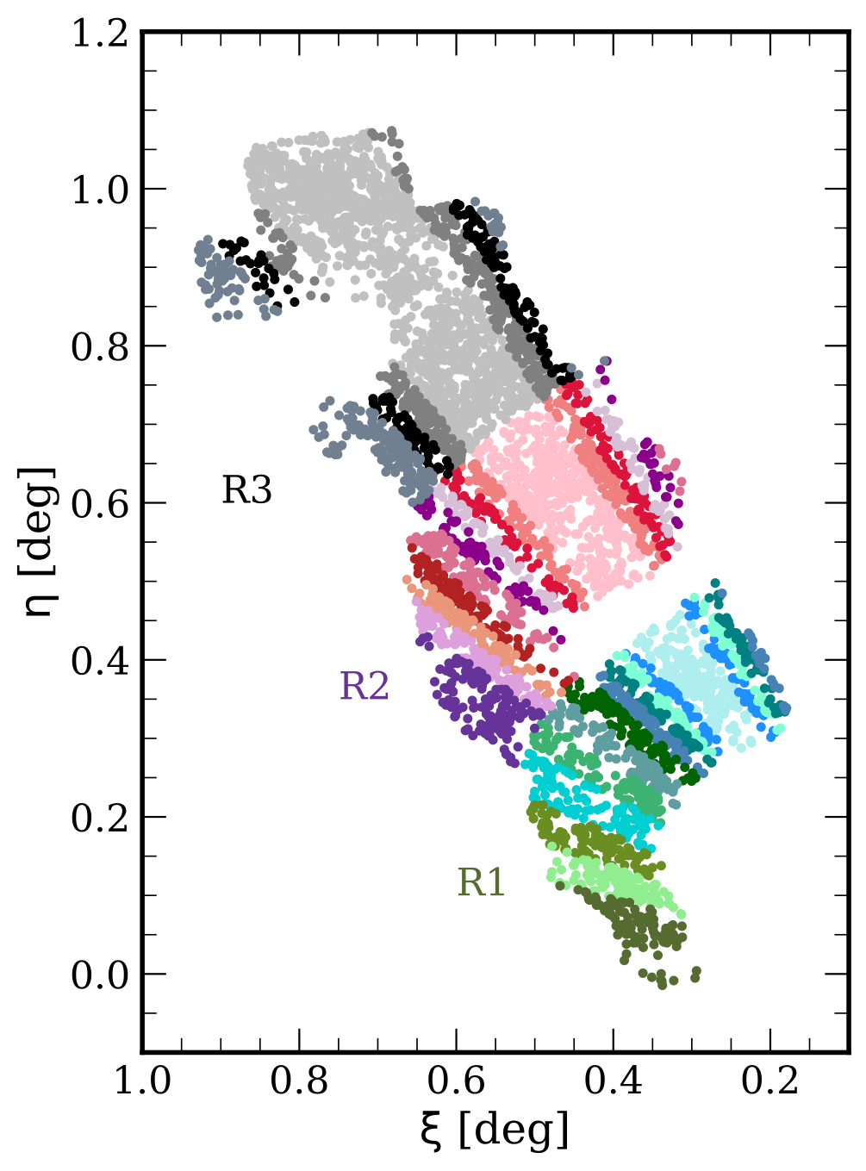
Kinematical decomposition into disk and halo populations
Escala et al. 2023
I. Escala (Princeton)
Notes:
Separate disk vs. halo stars in order to explore their properties
Radial and annular subregions along the major axis
Simple two-component halo+disk models which are sufficient (ask me about later)
Indicates the dominant RGB population appears to belong to a single high-velocity dispersion disk

Slide 13
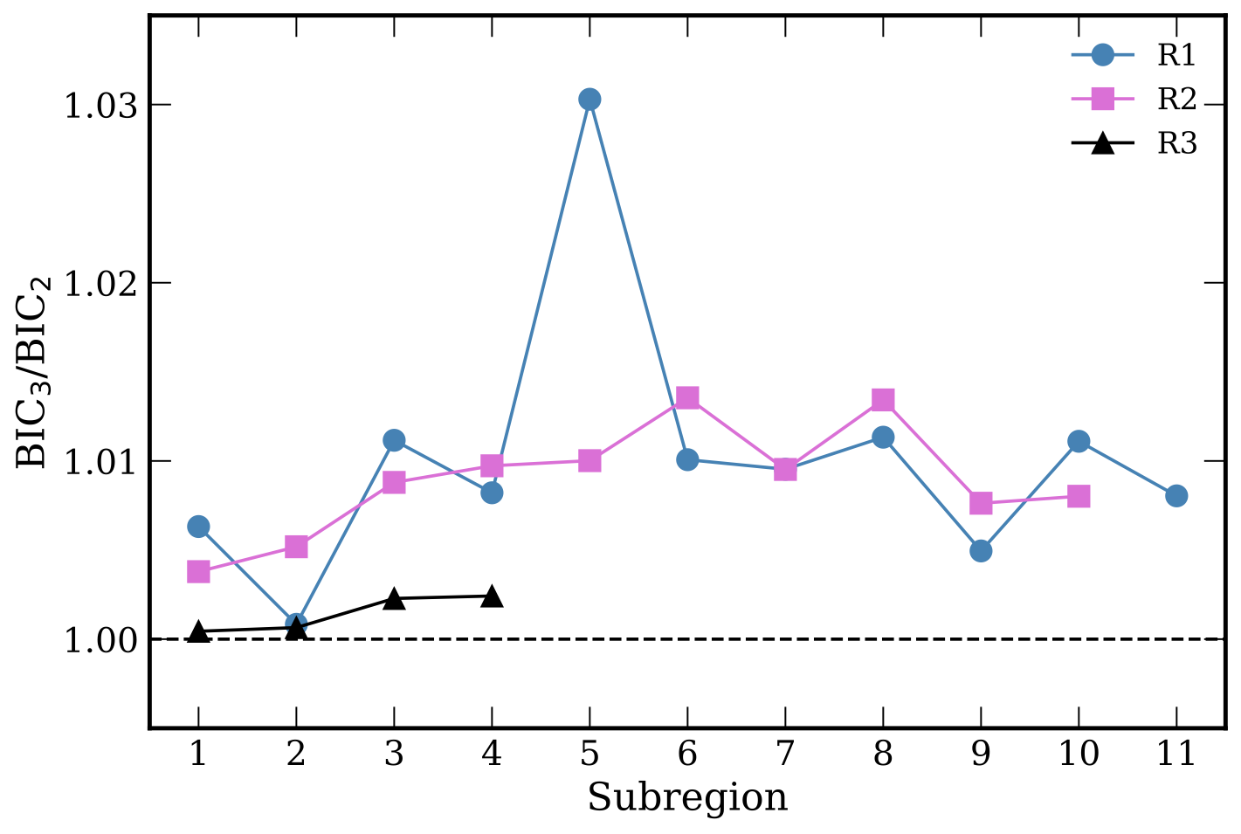
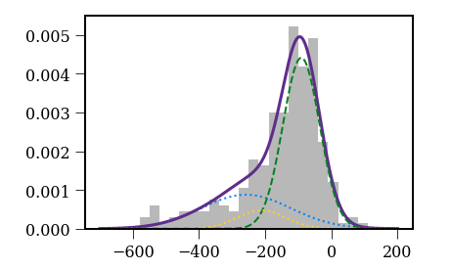
Two component (disk+halo) models sufficiently describe the velocity distribution near M31’s disk
R1₁
Probability
v_{helio} (km/s)
Escala et al. 2023
I. Escala (Princeton)

Slide 14
The inner stellar halo near M31’s disk contains metal-rich stars
Escala et al. 2023
I. Escala (Princeton)

Slide 15
These metal-rich halo stars are an extension of the dominant disk population
Escala et al. 2023
I. Escala (Princeton)
Notes:
Looking at velocity vs. metallicity space for each population, we see that the majority of metal-rich stars are clustered in a clump
Continuous extension
Is it related to the disk, despite its secure halo-like velocities?

Slide 16
The kinematical properties of these metal-rich halo stars are consistent with the broader halo, and not the disk
Halo
Disk
AD = asymmetric drift lag between rotation of gaseous and stellar disks
(Quirk et al. 2019)
Escala et al. 2023
I. Escala (Princeton)
Notes:
Are these actually just disk stars? Probably not.
Look at additional kinematics - AD (explain)
Explain plot — coloring and why on major axis
Evidence for disk and halo dynamical heating (~60-70 km/s AD)
Despite this, there are meaningful statical differences between disk and halo AD
Metal-rich halo stars do appear to be fully consistent with halo-like kinematics, instead of a thick disk that shows more co-rotation

Slide 17
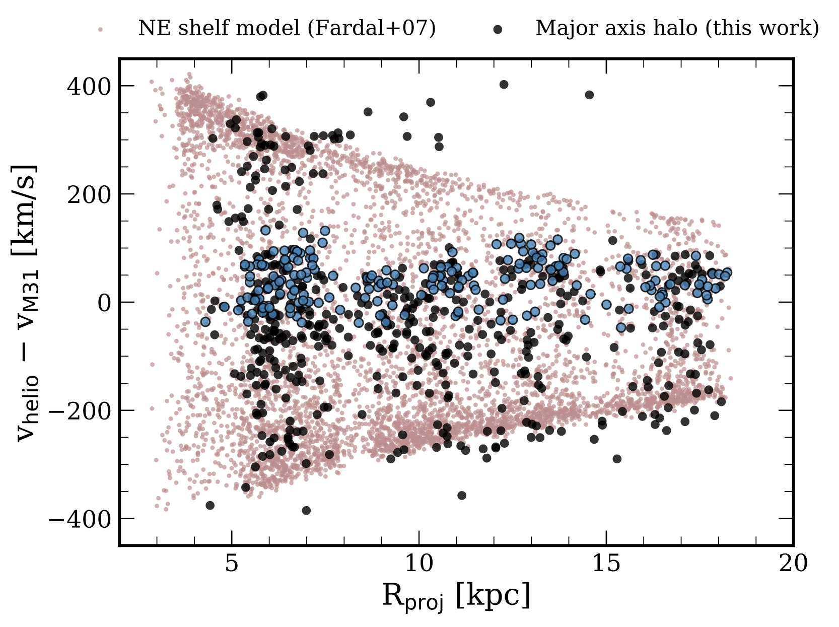
The projected phase space properties of these stars are inconsistent with a GSS-related tidal origin
dominated by the disk
metal-rich halo population
expected GSS tidal debris
Escala et al. 2023 See also Escala et al. 2022 (on M31’s NE shelf)
I. Escala (Princeton)
Notes:
Another explanation: Accreted tidal debris?
We would expect stars as metal-rich as this to be related to M31’s last significant merger, otherwise that would require a second very massive merger, which is unnecessary and could not explain the stellar mass budget of the halo
Expected location in projected phase space of tidal debris at SPLASH fields location
Would not actually detect tidal debris at disk-like velocities
Expect to observe the lower envelope

Slide 18
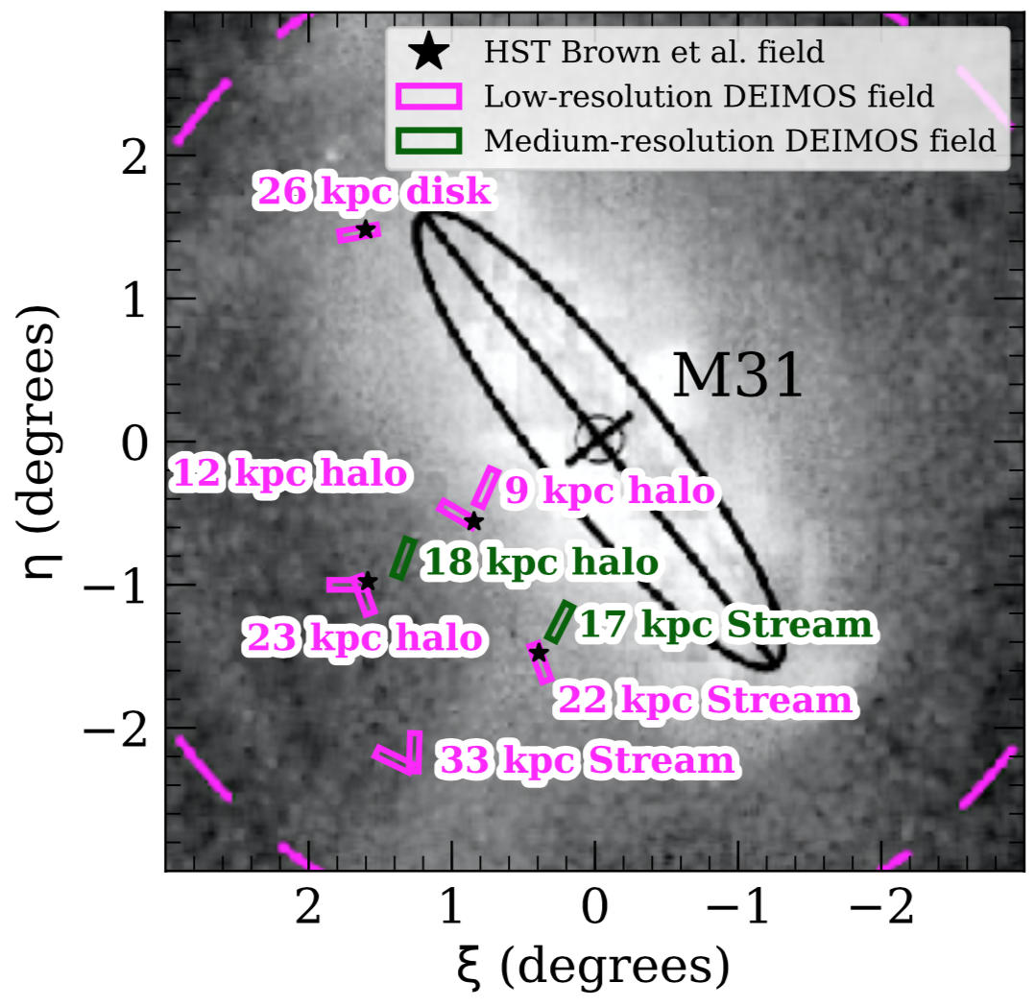
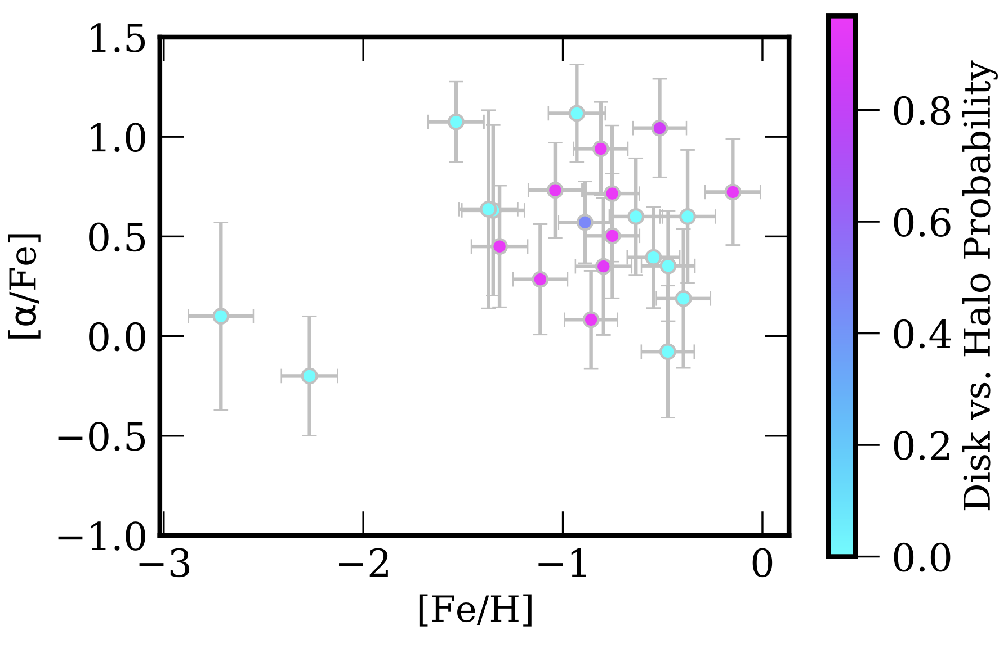
Current ground-based resolved stellar abundances in M31’s disk
Escala et al. 2020a
I. Escala (Princeton)

Slide 19
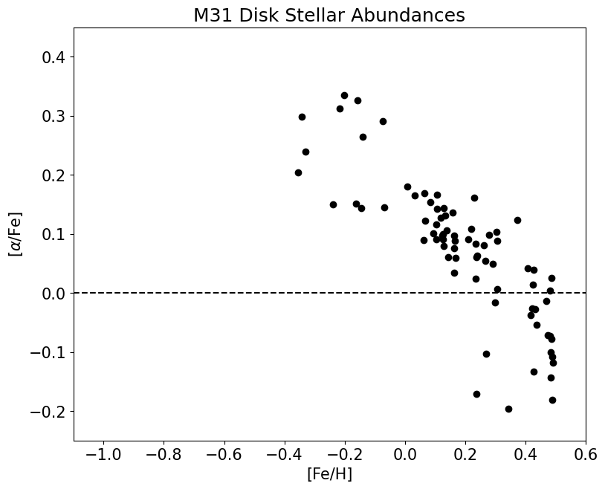
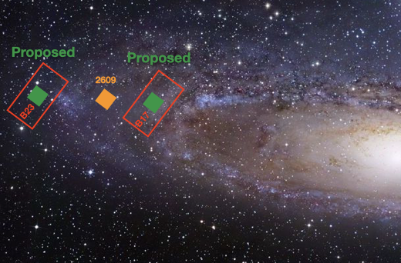
More detailed chemical information for individual giant stars from JWST/NIRSpec and Keck/DEIMOS
Preliminary!
JWST GO 2609 PI Nidever (co-I Escala) Nidever(+Escala) et al. 2024 (conference proceedings)
I. Escala (Princeton)

Slide 20
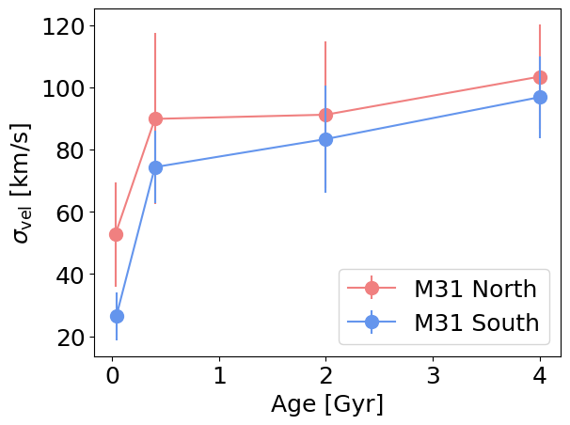
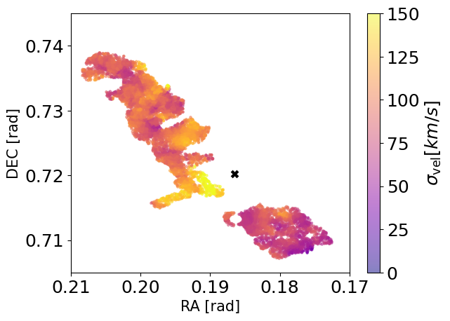
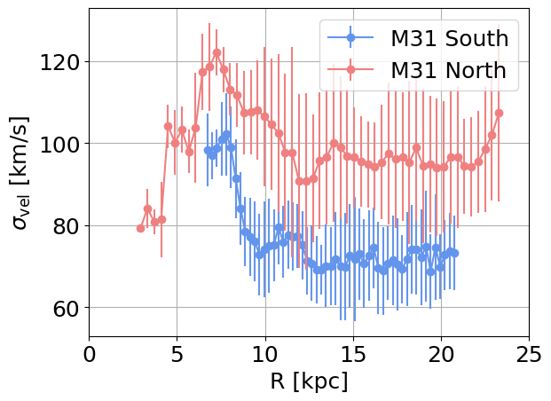
Painting a global picture of M31’s disk evolution
Preliminary!
Grion Filho (+Escala) et al. in preparation
I. Escala (Princeton)

Slide 21
What have we learned from chemodynamics along the line-of-sight to M31’s disk?
Current evidence supports a thickened disk structure for M31
The spatial, kinematical, and chemical properties of the metal-rich inner halo stars suggest they were born in the disk but kicked-up into the halo
M31’s disk appears to be alpha-enhanced and potentially lacking a low-alpha sequence
These findings point to an entangled evolutionary history between the disk and major-axis halo potentially driven by merger(s)
I. Escala (Princeton)
I. Escala (Princeton)

Slide 22
M31 disk backup slides

Slide 23
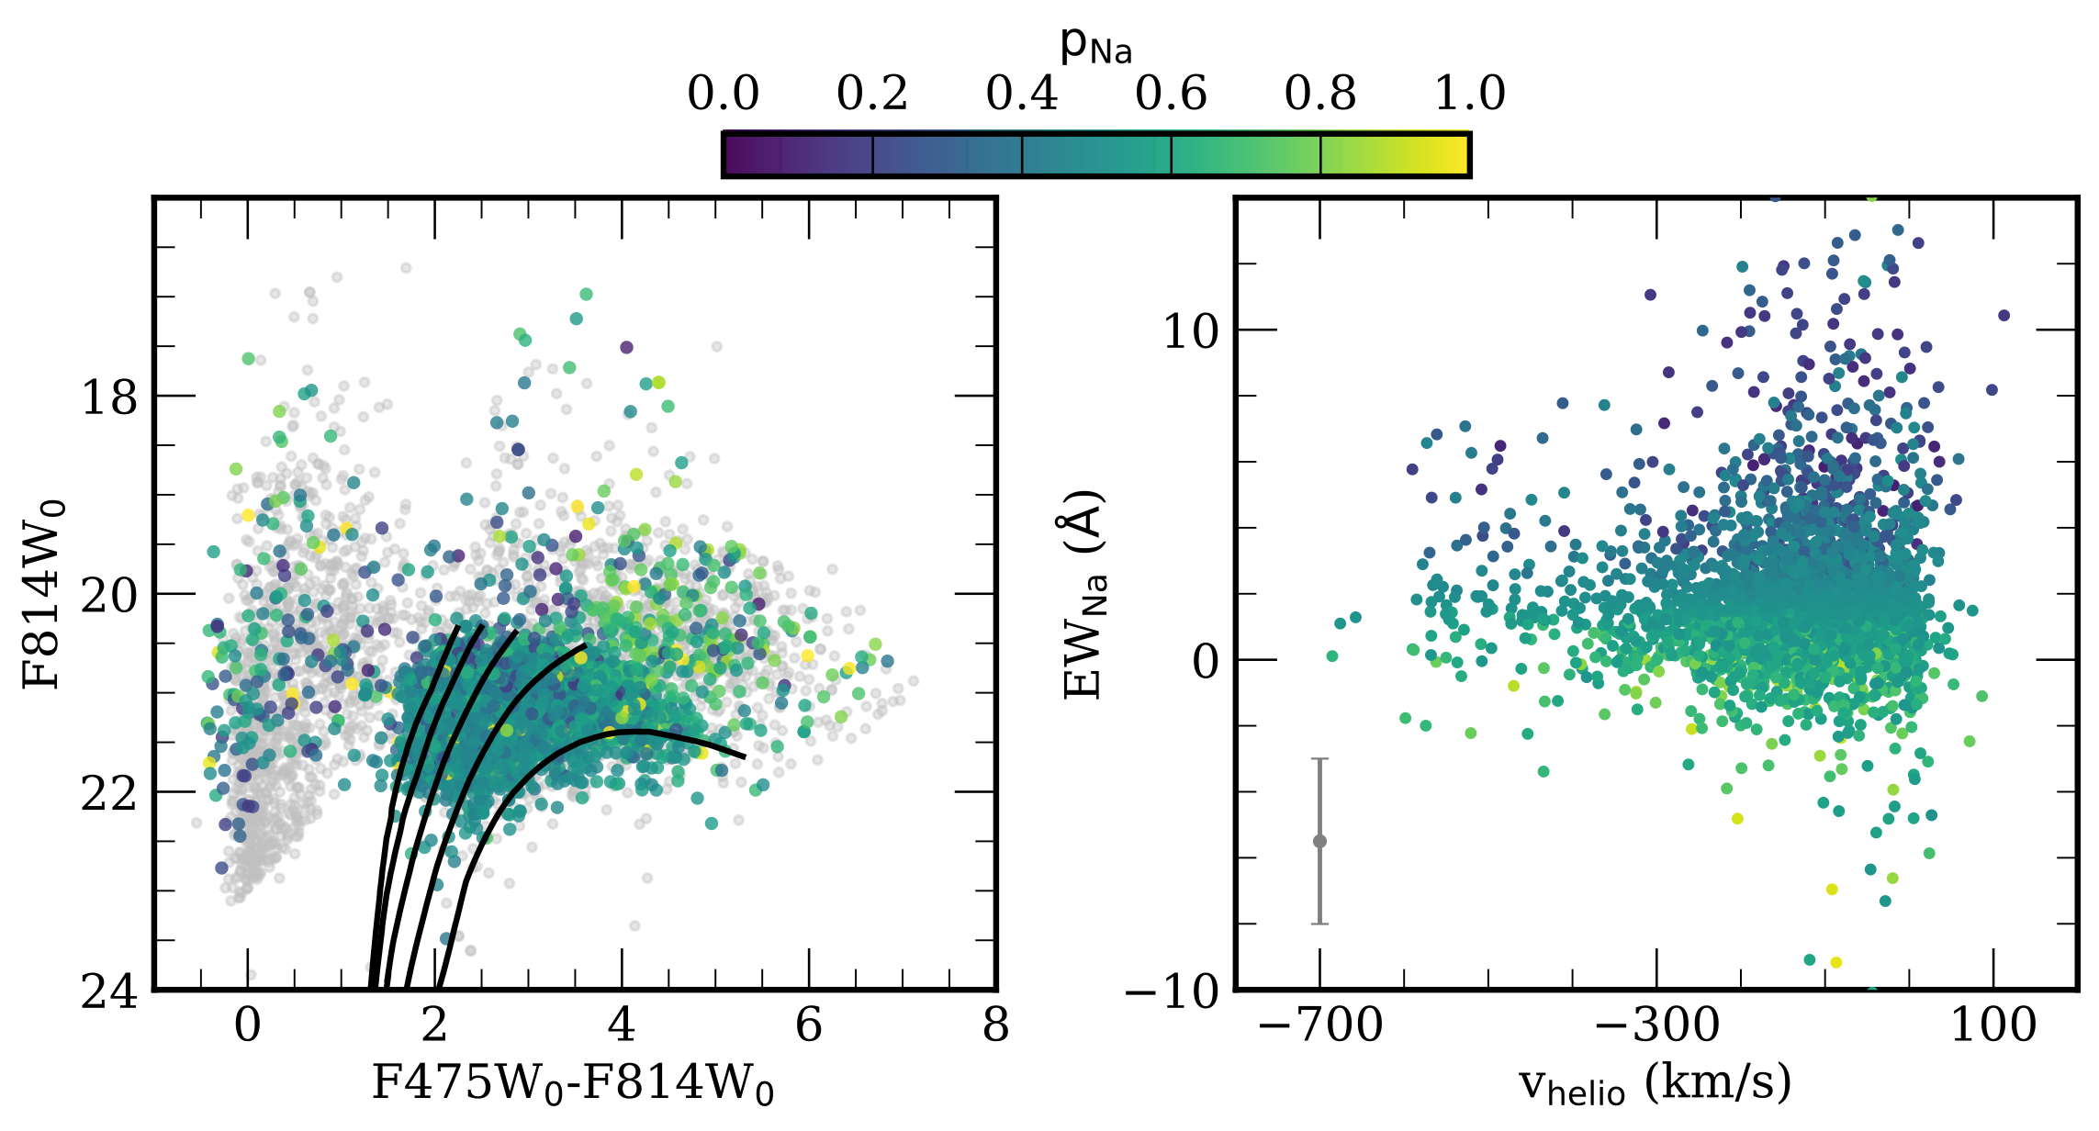
M31 membership determination along the line-of-sight to the disk
Escala et al. 2023
I. Escala (Princeton)

Slide 24
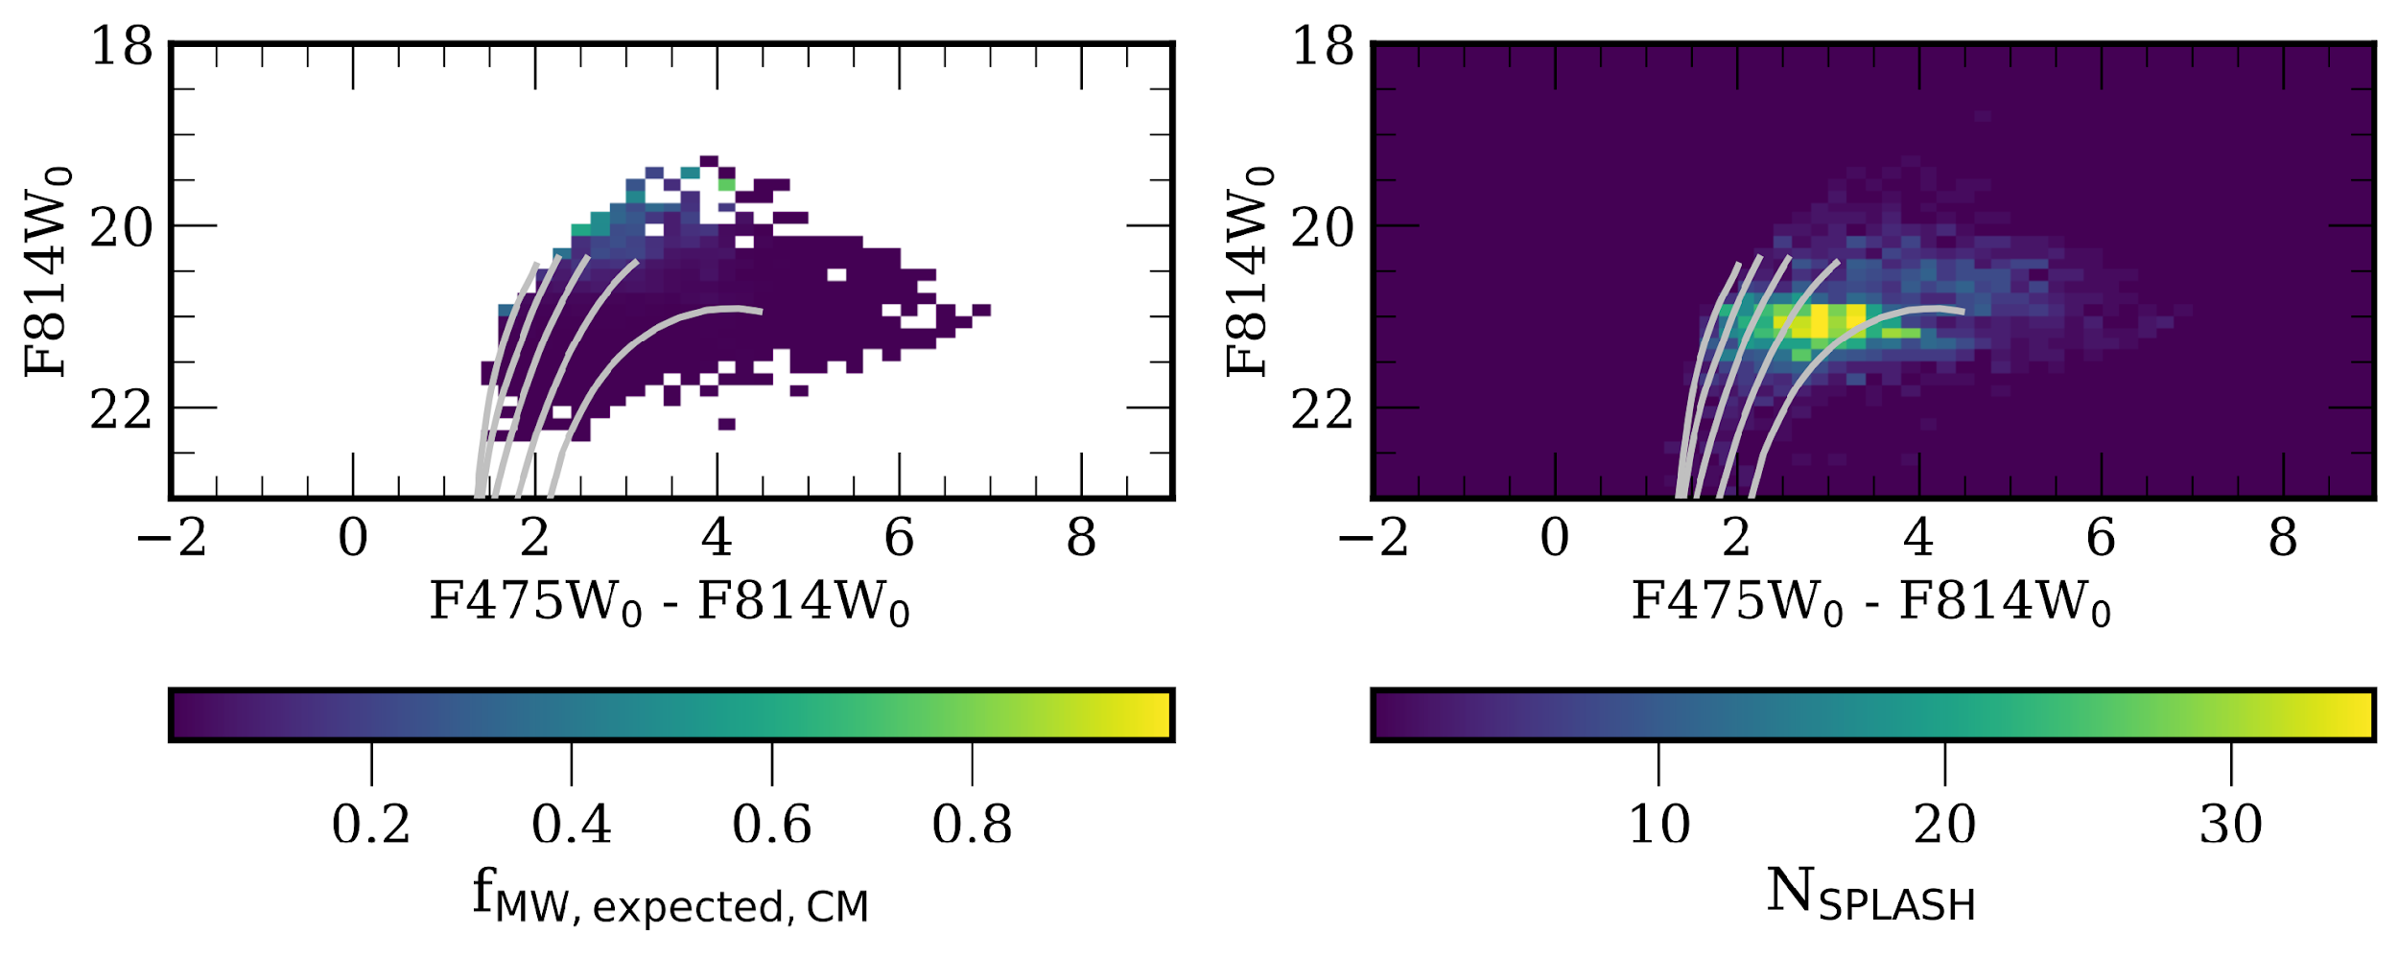
Contamination from the MW foreground is negligible (<1%)
Escala et al. 2023
I. Escala (Princeton)

Slide 25
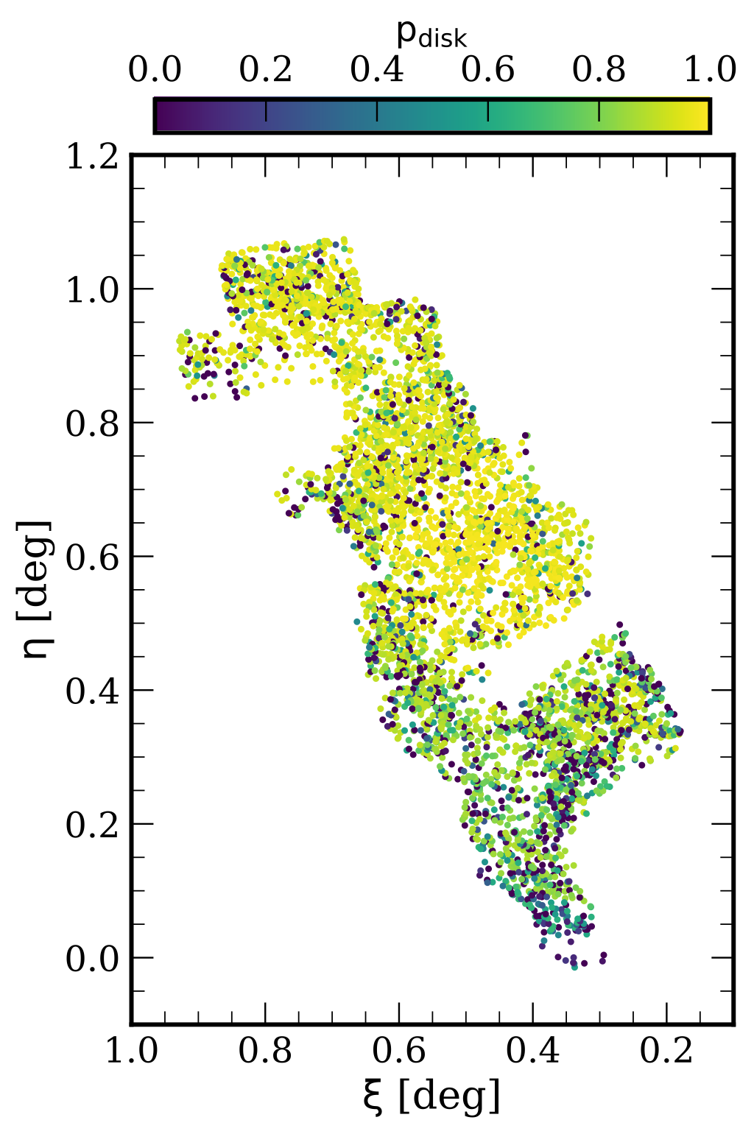
We probabilistically separate stars into disk vs. halo populations based on their positions and velocities
Escala et al. 2023
I. Escala (Princeton)

Slide 26
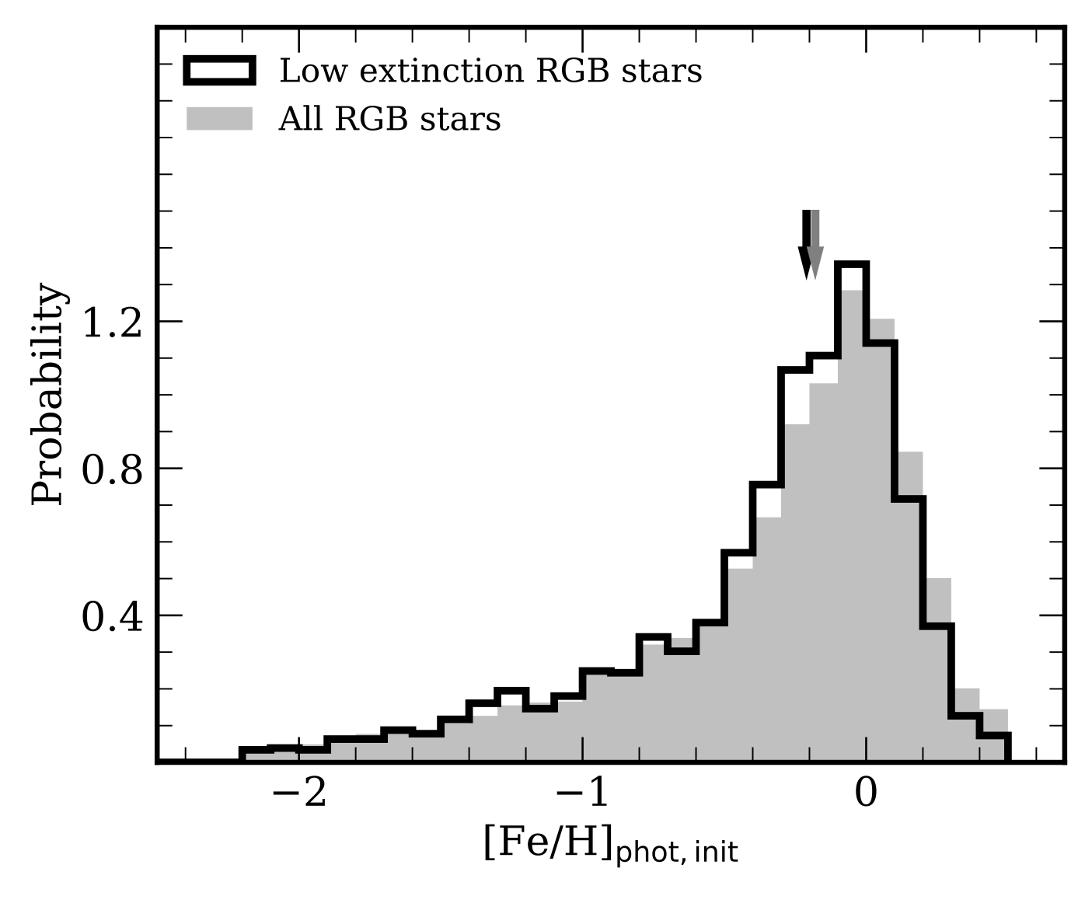
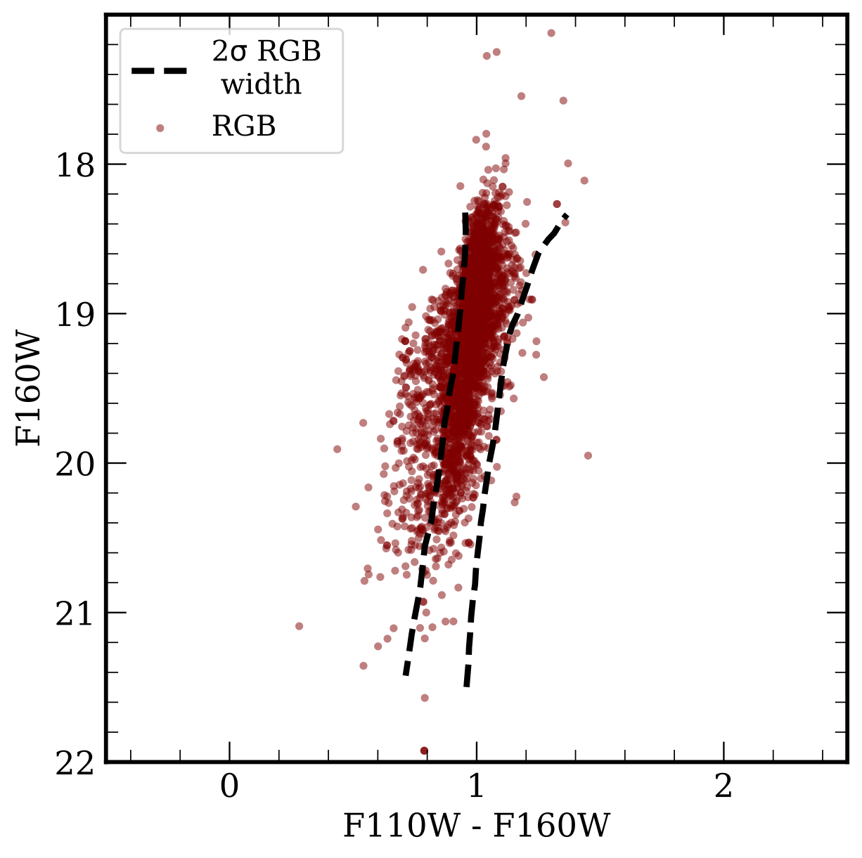
The photometric metallicity distributions are not significantly affected by dust in M31’s gaseous disk
Escala et al. 2023
I. Escala (Princeton)

Slide 27
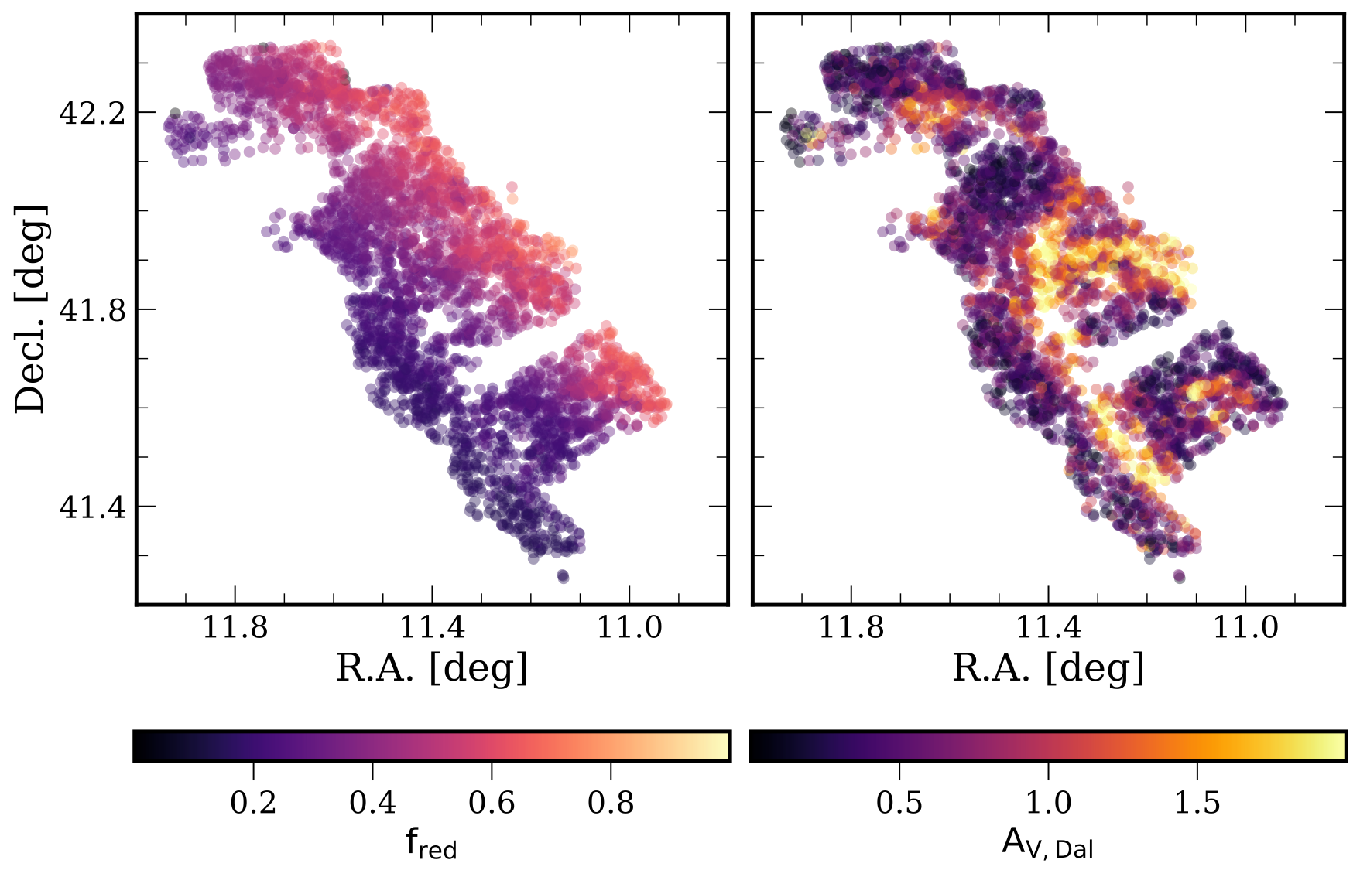
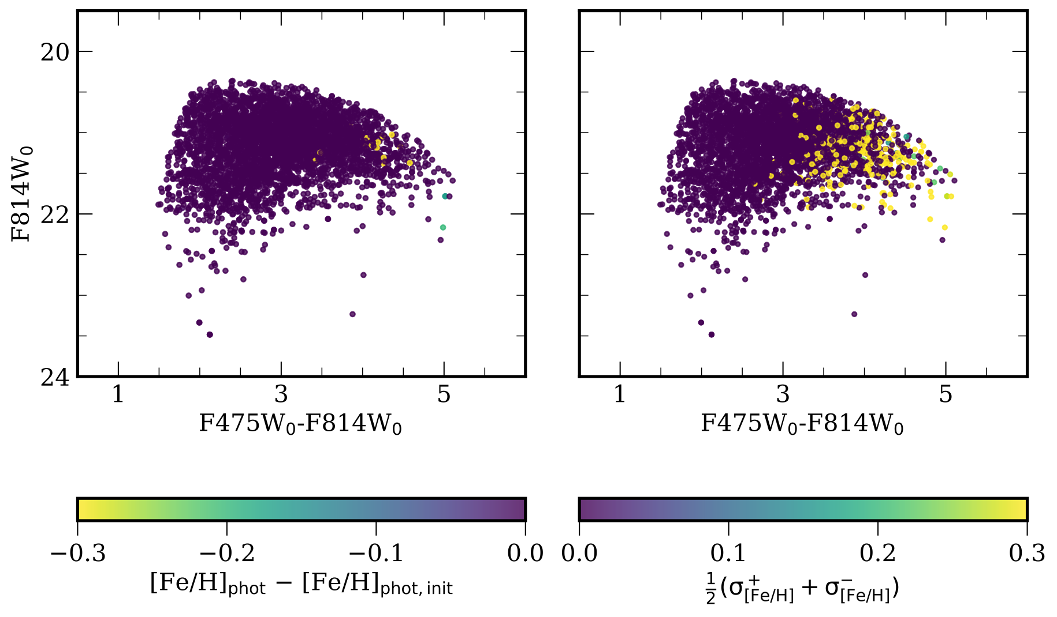
We corrected the photometric metallicity for internal dust extinction using both position and color-magnitude information
Escala et al. 2023
I. Escala (Princeton)

Slide 28
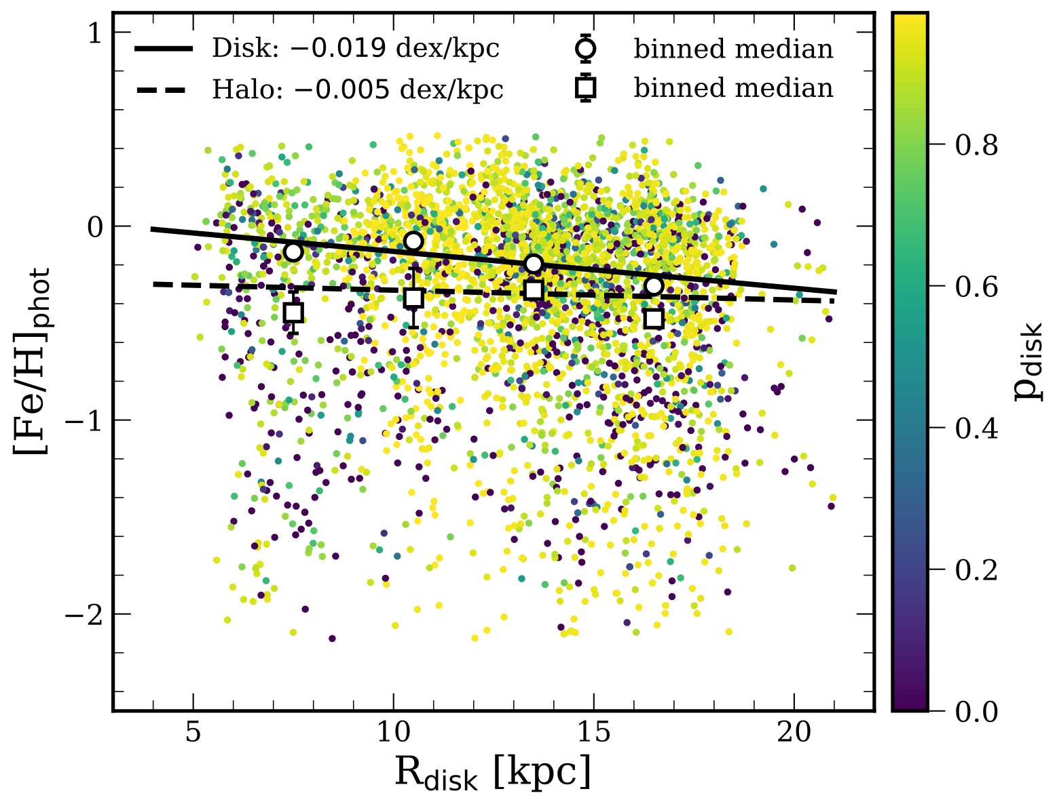
Metallicity gradients in M31’s disk and inner halo
Escala et al. 2023
I. Escala (Princeton)

Slide 29
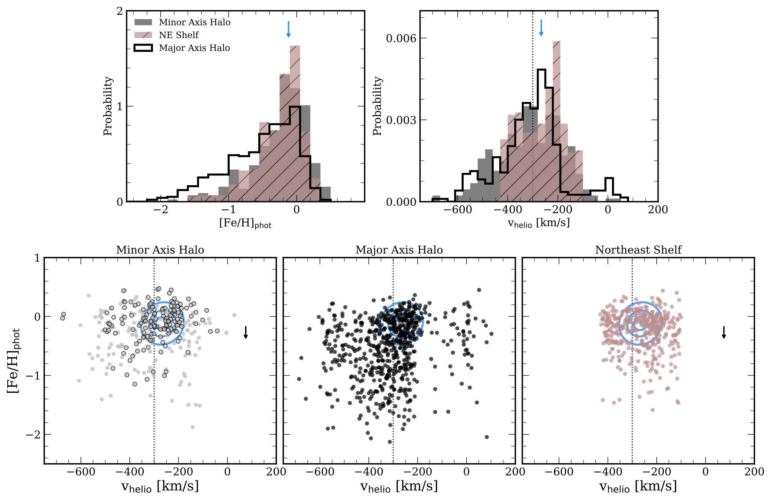
The metallicity distributions further support this inconsistency. They also suggest the major-axis halo is distinct from the minor-axis halo
Escala et al. 2023
I. Escala (Princeton)

