Slide 1






The impact of early mergers in the star formation history of the Milky Way’s disc
Emma Fernández-Alvar
(MSCA fellow)
Carme Gallart, Santi Cassisi, Anna Queiroz, Tomás Ruiz-Lara, Francisco Surot, Guillem Aznar-Menargues,
David Mirabal, Alicia Rivero, Judith Santos et al.
“The Milky Way Assembly Tale”
Bolonia, 28th May 2024

Slide 2
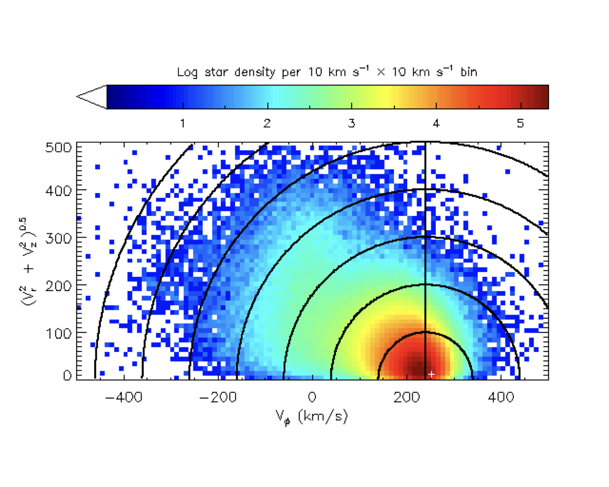
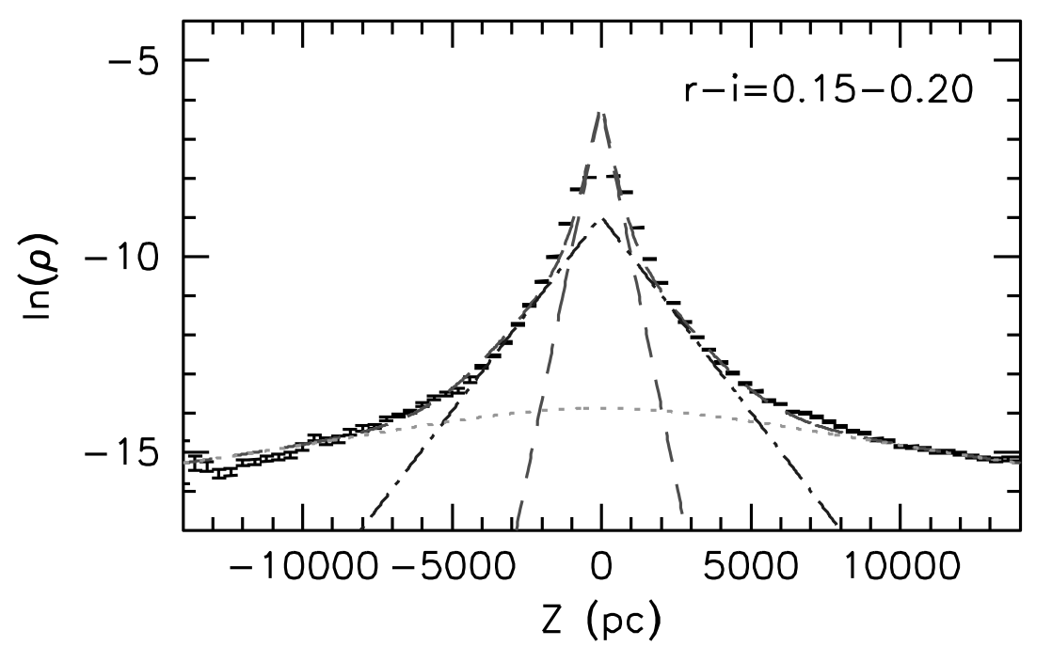
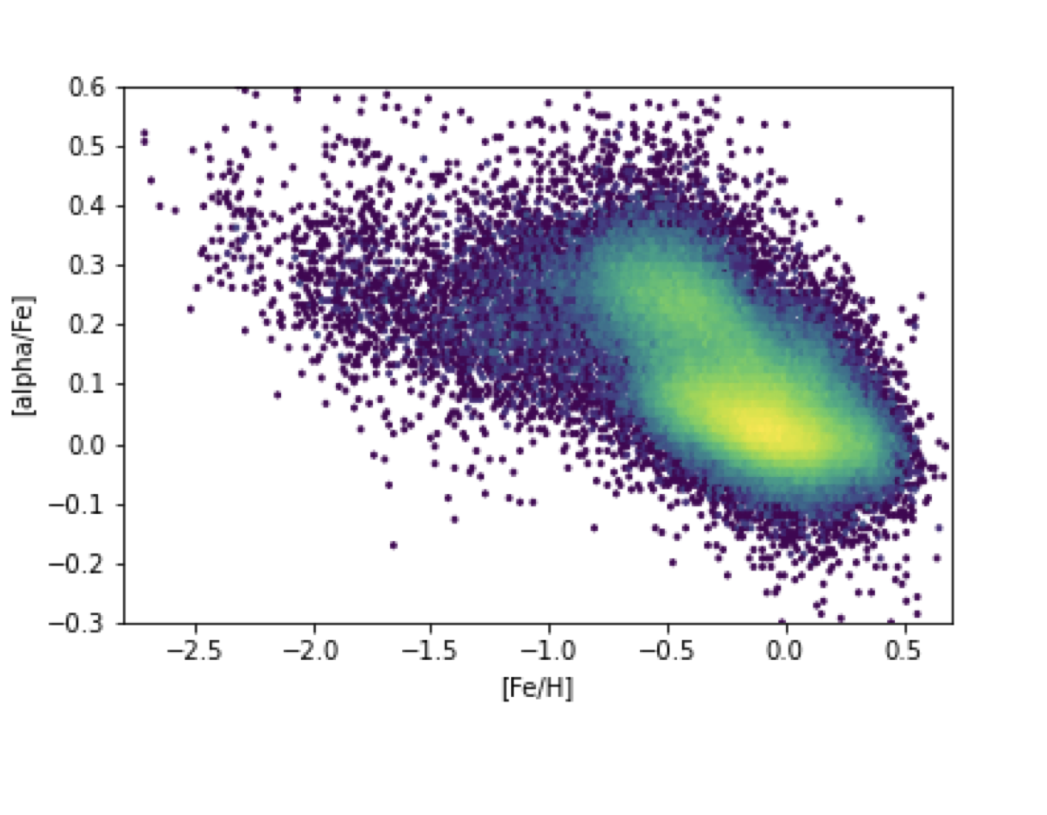
The Milky Way’s disc and its formation.
Juric et al. 2008
Gaia Collaboration, Katz + 2018
Some open questions…
- which processes led to the formation of the thick and the thin disc?
- which component formed first? Did they formed at the same time?
- what was the role of mergers in the formation of the Milky Way’s disc?
APOGEE data

Slide 3
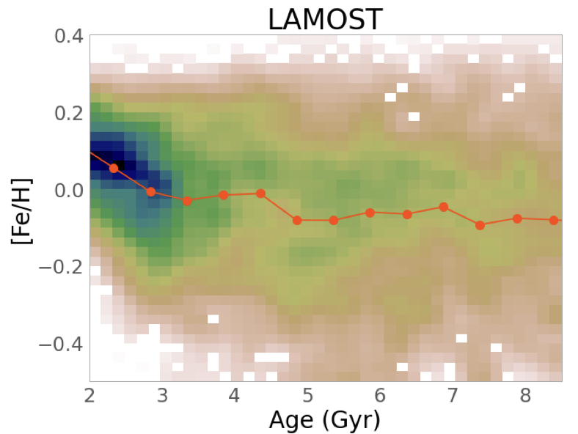
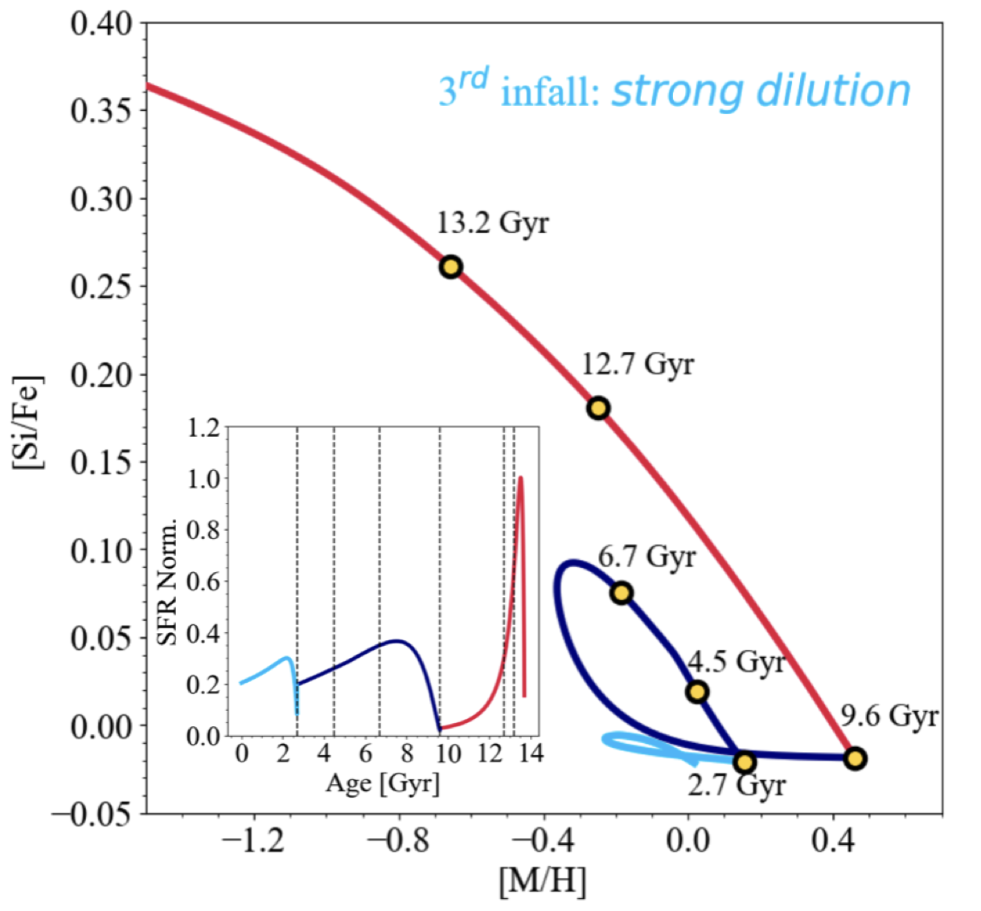
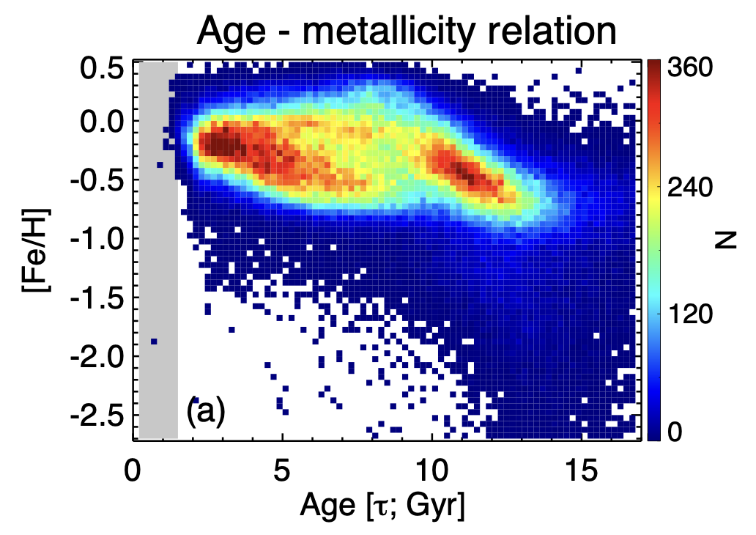
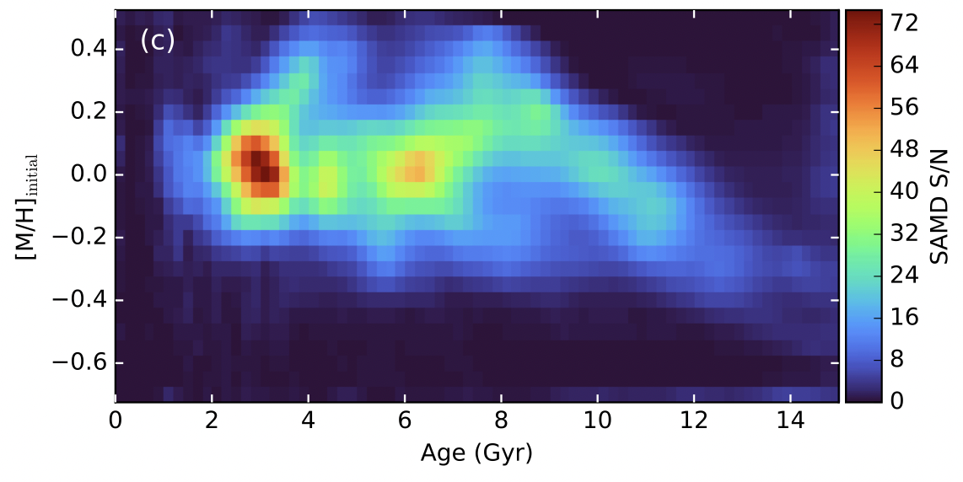
The Milky Way’s disc and its formation.
Chemical evolution models
Age-metallicity relations from individual stellar ages
Queiroz + 2023
Xiang & Rix 2022
Spitoni + 2023
Sahlholdt + 2022
Still large uncertainty in the star formation history of the thick and thin disc components:
lack of accurate ages for large distributions of stars

Slide 4
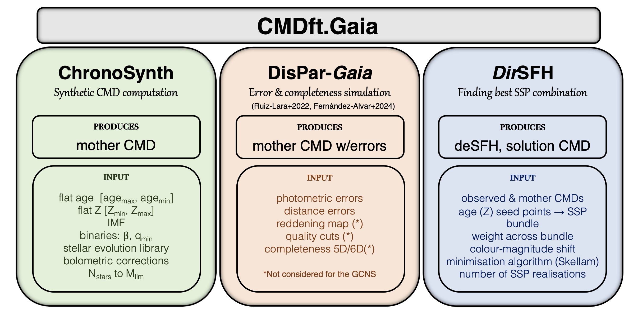
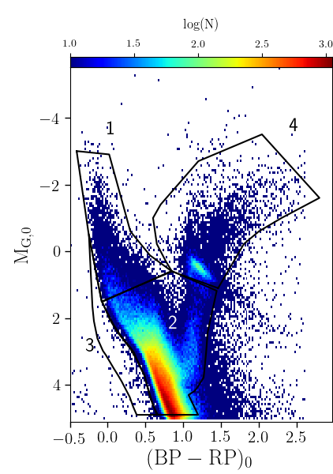
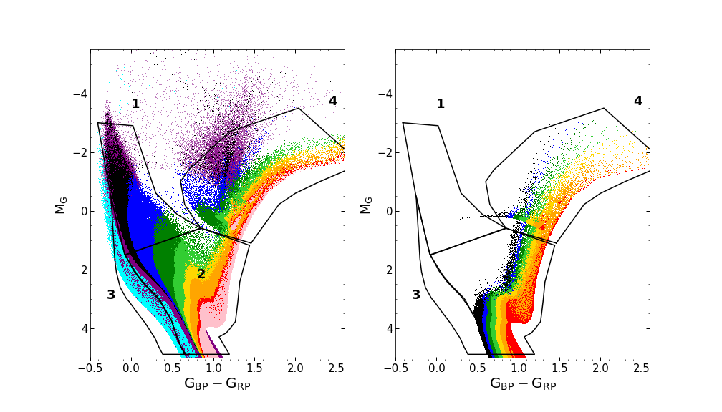
Star formation histories from CMD-fitting
See Gallart’s talk on Thursday!!
Gallart et al. 2024
  Gaia photometry
Any SFH can be obtained as a combination of SSPs:
We obtain the best fit SFH by comparing the distribution of stars in the observed and in a large number of arbitrary model CMDs, constructed from combinations of simple stellar populations (α_{i}), until a good match is found.

Slide 5
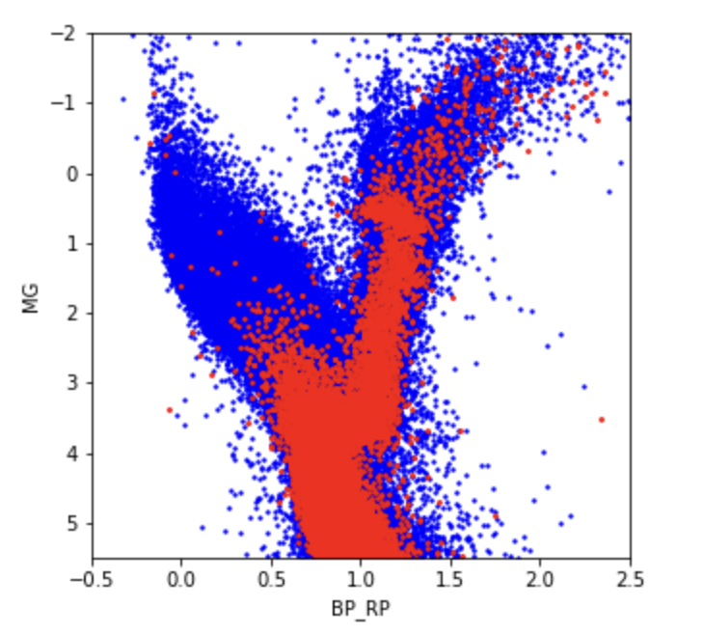
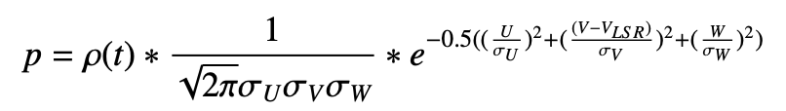
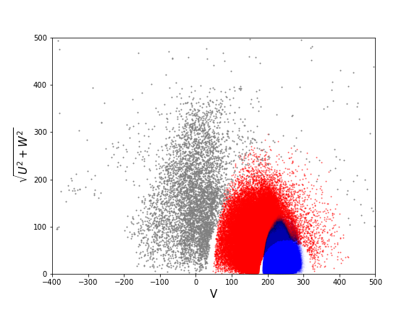
Kinematic selection of thick and thin disc stars
Volume:
    cylinder centered in the Sun, radius = 250 pc, height = 1 kpc
Thick disc
Thin disc
Probability based on velocity and position of stars:
  Gaussian velocity distributions.
  Density profiles for the thin, thick discs and halo.
Color-magnitude diagram
(as in Bensby et al. 2003)
Fernández-Alvar + 2024 (in prep.)

Slide 6
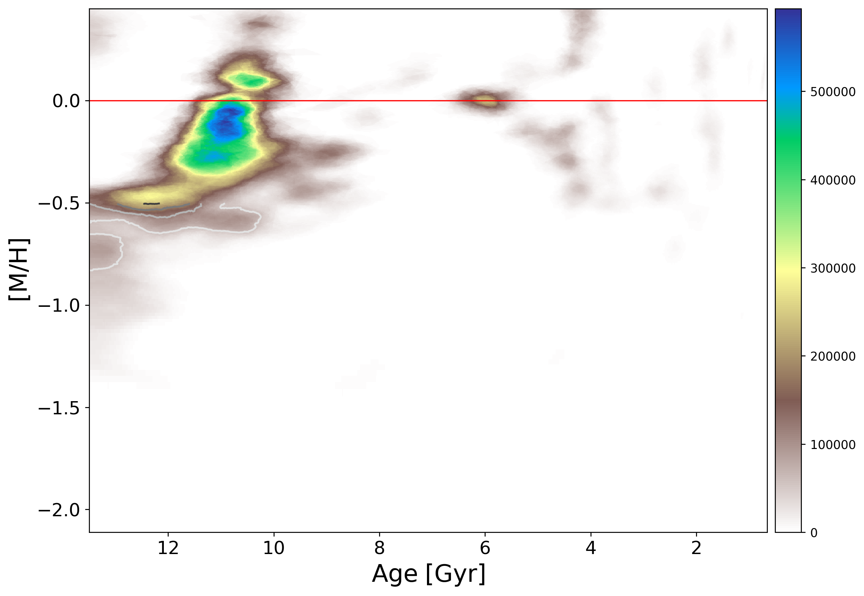
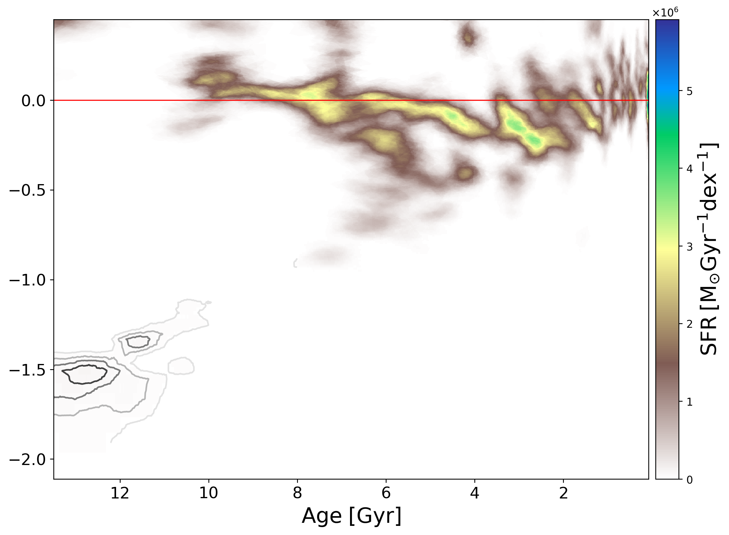
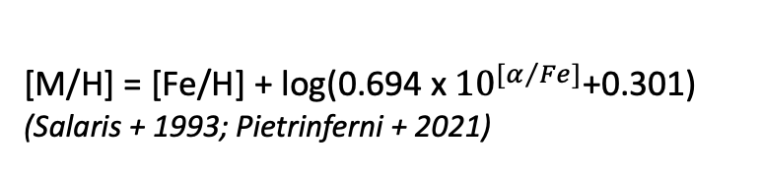
Thick disc SFH
Thin disc SFH
Formed BEFORE 10 Gyrs ago
Formed AFTER 10 Gyrs ago
Fernández-Alvar + 2024 (in prep.)
Merger of Gaia-Sausage-Enceladus
dated also 10 Gyrs ago!!
Belokurov+2018, Helmi+2018, Vincenzo+2019, di Matteo+2019, Montalban+2020, Bonaca+2020, Gallart+2020,…
[M/H] = [Fe/H] + log(0.694 x ${10}^{[α/{Fe]}}$+0.301)
(Salaris + 1993; Pietrinferni + 2021)

Slide 7
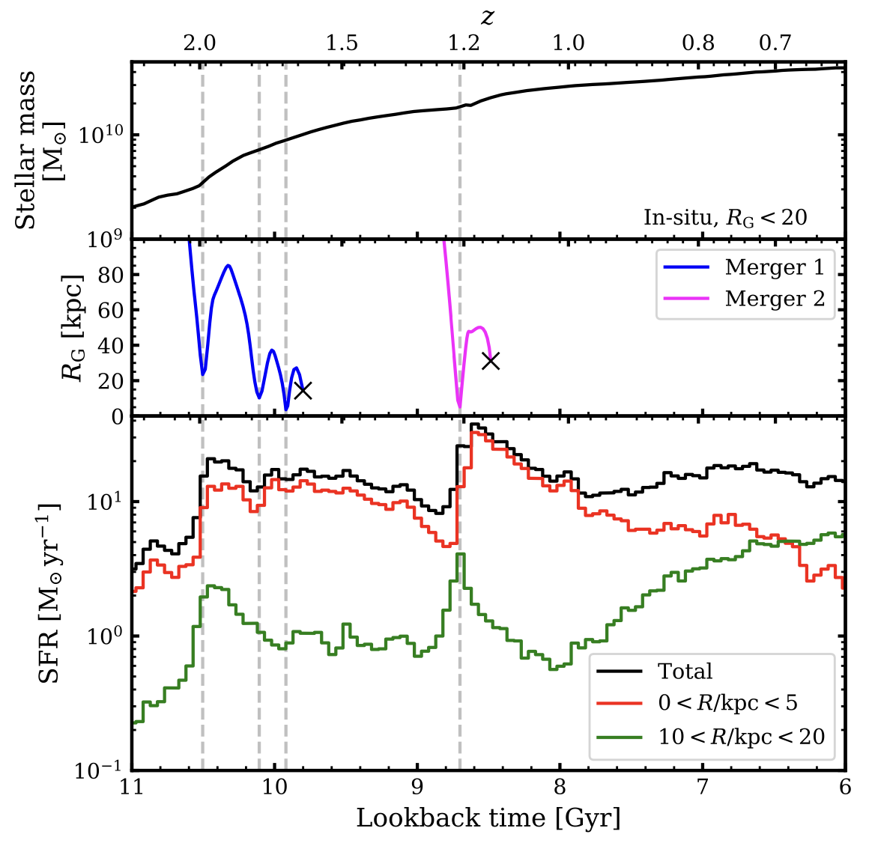
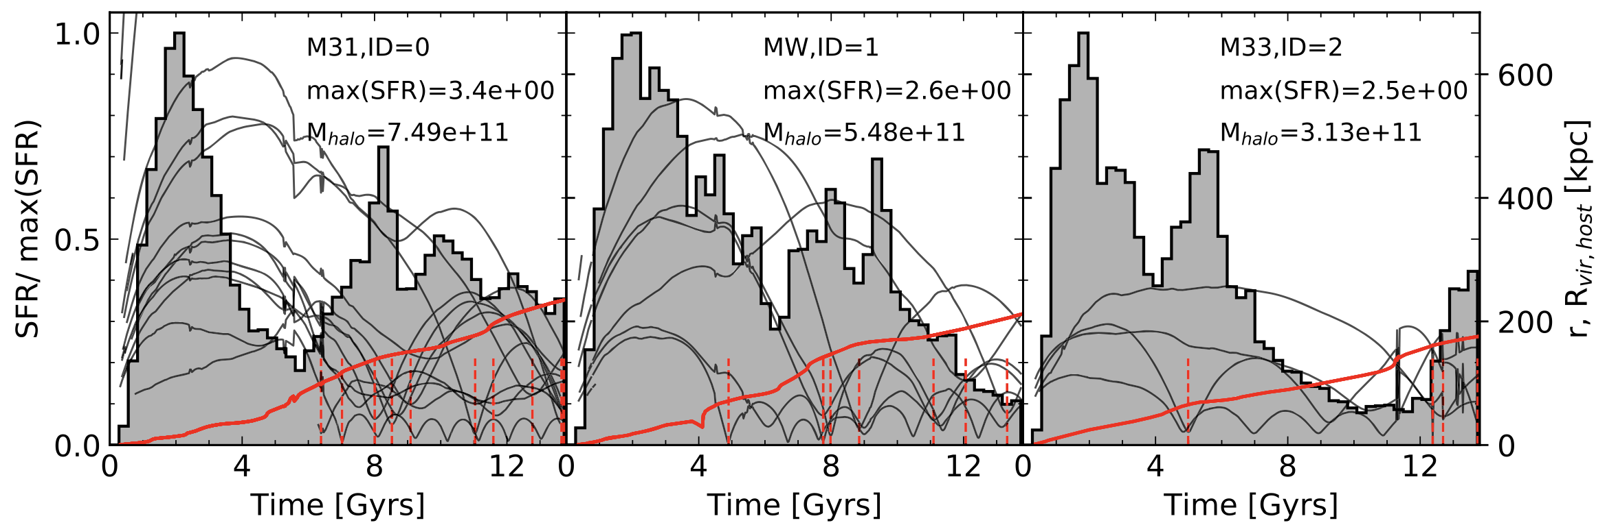
Cosmological simulations:
Star formation boosted in the host galaxy from pericenter passages of accreted galaxy
Di Cintio + 2021
Also Chen’s talk yesterday
Orkney + 2022

Slide 8
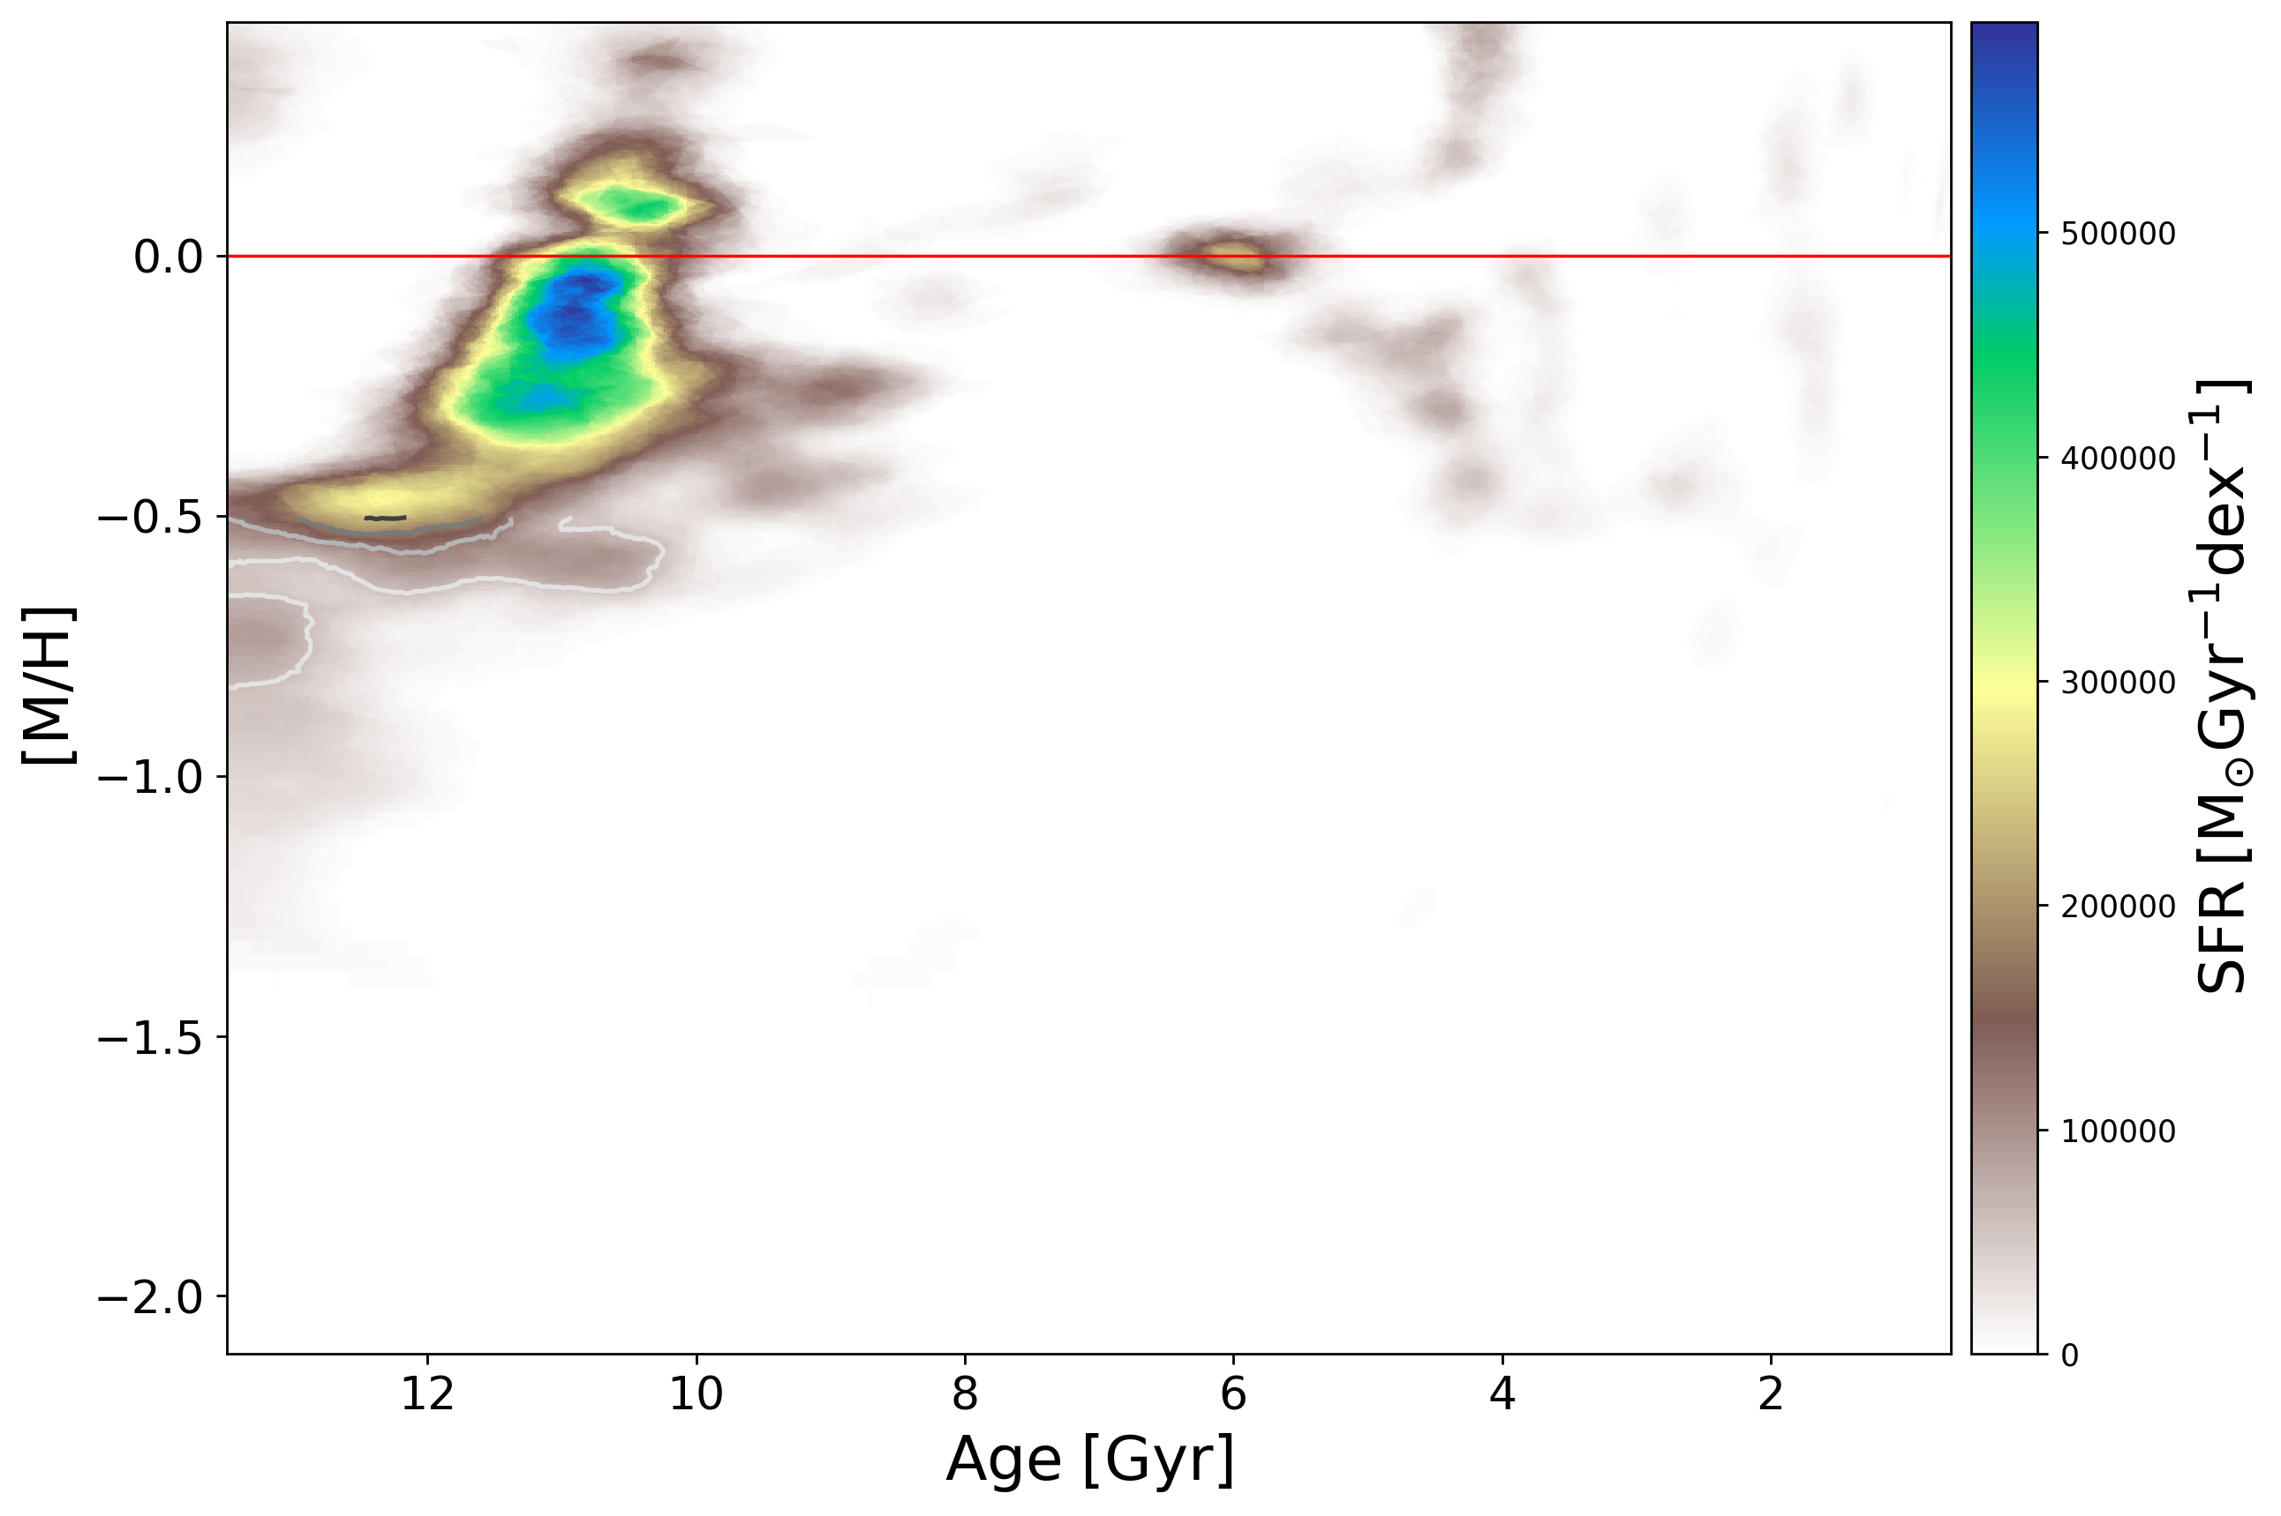
Thick disc SFH
3
1: very old star formation in the Milky Way
2
2 and 3: star bursts induced by pericenter passage of GSE?
1
Star burst 6 Gyrs ago:
Time estimated of the first Sagittarius pericenter
(Law + 2010; Laporte + 2018)
Fernández-Alvar + 2024 (in prep.)

Slide 9
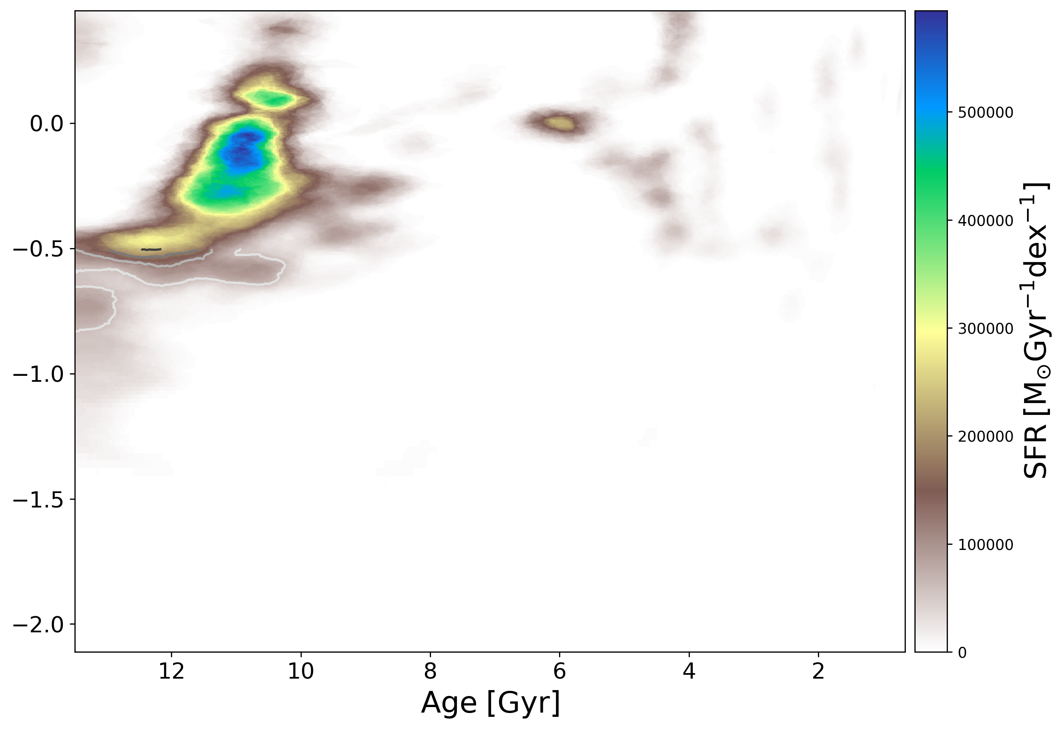
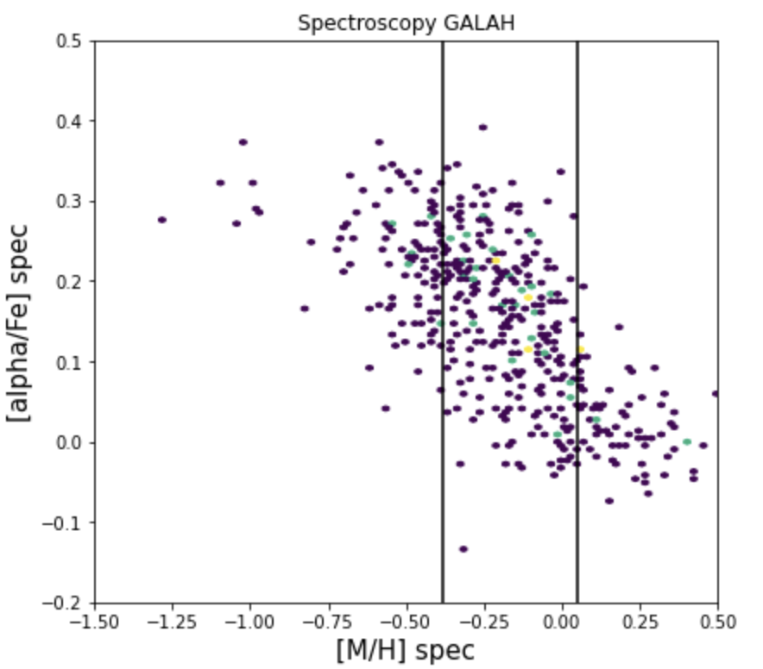
Thick disc chemical trends
Fernández-Alvar + 2024 (in prep.)

Slide 10
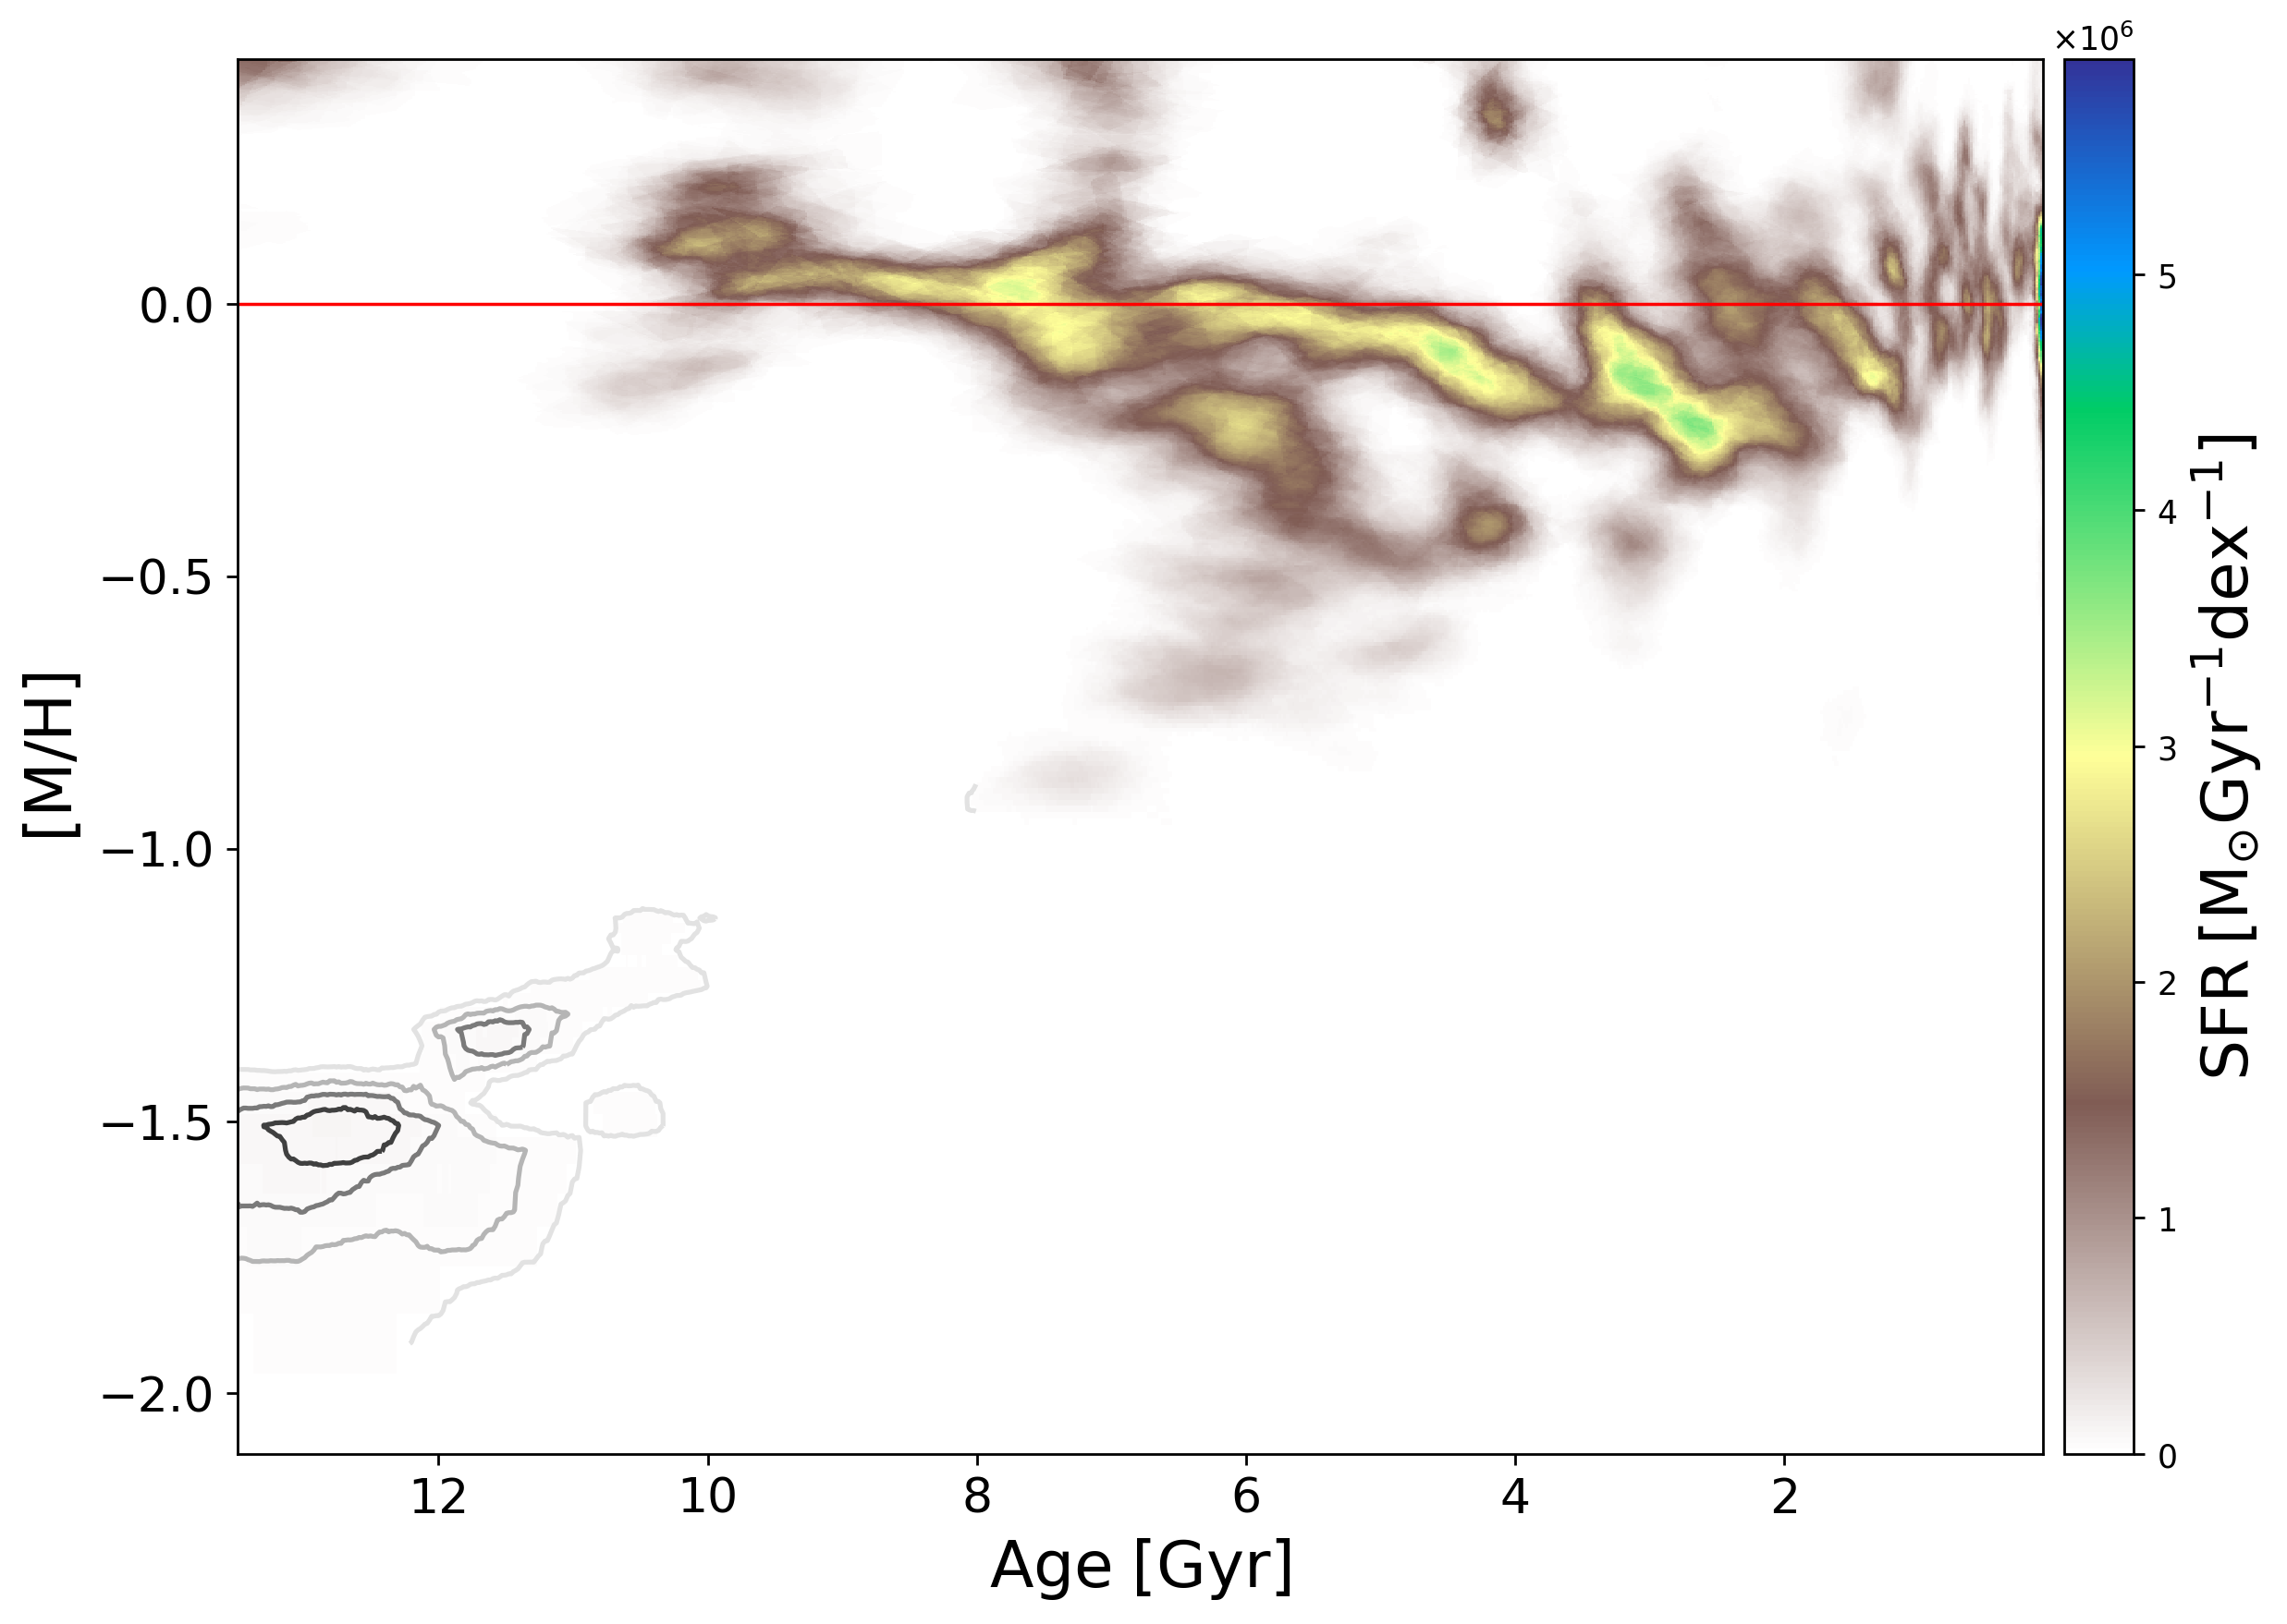
Thin disc SFH
The resulted age-metallicity distribution is a mix of populations:
stars born in the solar neighbourhood and stars migrated from the inner and the outer disc.
See Queiroz’s talk on Wednesday!!
Dating the formation of the outer disc: 8 Gyrs ago.
Very metal-poor stars in thin-disc-like orbits:
Sestito+2019,2020,2021
Fernández-Alvar+2021,2024
Yuan+2023; Zhang+2023
Nepal+2024; González-Rivera+2024 (submitted)
Fernández-Alvar + 2024 (in prep.)

Slide 11

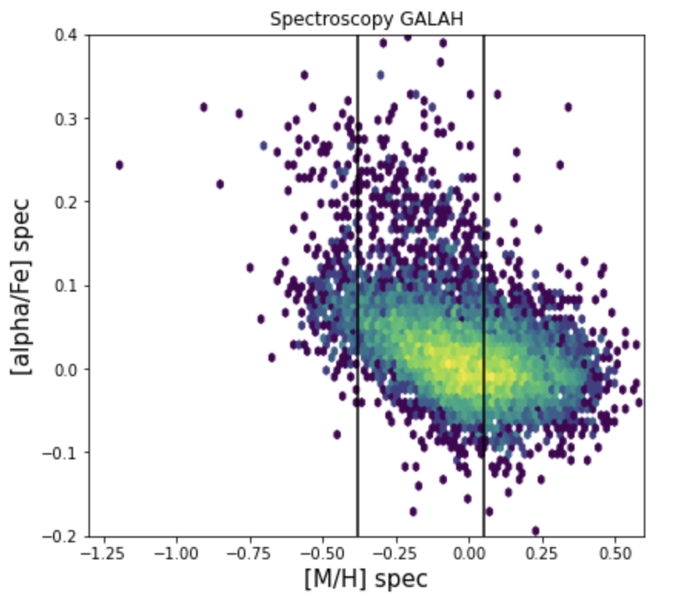
Thin disc chemical trends
Precise constraints on models to infer the chemical evolution of the Milky Way.
Metal-rich end of
low-alpha sequence:
Old and young stars
Metal-poor end
of low-alpha sequence:
8-3 Gyrs
Fernández-Alvar + 2024 (in prep.)

Slide 12
Summary
Thick disc formed very early, before 10 Gyrs ago. Thin disc started forming right after the thick disc stopped forming, 10 Gyrs ago, at the same metallicity.
  The thin disc origin is connected with the end of the thick disc star formation and the merger with GSE.
Thick disc: three main episodes, increasing trend with metallicity.
  Thick disc star bursts might be connected with the pericenter passages of GSE during its accretion.
Thin disc: decreasing trend with metallicity up to 3 Gyrs.
  High dispersion of metallicities at particular ages likely reflects radial migration.
  Time constraint on the outer disc formation: 8 Gyrs ago.

Slide 13
