Slide 1
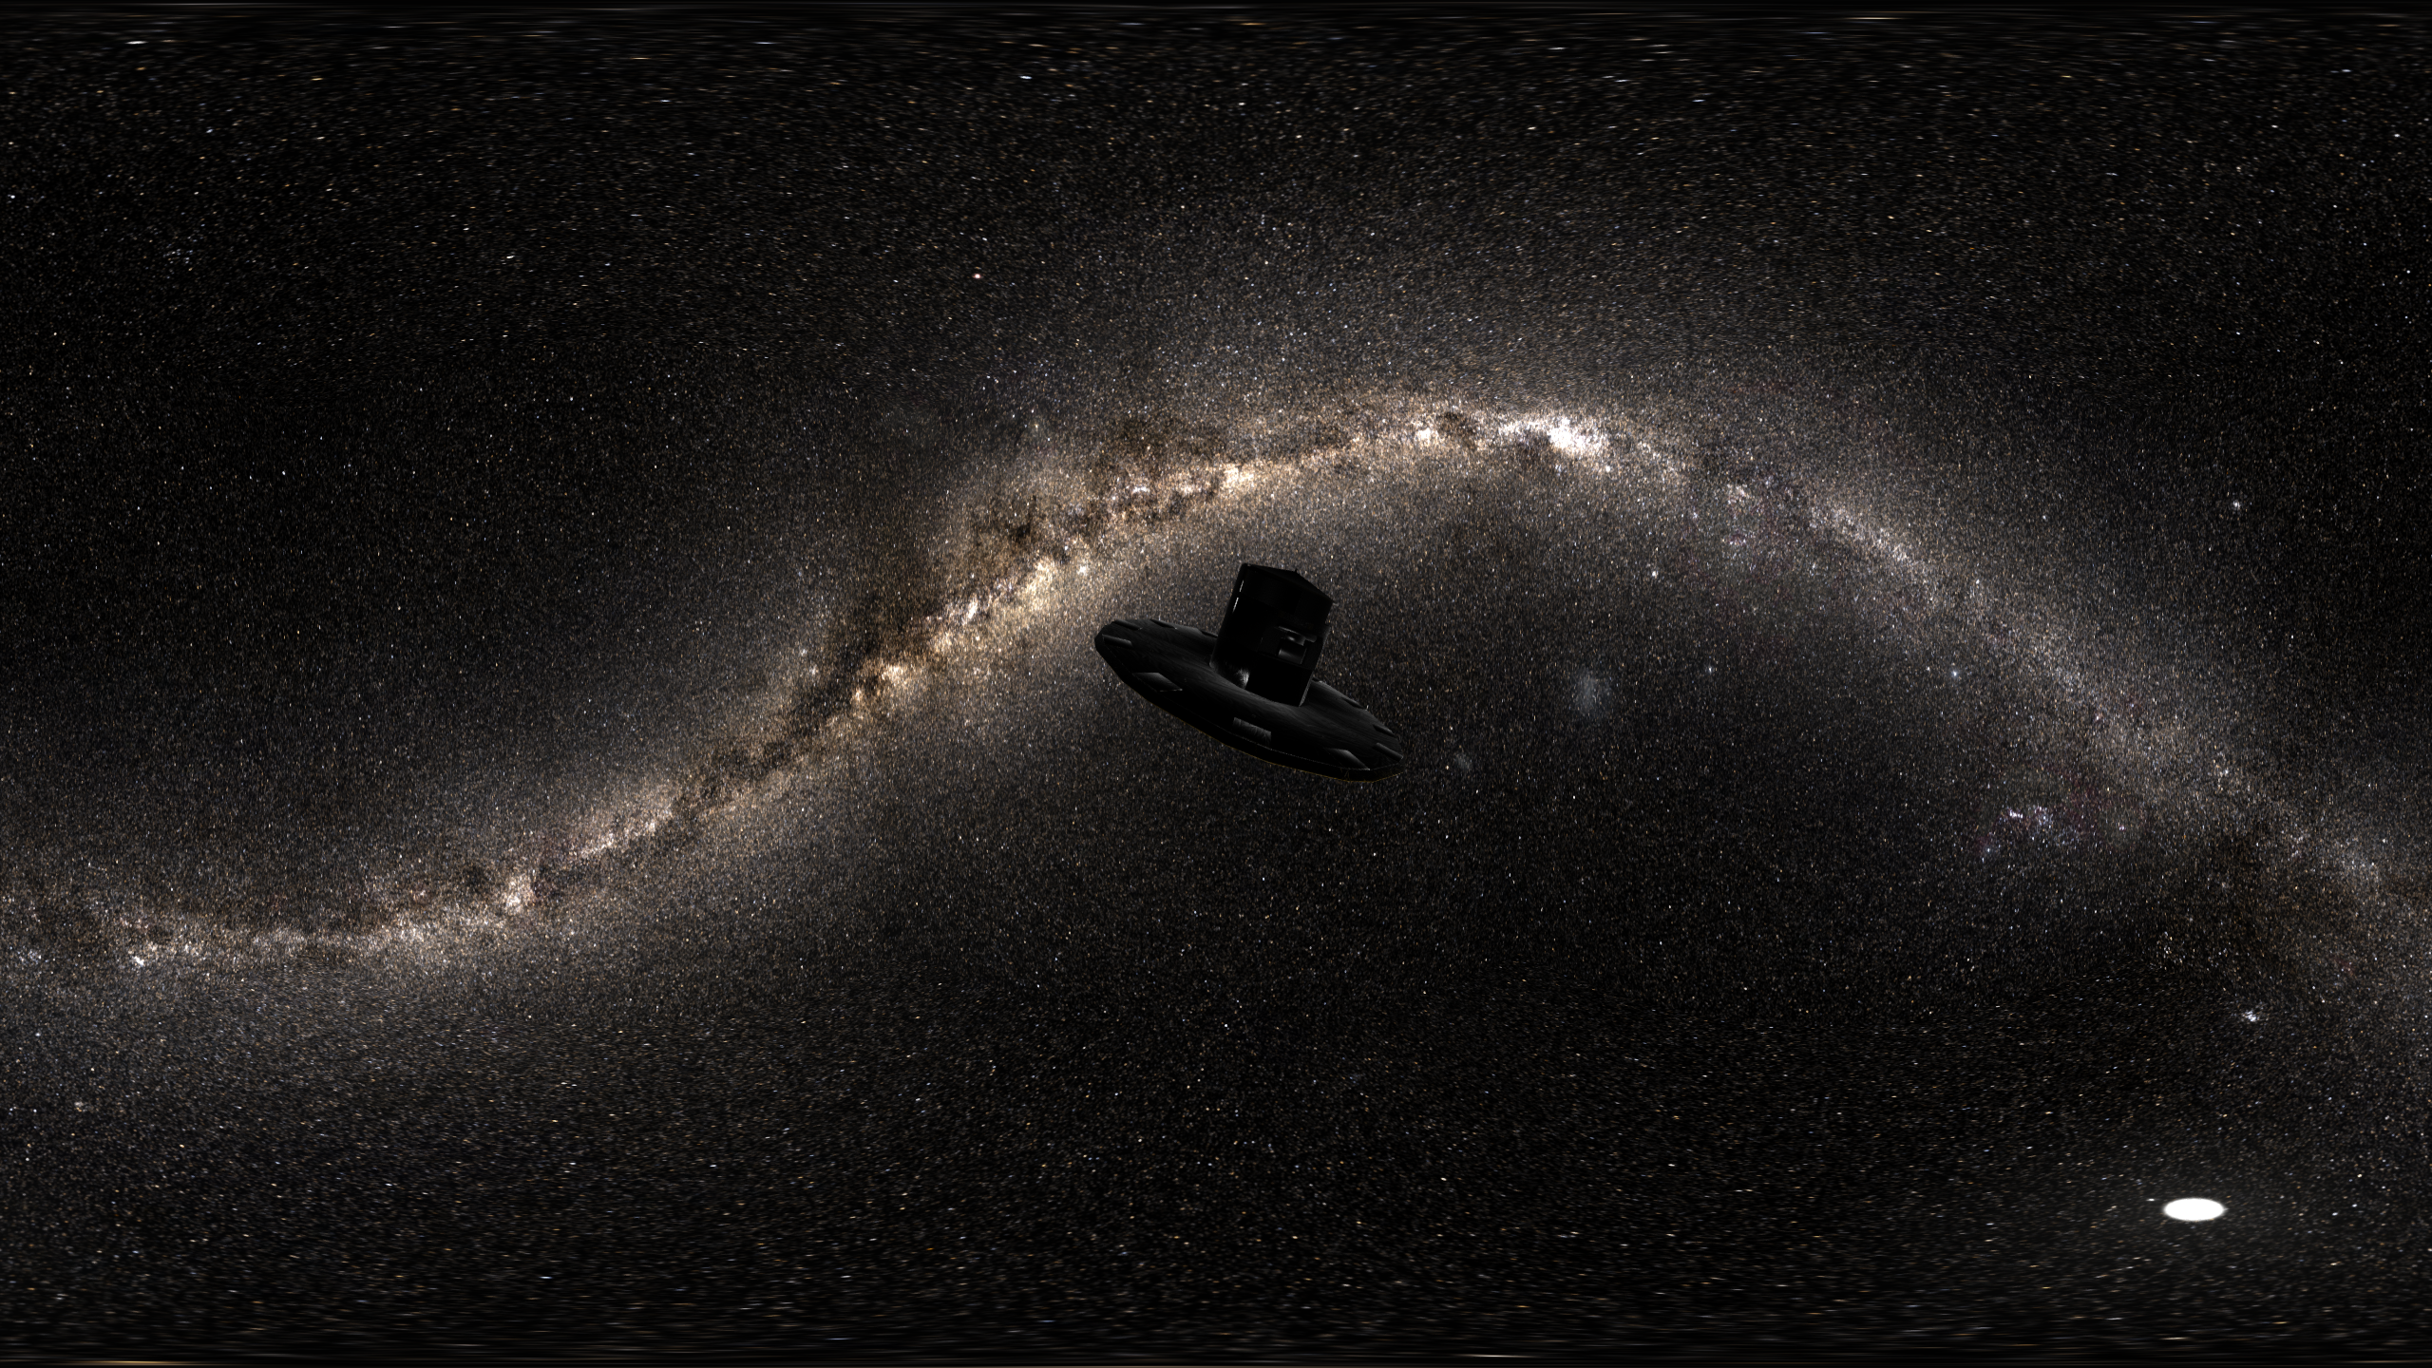
The History of the Milky Way‘s Disk(s)
Rene Andrae, Vedant Chandra , Neige Frankel, Jiadong Li, Maosheng Xiang
& the Gaia, SDSS IV/V, TNG50 teams
Hans-Walter Rix (MPIA) Bologna, May 28, 2024
Notes:
I love the halo, too, of course, but must remind us that only a tiny fraction of all Galactic stars live in the halo; we are a disk dominated galaxy. And disk dominated galaxies are the most common/important type of big galaxies (except for the extremely massive center)
As with most aspects of galaxy formation, one can seek simplicity, or one can embrace the complexity, which is messy but drives the evolution.
Landscape picture of what the last 5+ years have taught us about the disk formation.

Slide 2
What do we want to learn about the disk history?
When and how did disk formation get going?
  Which stars formed in a disk? Which survived?
What about the ‘bimodality’?
  What was special about the high-𝛂 phase?
  Did the high- and low-𝛂 phases overlap in time?
How strong is ‘secular evolution’?
  How much dynamical memory loss?
  What drives it?
What is normal, what unusual about our disk?
  comparison with simulations
  comparison with external galaxies

Slide 3
What’s the ultimate stellar data set?
Know every star’s orbit, 𝛕_{age} & element composition !
  Orbits:
    (3D position; 3D velocities) → E, L_{z}, ecc, … or actions
  Ages:
    inevitably (stellar evolution) model-dependent
    𝛕_{age} precision depends on evolutionary phase
      sub-giants: CMD → 𝛕_{age} (7%) ← need parallaxes
      red giants: mass → 𝛕_{age} (25%)
  Element composition [X/H]
    [Fe/H] or [M/H] is central quantity
    [𝛂/Fe] next: fast or slow enrichment?
    other [X/H] inform about formation origin and nucleosynthesis physics

Slide 4
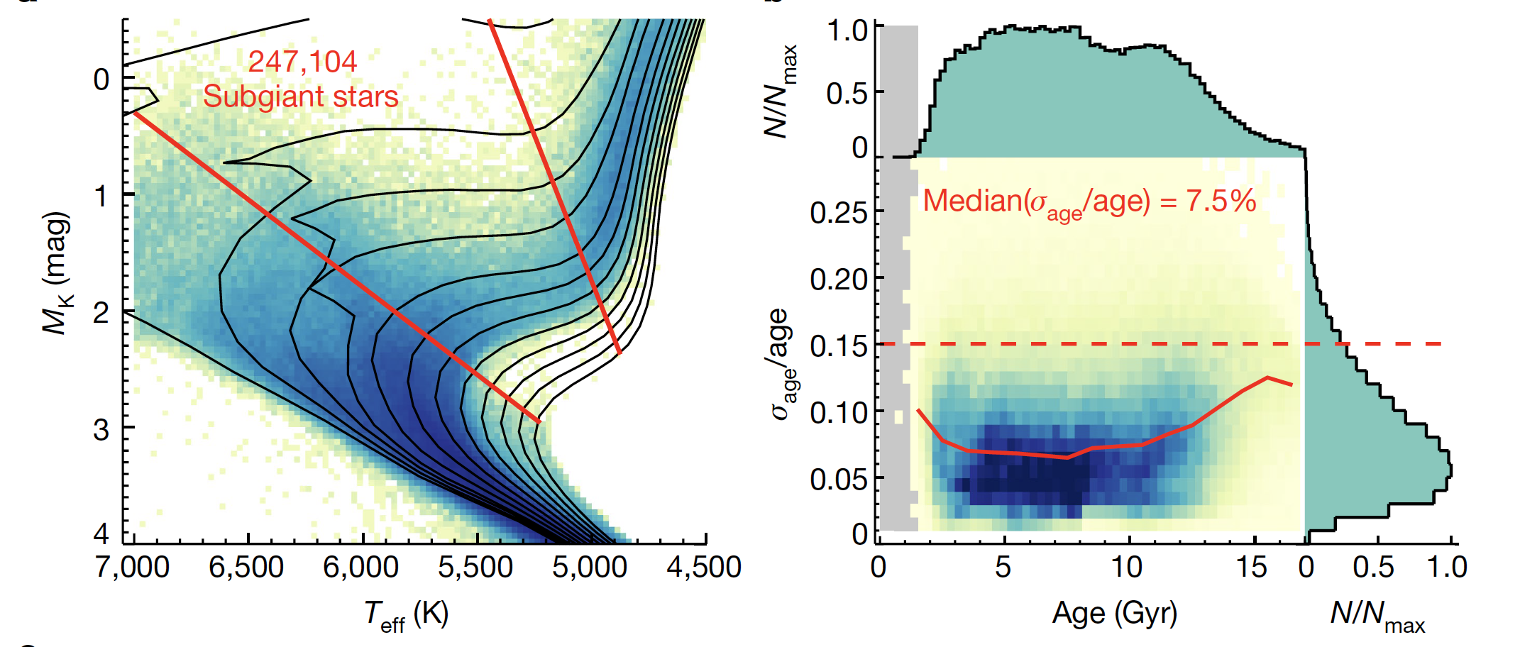
Precise (7.5%) ages for 250,000 sub-giant stars
Xiang & Rix 2022
needs good [Fe/H], [𝛂/Fe] (here, LAMOST) and distances (Gaia)

Slide 5
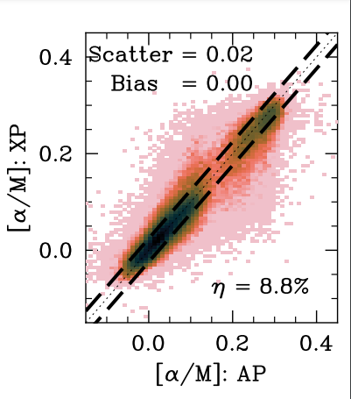
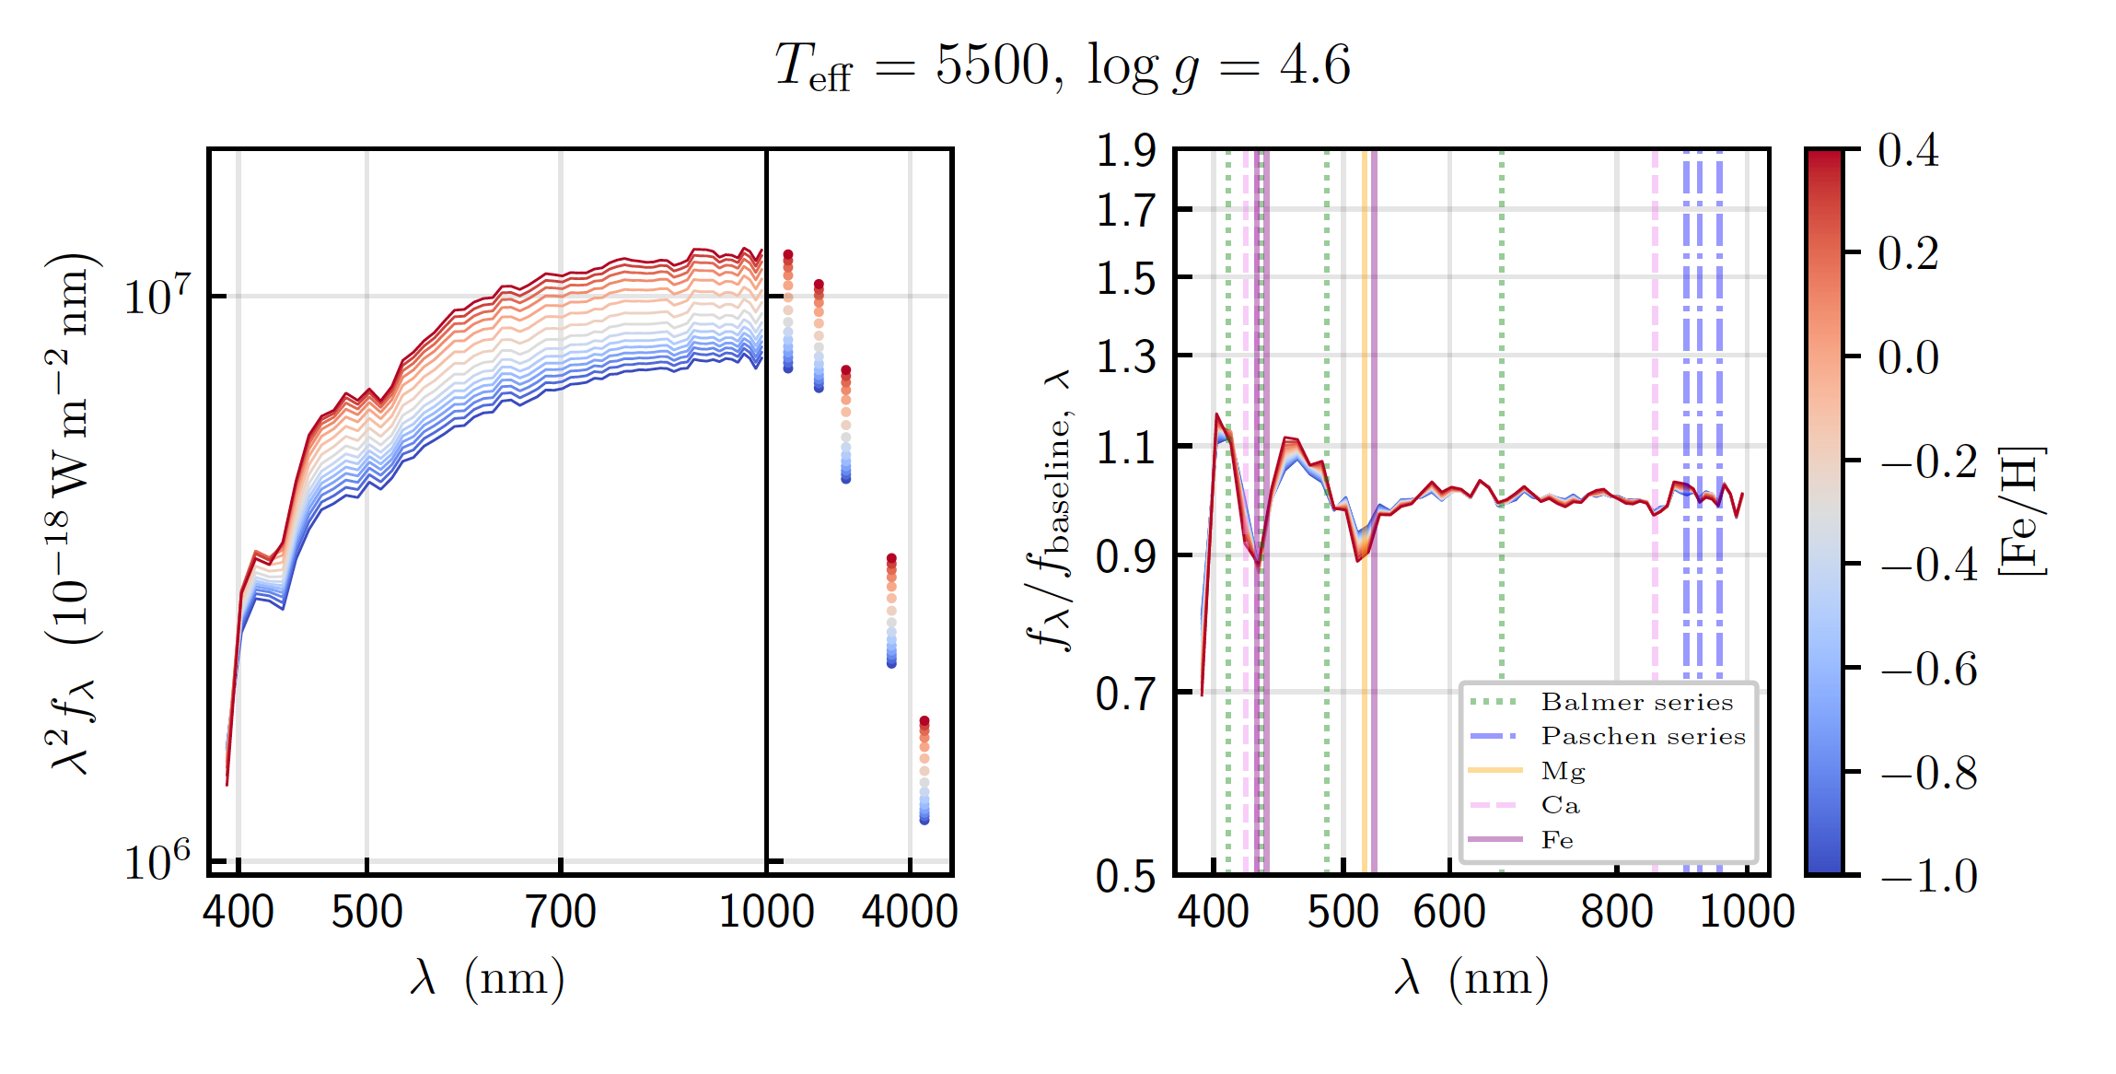
Abundances from the interplay of
„good“ spectra (e.g. SDSS/APOGEE) and Gaia XP
from Zhang, Green
& Rix 2023
Rix+ 2022. Andrae, Rix & Chandra 2023
Li+ 2024
The power of SDSS spectra tranferred to >10⁷ spectra!

Slide 6
all-sky stellar mono-abundance maps
Rix+ 2022
Andrae+2023

Slide 7
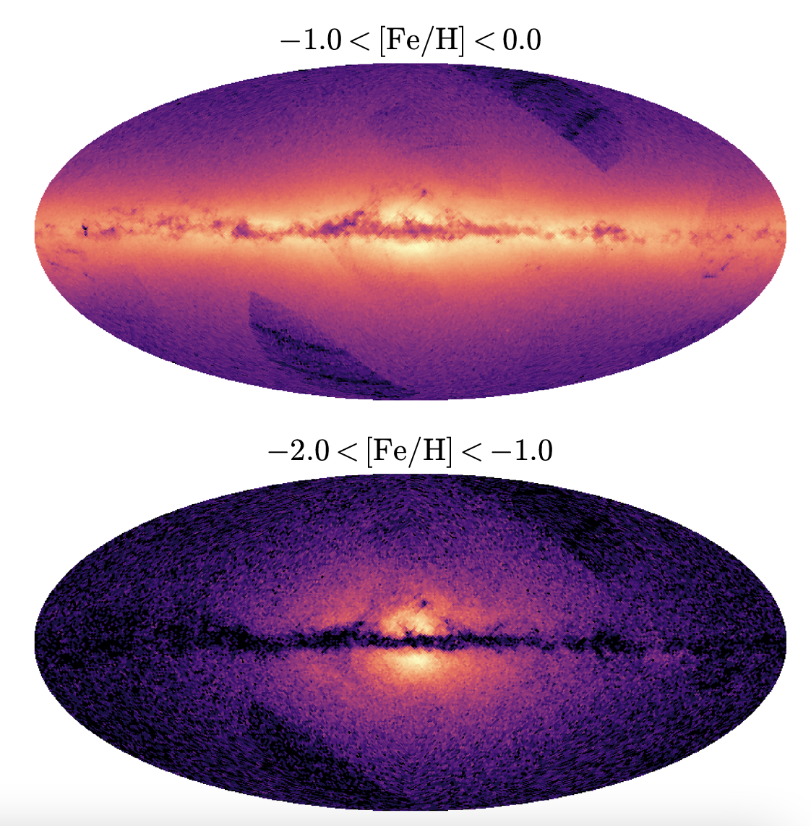
all-sky stellar mono-abundance maps
Gaia scan
pattern
poor old heart
Rix+ 2022
Andrae+2023
Chandra+2023

Slide 8
all-sky stellar mono-abundance maps
at the extremely metal-rich end
extremely metal rich knot
Rix + 2024 (next week)
see also Horta + 2024

Slide 9
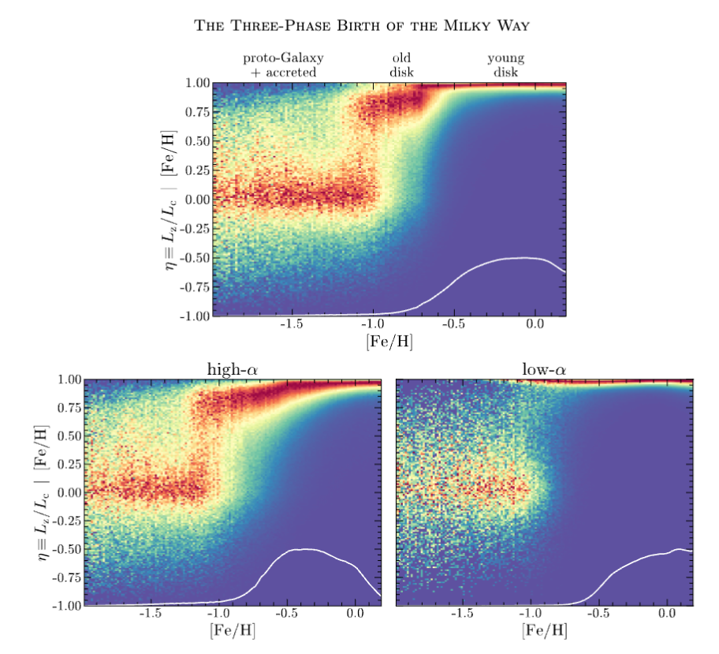
The three epochs of Milky Way formation
Chandra + 2023
(in-plane) orbit circularity
enabled by
Li+ 2024 results

Slide 10
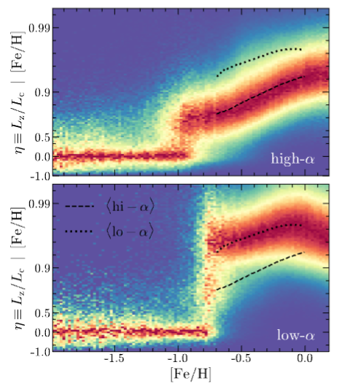

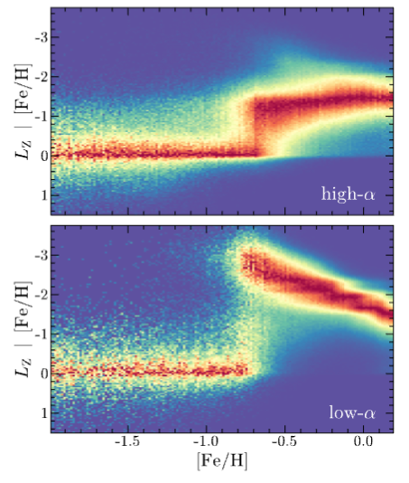
Let’s first look at the ‘old’ high-𝛂 disk?
orbit circularity
angular momentum
Chandra + 2023

Slide 11
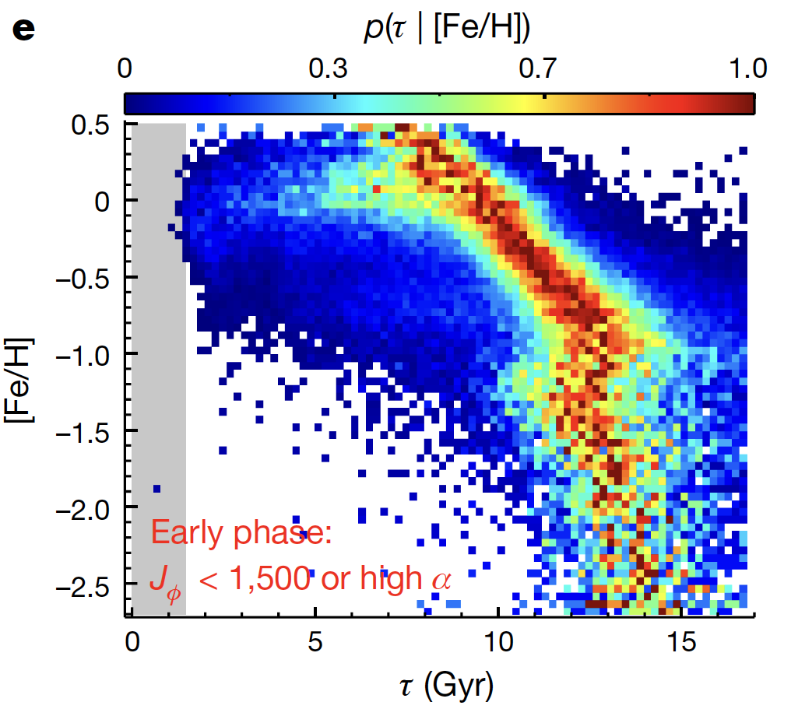
Stellar ages of the high-𝛂 disk
Xiang & Rix 2022
p( 𝛕_{age} | [Fe/H] )
old disk
halo
Can we fit the structure 𝛒o,H_{z},H_{R} = f( 𝛕_{age} , [Fe/H] )?

Slide 12
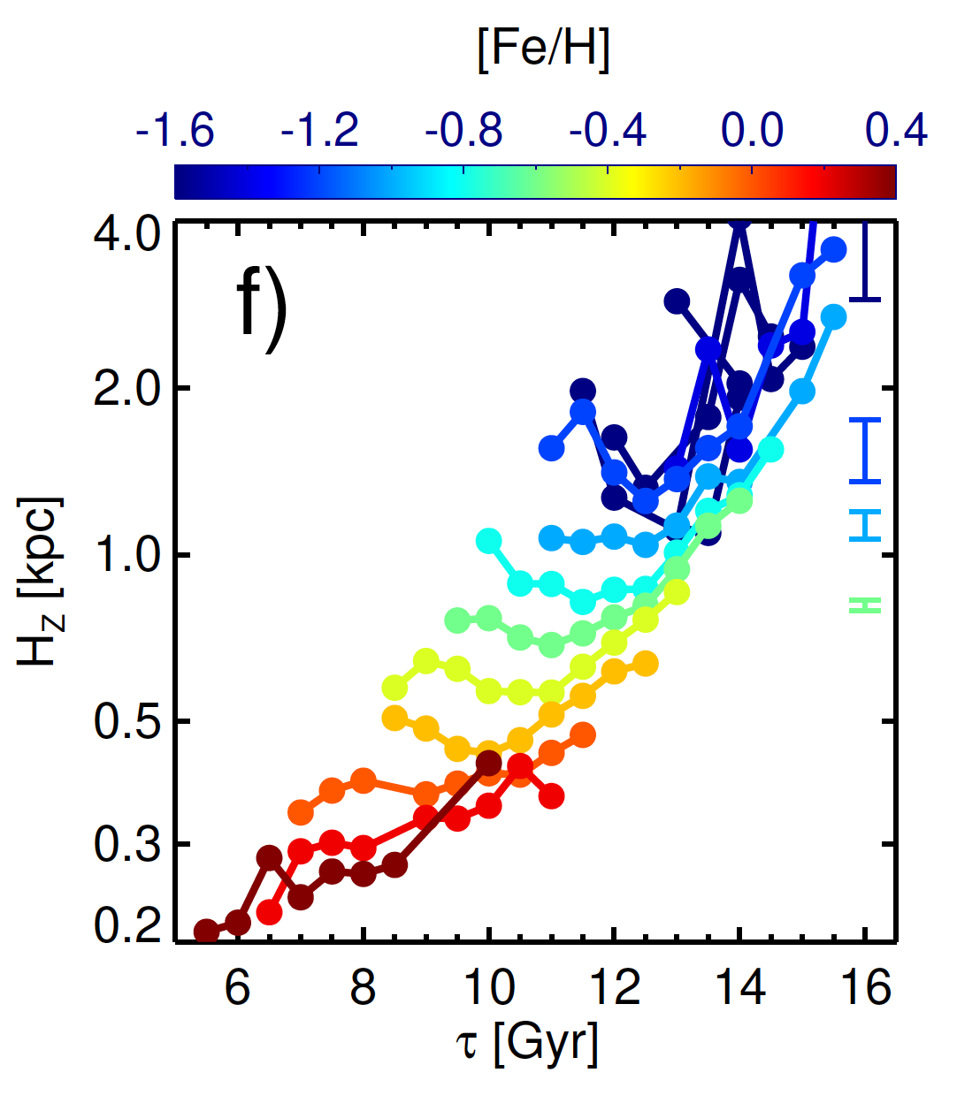
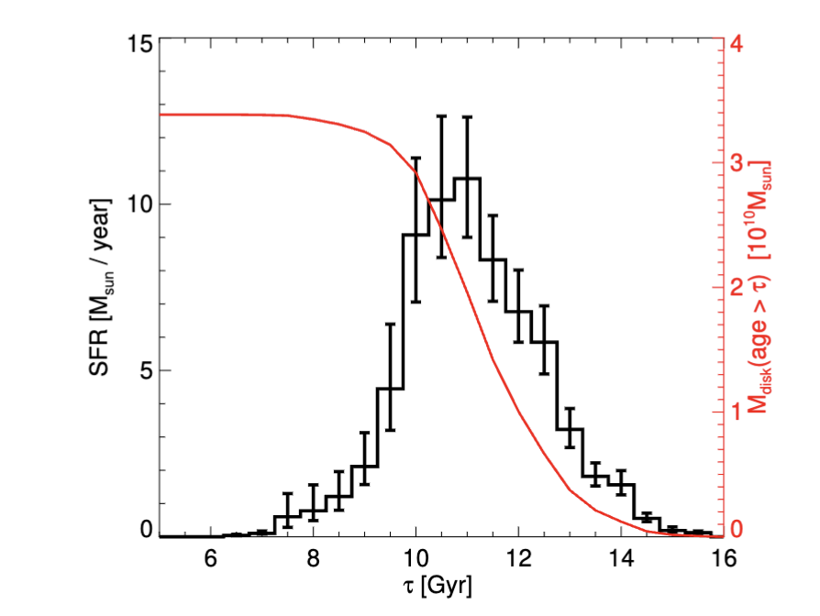
The age-dependent structure of the high-𝛂 disk
Xiang, Rix+ 2024

Slide 13
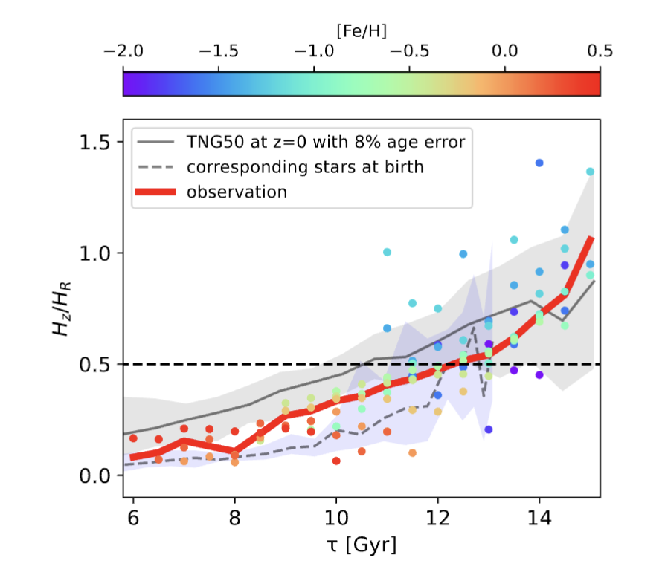
How does the MWs H_{z}(𝛕_{age}) compare to TNG50 simulations?
Xiang, Rix + 2024
disk flatness
H_{z}/H_{R}
both “upside-down formation” and disk heating at work

Slide 14
Now let’s look at the low-𝛂 disk
from Chandra+23
angular momentum
large radii
prograde
small radii
retrograde
Note: high/low-𝛂 disk are almost disjoint in L_{z}!

Slide 15
Now let’s look at the low-𝛂 disk?
orbit circularity
from Chandra+23

Slide 16
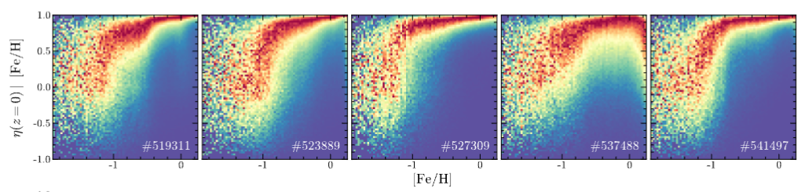
What do we see in TNG50 simulations?
orbit circularity

Slide 17
What happened to the Milky Way’s disk (dynamically) over the last 8 Gyrs?
Gradual, but extensive, change of orbital radii
..by stars “surfing” randomly in front of, or behind, fleeting perturbations
Frankel, Rix + 2018, Frankel + 2020
Building on Sellwood & Binney 2002; Binney & Schönrich, Roskar+2008, ..
Notes:
14 minutes

Slide 18
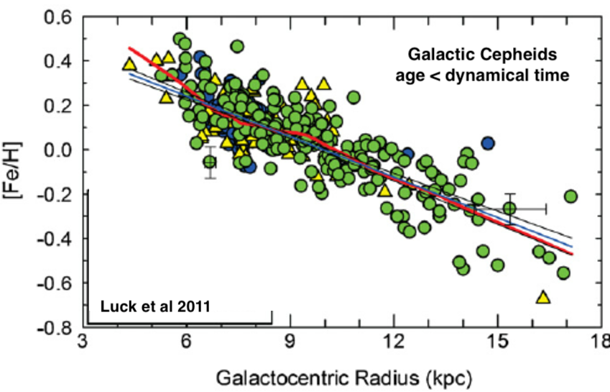
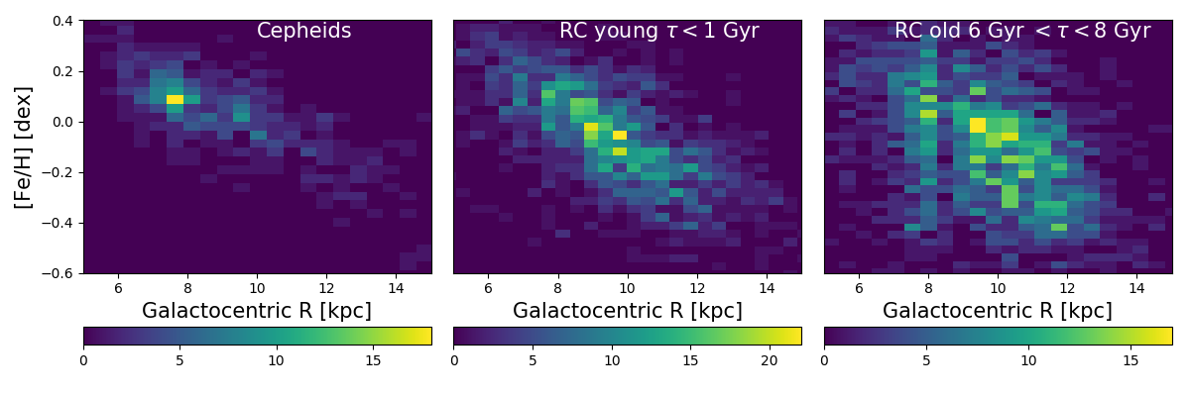
What’s the qualitative observational evidence for radial orbit migration in the Milky Way?
..considering old and young stars across the disk …
Genovali+14
Genovali+14
Ness+16
# stars

Slide 19
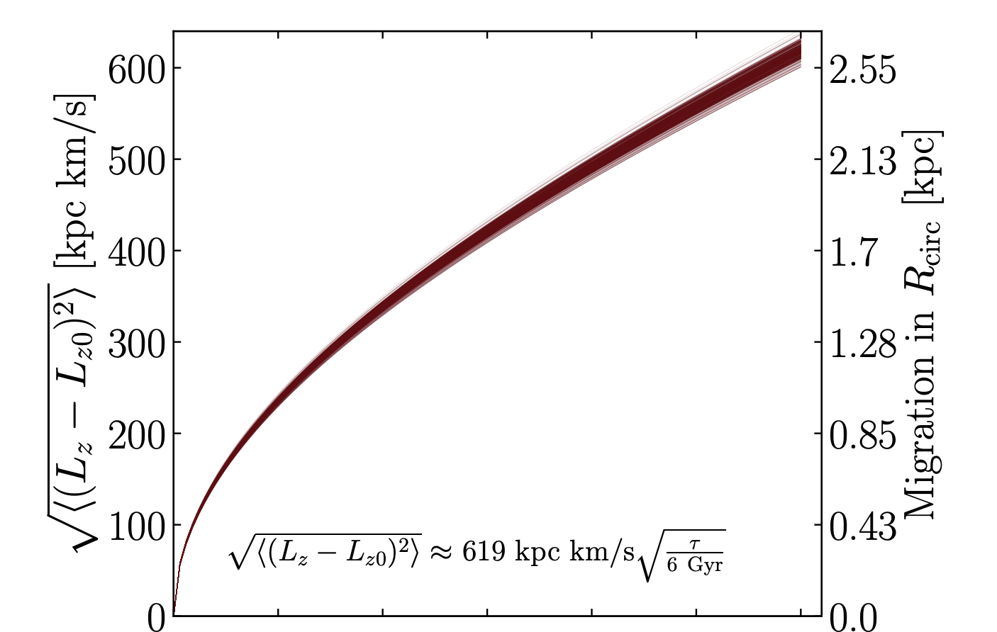
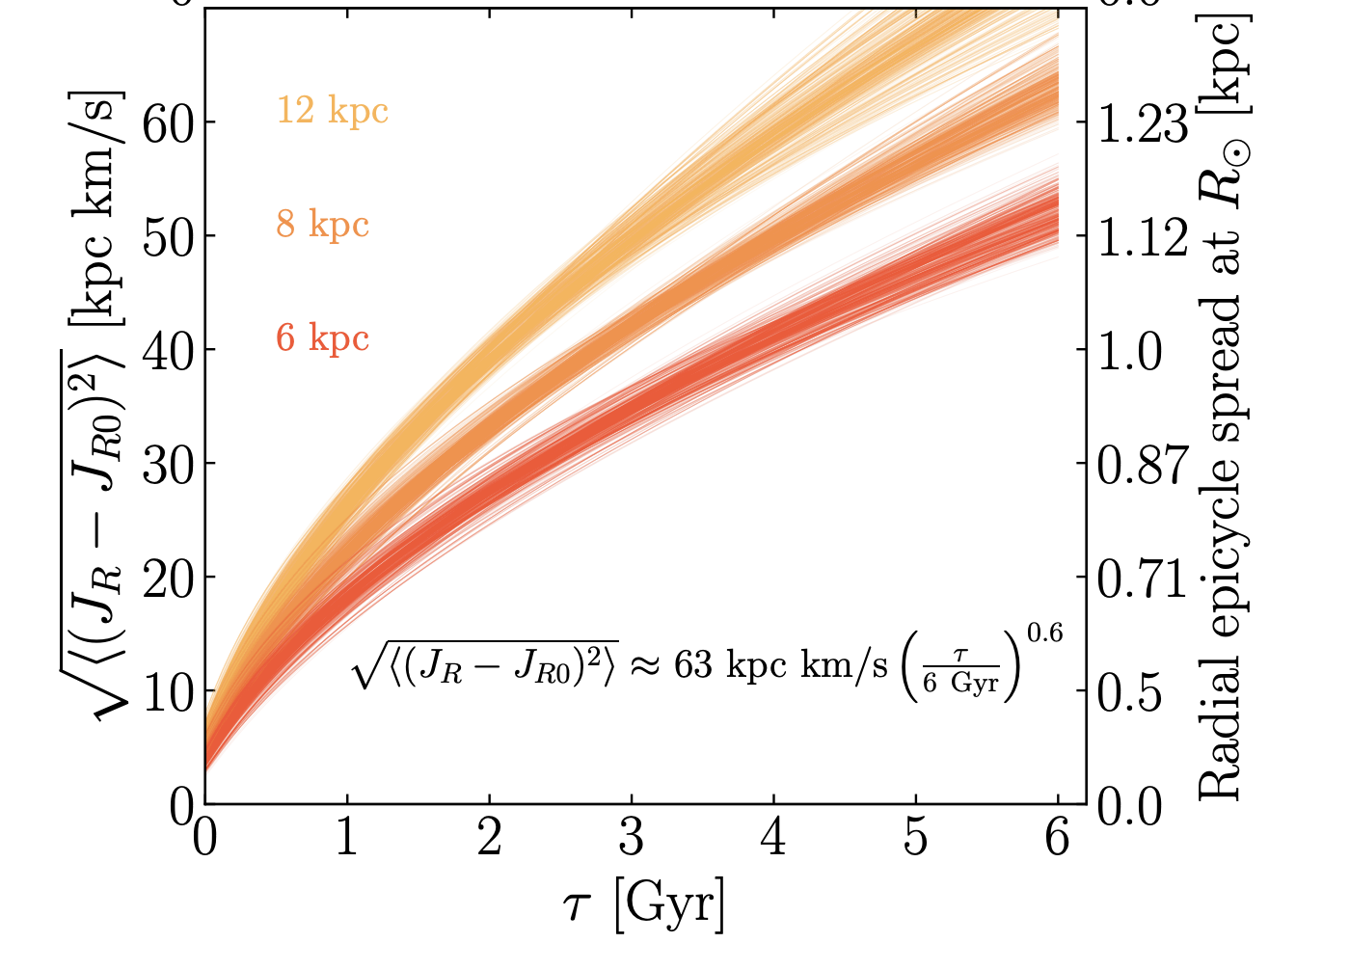
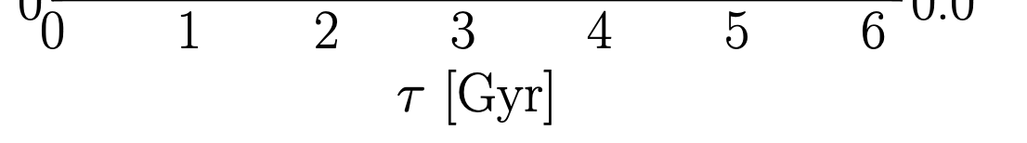
How much gradual orbit change over the last 8 Gyrs?
mean change in orbital radius
boost in eccentricity
Extensive change in orbital radius (1 scale length!),
at little eccentricity boosting!
Frankel+2020, ..

Slide 20
(My) Near-Term Future: SDSS-V
the inner galaxy
  <5kpc where disk and bar blur
the recent disk (the disk is ”alive”)
  ≲ 1 t_{dyn.} & phase-space spirals
➜ spectral focus on the Galactic plane
SDSS-V
Kollmeier+17/24
we’re ~1.5 years
into the science survey…

Slide 21
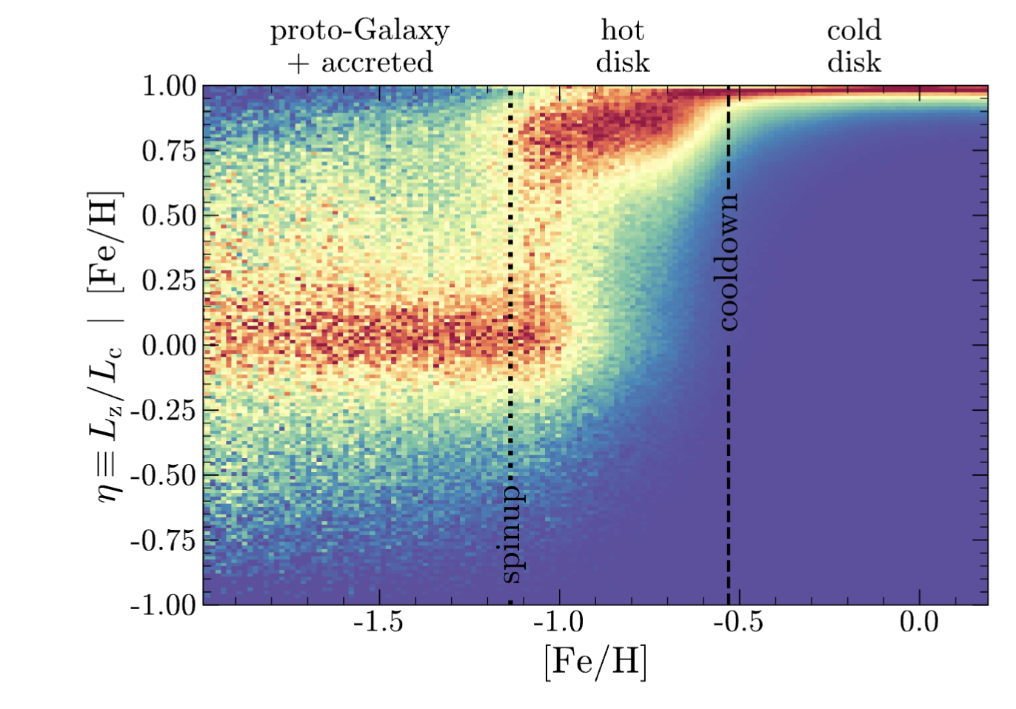
The History of the Milky Way Disk in Pictures
Frankel+ 2020
mean change in orbital radius
Chandra+ 2023
Xiang & Rix 2022
p( 𝛕|_{age} [Fe/H] )
Xiang + 2024
Notes:
Let me now re-cap in the proper ordering of time:
-- downtown Milky Way contains not only young, metal rich stars, but also the by far largest concentration of ancient, metal-poor stars. [No; the oldest stars are not “out there” in the halo]
-- 12-8 Gyrs ago, the basic angular momentum plane was set; intense star-formation happened, from a ever-well-stirred ISM
-- then an abrupt transition in metallicity (but also in time) ~8Gyrs ago to more gradual SF, but clear evidence that the multitude of small perturbation cause extensive radial orbit radius change, among near-circular orbits

Slide 24
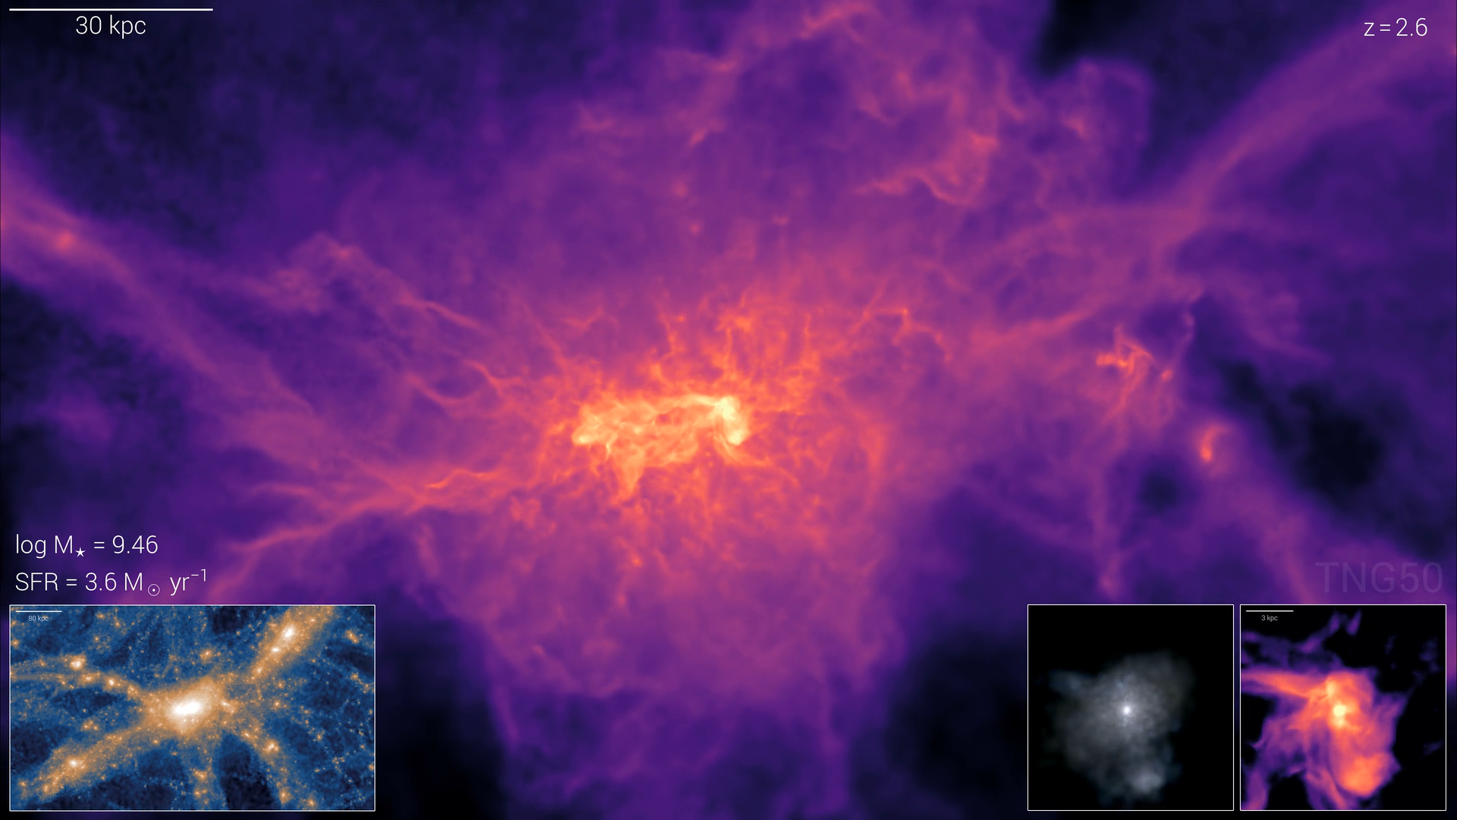
(Simulated) Disk Galaxy Formation in a LCDM context here: TNG50 Pillepich, Dylan, Springel et al 2019-2024

Slide 25
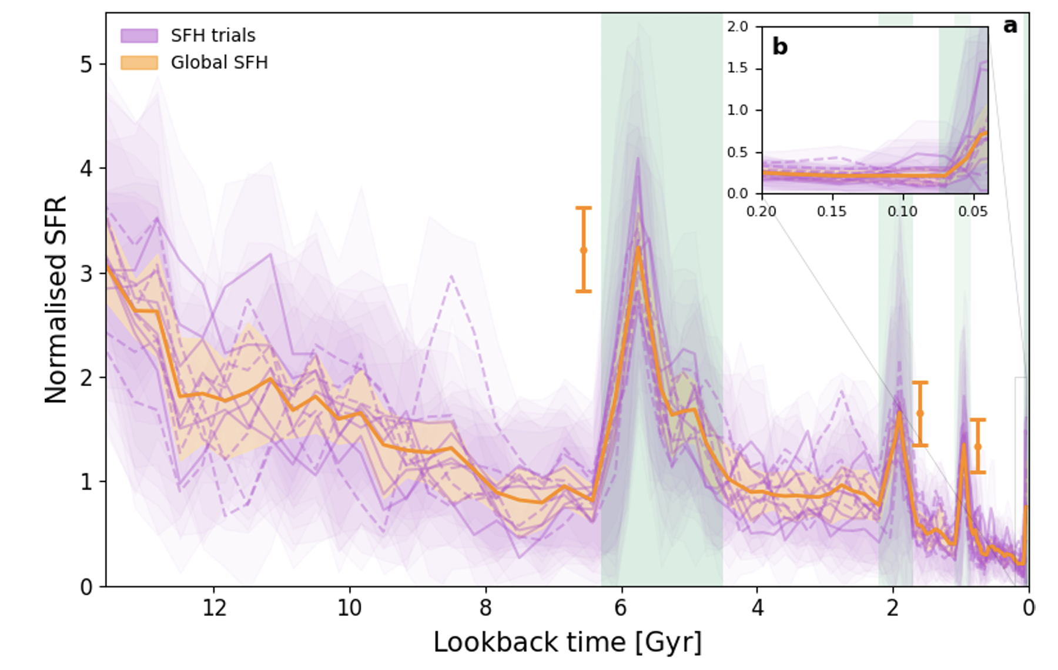
Ruiz-Lara+2020

Slide 26
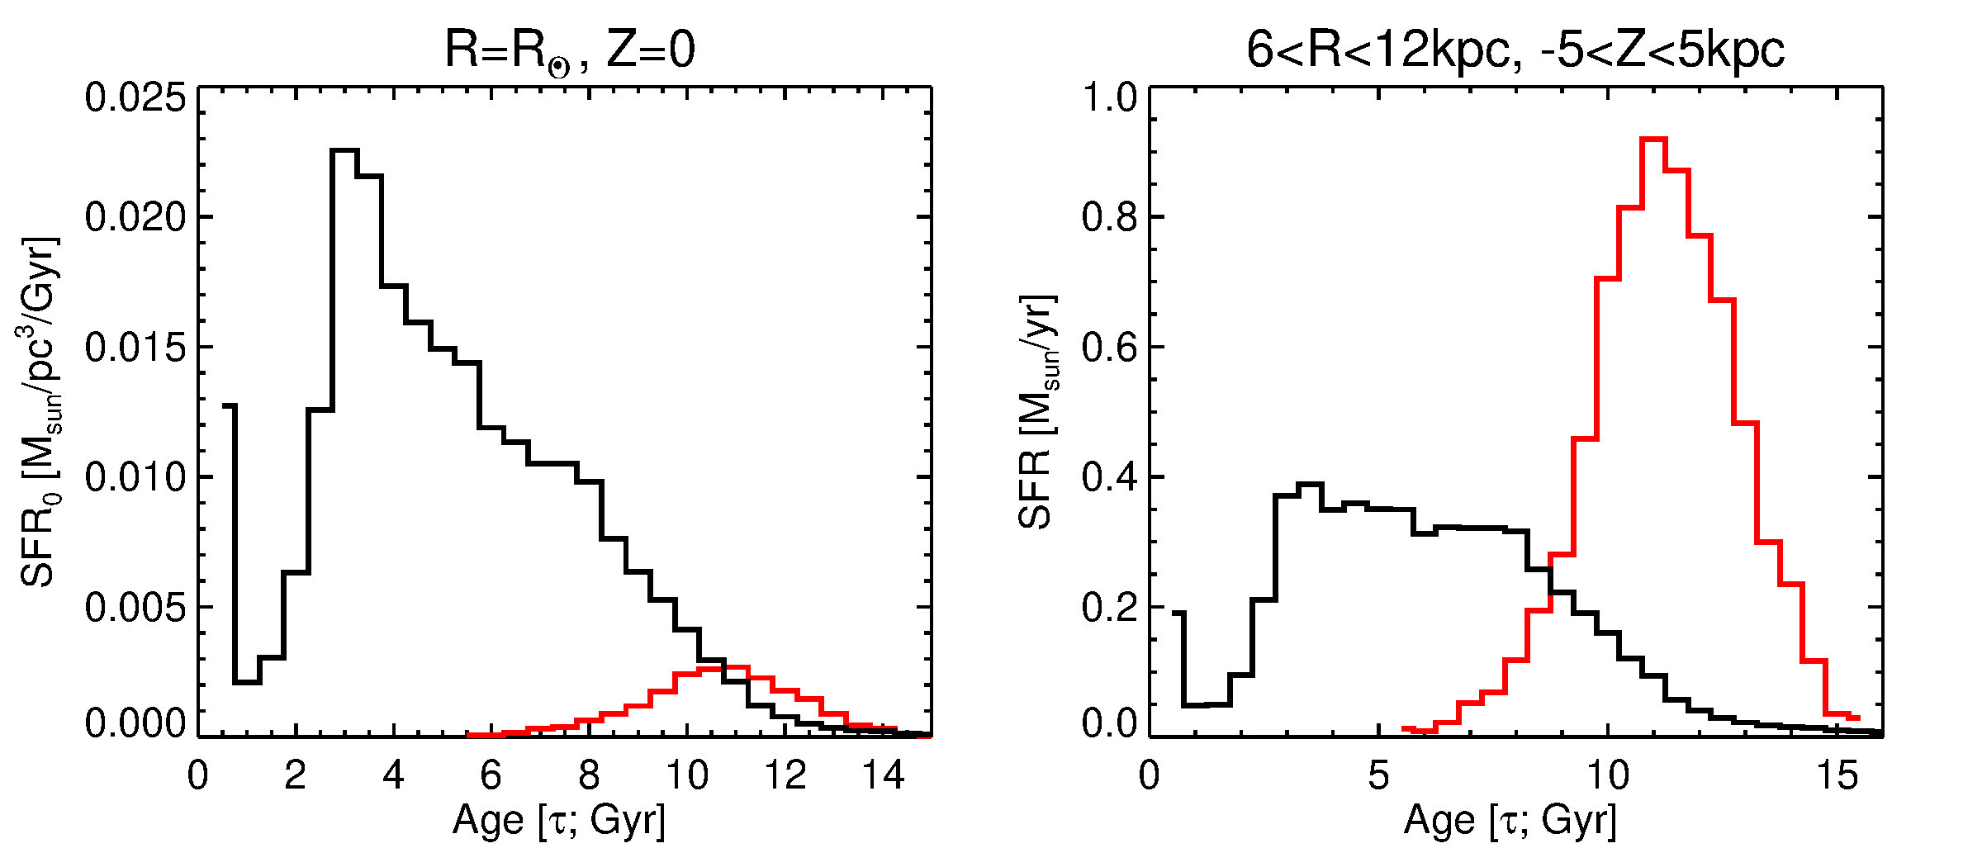
Ruiz-Lara+2020

