Slide 1

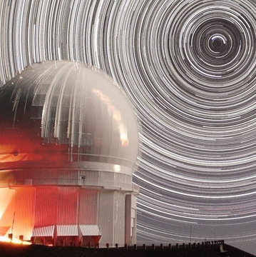
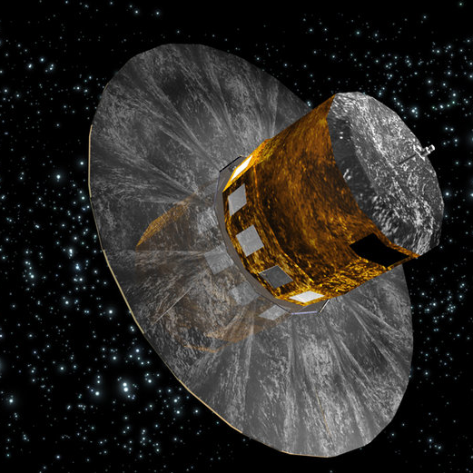
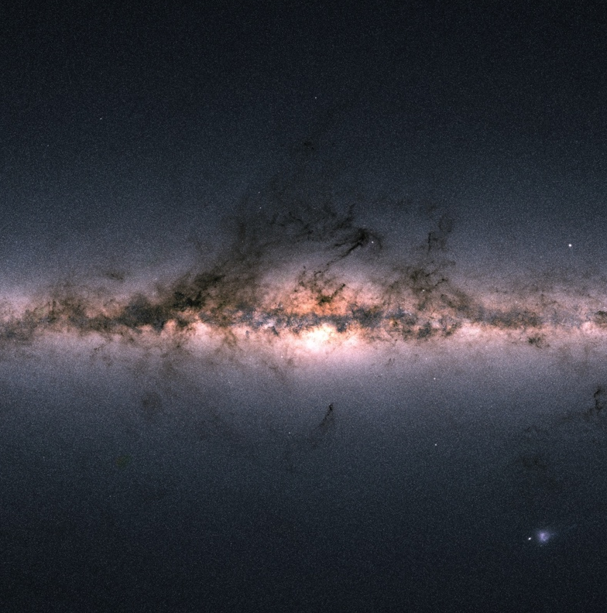
New views on the metal-poor Milky Way halo
Else Starkenburg

Slide 2
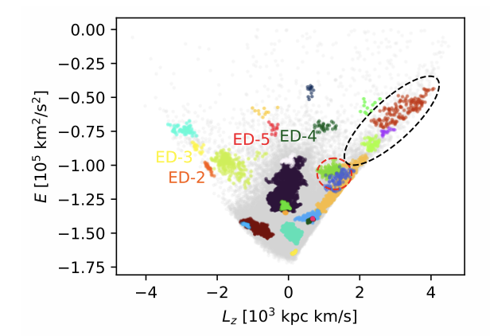
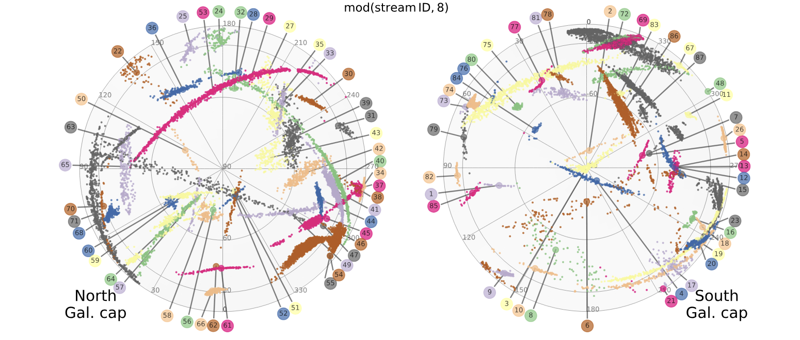
We are learning a lot about our Galaxy
The Galactic halo is studied extensively by Gaia & spectroscopy
More and more discoveries of very faint streams & mixed substructures
  Remnants from dwarf galaxies & globular clusters
  Important measuring tools for the Galactic potential
  Messengers of the Milky Way’s (distant) past
Dodd et al., 2023 using DR3
Ibata et al., 2024

Slide 3
Pushing our knowledge from the Galactic halo
Earlier in time
Studying the earliest chemodynamics of our Galaxy
Cartoon!

Slide 4
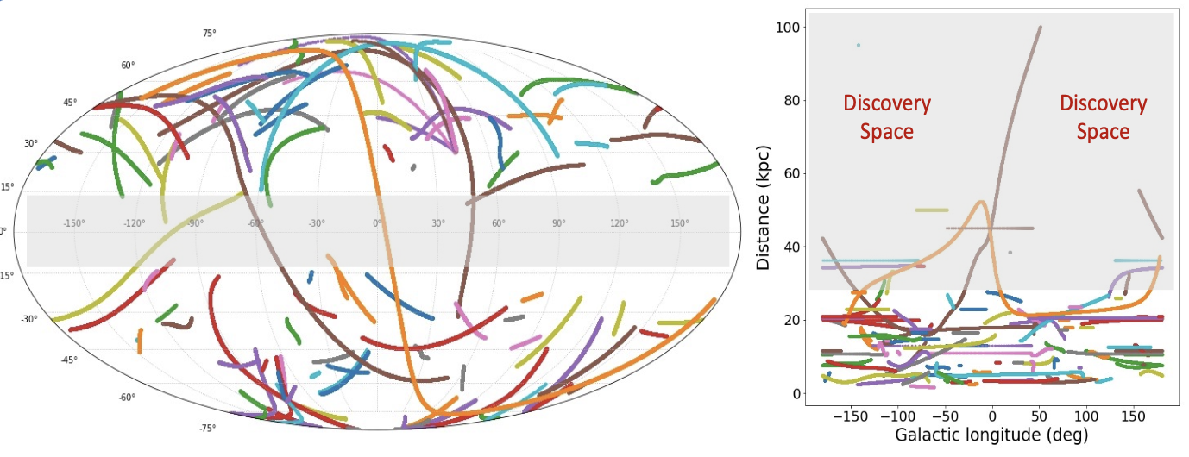
Pushing our knowledge from the Galactic halo
Farther out
(also well-argued by Vedant Chandra)
From galstreams package, Mateu, 2023

Slide 5
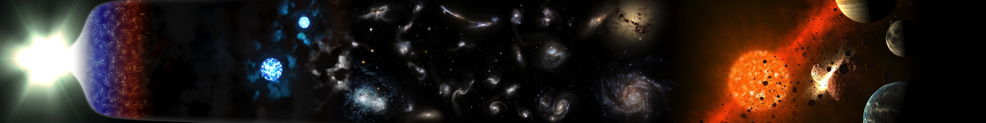
Study the build-up of the Milky Way galaxy
Find and research first generations of stars
time
Big Bang
First Stars
Limit
Galaxy Evolution
Solar System
Now
Galactic archaeology
Step 1:
Finding these rare stars
The Pristine survey
Gaia XP spectra
Using narrow-band photometry or
Gaia “spectrophotometry”/ XP spectra

Slide 6
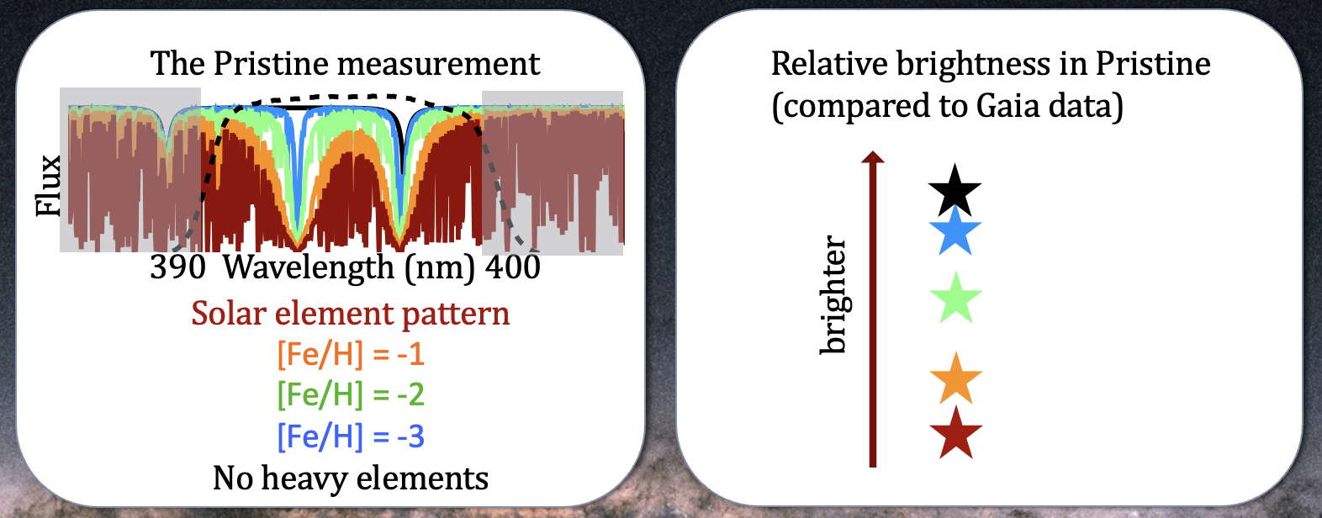
The Pristine survey
Starkenburg, Martin et al., 2017

Slide 7
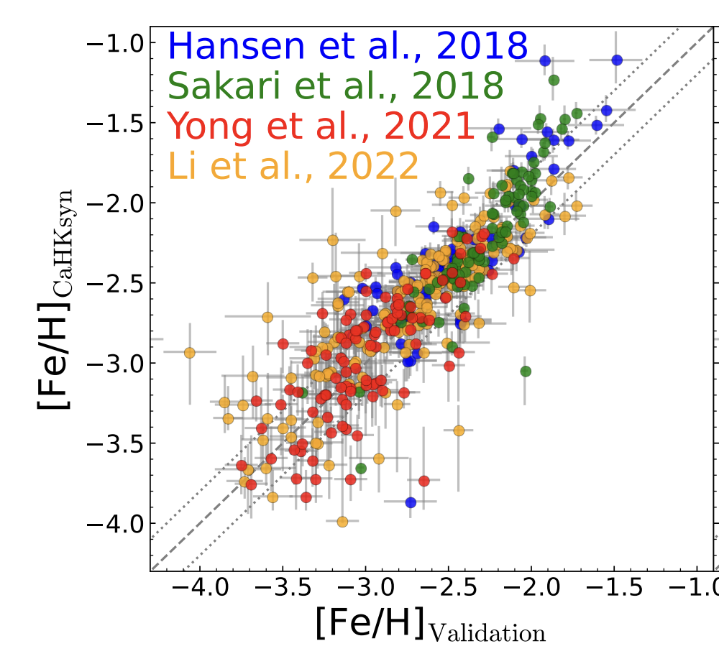


Low-metallicity stars
Martin, Starkenburg et al., 2023
Works well until extremely low-metallicity regime
Dataset (+ Pristine data) released Martin, Starkenburg et al., 2023
Great success rates
  talk Akshara Viswanathan
Input catalogues for upcoming highly-multiplexed spectrographs

Slide 8
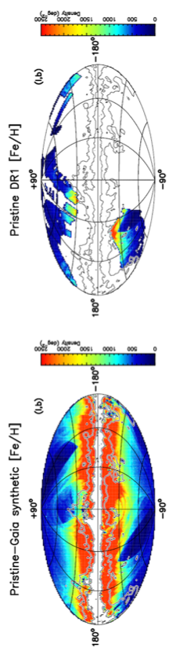
Pristine Data Release 1
Martin, Starkenburg et al., 2023
Based on Gaia XP
Based on Pristine CaHK
Complementary to catalogues by e.g., Andrae et al., 2022, 2023; Zhang et al., 2023; Bellazzini et al., 2023

Slide 9
Pristine Data Release 1
Martin, Starkenburg et al., 2023
Difference in quality at the fainter end (G_{BP} > 16)

Slide 10
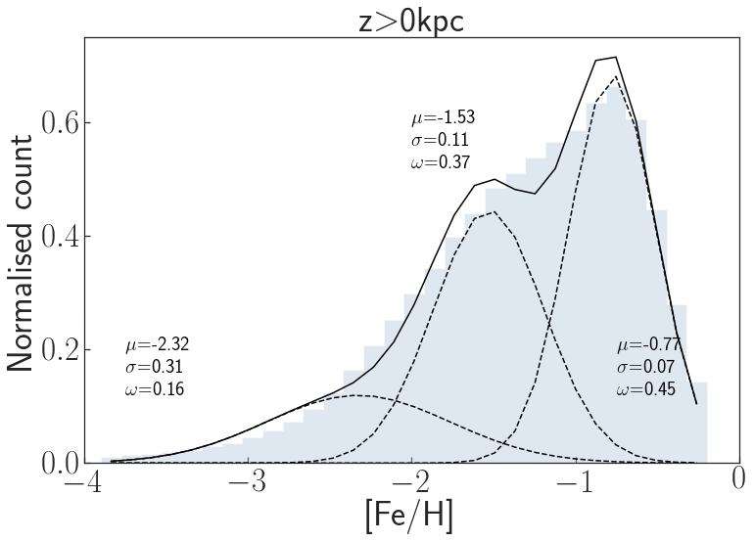
Using metallicity to study structure
Peak of halo MDF
Hot thick disc
A metallicity view of populations varying with height above the disk from halo main-sequence stars
Viswanathan et al., in prep.
Metal poor tail

Slide 11
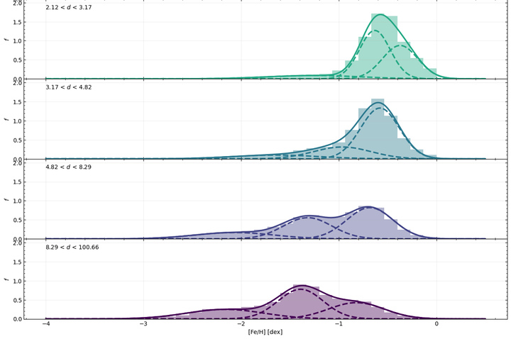
Viswanathan, Byström et al.,
in prep.

Slide 12
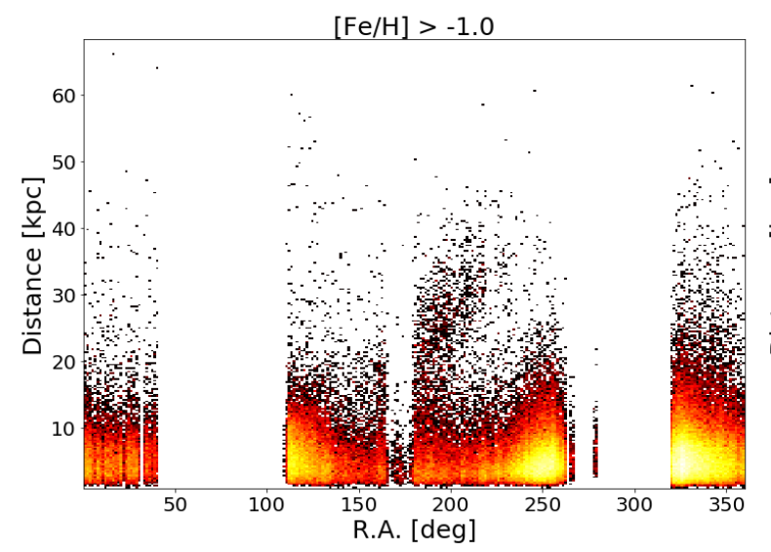
Using metallicity to study structure
A metallicity slice of
brighter red giants with [Fe/H] > -1, reaching larger distances
Viswanathan, Byström et al.,
in prep.

Slide 13
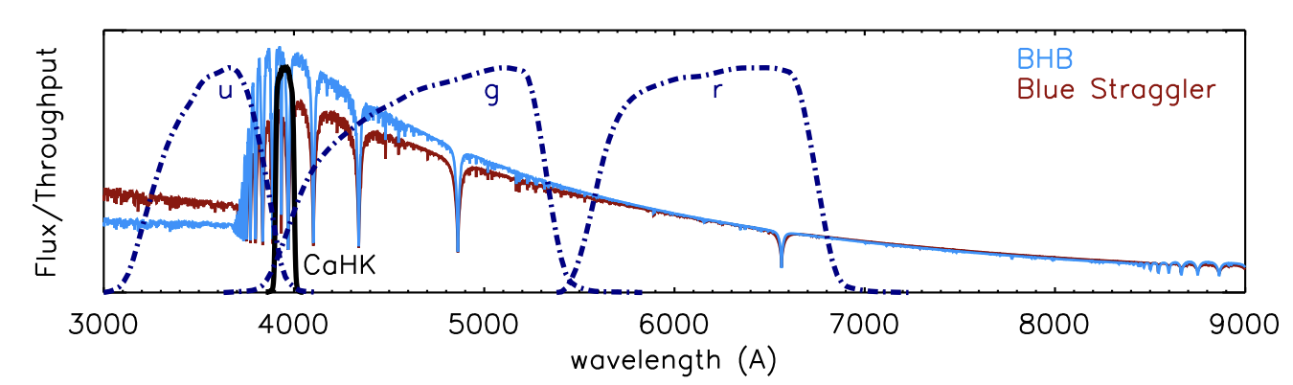
Serendipitous science:
Blue Horizontal Branch stars
Select A-stars, but disentangle AGN, blue stragglers, main-sequence …
  .. and genuine blue horizontal branch stars
Starkenburg et al., 2019

Slide 14

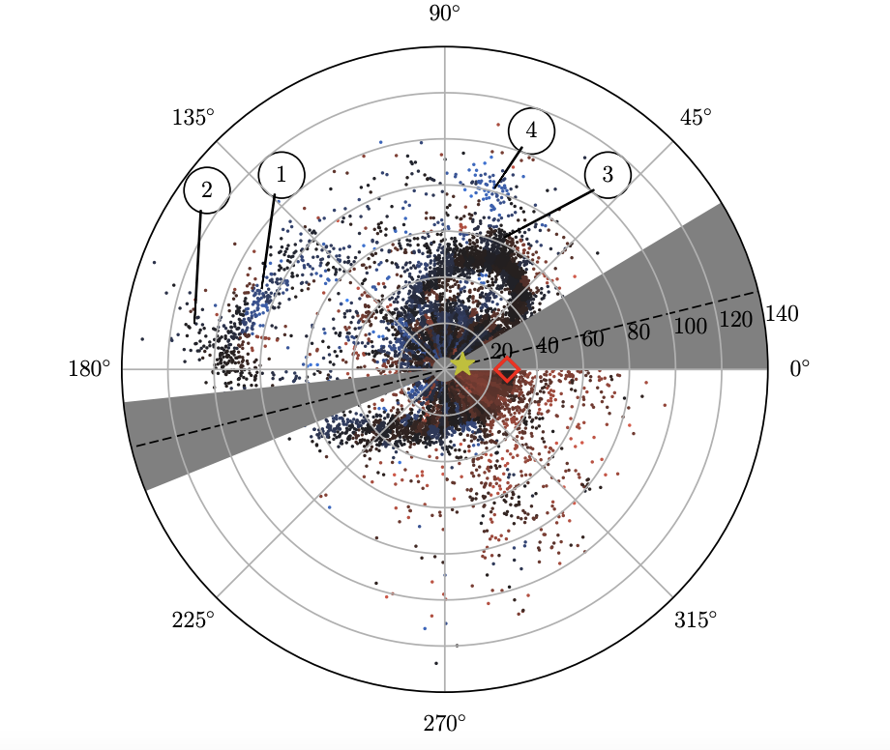
Pristine – Going into the outer halo
Can take you to beyond > 100 kpc
Combining deep Pristine CaHK & CFIS u-band
Bayer, Starkenburg, Thomas et al., in prep.
Sesar et al., 2017

Slide 15
Pristine – Going into the outer halo
Very high success rate of the selection
Bayer, Starkenburg, Thomas et al., in prep.

Slide 16
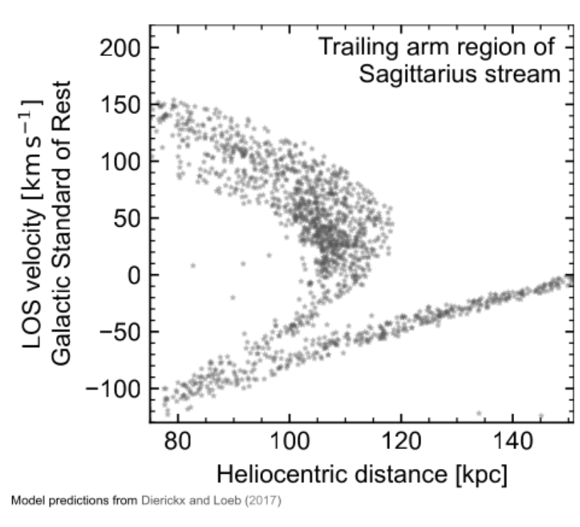
Pristine – Going into the outer halo
Measure velocities at the very outer halo – with good distances
Bayer, Starkenburg, Thomas et al., in prep.
Preliminary
Models:
Dierickx & Loeb 2017 (grey)

Slide 17
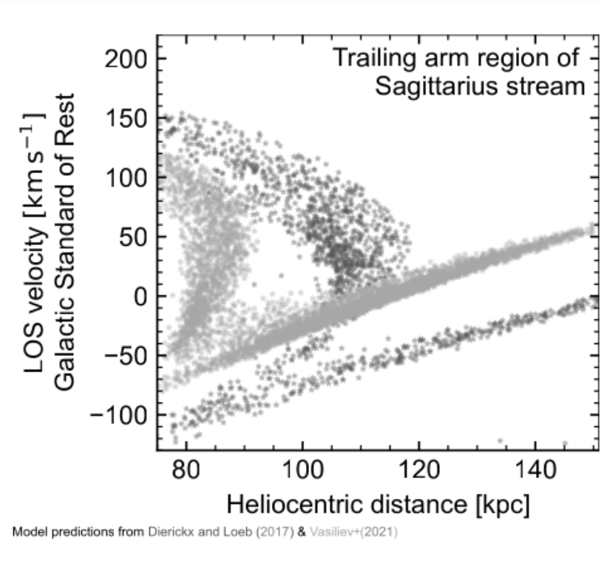
Pristine – Going into the outer halo
Measure velocities at the very outer halo – with good distances
Bayer, Starkenburg, Thomas et al., in prep.
Preliminary
Models:
Dierickx & Loeb 2017 (grey)
Vasiliev+2021 (light grey)

Slide 18
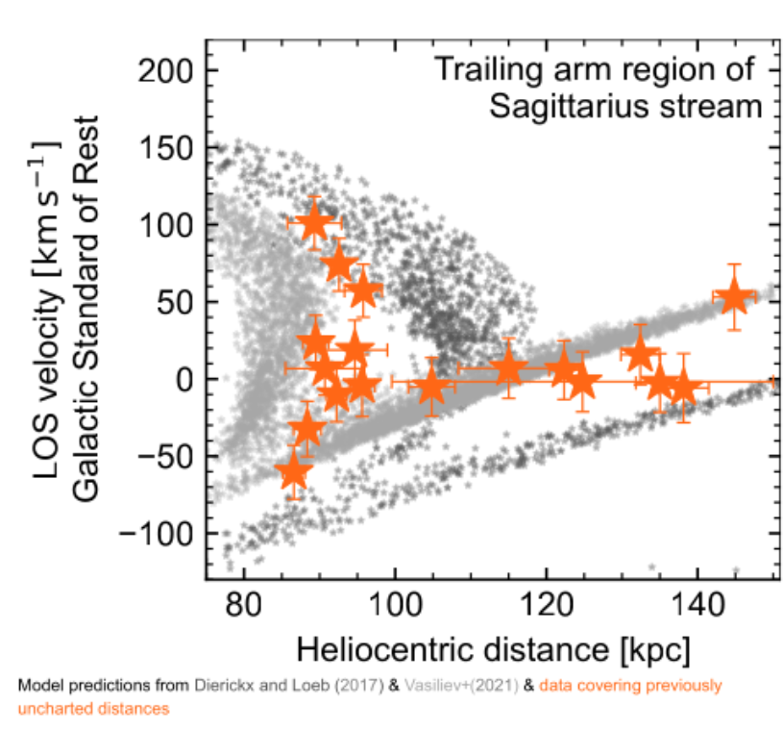
Pristine – Going into the outer halo
Measure velocities at the very outer halo – with good distances
Bayer, Starkenburg, Thomas et al., in prep.
Preliminary
Models:
Dierickx & Loeb 2017 (grey)
Vasiliev+2021 (light grey)
Data of BHB stars (orange)

Slide 19
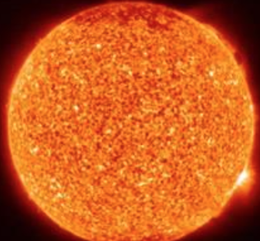
Pushing earlier and farther: The future
Pristine & WEAVE agreement:
  Spectroscopy for extremely metal-poor star candidates
  Homogeneous study > 30,000 stars
    Increase samples > 10-fold
Pristine & 4MOST follow-up the inner Galaxy
  Pristine-Gaia used to remove metal-rich foreground
millions known well
+30,000 new stars!?!
1%
-5
-4
-3
-2
-1
0
0.5

Slide 20
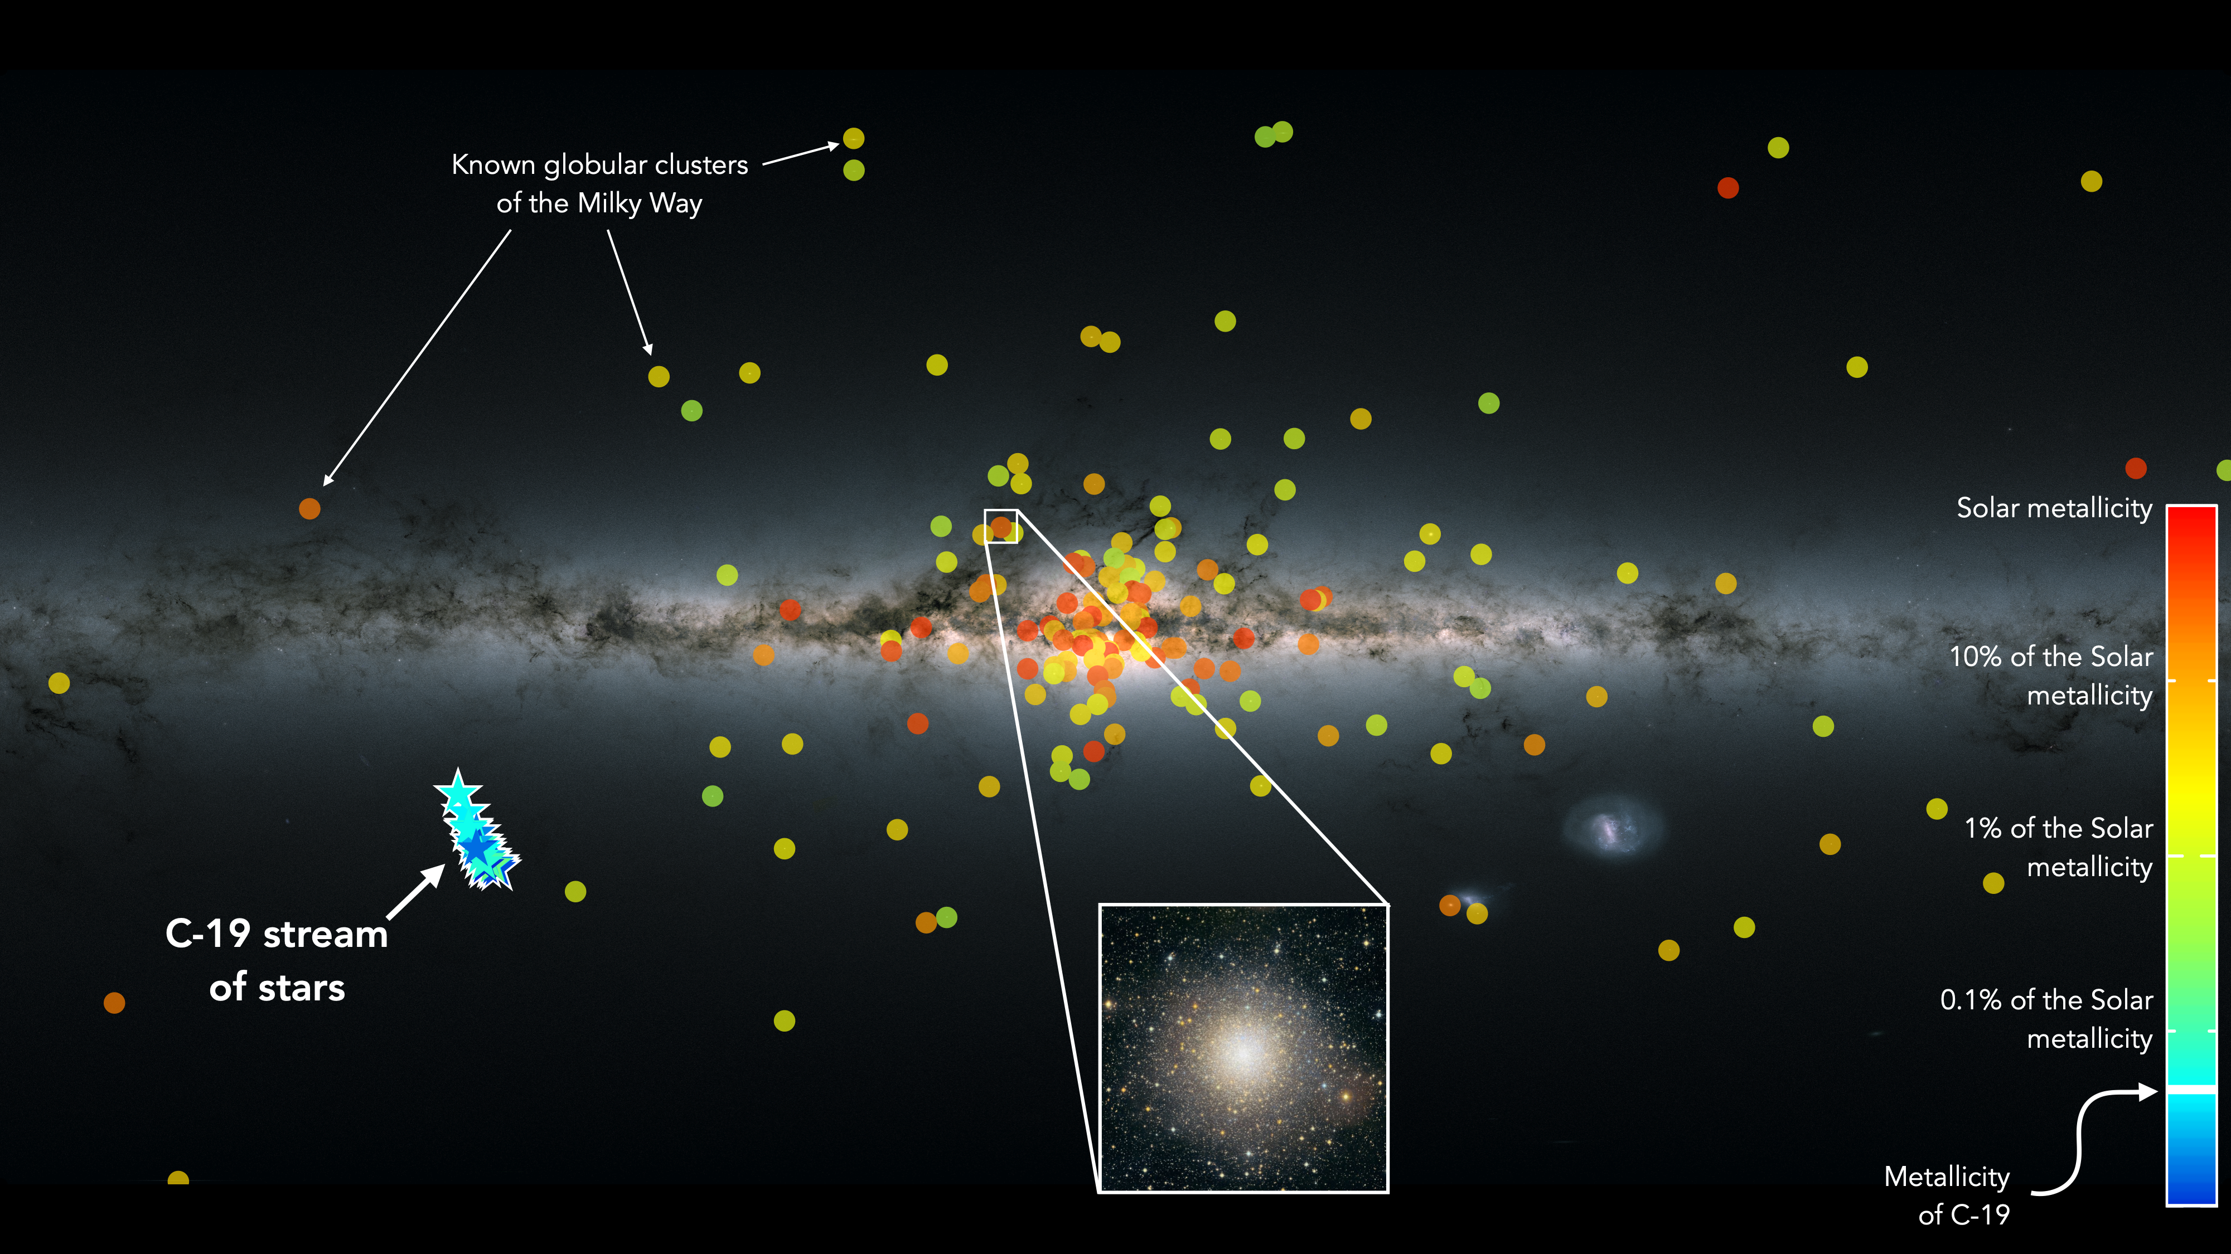
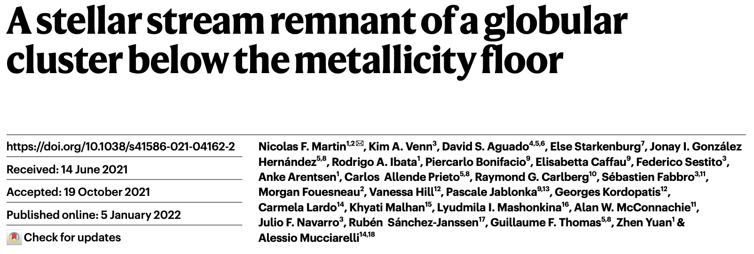
Will we find more of these?
Martin et al. (2022a, Nature 601, 45)
Martin, Venn, Aguado, Starkenburg et al., 2022

Slide 21
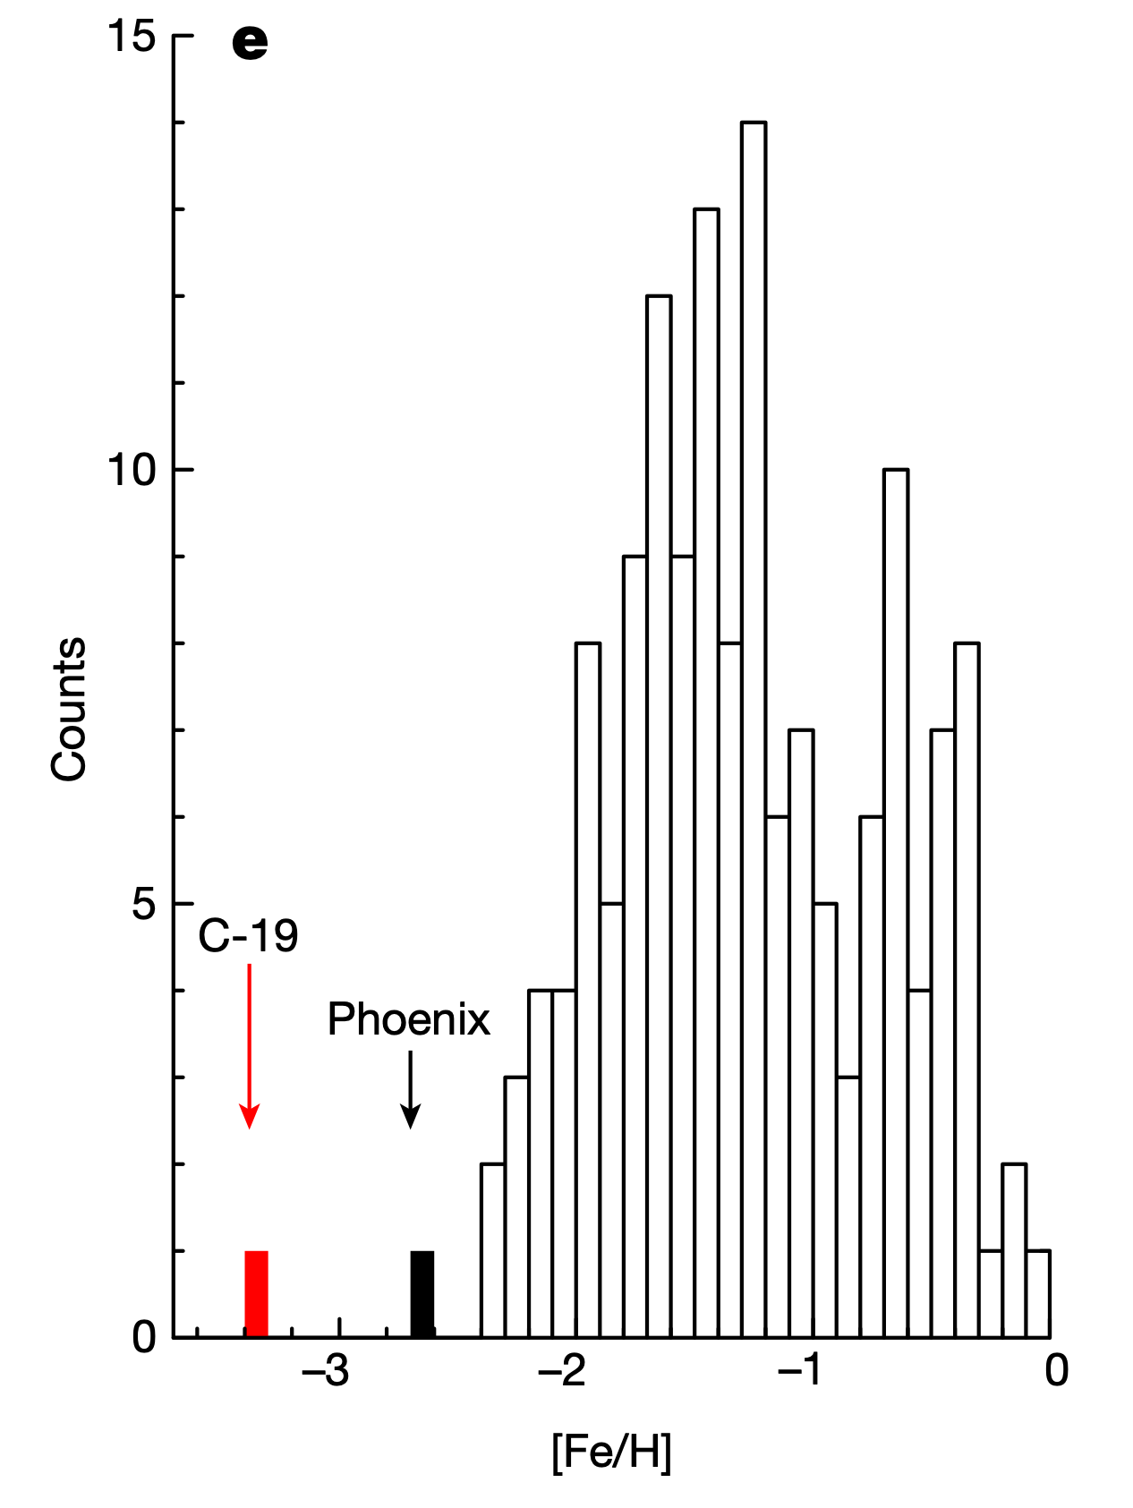
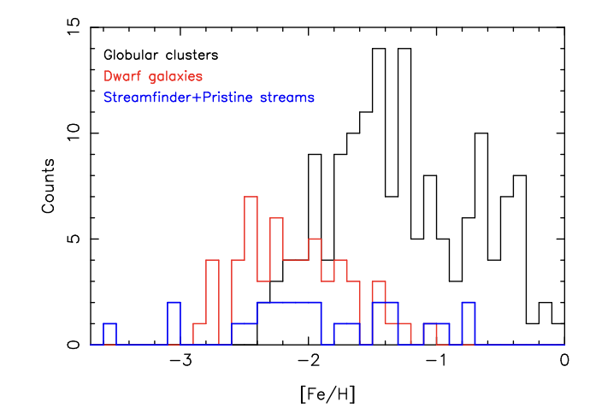
Will we find more of these?
Martin, Ibata, Starkenburg et al., 2022
Martin, Venn, Aguado, Starkenburg et al., 2022

Slide 22
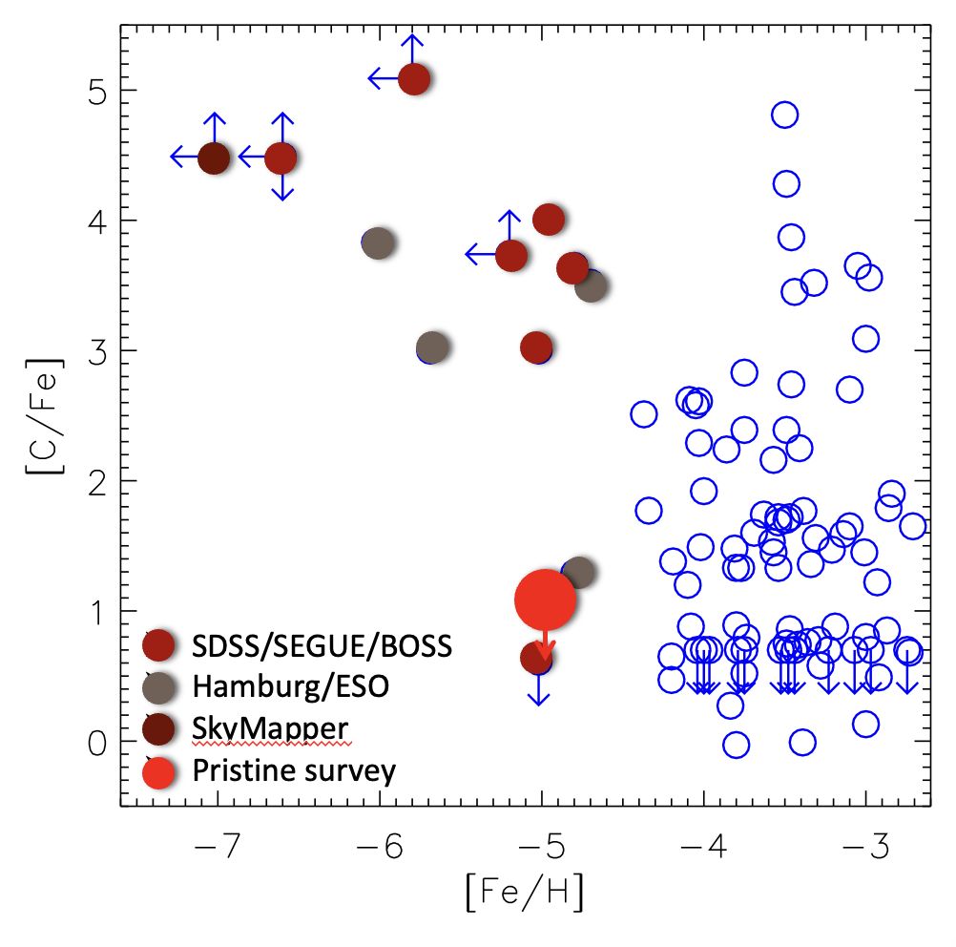
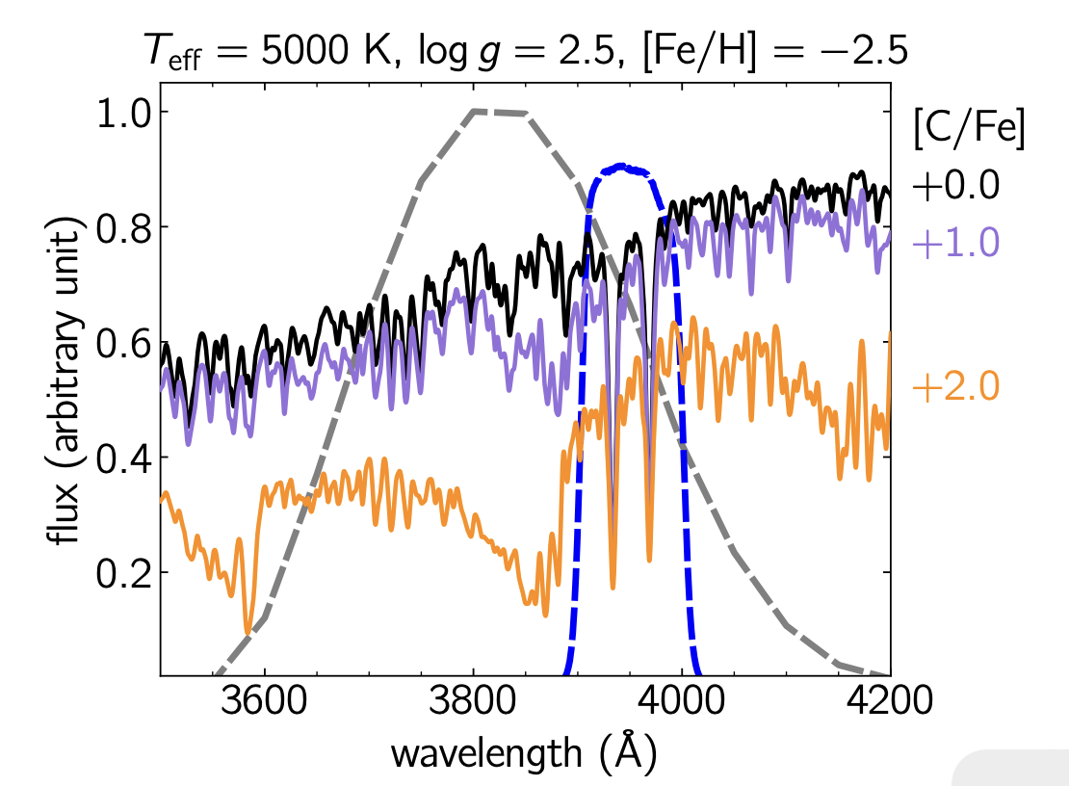
What are we missing?
[C/Fe]
[Fe/H]
Literature compilation from Aguado et al., 2017 & 2018 + Starkenburg et al., 2018, Nordlander et al., 2019
Arentsen, Starkenburg et al., 2021

Slide 23
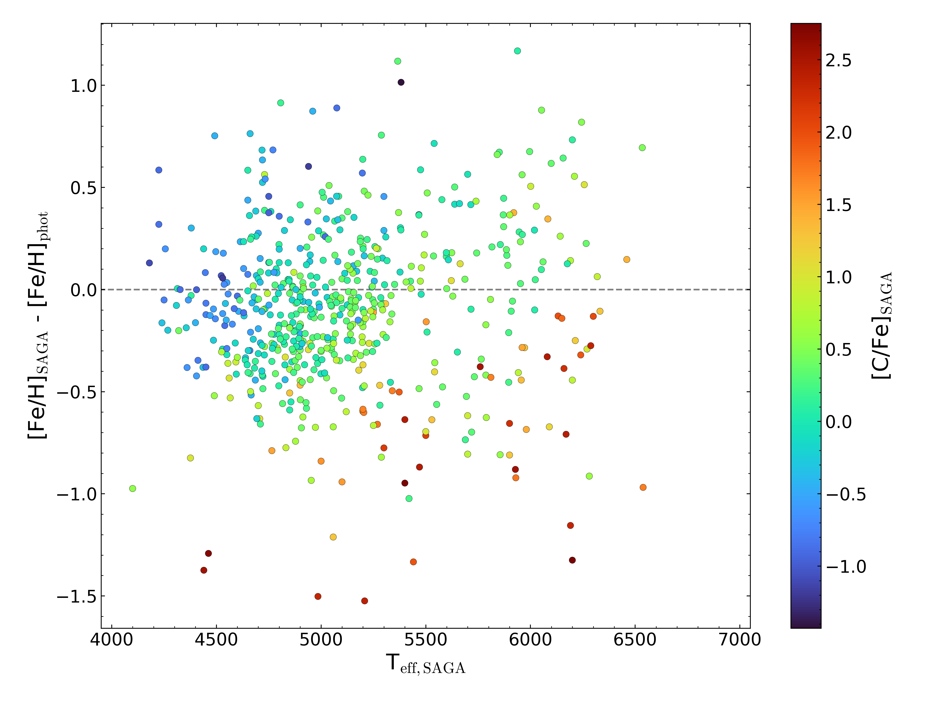

What are we missing?
We know we are missing the most extreme carbon-rich and cool stars
A more careful selection of targets using a much wider wavelength range is needed
[Fe/H]high-res - [Fe/H]phot
[C/Fe] high_res
Martin Montelius
Teff high_res (K)

Slide 24
Getting ready for the future …
to better study the past
Big Bang
First Stars
Galaxy Evolution
Solar System
Now
Galactic archaeology
Finding these rare stars
The Pristine survey
SkyMapper survey
Gaia BPRP spectra
Pushing earlier
Extremely metal-poor stars
WEAVE
4MOST
Pushing farther
With red giants
BHB stars
Carbon-rich stars

Slide 27
Spectroscopic follow-up of stars with -2.8 < [Fe/H] < -2.0:
The chemical pattern of the stars studied is very similar, more similar (from the Median Absolute Deviation) than random halo samples at the same metallicity
They are consistent with the accreted population in [Mg/Mn]-[Al/Fe] space
(Sestito & Fernandez-Alvar et al., in prep.)

