Slide 1
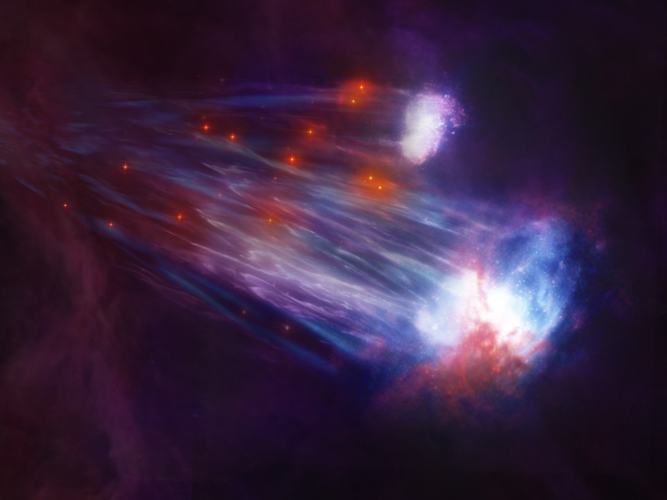
Unveiling the Galactic Horizons: From the Heart to the Halo
Vedant Chandra
May 27, 2024
The Magellanic Stellar Stream, by Melissa Weiss

Slide 2
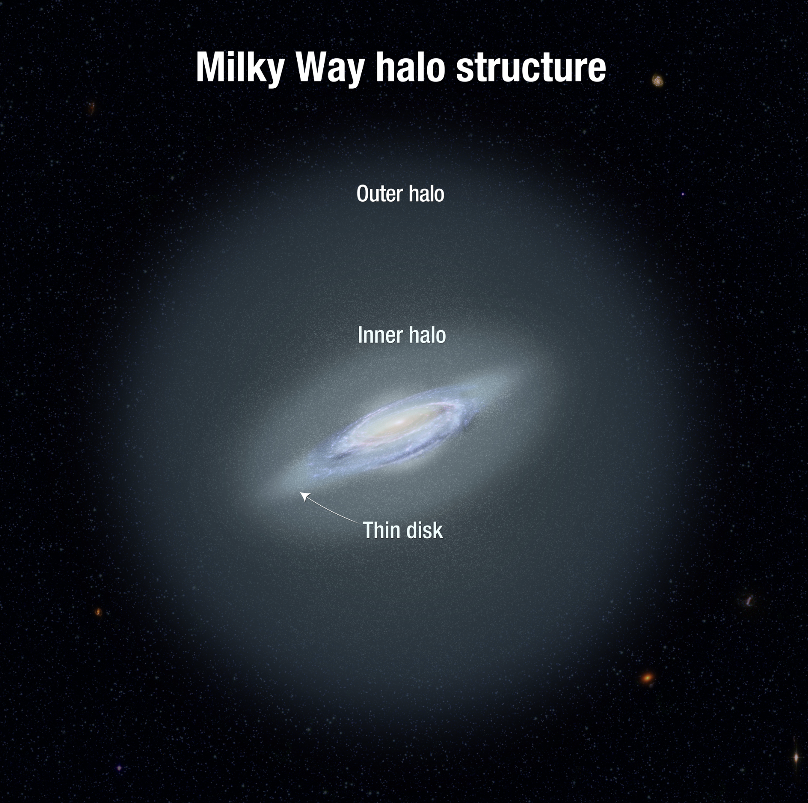
Outline
The Formation and Evolution of our Galaxy from Gaia
Tales from the Galactic Outskirts
Echoes of our Last Major Merger
The Magellanic Stellar Stream
The Dynamical Response to the Large Magellanic Cloud (LMC)
A. Feild

Slide 3
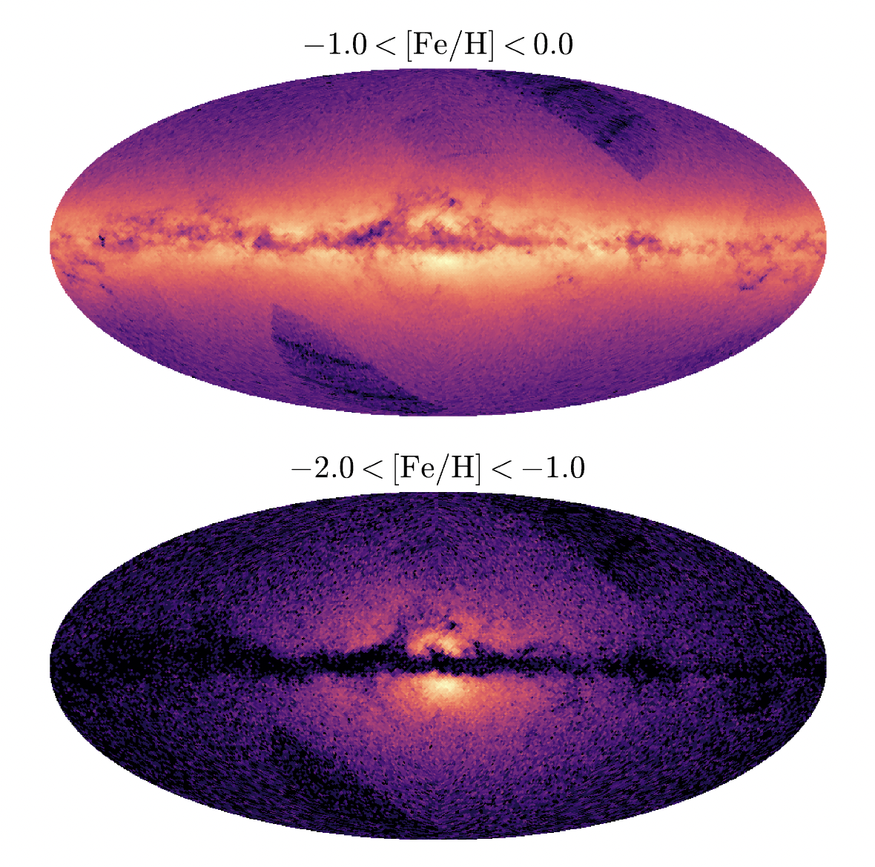
The Heart of the Milky Way
Gaia XP metallicities revealed the ‘poor old heart’ of the MW in its entirety
See talks by Rix, Ardern-Arentsen, and Horta
Rix, Chandra+22
Chandra+24a

Slide 4
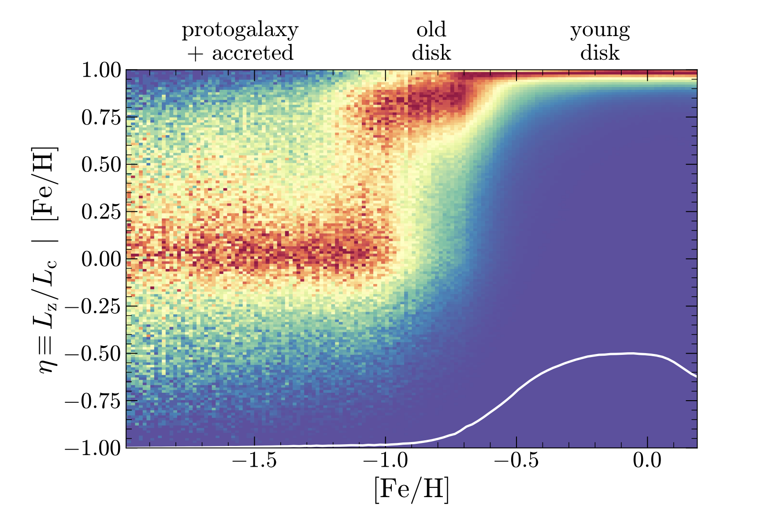
The Birth of the Disk(s)
Gaia metallicities + RVs map the angular momentum evolution of the Galaxy over cosmic time → interpret with Illustris-TNG50
See talk by Rix tomorrow morning
Belokurov+22
Conroy+22
Semenov+23a,b
Chandra+24a

Slide 5
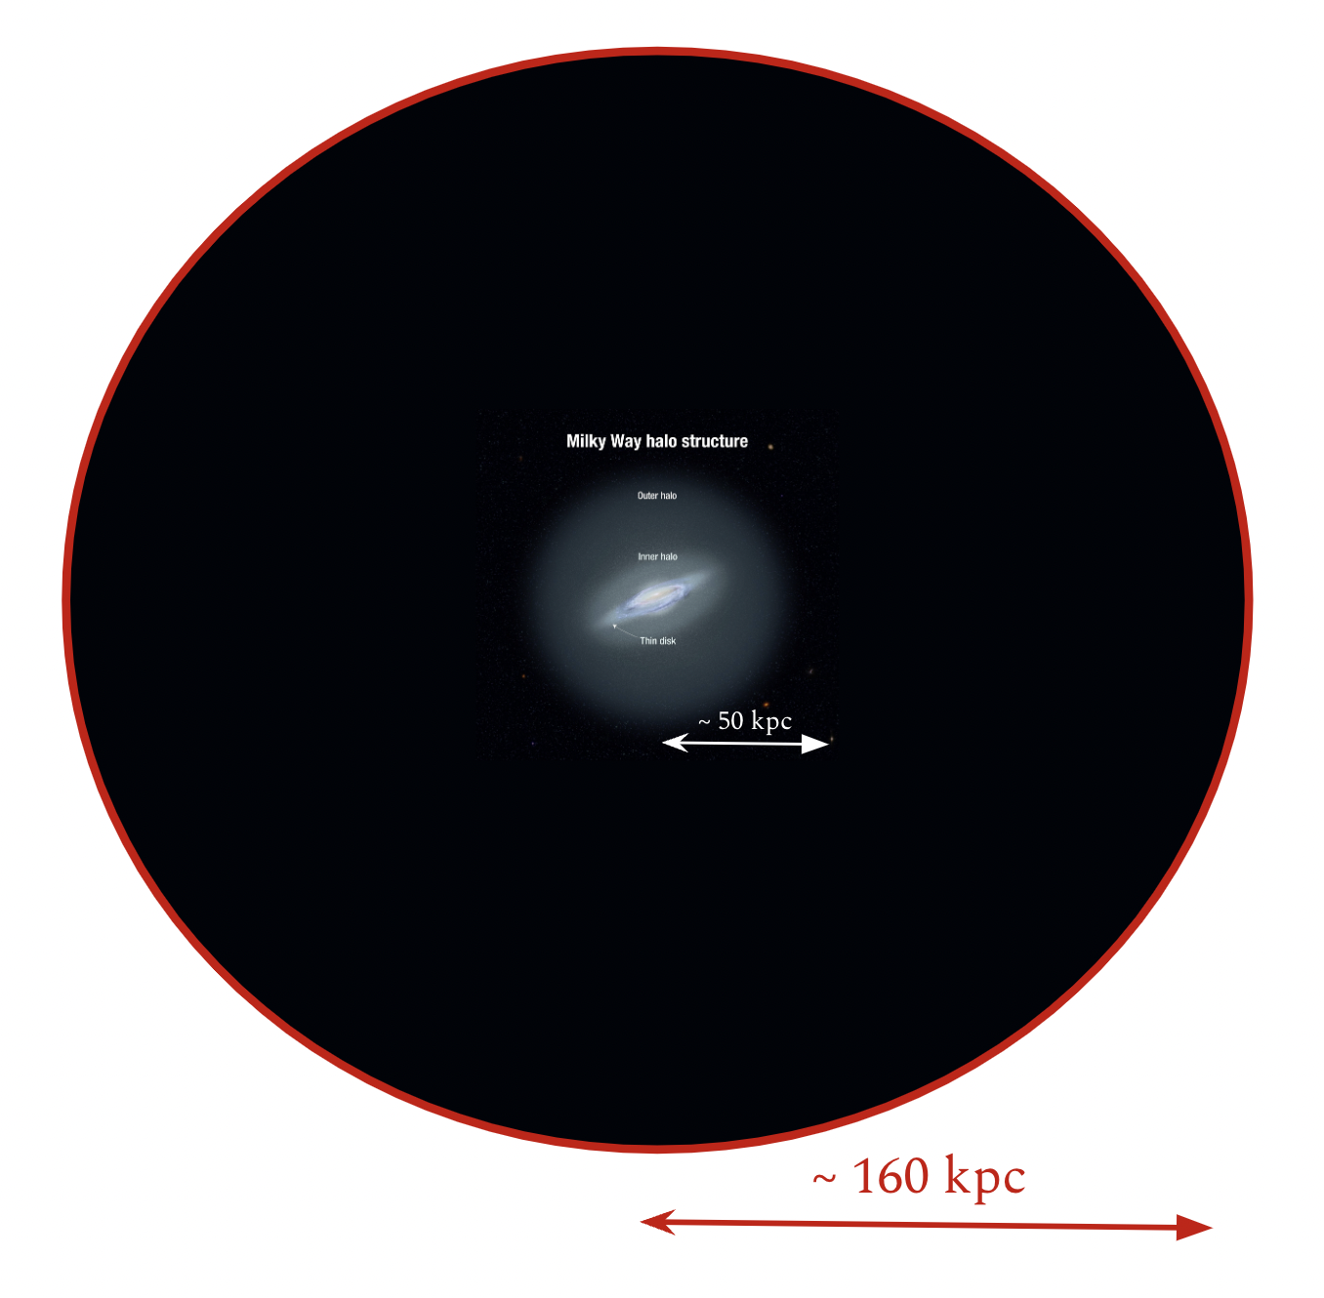
The Goal:
Growing the ‘outer halo’ horizon to 100 kpc and beyond

Slide 6
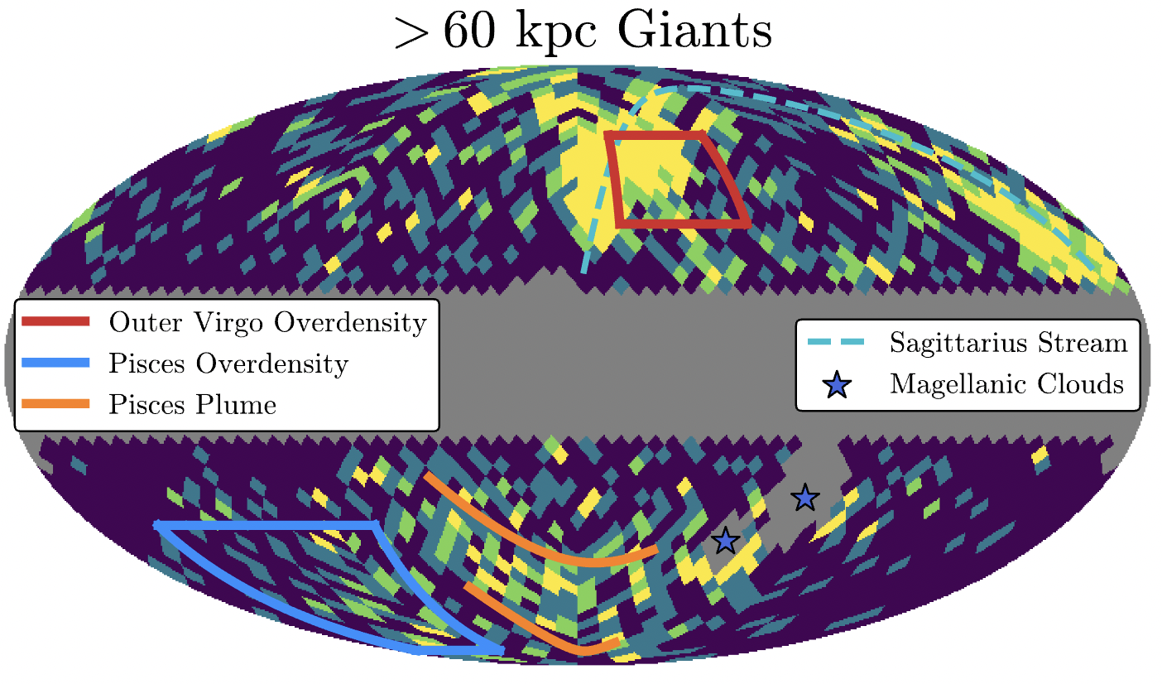
Towards the Galactic Outskirts with RGB Stars
A parallax + color selection to unveil the halo out to ~150 kpc
Majewski+03; Conroy+18
Chandra+23a,b

Slide 7
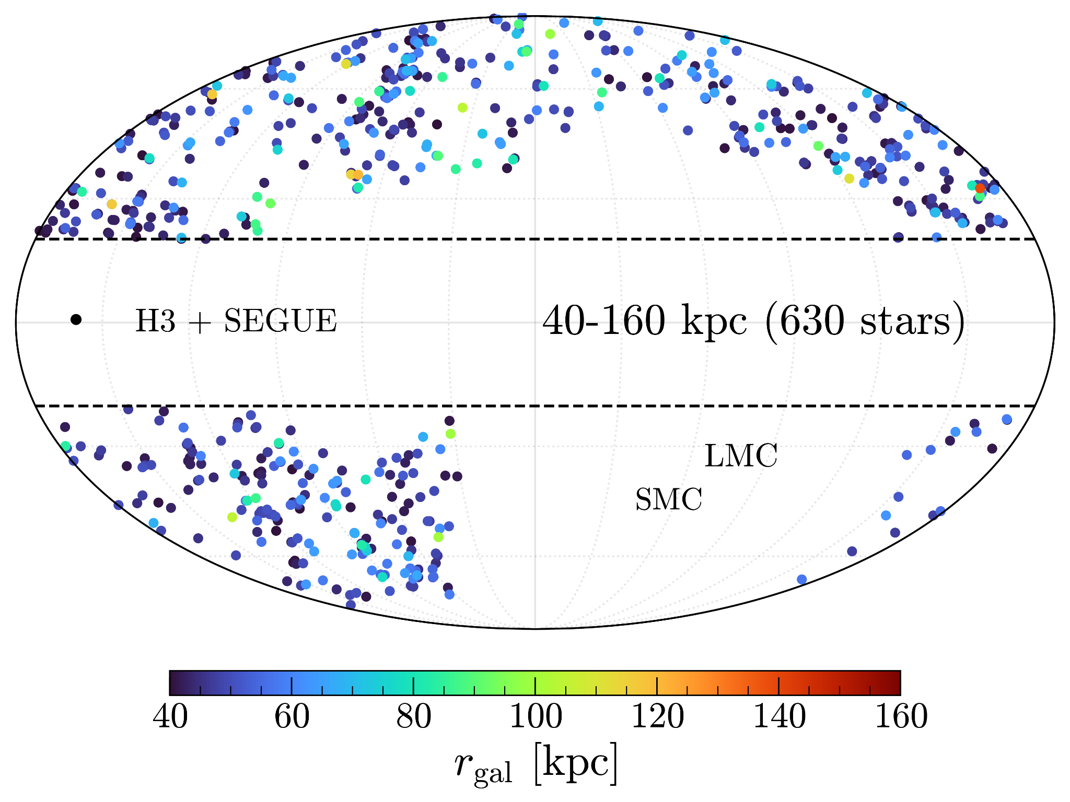
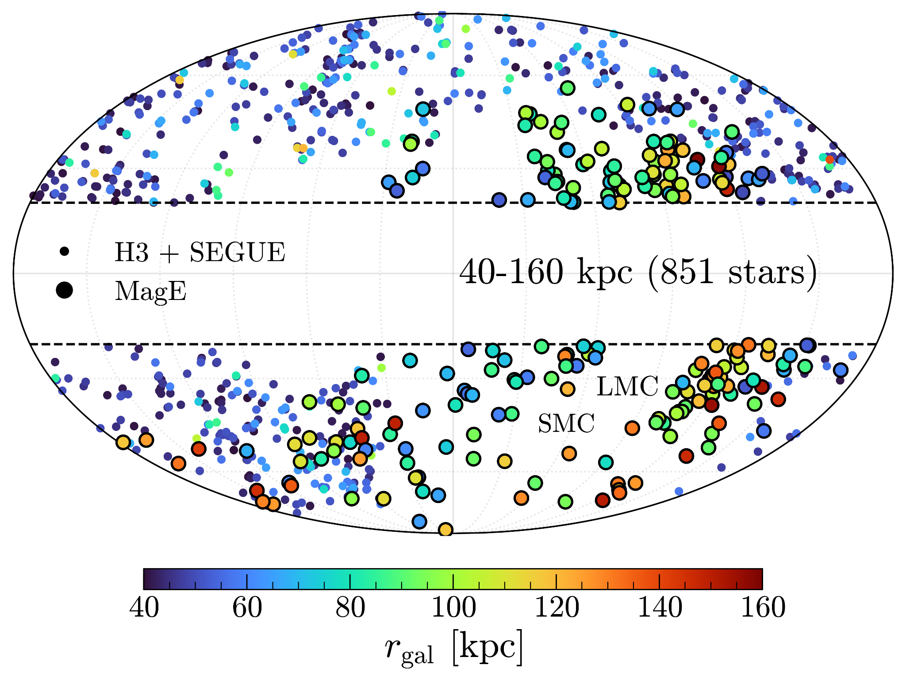
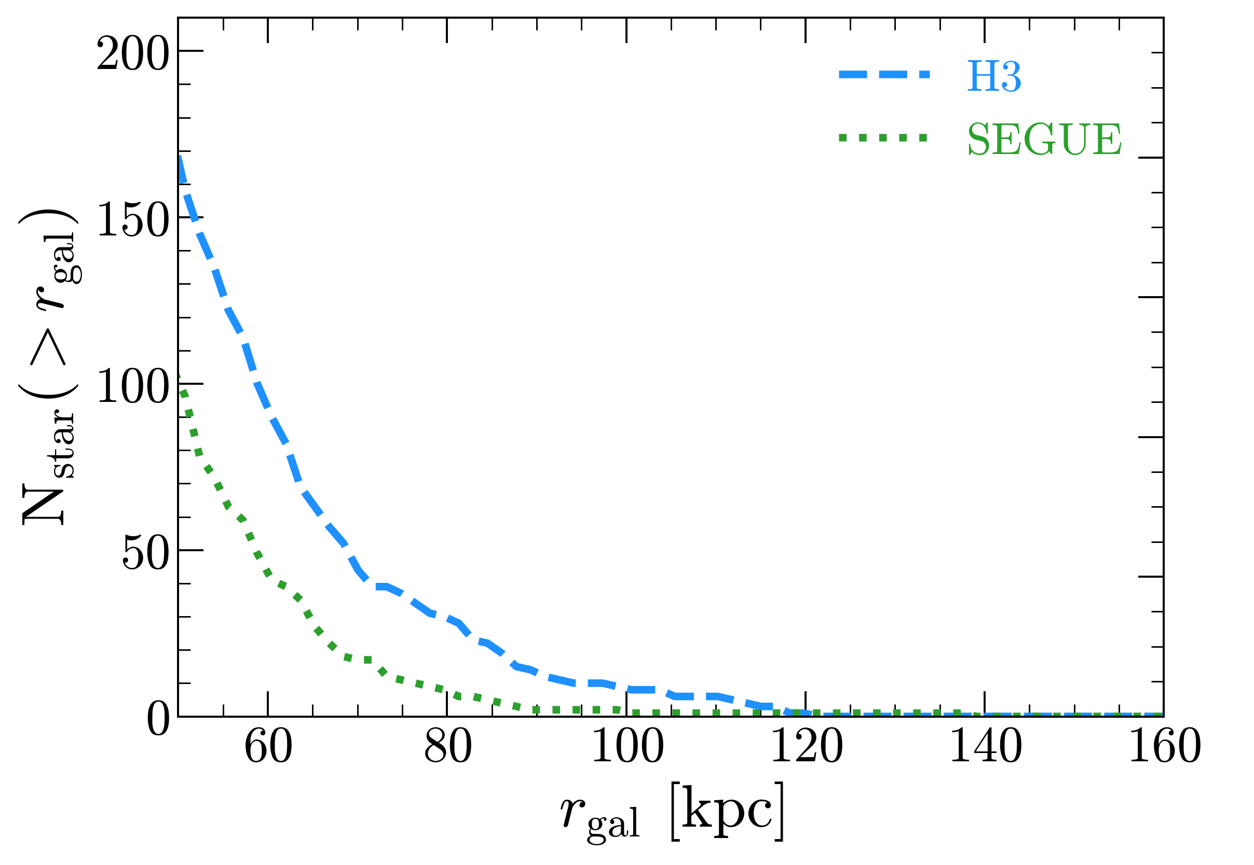
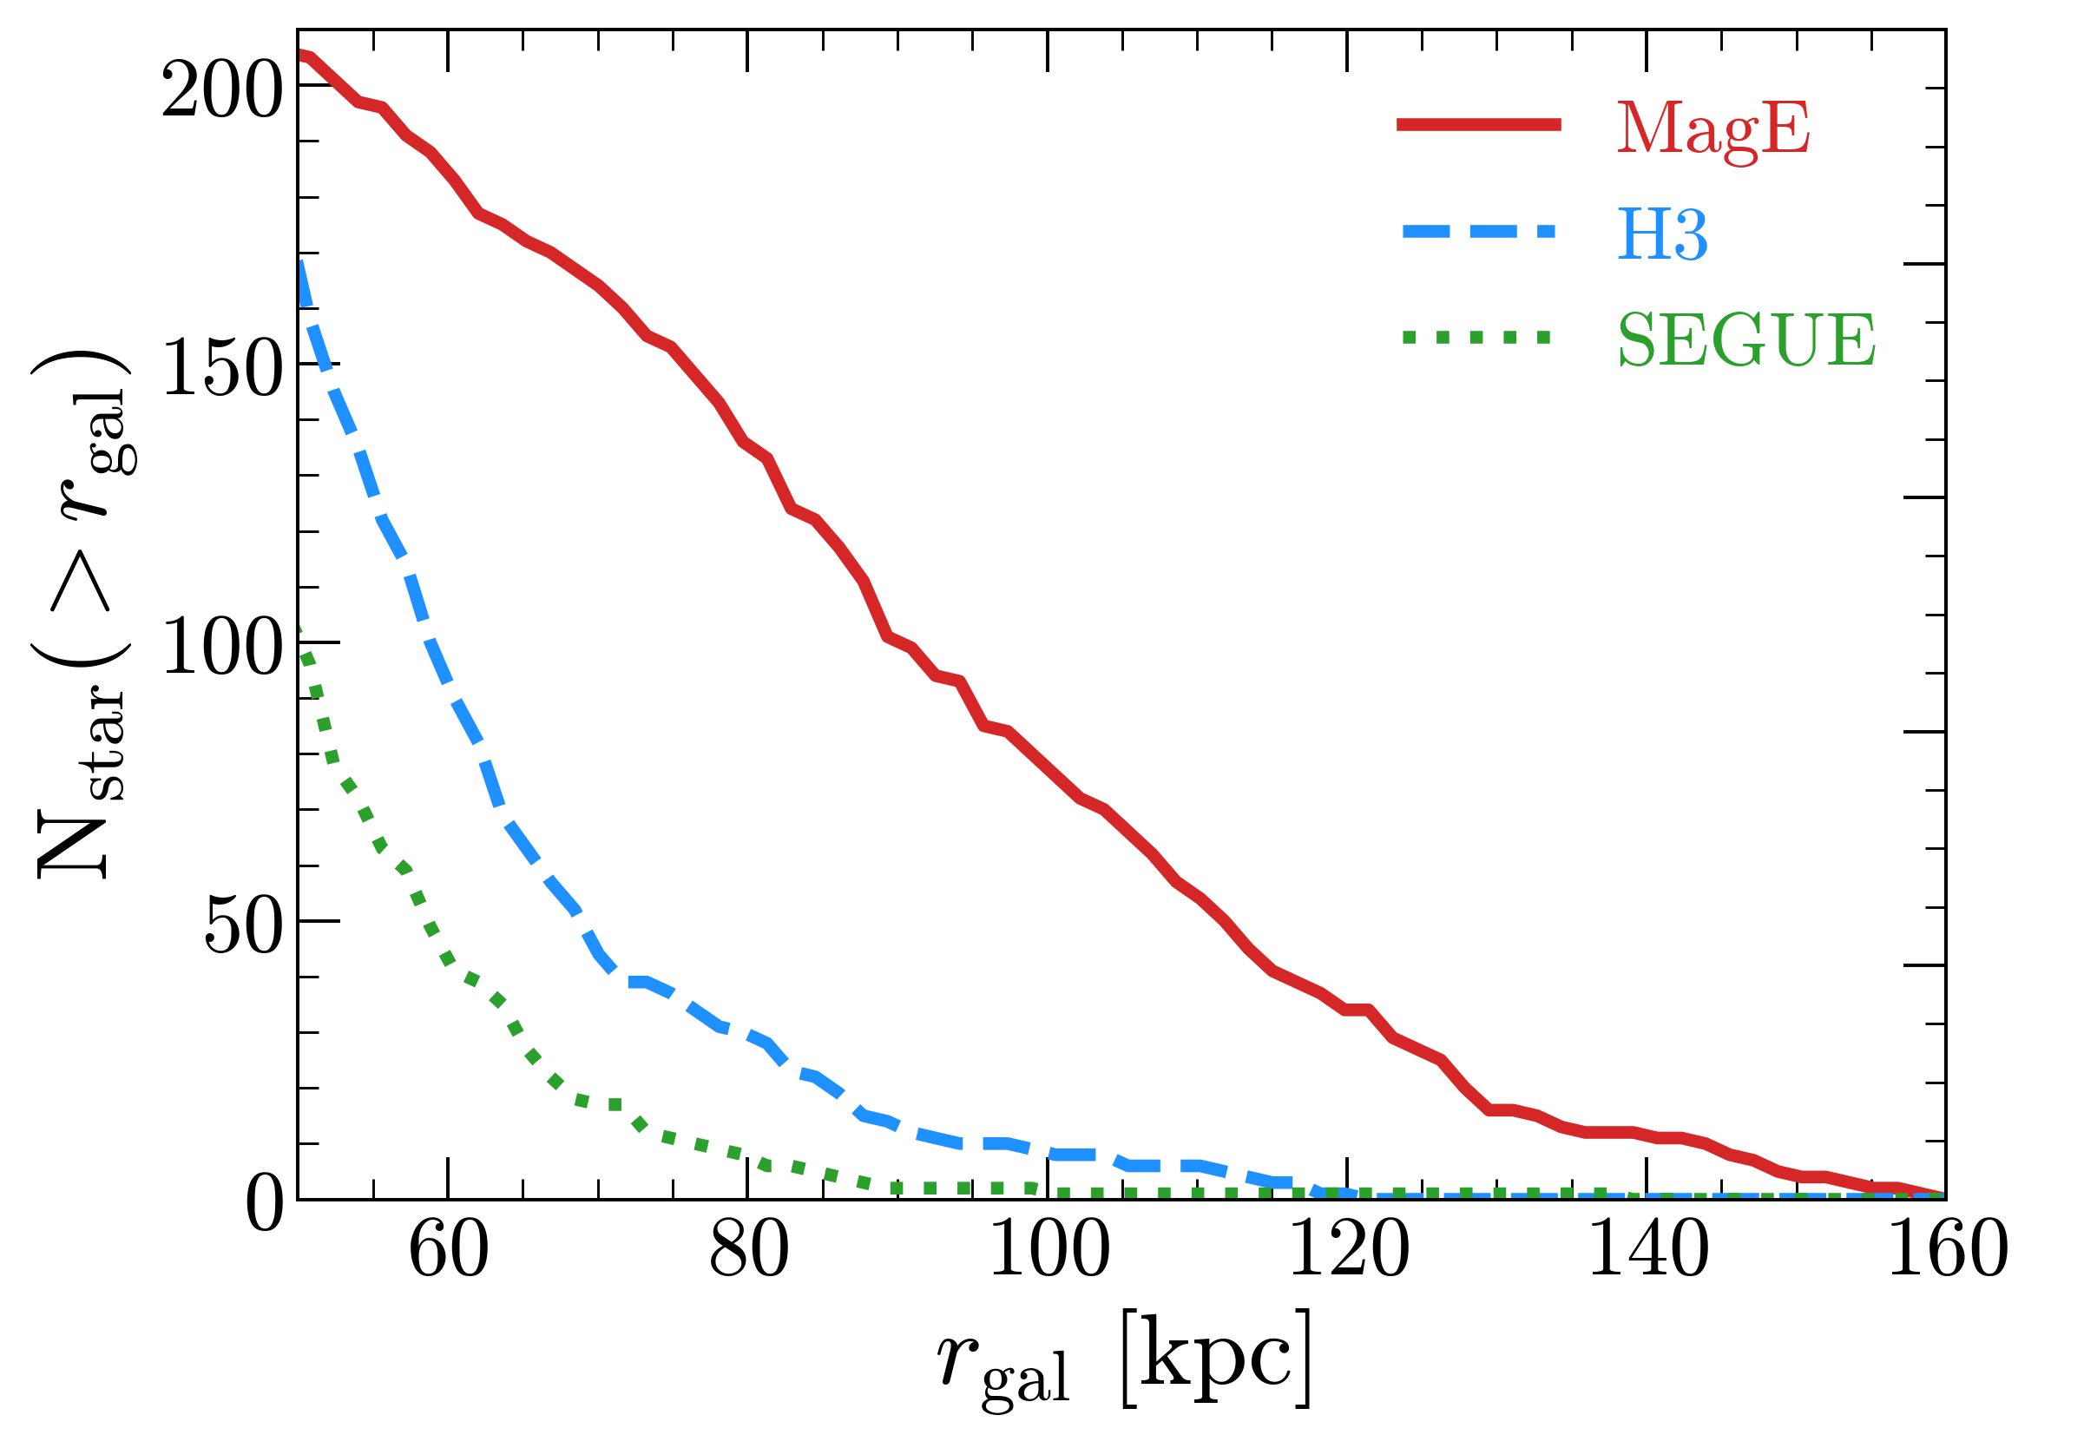
The MagE Outer Halo Survey
Filling the southern gap with Magellan/MagE spectroscopy Distance – RV – [Fe/H] – [𝛼/Fe] > 100 stars beyond 100 kpc | > 250 stars beyond 50 kpc
with R. Naidu (MIT)

Slide 8
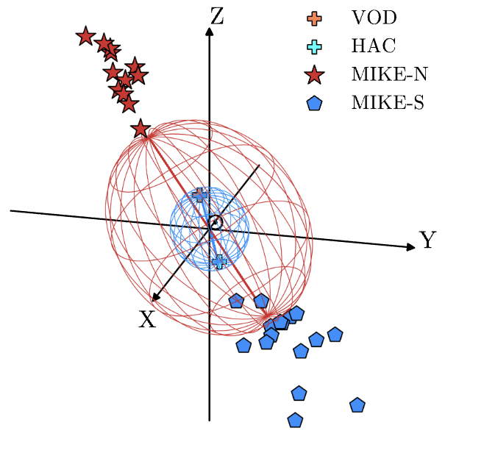
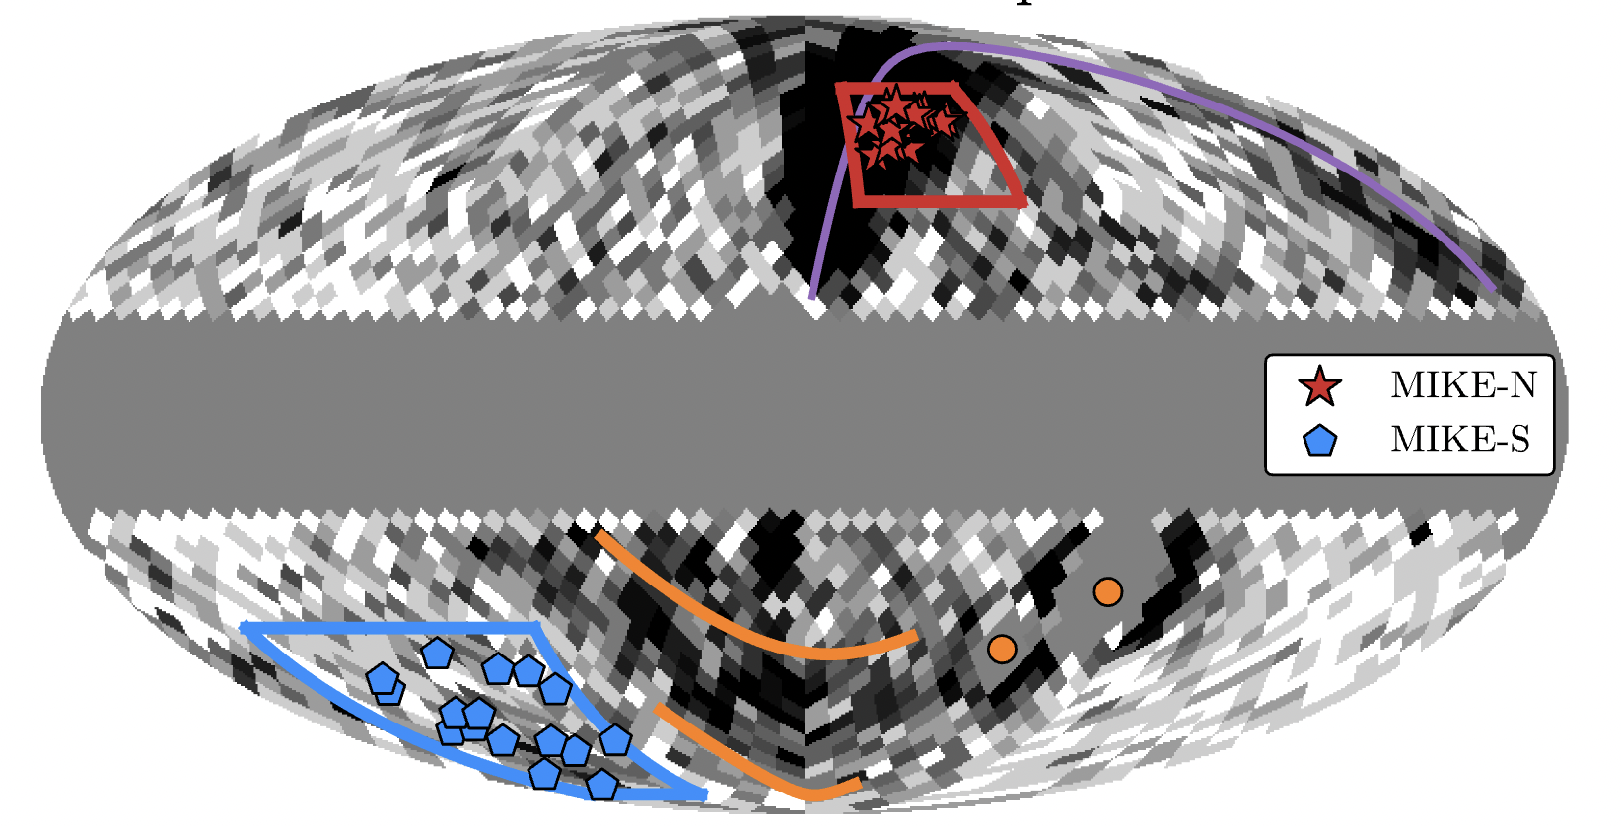
Distant Echoes of the Last Major Merger
The Outer Virgo and Pisces overdensities have retrograde orbits
→ Early-stripped debris from the Gaia-Sausage-Enceladus merger?
Naidu20,21; see Belokurov+23a
Chandra+23a

Slide 9
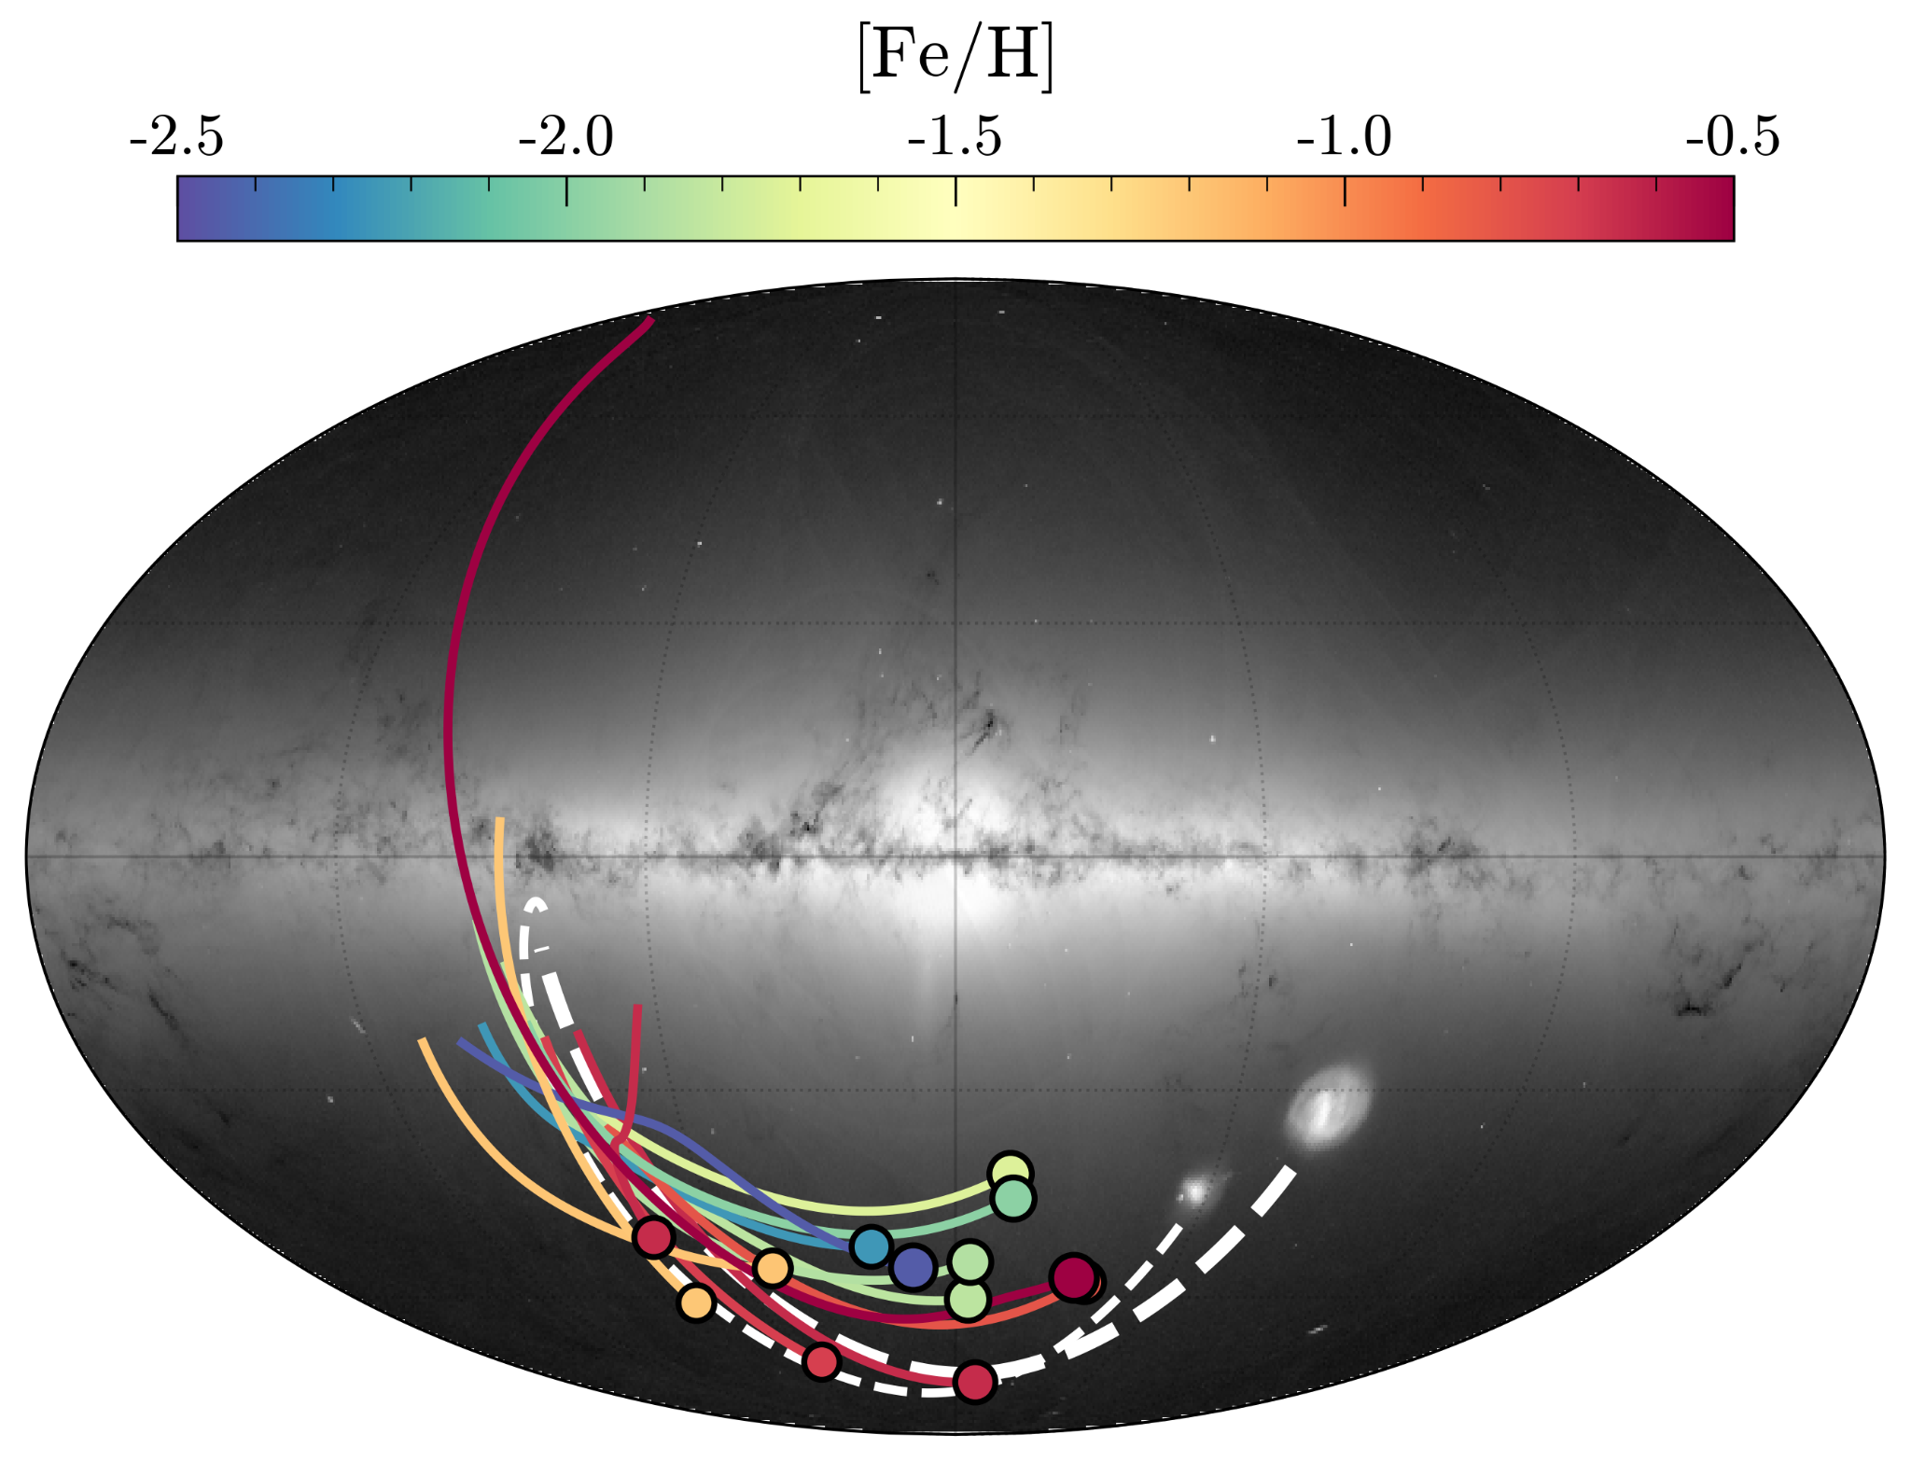
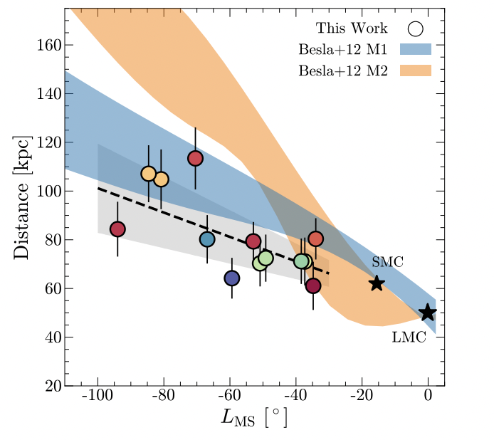
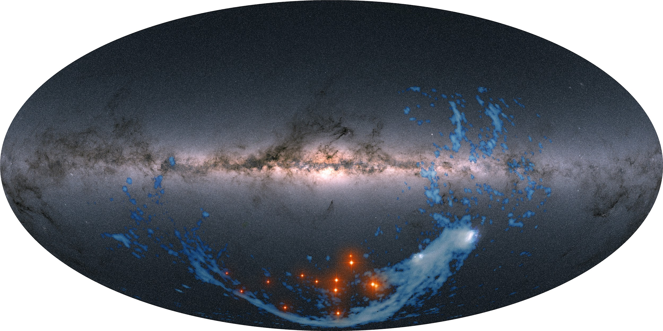
The Magellanic Stellar Stream
13 stars with orbits and abundances matching the Clouds
100° long stellar counterpart to the gaseous Magellanic Stream
see also Belokurov+16; Zaritsky+20
Chandra+23b

Slide 10
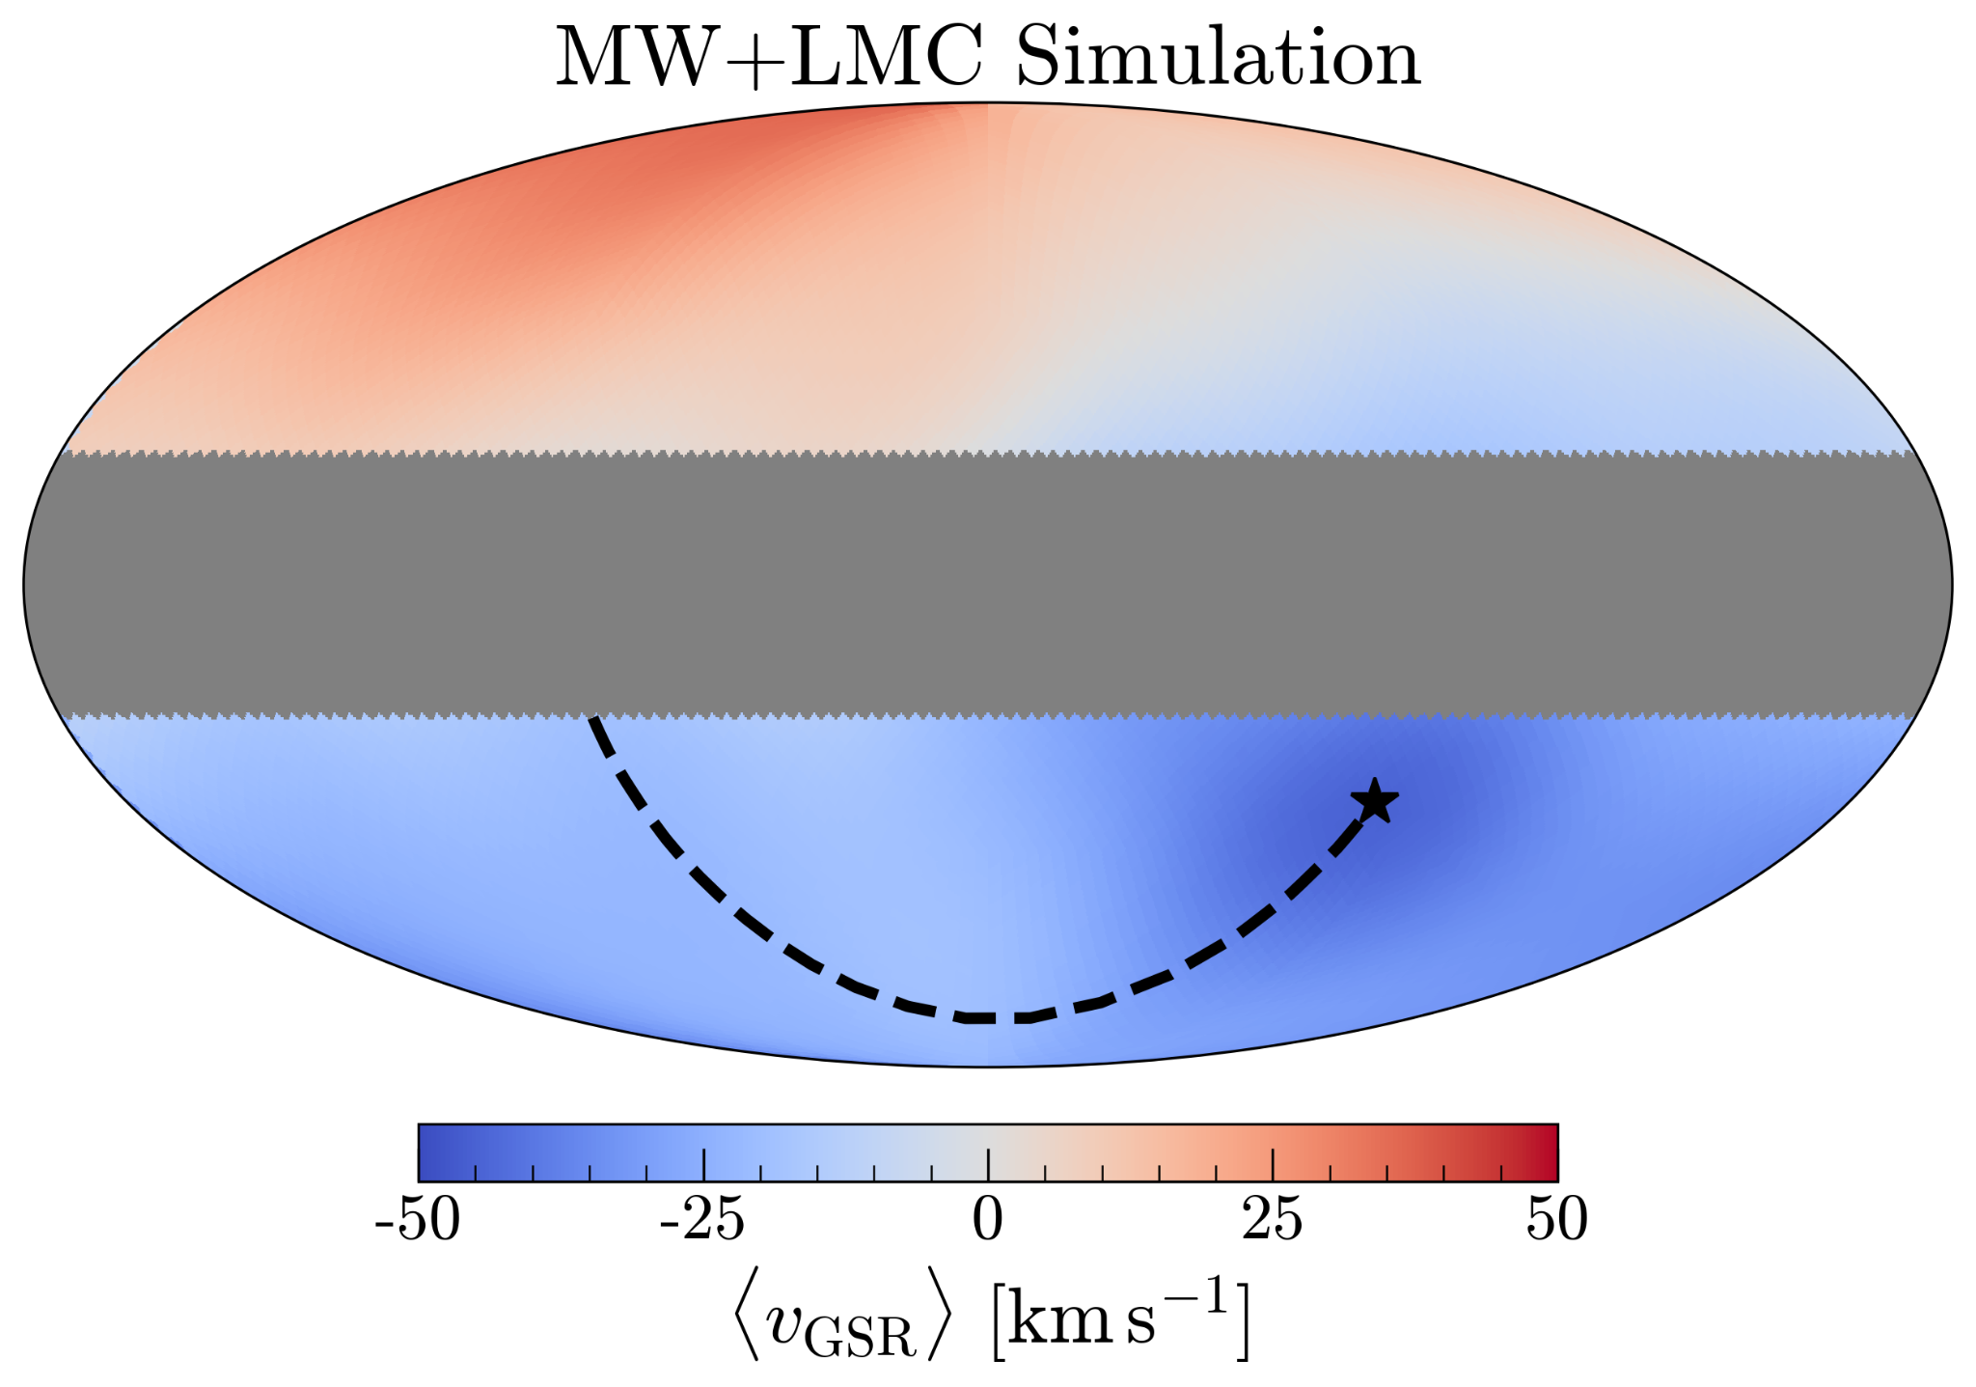
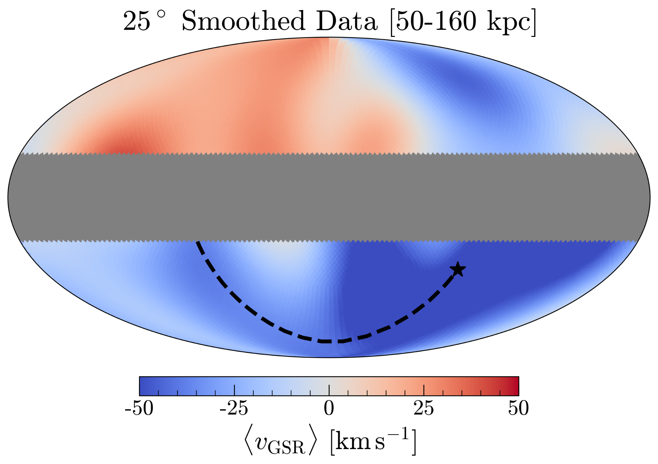
The LMC’s Influence on the MW
If the LMC is massive and on first infall, it pulls at the MW barycenter
imparts a global velocity dipole – reflex velocity – relative to distant halo stars
Garavito-Camargo+19,21
Chandra+24b, in prep

Slide 11
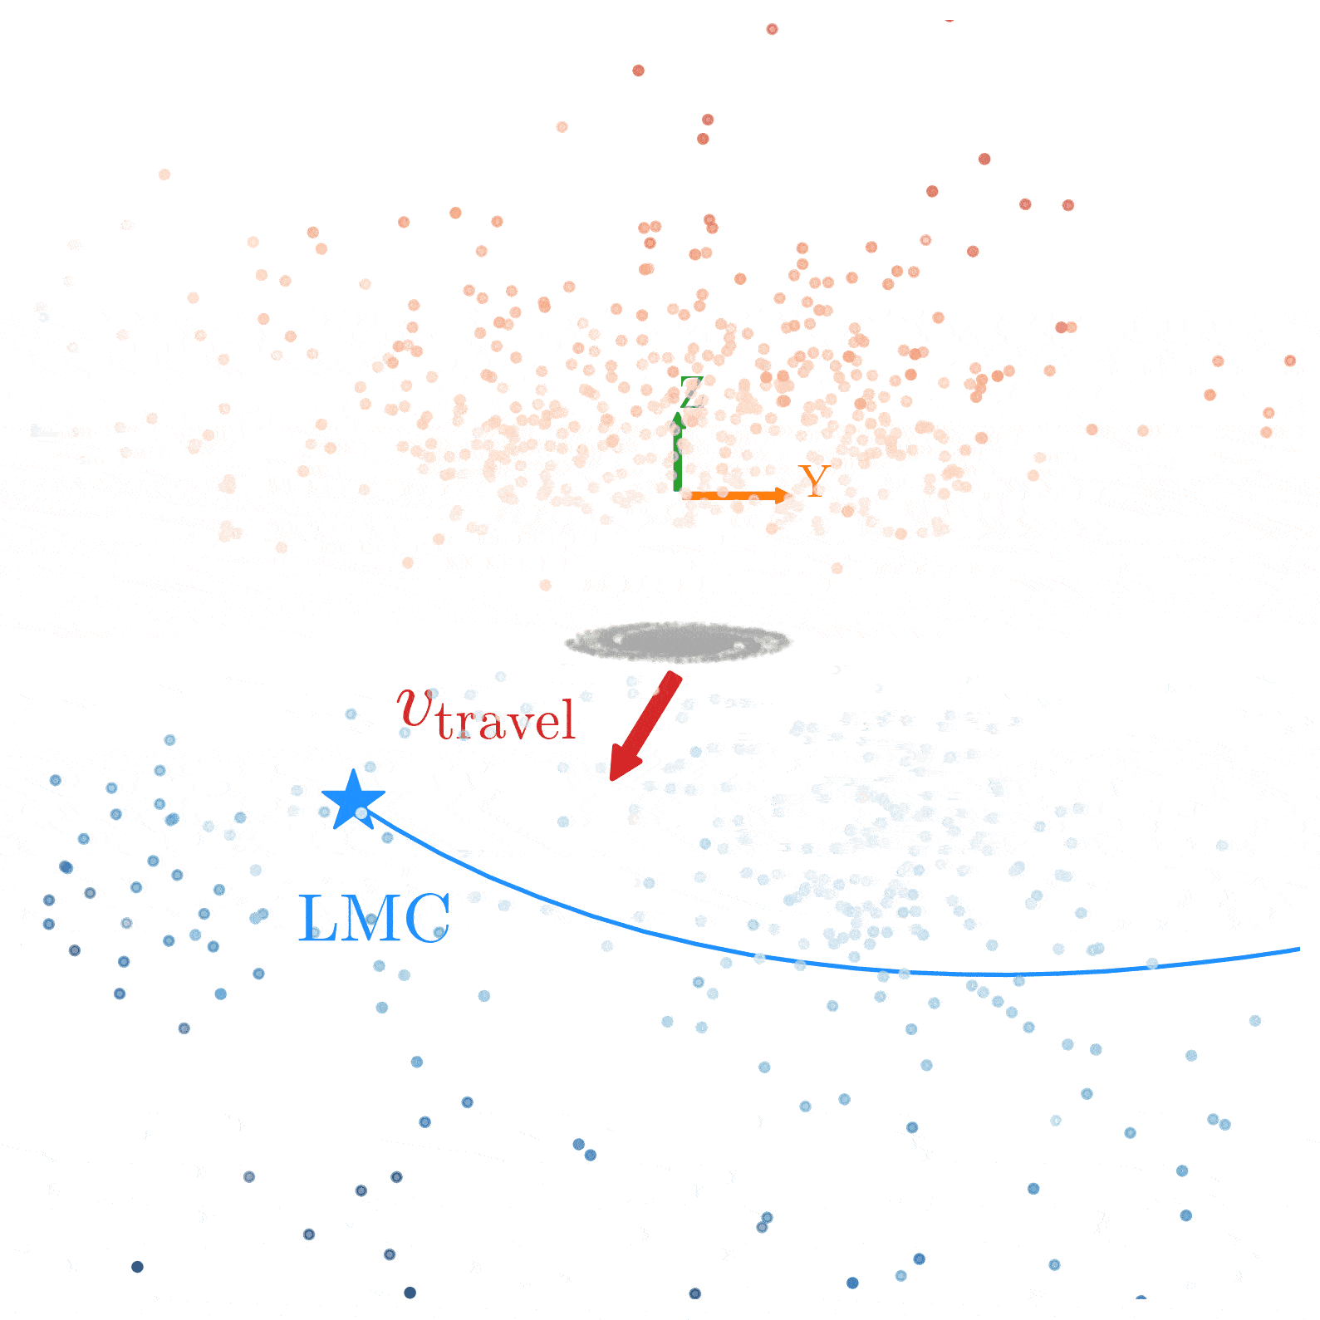
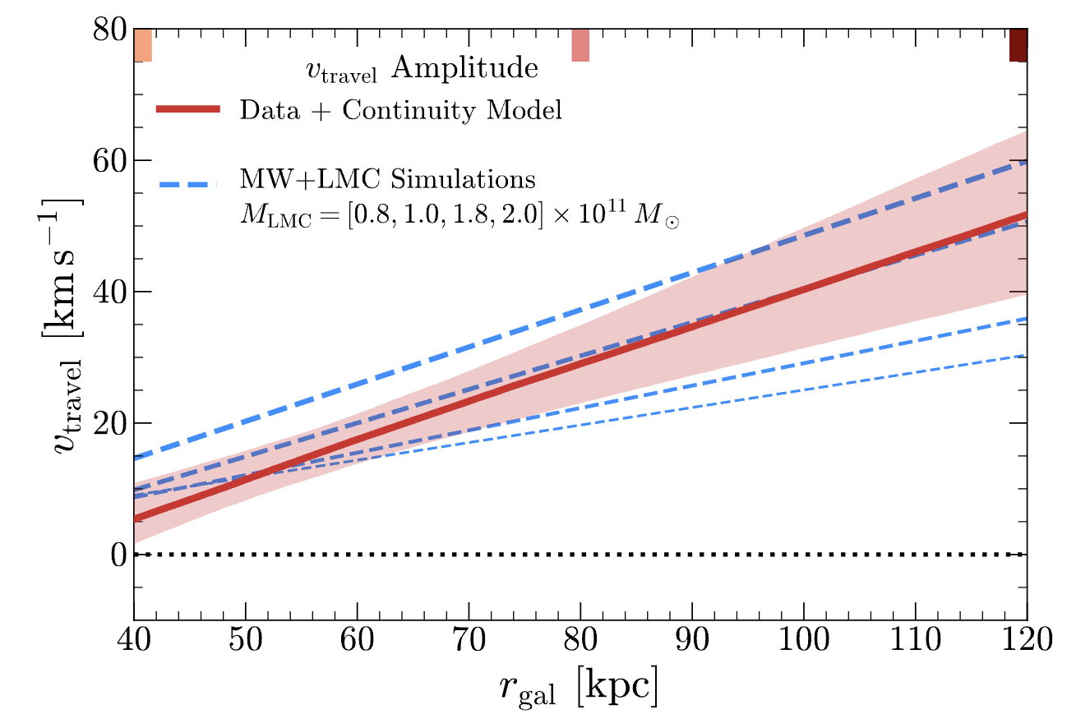
Tomography of the Reflex Velocity
Fit 6D positions + velocities of 850 all-sky giants beyond 40 kpc
MW travel velocity points directly along the past orbit of the LMC, amplitude grows with distance
Suggests a massive > 10¹¹ M☉ LMC
Garavito-Camargo+19,21 Erkal+21; Petersen+21; Yaaqib+24
Chandra+24b, in prep

Slide 12
Summary
Gaia + spectroscopy breaches two horizons of the Milky Way: the heart and the distant halo
Gaia reveals the MW’s evolution from protogalaxy to disks (Rix+22, Chandra+24a)
Our MagE survey fills the southern gap in the outer halo, to 100 kpc and beyond
The Milky Way’s outer halo is coming into focus
Coherent debris from our last major merger from 50-90 kpc (Chandra+23a)
Discovery of the Magellanic Stellar Stream (Chandra+23b)
All-sky reflex response to the infalling LMC (Chandra+24b, coming soon!)

Slide 14
extra slides

Slide 15
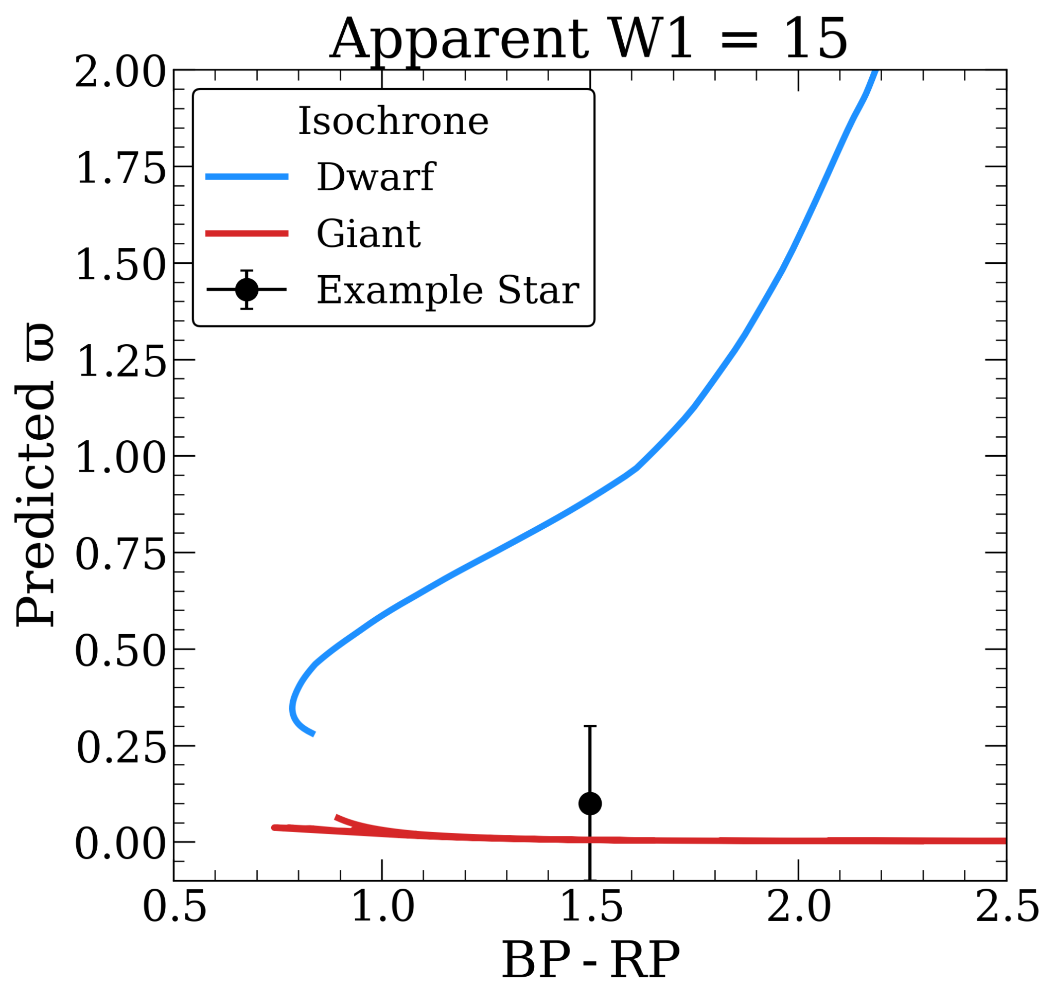
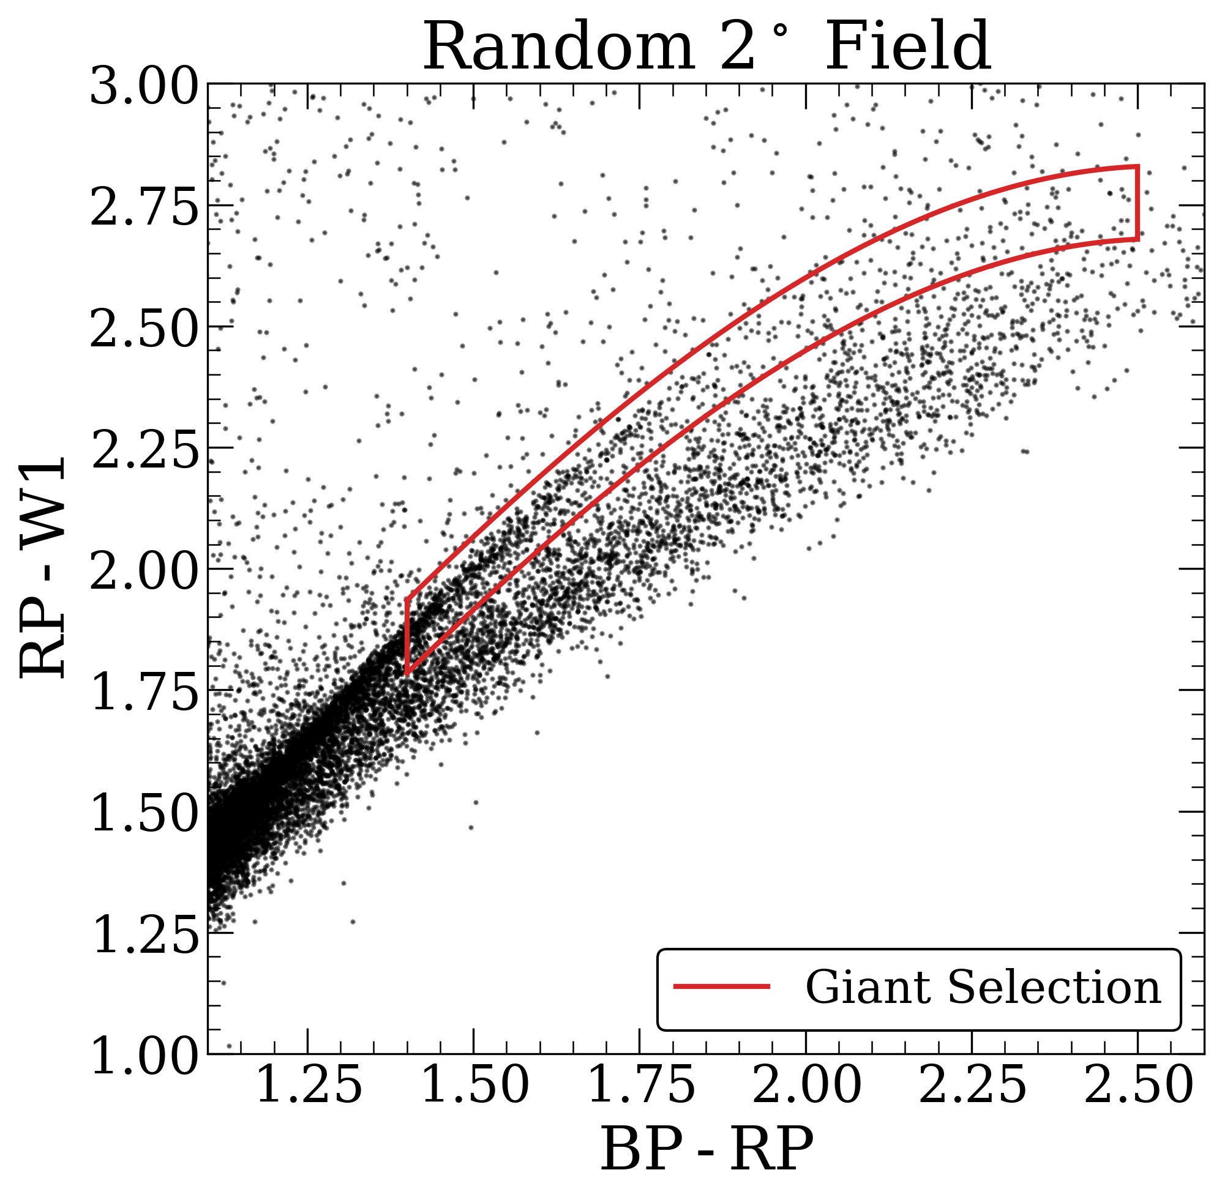
Separating Dwarfs and Giants
2. IR Color-Color
Selection
Gaia Parallax

Slide 16
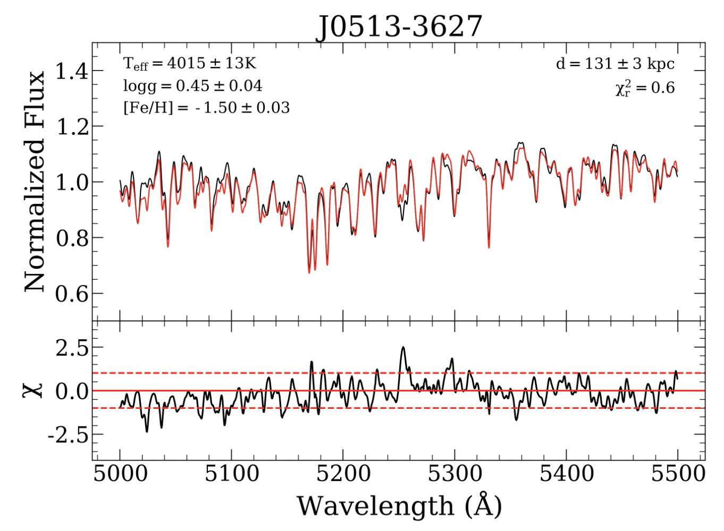
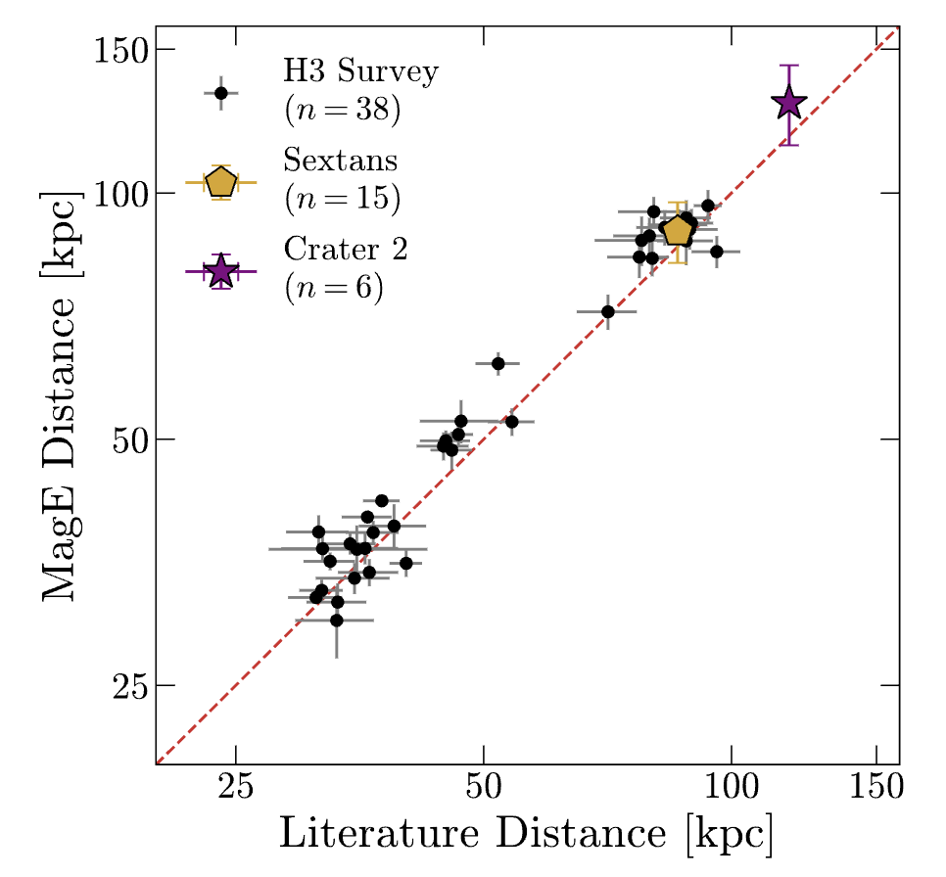
MagE + merlin
+ P. Cargile (CfA))

Slide 17
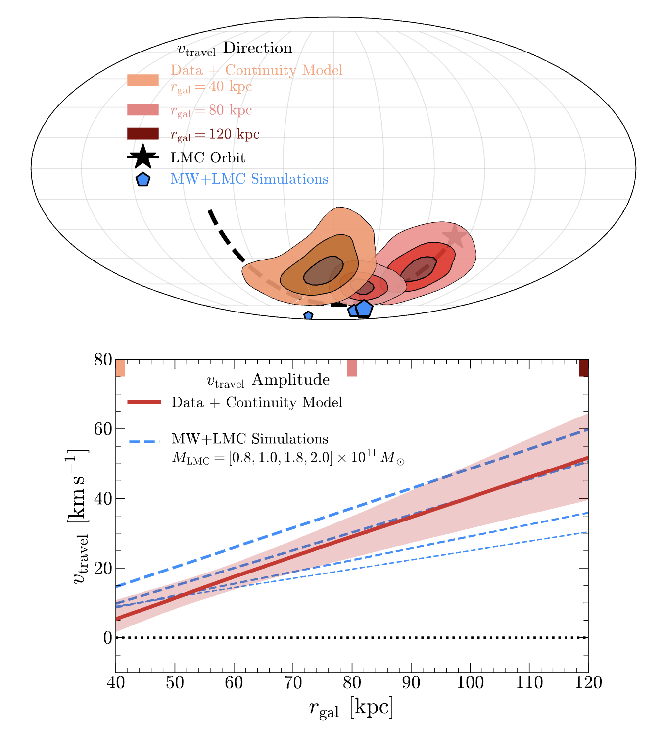

Slide 18
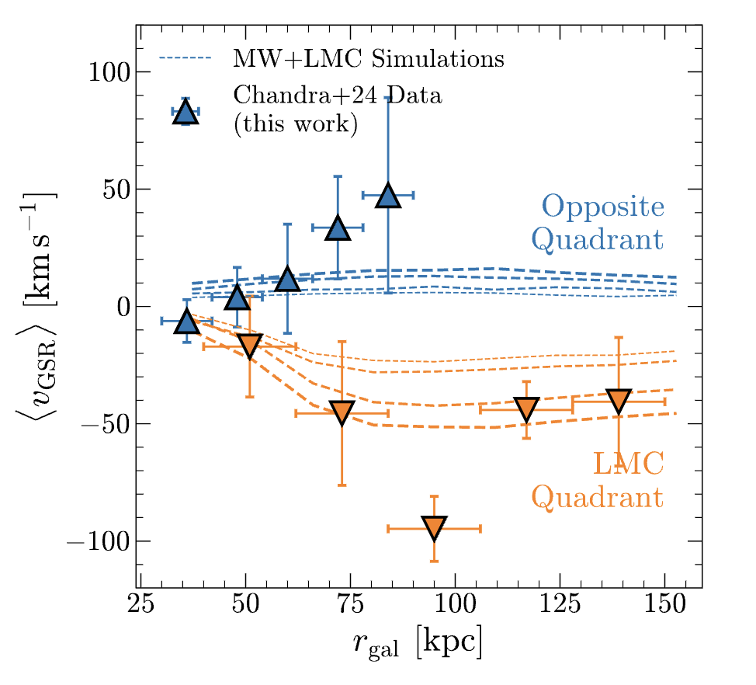
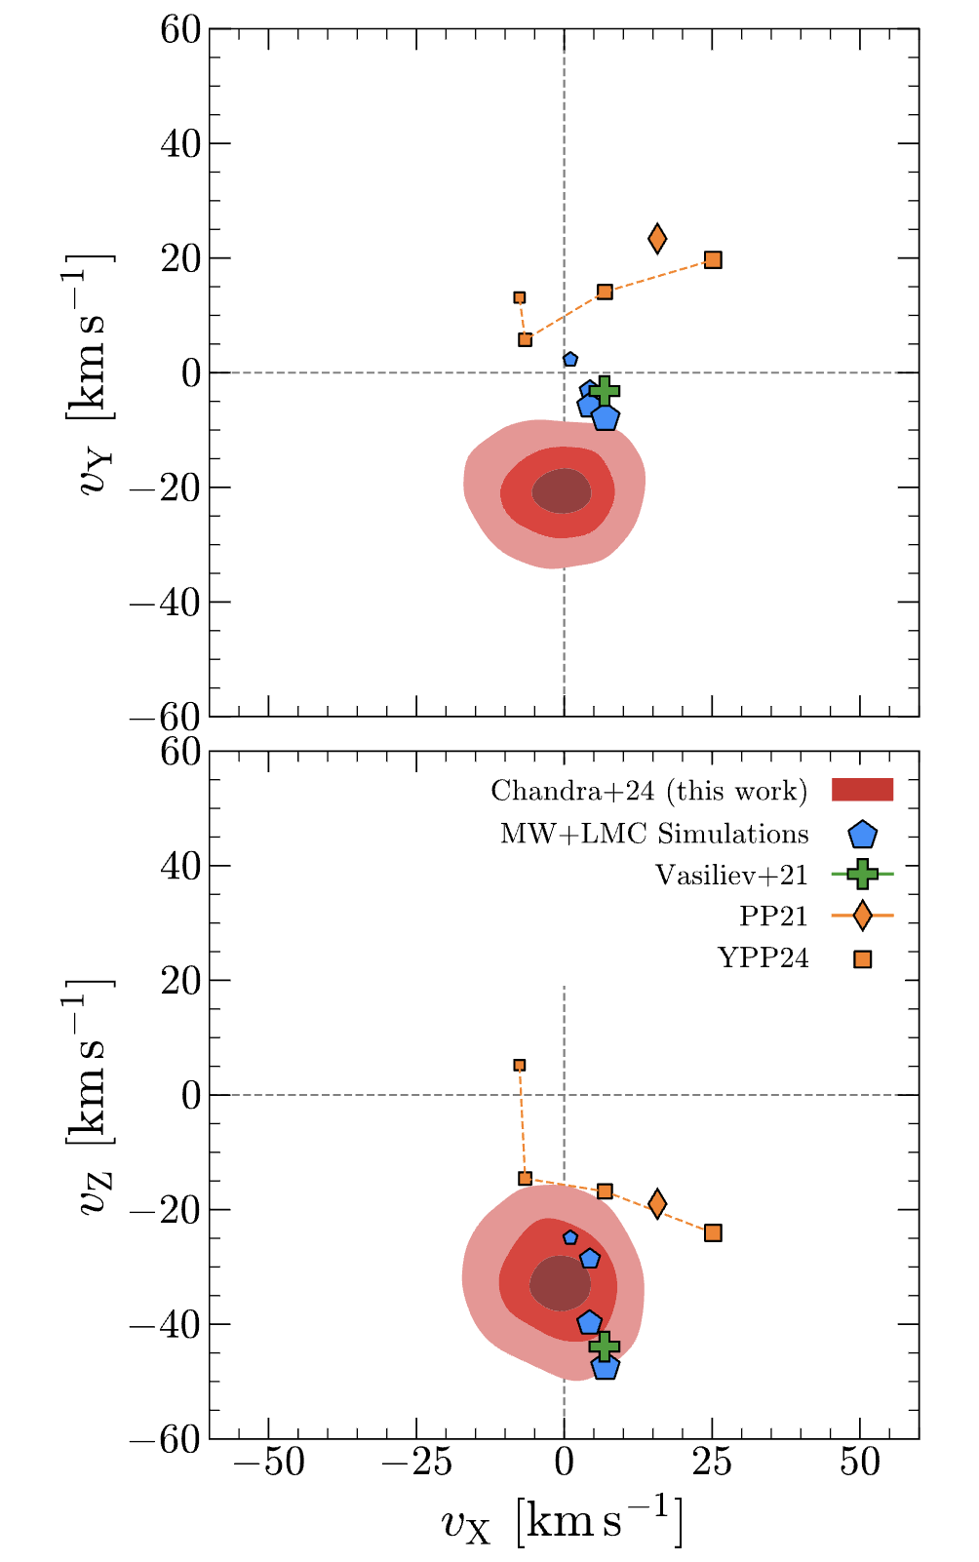
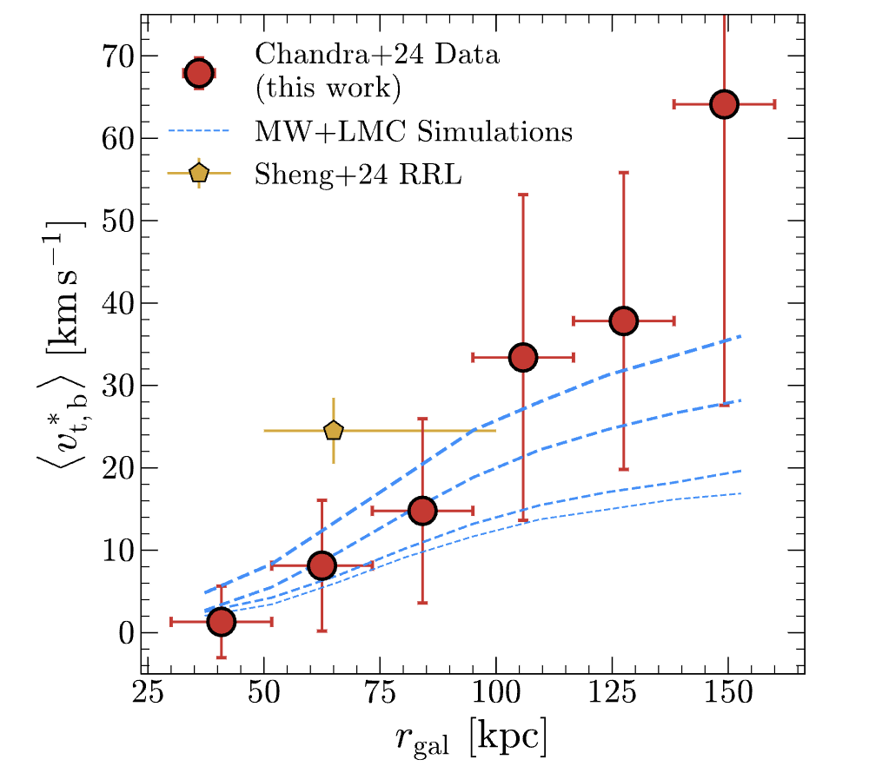

Slide 19
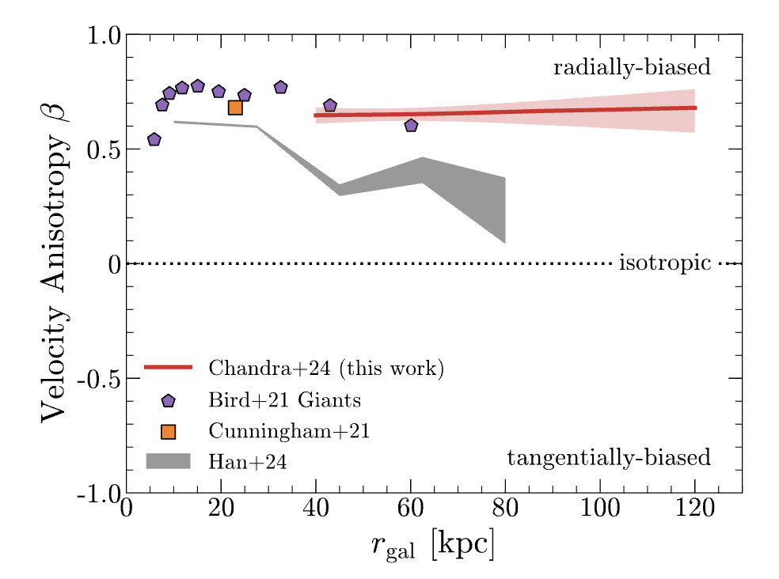

Slide 20
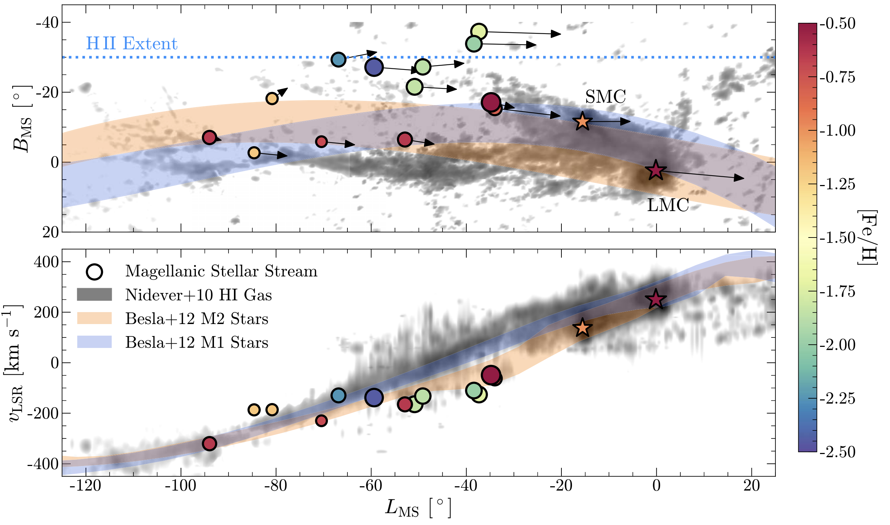

Slide 21
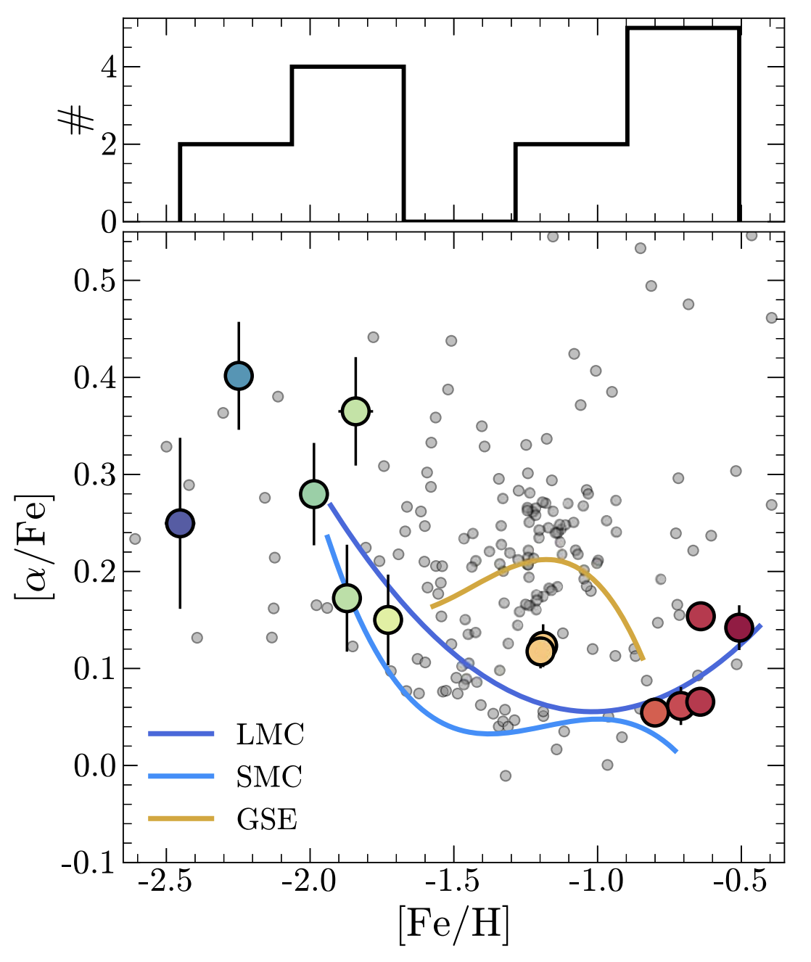
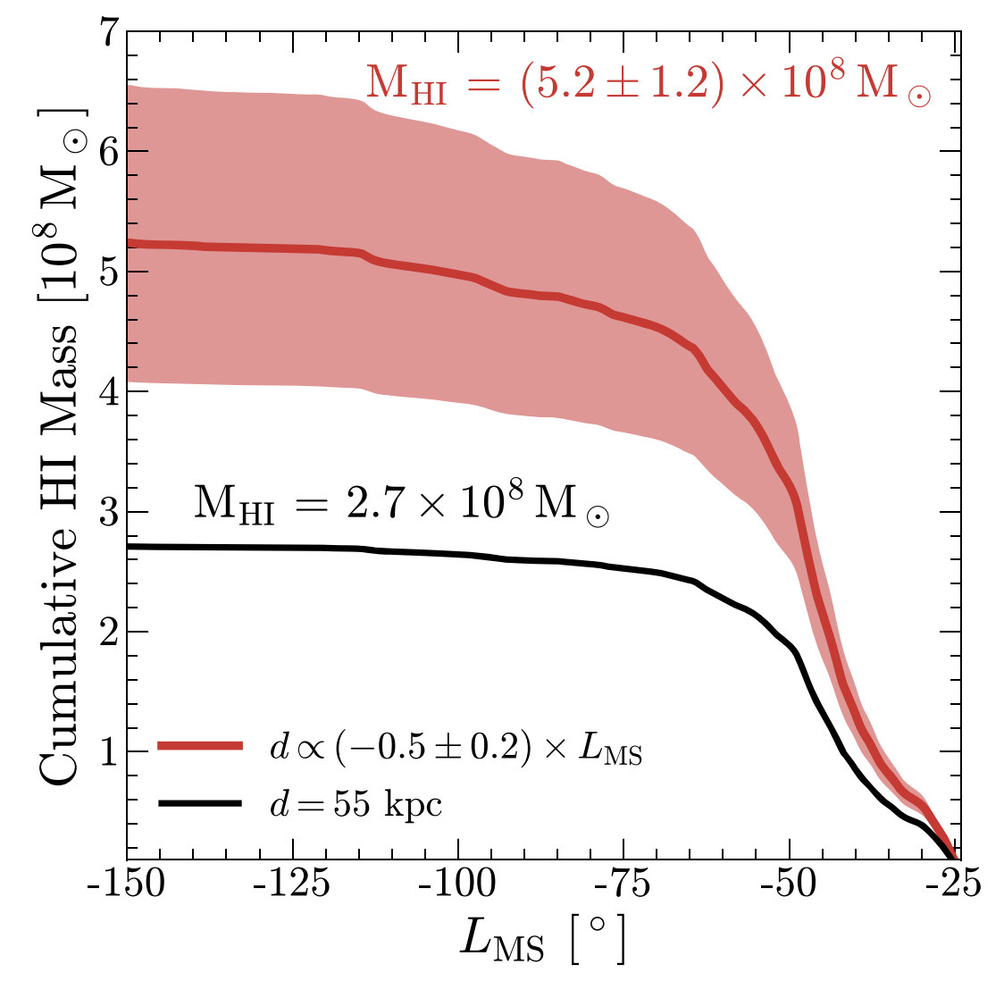

Slide 22
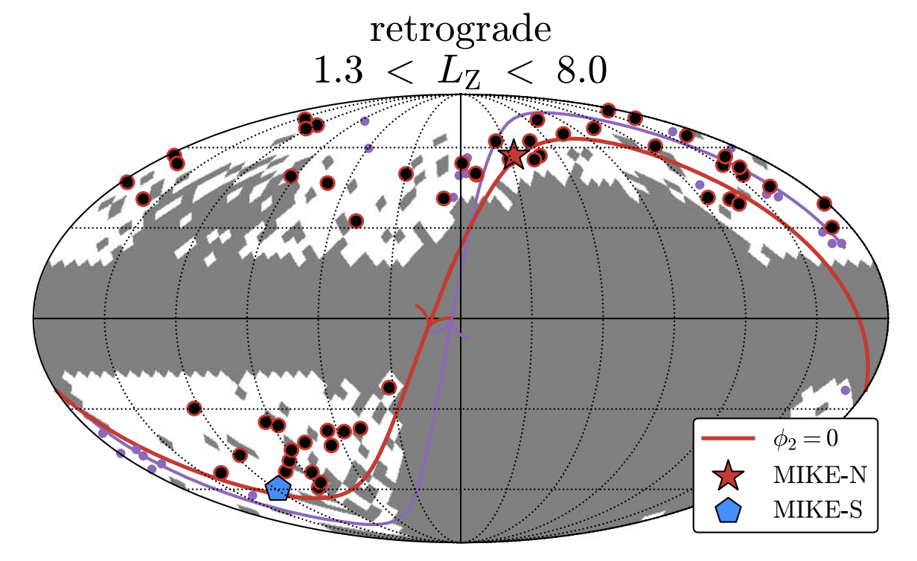
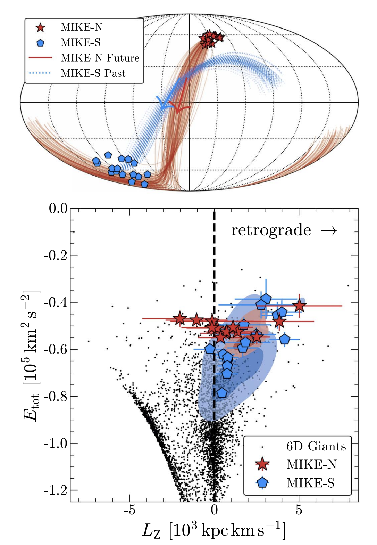
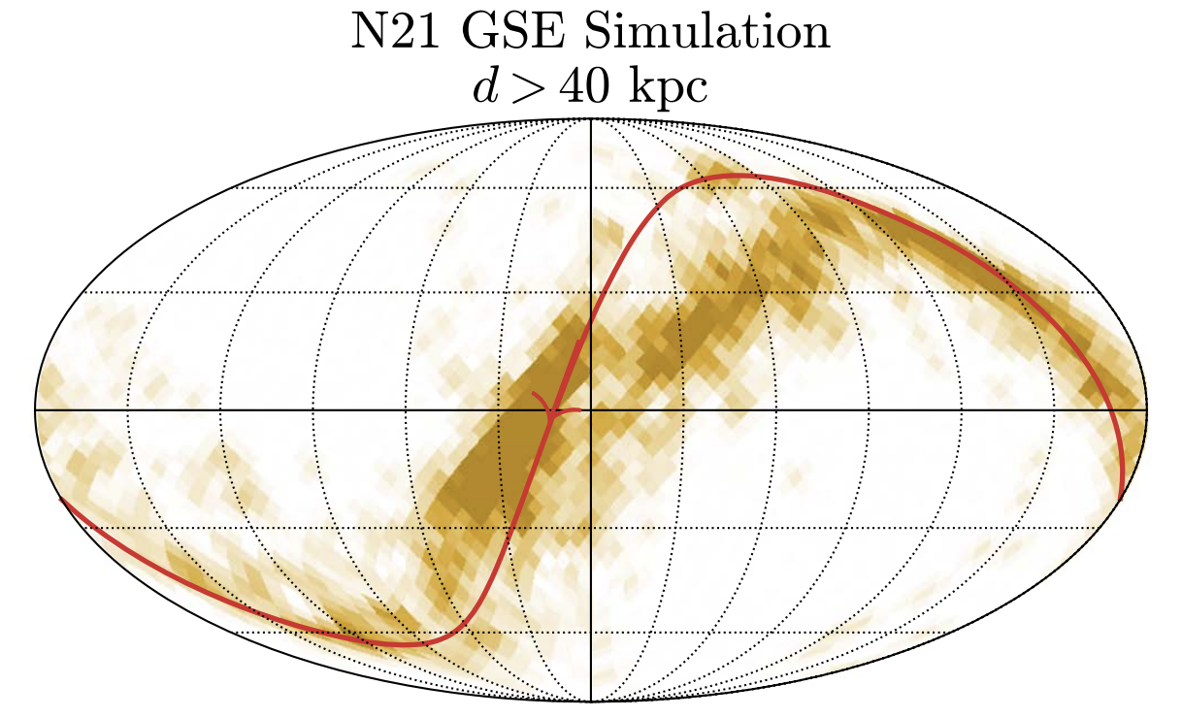

Slide 23
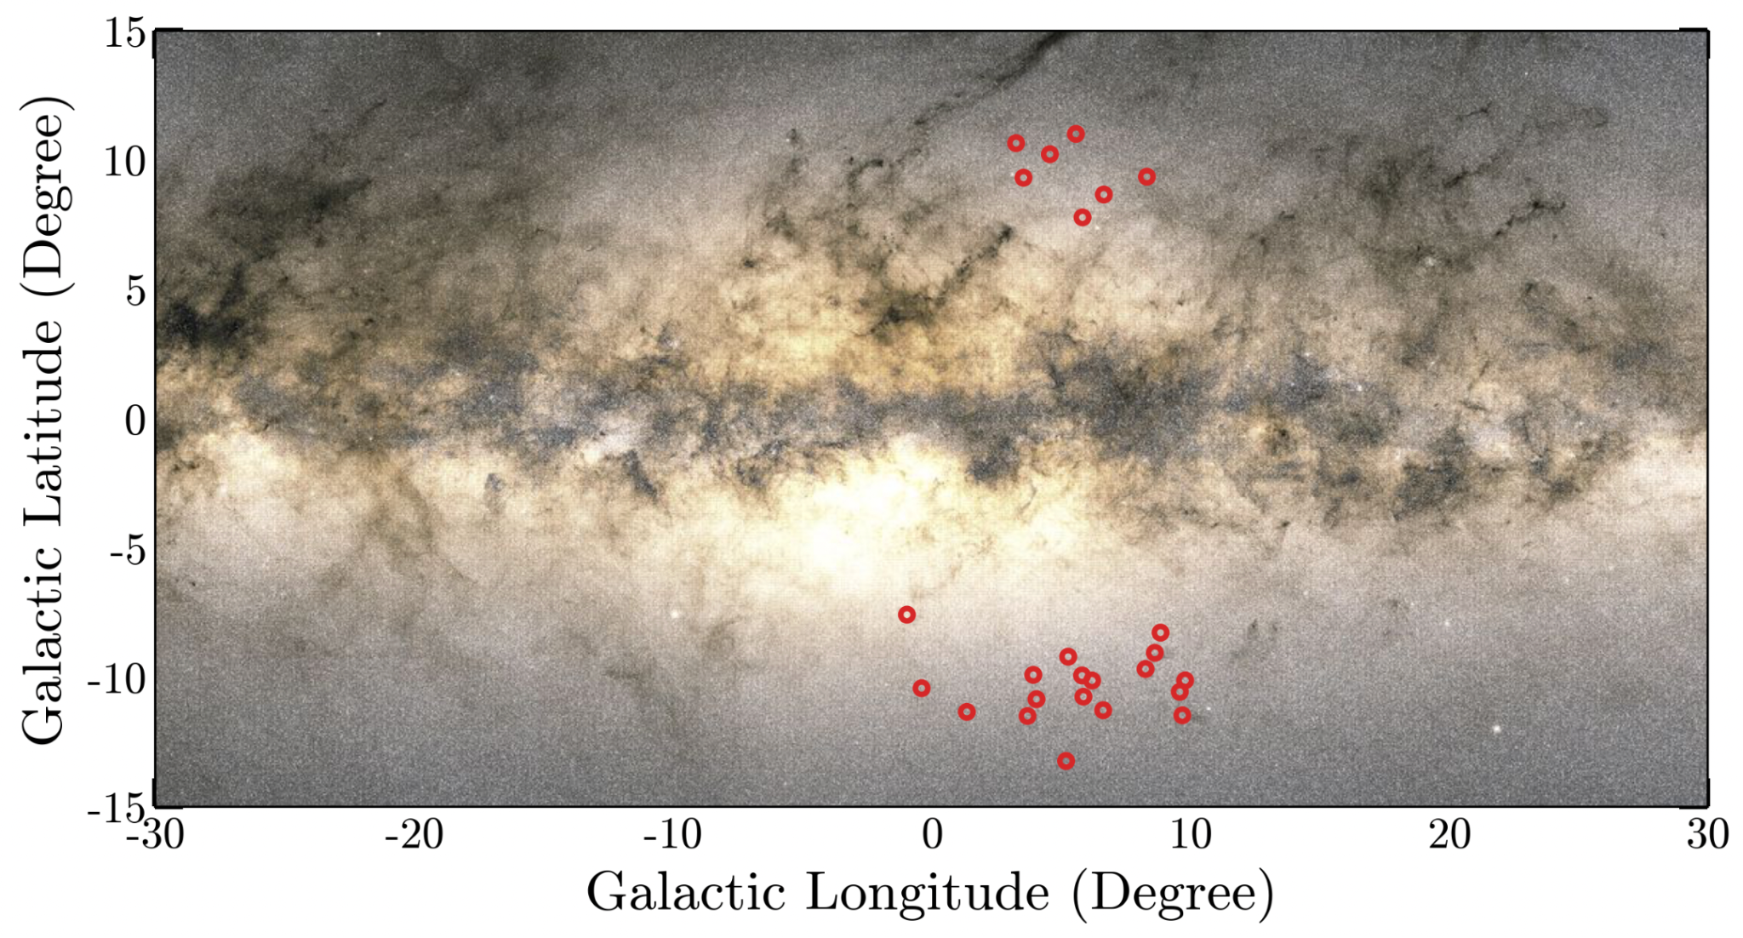
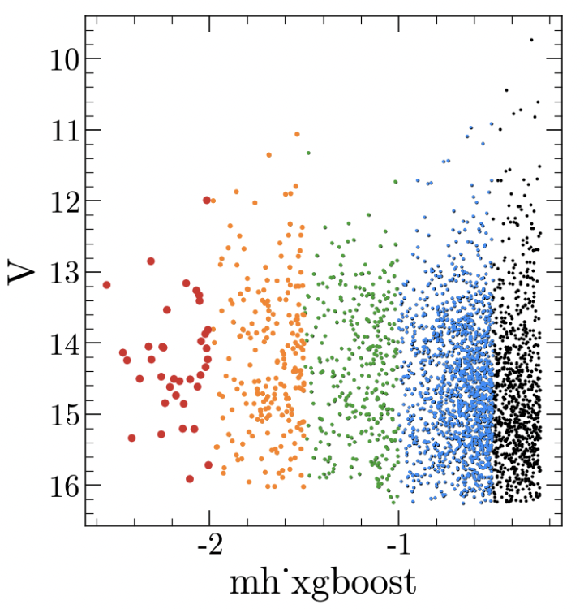
The VLT Protogalaxy Survey
The ‘heart’ has an unprecedented surface density of bright field metal-poor stars
Allocated 75 hours on VLT-FLAMES (PI: Chandra) for R ~ 20,000 spectroscopy of > 1000 stars with [Fe/H] < -1.0
Science:
accreted vs. in-situ components of the inner galaxy via 6D kinematics + abundances
channels of r-process enrichment via Eu+Ba
modeling the chemical evolution of the high-redshift Milky Way
+ proto-Galaxy → disk transition
+ tomography of the disk’s ISM with Na D
VLT Survey Fields
allocated fibers
Gaia XP [Fe/H]
+ H.W. Rix (MPIA)

