Slide 1
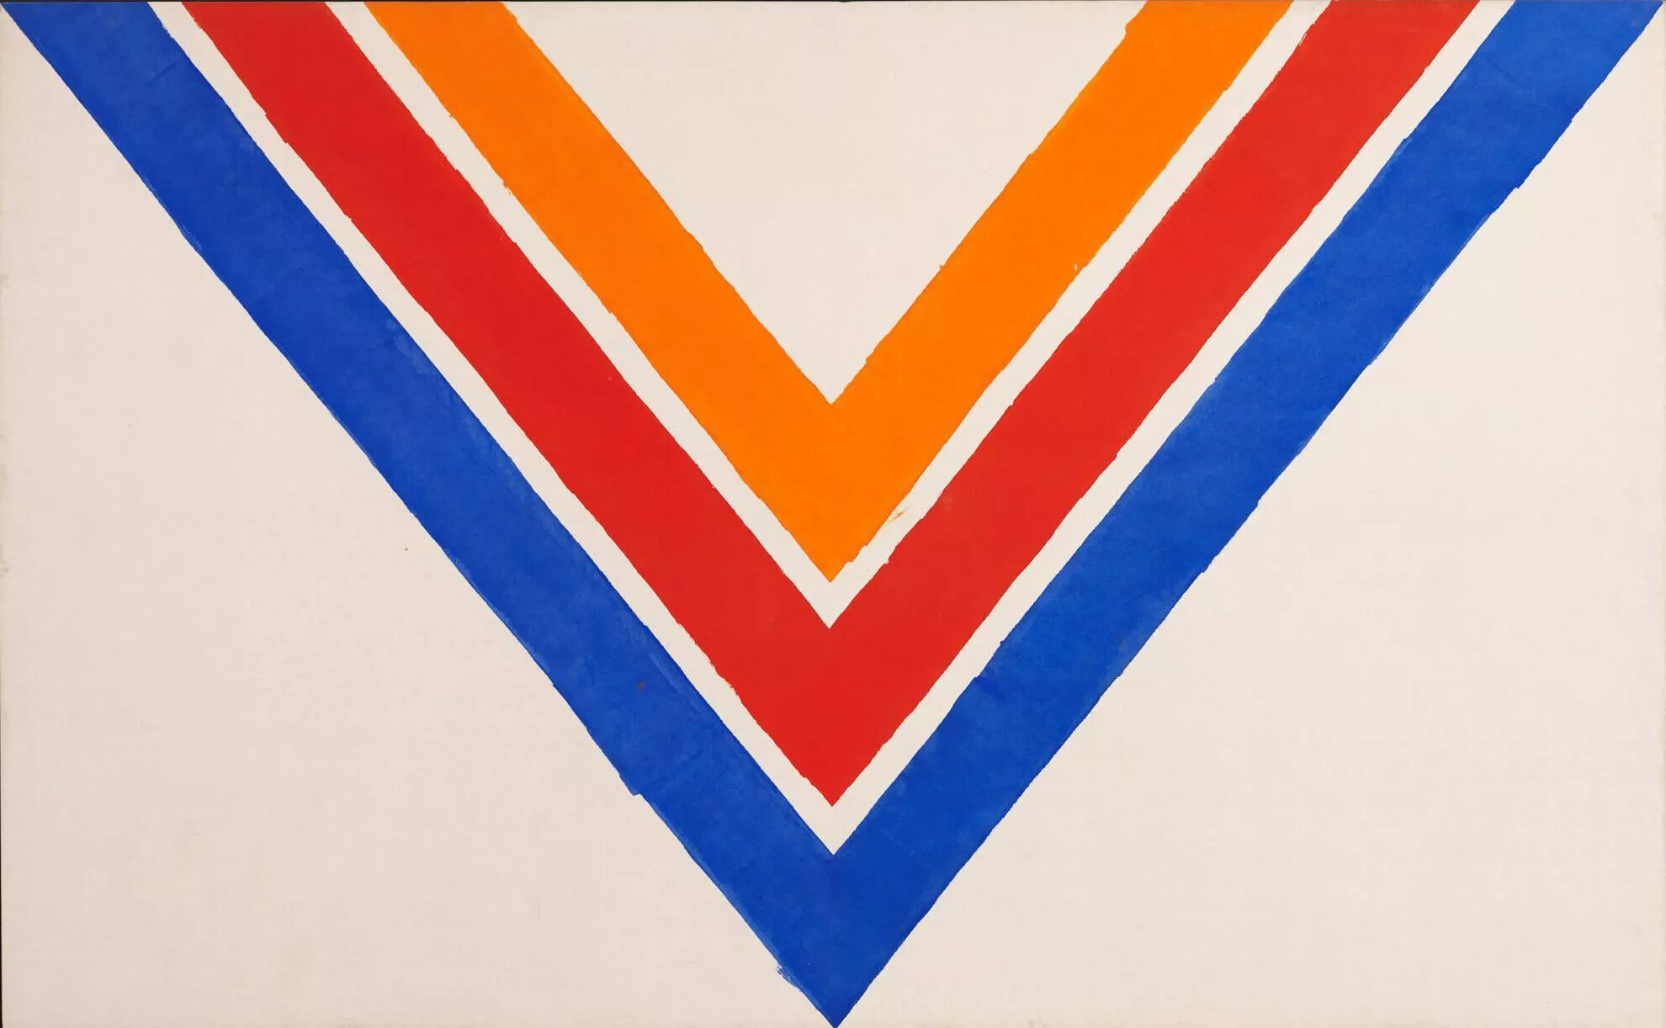
Halo substructure in harmony with the Galactic bar
Adam Dillamore
Collaborators: Vasily Belokurov, Wyn Evans, Stephanie Monty
© 2022 The Kenneth Noland Foundation / Licensed by VAGA at Artists Rights Society (ARS), New York
Photo © The Israel Museum, Jerusalem, by Elie Posner

Slide 2
Radial halo substructure
Radial velocity vs radius
Chevron
‘Chevron’ overdensities have been discovered in the $(r,v_{r})$ space of highly eccentric halo stars using data from Gaia DR3
These have been associated with the phase-mixing of debris from Gaia Sausage-Enceladus
If so, these could be used to time the merger event
However, the overdensities are highly asymmetric, which is inconsistent with an ancient merger event (Donlon+ 2024)
Alternative origin: the chevrons are bar resonances
[Belokurov+ 2023]
$v_{r}$[km/s]
[Dillamore+ 2023]

Slide 3
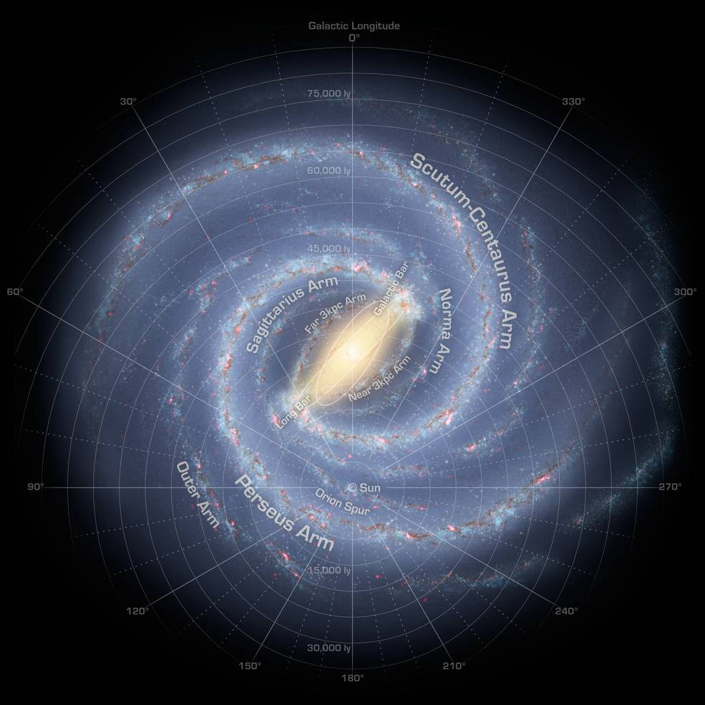
The Milky Way’s bar
$$Ω_{\text{b}}$$
Rotates at a pattern speed (angular frequency) $Ω_{\text{b}}≈35$ km/s/kpc
This provides a rotating non-axisymmetric component to the Galactic potential, which has implications for stellar dynamics
[NASA/JPL-Caltech/R. Hurt]

Slide 4
Bar resonances
Velocity space
Orbital motion of a star can be described by a set of frequencies, $Ω_{R}$, $Ω_{φ}$ and $Ω_{z}$
Resonances with the bar occur when the frequencies relative to the bar have an integer ratio: $lΩ_{R}+m\left(Ω_{φ}−Ω_{\text{b}}\right)=0$
E.g. corotation resonance: $Ω_{φ}=Ω_{\text{b}}$
Stars can become trapped in these resonances, creating substructure in phase space
Resonances in the disc have been extensively studied
But stars on halo-like orbits can also be trapped by the bar
[Trick+ 2019]

Slide 5
Can we build models of bar resonances that explain all features of the observed radial phase space?

Slide 6
Two models of bar resonances:
Analytic toy model
In the isochrone potential
Test particle simulations
In a realistic MW potential with a slowing bar

Slide 7
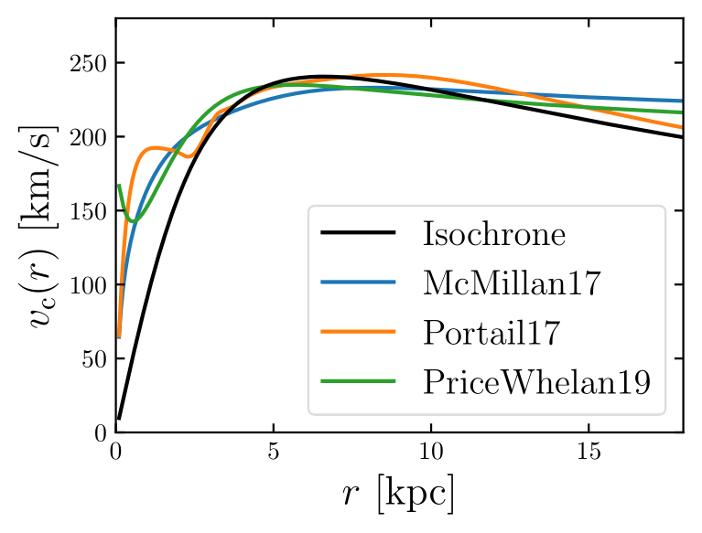
The isochrone potential
A simple approximation to a spherical galactic potential
Nothing to do with isochrones!
All orbits are fully analytic so resonant orbits can be easily and rapidly calculated
This allows the qualitative appearance of resonant substructure to be understood and predicted
[Dillamore+ 2024]

Slide 8
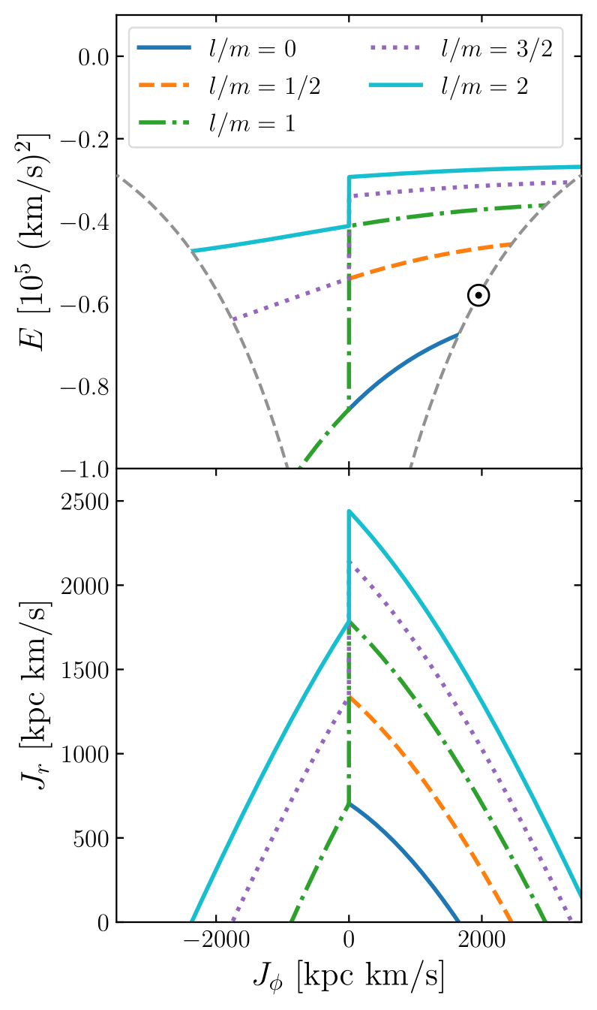
Resonant orbits in the isochrone potential
Energy
Resonances are found by analytically solving the resonance condition and equations for $Ω_{i}$
The bar is assumed to be weak, so that true frequencies ${≈Ω}_{i}$
Resonant perturbation theory required to determine stable orientations
Radial action
Angular momentum
[Dillamore+ 2024]

Slide 9
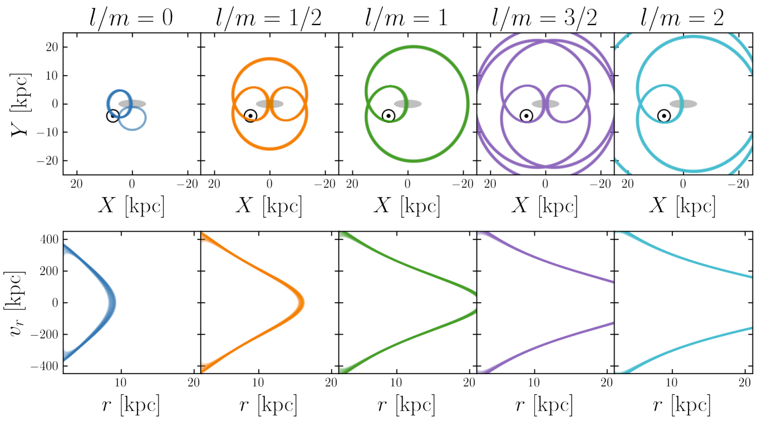
Resonant orbits in the isochrone potential
Corotating
frame
Radial phase
space
[Dillamore+ 2024]

Slide 10
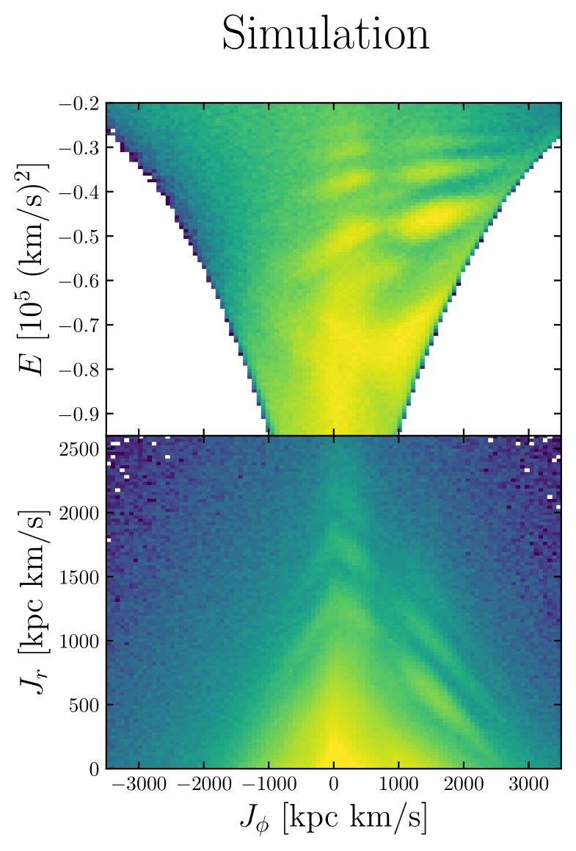
Test particle simulations
Energy
A steady-state halo-like distribution of particles is initialised in a realistic axisymmetric Milky Way potential
A rotating and slowing Portail (2017) bar is then smoothly introduced
The particles’ orbits are integrated in this barred potential using AGAMA
Radial action
Angular momentum
[Dillamore+ 2024]

Slide 11
Models in radial phase space
The particles in each model are weighted to simulate selection effects, based on their distance from the Sun
This reproduces the asymmetry in radial velocity, with more local resonant stars at $v_{r}<0$
Simulation
Isochrone model
[Dillamore+ 2024]

Slide 12
Why is there $v_{r}$ asymmetry?
$v_{r}>0$
$v_{r}<0$
Highly eccentric resonant orbits pass through the Solar neighbourhood with $v_{r}<0$
[Dillamore+ 2024]

Slide 13
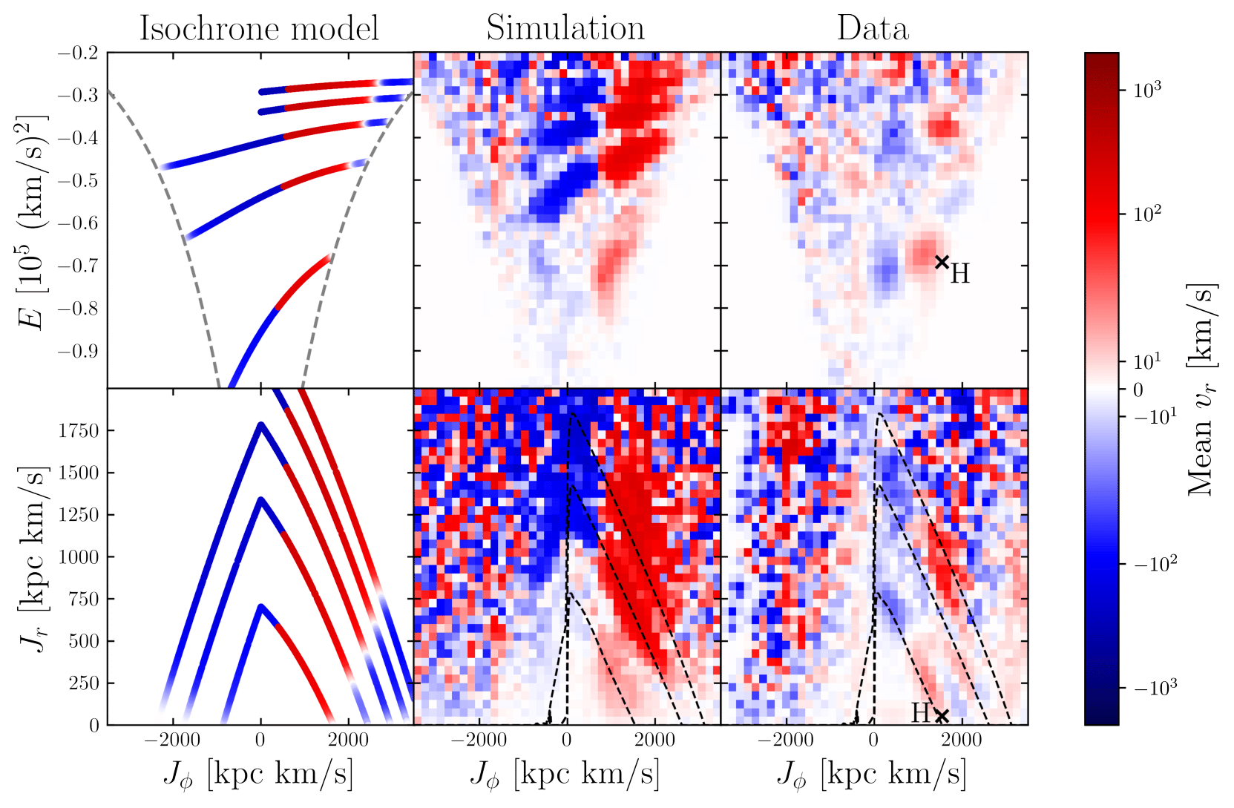
$v_{r}$asymmetry in energy/action space
Hercules stream
Models again weighted to simulate selection effects
${\overline{v}}_{r}>0$
${\overline{v}}_{r}<0$
As $J_{φ}$ decreases, ${\overline{v}}_{r}$ becomes negative along the resonances
Energy
Radial action
Resonances
Angular momentum
[Dillamore+ 2024]

Slide 14
Resonances ↔ chevrons
CR
Background shows Gaia data
Contours show stars near resonances for $Ω_{\text{b}}=35$ km/s/kpc
These coincide almost exactly with the observed chevrons
Each chevron can therefore be matched with a specific resonance
Chevron
[Dillamore+ 2024]

Slide 15
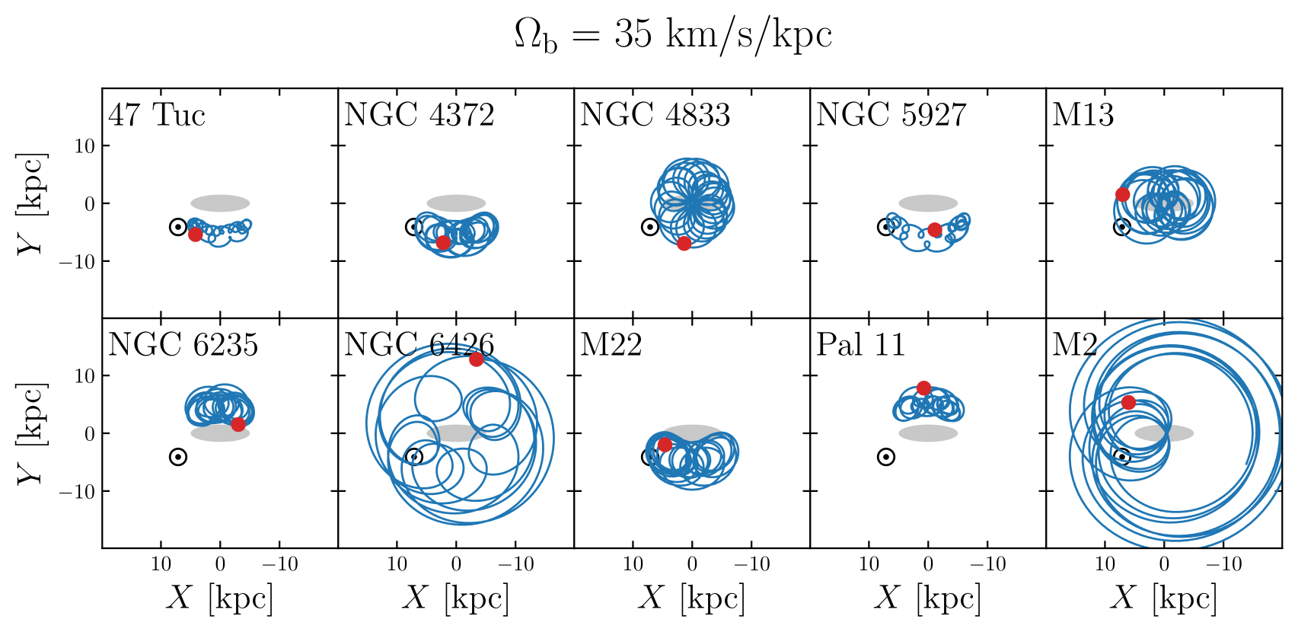
Globular clusters trapped in resonances
~6 GCs could also be trapped in the corotation resonance
These include M22 and 47 Tuc
A slowing bar could have transported them outwards from lower radius, energy and angular momentum
See paper on arXiv
[Dillamore+ 2024]

Slide 16
Summary
Models of highly eccentric resonant orbits accurately predict many aspects of the chevrons:
$v_{r}$ asymmetry
Positions in radial phase space
Innermost chevron associated with the CR and the Hercules stream
Dynamical origin of chevrons likely: beware of using to infer assembly history!
However, may be used to constrain $Ω_{\text{b}}$ + MW potential
More data at large distances required for further tests
Paper: arXiv:2402.14907
amd206@cam.ac.uk

