Slide 1


ICSC_progetto_comunicazione**
Interoperable Data Lake (IDL)
Kick-off meeting, 6-10-2023
Centro Nazionale di Ricerca in High-Performance Computing, Big Data and Quantum Computing
Missione 4 • Istruzione e Ricerca

Slide 2
Summary
Data Space & High-Level Technical Concepts
Interoperable Data Lake - General Objectives
INFN - DataLake & BlockChain system
INAF - Data Models and metadata definition
Leonardo - Database technology
Thales Alenia Space - Architecture and Algorithms for SSA Processing

Slide 3
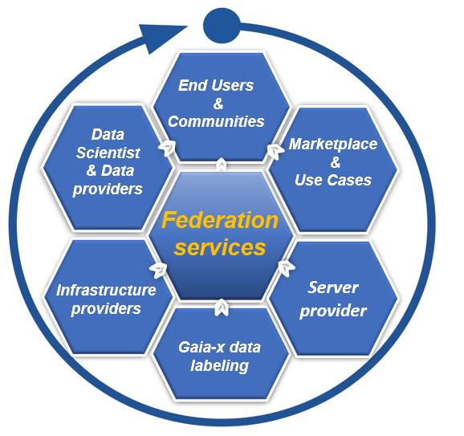
Space Data Space
Our objective is to facilitates access to space data, to foster innovation and to help attract new potential partnership
The Space industry is characterized by the sharing economy, there is a more open, wider market participant outreach that includes academic, commercial and governmental players.
Our solution is a data exchange platform, builds on existing infrastructures (CN HPC), where data acquirers and data providers meet to source, distribute, exchange data securely, in compliance with Gaia-x regulations
The initiative combines platforms and different ecosystems that all follow a common set of rules and policies and deploy a common marketplace to enable a Federated Data Ecosystem

Slide 4


Embedding space ecosystem into data value chain
Data sources
Standardized data
Optimized data
Sharing models
Data use
Input sensor and data layer
Aggregation and normalization of data within local, interoperable repositories
Sharing prerequisites through harmonized access management
Depending on the legal basis and use case
Data, insights, software and algorithms as a service
Space satellite sensor
Providers and
Metadata
Security & access management
National Hubs
research institutions
Observatory
Use case
FAIR data
Findability Accessibility
Interoperability Reusability
Data catalogue
Insights
Data
Data Space
data repository
user communities
Harmonized Privacy management
ESA - DIAS
ASI - SSDC
Marketplace
PAAS
SAAS

Slide 5
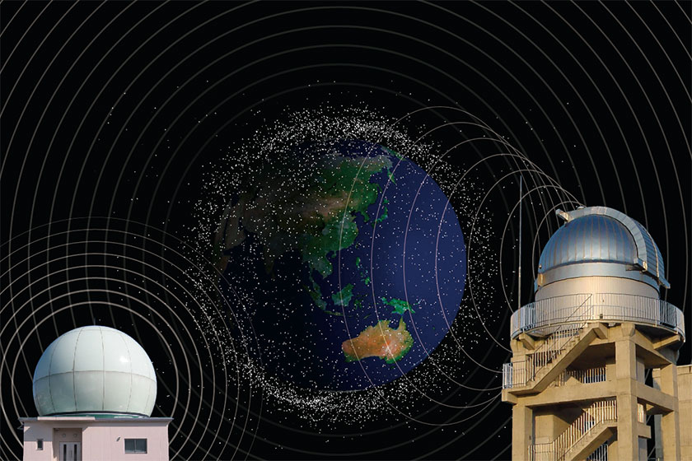
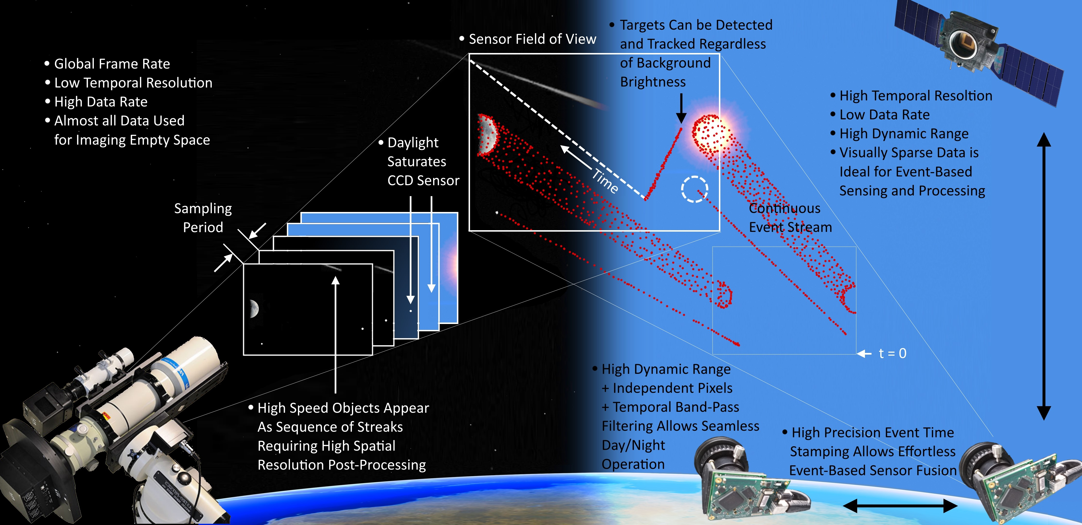
Space Situational Awareness (SSA)
SSA refers to the knowledge of the space environment, including location and function of space objects and space weather phenomena. SSA is generally understood as covering three main areas:
Space Surveillance and Tracking (SST) of man-made objects
Space Weather (SWE) monitoring and forecast.
Near-Earth Objects (NEO) monitoring (only natural space objects)

Slide 6
IG Project: Interoperable Data Lake (IDL)
The Project aims at creating a Data Lake service, supporting a seamless access to space and ground-based observations and simulated data.
The project addresses the design and commissioning of an interoperable, distributed data archive, relying on state-of-the-art open technologies, supporting both science and industry.
The service will specifically address the challenges related to the big data scenario, in terms of both data management, storage, access, identification and of access to computing resources necessary to process the data.

Slide 7

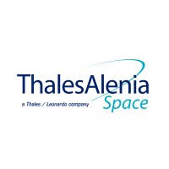


General Objectives
Improvement of existing catalogs of near-earth object or space debris integrating ground-based observations with space-based simulation;
Create a federated data infrastructure that follows the FAIR data principles;
Design and implement a prototype application performing the end-to-end processing chains to demonstrate the Data Management (DM) capability;
Exploit a cloud-native distributed database to support the integration and query of data coming from different sources;
Create a mock-up to generate a synthetic data set, define the algorithms of the processing chain and evaluate the computational load.

Slide 8
Activities & Work Packages structures of the project
Centro Nazionale di Ricerca in High-Performance Computing, Big Data and Quantum Computing
Missione 4 • Istruzione e Ricerca

Slide 9
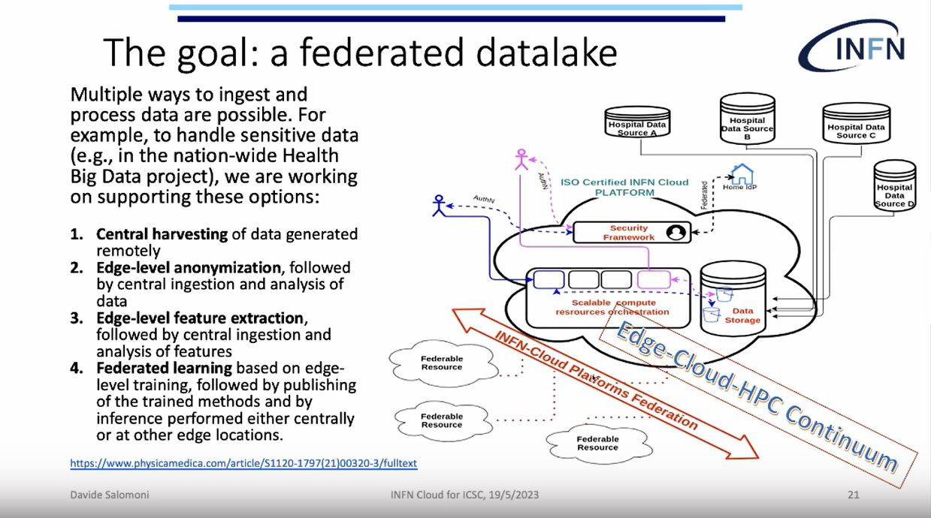
INFN – WP1: DataLake & WP3,4: BlockChain system
Integration with Spoke 2 Research Program
DataLake
BlockChain system
INFN proposes to test solutions for managing data in a geographically distributed environment to exploit the Datalake. All the services will be deployed in the form of containers managed via container orchestrators.
The prototype will show the feasibility to deploy PaaS services for the actual processing of the data ingested into the Data lake.
Deployment of a blockchain network to execute fundamental CRUD (Create, Read, Update, Delete) operations, catering to the requirements of the project. This blockchain network will be accessible through a REST API with an HTTPS backend, facilitating seamless communication between the blockchain and databases.

Slide 10

INAF – WP2: Data Models and metadata definition
Integration with Spoke 3 Research Program
Data Models and metadata definition
Spoke 3 - WP4 - Big Data Management, Storage and Archiving
Objectives and Methodologies:
Objective 2. Big data processing and visualization, via adopting innovative approaches for the analysis of large and complex data volumes and for their exploration.
Objective 3. High Performance storage, Big Data management, and archiving applying the Open Science principles and implementing them in the Big Data Archives.
ACO-S will promote the FAIRness of the research outputs and services across research communities involved in the project
Study and implementation of an IVOA/FAIR compliant data model for the correct description and handling of the data sets.
The data model will include all relevant information about data, software for data reduction, analysis, data policy, and all the information for data filtering for retrieval.

Slide 11
Leonardo - Cloud-native distributed database
WP2: Data Models and metadata definition, data archiving
Objective. Support the integration and query of data coming from different sources, complemented with simulated data, with a performance that enables novel application with real-time requirements in SSA use case, to achieve maximum effectiveness and efficiency in data provisioning and exploitation
Requirement analysis: Gather information necessary for the definition, implementation, testing and verification of the database technology to be integrated on top of the data-lake. Analysis and definition of the required data processing activities: preprocess, cleaning, normalize, rescale data, with a focus on data models and metadata definition.
Database deployment in ICSC infrastructure, validation and testing
Implementation of the data ingestion service, to collect data efficiently from the instrument/sensor network. Integrate the components of the prototype system with their applications and data platform and deploy them on the Consortium infrastructure.

Slide 12
Thales Alenia Space
WP5: Architecture and Algorithms for SSA Processing
Simulation of state of art algorithms for processing of space based sensors data for SSA and evaluation of the computational load. The simulator will provide:
Information to support architectural trade offs in terms of optimal split between on board and on ground processing
A reference to evaluate complex scenarios with multiple sensors processing
Topics
Investigate existing and upcoming sensors typologies and technologies for space based ssa applications, identify measurable space objects characteristics they can detect and the data typologies they generate
Selection of a representative subset of sensors and identification of the state of art algorithms for data processing
Design and implementation of a mock up (simulator) which is capable to generate a synthetic data set for the selected sensors, implement the algorithms of the processing chain and evaluate the computational load

Slide 13
Expected Results
Design and commissioning of an interoperable, distributed data archive in the perspective on the ICSC HPC, Cloud and Data infrastructure;
Availability (to both scientific and industrial users) of effective interoperable services for the storage and the processing of the data;
Experimentation and Demonstration of the use of blockchain sw stacks for the certification / tracking of valuable datasets;
Updating existing debris databases with new space–based observations and observations from space;
Creation of a public data archive of state-of-the-art astrophysical simulations;
Experimentation of technological solutions capable to support science in large astronomy observatories like LOFAR and the SKA.

Slide 14
Thank you for your attention!
Centro Nazionale di Ricerca in High-Performance Computing, Big Data and Quantum Computing
Missione 4 • Istruzione e Ricerca

Slide 15
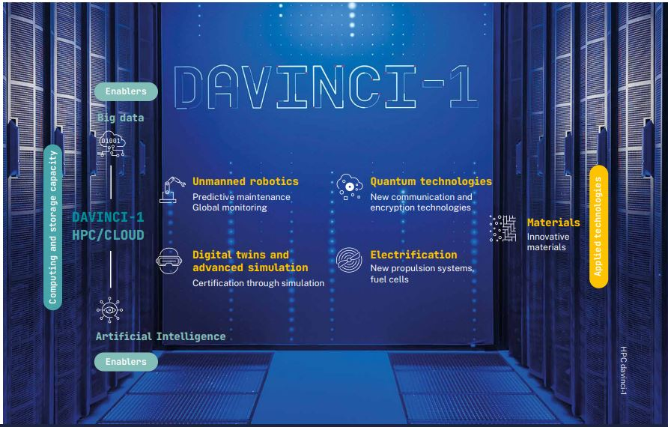
Technological Leadership
As a driver of innovation Leonardo is committed to:
digitalisation processes and the enabling technologies
technological research
13% OF REVENUES
SPENT ON R&D ACTIVITIES
COOPERATION WITH MORE THAN 90 UNIVERSITIES
& RESEARCH CENTRES
MORE THAN 400 TECHNOLOGIES
IN LEONARDO’S PORTFOLIO
9,600 PEOPLE
INVOLVED IN R&D AND ENGINEERING
20 mln. gb memory capacity
5 mln. bil. floating-point operations per second
100 gb per second reading and writing speed

Slide 16
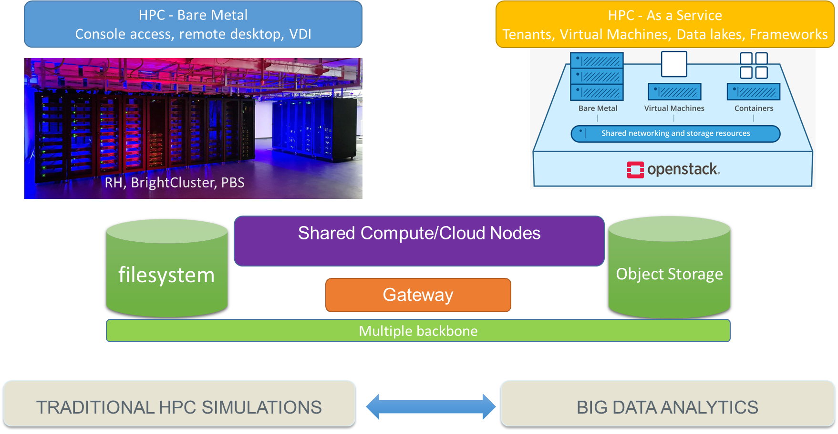
Davinci-1 High Level architecture and supported usage model

Slide 17
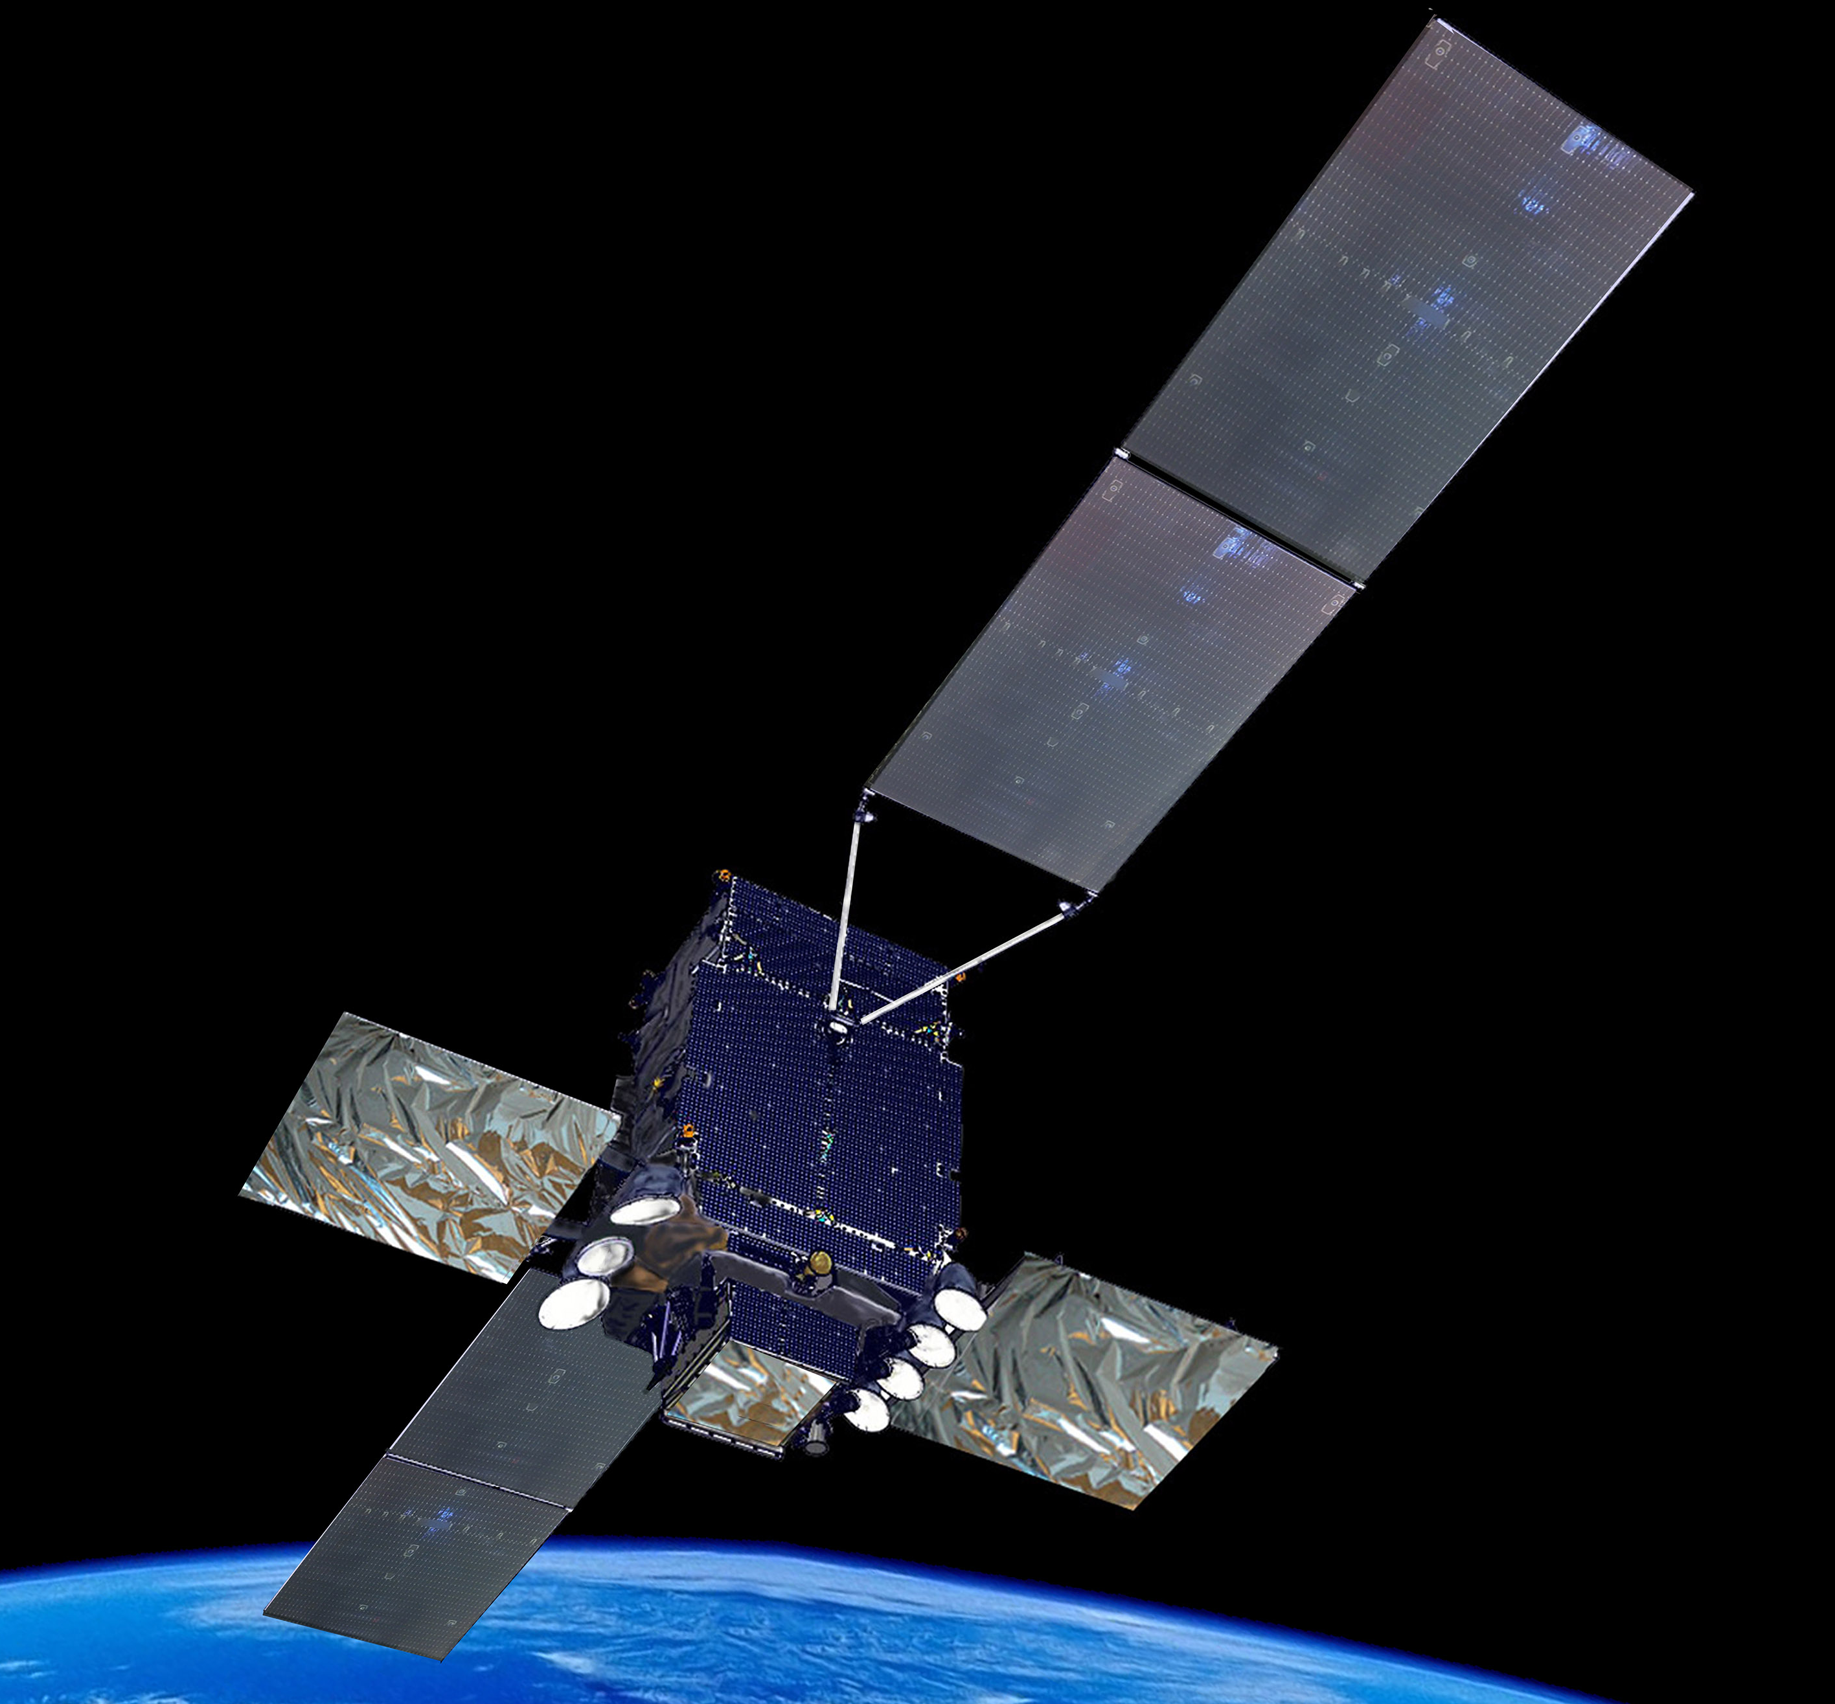
Space sector
Telespazio (67%)
Thales Alenia Space (33%)
Avio (29,6%)
Satellite services for the design, development, launch and in-orbit control of space systems, and services and applications for Earth observation, communications, navigation and satellite localisation.
Satellite systems for telecommunications, navigation, Earth observation, probes and rovers for space exploration, and multi-function orbiting modules.
Instruments: electro-optical and hyperspectral payloads, laser transmitters and robotic systems for space exploration and the study of our planet.
Equipment: photovoltaic panels, atomic clocks, attitude sensors, power distribution systems, orbital micro-propulsion.
>2 million
>50%
>50
radar images acquired by COSMO-SkyMed, the constellation of ASI and the Italian Ministry of Defence
of the living space of the International Space Station developed by Thales Alenia Space
atomic clocks on board the Galileo constellation

Slide 18






Telespazio relevant assets & skills
Profound knowledge of
Thematic End User needs
In several vertical applications (maritime, agriculture, forestry, environmental monitoring, infrastructure and asset management, cultural heritage, insurance, D&I)
Remote sensing Opt./SAR data processing
Optical (Multispectral/Hyperspectral) / SAR signal processing to derive model based observations and measurements and monitoring capacity from single image or multitemporal time series
3D modelling
Desing and implementation of detailed 3D models from satellite/aerial/drone imagery at multiple scales and LOD.
Artificial Intelligence
ML/DL networks applied to several geosptial challenges (object detection, anomaly detection, trend analysis, ..) and data (satellite, eaerial ,drone imagery, social media, marine traffic, …)
HPC / Cloud / Big Data / Microservices
Management and exploitaiton of scalable computing infrastructure and processing platforms, on prem and in various cloud environments
Modelling (Hydraulic/Climate/
Agriculture) and scenario simulation
Design and implementation of modelling and scenario simulation tools to build flood risk and impact scenarios, including climate change effects

Slide 19
Data Space & High-Level Technical Concepts
Centro Nazionale di Ricerca in High-Performance Computing, Big Data and Quantum Computing
Missione 4 • Istruzione e Ricerca

Slide 20
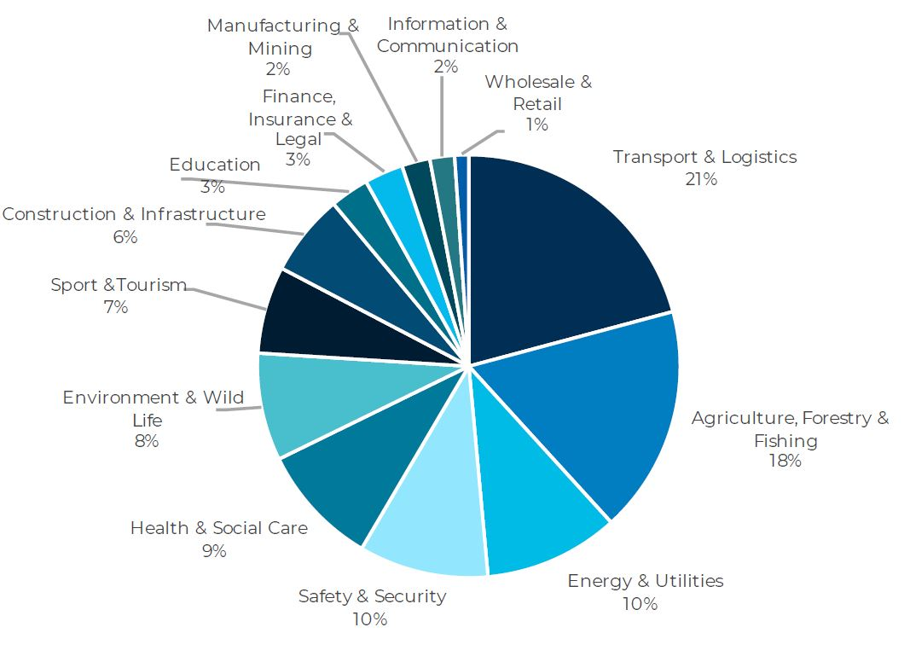



Space Economy Ecosystem
Building a digital infrastructure to bring user to the data
Academia/ Research
More than 400 scientific papers were published
focusing on Future EO Earth Explorers
Entreprise/ SMI/Startup
There are 144 companies (ITA) in the downstream segment ( included IT providers and system integrators) operating in the sector
Data provider
(National/Local PA)
Commercial Data Providers (imagery, analytics, road traffic)
User (end & intermediate)
Communities
1008 applications satellite-based that traditionally would have no interest in space
Cloud-to-edge federations Middleware
Osservatorio Space Economy 2023
ICSC infrastructure

