Slide 1
Interoperable Data Lake
WP4: Blockchain deployment on the ICSC Datalake
Alessandro Costantini, Barbara Martelli
INFN- CNAF
alessandro.costantini<at>cnaf.infn.it
barbara.martelli<at>cnaf.infn.it

Slide 2
The Problem to be addressed
Ownership and immutability of data are crucial for the project, this becoming clearer focusing on the creation of a marketplace of spatial data.
With the increasing volume and complexity of space-related information, ensuring the integrity, security, and accountability of data becomes critical.
Leverage blockchain technology to create an auditable trail of data actions in a secure and efficient manner,
enhancing security, privacy, cost efficiency, governance and control, trust and accountability, collaboration, and consortium building within the domain of space data.
Notes:
GDPR Rights for individuals:
the right to be informed,
the right of access,
the right to rectification,
the right to erasure,
the right to restrict processing,
the right to data portability,
the right to object and also rights around automated decision making and profiling

Slide 3
WP4 Objectives and Activities (M 0-24)
Objectives
Definition and PoC of the deployment strategies on the Datalake
Report on the BC technology tracking and comparison of solutions
Activities
Scouting and tech tracking of open source BC technologies
To be deployed on Cloud (ICSC federated resources)
As a managed infrastructure service
On-demand
Deliverables
DRL code | Definition | Del. date
TN1 | Report the deployment solutions on the Datalake, with initial evaluation of results | M12
TN2 | Technology tracking report on the blockchain solutions maturity | M24
Hardware needs from ICSC
● O (10) VMs on the Datalake, for R&D and PoC utilization ● O (20 VCPU) on the ICSC ● O (1-10) TB storage on the Datalake
Notes:
GDPR Rights for individuals:
the right to be informed,
the right of access,
the right to rectification,
the right to erasure,
the right to restrict processing,
the right to data portability,
the right to object and also rights around automated decision making and profiling

Slide 4
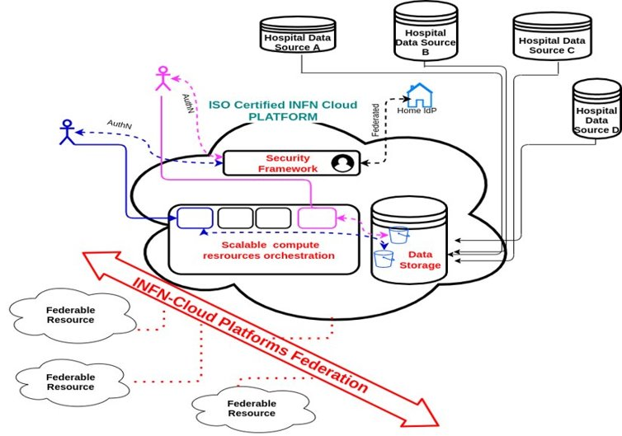
The Big Picture: toward an open-source genomic datalake for research
Many INFN life science research activities involve personal data processing related to healthcare patients and need to comply with the new norm (GDPR)
To address this issue, we have built EPIC Cloud (Enhanced PrIvacy and Compliance Cloud): an ISO 27001 27017 27018 certified partition of INFN Cloud adopting technical and organizational security measures that make it fit for processing personal data
INFN Cloud technologies are already the basis for several research projects at national and European level:
Harmony Alliance
Health Big Data
Several national projects funded under the EU Recovery and Resilience Plan
Blockchain technologies will be of paramount importance to enhance transparency, auditability and trust at various architectural levels
Can be applied to other scientific areas and needs

Slide 5
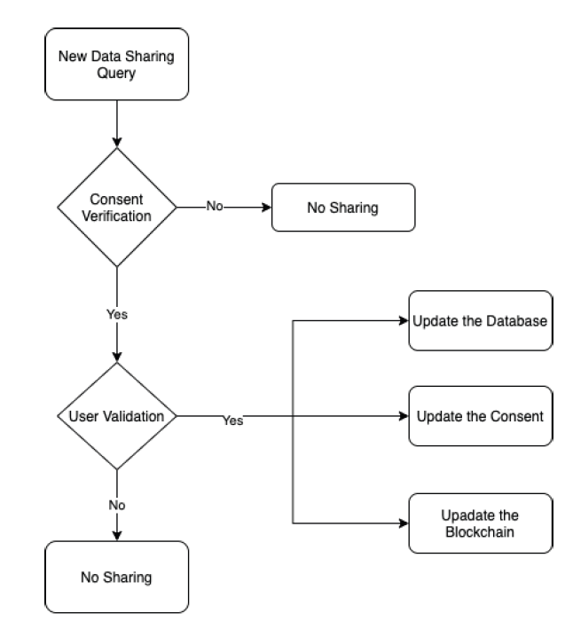
Actors
Adding transparency and trustworthiness to Data - The Blockchain
Informed Consent Workflow
A way of enhancing transparency and trustworthiness to current Data is the exploitation of blockchain technologies
Distributed ledgers implemented as concatenation of data blocks in a growing chain of immutable elements
Hospital Ethic
Committee
Patient
GDPR Role: Data Subject
Role: Whatchdog
The chain is maintained by several actors exploiting a combination of
cryptographic techniques
consensus algorithms
peer-to-peer communications
game theory
Hospital
GDPR Role: Data Controller

Slide 6
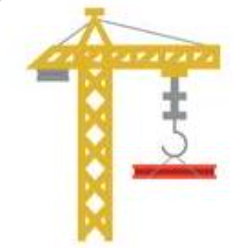
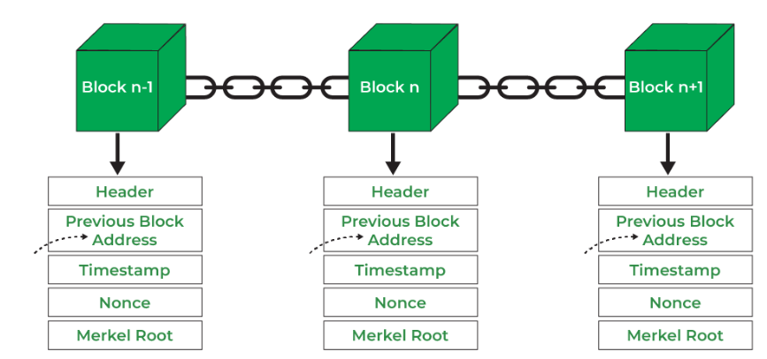
BC environment for developers: Scaffold-eth
User
Blockchain
(single node)
Smart Contract
Hardhat
UI
Solidity
Ant Design
React
Ethers
Notes:
Solidity for writing smart contracts
Hardhat for running local networks, deploying and testing smart contracts
React for building a frontend, using many useful pre-made components and hooks
Ethers.js for interacting with deployed smart contracts and the frontend
Ant for your UI. Can be easily changed to Bootstrap or some other library you prefer
Solidity for writing smart contracts
Hardhat for running local networks, deploying and testing smart contracts
React for building a frontend, using many useful pre-made components and hooks
Ethers.js for interacting with deployed smart contracts and the frontend
Ant for your UI. Can be easily changed to Bootstrap or some other library you prefer

Slide 7
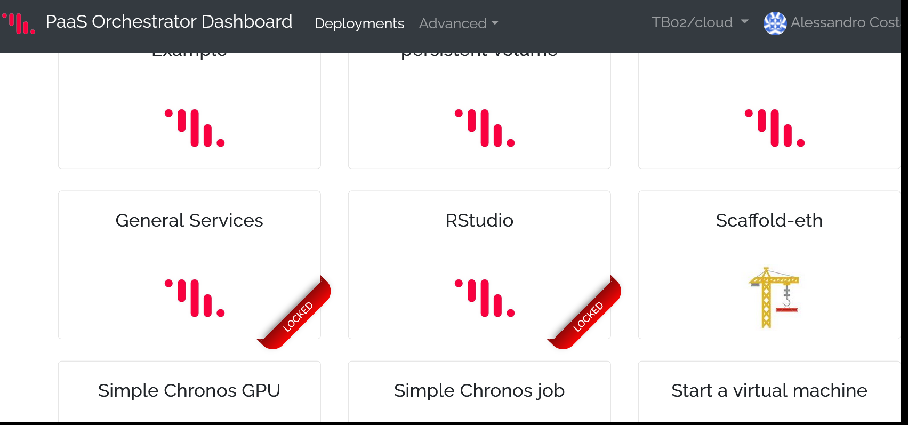
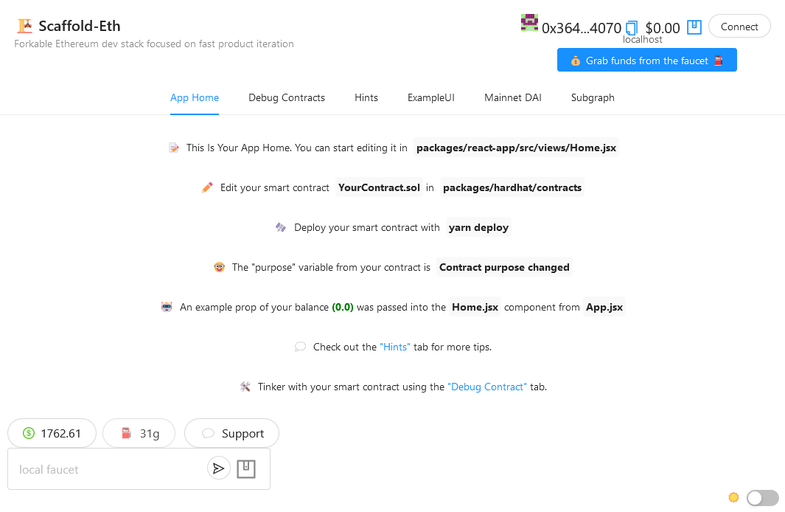
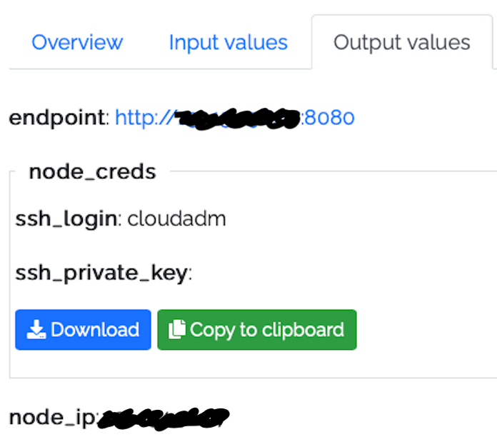
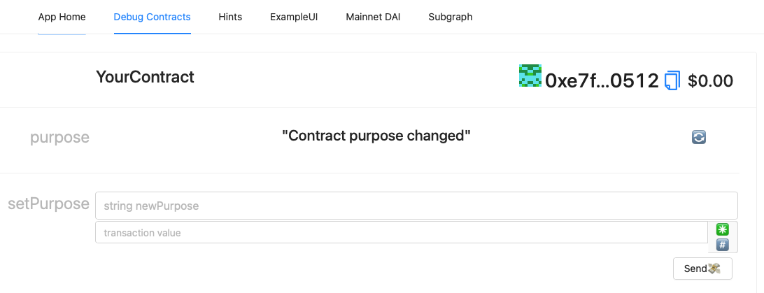
Scaffold deployment over Cloud: first attempt

Slide 8
WP4 effort
People
Alessandro Costantini, Barbara Martelli – Staff INFN-CNAF
Domingo Ranieri - Postgraduate fellow
1 new Research grant
Activities
Scouting and tech tracking of open source BC technologies
To be deployed on Cloud (ICSC federated resources)
As a managed infrastructure service
On-demand
Interaction with WP1, WP2, WP3, WP5
Deliverables
DRL code | Definition | Del. date
TN1 | Report the deployment solutions on the Datalake, with initial evaluation of results | M12
TN2 | Technology tracking report on the blockchain solutions maturity | M24
Hardware needs from ICSC
● O (10) VMs on the Datalake, for R&D and PoC utilization ● O (20 VCPU) on the ICSC ● O (1-10) TB storage on the Datalake

Slide 9
BK-Up

Slide 10
Main References
[1] Rishav Raj Agarwal et al. “Consentio: Managing consent to data access using permissioned blockchains”. In: 2020 IEEE International Conference on Blockchain and Cryptocurrency (ICBC). IEEE. 2020, pp. 1–9.
[2] Darine Ameyed et al. “Blockchain Based Model for Consent Management and Data Transparency Assurance”. 2021 IEEE 21st International Conference on Software Quality, Reliability and Security Companion (QRS-C)
[3] Merlec MM, Lee YK, Hong SP, In HP. “A Smart Contract-Based Dynamic Consent Management System for Personal Data Usage under GDPR”. Sensors (Basel). 2021 Nov 30;21(23):7994. doi: 10.3390/s21237994. PMID: 34883997; PMCID: PMC8659597
https://github.com/scaffold-eth/scaffold-eth
https://docs.scaffoldeth.io/scaffold-eth/
https://www.cloud.infn.it/

Slide 11
INFN Experience with blockchain
On 25th May 2018 a new European Union (EU) law came into effect: the General Data Protection Regulation (GDPR) with the aim of protecting EU individuals' privacy
EU individuals = whoever is on EU territory, not only EU citizens
Many INFN life science research activities involve personal data processing related to healthcare patients and need to comply with the new norm
To address this issue, we have built EPIC Cloud (Enhanced Privacy and Compliance Cloud): an ISO 27001 27017 27018 certified partition of INFN Cloud adopting technical and organizational security measures that make it fit for processing personal data
Among the rights of individuals, there are the rights To Be Informed, To Erasure and To Restrict Processing of personal data
We need to add functionalities to enable patients who provide personal data stored in EPIC Cloud to exercise their rights
Notes:
GDPR Rights for individuals:
the right to be informed,
the right of access,
the right to rectification,
the right to erasure,
the right to restrict processing,
the right to data portability,
the right to object and also rights around automated decision making and profiling

Slide 12
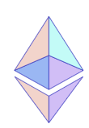
The open-source blockchain platforms
Ethereum
Hyperledger Fabric
Access: permissionless
Deployment: public
Consensus algorithm: Proof of Stake (PoS)
Development language: Solidity
Distributed App (DApp): Smart Contract
Access: permissioned
Deployment: private
Consensus algorithm: Practical Bizantine Fault Tolerance (PBFT) or dynamic (Sawtooth)
Development language: golang or JavaScript + Hyperledger Composer
Distributed App (Dapp): chaincode
Both
FOSS backed by an international foundation
Notes:
Hyperledger:
Permissioned -> MembershipServiceProvider (MSP) is the certificate authority that manages digital certificates
Distribution -> Endorser Peer Nodes (validate transactions and execute chaincode) Anchor Peer Nodes (receive and send messages to other peers) Orderer Peer Nodes (hold shared ledgers and keep the Word State across the peer2peer network)
Philosophy -> Hyperledger is a set of projects (Fabric is one of them) aimed at bring the blockchain technology at higher levels of maturity with opennes, modularity and interoperability in mind
Ethereum:
Permissionless -> (the main network where real value transactions are performed is called mainnet)
Distribution -> Nodes All nodes have the same role in the network and act as both:
execution client
consensus client
There are about 8800 nodes as of Jan '23. See https://etherscan.io/nodetracker
To run a node you need at least 8 GB RAM and 2TB SSD.https://ethereum.org/en/run-a-node/
The node can also run validator software to Stake ETH, in this case a deposit of 32 ETH is required.
Philosophy -> Develop Web3 where distributed apps (DApps) allow anyone to partecipate without monetizing personal data.
(not to be confused with Web 3.0 and the SOLID proposal by Tim Berners Lee)

Slide 13
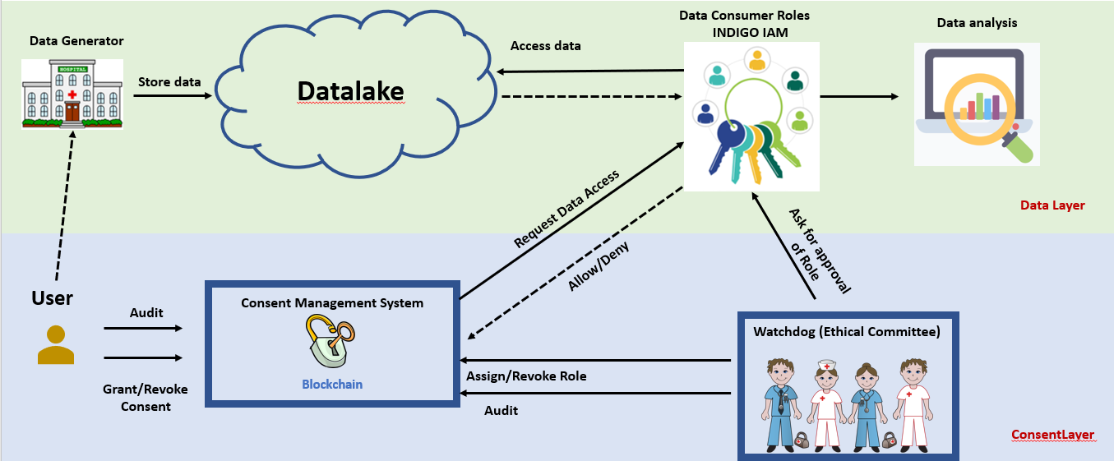
Consent Management System
A CMS supports users in controlling who can access their personal data and audit who has accessed their personal data by adding access control and transparency
Ideally a CMS shouldn’t be controlled by any individual/company, that’s why often blockchain approaches are considered for its implementation
A good practice in CMS is to decouple the consent layer from the data management layer
A CMS must be tamper-proof and auditable

