Slide 1
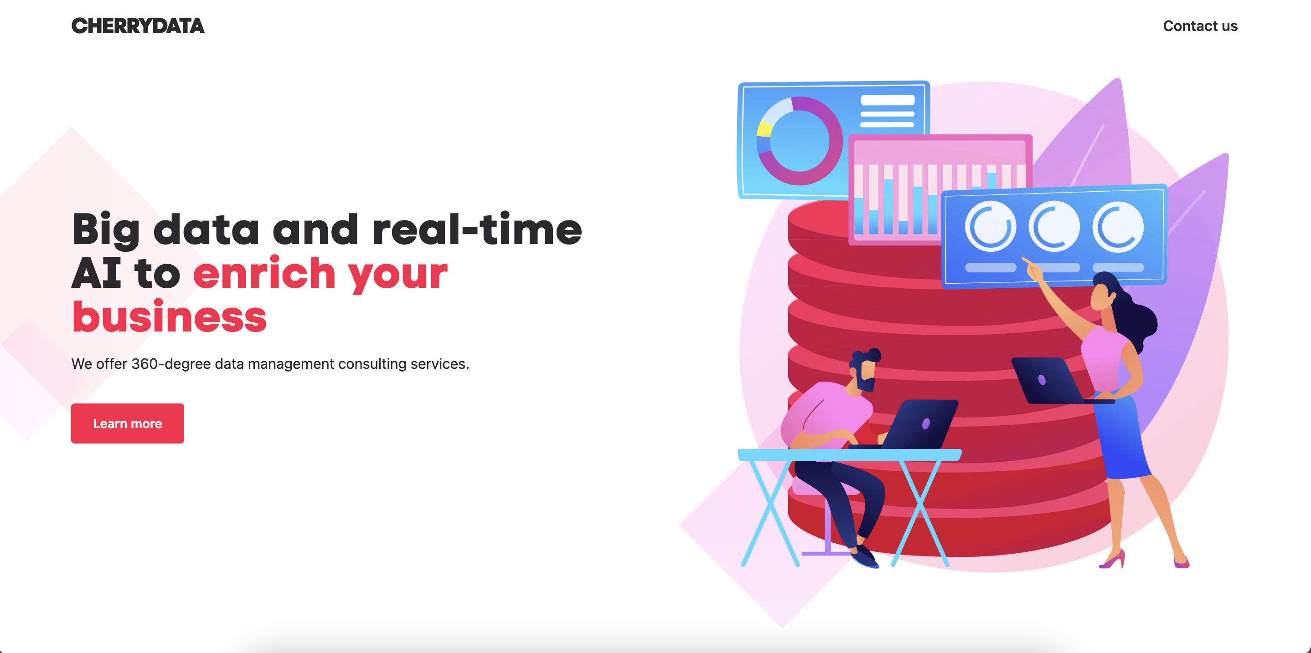
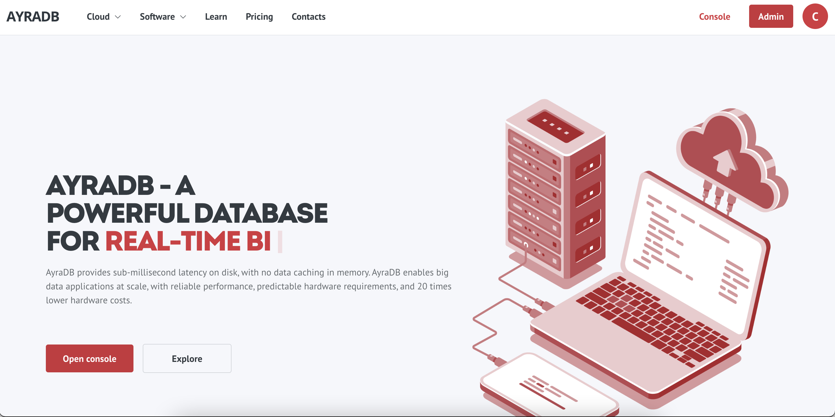
solutions for big data
efficient, scalable, green
www.cherry-data.com
www.ayradb.com
03/10/23

Slide 2
Contents:
Company Background ___________ 3
Technology ___________ 5
Performance ___________ 7
Benchmarks ___________ 8
Use cases ___________ 12
Business model ___________ 16
Strategy and Partnerships ___________ 17
Team and Organisation ___________ 18

Slide 3
Company Background
Cherrydata is a startup (and a spinoff of Politecnico di Milano) offering consulting, innovation, and research services on big data and analytics.
Our unique consulting skills are:
ability to make sense of data with a strong analytical, modeling, and scientific background,
ability to solve technical challenges, with a general, cross-industry hands-on approach to common issues in the application of innovative IT solutions to big data and analytics.
Traditional Business Intelligence
Advanced data analytics (Data Science with AI/ML techniques)
Real-Time data analytics exploiting Big Data
2000
2010
2018
Company founded

Slide 4
Experience
We have done over 30 projects of big data and analytics, about 10 in the space industry:
tackling the most difficult problems,
where market software tools do not satisfy requirements (or are unconvincing black boxes),
developing innovative ad hoc solutions that have provided tangible competitive advantage,
with a measurable returns (QoS, revenues, margins, adherence to therapy, customer retention…).
Change/anomaly detection (space, environmental and security domain)
Targeting and recommendations (retail, tourism, utility, pharma)
BDA for EO (space, emergency and security)
Couponing, churn and promotions (retail, travel)
Price optimization and dynamic pricing (travel, retail)
Data monetization (energy)
Assortment optimization (retail)

Slide 5
Technology
✓
€
PROJECT START
2018
UPTIME
36 MONTHS
DATA HANDLED
10 PETABYTE
TOTAL DEV EFFORT
8 YEARS
x
Problem
statement
Failure to scale of open-source databases, lock in and high costs of proprietary solutions
Solution
We have designed AyraDB to enable the economic scalability of big-data projects with a green approach
Market traction
AyraDB is operational with 5 clients, including Bayer, Zeiss, and ESA
Partners
Team
7 people (6 tech)
7/2018
9/2018
12/2020
4/2021
9/2022
6,11/2021, 7/2022
8/2023
x
x
x
x
x
x
x
Company
founded
1st deployment
on-premises
(retail)
Signed
1st partnership
(KPMG)
Launched online demo service www.ayradb.com
Completed third-party benchmark (HPC Leonardo)
Winner AWS, DMS and Scaleway acceleration programmes
Signed
1st international
partnership (Yindeo)

Slide 6
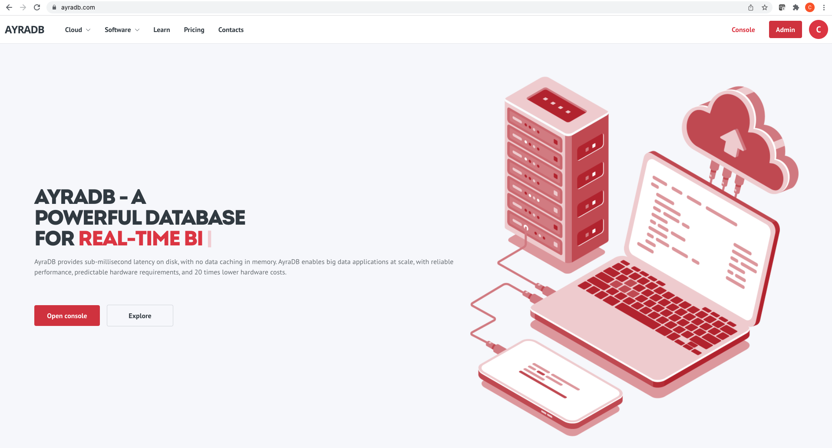
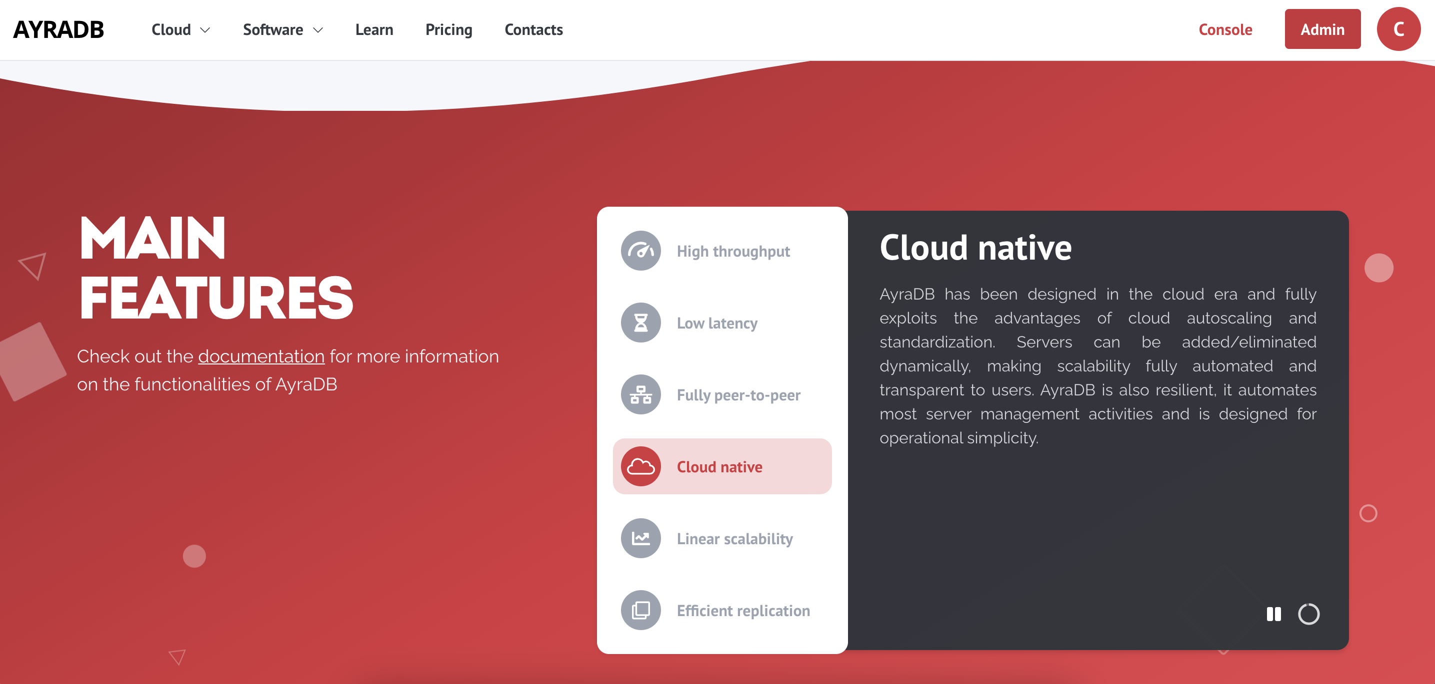
Technology Advantage
AyraDB matches the performance of the best in-memory databases at a fraction of the cost (20X reduction) by keeping data entirely on disk
AyraDB has consistent performance with all types of operations, read, insert, and update
AyraDB is the only existing database that is fully peer-to-peer, with a linear scalability that is not affected by data size
AyraDB is scalable both in cloud and on small edge devices, such as Raspberry (demo service available at www.ayradb.com)
AyraDB has an open community version available from https://hub.docker.com/r/cherrydatadocker/ayradb

Slide 7
Performance Edge
Results of Euro NCC project, tests on Leonardo Davinci-1 supercomputer
Maximum throughput of read/update operation, 1 to 13 servers (8 CPUs, 16Gbyte RAM, 256 Gbyte SSD), server, table size equal to 10 GByte/server, 20 GByte/server, 30 GByte/server, 40 GByte/server.
Test performed with 10 Gbps Ethernet (teststo be extended to Infiniband)
AyraDB has 5X throughput compared to best-in-class competitors.

Slide 8
Summary Comparison with Market Leaders
AyraDB and 10 times the performance of Google’s BIGTABLE (slide 8 and https://cloud.google.com/bigtable/docs/performance)
AyraDB has 10 times the performance of Google’s BIGQUERY (see https://www.toptal.com/database/google-bigquery-tutorial)
AyraDB has twice the performance of REDIS, but REDIS is in-memory, while AyraDB is on disk with no caching, 20X cost reduction (slide 9)
MongoDB does not have linear scalability with schemeless data, while AyraDB has linear scalability with AyraDB’s schemeless tables (slide 10)
AyraDB has 6 times the performance of COUCHBASE, with linear scalability, while COUCHBASE can scale to up to 10 servers (slide 8 and couchbase.com/benchmarks)
AyraDB and 15 times the performance of POSTGRES (see https://www.toptal.com/database/google-bigquery-tutorial)

Slide 9
Let’s Make Sense of Performance
Industry: space.
Use case: change/anomaly detection based on earth observation (EO) data and machine learning (ML) techniques.
Example: detect changes in the Arctic region with Sentinel 5p pollution data.
Data size: the Arctic is approximately 15 million Km², 1 pixel of Sentinel 5p is approximately 4 Km², for a total of 3.75 million pixels for the whole Arctic region. A time series of 1 year would be roughly 273 Gbyte.
AyraDB’s performance: We could query 1 year of a standard 100x100 km region in 1 second. With Google Bigtable we would need 100 servers instead of 13 to (possibly) obtain the same performance, or wait for 10 seconds with 13 server, or move data in RAM with massive costs.
Value proposition: enabling a shift of paradigm from batch processing and predefined tiled and time-sliced images, to real-time queries over a large area with an interactive visualization approach.

Slide 10
Technology Stack
USER
Distributed data integration (Alluxio, Anylog)
Client libraries
(Python, Node.js, Java, C)
End-to-end Machine Learning (OpenAPI)
Data Access (Open API) and visualization (Grafana)
API
Data Preparation (AWK, Pandas, PySpark)
Modeling
(Scikit-learn, Tensorflow)
Data authorization & authentication
AyraDB (Key-value, SQL, Geoqueries)
Blockchain
Knobs (Polygon, Algorand, Ethereum, Knobs)
CORE
AyraDB server
Docker container (public image on Dockerhub)
Kubernetes Helm Chart (public repository)
AWS AMI image (TBD)
AyraDB client libraries:
Python: https://pypi.org/project/ayradb/
Node.js: https://www.npmjs.com/package/ayradb
Java: publicly available on Maven (TBD)
C: publicly available on GitHub (TBD)
OpenAPI:
Automatic deployment on Docker/Kubernetes
API reference available on GitLab as Jupyter Notebooks

Slide 11
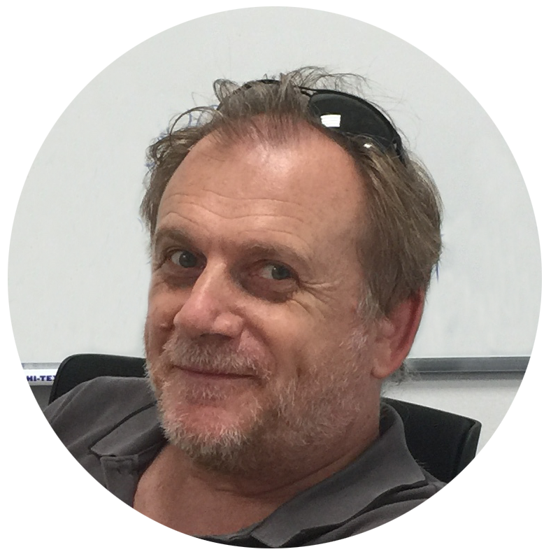
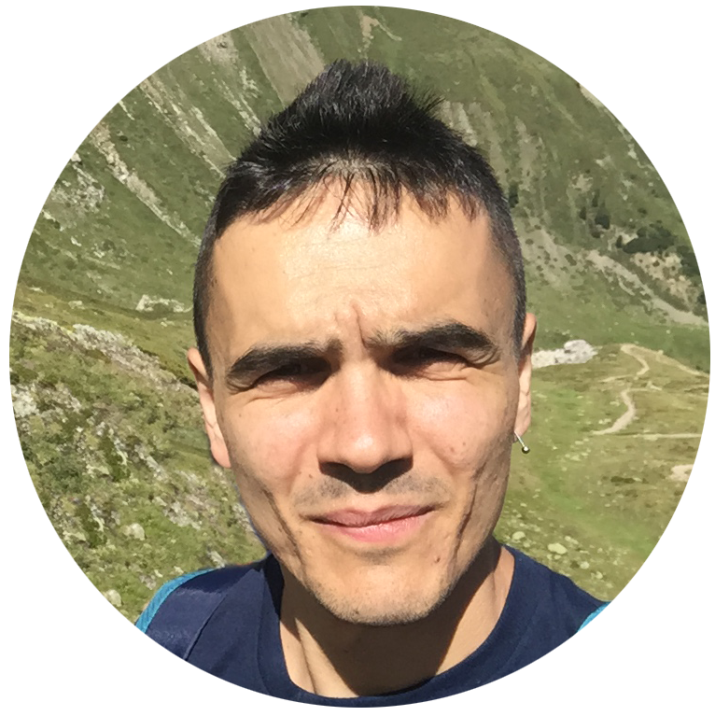
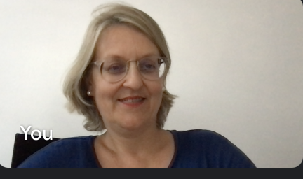
Team and Organisation
The current team has over 50 years of experience in management consulting.
Management Board (Co-founders)
TECHNOLOGY
CEO/ DEVOPS
SALES
Paolo Giacomazzi
20 years
High-efficiency software design experience
Paolo Ravanelli
10 years
Technology and Development
Experience
Chiara Francalanci
20 years
IT strategy and
business innovation experience
Technology development
Technology maintenance
Development
and testing
Support
Consulting
Clients & partners
Management Consulting
ADVISORY BOARD
Beppe Ugolotti
Business Angel
Carlo Alberto Carnevale Maffè, Professor of Strategy, Bocconi University
Gabriella Cattaneo, Associate Vice President, IDC European Government Consulting
Luigi Conti, President, Geminea VC
José Miguel Espinosa, Head of Digital Transformation, Galp
Paolo Valcher, Director, Microsoft Italy

Slide 12
Thank you!

Slide 13
Chiara Francalanci was born in 1968 in Piacenza (Italy). She graduated in Electronic Engineering from Politecnico di Milano in 1991, where she has also completed her Ph.D. in Computer Science in 1996. She has worked for two years as a junior consultant in Nolan Norton & Co. (now KPMG), assessing IT management maturity with the balanced scorecard. With the support of Nolan Norton & Co., she has worked for two years at the Harvard Business School, where she also graduated in Management of the Information Systems Resource. She has extensively consulted in the financial, retail and manufacturing industries, both in Europe and the U.S. In 2001, she became associate professor of business information systems at Politecnico di Milano. She has international teaching experience and consolidated management skills of research projects, both private- and public-funded, Italian and European. She has designed, developed, patented and sold to companies several innovative algorithms and systems. She has coordinated industrial projects on algorithms for customer segmentation, predictive modelling and online recommendation systems. In 2011, she has launched her first startup, Jeenuin Inc. in Silicon Valley, to develop a sentiment analysis software. In 2018, she co-founded Cherrydata in Milan, Italy.
Role: co-founder and innovation management, chiara.francalanci@cherry-data.com
info@cherry-data.com | www.cherry-data.com

Slide 14
Paolo Giacomazzi was born in 1965 in Mantova (Italy). From 1979 to 1983, he has worked as freelance programmer for Antek SaS (Mantova, Italy) for the development of accounting systems in Basic language, optimization algorithms of animal food composition in Pascal language on Apple II, special routines for microprocessors MOS 6502 in assembly code. From 1984 to 1990, he has studied Electronic Engineering at Politecnico di Milano, where he graduated magna cum laude and has been awarded the “Giovanni Oglietti 1991” prize from the AEI (Italian Association for Electronic Engineering). In 1990, he graduated in “Information Technology” from Cefriel research center. From October 1990 to the end of 1991, he has been Lieutenant of the Technical Corps of the Italian Army where he has participated in the development of optimization algorithms for the placement of anti-aircraft batteries, in C language. In 1992, he became assistant professor at Politecnico di Milano. In 1995, he has worked at the University of Mississippi (USA) as a visiting scholar, doing research on wireless communication networks. In 1998, he became associate professor of Multimedia Internet at Politecnico di Milano. In 1998, he has launched his first startup to develop fast simulation software for the performance evaluation of large-scale telephone and data networks. In 2011, he has launched his second startup, Jeenuin Inc. in Silicon Valley, to develop a sentiment analysis software. In 2018, he co-founded Cherrydata.
Role: co-founder and CTO, paolo.giacomazzi@cherry-data.com
info@cherry-data.com | www.cherry-data.com

Slide 15
Paolo Ravanelli is co-founder and CEO of Cherrydata. He graduated in Computer Engineering from Politecnico di Milano in 2011. After graduation, he has cooperated to research activities within the information systems group of the Department of Electronics, Information and Bioengineering of Politecnico di Milano, working at several projects, both funded and industrial, as head of the information system lab, ISOLAB, of Politecnico di Milano. He has vast knowledge of computer engineering, on different operating systems (Mac OS, Linux, Windows, iOS, Android), and with different programming environments (Java, C, Objective-C, Javascript, Python, Swift, Php, R). He has outstanding system management competences and can effectively perform the architectural design of complex software systems in an enterprise context. He has system integration experience, with over 10 projects in the space industry, and has designed and deployed several systems in industrial contexts, including time-critical applications. He is expert of big data solutions (Hadoop, Spark) and can design and manage the technology stack for big data, from the design of the hardware architecture, to application development. He has excellent teamwork skills, in national and international projects. He can manage a team, with a participatory management style that he had developed within research and innovation projects. In 2018 he has co-founded Cherrydata, where he has been appointed as CEO in 2021.
Role: co-founder and CEO, paolo.ravanelli@cherry-data.com
info@cherry-data.com | www.cherry-data.com

