Slide 1
Unraveling Solar Dynamics:
Metis Observations of Eruptive Flux Ropes
and
Magnetic Disturbances
Romano, P.(1), Wyper P.(2), Andretta V.(3), Spadaro D.(1), Russano, G. (3), Abbo L.(4), Romoli M.(5), Antiochos S.(6), MacNeice P.(6), Viall N.(6), Ventura R.(1) & the Metis team
INAF – OACT
(2) Durham University, UK
(3) INAF - OAC
(4) INAF – OATo
(5) Università di Firenze
(6) NASA/GSFC

Slide 2
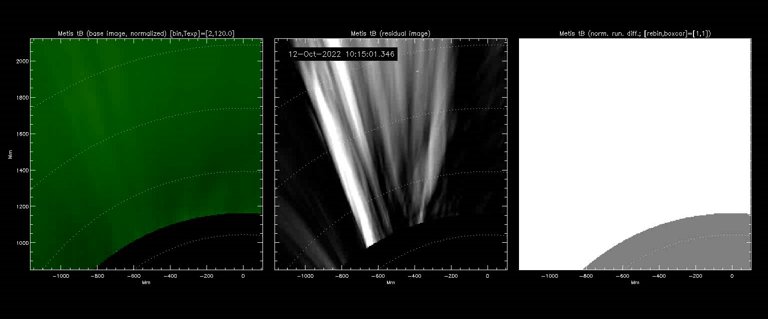
Solar eruption – Oct 12, 2022
Metis dataset
Total brightness
Normalized running differences
From 10:15:01 UT to 20:16:44 UT
Δt=2’01’’
No of images: 299

Slide 3
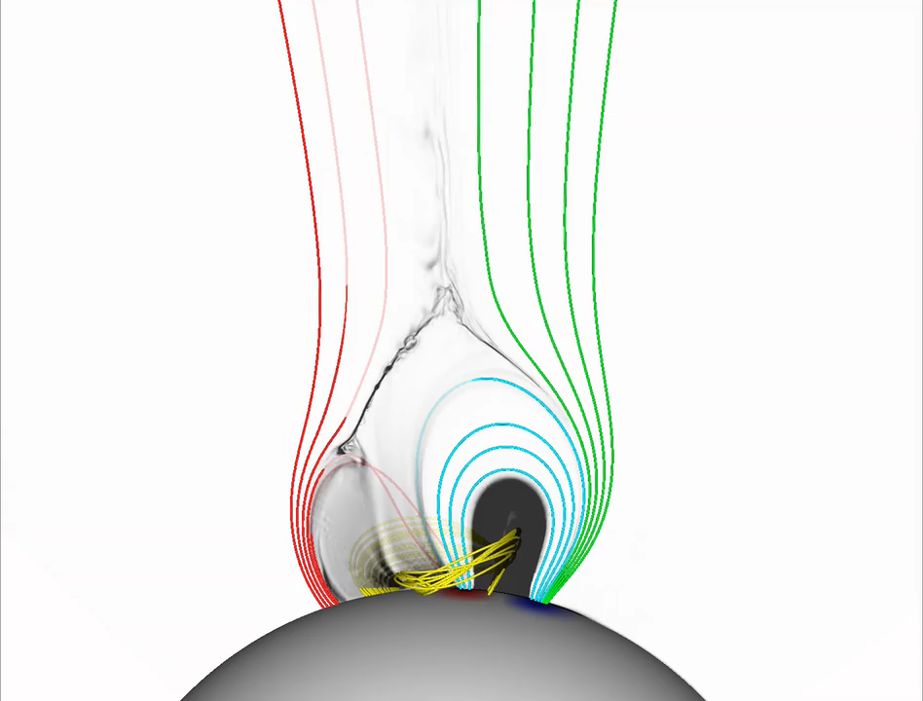
High-resolution magnetohydrodynamics simulation
ARMS (DeVore & Antiochos 2008)
The simulation is initialized with a monopolar ambient magnetic field combined with 16 subsurface magnetic dipoles.
They applied surface motions along contours of Br (Wyper et al., 2018)
Many plasmoids identifiable by their increased plasma density
by Wyper et al. (2022)
The disturbances are launched into the solar wind by intermittent interchange reconnection

Slide 4
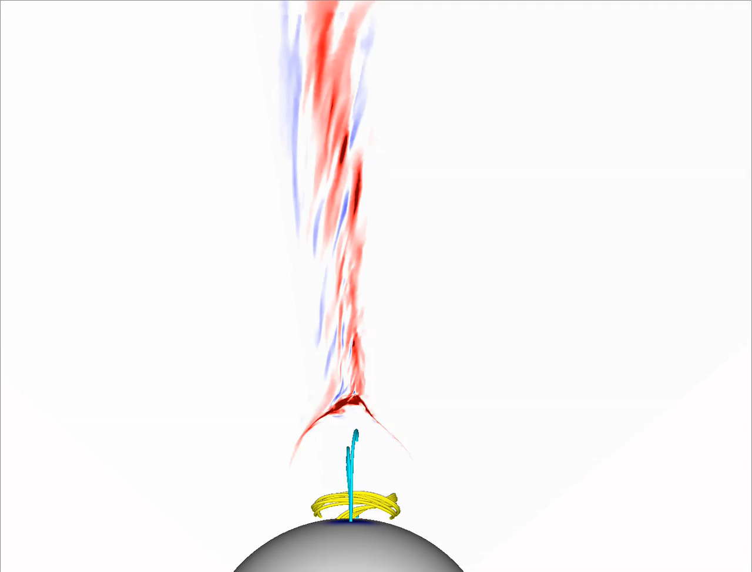
High-resolution magnetohydrodynamics simulation
As the plasmoid flux rope runs into the open field at the end of the current layer, the twist within the structure begins to spread along the length of the field lines.
This spreading launches a curtain of torsional Alfvénic waves.
by Wyper et al. (2022)

Slide 5
High-resolution magnetohydrodynamics simulation
A denser field aligned flow is a signature of the enhanced density previously present within the plasmoid flux ropes that trails the Alfvénic wave propagation at a lower speed.
The switchbacks could be the solar wind imprint of intermittent interchange reconnection in the corona

Slide 6
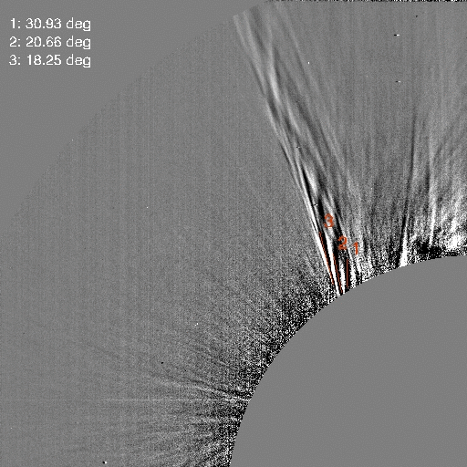
Solar eruption – Oct 12, 2022
Metis dataset
Total brightness
Normalized running differences
From 10:15:01 UT to 20:16:44 UT
Δt=2’01’’
No of images: 299
We measured the inclination of the "helicoidal" structures, represented by the black lines.
The reported angles (in degrees) represent the angles between the filamentary structures and the perpendicular to the solar surface.
Due to the 2-minute time cadence, establishing a direct correspondence among the filamentary structures in the sequence of frames is not feasible.

Slide 7

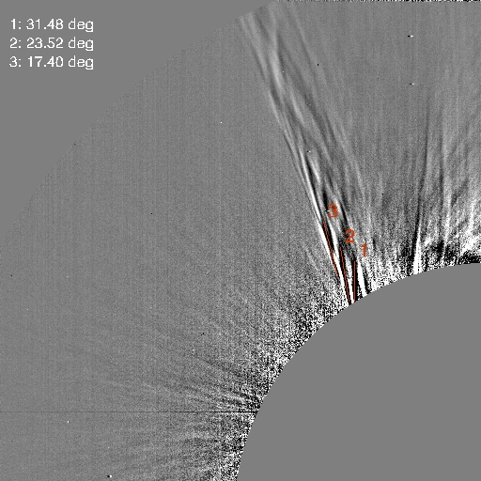
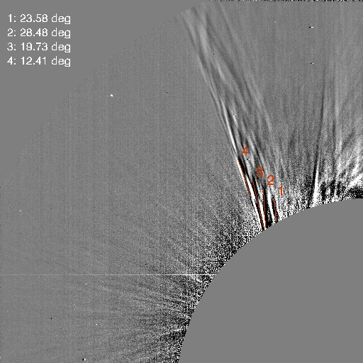
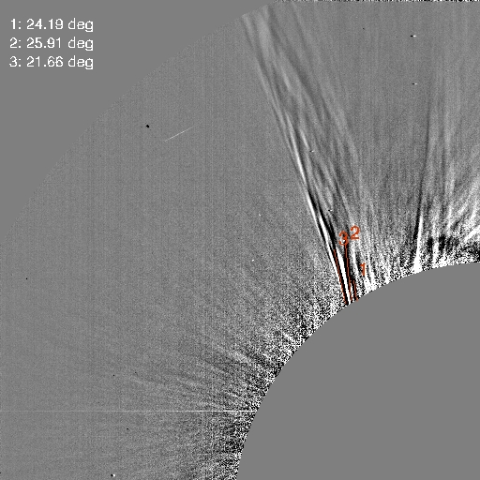
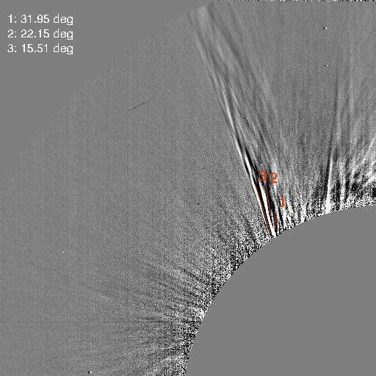
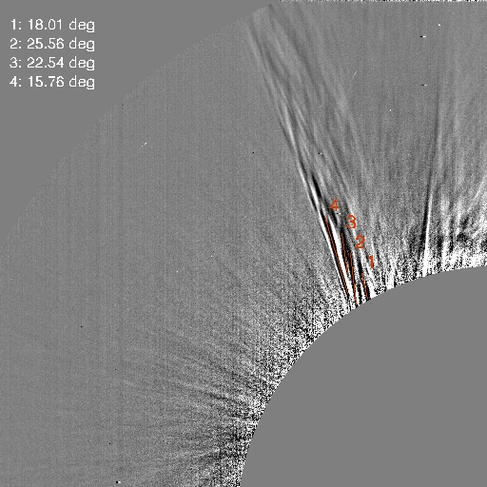
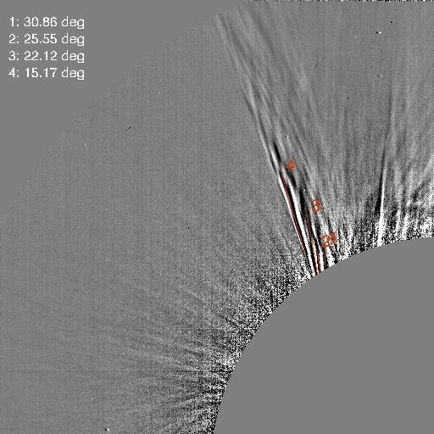
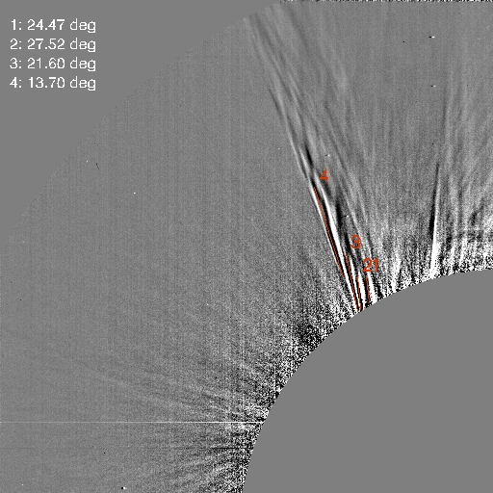
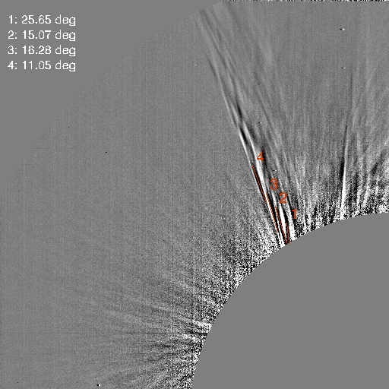
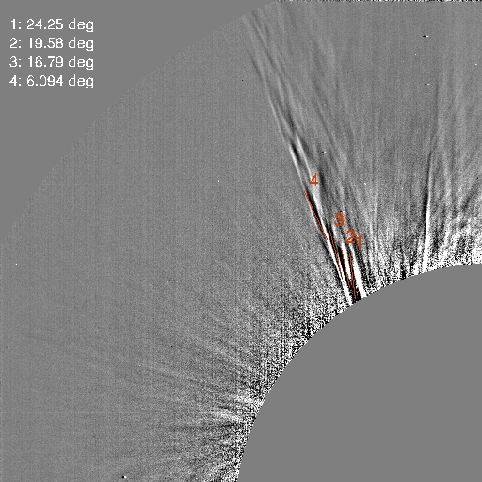
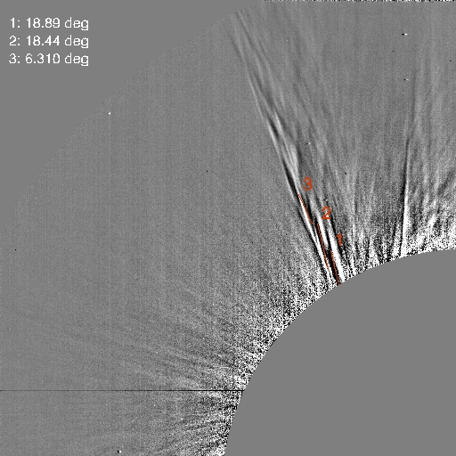
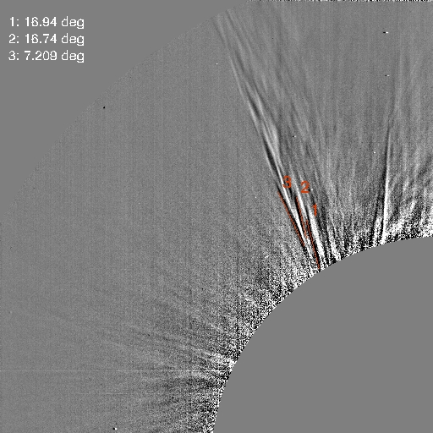
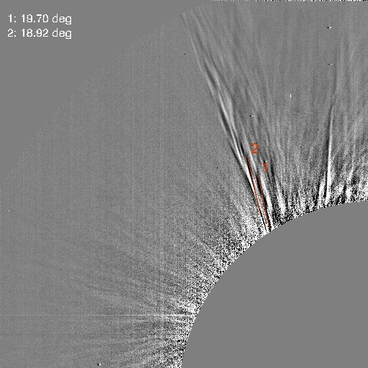
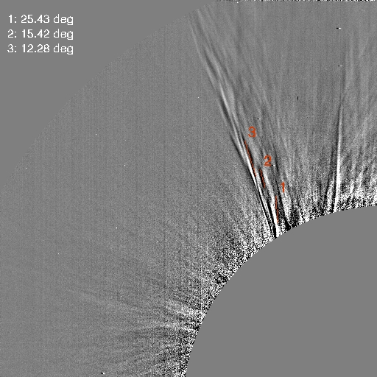
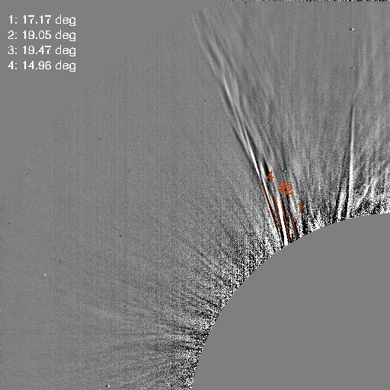
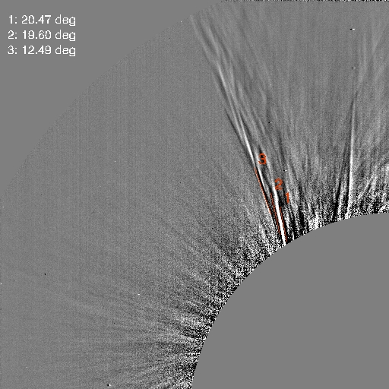
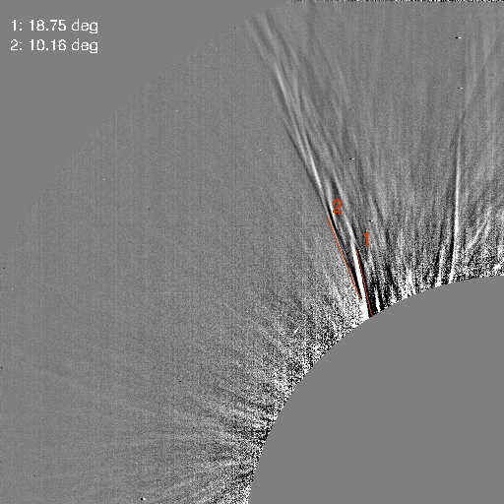
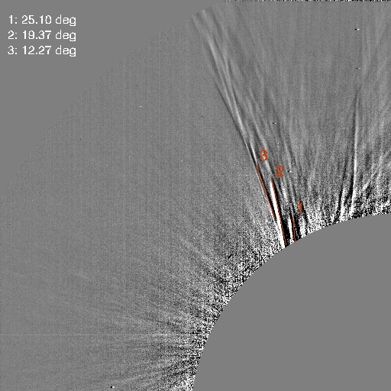
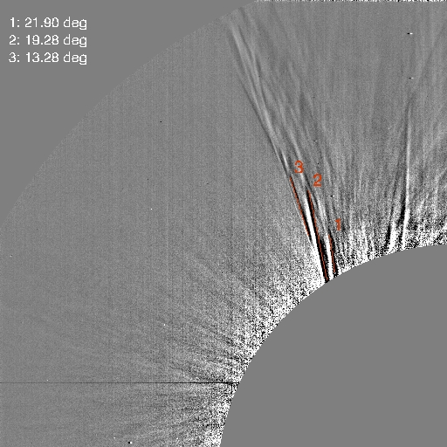
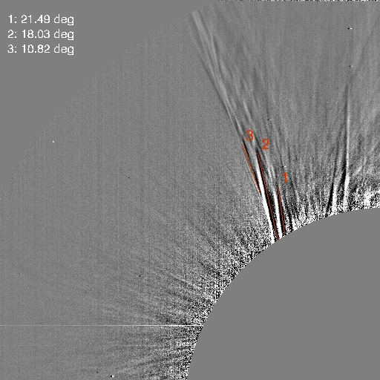
Inclination of the helix threads
Metis dataset
Total brightness
Normalized running differences
From 10:15:01 UT to 20:16:44 UT
Δt=2’01’’
No of images: 299
Oct 12, 2022
The higher the polar angle, the lower the inclination
While we did not measure the inclination of the bright filamentary structures, we speculate that they exhibit a similar behavior.
This assumption is based on the observation that the width of the bright and dark filamentary structures remains nearly constant along their length.

Slide 8
Solar eruption – Oct 12, 2022
Metis dataset
Total brightness
Normalized running differences
From 10:15:01 UT to 20:16:44 UT
Δt=2’01’’
No of images: 299
Oct 12, 2022
A similar helicoidal strucuture is visible at a lower polar angle.
This observation leads to the interpretation that it could be the other leg of the flux tube involved in the eruption.
It appears that in this portion of the flux tube, the inner helicoidal structures have a higher inclination than the outer ones

Slide 9
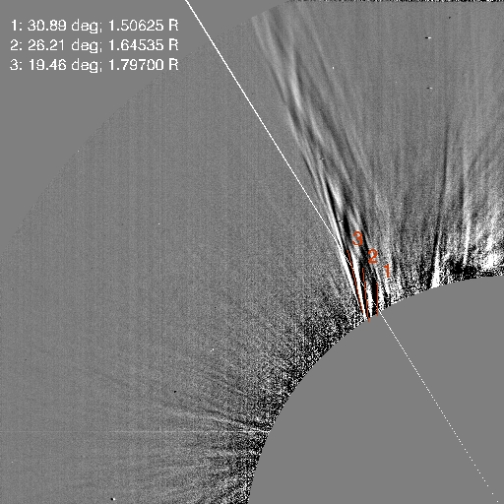
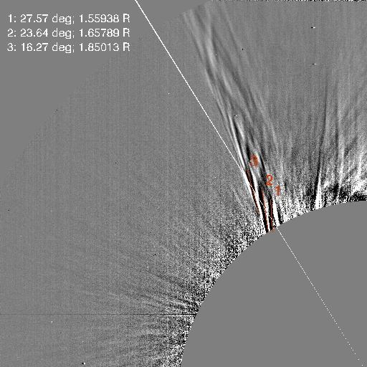
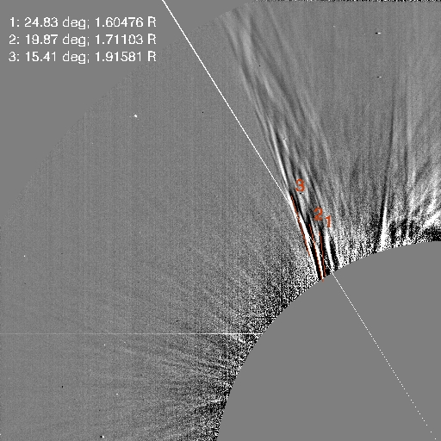
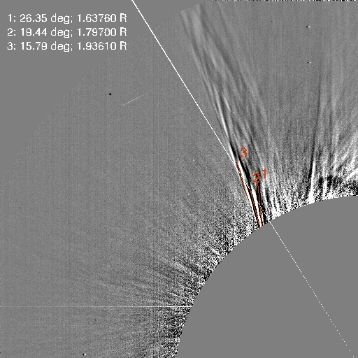
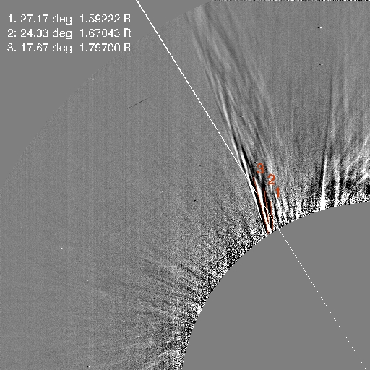
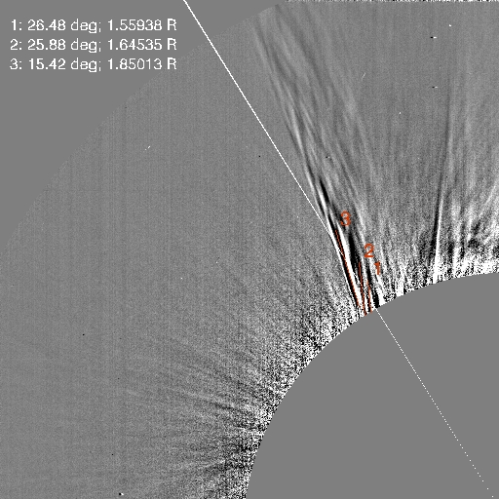
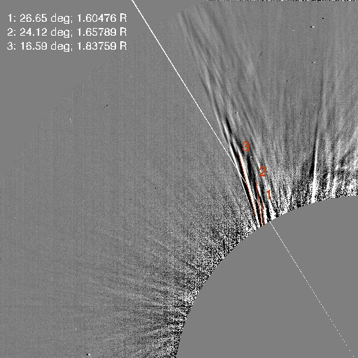
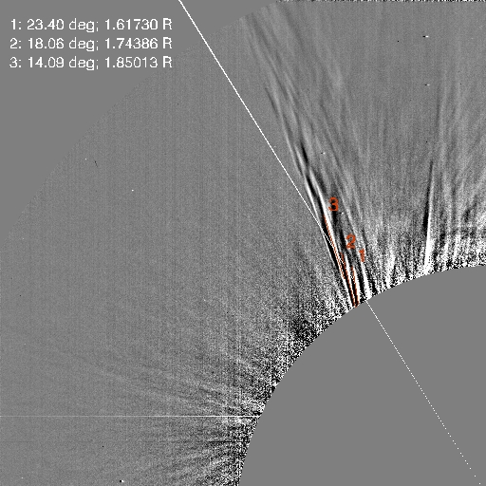
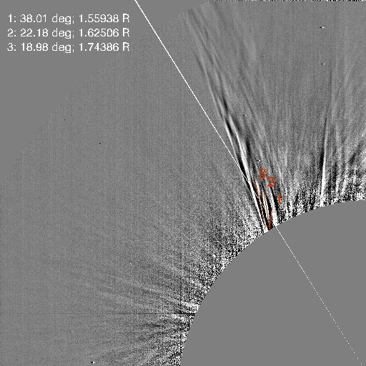
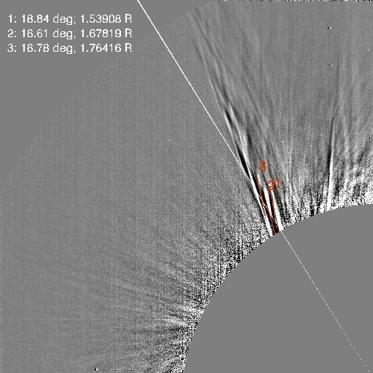
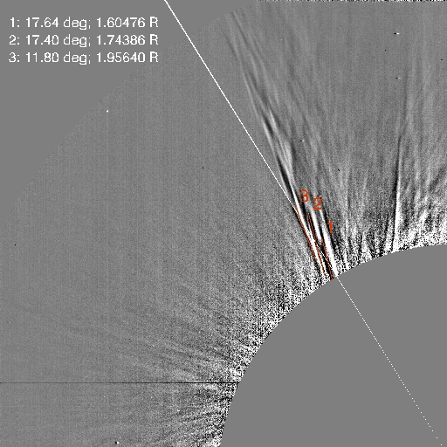
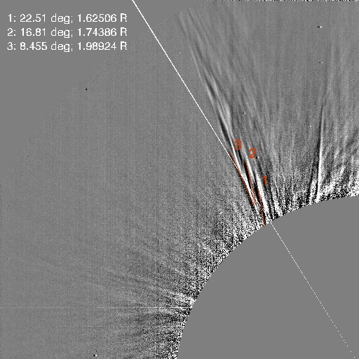
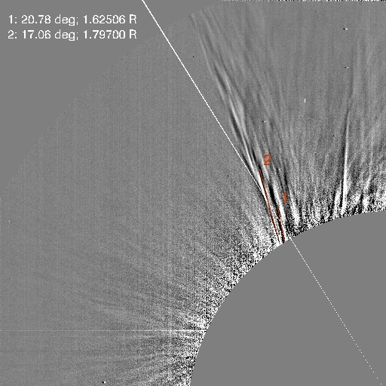
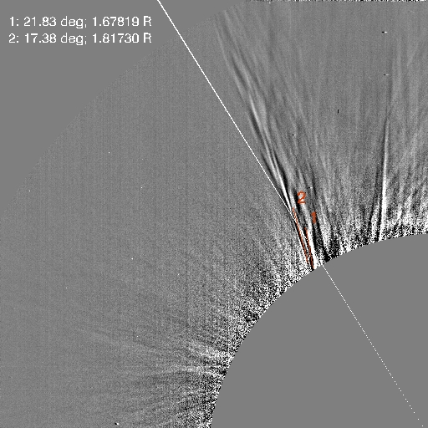
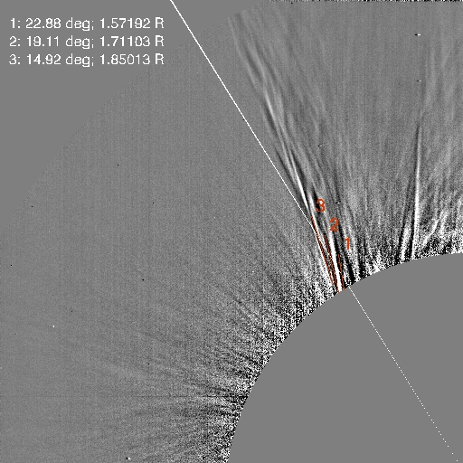
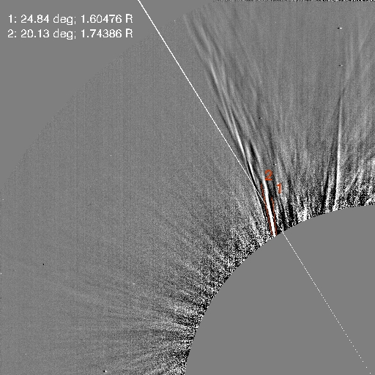
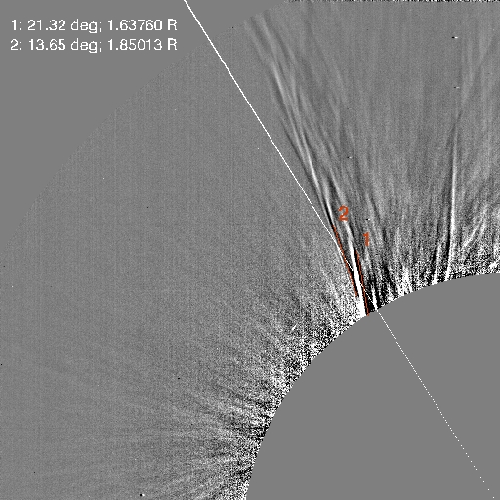
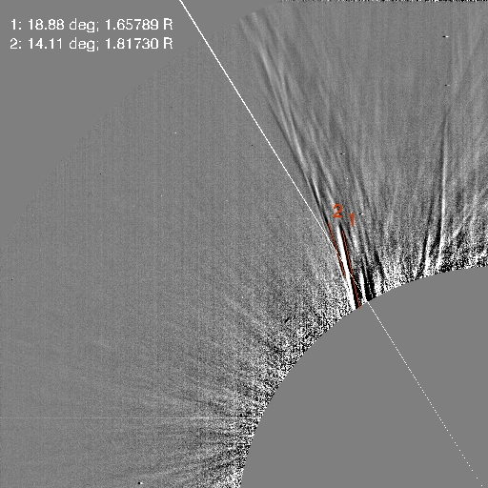
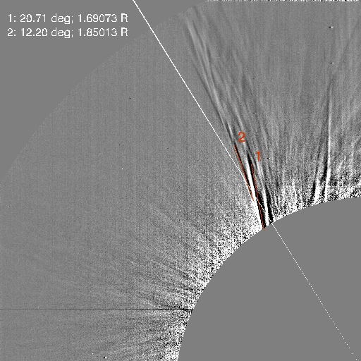
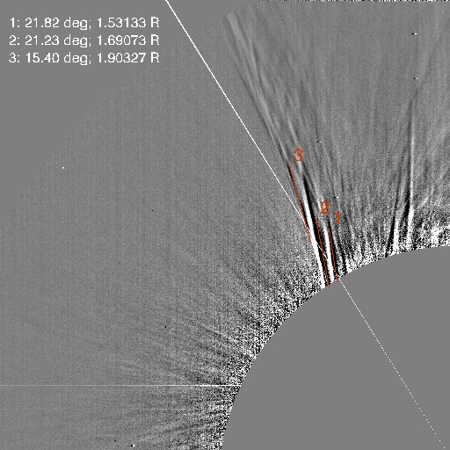
Frame | Feature | Inclination (degrees) | Helix pitch (Solar Radii)
1 | 0 | 30.8912 | 1.50625
1 | 1 | 26.2123 | 1.64535
1 | 2 | 19.4663 | 1.797
2 | 0 | 27.5778 | 1.55938
2 | 1 | 23.6442 | 1.65789
2 | 2 | 16.2753 | 1.85013
3 | 0 | 24.839 | 1.60476
3 | 1 | 19.8773 | 1.71103
3 | 2 | 15.4101 | 1.91581
4 | 0 | 26.3547 | 1.6376
4 | 1 | 19.4403 | 1.797
4 | 2 | 15.7972 | 1.9361
5 | 0 | 27.176 | 1.59222
5 | 1 | 24.3379 | 1.67043
5 | 2 | 17.6777 | 1.797
6 | 0 | 26.4856 | 1.55938
6 | 1 | 25.8865 | 1.64535
6 | 2 | 15.4286 | 1.85013
7 | 0 | 26.6512 | 1.60476
7 | 1 | 24.1253 | 1.65789
7 | 2 | 16.591 | 1.83759
8 | 0 | 23.4034 | 1.6173
8 | 1 | 18.0623 | 1.74386
8 | 2 | 14.0949 | 1.85013
9 | 0 | 38.01 | 1.55938
9 | 1 | 22.1853 | 1.62506
9 | 2 | 18.9802 | 1.74386
10 | 0 | 18.846 | 1.53908
10 | 1 | 16.6122 | 1.67819
10 | 2 | 16.784 | 1.76416
11 | 0 | 17.6461 | 1.60476
11 | 1 | 17.4032 | 1.74386
11 | 2 | 11.8018 | 1.9564
12 | 0 | 22.5109 | 1.62506
12 | 1 | 16.8132 | 1.74386
12 | 2 | 8.45584 | 1.98924
13 | 0 | 20.7827 | 1.62506
13 | 1 | 17.0695 | 1.797
14 | 0 | 21.8304 | 1.67819
14 | 1 | 17.3814 | 1.8173
15 | 0 | 22.8854 | 1.57192
15 | 1 | 19.1192 | 1.71103
15 | 2 | 14.9243 | 1.85013
16 | 0 | 24.8437 | 1.60476
16 | 1 | 20.1398 | 1.74386
17 | 0 | 21.3213 | 1.6376
17 | 1 | 13.6525 | 1.85013
18 | 0 | 18.8838 | 1.65789
18 | 1 | 14.1153 | 1.8173
19 | 0 | 20.7143 | 1.69073
19 | 1 | 12.2055 | 1.85013
20 | 0 | 21.8229 | 1.53133
20 | 1 | 21.2329 | 1.69073
20 | 2 | 15.4067 | 1.90327
Helix pitch
*
*
Oct 12, 2022
The pitch of the helix seems to increase with radial distance
Notes:
Having considered only three points, we observe that it doubles when considering the two intervals

Slide 10
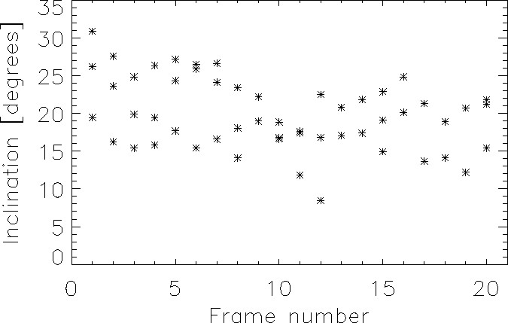
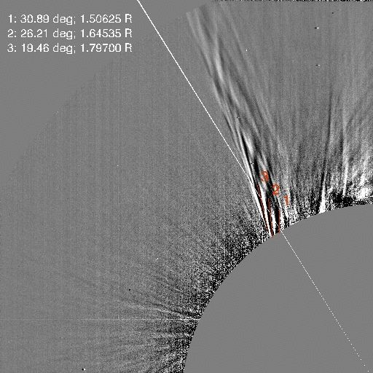
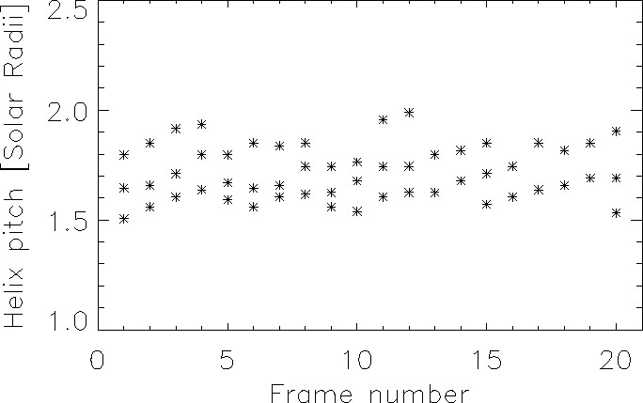
Inclination and pitch vs. time
Gradual reduction in the inclination angle of the structures over time.
Negligible variation in the pitch of the helix over time.

Slide 11
Next Step
Oct 12, 2022
Wyper et al. 2022
Comparison between Observations and Simulations

Slide 12
Summary
- The higher the polar angle, the lower the inclination
- The pitch of the helix seems to increase with radial distance
- Gradual reduction in the inclination angle of the structures over time
- Negligible variation in the pitch of the helix over time
A gradual opening of the legs of the flux tube, constituting the coronal mass ejection, and its unfolding
Next steps
Pursue the analysis of parameters, considering all frames, i.e., extending the temporal analysis
Verify the potential for intermittent interchange reconnection processes through comparison with the same parameters derived from simulations.

Slide 13
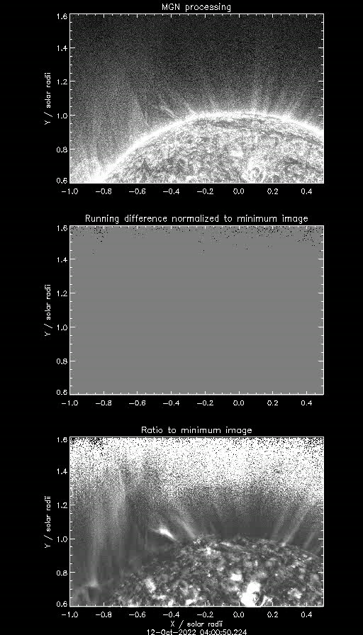
Solar eruption – Oct 12, 2022
EUI dataset
By examining the running difference of the EUI images, we observe an eruptive flux rope where we can distinguish the presence of two footpoints.
This finding leads us to interpret the Metis helicoidal features as a consequence of the growing and opening flux tube in the outer corona.
To further investigate this correlation, it might be beneficial to measure the inclination of the main visible structures in EUI images and seek potential correspondence with the filamentary structures visible in Metis images.

Slide 14
Thank you for your attention

