Slide 1
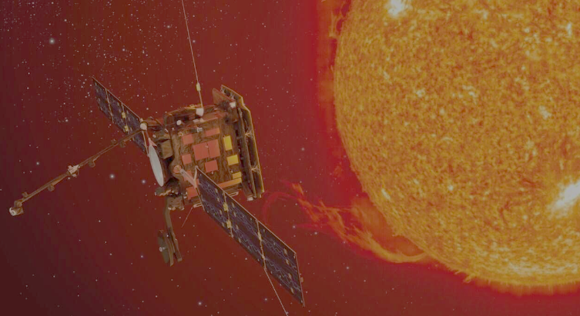
Evolution of the streamer belt and magnetic field topology in the middle corona: the Metis coronagraph point of view (work in progress)
F. Frascella^{1,2}, S. Fineschi¹, R. Susino¹ and Metis Team
9th Metis Workshop, Catania
24-26/01/24
¹ INAF, OATo
²Univ. Turin

Slide 2
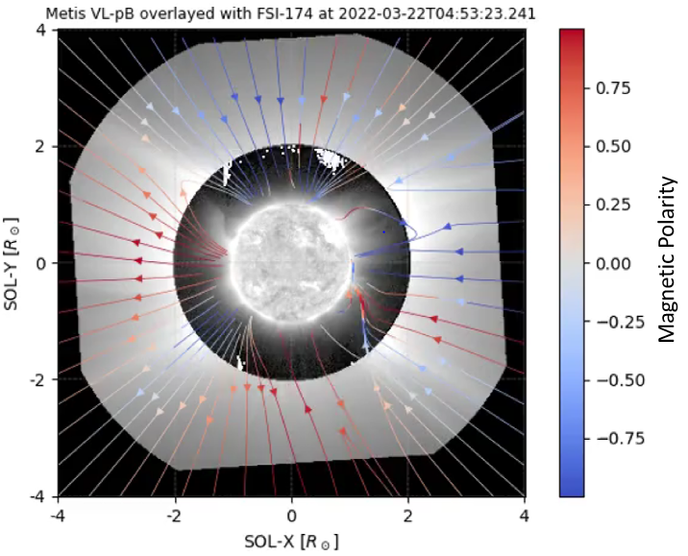
Introduction
Global evolution of the streamer belt & Magnetic topology for channeling solar wind
The high spatio-temporal resolution of the Metis coronagraph allows us to monitor the longer-term evolution and thus address the physics and evolution of the large-scale corona in response to the evolution of the magnetic field of the Sun
Metis can outline the magnetic features of the solar atmosphere based on polarised visible light (VL-pB) images, and trace the regions where the coronal magnetic field is open/closed
These observations are also crucial to the assessment of the role of magnetic topology in regulating the solar wind speed and properties and thus to test alternative hypotheses on the origin and sources of the fast and slow wind.

Slide 3
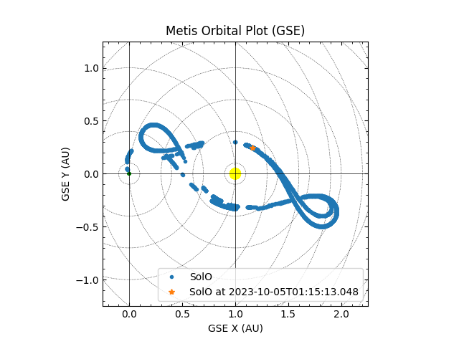
Metis VL-pB & LASCO/C2 WL comparison
An example: 4st perihelion
Possibility of 3D reconstruction of CME events in LASCO/Metis quadrature
Metis VL-pB intensity shows variability due to orbit phase

Slide 4
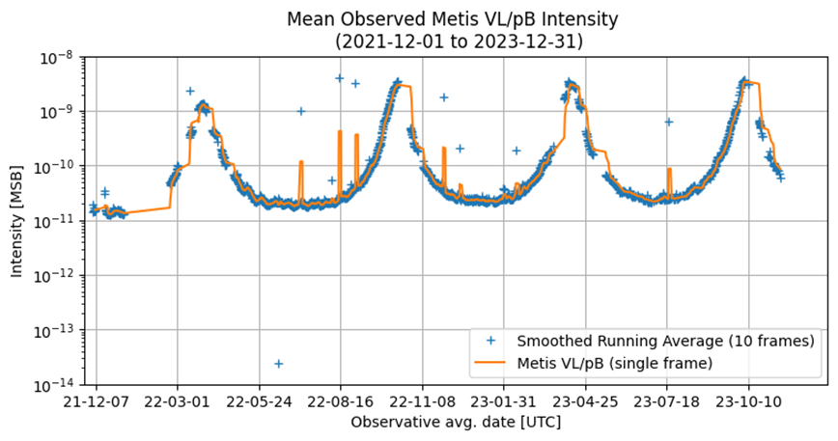
Metis VL-pB intensity variability
Remote Sensing Windows (Near Perihelia)
Corrupted FITS/Debris
Synoptic Observation

Slide 5
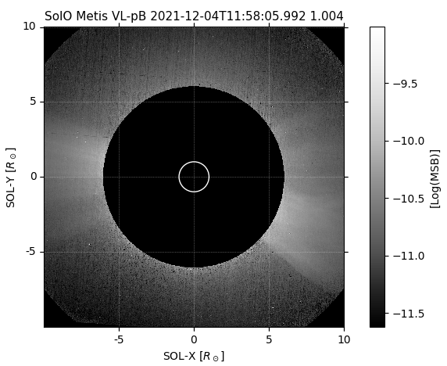
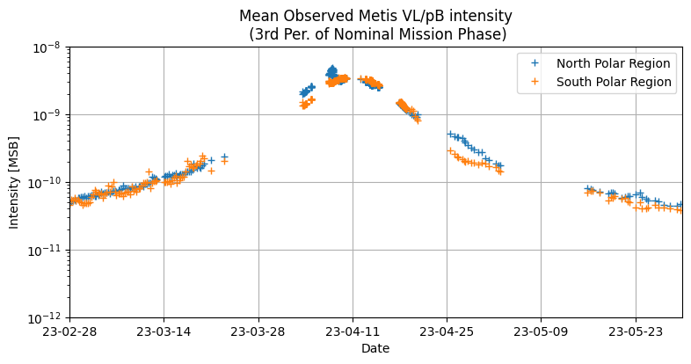
Metis VL-pB intensity variability (polar regions)

Slide 6
Post-processing
Streamer belt evolution
Sub-set selection:
One image every 6 hour (>0.35 AU)
Every image near perihelia RSW (<0.35 AU)
Standardisation:
Rotating (North Up)
Re-centering w.r.t. sun center
Fixing the plate scale so that Rsun = 50 pix
Fixing the Field of View (FoV) to 10 Rsun
Data Filtration via NRGF (Morgan + 2006)
Time-lapse generation for the NMP (1° Dec 21 → end of 2023)
Coronal topology
Overplot MAS fieldline and compute polarity

Slide 7
VL-pB streamer belt evolution

Slide 8
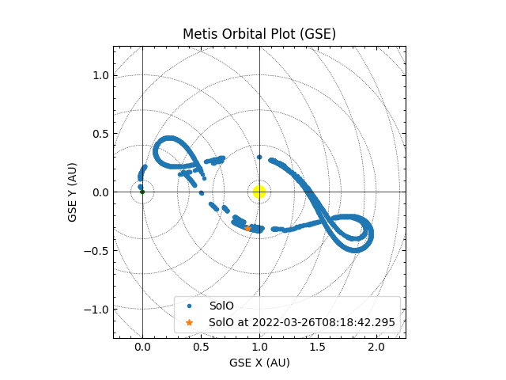
Coronal Magnetic Topology with PSI-MAS Model
PSI-MAS (Magneto-hydro Alg. Around a Sphere):
Resistive force-free MHD model
Used from late 90s for eclipses/Whole Sun Month (Lionello+ 2009)
Steady Corona
Data range: 1° NMP perihelium (22 Apr 2022 → 29 Apr 2022)
Fieldlines related to steady-coronal structures (streamers, CHs etc.) but transients are not descripted by PSI-MAS
1st perihelion
Magnetic Polarity

Slide 9
Comparison Metis pB/Simulated pB/Bmag (in PoS)

Slide 10
Early results & further directions
The VL-pB subset shows a high brightness variability, due to both the orbital phase and increasing solar activity
Streamer belt moves mid-to-high latitudes
Increase in transients phenomena
Good qualitative match between PSI-MAS fieldlines and the quasi-steady corona topology
Comparison with other model (PSFF) and with other coronagraphs (e.g. LASCO, STEREO-A/COR2)
Further study on possible Bmag/pB anticorrelation in the middle corona
Bmag in shock CME
Investigating the differences in the intensity of the two polar regions

Slide 11
Thanks for the attention

