Slide 1
17th European Solar
Physics Meeting

Slide 2
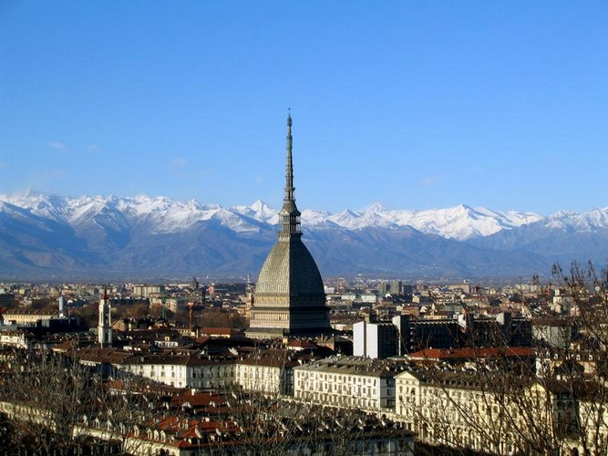
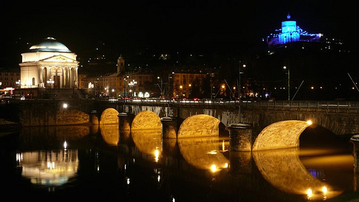
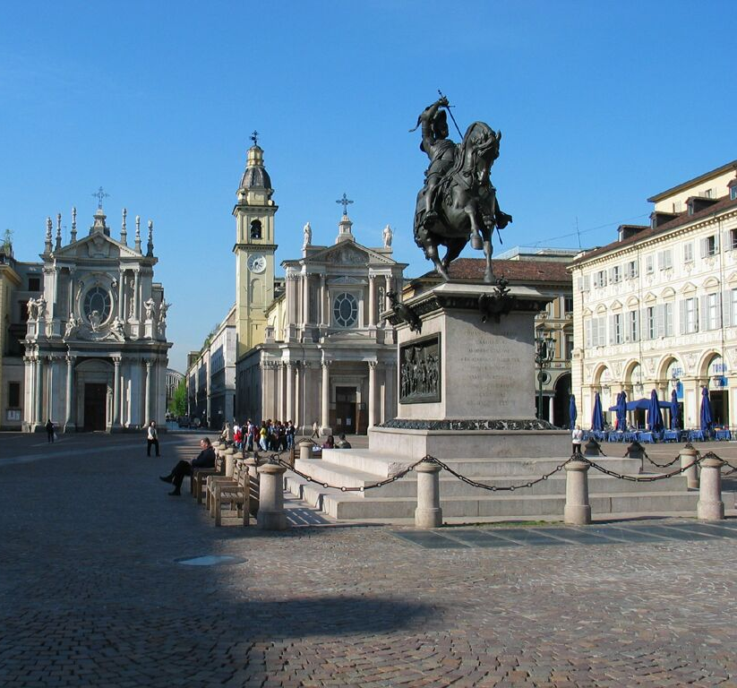
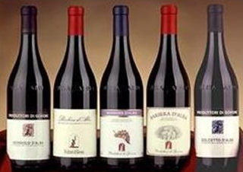
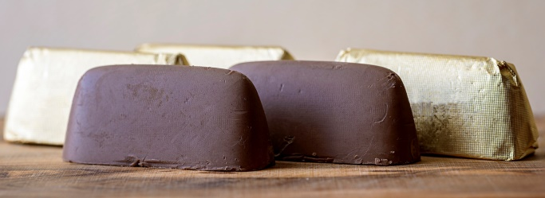
Welcome to Turin!

Slide 3
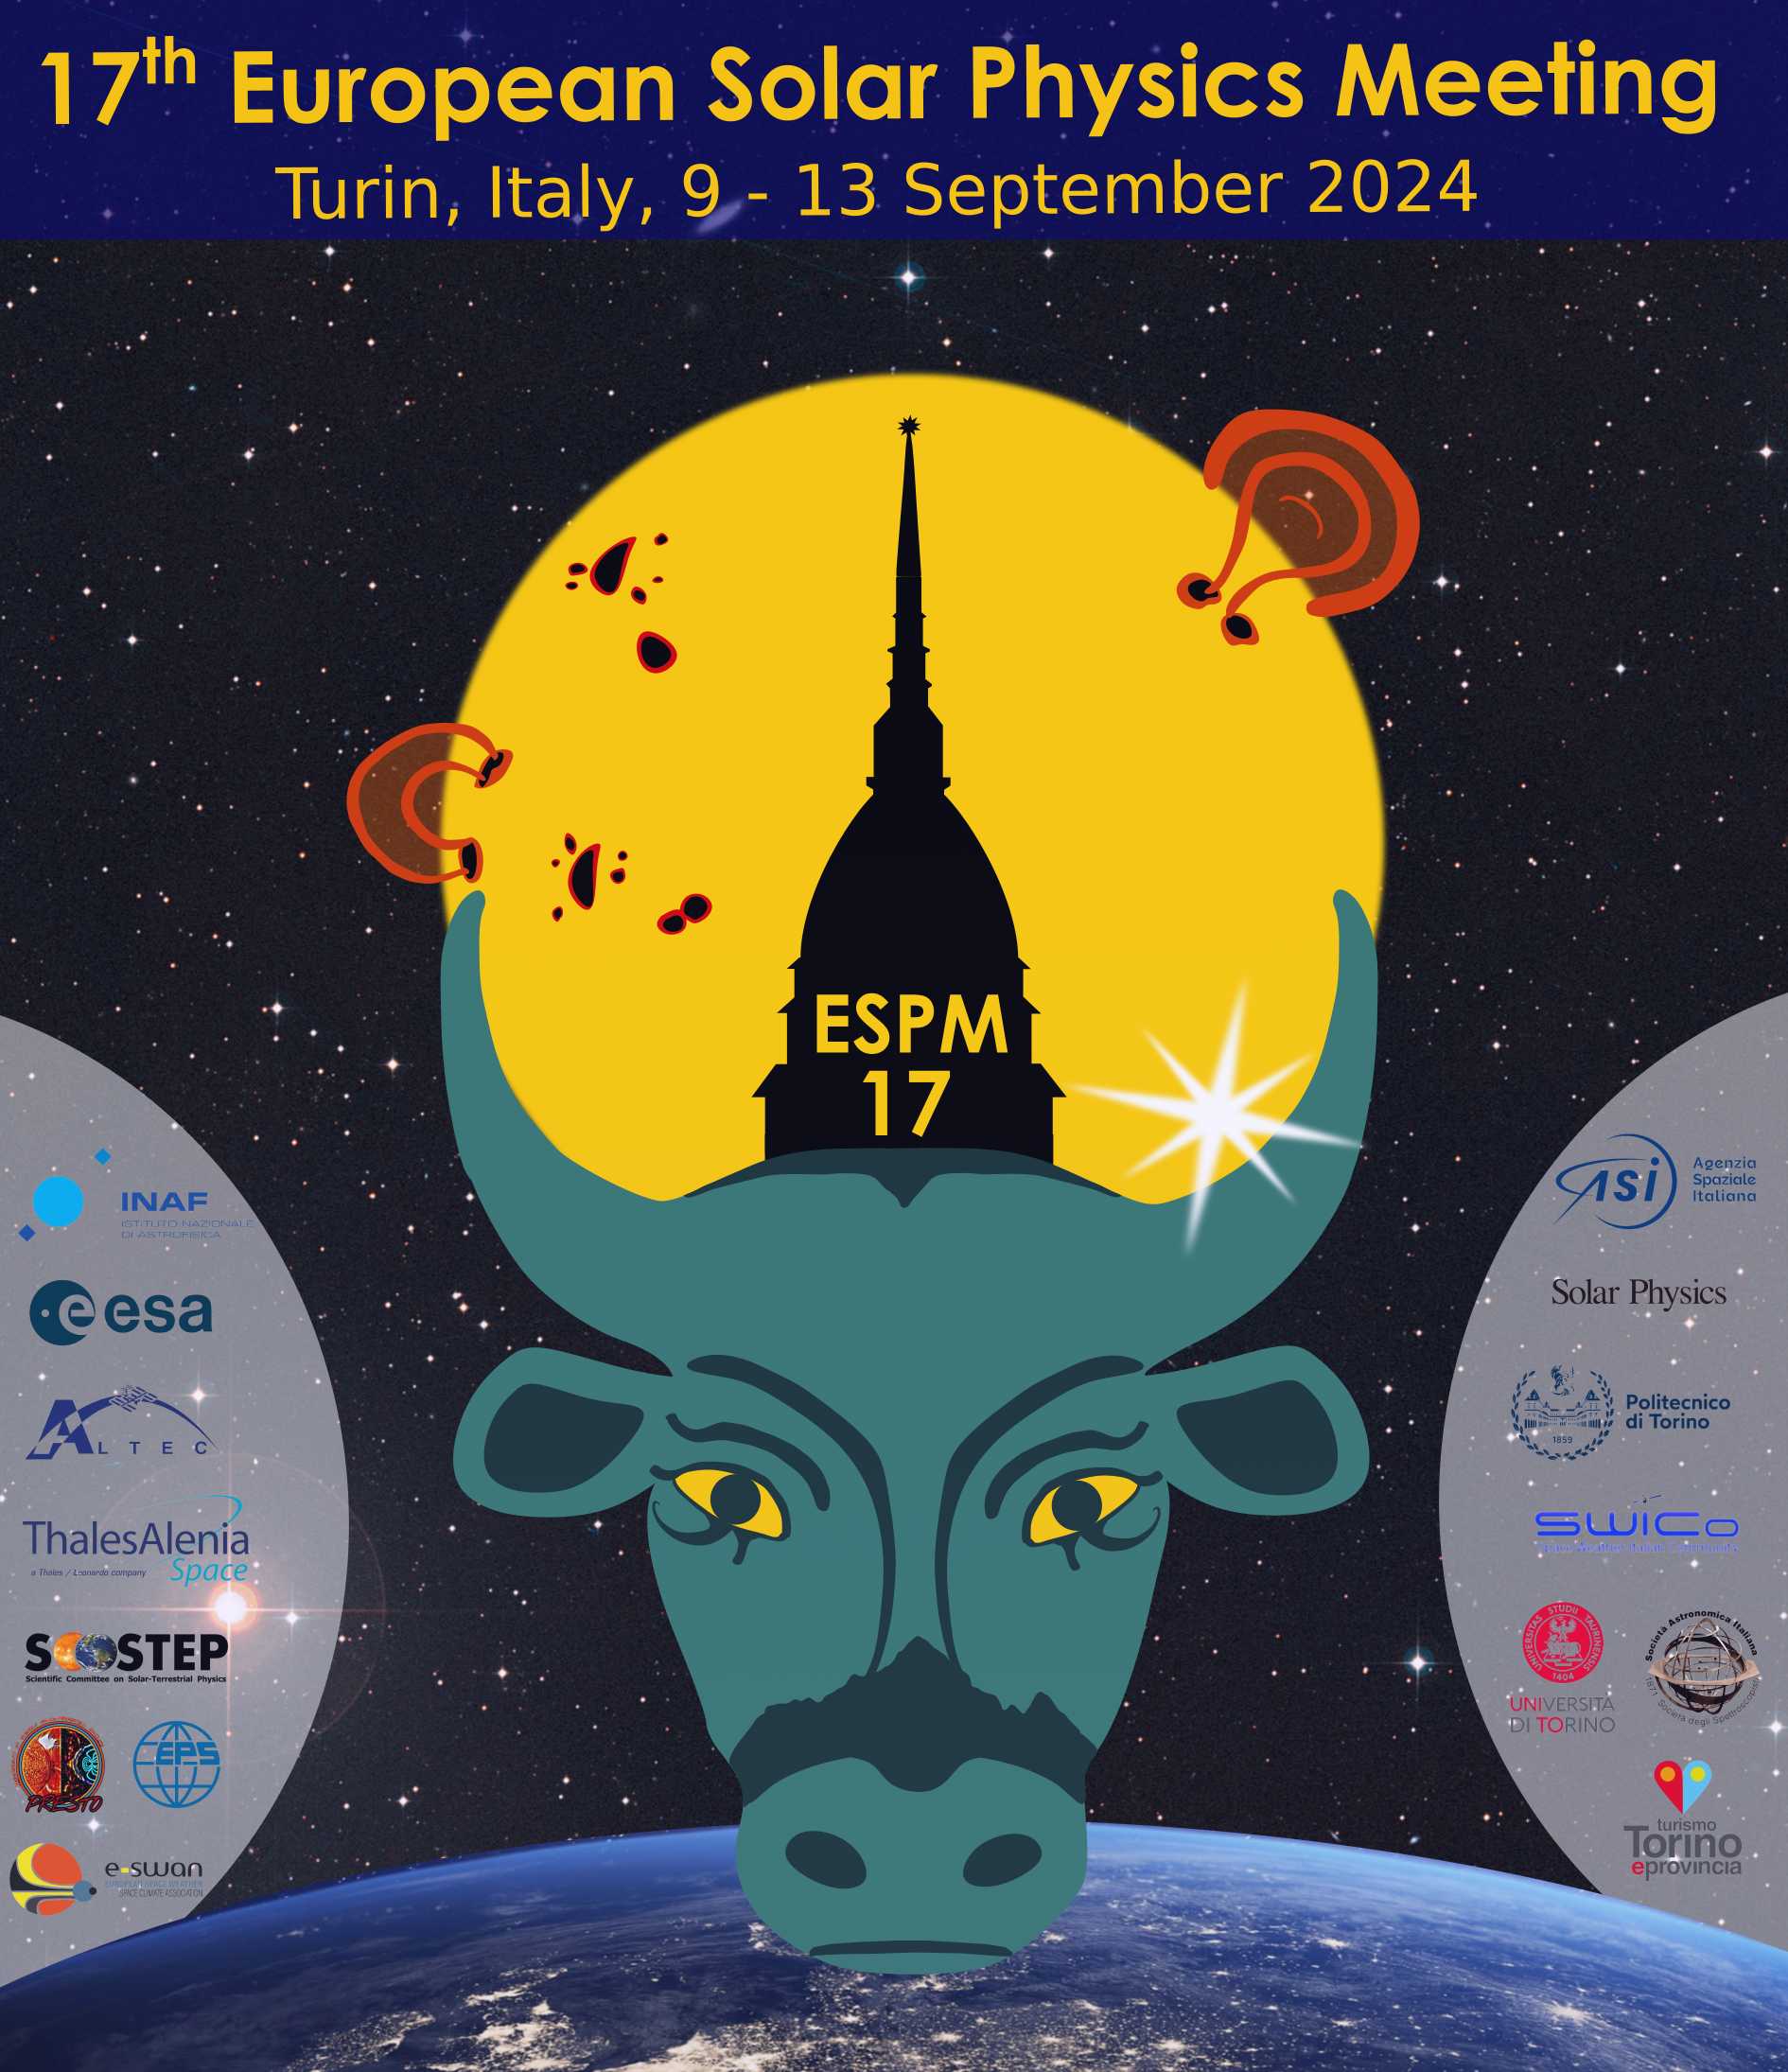
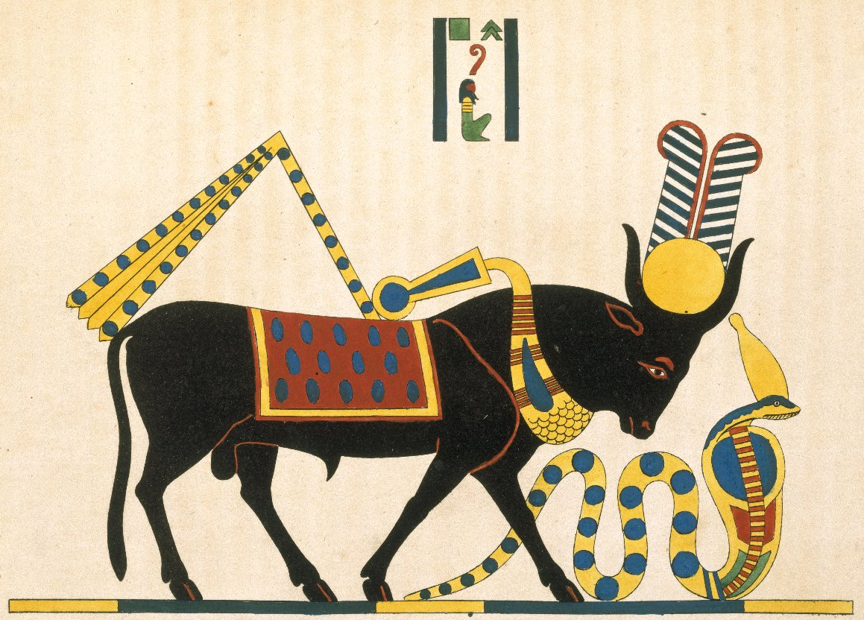
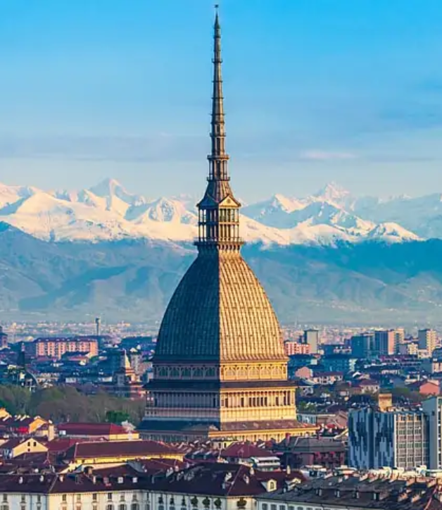
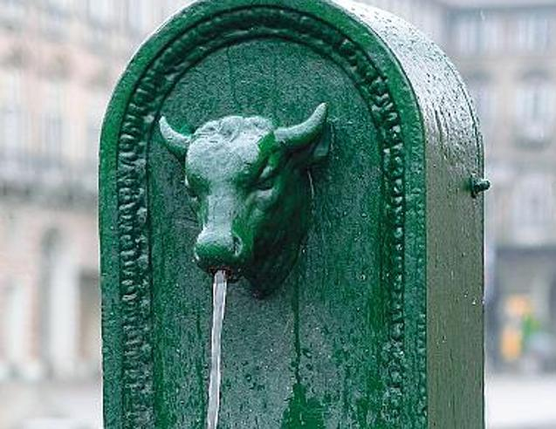
The ESPM-17 poster
… plus another hidden citation of the Turin landscape

Slide 4
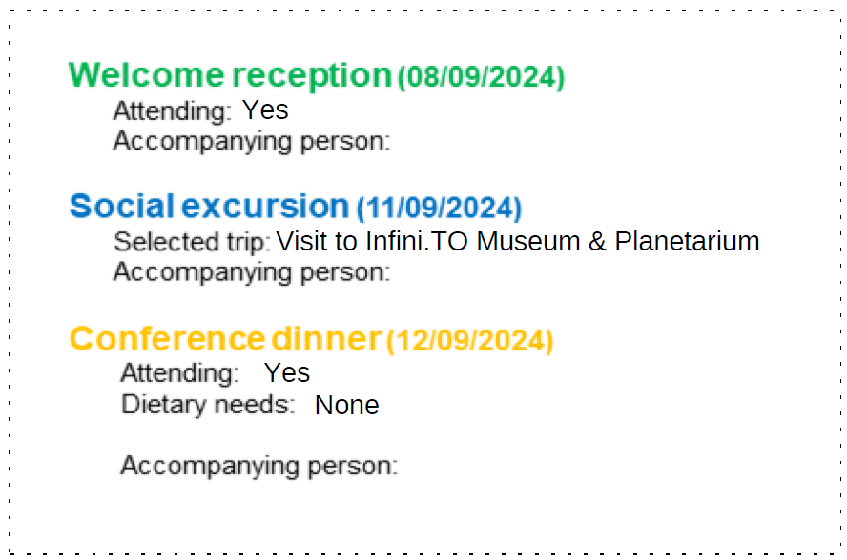
The ESPM-17 badge
Name Surname
Affiliation
Please check all the info here
Country
Always bring your badge with you for social events
Your badge also has a power!

Slide 5
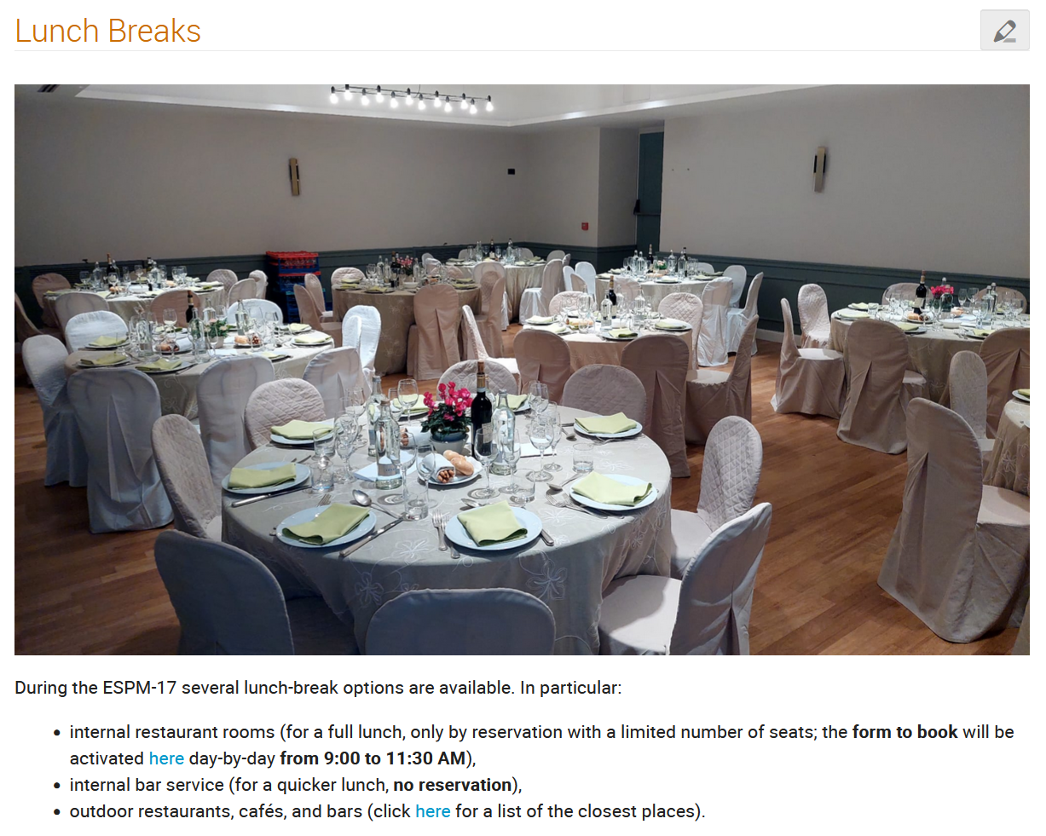
Lunch break options

Slide 6
Sponsors
Partners

Slide 7
Organizing Committees

Slide 8
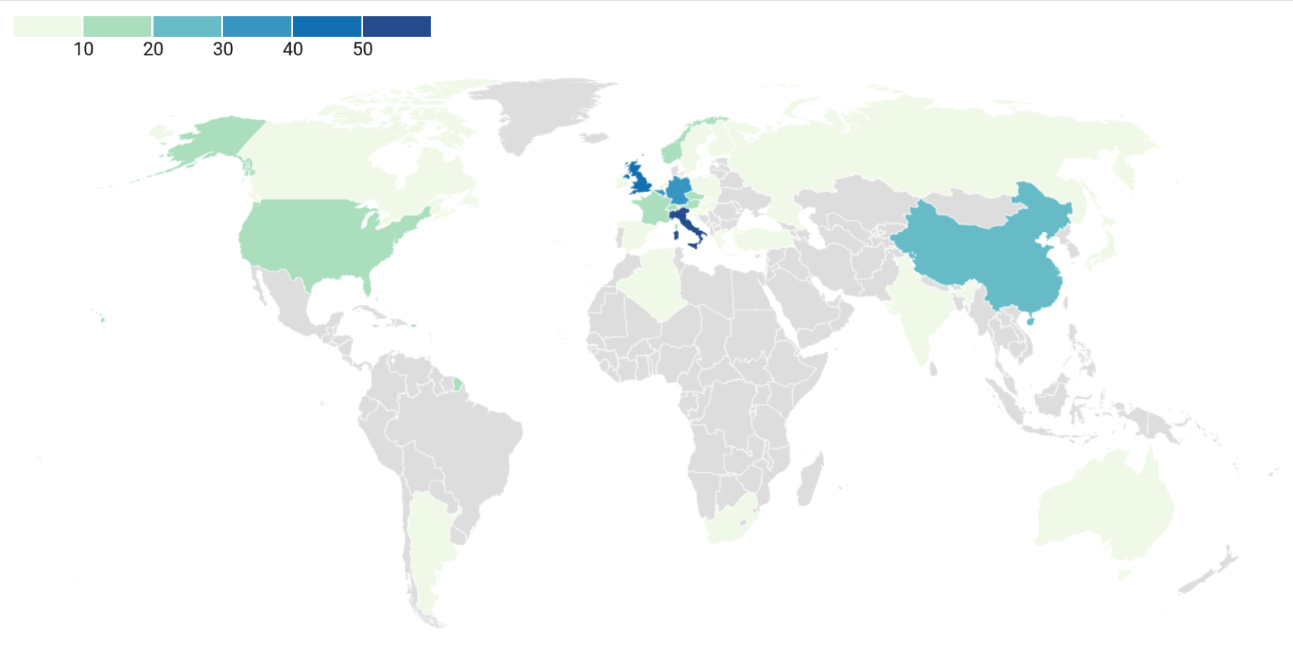
ESPM-17 participants
Number of people from each country
More than 330 participants (including online people) not just from European Countries
Approximately 1/3 of participants are students → a vital and growing community!

Slide 9
Not only a scientific meeting
ESPD board
elections
ESPD prizes
award
Solar Physics Science
EPS prizes for talks and posters
“Solar Physics” best presentation prizes
Outreach in
Solar Physics
1 senior prize lecture, 18 invited, 59 contributed talks, and 237 posters divided in two sessions

Slide 10
Enjoy the ESPM-17 meeting
and your stay in Turin!

