Slide 1
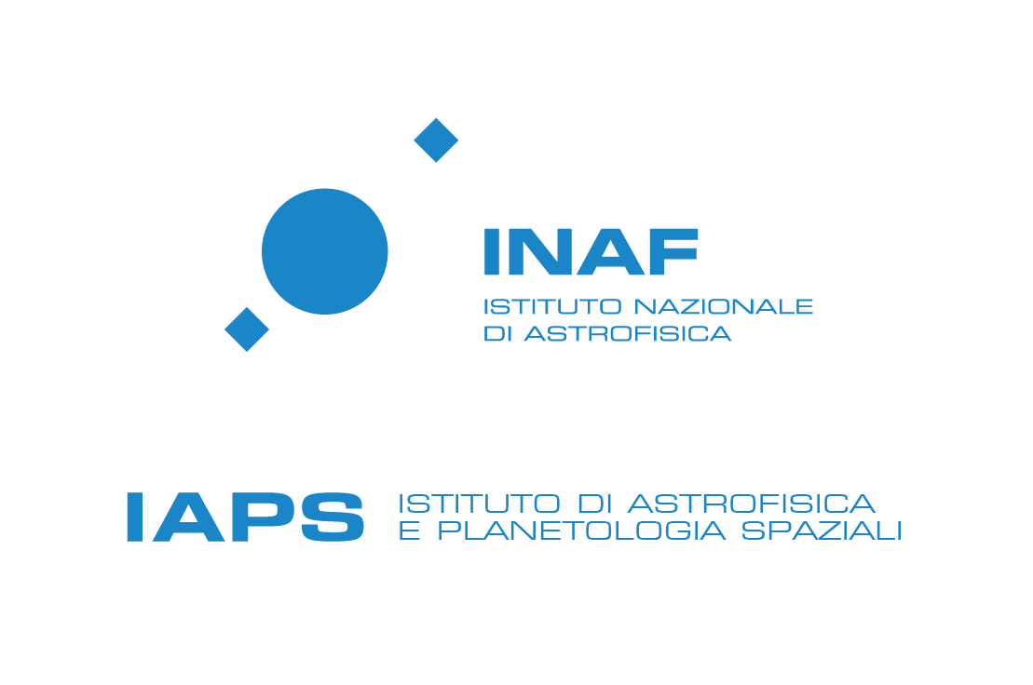



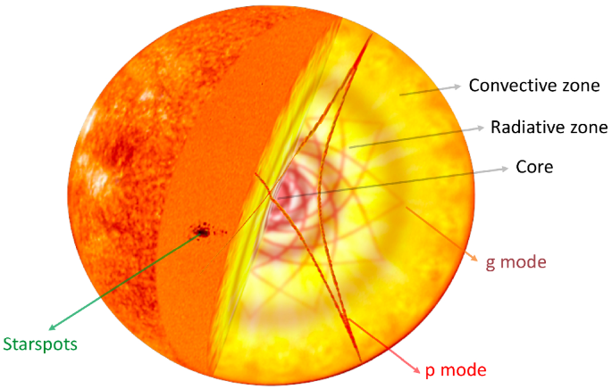
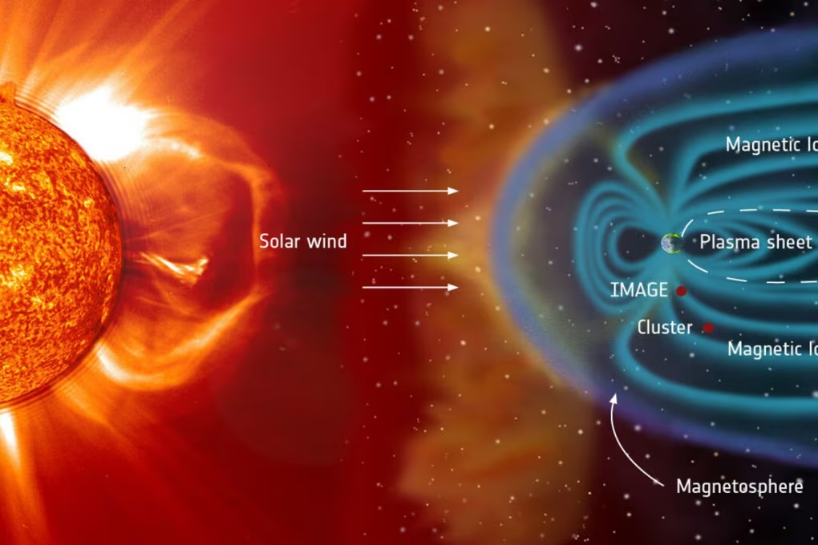
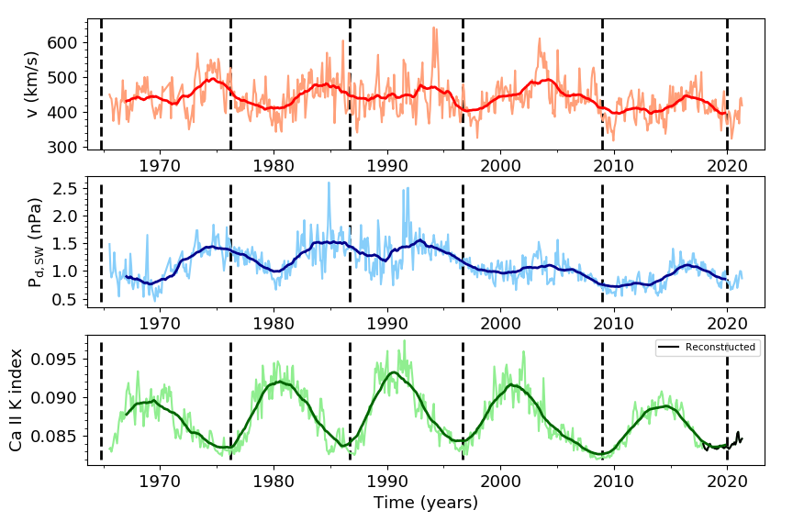

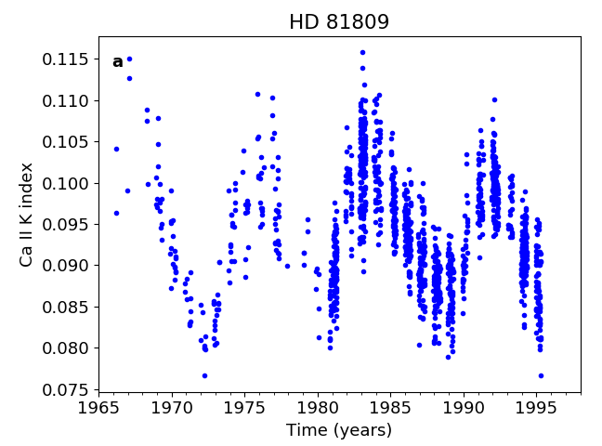
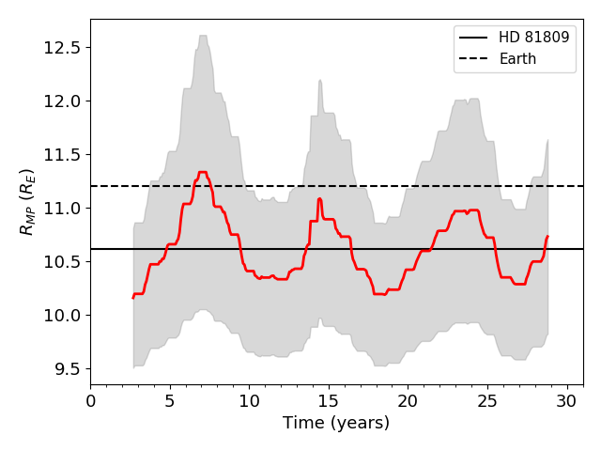
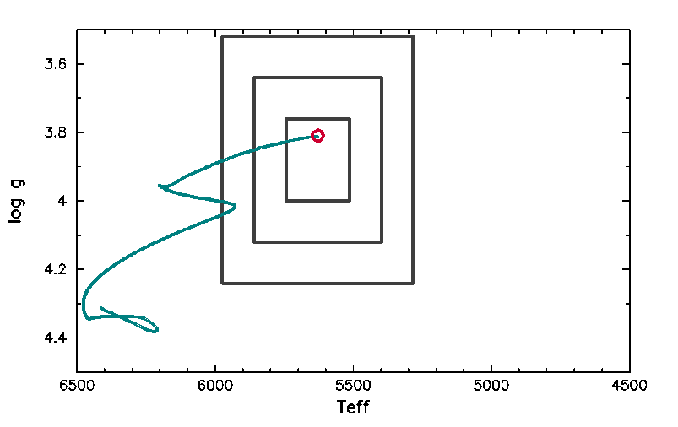
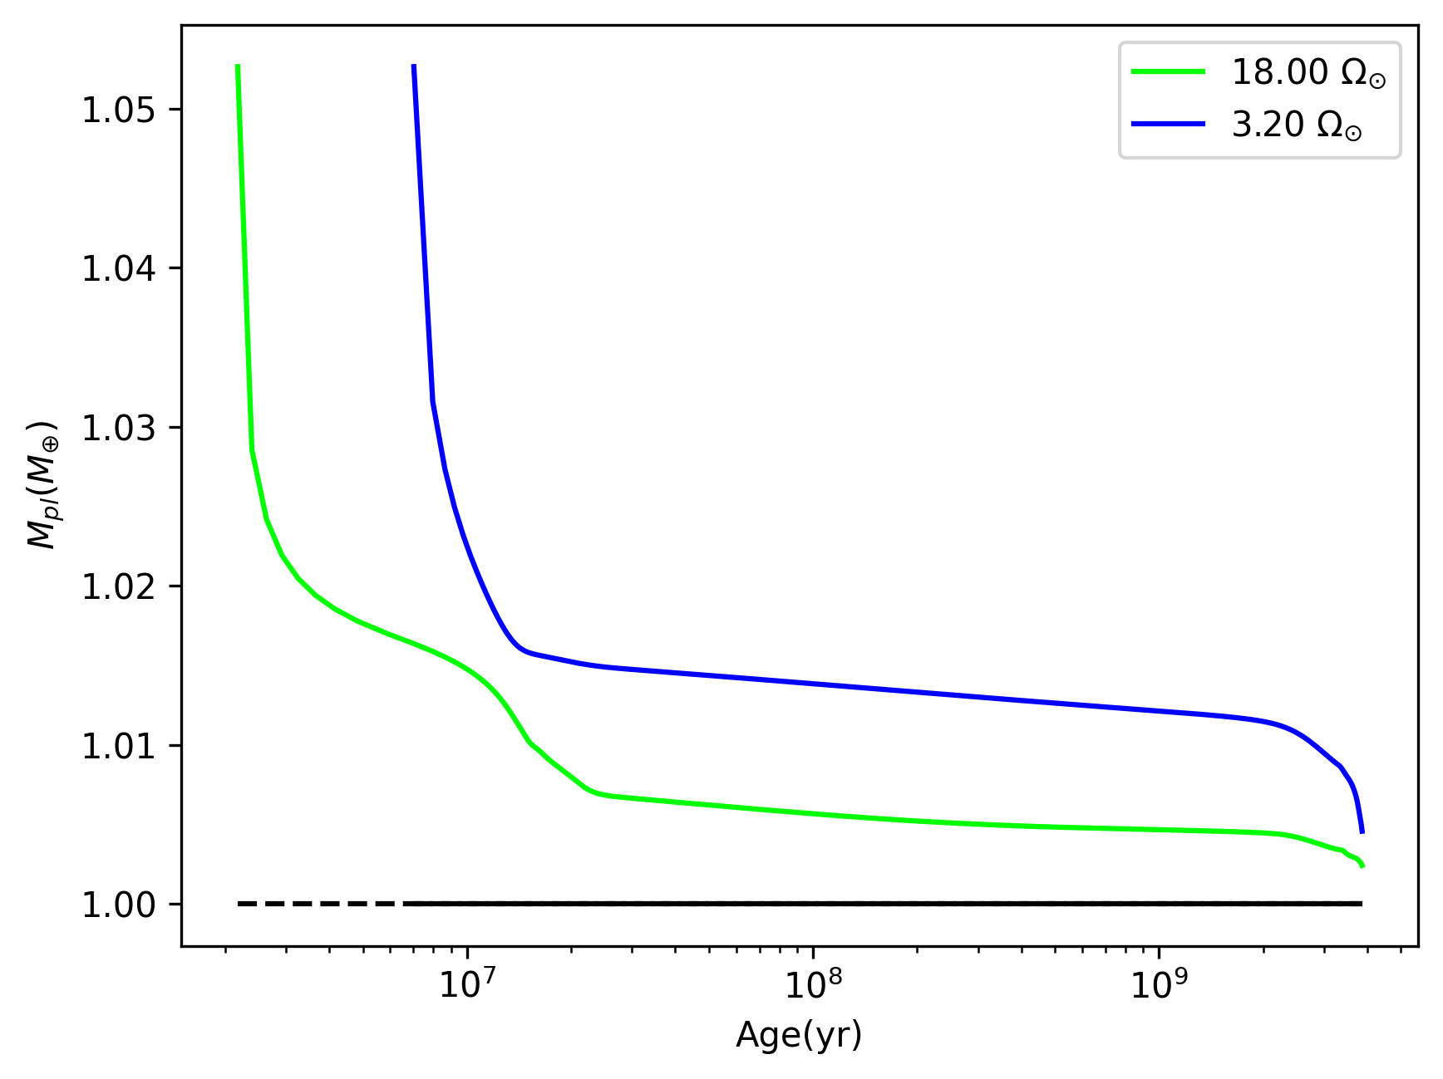
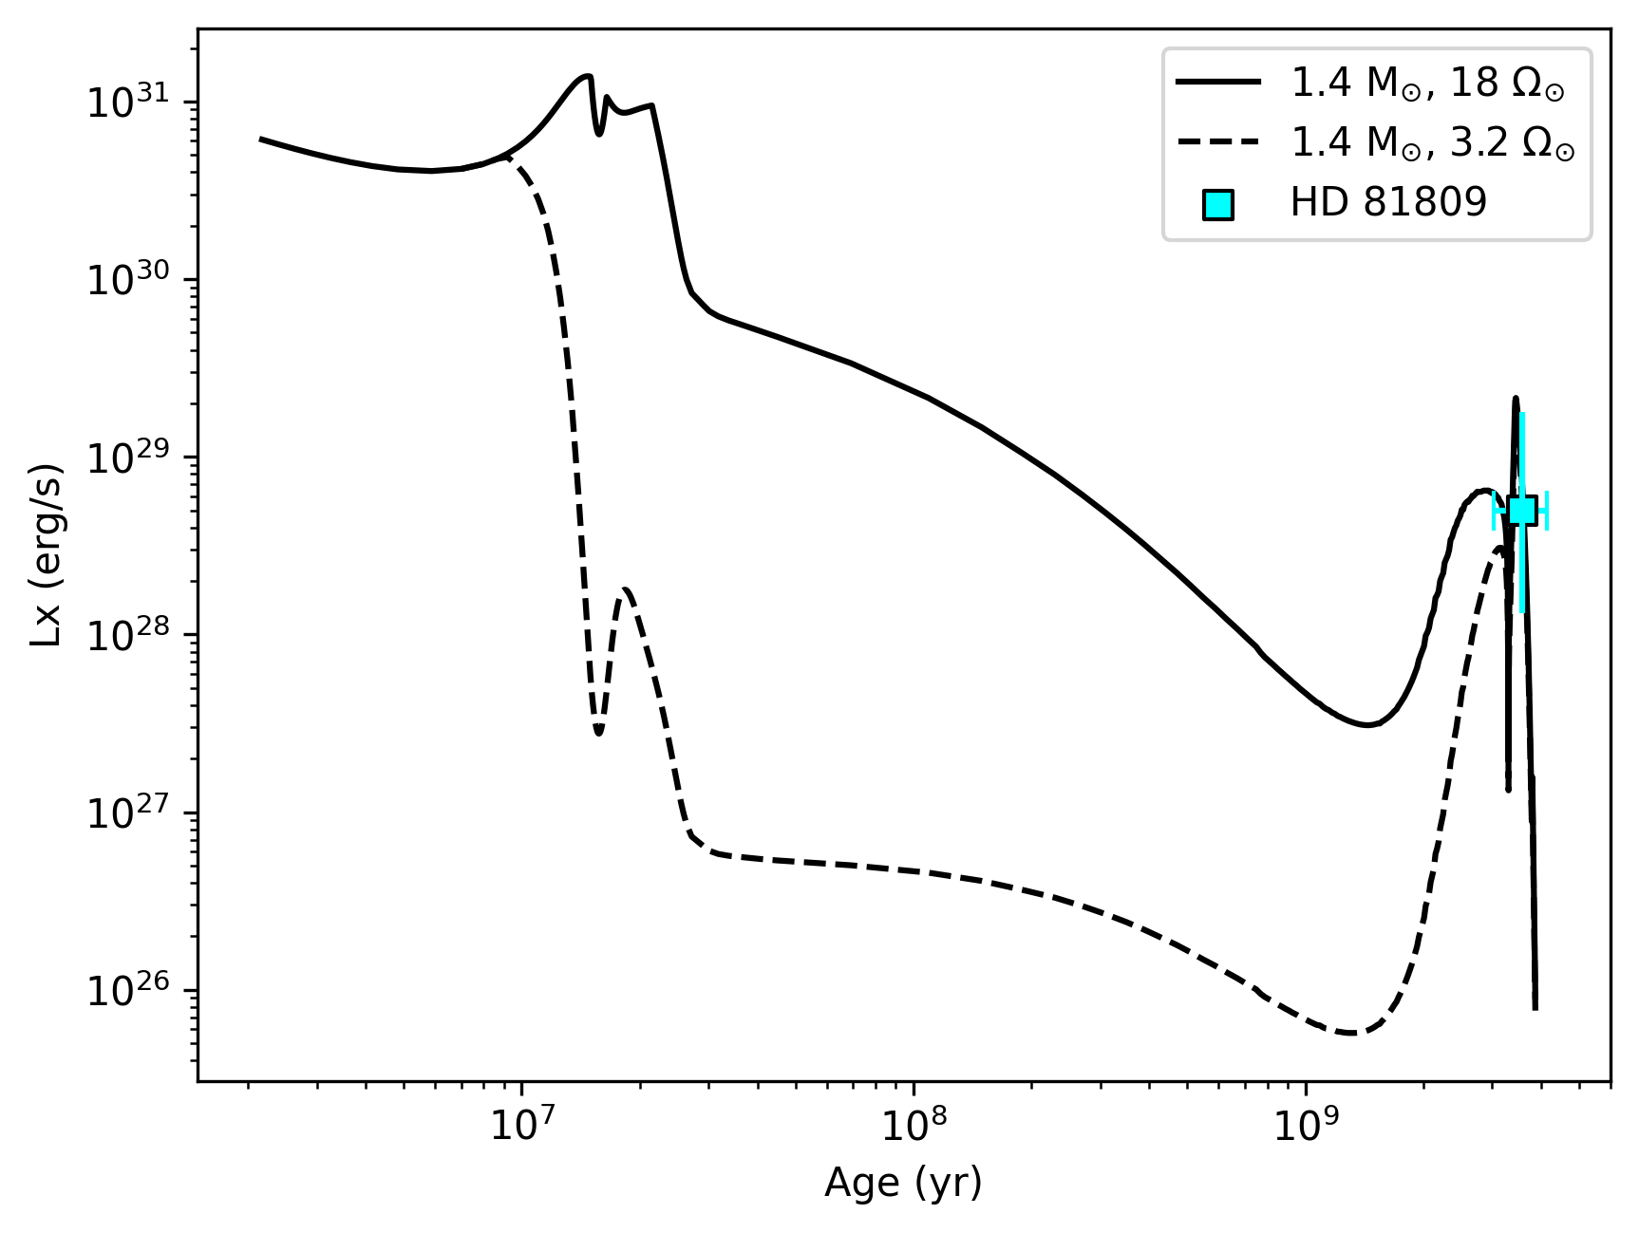
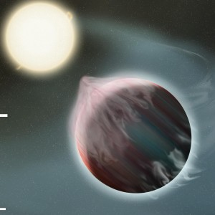

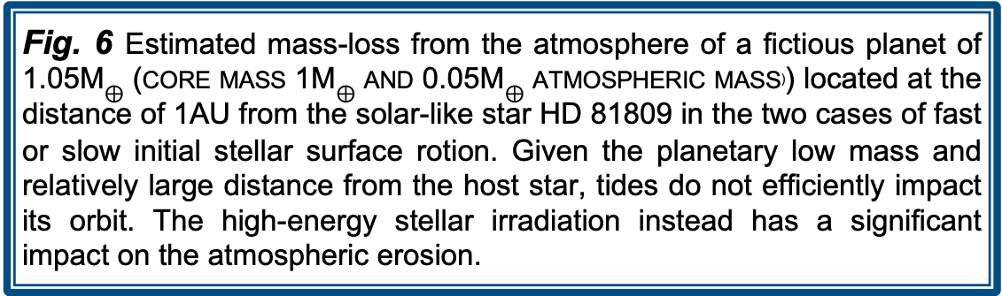
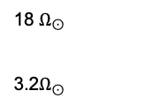

Using the Sun as Rosetta stone to study the properties of other solar-like systems
M.P. Di Mauro ⁽¹⁾, C. Pezzotti ⁽²⁾, R. Reda ⁽³⁾,
F. Berrilli ⁽³⁾, A. Bonanno ⁽⁴⁾, G. Buldgen ⁽²⁾, E. Corsaro ⁽⁴⁾, L. Giovannelli ⁽³⁾ ,V.Penza ⁽³⁾
INAF-Istituto di Astrofisica e Planetologia Spaziali, Roma, Italy (2) STAR Institute, Université de Liège, Liége, Belgium
(3) Department of Physics, University of Rome Tor Vergata, Italy (4) INAF-Osservatorio Astrofisico di Catania,Italy
ABSTRACT
We present our new approach to characterize solar-like stars and their interaction with hosted exoplanets in analogy to the Sun-Earth system.
Our investigation allows us to obtain not only a highly accurate characterization of the mother star, but also to study the impact of the star's rotational and activity history on the evolution of its exoplanets.
This information, coupled with the precise age estimated by asteroseismology, allows determining how long an atmosphere of terrestrial type could resist to the action of stellar wind and the XUV flux enabling to directly quantify the portion of the atmosphere which could potentially be eroded.
SELECTION OF THE STELLAR TARGETS
Using the Sun-Earth system as guiding light
Main sequence solar-like G type stars
Mass ---> 0.8-1.4 M⊙
Photospheric temperature ---> 5000–6000 K
Similar activity regime of the Sun
Rossby number R₀ $≥$ 1 faculae dominated regime
The global parameters of the host-star are
fundamental information to characterise an exoplanetary
system.
The suitable targets for this approach are solar-like
stars that have been studied by asteroseismology
techniques using data provided by TESS or Kepler/K2 satellites. Our strategy (Reda et al. 2022) starts from the detection and identification of the pulsations properties of a star by a careful analysis of the photometric time series using the public tool DIAMONDS (Corsaro & De Ridder, 2014) in order to extract stellar radius, stellar mass and age of the star.
Asteroseismic tools | _{Error in the} _{estimated quantity}
 | R✭ | M★ | Age
Scaling laws | 5-7% | 5-7 % | no
Stellar models and main asteroseismic parameters | 3-5 % | 3-5 % | <15%
Stellar models and individual oscillation frequencies | 0.3 % | 0.8 % | 3.7 %
SOLAR WIND-EARTH MAGNETOSPHERE INTERACTION
The dataset used to study the decennial time-scales relation between the solar activity and the solar wind properties consists of:
Ca II K index (Jul. 1965 - Oct. 2017), Bertello et al. (2017) composite;
Mg II index (Nov. 1978 - Apr. 2021), Bremen composite, Viereck et al. (2004);
Solar wind speed (v) and dynamic pressure (P_{d,SW}) (Jul. 1965 - Apr. 2021),
OMNI database.
We find a strong delayed correlation (r≥0.84) over each solar cycle between the solar Ca II K index and the solar wind parameters (velocity v and pressure P_{d,SW} ) acting on the Earth, obtaining the following relation:
STELLAR WIND-EXOPLANET MAGNETOSPHERE INTERACTION
In order to assess the habitability conditions of the exoplanets, we need to study the stellar magnetic activity variability, as well as its effects on the circum-planetary environment. This can be done by monitoring the chromospheric emission measurements in Ca II H & K available from the S-index for thousands of stars. By using the relation calibrated on the Sun, we are able to estimate the mean stellar wind parameters such as the pressure P_{d,SW} acting on the exoplanets and to compute the magnetopause standoff distance from the following formula, where 𝜇₀ is the vacuum permeability, M_{E} is the Earth’s magnetic moment, while f₀ is a form factor
Grießmeier et al. (2004)
Fig. 1
Monthly averages and superimposed 37-month averages of the signals.
P_{cyc}= 8.01 yrs
Slow rotator P_{rot}=40.2 d
S =0.172 =1.01 S⦿
Reda et al. (2023)
Fig. 2 Ca II K index of the star HD 81809 for the time interval 1966-1996, obtained from the MWO S-index
Fig. 3 Magnetosphere extension (red line) and its confidence interval (shaded area) of a fictitious Earth-twin planet at 1 AU as obtained from Ca II K
RADIATIVE AND GRAVITATIONAL-TIDAL INTERACTIONS
After the evaluation of the magnetic activity on the hosted planet, we proceed with the study of the evolution of the system under the impact of the radiative and gravitational-tidal interactions. This simulation uses as input the stellar structure model which best-fit the observed asteroseismic and spectroscopic constraints at the age of the host star, as obtained above. This model is thus coupled to a star-planet interaction code (e.g. Privitera et al. 2016, Rao et al. 2018, Pezzotti et al. 2021) in which the evolution of the host star and that of the planet is computed under the mutual impact of the radiative and tidal interactions, starting from the dissipation of the protoplanetary disk to the age of the system. Thanks to this approach, it is possible to account for the change in efficiency of the considered interactions, which is tightly linked with the evolutionary stage of the system’s components.
Disc-locking phase
L_{x} $\sim const$
$$Ωsurf\sim const$$
PMS phase
Rapid contraction
    MS phase
Rotational braking due to magnetized solar-wind
18 $Ω_{\begin{aligned}⊙ \\ \\ \\ \end{aligned}}$
3.2$Ω_{⊙}$
Fig. 4 The evolution of the theoretical X-ray luminosity as computed for a 1M☉ orbital stellar model calculated in case of fast (solid line), moderate (dashed line) and very slow rotation (dotted line). The starting point of the tracks corresponds to the dissipation of the protoplanetary disc. The result well reproduces the actual observed value of the Sun.
Fig. 5 The evolution of the computed emission of X-ray luminosity for a massive orbital stellar model, computed by recalibrating the perscription of Wright et al. (2011). In case of fast (solid line) and slow rotator (dashed line). Comparison with the observed values for HD81809 (Favata et al. 2008) is also given.
Fig. 6 Estimated mass-loss from the atmosphere of a fictious planet of 1.05M$⊕$ (core mass 1M$⊕$ and 0.05M$⊕$ atmospheric mass⁾) located at the distance of 1AU from the solar-like star HD 81809 in the two cases of fast or slow initial stellar surface rotion. Given the planetary low mass and relatively large distance from the host star, tides do not efficiently impact its orbit. The high-energy stellar irradiation instead has a significant impact on the atmospheric erosion.
SUMMARY SYNERGIC STRATEGY
REFERENCES
Bertello et al. (2017), Sol. Phys., 291, 2967
Corsaro & De Ridder 2014 A&A 571, A71
Favata et al. 2008 A&A 490, 1121
Grießmeier et al. 2004 425, 753
Pezzotti et al. 2021 A &A 650, A108
Privitera et al. 2016, A&A 593, A128
Rao et al. 2018, A&A 618, A18
Reda et al. 2022, Front. Astron. Space Sci., 9, 909268
Reda et al. 2023, MNRAS, 519, 4, 6088
Viereck et al. (2004), Space Weather, 2, S10005
Wright et al 2011 ApJ 743, 48
Accurate stellar characterisation by asteroseismic methods
Stellar wind pressure from Ca II H & K lines emission
Estimate of the magnetic activity cycle and extent of the planetary magnetosphere
Study of the radiative, gravitational-tidal star-planet interaction
Conclusion on exoplanet mass-loss and atmospheric erosion

