Slide 1
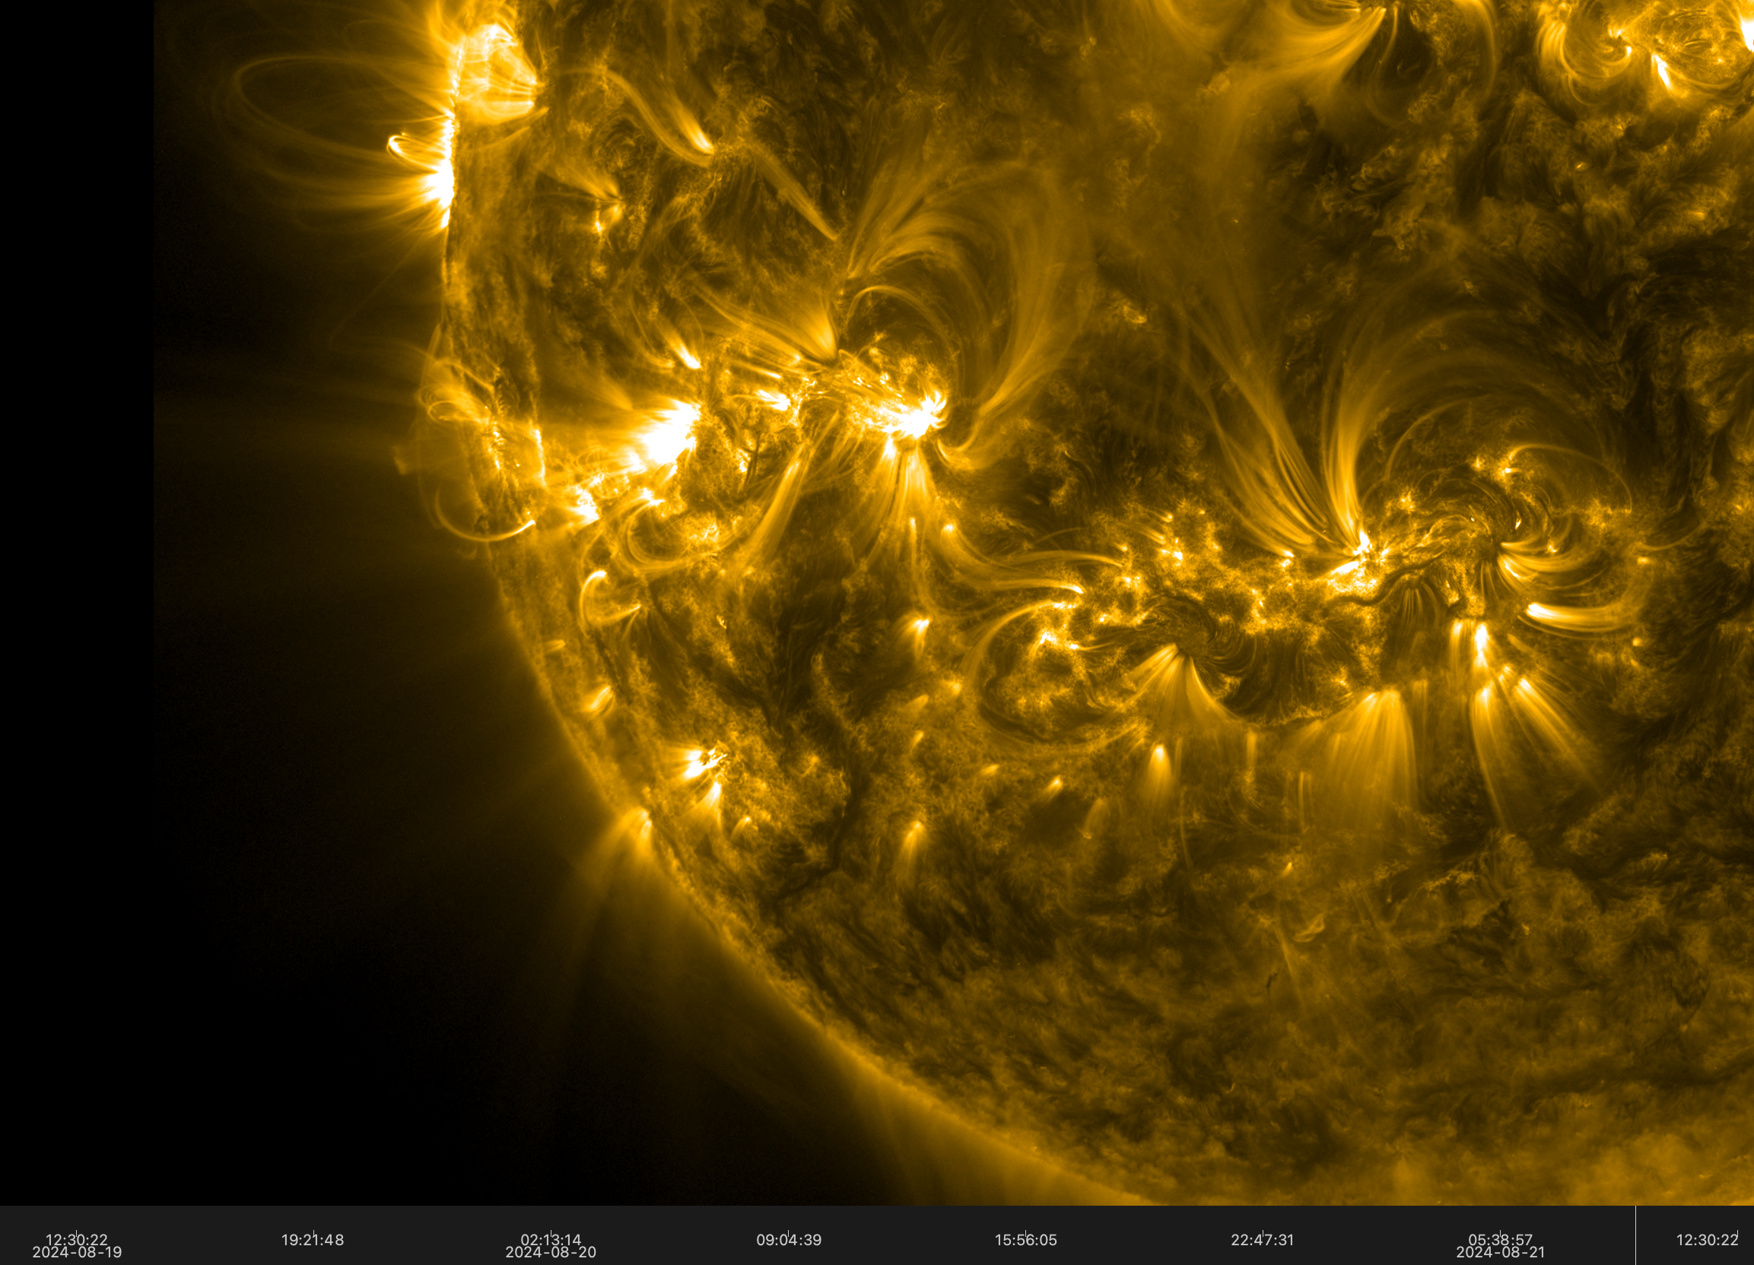
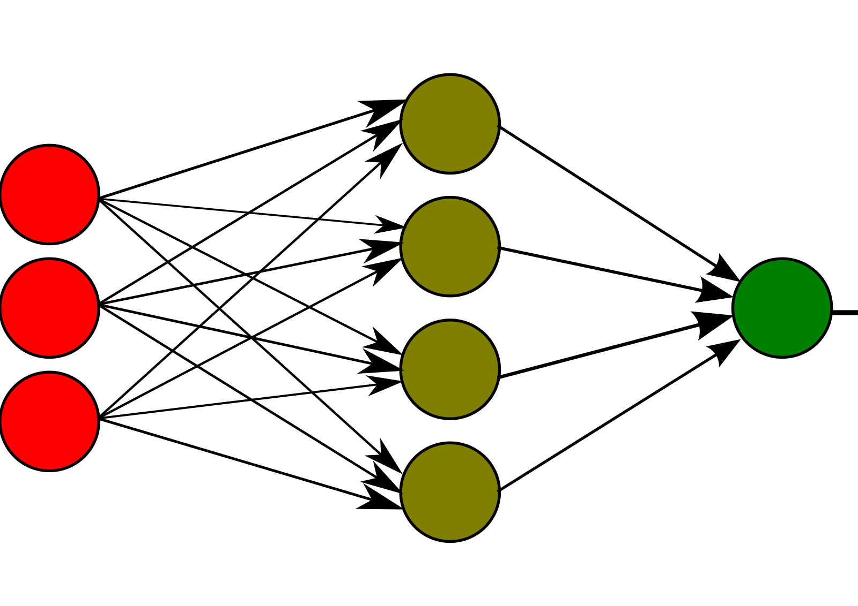
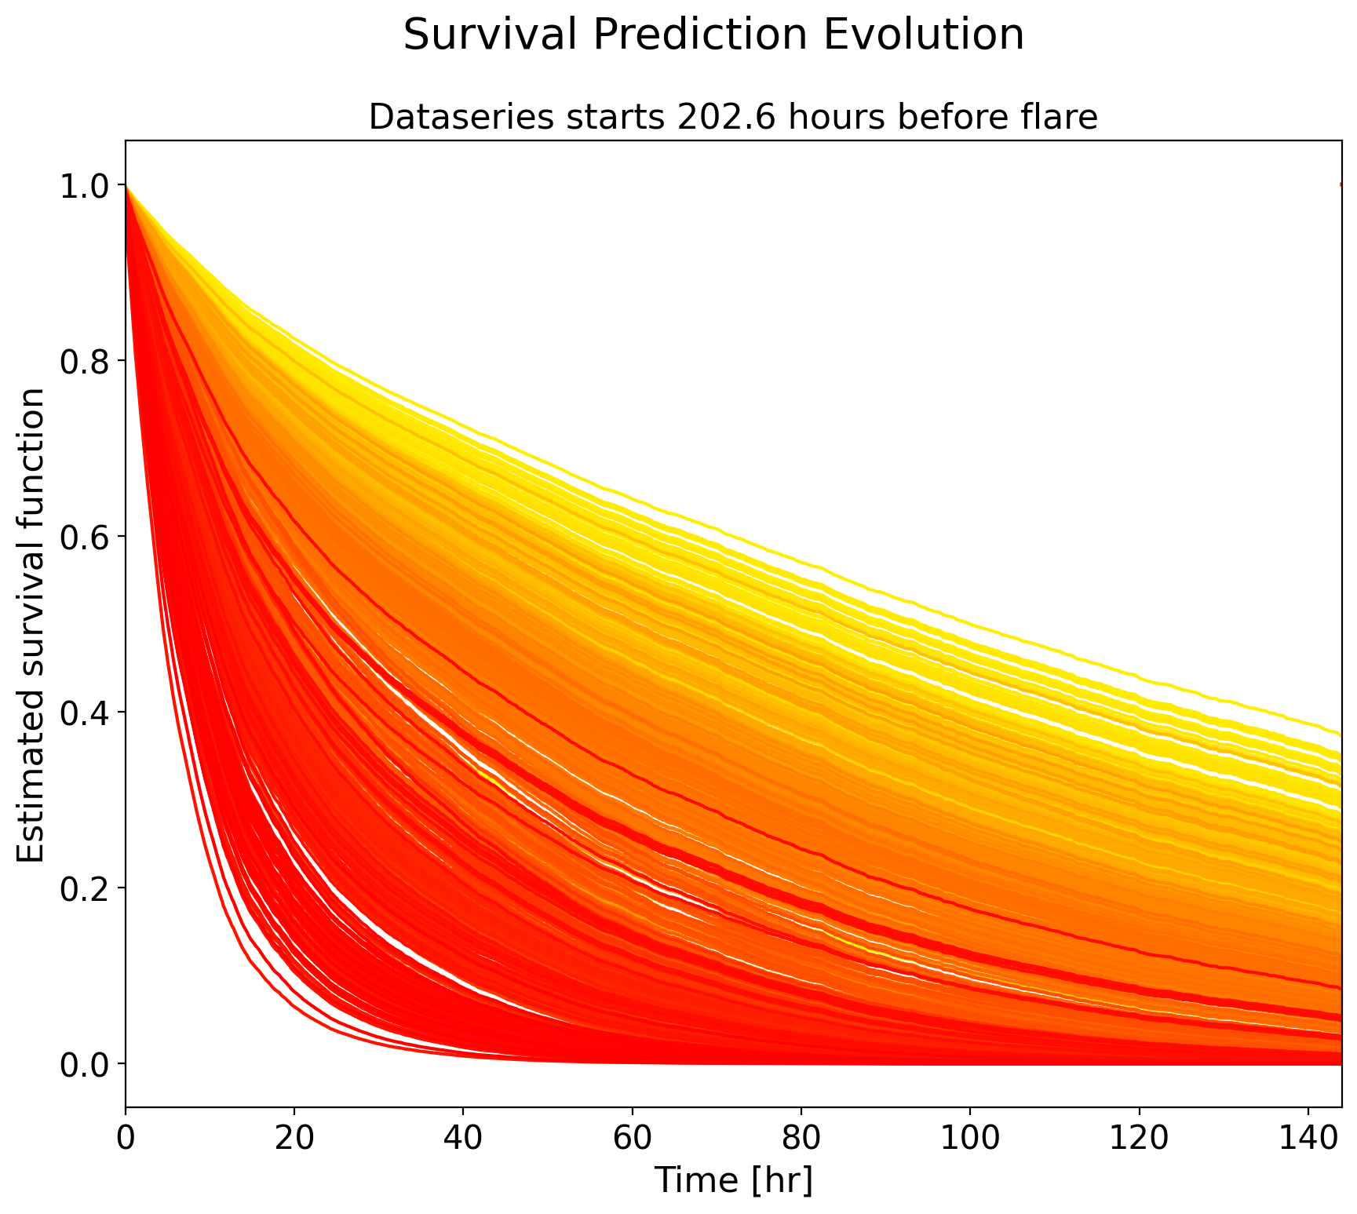
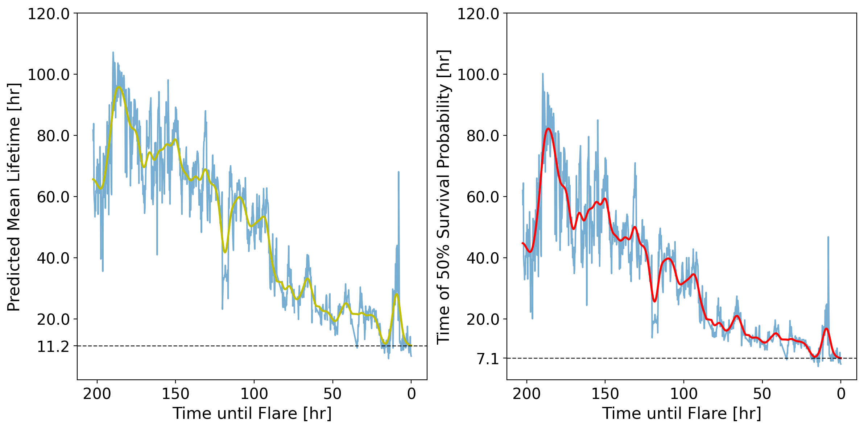
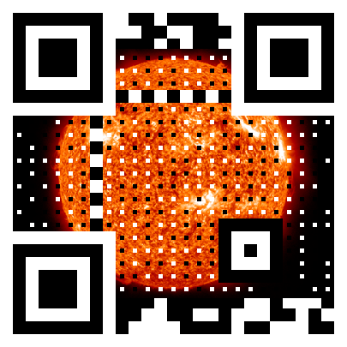
Flare Forecasting using
Deep Survival Analysis
Moritz Meyer zu Westram, Lucia Kleint
Astronomical Institute, University of Bern, Switzerland
Contact: moritz.meyerzuwestram@unibe.ch
Introduction
The Model
Training the Model
Flare forecasting has mostly been studied in form of binary classification models (e.g. $≥$ M-class flare within the next 24 hours – yes/no).
Utilize (deep) survival analysis in order to…
… increase flexibility by removing decision boundaries
… increase interpretability by allowing continuous time analysis
Application of a mixed-input multi-layer perceptron
Includes categorical features (flare type + B/C flare occurences)
On test set: First use a random forest classifier to estimate the flare type!
Different models depending on the separation of data between training and validation sets
Random sampling (no constraints)
With flare separation (same active regions allowed – not the same flare)
With active region separation (strict separation of active regions)
With random sampling the model might just interpolate data…
But some active regions might be too chaotic or too close to the limb…
Concepts
$$X_{T}$$
$$\hat{h}(t|X_{T})$$
Survival function of a random variable $T$:
$$S_{T}\left(t\right)=P\left(T>t\right)=1 −F_{T}(t)$$
Instantaneous risk of the event occuring at time $t$ is given by the hazard rate $h_{T}\left(t\right)=\frac{f_{T\left(t\right)}}{S_{T}\left(t\right)}$.
In our case the event is a M or X flare.
We model the hazard rate as the product of an estimated baseline hazard and an exponential risk: $h\left(t | X\right)=h_{0}\left(t\right)\exp\left(β^{T}⋅X\right)$ Cox model
Replace $β^{T}⋅X$ by a neural network: $g\left(X|β\right)$.
Handle time as an additional covariate in $X$.
Enables modelling of interactions between time and other covariates.
Results
Cumulative Distribution Function
Probability to survive beyond time $t$
Example: SHARP 407 – M4.2 Flare : Active Region-Separated Datasets
$$\hat{S}(t|X_{T_{i}})$$
Long before flare
$$μ(X_{T_{i}})=\int_{0}^{∞}{\hat{S}\left(t | X_{T_{i}}\right) dt}$$
$$τ(X_{T_{i}})=t :\left(\hat{S}\left(t | X_{T_{i}}\right)=1/2\right)$$
Close to flare
Survival probabilities decrease faster as data series approach the flare
Machine Learning Evaluation Metrics
on full dataset !
Common metrics like accuracy, recall, TSS, etc. cannot be applied due to probabilistic nature and non-existent decision boundaries.
Use ”concordance (C-) index” and Brier Score.
C-index (0-1): Close relationship to accuracy. Describes the probability that, for a random pair of events, the predicted survival times of the two events have the same ordering as their true survival times. Focuses on ordering!
Brier Score (0-1): Mean square difference between the survival status $∈$ {0, 1} and the predicted survival probability [0, 1].
peak below zero
centered at zero
Evaluation metrics of (currently) best model:
Random sets:
C-index of 0.89 (1 is best, 0 worst)
(Integrated) Brier Score of 0.03 (0 is best, 1 worst)
Active region separated sets:
C-index of 0.71 (1 is best, 0 worst)
(Integrated) Brier Score of 0.07 (0 is best, 1 worst)
Survival Analysis of a M4.2 flare at NOAA 11169
Dataset
Multivariate time series from photosperic vector magnetograms in SHARP series (SWAN-SF)
Data between May 2010 and Dec. 2018
Cadence: 12-minutes
Preprocessing: Incorporate the maximum of 1-minute averaged GOES X-ray flux data during the 12 minutes.
Instead of running on raw data, I use statistics of the data in 4-hour running windows!
Magnetic Field Parameter | Description | Formula
TOTUSJH | Total unsigned current helicity | $$∝∑|B_{z}⋅J_{z}|$$
TOTBSQ | Total magnitude of Lorentz force | $$∝∑B^{2}$$
TOTUSJZ | Total unsigned vertical current | $$∑\left|J_{z}\right|dA$$
USFLUX | Total unsigned flux | $$∑\left|B_{z}\right|dA$$
TOTPOT | Total photospheric magnetic free energy density | $$∝∑{\left(B^{Obs}−B^{Pot}\right)}^{2}dA$$
… | … | …
Conclusion & Outlook
New approach to flare forecasting
No decision boundaries
Probabilistic
Current model is not yet optimized
Find best hyperparameters
Use other underlying neural networks instead of MLP
Develop/adapt neural networks to be suited for the task
Deep survival analysis provides new avenue for hour-precision forecasts
Need to test on more recent data
Find best and most robust criteria for warning systems
Expand on features (light-curves or image data)
Predictions are not binary and allow for continuous time statements
Also means that there are multiple prediction and warning criteria

