Slide 1
High-Resolution Observations from the Solar Orbiter Major Flare SOOP Campaign
X-ray and Fast Cadence EUV Observations of Solar Flares
ESPM 17 2024
Laura A. Hayes¹
D. Ryan (SOOP Coordinator), S. Krucker, H. Collier, D.Berghmans, M. Dominique, A. Inglis, G. Kerr, E. Kraaikamp, S. Parenti, A. Inglis, C. Verbeeck + STIX + EUI teams
sunpy powered
¹ESA Fellow, ESTEC

Slide 2
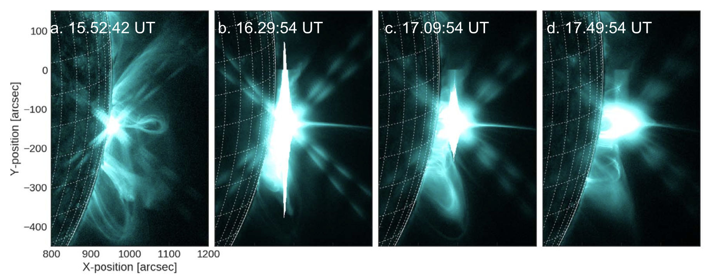
Motivation: The need for high cadence/resolution observations
Need high temporal, spatial and spectral multi-wavelength observations in order to identify fine details of energy release in flares, particle acceleration, heating etc.
Filament eruption
X-rays provide most direct diagnostic of flare-accelerated electrons and flare-heated hot plasmas (>10MK)
e⁻
EUV observations provide details on flare evolution, ribbon kernels/ motions, heating+cooling, loop motions+oscillations
AIA 12s cadence (miss things)
Detector saturation! moderately sized C-class flares saturate!
Challenges
e⁻
Hot flare loop
Hard X-ray footpoints
Flare ribbons
Hayes et al. 2019

Slide 3
Motivation: The need for high cadence/resolution observations
Need high temporal, spatial and spectral multi-wavelength observations in order to identify fine details of energy release in flares, particle acceleration, heating etc.
Filament eruption
X-rays provide most direct diagnostic of flare-accelerated electrons and flare-heated hot plasmas (>10MK)
e⁻
EUV observations provide details on flare evolution, ribbon kernels/ motions, heating+cooling, loop motions+oscillations
AIA 12s cadence (miss things)
Detector saturation! moderately sized C-class flares saturate!
Challenges
e⁻
Hot flare loop
EUI/HRI on-board Solar Orbiter can be used for this!
EUV instruments are not optimised for flares
→Need high-cadence, short exposure observations!
Hard X-ray footpoints
Flare ribbons
Hayes et al. 2019

Slide 4
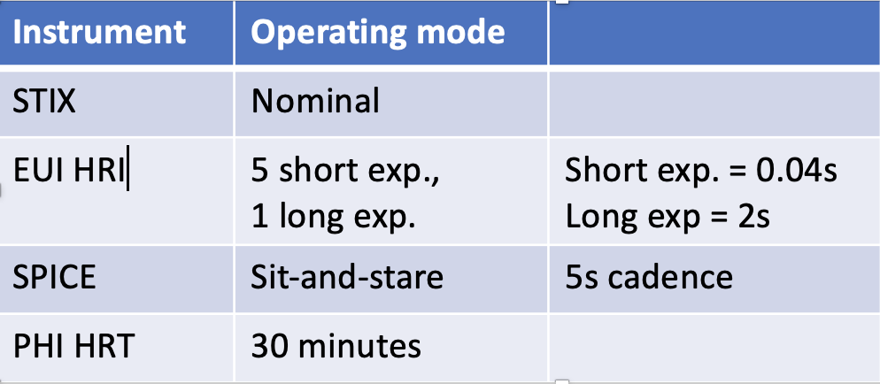
What is a Solar Orbiter SOOP?
SOOP = “Solar Orbiter Operational Plan”
Coordinate observations with high-resolution operating modes with specific science goal
Major Flare SOOP:
6 windows of 4 hours each in Spring 2024
Aims: for first ever high-cadence, short exposure high resolution EUV flare observations, coupled hard X-rays and UV spectroscopic
Combined EUI/HRI + STIX + SPICE (+PHI)
Mar/Apr 2024

Slide 5
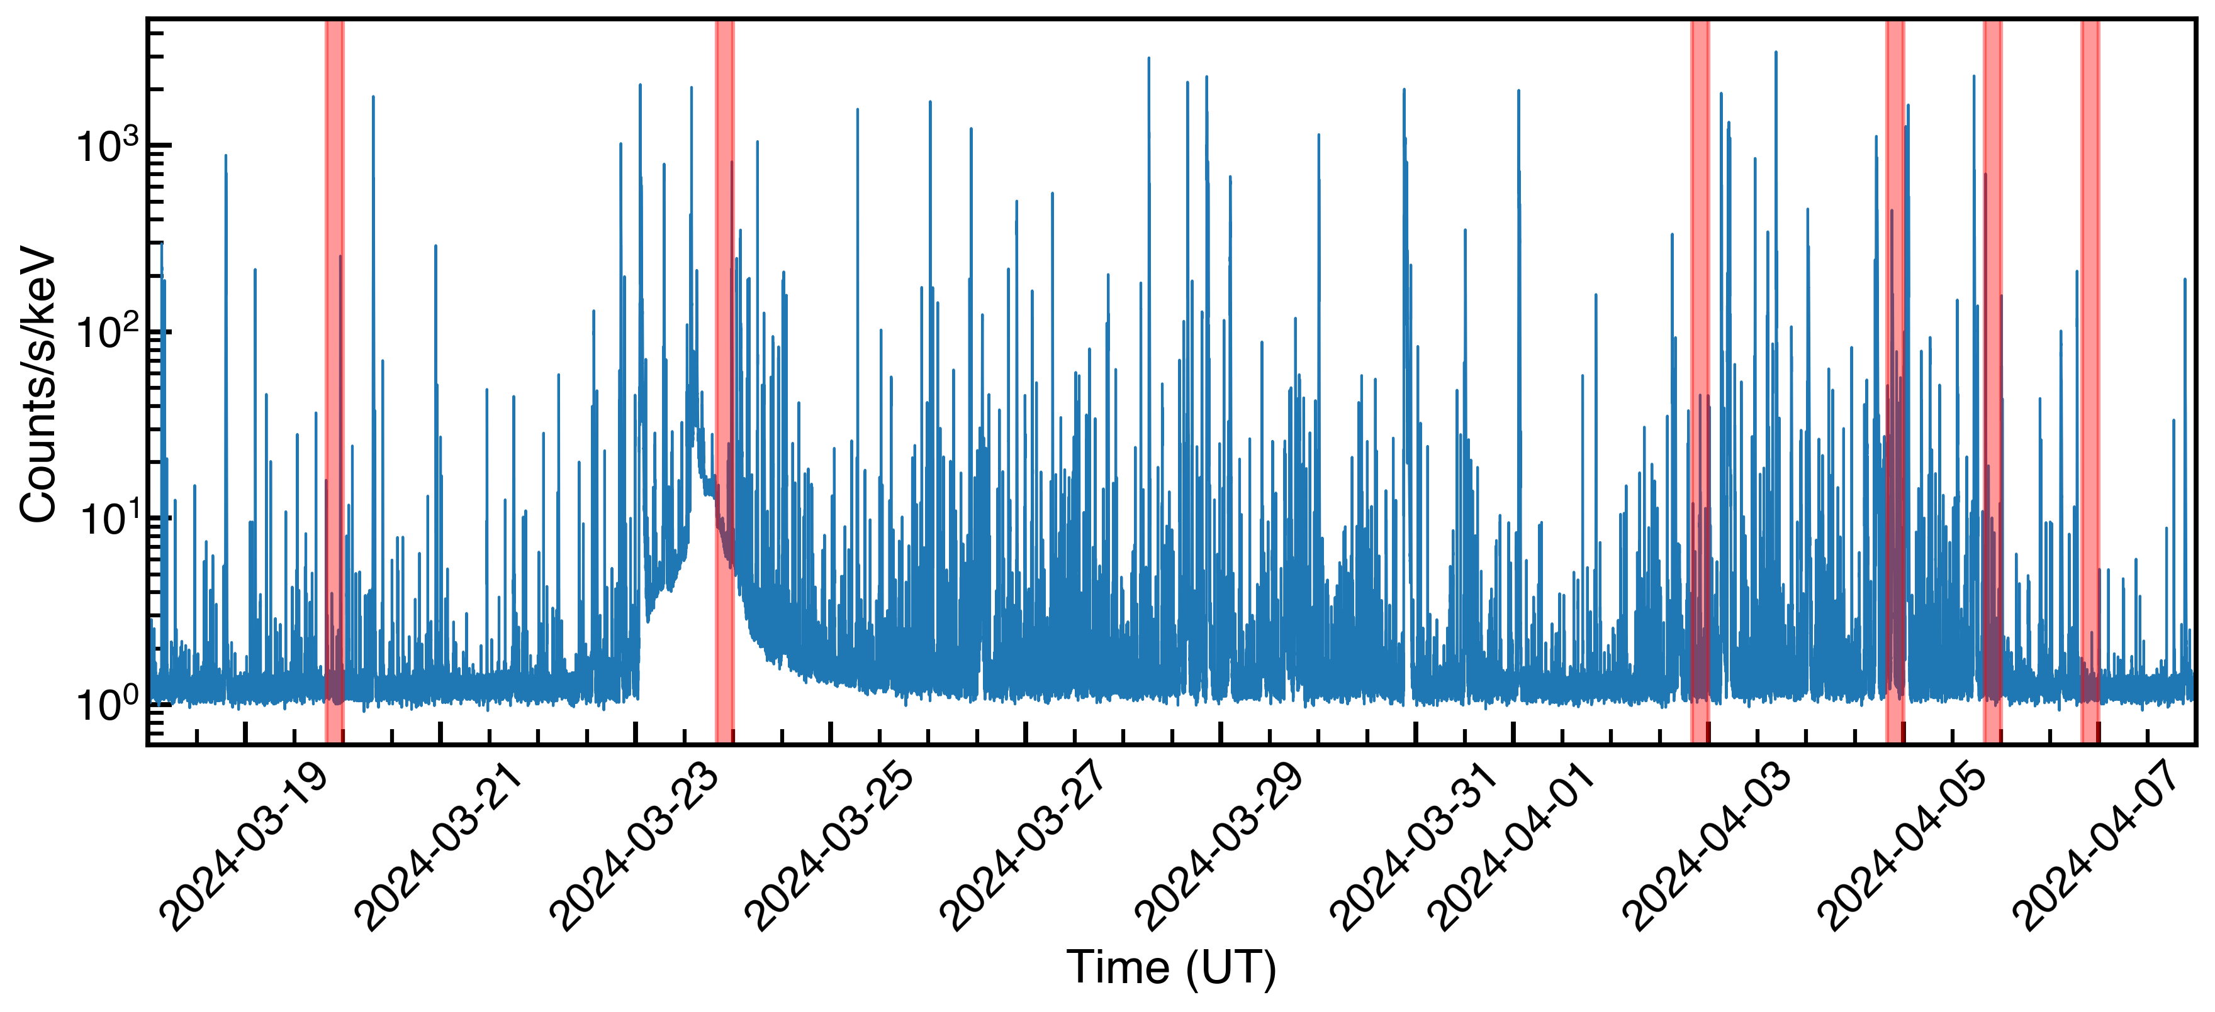
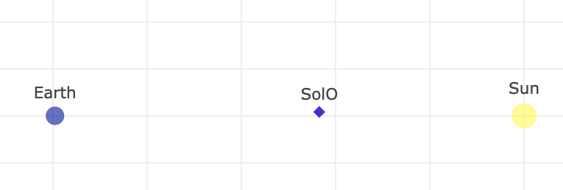
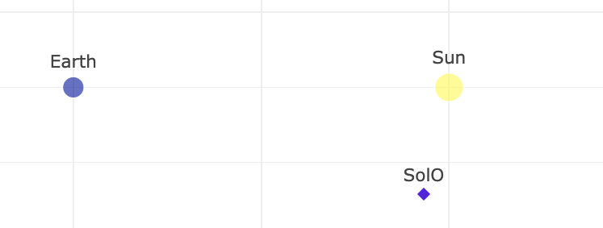
Overview of the SOOP campaign
STIX quicklook 15-25 keV
Campaign Windows
2024-03-19 20:00-00:00
2024-03-23 20:00-00:00
2024-04-02 20:00-00:00
2024-04-04 20:00-00:00
2024-04-05 20:00-00:00
2024-04-06 20:00-00:00
Ryan, et al. 2024/5 in prep
19-03-2024
0.43AU
04-04-2024
0.29AU
06-04-2024
0.3AU

Slide 6
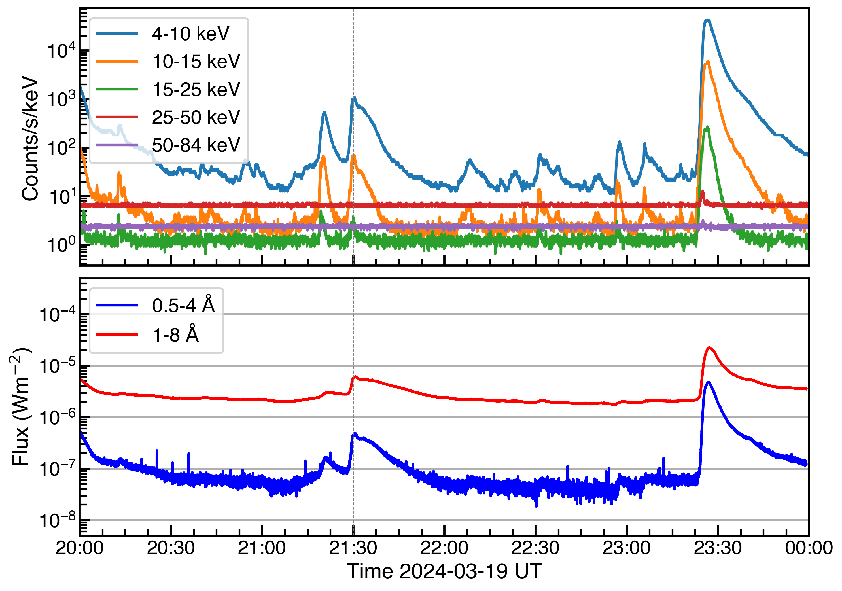
Overview of the SOOP campaign
STIX quicklook 15-25 keV
Campaign Windows
2024-03-19 20:00-00:00
2024-03-23 20:00-00:00
2024-04-02 20:00-00:00
2024-04-04 20:00-00:00
2024-04-05 20:00-00:00
2024-04-06 20:00-00:00
STIX
GOES/XRS
19-03-2024
0.43AU

Slide 7
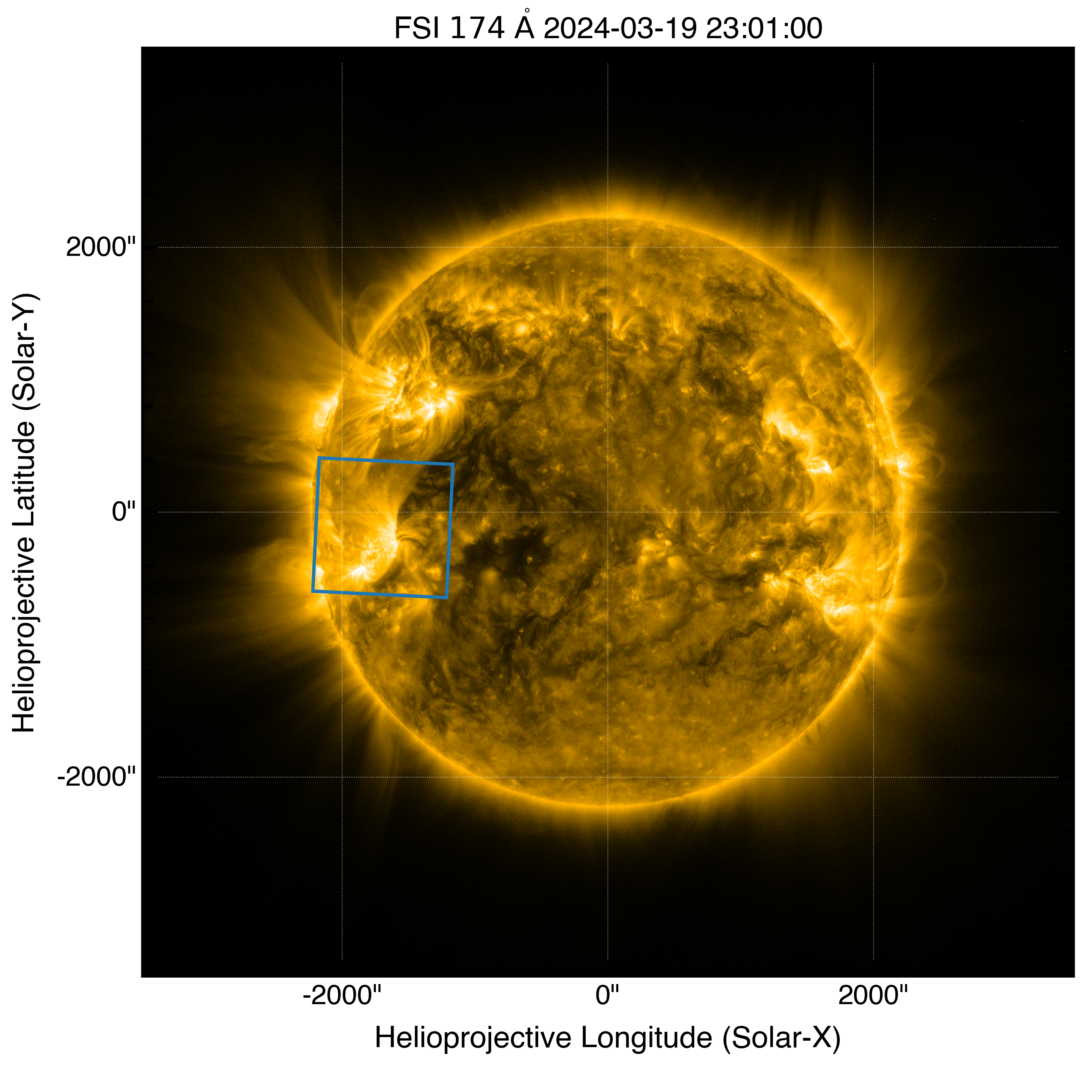
Flare caught Mar 19 2024 M-class event
Are these flares within field of view of EUI/HRI?
C3.0
M2.1
C6.0
HRI field of view

Slide 8
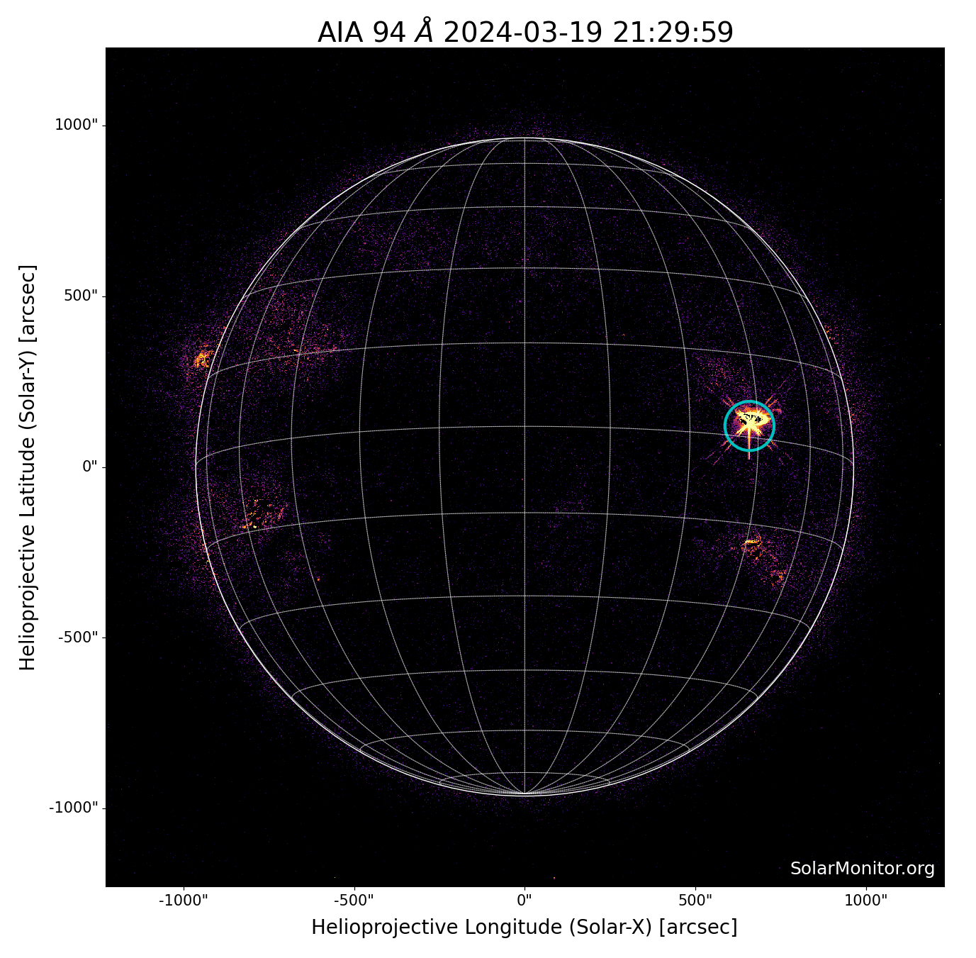
Flare caught Mar 19 2024 M-class event
C3.0
M2.1
C6.0
solmon.dias.ie

Slide 9
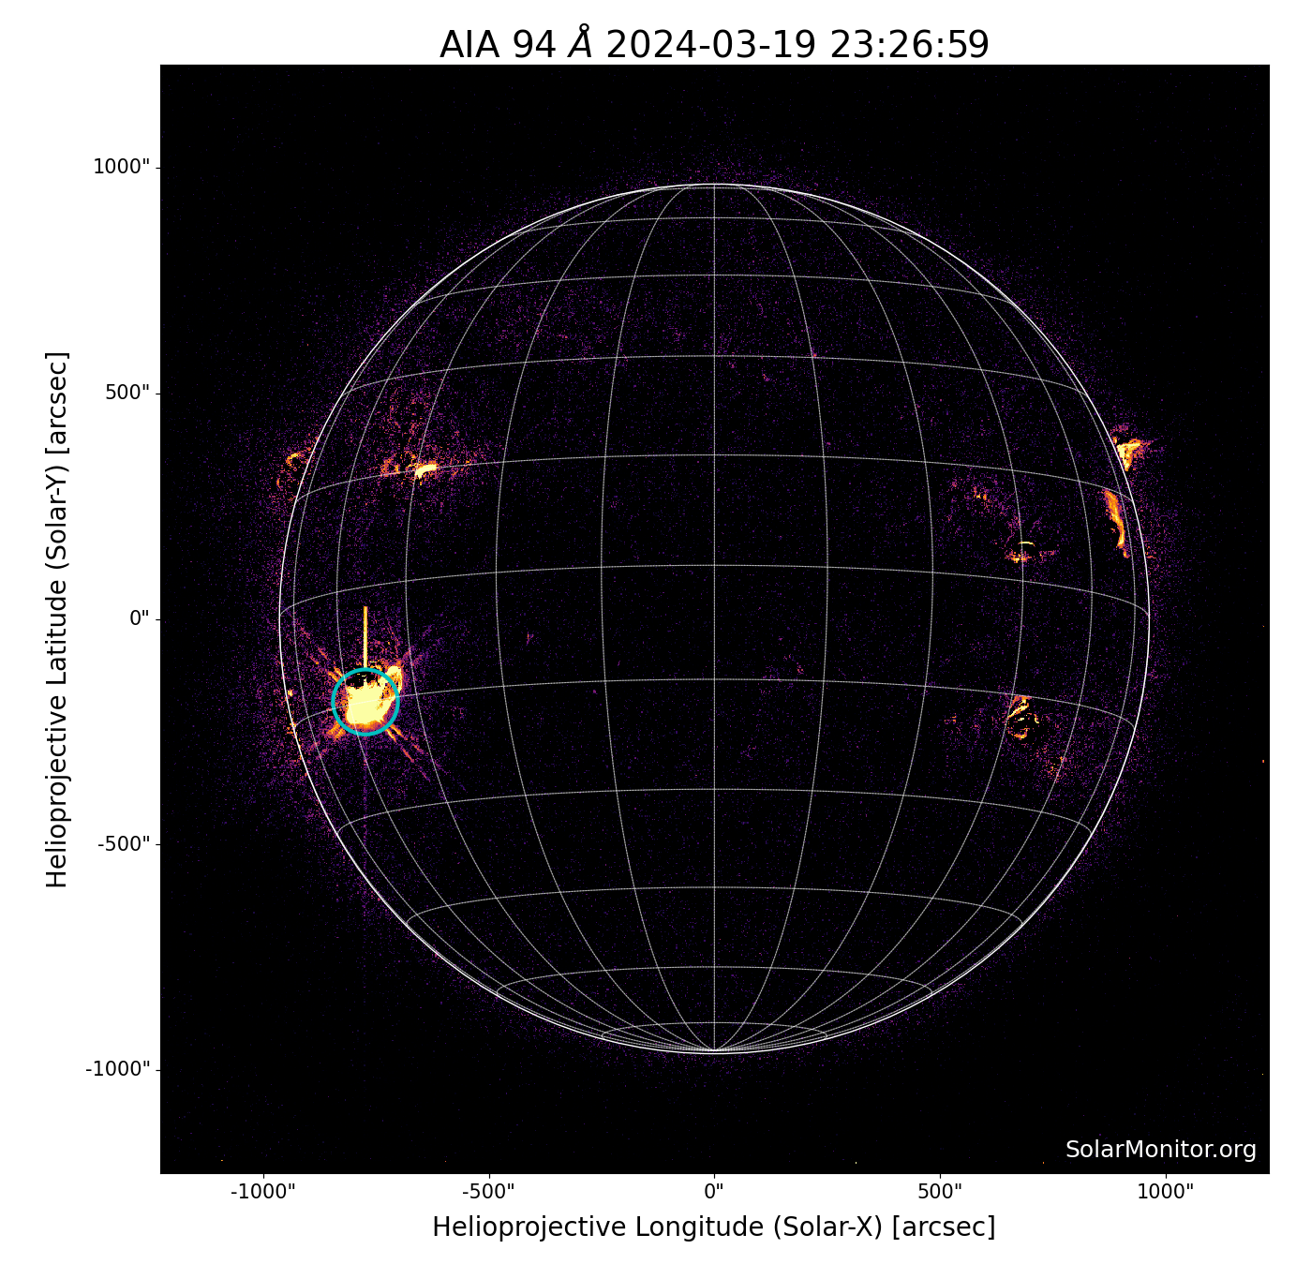
Flare caught Mar 19 2024 M-class event
C3.0
M2.1
C6.0
solmon.dias.ie

Slide 10
Flare caught Mar 19 2024 M-class event
M-class flare caught!
C3.0
M2.1
C6.0
🥳
HRI field of view

Slide 11
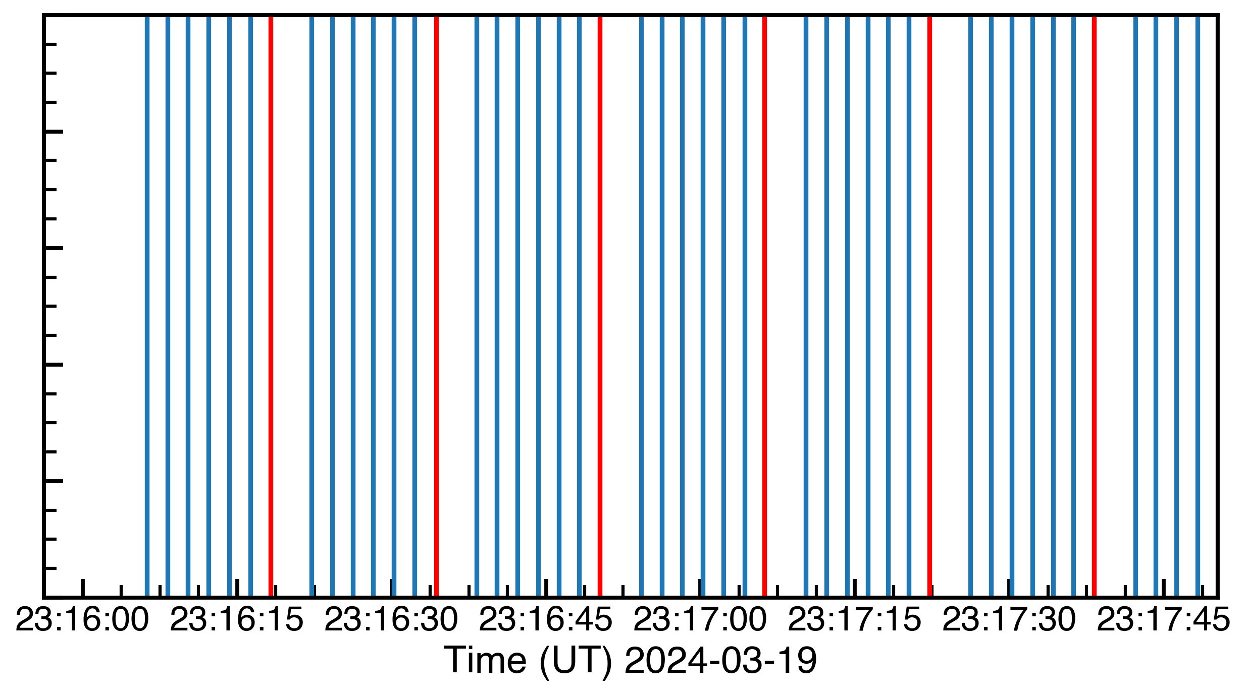
EUI/HRI Flare watch mode - normal + short exposures
HRI 174Å ran in a sequence of “short” exposure (0.04s) and several normal (“long”) exposure (2s) observations
Most data in short exposure is 0 (can compress to v.small!)
Short exposure frame image every 2s and long exposure 16 s
2s exposure “normal”
0.04s exposure “short”
“short"
“normal”
https://www.sidc.be/EUI/data/movie/SOOPs/

Slide 12
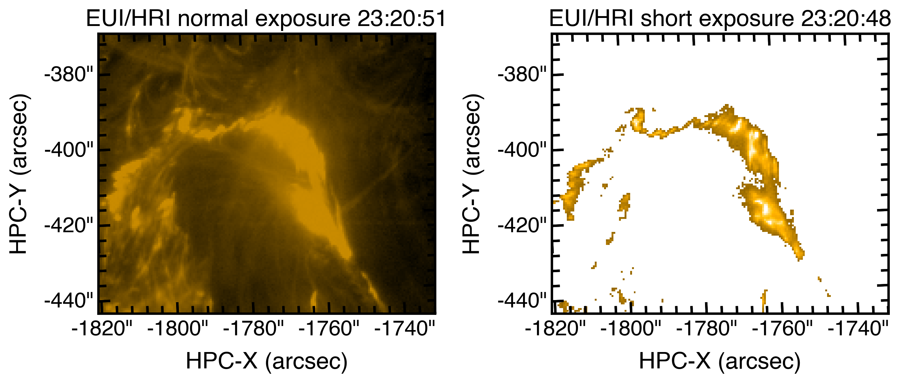
EUI/HRI Flare watch mode - normal + short exposures

Slide 13
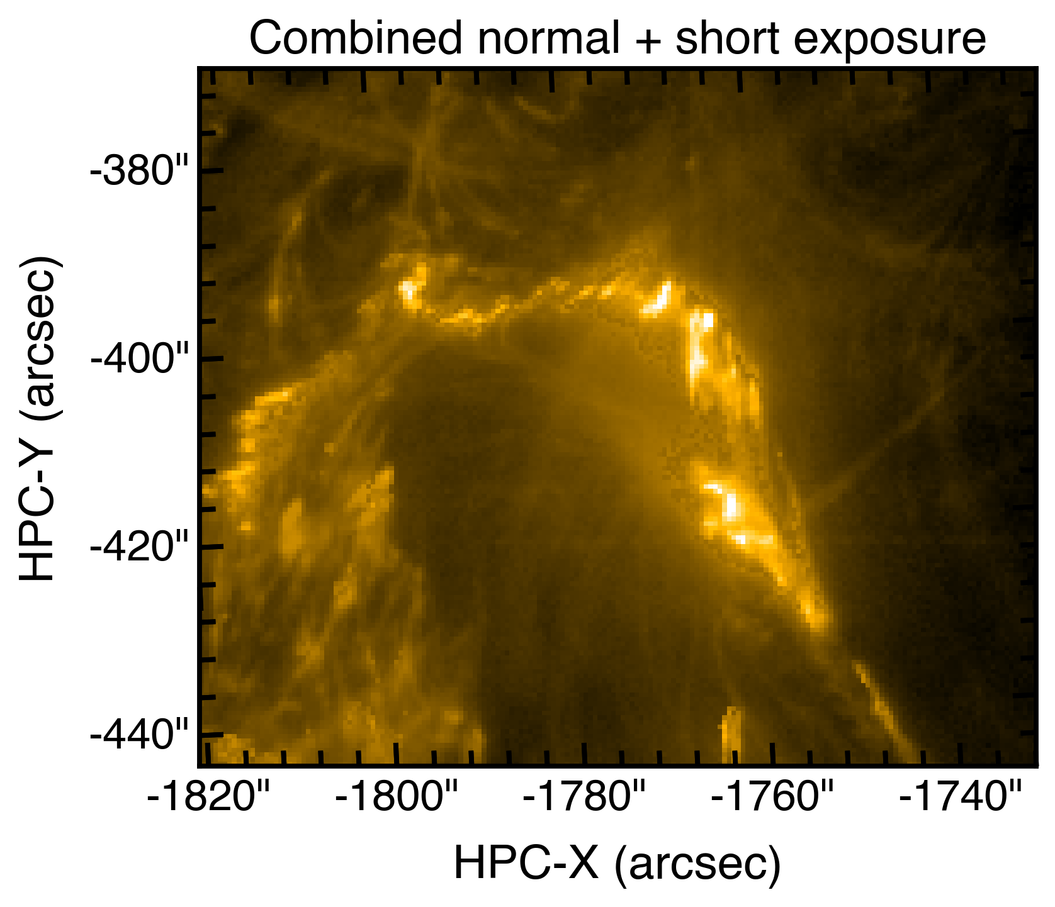
EUI/HRI Flare watch mode - normal + short exposures

Slide 14
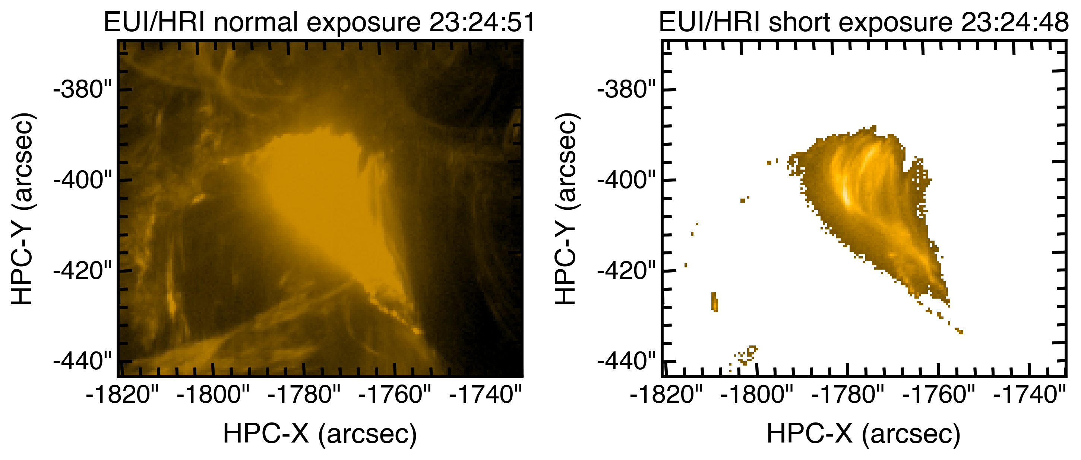
EUI/HRI Flare watch mode - normal + short exposures

Slide 15
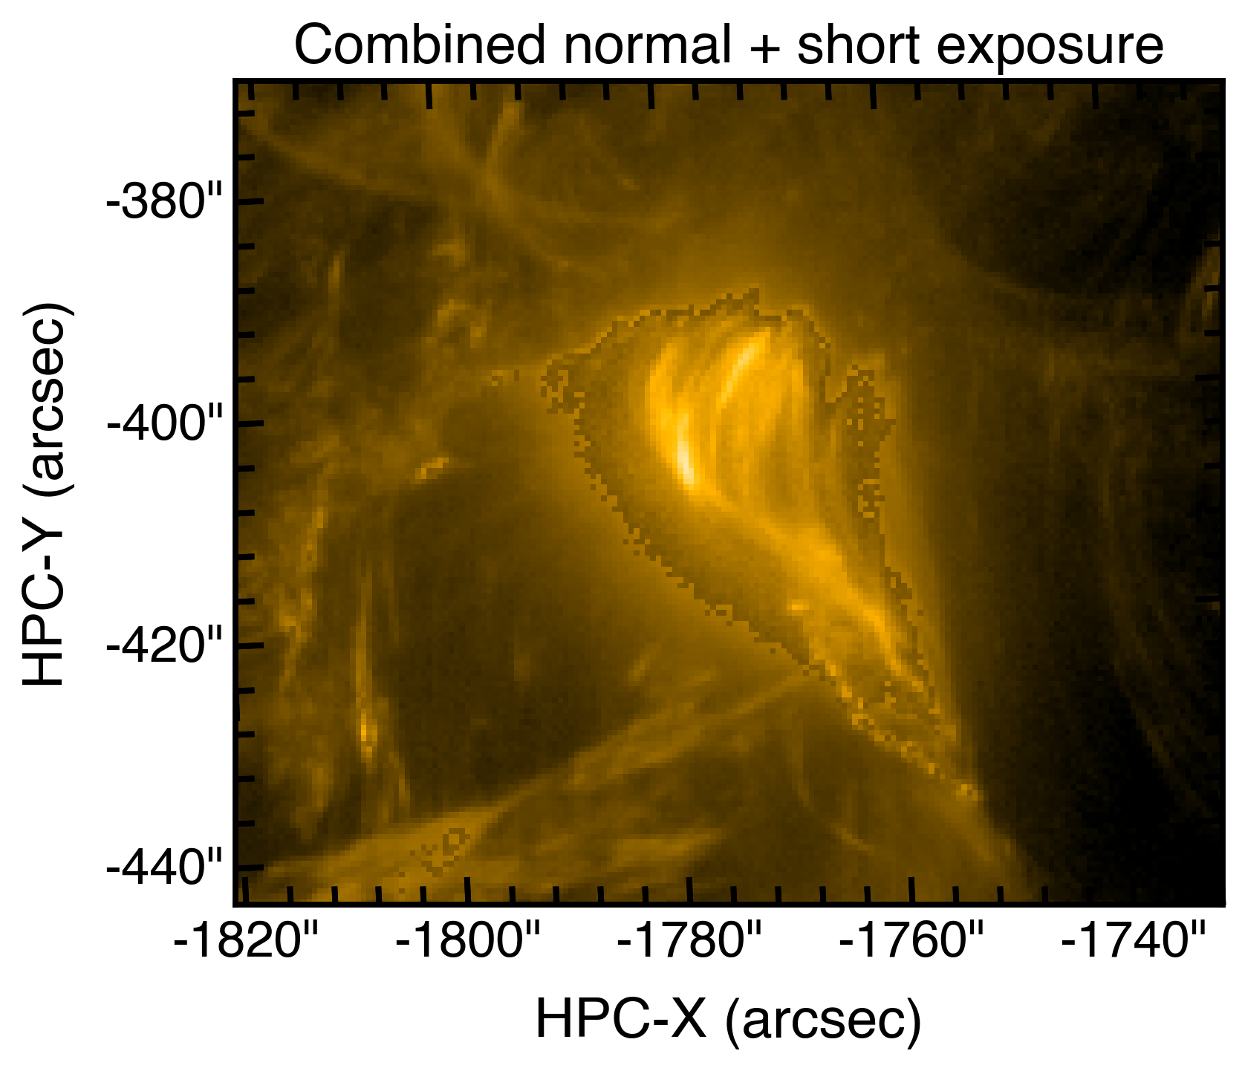
EUI/HRI Flare watch mode - normal + short exposures

Slide 16
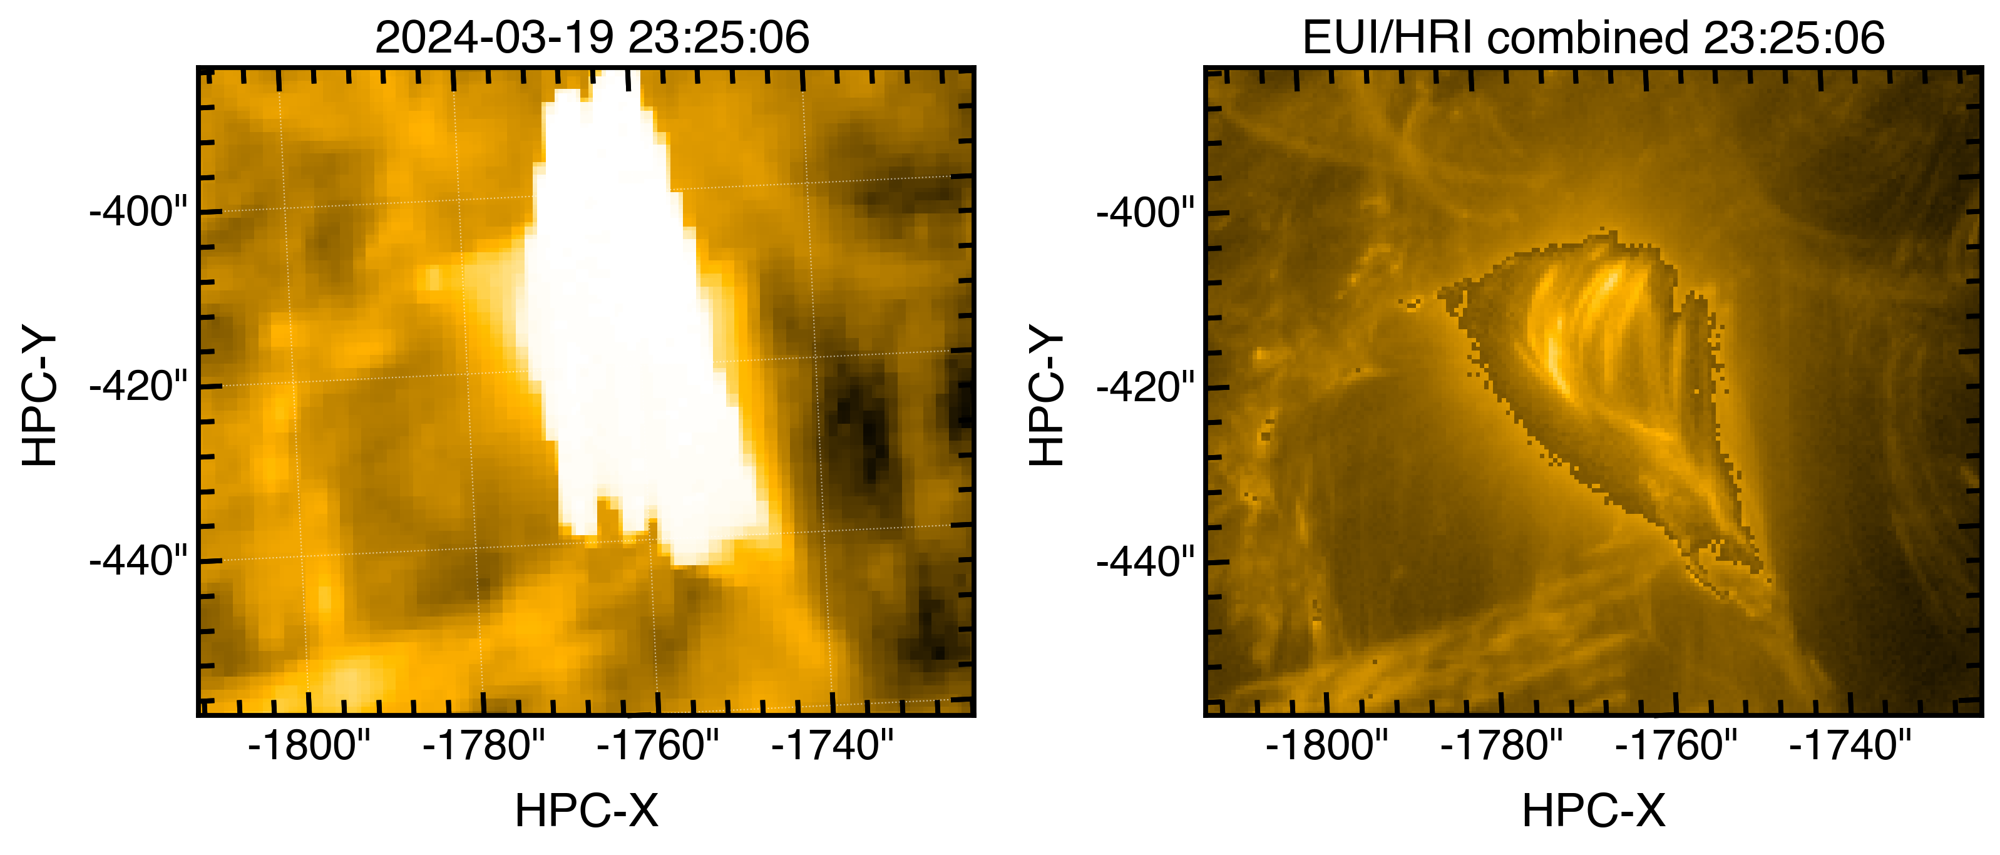
EUI/HRI Flare watch mode - comparison with SDO/AIA
SDO/AIA 171Å
EUI/HRI 174Å
😍
Pixel scale~ 433km
Pixel scale~ 155km
HRI/EUI is actually allowing us to “see” the flare in EUV!

Slide 17
Highest cadence non-saturated EUV observation of flare!
2s cadence!
- 155km per pixel!
(0.492’’ at 0.43AU)
Summed pixel values (DNs)
Time (UT)

Slide 18
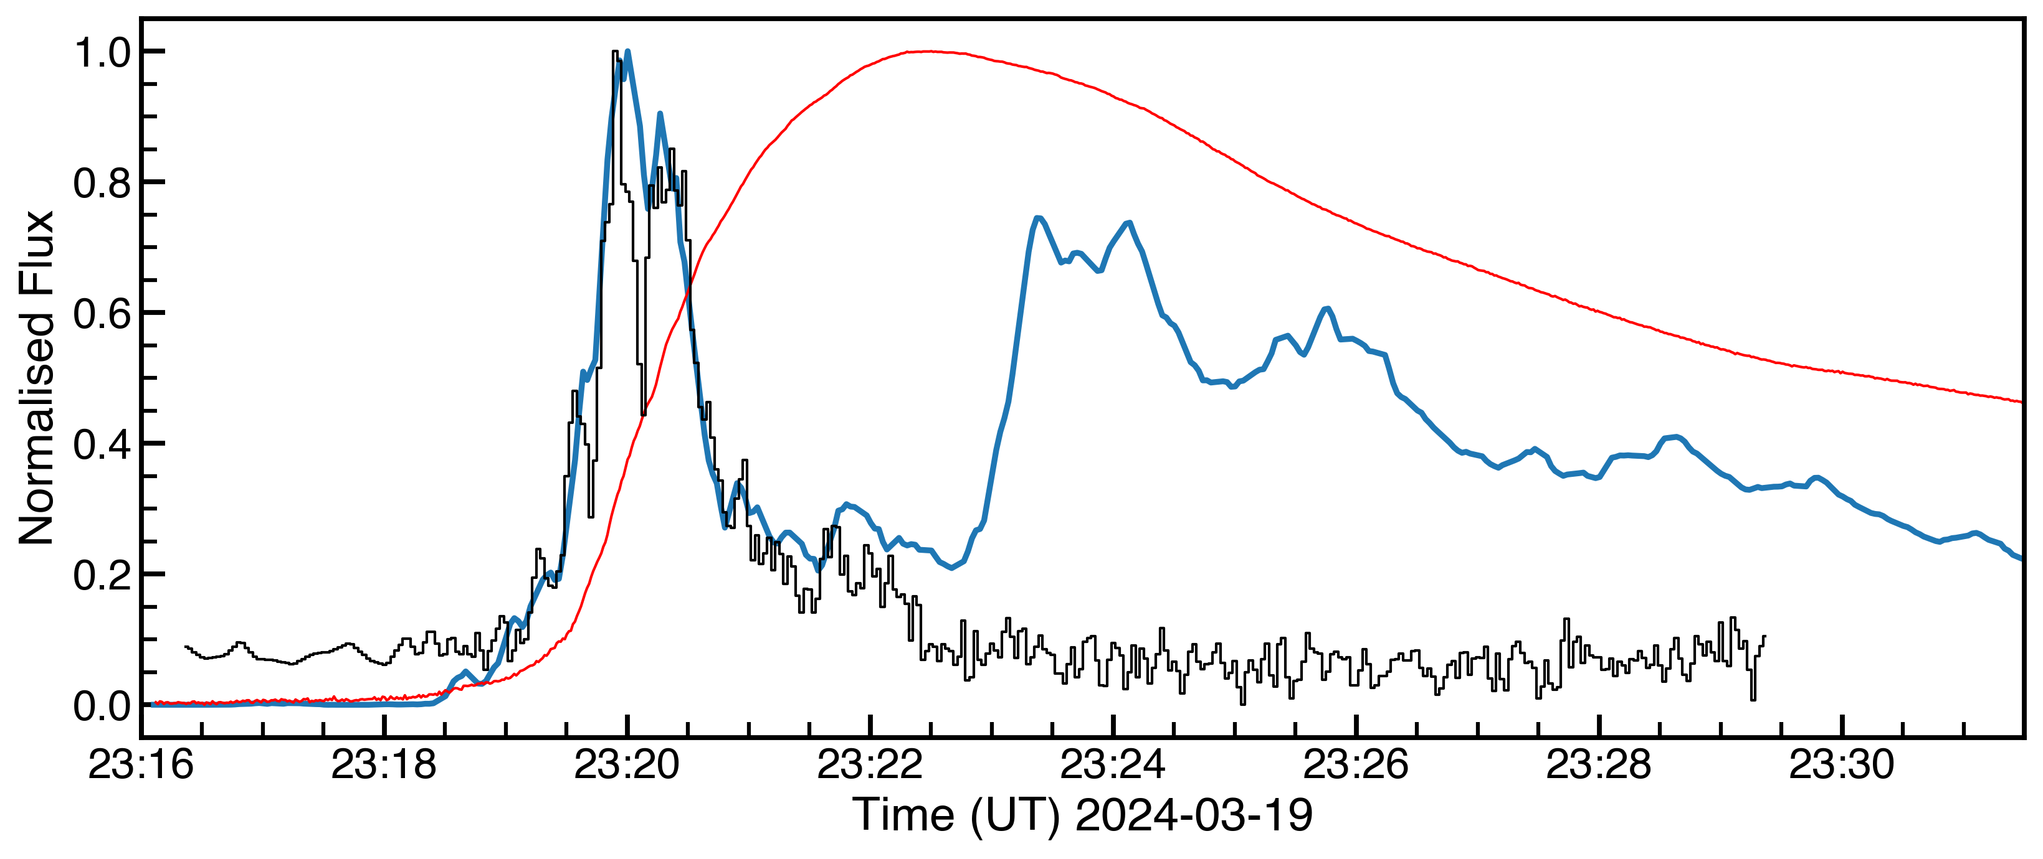
STIX X-rays + EUI fast cadence
STIX 22-45 keV
HRI 174Å short exposure
GOES 1-8Å

Slide 19
STIX X-rays + EUI fast cadence
STIX 22-45 keV
HRI 174Å short exposure
GOES 1-8Å
Flare loop (~1MK)
Ribbons in HRI

Slide 20
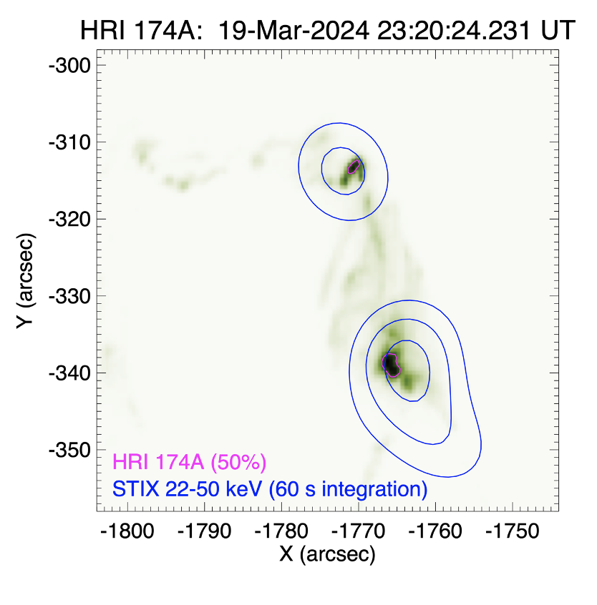
STIX X-rays + EUI fast cadence
STIX 22-45 keV
HRI 174Å short exposure
GOES 1-8Å

Slide 21
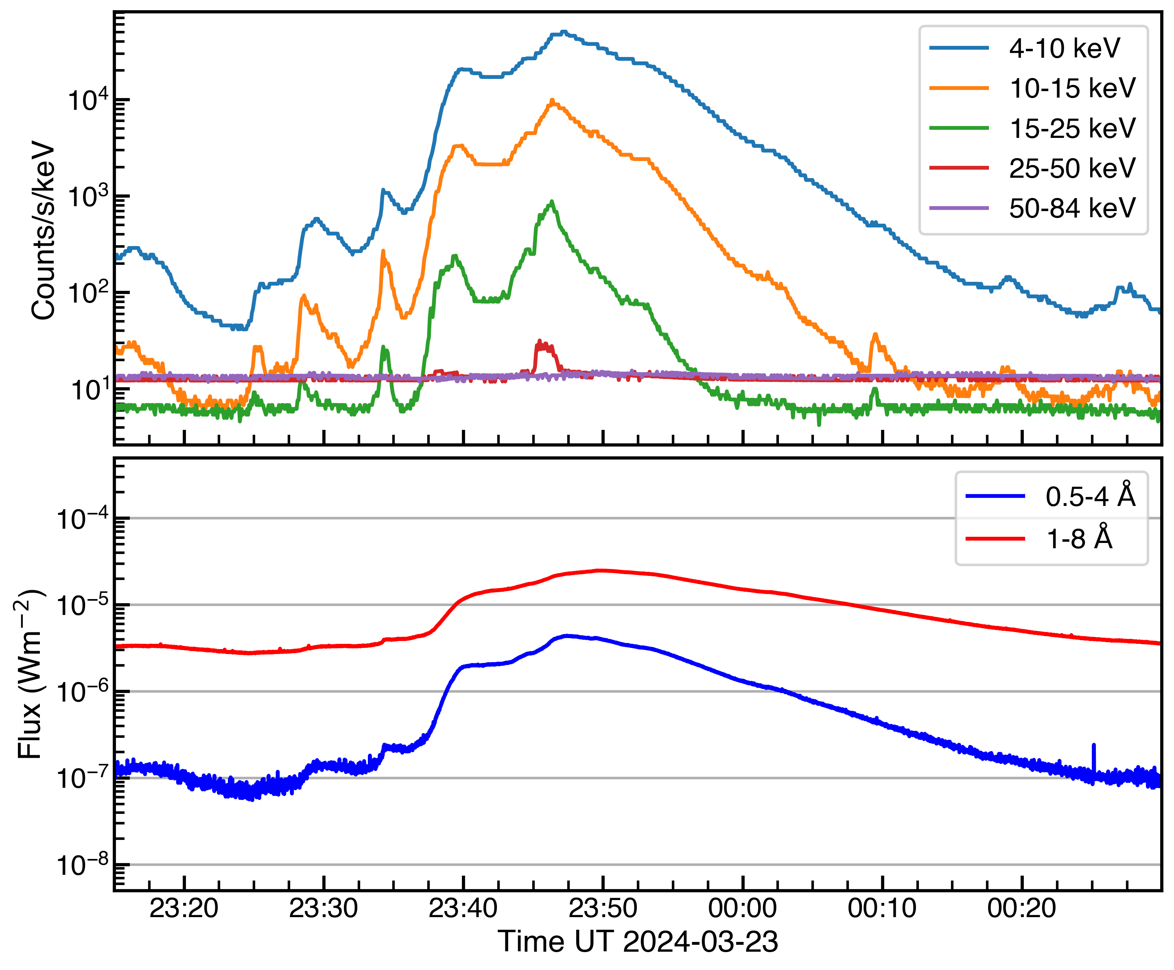
Mar 23 2024 - two ribbon flare
STIX
EUI/HRI
SDO/AIA
GOES/XRS
M2
https://www.sidc.be/EUI/data/movie/SOOPs/
0.381AU

Slide 22
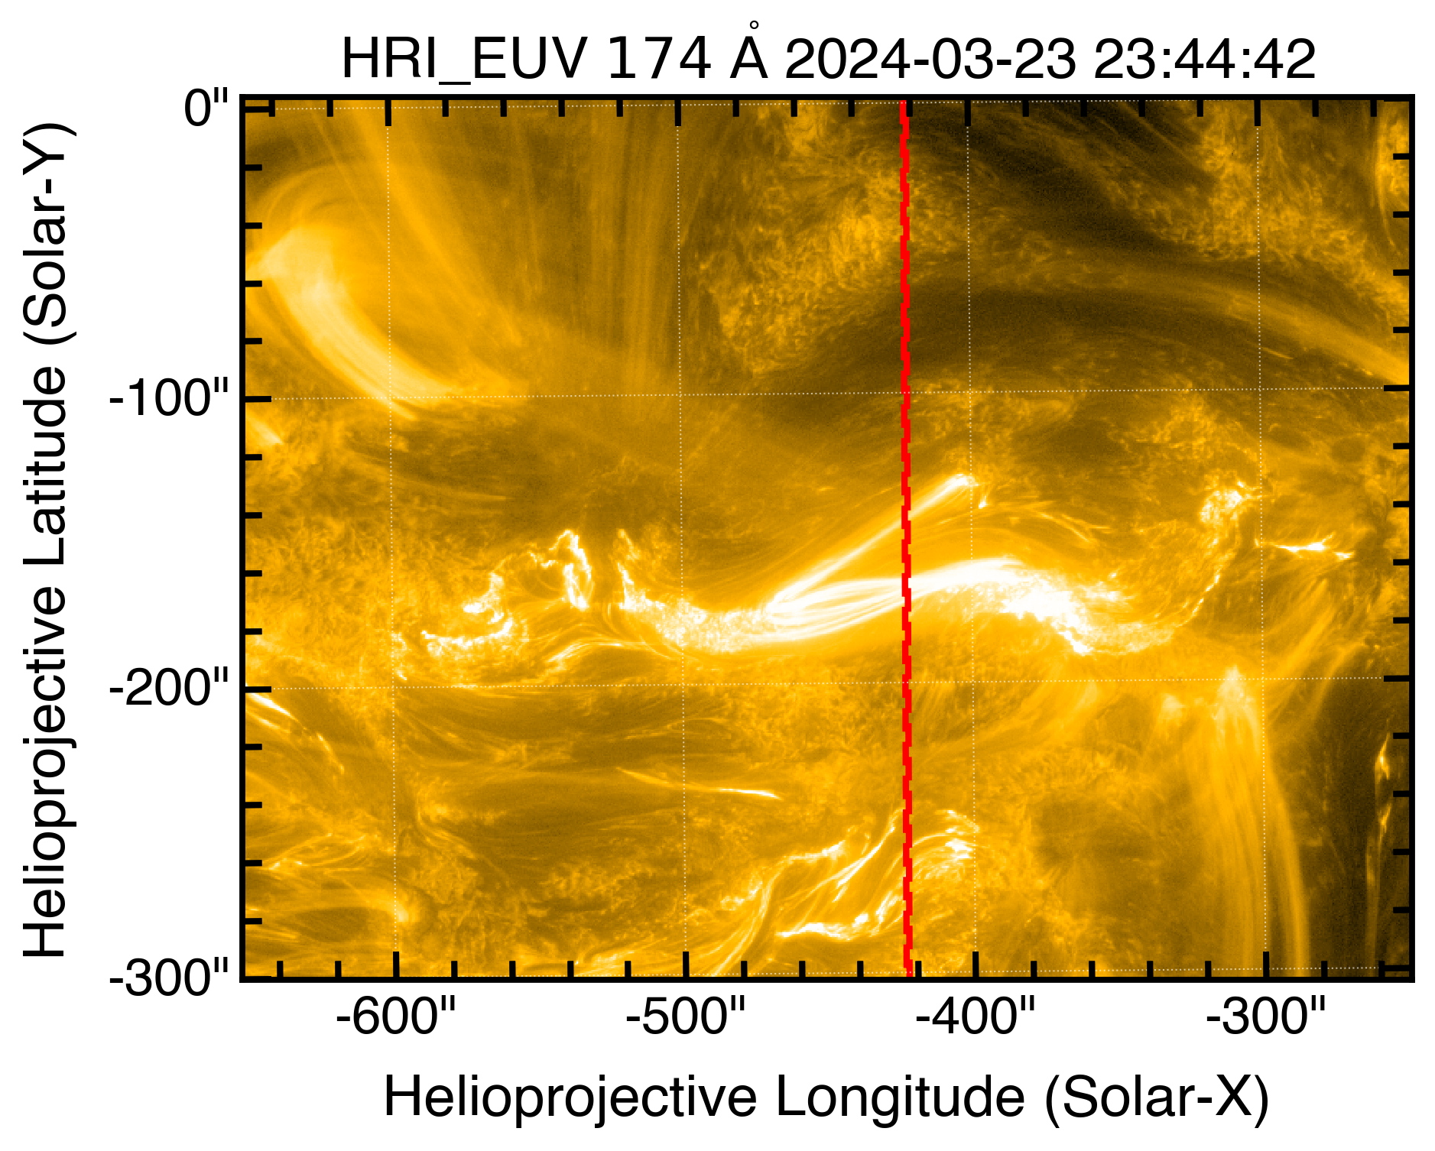
Mar 23 2024 - two ribbon flare
STIX
EUI/HRI
SDO/AIA
GOES/XRS
M2
SPICE slit
https://www.sidc.be/EUI/data/movie/SOOPs/
SPICE also caught this flare!
0.381AU
See Graham Kerr's poster (#170!)

Slide 23
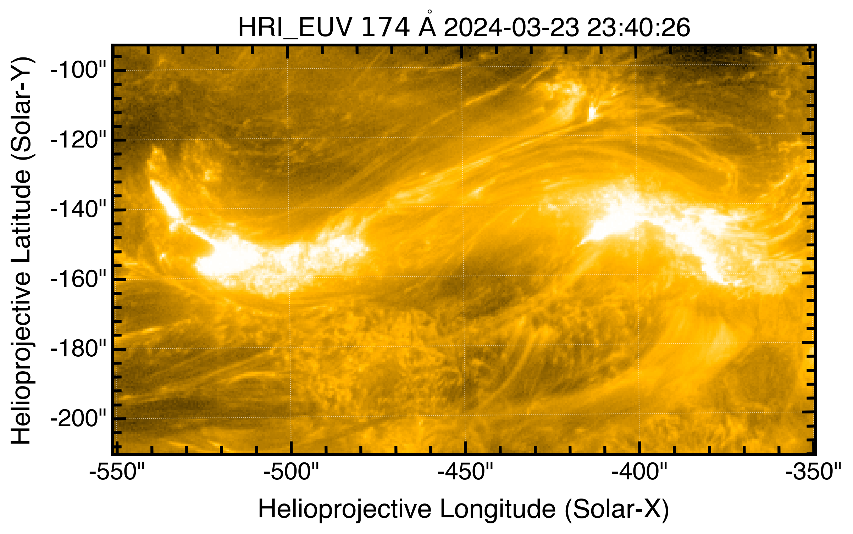
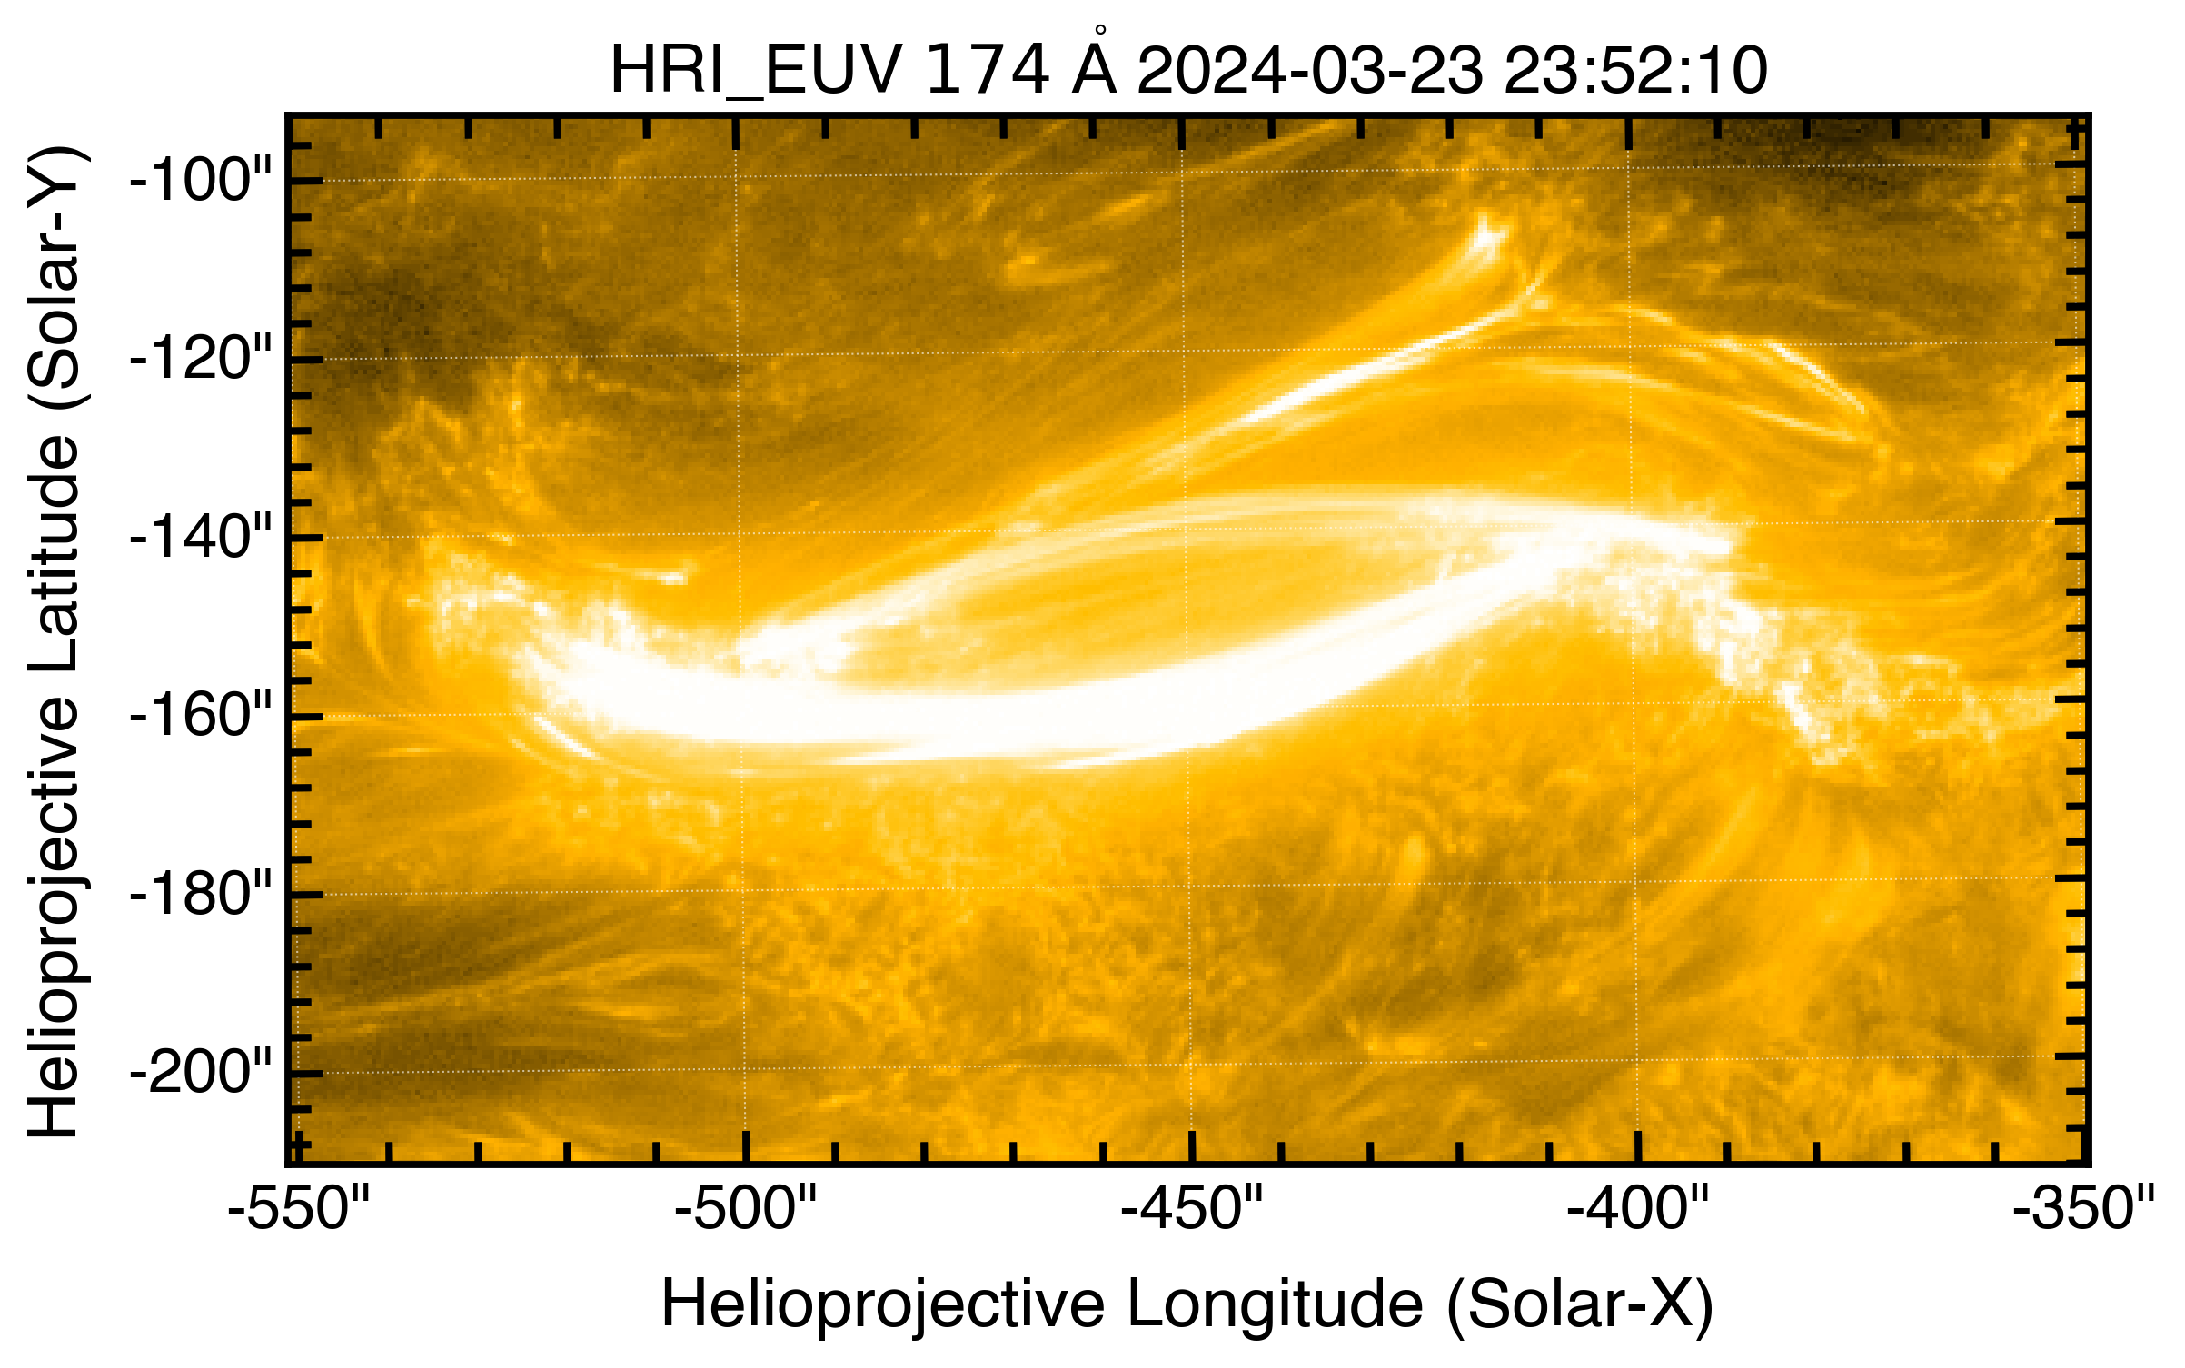
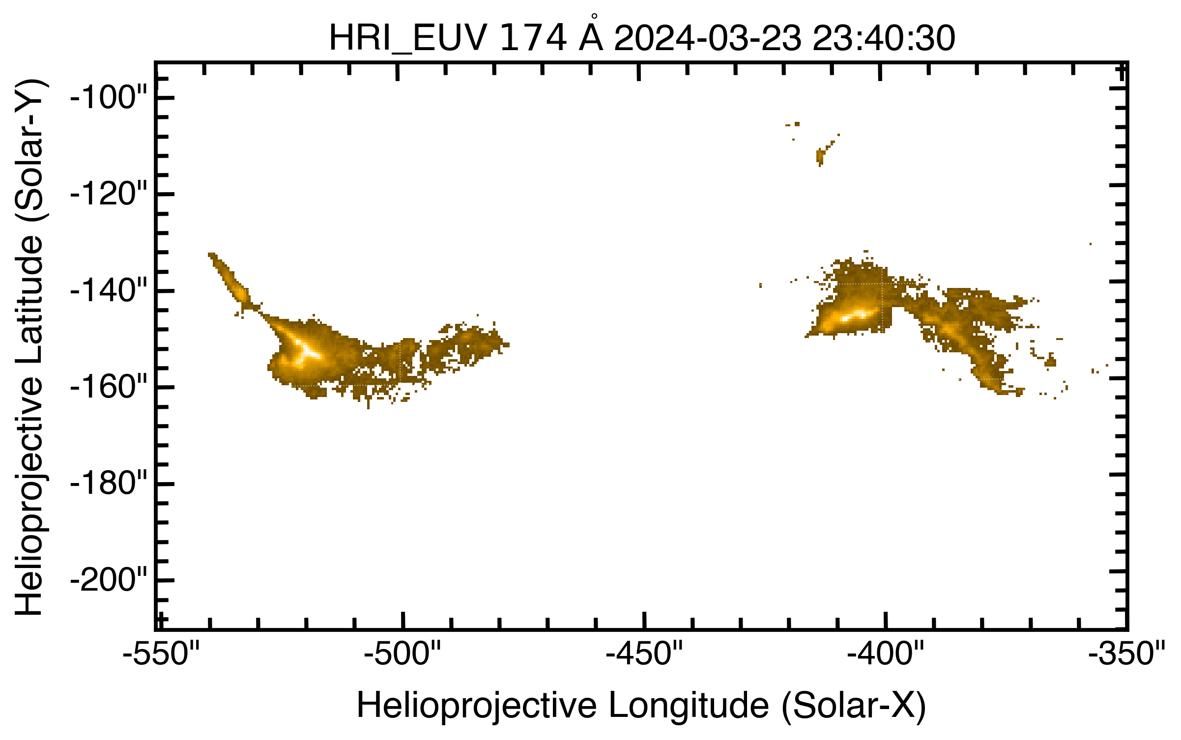
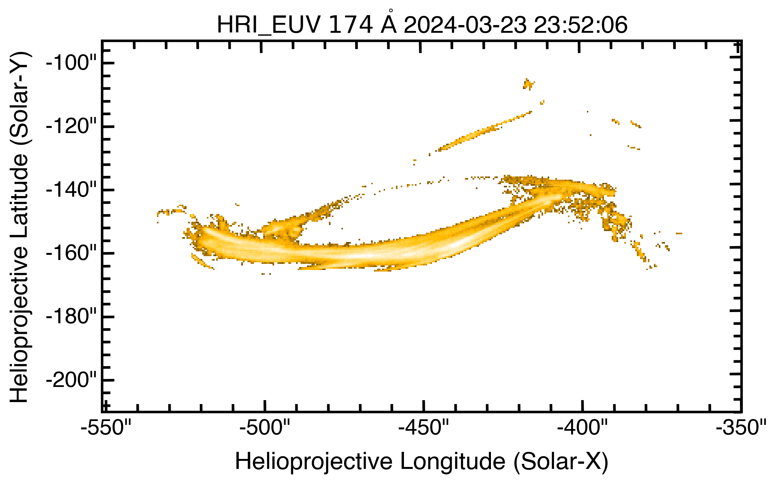
Mar 23 2024 - two ribbon flare
12 minutes later
Normal exposure
Normal exposure
Short exposure
Short exposure

Slide 24
Summary
Major flare campaign was very successful - a very unique dataset, >8 flare observed
Reach out if interested (D. Ryan coordinator)
The highest cadence & resolutions short exposure observations of flare to date!
very compact sources, short lived, ribbon “motions” and kernels identified - can resolve loop structures in later stages with 155km pixel scales
Coordinated X-ray + EUV studies
Campaign to run again next Spring (with HRI)
Proof of concept for need for a flare-focused EUV imager with high cadence and short exposures
Check out https://datacenter.stix.i4ds.net/ for STIX observations

