Slide 1
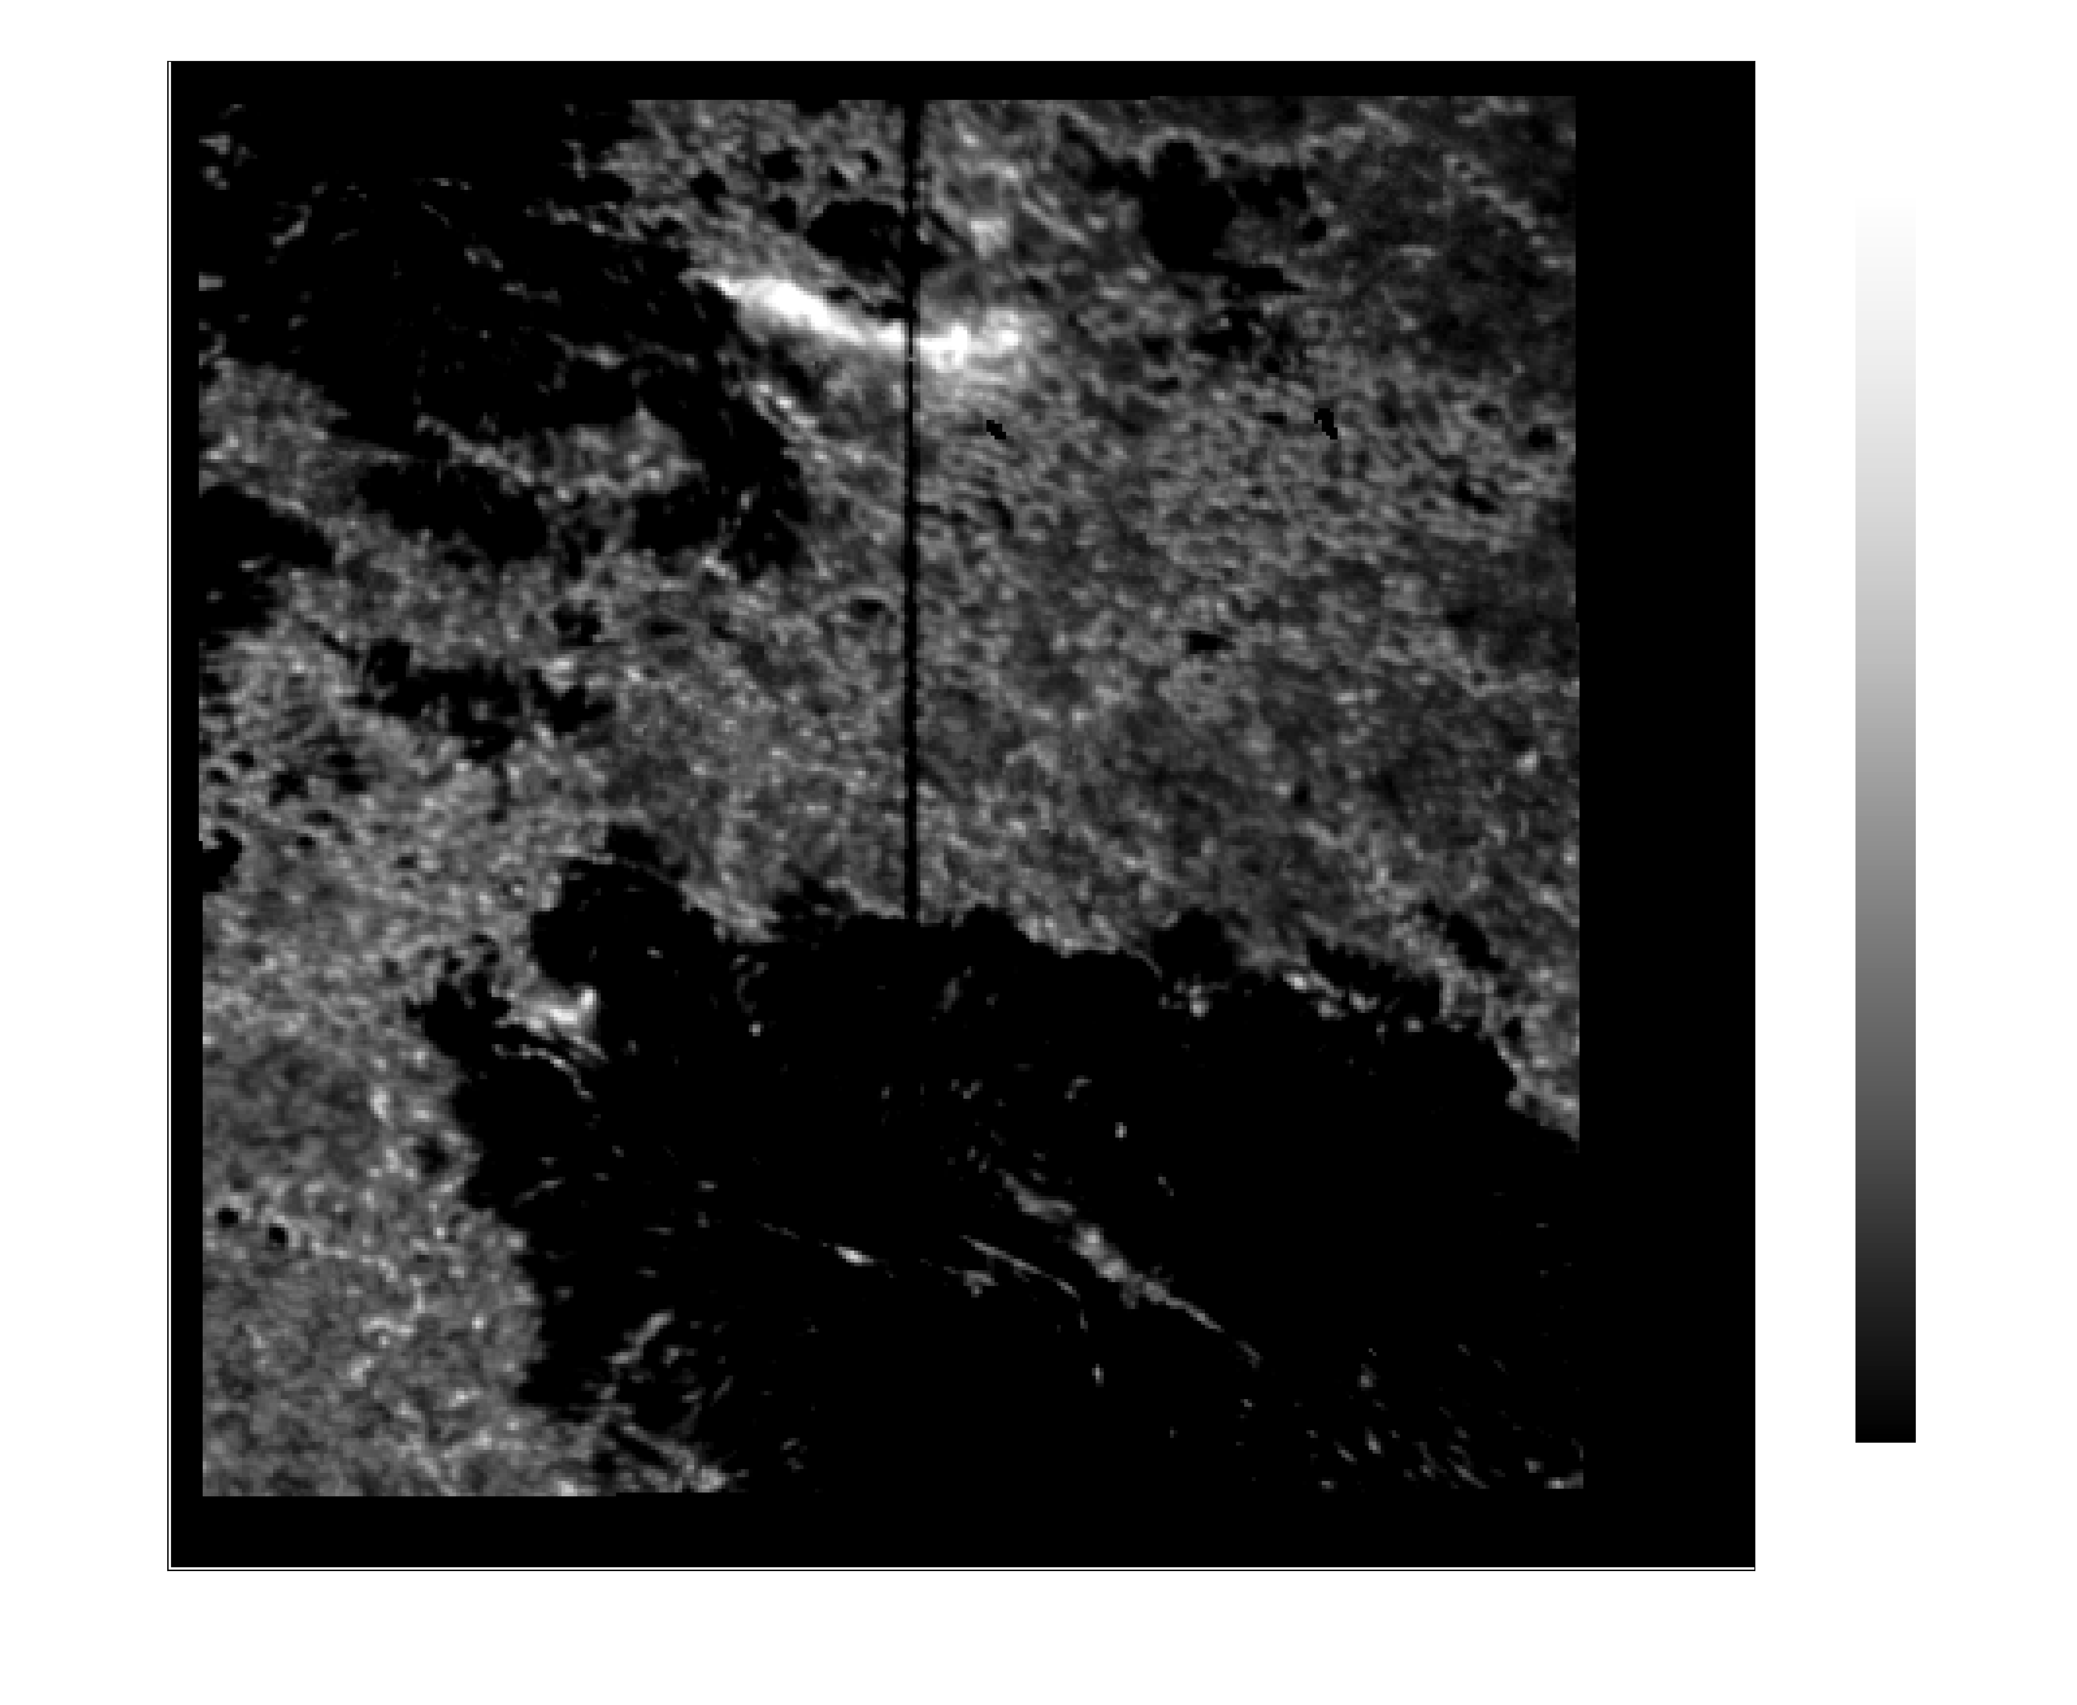
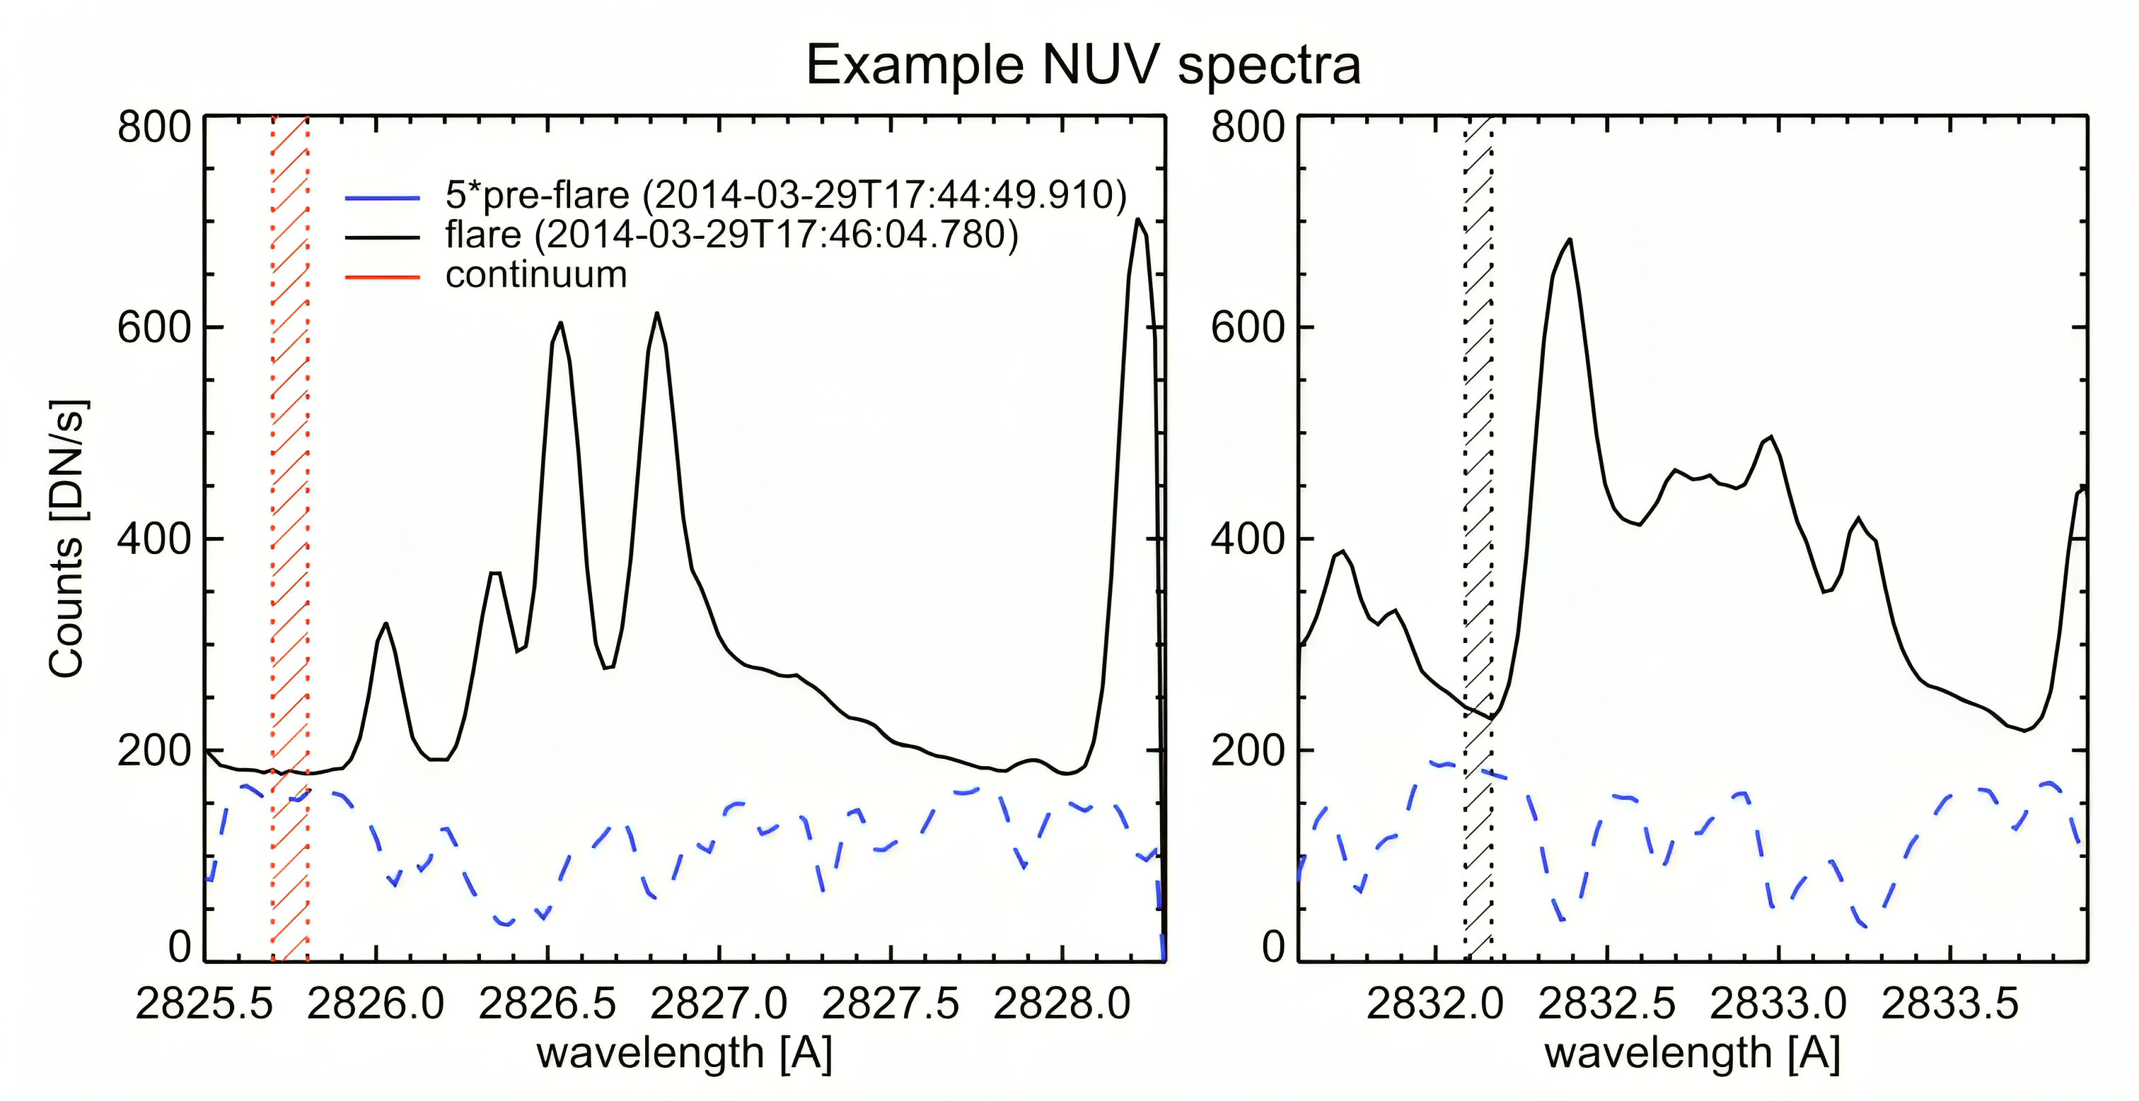
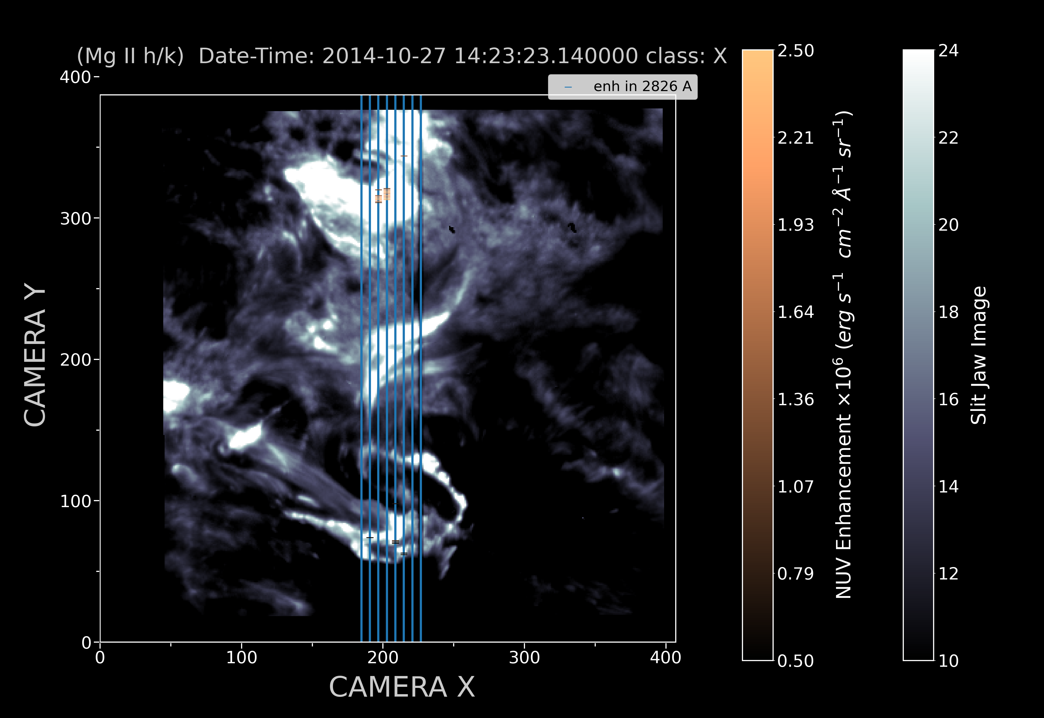
THE FLARE CONTINUUM ENHANCEMENT PUZZLE
Pranjali Sharma, Lucia Kleint, Jonas Zbinden
ABOUT
This study is a statistical analysis of Balmer continuum enhancement in 29 solar flares. We further probe the physical cause of such enhancement.
(2832 Å Mg II wing) Date-Time: 2014-10-27 14:23:04.360000 Class : X
OVERVIEW
a)
a)
Motivation : Solar flares radiate away most of their energy via continuum emission, but the mechanism behind this emission is not yet fully understood.
Challenges : Understanding this mechanism across all spectral regions is challenging due to the rarity of visible continuum spectra and limited coordinated observations.
Objective : to constrain the continuum enhancement process in the spectral region with the strongest continuum emission -the NUV continuum, by analysing multiple flare events.
b)
Enhanced emission (red dotted region) in the 2832 Å IRIS NUV continuum image, with potential contribution from spectral lines
Primary hypothesis : hydrogen
recombination + photospheric
back-warming.
Constraining the continuum enhancement process would serve as a test to the standard flare model. (Image adapted from Kowalski & Allred 2018)
METHODS
DATA
Two continuum windows were selected from the
wavelength ranges with the least observed
enhancement (figure c).
Instrument used : IRIS (Infrared Region Imaging Spectrograph)
c)
Broad bandpass ( 40 or 4 Å ) image of the active region - Slit jaw image
(Kleint et al. 2016)
We use four sigma intensity thresholding to detect
outliers within the continuum time-series for each
pixel along the slit.
Spectral data : NUV and FUV spectra along
the vertical slit positions
, figure(d) .
Wavelength range depends on the line-list.
If the outlier exceeds the enhancement threshold of
the quiet Sun in both continuum windows, the
timestamp is marked as an event of NUV continuum
enhancement.
The two continuum windows (red and black shaded region)
are near 2826 Å and 2832 Å.
RESULTS
d)
e)
(Mg II h/k) Date-Time: 2014-10-27 14:23:23.140000 Class X
X 10⁶
Horizontal, orange markers are the locations of
NUV continuum enhancement.
X-class flares show the strongest enhancement. NUV continuum enhancement more or less follows the order of the flare class.
Majority of the enhanced pixels lie on the
flare ribbon.
Simulations using RH and RADYN show realisitic enhancement only for low
beam-flux and cut-off energy.
SUMMARY
This study characterises the occurrence of Balmer continuum enhancement in solar flares, to constrain its underlying physical process.
From the analysis of 29 flares, we infer that NUV enhancement follows the order of the flare class. Most enhanced pixels lie on the
flare ribbons.
Further steps : simulate NUV continuum for different flare classes and compare with the results of our study.
Email : Pranjali.sharma@unibe.ch

