Slide 1
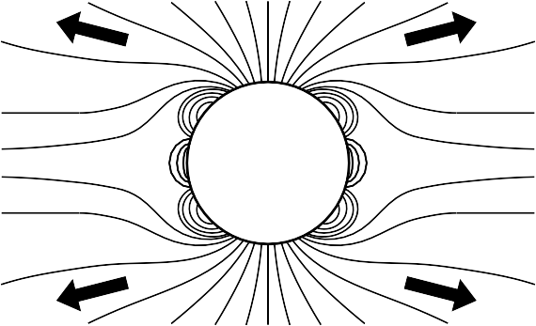
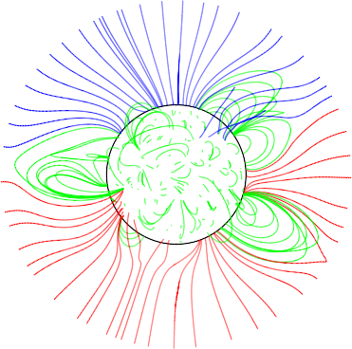
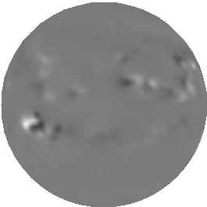
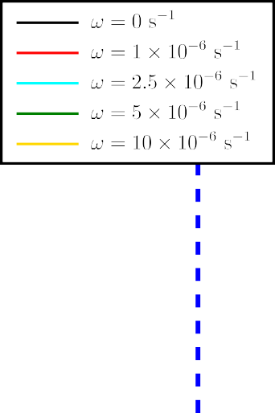
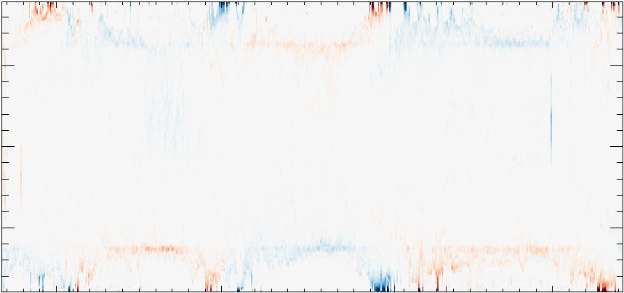
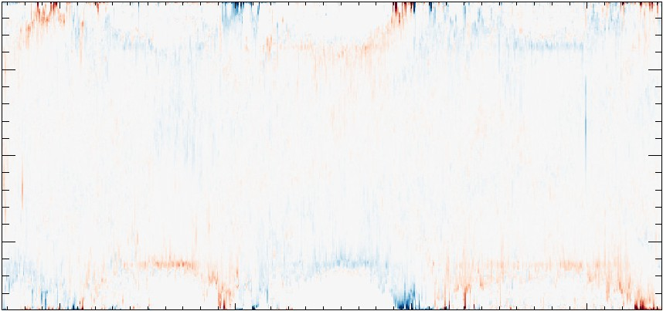
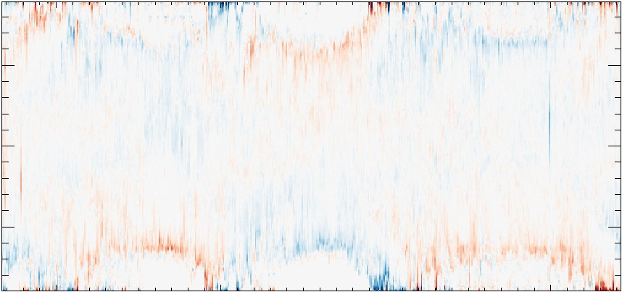
Investigating the effect of statistically-averaged helicity condensation on ambient increase in the Solar Open Flux
Jonah Klowss¹ and Duncan Mackay¹
¹School of Mathematics and Statistics, University of St Andrews
Objectives
Magnetic helicity condensation
Magnetofrictional model
We aim to investigate the specific contribution of the
statistically-averaged helicity condensation (SAHC) model to the amount of Solar Open Flux.
Disentangle features from previous studies to isolate the SAHC contribution and observe the spatio-temporal evolution of Open Flux over several solar cycles.
Helicity is injected into the field by vortical motions in small-scale rotating convective cells, which is transferred to large scales by magnetic reconnection. These cells rotate at a rate ω with radius l at the footpoints of the coronal magnetic field (where the field meets the photospheric surface, r = R⊙).
The magnetofrictional model is a method used to produce non-linear force free fields (NLFFFs) in the solar corona. A constraint of NLFFFs is that they must satisfy
j = α(r)B, (1)
or that the force-free parameter, α, depends on position, and the Lorentz force vanishes. We introduce an artificial, dissipation-like frictional term to the MHD equation of motion (Yang et al., 1986),
Introduction
$$ρ\frac{Dv}{Dt}=ρg −∇p+j×B −νv.$$
(2)
The Solar Open Flux is the part of the Solar magnetic field that extends out past 2.5R⊙, and is the origin of the interplanetary magnetic field, which interacts with Earth and has an influence on ambient space weather.
Assuming time-invariance, a small plasma beta, and length scales smaller than the pressure scale height, the force free approximation,
$$j×B−νv=0⇒v=\frac{1}{ν}j×B,$$
(3)
This generates a horizontal twist component in B at the solar surface, which is cancelled out between adjacent cells’ antiparallel directions. Horizontal twist at the photosphere is then propagated up into the corona by the advection term in the induction equation, v × B.
causes the coronal magnetic field to evolve frictionally through several NLFFF equilibria. Departure from these coronal field equilibria is motivated by injection of energy and electric currents in the photospheric (surface) distribution of the magnetic field.
Coronal evolution in response to photospheric change is modelled by the induction equation:
Modelling approach
∂A
= v × B + H_{sg},
(4)
Mackay and Upton (2022) considered several key helicity injection mechanisms:
▶ Photospheric flux transport,
▶ Emergent bipole twist,
▶ Statistically-averaged helicity condensation.
To disentangle the contribution of SAHC to the Open Flux, we hold the photosphere fixed, based on a magnetogram observation of the Solar surface at each Carrington solar rotation. This means that helicity is only injected into the field through the helicity condensation mechanism.
The simulations are structured as 30-day models, corresponding approximately with the cadence of Carrington rotation observational data. Simulations are repeated in-series over 504 different observations (September, 1976 to April, 2014), for various values of the helicity injection rate, ω, in Equation (7).
Each new simulation commences with a new photospheric boundary condition, which is taken from the corresponding Carrington rotation observation. The initial coronal field is modelled from a potential field extrapolation (PFSS) of the magnetogram observation.
∂t
Being one part of the Sun’s magnetic field we can directly measure, global solar models aim to reproduce the total amount of Open Flux. However, potential field models consistently underestimate this quantity when compared with OMNI observations. As such, we turn to non-potential models of the Solar corona, such as Mackay and Upton (2022), which used a wide variety of mechanisms to inject helicity into the coronal field.
Here, we focus entirely on the helicity injection mechanism of statistically-averaged helicity condensation (SAHC), as described by Antiochos (2013); Mackay et al. (2014). This models the large-scale effect of vorticity in convective cells on the solar surface injecting helicity into the corona (see Equation (7)).
where v is comprised of the NLFFF frictional term,
$$v_{NLFFF}=\frac{1}{ν}\frac{j×B}{B^{2}},$$
and a term that enforces a strong outflow velocity that makes v radial at 2.5R⊙:
(5)
$$v_{out}=v_{0}\exp{−\frac{2.5R_{⊙}−r}{r_{w}}\hat{r},}$$
(6)
with v₀ = 100 km s⁻¹. This term, and the radial velocity field it produces, mimicks the effects of the Solar wind. The r_{w} parameter prevents this term from having an influence in the low corona.
Helicity is condensed at the photosphere,
$$\{$$
$$H_{sg}=\begin{matrix}∇_{r}\left(ζB_{r}\right), r=R_{⊙,} \\ 0, otherwise,\end{matrix} with ζ=\frac{\overline{l^{2}ω}}{2}$$
(7)
and the introduced twist is propagated up into the corona as a result of the Lorentz force.
Open Flux over solar cycles
4.5
4.0
3.5
3.0
2.5
2.0
1.5
1.0
Ratio with PFSS
1980 1990 2000 2010
Year
Figure 1: Comparison of the amount by which the introduction of helicity condensation rate enhances the amount of unsigned Open Flux in comparison to the PFSS model. Data are calculated as the ratio between Open Flux with different values of ω and Open Flux in a PFSS model at the corresponding time. Red vertical dashed lines indicate times of peak solar activity, whereas blue vertical dashed lines indicate times of solar minimum. The ω = 0 s⁻¹ case correponds to change driven entirely by the radial outflow condition (Equation (6)).
Spatial distribution of Open Flux
Conclusions
Further reading
90
Key results
▶ An increase in the rate of helicity condensation, ω, consistently causes an increase in the amount of unsigned Open Flux. This ranges from around a 20% increase for no/low helicity condensation, to increases of around 100% when compared to Open Flux estimates from potential field (PFSS) models. These enhancements on the Open Flux can be 4.5 times that of the PFSS model for some observations.
▶ Contribution of helicity condensation to Open Flux appears cyclic, with the effect of SAHC lessened at cycle minimum, but enhanced when there is significant Solar activity.
▶ The enhancement in the spatial distribution of the Open Flux appears to be dominant around the polar coronal holes, with helicity condensation generating an expansion of pre-existing Open Flux regions.
▶ Higher values of helicity condensation rate contribute more significant opening of new coronal hole regions around the equator, through enhanced rates of ejections of flux ropes and other mechanisms that open field lines.
▶ While large values of helicity injection enhance the Open Flux over PFSS modelling approaches by up to 350%, and frequently cause a 100% increase in the Open Flux around cycle maximum, these Open Flux estimates are still around a factor of 3 lower than the observed Open Flux.
S. K. Antiochos. Helicity Condensation as the Origin of Coronal and Solar Wind Structure. The Astrophysical Journal, 772(1):72, 2013. doi:
10.1088/0004-637X/772/1/72.
Andre Balogh, E. J. Smith, B. T. Tsurutani, D. J. Southwood, R. J. Forsyth, and
T. S. Horbury. The Heliospheric Magnetic Field Over the South Polar Region of the Sun. Science, 268(5213):1007–1010, 1995. doi: 10.1126/science.268.5213.1007.
D. H. Mackay and L. A. Upton. A Comparison of Global Magnetofrictional Simulations of the 2015 March 20 Solar Eclipse. The Astrophysical Journal, 939 (9):22, 2022. doi: 10.3847/1538-4357/ac94c7.
Duncan H Mackay, C Richard DeVore, and Spiro K Antiochos. Global-Scale Consequences of Magnetic-helicity Injections and Condensation on the Sun. The Astrophysical Journal, 784(164):15, 2014. doi: 10.1088/0004-637X/784/2/164. Edward J. Smith and Andre Balogh. Decrease in heliospheric magnetic flux in this solar minimum: Recent Ulysses magnetic field observations. Geophysical
Research Letters, 35(22):L22103, 2008. doi: 10.1029/2008GL035345.
W. H. Yang, P. A. Sturrock, and S. K. Antiochos. Force-free Magnetic Fields: The Magneto-frictional Method. The Astrophysical Journal, 309:383, 1986. doi: 10.1086/164610.
Anthony R. Yeates, Tahar Amari, Ioannis Contopoulos, Xueshang Feng, Duncan H. Mackay, Zoran Mikic´, Thomas Wiegelmann, Joseph Hutton,
Christopher A. Lowder, Huw Morgan, Gordon Petrie, Laurel A. Rachmeler, Lisa A. Upton, Aurelien Canou, Pierre Chopin, Cooper Downs, Miloslav Druckmu¨ ller,
Jon A. Linker, Daniel B. Seaton, and Tibor To¨ ro¨ k. Global Non-Potential Magnetic Models of the Solar Corona During the March 2015 Eclipse. Space Science Reviews, 214(5):99, 2018. doi: 10.1007/s11214-018-0534-1.
Latitude
0
-90
90
Latitude
0
-90
90
Latitude
0
Future considerations
▶ While the SAHC model clearly contributes to the simulated Open Flux, the model estimates still fall short of observations. The next step is studying the contribution of SAHC with other mechanism that enhance Open Flux, including other methods that inject helicity at the photosphere.
▶ The contribution of statistically-averaged helicity condensation being small at cycle minimum, and more significant at cycle maximum, offers an opportunity to observationally study the Sun in cycle maximum with the goal of investigating the efficacy of the SAHC model in situ.
▶ Following on from modelling how SAHC contributes to the spatial evolution of Open Flux, the next step is to investigate the relationship between different Open Flux footpoint regions and the amount of Open Flux predicted by global coronal models.
▶ The SAHC model may also be applicable to convective stars, particularly in the analysis of:
▶ Open Flux in convective stars, and subsequently,
▶ Angular momentum loss and the spin-down rate of these stars.
⁻⁹⁰ 1980
1990
Year
2000
2010
Acknowledgements
Open negative
Closed
Flux
Open positive
We acknowledge financial support from the Science and Technology Facilities Council for this project, and appreciate the resources of the University of St Andrews High Performance Computing facilities.
Figure 2: Longitudinally-averaged change (relative to PFSS models) of spatial distribution of Open positive (red), Open negative (blue), and closed (white) flux at the photosphere over time, for various values of helicity injec- tion rate, ω. Plot regions of more intense colour represent more significant enhancement of Open Flux areas in comparison with PFSS modelling.
Contact Information
▶ Email: jk306@st-andrews.ac.uk

