Slide 1


The fine scales of solar flares
Lyndsay Fletcher
University of Glasgow
Rosseland Centre for Solar Physics, University of Oslo
European Solar Physics Meeting 17, Turin, September 12 2024

Slide 2
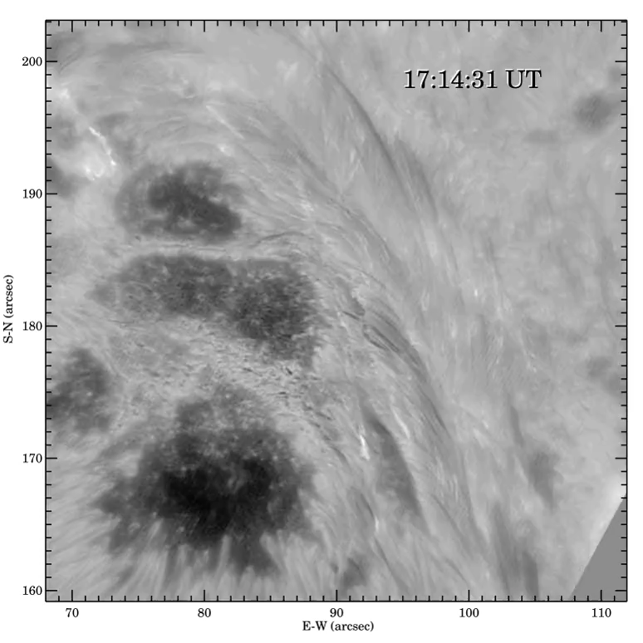
Overview
What are the finest scales?
Motivation for looking at fine scales
Fine structures in space
  Reconnection rate
  Ribbon front
  Ribbon sub-structure
  Vertical structure
Fine structures in time Dudik talk!
Conclusions
Flare ribbon observed in Hα red wing
Big Bear Solar Observatory
~30,000 km
Wang+2017
10”
Discussion will be limited to the lower atmosphere

Slide 3
What are the finest scales?
Photospheric/chromospheric footpoints are at or close to the diffraction limit.
As resolution increases, scales of smallest reported flare features decrease.
Facility | primary diameter | wavelength (nm) | 1.22λ/D | Smallest flare feature reported | reference
Hinode/SOT | 0.5 m | 630.2 | 0.”32 | FWHM = 0.”5 | Isobe+07
Dunn | 0.76 m | 1560 | 0.”5 | FWHM = 1.”3 | Xu+12
SST | 1 m | 486.1 | 0.”12 | Width ~ 0.”2 | Faber+24
BBSO NST/GST | 1.6 m | 656.3 | 0.”1 | Width ~ 0.”1 | Sharykin+Kosovichev ‘14
Space telescopes often have critical sampling (2 pixels across the PSF) e.g. IRIS smallest features are 2 pixels wide = 0.”33
French+21
So, it is almost certain that there is structure at < 100km scales

Slide 4
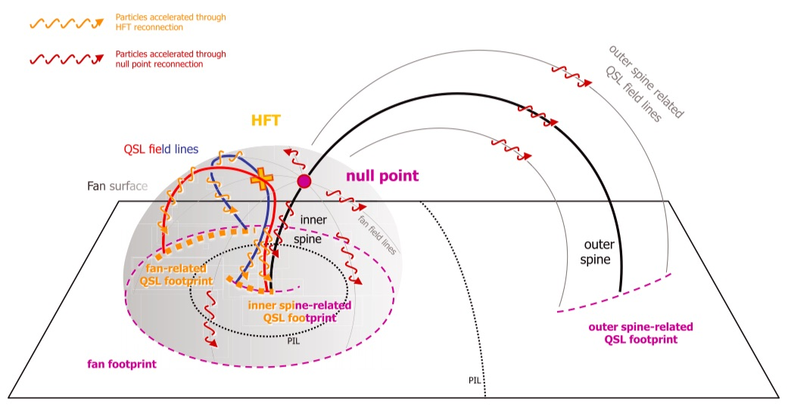
Motivations for looking at fine scales
Ribbons appear at (or close to?) where quasi-separatrix layers intersect with the chromosphere (e.g. Mandrini+95, Démoulin+97, Aulanier+00, Fletcher+01, Masson+09 )
Ribbons are key to understanding coronal reconnection
Large scale ribbon movements are used to estimate bulk reconnection rate/reconnection electric field (e.g. Poletto & Kopp 86, Qiu+02, Fletcher&Hudson 01, Naus+22)
Fine scale ribbon appearance determined by
  Flare energy release and transport process
  Fine structure of coronal magnetic field
  Atmospheric structure
Dudik+16, also Janvier+14
Current sheet configuration
Reid+12
Spine-fan configuration

Slide 5
Motivations for looking at fine scales
Ribbons appear at (or close to?) where quasi-separatrix layers intersect with the chromosphere (e.g. Mandrini+95, Démoulin+97, Aulanier+00, Fletcher+01, Masson+09 )
Ribbons are key to understanding coronal reconnection
Large scale ribbon movements are used to estimate bulk reconnection rate/reconnection electric field (e.g. Poletto & Kopp 86, Qiu+02, Fletcher 09, Naus+22)
Fine scale ribbon appearance determined by
  Flare energy release and transport process
  Fine structure of coronal magnetic field
  Atmospheric structure
Dudik+16, also Janvier+15
Reid+12

Slide 6
Ribbon fine scales and reconnection
At high enough cadence and spatial resolution can track UV ‘blobs’ within a flare ribbon
Then use flux ‘swept out’ by blobs to estimate local flux-transfer (reconnection) rate
17-Jul-2002 TRACE 1600Å footpoints (2s cadence) on TRACE WL
TRACE UV footpoints and RHESSI on MDI magnetogram
Orange contours = RHESSI 25-50keV
Blobs colour coded by local magnetic reconnection rate
Blue =
Pink =
Fletcher 09
Non-thermal HXRs seen where local reconnection rate is high

Slide 7
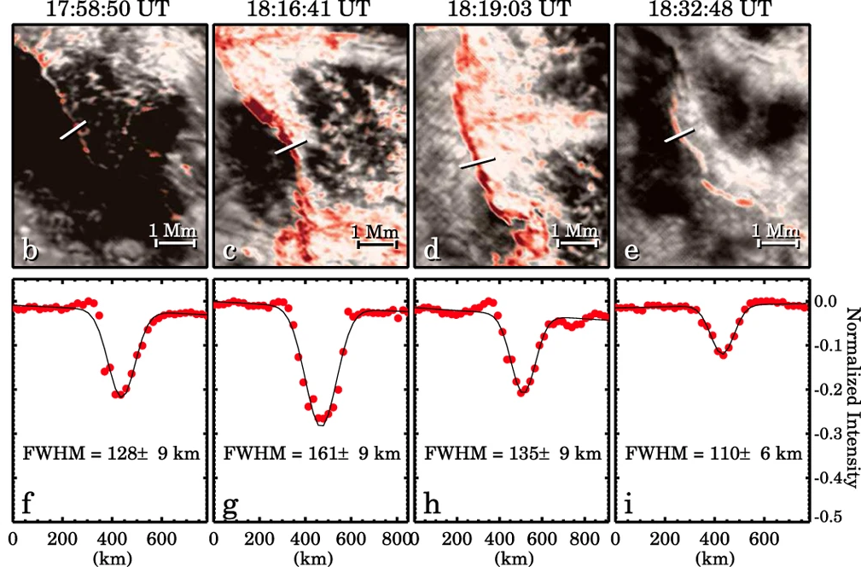
Ribbon fine structure: the ribbon front
Flare ribbons have a narrow front (100 - 150km in ground-based observations)
Fronts have different spectroscopic signatures from the rest of the ribbon
Fronts associated with strong redshifts at low T and blueshifts at high T
BBSO/NST
red = I_{red} - I_{blue}
(~redshift)
Jing+16
Intensity along cuts through the ribbon front
Fe XXI upflows
Mg II downflows
Graham & Cauzzi 15
Implication: strongest energy input at leading edge gives
- downward moving ‘condensation’ (10s of km/s)
- upwards ‘evaporation’ (100s of km/s)
IRIS

Slide 8
Ribbon fine structure: the ribbon front
At the ribbon front, He 10830 is seen in absorption in a narrow (~340 km) region, lasting 10s-100s of seconds
Kerr+21 used RADYN modelling to explain as:
nonthermal collisional ionisation of helium by electrons followed by
recombination to the atomic levels that produce strong absorption
Duration harder to explain – possibly a weak flux of electrons prior to main burst.
BBSO/NST Xu+16
Implication: strongest energy input at ribbon edge involves a lot of non-thermal electrons

Slide 9
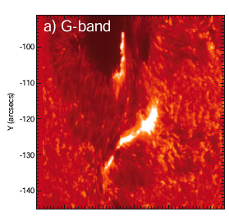
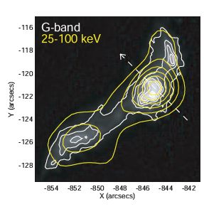
Fine structure and energy deposition
Flare energy is stored in a large coronal volume
Release of this energy is enabled by magnetic reconnection
Energy transported along the field is deposited in highly concentrated footpoint/ribbon sources.
The small sizes of footpoints challenge the electron-beam energy transport model.
Reconnection region
Energy transport
Hinode/SOT
SOT&RHESSI
Chromosphere
e.g. Krucker+11 used SOT G-band and RHESSI measurements to deduce e⁻ beam properties:
- Energy deposition rate > 5 x 10¹² erg cm⁻² s⁻¹
- Nonthermal electron beam density > 10¹⁰ cm⁻³
(Krucker+11)

Slide 10
Fine scales within the ribbon
As already seen (e.g. talks by Dudik, Faber) ribbons have sub-structure.
This may be linked to properties of reconnection region, e.g. tearing mode & plasmoids (Wyper & Pontin 21) or turbulence (French+21)
Footprint of plasmoids in numerical simulations
Spatial scales of blobs with time
Power spectrum
Spatial scale (Mm)
Wyper & Pontin 21
Waves/spirals in ribbons predicted by current sheet tearing/plasmoid formation
French+21: exponential growth at 1.75Mm spatial scale, possible forward/inverse cascade
Notes:
French et al ribbon only ~20 Mm long

Slide 11
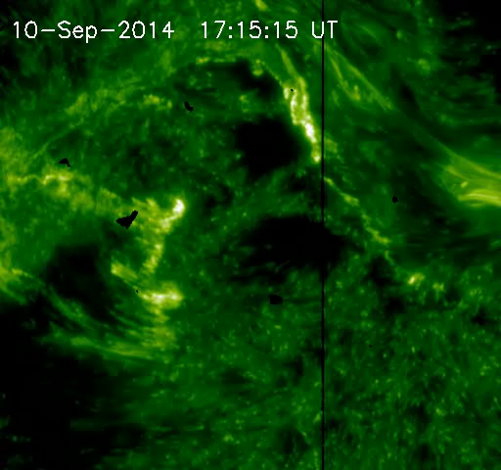
Fine scales of the atmosphere
Let’s not forget the pre-flare atmosphere!
The flare chromosphere has a complicated spatial structure
The field that is illuminated by flare energy release is embedded in that structure
So chromospheric scales are ‘imprinted’ on the ribbons (particularly visible behind the ribbon front)
Though in other places the flare ribbon just ignores the underlying structure!
Not investigated much… (though see Fletcher+04)
IRIS 1400 Liu & Zhang 15

Slide 12
Vertical fine scales from back-illumination
White light flare footpoints at high resolution can show a bright central part – core surrounded by a more diffuse part - halo (Neidig+93,Hudson+06, Isobe+07)
Hinode SOT G-band
This is interpreted as back-illumination: bright source irradiates/warms a lower layer, producing diffuse source
Isobe+07 used a geometric model to estimate h
Isobe+07
G-band: h = 124km
630.2nm: h = 300km
This gives us some insight into vertical structure of flare chromosphere

Slide 13
Vertical fine scales from back-illumination
This is also done with IRIS using fluorescence by Mulay+23
Several lines of H₂ are observed in the UV by the IRIS spacecraft.
These are fluorescence lines excited by Si IV (Jordan+77,78)
H₂ is dissociated at T ~ 4800K, so will be present only at the temperature minimum region (TMR)
The fluorescence “illuminates” the dynamics of the TMR during flares
Flare energy
Si IV
T = 80,000 K
Pump Si IV photons
H₂
H₂
H₂
H₂
T < 4,800 K
Fluoresced H₂ photons

Slide 14
H₂ fluorescence: depth of the TMR
H₂
H₂ emission is more diffuse than Si IV
Explained by Si IV radiation spreading out
Applying Isobe+07 geometric model can work out the distance between the Si IV patch emission and the H₂ patch
Si IV
H₂
Mulay+23
e.g., In marked area the separation between Si IV source and H₂ source is 1200 ± 100km
See also height measurements from DKIST! poster#233 by Cook et al.

Slide 15
Temporal fine scales
Very high cadence observations crucial for uncovering physics (e.g. Lörinčík+24 result).
Understanding flare energy transport needs sub-second timing, possible in HXR time-series, UV/optical images (just about)
Simões+24 used IR observations at McMath-Pierce to obtain sub-second correlation of two flare footpoints.
Measured time lag of 0.75±0.07s is ~2-5 times longer than electron time-of-flight + trapping delay + radiation generation timescales
More IR data are available, and more such analyses are needed

Slide 16
Summary
It is very unlikely that we have actually resolved the finest scales so far
Scales so far consistent with resolution limits
Will DKIST, and later EST, finally resolve “basic scales”? (I doubt it)
Observations at fine scales enable important physics to be investigated
Evidence for / constraints on highly concentrated, intense energy input
Constraints on height structure of flaring chromosphere
Vital clues to invisible reconnection processes in the solar corona
But disentangling all of the influences on observed fine structure is challenging; detailed work with large datasets. We need smart analysis techniques!

Slide 17
Extra Slides

Slide 18
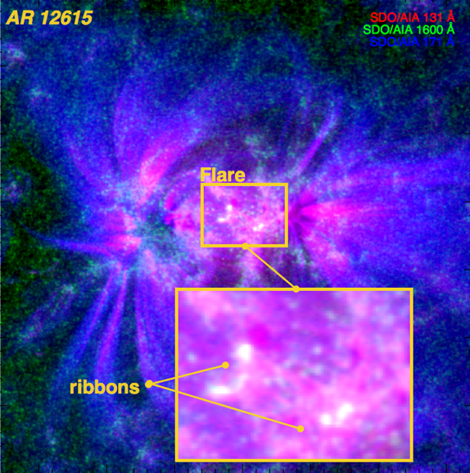
Fine scales in spectroscopy of flare ribbons
Non-thermal broadening of (E)UV spectral lines can be interpreted as a signature of plasma turbulence (e.g. Jeffrey+16, 17, 18, Stores+21,23)
E.g. High-cadence slit spectroscopy of a flare ribbon (Jeffrey+18) revealed:
Strong non-thermal broadening that peaks before flare heating/acceleration
non-thermal broadening decays as particles accelerated
Conclusion: consistent with Alfvénic turbulence in chromosphere preceding electron acceleration
Non-thermal line broadening (blue)
Jeffrey+18
Time (s)

Slide 19
Reconnection – large scales
Global properties of coronal reconnection can be determined from ribbons
Flux `swept out’ by ribbons
Measured at photosphere
Coronal evolution (via flux conservation)
Coronal reconnection electric field
Qiu+21
Naus+22

